Slide 1
SMCTM1a/b test summary and data analysis
MDP collaboration meeting
April 30- May 3
Maria Baldini
US Magnet Development Program
Fermi National Accelerator Laboratory

Slide 2
Outline
Magnet design and test goals
Magnet instrumentation
SMCTM1a: 2L mirror test plan and quench performance
SMCTM1b: 4L mirror test plan and quench performance:
Heater study
RRR measurement
Summary

Slide 3
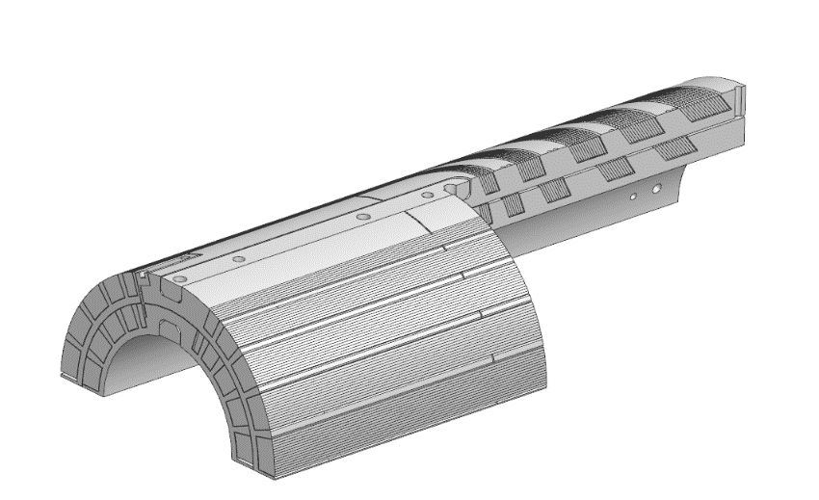
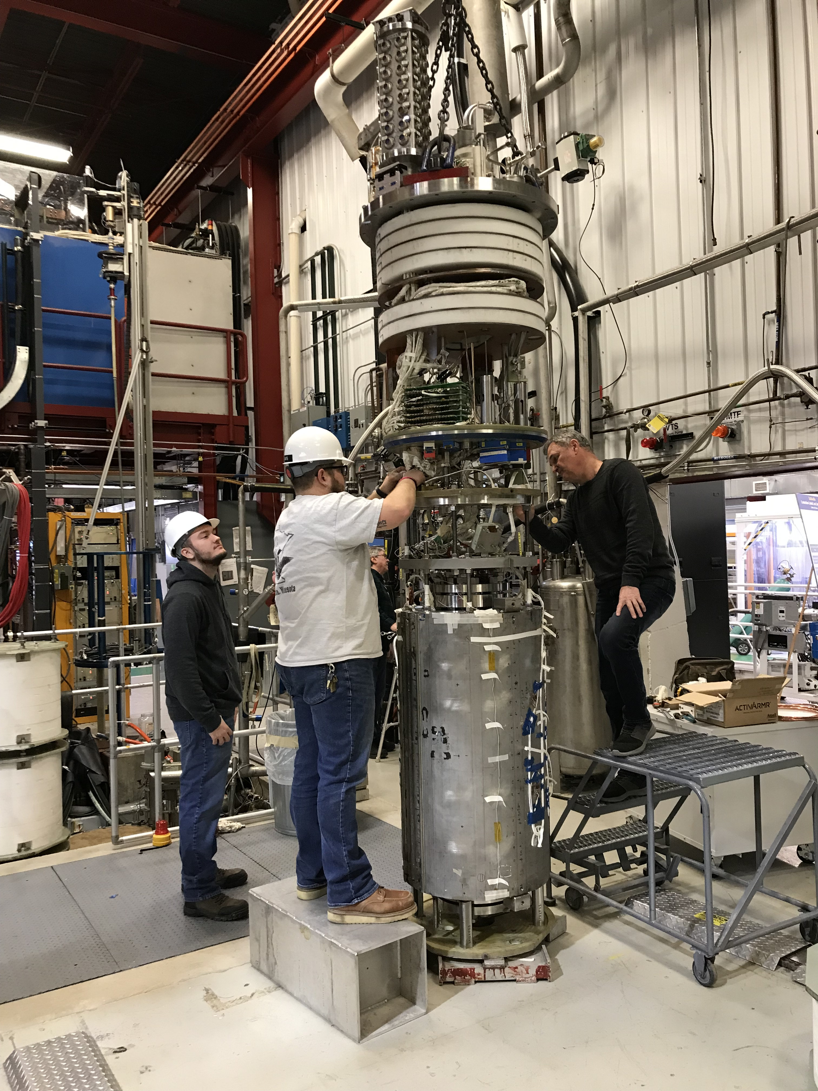
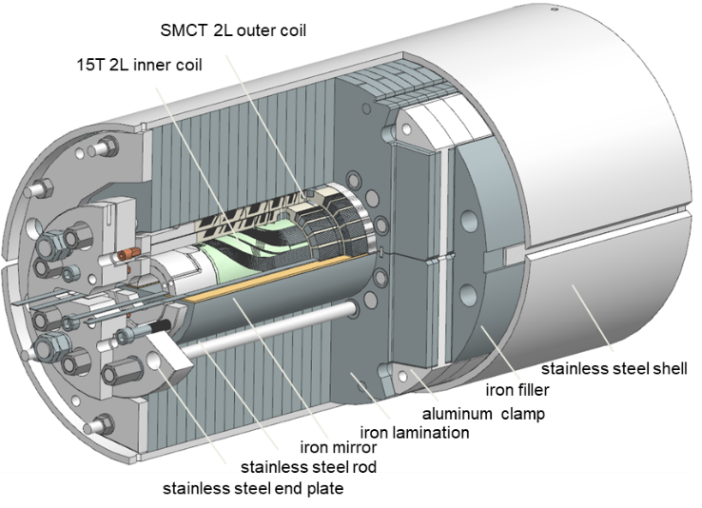
SMCTM1 design and test goals
Test goals
Prove the concept of SMCT dipole coil design in 2-layer and 4-layer mirror configurations
Demonstrate the magnet can reach the targeted quench current at the set pre-load
Study coil training, ramp rate and temperature dependences of magnet quench current
QP heater test

Slide 4
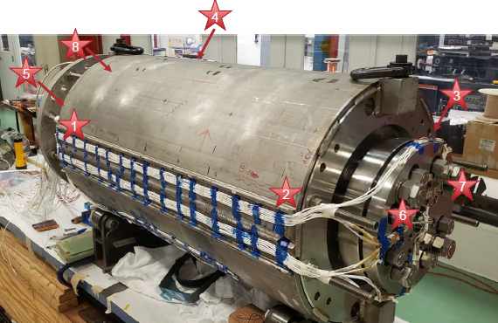
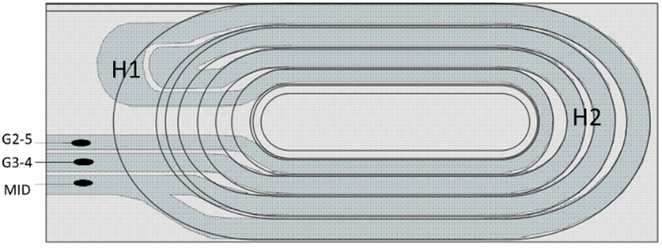
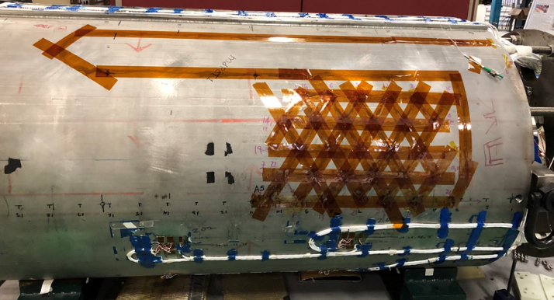
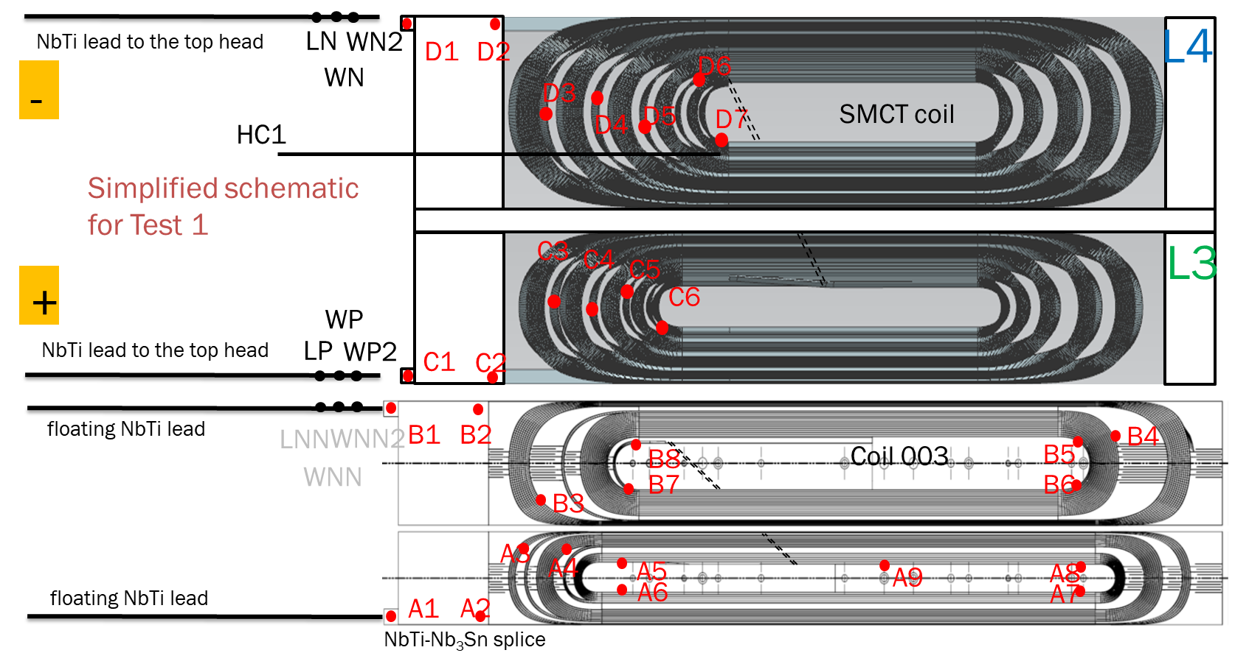
SMCTM1 Instrumentation – General overview
VT – for quench detection; splice resistance measurements
SG on coils, poles, bullets/rods and shell – strain monitoring during cool down, warm up and quenches
QPH – for SC coil quench protection
  this magnet was protected by energy extraction system
Acoustic Sensor - for independent quench characterization
Fiber Optics – strain measurements of the shell
TS – outside magnet/coil temperature
C3-C6 taps are open: it is not possible to locate a quench in L3 layer of SM coil.

Slide 5
SMCTM1a Test plan and Quench summary
Test plan:
Training quenches at 1.9 K.
Ramp rate dependence at 1.9 K.
Temperature dependence.
Thermal cycle and test repeated.
Splice R measurements
Notes:
Description of test plan and wramp rate dependence at 1. 9 K started close to a plateau hat happened

Slide 6
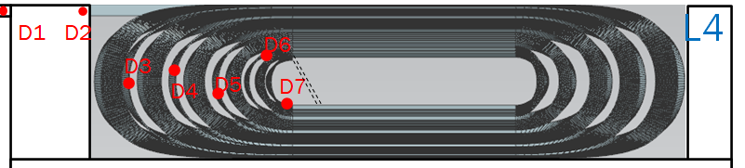
SMCTM1a Training at 1.9 K
L4 layer of the SM coil quenches:
1st quench was in the D4-D5 segment
3 more quenches in the D6-D7 segment (pole turn); the last one at 50 A/s
Remaining quenches were all in L3:
Location is unknown because VTs were open
14.3 kA 12.7 T was reached in 24 quenches
No memory after thermocycle
Notes:
Add TC
T 86% of SSL
Check field at 12. 5 kA

Slide 7
SMCTM1a Ramp rate dependance
Linear extrapolation at 0 ramp rate: maximum quench current is 15 kA and 13.1 T (91%of SSL).
All quenches were in L3 beside the first one at 50 A/s (L4- layer).
Maximum current was at 50 A/s at 14.3 kA
No degradation during TC2
Notes:
91% of SSL at 1.9 K
9% reduction of maximum achieved quench current with respect to SSL
m

Slide 8
SMCTM1a Temperature dependance
No degradation in TC2: all quenches in the inner layers
Magnet was still training in TC2
Data at 4.5 K were collected when Iq> 13600 A (same force level observed during TC1 at 4.5 K)

Slide 9
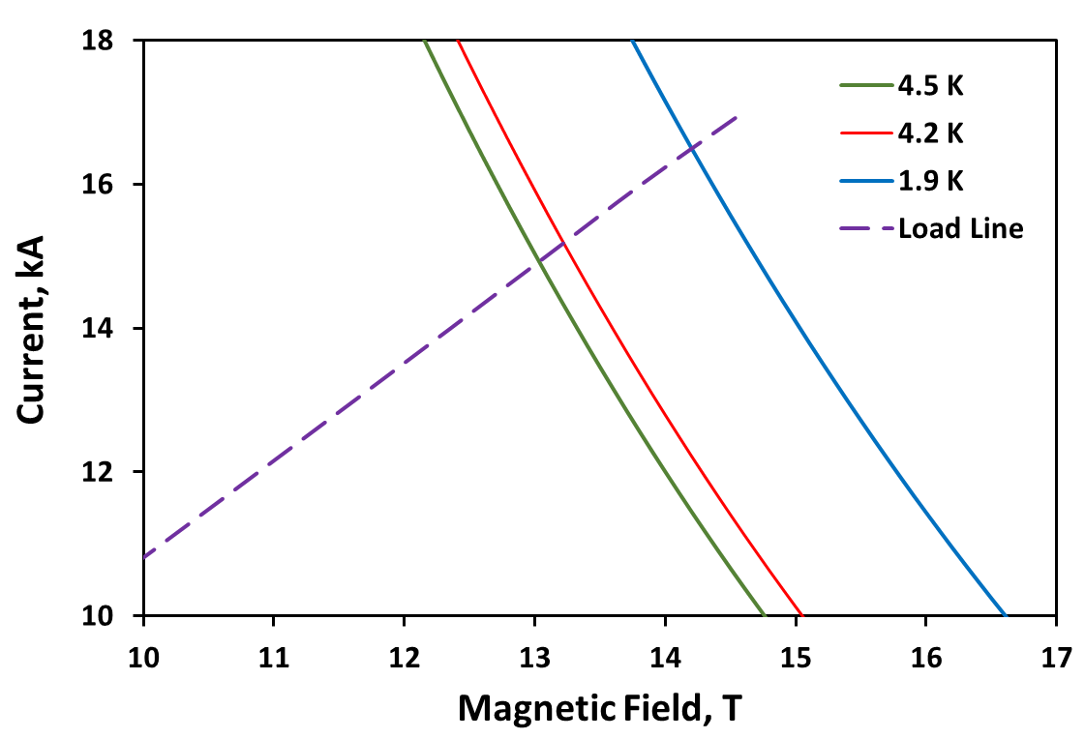
SMCTM1a short sample limits
Outer 2L mirror
 | 1.9 K |  | 4.5 K
 | Ic, kA | Bc, T | Ic, kA | Bc, T
SSL | 16.47 | 14.21 | 14.89 | 13.04
test | 14.3 | 12.68 | 13.45 | 11.98
test/ssl | 0.87 | 0.89 | 0.90 | 0.92
14.3 kA 12.7 T was reached in 24 quenches
No memory after thermocycle

Slide 10
SMCTM1a quench performance summary
TC1:
Coil training at 1.9 K started at 10.6 T
~25 quenches to I_{max}
Except 4, all the quenches are in L3
Maximum field in coil straight section
  B_{max}=12.7 T at 1.9 K
  B_{max}=12.0 T at 4.5 K
SMCT coil conductor degradation 92%
TC2:
Coil re-training at 1.9 K started at 11.2 T: no good memory
Similar training rate as in TC1
No degradation after TC

Slide 11
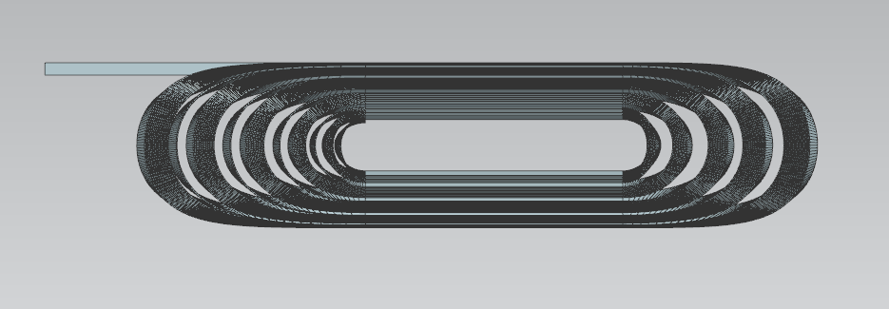
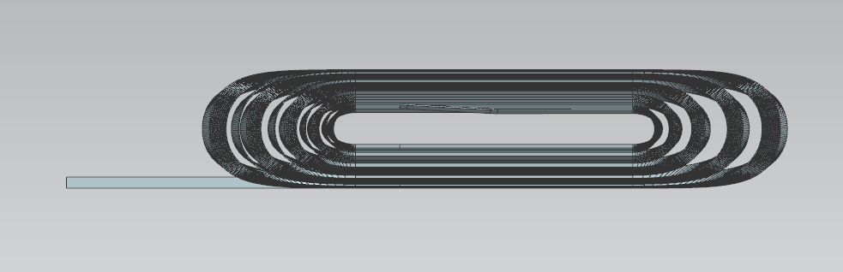
SMCTM1b: 4-layer mirror test
SMCTM1a was warmed up and SMCT coil and coil 003 were connected in series (no magnet disassembly).
NbTi-Nb₃Sn splice
LN
WN2
D1
D2
L4
SMCTM1b test: both coils connected to the power supply
Test plan was the same:
  Training quenches
  Ramp rate dependence
  Temperature dependence
  QH studies
  Coil RRR measurement
Spikes since ramp 1.
  Test plan was adjusted because of spike occurrence.
WN
D6
D3
D4
D5
D7
SMCT coil
Simplified schematic
for Test 2
C3
C4
C5
L3
C6
NbTi-NbTi splice
+
WP
LP
WP2
C1
C2
NbTi leads to the top head
-
B1
B2
B4
L2
LNN
WNN2
B8
Coil 003
B5
WNN
B7
B6
B3
A3
A4
A5
A8
A2
A6
A9
A7
L1
A1
NbTi-Nb₃Sn splice
Notes:
Coil 3 how many quenches (check)

Slide 12
Initial trips
Spike triggers the quench detection
Spike signal is present in most of the voltage taps with positive or negative sign
Spike duration is 1 ms
No detection time, so build some filters
Notes:
No detection time

Slide 13
Quench types
Inner/SMCT coil quench no spike
Spike induced quenches of both coils
Spike induced quenches in inner coil
Notes:
It covers all the turns

Slide 14
SMCTM1b Test results: all data
Highest current was 11.46 kA
14.5/12.6 T maximum field in the inner/SMCT coils
The majority of SQuenches are spike induced quenches of the inner coil
Spike induced quenches of the SM coil are always simultaneous with inner coil quenches (inner layer pole)
Most of the quenches with no spike takes place in the SM coil.

Slide 15
Training quenches
Highest current was 11.46 kA
14.5/12.6 T maximum field in the inner/SMCT coils
Large variety of quench location
  At plateau several quenches on Inner + SM coils and on inner coil
Notes:
Try to add

Slide 16
Ramp rate and temperature dependence
Quench in SM coil at high RR at 1.9 K;
different slope at 1.9 and 4.5 K
20 a/S Quench in inner coil at higher T
Quench current varies for T>2.5 K
Iq jump at T<2 K at 300 A/s
Notes:
data variation vs RR;

Slide 17
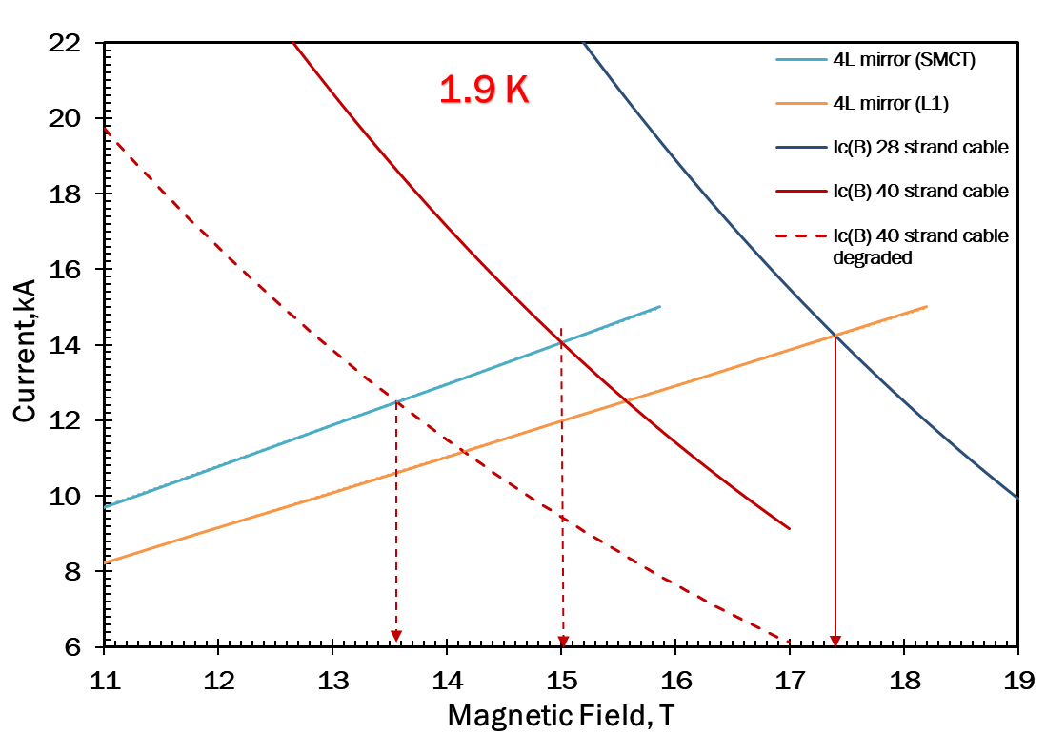
Short sample limit
Outer 4L mirror (SMCT)
 | 1.9 K |  | 4.5 K
 | Ic, kA | Bc, T | Ic, kA | Bc, T
SSL | 14.06 | 15.01 | 12.69 | 13.76
test | 11.46 | 12.62 | 10.39 | 11.63
test/ssl | 0.82 | 0.84 | 0.82 | 0.85
Inner 4L mirror (inner layer)
 | 1.9 K |  | 4.5 K
 | Ic, kA | Bc, T | Ic, kA | Bc, T
SSL | 14.25 | 17.4 | 12.73 | 15.81
test | 11.46 | 14.45 | 10.39 | 13.31
test/ssl | 0.80 | 0.83 | 0.82 | 0.84

Slide 18
SMCTM1b quench performance summary
TC1:
Coil training at 1.9 K started at 13.5 T.
First 7 trips started at 9.5 T.
~10 quenches to Imax
Voltage and acoustic spikes to be understood and eliminated
Maximum field in coil straight section
  B_{max}=14.45/12.62 T (IL/OL) at 1.9 K
  B_{max}=13.31/11.63 (IL/OL) T at 4.5 K
IL/OL coil conductor degradation
  Test/SSL=83/84% (IL/OL) - to be understood and reduced

Slide 19
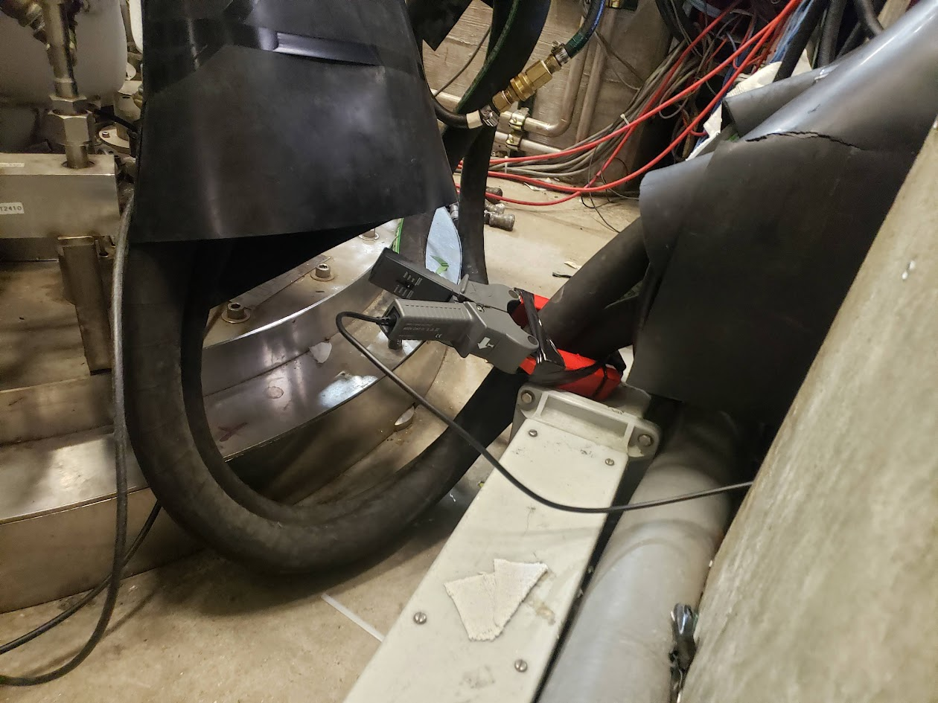
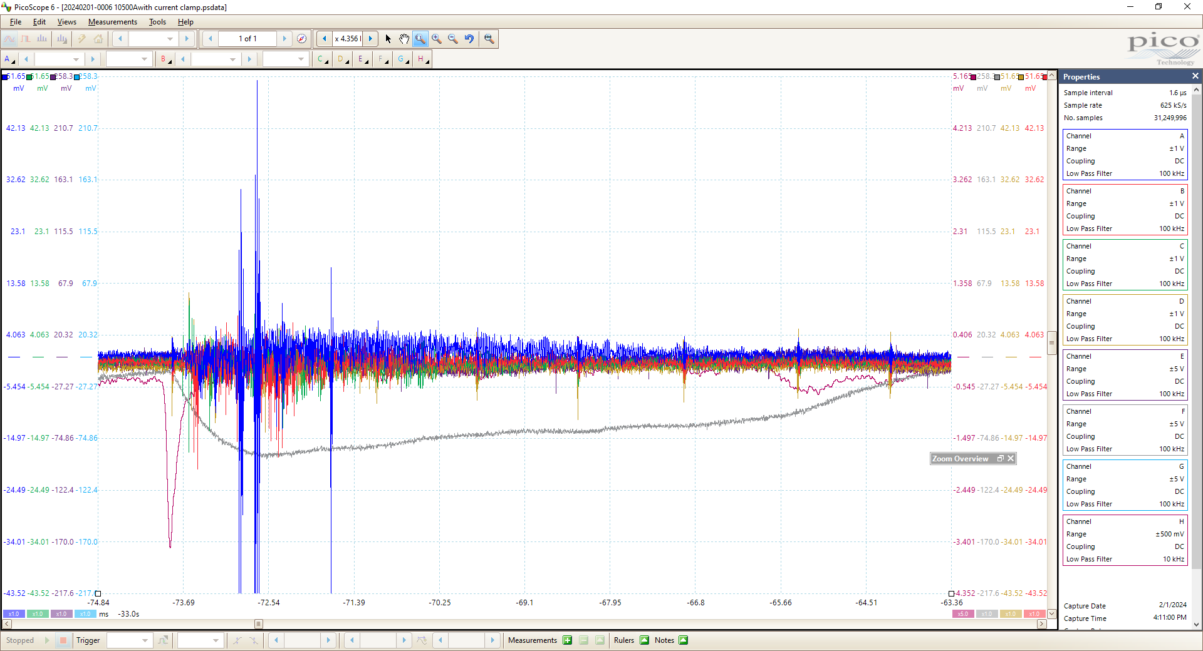
Origin of the spike voltage: acoustic sensor results
Acoustic sensors were wired incorrectly.
Broken sensors pick up EMI.
  Uncharacterized quench antennas
We had extra channels on the picoscopes and we measured:
  Halfcoil Bucked from AQD
  Current (1V = 3kA)
  Quench Trigger
Several spikes observed during ramp
Spike amplitudes vary and there is no correlation with quench
Transient Current Measurements
suggest inductance change due to mechanical stick slip between too coils
Current Drop
-340 mA
Half Coil Bucked ~100 mV

Slide 20
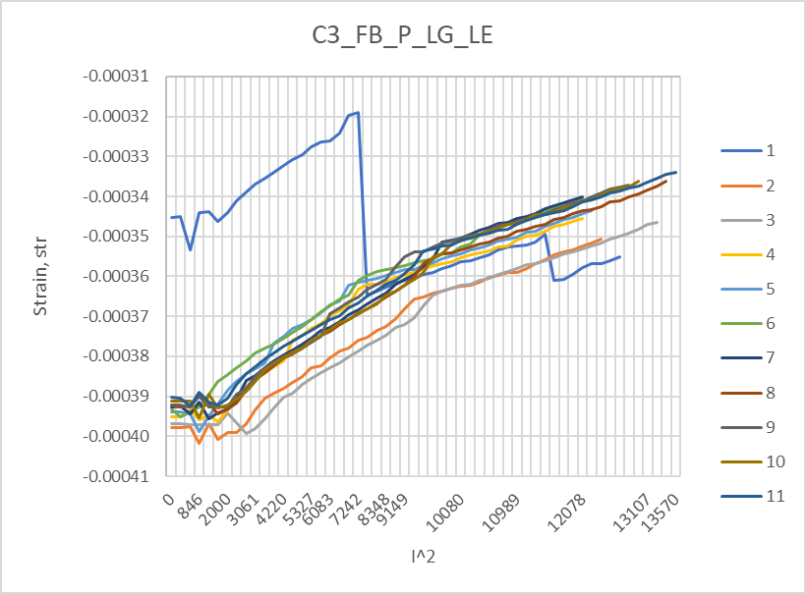
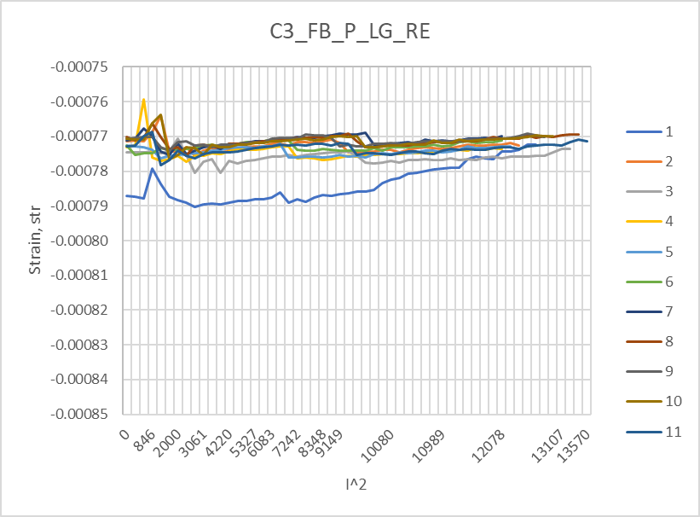
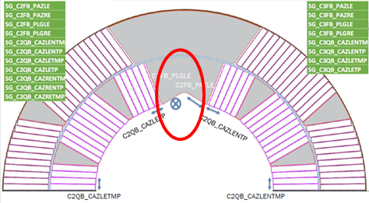
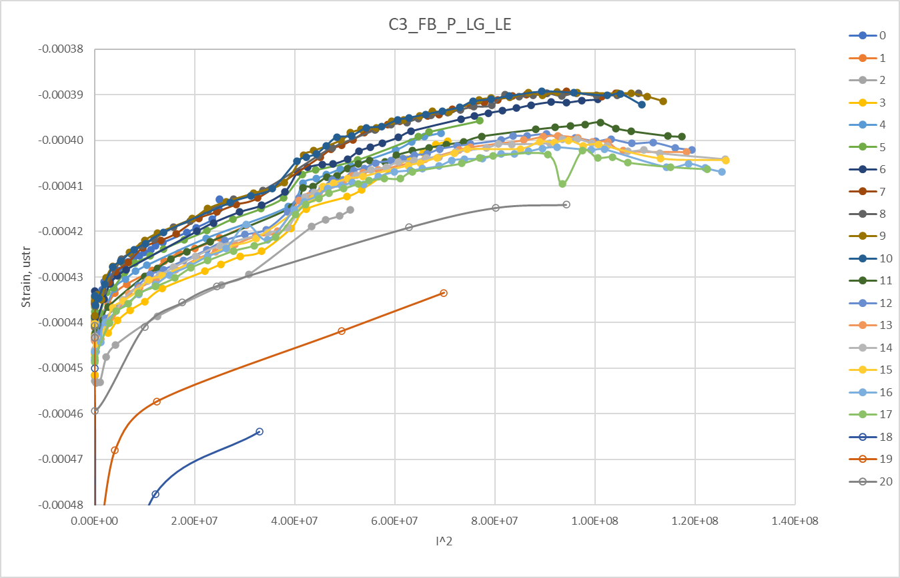
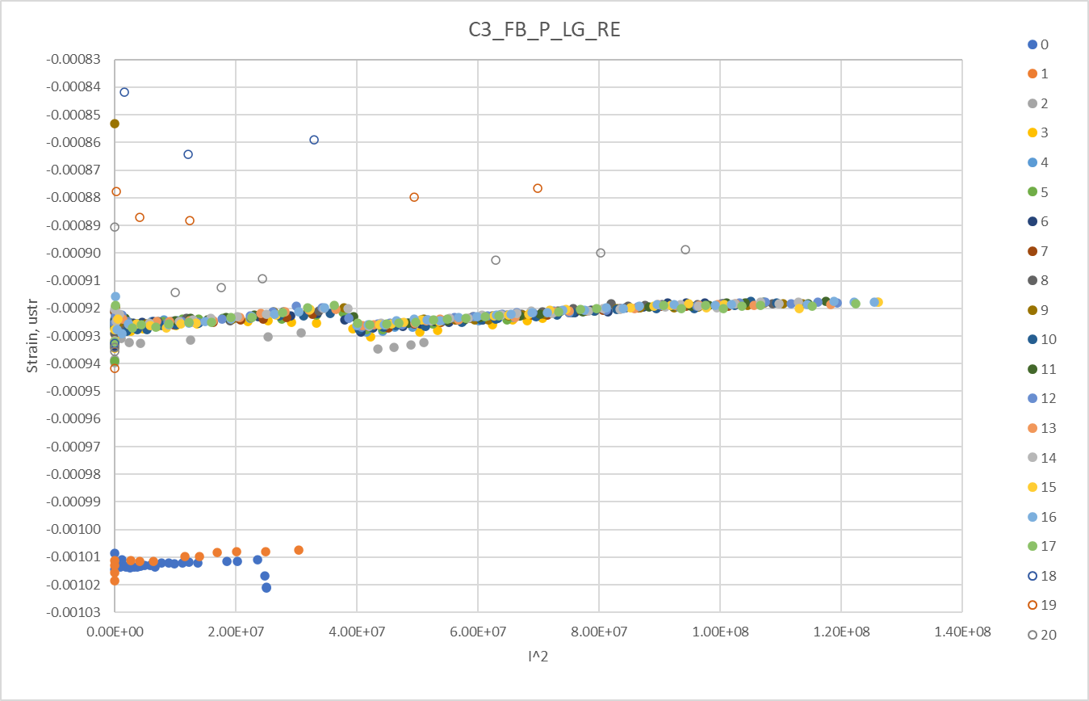
Origin of the spike voltage: strain gauge data
0.00006/0.00005
0.00001/0.00002
Test 2L
Test 4L
0.00004/0.00002
0.00001/0.00008

Slide 21
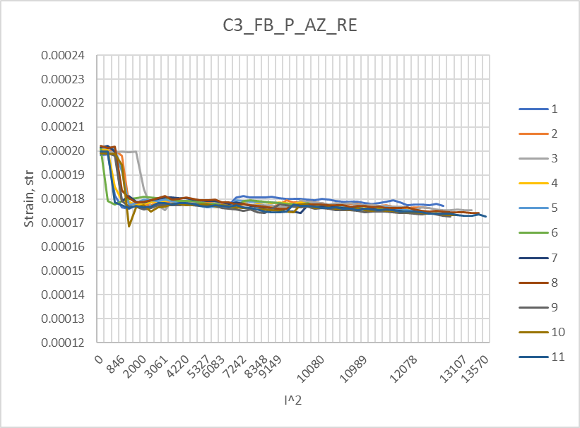
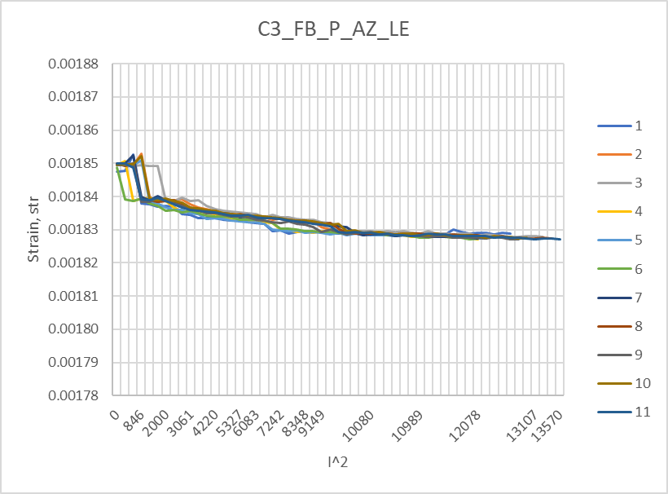
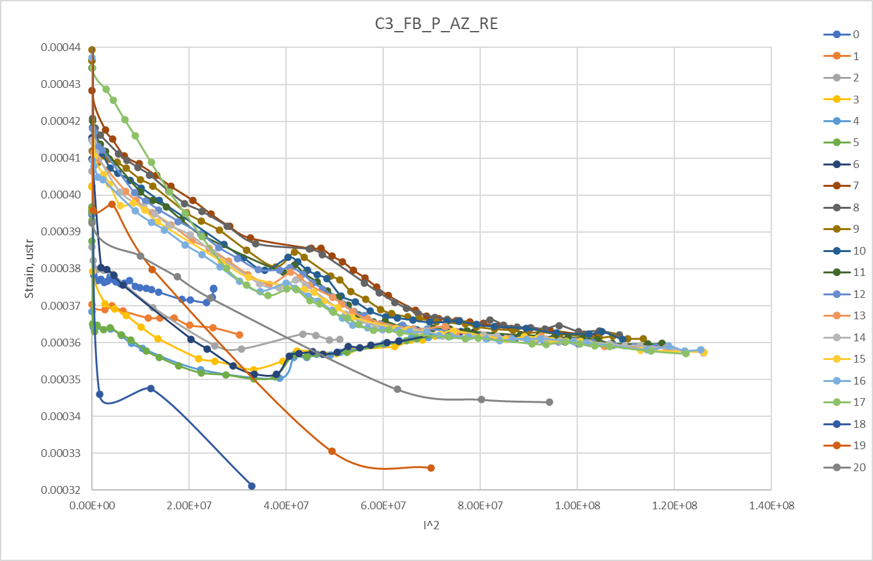
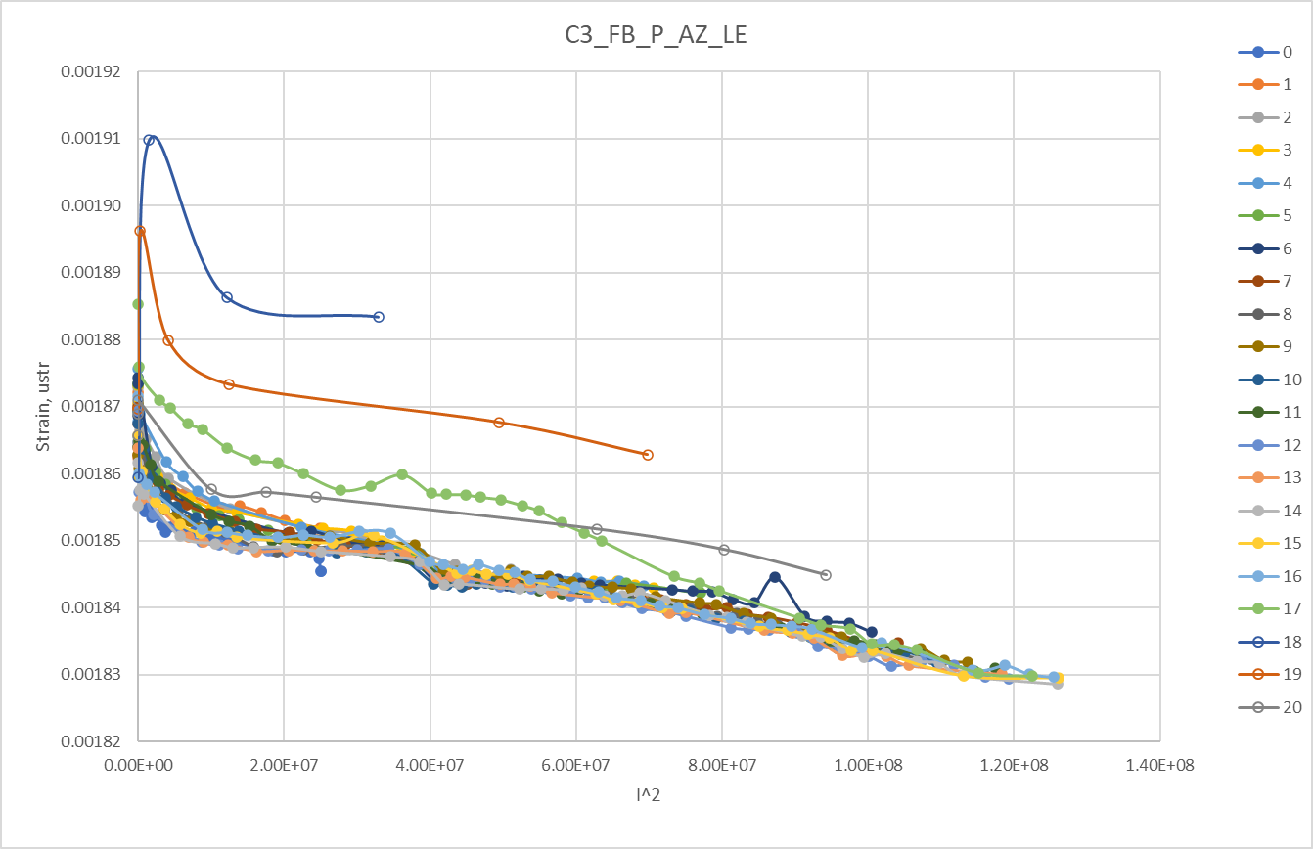
Test 2L
Test 2L
0.00002/0.00000
0.00002/0.00000
Test 4L
Test 4L
0.00003/0.00001
0.00005/0.00005
“Ratcheting signals”

Slide 22
Some general comments
SMCTM1a: SMCT coil powered
No training memory => possible conductor motion or epoxy cracking inside the mandrel grooves friction between coils => bullets on unpowered 15T coil saw load from SMCT coil
SMCTM1b: 2 coils powered
Coils difference:
  mechanical properties
  applied longitudinal LF: SMCT~15T coil*3
  end support =>relative end motion with friction =>stick/slip behavior
Simultaneous quenches in SMCT and 15 T coil: Electromagnetic coupling? spike nature
Source of the motion=> majority of quenches =>relative movement at the end
additional motion from friction for the inner coil and vice versa => outer/inner coil additional degradation and training

Slide 23
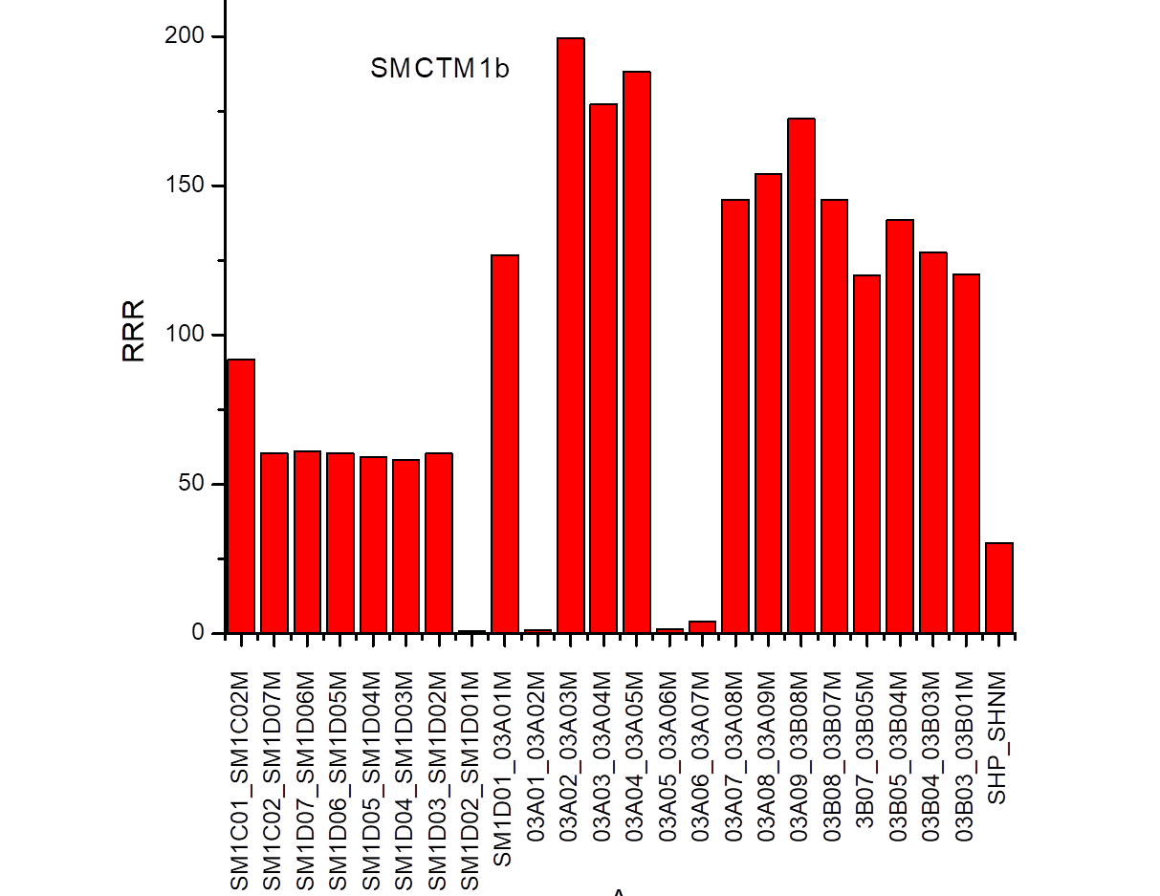
Splice R and RRR measurements
RRR measured with 10 A current at cold and room temperatures
Splice R=0.3 nOhm
AUP coils < 1 nOhm
Data are very noisy.
Notes:
15 T magnet plot…
SM coil has different heat treatment

Slide 24
Quench heater test
Heater is installed on the outer layer of the SM coil
Heater delay and minimum quench energy at selected current level and HFU power. Maximum power is with 340 V
Results are being analyzed and compared with MBHSM01 mirror magnet
Notes:
Minimum quench energy…
Cable is the same/ check insulation thinkness

Slide 25
Summary
SMCTM1 mirror magnet with the 1st SMCT coil has been assembled and tested in two configurations
  In the first configuration only the SMCT coil was powered (SMCTM1a)
  In the second configuration both coils were powered in series (SMCTM1b)
SMCTM1a test:
  the maximum current of 14.3 kA was reached at 1.9 K which corresponds to B_{max} in the SMCT coil of 12.7 T
  Ramp rate data suggest 9% reduction of maximum achieved quench current wrt coil SSL based on WS data
  No training memory and no performance degradation was found after thermal cycle
SMCTM1b test:
  11.4 kA current and 14.5 T/12.6 T maximum field in the inner/SMCT coils were reached
  Test was complicated by presence of the current and voltage spikes detected before some quenches
  Quench location varied and it was often simultaneous in both inner and SMCT coils
  Origin of spikes seems associated with relative coil mechanical movement – still needs to be understood

Slide 26
TEST FACILITY INSTRUMENTATION IMPROVEMENTS
Test facility instrumentation improvements
  Improve VT technology for SMCT coils
  Add time validation time to QDS at VMTF PS
  Better understand and improve acoustic measurements and data analysis
  Better coil temperature measurements – installation of fiber optics during magnet assembly?
  Fiber optics technology for mechanical and temperature measurements

Slide 27
Origin of the spike voltage
The spike voltage seem to be originated by relative coil motion: stick slip mechanism
Notes:
SS rods are supposed to shrink as the SM structure and 15 T coil. With cooldown coil should shrink and so the rods in similar way.
One of th

Slide 30
Ramp 15 and 16: Type D. Quench on both coils: Inner SM coil and pole turn of the inner 15T coil

Slide 31
Ramp 22, Type F quench: on both coils inner SM coil + pole turn and transition turn of inner 15T coil
Ramp 55, Type E quench: inner 15T coil quench

Slide 33
Quench/SQuench analysis and classification

Slide 34
Quench types: inner coil quench
First quench ramp 7: 15 T inner coil quench no spike
D1
D2
L4
D6
D3
D4
D5
D7
C3
C4
C5
L3
C6
C1
C2
B1
B2
B5
B4
B8
B3
B7
B6
A3
A4
A5
A8
A6
A9
A1
A2
A7
Notes:
It covers all the turns

Slide 35
Quench type: SM coil quench
D1
D2
L4
D6
No spike: L3 of SM coil quenches
D3
D4
D5
D7
C3
C4
C5
L3
C6
C1
C2
B1
B2
B5
B4
B8
B3
B7
B6
A3
A4
A5
A8
A6
A9
A7
A1
A2

Slide 36
Quench types: Spike induced quenches of both coils
D1
D2
L4
D6
D3
Second quench ramp 8
D4
D5
D7
C3
C4
C5
L3
C6
C1
C2
B1
B2
B8
B4
B5
B3
B7
B6
A3
A4
A9
A8
A5
A1
A2
A6
A7
Quench observed simultaneously in inner and outer coil: A08-A09 and C02-D07
Notes:
A3-A4 check if it is simultaneous and expand plot

Slide 37
Quench types: Spike induced quenches in inner coil
D1
D2
L4
D6
D3
D4
D5
D7
C3
C4
C5
L3
C6
C1
C2
B1
B2
B8
B5
B4
B3
B7
B6
Spike is seen in both coils
A3
A4
A5
A9
A8
A1
A2
A6
A7

