Slide 1
Nb₃Sn Magnets – CCT Status and Next Steps
Diego Arbelaez (for the Nb₃Sn CCT Team)
U.S. MDP Collaboration Meeting
04/30/2024

Slide 2
The Nb₃Sn Magnet Area Focuses On The Development Of Stress Management Techniques For High Field Magnets
“The updated Nb₃Sn magnet roadmap works to develop and demonstrate effectiveness of stress-managed (SM) approaches”
“The program focuses on a) increasing magnet operational field and aperture, b) reducing potential for magnet degradation, and c) reducing magnet training”
“The program furthermore considers means to minimize magnet cost”
“Stress management approaches are also critical for HTS program elements, thus linking the aims of the Nb₃Sn program to those of the HTS program.”

Slide 3
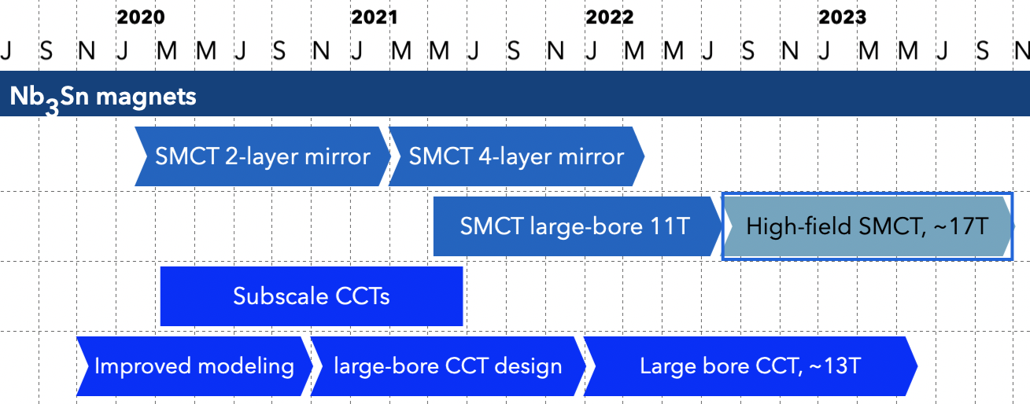
The Nb₃Sn CCT Road Map Focuses on Improving Training and Demonstrating High Field Performance for Large Bore Magnets
Five magnets have been tested to date (Eleven total tests)
Two more magnets in preparation for FY24 (Filled Wax and Telene)
Models have been developed & continuously improving – see talk by G. Vallone
Basic Design complete – May iterate slightly depending based on fabrication tests - preparing for fabrication of first layer
Task 1. Use CCT subscale program to increase understanding and improve training in stress managed magnets.
Task 2. Improve numerical modeling of magnet mechanics to accurately predict stresses when surface failure/delamination can occur.
Task 3. Design of CCT6 4-layer magnet with target field of 13 T and bore diameter of 120 mm (with feedback from desired diameter from HTS components of MDP). Design of CCT6 will profit from feedback provided by subscale testing and improved modeling methods.
Task 4. Fabrication and test of CCT6 4-layer CCT magnet.

Slide 4
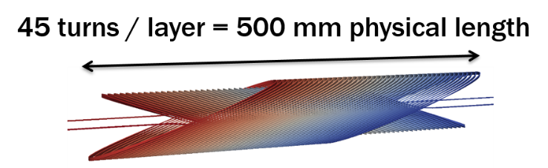
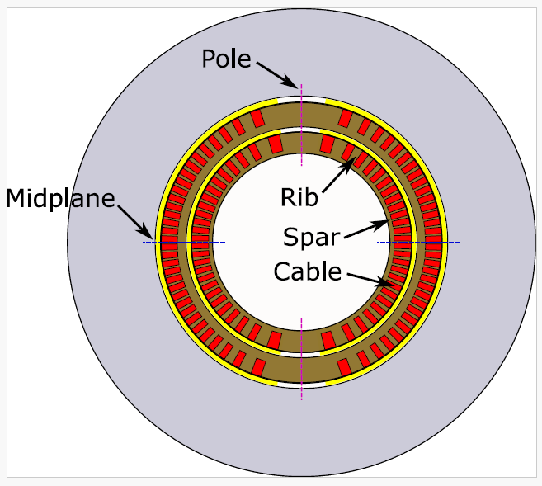
Task 1. Use CCT subscale program to increase understanding and improve training in stress managed magnets.
Subscale models can lead to faster turnaround for dedicated training experiments, for example:
  Epoxy (or other impregnation materials) influence on training (e.g. different epoxies, wax, filled resins)
  Structural influences (e.g. spar thickness)
  Interface conditions (e.g. inter-layer shim angle)
Subscale models are complementary to overall MDP program and will give feedback to design of future large stress managed magnets

Slide 5
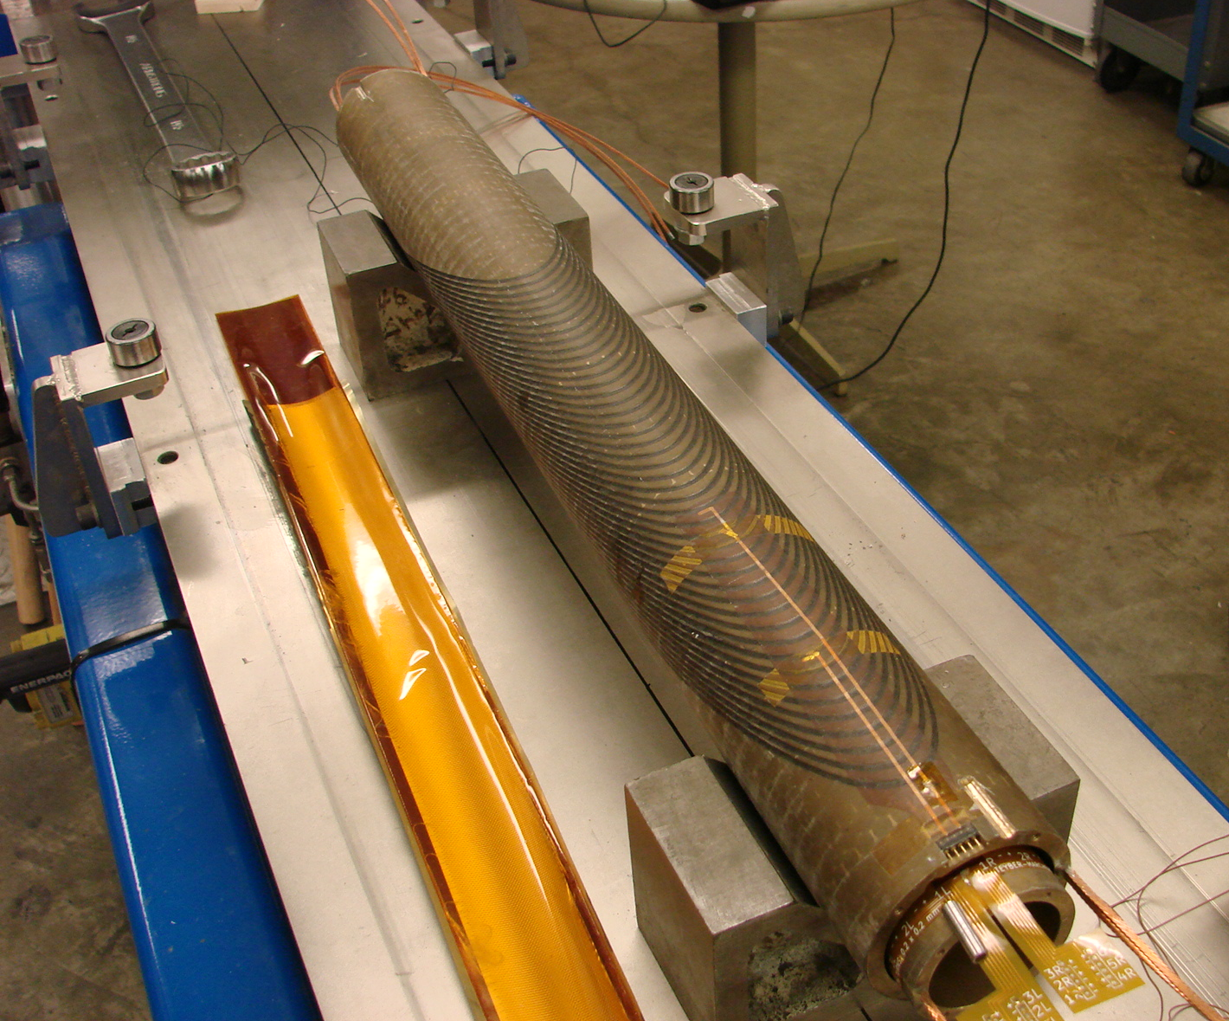
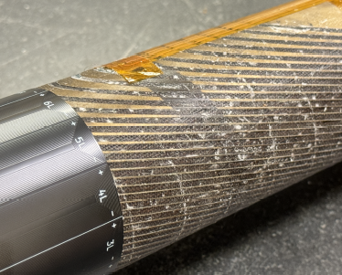
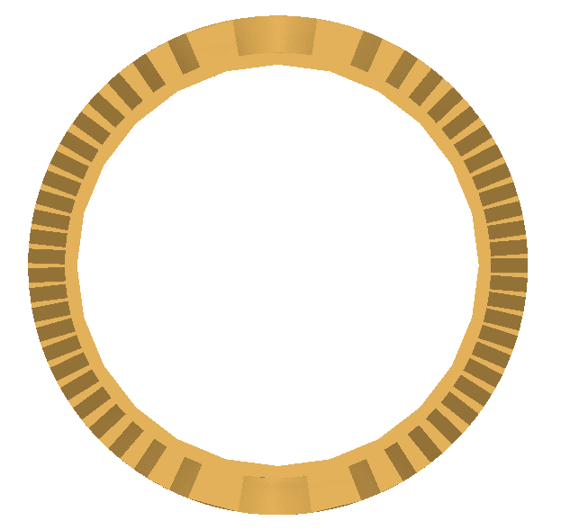
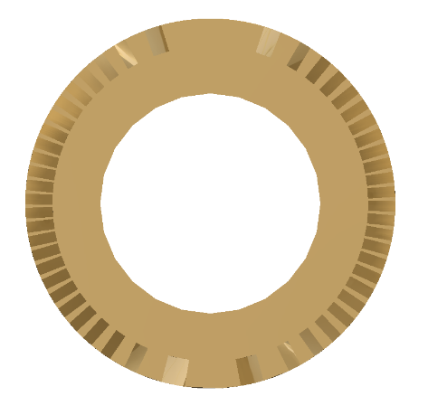
Five subscale magnets have been fabricated and tested
First magnet (Sub 2: baseline / Thin spar)
Second magnet (Sub 3: Thick spar) increased interface shear stress and reduced normal stress due to bending
Third magnet (Sub 4) used new non-epoxy high toughness resin CTD-701x (SBIR collaboration led by T. Shen at LBNL)
Fourth magnet (Sub 5) with wax impregnated inner layer
Fifth magnet (Sub 6) Full wax magnet (inner and outer layers)
Sub 2 (Baseline)
Wax Impregnated Coil
Thin Spar
(Baseline)
Thick Spar

Slide 6
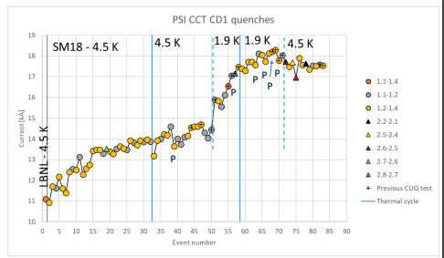
A Total of Eleven Magnet Tests Have Been Performed Until Now
CCT Sub2 (thin spar / baseline)
Initial Test
Test after thermal cycle
Test after disassembly and reassembly
FNAL Test at 4.5 K, 2.2 K, 1.9 K (test affect of temperature on training)
CCT Sub3 (thick spar)
Initial Test
Test after thermal cycle
CCT Sub4 (CTD 701x impregnation)
Initial Test
Test after thermal cycle*
CCT Sub5 (Inner layer wax impregnation)
Initial Test (All quenches in outer layer)
CCT Sub5 (Inner layer wax impregnation)
Initial Test
Test after thermal cycle
PSI CD1 CCT showed accelerated training at 1.9 K (CLIQ also used at that time)
PSI CCT CD1 Training
Courtesy of M. Daly
* Magnet was limited at or near the internal splice
** Tests performed since last collaboration meeting

Slide 7
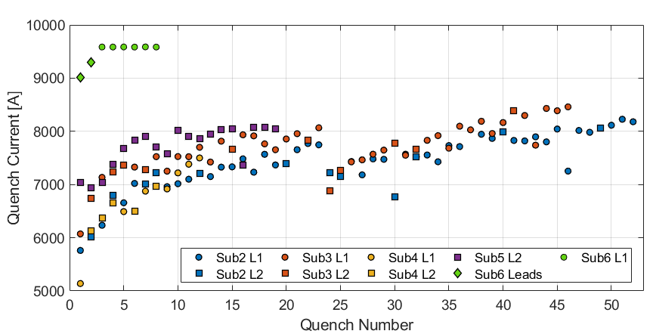
Wax Impregnated Magnet Reaches Plateau On First Quench Inside the Coils
First two quenches are outside of the coils
Reach plateau on first quench inside the inner layer coil
All quenches in same inner layer segment
Magnet Training
Thermal Cycle
Sub 2 / Sub 3
See talk by R. Teyber

Slide 8
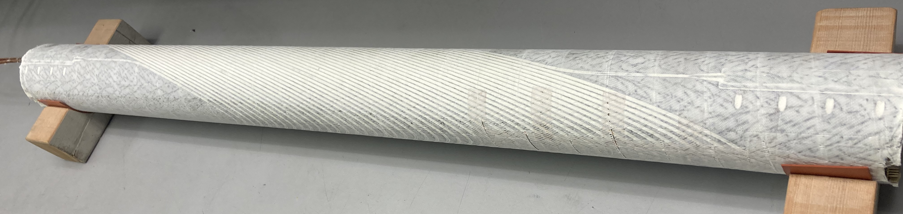
Next subscale Deliverables
Deliverables over the next ~1 year
Test of magnet with filled-wax inner layer* – completing final assembly (see talk by J.L. Rudeiros Fernandez)
  Wax highly filled with Alumina particles has increased bulk modulus
  Training behavior was shown to be similar to plain wax in BOX experiments at PSI
  Showed good behavior in transverse pressure test (comparable to epoxy impregnated cables)
Test of magnet with Telene impregnated inner layer* - coil being heat treated (collaboration with E. Barzi)
Test of Stycast or filled epoxy impregnated subscale magnet
  Stycast BOX samples showed similar training to wax but may not have low shear strength limitations
  Exploring material properties to understand quench behavior* - possible reasons include close match of thermal contraction of metals, high thermal conductivity, high toughness, perhaps lower adhesion strength to mandrel surfaces
* Will use plain wax outer layer

Slide 9
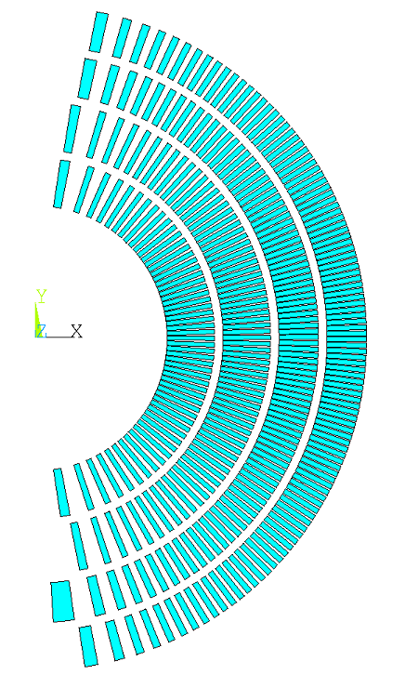
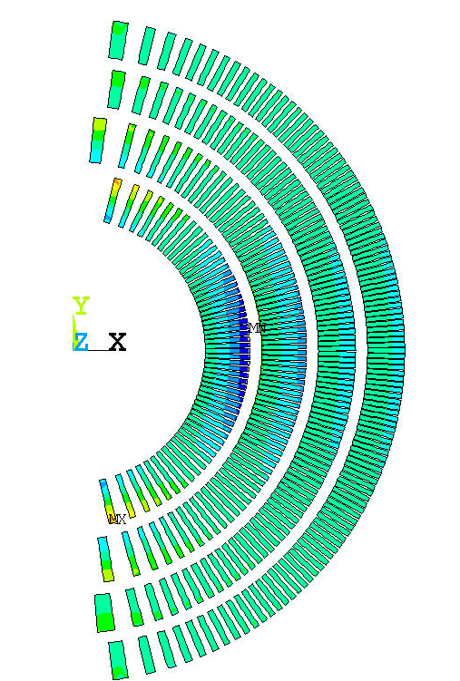
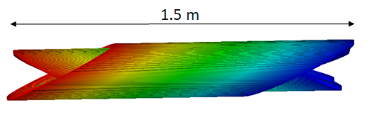
Task 3. Design of CCT6, target field of 13 T and bore diameter of 120 mm
Task 4. Fabrication and test of CCT6
Target Parameters
  4 layers
  Bore field of 12 T / 13 T for standalone operation (30+ % current margin at target fields of 12 T, 4.2 K and 13 T, 1.9 K)
  Bore diameter: 120 mm
Field strength and bore size needs are compatible with HTS programs for hybrid testing
Use feedback provided by subscale testing and improved modeling methods in CCT6 design
Goals:
Demonstrate scale up for more than two layers
Demonstrate feasibility of CCT at higher field with a large bore
CCT6 Design

Slide 10
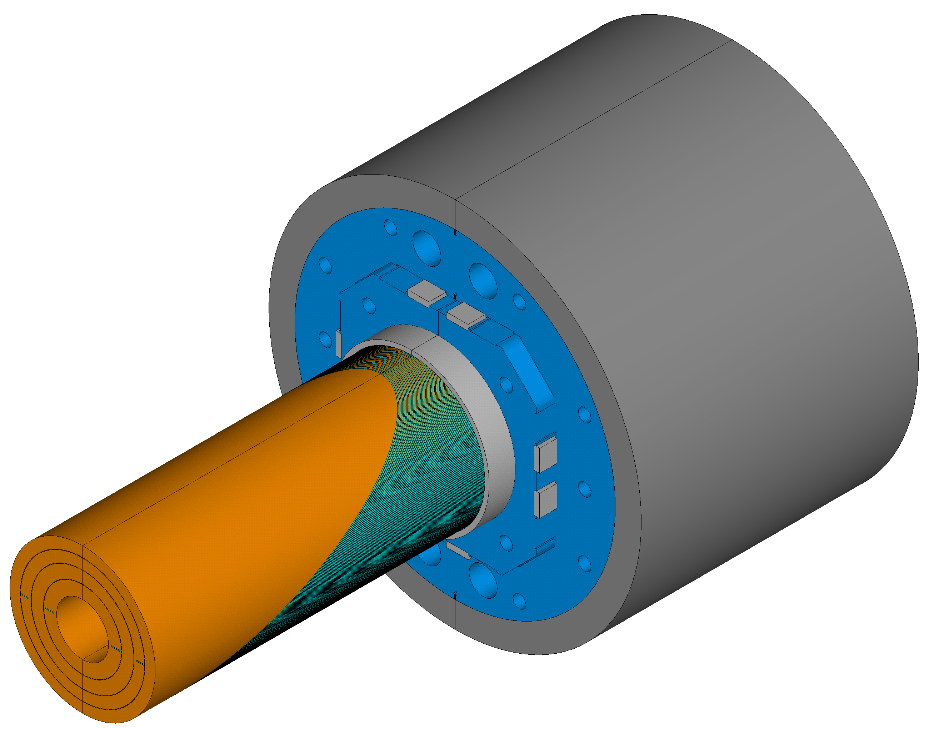
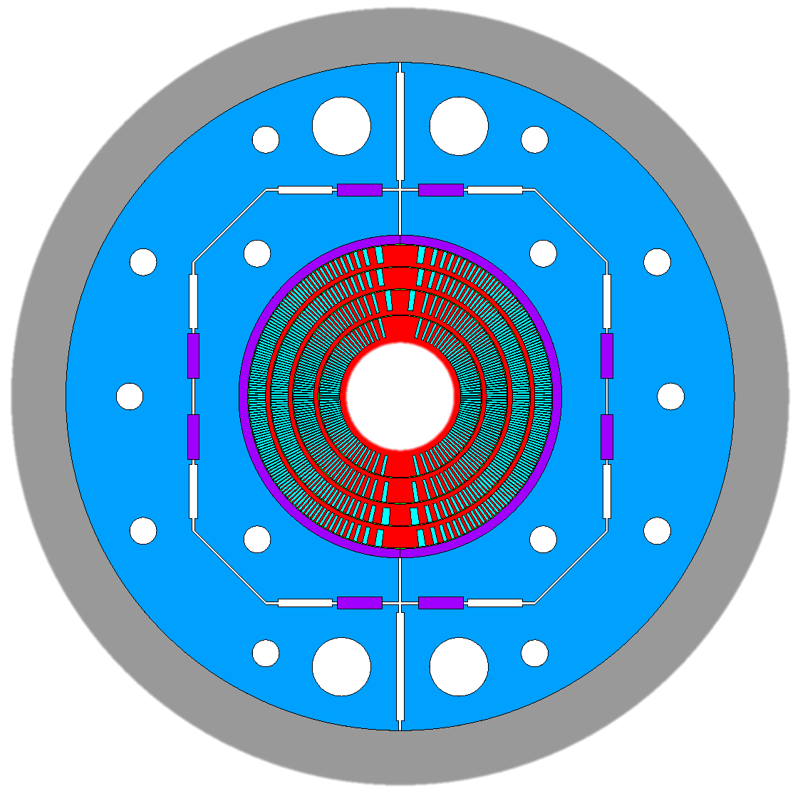
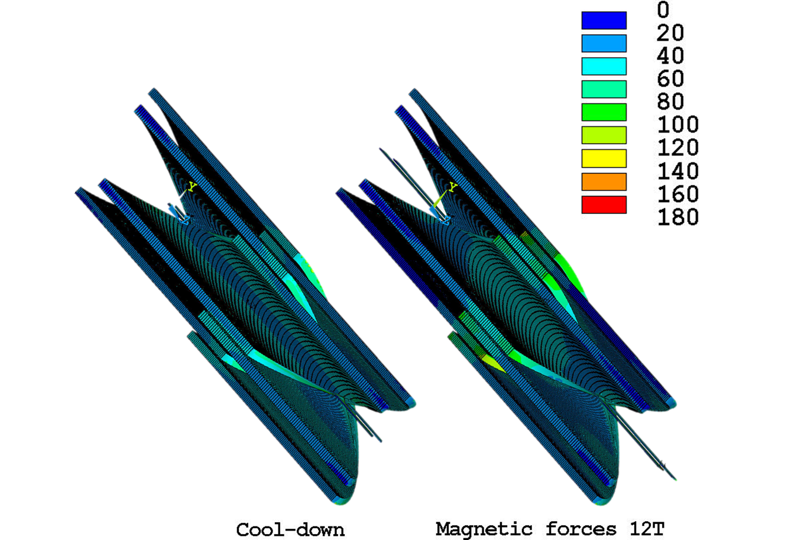
Current Status And Next Steps
Current Status
Current conceptual design assumes use of existing LD1 (in-hand) cable for inner layers and MQXF type (needed) cable for outer layers
Completed baseline 3D analysis
Baseline structure design is complete (from analysis standpoint)
First set of winding, reaction, and impregnation tests have been performed on 7-turn Coil (demonstrated feasibility of winding wide cable)
Delays were incurred due to machinist leaving group, moved machining operation to main LBL shop, ready again to continue on second test (20-turn) followed by machining of inner layer
Upcoming Work
Complete second 20-turn test mandrel to finalize coil geometry
Machining of layer 1
Winding, Reaction, and Impregnation of layer 1
4 Layer CCT Magnet
* See talk by J.L. Rudeiros Fernandez (fabrication updates)
* See design talks by L. Brouwer (CCT6) and M. Juchno (Utility Structure)

Slide 11
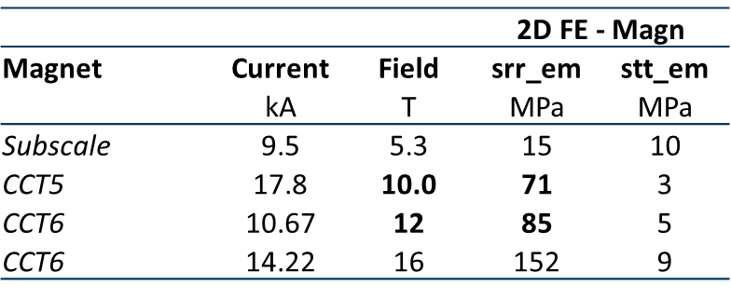
CCT6 Impregnation Decision Plan
Desire to operate close to the conductor limit with minimal training for CCT6
Wax subscale has been completed without training and we are currently working on filled wax subscale magnet
Have started work on building a wax impregnated CCT5 @10T (CCT5W) as a stepping stone towards CCT6
  Average radial stress of CCT5 at 10 T is representative of CCT6 at ~12 T. Subscale stresses are significantly lower
  The cost and effort to build CCT5W is only slightly more than for a subscale magnet since the process is the same, the machining cost is only slightly higher, and cable is available
Stress on Turn from Lorentz Force
Plain Wax SUB
CCT5W
CCT6
Filled Wax SUB

Slide 12
Next “Large” CCT Model Milestones & Deliverables
Deliverables
Design, fabrication, and test of 4-layer CCT magnet
Milestones
Original milestone: Design completed at the end of Q1 FY2022 (with input from modeling and subscale work)
  Design nearly complete, awaiting feedback from 20-turn test (expected July 2024)
Original Milestone: Full magnet assembly and testing Q3 FY2023
  Fabricate layer 1 by end of 2024
  Current plan is to test two inner layers ~ Q3 FY 2025
  Full magnet test would be approximately 1 year later

Slide 13
Conclusions
Training free demonstration of wax impregnated CCT subscale magnet
Subscale program has led to improvement in fabrication techniques and development of new methods (synergistic with HTS programs) * See talk by Jose Luis Rudeiros
Advanced the design of 120 mm bore 12 - 13 T 4 layer CCT dipole * See talks by Lucas Brouwer (CCT6) and Mariusz Juchno (Utility Structure)
Developed plan for CCT6 impregnation decision process that includes CCT5W (fabrication in progress)
Improved modeling efforts to better understand the interfaces in stress managed magnets are ongoing * See talk by Giorgio Vallone in Modeling Section
Focus for next step in road map
Continue working on understanding and improving training in stress-managed Nb₃Sn magnets
Demonstration of higher field model magnets (4 layers) and HTS hybrid magnet operation
  Plan to test CCT5 for future use as an outsert in this calendar year – See talk by Reed Teyber
  Continue work on design and fabrication of CCT6

