Slide 1
CCT6 Design and Prototyping
Lucas Brouwer, Mariusz Juchno, Diego Arbelaez, Paolo Ferracin, Jose Luis Rudeiros Fernandez, and Giorgio Vallone (for the CCT Team)
4/30/2024

Slide 2
Outline
review of nominal CCT6 design
impact of all MQXF cable option (potential for mitigating machining risk)
prototyping results and near-term plans

Slide 3
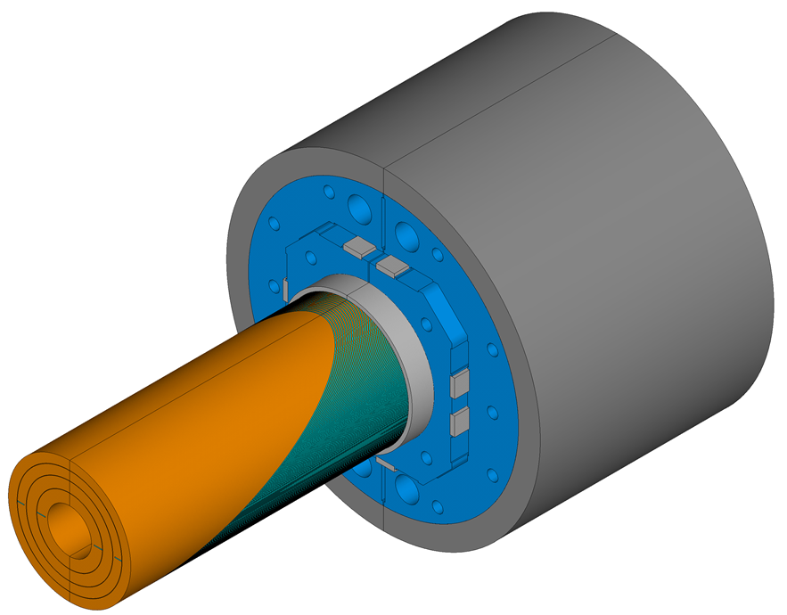
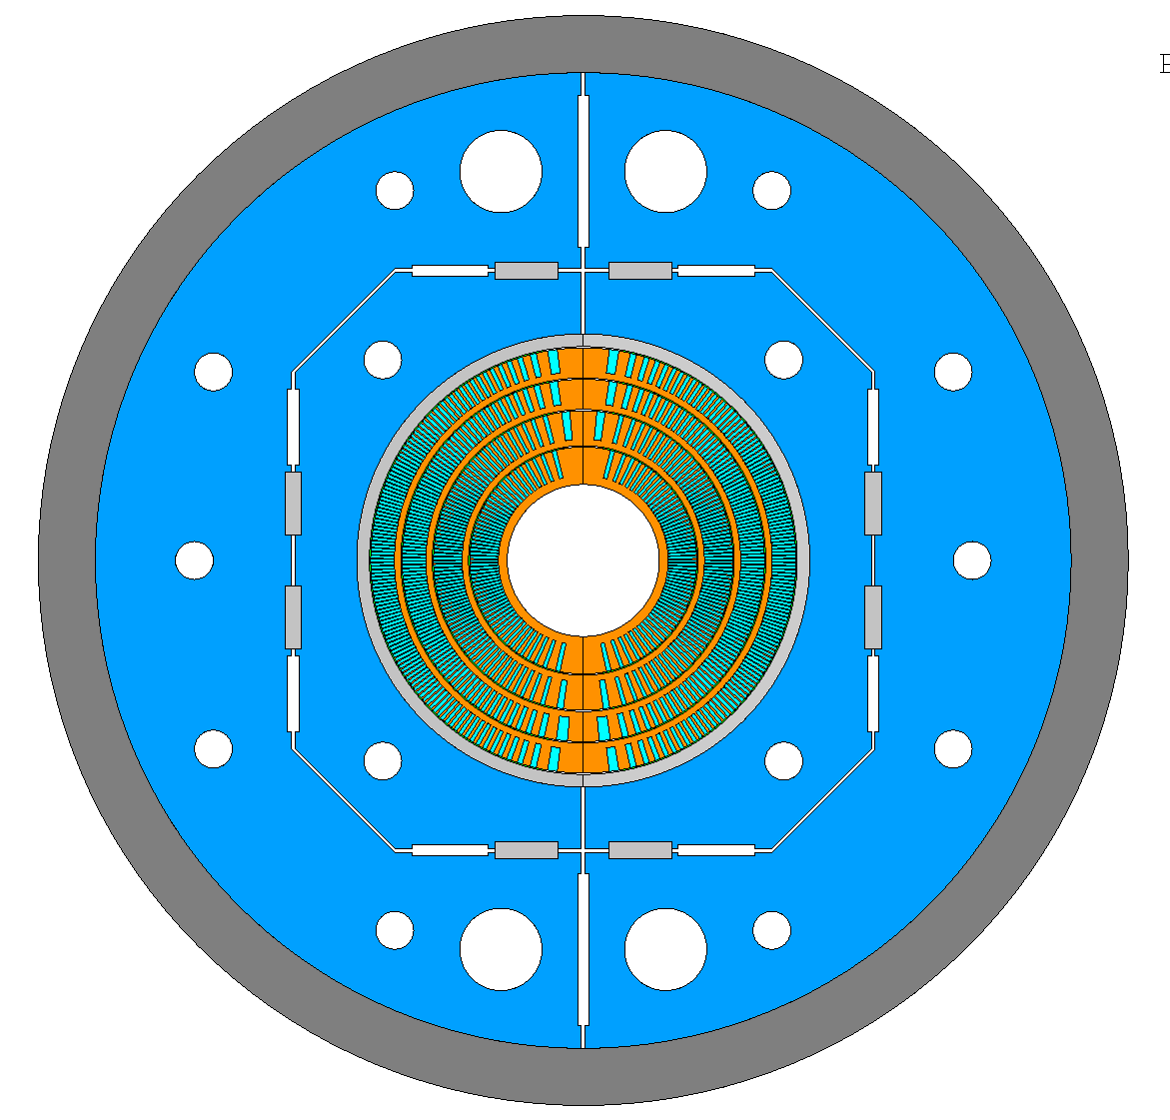
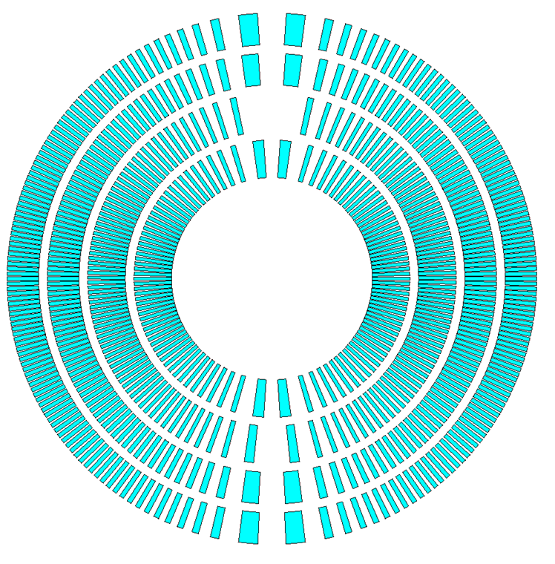
CCT6 is a 4-layer, Nb₃Sn dipole to provide 12-13 T background fields for HTS insert testing within US-MDP
Targets from MDP program plan
120 mm clear bore diameter for inserts
four layers
12 T at 4.2 K, 13 T at 1.9 K (at ~70% short-sample)
2D/3D mechanical design is well-advanced for the nominal case, and employs the utility structure
Nominal CCT6 design leverages grading and existing cables
MQXF cable for outer layers (Hi-Lumi Dropouts)
LD1 cable for inner layers (on-hand)
See next talk by Mariusz for details
https://doi.org/10.1109/TASC.2022.3151723

Slide 4
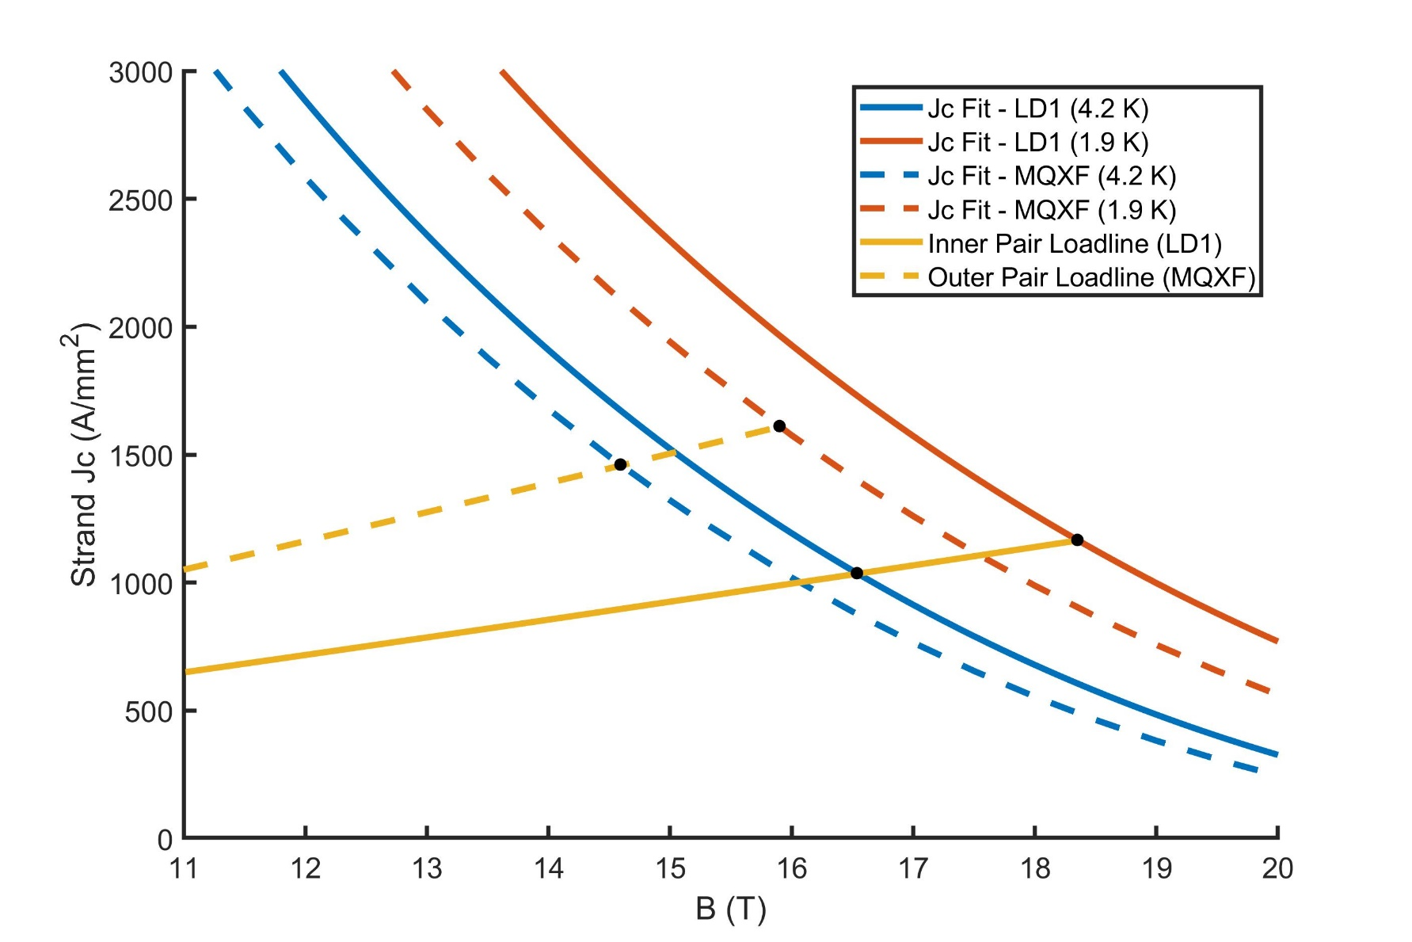
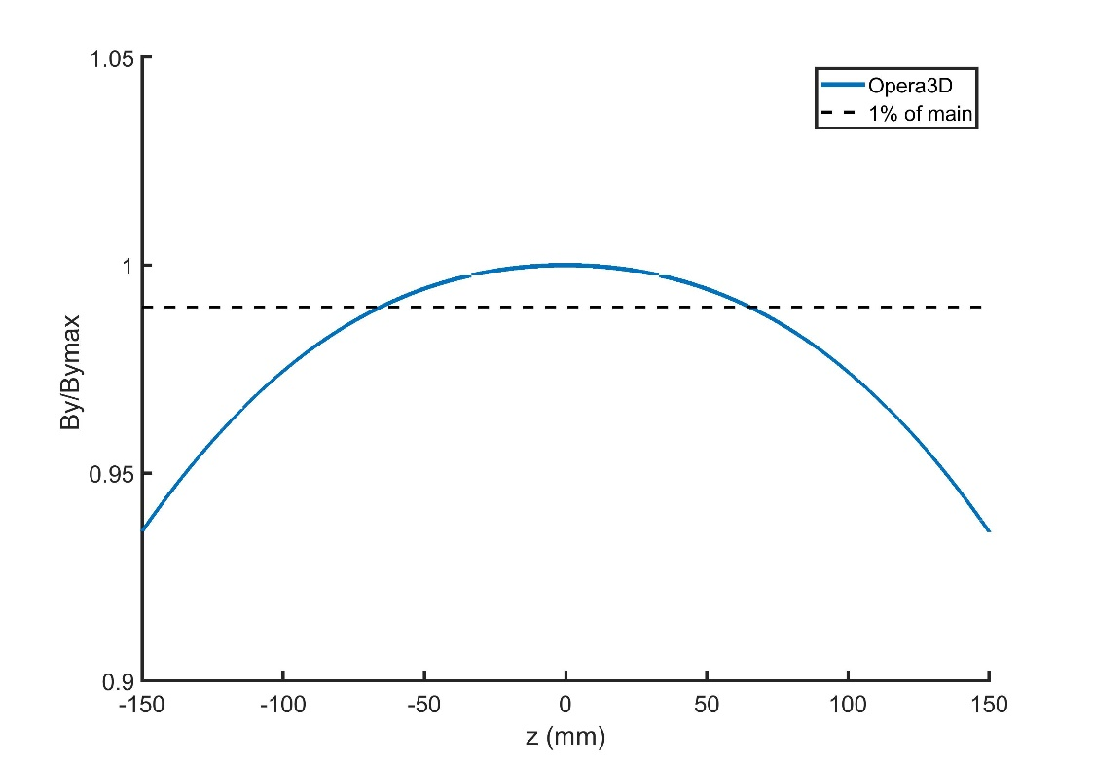
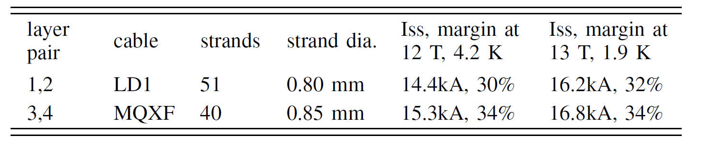
Operational margin for the nominal design is ~30% at MDP target of 12 T at 4.5 K, and 13 T at 1.9 K
1.5 m physical length, straight-section length of 130 mm based on 1% criteria
1-2% rise of field at conductor

Slide 5
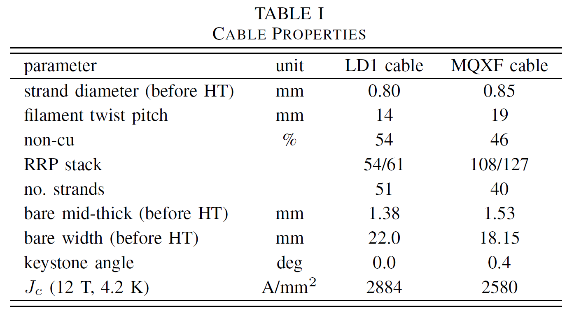
Study impact of switching from LD1 to MQXF cables for the inner layers (possible risk mitigation for machining)
Improves machinability (+)
drop in channel aspect ratio from 15.7 to 12
Reduces magnet short-sample (-)
drop in SC fraction
drop in strand number
drop in Jc

Slide 6
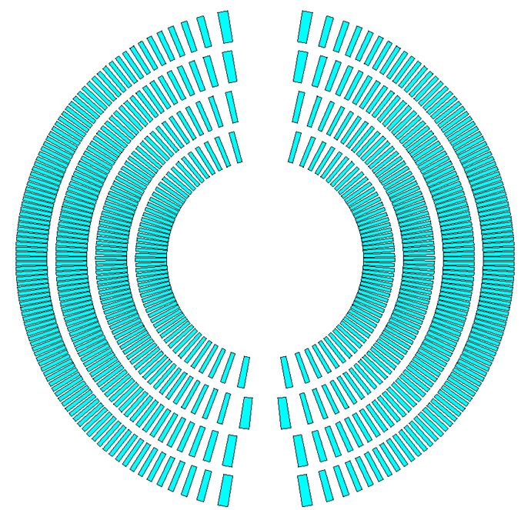
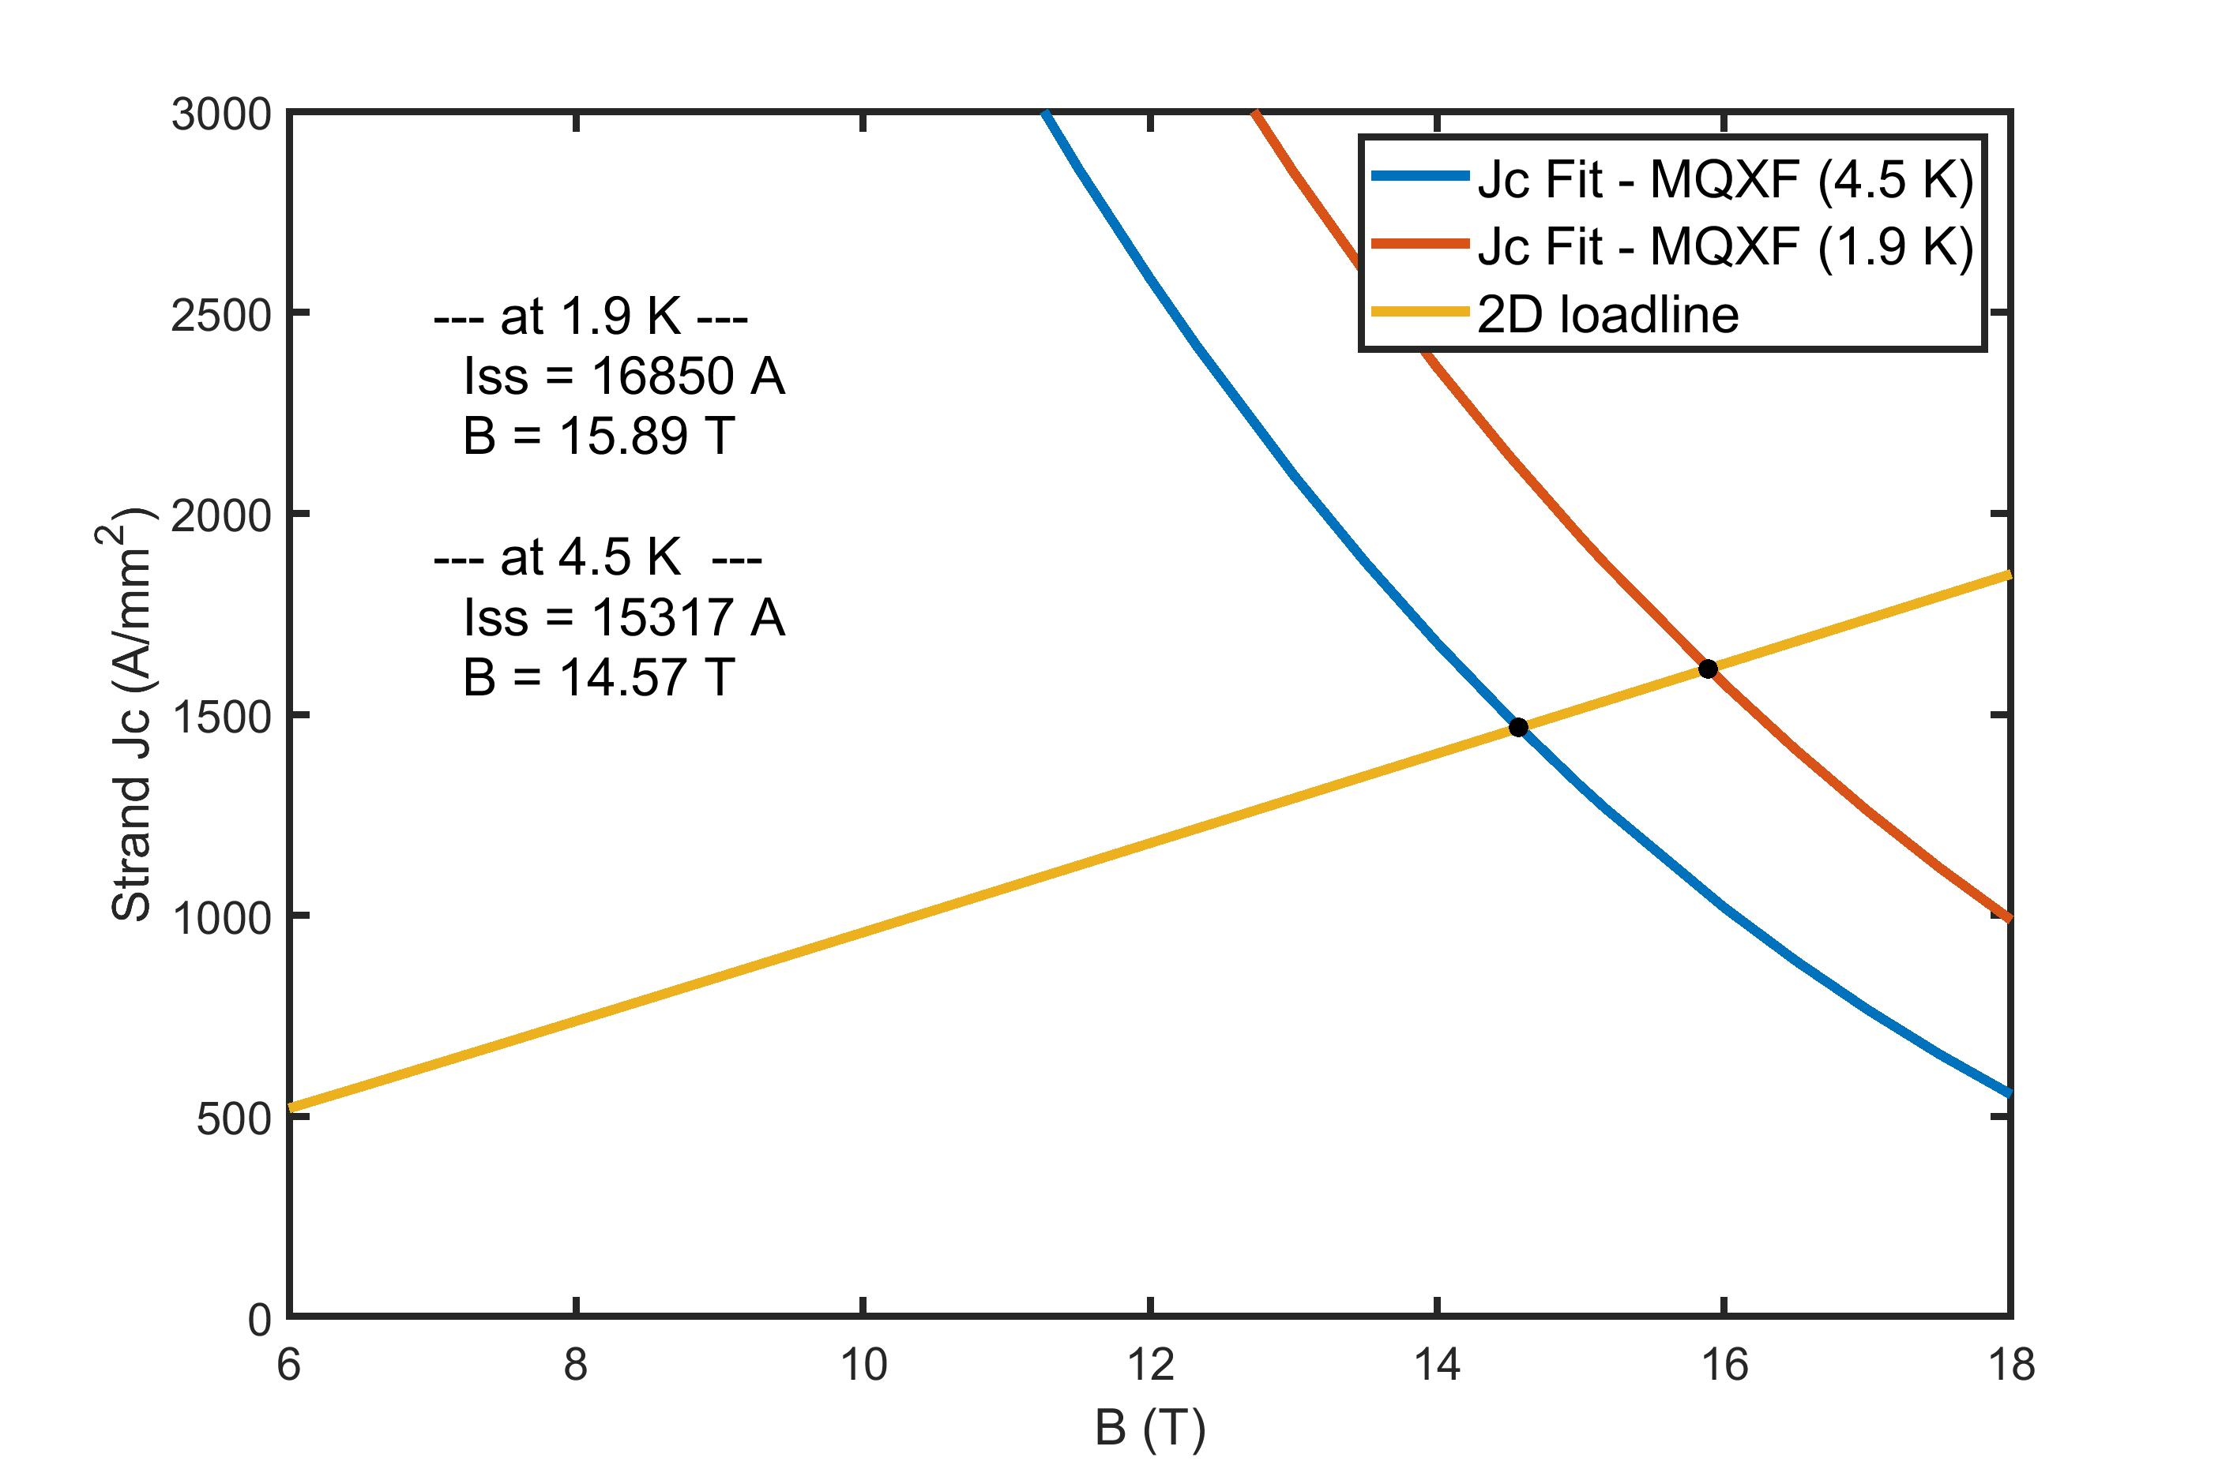
The margin with the MQXF cable option is to reduced to around 20% for both targets
All four layers MQXF cable
Target | I (kA) | Loadline margin
12 T at 4.5 K | 12.62 | 18%
13 T at 1.9 K | 13.79 | 18%

Slide 7
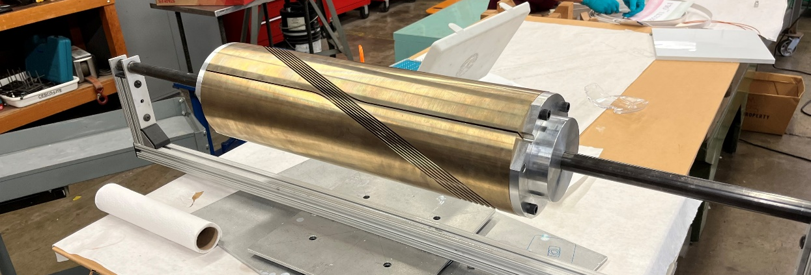
Prototyping: where we were at the last CM meeting
Feasibility of fab.
Feasibility of winding
Feedback on gaps/channel
Feedback on updated channel/gaps
Cable inspection at pole
First 7-turn
Machining
1st Winding
1st Reaction
2nd winding
w/spacers
2nd Reaction
Epoxy
impregnate
Cut & Inspect
Last Collaboration Meeting
Use updated channel/gaps
Second 7-turn
Not yet complete
Machining w/new bronze
Wind
React
impregnate
Cut/Inspect
For nominal design with LD1 cable
demonstrated machining of 7-turn mandrel
demonstrated feasibility of winding
established nominal channel depth and width, including reaction gaps
Encountered challenges with machining efficiency and quality (see Jose Luis talk)

Slide 8
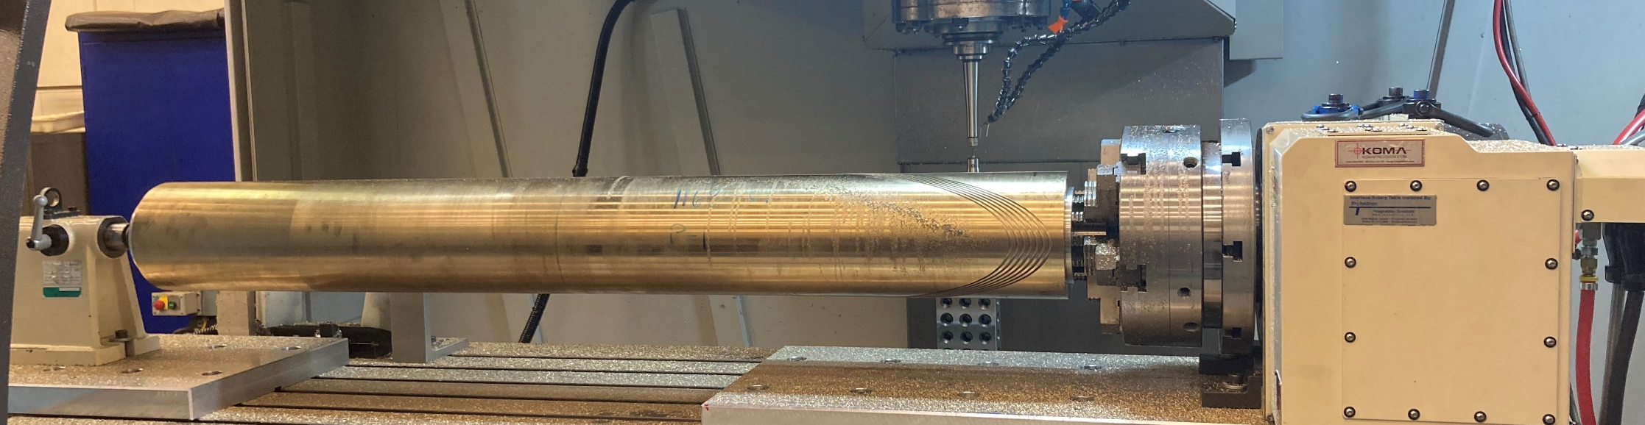
Updated prototyping plan and next steps
Initial feedback on impact of LD1 vs. MQXF channel for scale up
Flat plate optimizing both LD1 and MQXF grooves for speed
selection of optimal machining parameters
Final feedback on impact of LD1 vs. MQXF channel
+ demonstrate machining of long-length tube
Procurement of first 1.5 m length tube (defect)
7 turn testing + 20 turns of final channel in 1.5 m tube
reaction testing
Final groove parameters based on machining / reaction
Procurement of final 1.5 m length tube
Full inner layer machining
Where we are now

Slide 9
Summary and Next Steps
Summary
graded magnetic design for 12 T at 4.5 K and 13 T at 1.9 K with ~30% margin using existing Nb₃Sn cables (LD1 + MQXF)
reminder: this is a 16 T+ short-sample magnet
all MQXF cable option for mitigating machining risk lowers the margin to ~20%
a new prototyping plan seeks to demonstrate an efficient path to long-length layers and will provide feedback on choosing between the nominal design and the all MQXF option
Next Steps
complete prototyping and selection final cable and machining parameters
fabrication of first layer (end of 2024)
further optimization of 3D mechanical structure (ongoing)

Slide 10
Extra

Slide 11

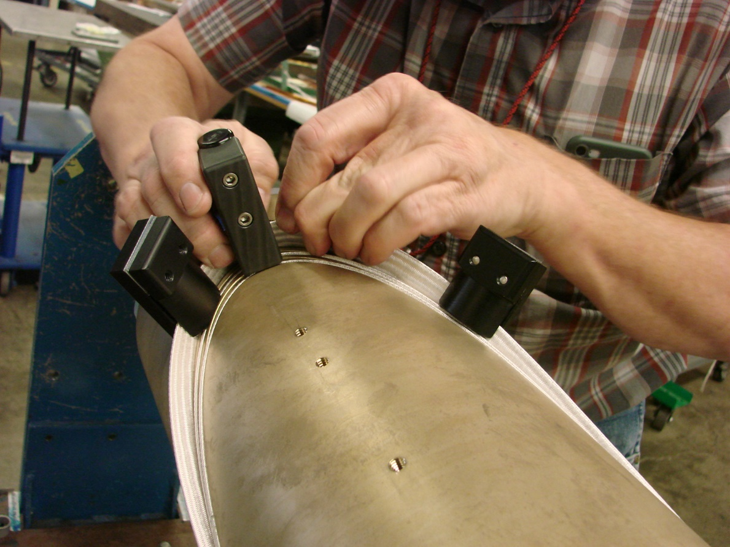
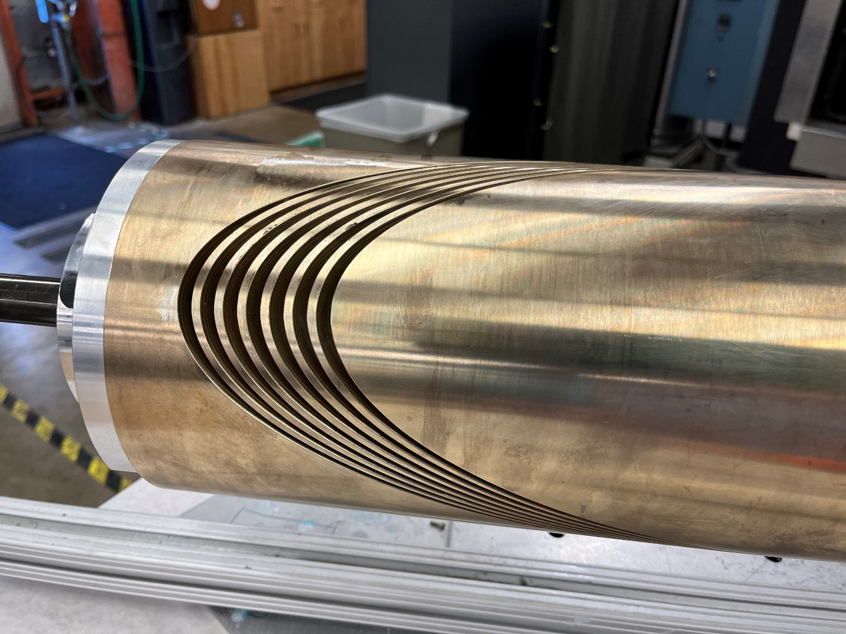
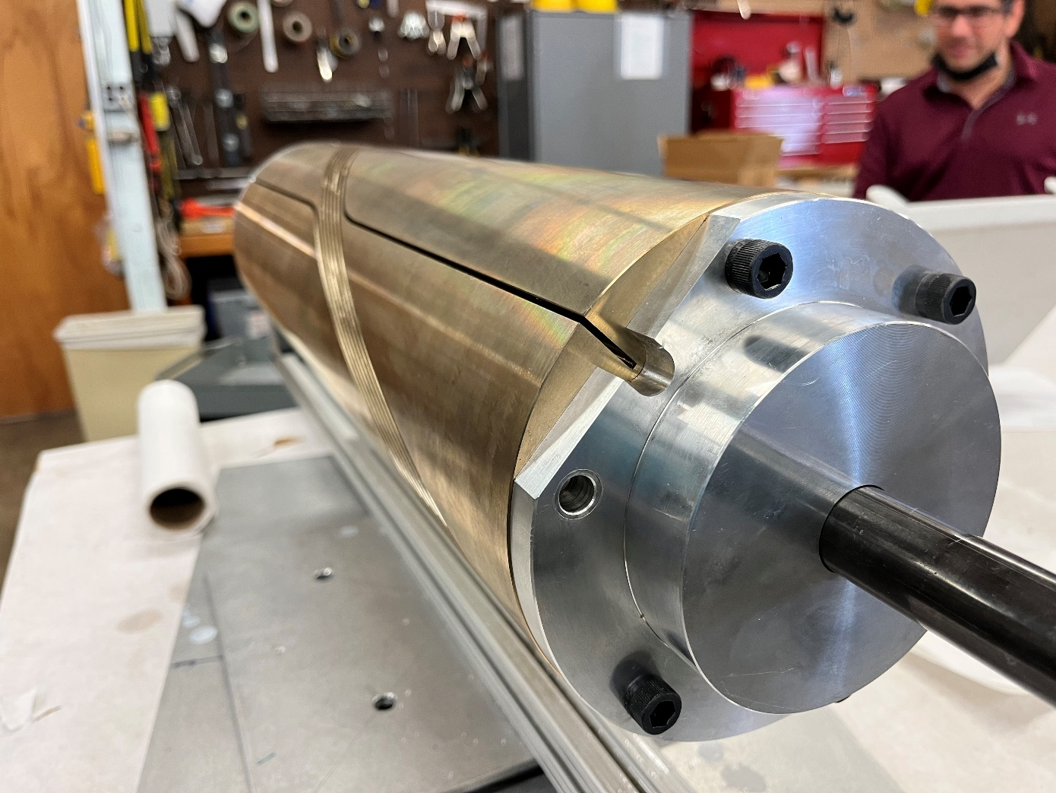
A seven-test mandrel to demonstrate feasibility of machining and winding, and to measure reaction gaps of conductor
First seven-turn mandrel matching the inner layer of CCT6 (22.6x2 mm grooves)
Winding of 51 strand LD1 cable into deep grooves is challenging, but feasible
clamps prevent popped strands in the pole region

Slide 12
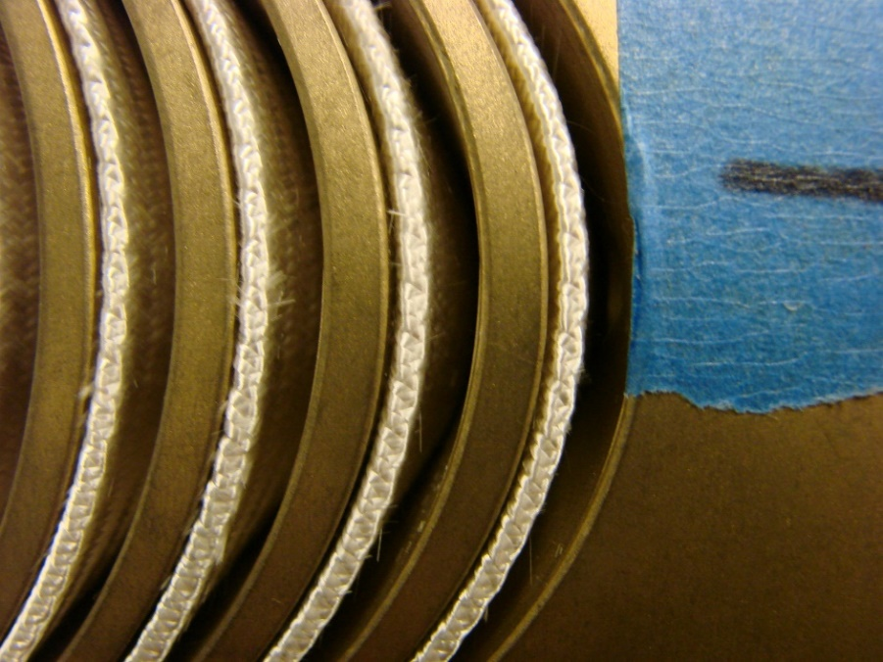
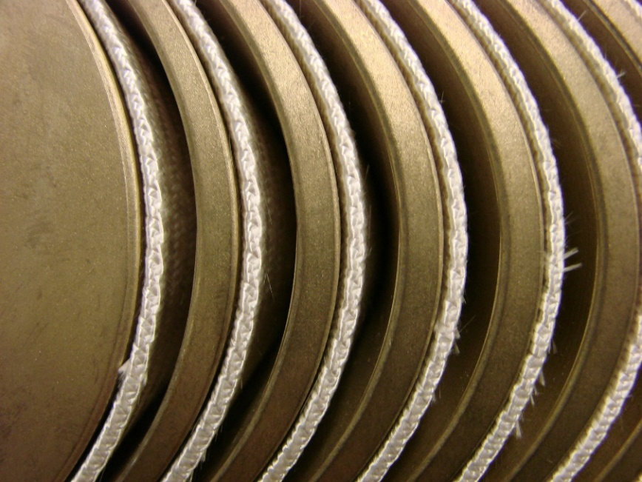
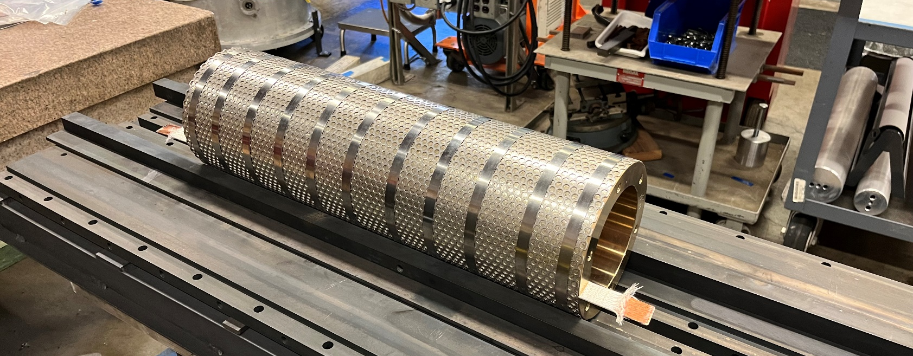
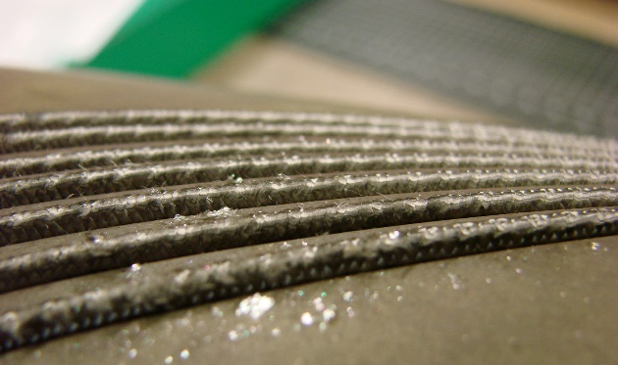
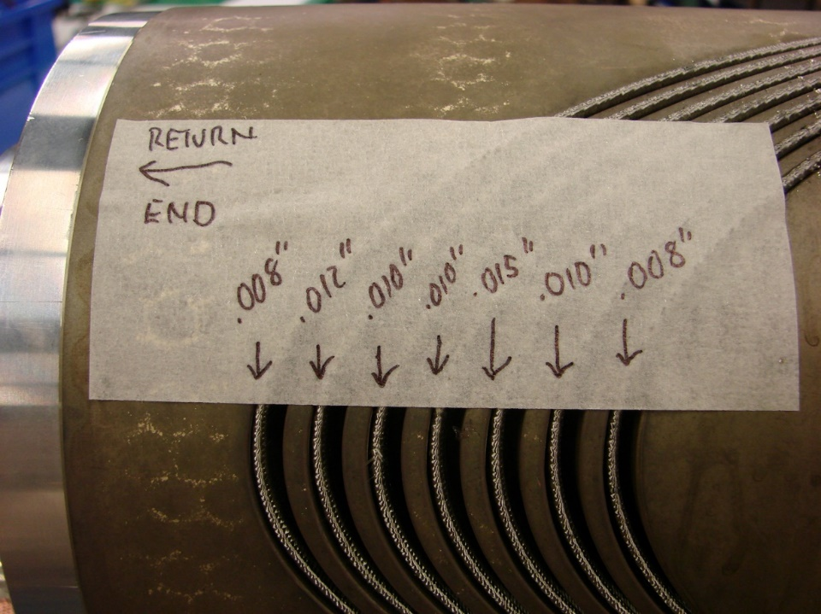
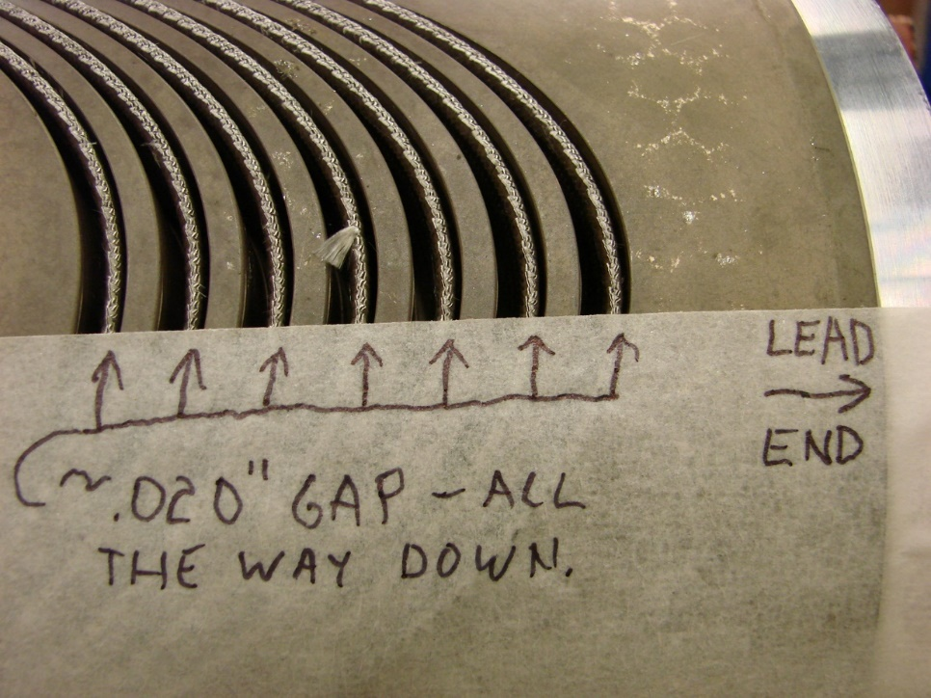
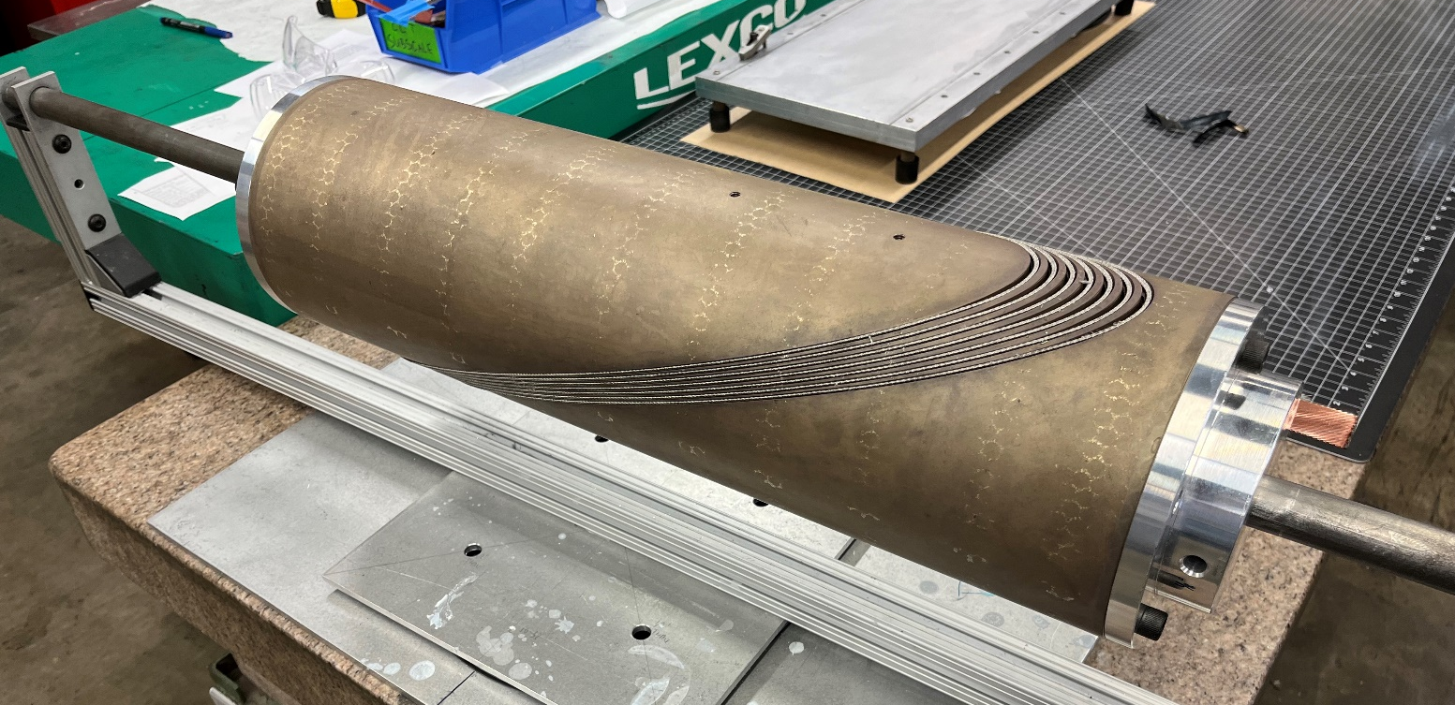
Revision of the groove based on position of cable after reaction
Reaction gives first feedback on channel depth and reaction gaps
before reaction
after reaction

Slide 13
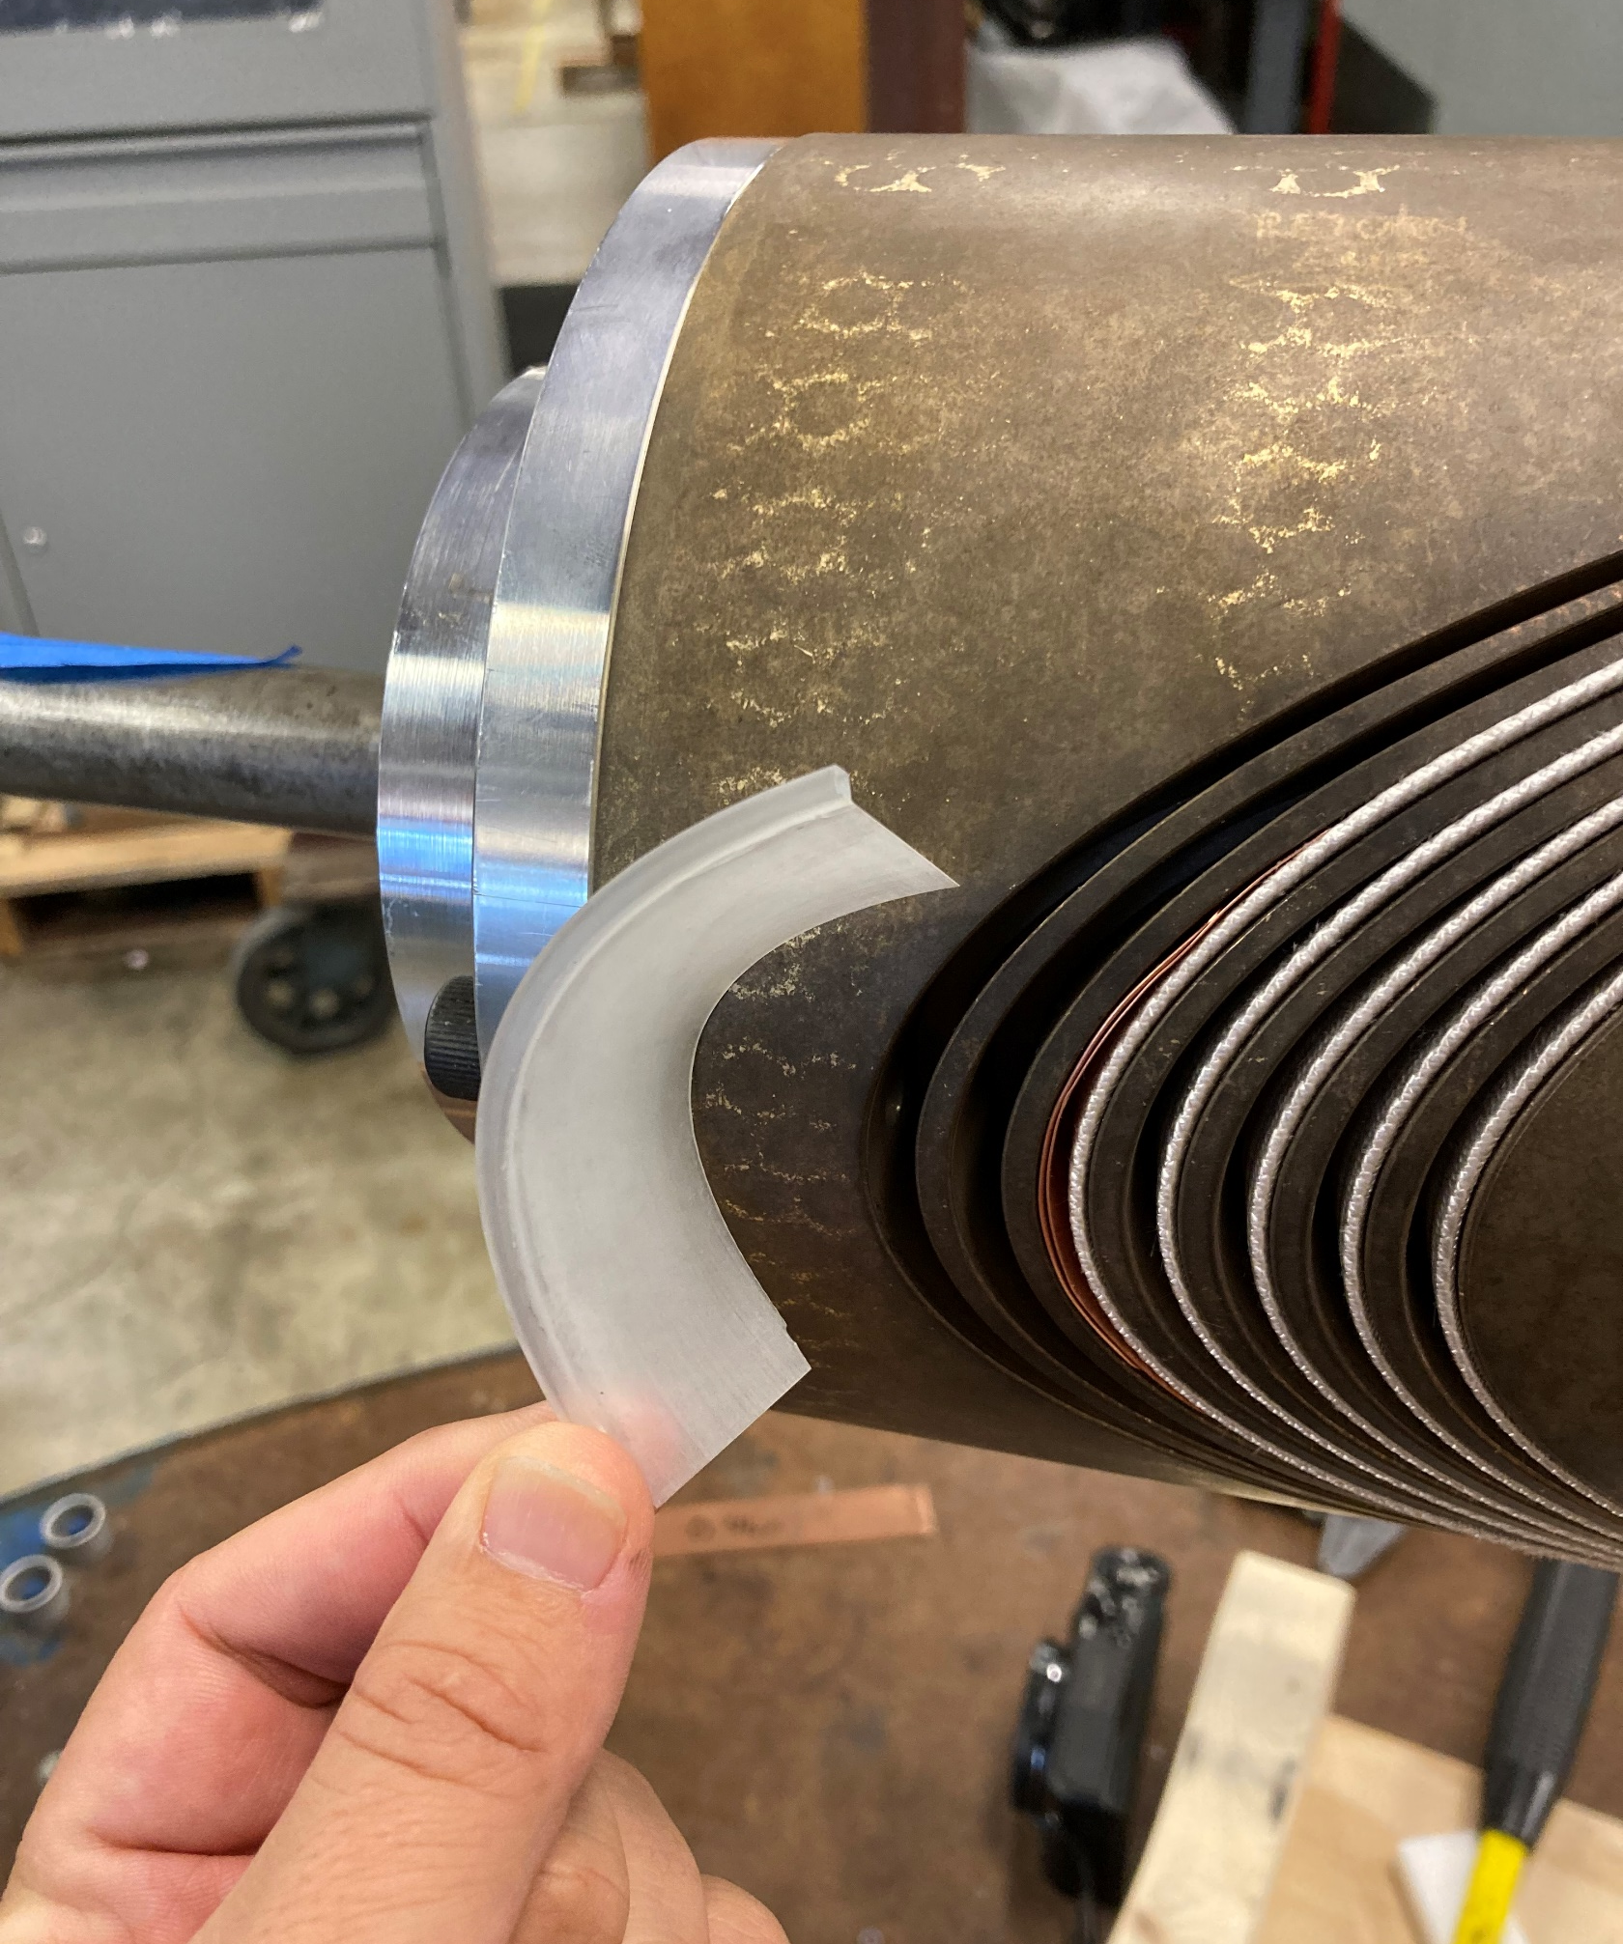
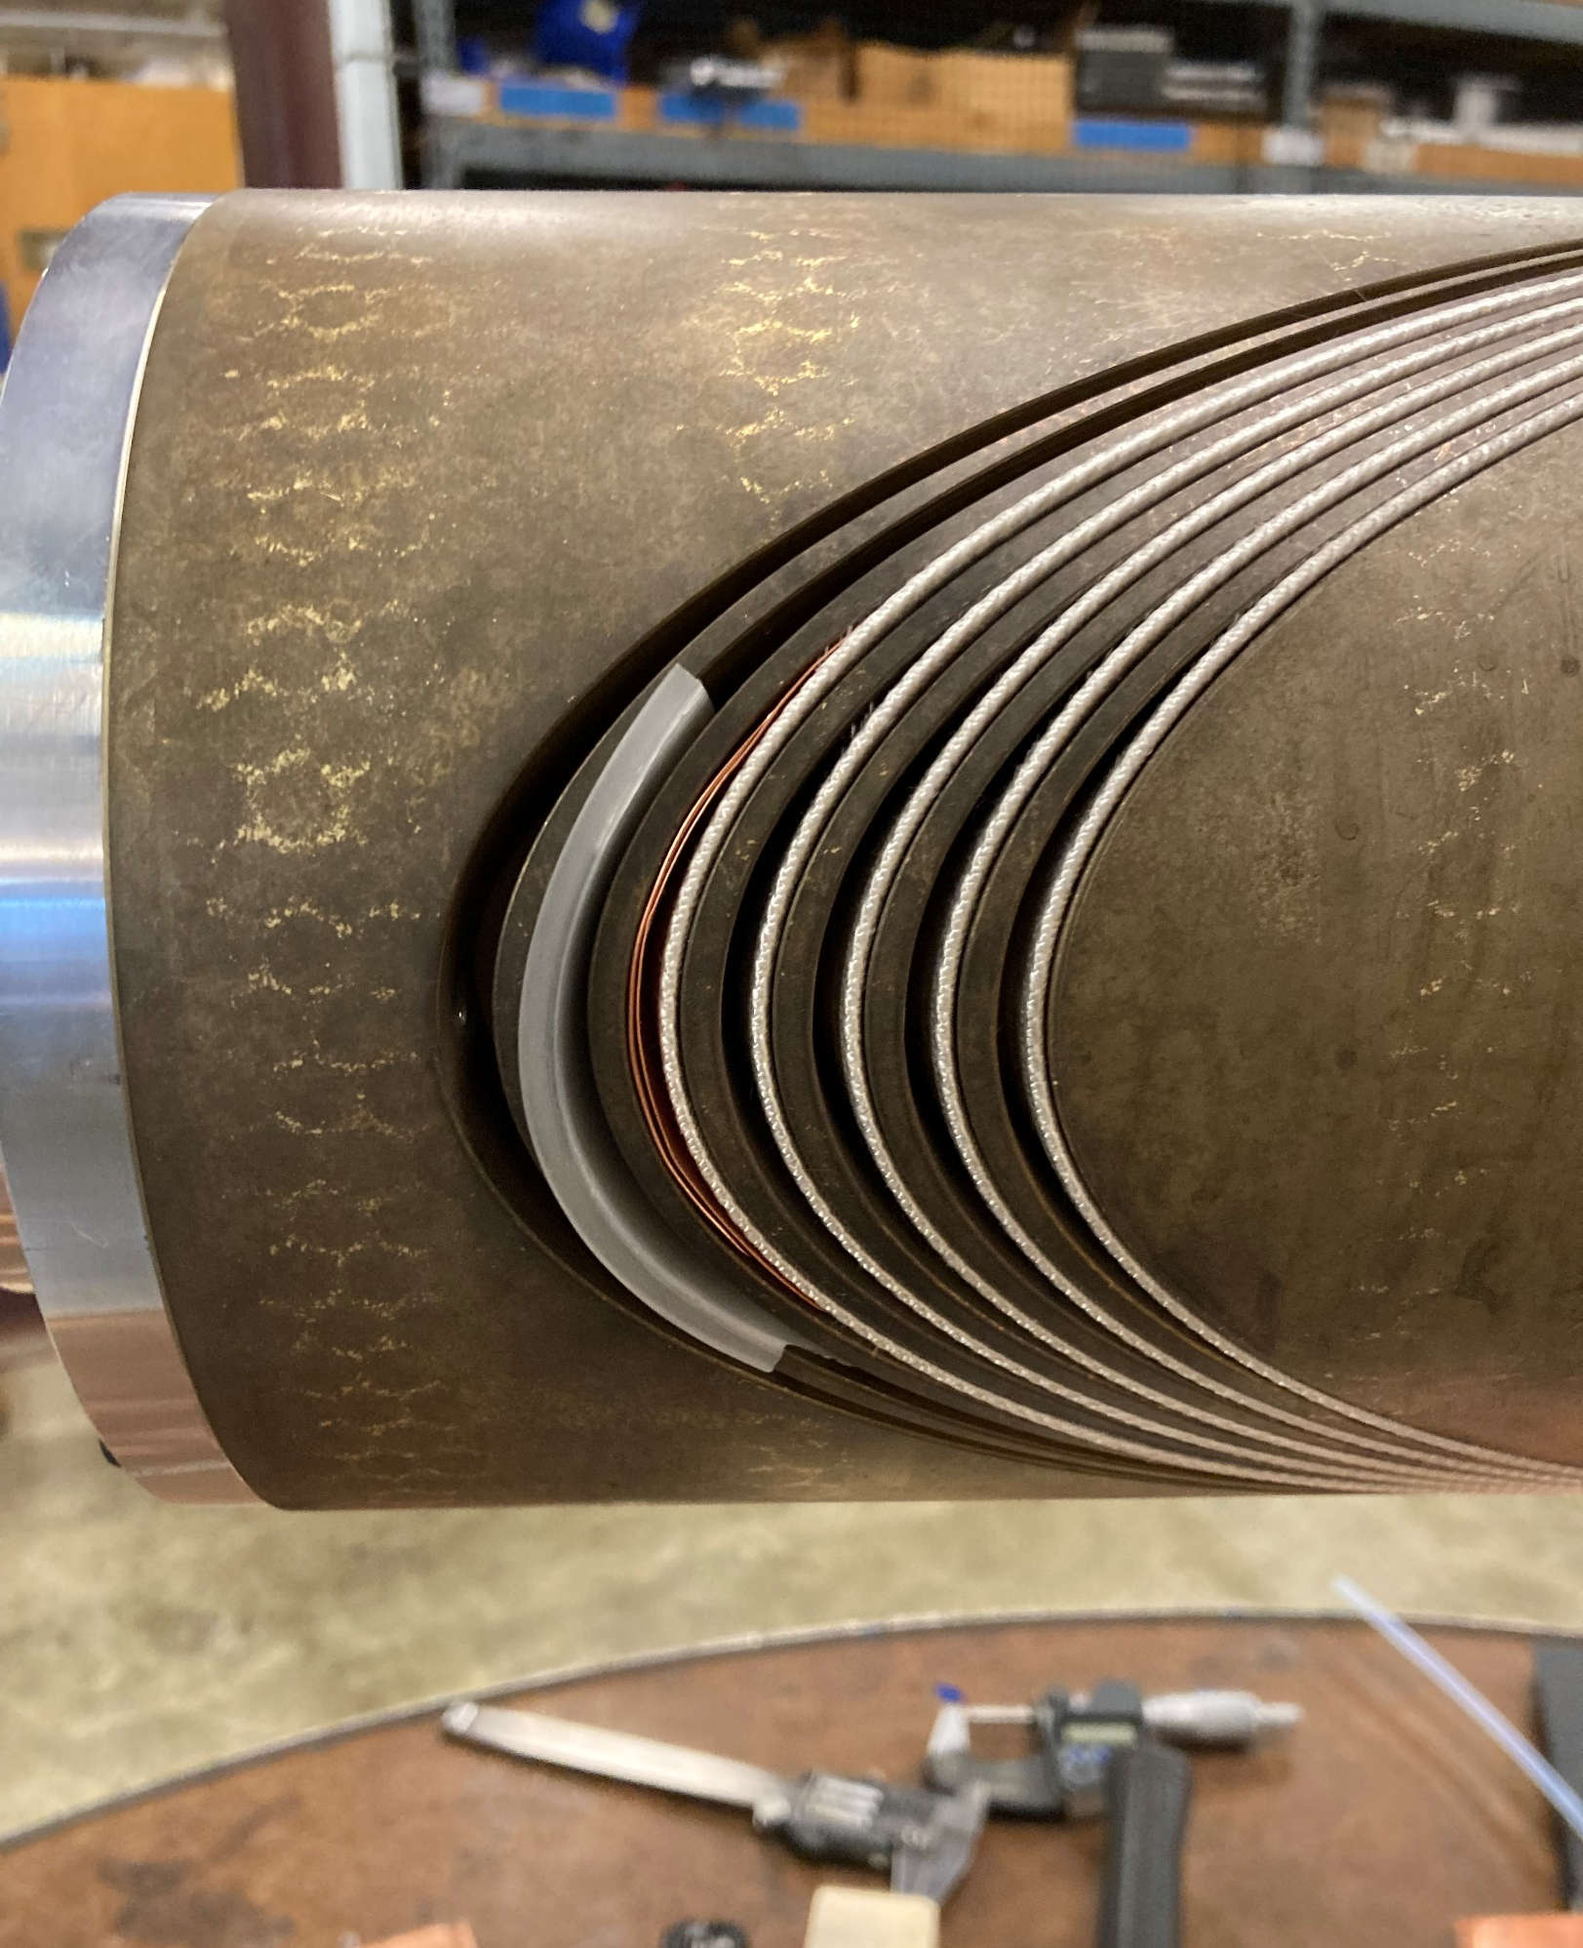
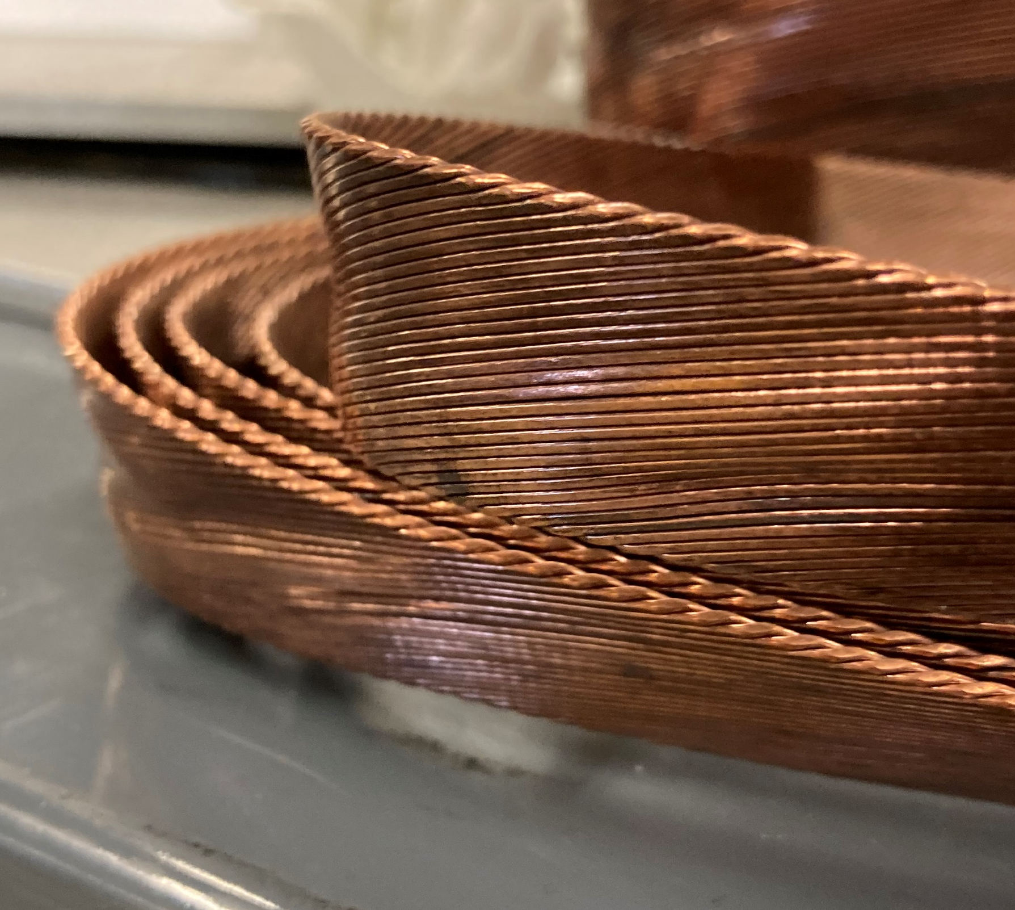
Rewinding + reaction of the mandrel with spacers matching the updated groove

Slide 14
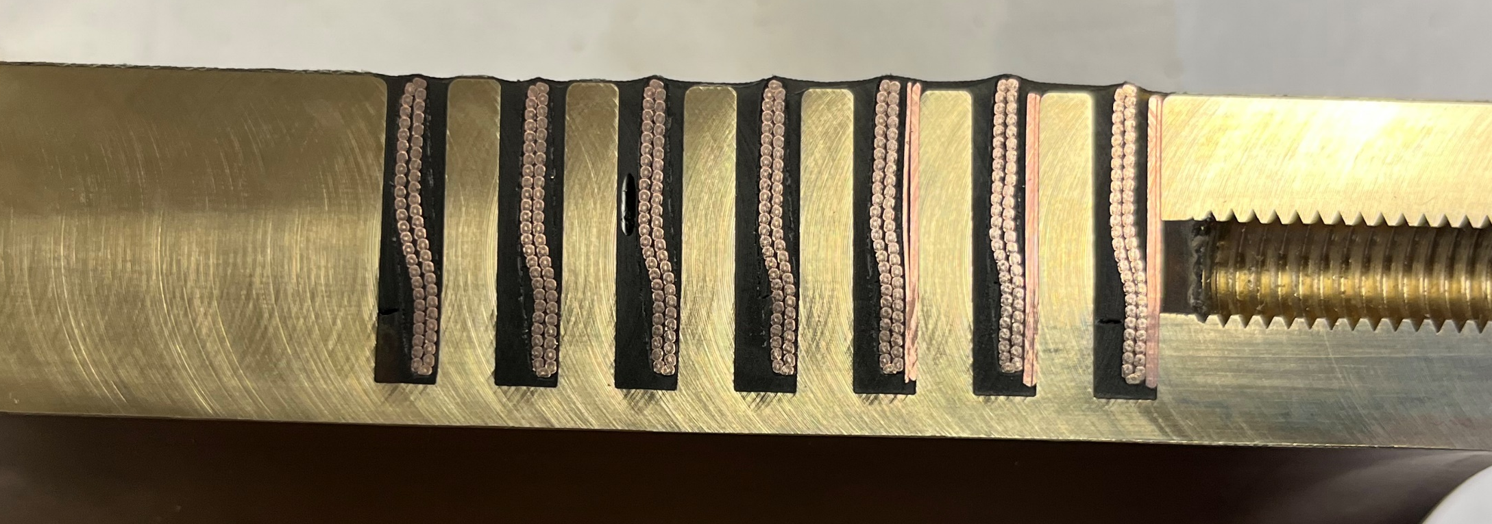
Cutting showed no popped strands in the pole region
Copper shims simulate updated channel in half of the turns

Slide 15
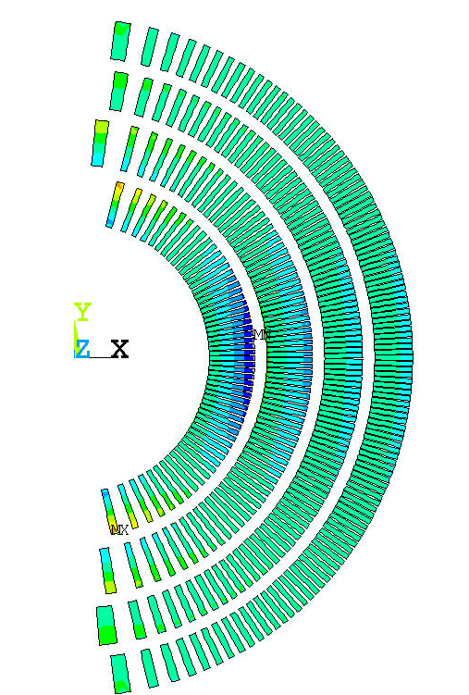
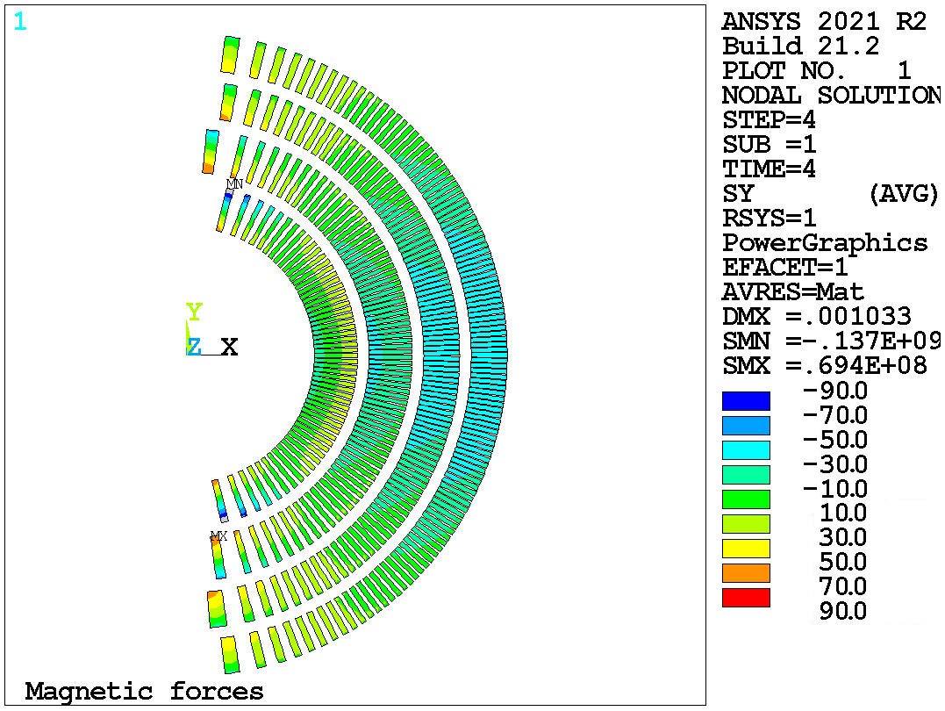
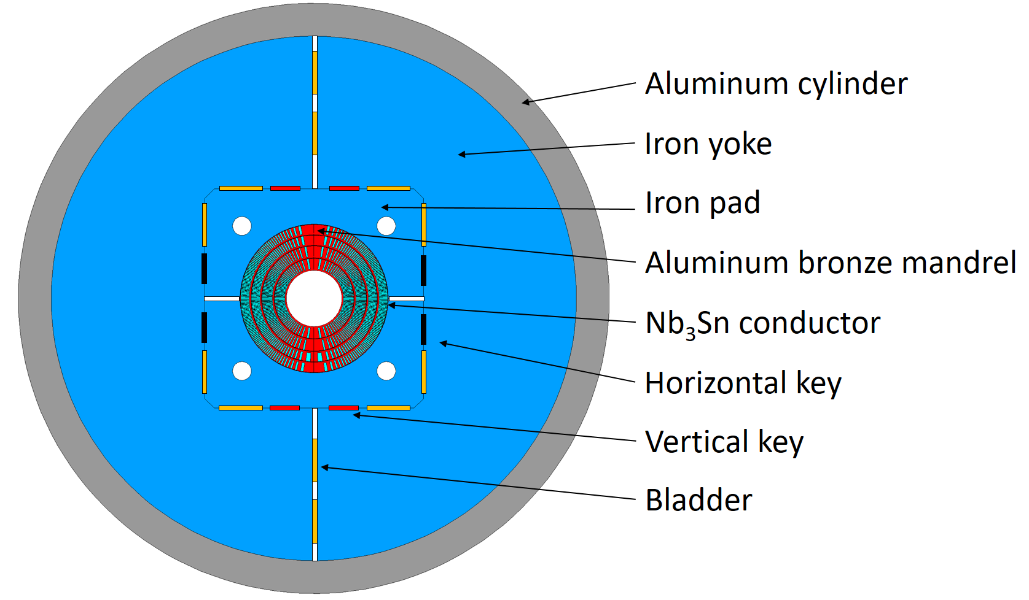
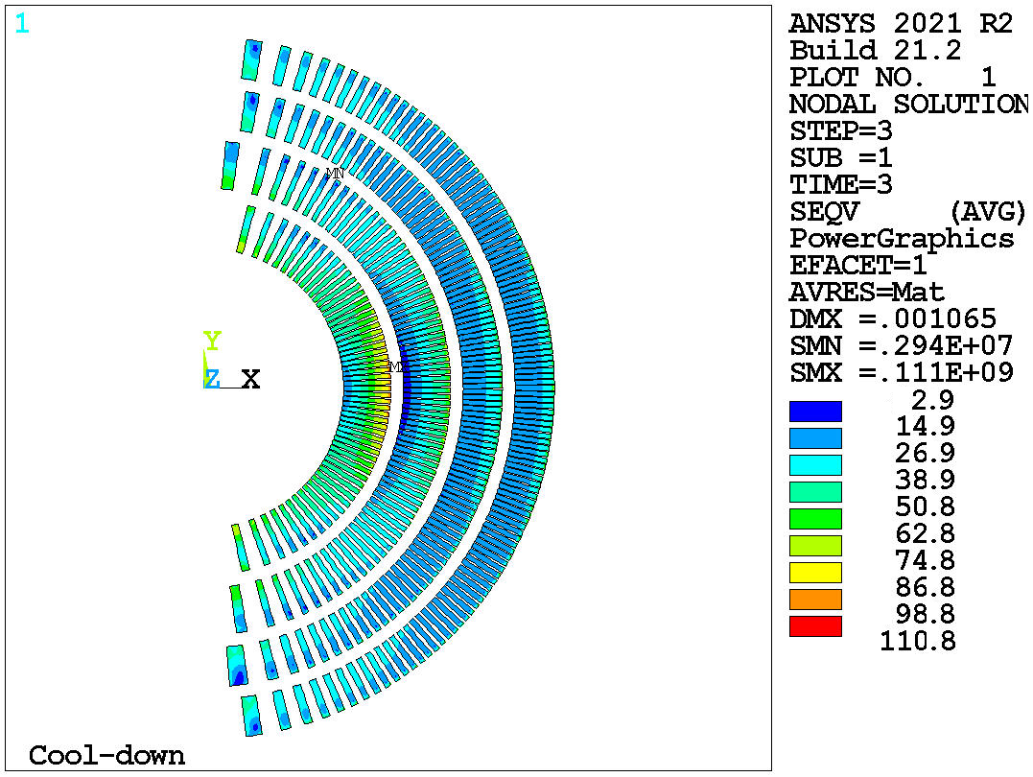
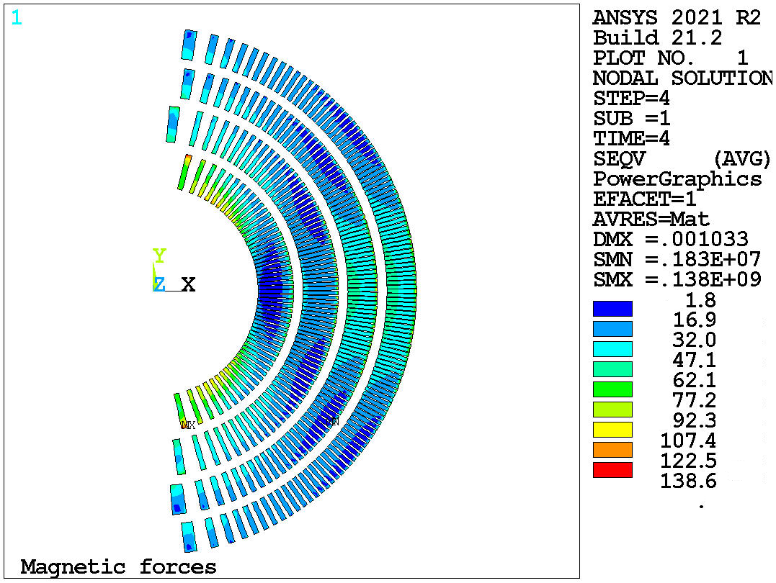
Updated structural cross section is optimized to fit in LBNL cryostat (Mariusz Juchno)
Original structure made use of existing LD1 shell (presented at MT27)
Conductor stress results from the new 2D cross section
Cooldown
13 T
1260 mm OD
Sθ (MPa)
Cooldown
13 T
von Mises (MPa)
von Mises (MPa)
860 mm OD
New structure reduces the OD by 400 mm to be compatible with testing at LBNL

Slide 16
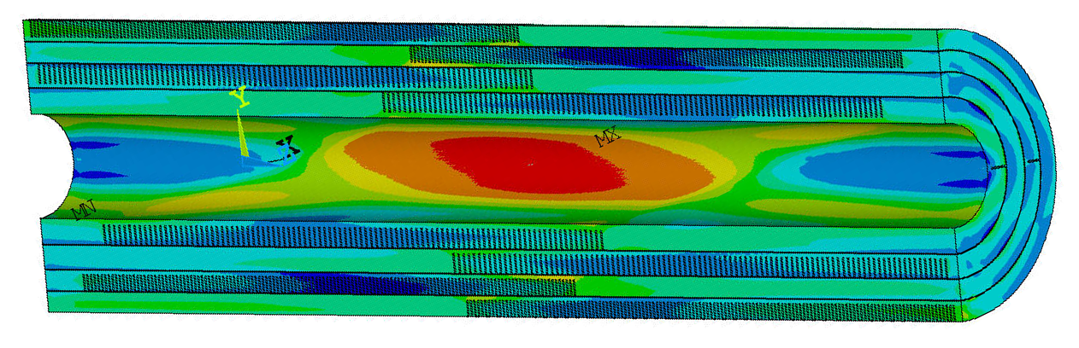
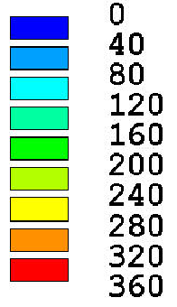
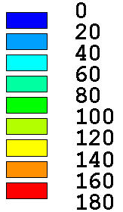
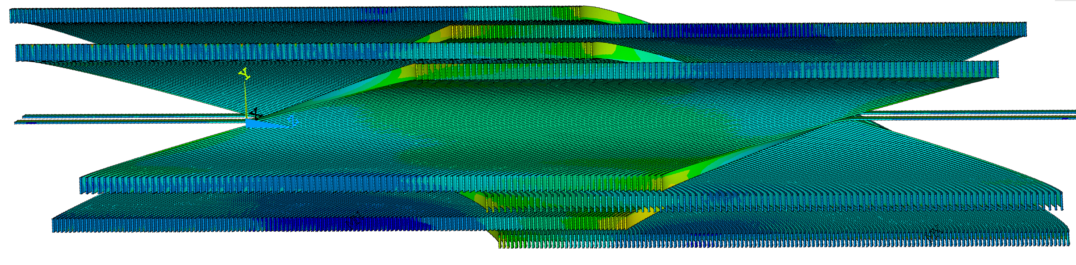
3D analysis is in progress, with initial results showing no show-stoppers in the conductor, mandrels, and structure
Von Mises in mandrels: cooldown + 14 T
See talk by Mariusz next for details

Slide 17
Conductor Needs for CCT6 are covered by existing “LD1” cable at LBNL and Hi-Lumi Dropouts (no request to CDP)

