Slide 1
Progress on Nb₃Sn CCT: fabrication and assembly methods
J. L. Rudeiros Fernandez* D. Arbelaez, C. Bird, L. Brouwer, E. Buron, J.F. Croteau, P. Ferracin, S. Prestemon, A. Saravanan, G. Vallone
US Magnet Development Program
Lawrence Berkeley National Laboratory
US-MDP Collaboration Meeting 2024

Slide 2
Table of contents
01
Mandrel fabrication
02
Impregnation materials
03
Assembly progress
04
Conclusions and next steps
J. L. Rudeiros Fernandez et al.

Slide 3
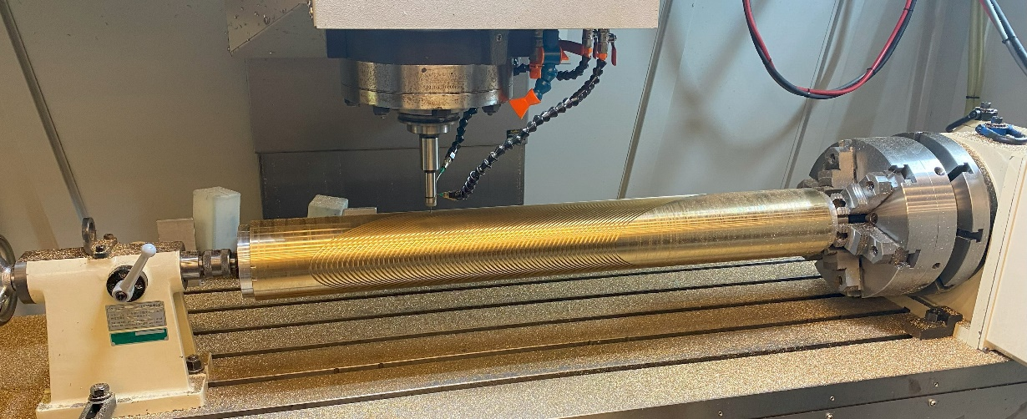
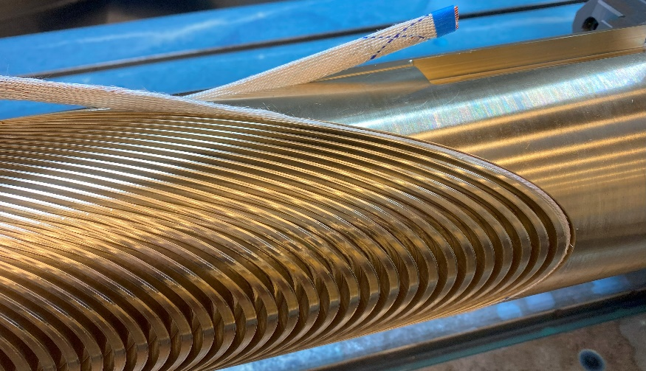
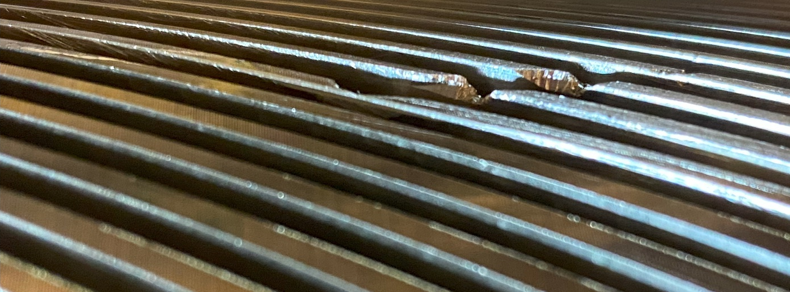
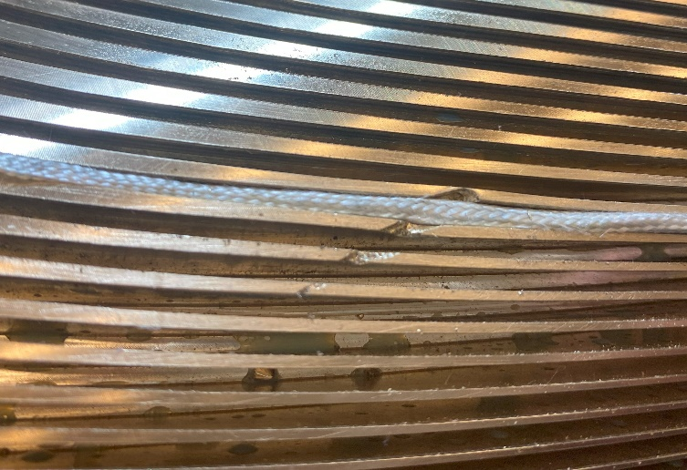
1. Mandrel fabrication - Fabrication of mandrels for CCT5-W
Status update
Finished
Layer 1
Fabrication time of 1 week.
Error during the last machining operation.
New mandrel to be produced.
Layer 2
J. L. Rudeiros Fernandez et al.

Slide 4
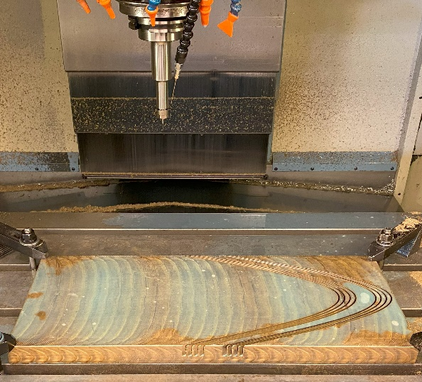
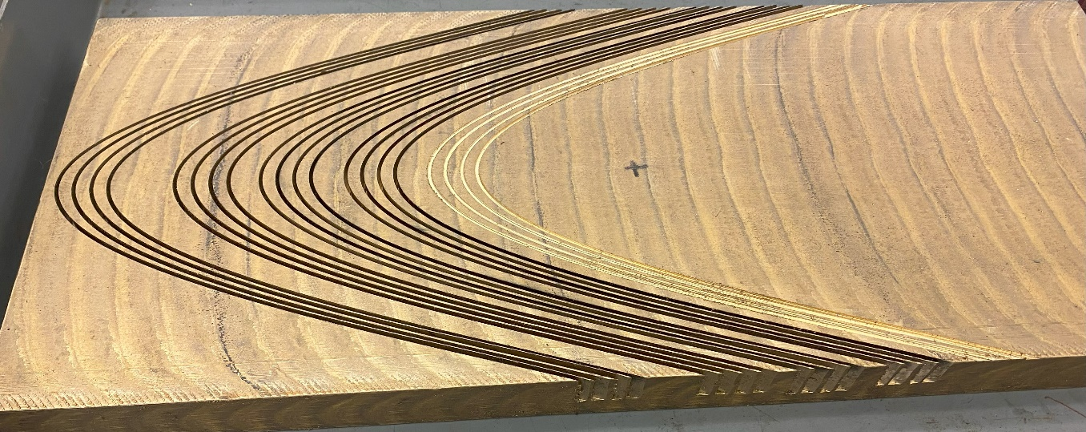
1. Mandrel fabrication - Machining development for mandrels for CCT6
Optimization of parameters for increase of machining speed and reduction in risk of tool breakage
Test number | Spindle speed (rpm) | Feed (in/min) | Depth of cut (in) | Final depth of cut (in) | Final depth of cut (mm) | Tool manufacturer | Tool ID | Tool cutter diameter | Tool length of cut | Tool overall reach | Flutes | Program configuration | Results
1 | 10000 | 30 | 0.03 | 0.35 | 8.89 | Harvey tool | 41578-c4 | 0.0780" (5/64) | 0.1170" | 0.4060" (13/32) | 3 | Two passes per groove | OK
2 | 10000 | 30 | 0.03 | - | - | Harvey tool | 41778-c4 | 0.0780" (5/64) | 0.1170" | 0.6250" (5/8) | 3 | Two passes per groove | The tool brooke at a depth of 0.43 in
3 | 10000 | 20 | 0.03 | 0.6 | 15.24 | Harvey tool | 41778-c4 | 0.0780" (5/64) | 0.1170" | 0.6250" (5/8) | 3 | Two passes per groove | OK
4 | 10000 | 40 | 0.01 | - | - | Harvey tool | 41978-c4 | 0.0780" (5/64) | 0.1170" | 0.9400" | 3 | Two passes per groove | The tool broke after after a few minutes.
5 | 10000 | 20 | 0.01 | - | - | Harvey tool | 41978-c4 | 0.0780" (5/64) | 0.1170" | 0.9400" | 3 | Two passes per groove | The tool broke after after a few minutes.
6 | 10000 | 20 | 0.005 | 0.94 | 23.876 | Harvey tool | 41978-c4 | 0.0780" (5/64) | 0.1170" | 0.9400" | 3 | Two passes per groove | OK
7 | 10000 | 20 | 0.02 | 0.77 | 19.558 | Harvey tool | 953778-C3 | 0.0780" (5/64) | 0.1170" | 0.8000" | 3 | Two passes per groove | OK
J. L. Rudeiros Fernandez et al.

Slide 5
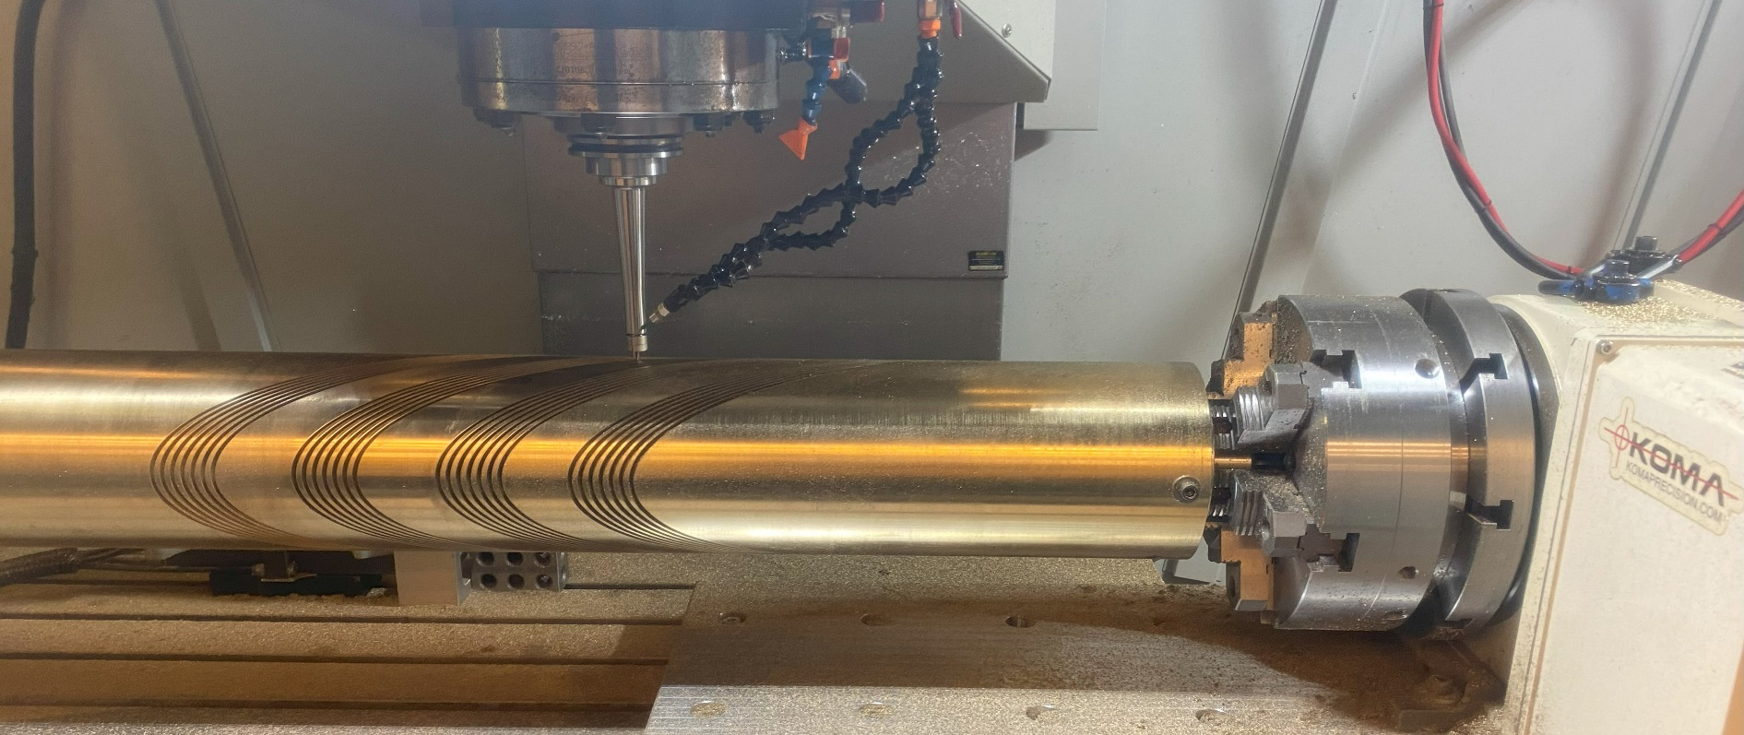
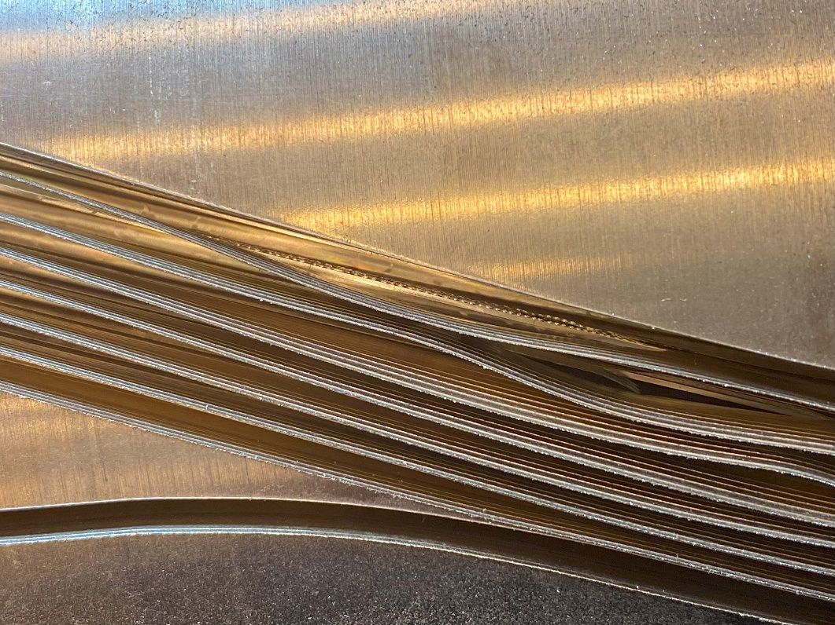
1. Mandrel fabrication - Machining development for CCT6 mandrels
Machining of several 7-turns on a full scale 1.5 m long CCT6 inner layer
Improving the process to reduce potential risks
The next step will be to machine 20-turns on a full scale 1.5 m long CCT6 inner layer
Based on current machining parameters full size mandrel fabrication is estimated between 1 to 2 months
J. L. Rudeiros Fernandez et al.

Slide 6
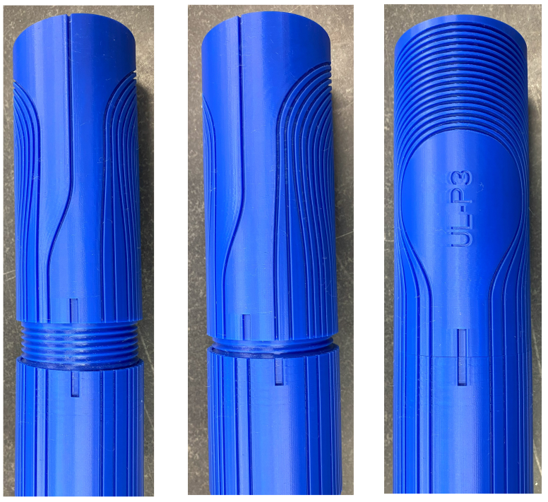
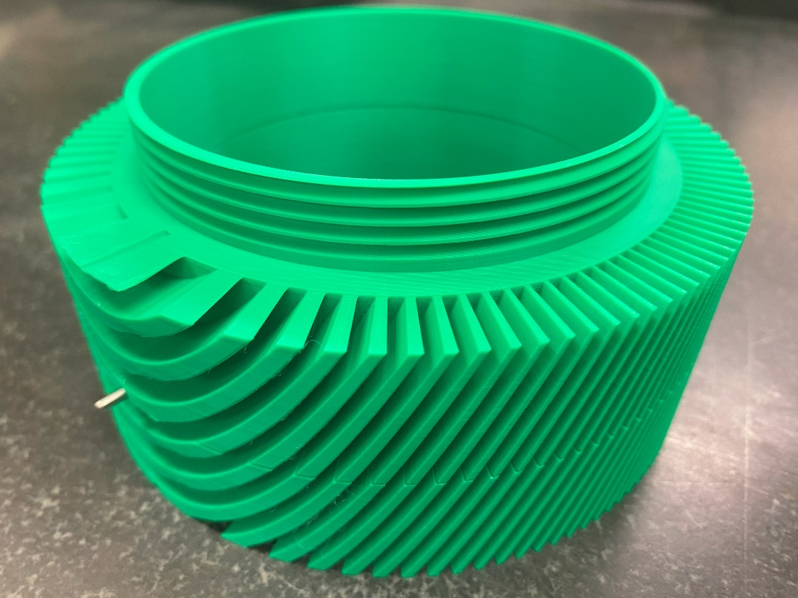
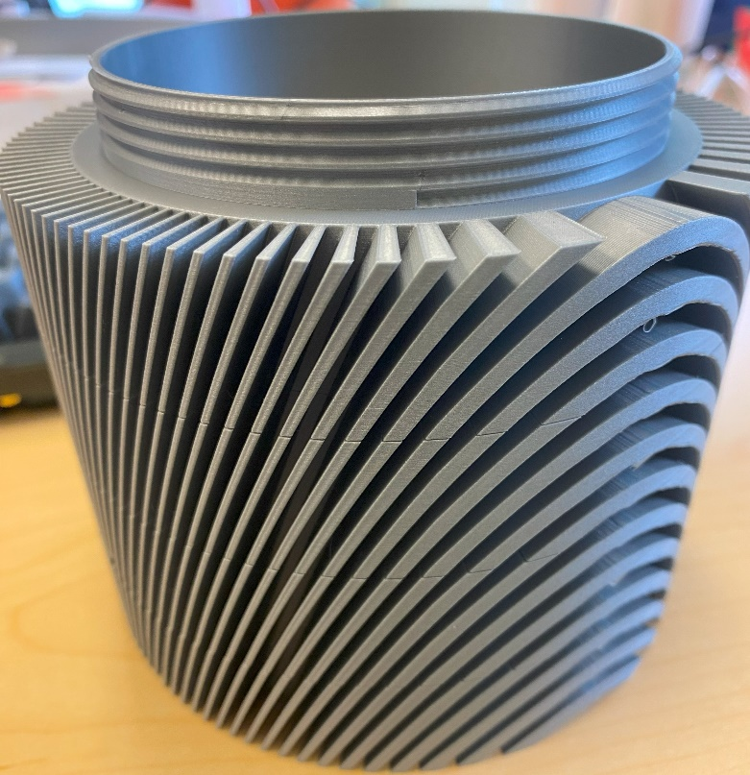
1. Mandrel fabrication – Mandrel segmentation development
As an alternative route to machining mandrels out of a single part, segmented mandrels are in development.
The current design relays on self aligning features. The two parts are locked in the angular direction through a pin or key in the pole region.
J. L. Rudeiros Fernandez et al.

Slide 7
Table of contents
01
Mandrel fabrication
02
Impregnation materials
03
Assembly progress
04
Conclusions and next steps
J. L. Rudeiros Fernandez et al.

Slide 8
2. Impregnation materials
Resins used for the subscale program
IL
OL
IL
OL
Mix61
CTD-701X*
Paraffin wax
Training might be related to interfacial mechanisms (heat dissipation due to frictional motion, debonding, crack propagation…) and therefore the change of resin might play a big role.
Resin
Mix61
Filled Paraffin wax
Paraffin wax
Paraffin wax
CCT sub2
CCT sub3
CCT sub4
CCT sub5
CCT sub6
CCT sub7
Magnet
*Haight, A., Haynes, M. M., Krave, S. T., Rudeiros-Fernandez, J. L., & Shen, T. (2021). Characterization of Candidate Insulation Resins for Training Reduction in High Energy Physics Magnets. CEC-ICMC.
*Krave, S., Shen, T., & Haight, A. (2021). Exploring New Resin Systems for Nb3Sn Accelerator Magnets. IEEE Transactions on Applied Superconductivity, 31(5), 1-4.
J. L. Rudeiros Fernandez et al.

Slide 9
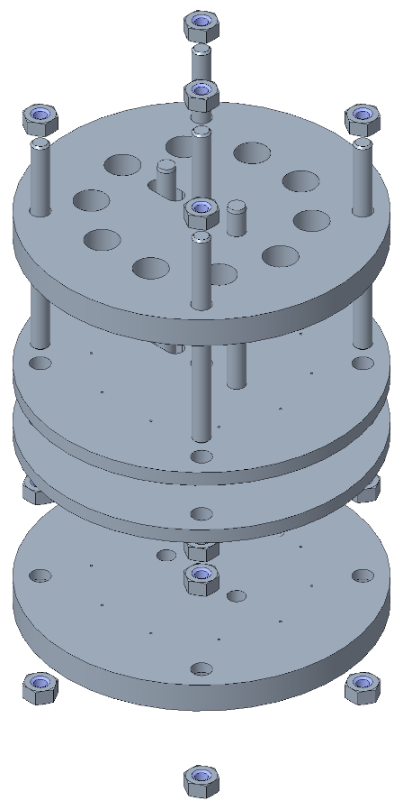
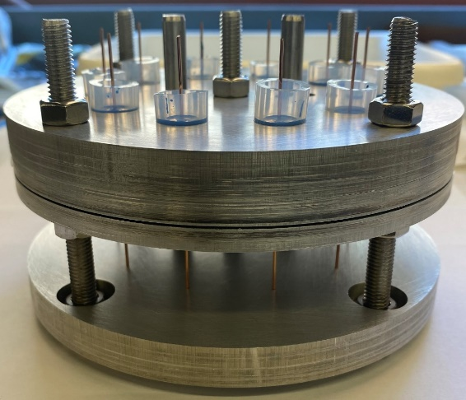
2. Impregnation materials – Characterization of materials
Interface characterization
Sample preparation
The idea was to develop a method to constitute the simplest possible material system that will allow for the fundamental characterization (at various temperatures) of the adhesion and related phenomena between components normally used in superconducting magnets.
Resin transfer
Copper wire
Resin
Copper wire
a
PVC tube
Assembly
Precision machined aluminum plates
a
b
b
Teflon disc
c
Silicone O-Ring
c
Single fiber pull-out (SFP) testing
The specific resin is transferred to the mold formed by the assembly.
d
d
$$F$$
Strand
Pull-out frame
Paraffin wax
Stycast 2850 MT
CTD-101K
Mix 61
Resin
J. L. Rudeiros Fernandez et al.

Slide 10
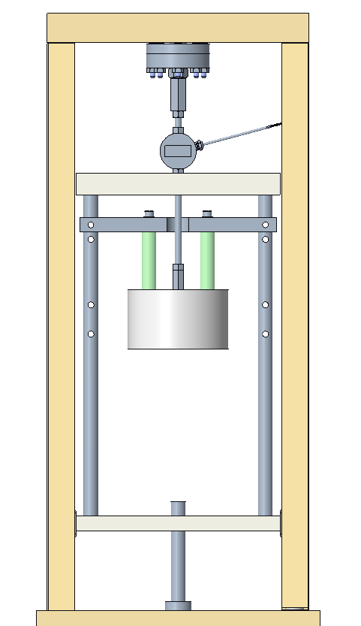
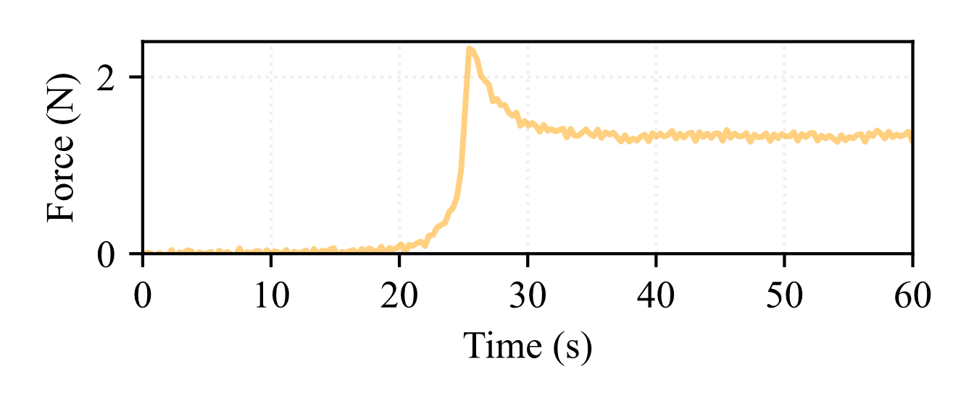
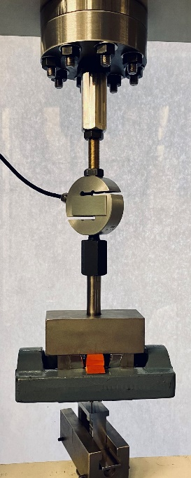
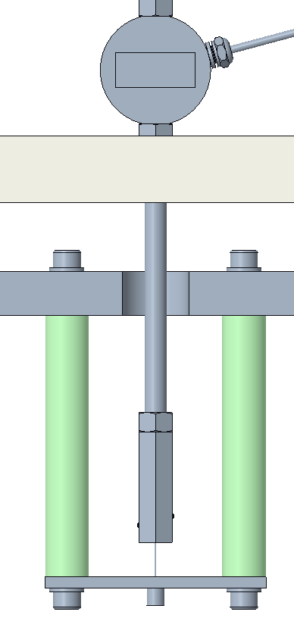
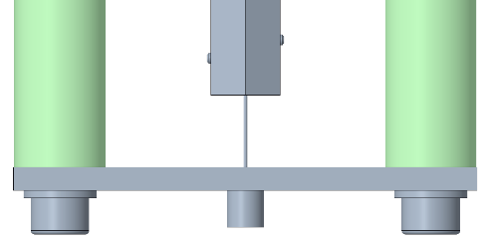
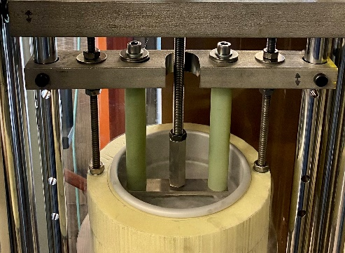
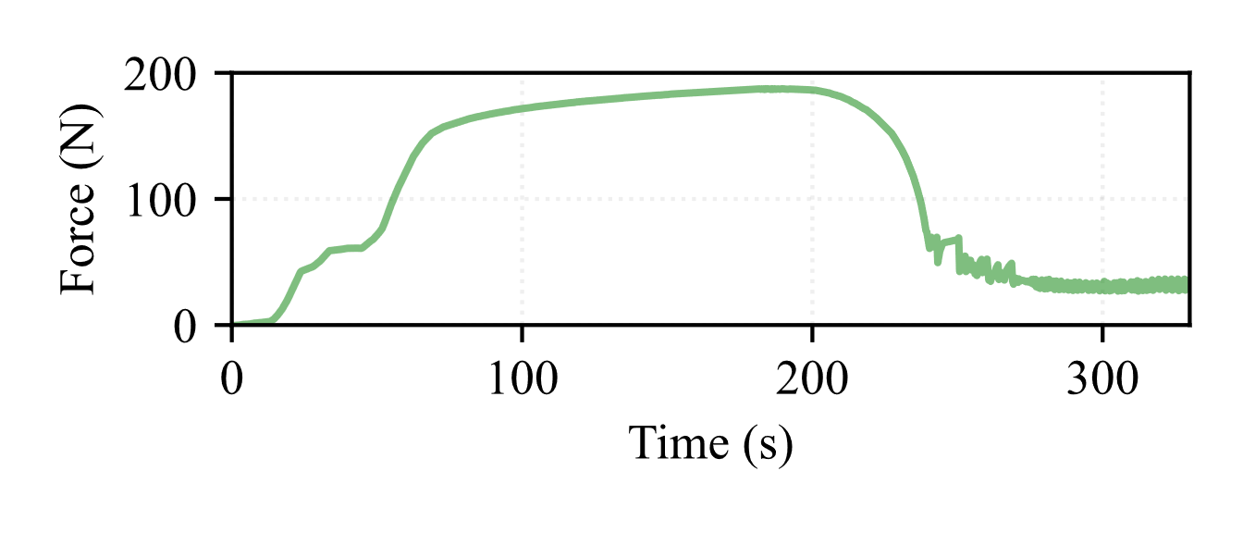
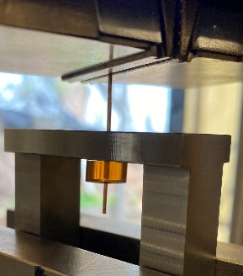
2. Impregnation materials – Characterization of materials
Interface characterization
Sample preparation
Example debonding curves
Tensile tester adapter
$$F$$
Wire grips
Copper wire
Paraffin wax
Load cell
Liquid nitrogen level
Pull-out frame
Resin block
Tensile grips
Resin block
Pull-out frame
Copper wire
G10 bars
Mix 61
Dewar
Pull-out frame
Resin block
J. L. Rudeiros Fernandez et al.

Slide 11
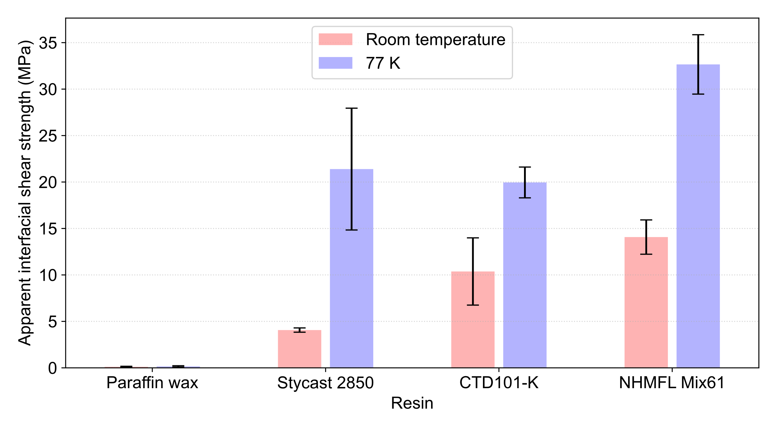
2. Impregnation materials – Characterization of materials
Interface characterization
Initial results
For each individual test, and based on a few simplification assumptions, one could compute the apparent interfacial shear strength based on: where $F_{max}$ is the peak load, $P_{f}$ is the perimeter of the wire, and $L_{e}$ is the embedded length.
$$τ_{app}= \frac{F_{max}}{P_{f}L_{e}}$$
Rudeiros Fernández, J.L., Bird, C., Arbelaez, D., Ferracin, P., Prestemon, S., Shen, T. and Vallone, G., 2024. Interface Characterization for Superconducting Magnets. IEEE Transactions on Applied Superconductivity.
J. L. Rudeiros Fernandez et al.

Slide 12
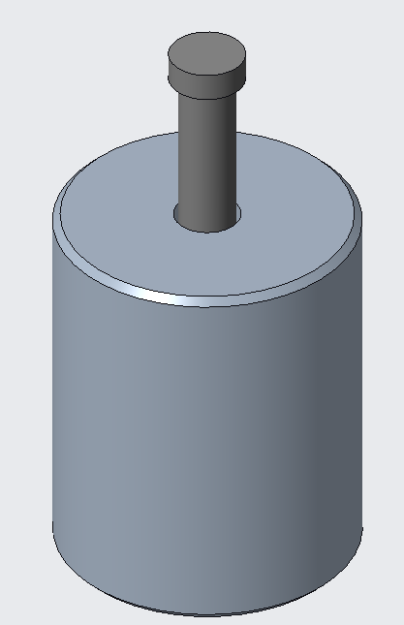
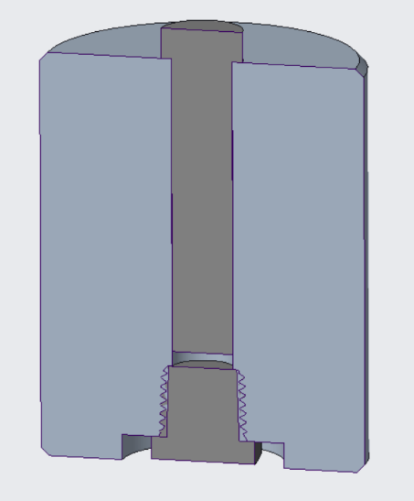
2. Impregnation materials – Characterization of materials
Next steps
Single fiber pull-out (SFP) testing
Complete the characterization of interfacial properties with the addition of filled systems (i.e. filled paraffin wax and epoxy resins).
Characterize the interfacial properties at 4.2 K as well as energy deposition in the copper strand during debonding (lead by M. Martchevskii).
$$F$$
Strand
Pull-out frame
Resin
Characterization of bulk properties of resin systems at various temperatures. This is especially relevant to understand the impact of filled systems (e.g. filled paraffin wax) on the stress on the strands due to Lorentz forces.
J. L. Rudeiros Fernandez et al.

Slide 13
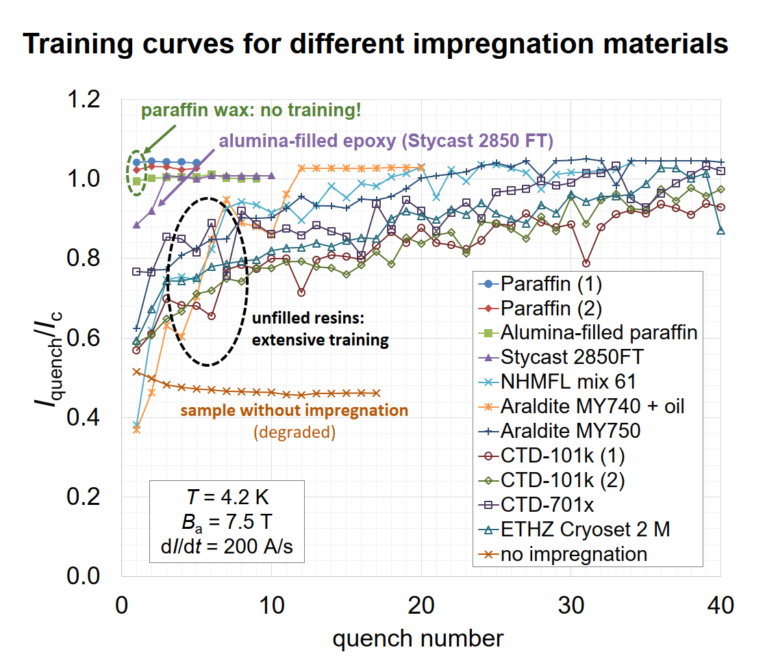
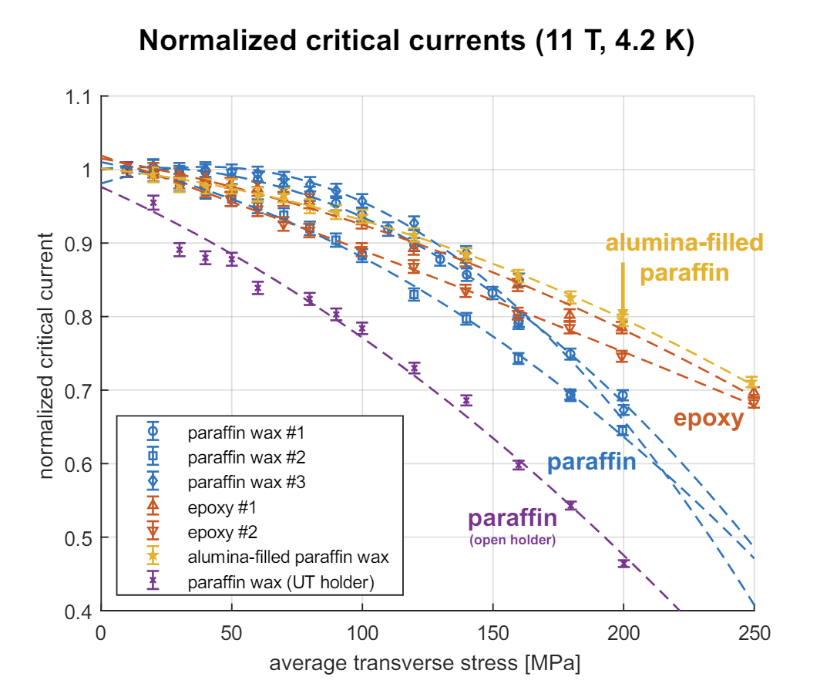
2. Impregnation materials – Development of filled wax impregnation
Motivation: No training and increased resilience to high transverse stress
Presented at MT28 by Simon Otten
J. L. Rudeiros Fernandez et al.

Slide 14
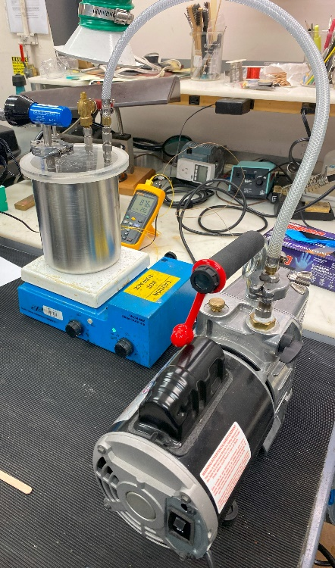
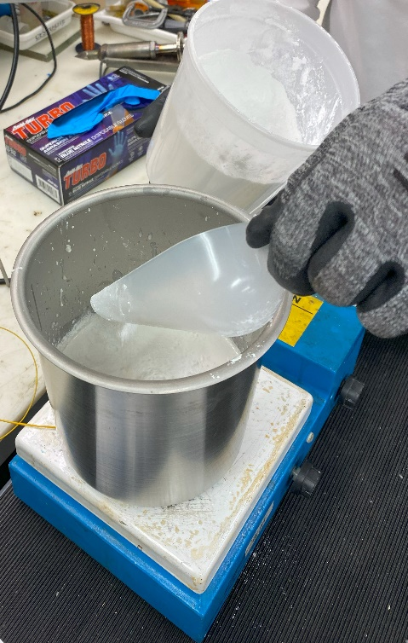
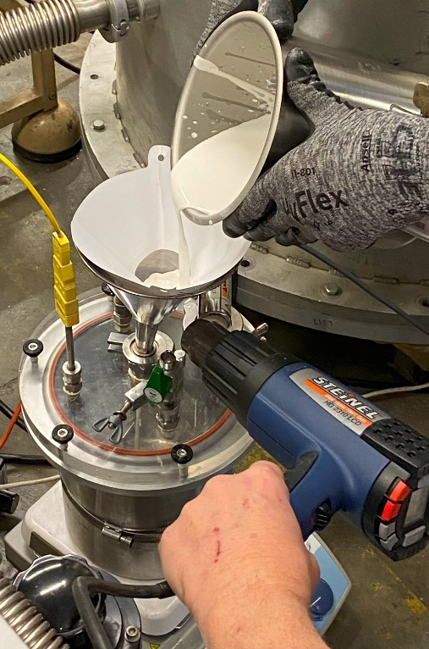
2. Impregnation materials – Development of filled wax impregnation
Based on
Brem, A., Duda, M., Müller, C., Garcia, H., Hug, C., Daly, M., Araujo, D.M., Kosse, J., Otten, S., Kario, A. and Ten Kate, H.H., 2023. From hot to cold: Advanced materials and processes for Nb 3 Sn based magnets. IEEE Transactions on Applied Superconductivity.
Process for uniform mixing
Mix for 100 ml
Degassing the preheated paraffin wax + carnauba wax
Mixing particles by hand or light stirring
High shear mixing at 10000 rpm + ultrasonic homogenizer
12 hours of stirring + final filter before transfer to mixer
Material | Weight (g)
Polarit 56/58 (Deffner & Johann GmbH- Germany) | 45.5
Carnauba | 5
PB4 MAR alpha-alumina powder from Baikowski | 180
Normal microscopy techniques have been proven extremely challenging for evaluating particle content.
Due to the very high weight ratio of , density measurements were used as a reliable method to established the quantity of particle through all the development processes.
J. L. Rudeiros Fernandez et al.

Slide 15
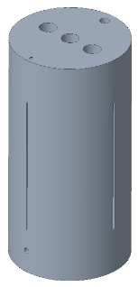
2. Impregnation materials – Development of filled wax impregnation
Development of VPI process for transfer to coil
Top reservoir
Compressed air
Coil
Vacuum chamber
Aluminum-bronze
Aluminum
Aluminum
Phase 1
Phase 2
Phase 3 (Final coil)
Resin mixer
Vacuum pump
Development
J. L. Rudeiros Fernandez et al.

Slide 16
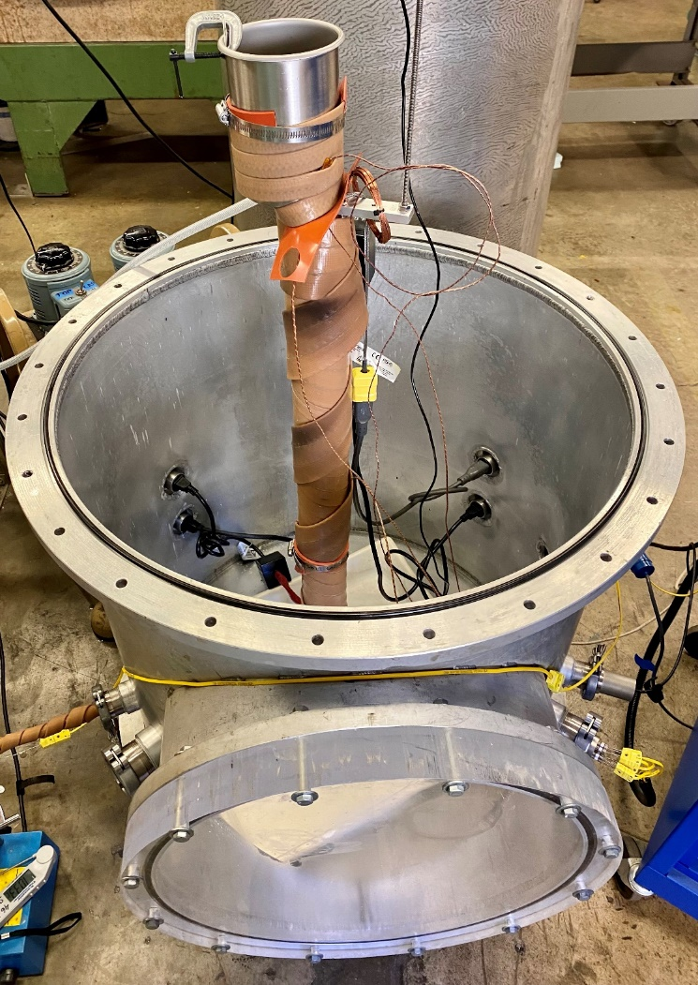
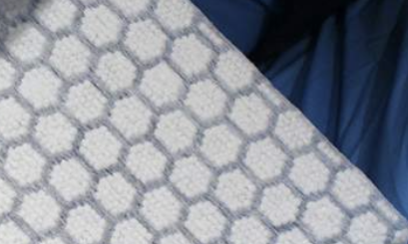
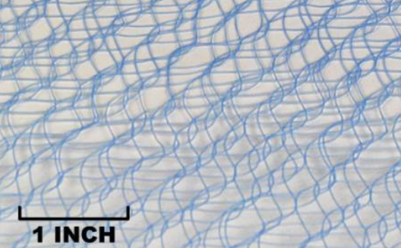
2. Impregnation materials – Development of filled wax impregnation
Development of VPI process for transfer to coil
Diagram of the impregnation bag system
New peel ply
Cooling by convection
Mandrel
$$T_{1}$$
$$T_{2}$$
$$∆T$$
Cable
PTFE + glass fiber
Nylon based
New flow media
Mandrel OD
Mandrel ID
New glass fiber tape
New Peel ply
New Flow media
Vacuum bag
External heating elements
J. L. Rudeiros Fernandez et al.

Slide 17
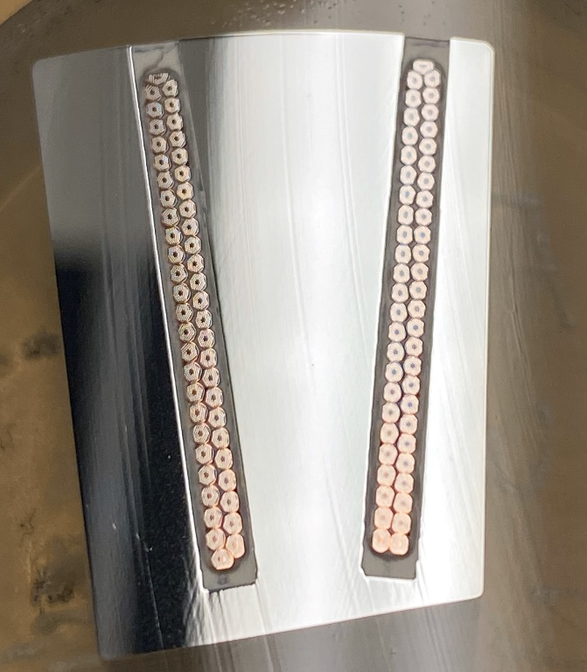
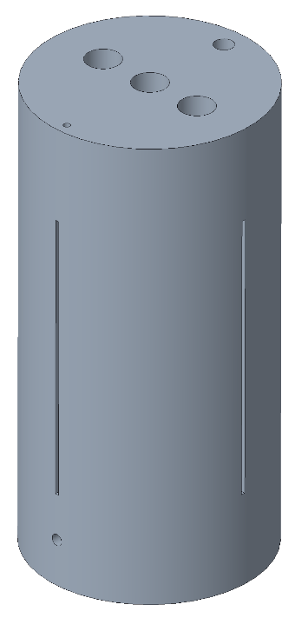
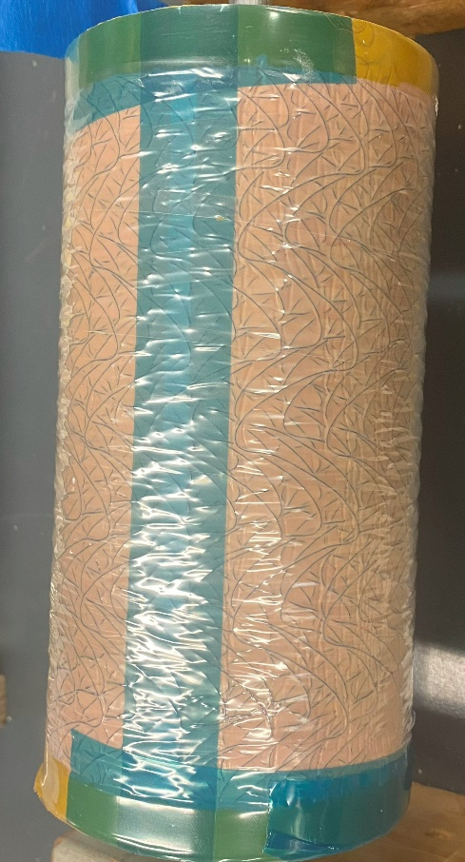
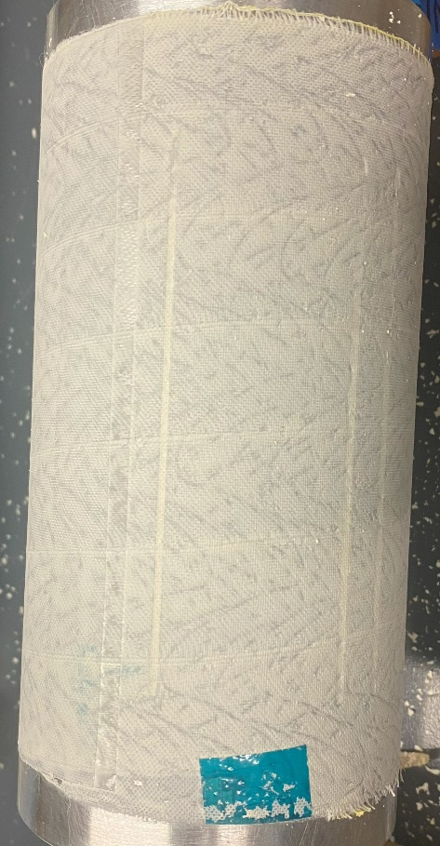
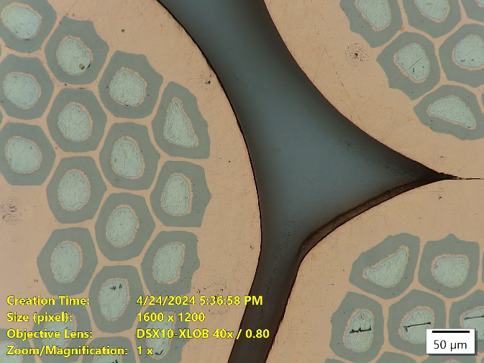
2. Impregnation materials – Development of filled wax impregnation
Development of VPI process for filled resins
LD1 Nb₃Sn cable (plan for CCT6)
Subscale Nb₃Sn cable
The impregnation of wide cables in groove (of up to 22 mm wide) with filled resin systems was demonstrated.
J. L. Rudeiros Fernandez et al.

Slide 18
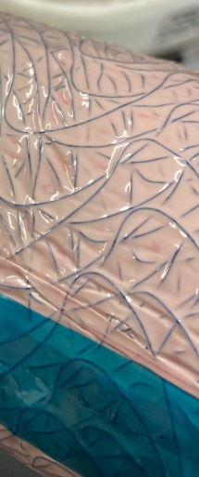
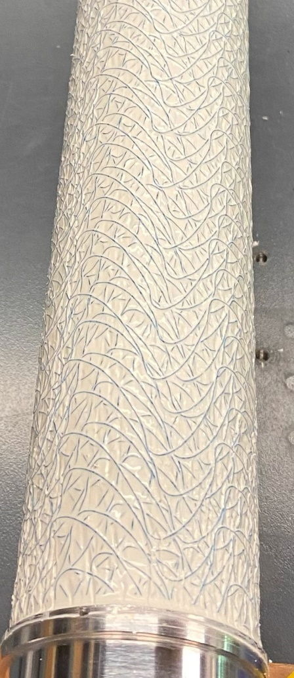
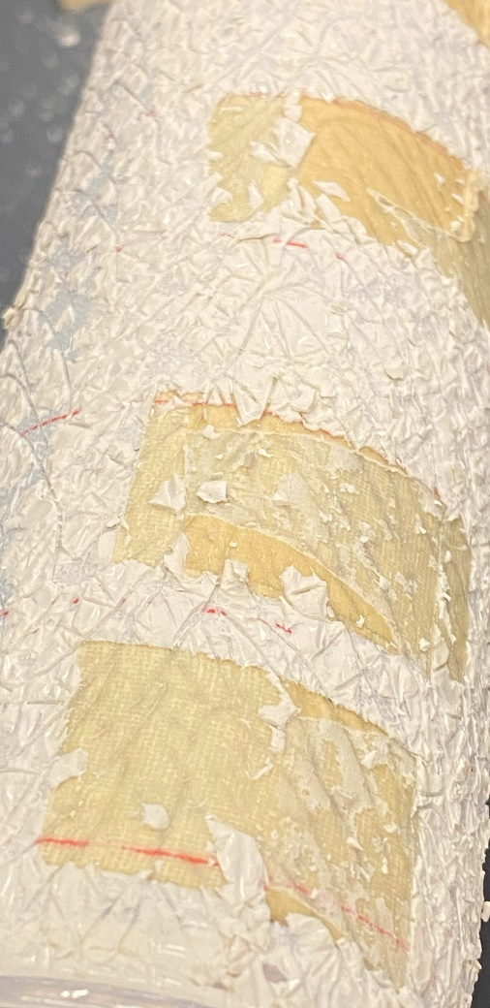
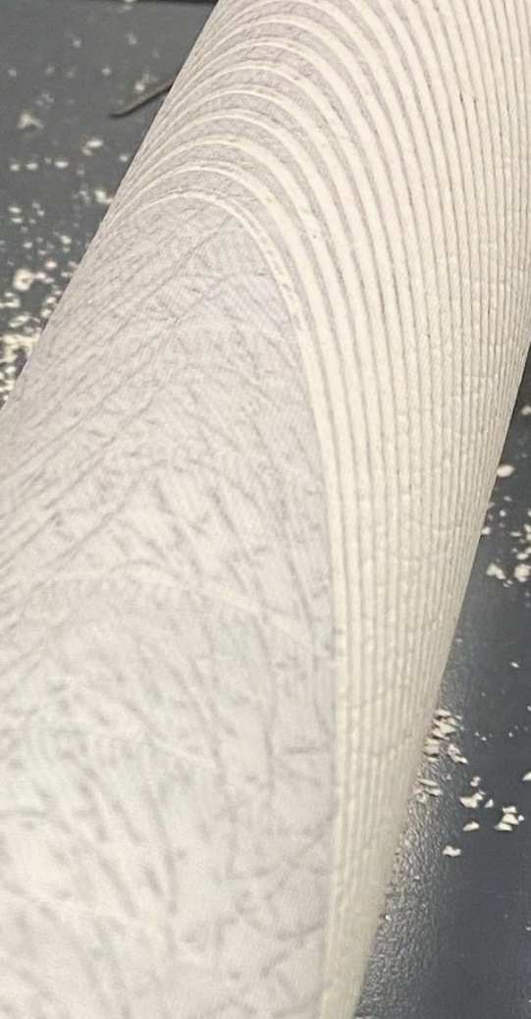
2. Impregnation materials – Development of filled wax impregnation
Impregnated coil for CCT sub7: Final surface reveal
Final surface after peel ply is removed
After impregnation
Vacuum bag removed
Vacuum bag removed
Mandrel
Cable
Mandrel OD
New glass fiber tape
New Peel ply
New Flow media
Vacuum bag
J. L. Rudeiros Fernandez et al.

Slide 19
Table of contents
01
Mandrel fabrication
02
Impregnation materials
03
Assembly progress
04
Conclusions and next steps
J. L. Rudeiros Fernandez et al.

Slide 20
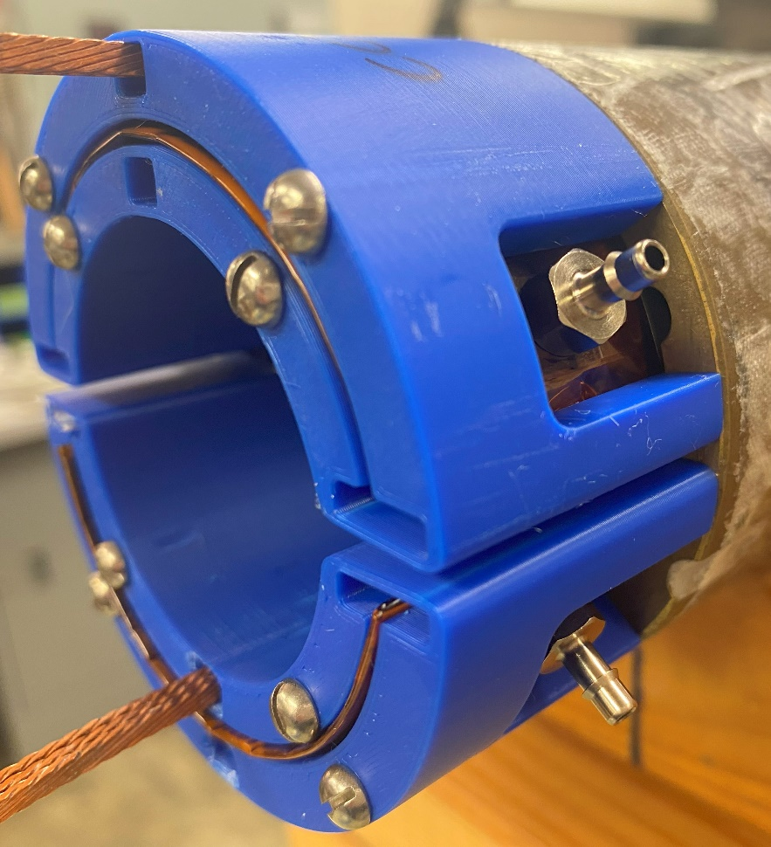
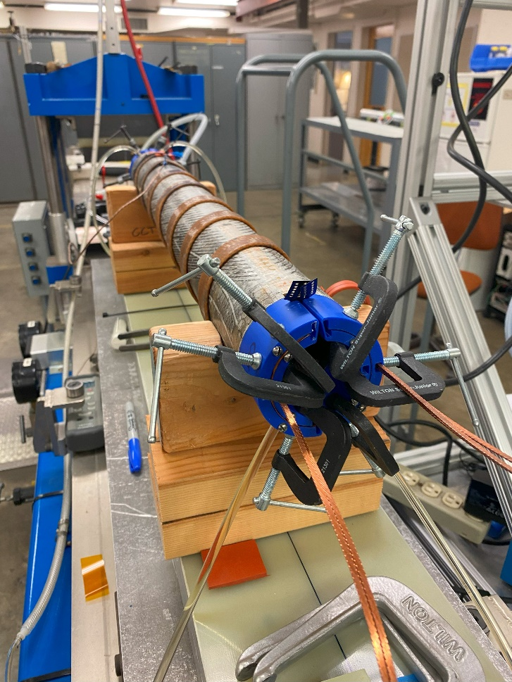
3. Assembly progress
Assembly of CCT sub7 is in progress (smartshim
Continuous incremental improvements have been made to the fabrication and assembly process of the smartshims.
IL
OL
Filled Paraffin wax
Paraffin wax
Compressed air
Smartshim left
CCT sub7
Smartshim right
Vacuum pump
Resin mixer
Overflow
J. L. Rudeiros Fernandez et al.

Slide 21
Table of contents
01
Mandrel fabrication
02
Impregnation materials
03
Assembly progress
04
Conclusions
J. L. Rudeiros Fernandez et al.

Slide 22
4. Conclusions
Manufacturing of CC5-W and CCT6 mandrels is in progress, with an emphasis on developing reduced risk manufacturing methods.
The paraffin wax interfacial strength with copper wire has been characterized, showing two orders of magnitude lower adhesion in relation to the epoxy resin used for previous CCT magnets (i.e. Mix61) at RT and 77 K.
The paraffin wax system shows evidence of very low energy deposition in the conductor due to interfacial phenomena.
A method to successfully impregnate CCT magnets with filled resins based on the VPI method has been developed.
The assembly of a subscale with filled wax (IL) is in progress and should be ready for testing in the following months.
J. L. Rudeiros Fernandez et al.

Slide 23
Thanks!
J. L. Rudeiros Fernandez et al.

