Slide 1
Recent Test Results
Diego Arbelaez and Reed Teyber on behalf of LBNL Nb₃Sn CCT Team

Slide 2
Outline
Improved inter-layer quench antenna localization method
Test results from wax CCT subscale

Slide 3
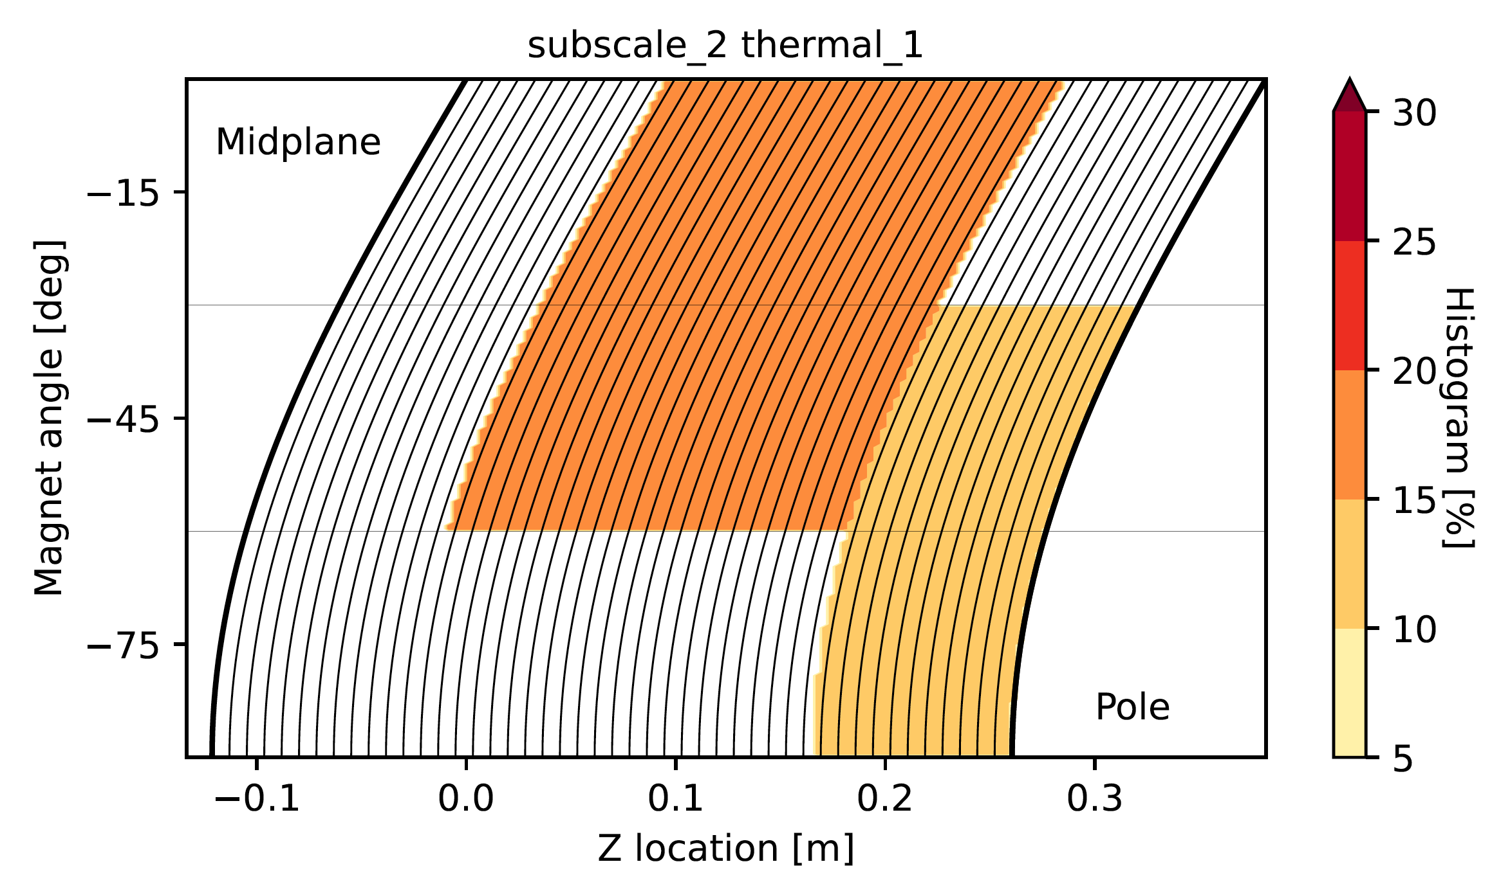
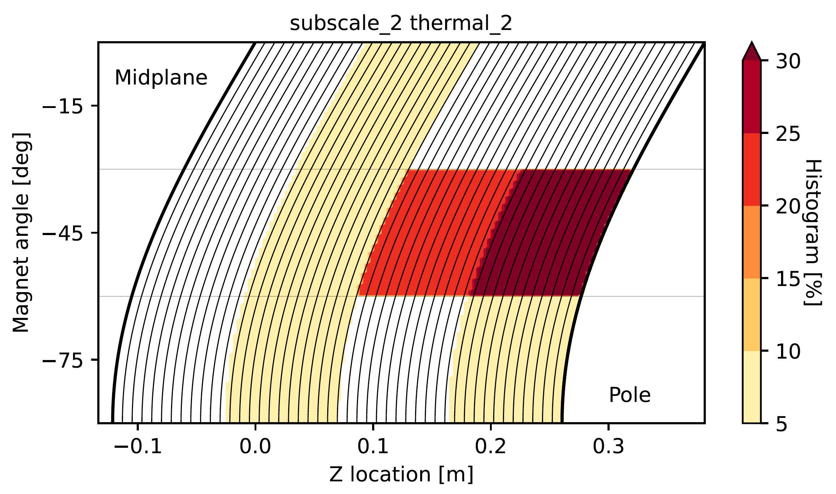
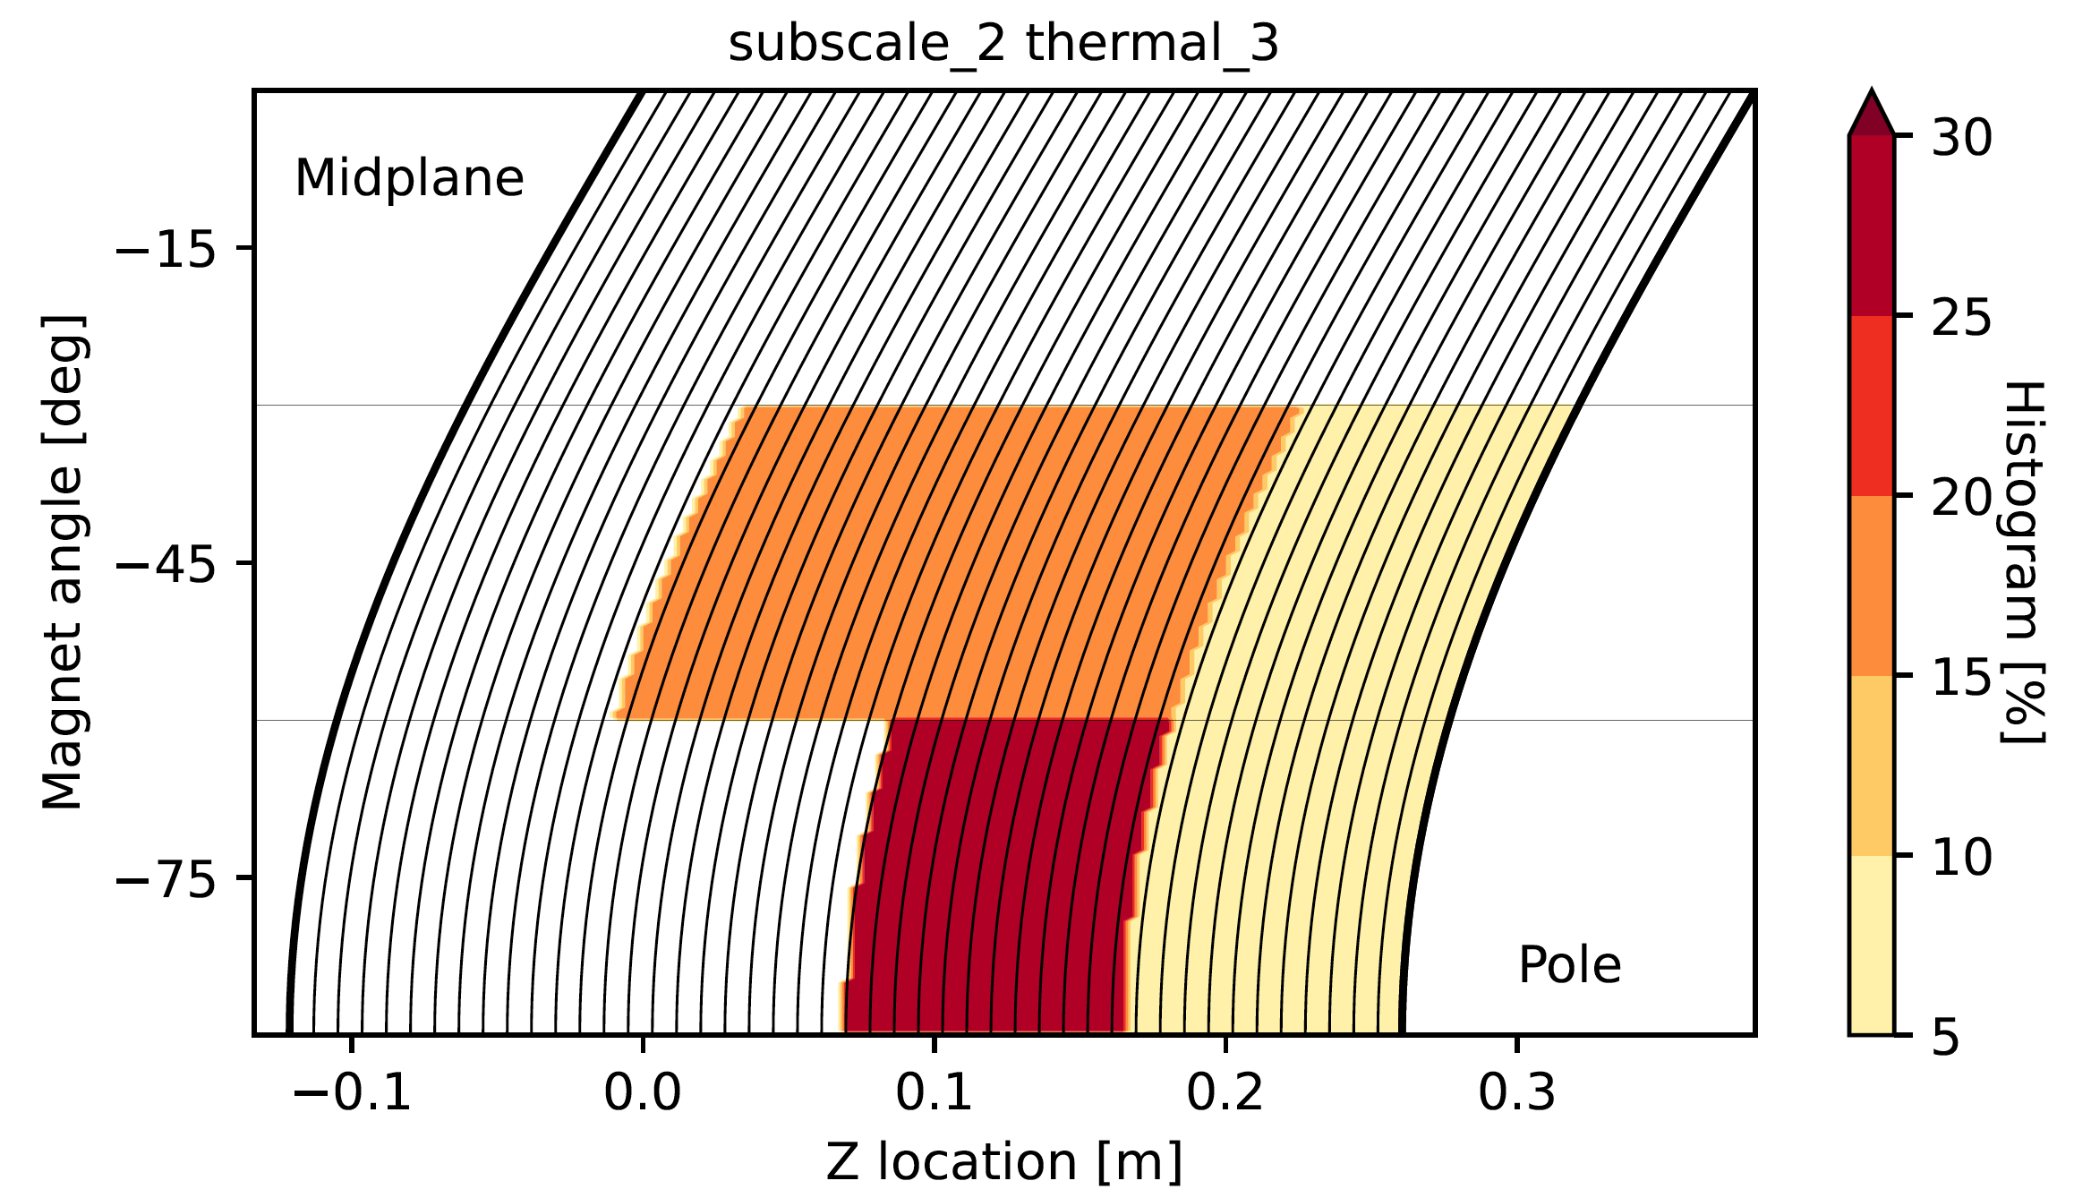
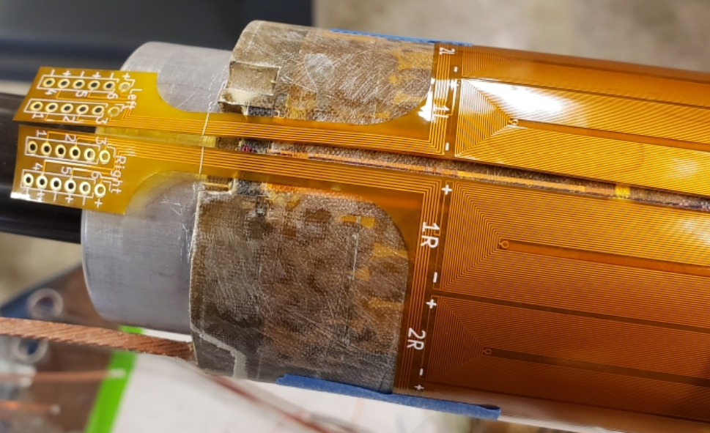
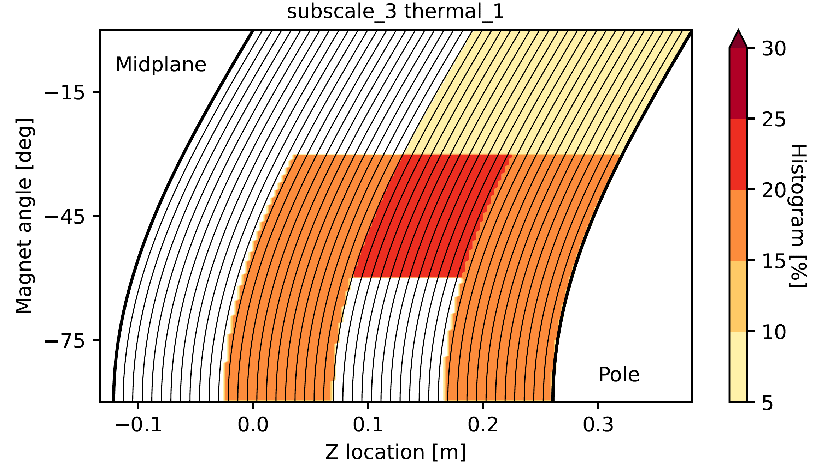
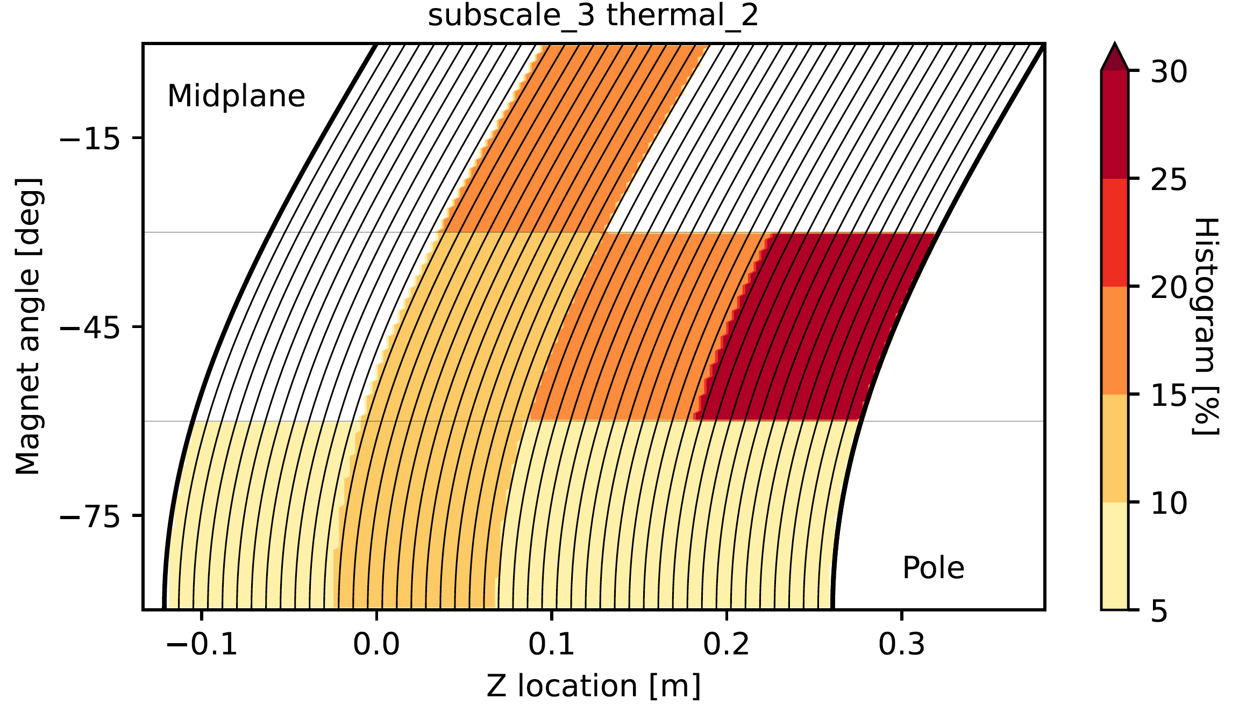
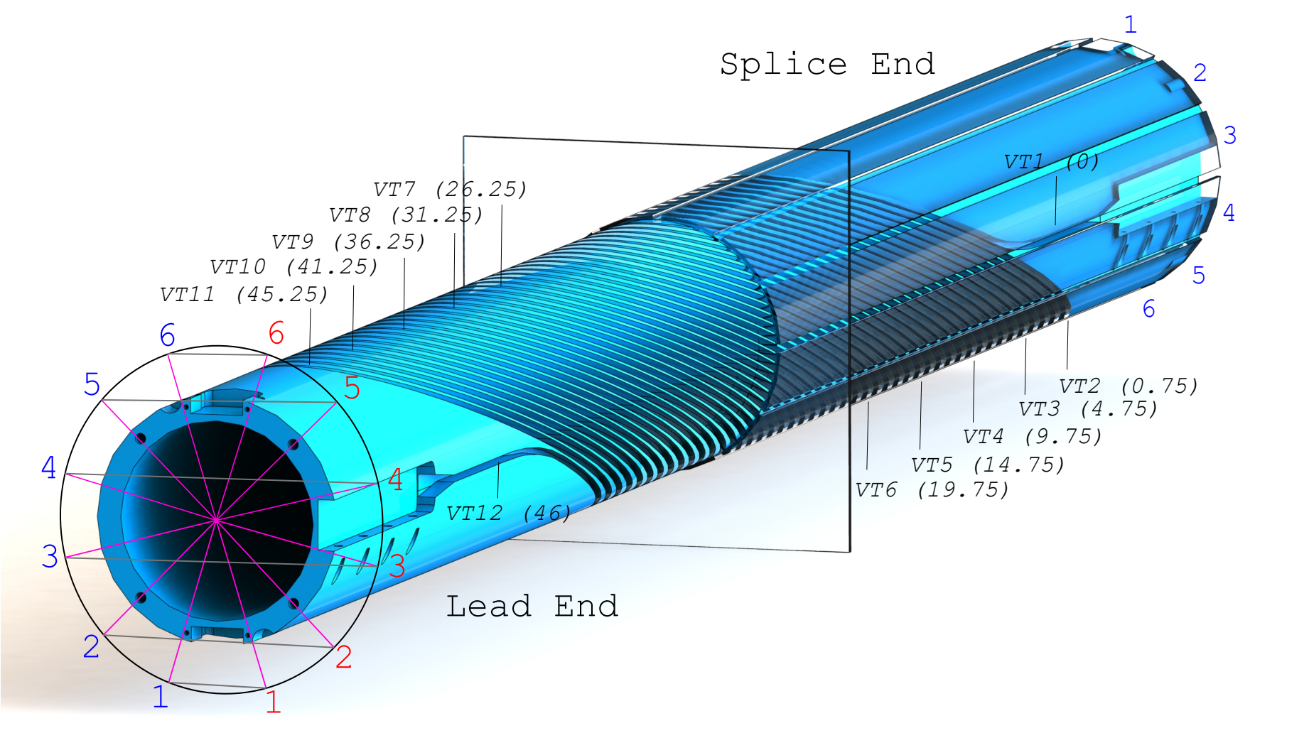
Quench Localization Analysis
Extensive analysis was performed by R. Teyber
Combine Vtap and quench antennas to localize quenches
Histogram bins to 15, 45 or 75 degrees based on antenna element with largest measured flux
New method was recently introduced to improve the resolution of angle localization by using correlation between antenna segments
Vtap - turn
Antenna - angle
Work by R. Teyber

Slide 4
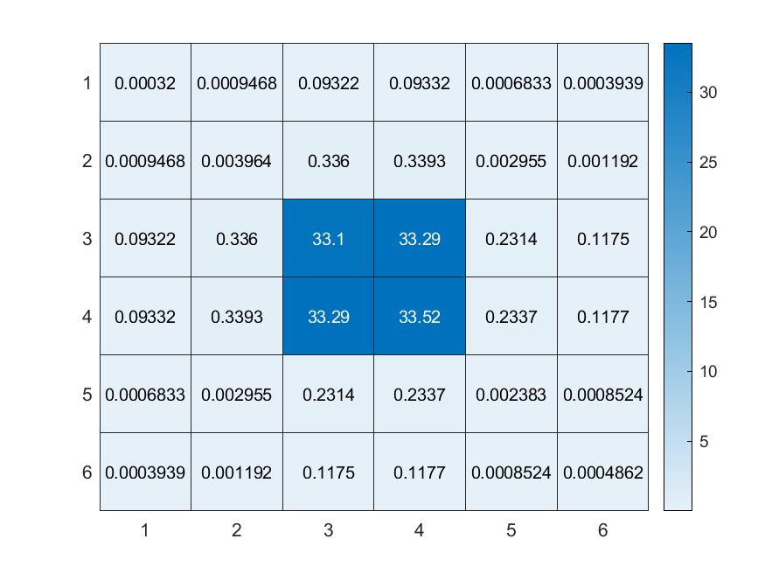
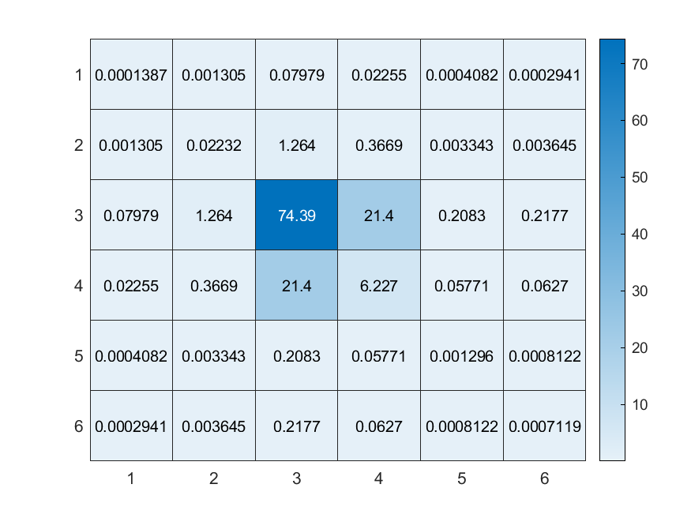
Improved Quench Localization Method
Define Correlation parameter as $C_{ij}=\int_{0}^{t_{0}}{\left|φ_{i}φ_{j}\right|dt}$
Improve localization by accounting for signals from neighboring antenna elements
Cross-Correlation between neighboring antennas
Self-Correlation of neighboring antennas
Use Quench simulations to determine relationship between correlation parameters and quench initiation angle
0⁰ Simulation
5⁰ Simulation
Straight cable simulation performed by Ruben Keijzer & Gerard Willering

Slide 5
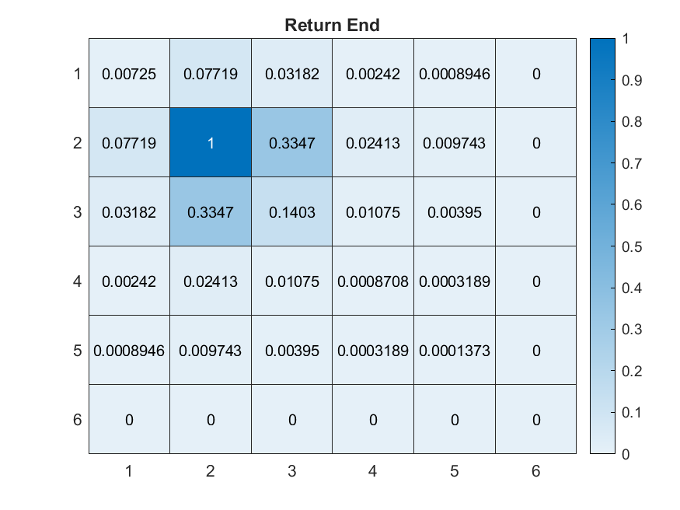
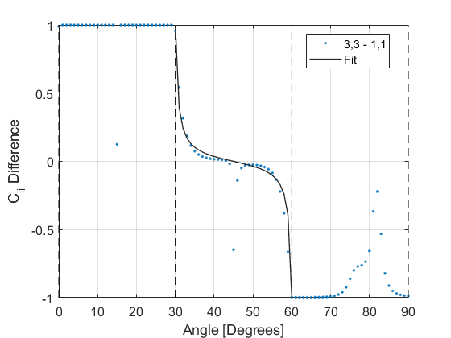
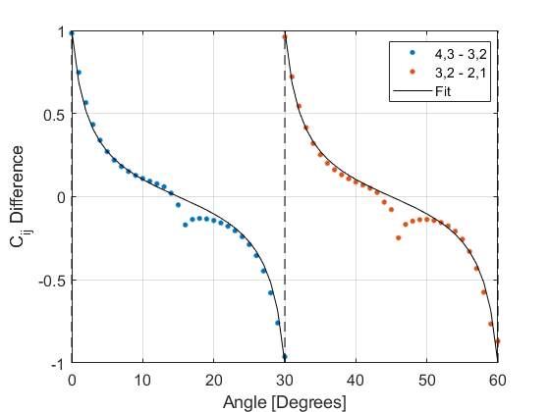
Improved Quench Localization Method (cont.)
Find quench location segment by identifying maximum $C_{ii}$
Within this segment compare the normalized values of the two neighboring self and cross-correlation values
Neighbor self-correlation difference: ${\left({ C}_{i+1,i+1}−{ C}_{i−1,i−1}\right)}/{C_{i,i}}$
Neighbor cross-correlation difference: ${\left({ C}_{i+1,i}−{ C}_{i,i−1}\right)}/{C_{i,i}}$
Use fit function derived from simulations to determine angle for each case (should be consistent)
$$f\left(θ\right)=−\frac{\tan\left(bθ\right)}{\tan\left(bπ/12\right)}$$
Normalized Correlation Matrix
Self-Correlation Neighbor Difference
Cross-Correlation Neighbor Difference
Points are simulation results (deviations near “dead” zones)

Slide 6
Quench Localization SUB2 and SUB3
CCT Subscale 2
CCT Subscale 3
SUB2 T1
SUB3 T1
SUB2 T2
SUB3 T2
SUB2 T3
Dashed lines represent Vtap segment
Color represents quench number

Slide 7
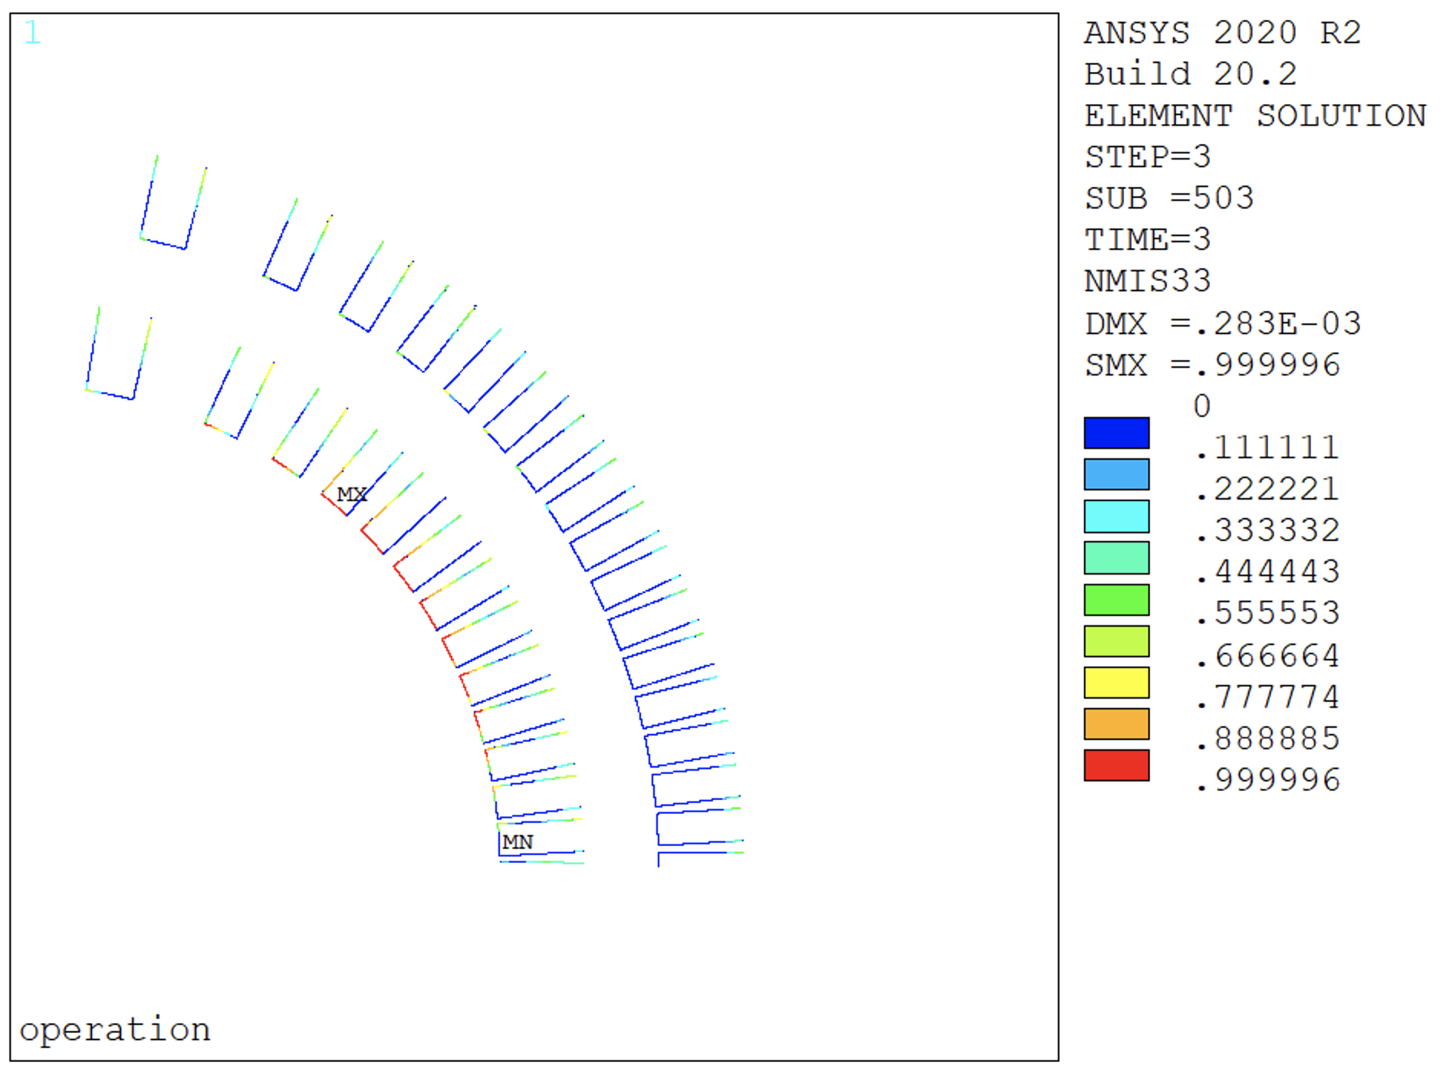
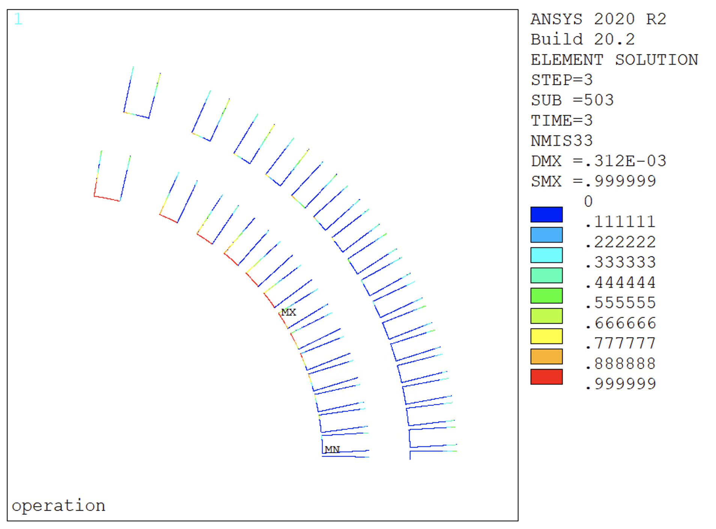
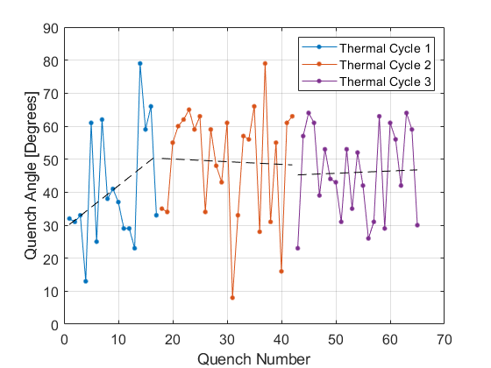
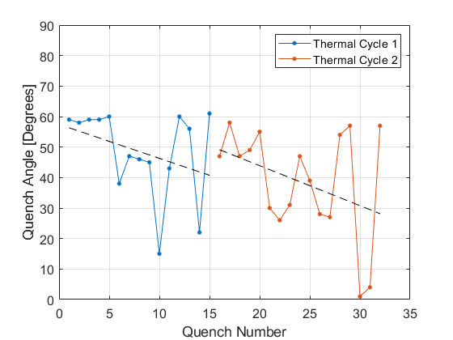
Quench Angle Localization Summary and Next Steps
Debonding Simulations by G. Vallone
General trends for quench angle on thin and thick spar magnets have been established
Simulations of debonding and training in CCT magnets are being performed by G. Vallone
Will continue to use available information and tools to improve understanding of training mechanisms in these magnets
SUB2
SUB3
SUB2 Quench Angle
SUB3 Quench Angle

Slide 8
Subscale 6 Test Results

Slide 9
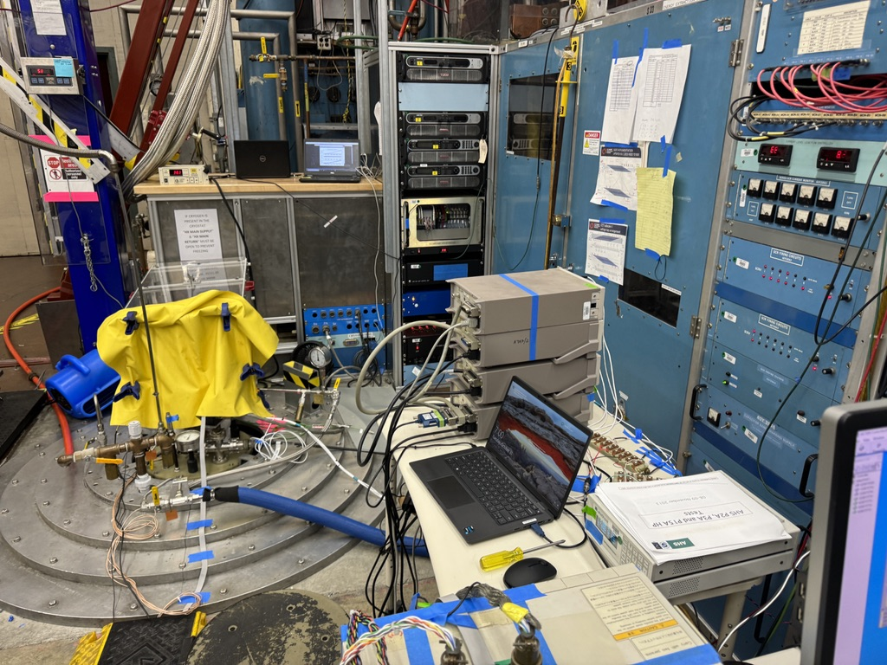
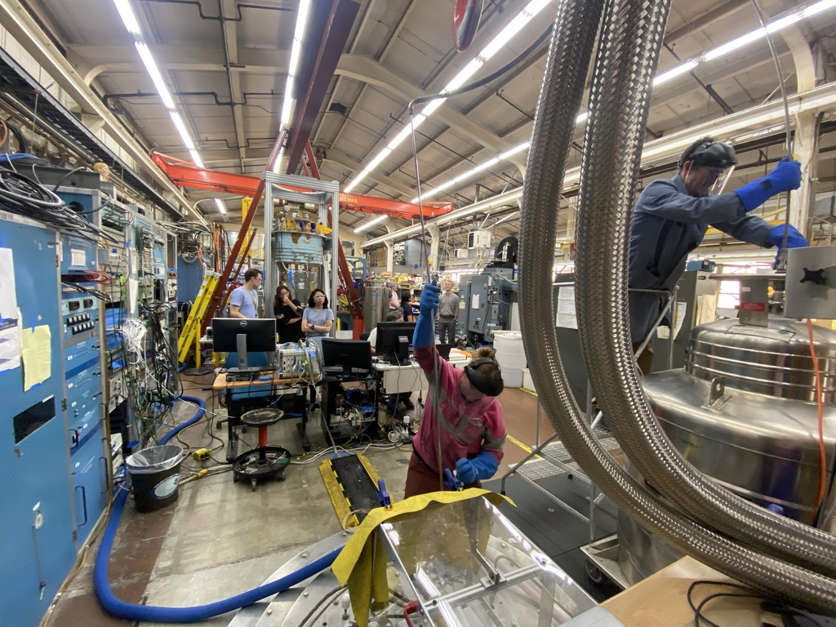
Subscale 6 – Thermal 1 + 2
Full wax subscale tested august (T1), october (T2) 2023

Slide 10
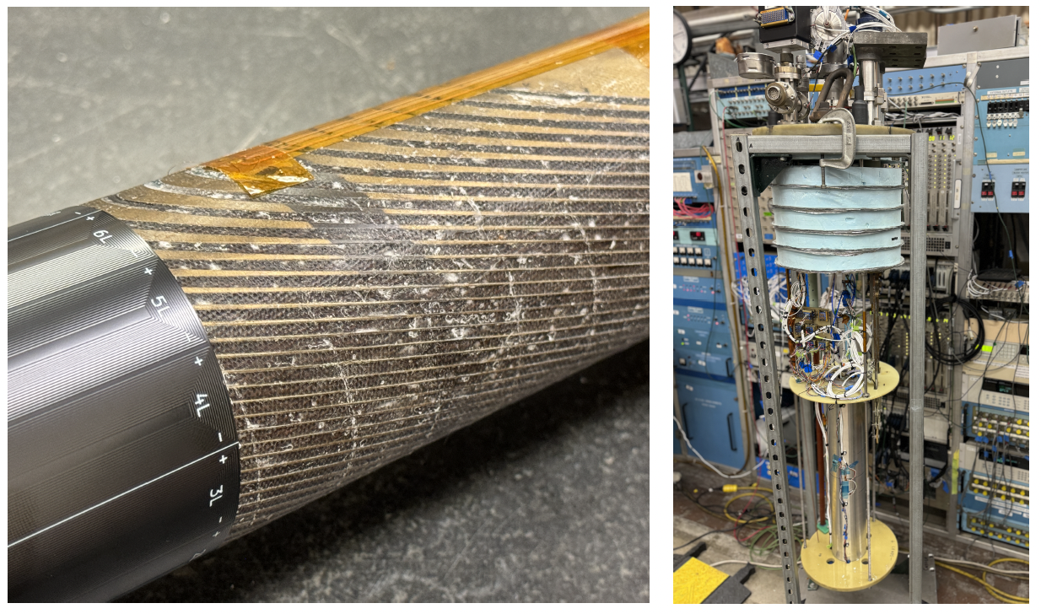
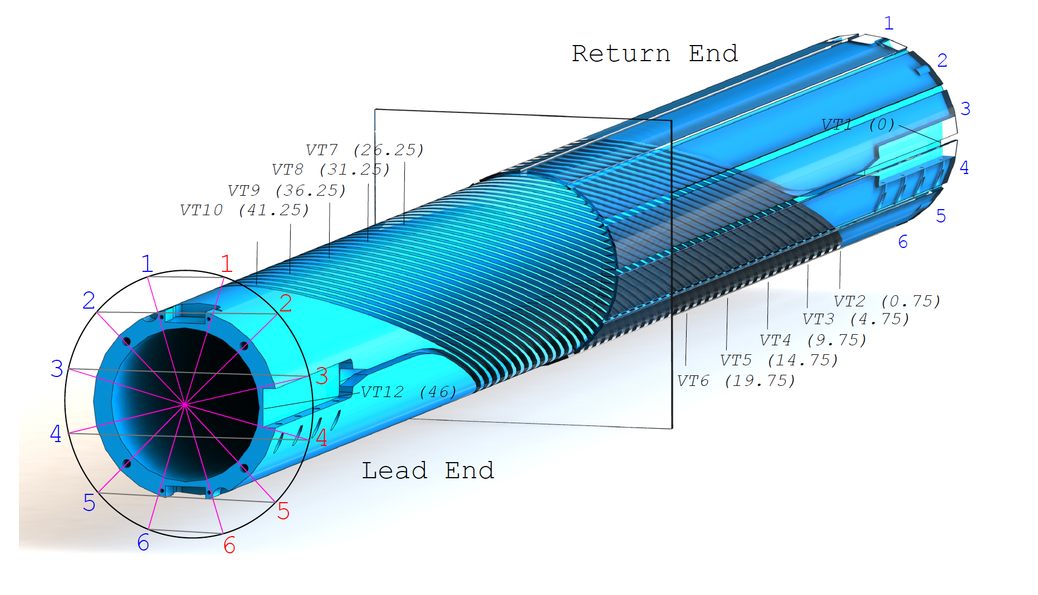
Subscale 6 – Thermal 1 + 2

Slide 11
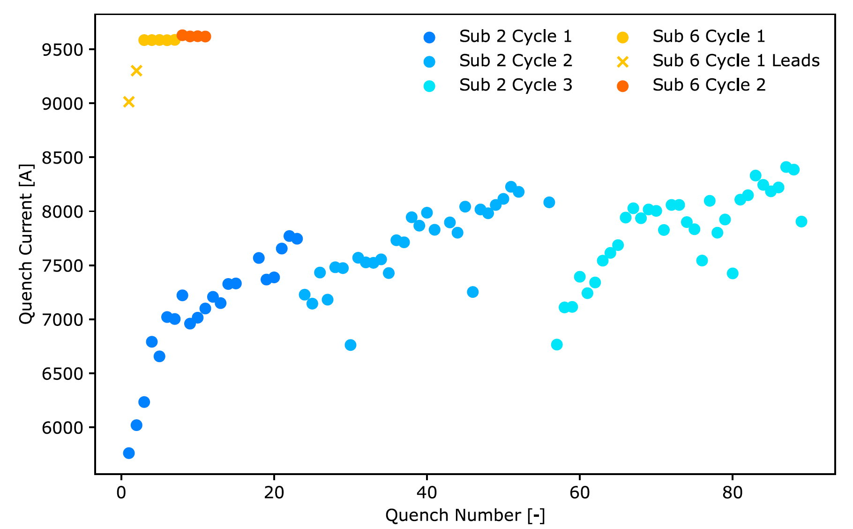
Subscale 6 – Thermal 1 + 2

Slide 12
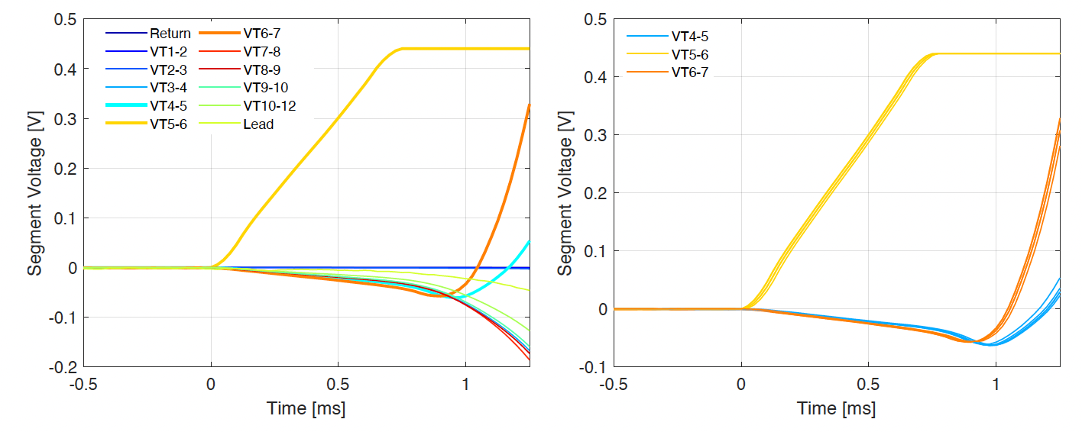
Subscale 6 – Thermal 1 + 2

Slide 13
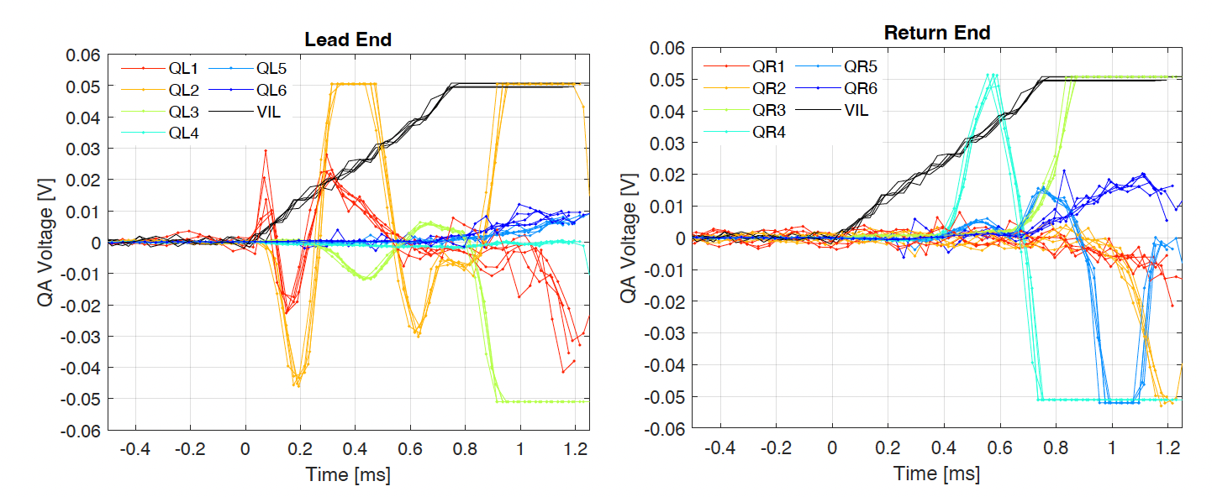
Subscale 6 – Thermal 1 + 2

Slide 14
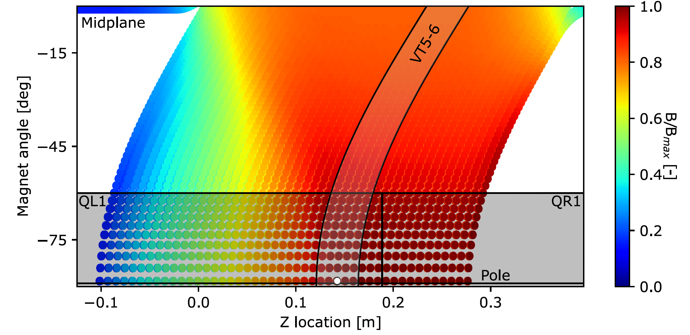
Subscale 6 – Thermal 1 + 2

Slide 15
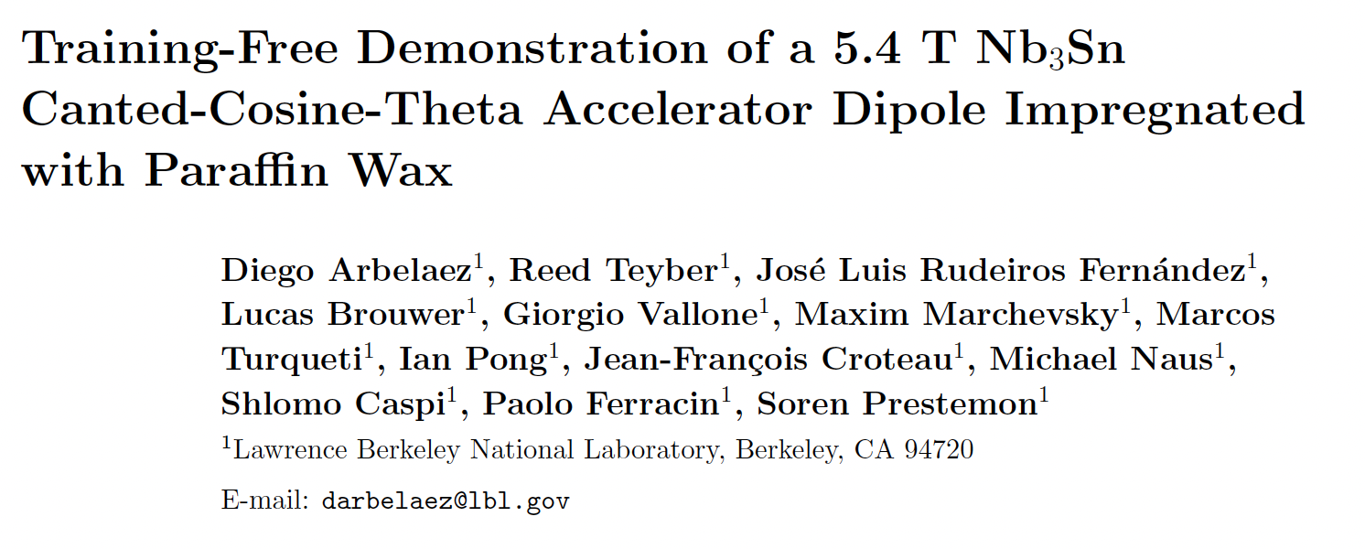
Subscale 6 – Thermal 1 + 2
The wax subscale test results were just published by Diego, just accepted by Superconductor Science and Technology

