Slide 1
Acoustic emission in the wax-impregnated CCT subscale
Maxim Marchevsky (for the CCT team)
LBNL
US MDP Collaboration Meeting
04/30/2024

Slide 2
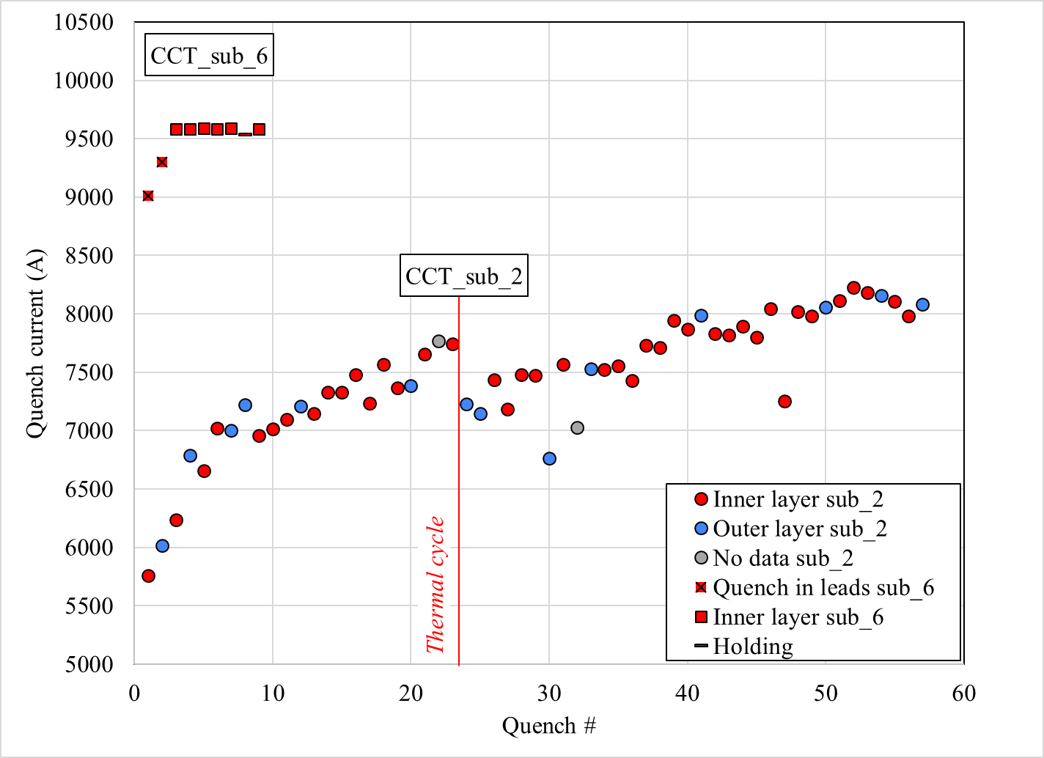
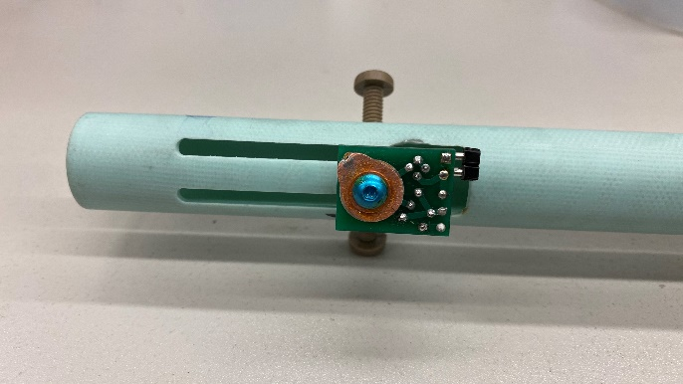
Wax-impregnated subscale (sub 6) training and AE instrumentation
AE sensor installed on the bore
Bore tube installed in the CCT magnet bore

Slide 3
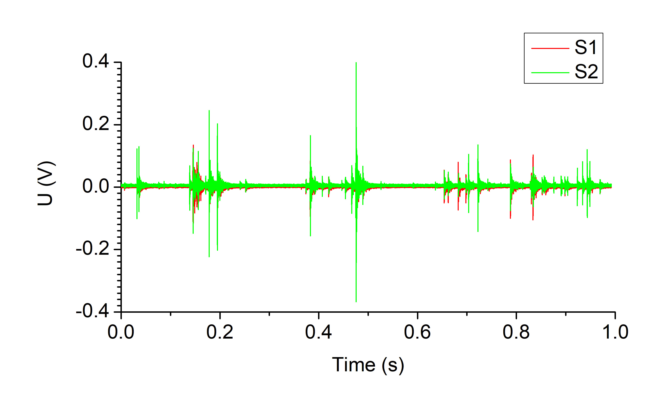
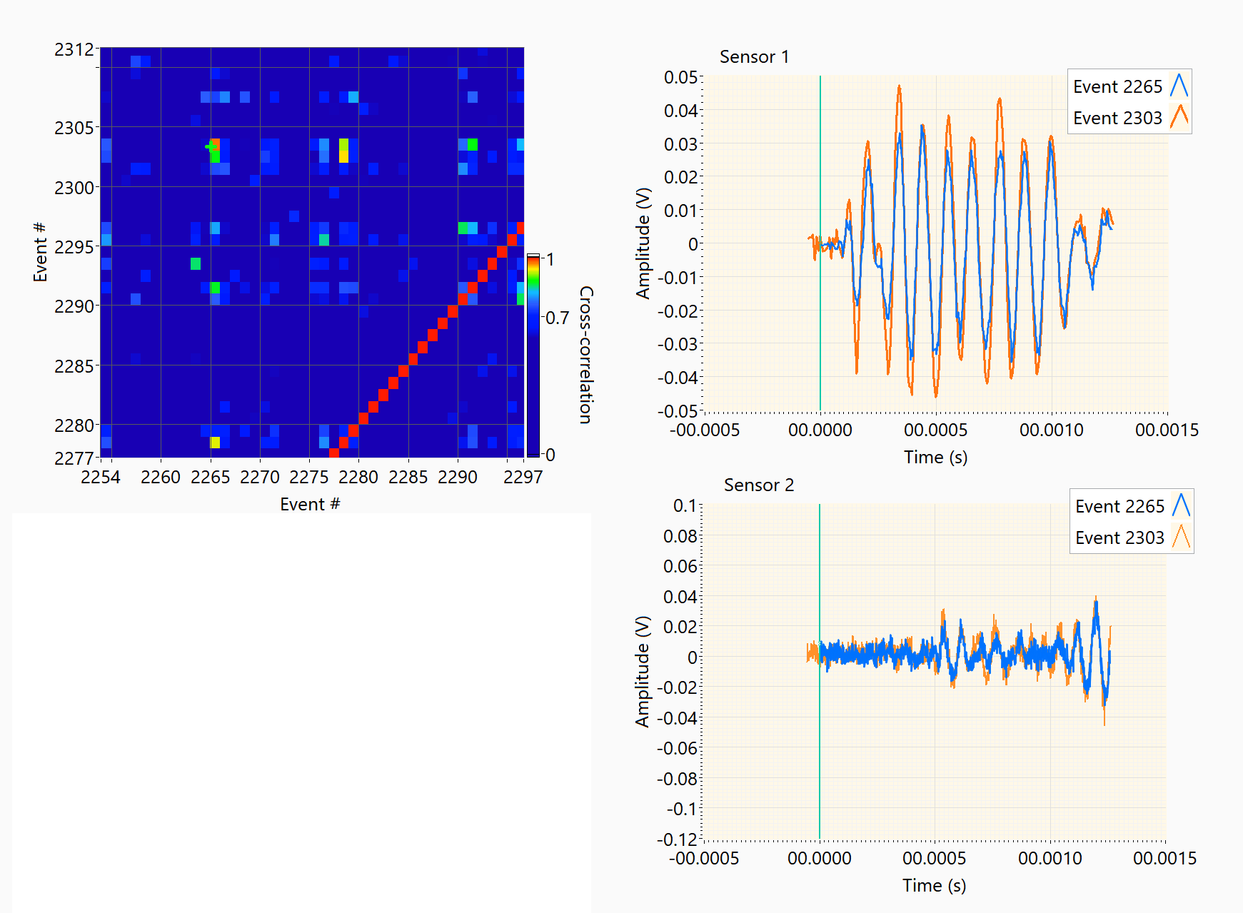

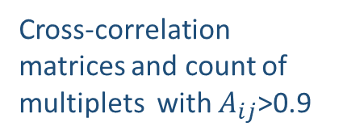
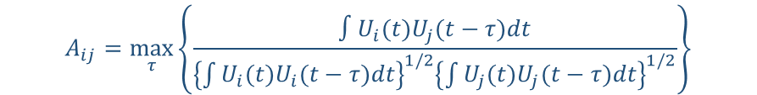
Data processing and analysis
Individual AE events are extracted from every ramp to quench by thresholding the acoustic data stream at 20 mV level and then cross-correlated as follows:
$$A_{ij}=\max_{τ}\left\{\frac{∫U_{i}(t)U_{j}(t−τ)dt}{{\left\{\int{U_{i}(t)U_{i}(t−τ)dt}\right\}}^{1/2}{\left\{\int{U_{j}(t)U_{j}(t−τ)dt}\right\}}^{1/2}}\right\}$$
+/- 20 mV threshold
Wavelet-filtered AE waveforms
$$E=\int_{t_{0}}^{t_{0}+∆t}{U^{2}\left(t\right)dt}$$
Cross-correlation matrices and count of multiplets with $A_{ij}$>0.9
- AE event energy

Slide 4
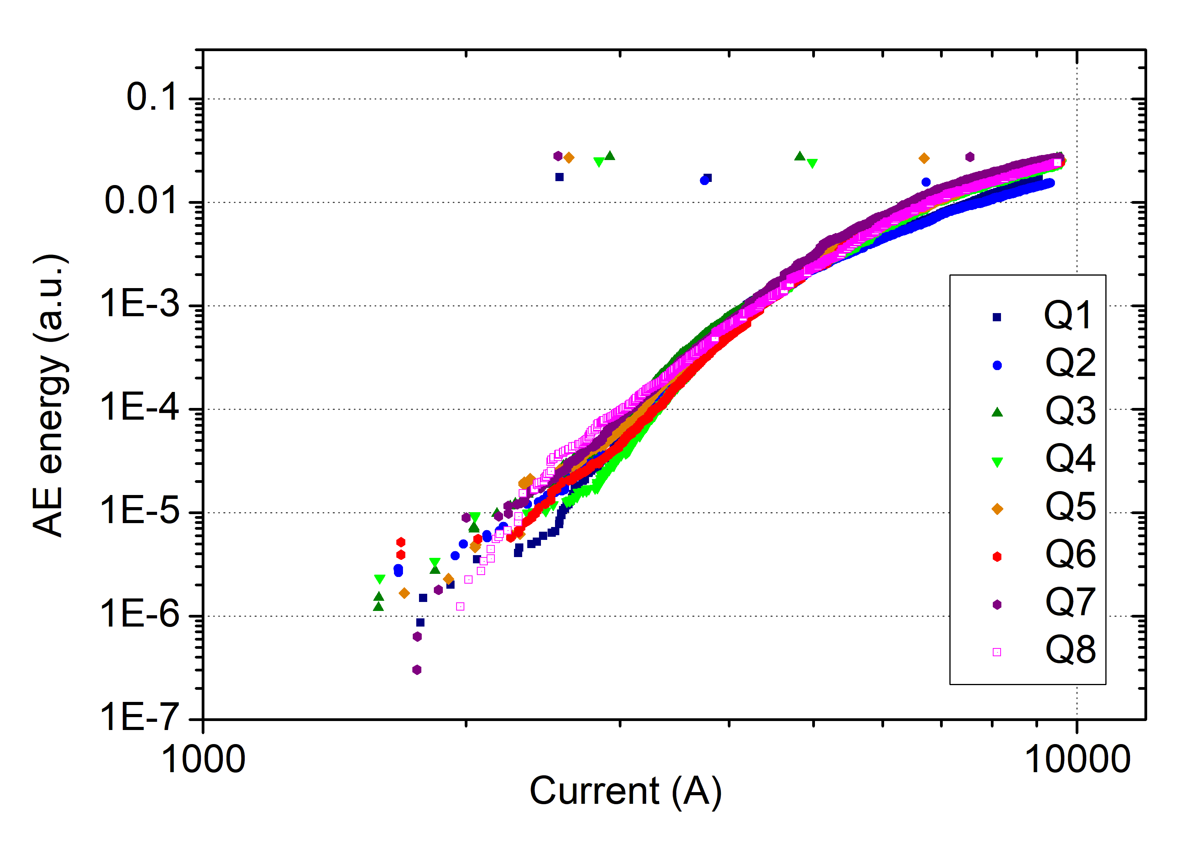
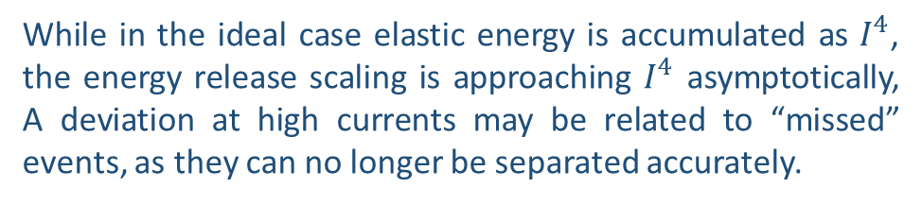

Sub 6 AE cumulative energy release and its evolution with the training
While in the ideal case elastic energy is accumulated as $I^{4}$, the energy release scaling is approaching $I^{4}$ asymptotically, A deviation at high currents may be related to “missed” events, as they can no longer be separated accurately.
Cumulative energy release is increasing with training.
~$I^{4}$
The magnet evolution in terms of energy release continues even so the plateau in quench current has been reached!
So how should we really define training and memory in magnets? Should we consider the quench current alone or also take into account the mechanical state of the magnet?

Slide 5
Thermal cycling the sub 6 did not affect AE energy release and AE event count
Plots comparing cumulative energy release and event count for the Sub 2 (CTD101K), Sub 6 (wax) and Sub 6TC
Memory” seems to be very good also from the energy release prospective!

Slide 6
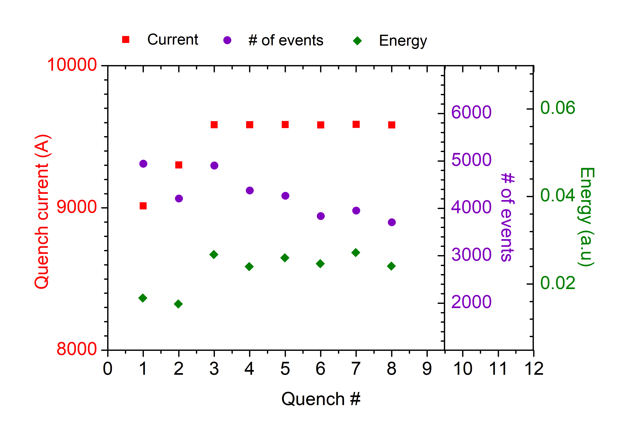
A summary of AE event # and AE energy accumulation over the training history
The cumulative AE energy release remains is initially increasing with repeated quenching of the magnet, then sets at a plateau
The number of AE events is decreasing with repeated quenching of the magnet

Slide 7
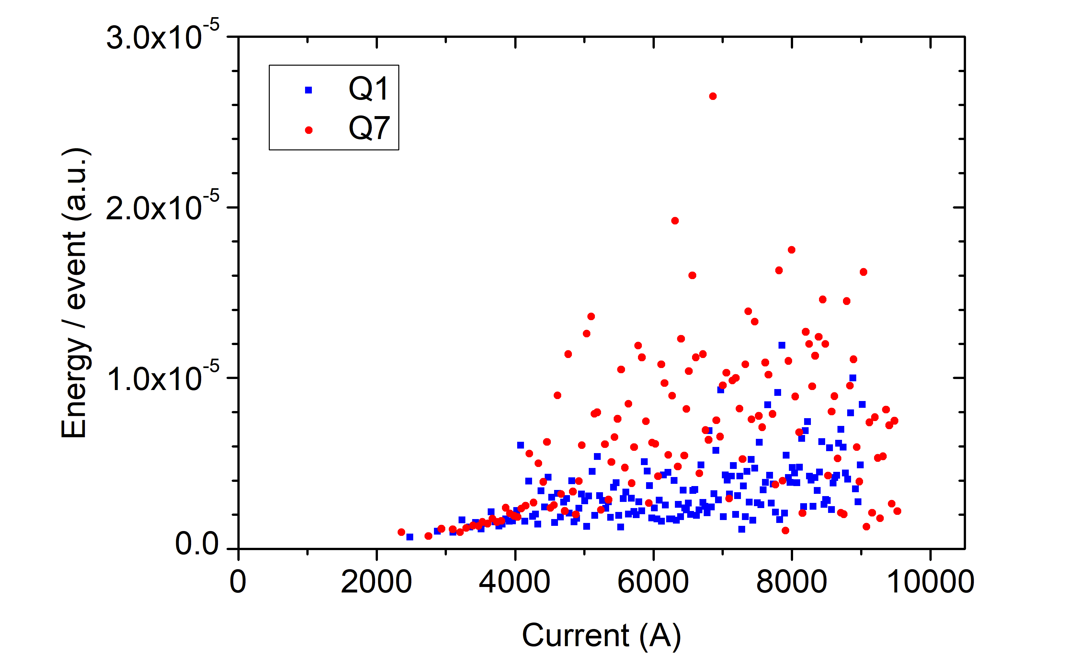
AE energy release per event increases with training
How do we interpret this?
As we “train”, do cracks in the wax impregnations become progressively larger in size while occurring less often?

Slide 8
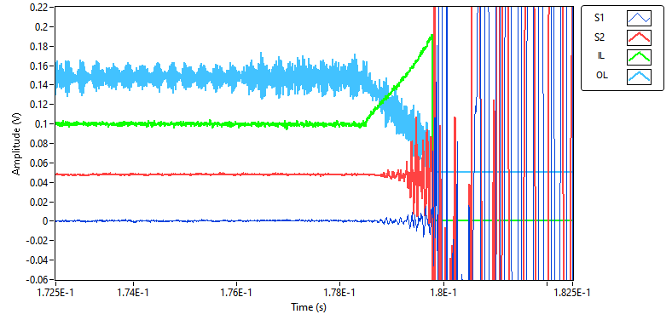
No AE precursor to the quench
Q7
No AE event can be identified as “precursor” to the quench
AE begins almost immediately after quench starts

Slide 9
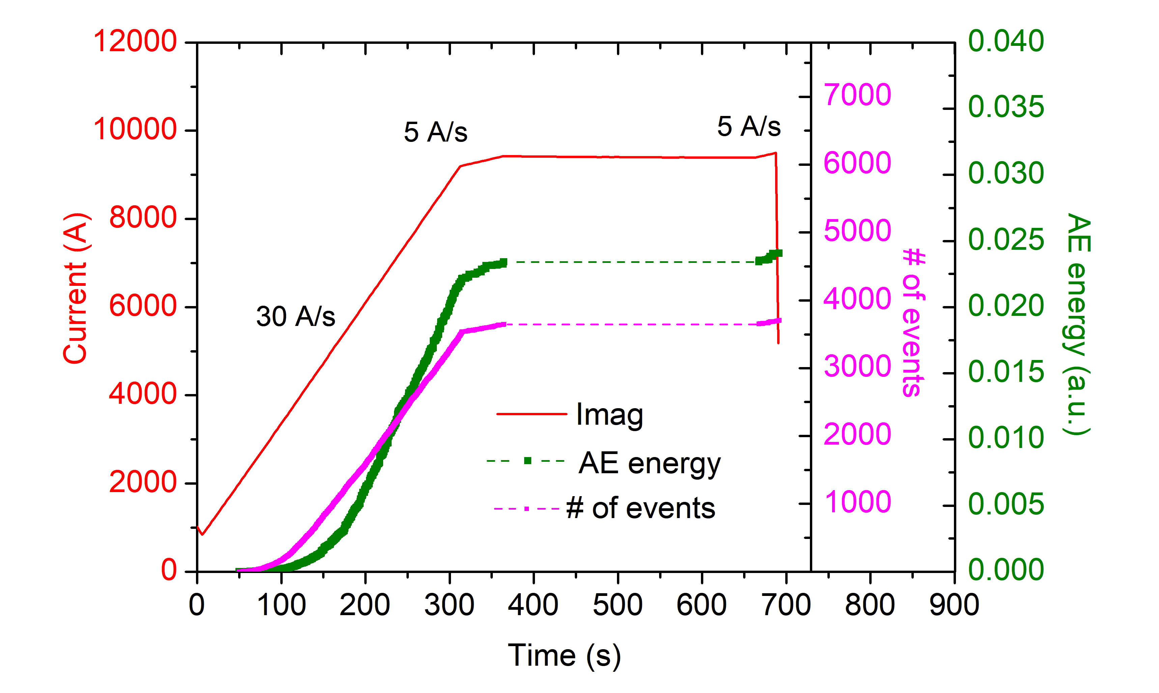
No AE events during a 5+ min holding at 50 A below short sample limit
The magnet remains “silent” during the hold

Slide 10
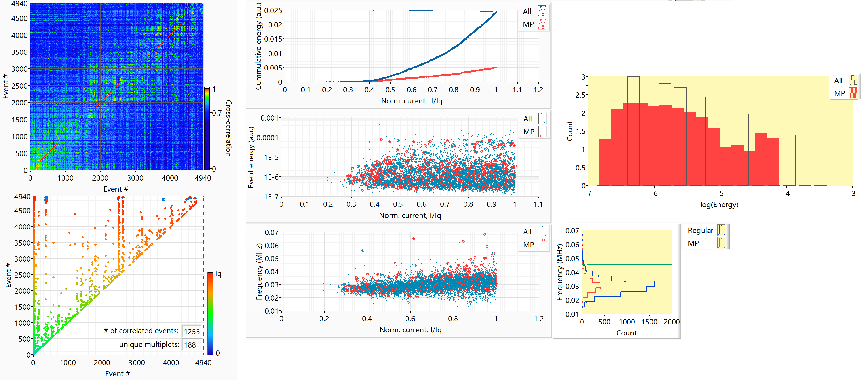
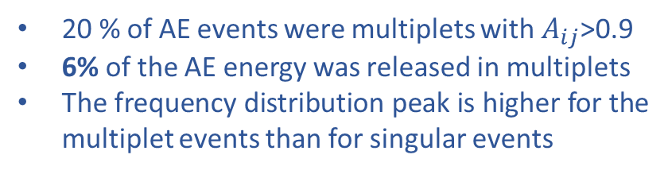
Multiplet analysis: Quench #1
20 % of AE events were multiplets with $A_{ij}$>0.9
6% of the AE energy was released in multiplets
The frequency distribution peak is higher for the multiplet events than for singular events
Multiplet frequency statistics is roughly the same as for the singular AEs

Slide 11
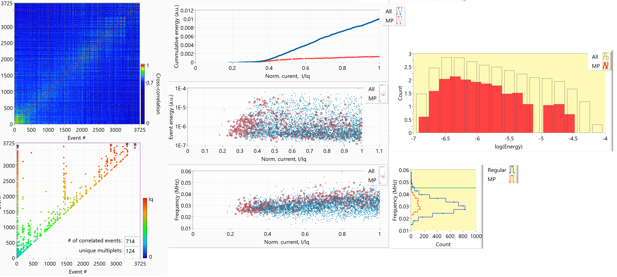
Multiplet analysis: Quench #7
∼ 12% of energy is released in multiplets, i.e. at the same locations within the coil. Growing in size cracks?
Some high frequency shift in multiplet frequency distribution is seen relative to the singular events
The absolute amount of correlated events has decreased

Slide 12
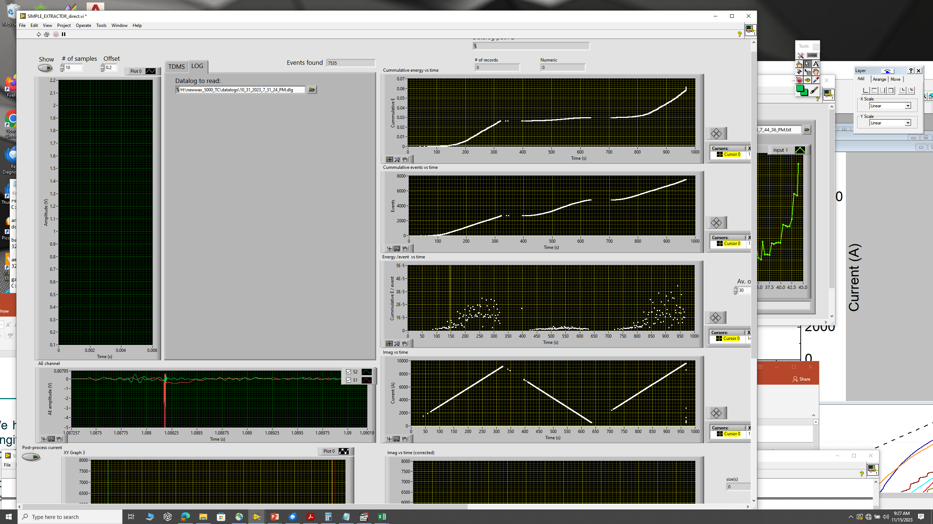
The up-down-up ramp puzzle
Magnet current was ramped up to 9.5 kA, then ramped down to 200 A, ramped back up to 9.5 kA and then energy was extracted
Net energy release plot. A small release occurs also during the ramping down phase
Net event # plot. Some significant amount of AE events occurs during the ramp down!
Energy per event has somewhat increased in the second up-ramp. We also see multiple events on the ramp down, but their energy is very small, an order of magnitude less than during ramping up phase! Are they conductor motion-related?

Slide 13
Future work: a small scale “calibration” experiment is needed!
AE sensor
waveguide
thermometer
impregnation
Same principle as was presented in J. L. Rudeiros Fernadez’s talk on debonding strength measurements
Goals:
Providing cross-calibration between AE energy release and heat release => enables analysis of heat release in CCT subscales using AE data
Providing a direct input to FEA modeling of energy release with impregnation cracking
CCT4 experiment: thermometer built into the OL winding

Slide 14
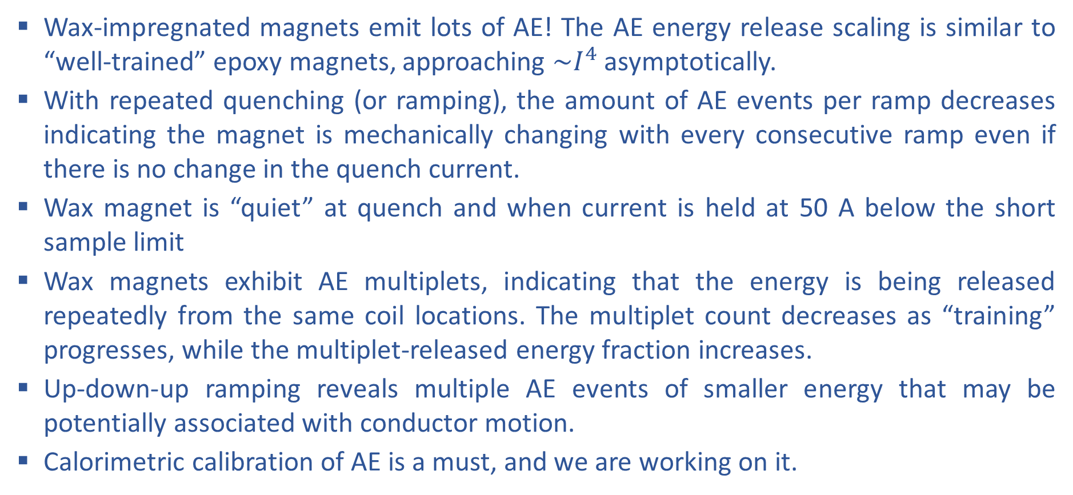
Preliminary conclusions
Wax-impregnated magnets emit lots of AE! The AE energy release scaling is similar to “well-trained” epoxy magnets, approaching ${\sim I}^{4}$asymptotically.
With repeated quenching (or ramping), the amount of AE events per ramp decreases indicating the magnet is mechanically changing with every consecutive ramp even if there is no change in the quench current.
Wax magnet is “quiet” at quench and when current is held at 50 A below the short sample limit
Wax magnets exhibit AE multiplets, indicating that the energy is being released repeatedly from the same coil locations. The multiplet count decreases as “training” progresses, while the multiplet-released energy fraction increases.
Up-down-up ramping reveals multiple AE events of smaller energy that may be potentially associated with conductor motion.
Calorimetric calibration of AE is a must, and we are working on it.

