Slide 1
Updates on 20 T common-coil design
Ramesh Gupta, BNL
(part 1; part 2 by Douglas M. Araujo, PSI)

Slide 2
Common Coil Design and BNL@MDP
(contributions since last meeting & possible future role)
Updated magnetic design for >15% margin (over 20 T) for the same conductor parameters as those used in the comparative studies of the other designs.
Worked with international collaborators (PSI, CIEMAT, CERN, KEK, IHEP, …) to help advance the common coil design for (a) lower field demos (designs for meeting short term R&D goals) and for (b) higher field pre-engineering designs (designs for meeting long term goals for larger scale industrial production).
Worked with international accelerator community (CERN, KEK, …) and with HEP and Fusion community (via INFUSE, arpa-e, …) to use common coil dipole DCC017 as a tool to carry out unique, low-cost and rapid-turn-around R&D
While US magnet R&D is going to align more with the muon colliders, some interest remains worldwide with p-p colliders, and in particular on the common coil design. With BNL’s background with the common coil, USMDP can still play a significant role and stay engaged in this space at a relatively low budget.

Slide 3
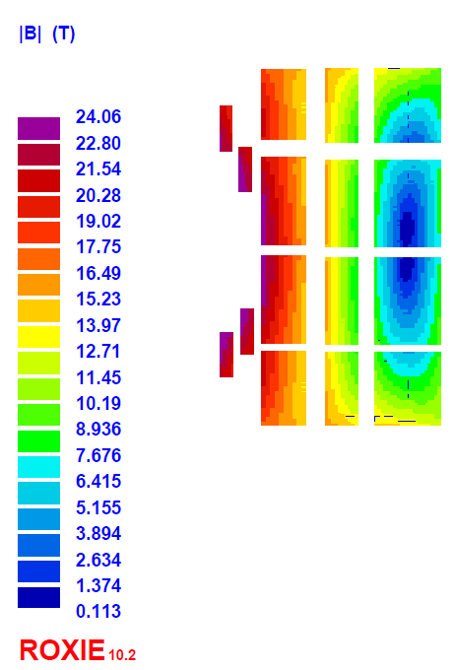
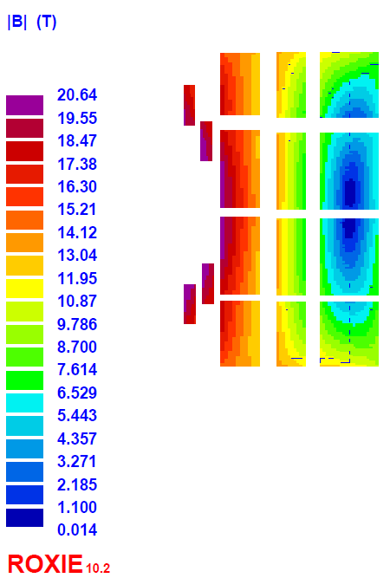
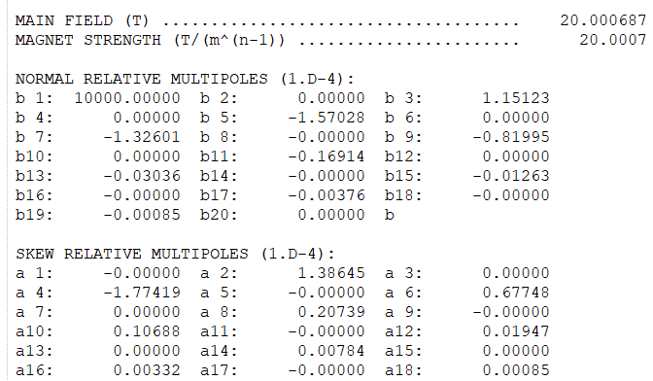
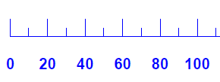
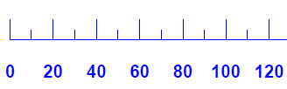
20 T Common Coil Magnetic Design (with >15%, ~16.5% margin)
Present design uses the same cable and number of turns as the 2023 design: (85 HTS + 210 LTS = 295 Total)
Design is better optimized for margin than the field quality (harmonics still <2 units)
B_{ss} = 23.35 T (~16.5% over 20 T)
@Quench Field: 23.35T
@Design Field: 20 T

Slide 4
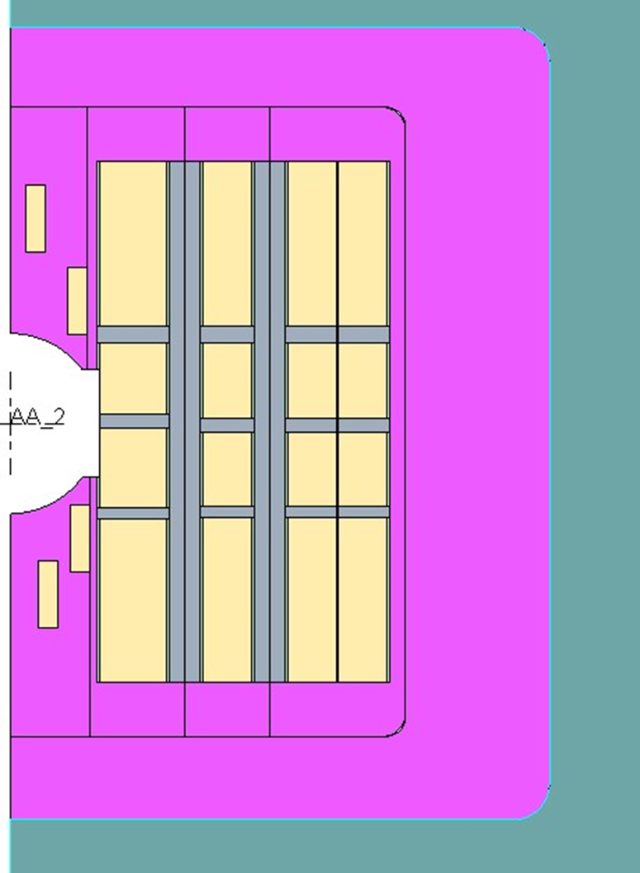
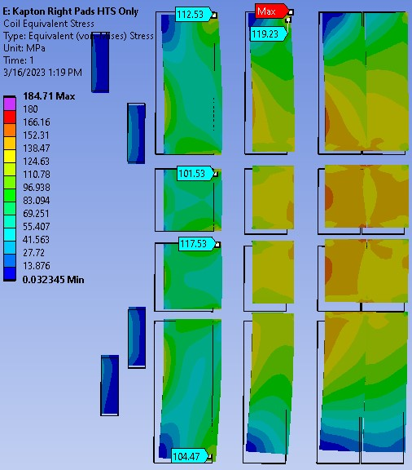
Mechanical Design Approach Under Consideration (vertical spacers with soft material next to coils)
Courtesy:
Anerella, Cozzolino and Runyan
Coil Equivalent Stress – Fixed Vertical Separators
Stainless steel collars are fully bonded together.
Right pads are Kapton on HTS only. All others are stainless steel
Horizontal stress supports are stainless steel.
  112MPa max in HTS
  ~180MPa max* in LTS
Work under progress, proposed to be continued

Slide 5
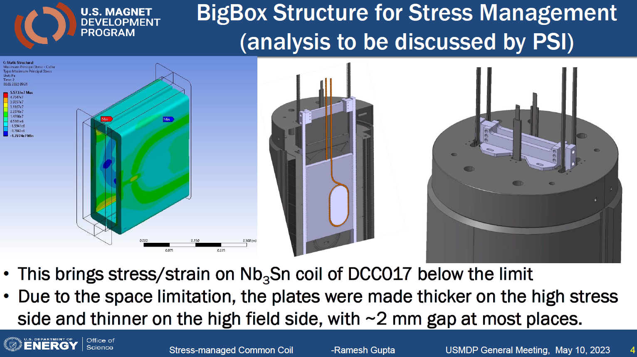
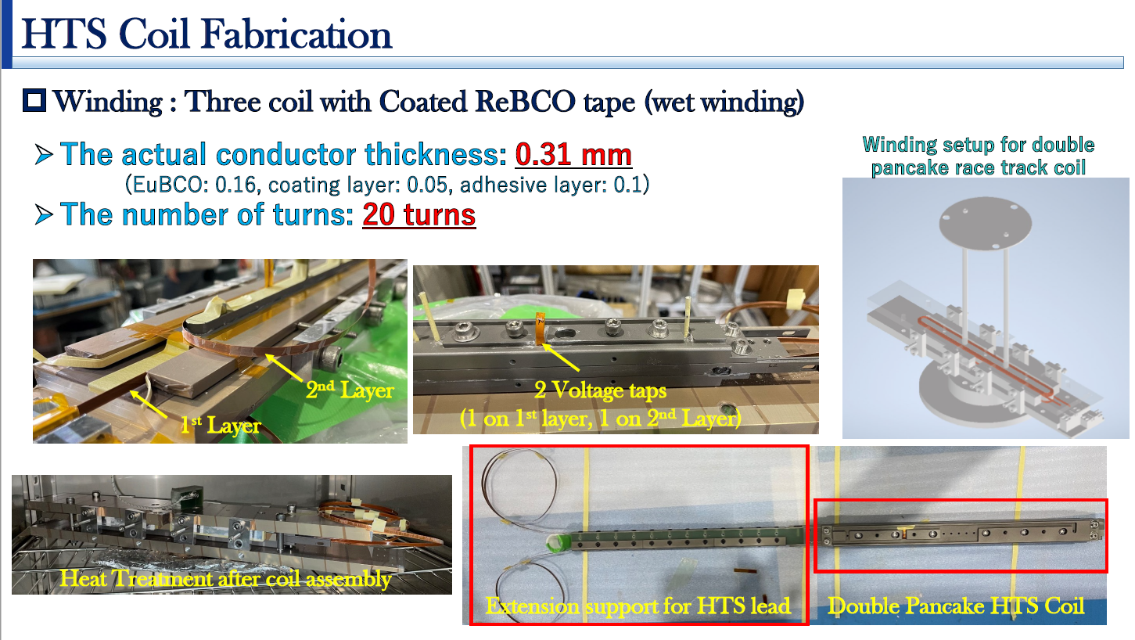
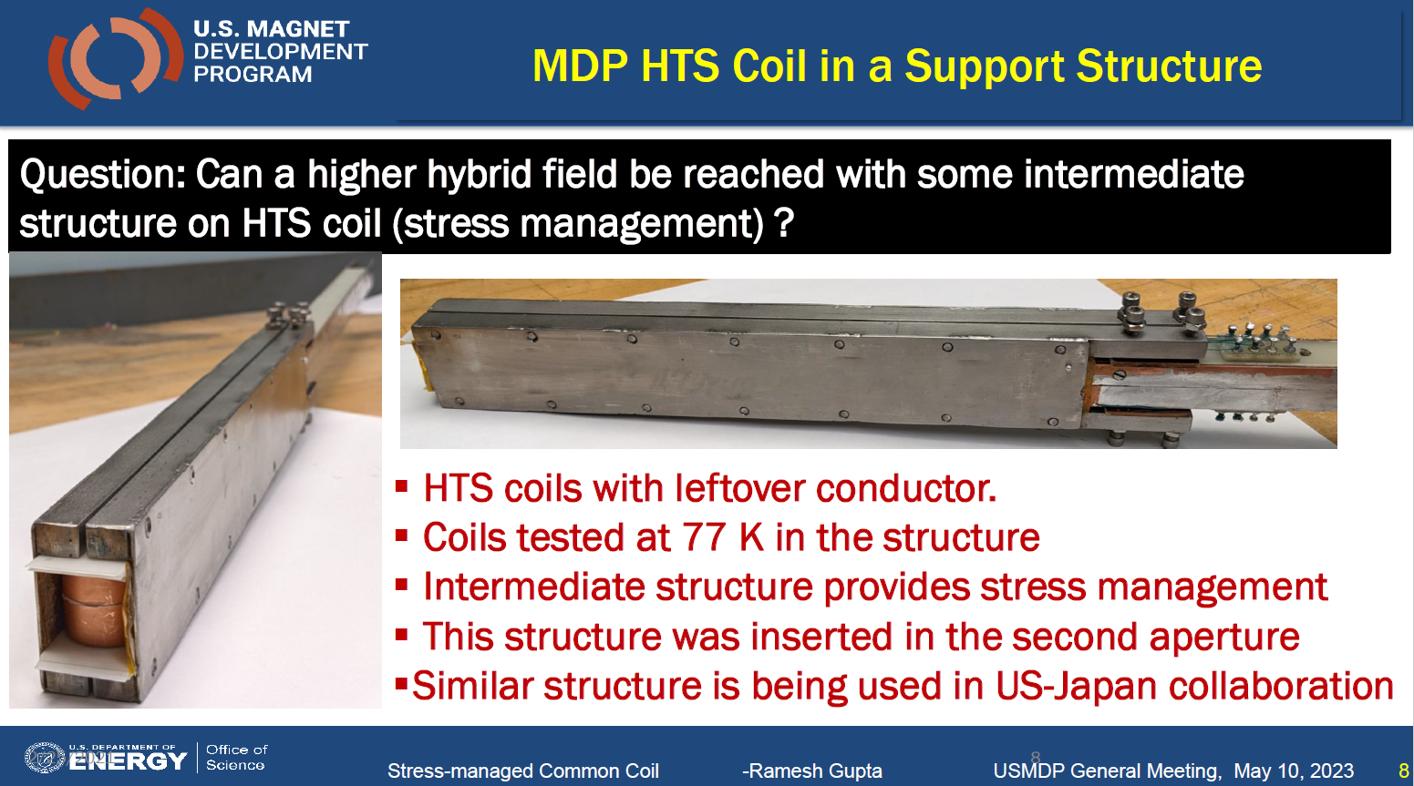
Hybrid Field Test in Common Coil Dipole DCC017
(MDP 2020 Test of 12.3 hybrid field was limited by the structure)
Test of two sets of HTS coils in structure attempted: (a) KEK coils with 4 mm tape, and (b) BNL coils with 12 mm tape, with a goal to exceed 14 T hybrid field. This program can be resumed.
See another presentation by Mithlesh Kumar.
Courtesy: KEK, US Japan Collaboration

Slide 6
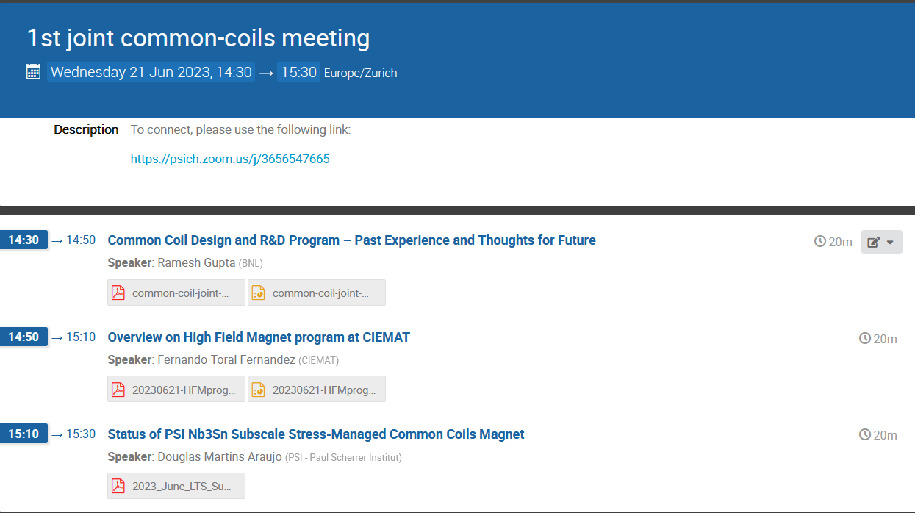
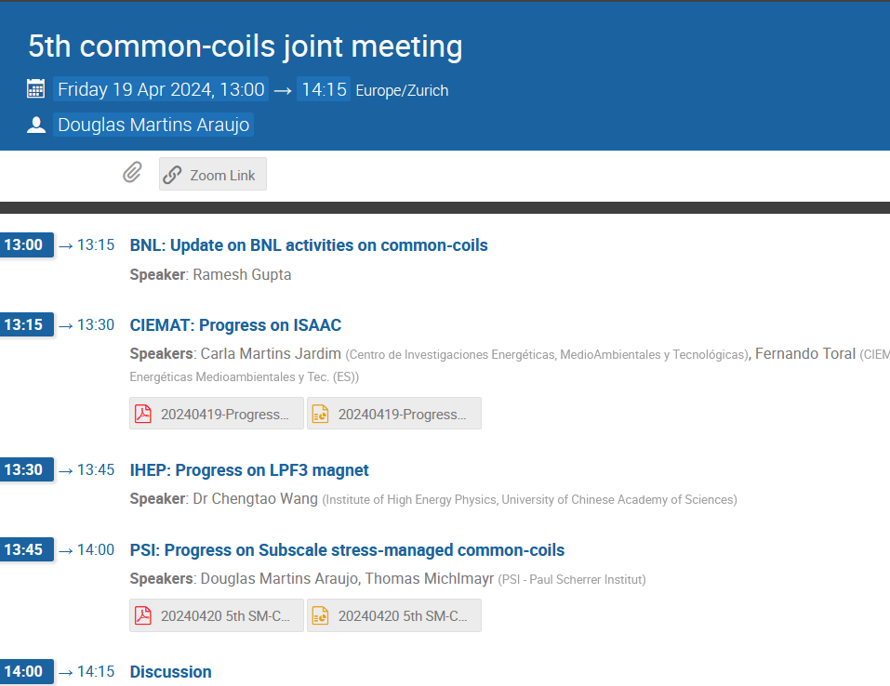
Joint Common-coils Collaboration Meetings (hosted by the HFM program)
https://hfm.web.cern.ch/hfm-working-groups
BNL participants: R. Gupta, M. Anerella, P. Joshi, J. Cozzolino, C. Runyan, F. Kurian, M. Kumar, V. Teotia, …

