Slide 1


Design of 20 T cosθ dipole hybrid magnet
Mechanical status update
Marika D’Addazio^{[1,4]}, G. Vallone^{[1]}, E. Ravaioli^{[2]}, V. Marinozzi^{[3]}, P. Ferracin^{[1]}
[1] LBNL, [2] CERN, [3] FNAL, [4] POLITO
04/30/2024

Slide 2
Table of contents
Introduction
Assumptions
Conductor material properties
Element solution for stresses
Structural limits
Rigid structure vs Real structure
Structure design
Components description
Cross-section results in a rigid structure
Structure design optimization
Stress results with optimized key position
Cross-section study
Rigid cross-section comparison
Stresses in a real structure
Cross-section of REBCO coated conductors
Conclusion

Slide 3
Table of contents
Introduction
Assumptions
Conductor material properties
Element solution for stresses
Structural limits
Rigid structure vs Real structure

Slide 4
Introduction
1. Assumptions
Coil and magnet parameters
  Free coil aperture (diameter) 50 mm
  Operational bore field 20 T
  Load-line fraction @ 1.9K: I_{op}/I_{ss} ≤ 87 %
  2D Geometrical harmonics bn < 3 units for n<10 (at R_{ref} = 17 mm)
Quench protection
  All coils powered in series
  Maximum hot spot temperature 350 K
Mechanics
  Maximum Nb₃Sn coil stress <180 (<150) MPa at 1.9 (293) K
  For the HTS <120 MPa

Slide 5
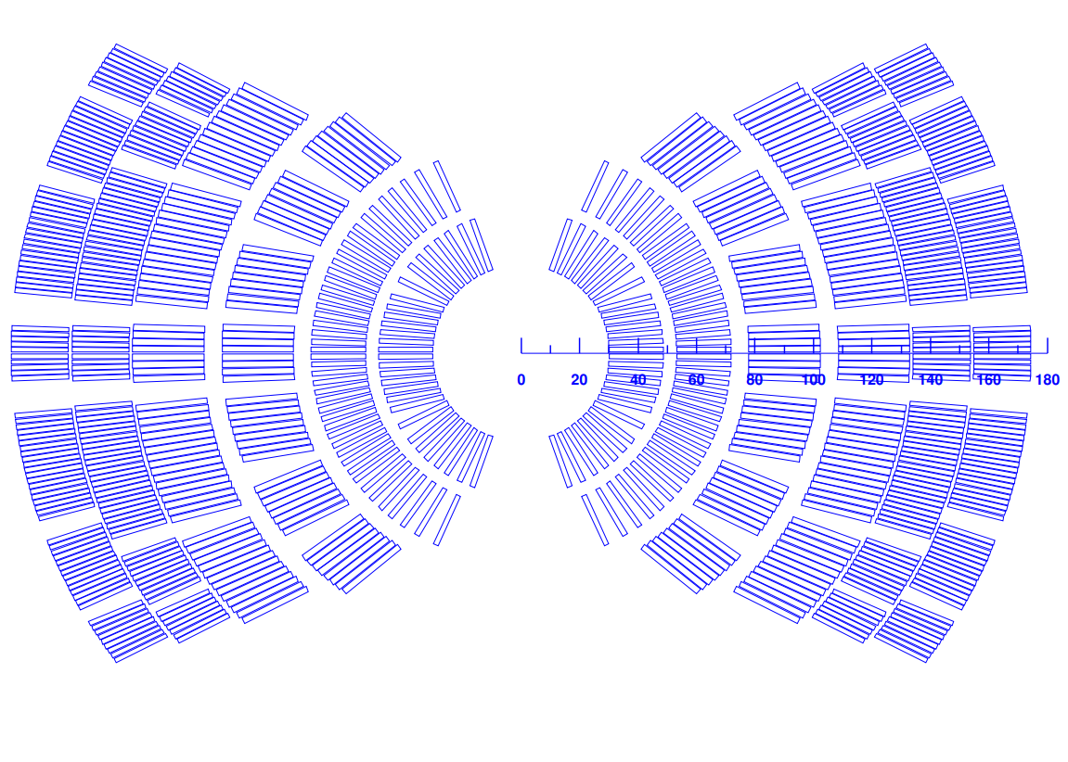
Introduction
1. Assumptions
Layer 1-2: HTS (Bi2212)
Layer 3-6: Nb₃Sn
Strands [mm]: 0.9 – 1.1 – 0.8
Turns [-]: 36 – 40 – 44
Cable width [mm]: 18.59 – 24.38 – 19.50
Stabilizer/Superconductor [-]: 3 – 1 – 1.8
Coil width [mm]: 143
Current [A]: 13500
Peak field [T]: 20.45 – 15.95 – 13.6
Margin [%]: 87 – 84 – 87

Slide 6
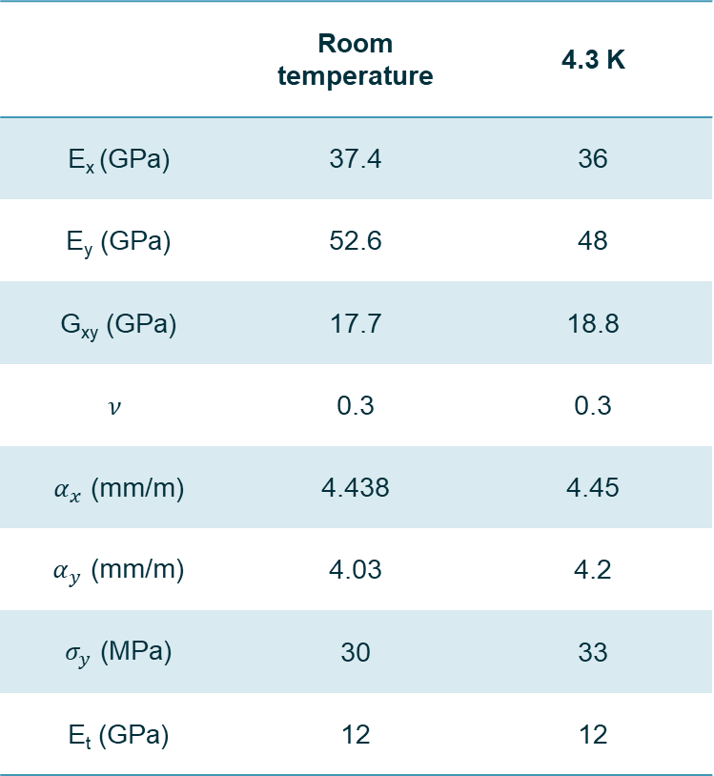
Introduction
2. Conductor material properties
 | Room temperature | 4.3 K
E_{x} (GPa) | 37.4 | 36
E_{y} (GPa) | 52.6 | 48
G_{xy} (GPa) | 17.7 | 18.8
$$ν$$ | 0.3 | 0.3
$α_{x}$ (mm/m) | 4.438 | 4.45
$α_{y}$ (mm/m) | 4.03 | 4.2
$σ_{y}$ (MPa) | 30 | 33
E_{t} (GPa) | 12 | 12
The model is simulated with non-linear properties; specifically, Nb₃Sn properties are used also for Bi2212 conductors waiting to retrieve the Bi2212 properties.
Properties obtained from the RVE model: the assumption is that for single loading, isotropic hardening might be good enough.
Notes:
Alpha_x and alpha_ y: Secant coefficients of thermal expansion
E: Young modulus
Gxy: Shear modulus
v: Major Poisson ratio
Sigma_y: yield stress
E_t: tangent modulus (mostly used to describe the stiffness of a material in the plastic range)
RVE = representative volume element
Non-linear properties extracted from cable stack ‘submodel’ seem to match well measured strain/stress on MQXF (with some limits…)
There is no reason to believe that the linear model would allow for a more accurate prediction of the stress level

Slide 7
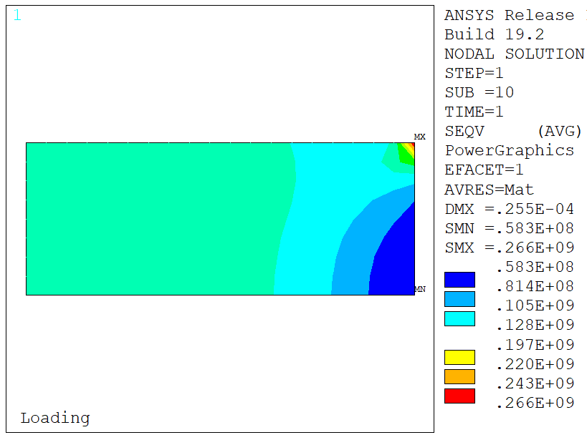
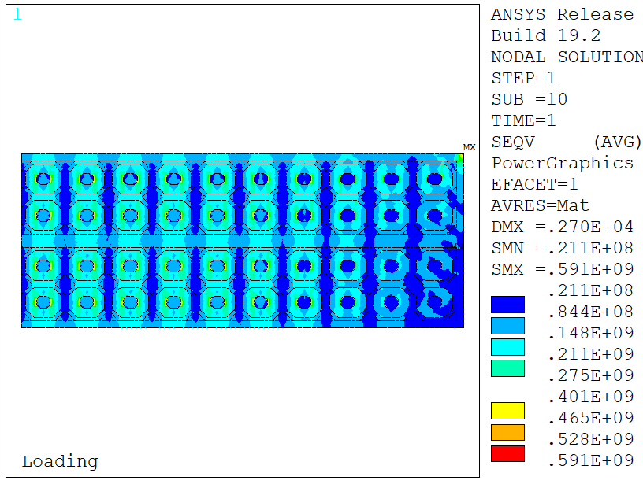
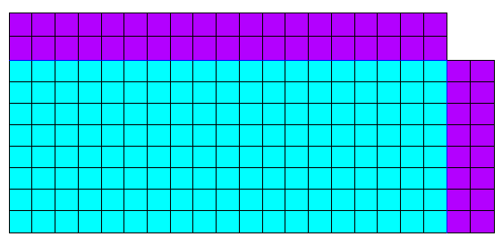
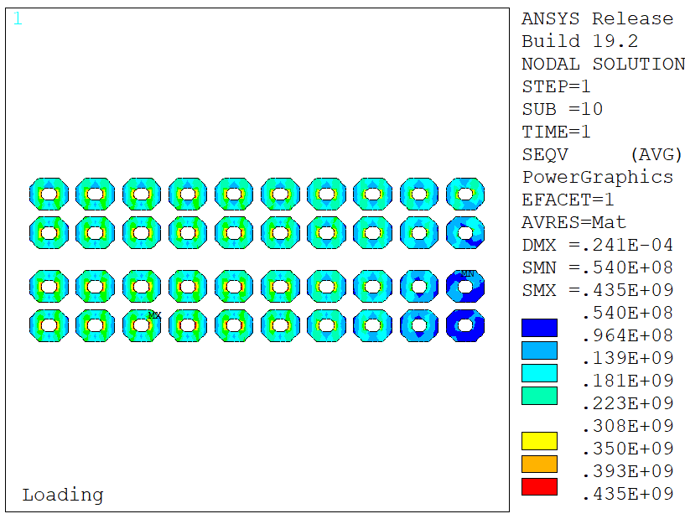
Introduction
3. Element solution for stresses
Sliding
Bonded
Fixed x
Stresses in a ‘corner-test’ model:
Block model goes to 266 MPa equivalent stress in the corner;
Strand model goes to 591 MPa (smaller elements) in the insulation;
No trace of this appears in the Nb₃Sn region stresses.

Slide 8
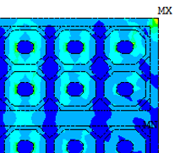
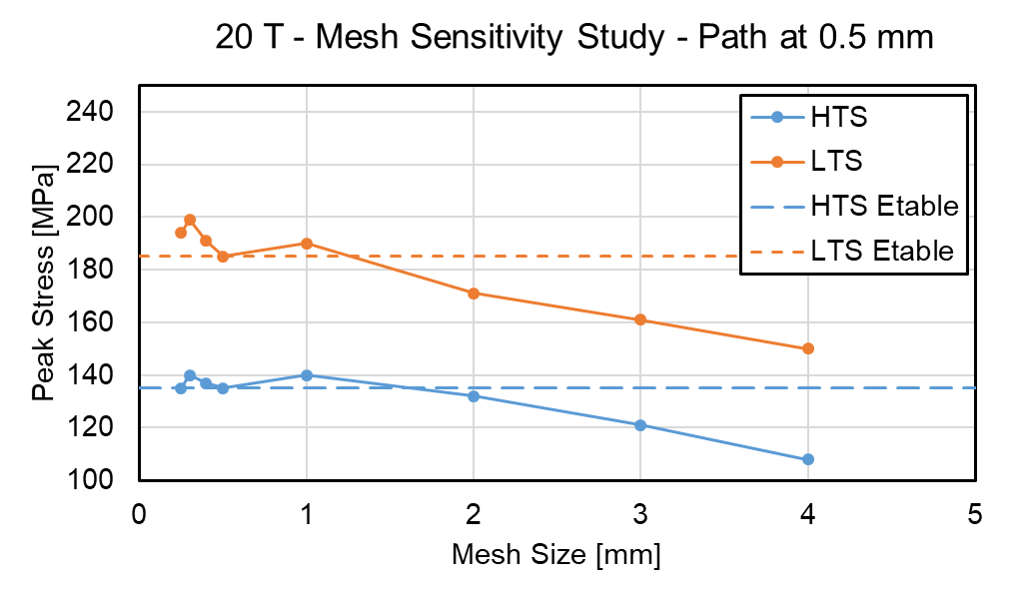
Introduction
3. Element solution for stresses
Explicitly modeling the insulation might increase significantly the model size.
One feasible approach could be extract the strain/stress at the strand location and this is similar to neglect 1 mm for insulation wrap and cable insulation.
In the 20 T CT model, an element size of 1 mm (linear) is used in order to find a compromise between computational load and accuracy.
Notes:
Sensitivity study:
- dots (nodal peak stress): does not converge, even using the elasto-plastic material model
- Line evaluated by considering 5 mm from the edge (equivalent stress at the ‘conductor’ point): results converge to a ‘constant’ value starting from a mesh size of 1 mm

Slide 9
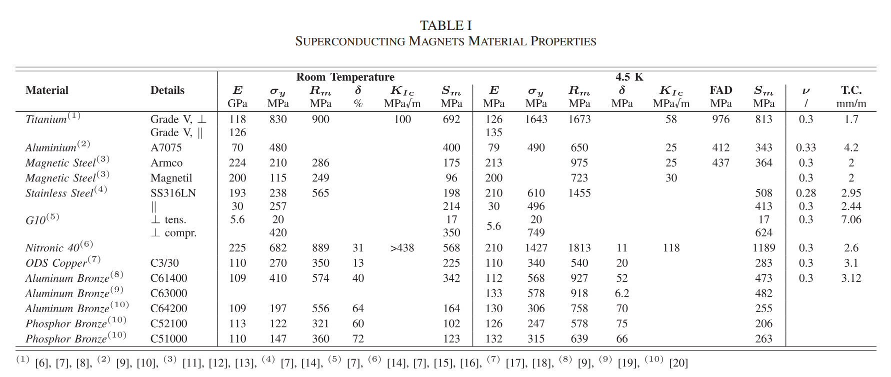
Introduction
4. Structural limits
Reference table for the material properties used in the simulations.
G. Vallone et al., A Review of the Mechanical Properties of Materials Used in Nb3Sn Magnets for Particle Accelerators, IEEE Transactions On Applied Superconductivity, 2023
Notes:
In yellow, some of the materials currently used in the simulations. Other options are under investigation, especially for the mandrel of the magnet.

Slide 10
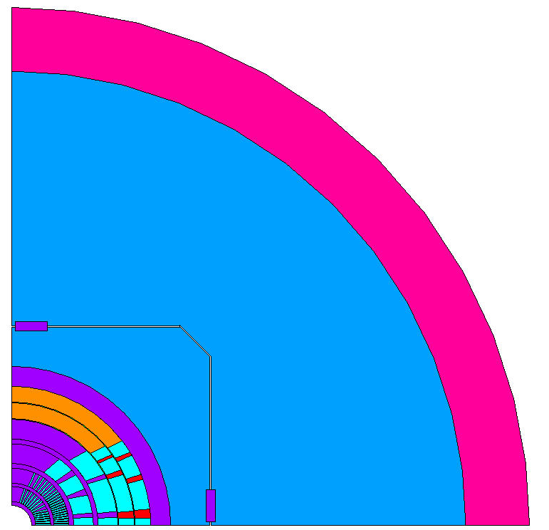
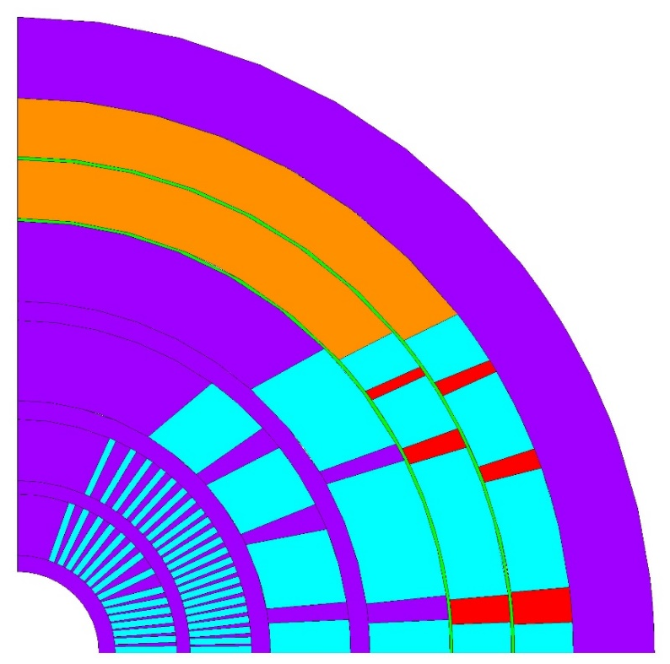
Introduction
5. Rigid structure vs Real structure
Poles
Shell
Collar
Yoke
Spare + ribs
Pad
Wedge
Collar
Not in scale

Slide 11
Table of contents
Introduction
Assumptions
Conductor material properties
Element solution for stresses
Structural limits
Rigid structure vs Real structure
Structure design
Components description
Cross-section results in a rigid structure
Structure design optimization
Stress results with optimized key position

Slide 12
Structure design
1. Component description
Thickness:
  Collar – 25 mm
  Pad – 50 mm
  Yoke – 320 mm
  Shell – 80 mm
  Key x2 – 10x40 mm
Shell
Characteristic:
  Coil element size: 1 mm
  Friction: 0.2
  Layers 1 – 4: Spar + Ribs
  Layers 5 – 6: Pole + Wedges
  Interference: 1.7 mm on the horizontal key → first attempt to ensure the maximum allowable stress in the shell
Yoke
Pad
Collar
Notes:
Separation and sliding are allowed in the coils.
Bonded only the thin interlayers that represent the insulation in layers 5 and 6.
For the wedges, the nodes are coupled (cpintf).

Slide 13
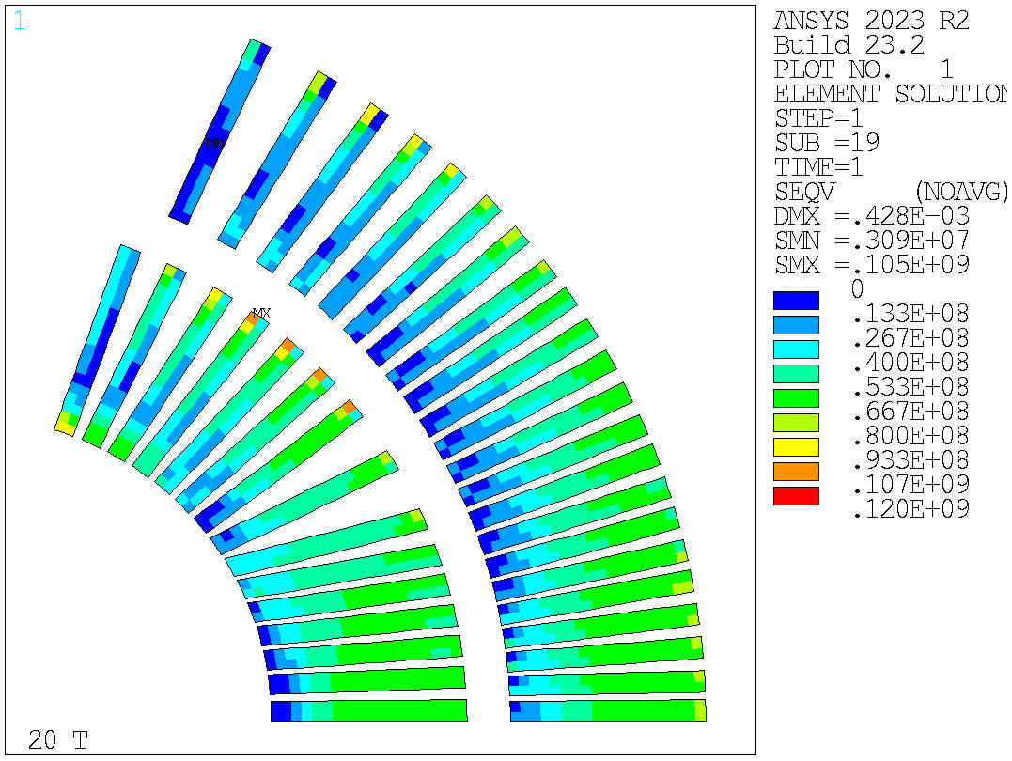
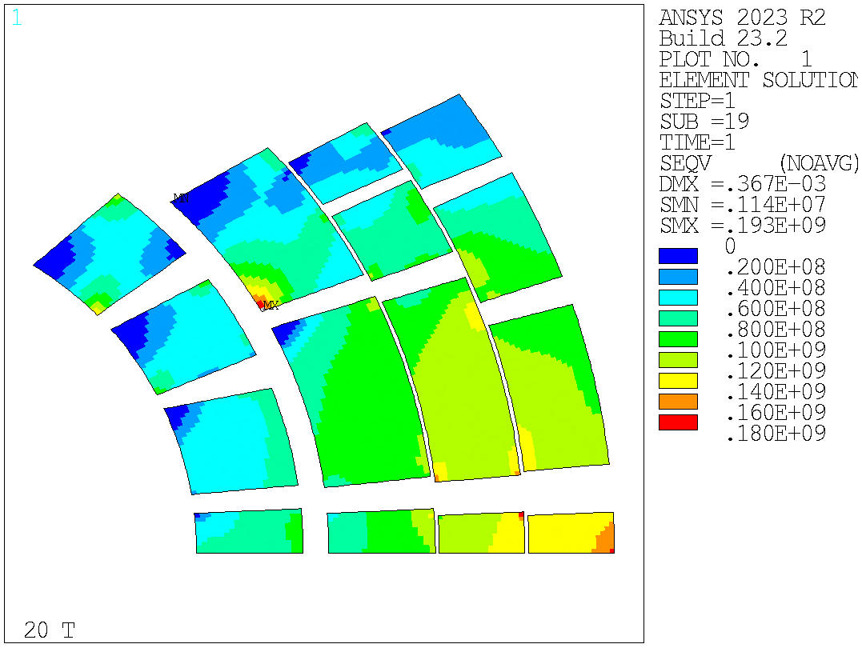
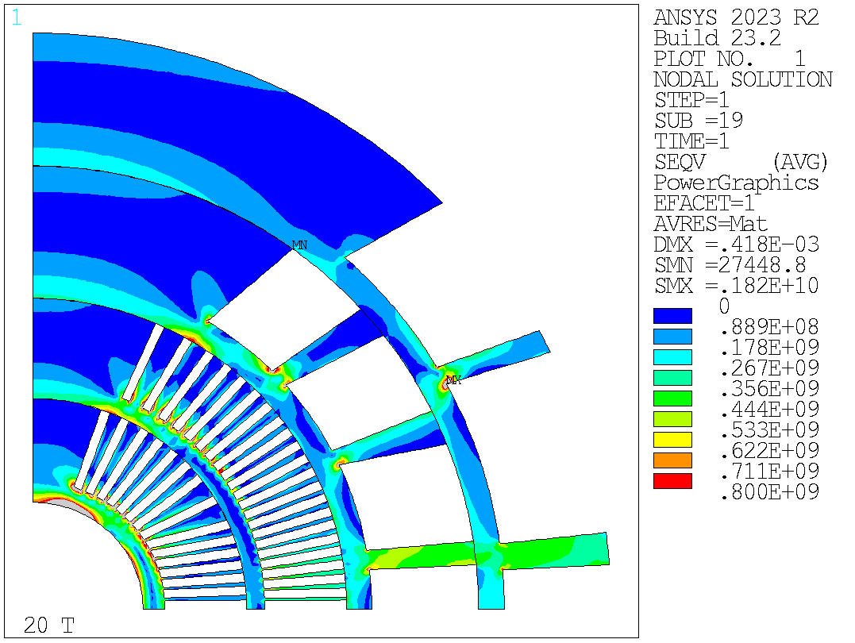
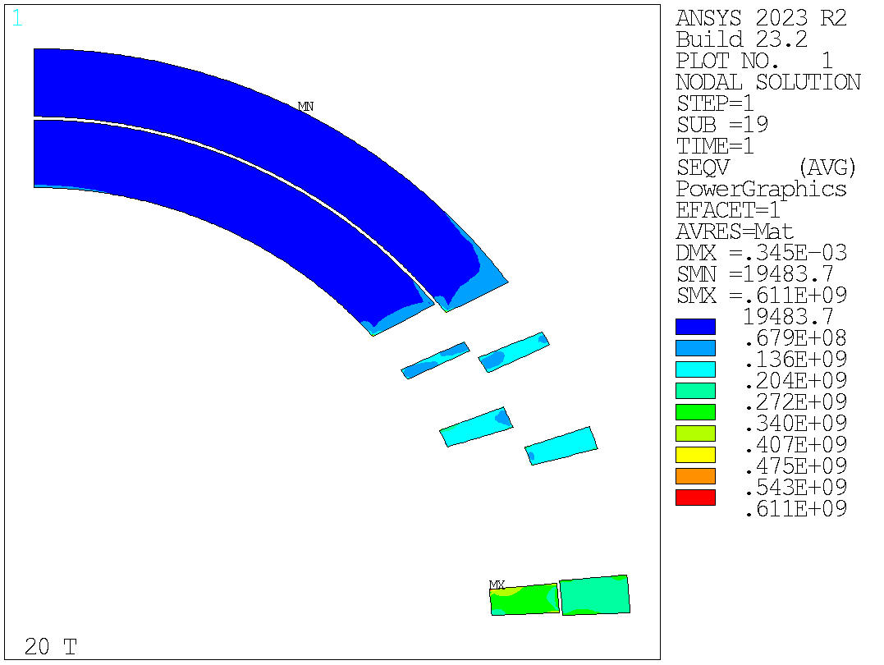
Structure design
2. Cross-section results in a rigid structure
Ideal case simulated with the infinitely rigid structure to easily compare different cross sections.
Equivalent stress
Element solution
Equivalent stress
Nodal solution
1820 MPa
Notes:
Comment on the mandrel: high stresses in the mandrel, we have few options to try to solve it.

Slide 14
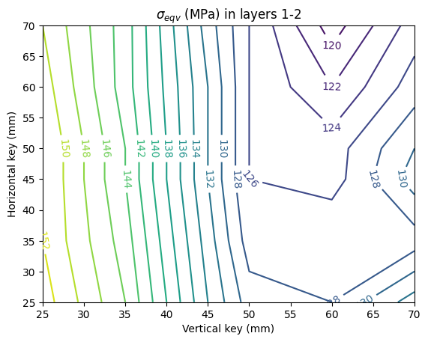
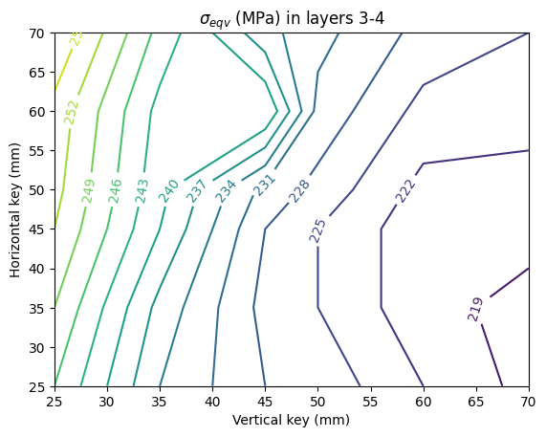
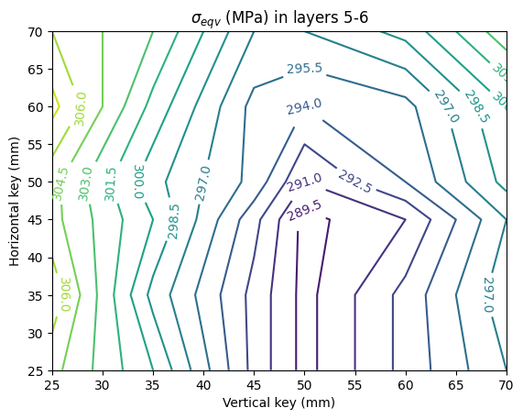
Structure design
3. Structure design optimization
A first optimization analysis was performed by changing the position of the horizontal and vertical keys.
Equivalent stress (nodal solution) evaluated in all the layers of the dipole magnet after powering.
Notes:
These values are evaluated considering the nodal solution (not the element one). So, these results are higher than the one showed considering the element solution.

Slide 15
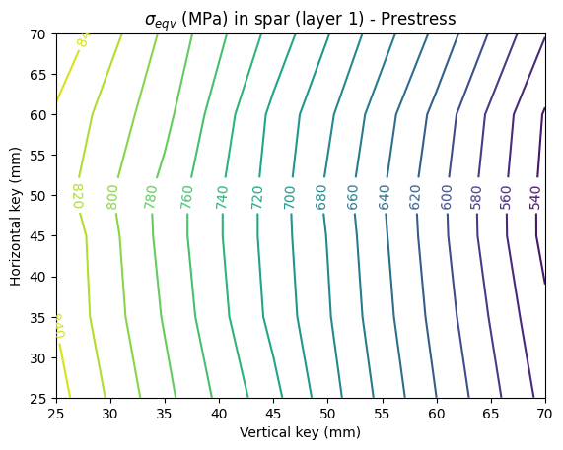
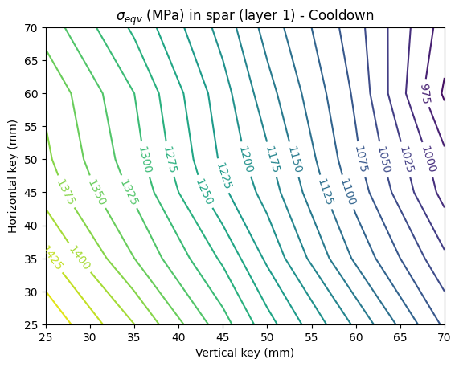
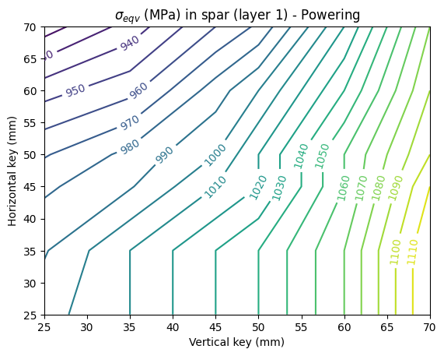
Structure design
3. Structure design optimization
Equivalent stress (nodal solution) evaluated in the spar of the first layer of the magnet after each phase.

Slide 16
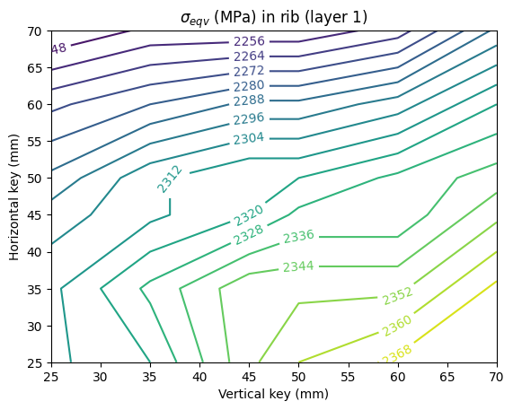
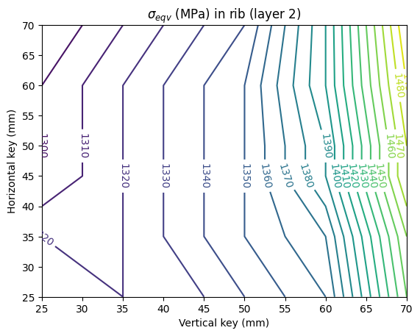
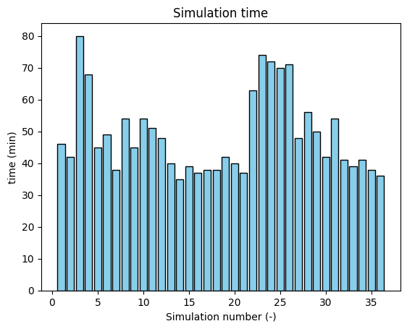
Structure design
3. Structure design optimization
Equivalent stress (nodal solution) evaluated only in the ribs of layer 1 and 2 of the magnet.
Simulation time

Slide 17
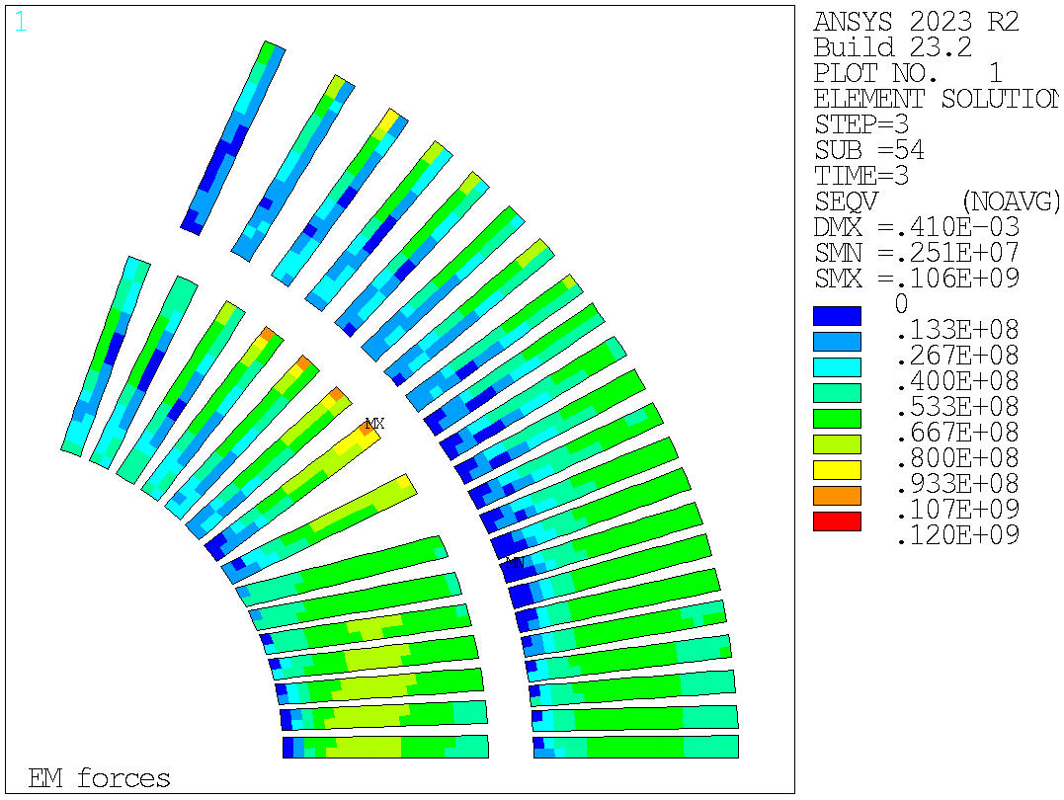
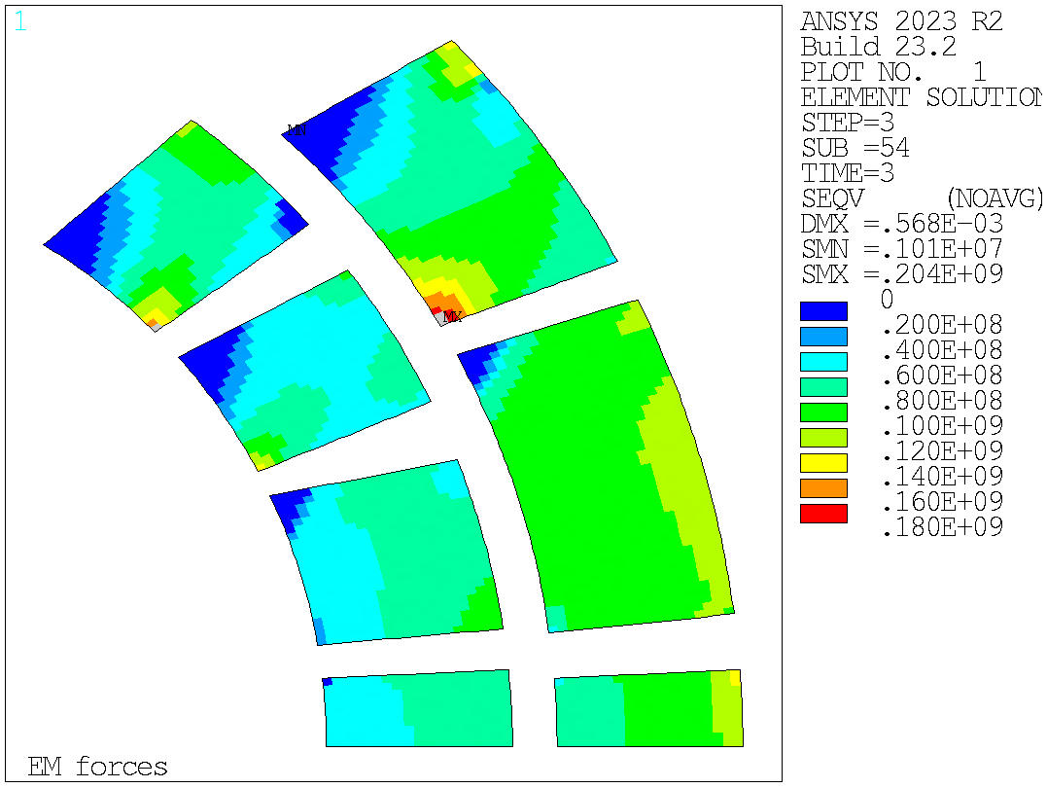
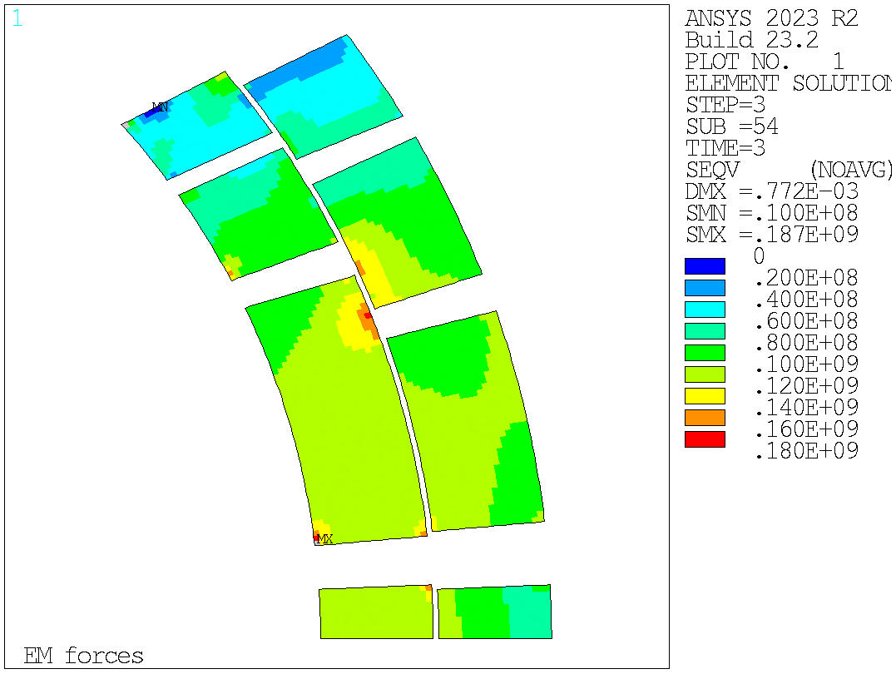
Structure design
4. Stress results with optimized key position
Equivalent stress (element solution) in all the layers of the dipole after powering.
This results are obtained considering the vertical key at 70 mm and the horizontal one at 60 mm.

Slide 18
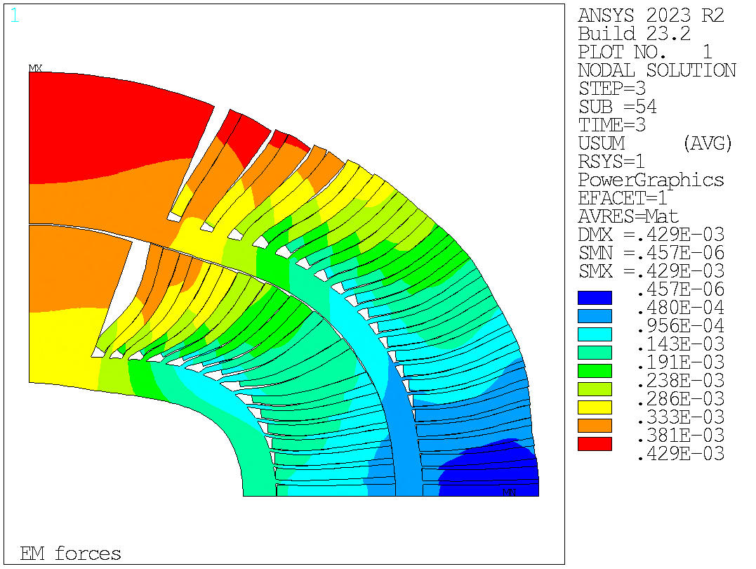
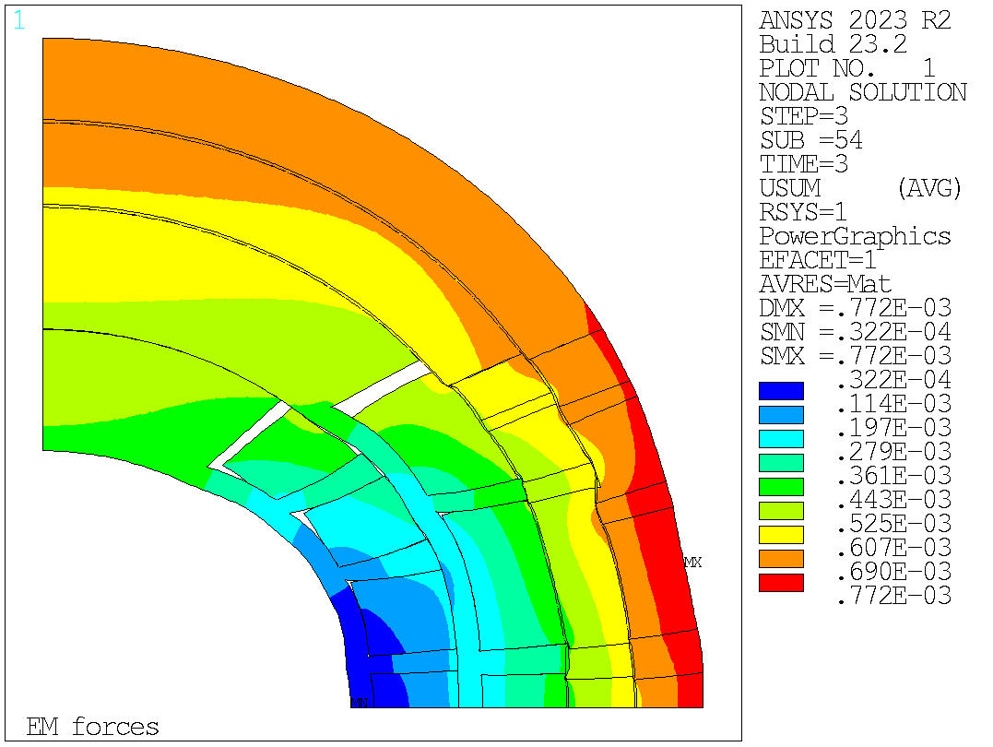
Structure design
4. Stress results with optimized key position
Displacements of all the layers of the magnet after powering.
High stress area
This results are obtained considering the vertical key at 70 mm and the horizontal one at 60 mm.

Slide 19
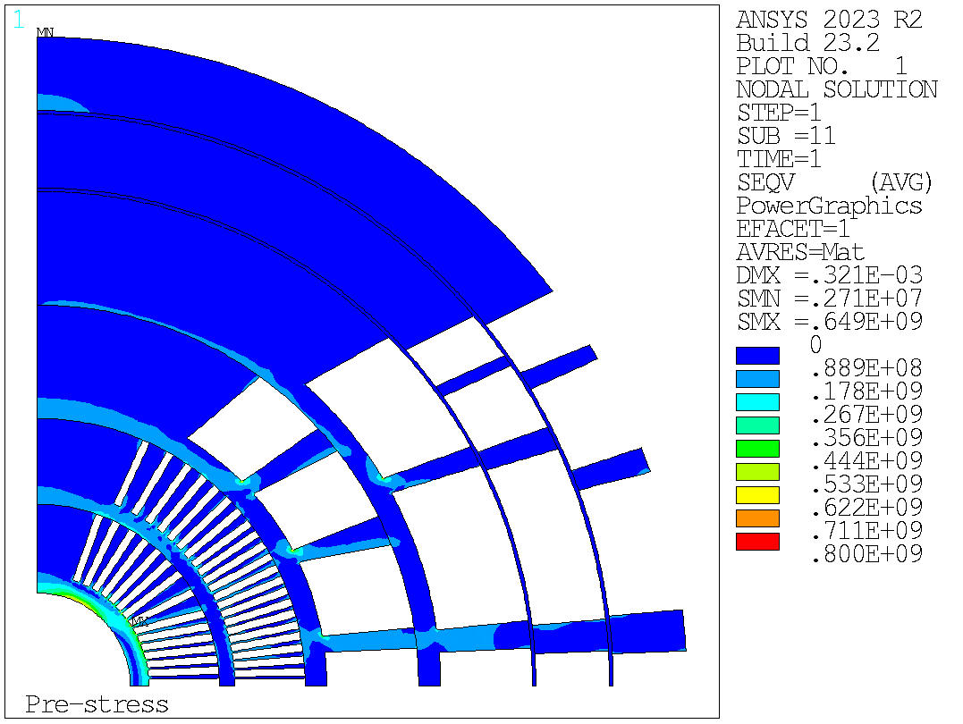
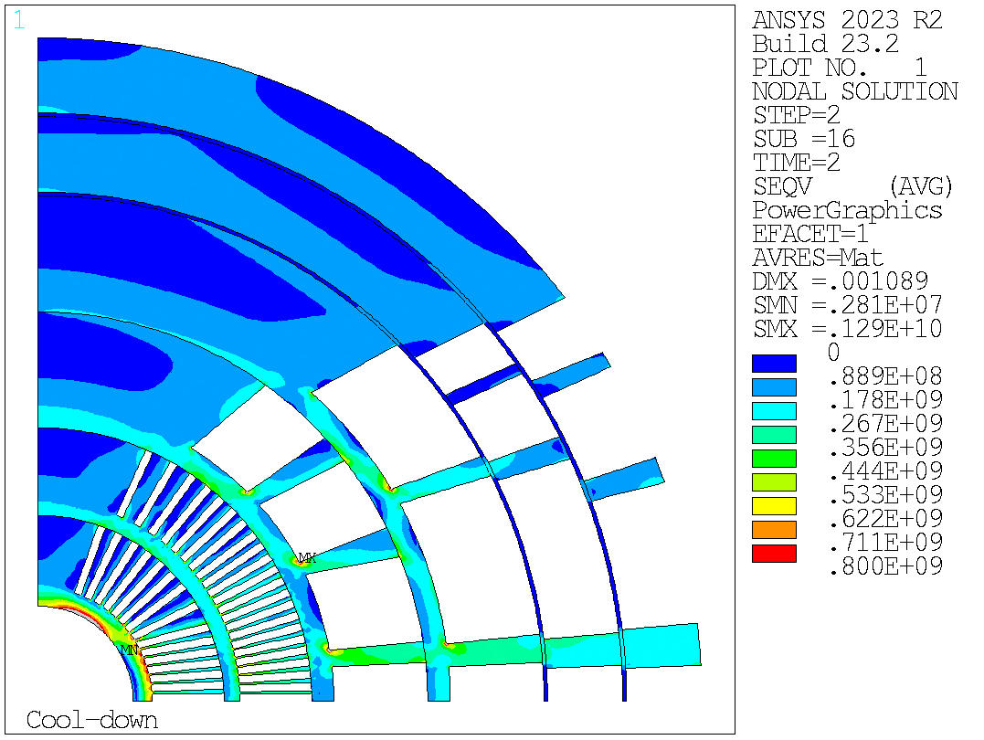
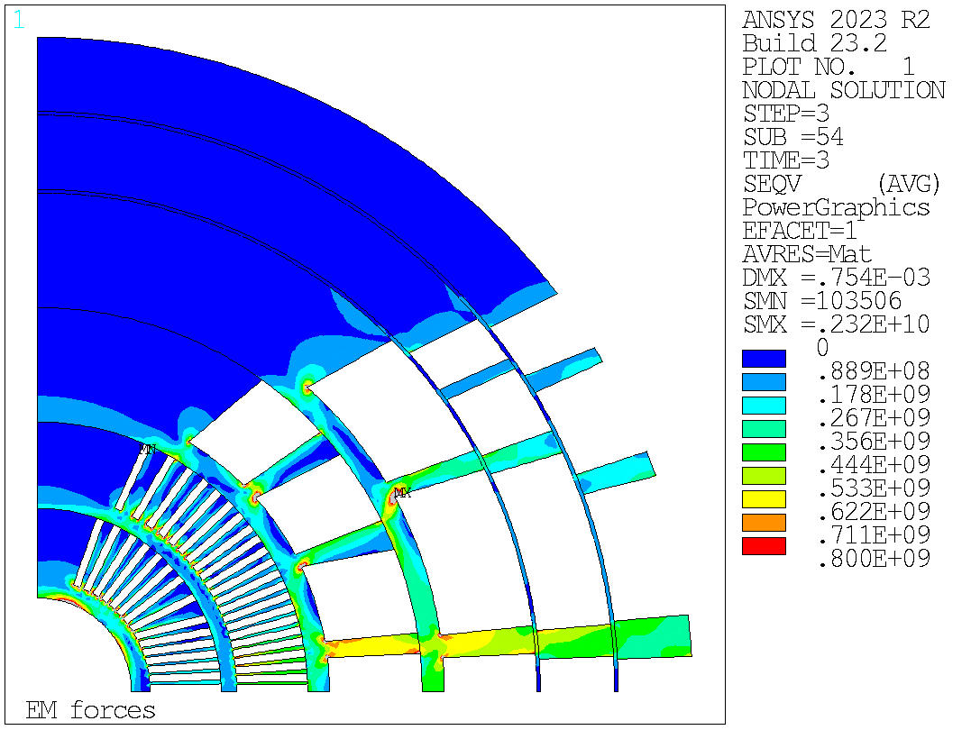
Structure design
4. Stress results with optimized key position
Equivalent stress of the mandrel of the magnet after prestress, cooldown and powering considering the nodal solution.
This results are obtained considering the vertical key at 70 mm and the horizontal one at 60 mm.
Notes:
Inserire slide 30 e 31 per mostrare meglio dove è localizzato lo stress?

Slide 20
Table of contents
Introduction
Assumptions
Conductor material properties
Element solution for stresses
Structural limits
Rigid structure vs Real structure
Structure design
Components description
Cross-section results in a rigid structure
Structure design optimization
Stress results with optimized key position
Cross-section study
Rigid cross-section comparison
Stresses in a real structure
Cross-section of REBCO coated conductors

Slide 21
Cross-section study
1. Rigid cross-section comparison
Other possible cross-sections for the dipole design are currently under investigation.
The selected parameters for three of them are reported in the table below as a reference.
 | Version 17 | Version 27 | Version 60
Description | Design with low-aspect ratio conductors in layers 3-6 and high-aspect ratio conductors in layers 1-2 | Design with 2-by-2 turns stress-management in layers 1-2 and low-aspect ratio conductors in layers 3-6. | Design with 3-by-3 turn blocks for layers 1-2 and layers 3-6 are moved outward by 10 mm to use less HTS.
Strands (mm) | 0.9 – 1.1 – 1.1 | 0.9 – 1 – 1 | 1 – 0.8 – 0.7
Turns (-) | 38 – 30 – 22 | 40 – 40 – 30 | 26 – 50 – 50
Bare cable width (mm) | 17.66 – 18.28 – 13.40 | 18.59 – 22.16 – 16.62 | 13.42 – 22.16 – 19.39
Cu/SC (-) | 3 – 1 – 2 | 3 – 1 – 2.2 | 3 – 1 – 2
Current (A) | 14454 | 14567 | 16620
Notes:
To be finished

Slide 22
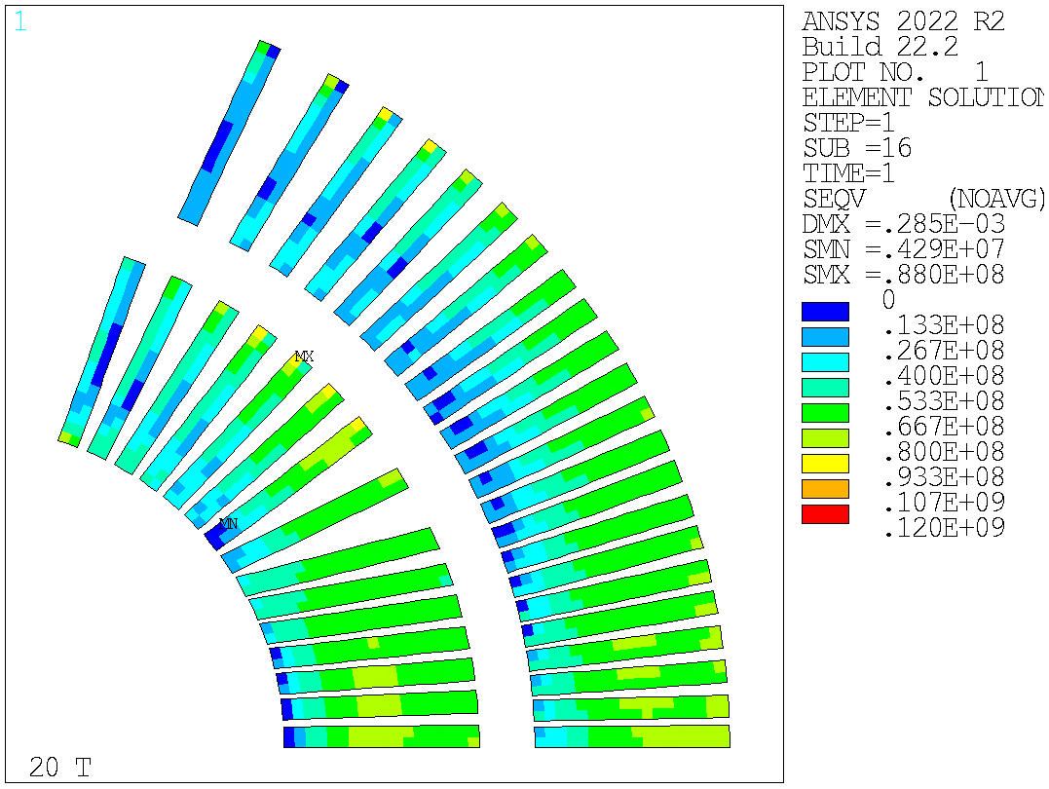
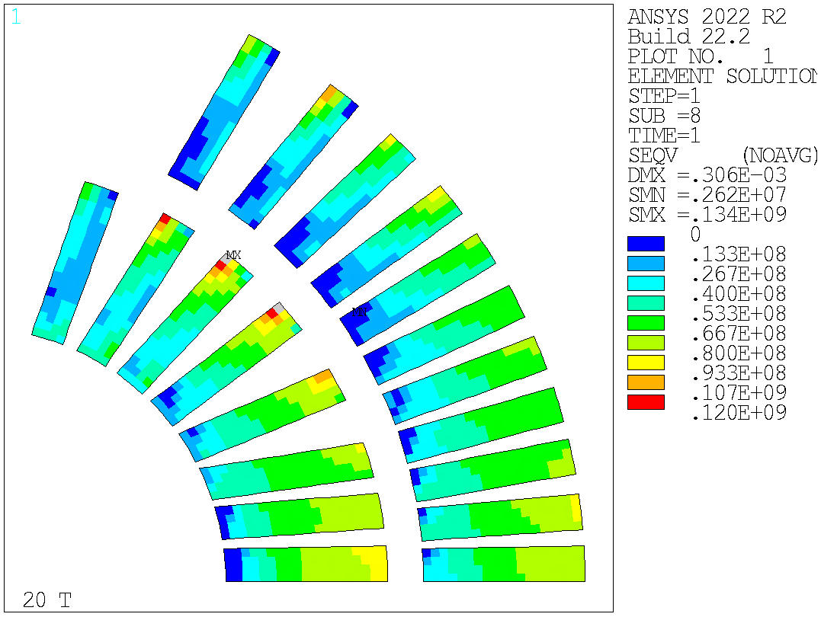
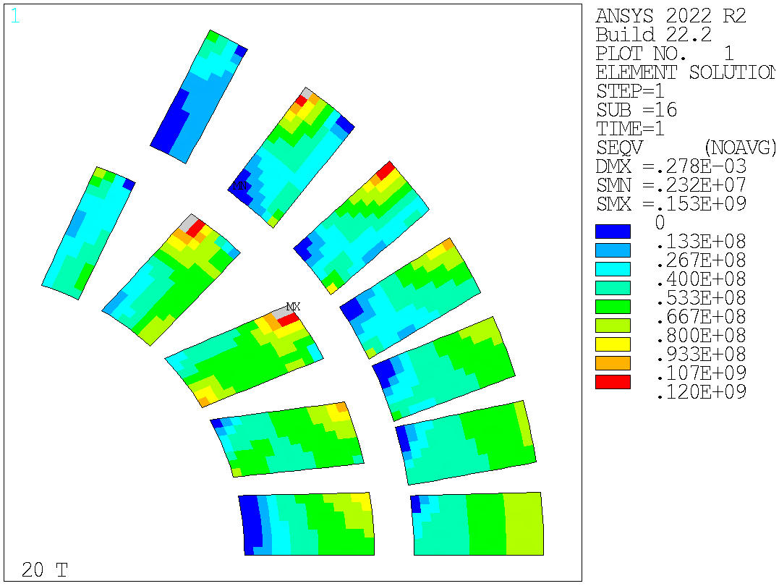
Cross-section study
1. Rigid cross-section comparison
Other possible cross-sections for the dipole design are currently under investigation. The stress results of the mechanical analysis performed considering an infinitely rigid structure are shown.
Equivalent element stress in HTS conductors.
v17 | v27 | v60

Slide 23
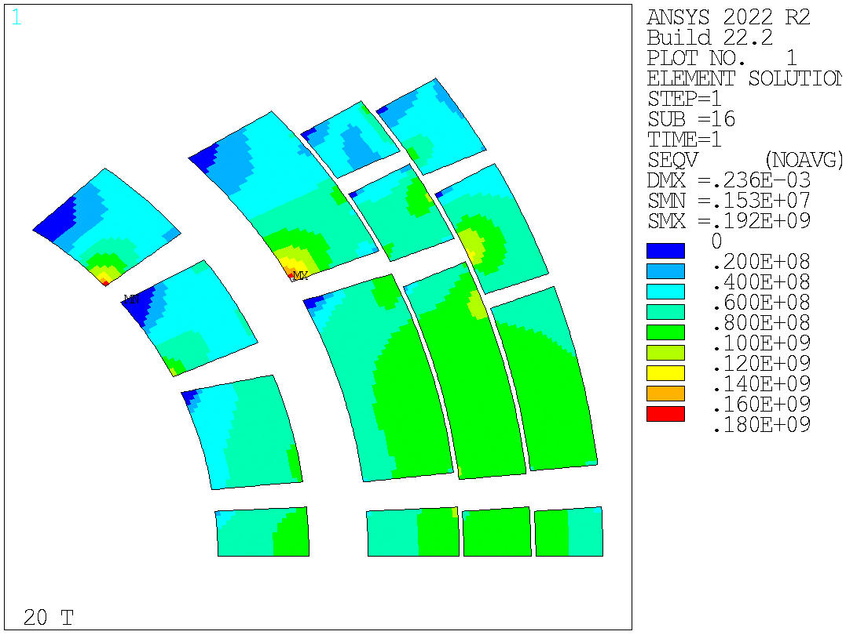
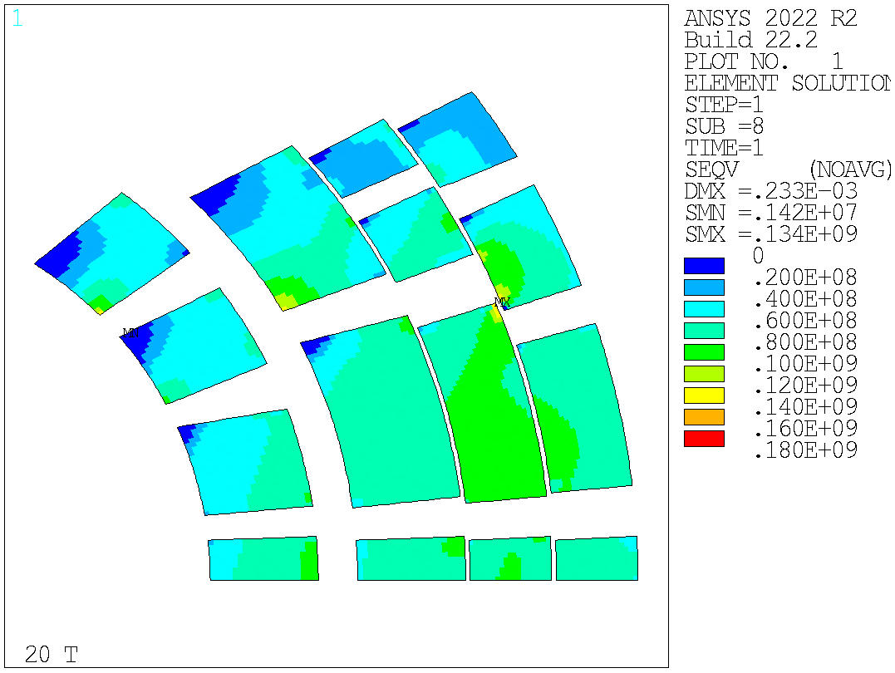
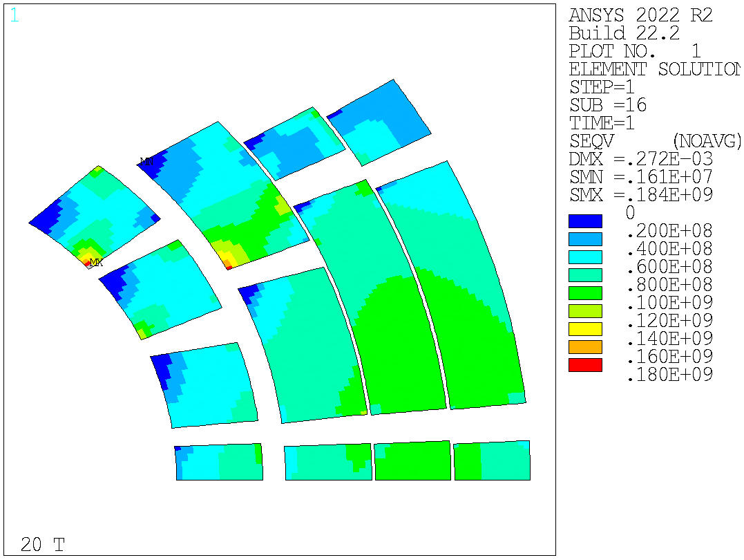
Cross-section study
1. Rigid cross-section comparison
Other possible cross-sections for the dipole design are currently under investigation. The stress results of the mechanical analysis performed considering an infinitely rigid structure are shown.
Equivalent element stress in LTS conductors.
v17 | v27 | v60

Slide 24
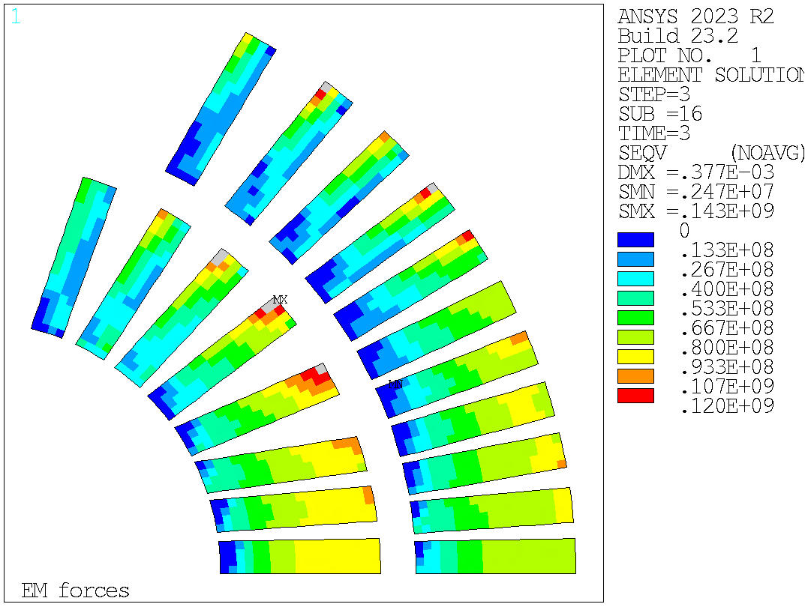
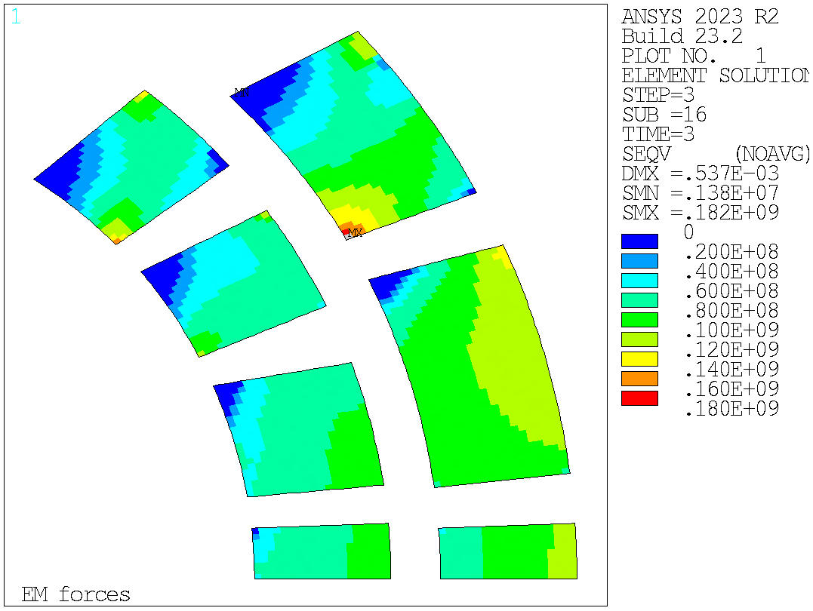
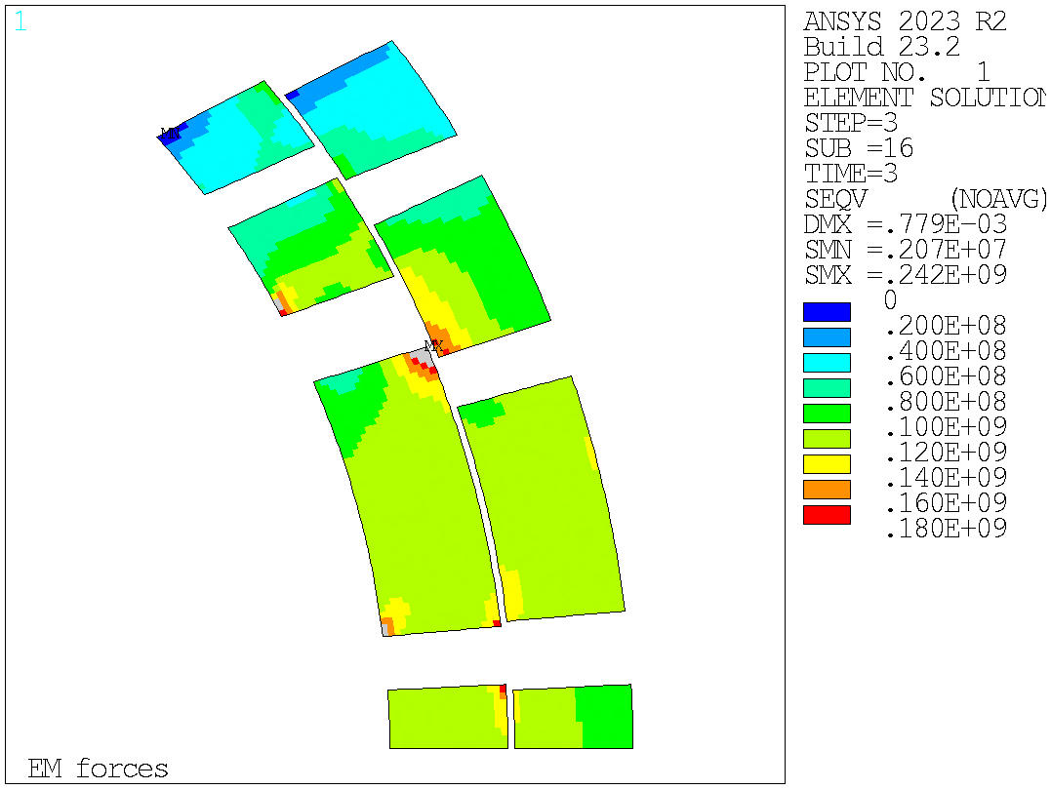
Cross-section study
2. Stresses in a real structure
Version 27
Equivalent stress (element solution) in all the layers of the magnet after powering.
The real mechanical structure is the same used in the previous analysis.
Notes:
Regarding the simulations with a real mechanical structure, I considered just the cases 27 and 60 because they are more critical than the version 17.

Slide 25
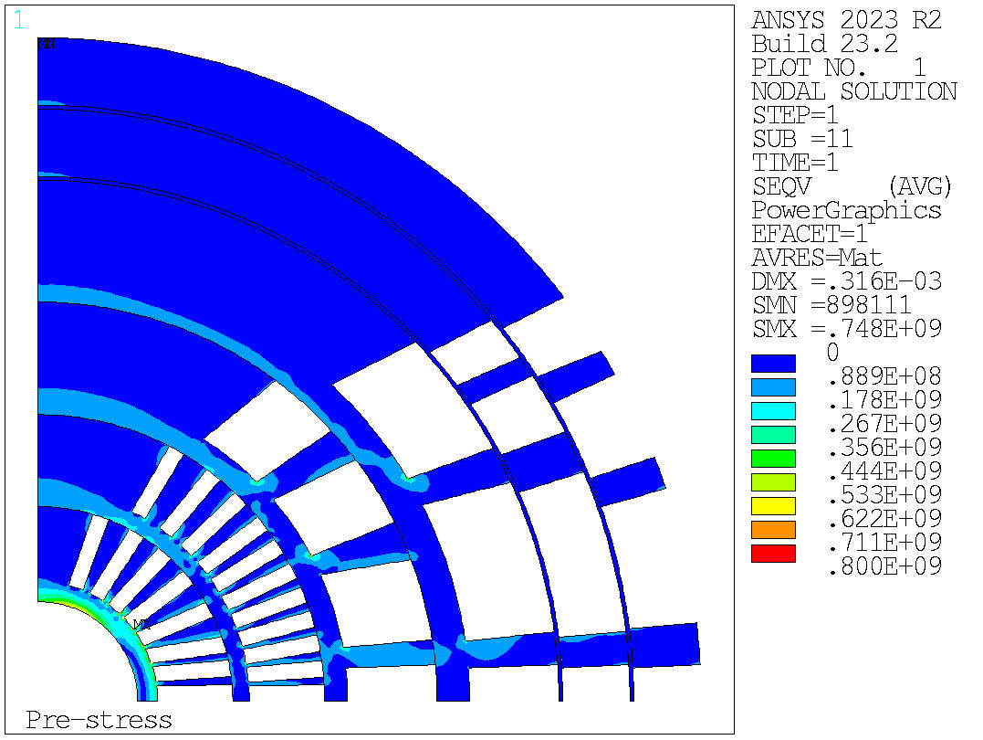
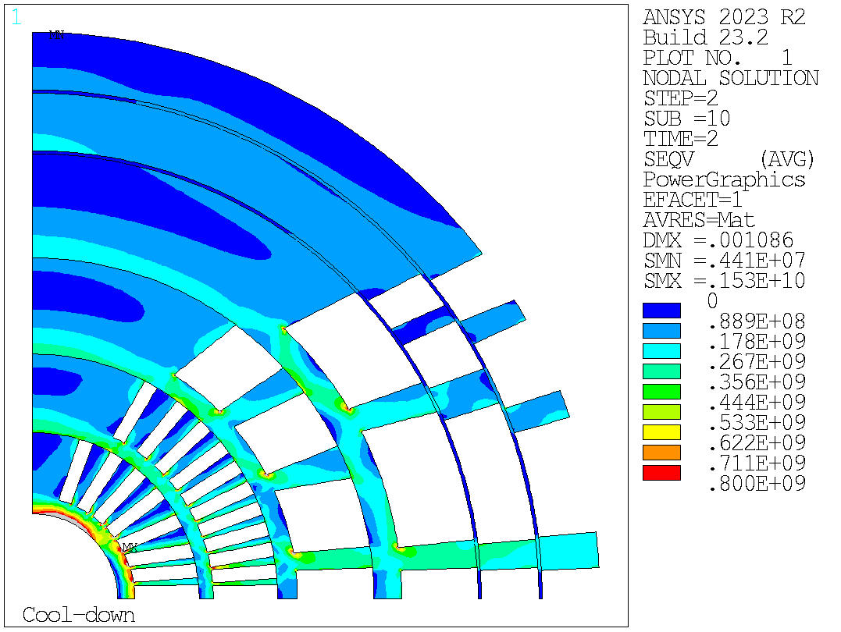
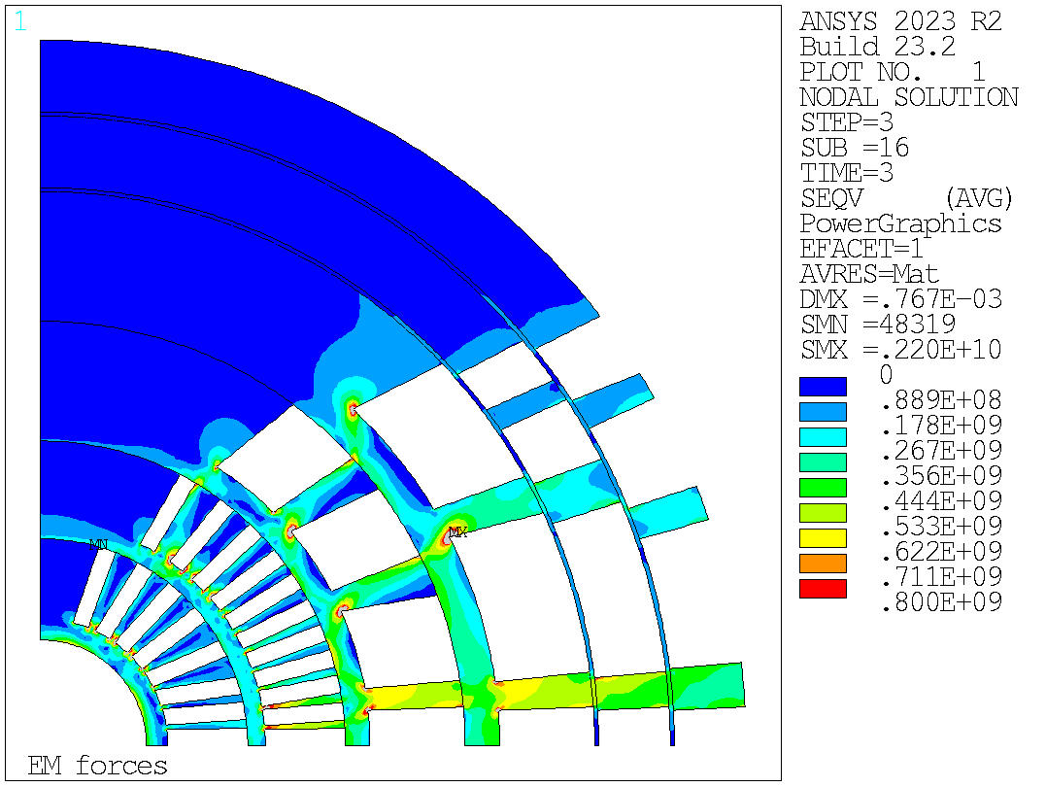
Cross-section study
2. Stresses in a real structure
Version 27
Equivalent stress of the mandrel of the magnet after prestress, cooldown and powering considering the nodal solution.
The real mechanical structure is the same used in the previous analysis.
Notes:
At least an improvement in the spar of the magnet after the powering phase.
Inserire slide 30 e 31 per mostrare meglio dove è localizzato lo stress?

Slide 26
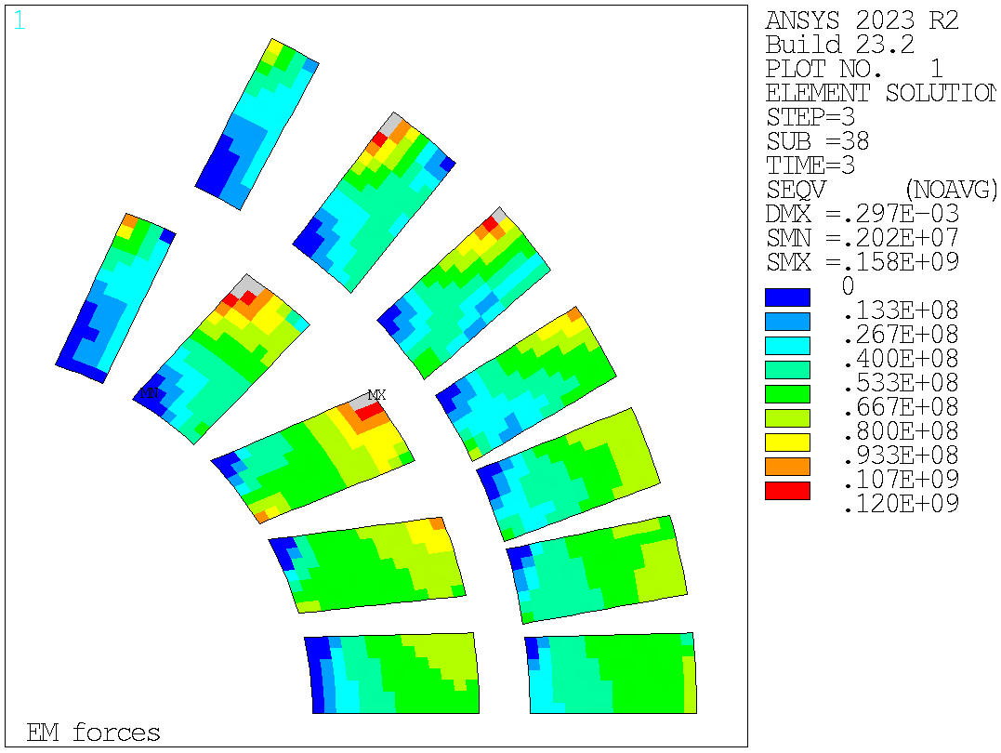
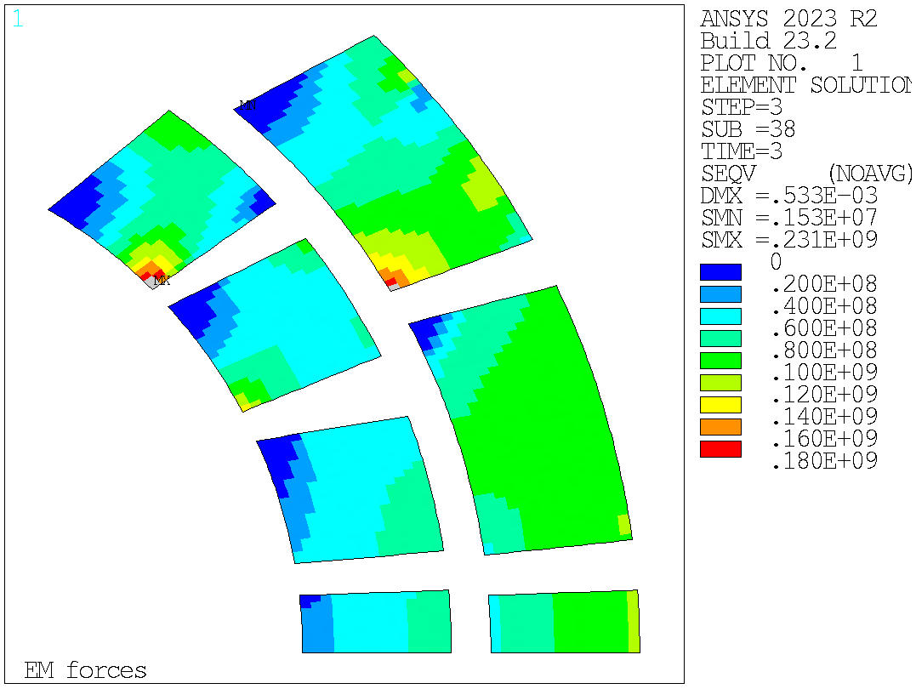
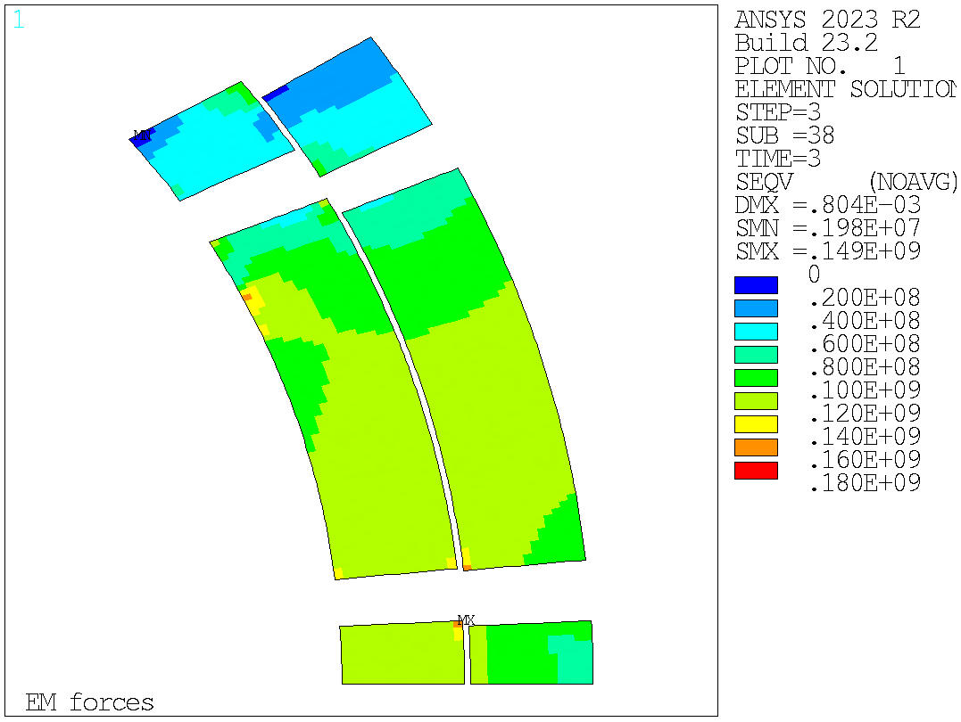
Cross-section study
2. Stresses in a real structure
Version 60
Equivalent stress (element solution) in all the layers of the magnet after powering.
The real mechanical structure is the same used in the previous analysis.

Slide 27
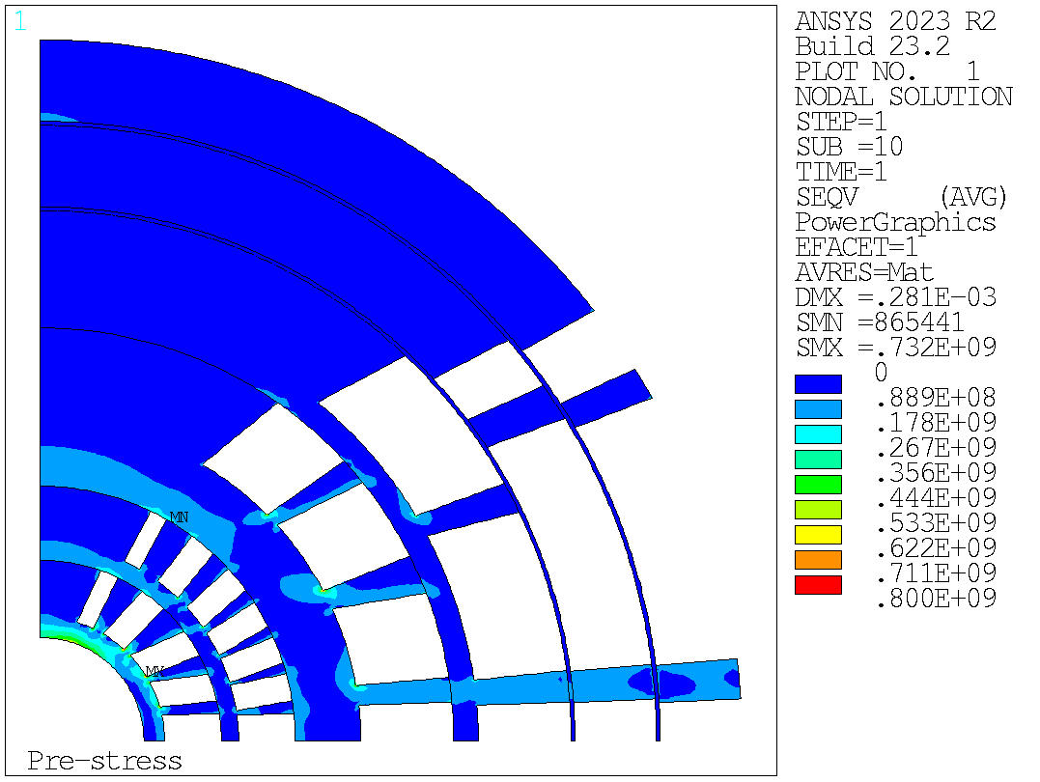
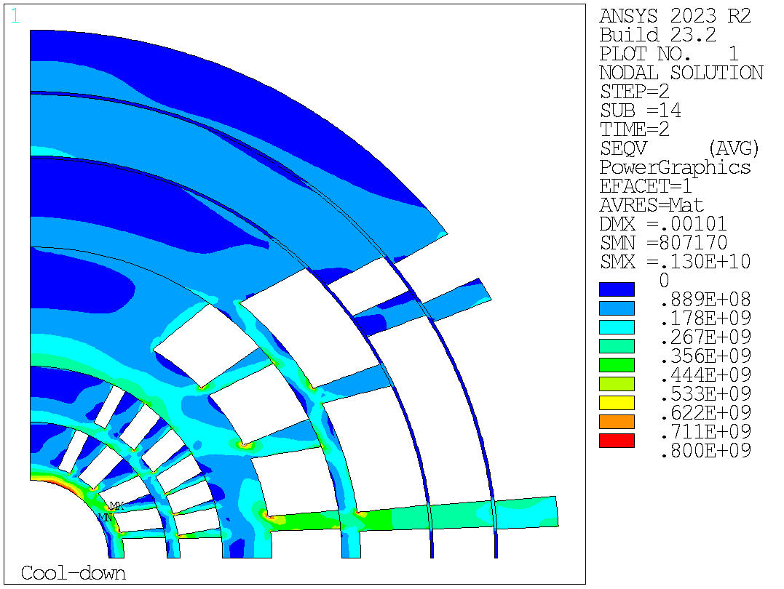
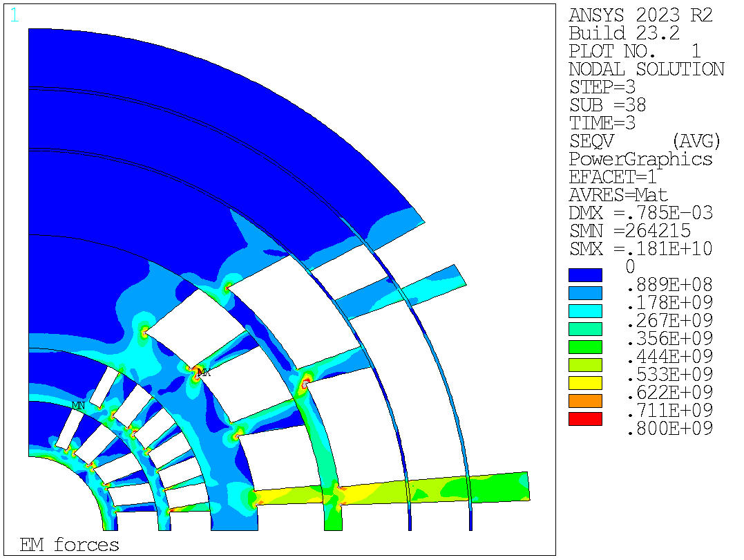
Cross-section study
2. Stresses in a real structure
Version 60
Equivalent stress of the mandrel of the magnet after prestress, cooldown and powering considering the nodal solution.
The real mechanical structure is the same used in the previous analysis.
Notes:
In this case, we have a reduction of the maximum equivalent stress value than the case with the version 27 but still high, while the grey area seems to be better than before.

Slide 28




Cross-section study
3. Cross-section of REBCO coated conductors
Preliminary analysis with REBCO coated conductors in the insert of the magnet.
Assumptions:
  Each STAR® wire is considered as a current line (in the ROXIE program)
  The 6 around 1 cable is modeled as 6 current lines distributed in a circle.
  (STAR = strand, 6 around 1 = cable)
Notes:
Aggiungere slide con cross section e margine
CAMBIARE LA CROSS SECTION + MARGINE?

Slide 29


Cross-section study
3. Cross-section of REBCO coated conductors
Cross-section where the HTS conductors are 6 around 1 cables. The LTS conductors are the same shown before.
Margin
HTS - REBCO | LTS1 | LTS2
80.3% | 81.5% | 80.4%

Slide 30
Table of contents
Introduction
Assumptions
Conductor material properties
Element solution for stresses
Structural limits
Rigid structure vs Real structure
Structure design
Components description
Cross-section results in a rigid structure
Structure design optimization
Stress results with optimized key position
Cross-section study
Rigid cross-section comparison
Stresses in a real structure
Cross-section of REBCO coated conductors
Conclusion

Slide 31
Conclusion
The equivalent stresses evaluted in the HTS and LTS conductors have shown reasonable results; however, the real mechanical structure requires more investigation in order to reduce the high stresses in the spar and in the ribs of the mandrel in layers 1 and 2.
Other possible cross-sections are currently under studying in order to find a balance between the mechanical performances and the quench protection of the magnet. A more detailed examination taking into account a real mechanical structure needs to be done.
Regarding the analysis of the REBCO coated conductor insert, an optimized cross-section for the field quality and for the quantity of conductors utilized is under investigation.
Notes:
Other conclusion?

Slide 32
Acknowledgements
US MDP (in particular, the “20 T working group”)
  LBNL: D. Arbelaez, E. Anderssen, L. Brouwer, M. Naus, L. Garcia Fajardo, J.L. Rudeiros Fernandez, M. Juchno, S. Prestemon, T. Shen, R. Teyber, X. Wang
  FNAL: G. Ambrosio, M. Baldini, E. Barzi, S. Gourlay, V. Kashikhin, V. Marinozzi, I. Novitski, G. Velev, A. Zlobin
  NHMFL: L. Cooley, D. Larbalestier
  BNL: K. Amm, M. Anerella, J. Cozzolino, R. Gupta, F. Kurian, B. Yahia
Contributions from
  E. Rochepault (CEA): 20 T dipole block design
  D. Martins Araujo (PSI): 20 T dipole quench protection
  B. Bordini (CERN)
  F. Niccoli (UNICAL)

Slide 33
Thanks for your attention!
Any question?

Slide 34
Back-up slides

Slide 35



Structure design
4. Stress results with optimized key position
Equivalent stress (nodal solution) of the spar in the first layer
This results are obtained considering the vertical key at 70 mm and the horizontal one at 60 mm.

Slide 36


Structure design
4. Stress results with optimized key position
Equivalent stress of the ribs in layers 1-2 after powering considering the nodal solution.

Slide 37

Structure design
4. Stress results with optimized key position
A possible way to reduce the peak stress in layers 3 – 4 could be split the last conductor block in layer 4.
The field quality needs to be optimized for this solution.
Old version without splitting the block
New version with the split block
Notes:
Just a comparison between layers 3-4 but, in general the stresses are lower than the previous solution.

Slide 38



Rigid cross-section study
1. Cross-section comparison
Other possible cross-sections for the dipole design are currently under investigation. The displacement results of the mechanical analysis performed considering an infinitely rigid structure are shown.
Displacement in HTS conductors.
v17 | v27 | v60

Slide 39



Rigid cross-section study
1. Cross-section comparison
Other possible cross-sections for the dipole design are currently under investigation. The displacement results of the mechanical analysis performed considering an infinitely rigid structure are shown.
Displacement in LTS conductors.
v17 | v27 | v60

