Slide 1
ANSYS Heterogeneous Models for Cosine-Theta Dipoles
Alessio D’Agliano, PhD student 04/30/2024
Advisors: E. Barzi (FNAL), S. Donati, V. Giusti (Pisa University)

Slide 2
OUTLINE
Introduction – Results on previously obtained Nb₃Sn 10-stack models, Homogenous vs. Heterogenous
Bi-2212 insert model – Homogeneous vs. Heterogeneous Magnetic and Mechanical analysis
Conclusions
Next steps

Slide 3
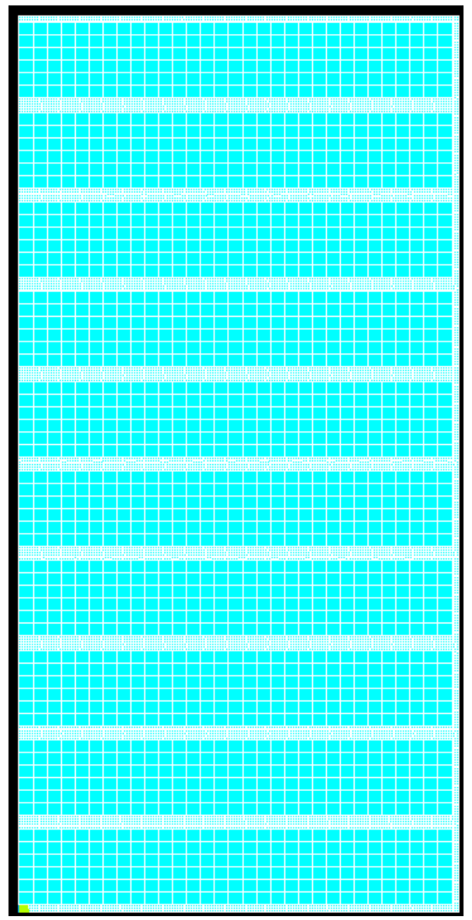
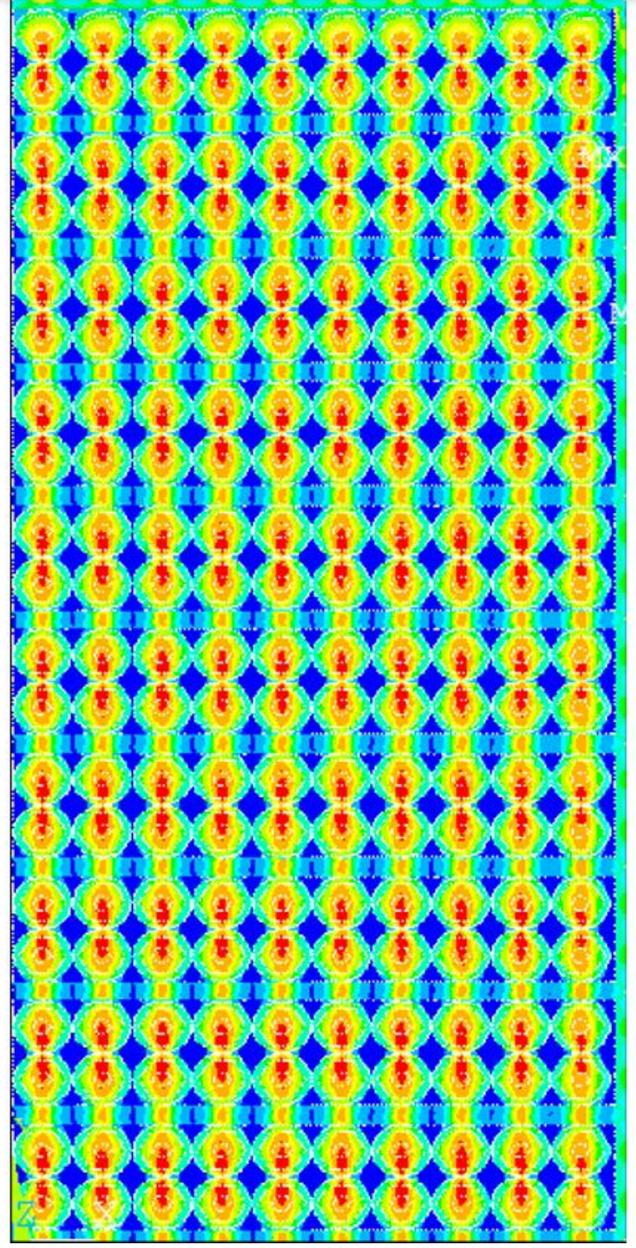


ANSYS Homogeneous vs. Heterogeneous Model Nb₃Sn 10-Stack
E. Barzi et al., “Measurements and Modelling of Mechanical Properties of Nb₃Sn Strands, Cables and Coils”, IEEE Trans. on Appl. Supercond., V. 29, no. 5, Art. no. 8401808, Aug. 2019
Uniform Pressure Applied, MPa | Heterogeneous model Max internal Equivalent stress, MPa
40 | 87
80 | 174
120 | 260
Meso-mechanical model for Nb₃Sn Rutherford cable
Nb₃Sn, insulation, and epoxy: linear elastic materials; Cu: elastic, perfectly plastic behavior.
Used PLANE182 element with generalized plane strain option, for homogeneous non-zero strain in the axial direction.
HOMOGENOUS
HETEROGENEOUS
Equivalent stress
Orthotropic transversally isotropic model, i.e. macro mechanical model of a homogenous material with anisotropic properties.
Rutherford cable with elementary cell

Slide 4
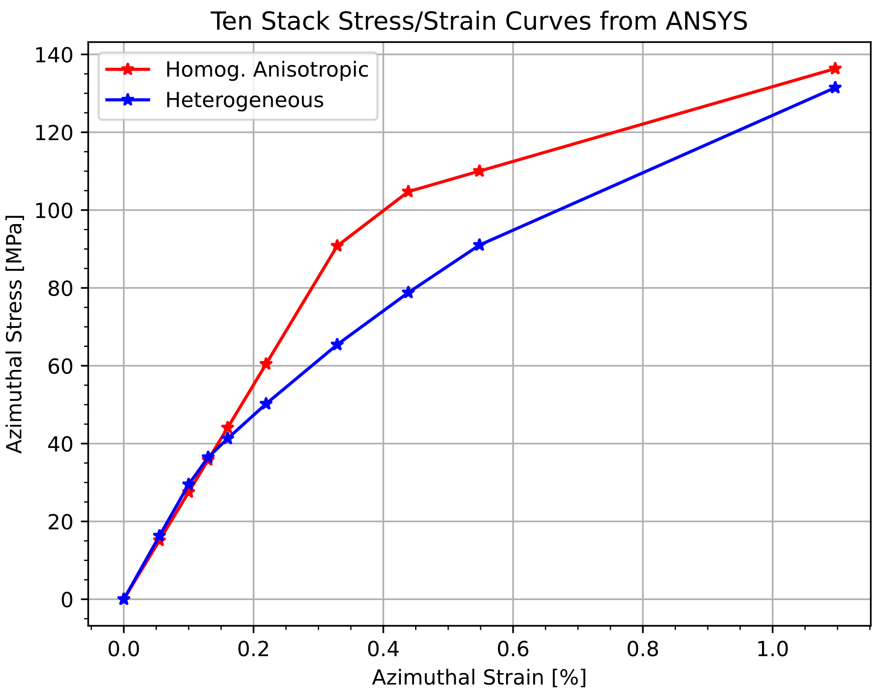
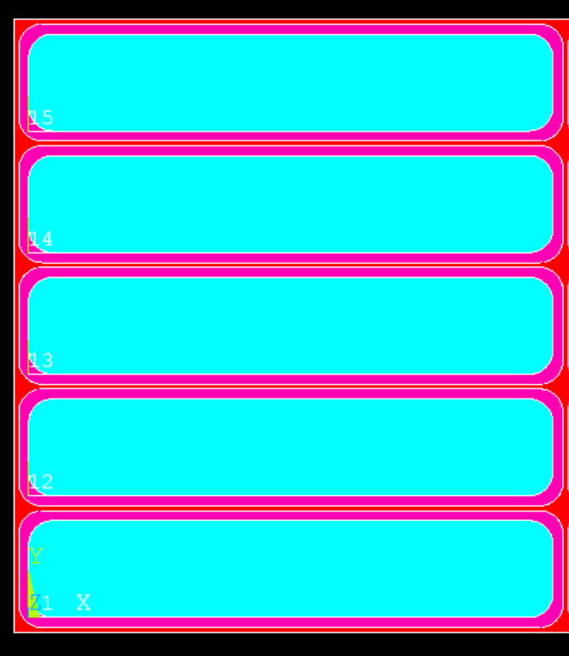
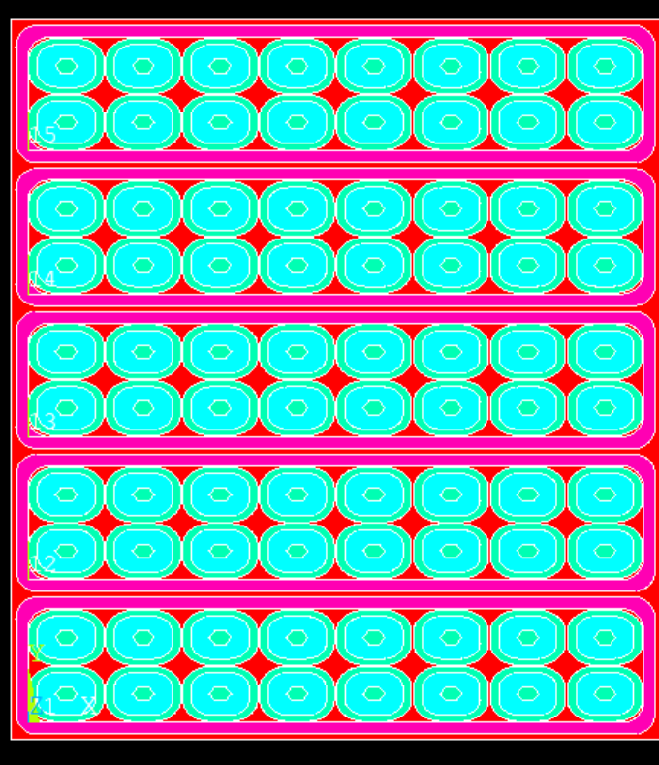
Bi2212 Ten Stack ANSYS Analysis and Comparison
The ten-stack model (5x2) with detailed heterogeneous cables was used for the compression test in ANSYS.
Imposed displacement on the top surface.
Symmetry and displacement constrain were inserted as boundary conditions.
300 K
σ = F/B
ε = δ/H
H = 9.1 mm
θ
r
Thermal-Mechanical Properties of Epoxy-Impregnated Bi-2212/Ag Composite
Pei Li, Yang Wang, Arno Godeke, Liyang Ye, Gene Flanagan, and Tengming Shen, Member, IEEE
B = 16.4/2 mm

Slide 5
Main Goal of Heterogeneous Models
FNAL Bi-2212 Insert Coil
Magnetic analysis:
1. Homogeneous model (ROXIE and ANSYS)
2. Heterogeneous Rutherford cable, in the same mandrel geometry
Mechanical analysis:
Homogeneous model (isotropic and anisotropic)
Heterogeneous mechanical model using detailed strand geometry (direct approach)
FEM models for large accelerator magnets are typically homogeneous.
The detailing of the Nb₃Sn Rutherford cable and strand improved accuracy in the mechanical analysis of 10-stack models.
The goal is to use strand and cable detailing for the FNAL Bi-2212 insert to verify whether we can similarly improve the accuracy of the mechanical analysis.

Slide 6
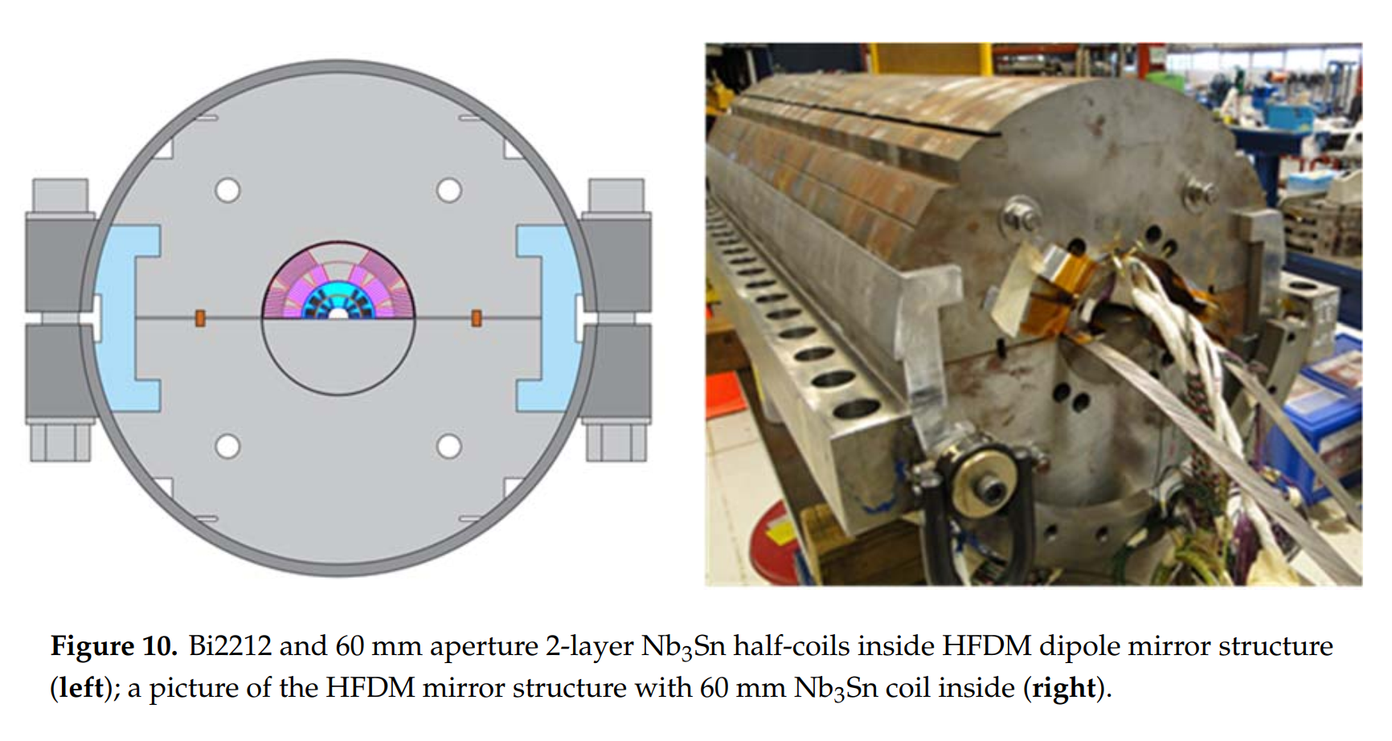
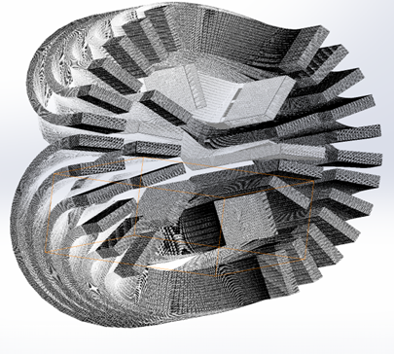
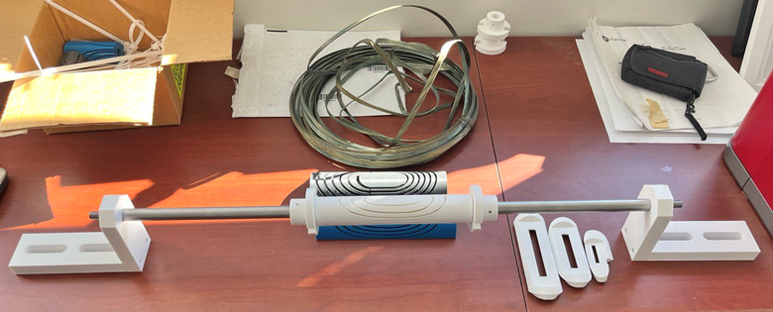
Context – Bi-2212 Dipole Insert within Nb₃Sn Outer Coils
“Conceptual Design of a HTS Dipole Insert Based on Bi-2212 Rutherford Cable”
Alexander V Zlobin , Igor Novitski and Emanuela Barzi

Slide 7
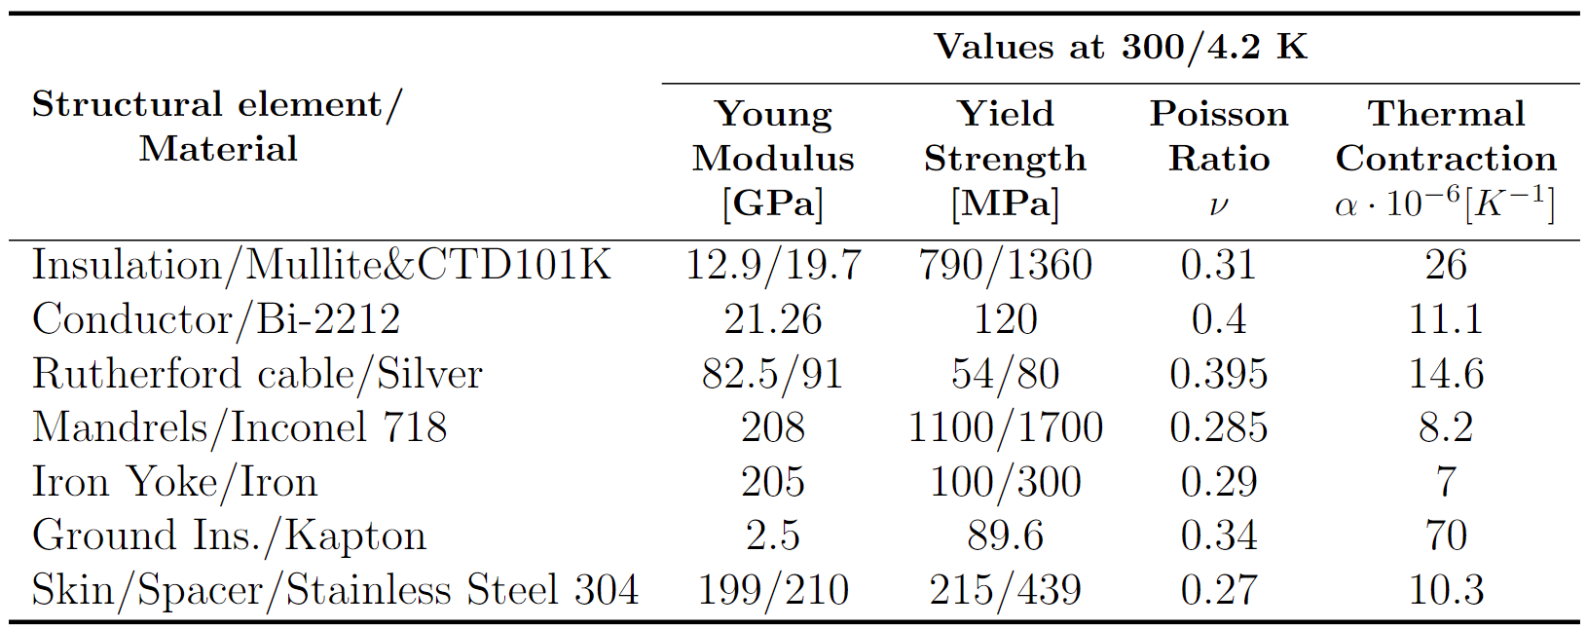
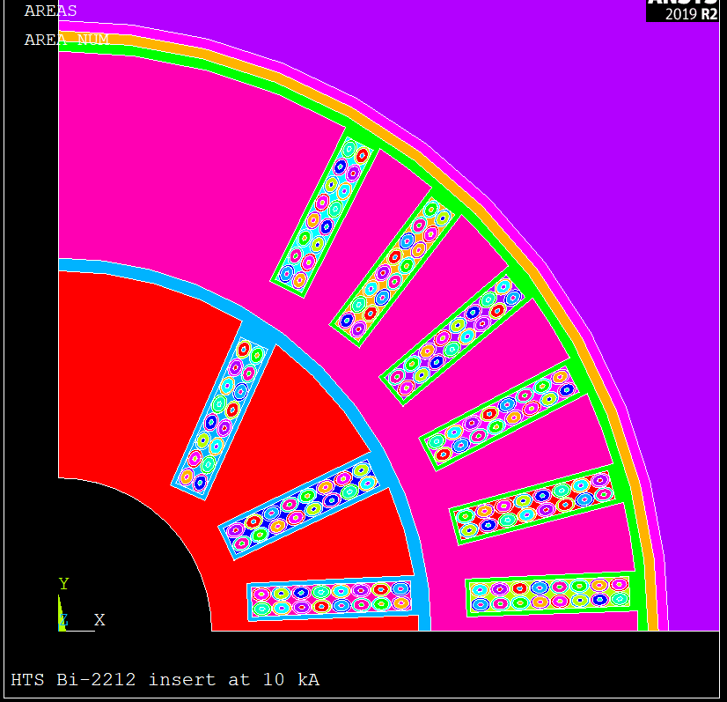
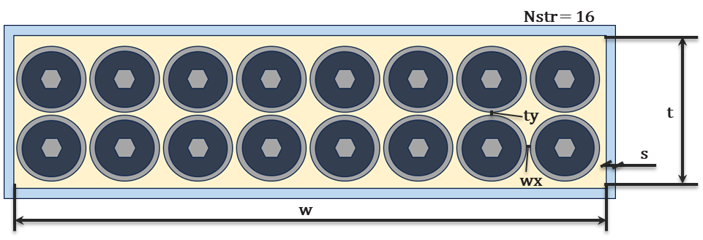

HTS Insert FEM model – Geometry and Mat. Properties
Inconel
Iron Yoke
Stainless Steel
https://cds.cern.ch/record/1973682/files/arXiv:1501.07100.pdf
Kapton
https://trc.nist.gov/cryogenics/materials/materialproperties.htm
Bi-2212 + Silver Rutherford cable
l
R
Epoxy + Mullite
ts
r
Cable dimensions:
w = 7.8 mm t = 1.44 mm r = 0.27 mm ts = 0.08 mm
s = 0.15 mm R = 0.35 mm l = 0.1 mm wx = 0.02 mm
R_{fillet} = 0.1 mm

Slide 8
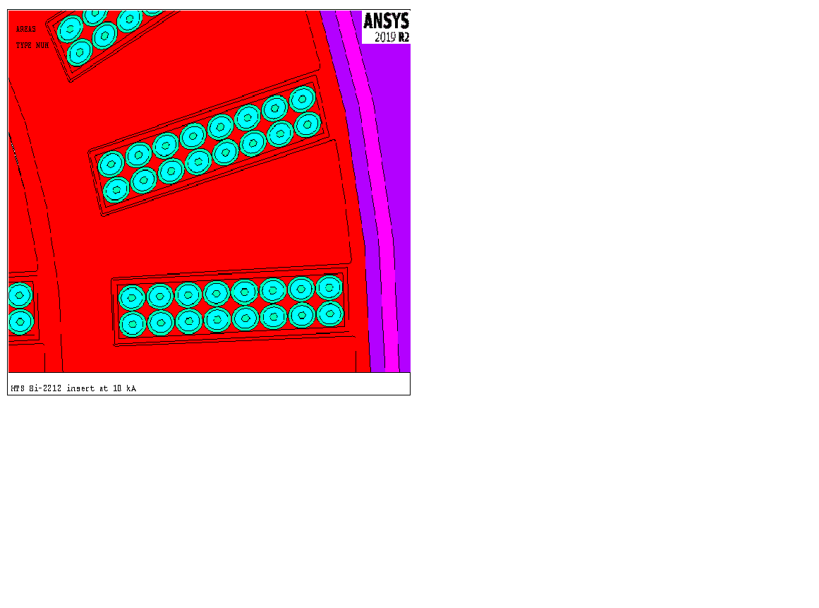
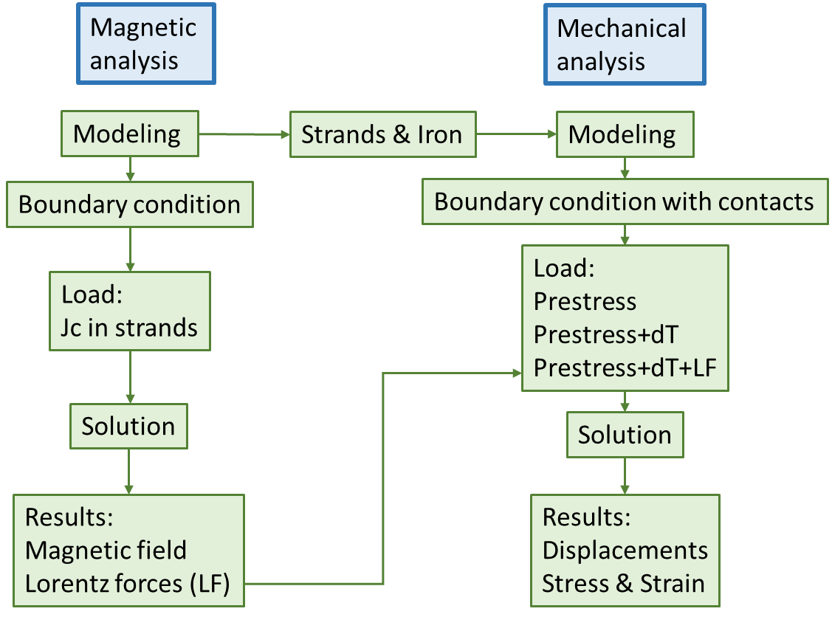
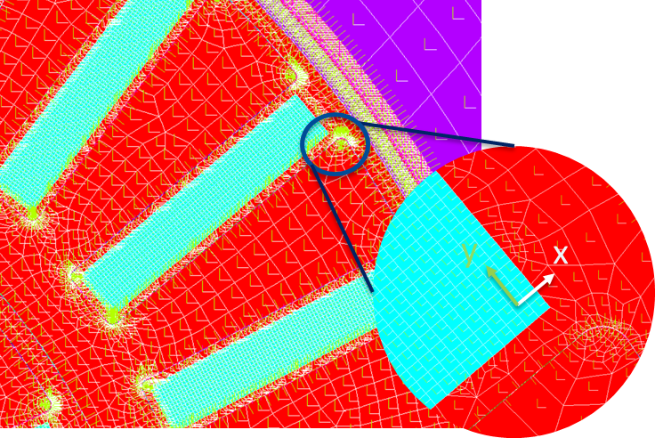
HTS Insert FEM Model – Logic of the Simulation
The logic of the simulation is shown in detail in the scheme:
All the material rheological behavior is elastic perfectly plastic isotropic material and considered homogeneous.
Fillets radius: r_{fill} = 0.1 mm
Composite Bi-2212 Rutherford cable material properties traduced with the anisotropic definition:
Ex, Ey, Ez, νxy, νyz, νxz, Gxy.
Fillets were introduced at the bottom of every groove to allow for a more realistic behavior of the contacts.
The Young Modulus hardening value is considered 10% incremented with respect to the warm value for the Bi-2212 conductors. For the other materials, cold temperature values were taken from the literature.

Slide 9
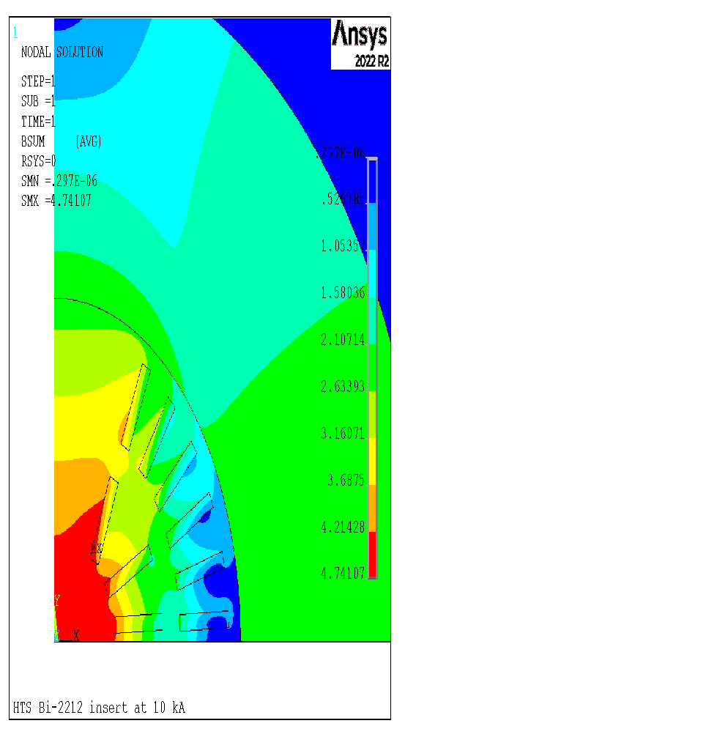
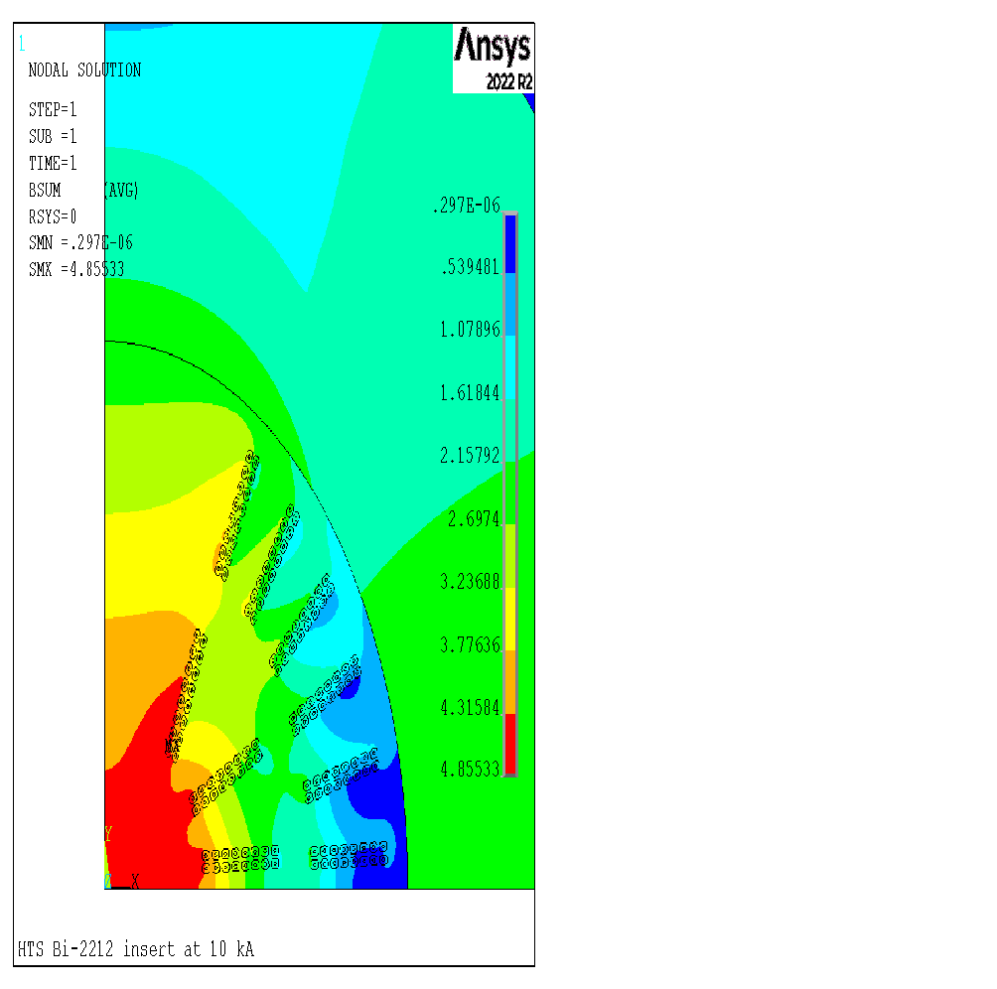
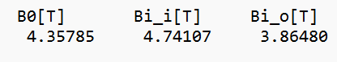
HTS Insert Coil – Magnetic Field comparison
The magnetic field in the bore is almost the same in both simulations, with negligible differences between the homogeneous strand and the heterogeneous one.

Slide 10
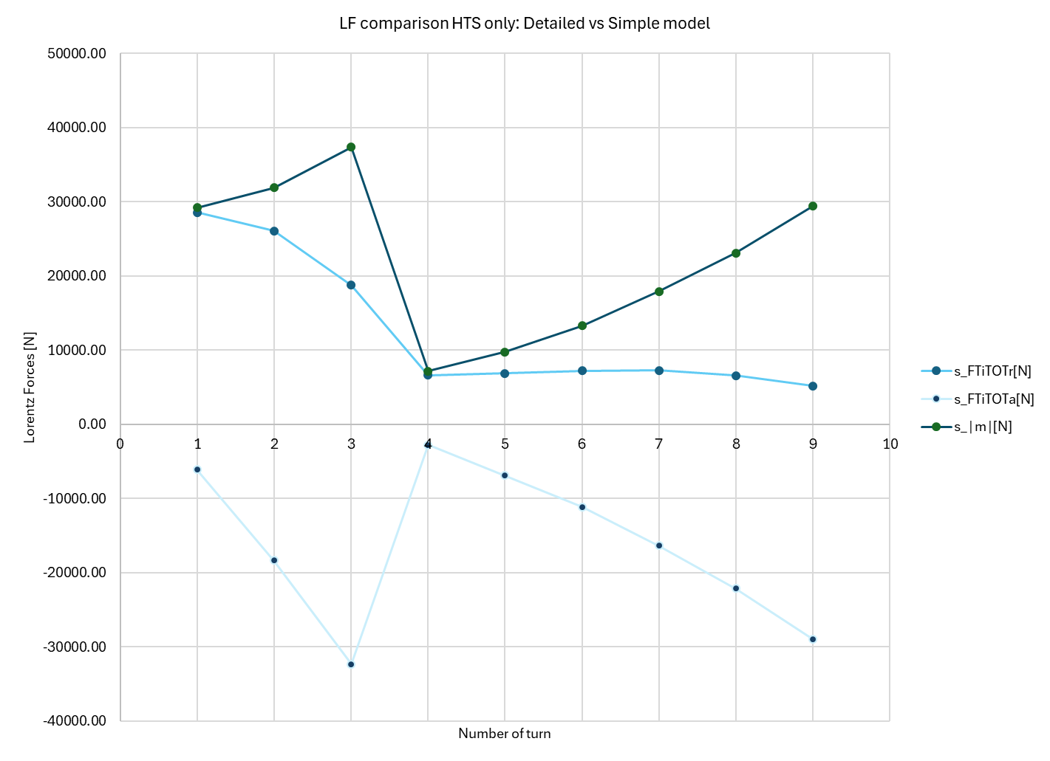
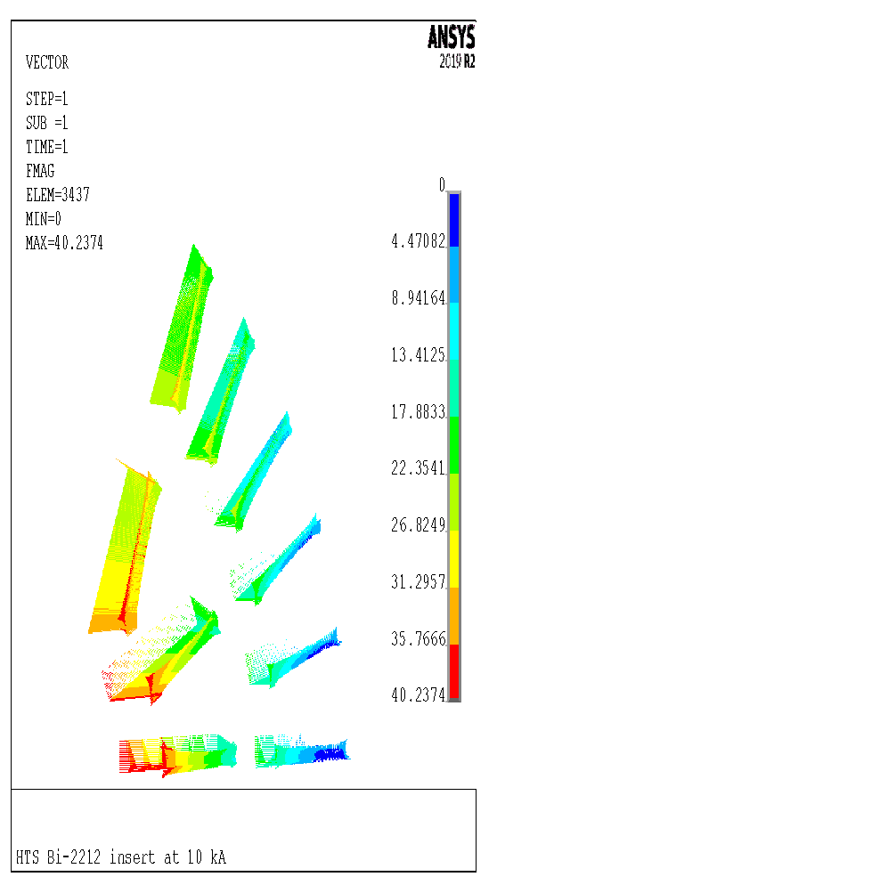
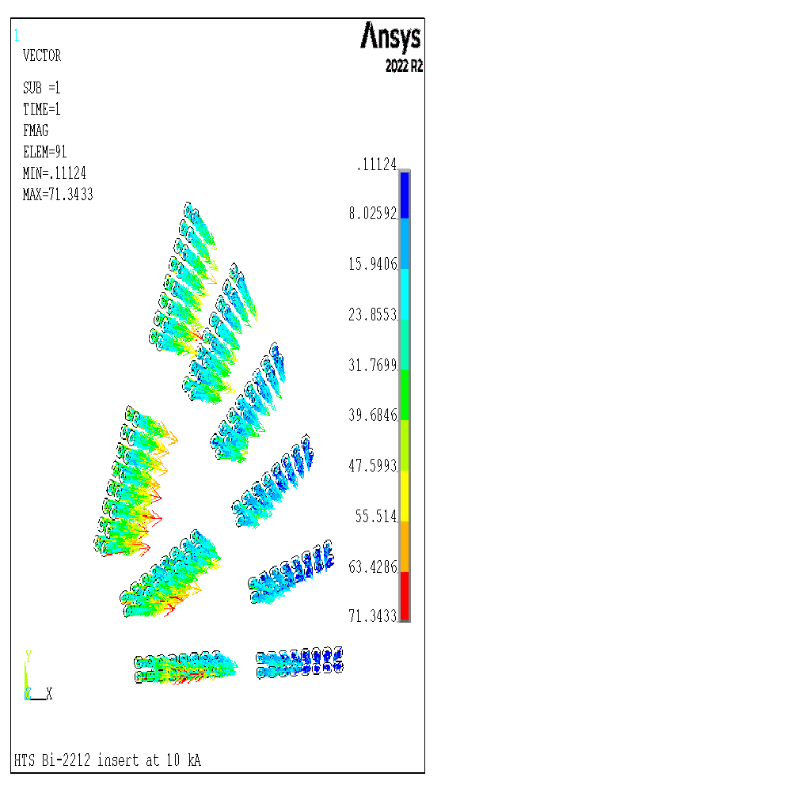
HTS Insert Coil - Lorentz Force Comparison in the Turns
LFs inside the turn are identical in both models (differences are negligible compared to the module).
However, the LF densities in the ANSYS plot are different due to noticeably smaller conductor areas.
Both simulations ran with the same value for mesh dimension.
LFs homogeneous model model
LFs heterogeneous model
LF comparison: Hom. Vs Het. model
[N/m]
[N/m]
9
8
Lorentz Forces Sum [N/m]
7
6
3
5
2
4
1
Number of turn

Slide 11
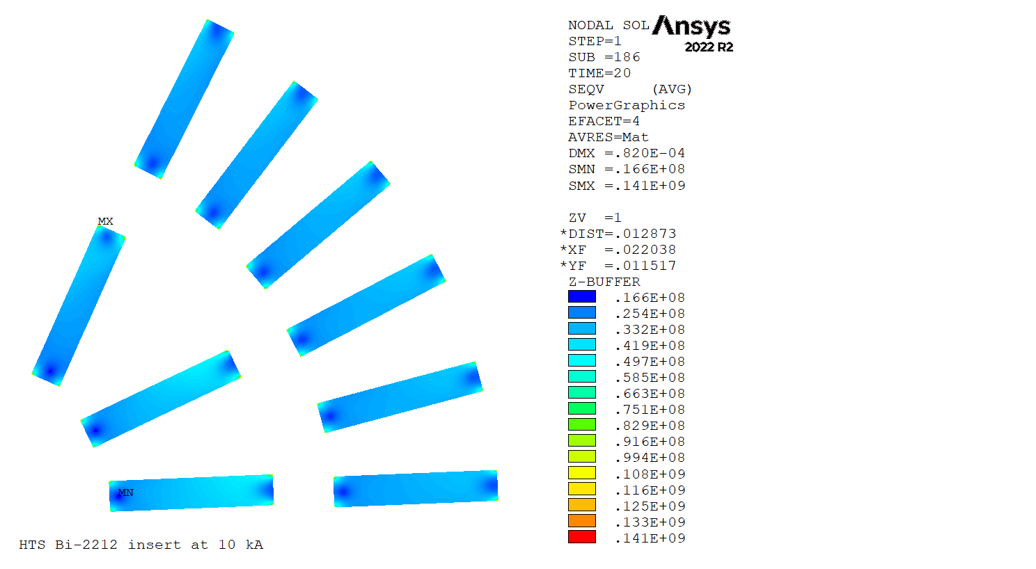
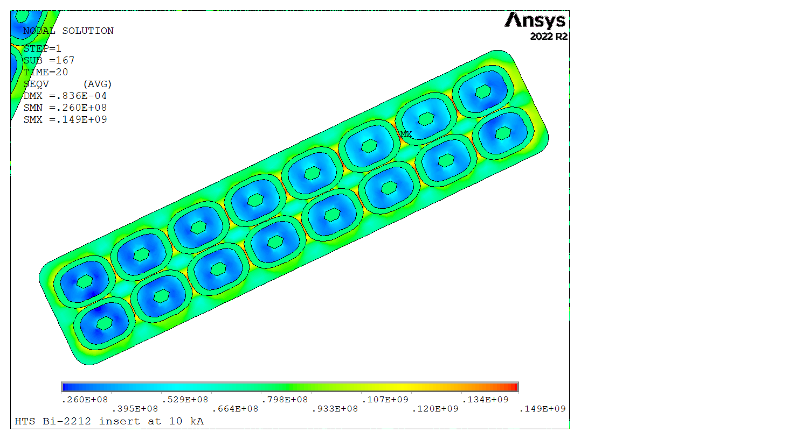
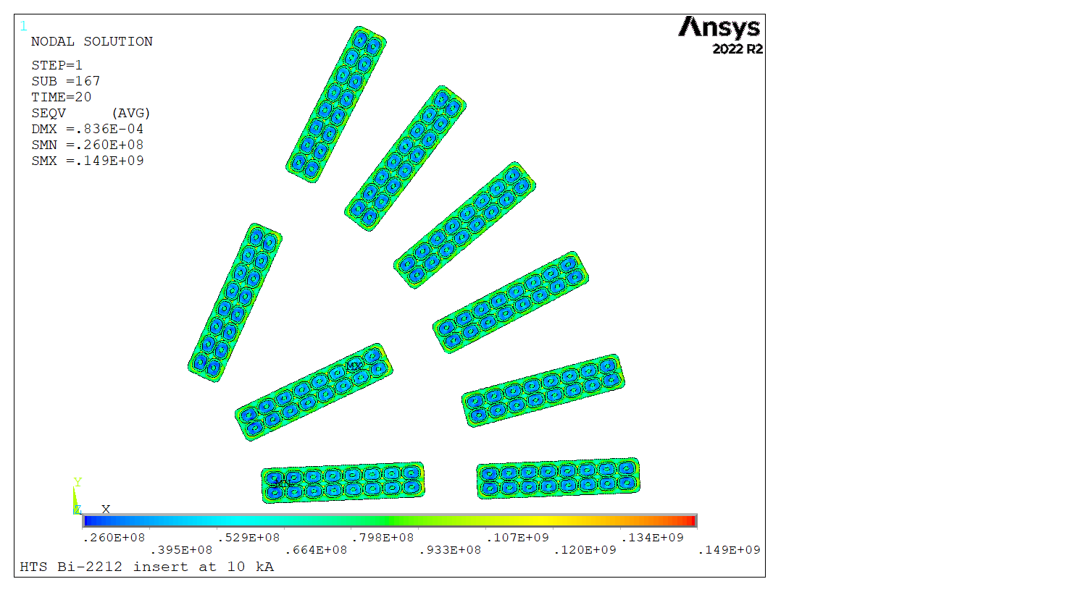
Equivalent Stress in the Coils – 3rd Load Step Comparison
Max stress in the epoxy region: 149 MPa
Max stress in the edges: 141 MPa
Max equivalent stress in Bi-2212: 69 MPa
The highest eq. stress in the heterogeneous conductor is in the epoxy region. In the homogeneous conductor, it is instead at the edge of the cable, which corresponds to the insulation region of the detailed Rutherford cable.

Slide 12
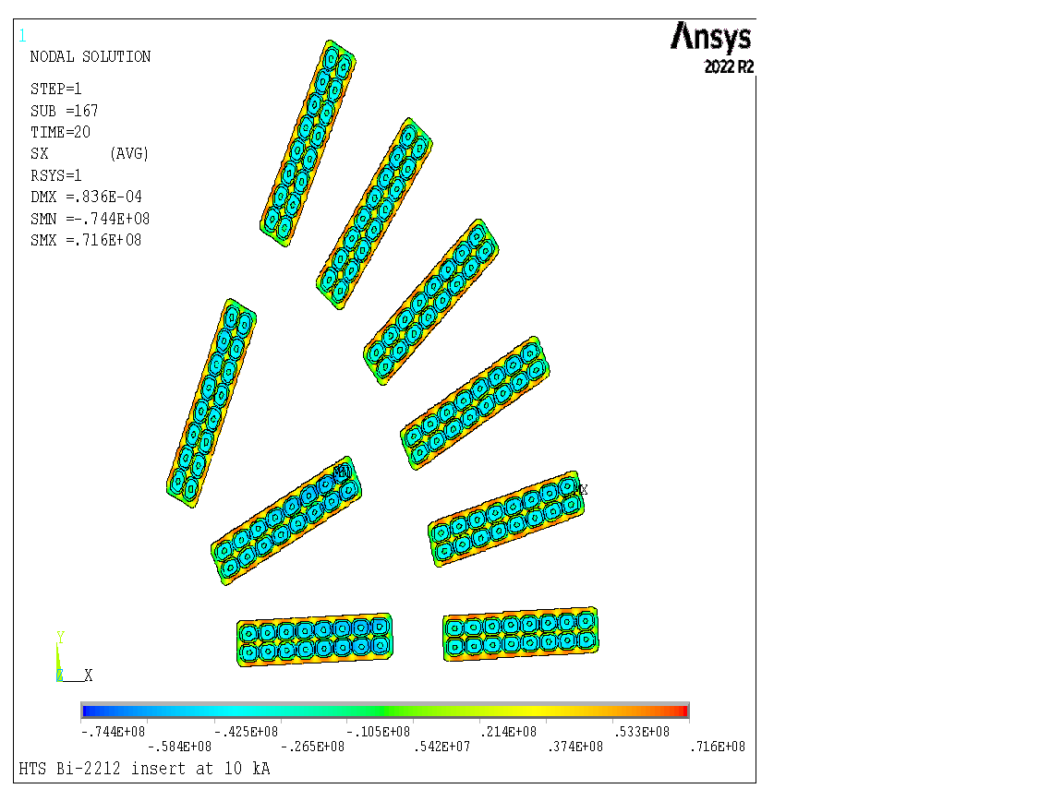
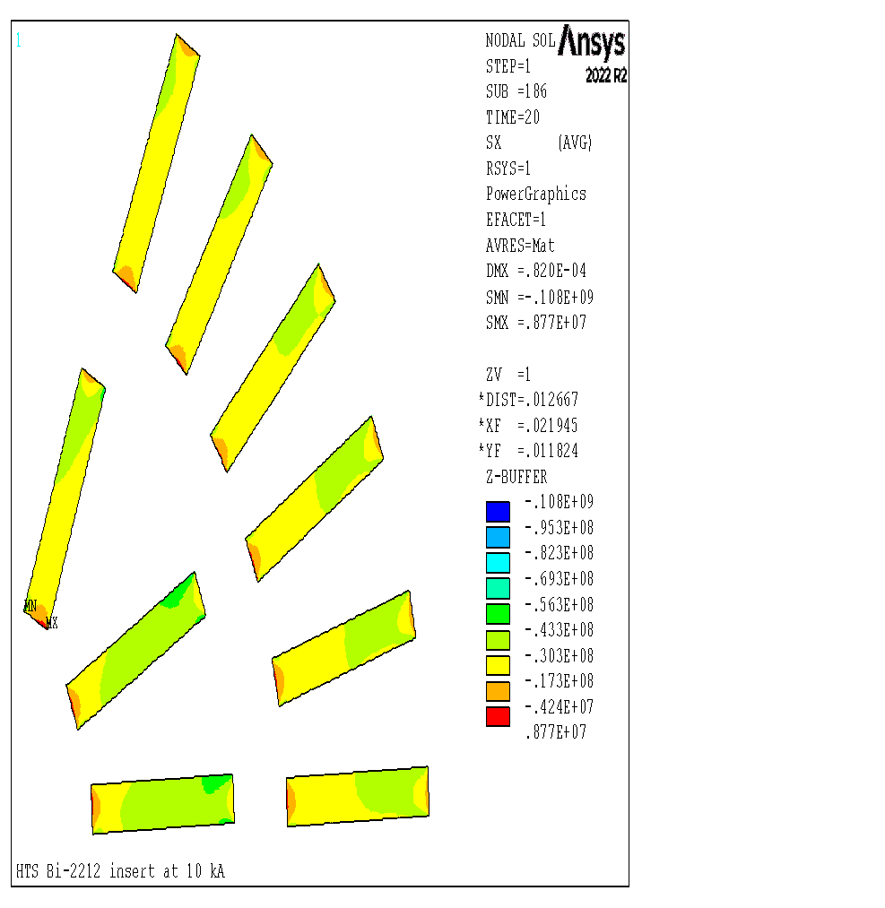

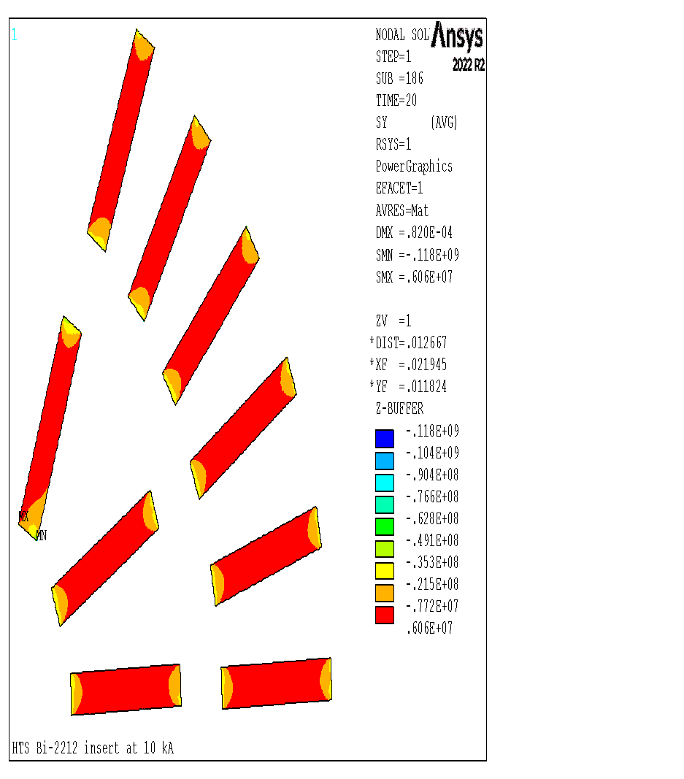

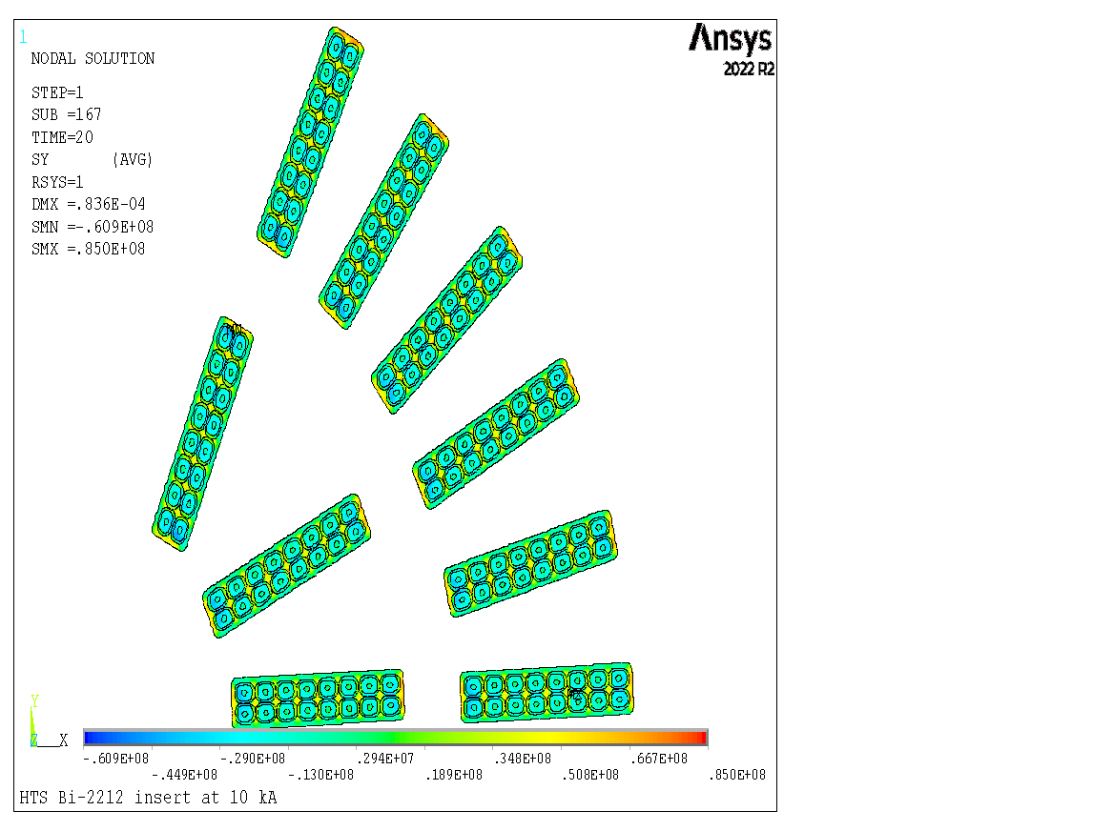
Stresses in the Conductors – 3rd Load-step: Radial, Azimuthal
Homog. Heterog.
Radial 8.8 71.6
(MPa) -108.0 -74.4
Azimuthal 6.1 85.0
(MPa) -118.0 -60.9
------------------------------------------
Δ≈120 Δ≈140
Radial Stress component
Radial Stress component
Azimuthal Stress component
Azimuthal Stress component
Radial and azimuthal stress in the homogeneous anisotropic coil, and the heterogeneous one. Delta (max – min) values differ by 20 MPa between the two models.

Slide 13
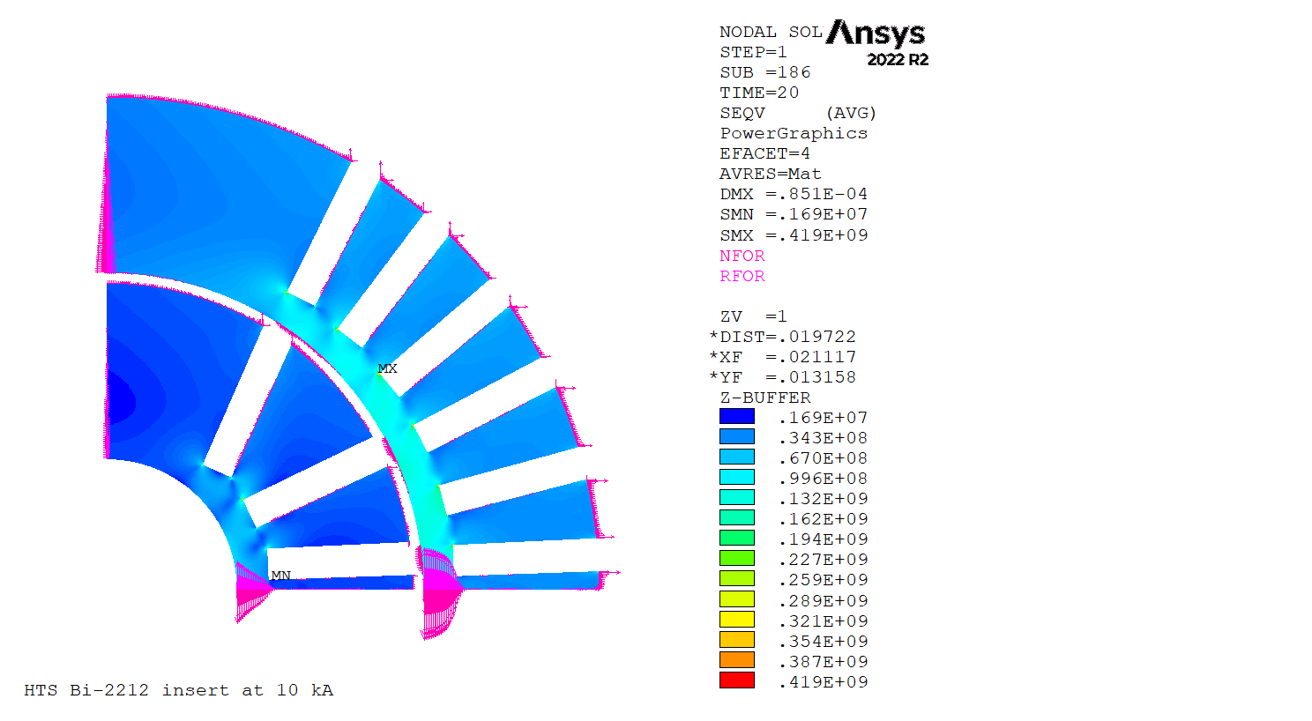
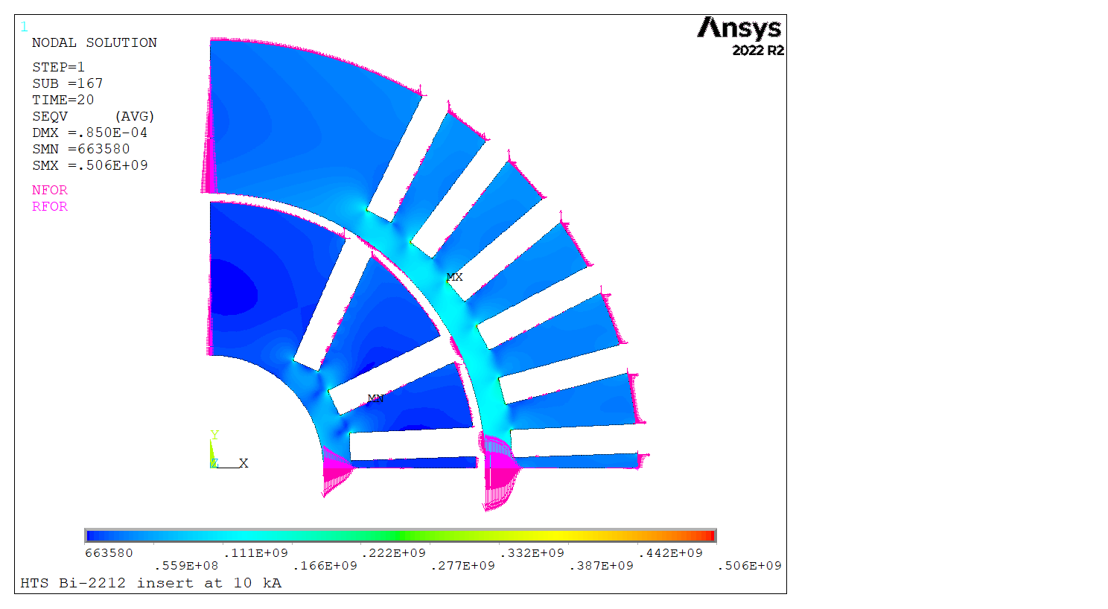
Equivalent Stress in the Mandrels – 3rd Load Step Comparison
Homogeneous model
Heterogeneous
model
In the sub-modeled analysis, the mandrel structure reaches higher stress values at the bottom of the grooves. The plasticity margin is still quite large, and the mandrels maintain elastic behavior.

Slide 14
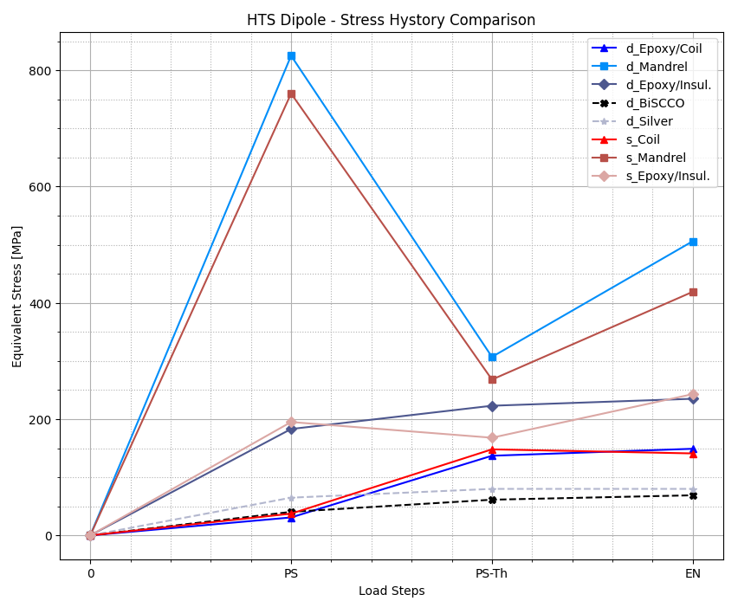
Stress History – Homogeneous and Heterogeneous HTS Insert
Mechanical Analysis results considerations:
Maximum eq. stress for the three load steps of the simulation, with ‘s_’ highlighting the homogeneous model and ‘d_’ the heterogeneous one. The latter shows higher stress states in the structural materials.
The homogeneous model does not meet the HTS threshold of 120 MPa due to edge concentration issues, even if 2L only design. The heterogeneous model shows the same stress profile for the coil epoxy and gives data for Silver and Bi-2212 materials, which remain under 100 MPa.
Remaining structural and former materials don’t reach critical equivalent stresses.
RT assembly
Cool-down
Operation

Slide 15
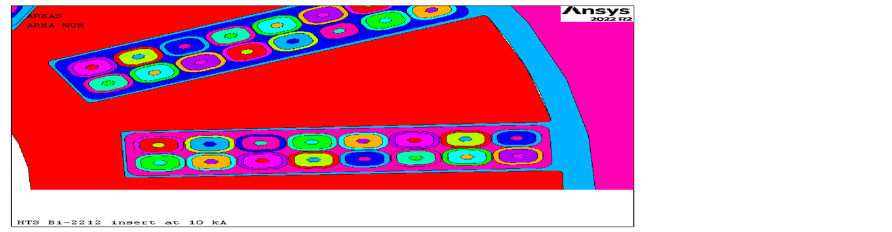
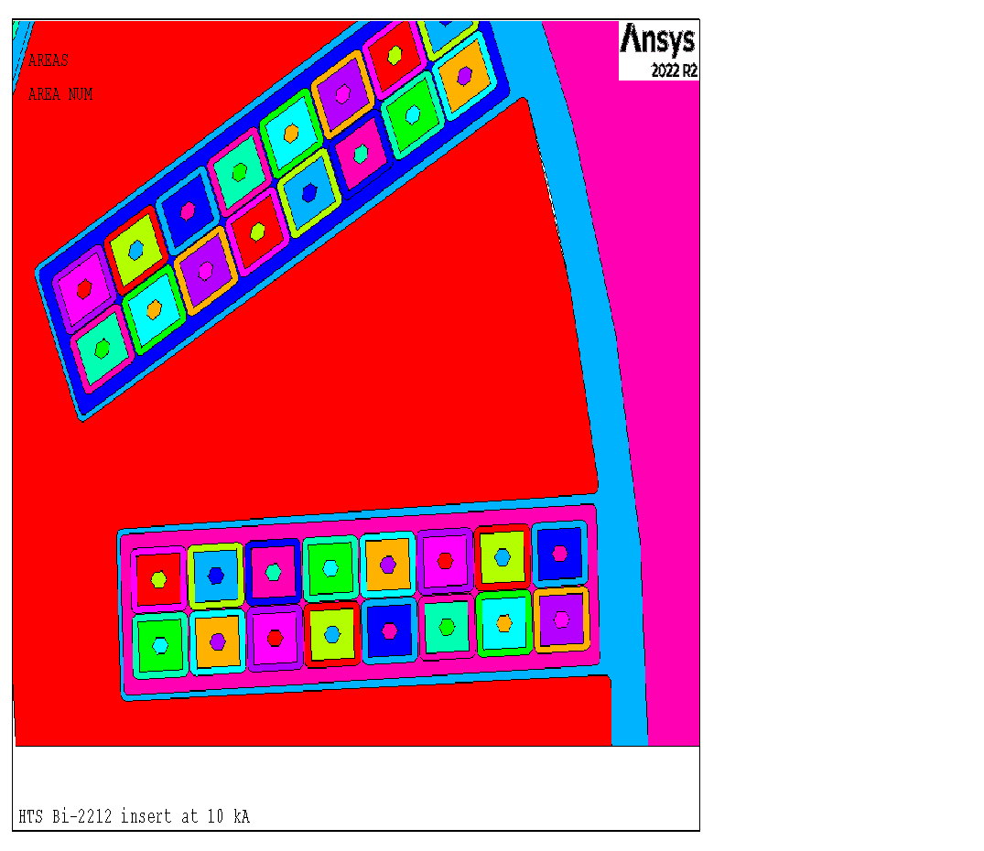
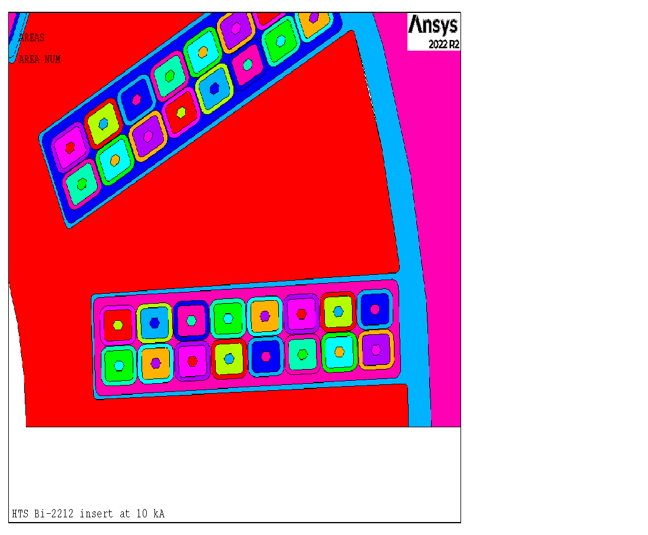

Strand Shape Parameter Stress Sensitivity – 3rd Load Step
The most important difference is in the Bi-2212 elements. The more conservative configuration is a cable with a shape parameter of 0.7.
 |  |  | Structural Material
Shape Parameter | 0 | (MPa) | Bi-2212 | Coil Epoxy | Insu. Epoxy | Silver | Mandrel | Full Coil
 |  | max | 86.3 | 134 | 235 | 80 | 504 | 134
 |  | min | 25.1 | 57.7 | 69.3 | 68.3 | 0.68 | 25.1
 | 0.3
 |  | max | 67.7 | 141 | 234 | 80 | 504 | 141
 |  | min | 25.4 | 62.8 | 69.1 | 68.3 | 0.68 | 25.4
 | 0.7
 |  | max | 69 | 149 | 235 | 80 | 506 | 149
 |  | min | 26 | 60.8 | 67.9 | 68.3 | 0.66 | 26

Slide 16
Conclusions
Comparisons between homogeneous and heterogeneous magnetic models, including magnetic field and Lorentz forces, have been made. Results show almost no differences between the magnetic field distribution and intensity. The Lorentz forces sum is also similar, but forces density differs between the two models.
The code output has been investigated for the three load cases (Pre-stress, Thermal load, and Energization). A plot of all components' stress histories has been made for homogeneous and heterogeneous analyses. Structural components are more stressed in the sub-modeled geometry. Detailed strands and cables with fillets meet the Bi-2212 material limits and give more information about the conductor’s elements. With detailed modeling, stresses in the Bi-2212 critical elements are almost 51% less than stresses mapped with the homogeneous model.
Stress sensitivity concerning the Strand Shape parameter has been done, and results have been collected in a table. Results differ mostly in the Bi-2212 area of the conductor since Silver reaches plasticity. The most conservative and realistic 0.7 shape parameter was set for the model comparison.
Finally, I want to thank Igor Novitski for the valuable suggestions and ideas given during the realization of this analysis.

Slide 17
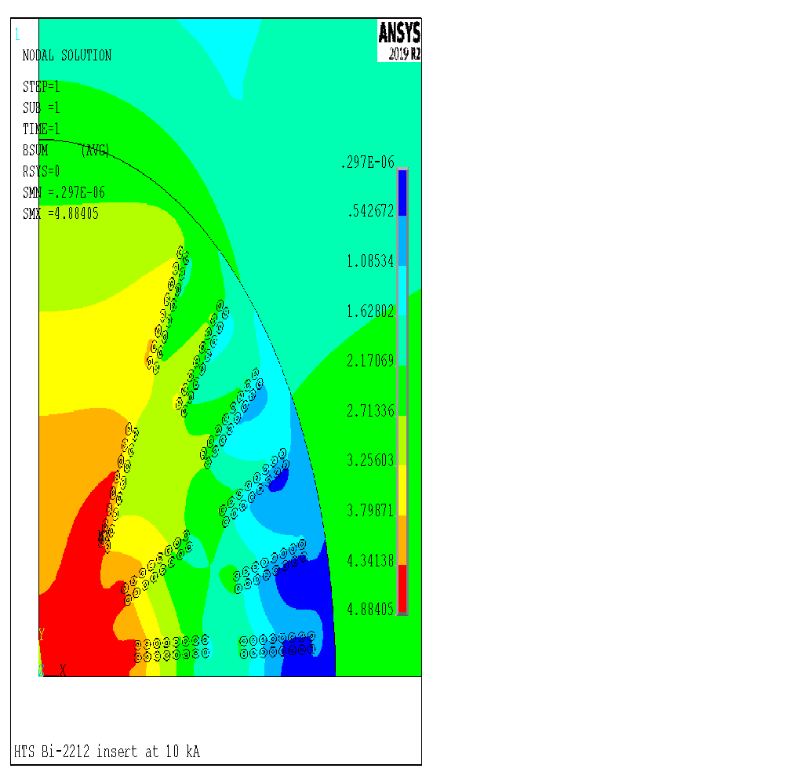
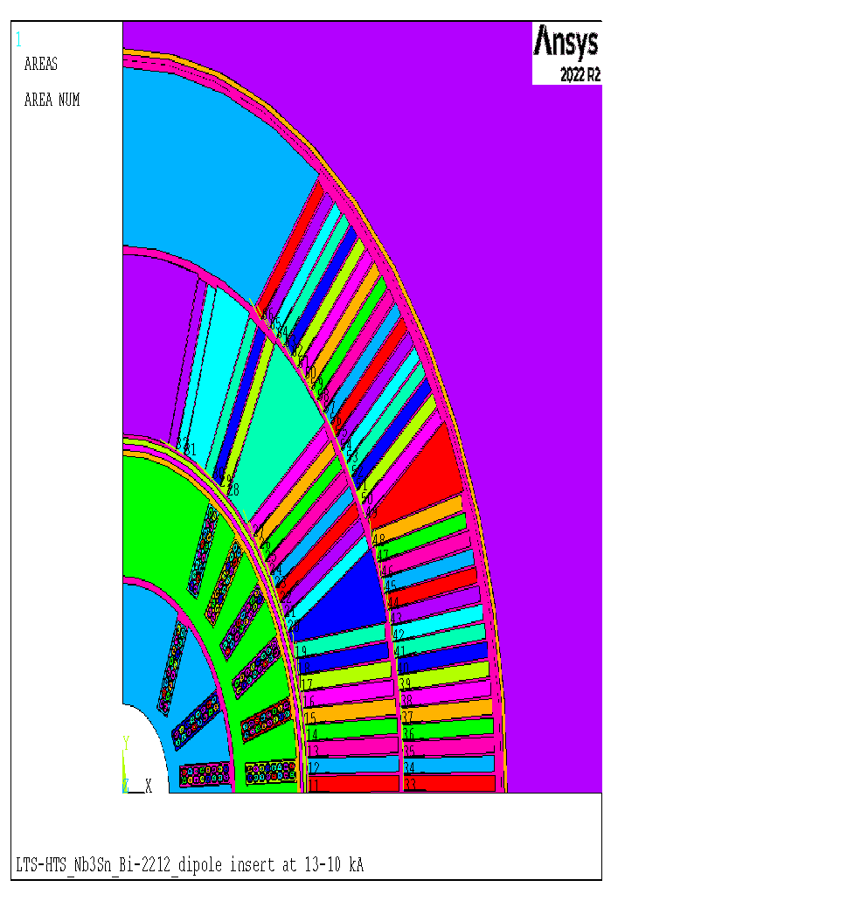
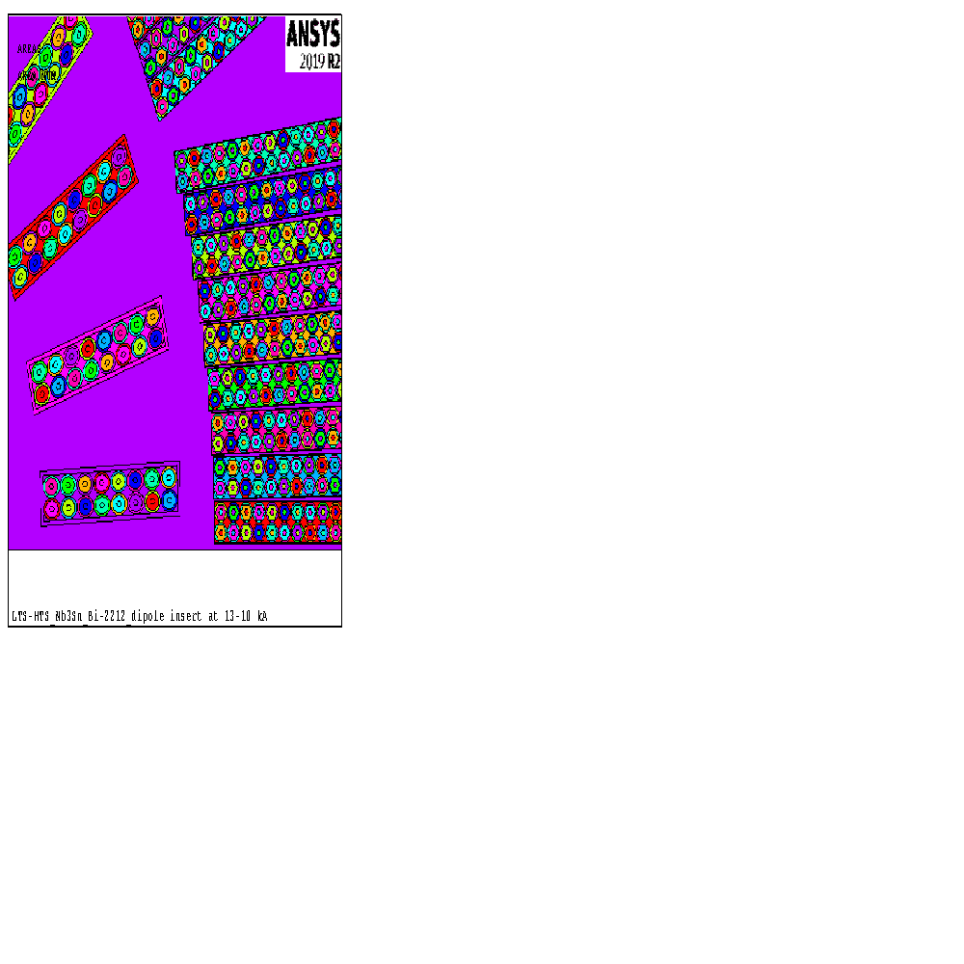
NEXT STEPS
Based on sub-modeling previous work, a Bi-2212 dipole
insert was sub-modeled to verify possible benefits, such as
increased accuracy in the mechanical analysis, with respect
to a homogeneous model.
Next, the whole hybrid model will be modeled, with the Bi-2212 heterogeneous strand insert and the outer Nb₃Sn outsert as a homogeneous model.
Finally, the whole hybrid magnet will be modeled.
In each case, first the magnetic field distribution and Lorentz forces are compared with respect to a fully homogeneous model. Then, the stress/strain distributions are compared.

Slide 18
BACKUP SLIDES

Slide 19
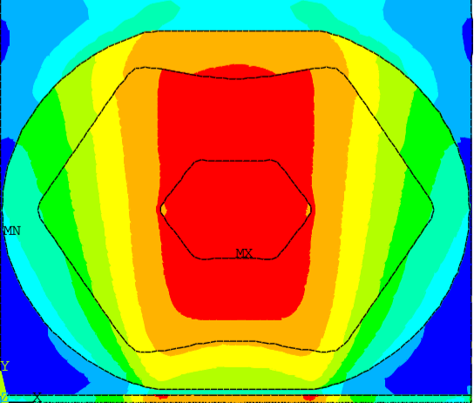
SENSITIVITY TO Nb₃Sn STRAND SHAPE AND PROPERTIES
Max Equivalent stress
80 MPa
¼ of a cable with elementary cell
163 MPa
¼ of a cable with detailed cell
165 MPa
CONCLUSION
Heterogenous models provide more accurate information on the internal stress distribution of strands and cables.
For Nb₃Sn cables, there is clear local x2 stress enhancement that does not depend on geometry or boundary conditions.
Single elementary cell
163 MPa
Single detailed cell- Hard Cu
158 MPa
Single detailed deformed cell- Hard Cu
158 MPa

Slide 20
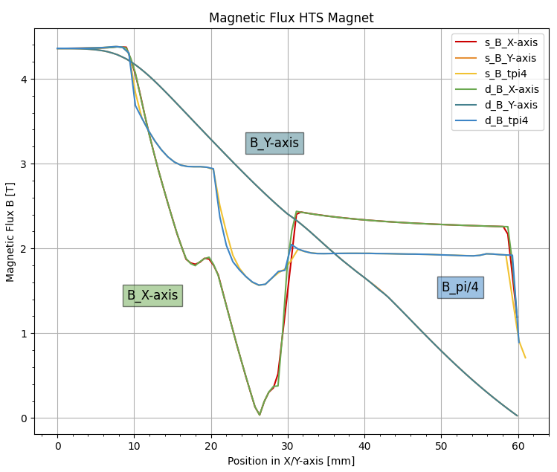
Backup Slides – Magnetic Field Comparison

Slide 21
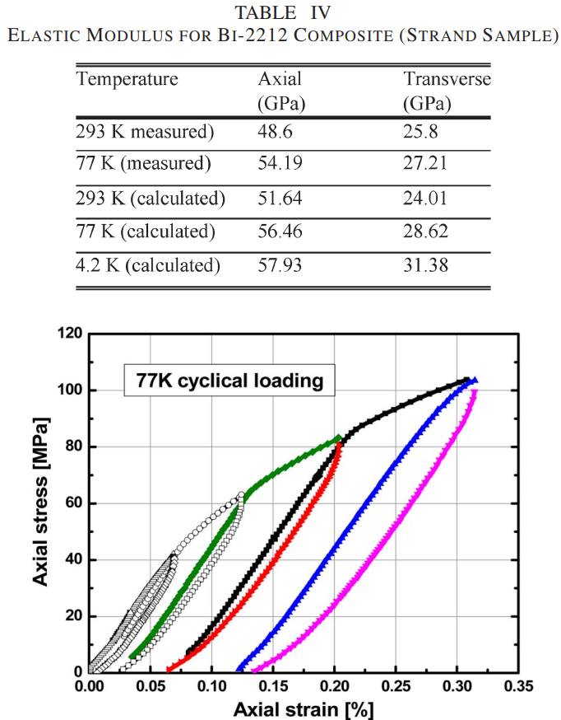
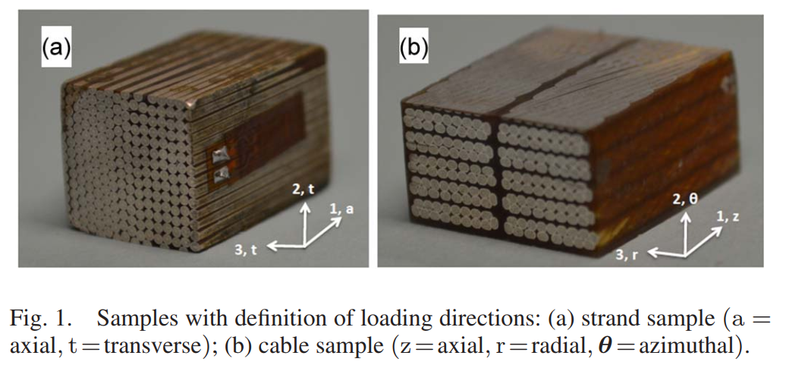
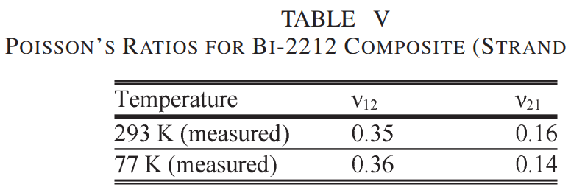
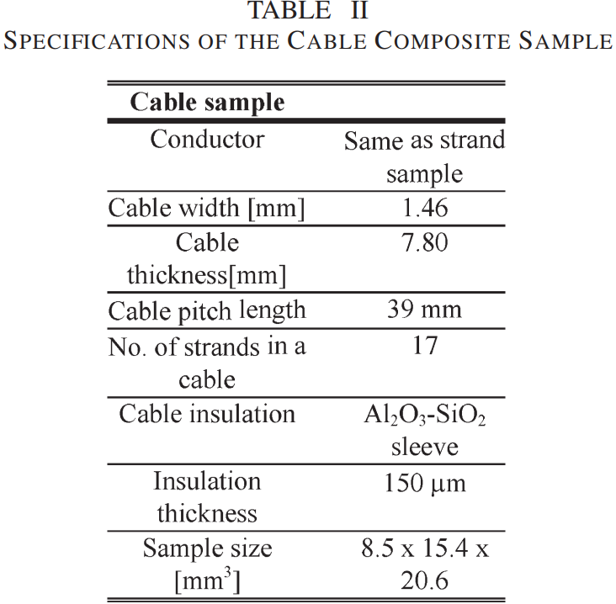
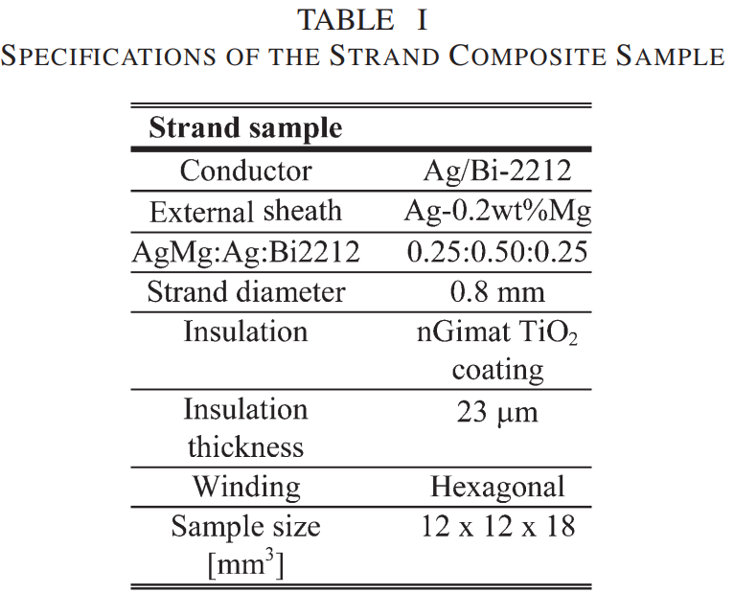

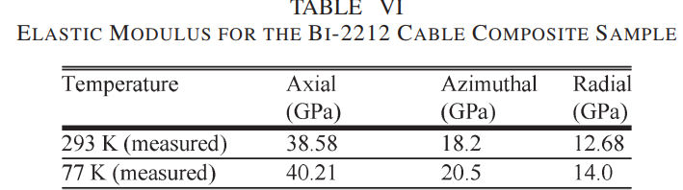
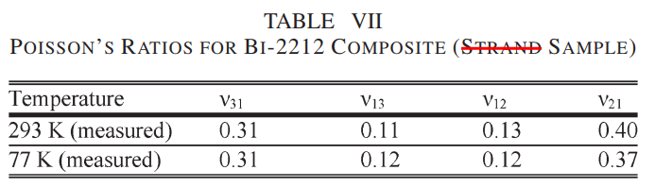
Ten Stack Model Properties
Orthotropic material properties, only axial and transverse because for 2 directions properties are the same. The material shows multilinear and hardening behavior.

Slide 22
Backup Slides – Tensile Test Results
Results

Slide 23
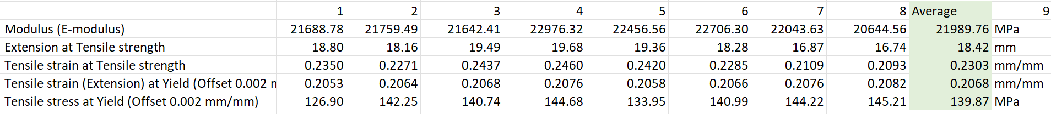
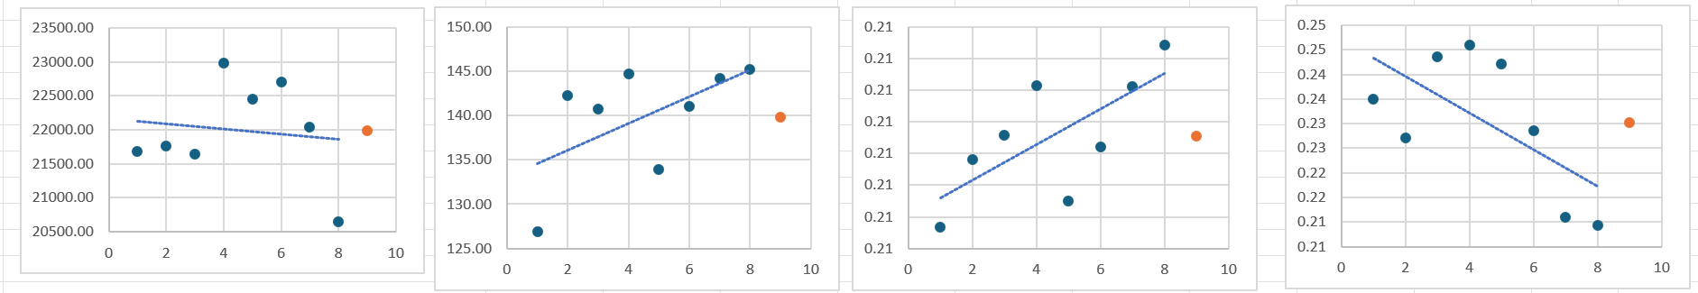
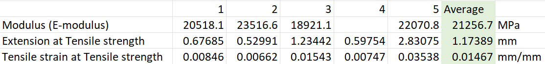
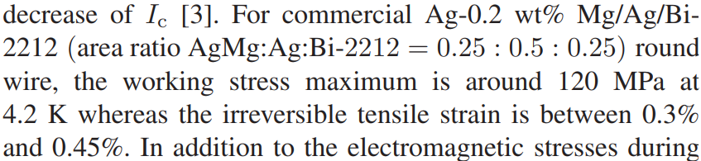
Backup Slides – Tensile Test Results
Un-reacted
Reacted
Paper in literature

Slide 24
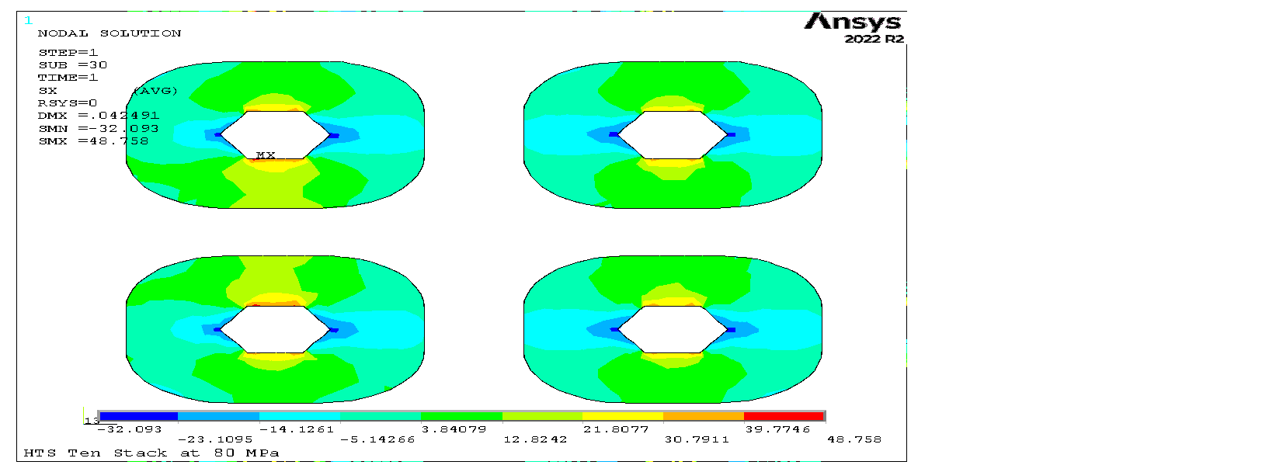






Ten Stack Bi-2212 Stress Results
Radial@80MPa
The ten-stack results for the sensitivity analysis of stresses in respect with mesh size and results of eq. Von Mises stress in all former material under three different load case: 80, 100 and 120 MPa. The less stressed element is the Silver sector, probably due to its higher value of Y. Modulus, it’s more rigid than Bi-2212 and Epoxy.
Azimuthal@80MPa

Slide 25




Backup Slides – Composite Properties check

Slide 26

Backup Slides – Tensile Test Results
Xiao, Y., Wu, J., Shen, H. et al. Damage behavior in Bi-2212 round wire with 3D elastoplastic peridynamic. Acta Mech. Sin. 39, 422431 (2023). https://doi.org/10.1007/s10409-023-22431-x

Slide 27

Backup Slides – Composite Properties check
Xiao, Y., Wu, J., Shen, H. et al. Damage behavior in Bi-2212 round wire with 3D elastoplastic peridynamic. Acta Mech. Sin. 39, 422431 (2023). https://doi.org/10.1007/s10409-023-22431-x

