Slide 1
FNAL update and conductor needs
Vadim Kashikhin
MDP Collaboration Meeting
1 May 2024

Slide 2
FNAL REBCO-related activities
Accelerator magnet development
  Conductor-dominated
    COMB
    TST
  Iron-dominated
Material development
  Exfoliated/soldered tape studies
  Tape/cable impregnation studies
  Fusion tape/cable/coil testing
Diagnostic development
  Fiber-optic
  Quench antenna
  Acoustic
Testing infrastructure upgrades
  VMTF/HFVMTF
  IB1/Stand 3
  IB3A/Superconducting Lab

Slide 3
Magnet development with STAR wires
COMB-STAR-1 – the Phase-I SBIR magnet was fabricated and tested in LN₂ and LHe
  Milestone AIIb-M2: “Demonstrate first COMB (Conductor on Molded Barrel) technology” - complete
  Recently tested in LHe - reached ~1.5 T bore field at 3.2 kA
    Performance lower than expected – limited by one half-coil
  Possible next steps
    Re-test in LN₂ (done)
    Disassembly/autopsy/micro-CT scan of the bad half-coil
    Re-test of the good half-coil in LHe (as a “mirror”) and/or replace the other half-coil with a new conductor
      Depends on VMTF schedule and conductor availability
      Need to improve the VMTF dump system prior to the next test
COMB-STAR-2 – the Phase-II SBIR magnet is to be fabricated/tested next year
  100 m of STAR wire will be delivered later this or early next calendar year
  The magnet will have
    60 mm clear bore
    4 layers of STAR wire
    target bore field ~5 T

Slide 4
Magnet development with CORC cables
COMB-CORC-1 magnet is the next one to fabricate and test
  Conductor is available, bending performance is to be verified
    Built a 1 T resistive dipole magnet that will be used for in-field cable testing in LN2
      nice project for a student!
  The magnet will have
    ~100 mm clear bore
    ~120 mm coil OD
    2 layers of CORC cable with 24 HM Superpower tapes
    target bore field ~5 T
Standalone test this year in LN₂/LHe
  Milestone AIIb-M7: COMB performance demonstration. Expected completion at the end of this calendar year if the GARD funding is not interrupted
Hybrid test next year with a Nb₃Sn coil
  Milestone AIIb-M5: Complete COMB insert test. Successor to AIIb-M7, expected completion in spring of 2025 if the test facility is upgraded for that test
  Need to coordinate the interfaces between REBCO and NB₃Sn coils soon

Slide 5
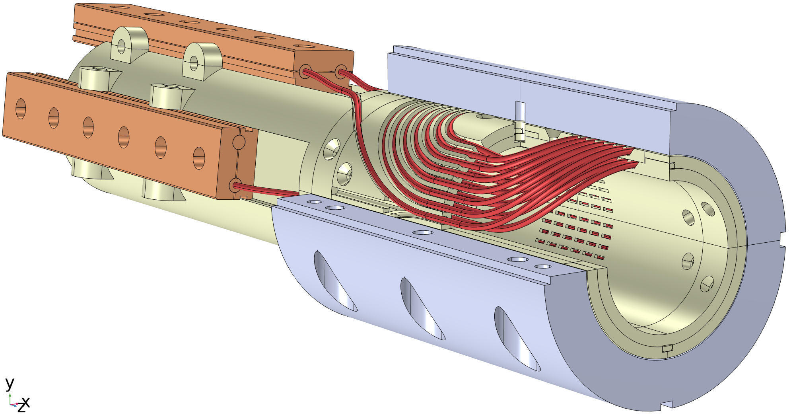
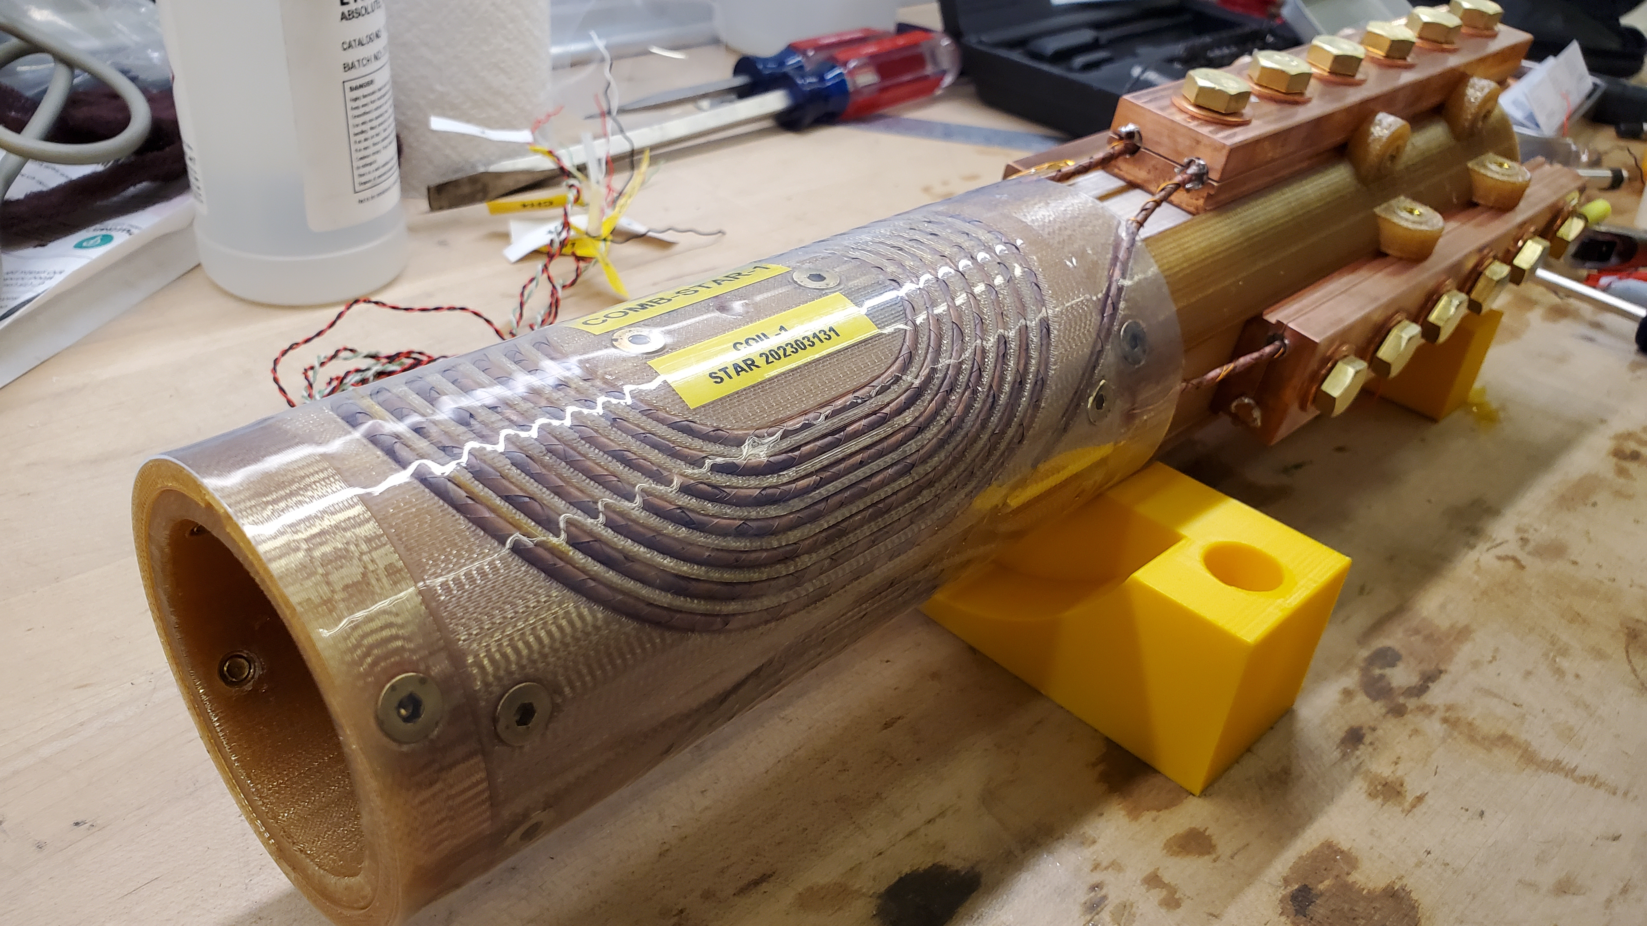
COMB-STAR-1 dipole magnet design
60 mm clear bore
Two half-coils made with two layers of round REBCO STAR® wire
The cable is wound into a continuous channel without internal splices
Coil support structures 3D printed from ULTEM
The leads are terminated at 3 copper adapters that allows to test each coil individually
Redundant voltage taps co-wound with the conductor into the support structure to minimize the noise

Slide 6
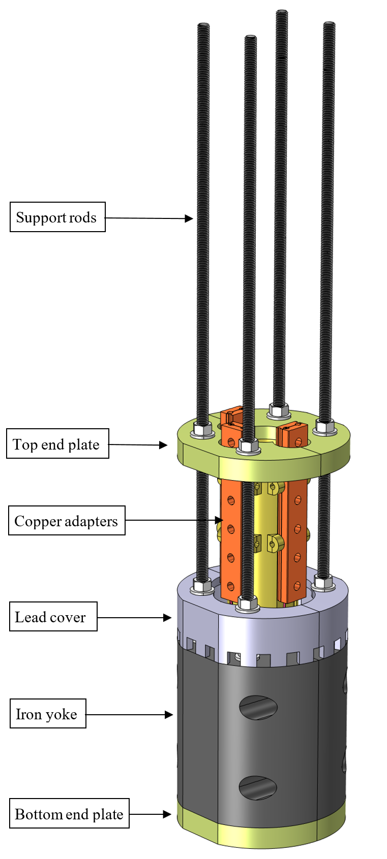
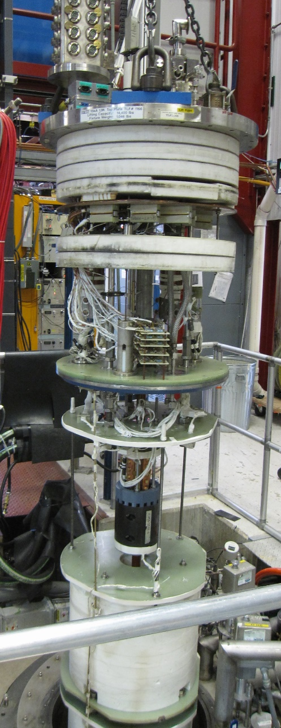
Magnet testing
COMB-STAR-1 was fabricated and tested in liquid nitrogen in 2023. It was the first experimental demonstration of a multi-layer COMB magnet fabricated with ~10 m of REBCO conductor
  the magnet went through four thermo-cycles and multiple energization cycles
  the measured critical current retentions for the coils were in 93-99% range, which exceeded the ultimate project target (over 90% Ic retention)
    One conductor showed a progressive reduction of Ic with each subsequent ramp when tested standalone prior to the coil winding
    That particular coil demonstrated the lowest Ic retention of 93% in the magnet
The magnet was re-assembled with a larger iron yoke and tested in liquid helium at 1.8-4.5 K

Slide 7
Magnet quench history
First intentional ramp to quench
The QP thresholds had to be increased from ±1 mV to ± 2.5 mV to avoid trips
  Still a very low number comparing to LTS!
The highest current reached was 3273 A
  1.5 T bore field
  2.3 T peak coil field
All the quenches were localized in half-coil 2
  The same conductor showed a small, but progressive reduction of I_{c} when tested standalone at 77 K
  It seems that whatever caused that reduction in liquid nitrogen was amplified when tested in liquid helium
Trips while adjusting DQD/FPGA thresholds and offsets
Quench/thermal runaway at 2800 A plateau that limited the currents in subsequent ramps

Slide 8
Typical quench protection triggers
1.8 K
4.5 K
The differential voltages (half-coil 1 minus half-coil 2) showed a considerable noise level
  Despite that, there was a clear quench onset after the thresholds were adjusted
The quench behavior was very different between 1.8 K and 4.5 K
  At 1.8 K, the quench development time was ~20 ms with a rapid voltage growth
  At 4.5 K, the quench development time was ~350 ms with a slow voltage growth

Slide 9
Typical V-I curves at 1.8 K
The half-coil 2 that limited the magnet performance also showed a much larger voltage than the half-coil 1
  There was a drastic change of resistance at ~1250 A in the half-coil 2 observed in all the ramps
That coil will be closely examined after the magnet is disassembled

Slide 10
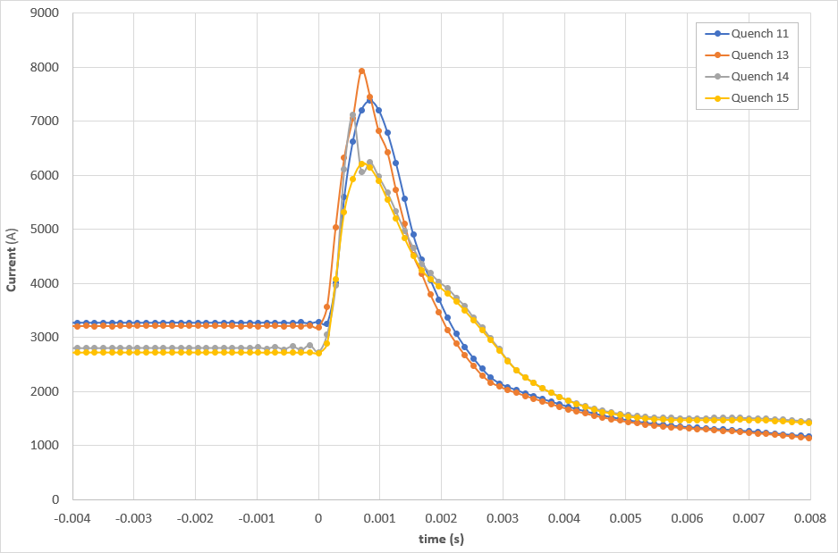
Current spikes
The magnet was protected by a 60 mΩ dump resistor
The dump activation system requires a relatively large capacitor charged to 400 V to be connected across SCR (thyristor) in series with the magnet
Due to the low magnet inductance, it caused ~5 kA spikes through the magnet in all cases of dump activation
  The additional MIITs due to the spike was ~0.1 corresponding to 50 K coil temperature
  It is possible the current spikes could degrade the magnet performance due to Lorentz forces and rapid heating
The dump activation system will need to be improved for the future HTS magnet testing

Slide 11
V-I ramp history
Half-coil 1
Half-coil 2
The half-coil 1 did not show a significant reduction of the critical current throughout testing
  However, it went through ~15 events (each one having ~5 kA spikes on top of the magnet current) prior to the start of V-I measurements, so it was very likely degraded by that time
The half-coil 2 experienced a progressive reduction of the critical current during testing in addition to a factor of 8 higher resistance comparing to half-coil 1

Slide 12
Re-test in LN2 after LHe test
The magnet was re-tested in LN2 after the test in LHe to compare its performance with the previously established baseline
The Ic retention with respect to the previous LN2 test was
  69% for the half-coil 1
  60% for the half-coil 2
Both coils showed Ic reduction and the half-coil 2 had a larger resistive component comparing to the previous LN2 test, however the difference between half-coils 1 and 2 was not as dramatic as during the LHe test

Slide 13
Comparison between 77 K and 1.8 K tests
The performance of both coils in LN2 was reduced by 30-40% after the test in LHe
  However, based on the virgin tape Ic measurements by the vendor at 77 K and 4.2 K, even the half-coil 2 with the lowest Ic should have reached >4 kA
  The difference may be related to strain-induced change in the field and/or temperature dependence due to
    current spikes (primary suspect for the limited LHe performance)
    strains built in during the wire fabrication (Ic reduction in standalone test of half-coil 2 wire in LN2)
Need to test extracted tapes or (preferably) the whole cable in field at LHe temperature to determine the expected Ic (such tests were not in the scope of this SBIR)

Slide 14
Lessons learned
The magnet did not burn despite ~40 x 8 kA pulses, but this is not the way to test HTS magnets!
The test facility needs improvements to test REBCO magnets standalone in LHe
  Decrease/eliminate current spikes from the dump switch
    reduce voltage on the capacitors (low-cost but partial solution)
    replace with IGBTs (higher-cost but preferred in the long term)
  Reduce noise in the fast DAQ channels to preferably <0.5 mV
  A true simultaneous multi-channel V-I measurement system with low noise
The test facility needs upgrades to test hybrid magnets in LHe
  Separate/integrated QD/QP systems for HTS and LTS coils with different thresholds
  The REBCO coil should be discharged in a few ms. Doable standalone, but will not be possible when connected in series with the Nb₃Sn coil due to its much higher inductance
    Cold bypass diode and a cold dump resistor to protect HTS coil
    Separate magnet powering and protection circuits
  These development activities should start ASAP to meet the hybrid test milestone next year
Need to establish testing standards for REBCO “short samples” suitable for predicting the magnet performance
  The virgin tape testing in LHe is not representative of the cable/magnet behavior
    Replace it with extracted tape or whole cable or small coil testing in background field in LHe
  Use constant voltage, constant electric field, etc. to determine the Ic?
    Remove the resistive component or leave it during fitting?

Slide 15
Conductor needs
The REBCO group was encouraged by CPRD to consider plans such that the conductor could be interchangeably used for the different magnet concepts, as well as in terms of length and performance requirements
  It seems that we can agree on some “standard” parameters for round conductors. The latest CORC cable with 30 Shanghai Superconductor tapes can be used as the baseline conductor
Conductor needs per COMB magnet
  30 m of baseline CORC cable is needed for one 2-layer COMB magnet (~5 T bore field), which can be split into two equal unit lengths (2x15 m)
  60 m of STAR wire with 12 tapes is needed for one 4-layer COMB magnet (~5 T bore field), which can be split into two equal unit lengths (2x30 m)
Short sample and small coil testing in background field
  20 m of CORC cable and 40 m of STAR wires; these can come in multiple piece lengths
With the present resources, we can fabricate and test ~ two COMB magnets per year
FNAL conductor needs per year
  30+20 m of CORC cable
  60+40 m of STAR wire
It can be assumed that FNAL will need such quantiles of CORC and STAR wires every year as long as we target ~5 T self-field in the bore
  For higher field targets (TBD) the conductor needs will increase
It would also be good to have a stockpile of virgin tapes used in these conductors as some experiments can be conducted on the tape itself

