Slide 1
REBCO Twisted Stack Tape (TST) coil R&D program and conductor needs
A.V. Zlobin, Fermilab
05/01/2024
MDP CM8, HTS-REBCO session
Fermilab

Slide 2
Outlines
TST cable original concept and its modification
20 T REBCO/Nb₃Sn hybrid dipole design studies
REBCO TST coil technology
Sub-scale coil testing
Summary and next steps

Slide 3
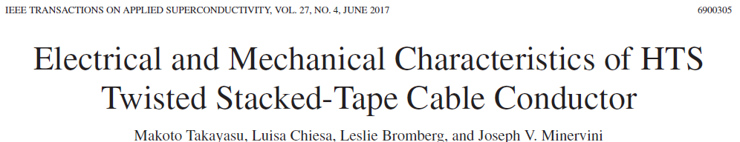
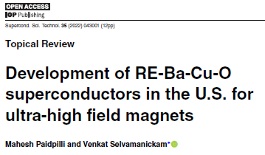
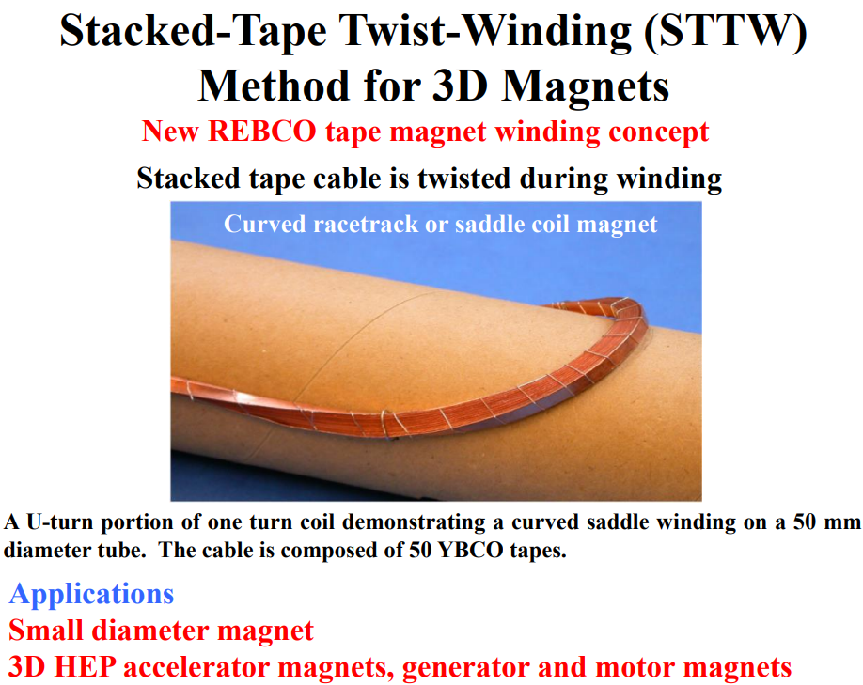
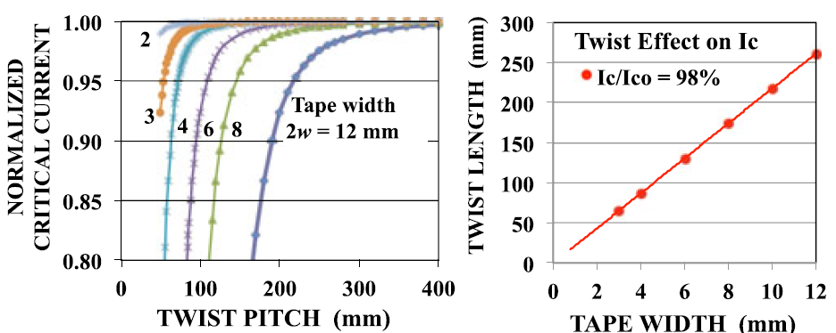
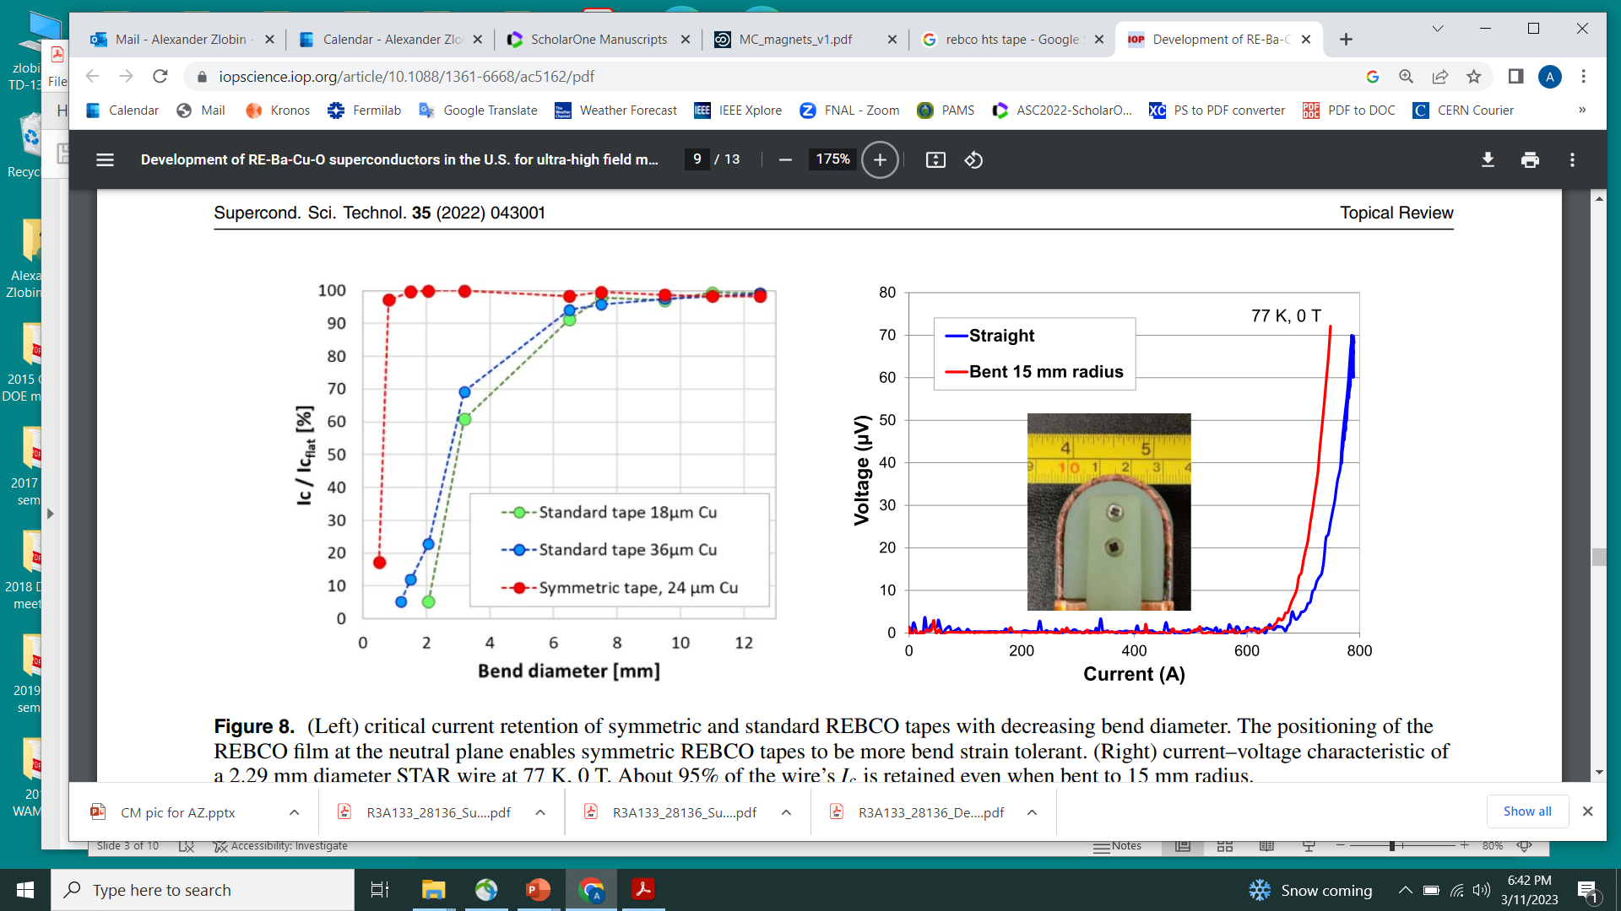
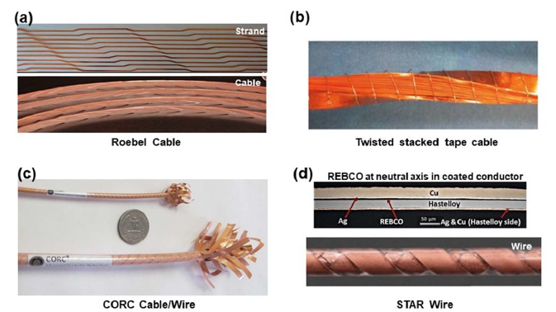
TST cable original concept and its modification
2014WAMHTS-1_REBCO Twisted Stacked-Tape Cable Takayasu
problem - relative tape axial shift during winding
proposed technique – stack forming and twisting during winding!
Minimal bending D~8 mm
For 4 mm wide 0.1 mm thick tape minimal L_{t}~80 mm

Slide 4
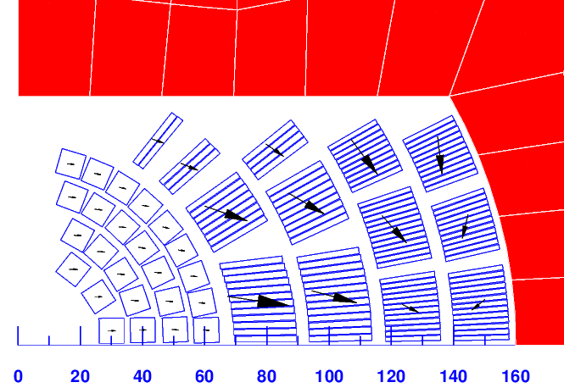
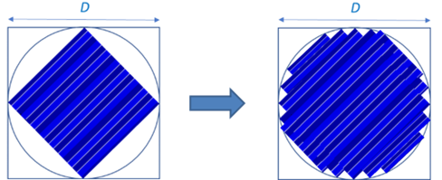
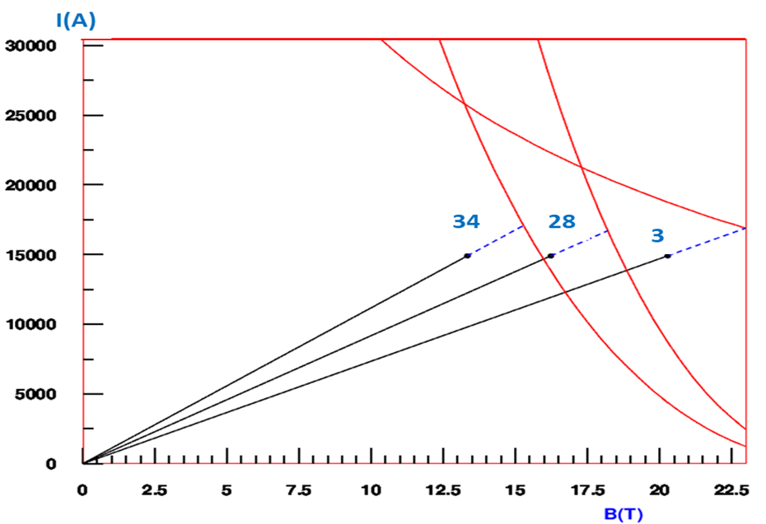
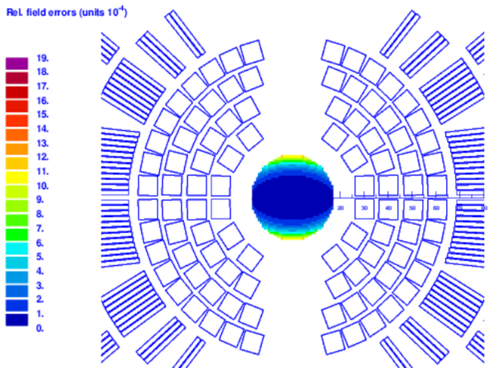
20 T REBCO/Nb₃Sn hybrid dipole based on TST
REBCO TST cable
Parameter | REBCO/ Nb₃Sn
Nominal current I_{nom}, kA | 14.90
Nominal bore field B_{nom}, T | 20.0
Coil nominal field B_{nom}, T | 20.34
Coil to aperture field ratio B_{max}/B_{o} | 1.017
Magnet margin at 1.9 K, % | 10.9
Total HTS coil area, mm² | 601
Total Nb₃Sn coil area, mm² | 3854

Slide 5
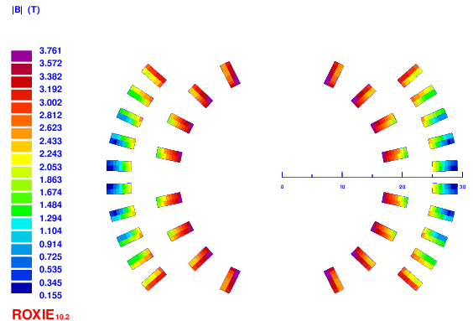
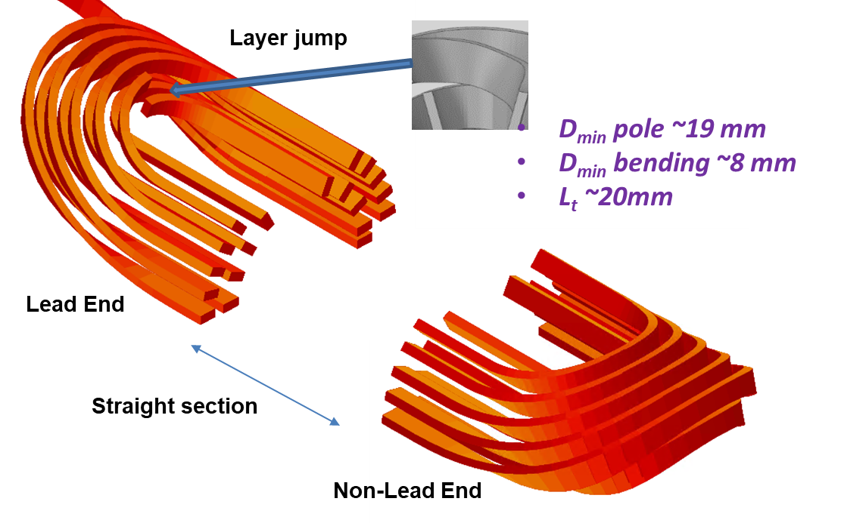
REBCO TST coil design
Coil cross-section
Coil end design
Parameter | Value
Number of layers | 2
Number of turns | 9 (4 IL+5 OL)
Coil ID-I/ID-O/OD, mm | 19/25/59
Yoke R_{in}, mm | 30
Coil B_{max}/I, T/kA | 3.739/8
Coil B_{o}/I , T/kA | 3.375/8
B_{max}/B_{o} | 1.108
L. mH/m | 0.282

Slide 6
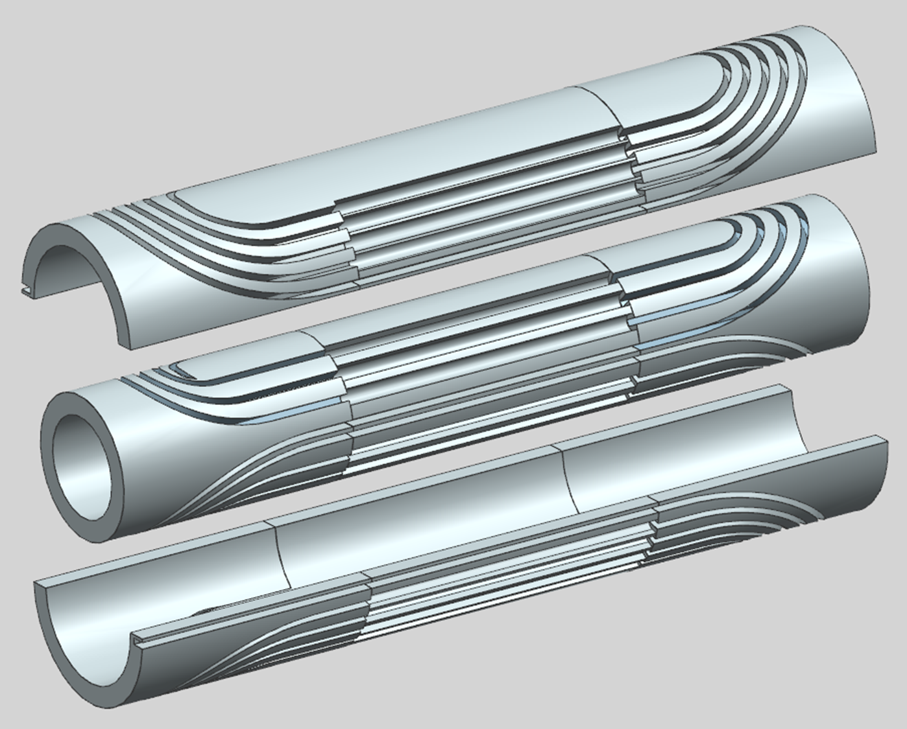
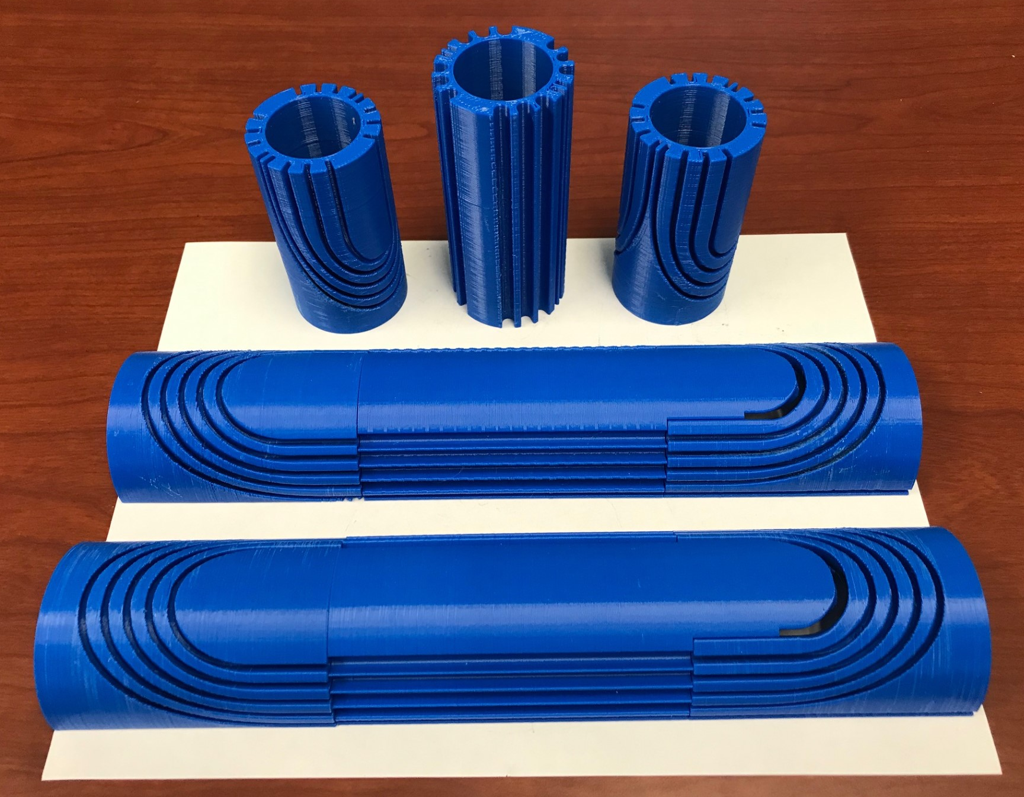
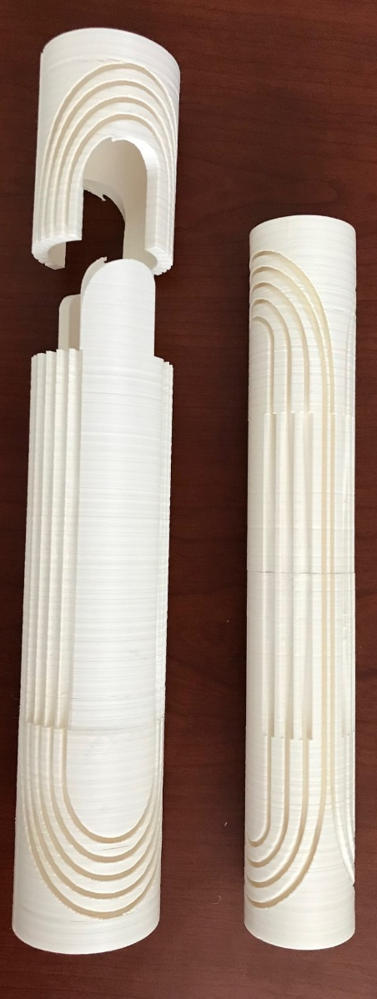
REBCO TST coil structure
Coil structure design
cylindrical IL
two half-cylindrical OL
Coil structure plastic parts
v1 with cylindrical groove
v2 with twisted groove

Slide 7
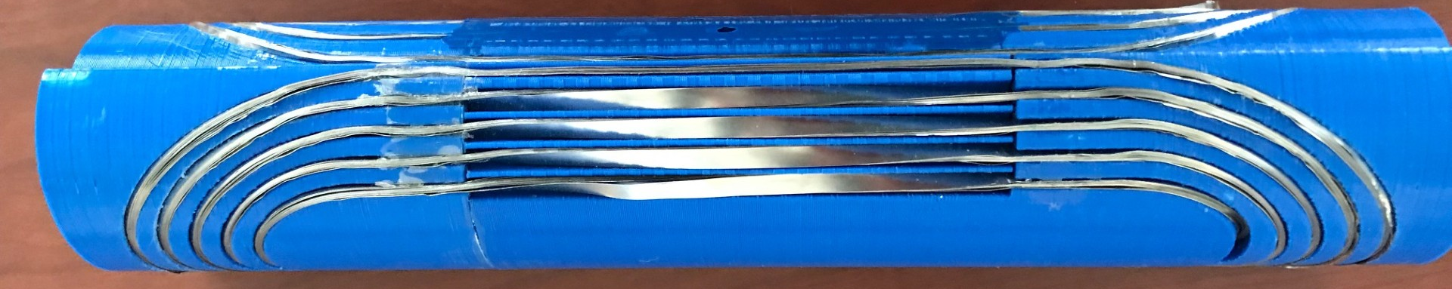
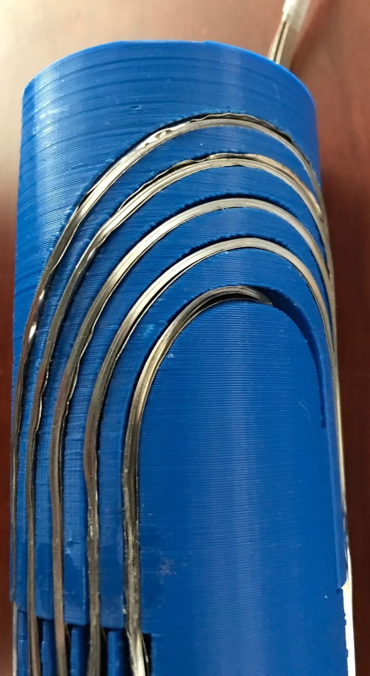
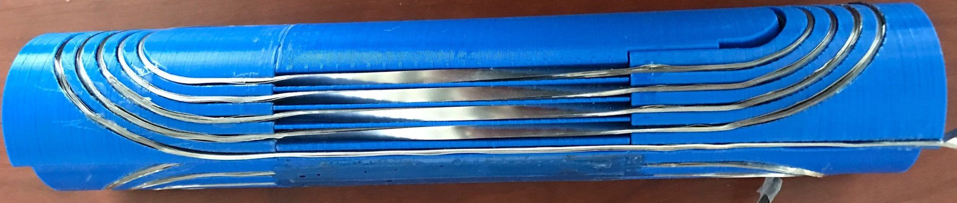
First demonstration of coil design and technology
1st practice coil used 16-tape stack cable made of 4 mm wide 0.1 mm thick SS tape and v1 coil structure
  480 m (4 spools) of 4 mm by 0.1 mm SS-304 Annealed AMS-5513 tape
2nd practice coil will use v2 coil structure

Slide 8
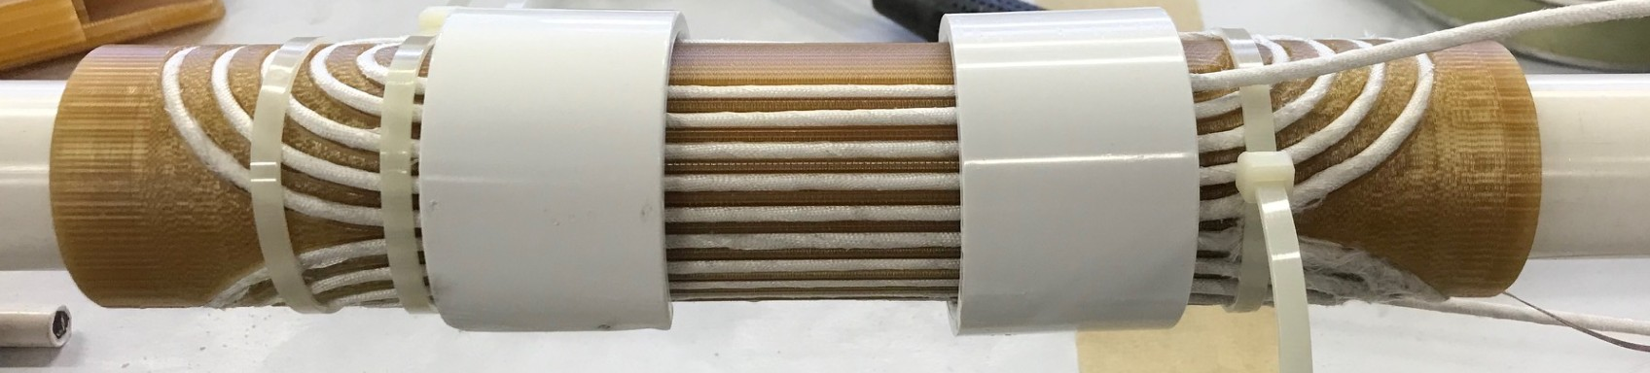
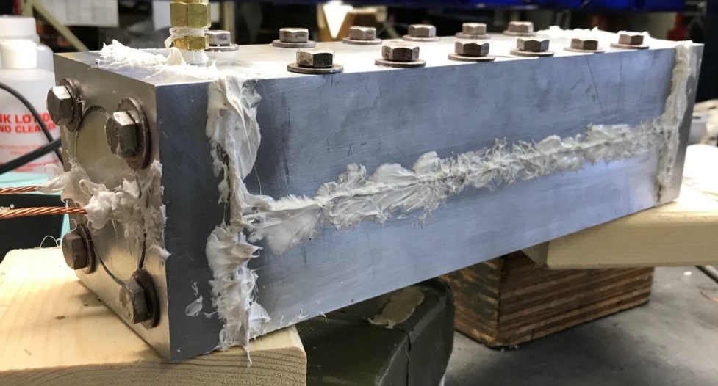
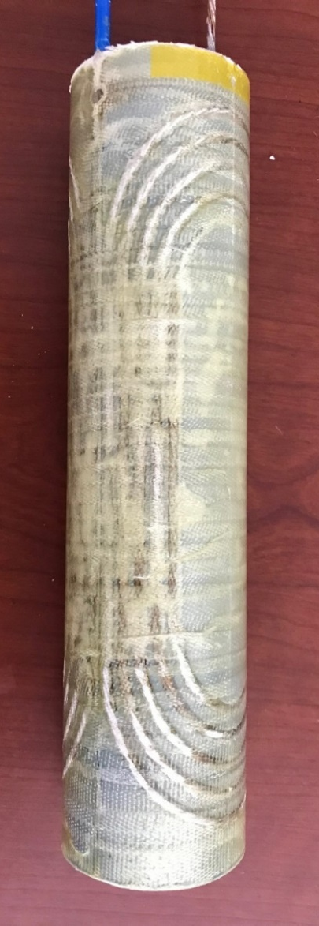
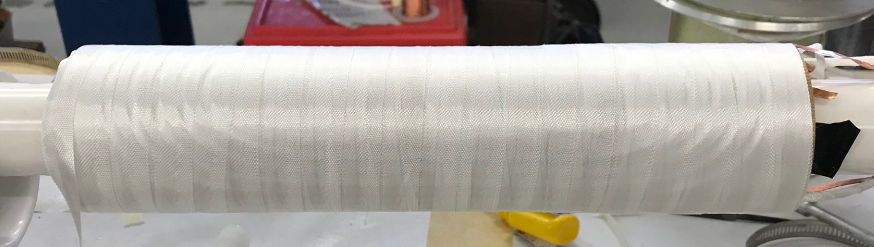
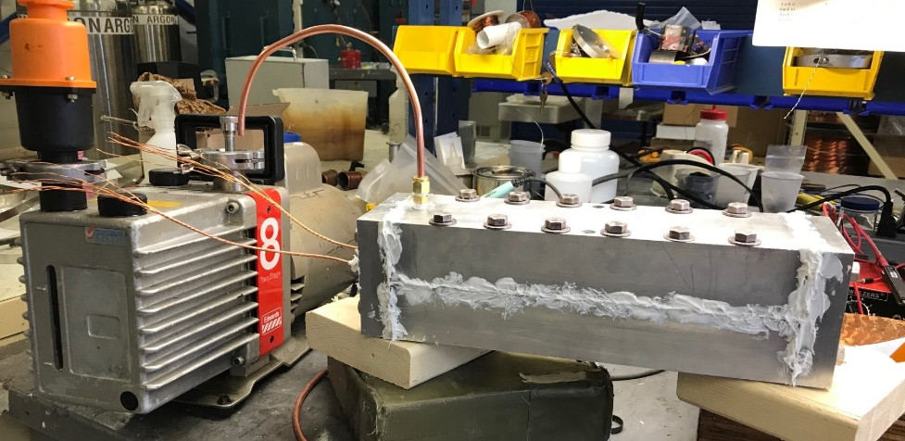
Coil winding and impregnation tooling
Practice coil has been wound with 6-on-1 Cu cable and impregnated with Telene
Nb-Ti has been wound into Ultem structure and is being prepared for impregnation and will be tested with SC transformer

Slide 9
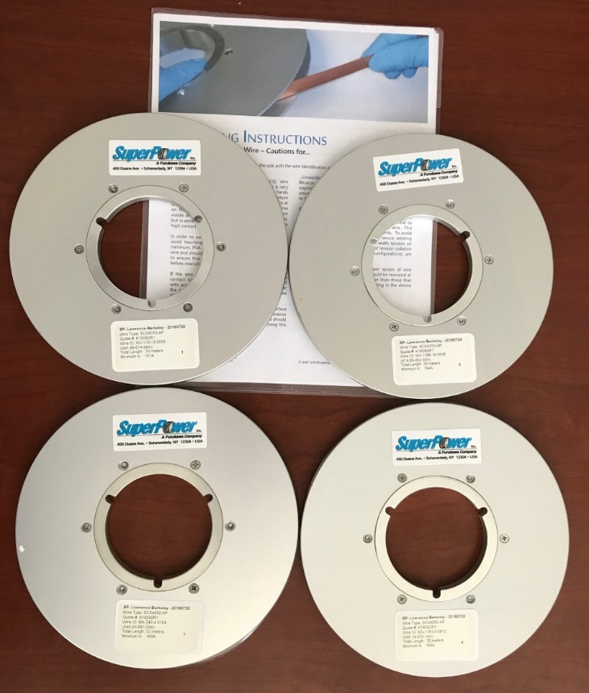
REBCO coil development plan and status
Spool | Tape length, m | Spool Ic, A | Cable length, m | Cable length, m | Cable length, m
 |  |  | 16 tapes | 12 tapes | 8 tapes
1 | 29 | 167 | 7.3 | 9.7 | 14.5
2 | 30 | 164 | 7.5 | 10.0 | 15.0
3 | 30 | 166 | 7.5 | 10.0 | 15.0
4 | 32 | 169 | 8.0 | 10.7 | 16.0
Cable unit length ~10 m => 16-tape stack with 12 REBCO tapes and 2 SS tapes on each side
121 m (4 spools) of 4-mm wide 0.1 mm thick REBCO tape with test data provided by LBNL(thanks to X. Wang)
The 1st coil structure will be printed from Ultem, later from SS or bronze

Slide 10
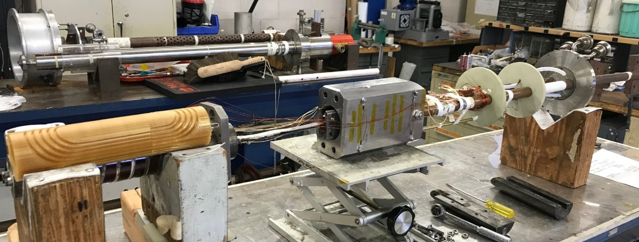
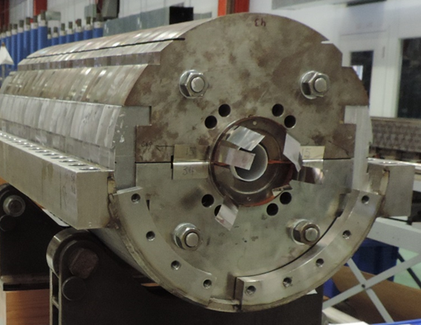
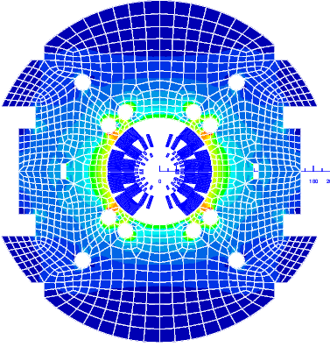
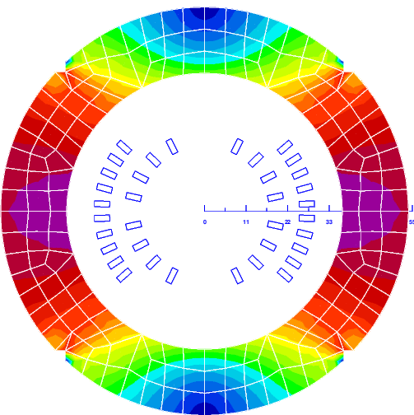
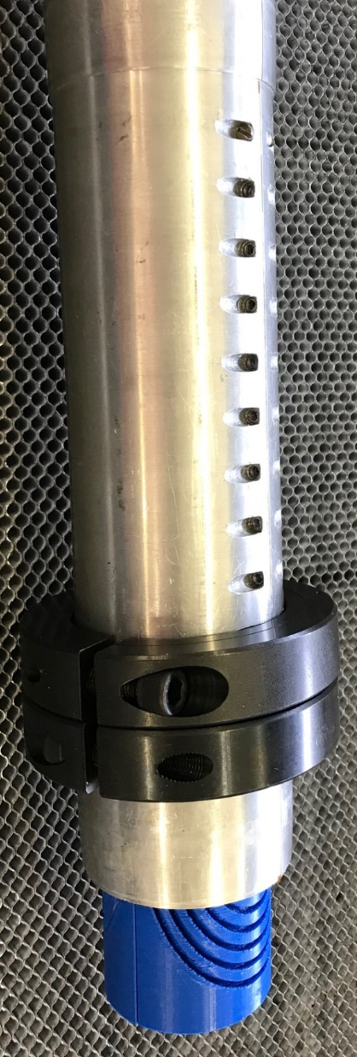
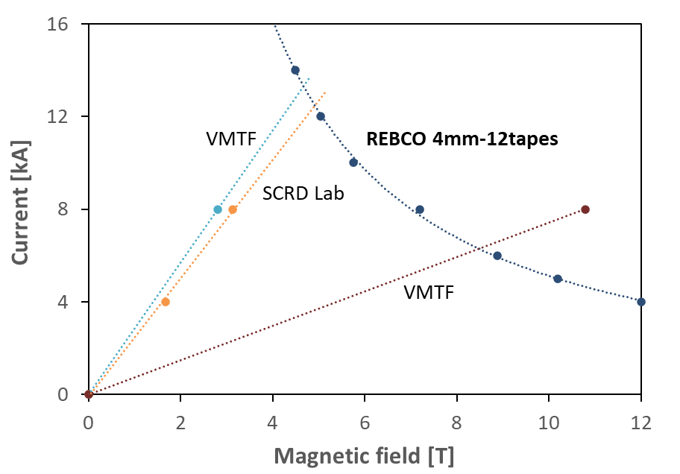
REBCO sub-scale coil test
Test single REBCO coil in LN and in LHe with SC transformer
  working on the coil-transformer mechanical and electrical interface
  practice test with Nb-Ti sub-scale model
Coil test inside MBHSP04
  REBCO coil powering and protection to be studied

Slide 11
Summary and possible next steps
The HTS coil technology based on a REBCO TST cable, proposed at MIT, is being developed at Fermilab in support of the 20 T hybrid dipole task and other possible applications
Designs of the small 2L REBCO coil and the SMCT coil support structure have been developed
The coil and SMCT structure designs, coil winding technology and fabrication tooling are being optimized using practice models made of SS tape of similar size and 3D printed plastic parts
REBCO tape and test data for the first coil have been provided by LBNL
The mandrel of the first coil will be 3D printed of Ultem and is ready for procurement
Preparation to testing of small LTS and HTS coils using SC transformer is in progress
Demonstration of the cost-effective REBCO coil design and technology is planned for 2024 in parallel with the Bi2212 insert coil task
  Bi2212 and REBCO coil parameters are close which allows direct comparison of the two technologies

Slide 12
Result discussion and publication
Presentations (since CM7):
A.V. Zlobin, “Update on the status of REBCO insert based on the parallel twisted-tape cable,” MDP general meeting, 07/19/2023.
A.V. Zlobin, “REBCO insert based on the twisted stacked-tape (TST) cable,” MSD REBCO working group meeting, 08/27/2023
A.V. Zlobin, “REBCO coils based on Twisted Stacked-Tape (TST) cable,” REBCO Round Table, 11/2–3/2023
A.V. Zlobin, “REBCO Twisted Stack Tape (TST) coil program activities,” MSD REBCO working group meeting, 04/17/2024
ASC’2024 abstract:
A.V. Zlobin, I. Novitski, E. Barzi, D. Turrioni, “Development and test of a two-layer subscale dipole coil made of REBCO Twisted Stacked-Tape cable,” poster.

