Slide 1
FNAL Bi2212 SMCT insert program overview
A.V. Zlobin
U.S. MDP Collaboration Meeting CM8
05/01/2024

Slide 2
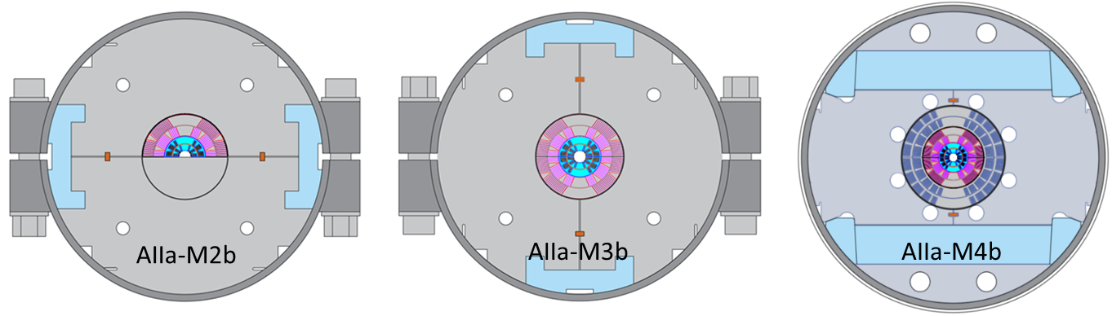
US-MDP Task: Bi2212 SMCT insert goals and milestones
The HTS coil technology based on a Bi2212 cable and SMCT coil design is being developed at Fermilab in collaboration with LBNL/NHMFL in support of the 20 T hybrid dipole task and other possible applications
Milestone # | Description | Target
AIIa-M2b | Design and fabricate the first small-aperture Bi-2212 coil using LBNL cable. Coil test independently and inside a 60-mm aperture 2-layer Nb₃Sn dipole coil in mirror configuration. | Aug-23
AIIa-M3b | Design and fabricate the 2nd small-aperture Bi-2212 coil using optimized Bi-2212 cable, coil structure, materials and technologies. Coil test independently and inside a 60-mm aperture 2-layer Nb₃Sn dipole coil in mirror configuration. | Mar-24
AIIa-M4b | Fabricate another small-aperture Bi-2212 coil using optimized Bi-2212 cable and coil structure. Bi-2212 coil test independently and inside a 60-mm aperture 4-layer Nb₃Sn dipole coil. | Sept-24

Slide 3
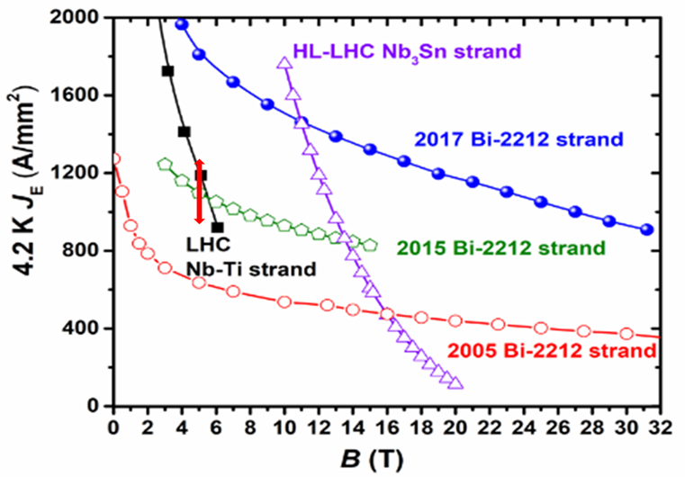
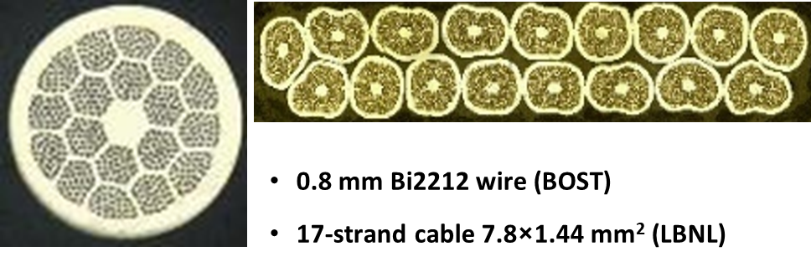
Bi2212 wire and cable
Bi2212 round composite wire and Rutherford cable
Bi2212 cable and strand parameters
The target field will be approached gradually by using the “old” 2015 and “new” 2017 generations of Bi-2212 wires.

Slide 4
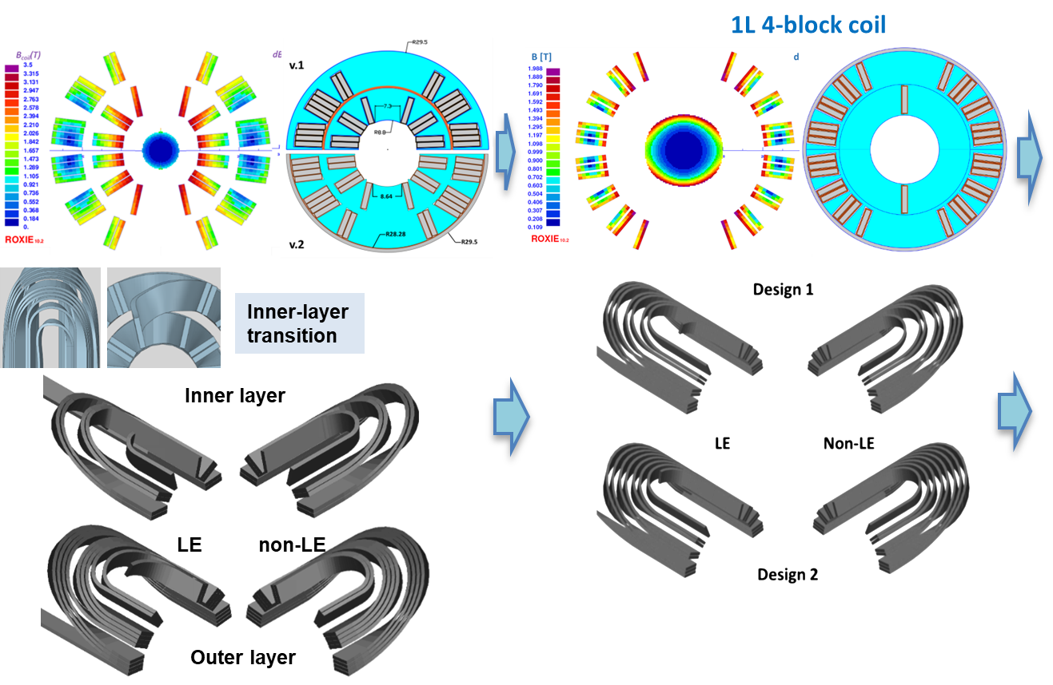
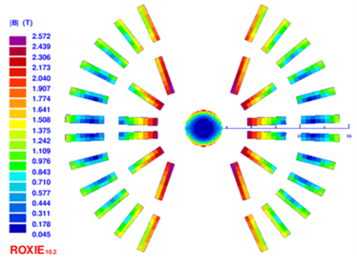
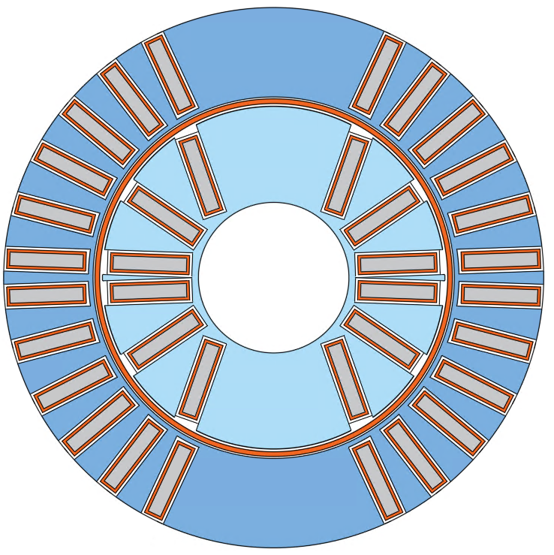
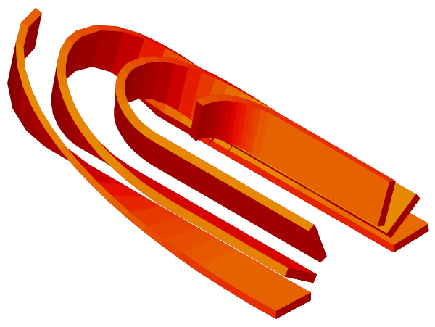
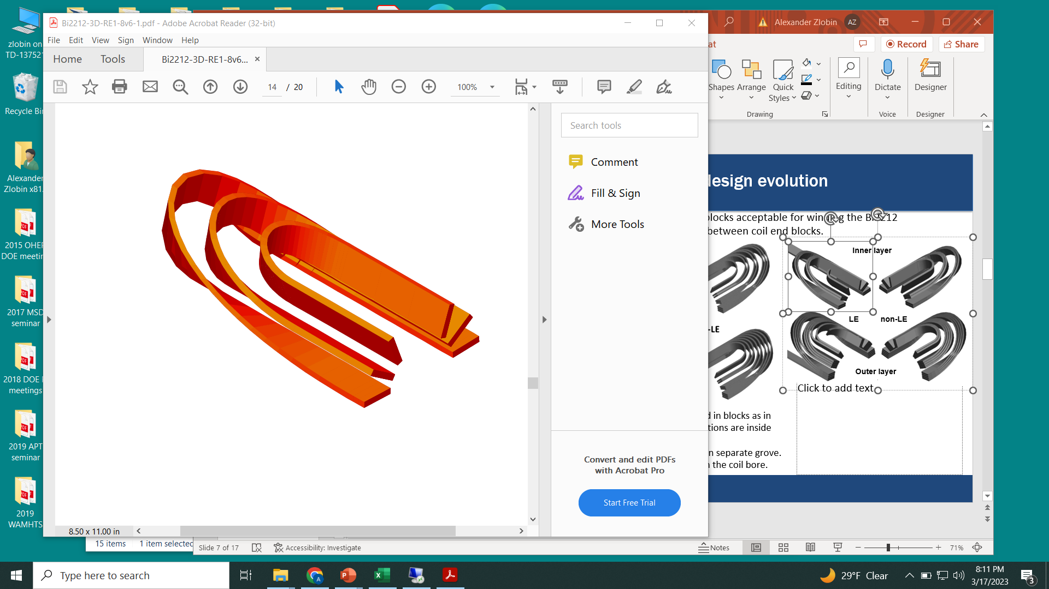
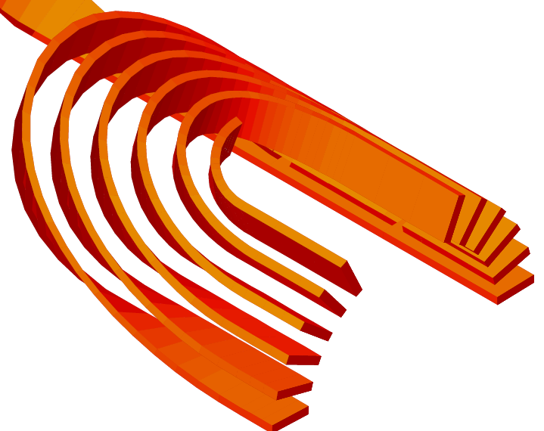
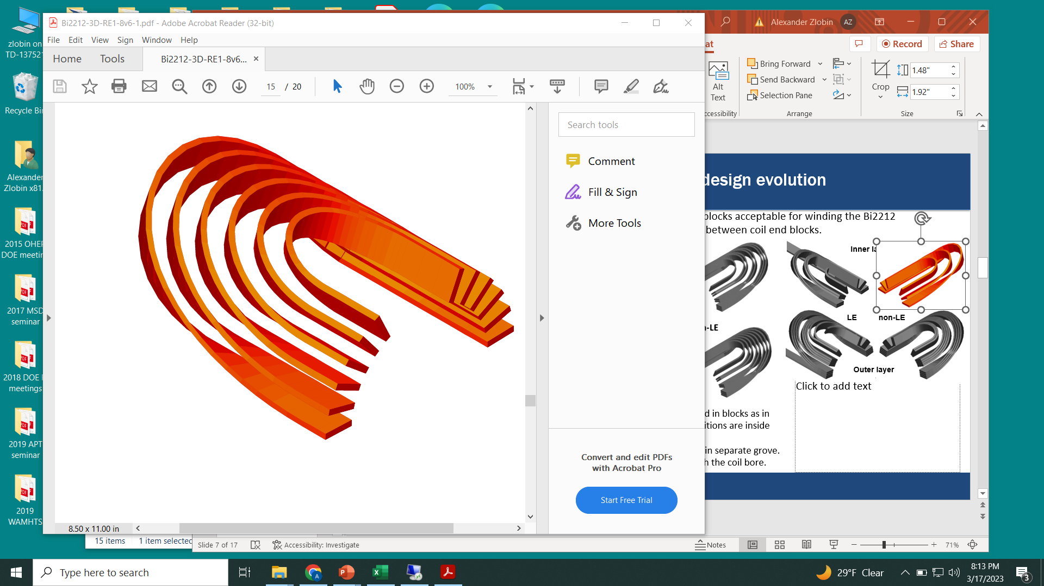
Bi2212 SMCT coil cross-section evolution
2L 6-block coil
2L 9-block coil
Inner layer
LE non-LE
Outer layer
Design 1: end turns are grouped in blocks as in the coil body
Design 2: end turns in separate grove
Design 1&2: pole leads go through the coil bore.
IL – whole coil with mid-plane cable transition
OL – independent half-coils

Slide 5
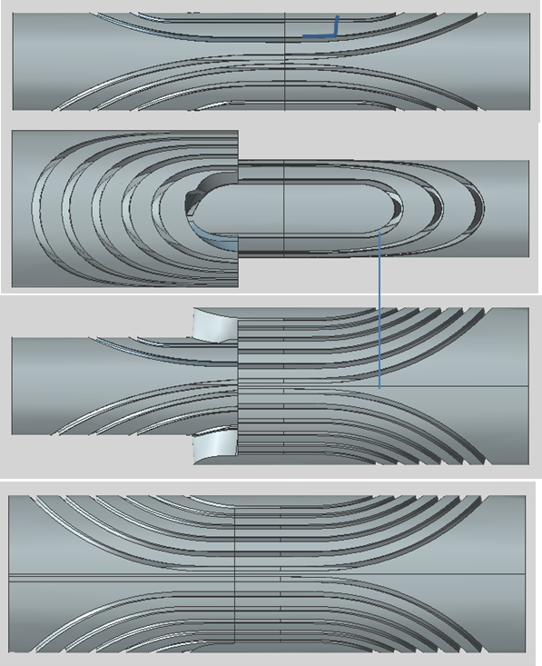
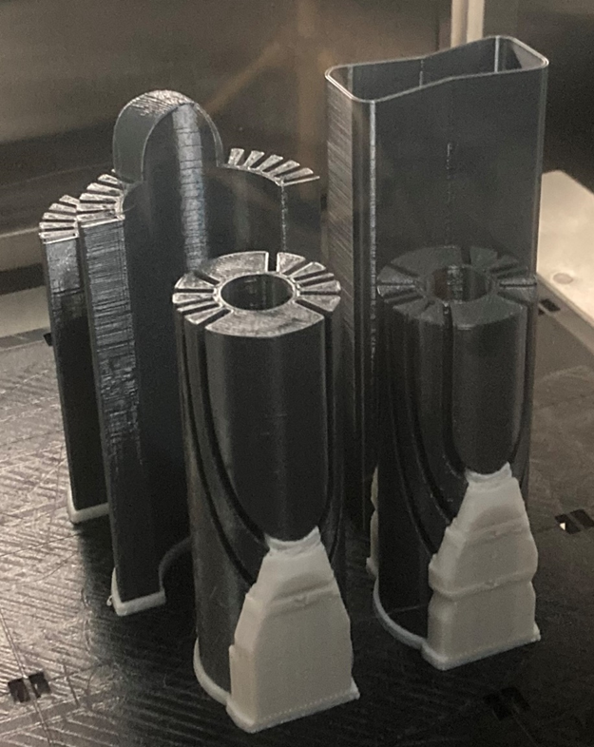
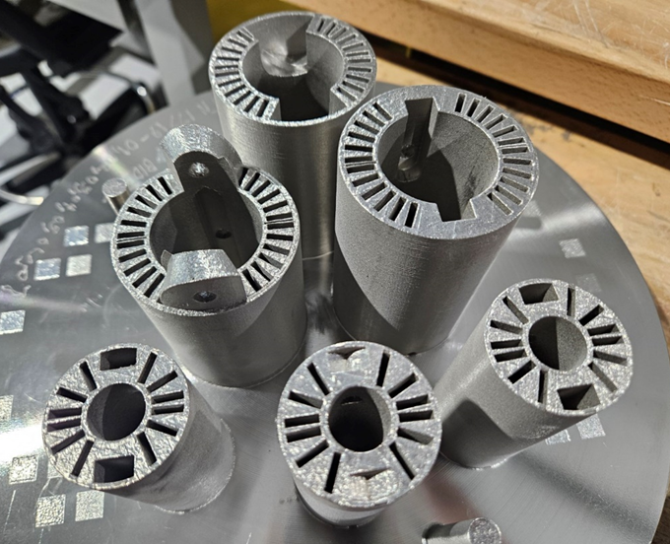
Bi2212 coil structure
Coil structure parts printed from plastic and Inconel 718
Inconel 718 chemical compatibility test – in progress
Coil structure solid model

Slide 6
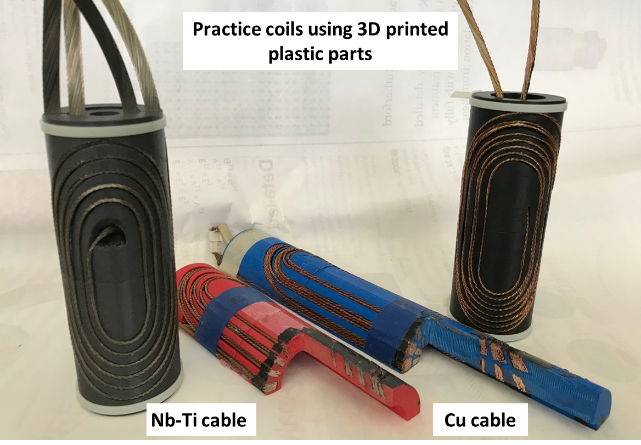
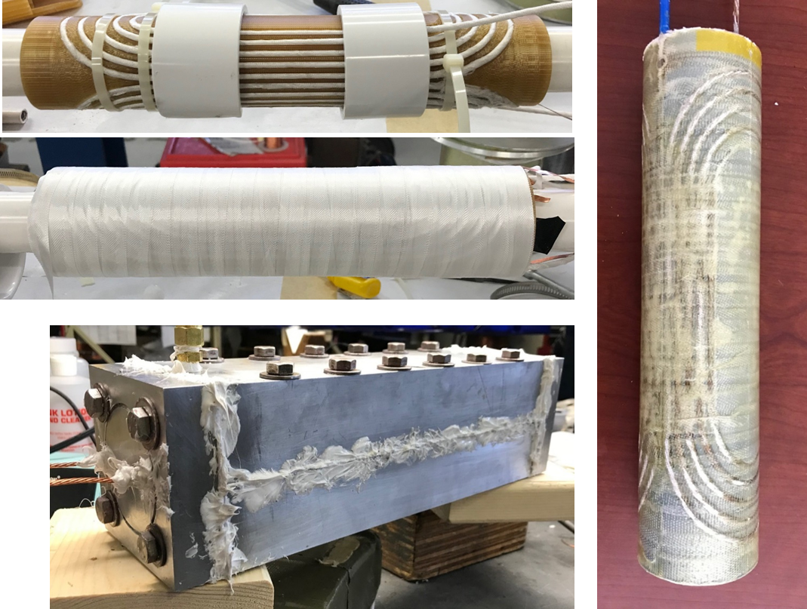
Coil winding and impregnation tooling
Coil winding tooling and technology test using Rutherford and round cables
Coil impregnation tooling and technology test with Telene
Coil reaction tooling is next

Slide 7
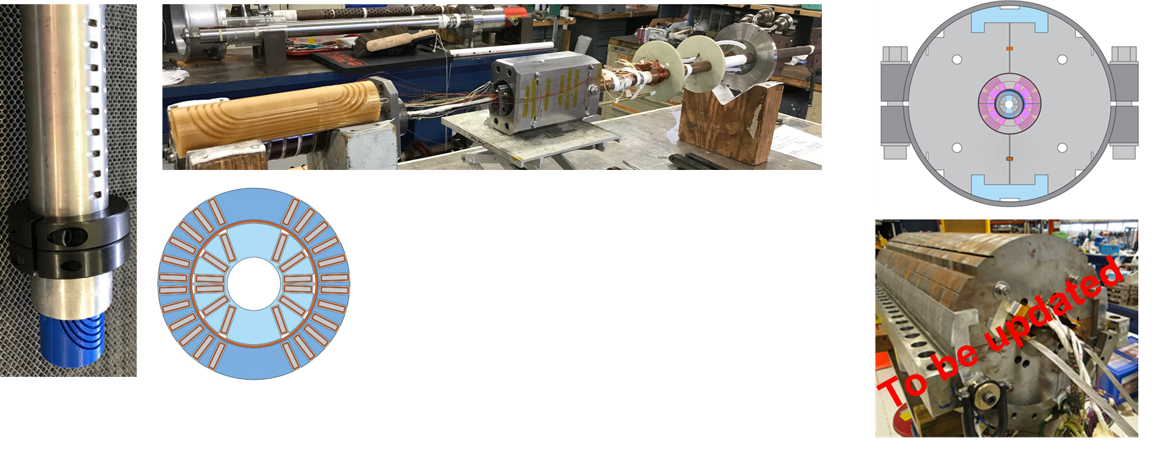
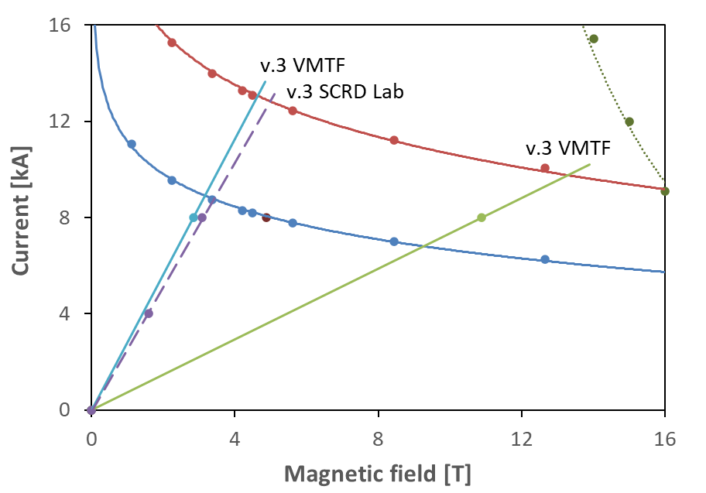
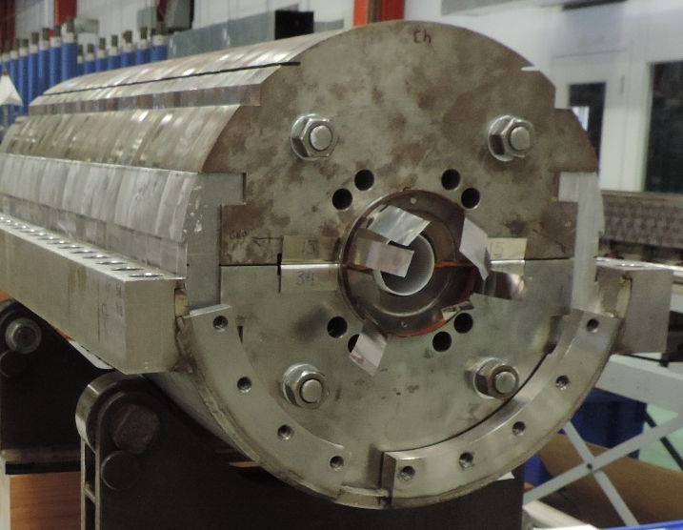
Bi2212 coil testing
Bi2212 coil testing with SC transformer
testing procedure is being developed using Nb-Ti sub-scale coil
Bi2212 coil test inside Nb₃Sn MBHSP04
Bi2212 coil powering and protection to be studied

Slide 8
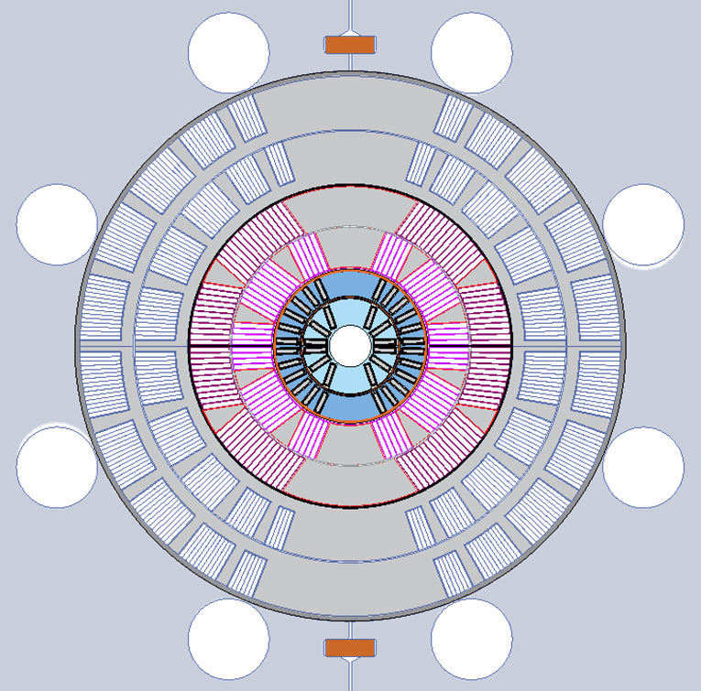
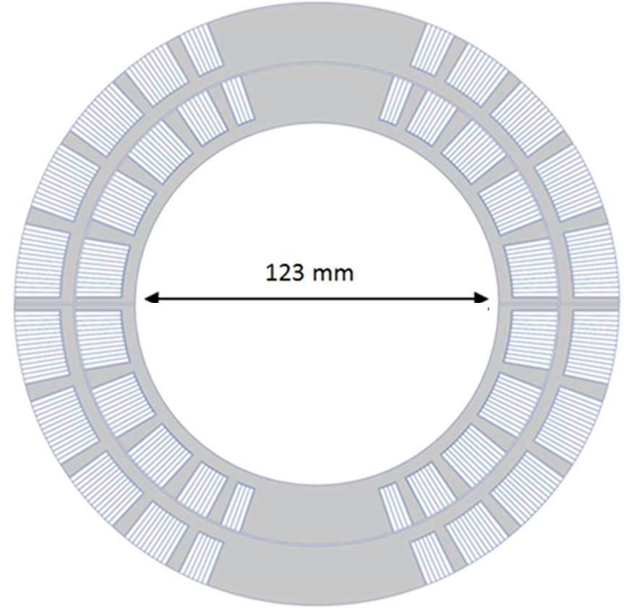
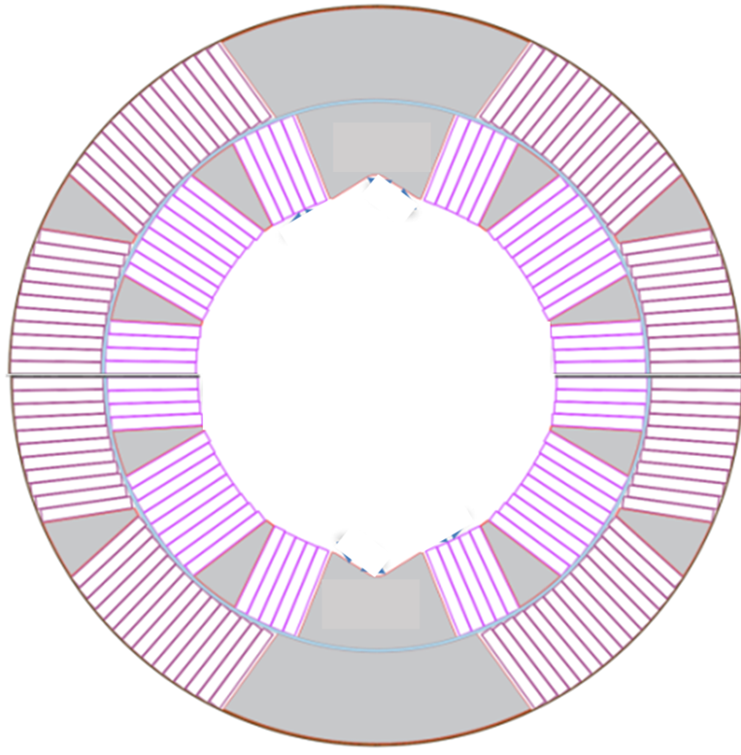
Towards 6L Hybrid HTS/LTS Dipole
123-mm 2-layer Nb₃Sn SMCT coil
Multilayer (6L) hybrid dipole coil
60-mm ID 2-layer Nb₃Sn coil (MDPCT1 inner coil)
19 mm ID 2-layer Bi2212 SMCT coil
1st 123-mm 2L Nb₃Sn SMCT coil has been tested
Development and test of 4L configuration in progress
4L dipole mirror has been assembled and tested
4L Nb₃Sn dipole magnet may be available in 2025

Slide 9
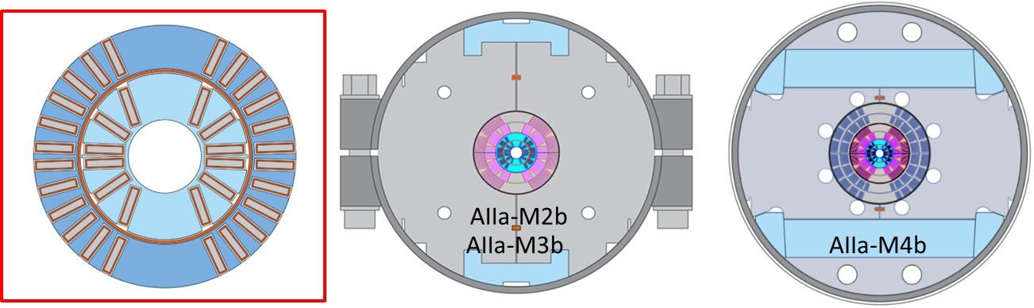
Bi2212 SMCT insert goal correction
Milestone # | Description | Target
AIIa-M2b | Design and fabricate the first small-aperture Bi-2212 coil using LBNL cable. Coil test independently and inside a 60-mm aperture 2-layer Nb₃Sn dipole coil in mirror configuration. | Dec-24
AIIa-M3b | Design and fabricate the 2nd small-aperture Bi-2212 coil using optimized Bi-2212 cable, coil structure, materials and technologies. Coil test independently and inside a 60-mm aperture 2-layer Nb₃Sn dipole coil in mirror configuration. | Dec-25
AIIa-M4b | Fabricate another small-aperture Bi-2212 coil using optimized Bi-2212 cable and coil structure. Bi-2212 coil test independently and inside a 60-mm aperture 4-layer Nb₃Sn dipole coil. - TBC | June-26
Task progress is limited by the available resources

Slide 10
Summary
The HTS coil technology based on a Bi2212 cable and SMCT coil design is being developed at Fermilab in collaboration with LBNL/NHMFL in support of the 20 T hybrid dipole task and other possible applications
After design studies, the final 2L design of Bi2212 dipole has been selected
Several practice models of the coil support structure have been 3D printed of plastic and used to develop and optimize coil winding and impregnation tooling and procedures
  the development of the coil reaction tooling will start soon
15 m long piece of Bi2212 cable is available for the first model. The cable request for the second coil has been submitted
Bi2212 coil engineering design is complete, Inconel 718 coil part procurement is in progress
Preparation to individual coil test with SC transformer is in progress
Development towards 4L and 6L Hybrid Bi2212/Nb₃Sn test configurations continues
  coil powering and protection still need to be analyzed and addressed
Bi2212 SMCT insert coil R&D plan has been reviewed and updated

Slide 11
Result discussion and publication
The work progress and results are being presented and discussed at various meetings and conferences and published
Presentations (since CM7):
A.V. Zlobin, «FNAL Bi2212 SMCT insert program update,» US MDP general meeting, 21 June 2023
E. Barzi, “The need to replace Bi2212 wire design for no-leaks magnets,” US MDP general meeting, 25 Oct 2023
Publications:
A.V. Zlobin, I. Novitski, E. Barzi (Fermilab) and P. Ferracin (LBNL), “A 20 T dipole magnet based on hybrid HTS/LTS coils with stress management,” IPAC’2023, Venice, Italy, 7-12 May 2023.
ASC’2024 abstracts:
E. Barzi et al., “Development and test of a subscale cos-theta dipole coil made of Bi2212 Rutherford cable”, oral

