Slide 1
Transverse stress susceptibility of Bi-2212 Rutherford cables at 4.2 K and 11 T
Anna Kario, Simon Otten, Sander Wessel, Jeroen Bijlsma, Mark Smithers, Herman ten Kate, Amalia Ballarino
Tengming Shen (LBNL), Ulf Trociewitz, Daniel Davis, Ernesto Bosque, David Larbalestier (FSU/NHMFL)

Slide 2
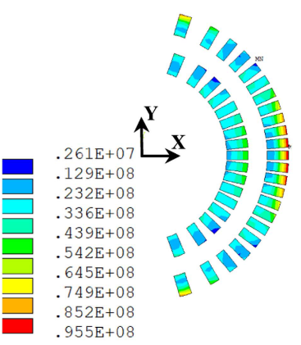
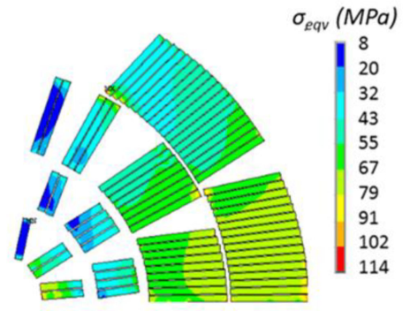
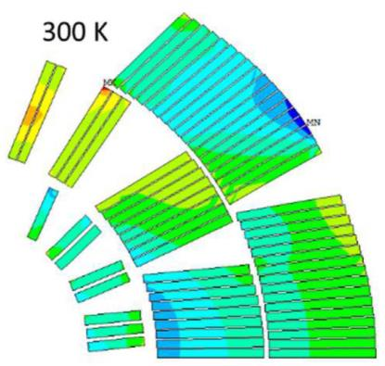
Motivation: stress in Bi-2212 dipole magnets
80 to 105 MPa azimuthal stress present in recent high-field Bi-2212 dipole magnet designs
Apart from one early date test, there are no systematic test data existing on cables
It would be useful to have experimental data on stress limits for recent Rutherford Bi-2212 cables
Garcia Fajardo et al. (2022) https://doi.org/10.1109/TASC.2023.3264788
Zlobin et al. (2022) https://doi.org/10.1109/TASC.2022.3158635
Zlobin et al. (2023) https://doi.org/10.1109/TASC.2023.3264165
96 MPa peak stress
104 MPa peak stress
80 MPa peak stress
Results are also highly relevant for high-field solenoids under high radial compressive load!

Slide 3
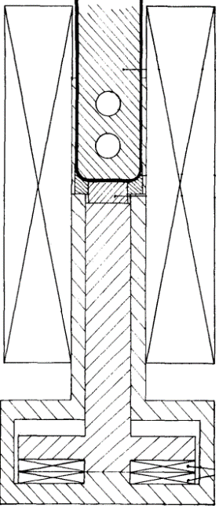
Content
Bi-2212 Rutherford cable
Bi-2212 samples and test setup
Sample preparation
Transverse stress results
Microstructural analysis of cable ross-sections
Conclusion
Cable press in 11 T solenoid

Slide 4
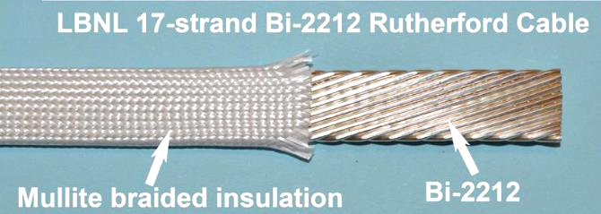
Bi-2212 Rutherford cable samples
Two sample were tested at Uni. Twente in transverse stress set-up
Zhang et al. (2018), https://doi.org/10.1088/1361-6668/aada2f
Cable cross-section
1.4 mm
7.8 mm
 | Sample 3 | Sample 4
Cable no. | LBNL1109 | LBNL2002
Number of strands | 17
Size excl. insulation | 7.8 mm x 1.4 mm
Twist pitch | 58 mm
Bi-2212 wire | Nontwisted PMM180207_4, 5, 6 ,7, 55x18, 0.8mm, Engi-mat powder LXB103 | PMM190118, 55x18, 0.8mm, Engi-mat LXB156
Insulation | Mullite sleeve, 150 µm thick
Test date at Uni. Twente | December 2022 | June 2023
Wire cross-section (Zhang et al.)
0.8 mm

Slide 5
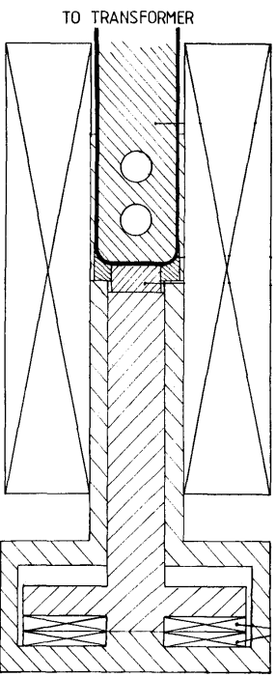
Transverse stress setup
50 kA trans-former
50 kA superconducting transformer
11 T solenoid magnet
250 kN press
4.2 K helium bath
Sample holder
11 T solenoid
Press coils
Image by Boschman et al.
https://doi.org/10.1109/20.133551

Slide 6
Content
Bi-2212 Rutherford cable
Bi-2212 samples and test setup
Sample preparation
Transverse stress results
Microstructural analysis of cable ross-sections
Conclusion
Cable press in 11 T solenoid

Slide 7
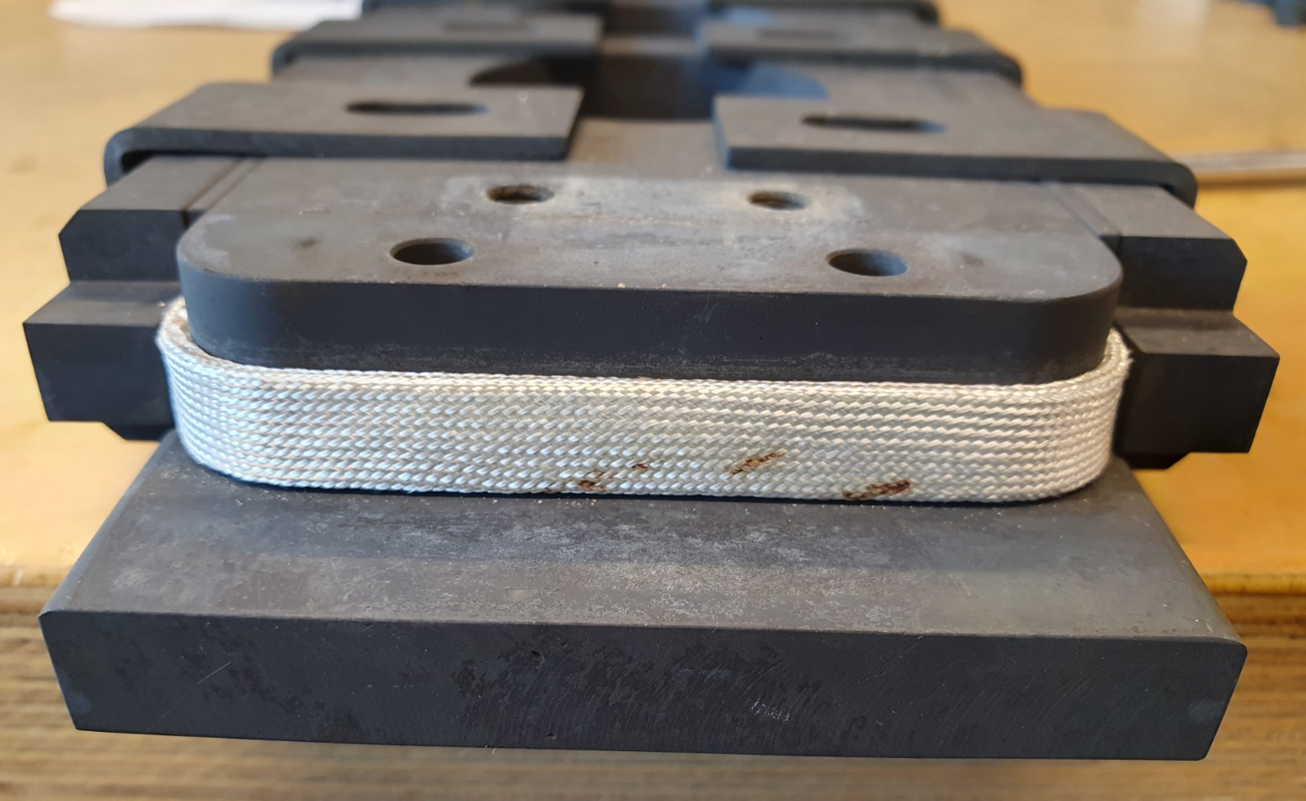
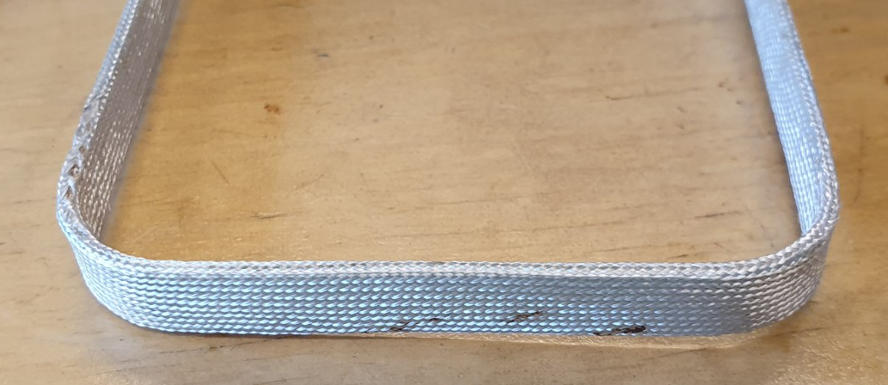
Rutherford cable after heat treatment
Pictures of sample 4 after heat treatment
Stainless steel reaction holder
Bi-2212 Rutherford cable in mullite sleeve
46 mm
Bi-2212 Rutherford cable in mullite sleeve
Removed from the holder
The samples were heat treated at NHMFL in 49:1 mixture of argon and oxygen with a total gas pressure of 50 bar (892°C)

Slide 8
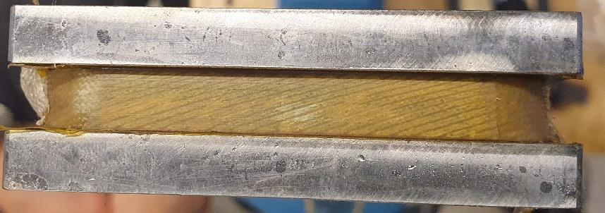
Epoxy impregnation
Impregnation setup
Vacuum impregnation with CTD-101k at 60°C, 0.6-0.8 mBar
Cured for 5 hour at 110°C and 16 hour at 125°C in a furnace
Vacuum chamber
Rod for moving the sample
Sample holder
Sample surface after heat treatment
50 cm
Heated resin container
45 mm pressed section

Slide 9
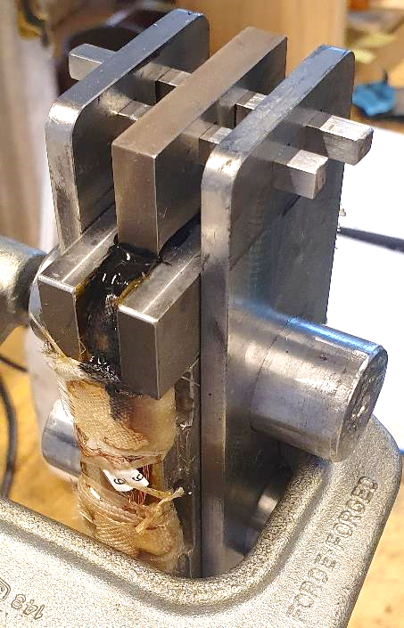
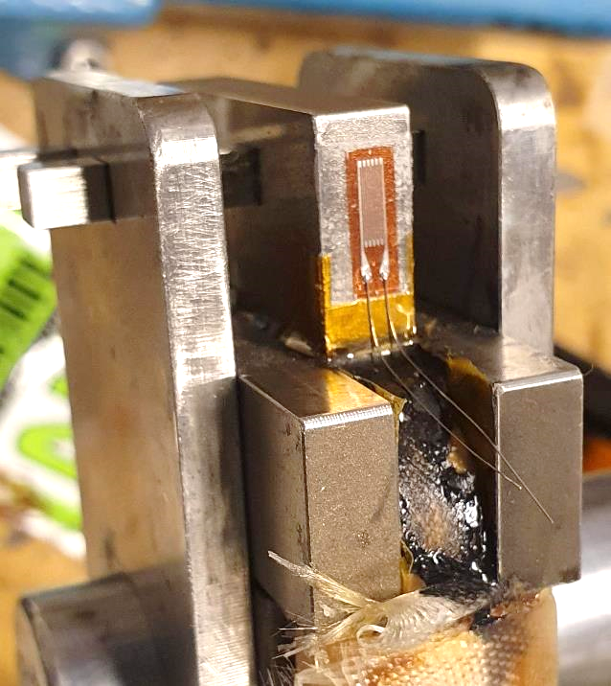
Pushing block positioning
Pushing block
Alignment plates
(removed when Stycast cured)
Block glued onto the sample with Stycast 2850FT/23LV and three layers of glass fibre ribbon
Pushed area is 8.1 mm x 45 mm = 3.654 cm²
Strain gauge (CFLA-6-350-17) on each side of the pushing block
Attached with cyano-acrylate glue (TMI CN)

Slide 10
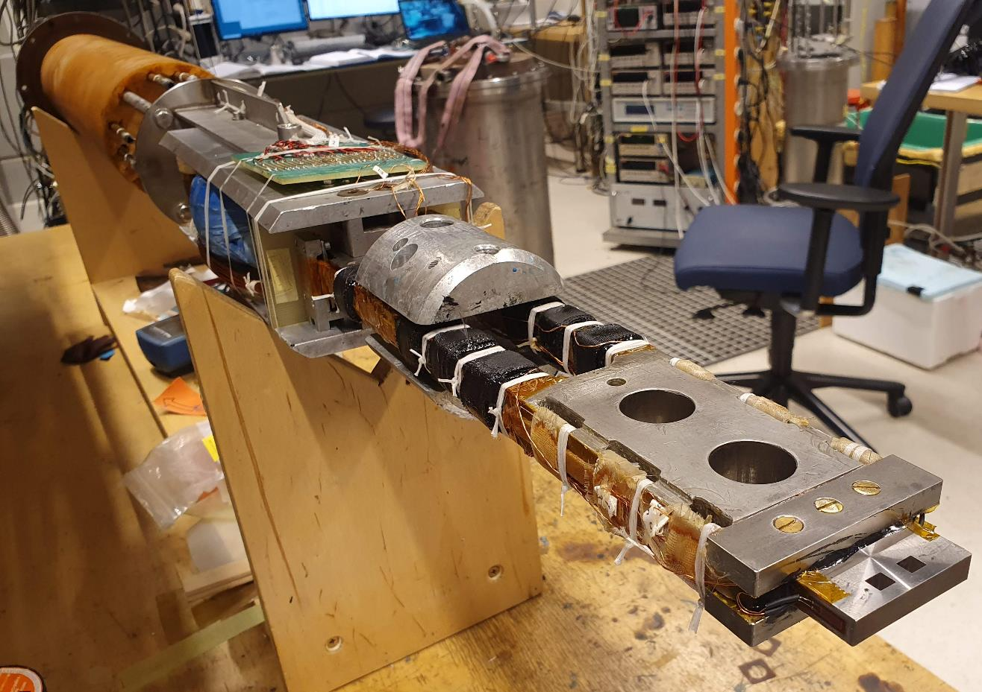
Sample connection to the transformer
Transformer
Joints
Bi2212-Rutherford cable
Soldered over $2ℓ_{t}=116 mm$ with SnAg. Fixed with Stycast.
Sample holder
Pushing block

Slide 11
Content
Bi-2212 Rutherford cable
Bi-2212 samples and test setup
Sample preparation
Transverse stress results
Microstructural analysis of cable ross-sections
Conclusion
Cable press in 11 T solenoid

Slide 12
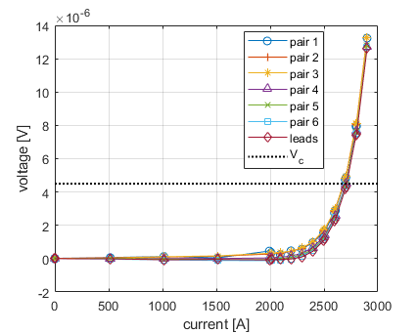
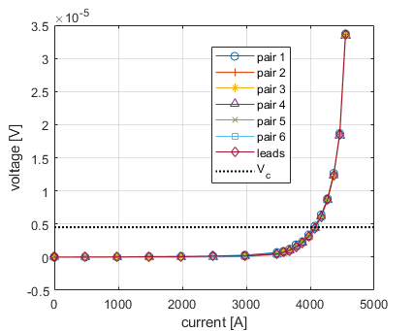
Initial VI curves
T = 4.2 K, B_{a} = 11 T, σ = 10 MPa
Voltage measured on 6 strands and current leads; they all look smooth and consistent
Voltage criterion of 4.5 µV results from E_{c} = 10⁻⁴ V/m and 45 mm pushing block length
Sample 3: LBNL1109 (Dec 2022)
Sample 4: LBNL2002 (June 2023)
I_{c} = 2.70 kA
n = 15
I_{c} = 4.07 kA
n = 15
V_{c} = 4.5 µV
V_{c} = 4.5 µV

Slide 13
Initial I_{c}(B) curve
Critical current and n-values at 10 MPa, 4.2 K
Comparison of samples:
Sample 3: LBNL1109, tested Dec 2022
Sample 4: LBNL2002, tested June 2023
Engineering current density at 5 T applied field using 7.8 mm² cross-sectional area is: 422 A/mm² for sample 3,
650 A/mm² for sample 4 (54% increase)
n-values are 14 to 15 for both samples and all applied fields in the range 5 to 11 T.
$$ℓ=45 mm,$$
$$V_{c}=4.5 µV$$
Sample 4 Ic (new)
Sample 3 Ic
n-values

Slide 14
Critical current versus transverse stress
Sample 3: LBNL1109 (Dec 2022)
Applied field 11 T, data normalized to initial I_{c} of 2.70 kA (sample 3), and 4.07 kA (sample 4)
Measurement sequence:
10 MPa
20 MPa
10 MPa
30 MPa
10 MPa
40 MPa
etc.
5% degradation reached at: 170-200 MPa in sample 3 and 120-150 MPa in sample 4
B_{a} = 11 T
Sample 4: LBNL2002 (June 2023)
B_{a} = 11 T

Slide 15
Comparison of the two samples 3 and 4
Sample comparison
Sample 3: LBNL1109, tested Dec 2022
Sample 4: LBNL2002, tested June 2023
Stronger stress dependence observed in sample 4, at 150 MPa:
Sample 3 has 3% degradation, whereas
Sample 4 has 6% degradation
Critical current as function of transverse stress
B_{a} = 11 T
The difference between the samples at 100 MPa is 1.5% and at 150 MPa is 3% only
Globally, from a magnet application point of view, the samples behave practically the same.

Slide 16
I_{c}(B) curves after applying 200 MPa
Sample 3: LBNL1109 (December 2022)
7 to 8% field-independent I_{c} reduction
n-value dropped by 1 to 2 points
Sample 4: LBNL2002 (June 2023)
12 to 13% field-independent I_{c} reduction
n-value dropped by 2 to 3 points
σ = 10 MPa
σ = 10 MPa
σ = 10 MPa

Slide 17
Effect of mechanical load cycling 10 to 200 MPa
Sample 3: LBNL1109 (December 2022)
2.5% I_{c} reduction after 50 cycles
No significant change in n-value
Sample 4: LBNL2002 (June 2023)
3.6% reduction after 50 cycles
4.6% reduction after 200 cycles
No significant change in n-value
B_{a} = 11 T
B_{a} = 11 T
Load cycling I_{c} reduction at 200 MPa is modest (some 5 %), and saturating (good) .

Slide 18
Content
Bi-2212 Rutherford cable
Bi-2212 samples and test setup
Sample preparation
Transverse stress results
Microstructural analysis of cable ross-sections
Conclusion
Cable press in 11 T solenoid

Slide 19
Microstructural analysis cross-sections of sample 3
Silver matrix removed with NH₃OH and H₂O₂
LBNL1109
5 cross-sections examined (200 MPa, 8% I_{c} decrease)
No obvious damage seen yet, main degrading cause not yet identified
I_{c}-degradation = broken current path + some residual stress redistribution effect
In Nb₃Sn we see filament µm-cracking, current in entire filament interrupted
May be here (hypothesis, for discussion) we brake with nm-cracking current path at grain boundaries mainly on surface of filaments, not leading to global cracking……
Sample 4 has seen 300 MPa and -45%, next to be examined….

Slide 20
Conclusion
Results obtained on 2 Bi-2212 cable samples, another 2 to be tested
Initial whole cable critical current density at 5 T applied field was 422 A/mm² in sample 3 (LBNL1109) and 650 A/mm² in sample 4 (LBNL2002)
5% critical current decrease reached at an average transverse stress of 170 to 200 MPa in sample 3 and at 120 to 150 MPa in sample 4
Progressive I_{c} reduction (but saturating) observed in both samples when cycling between 10 and 200 MPa
All changes in critical current were irreversible
LBNL1109

Slide 21
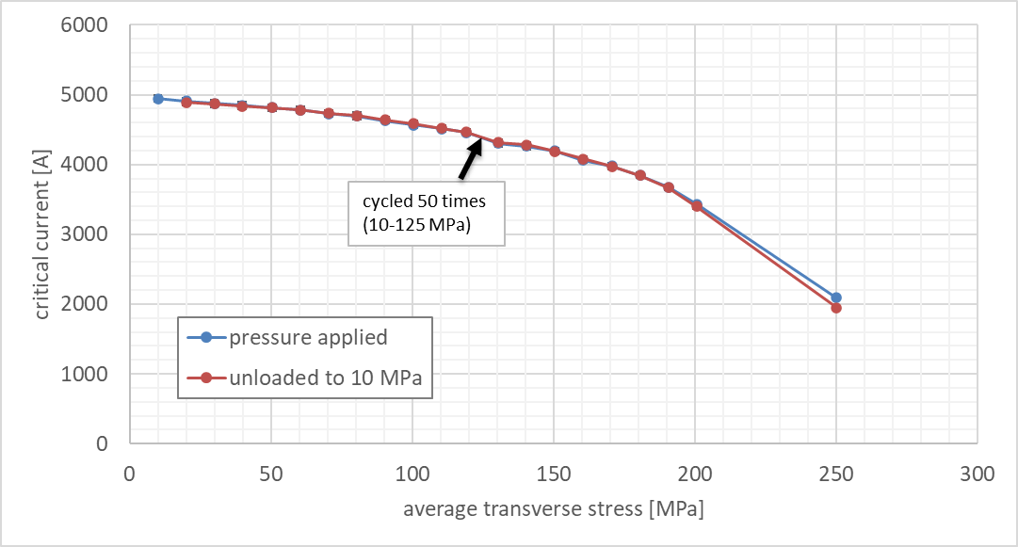
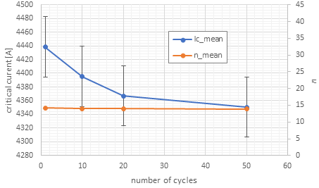
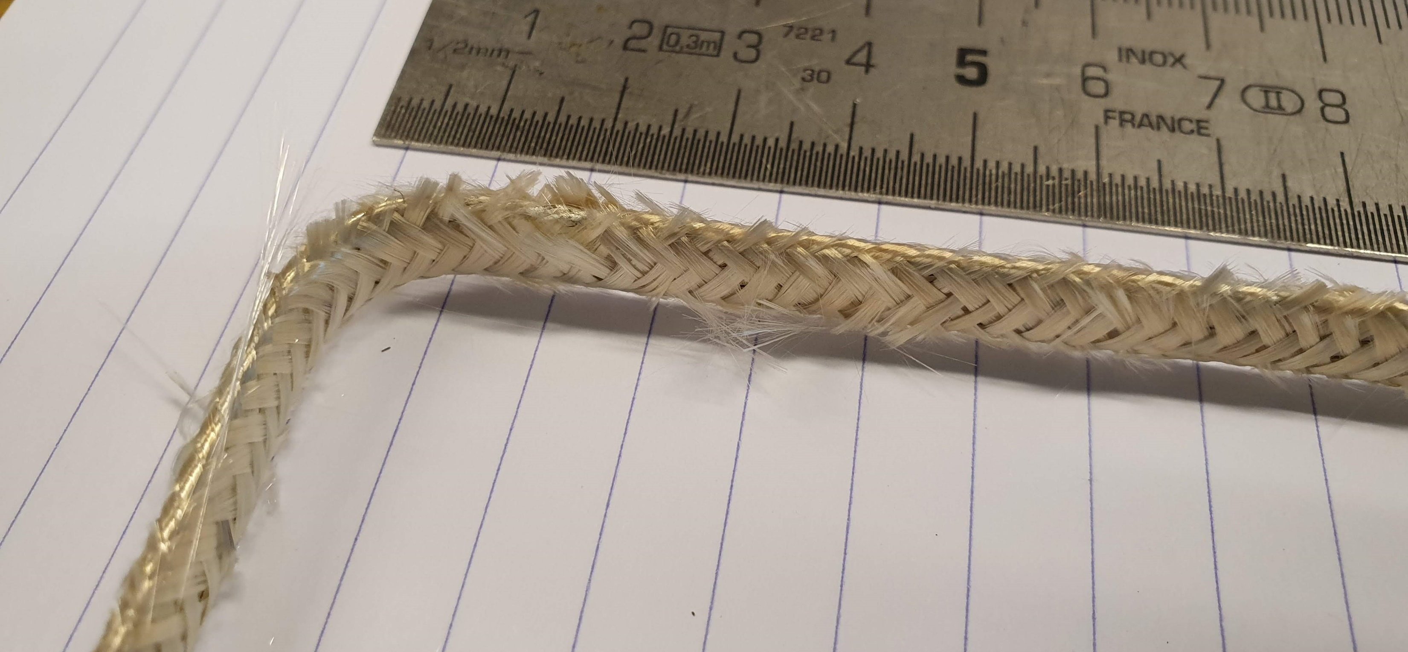
I_{c}(B) curves after applying 250 MPa
Sample 5: LBNL1109 (February 2024)
2 % I_{c} reduction after 50 cycles
No significant change in n-value
B_{a} = 11 T
B_{a} = 11 T
J_{c} = 782 A/mm² @ 5 T
Cycling between 10 and 125 MPa
24

Slide 22
Curve shape observations for samples 3 and 4
Sample 3 shows negligible degradation up to 50 MPa (no significant initial slope)
Sample 4 shows immediate degradation (clearly visible slope)
But the global shape of the curves is the same…..
When sample 4 curve is moved to the right by 50 MPa they nicely overlap.
Why?
Maybe (an unproven guess) sample 4 has a 50 MPa stress hot spot in the cable (where and how not known)
Critical current as function of transverse stress
B_{a} = 11 T

Slide 23
Stress level increase to 300 MPa (1st time ever done)
Sample 4 (after load cycling at 200 MPa, so after some 5% extra reduction)!
Loaded at 250 MPa and 300 MPa
For the 1st time ever a Bi-2212 cable was stressed up to this level
Rough indication of the degradation:
some 20% at 250 MPa, and
some 45% at 300 MPa
Critical current as function of transverse stress
B_{a} = 11 T
Typical shape of degradation curve maintains
No sudden collapse but gradually increasing degradation effect

Slide 24
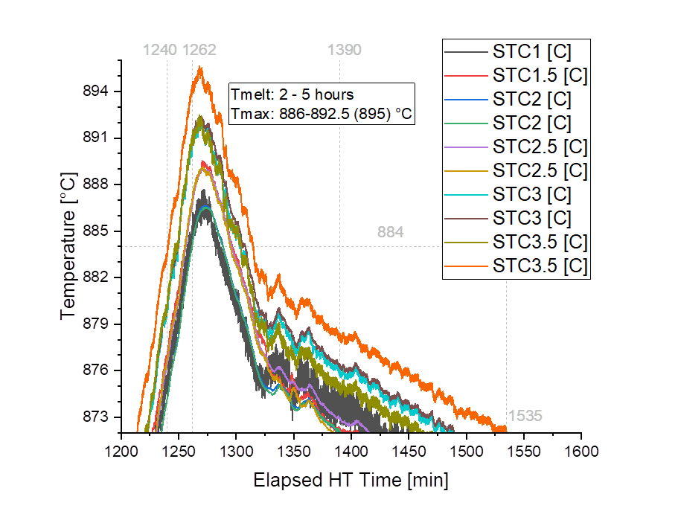
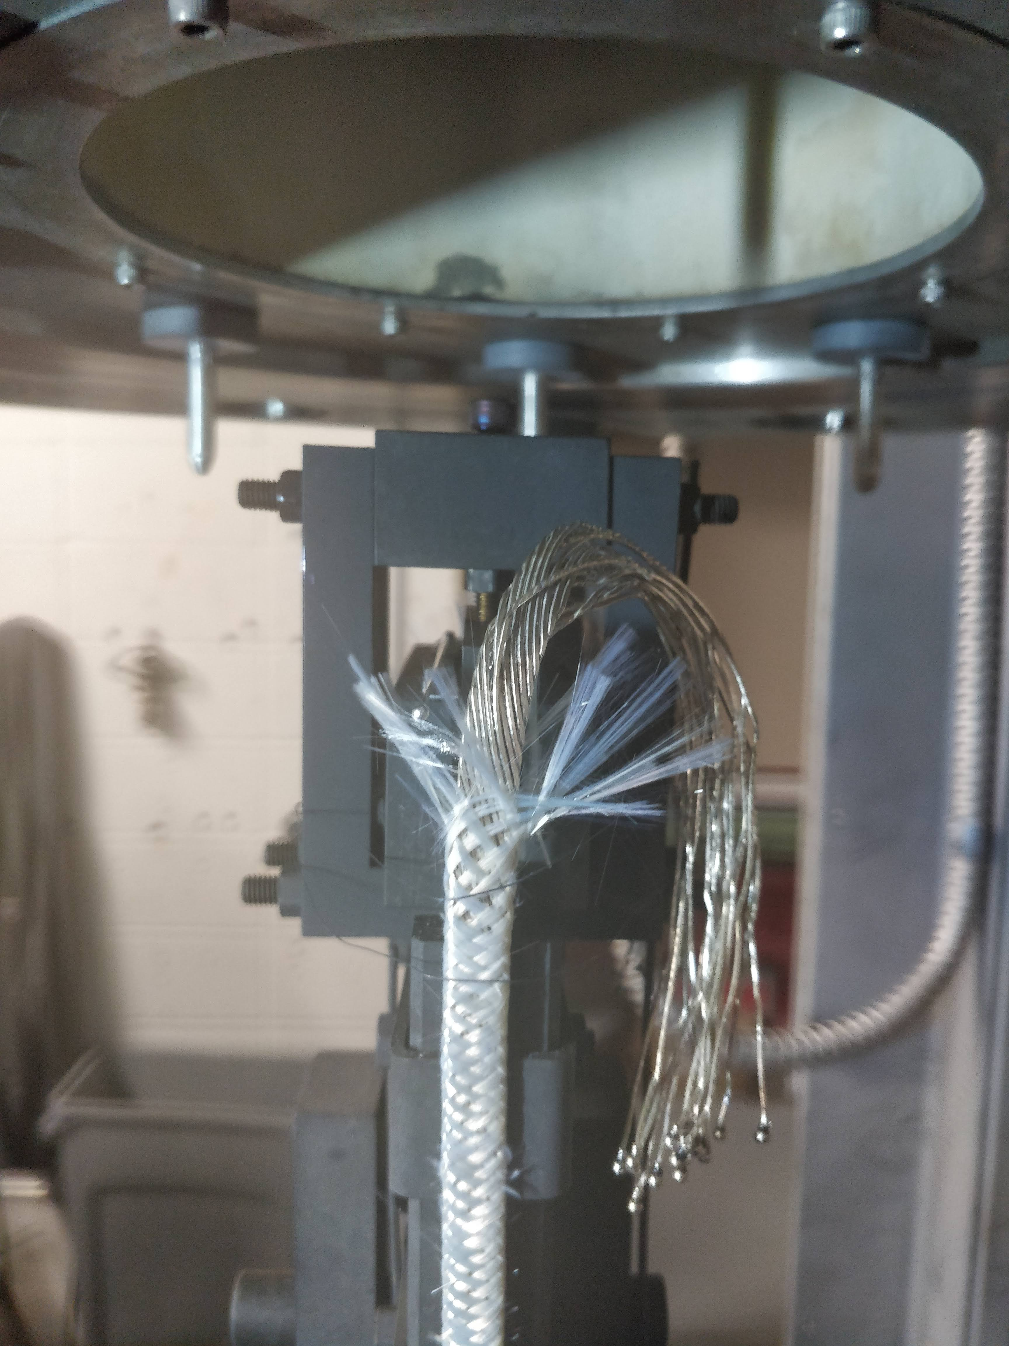
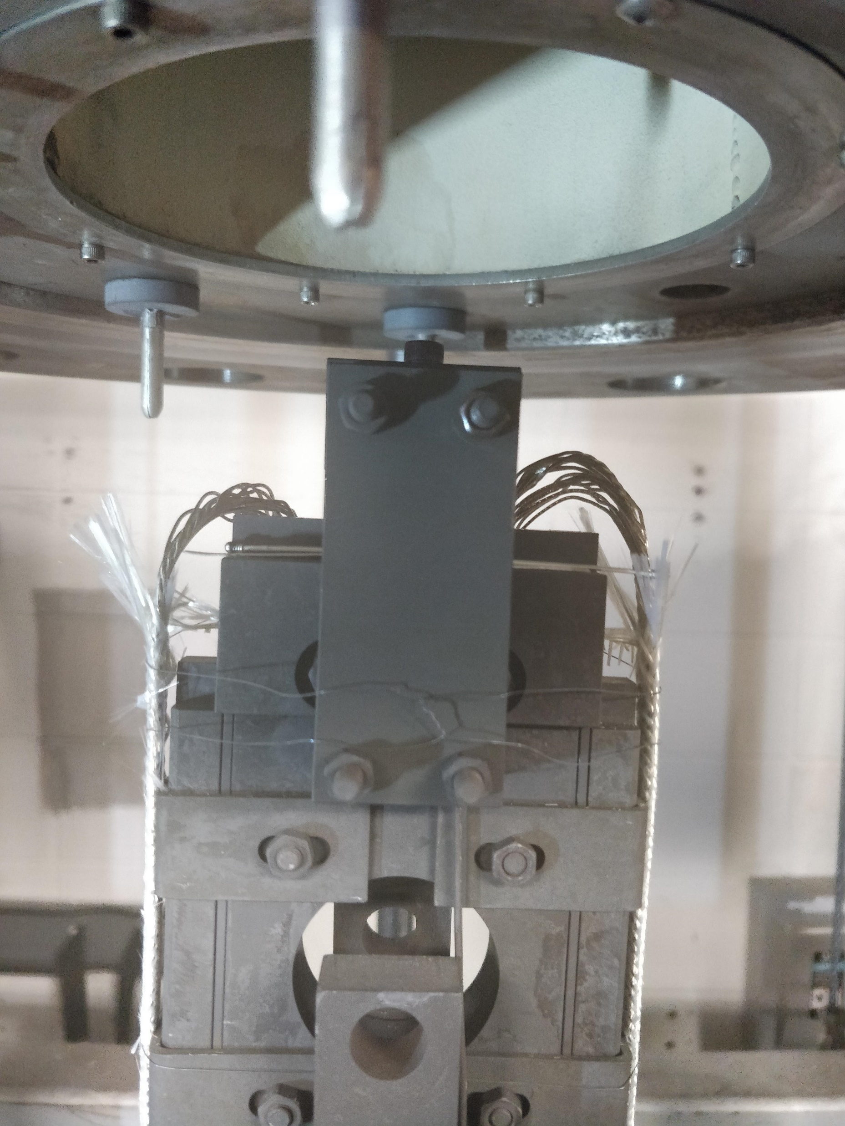
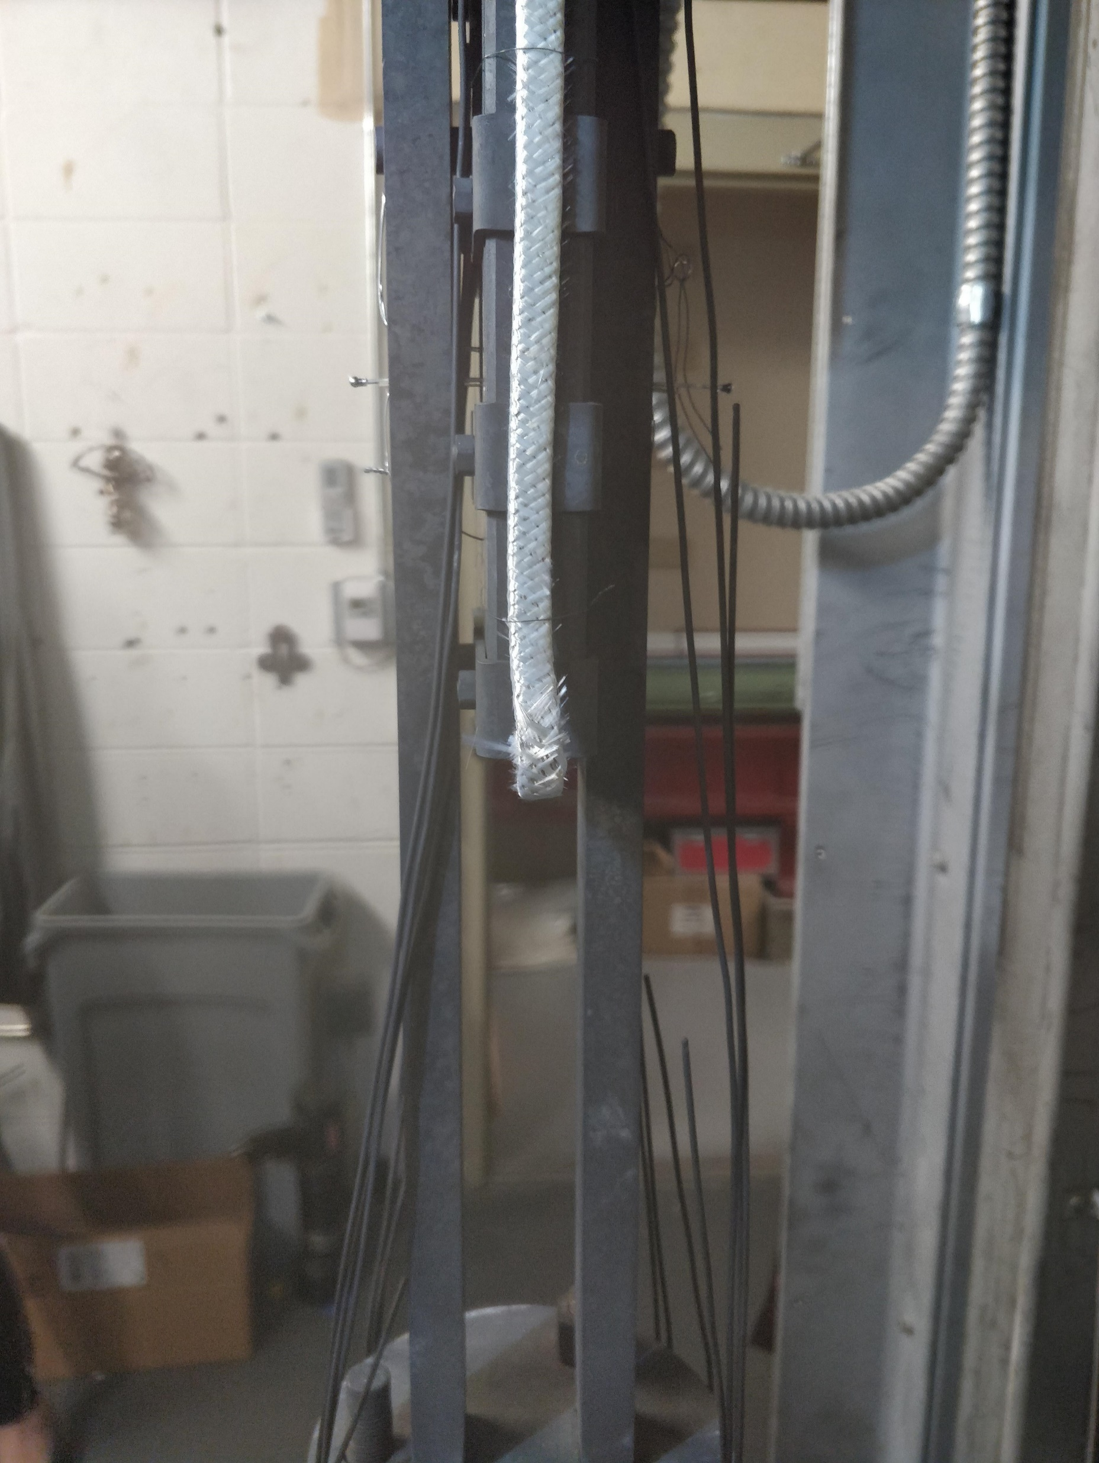
Heat treatment
 |  | J_{E} (A/mm^2) | index n-value
Zone 1.25, Top Witness Sample | 231120_TWENTE_Z1_25_PMM160301_I | 1020.2 | 22.69
Zone 3.0, Bottom Witness Sample | 231120_TWENTE_Z3_0_PMM160301_Ic | 914.7 | 18.53
Zone 1.5, "Left" lead sample | 231120_TWENTE_LEFT_Ic | 912.5 | 17.32
Zone 1.5, "Right" lead sample | 231130_TWENTE_RIGHT_Ic | 897.9 | 15.03
25

