Slide 1
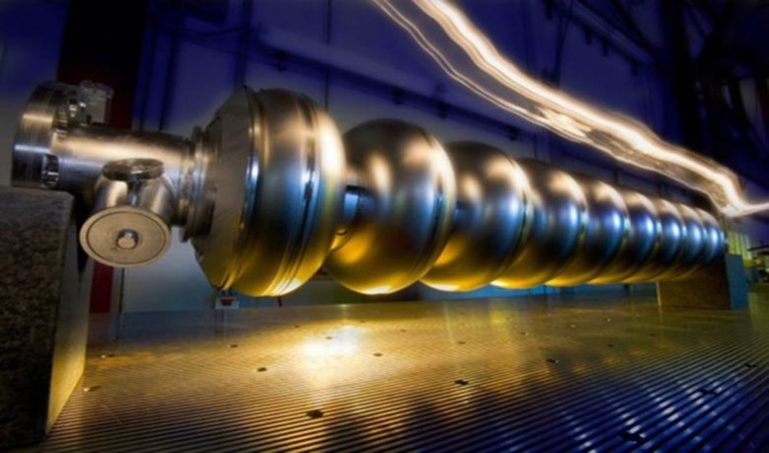
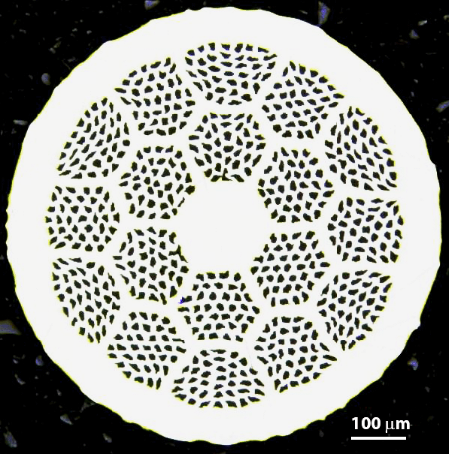




An ARDAP Project - Enhancing Domestic Production of High Temperature Superconducting Bi₂Sr₂CaCu₂O_{x}/Ag wires for High Field Magnets
ARDAP
Tengming Shen, LBNL
8th US Magnet Development Program Annual collaboration meeting, Fermilab, 04/30/2024-05/03/2024

Slide 2
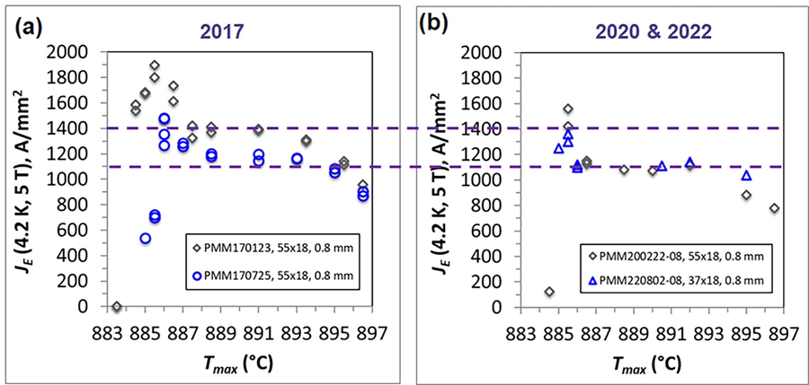
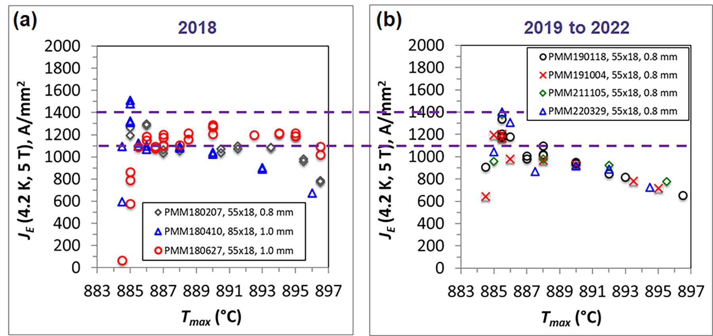
Motivations and background – wire front
2 kg billets
10 kg billets
Data by Dr. Jianyi Jiang, NHMFL with Billets from SBIR-STTR, CPRD.

Slide 3
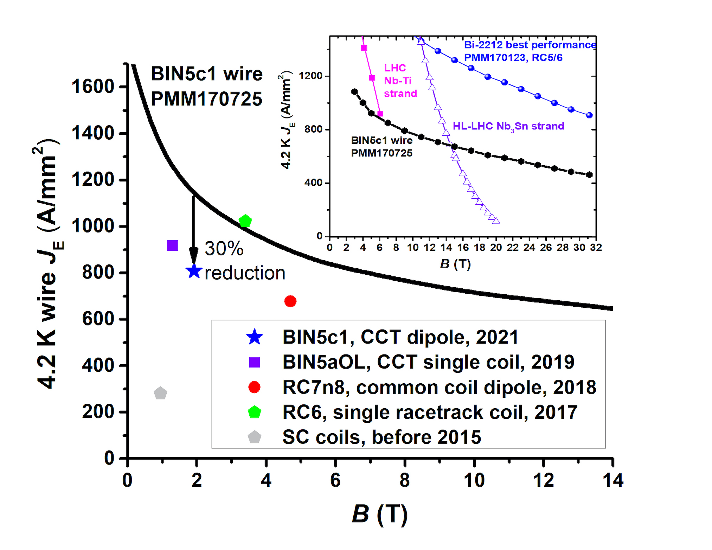
Motivations and background – cable and magnet fronts
Conductor science
Cable/coil fab
Made from 2 kg billets.
Made from 10 kg billet.
Made from a 2 kg billet.

Slide 4
Task overview
Task 1: Making precursor powder reproducible and improving production yield
Task 2: Manufacturing (five) 2 kg billets with reproducible plateau J_{E}(4.2 K and 5 T) > 1100 A/mm²
Task 3: Manufacturing (two) 10 kg billets with the target J_{E}(4.2 K and 5 T) > 1100 A/mm²
Task 4: Powder and wire characterization
Task 5: Understanding the science and technology of attaining high J_{E} in Bi-2212 Rutherford cables
Task 6: Demonstrating predictability in Bi-2212 coil heat treatment
Task 7: Insulation and leakage reduction for Rutherford cable coils
Task 8: Contracts to procure powder as a strategic reserve
Two billets produced.
A lot of new data
and understanding.
New insulation test.
Coil winding in progress.

Slide 5
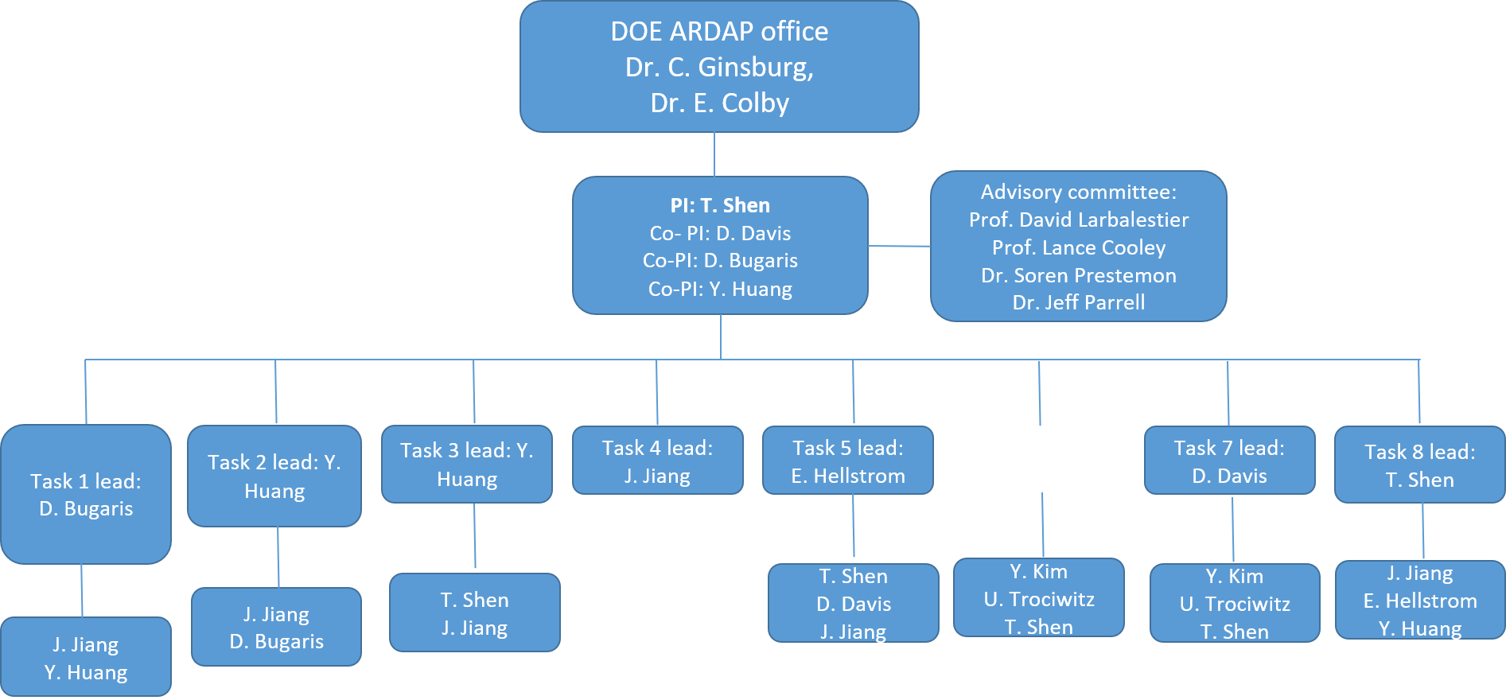
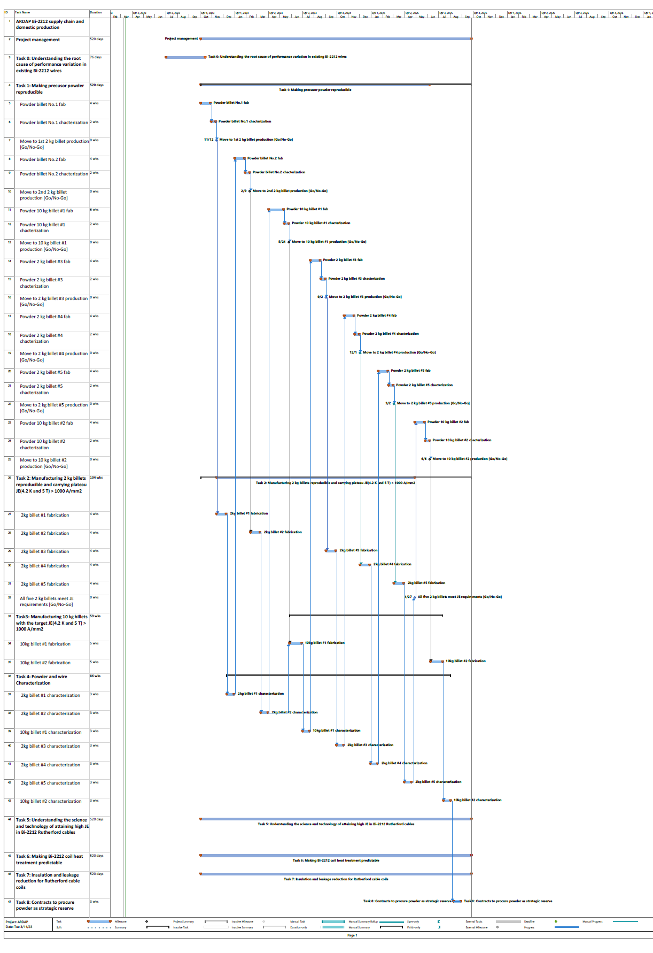
Project team and management
A virtual knowledge hub formed by private and public businesses, national labs and university
Supplemented by DOE-OHEP.
Daniel Davis, Ulf Trociewitz, Yongjae Kim
Jianyi Jiang, Eric Hellstrom
Tengming Shen*,
Jean-Francois Croteau, Marek Mosat, Chris Escobar
Fast-tempo.
Project-like management with milestones and risk mitigation measures.
Yibing Huang
Michael Brown
Daniel Bugaris
Claudia Goggin

Slide 6
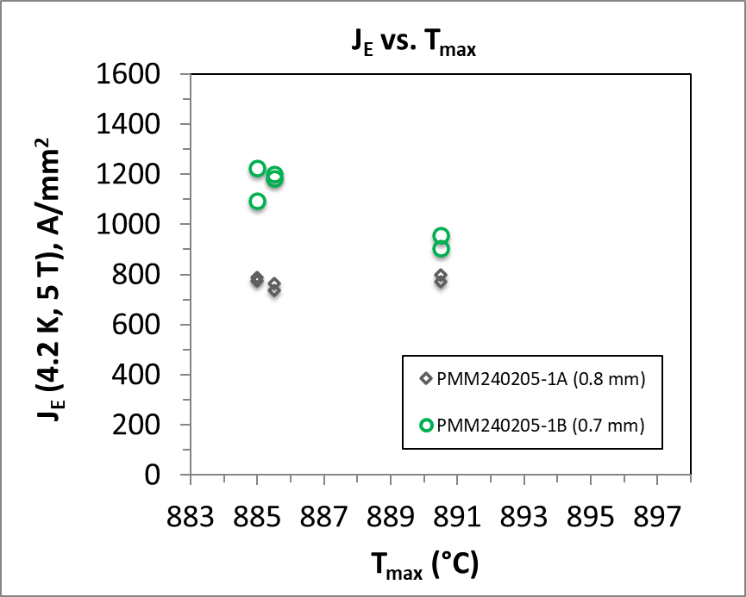
Task 1-4 – powder, wire manufacturing and characterization
Enhancing industry ability, product performance, and reproducibility
First 2 kg billet produced and received at LBNL.
Second 2 kg billet produced and QA/QC ongoing.
Third billet (10 kg billet) powder in production.
  1st batch with some secondary phase agglomeration.
First cable in May.
ARDAP billet #1
NEW understanding found by J. Jiang
(D. Larbalestier next)
(Potential end effect in this set of samples)

Slide 7
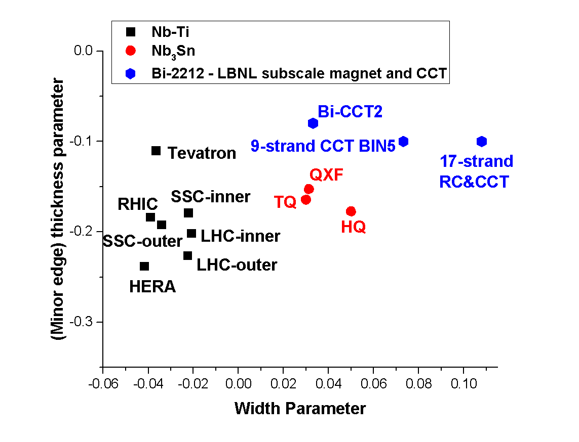
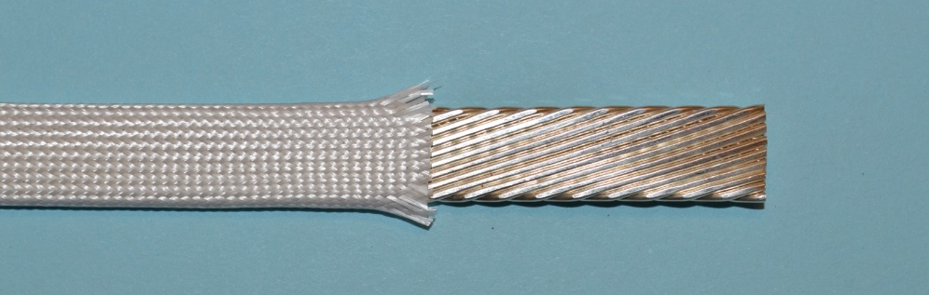
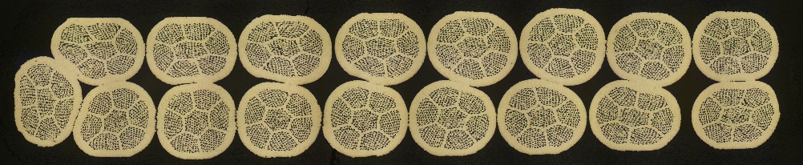
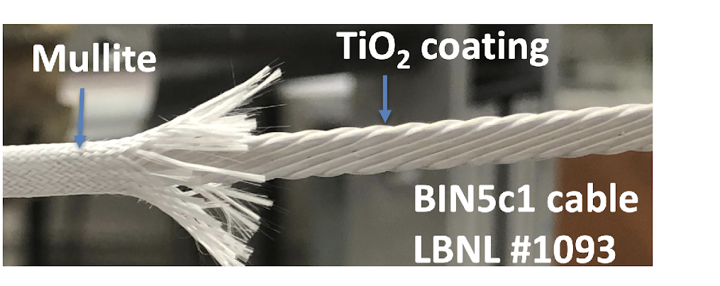
[Task 5] The science and art of fabricating 2212 Rutherford cables have yet been fully established
LBNL 17-strand Rutherford cable
Mullite braided insulation
Bi-2212
7
LBNL 9-strand Rutherford cable

Slide 8
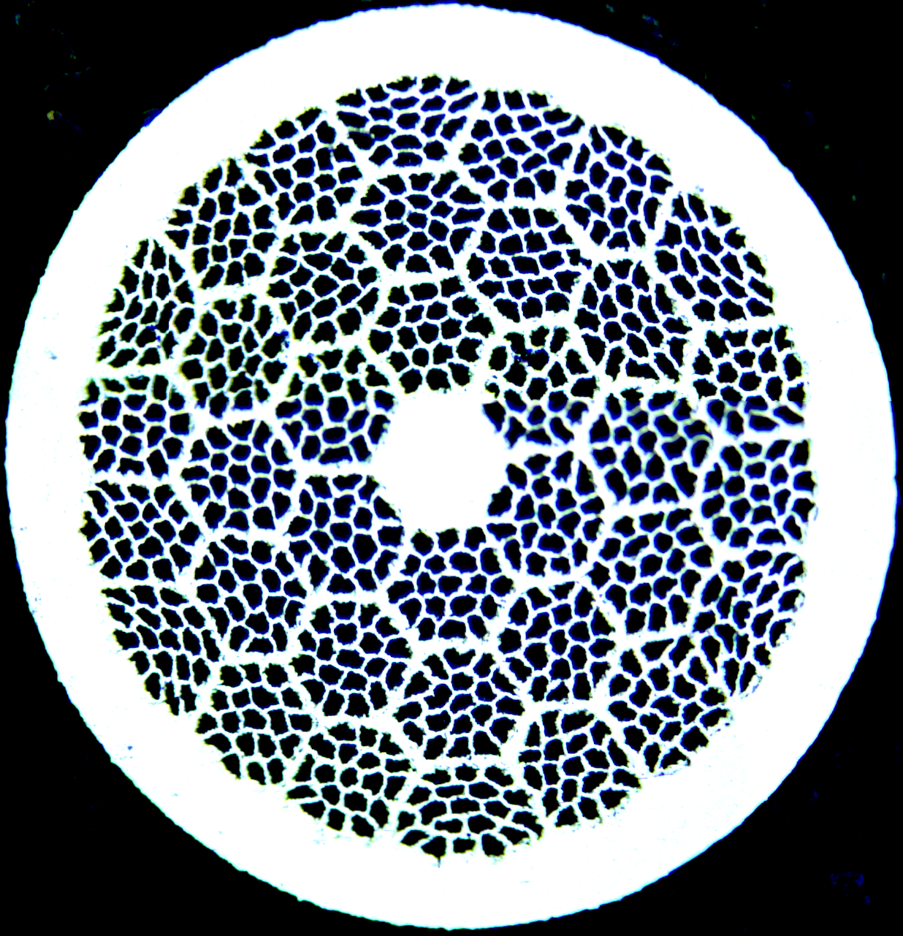
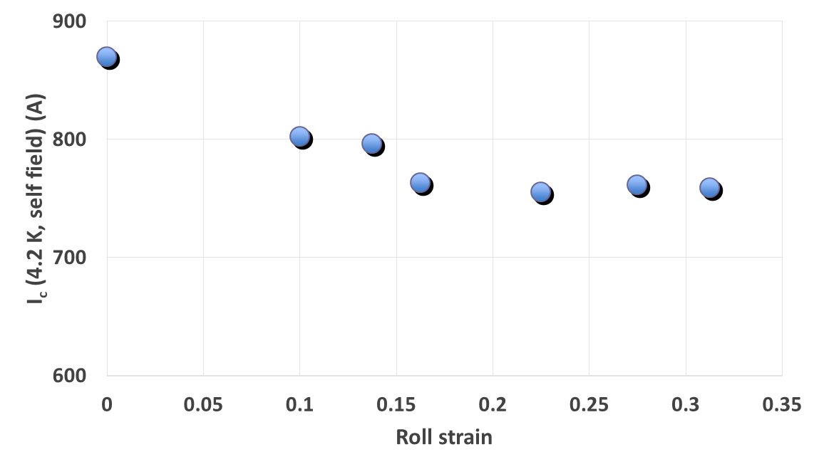
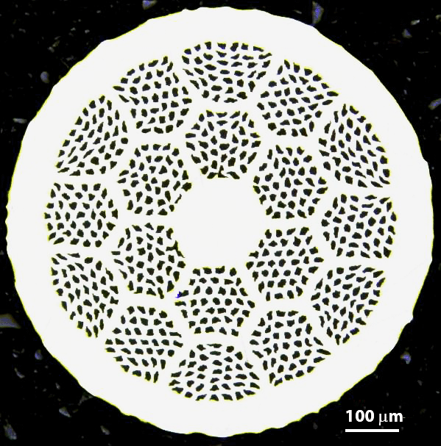
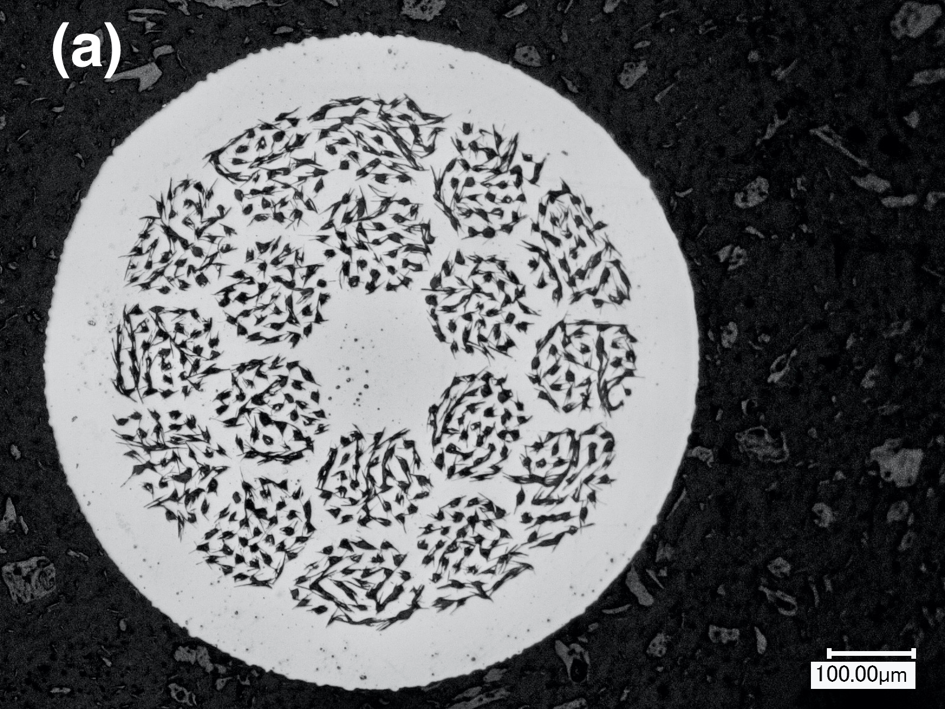
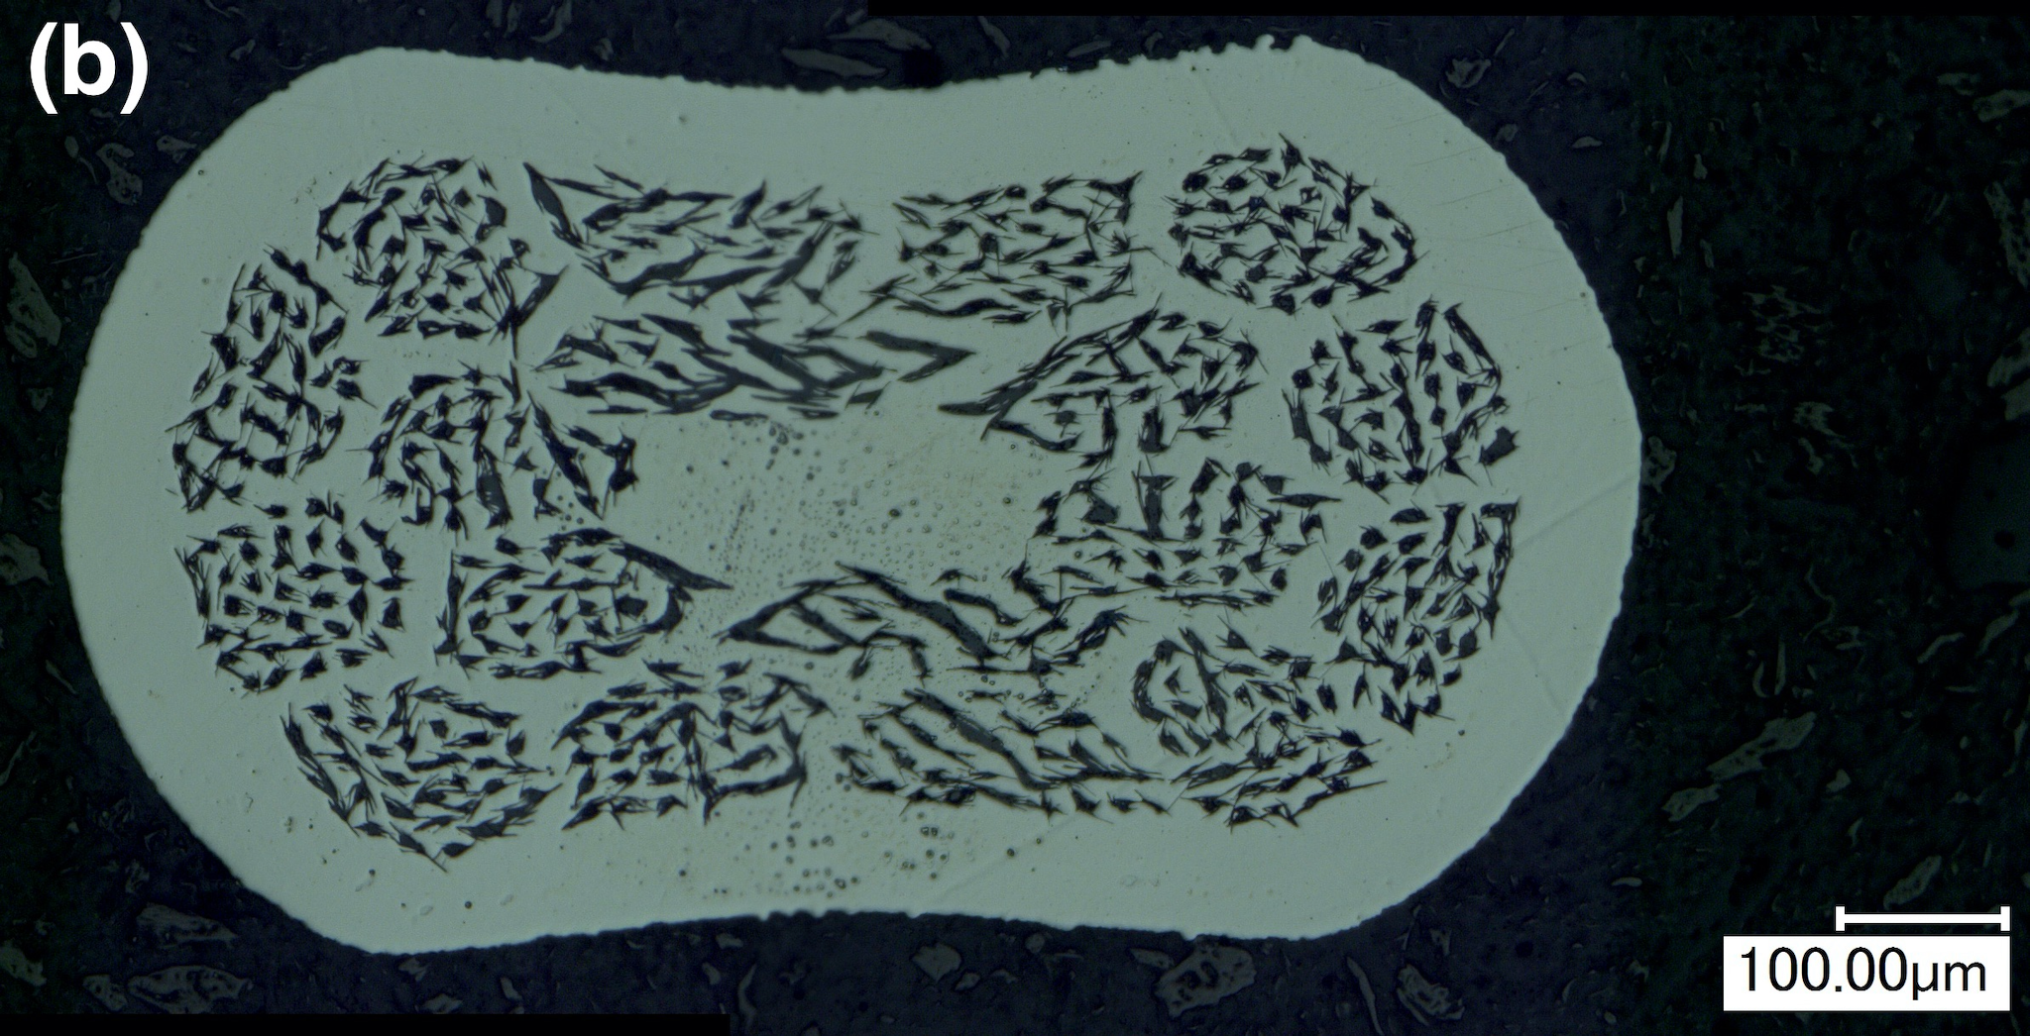
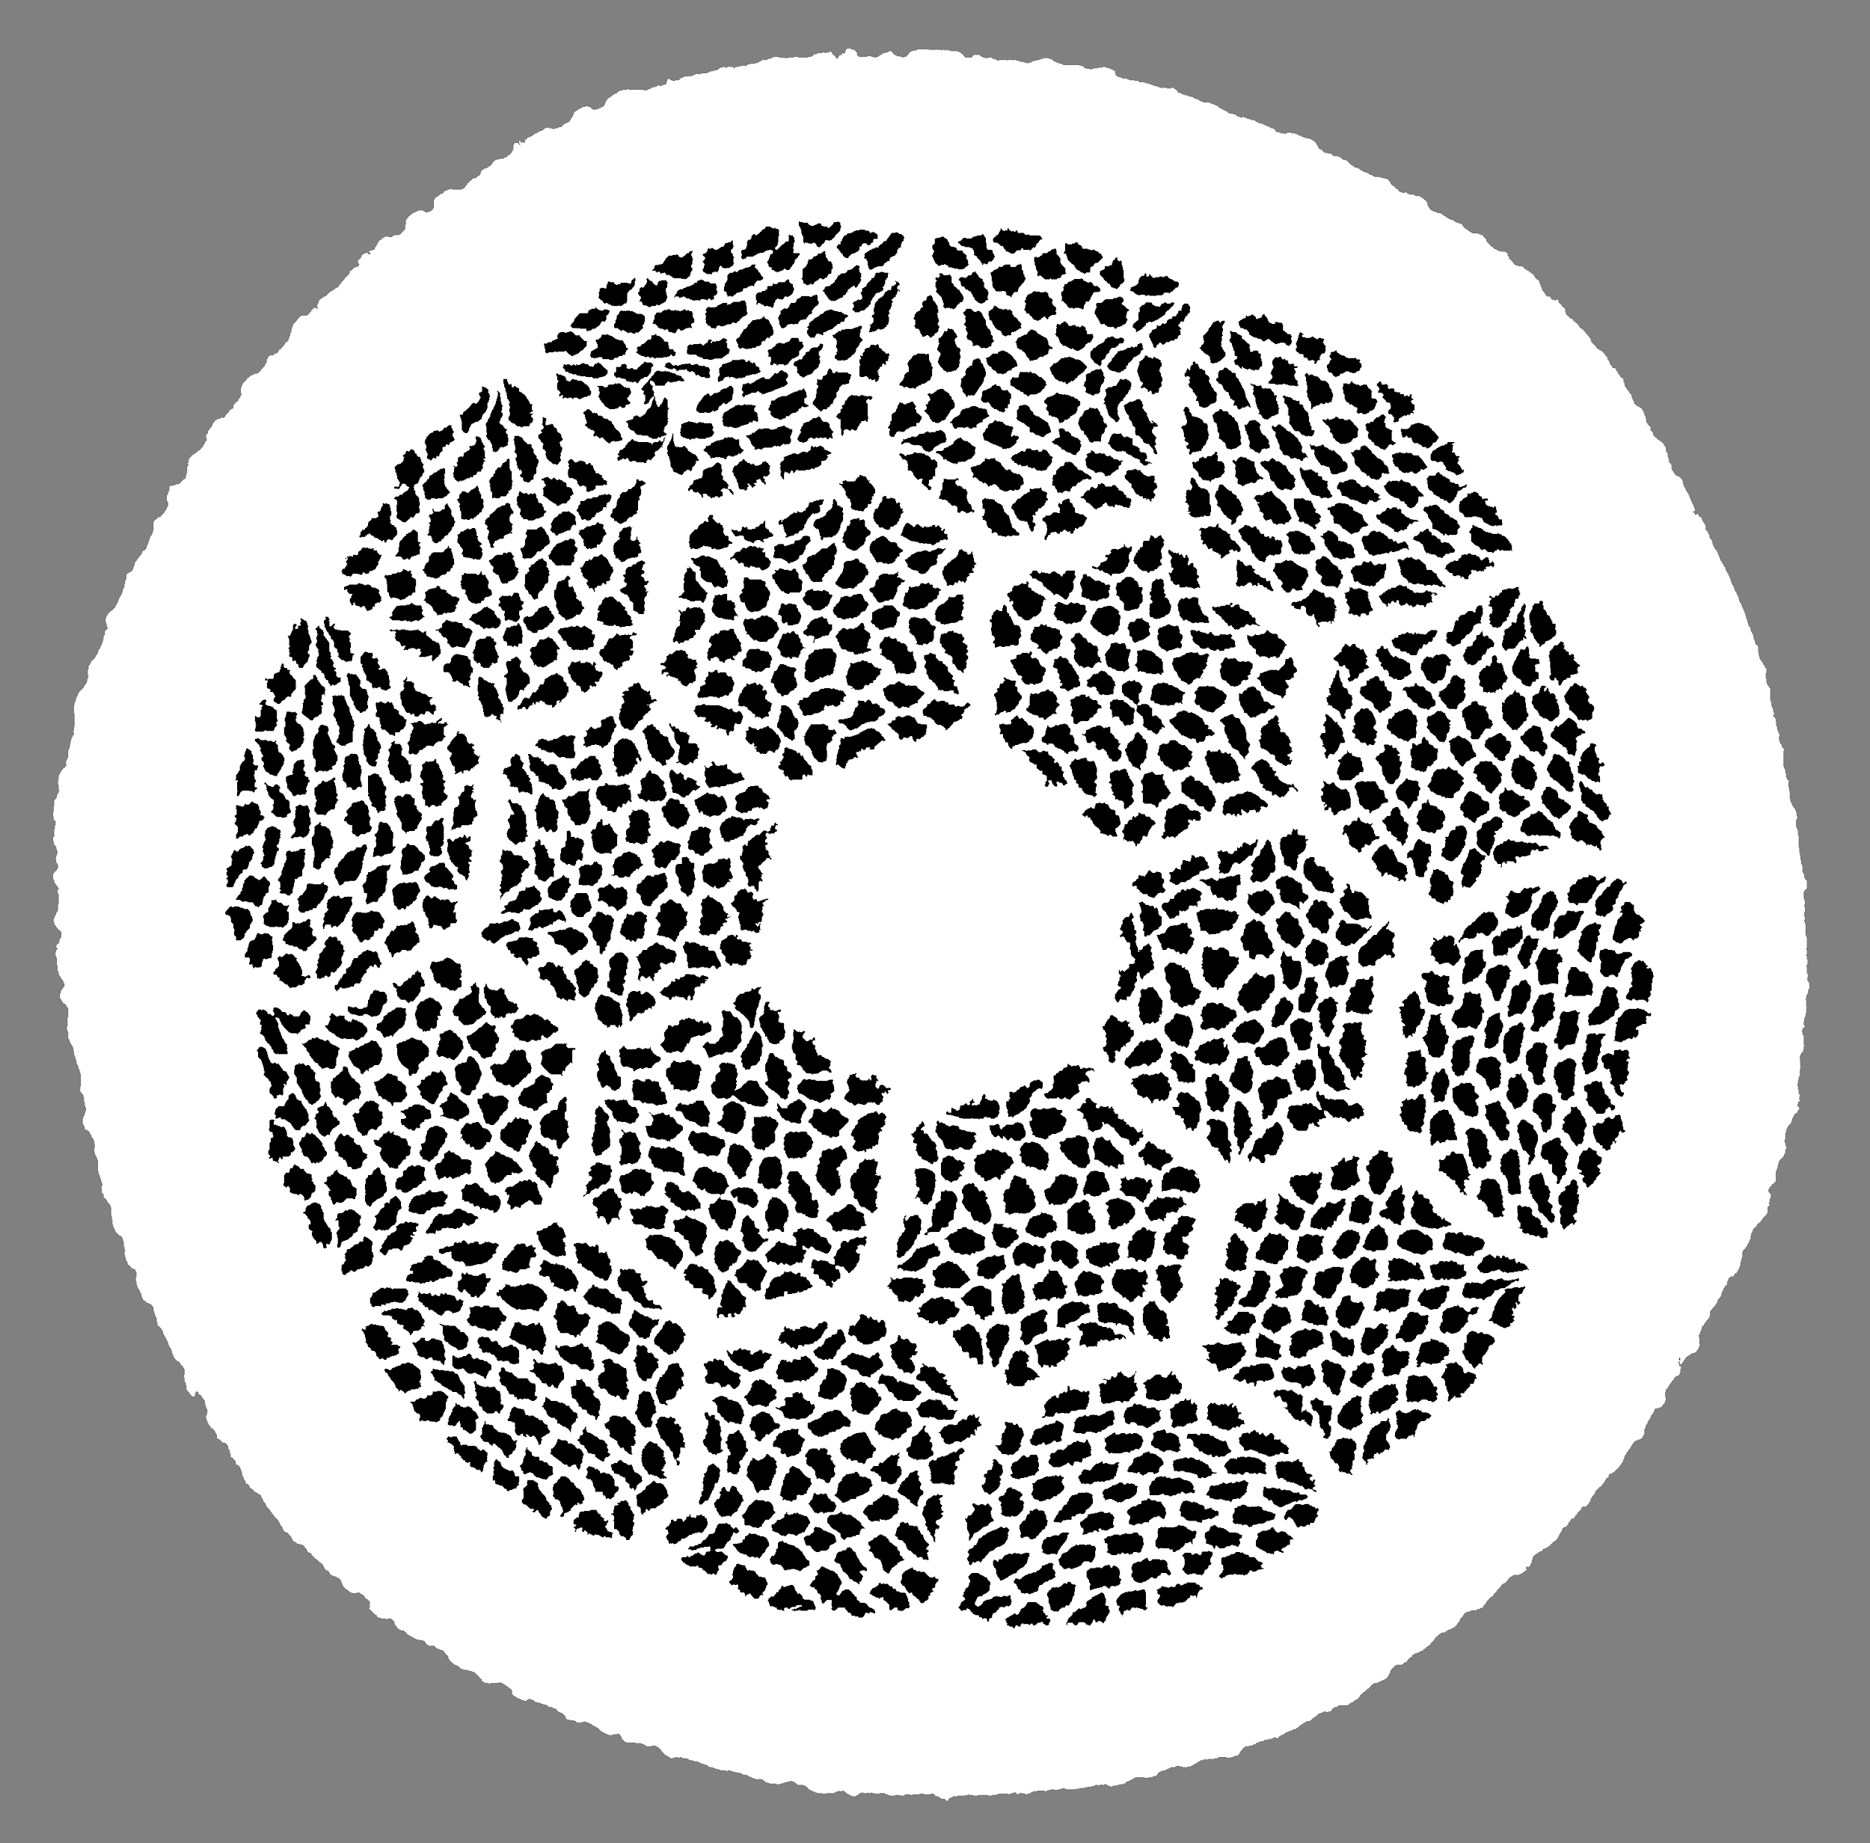
Technical progress
Task 5: Understanding the science and technology of attaining high J_{E} in Bi-2212 Rutherford cables
~13%
Shen et al., Scientific Reports Vol. 9, Art. No.: 10170 (2019) ​
Zhang et al Supercond. Sci. Technol. 31 105009 (2018)
After 50 bar OPHT
Strands | Powder | Coils
19 x 36, 0.8 mm strands | Nexans | RC1
37 x 18, 0.8 mm strands. | Nexans | RC2/3
55 x 18, 0.8 mm strands. | Engi-Mat | RC5/6/7/8, BIN5c1, BIN5OLa, Bi-CCT1OLa, Bi-CCT1ILb/c.
Shen et al., Phys. Rev. Accel. Beams 25, 122401 (2022);

Slide 9
Technical progress
Task 5: Understanding the science and technology of attaining high J_{E} in Bi-2212 Rutherford cables
19 x 36
Wire PMM220802, used for ARDAP CCT BIN5e magnet, 0.8 mm wire, 37 x18
37 x 18
Wire PMM170725, the wire used in cable 1093 and the magnet CCT BIN5c, 0.8 mm wire, 55 x18
55 x 18
Wire PMM211105, the candidate wire for the magnet Bi-CCT2. 1.0 mm wire, 55x18

Slide 10
Experiments
1. 50 bar OP-PD (830 °C/12 hrs) for measuring cross section area
2. 50 bar-OPHTs: Tmax = 885.5 °C and 890.5 °C
3. Cross sections of OP-PD samples
4. Cross sections of OP-HT samples
5. J_{E} of OP-HT samples
By Jianyi Jiang, FSU

Slide 11
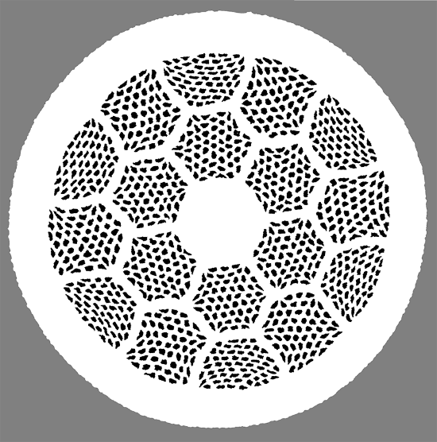
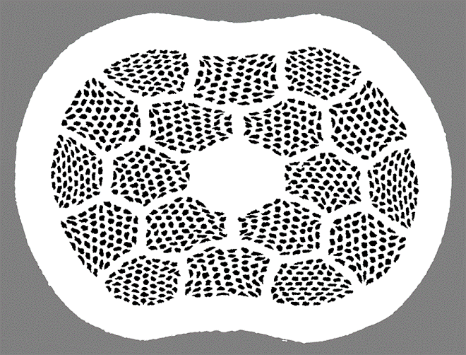
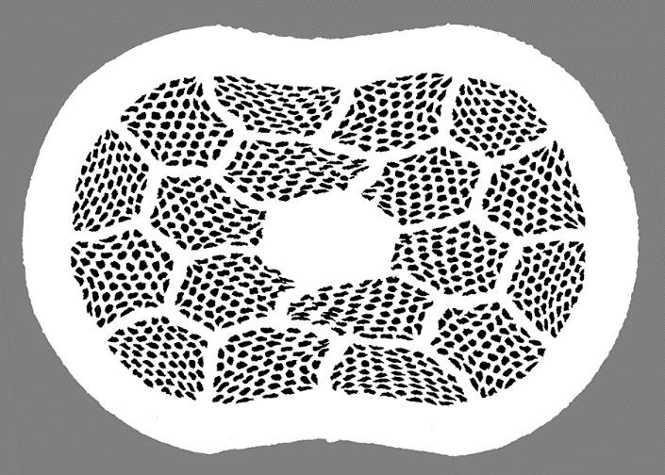
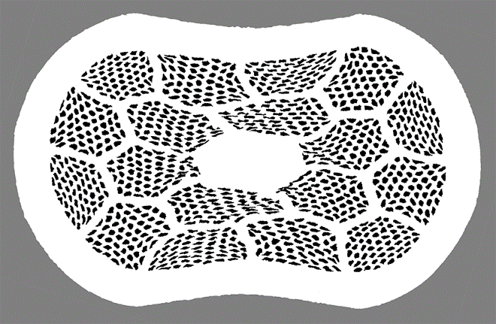
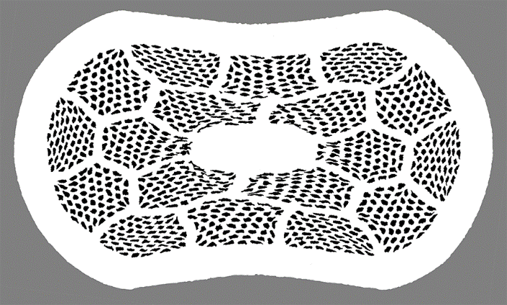
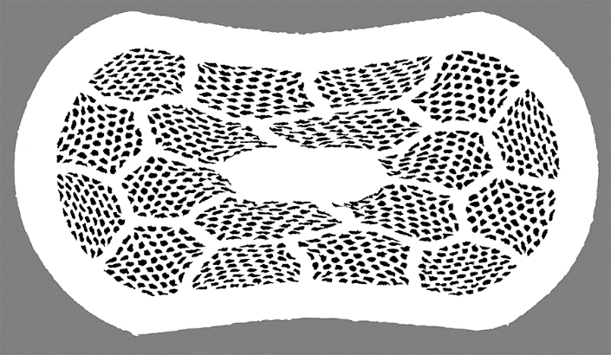
50 bar OP-PD (830 °C/12 hrs)
Round
S10
S15
S20
S25
S30
By Jianyi Jiang, FSU

Slide 12
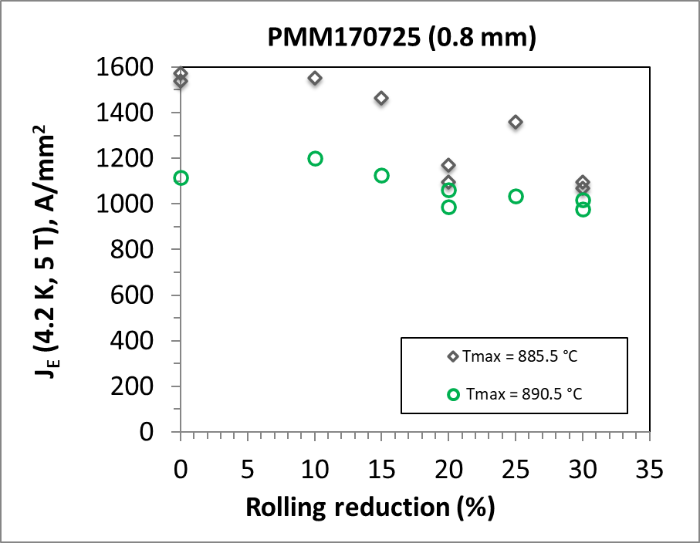
J_{E} versus rolling reduction – Wire PMM170725, 0.8 mm, 55x18
Reduction in J_{E} (read data points to closest 25 A/mm²)
T_{max} = 885.5 C 33%-% (lowest J_{E})
T_{max} = 890.5 C -13% (lowest J_{E})
By Jianyi Jiang, FSU

Slide 13
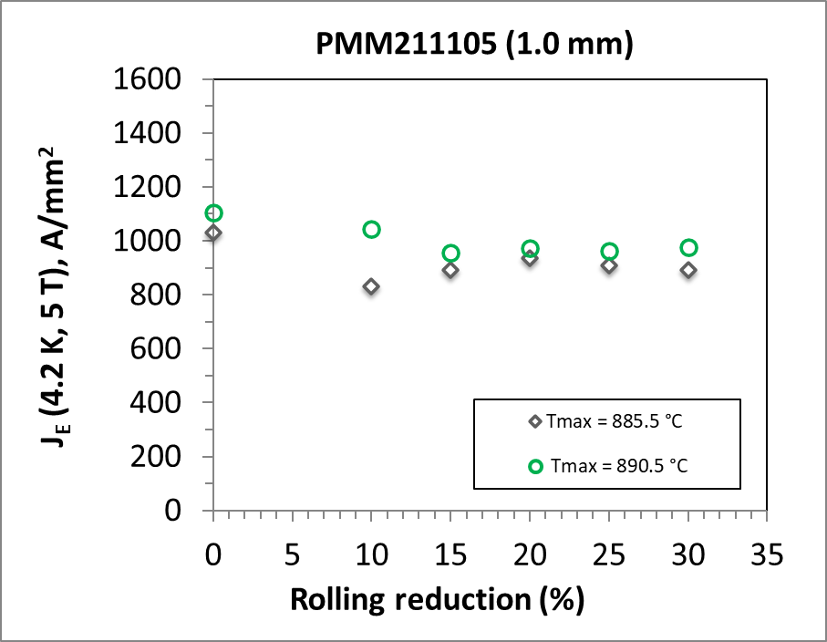
J_{E} versus rolling reduction – Wire PMM211105, 1.0 mm, 55x18
Reduction in J_{E}
T_{max} = 885.5 C -14% (plateau)
T_{max} = 890.5 C -20% (10% rolling)
T_{max} = 890.5 C -12% (plateau)
By Jianyi Jiang, FSU

Slide 14
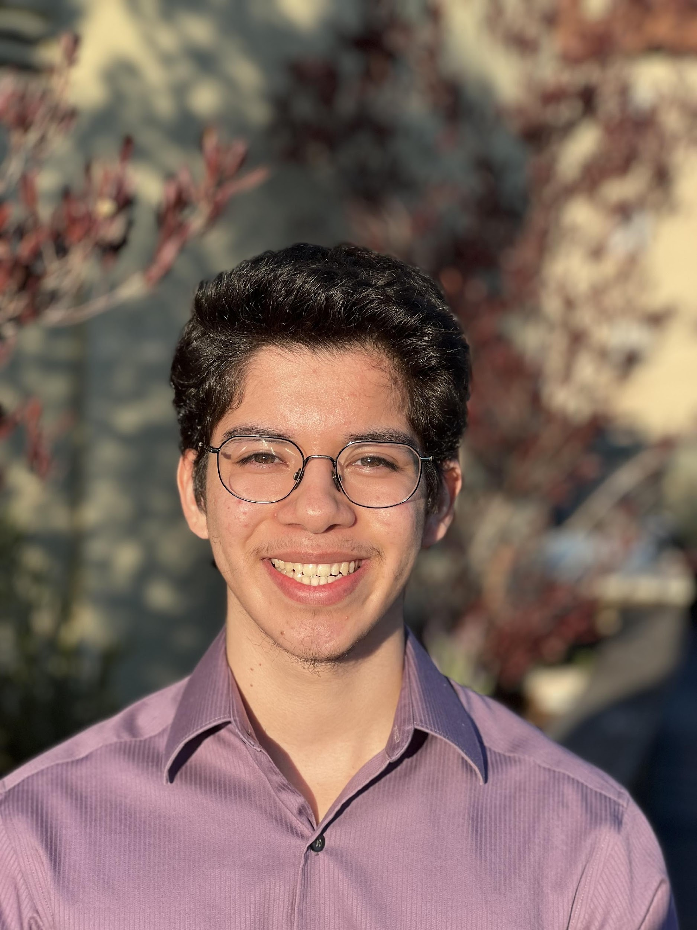
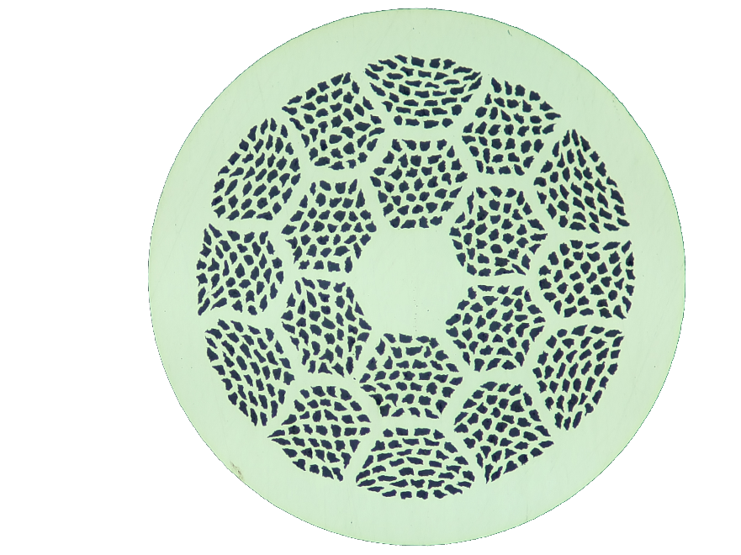
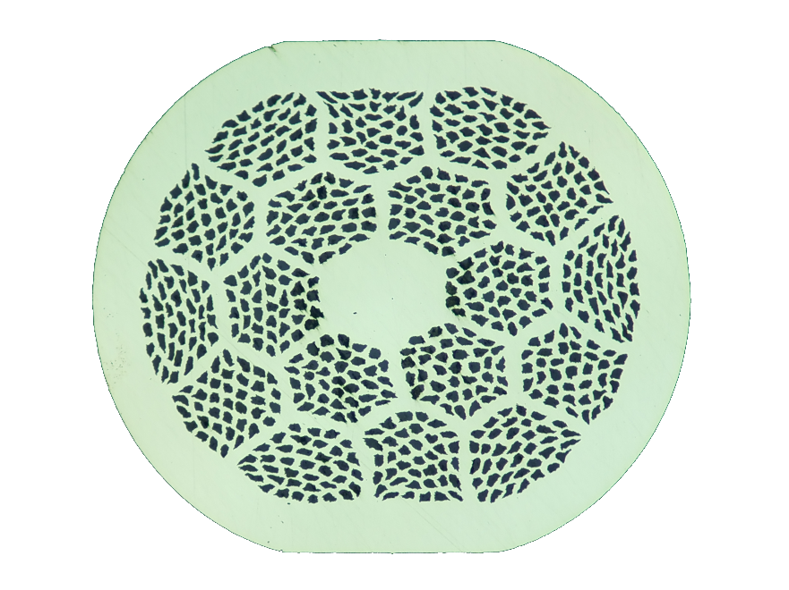
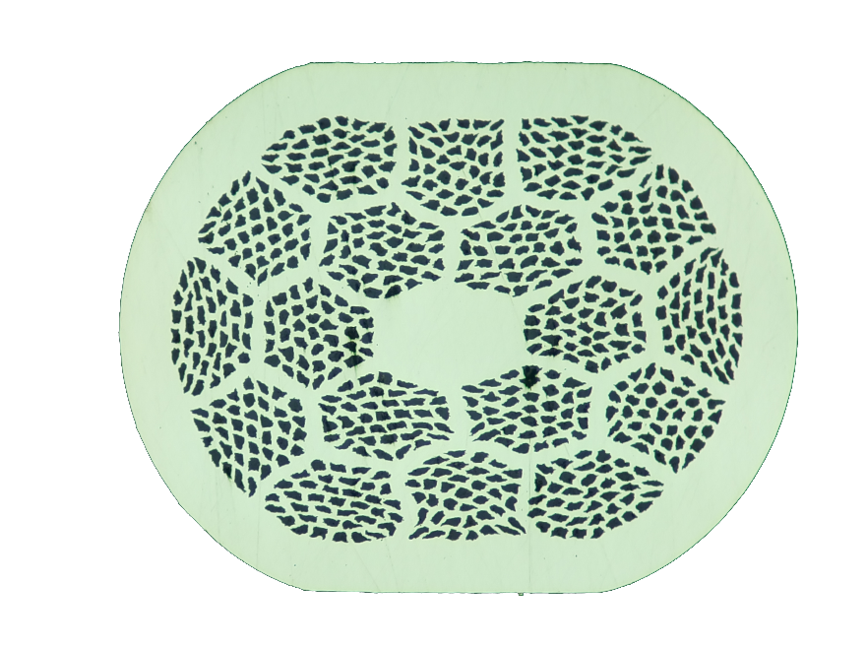
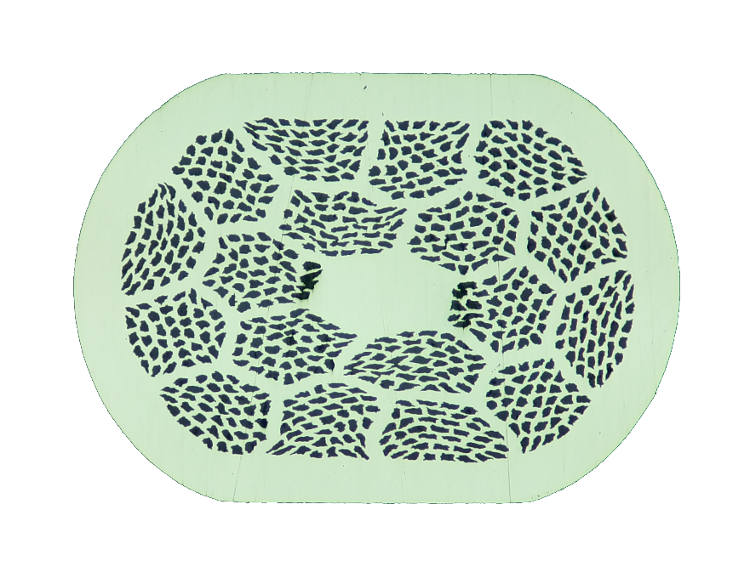
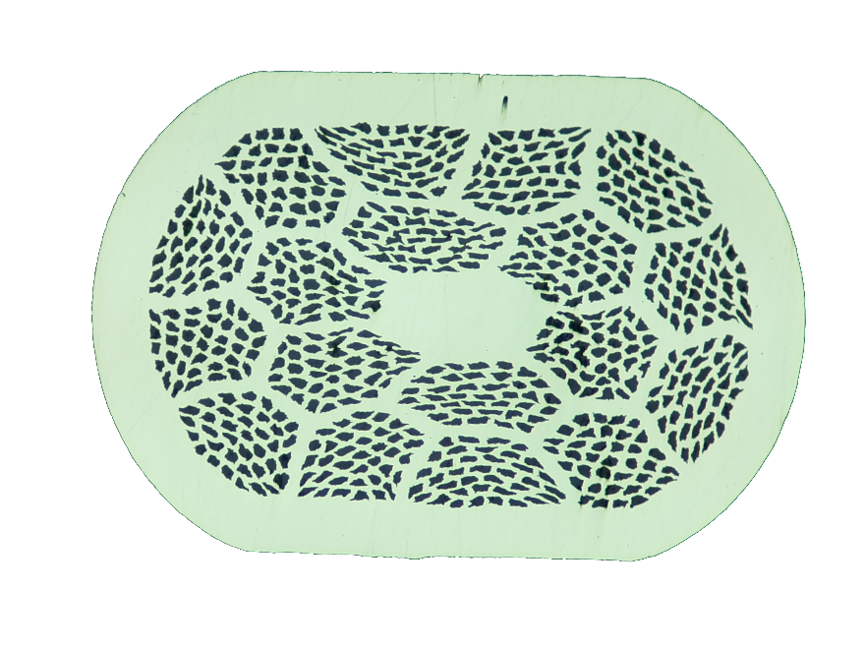
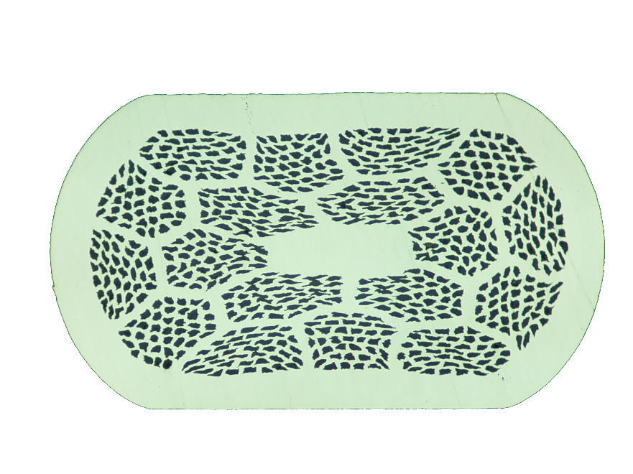
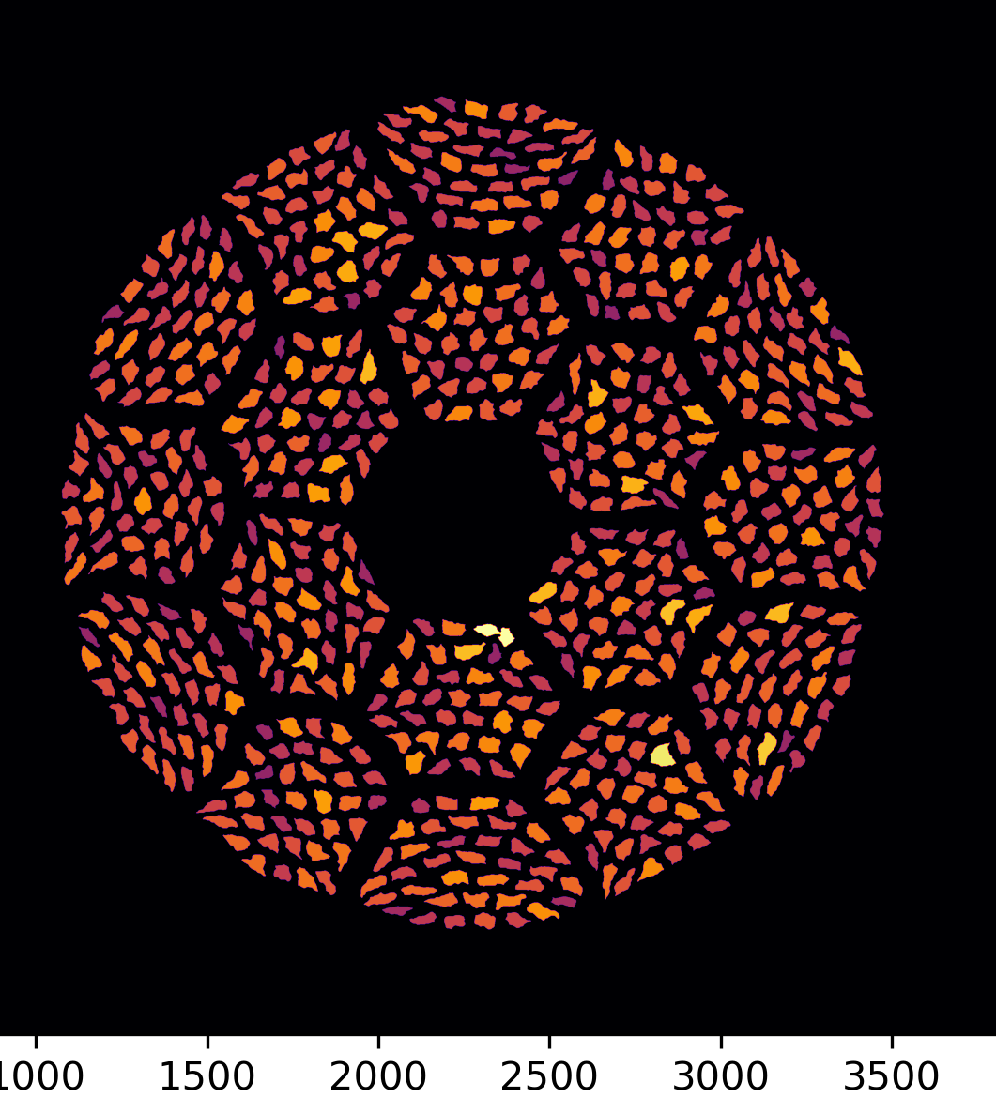
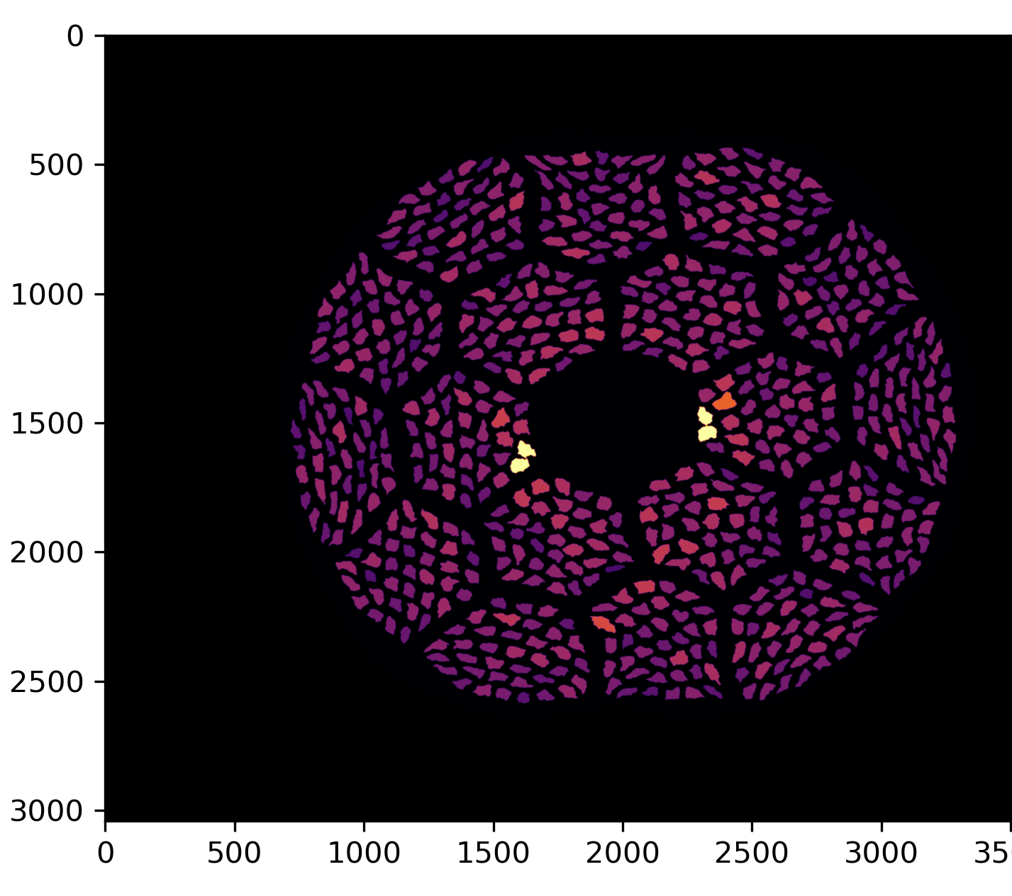
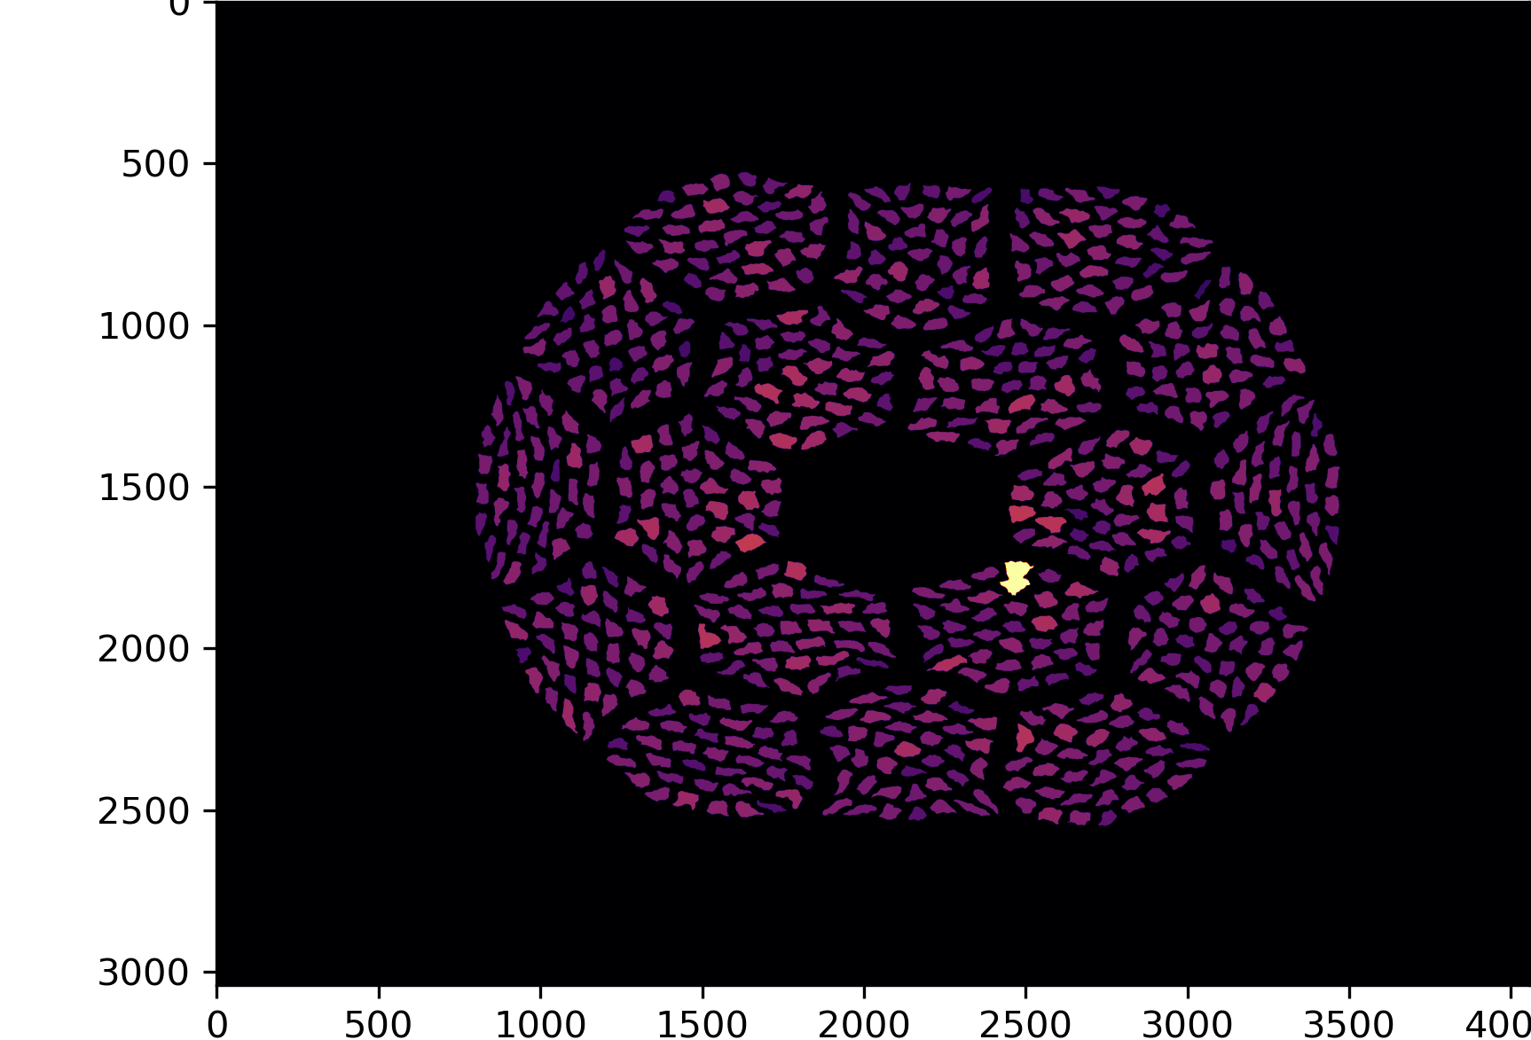
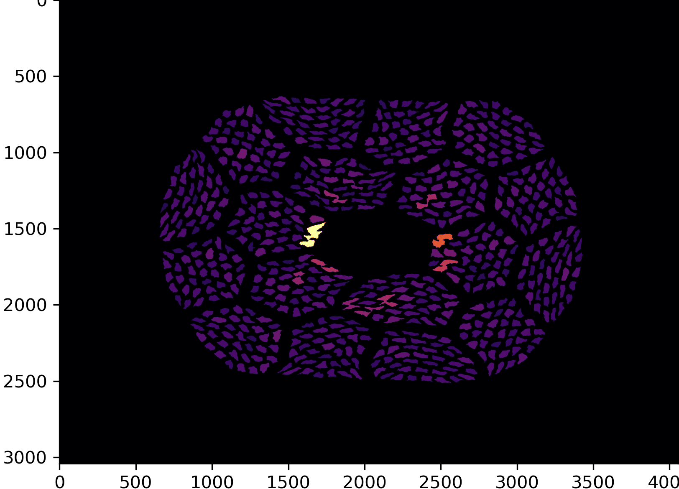
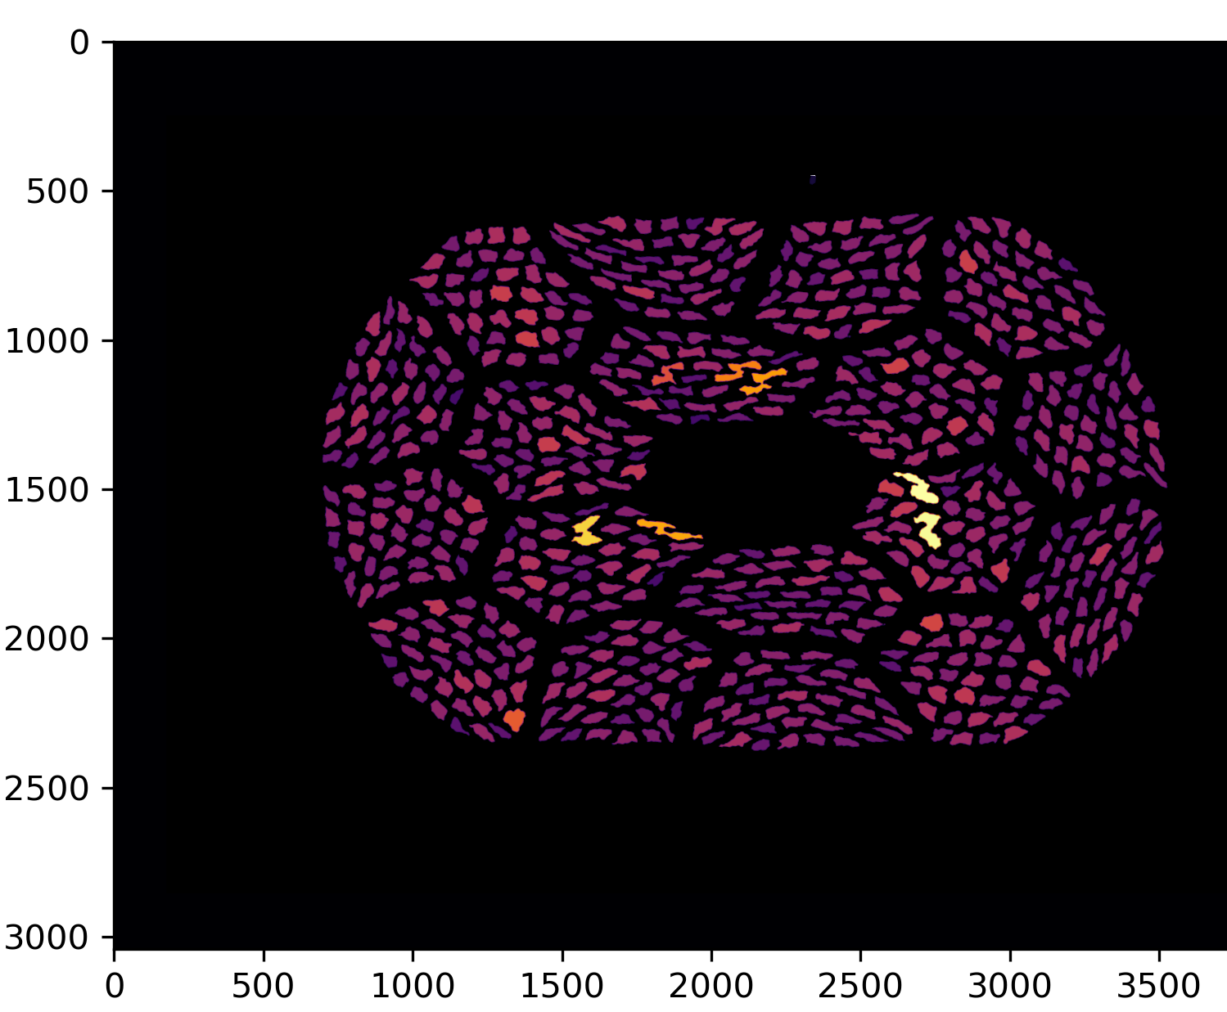
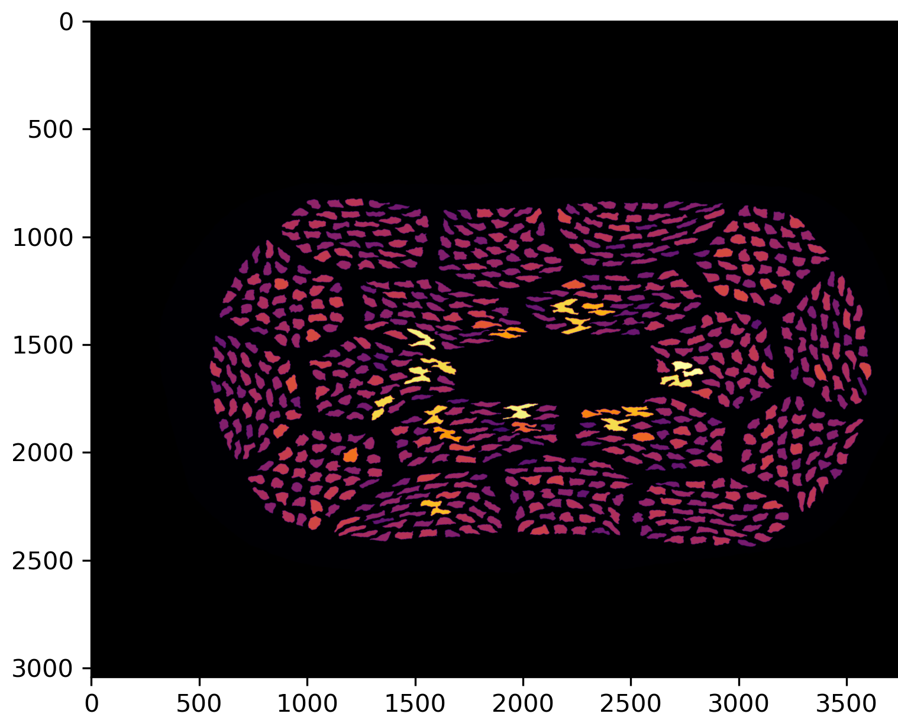
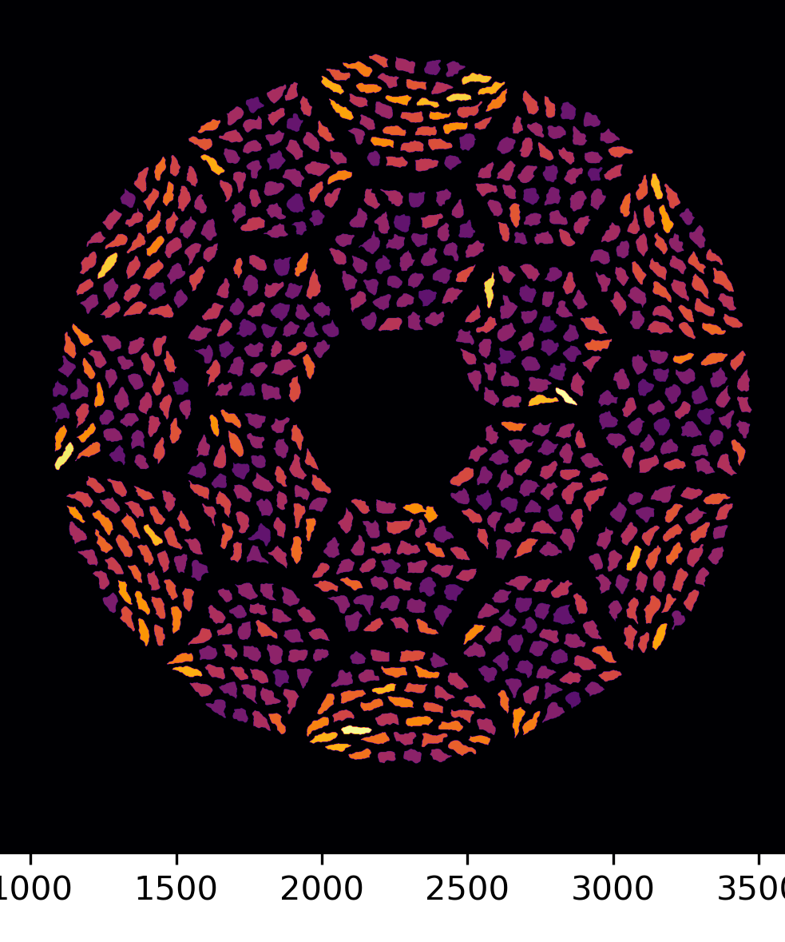
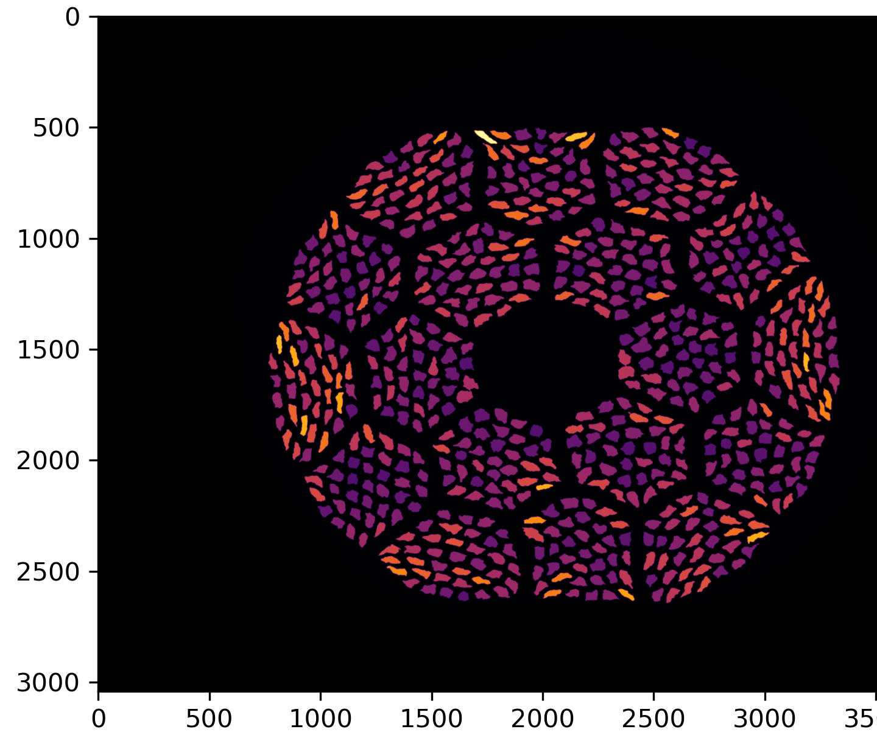
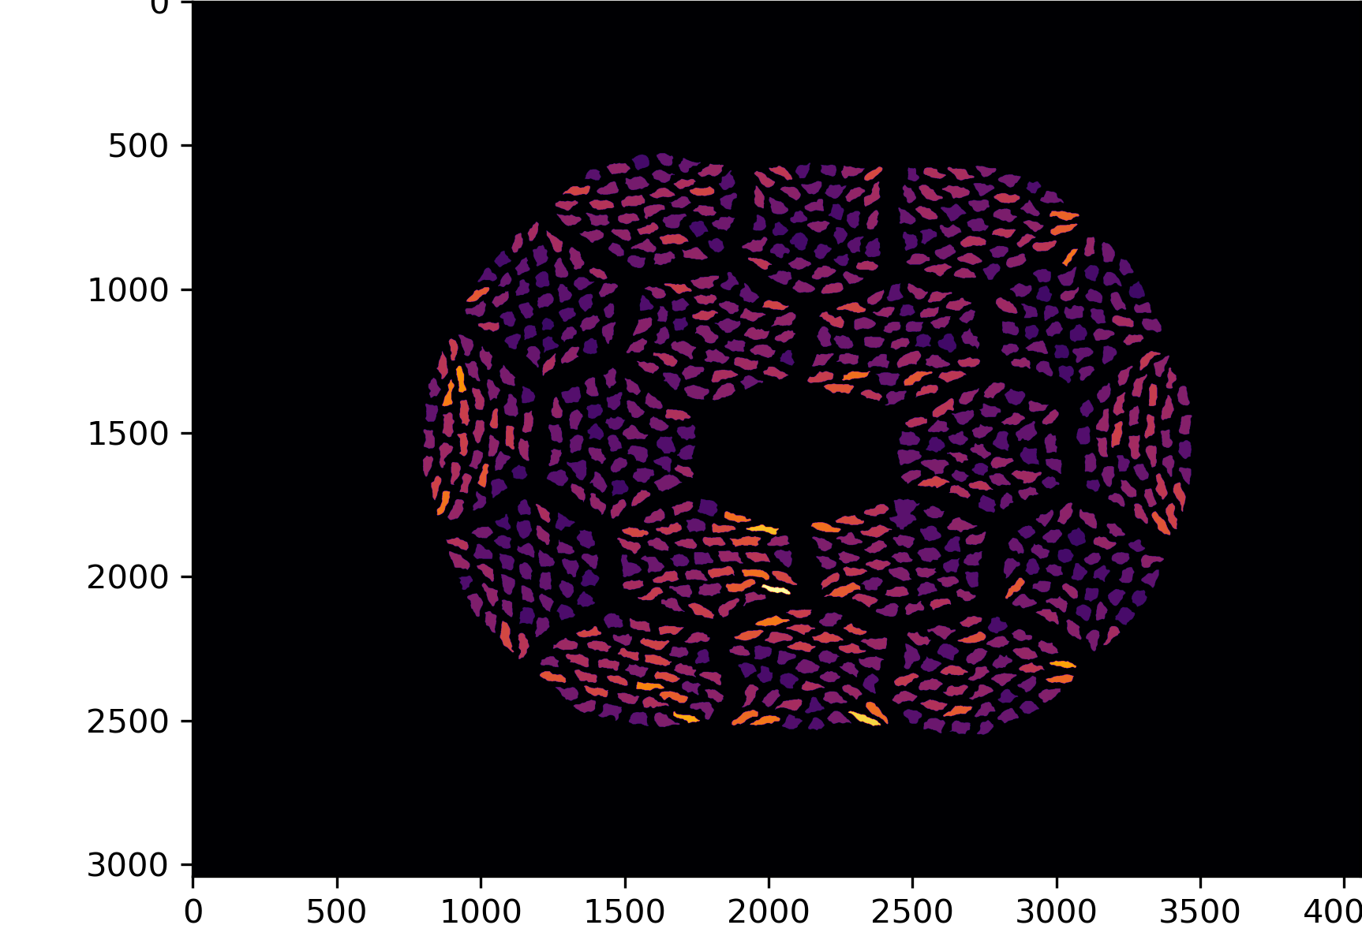
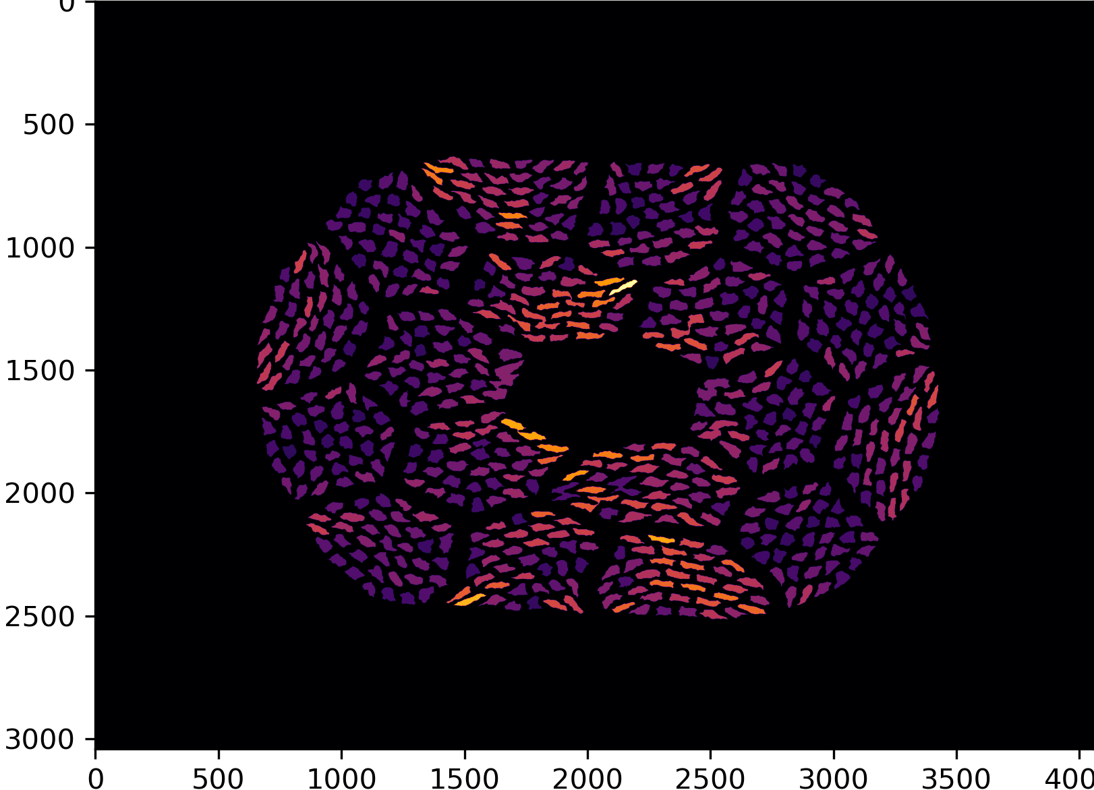
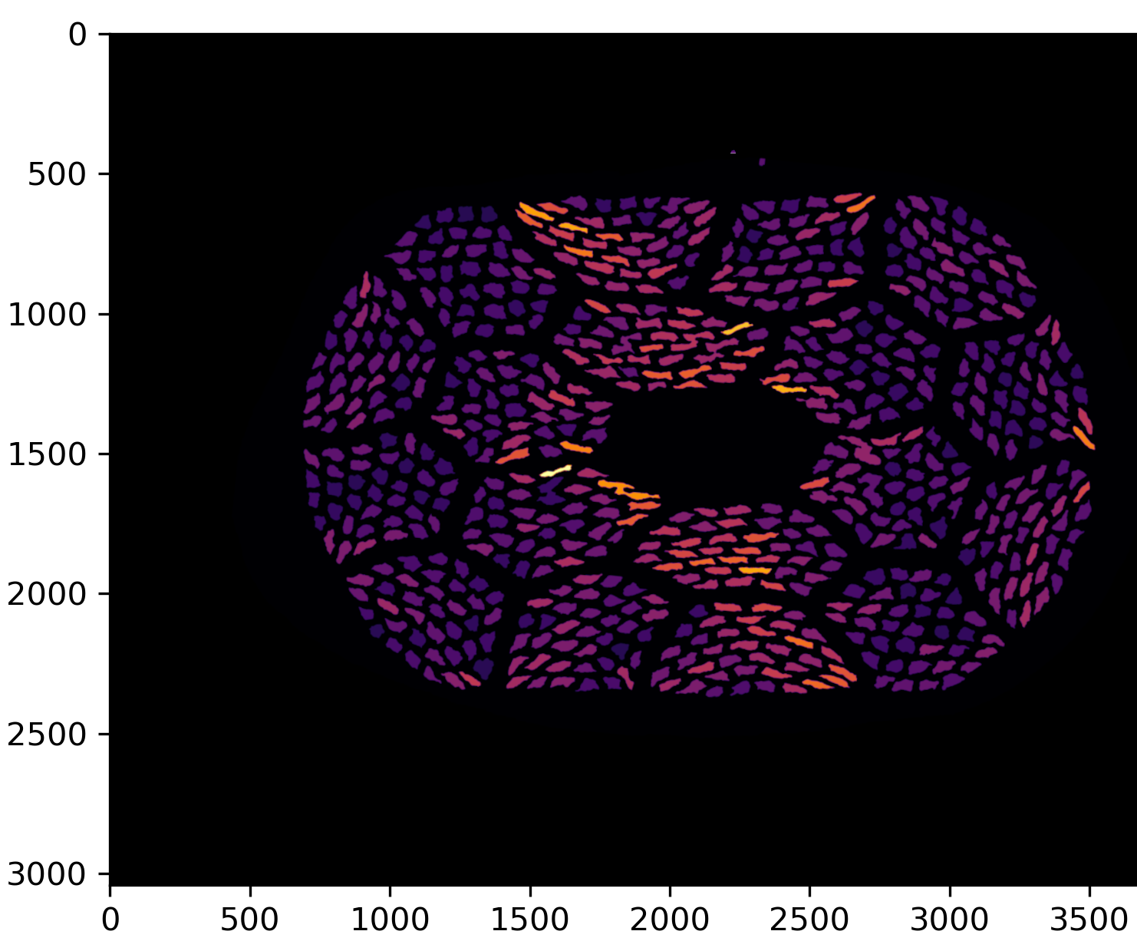
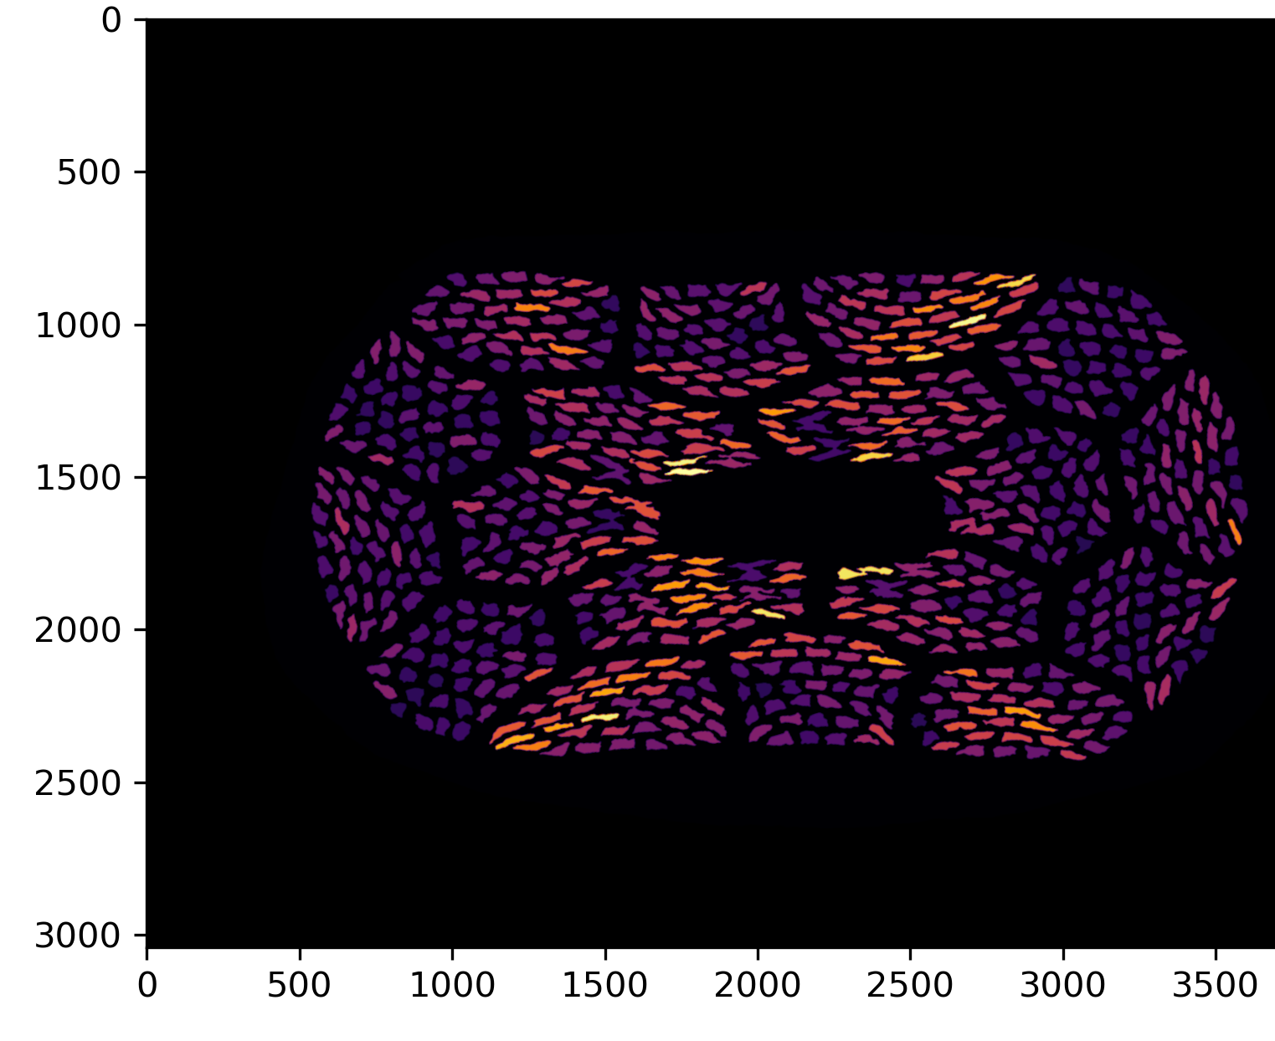
Image Analysis of Filaments in Rolled Strands
(PMM220802)
Chris Escobar, UC Berkeley
engineering, undergraduate
Jean-Francois Croteau
Area
Aspect Ratio
Shear bands from rolling
*colormap scales are relative to each image

Slide 15
Task 5 – cable fabrication – a cable that allows easy characterization and a good candidate for commercial applications 4-20 K
First billet, 37x18 wire, drawn to 0.7 mm.
The 0.7 mm strand will be made into a 6-strand Rutherford cable about 2.40 mm x 1.25-1.1.
Table 2: A Rutherford cable to be fabricated for cable properties evaluation and as a potential solenoid conductor
No. strands | Nominal dimensions | Cable twist pitch (mm) | Strand diameter and design | Projected I_{c} at 31 T (A)
6 | 2.4 mm x 1.25 mm | 15 - 21.9 | 0.7 mm and 37 x 18 | 1150
Cable thickness can be decreased to 1.1 mm to increase the packing factor from ~78.5% to 88.5%.
Cable characterization in ITER barrels at 4K and 31 T@NHMFL.
~80 or 160 m cable will be available for coil tests/developments with ASC’s 15 T, 52 mm bore oxford magnet and 31 T, 39 mm bore magnet.
Magnet time being applied by D. Davis, NHMFL and coil development by Davis, Trociewitz, Kim.

Slide 16
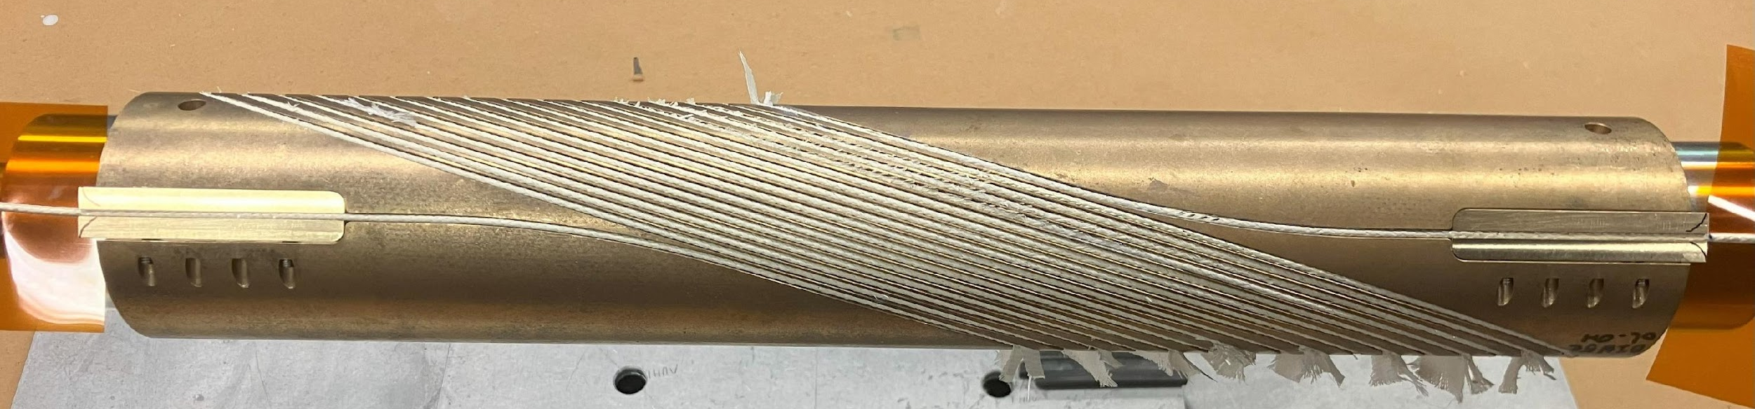
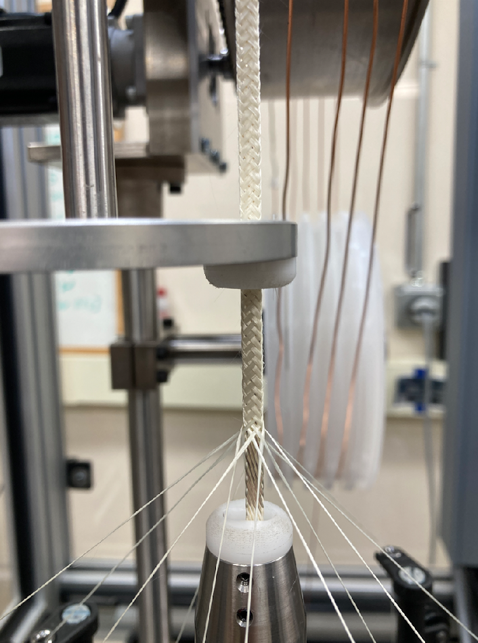
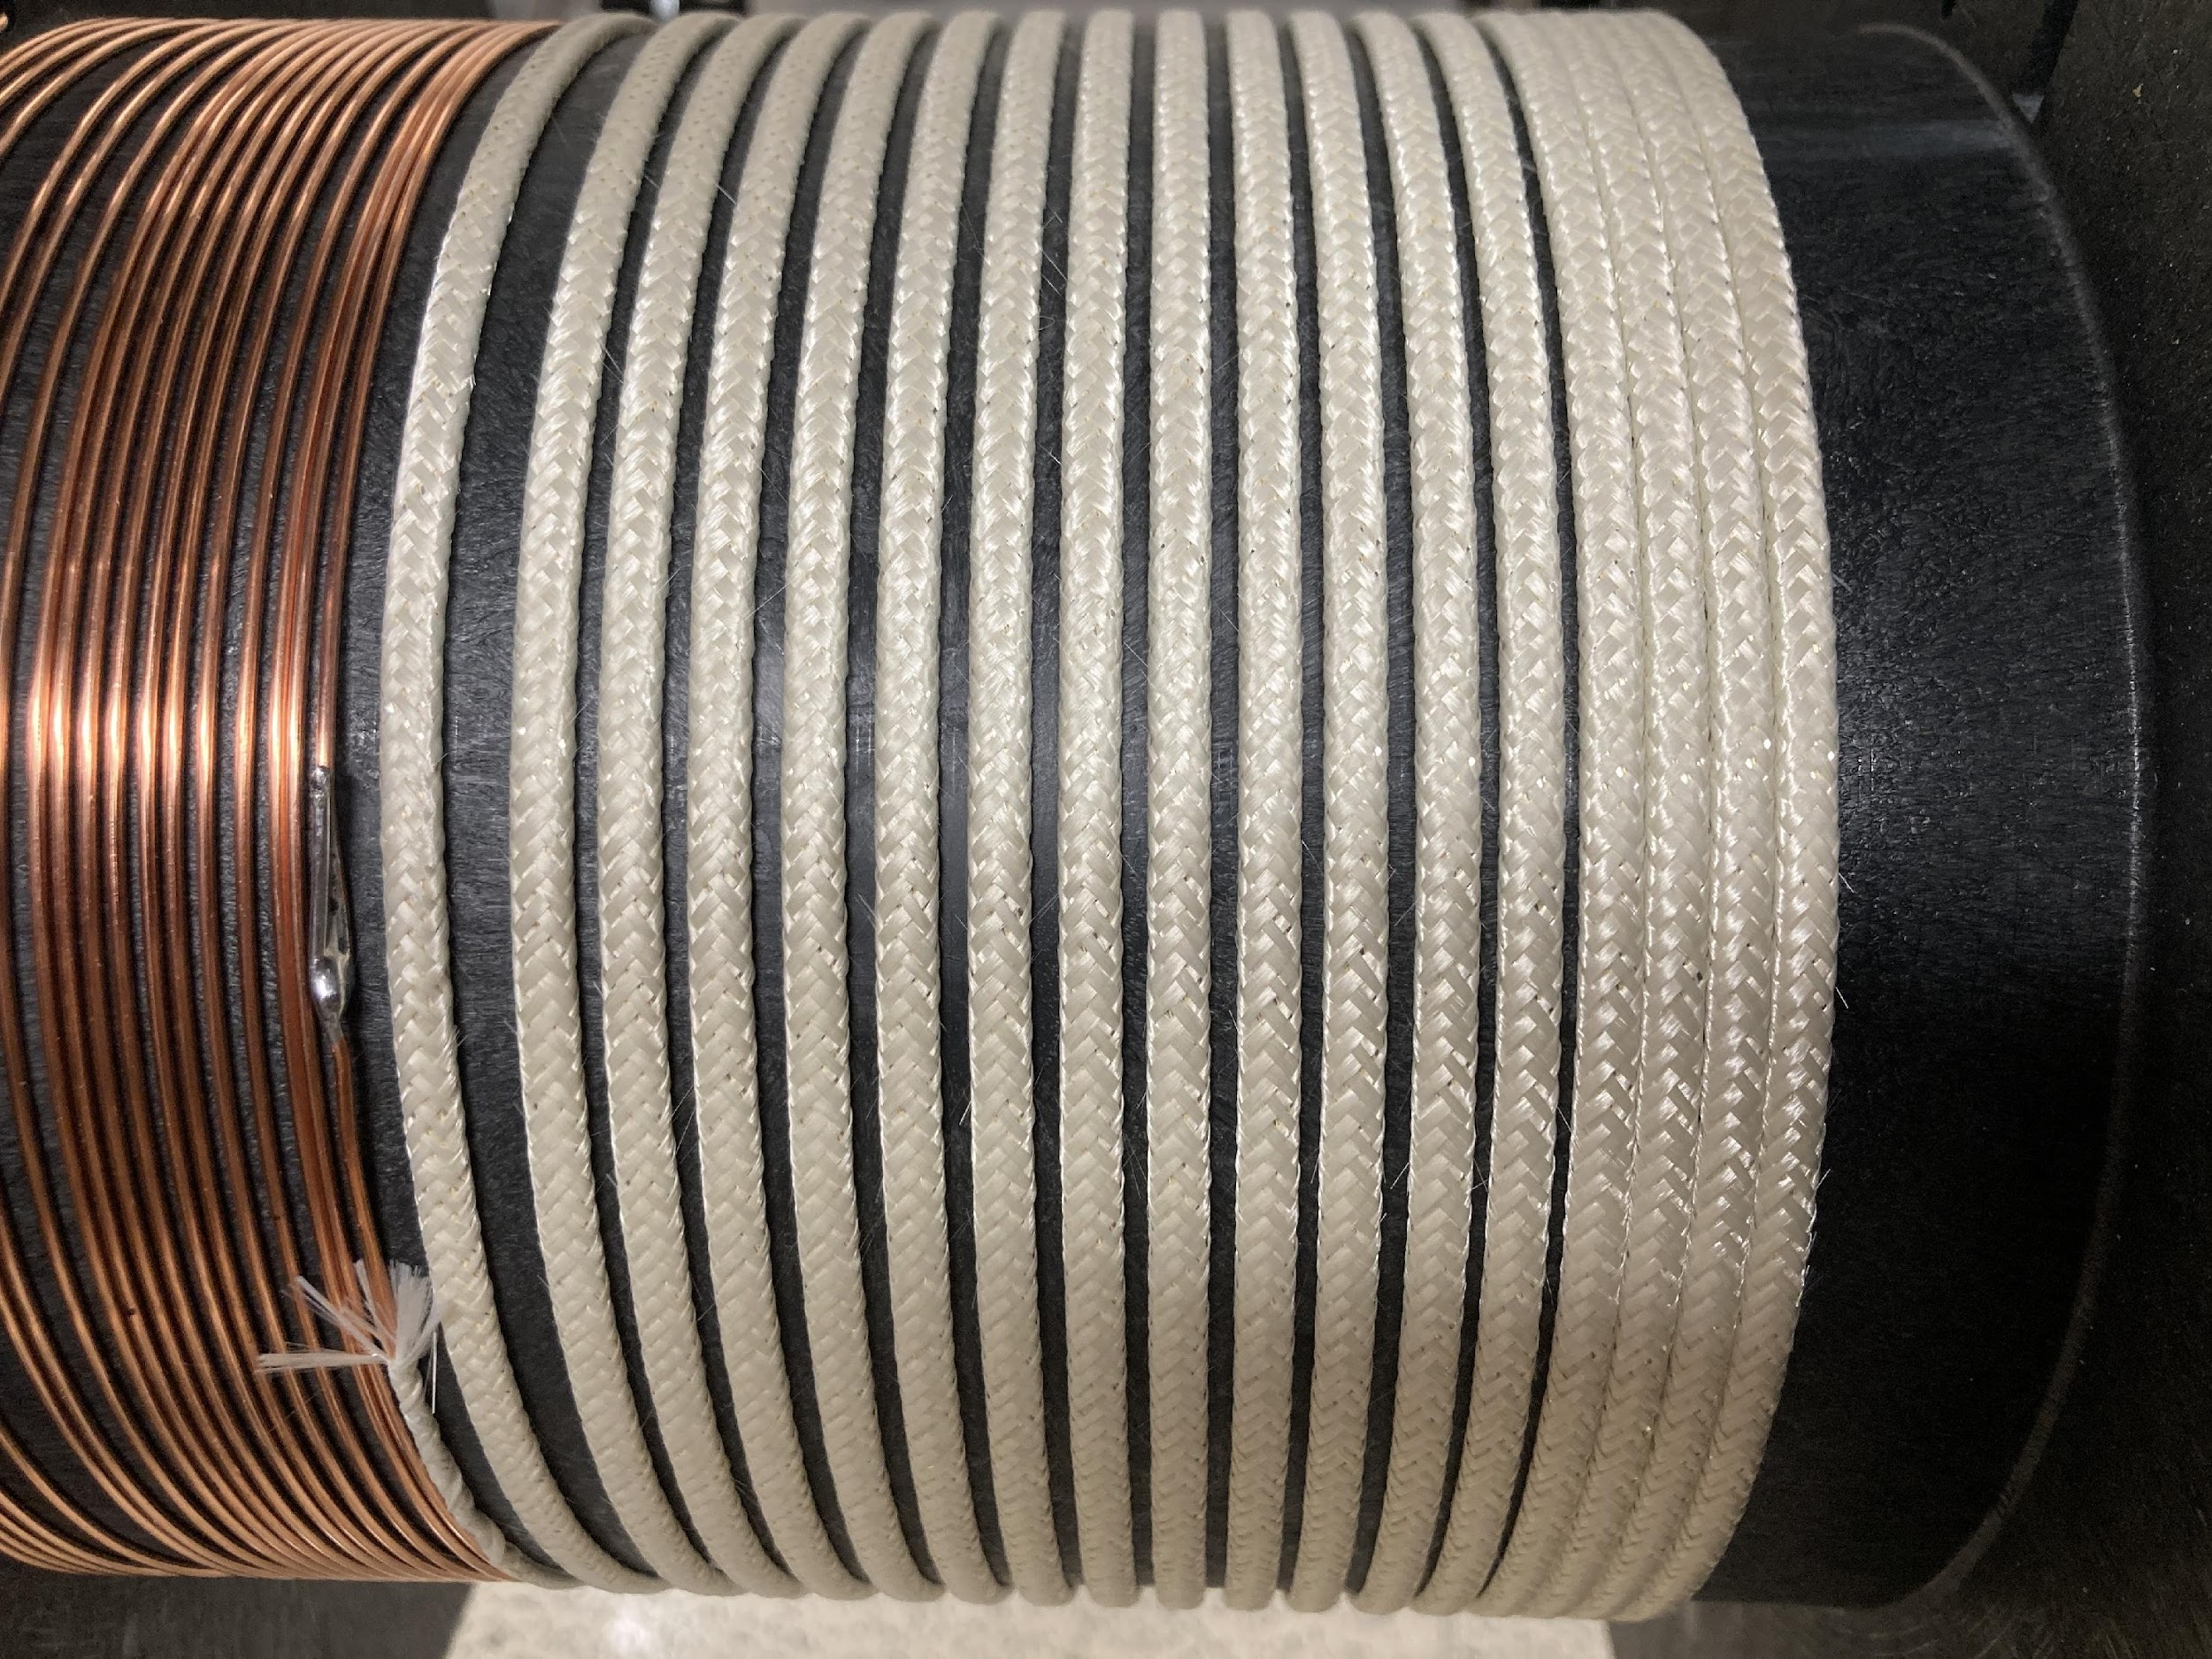
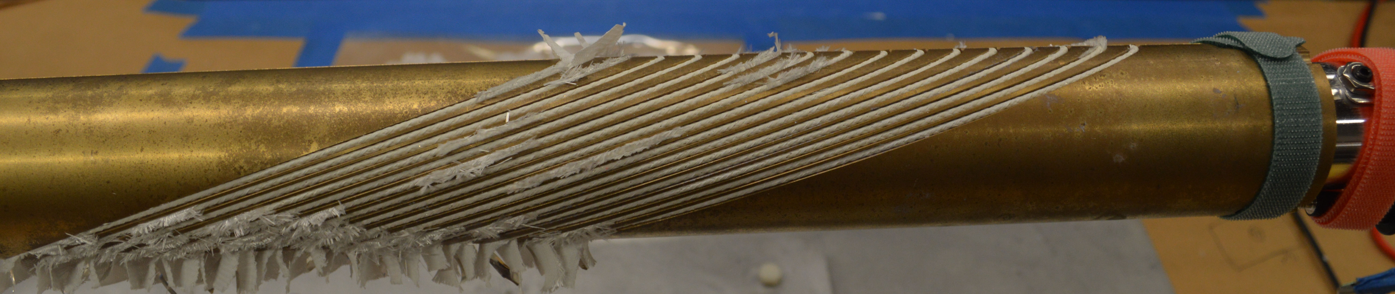
Task 7 – new insulation and removing leakage
7 m insulation braiding and coil winding trial completed.
24 m pure alumina insulated cable received.
Winding of the first coil completed.
ARDAP CCT coil BIN5E_OL, after winding, not yet reacted.
CCT ARDAP coil BIN5E:
  Outer layer coil wound. No electrical shorts.
  Have to use TiO₂ slurry to “repair, reinforce and lubricate” alumina fibers.
  Possible to replace TiO₂ slurry with Al₂O₃ slurry (courtesy of Dr. Jun Lu, NHMFL)
By Youngjae Kim, FSU et al.
CCT ARDAP coil BIN5E:
  Inner layer coil wound. No electrical shorts.
  NEW: Use Al₂O₃ slurry to “repair, reinforce and lubricate” alumina fibers. (courtesy of Dr. Jun Lu, NHMFL)

Slide 17
Summary
A virtual knowledge hub formed by private and public businesses, national labs and university, supported by DOE-ARDAP, to improve Bi-2212 conductor and coil technology.
Task 2: Manufacturing (five) 2 kg billets with reproducible plateau J_{E}(4.2 K and 5 T) > 1100 A/mm²
Task 3: Manufacturing (two) 10 kg billets with the target J_{E}(4.2 K and 5 T) > 1100 A/mm²
New data obtained to assist understanding the science and technology of attaining high J_{E} in Bi-2212 Rutherford cables
6-strand Rutherford from 0.7 mm wires enable fast-turn-around tests.
New insulation trial on LBNL CCT coil.

Slide 18
Thank You

Slide 19
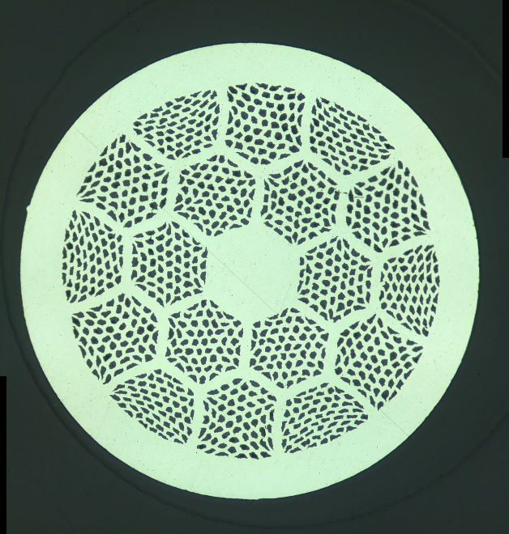

















Image Analysis of Filaments Rolled Strands (PMM211105)
Chris Escobar, UC Berkeley
engineering, undergraduate
Jean-Francois Croteau
Area
Aspect Ratio
*colormap scales are relative to each image

