Slide 1


Highlights of the Bi-2212
Conductor Session at
- principally on conductor
- magnet work presented here at MDP
David Larbalestier,
ASC-NHMFL and Mechanical Engineering and the new Department of Materials Science and Engineering in the FAMU-FSU College of Engineering
US-MDP Annual Meeting Fermilab April 30-May 3, 2024
Thanks to DOE-OHEP (award no. DE-SC0010421 PIs Larbalestier, Hellstrom, Jiang and Kametani), the NHMFL Core Grant support of NSF (award no. 1157490), DOE-OHEP STTR to Cryomagnetics FSU PI Trociewitz), DOE-SBIR to Engi-Mat (award no. DE-SC0018666, FSU PI Jiang) and Florida State University special allocation (PI Larbalestier) for Bi-2212 commercialization and the US Magnet Development Program Collaboration for much context and many collaborations

Slide 2
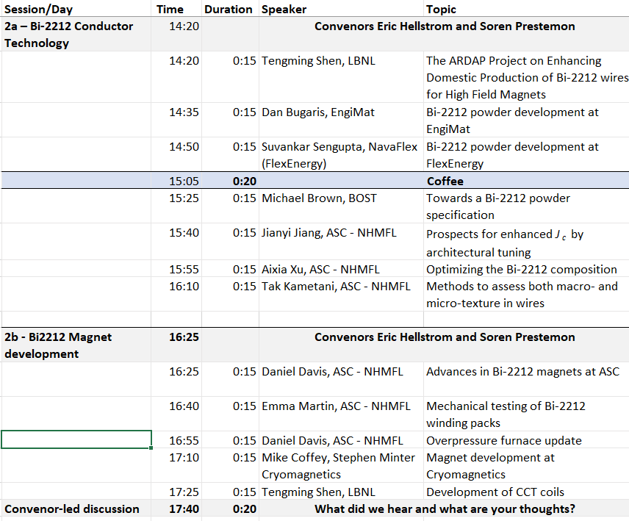
Bi-2212 Session
Heavy emphasis on the conductor – magnets discussed here at MDP
Powder manufacturers (EngiMat and NavaFlex)
Wire manufacturer (Bruker OST)
Understanding (ASC-NHMFL)
Coils (ASC-NHMFL, LBNL – Cryomagnetics could not attend at last minute and Oxford Instruments had UK tax year end conflict)
We expect a hybrid solenoid test with Cryomagnetics this year

Slide 3
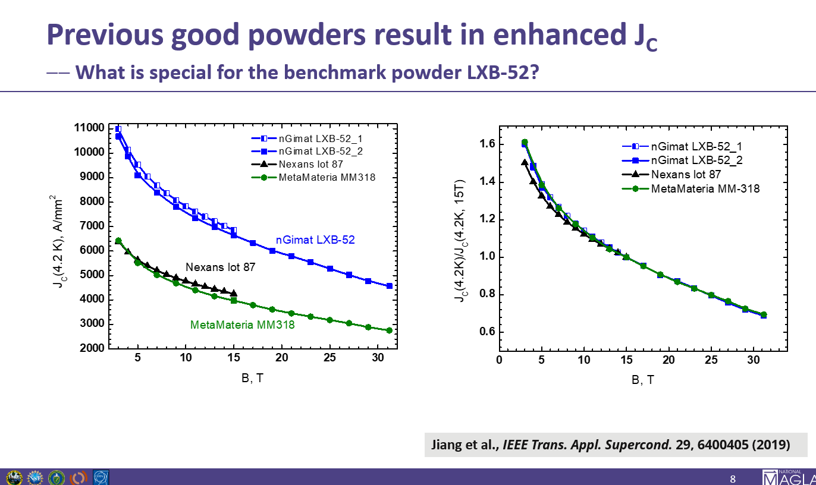
The initial switch to nGimat powders was spectacular (2016-2017)
A key issue for LTSW was powder quality and how to get it back…………….

Slide 4
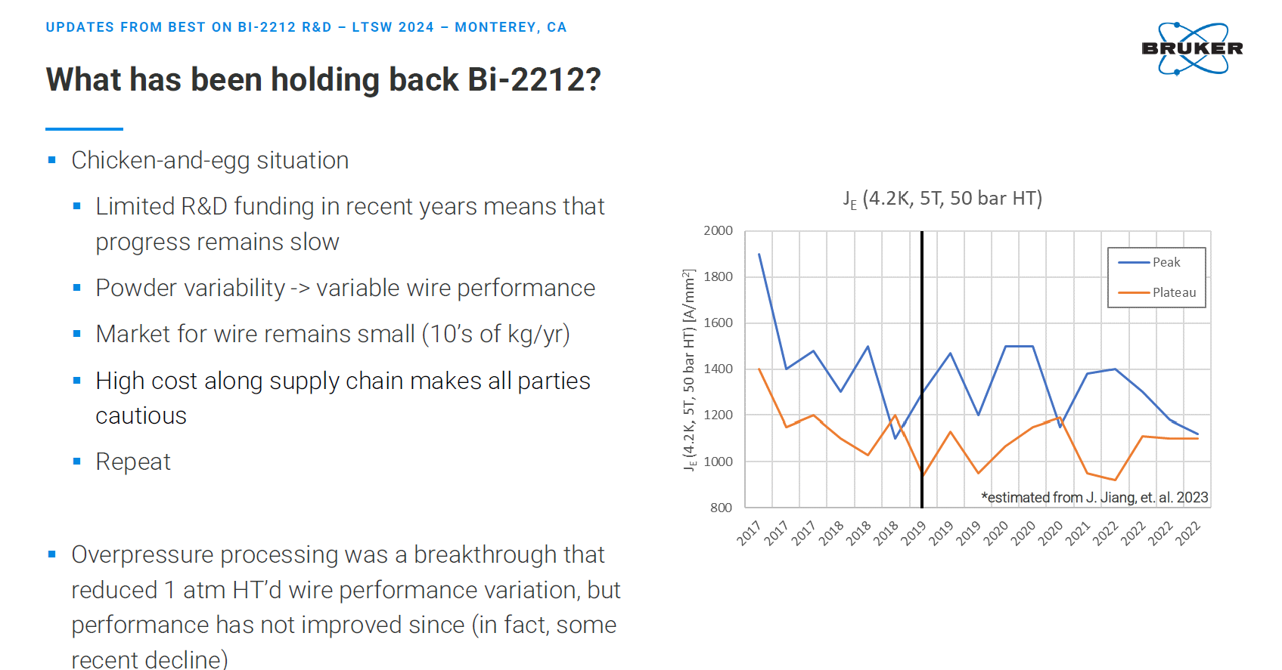
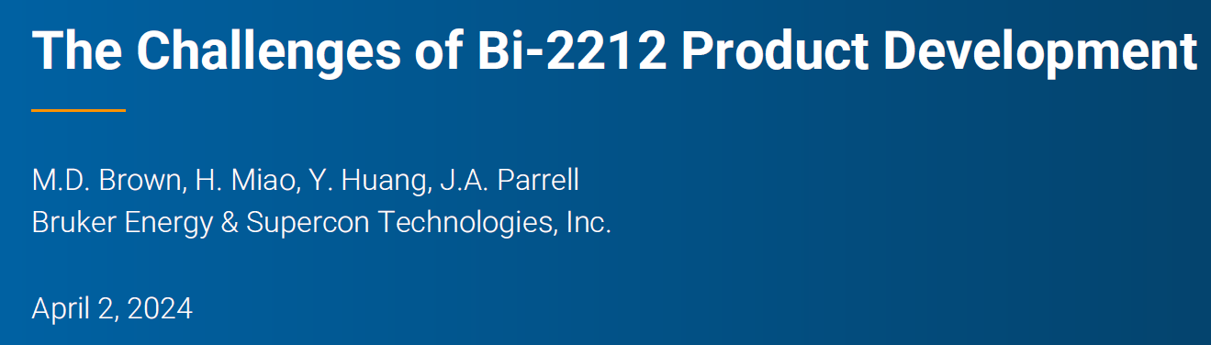
Trend of Jc is in the wrong direction

Slide 5
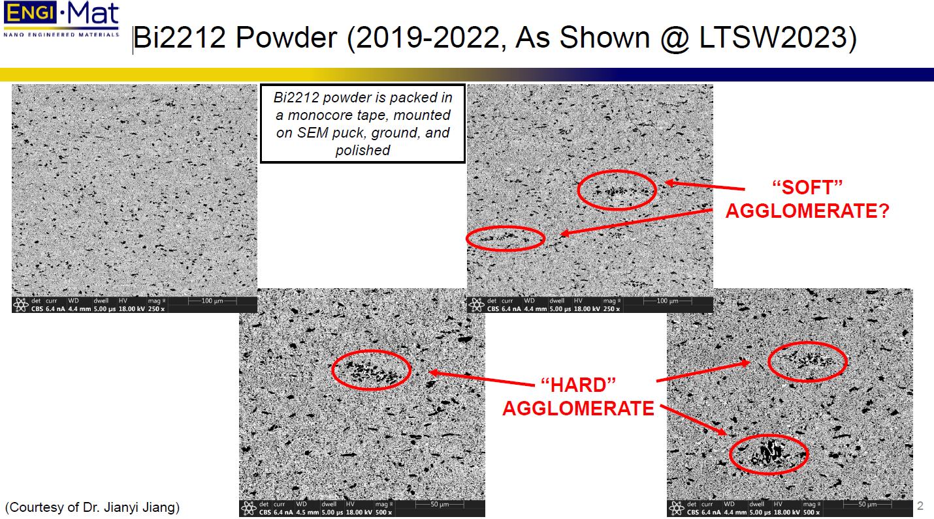
Powder – EngiMat – Dan Bugaris
The very best wires yet made were made by B-OST from Engi-Mat powder in 2016 (LXB52)
Retirements and change of ownership produced fairly stable powder at about 80-90% of LXB52 until sometime in 2021-2022
Recent SBIR awards to EngiMat have been addressing what might have changed
Powder should be of fine grain size (1-3 μm, certainly <5 μm) and free of agglomerates that distort the filament structure
C and H₂O must be low so as to minimize gas generation during reaction

Slide 6
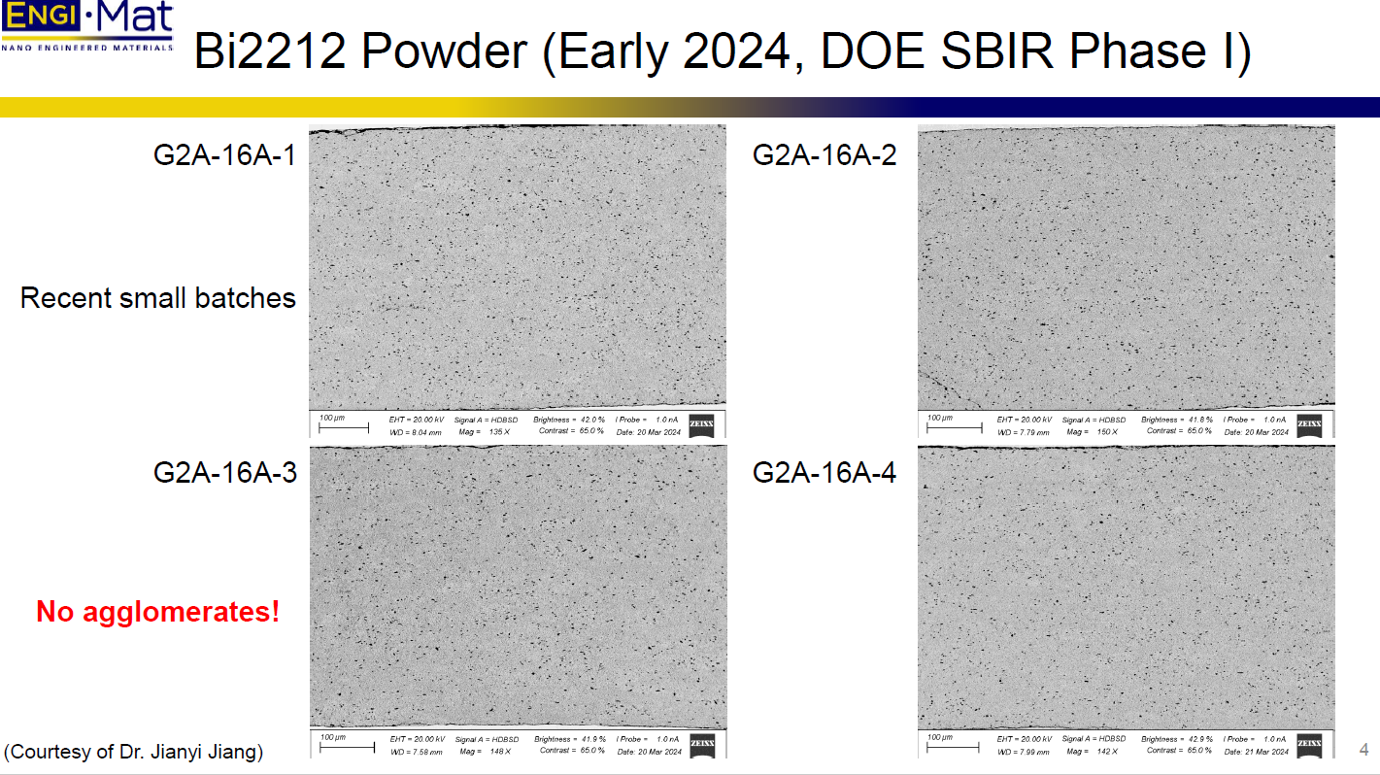
Recent SBIR powders are avoiding agglomerates

Slide 7
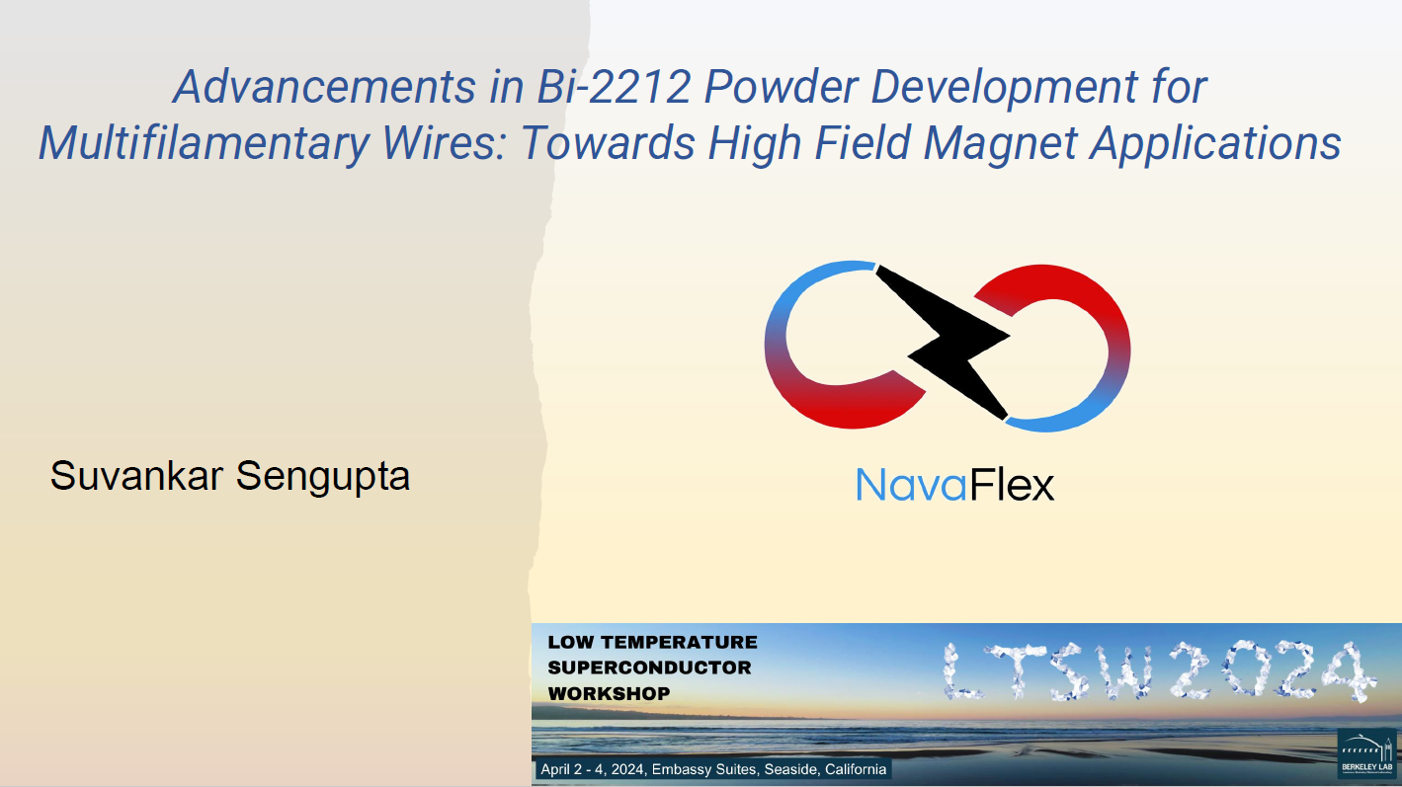
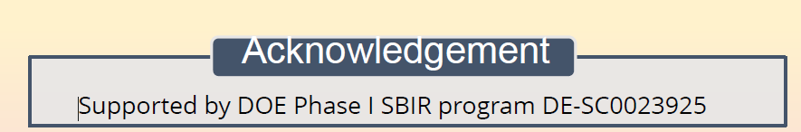
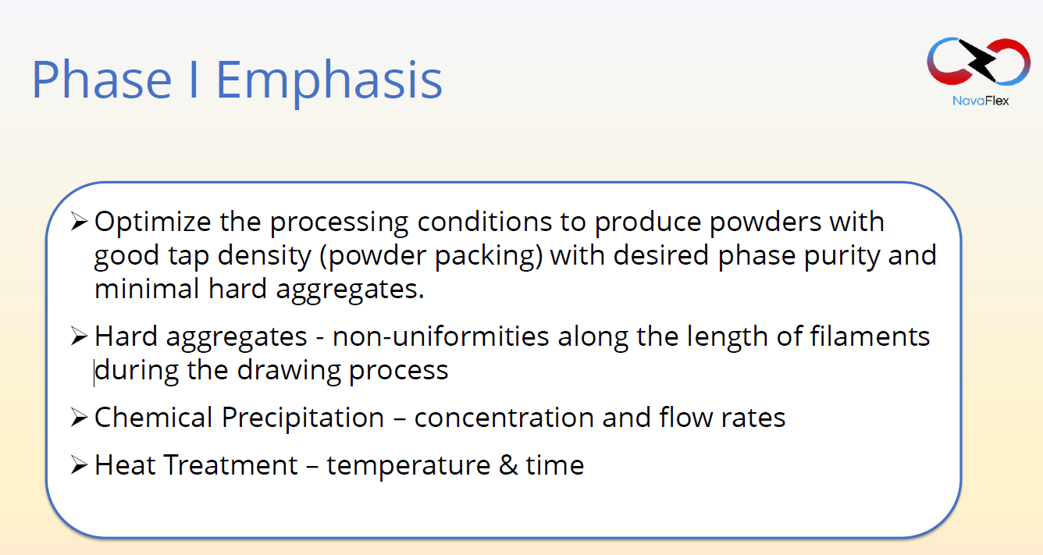
Powder – NavaFlex -

Slide 8
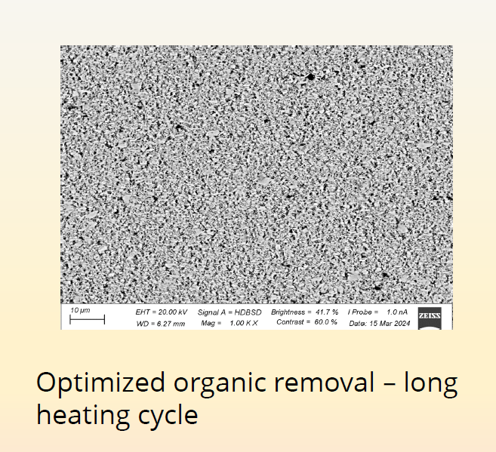
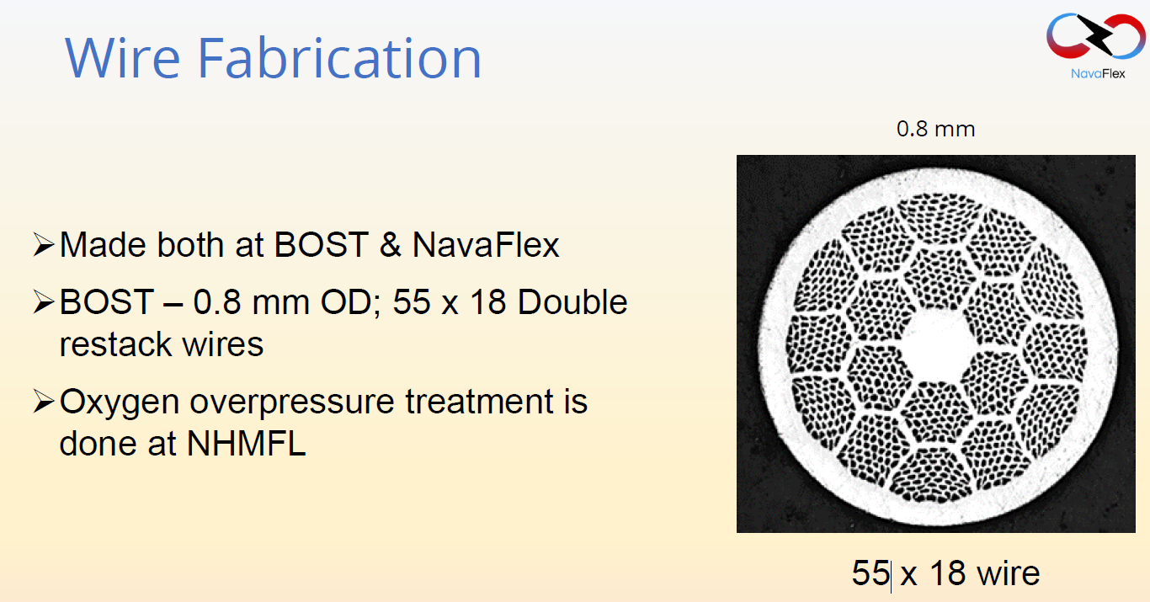
Powder – NavaFlex -
Powder seems to be free of large agglomerates and of suitable particle size………….

Slide 9
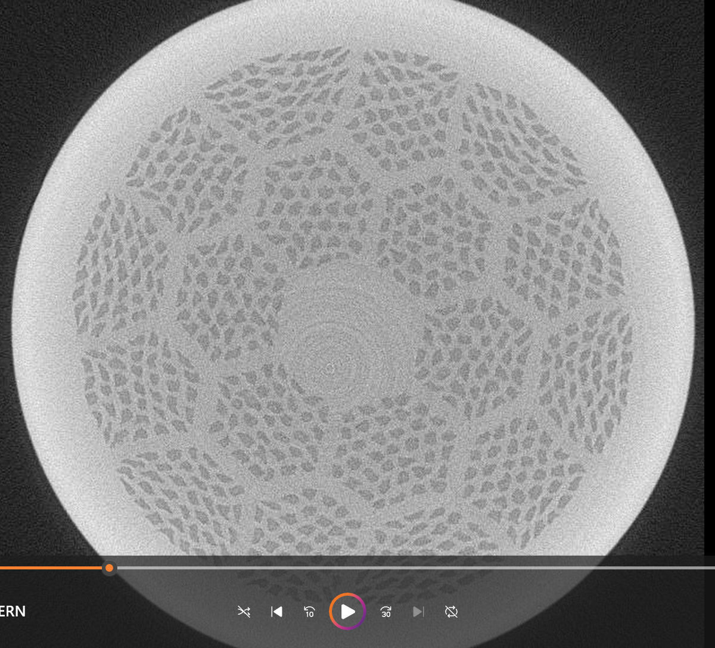
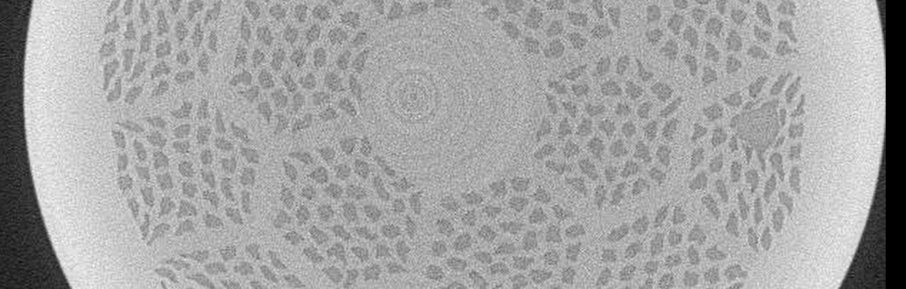
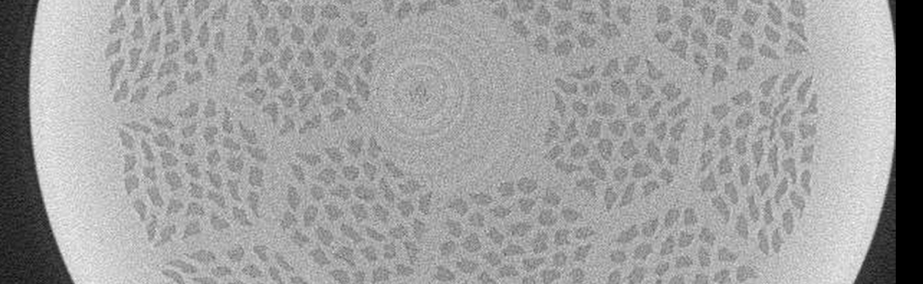
2011: Hard particles have big impact on sub-element uniformity (and J_{E})
X-ray tomographic images by Christian Scheuerlein (CERN) on 2013 BOST conductor made with Nexans powder containing large hard particles (“clunkers”)
Similar to conductor studied by Dan Davis in his BR-2 Rutherford cable today
Thanks to Eric Hellstrom’s archive of work done in collaboration between ASC and CERN

Slide 10
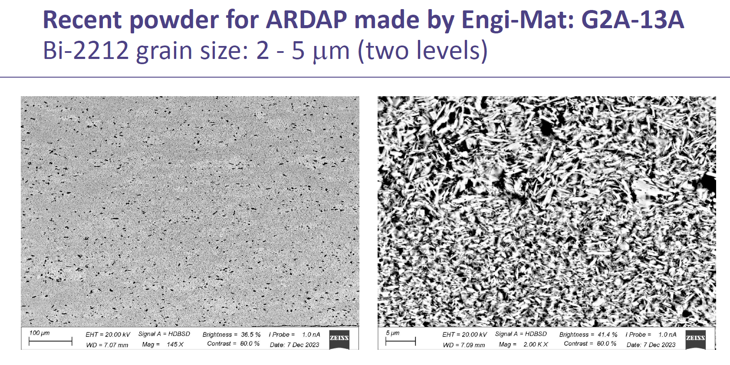
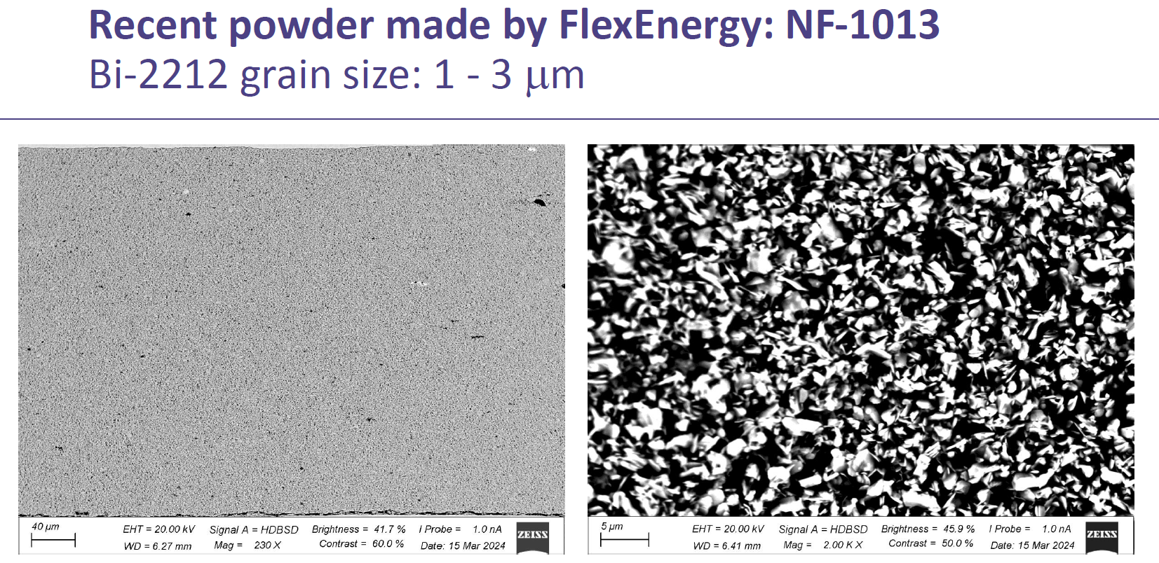
Recent evaluations by Jianyi Jiang
Both EngiMat and NavaFlex are showing control of 2nd phase and grain size
SBIR program is generating a counter effort to make powder of good quality with multiple characterizations that

Slide 11
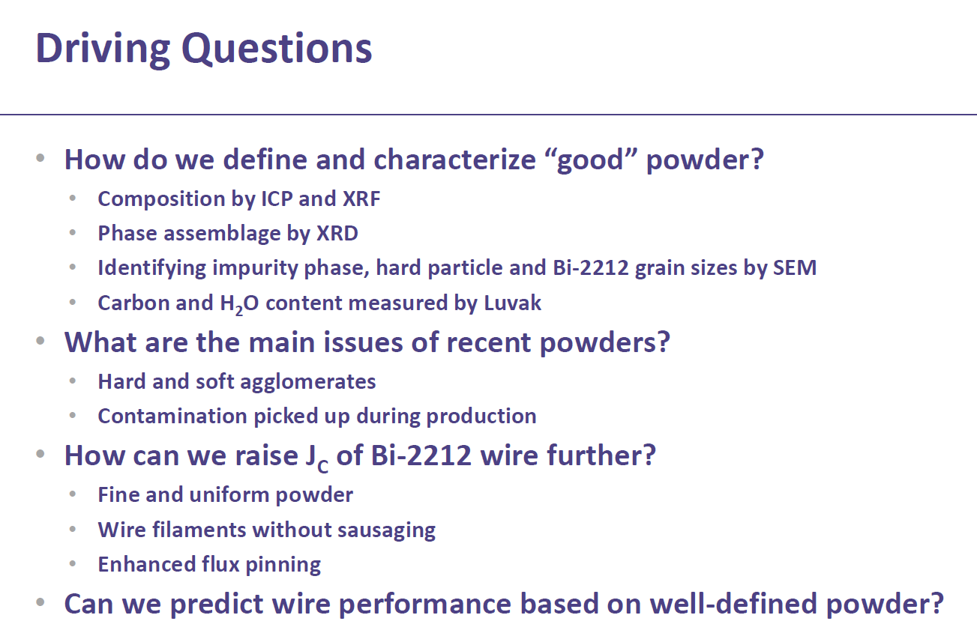
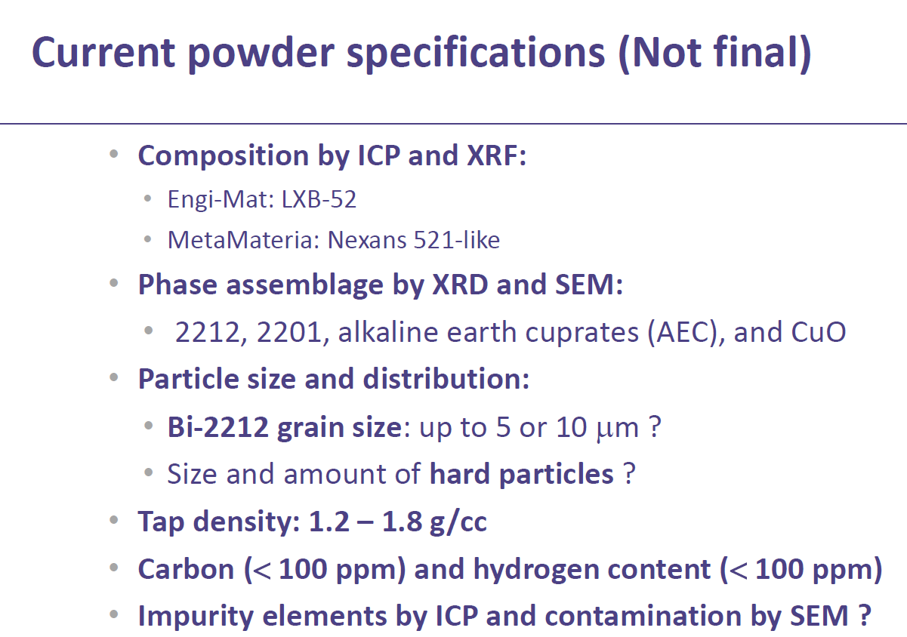
Key issues of the ASC work led by Jianyi Jiang

Slide 12
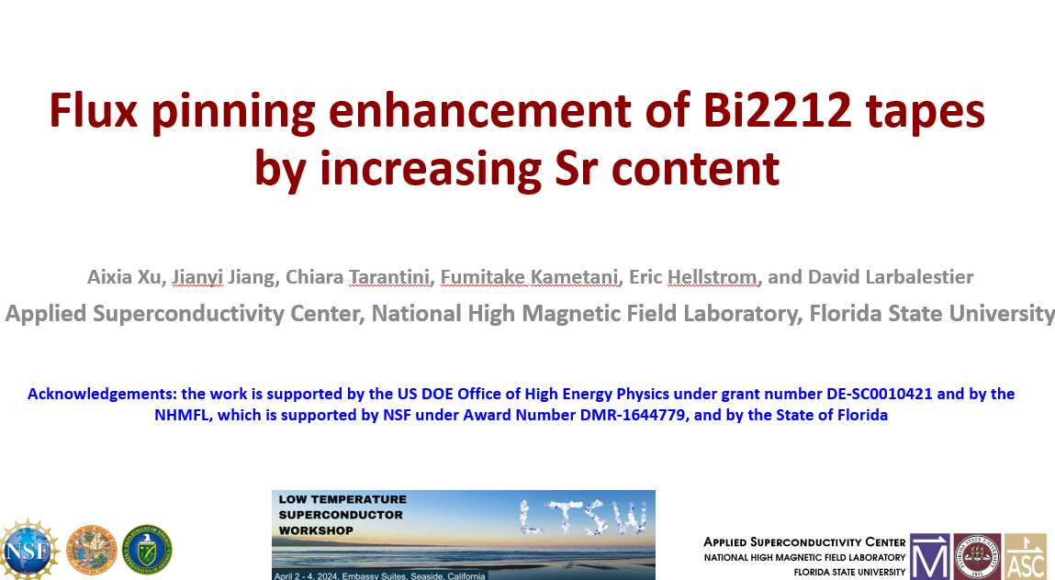
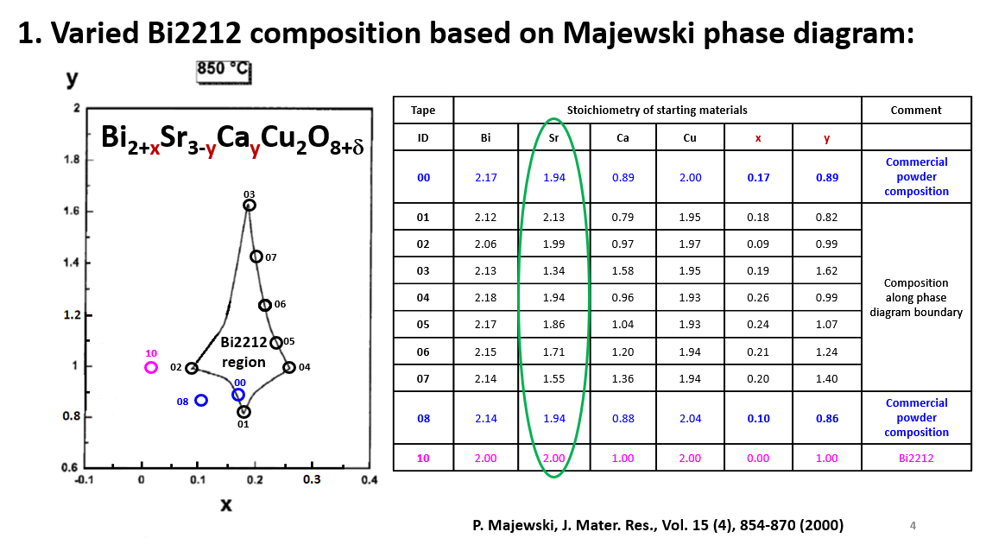
J_{c} may be enhanced by optimizing vortex pinning – Aixia Xu
Bi-2212 phase field is quite large (and outside the 2212 composition)
We hypothesize that vortex pinning is due to cation vacancies in the Bi-2212 lattice, so varying composition should vary H_{irr}
Compositional dependence of the irreversibility field at 20 K was studied with variable composition powders made by standard oxide grinding and reaction steps and then spreading on Ag foil
Goal was to find compositions with highest Kramer Field (which approximates H_{irr})

Slide 13
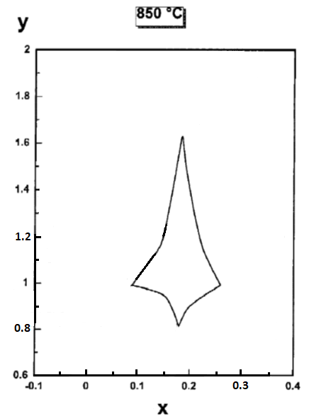
H_{k}(20 K, ⊥tape surface) increases with Sr content
03
07
06
05
10
02
04
00
08
01
Notes:
Here is would be good to have three figures. (1) Hk analysis, (2) Hk – Sr content and (3) Phase diagram. I think there is more correlation of HK and composition, which can be seen using the phase diagram. See the next slide
Further, Kramer field at 20 K also increase with Sr content. This plot shows how we extrapolate Kramer field from field dependence Jc plot. And based this extrapolation, Kramer field increases with Sr content. Meanwhile tape 08 shows higher Kramer field value than tape 00, and furthermore, high Kramer field value corresponds to low y value in this area on the phase diagram.

Slide 14
α(4.2 K, H//c) correlates with Sr content
The 01 composition may be worth exploring as other aspects of the powder production are brought under control
08 is close to standard 521 made today
03
07
06
05
10
02
04
00
08
01
Notes:
Here is would be good to have three figures. (1) One that shows how α is determine and that low α is what we want. (2) α - Sr content plot (3) phase diagram Then show region in phase diagram with low α
Alfa is an normally used metric for pinning strength for REBCO coated conductors, that is defined based on power law dependence of Jc. At 4.2 K, as increasing Sr content from 1.2 to 1.8, alfa vary weakly with Sr content, with further increasing Sr, alfa decreases with Sr, and the lower alfa value, corresponding to higher Tc and Kramer field at 20K. Also, tape 08 shows lower alfa value that tape 00. Similar to Kramer field and Tc, lower alfa vales correspond to low y value on the phase diagram.

Slide 15
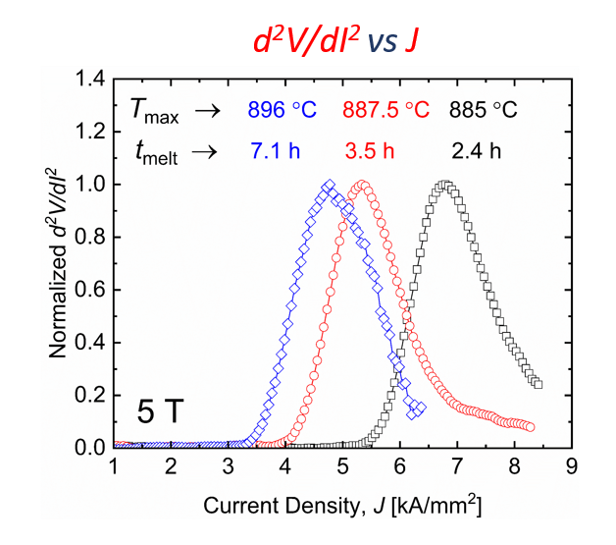
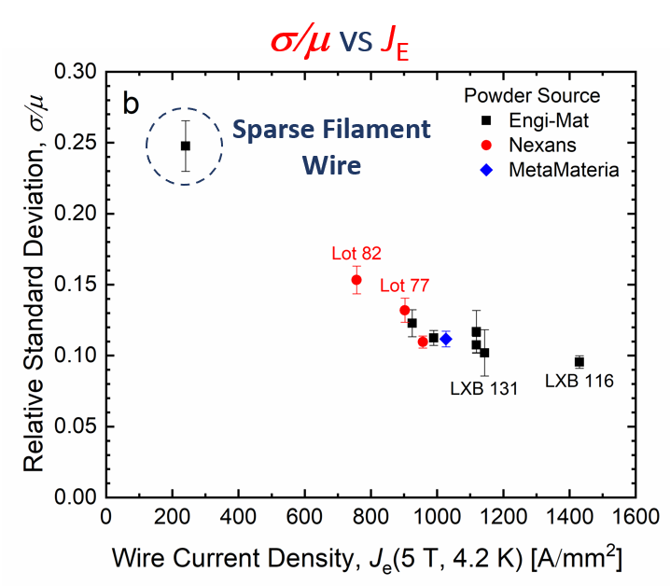
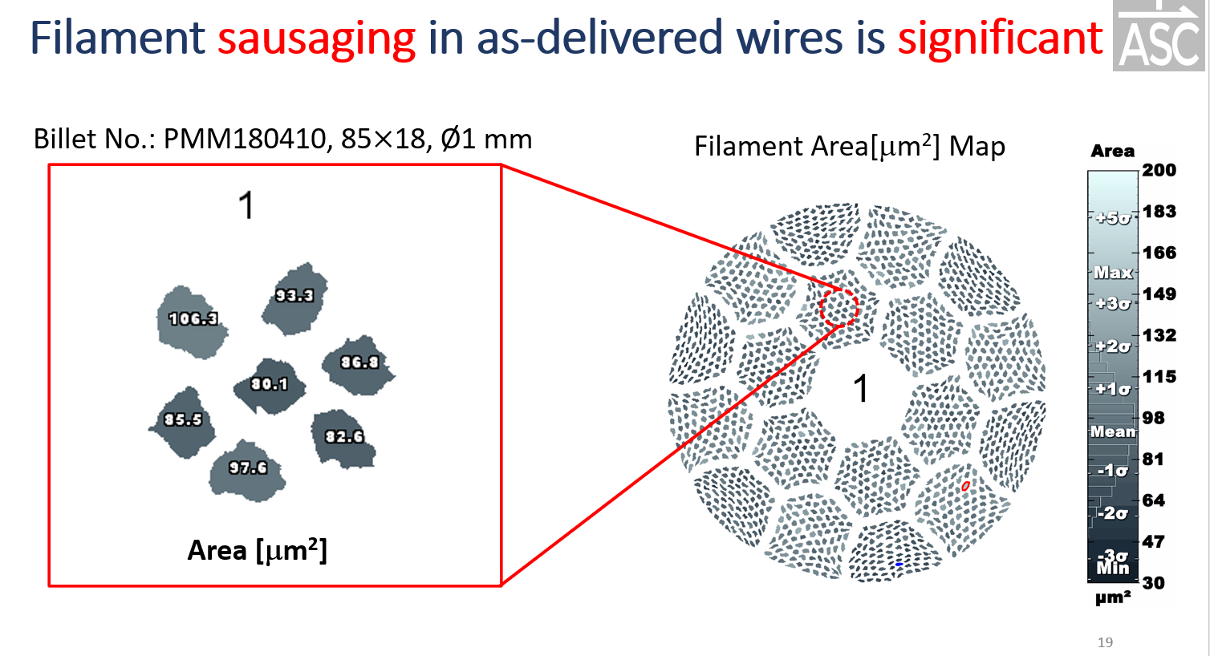
Final thoughts
Reliable, consistent powder is a present concern but the SBIR and ASC programs are providing basic characterization, amplified greatly by ARDAP efforts too
Using our standard J_{E}(5T) metric, we are not yet back to where we were in 2018-2020 (1100-1300 A/mm²) time frame but I am optimistic
As made wires have badly sausaged filaments – this strikes me as next path to greatly increasing Jc – recent PhD of Shaon Barua had much of interest on this

