Slide 1
Introduction and Milestones
S. Krave
US Magnet Development Program

Slide 2
Goals of the working group
Work to develop processes and materials to enable high performance magnet designs
  Evaluate resin systems for standard processing parameters
    Viscosity, mixing processes, curing etc…
      There are engineering solutions for most reasonable combinations and can be solved individually for specific instances
Applicable Driving Technical Questions:
  How do magnet materials directly affect magnet training and performance?
    Quite a bit
  How can magnet materials be designed to facilitate improved magnet performance?
    Sure
  Can improved processes lead to more cost effective and robust magnet designs?
    Probably, but this will be solution dependent.

Slide 3
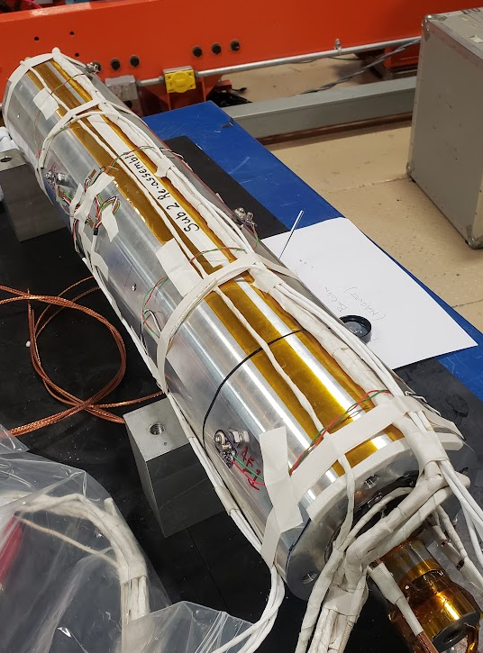
Materials…
There are several knobs available:
  Cp, CTE, Fracture toughness, bond strength, modulus, elongation, surface treatments, radiation stability, etc
  These knobs change response to the disturbance spectrum as well as the disturbance spectrum itself, perhaps in difficult to correlate ways
How these knobs are used is design dependent
  We can see that many material related tasks are contained within other projects, especially the subscale CCT program.

Slide 4
Milestones 2024 Update
I added a few, changed some around, but what would you want in a material?
Milestone # | Description | Target | Status * | Updated Target | Requestor | Comments
AIIIc-M1 | Demonstration of High Viscosity (Thermoplastic) Resin Systems for Superconducting Magnets | Jun-21 | Obsolete | Jun-24 | S. Krave | Initial attempts with thermoplastics proved challenging and require substantial additional resources. Negotiations are in progress with a partner to utilize injection molding equipment on subscale composites
AIIIc -M2 | Down-selection and Fabrication of CCT based on the above | Nov-21 | Obsolete |  | S. Krave | Listed as obsolete, can bring back based on the above if successful
AIIIc -M3 | Evaluation of de-sized glass | Dec-21 | Complete | Jun-23 | S. Krave | Samples have veen completed. Heat cleaned glass substantially outpreforms bare glass by 50%-100%. A followup task with re-sizing materials is added
AIIIc -M3b | Measurement of interlaminar Fracture toughness of Nb3Sn cable stacks and sensistivity to surface treatments |  | In Progress/Complete
AIIIc -M4 | Characterization of epoxy resin under gamma irradiation |  | Complete |  | T. Shen/ C. Reis
AIIIc -M5 | Evaluation of High Temperature compatible Mold Releases |  | Complete |  | S. Krave | Boron Nitride works OK. Nickel based plating (including nickel boron) is destroyed during heat treatment on stainless steel. Other substrates may be functional. Other resin systems may be compatible (release coatings are said to be comtatible with thermoplastics)
AIIIc-M6 | Evaluation of in-situ pre-impregnation silane treatment of de-sized cable | Mar-24 | Not Started |  | S.Krave

Slide 5
Driving technical questions:
How do magnet materials directly affect magnet training and performance?
How can magnet materials be designed to facilitate improved magnet performance?
Can improved processes lead to more cost effective and robust magnet designs?

Slide 6
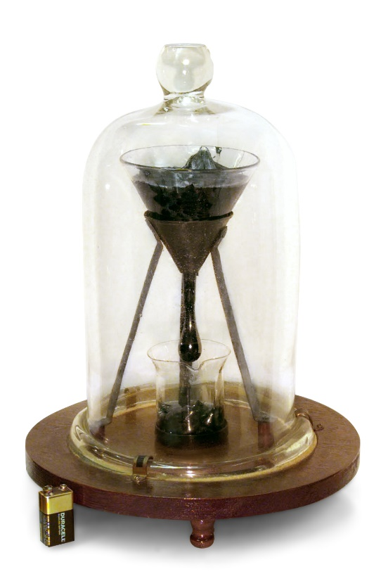
Milestones:
I’m retiring Thermoplastics (deferring indefinitely)
  Thermoplastics are a bit difficult and we don’t readily have resources to investigate
  Community interest seems low
Generic washing of cable has not been very promising as the sizing remains on the glass, but other options exist.
Mold Releases: Platings on stainless steel are destroyed during heat treatment and not reliable. Boron nitride works ok once sometimes.

Slide 7
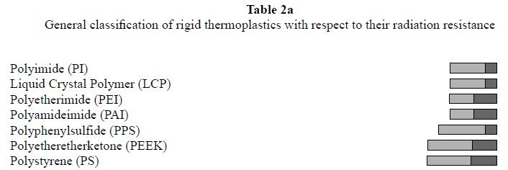
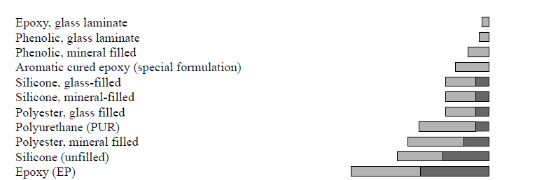
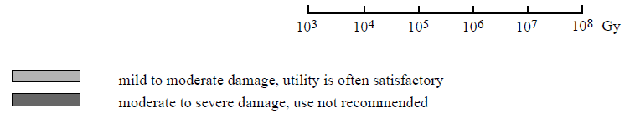
Retiring, but another note because I find it interesting
Impregnation with thermoplastics could enable high throughput of coil posting for a large project
High performance materials that likely exceed epoxy are available (PEEK, PI, PEI PPS, etc) that should have similar radiation performance when filled.
Thermoplastics
Thermosets

Slide 8
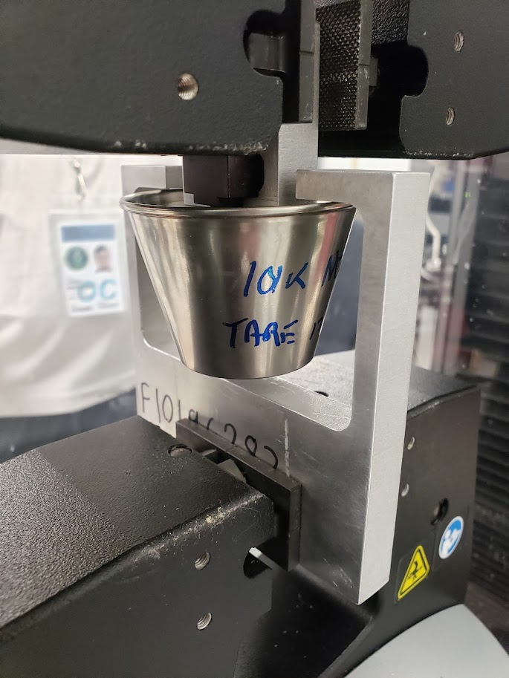
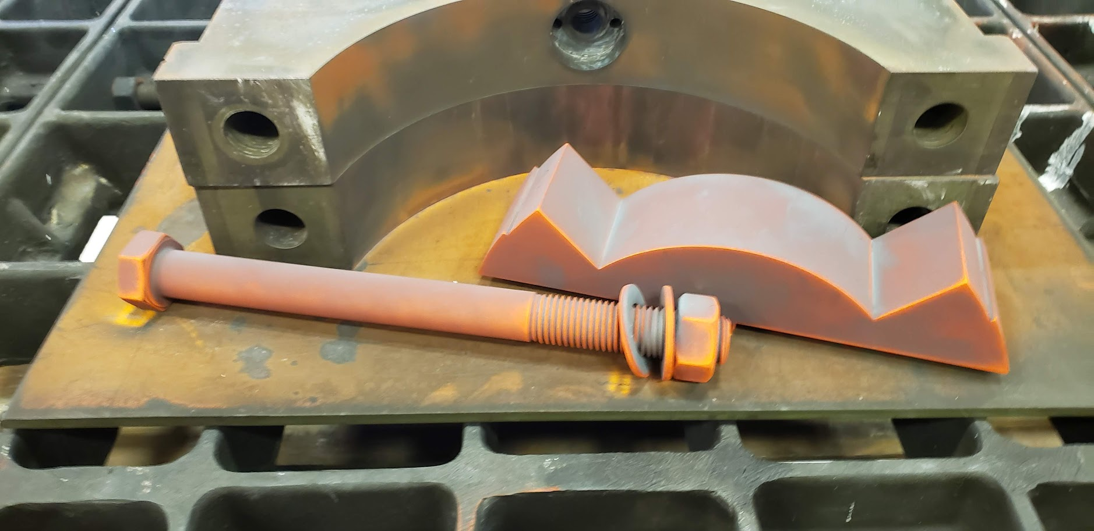
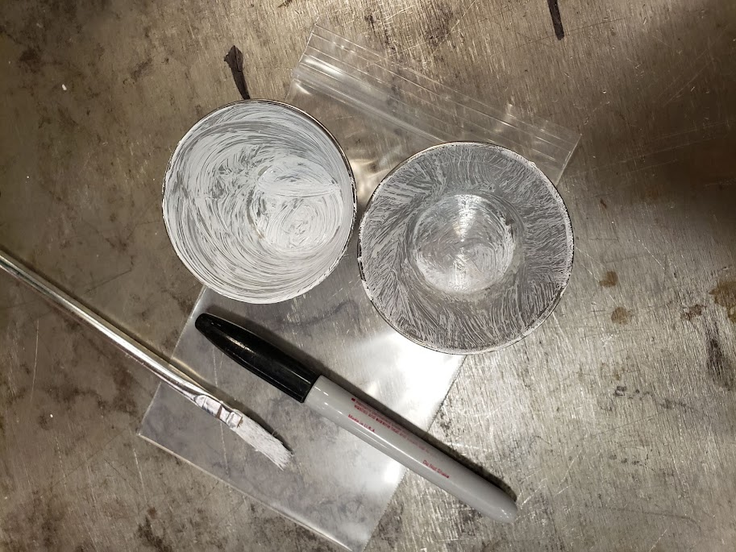
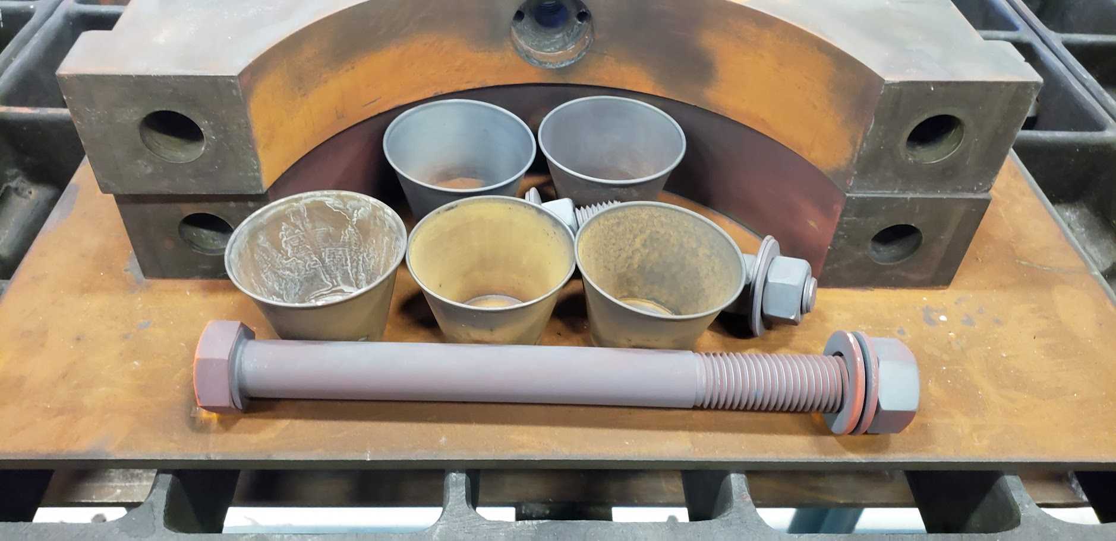
High Temperature mold releases
We have investigated a handful of “mold releases” to see if something would work through reaction
  Hint: All are boron based
They kind of worked…
  Not that great
  BN works OK without reaction. After reaction, it seems to be absorbed into epoxy and doesn’t work that well
  Nickel Boron is similar
    Will check surface under microscope. Possibly destruction of good surface properties.
    Still Rusts.

Slide 9
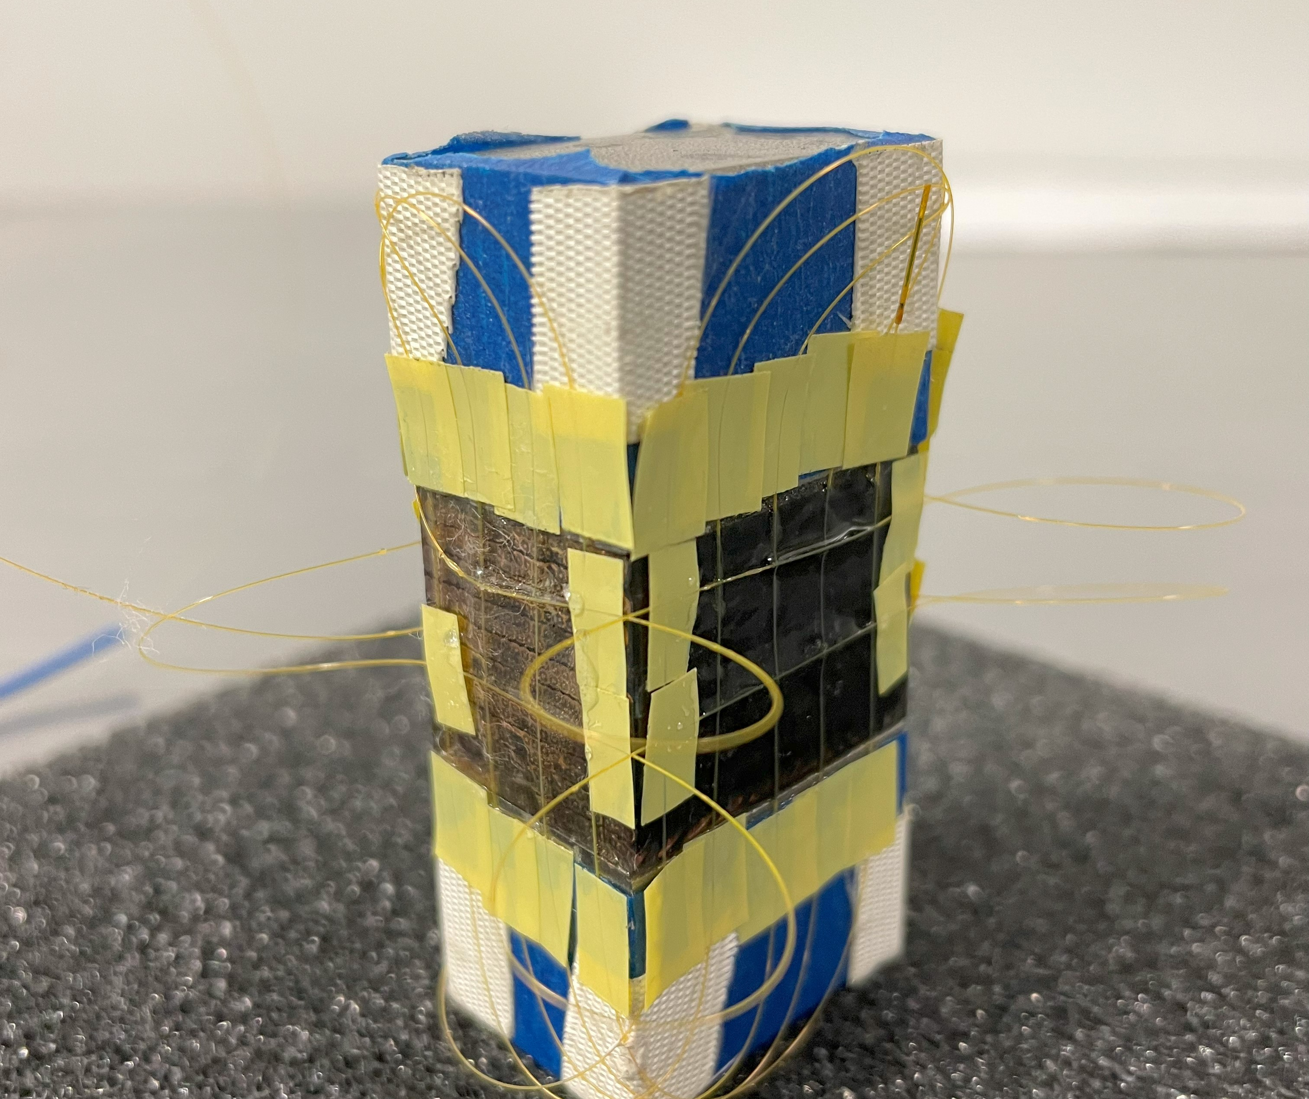
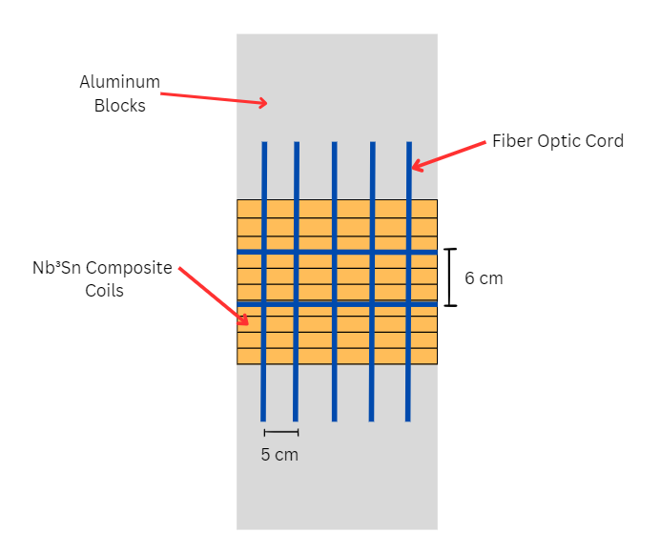
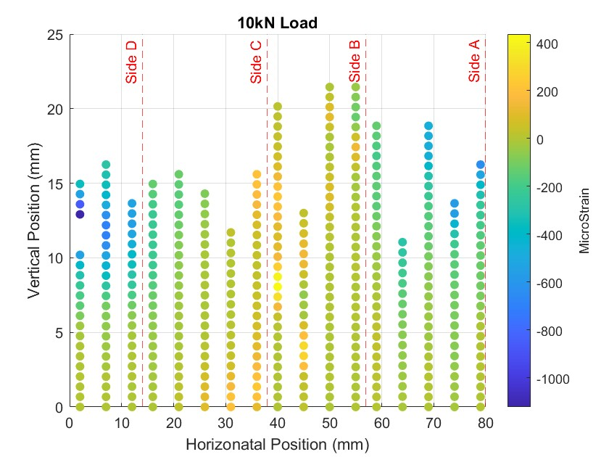
Fibers On Stacks
Not in the milestone, but we had a student working with Maria and I on fibers.
We installed fibers on Ten Stacks and made some measurements
We broke a lot of fibers…
We measured the room temperature modulus of 18 GPa
Test Goals:
  Observe clear periodicity to the strain in the readout
    The resolution of the sensor is not high enough (0.65mm gage pitch)
  Validate fiber strain vs material property on ten stacks
    Measured value is in line with other measurements.

Slide 10
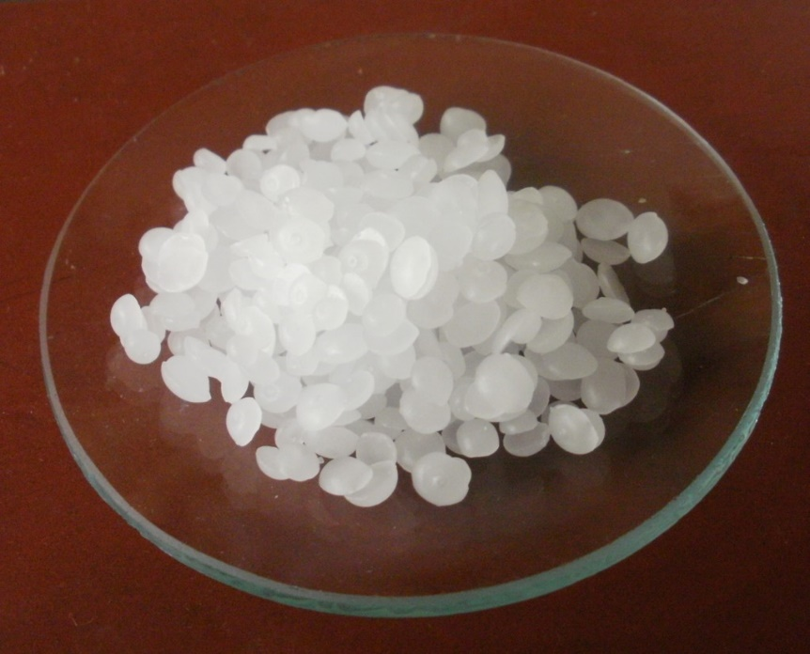
Upcoming Work
Collaborate with LBNL on measurement of 4-stacks
  Giorgio, I owe you some stacks…
Impregnation and measurement of Nb3Sn Cable stack with Wax
  Modulus, Short beam strength, CTE
Collect more data on Fracture Toughness
Test affect of silanes applied post reaction
  On regular glass
  On de-sized glass
Start Characterizing REBCO Stacks
  Open to suggestions…

Slide 11
Issues Encountered @ FNAL
One of our few remaining techs working on R&D left. Remaining technicians are supporting other projects and magnets.
We have had a couple short term students, but the time is simply not there to get them up to speed and through a couple iterations of samples/measurements before they go.

