Slide 1
CPRD Update
Lance Cooley and Ian Pong
CPRD Advisory Committee

Slide 2
Outline
Who we are, What we do
CPRD activities: recent POs
Related efforts
How we consider conductor needs and How we would invite your consideration of conductor needs
P5 related and thoughts from LTSW
Concluding remarks
Special thanks to Ken Marken
for the continued support for conductor procurement

Slide 3
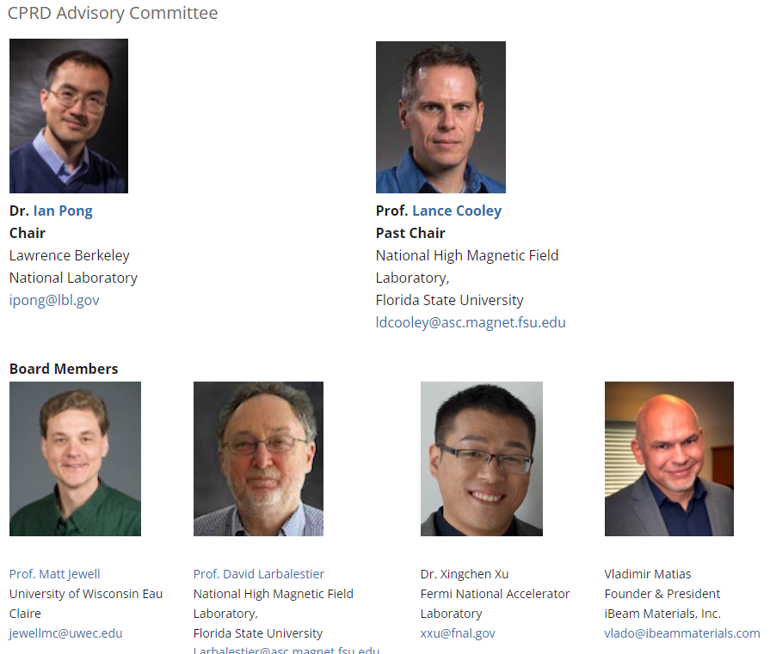
CPRD – Who we are
https://usmdp.lbl.gov/primary-program-element-4-conductor-procurement-and-rd-more-information/

Slide 4
CPRD – Who we are
CPRD is a part of USMDP
  Projects not under USMDP are not under CPRD
We are an advisory committee
  does not include cabling and other materials research efforts
  We would like to brainstorm about setting up a separate GARD Superconductor Working Group to coordinate the material characterization and research at national labs and universities
CPRD receives OHEP funding at LBNL to execute purchases and contracts that support USMDP partners

Slide 5
CPRD – What we do
The procurement responsibility of CPRD is to supply the MDP with production-quality conductors for the cables required for experimental magnets. ("near term")
The research and development responsibility of CPRD is to facilitate the understanding of performance limits, uniformity, reliability, scalability, and cost via industry development of advanced magnet conductors ("medium/long term")
We are the interface between magnet designers and conductor manufacturers:
  Help bridge the functional requirements & conductor specifications
  Identify potential conductor procurement challenges ahead of time

Slide 6
CPRD – Activities
CPRD strives to maintain a carefully balanced portfolio.
We look at the portfolio over a couple of years, not individual years because of the procurement nature or magnet usage, e.g.
  Some orders may take 18 months or longer to deliver
  No 2212 orders were placed in FY22, but nearly 50% of FY21 budget was spent on 2212 with half the deliveries coming in FY22

Slide 7
Update of Recent PO’s (1 of 3 - REBCO)
LBNL POs 7664886, 7702597, 7703532, 7730795 with ACT
  16 m CORC wire including in-field tests “QA” (completed)
  25 m CORC wire for MDP FNAL COMB (completed)
  12 m CORC wire for MDP Diagnostics (completed)
  20 m CORC wire for MDP LBNL pre-c4 coil (completed)
LBNL PO 7662506, 7652832 with AMPEERS
  24 m STAR wire development for MDP magnets (completed)
  24 m STAR wire development for MDP magnets (ongoing)
LBNL PO 7702532 with SuperPower
  124 m of tapes for MDP Instrumentation (completed)

Slide 8
Update of Recent PO’s (2 of 3 - Bi-2212)
LBNL PO 7702751 with BOST
  Three billets for powder spec evaluation and “QA” (ongoing)
LBNL PO 7721219 with SMS
  Two billets plus QA/QC (completing)

Slide 9
Update of Recent PO’s (3 of 3 - Nb₃Sn)
LBNL PO 7662740 with BOST
  >90 kg of 150/169 design for MDP FNAL SMCT (ongoing)
LBNL PO 7663793 with BOST
  R&D subelements then a restack for Hf-doped (ongoing)
LBNL PO 7663603 with HTR
  14 kg of a 217 high-c_{P} restack for cabling and beyond (ongoing)
LBNL PO 7718539 with HTR
  Phased tasks to develop APC (ongoing)

Slide 10
Other Efforts under GARD
University programs - ASC/NHMFL, Ohio State, TAMU, MIT, UWEC, Tufts, Houston… (did we get them all?)
SBIR-STTR
Advanced Conductor Technologies LLC | Next generation high-temperature superconducting CORC® conductors for high-field accelerator magnets
FlexEnergy LLC | Composition optimization Bi2Sr2CaCu2Ox powder for high JE multifilamentary wires for high field magnets
Engi-Mat Co. | Enhancement of Bi2212 Powder Consistency to Support Manufacture of High-Performance HTS Wire
AMPEERS LLC (Phase 2) | Conductor on Molded Barrel (COMB) magnets using Symmetric Tape Round (STAR®) Wires

Slide 11
CPRD – How we consider conductor needs
The “vetting” process philosophy is as follows:
  Discussion first takes place within the respective MDP areas to align conductor demand with area and community priorities
    CPRD communicates with Area Leads where needed
  Presentation at GM or CM is highly encouraged to ensure alignment with MDP milestones and HEP roadmaps
CPRD AC discussions and decisions are documented and archived on a Google drive
The requisition is approved by Soren and follows procurement rules

Slide 12
We invite YOU to consider Conductor Needs
Please consider the following:
  Interchangeability / shareability between magnet designs
  Accept a certain common spec and minimum acceptable performance, not always the best and customized
    Do we need to convene an ad-hoc committee to determine specs?
Reasons:
  Conductor inventory / repository – It’s not practical to store many types or grades. Magnets may have to accommodate.
    We hope that’s not a constraint, but let’s discuss.
  Suppliers need consistent specs for development.

Slide 13
Conductor Inventory
We want to encourage people to find use of lower performance conductor to make and break magnets and discover assembly and performance issues
What we have:
  Remnant AUP <340 m:
    ~60 km between 100 m and 340 m
    ~70+ pieces between 100 m and 150 m; ~250+ pieces between 150 m and 340 m
  Old CDP PO:
    mostly Nb₃Sn 0.6 mm to 0.85 mm, majority <500 m
  Small amounts of Bi-2212

Slide 14
P5 Related
Muon colliders providing guidance (e.g. aperture, field, radiation, T_{op}). For MDP and CPRD: understand the challenges and plan for investigations.
What will be the conductor needs?
How should the inventory be shaped?

Slide 15
From LTSW (1 of 3)
Making HTS magnets operating at fields where LTS magnets cannot go. For MDP: no conductor, no magnets. Should conductor cost be removed from magnet R&D and “hidden” within the CPRD repository?

Slide 16
From LTSW (2 of 3)
One cannot make high field magnets without knowing where things break. Magnet test completion is only the beginning of post-mortem analysis. For MDP: we need a post-mortem materials team. Topic for discussion with a new GARD Superconductor Working Group?

Slide 17
From LTSW (3 of 3)
Fast turn-around platforms. For CPRD: equally fast conductor procurement and availability – and QC! Will a limited inventory / repository with fixed specs ameliorate long delivery times?
LH2 collider? For CPRD: Characterization platforms at 20 K with high cooling capacity?

Slide 18
General Thoughts
From R&D towards Prototyping or Production
  Small things can impact magnets (e.g. oil on AUP strand); Damages can be very localized
  REBCO still has 15-30% variations end-to-end and spool-to-spool, and fitting is needed to substitute for the lack of testing capability at anticipated operating conditions.
  Commercial HTS still show uncertainties in performances
  Geometry uniformity is critical - more so than critical current?
Need to specify and QC what matters – (1) know what parameters (2) have the tools and experts available

Slide 19
Concluding Remarks
What are the near and long-term goals for Nb₃Sn and HTS conductor procurement and R&D?
  Near term to ensure the magnet programs are not limited by conductor availability
  Long term to ensure the magnet programs are not limited by conductor performance or cost
Need to understand the challenges (e.g. from muon collider / magnet designs) and plan for conductor investigations – spec, QC capabilities, people

Slide 20
EXTRA

Slide 21
Driving Question
What performance parameters in Nb₃Sn and HTS conductors are most critical for high field accelerator magnets?
  Answer: performance cost – consistent performance with low sigma/mean and small margin, quick/sans training

