Slide 1
Novel Diagnostics Milestones
Maxim Marchevsky (for the Diagnostics WG)
US MDP Collaboration Meeting
04/30/2024

Slide 2
Driving questions
Understanding the magnet disturbance spectrum. Localizing and identifying disturbances. Understanding mechanisms of elastic energy transformation into heat in magnets. Understanding why some impregnations materials work better than other for eliminating training.
How do we detect quenches and protect HTS magnets?
How do we design quench tolerant HTS conductors (current sharing in cables, defects, flux flow, quench propagation)
How do we improve diagnostics through novel hardware and data analysis

Slide 3
Key tasks
Resolving mechanical and electromagnetic disturbances in Nb₃Sn magnets and understanding physics of magnet training
Achieving a reliable and minimally invasive quench detection and localization capability for HTS and hybrid HTS/LTS magnets / Realizing a quench avoidance paradigm for HTS based on thermal runaway criterion
Resolving and understanding impact of current sharing in HTS cables and coils
4. Developing cryogenic quench protection solutions using active current controls
5. Understanding HTS conductor degradation mechanisms and exploring quench-
tolerant HTS conductor options

Slide 4
Diagnostics milestone table (2023)
Milestone # | Description | Target | Status * | Updated Target | Requestor | Comments
AIIId-M1 | Development of a new generation of self-calibrating acoustic emission diagnostics hardware | Dec-20 | Completed |  | M. Marchevsky
AIIId-M2 | Finalizing software algorithms for acoustic data analysis, completing analysis for the CCTs and 15T dipole | Dec-20 | Completed |  | M. Marchevsky
AIIId-M3ab | Development and implementation of non-optical distributed sensing for cables and magnets. RF TDR-based techniques. Ultrasonic waveguide-based techniques | Mar-23 | In progress |  | M. Marchevsky / G.S. Lee
AIIId-M4 | Test of a large-scale Hall array and imaging current distribution in HTS tape stacks and coils | May-21 | Completed | More work is ongoing
AIIId-M5 | Completing spot heater studies to improve voltage-based diagnostics and address “silent” quenches. | Jul-21 | Not started | Jun-25 | S. Stoynev | Coil instrumentation and mirror magnet assembly in the works for the last two years; test can be within an year
AIIId-M5a | Development and commissioning of a dedicated V-I measurement system (multichannel nanovoltmeter) for superconducting magnets | Jan-00 | In progress | Mar-23 | S. Stoynev | AIIId-M7
AIIId-M6a | Demonstration of acoustics-based probing of coil interfaces | Sep-21 | In progress | Dec-23 | M. Marchevsky
AIIId-M7 | Development of multi-element and flexible quench antennas and localization of quenches using flexible quench antenna arrays | 30-Sep-21 | Completed |  | S. Stoynev/J. DiMarco
AIIId-M7a | Characterization of different quench antenna designs for use in superconducting devices |  | In progress | Jan-23 | S. Stoynev/J. DiMarco | extended studies
AIIId-M7b | Development of a flexible ‘sinusoid-shaped’ quench antenna, which would have loops everywhere parallel to the CCT conductor. |  | Not started | Sep-23 | J. DiMarco/R. Teyber | extended goals
AIIId-M8 | Characterization of training-like behavior in different impregnation materials under load using a Transverse Pressure Insert (TPI) measurement system | Dec-21 | In progress | n/a | E. Barzi
AIIId-M9 | Development and test of a standalone acoustic quench detection and localization FPGA-based system | Dec-21
AIIId-M10 | Development and test of a non-rotating new magnetic probe prototype | Dec-21 | In progress | Dec-24 | M. Marchevsky / J. DiMarco
AIIId-M11a | Demonstration of a programmable fully-cryogenic FPGA “smart” sensor core with digital readout | Dec-21 | In progress | Jan-23 | M. Turqueti
AIIId-M12a | Calibration of FBG fibers in a small cryostat (2021) Installation of fibers on an MDP magnet and strain measurement during a quench. Modification of magnet test facility top plate to accommodate fiber line (2021) Design a proof of principle experiment for quench detection: Small coil fabrication and tests (March 2023) Energy spectrum analysis (Dec 2023) Coil azimuthal strain mapping: Experiment on coil ten stacks sample made with different epoxy (March 2023) Install distributed fiber on a mirror magnet for coil strain map (Dec 2022) | Dec-22 | In progress | Dec-23 | M. Baldini
AIIId-M13 | Develop quality control capabilities to identify defects and performance limiting regions in REBCO cables and accelerator magnets |  | In progress | Nov-23 | R. Teyber | + TITO tape / resistivity measurements
AIIId-M14 | Advance numerical and experimental abilities to monitor and predict current distributions in ReBCO cables for accelerator magnets |  | In progress | Mar-24 | R. Teyber | Seek to exploit recent FES research progress in HEP magnets

Slide 5
Diagnostics presentations at CM
#
Diagnostics work has grown into a sizeable fraction of the MDP output!
Year

Slide 6
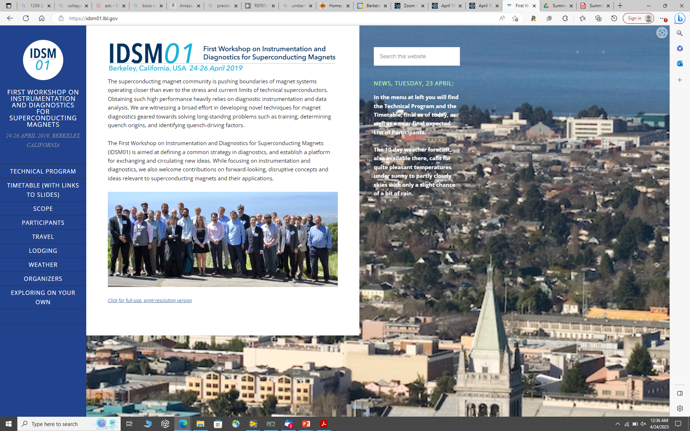
IDSM’02 Workshop
Understanding of magnet training (or lack thereof). Disturbance spectra of LTS high-field magnets
Quench detection and protection for HTS / hybrid magnet for HEP and Fusion
Novel diagnostic instrumentation approaches and techniques
Novel (cryo) electronics, data analysis, modeling
26-28 April, 2023, Paestum, Italy
A follow-up from IDSM’01 organized at Berkeley in 2019
Joint with the Test Stands Workshop
Co-sponsored by CERN and INFN
- 50 participants
- 27 presentations
https://agenda.infn.it/event/32061/

Slide 7
Main developments since the last CM
Diagnostics and hardware
Development of magnet impregnation monitoring using RF reflectometry (LBNL)
Tests of distributed temperature sensing with 3.3 m long ultrasonic waveguides down to 4.2K (LBNL)
New cryogenic options for current control were explored (LBNL)
Development of a Hall imaging system with pulsed current capability (LBNL)
New “TITO” approach to determine true contact resistances in HTS cables (LBNL)
Novel quench antennas (FNAL), quench antenna analysis for improved localization (LBNL)
Non-rotating magnetic field probe development (FNAL +LBNL)
Fiberoptic diagnostics tests on various magnets (FNAL, LBNL)
Cryo-electronics developments (BNL)
Power supply variation diagnostics (FNAL)
AI/ML for quench prediction (FNAL)

Slide 8
Synergistic projects
FES Magnet R&D Program
HEP SBIR Phase I with Alphacore – development of a cryogenic IC for HTS quench protection, integrating QD data acquisition with active current control
FES Infuse with General Atomics - Joint hall probe arrays to explore joint current distributions, inverse modeling to extract joint parameters
FES SBIR phase 1 - contact resistivity extraction and modeling of CORC cables with joints (dropouts) via "TITO" measurements, useful for both modeling, cable optimization and also useful for quality control
FES SBIR phase 2B - quench detection via Hall probe arrays, development of real-time quench detection "product" for CORC CICC's and for two-phase CORC cables, development of cryo current-sensing techniques that have improved immunity to dynamic background fields
The fiberoptic effort is supported by LDRD funding (FNAL)
A scalable acquisition upgrade to VMTF based on FPGAs and probably 20MSPS 14 bit ADC's. This would likely use the Captan system and OTSDAQ (FNAL)

Slide 9
Published works (2023-24)
Thermal runaway criterion as a basis for the protection of high-temperature superconductor magnets
M Marchevsky and S Prestemon 2024 Supercond. Sci. Technol. 37 035012, DOI 10.1088/1361-6668/ad20fe
Impregnation damage monitoring for the canted-cosine-theta magnets using time-domain reflectometry
G. S. Lee et al., Supercond. Sci. Technol., accepted, DOI 10.1088/1361-6668/ad44e5
H. M. Seong, Y. -S. Sim, G. S. Lee and S. J. Chang, "Development of Quench Detection Method Around the Joint Box for HTS Cable Using TFDR and EM Algorithm," in IEEE Transactions on Applied Superconductivity, vol. 34, no. 3, pp. 1-5, May 2024, Art no. 4701905, doi: 10.1109/TASC.2024.3356454
S. Stoynev and J. DiMarco, "Assessment and Performance of Flexible Quench Antenna Array Diagnostics for Superconducting Magnets," in IEEE Transactions on Applied Superconductivity, vol. 33, no. 5, pp. 1-5, Aug. 2023, Art no. 4700205, doi: 10.1109/TASC.2023.3238677
M. Baldini, S. Krave, R. Bossert, S. Feher, T. Strauss, and A. Vouris, “Application of Distributed Fiber Optic Strain Sensors to LMQXFA Cold Mass Welding”, IEEE Transactions on Applied Superconductivity vol. 33, no. 5, pp. 1-5, Aug. 2023, Art no. 9000705, doi: 10.1109/TASC.2023.3258904
Training-free demonstration of a 5.4 T Nb₃Sn canted-cosine-theta accelerator dipole impregnated with paraffin wax
D. Arbelaez et al., 2024 Supercond. Sci. Technol, accepted, DOI 10.1088/1361-6668/ad44e6

Slide 10
Diagnostics session

