Slide 1
Non-Rotating Magnetic Probe Update
02May2024
J. DiMarco, M. Marchevsky

Slide 2
Torsionally oscillating piezo probe for magnetic measurements
Original idea from Maxim
Torsional piezo-transducer attached to cylindrical probe form
Wires/spools on probe cylinder excited with AC current at piezo resonance
Get piezo torque response as a function of angle ➔ sensitive to all harmonics
Use piezo transducer amplitude at resonance vs angle to determine main field and harmonic content
Eventually would calibrate against known coil

Slide 3
Why make such a device?
Piezo transducers have the resolution necessary
Probe could be simple and robust
Probe could be used without anticryostat or mechanical feed-through to cryogenic condition
Depending on time to settle at resonance when multiplexing, the measurement may be very fast and useful for seeing transients

Slide 4
First design – torque vs angle
Single wire measurements at radius of probe
16 single wires mounted on cylindrical form
Powered AC with few Amps of current
Frequency control of AC current so can tune to piezo resonance
Use multiplexer to select power applied to each wire at angle paired to neighboring wire
Piezo probe is comprised of some number of wires precisely positioned around perimeter of cylinder (shown are 16)
Power each wire in turn with AC current corresponding to resonant frequency of piezo, with return of circuit being on neighboring wire or at center
Each wire will be sensitive to all harmonics fields and torque will depend on field vs angle

Slide 5
S
$$\vec{F}=\vec{I}L x \vec{B}$$
B
F
I into page
$$I=I_{0}\cos\left(ωt\right);$$ $ω$is resonant frequency for piezo excitation
Radial portion of field contributes to torque on current carrying windings
N
$B_{r}=\sum_{n=1}^{∞}{{\left(\frac{r}{R_{ref}}\right)}^{n−1}∗\left[B_{n}\sin\left(nθ\right)+A_{n}cos⁡(nθ)\right]}$
At each perimeter position, since the winding is being excited at resonance frequency, can use an FFT (or lock-in amp) to determine the amplitude of the torque at each angle. Then determine the harmonic fields as a function of angle around the perimeter from the torque amplitudes.

Slide 6
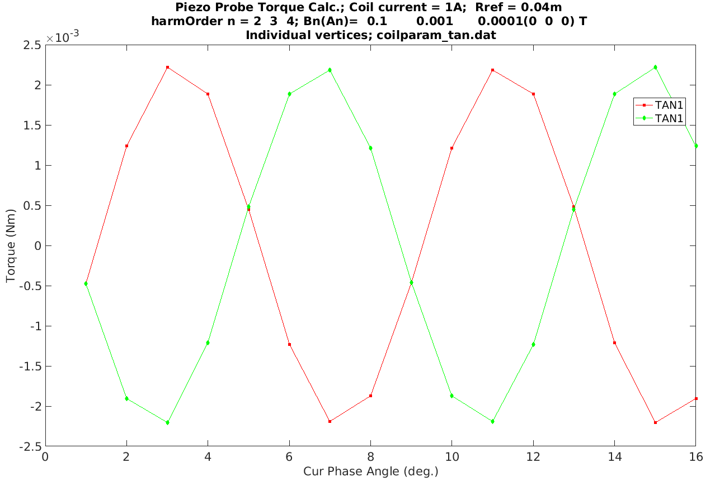

Slide 7
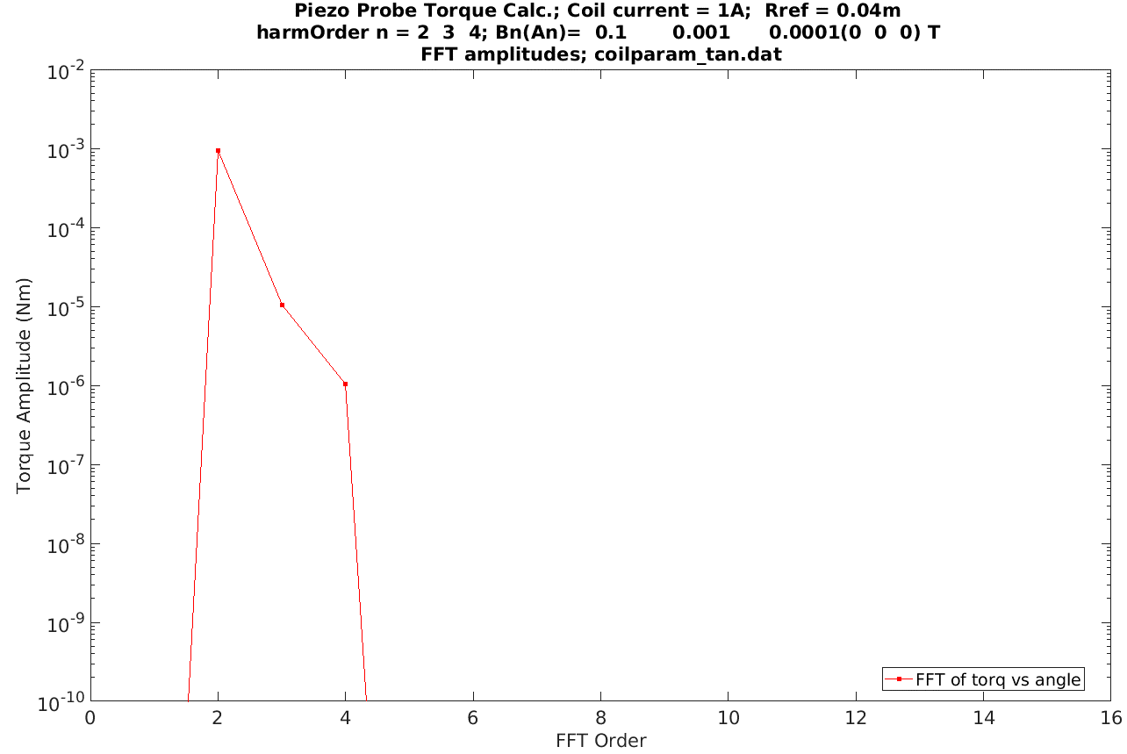

Slide 8
Present design – AC multi-turn coils at angles
Small multi-turn solenoid coils at radius of probe
16 ‘spools’ on cylindrical form
Powered AC with low current
Frequency control of AC current so can tune to piezo resonance
Use multiplexer to select spool being powered

Slide 9
AC coils
Shear
piezoplates

Slide 10
$$\vec{m}=\vec{I}A$$
Magnetic dipole moment
S
$$\vec{F}=∇(\vec{m}∙\vec{B});$$
I
m
Portion of field parallel to each AC coil powered in turn contributes to torque on probe
➔ Get torque at each angle proportional to field
N

Slide 11
f₀
MUX @ f₀
Microprocessor
MUX
1:16
To ac coils
ref
Lock-in
DC source
From piezoplates
Out (R, θ)
(f₀ , 2f₀ , 3f₀ ,…)*16

Slide 12
Status:
Finish detailing design
Obtain materials (partially in hand)
Assembly and test
➔ Find time/student for this…

