Slide 1
Update on the fiberoptic task
M. Baldini, S. Krave
MDP collaboration meeting
April 30-May 3 2024

Slide 2
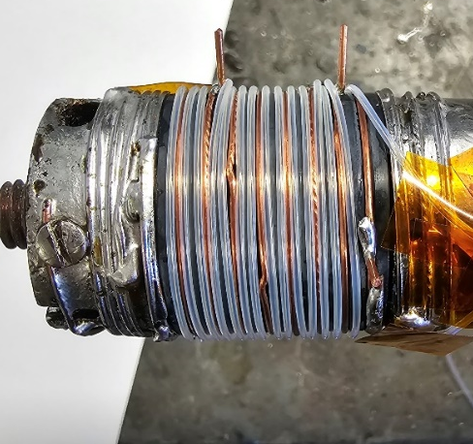
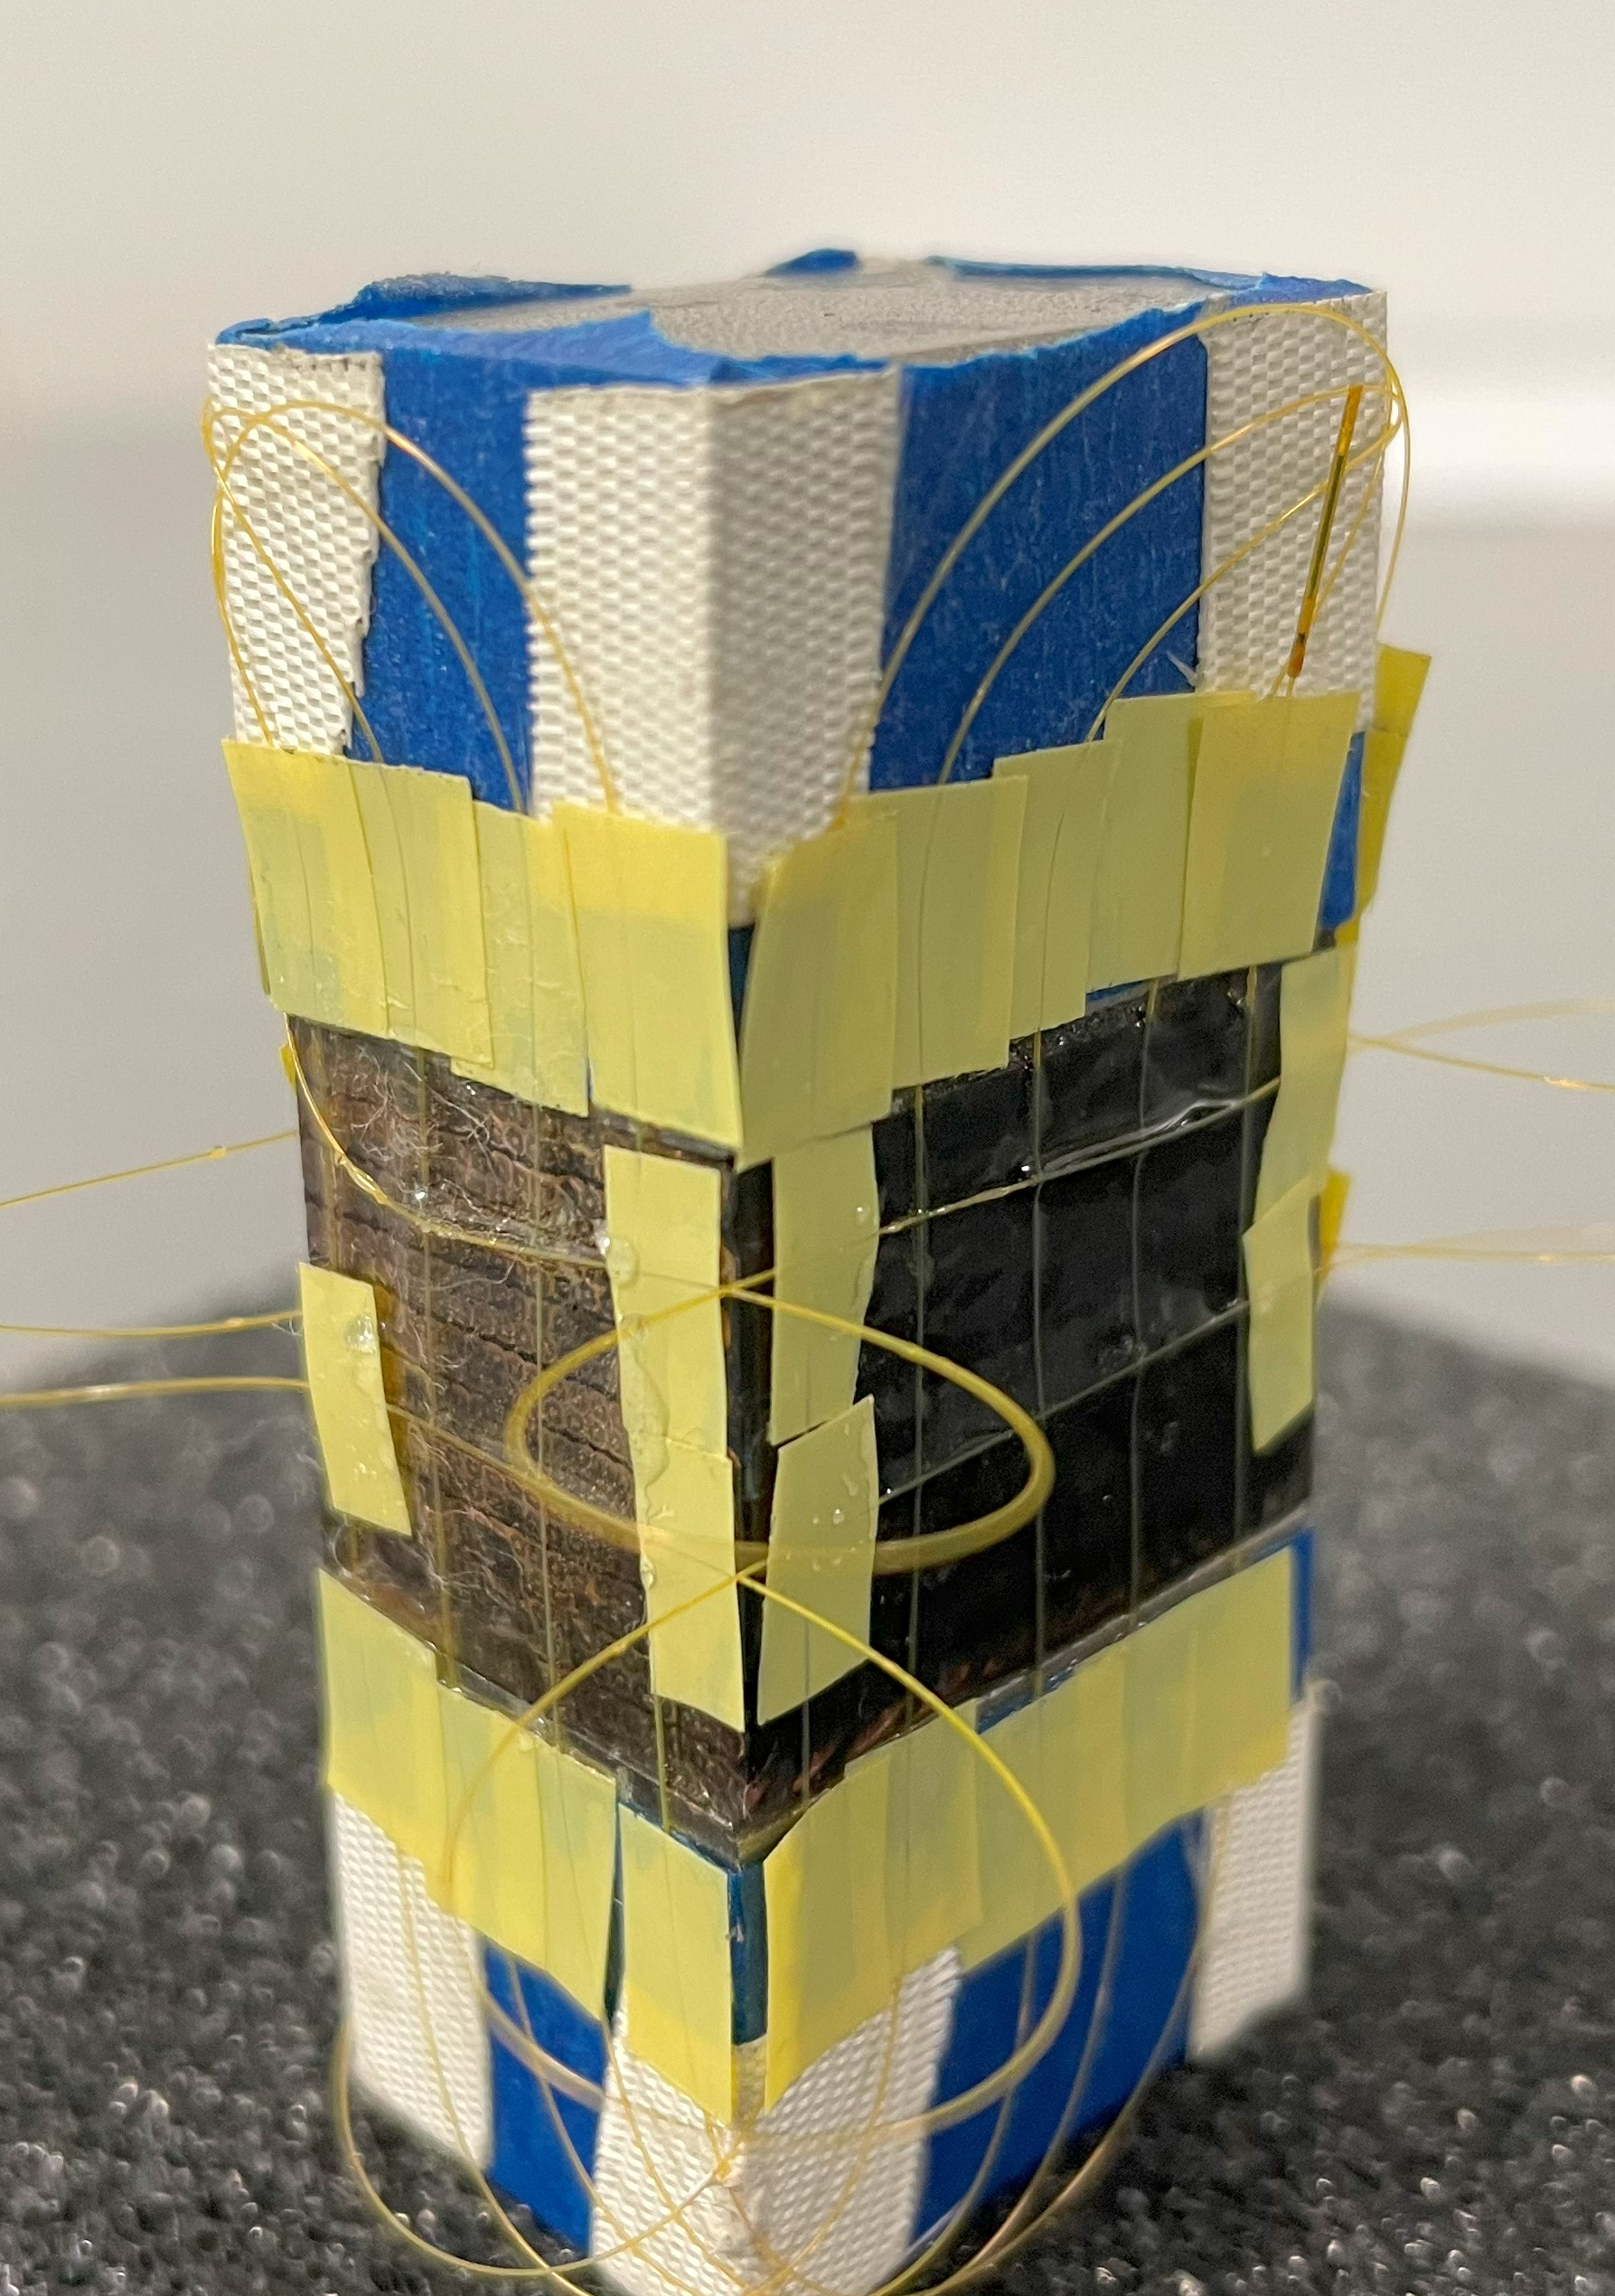
Outline
Quench propagation study using temperature fiber sensor
  Barrel Samples: Nb3Sn and REBCO
  Test with a star cable
Strain measurements on R&D magnets

Slide 3
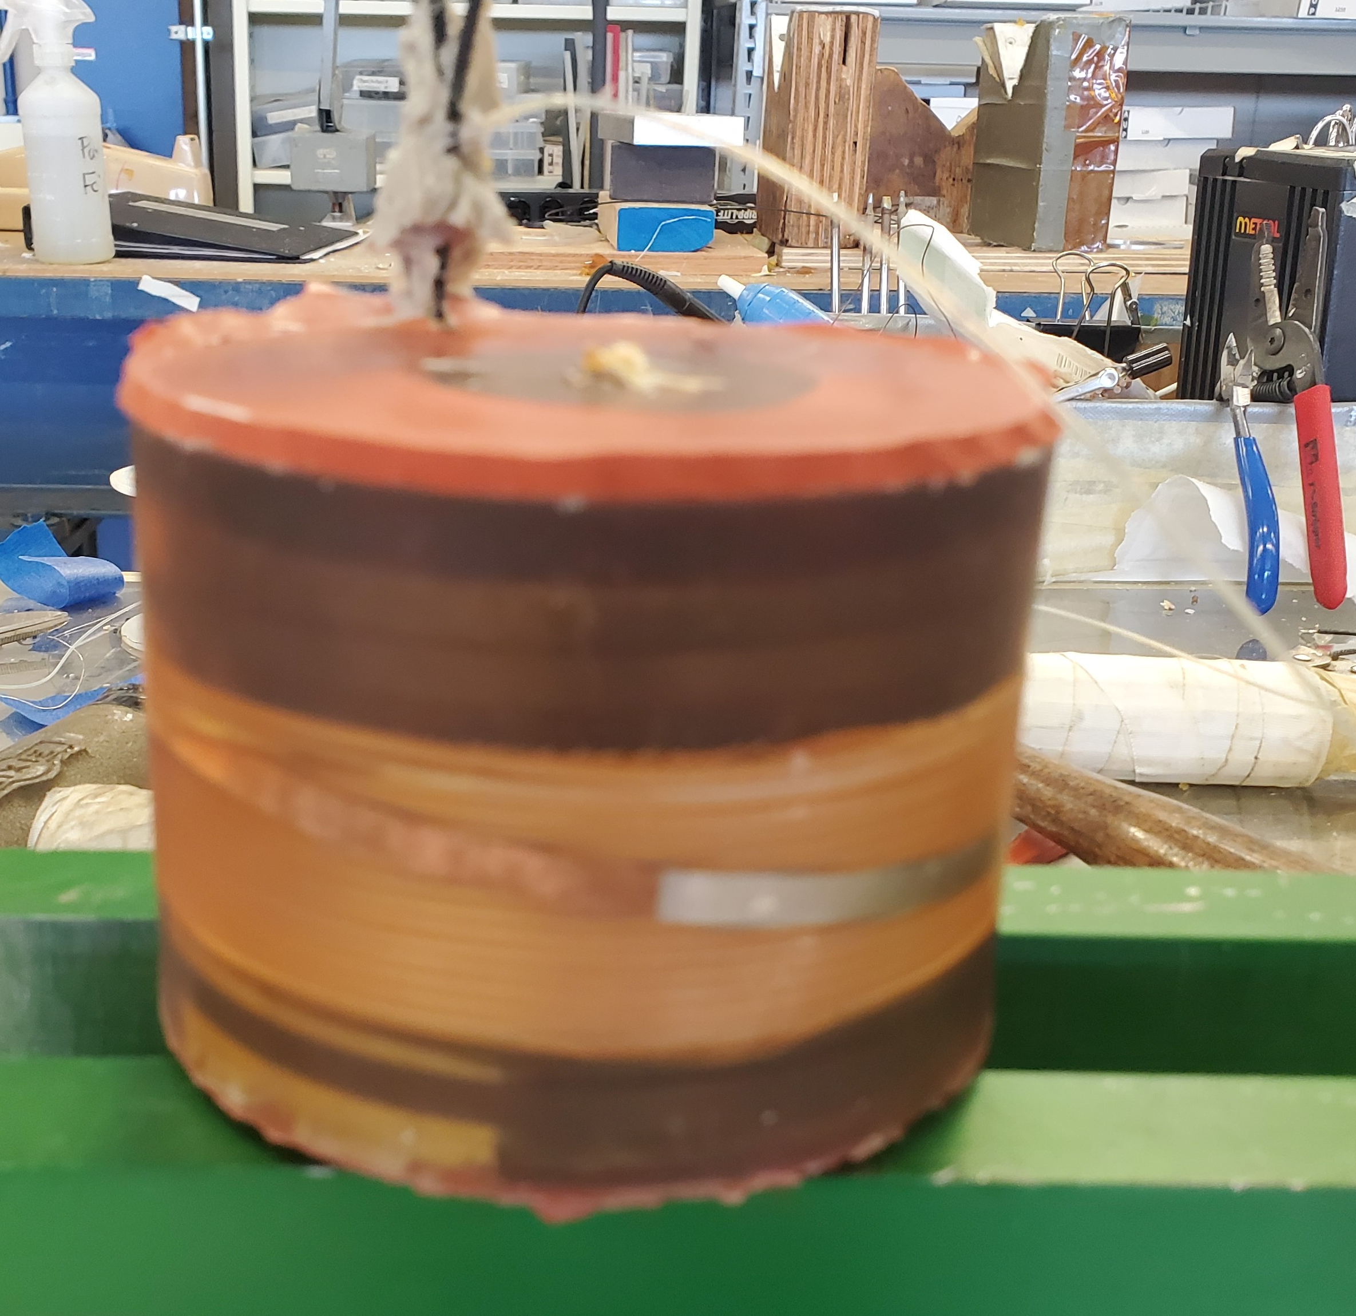
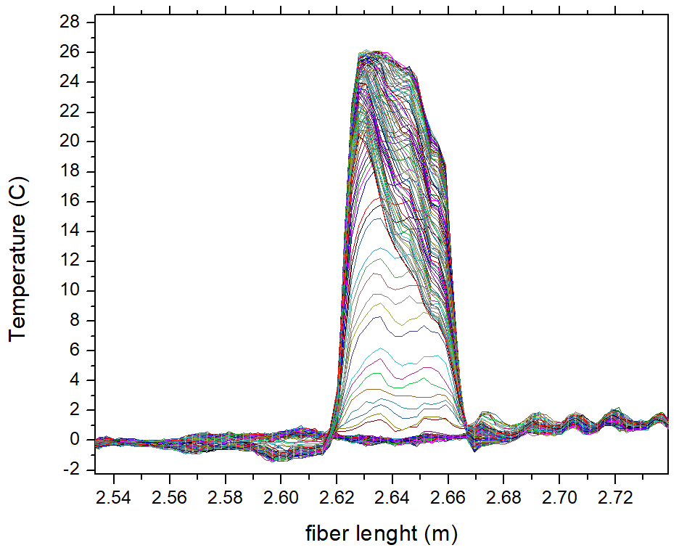
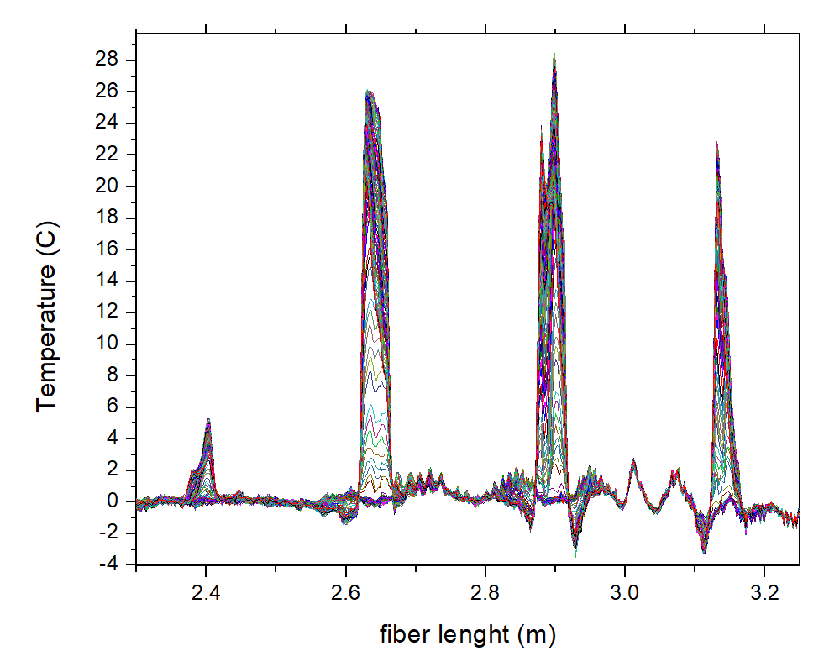
Temperature fiber sensors for Quench detection
Year 2022
Pros: Fibers very promising for T sensing
Cons: how to handle feedthrough/impregnation
Test in liquid N on a resistive coil
Fiber Temperature sensors: 3 turn underneath the spot heater
Discharge a capacitor
Break most of the strain sensor at feedthrough during epoxy impregnation

Slide 4

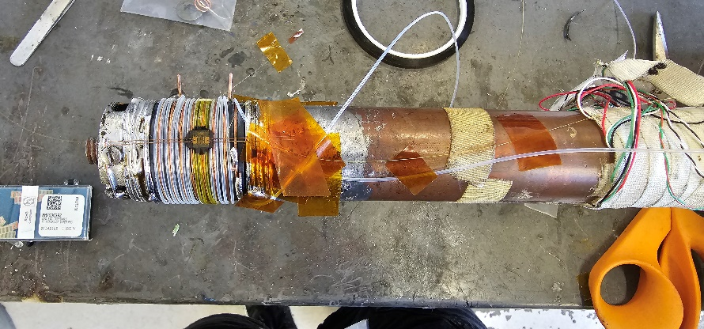
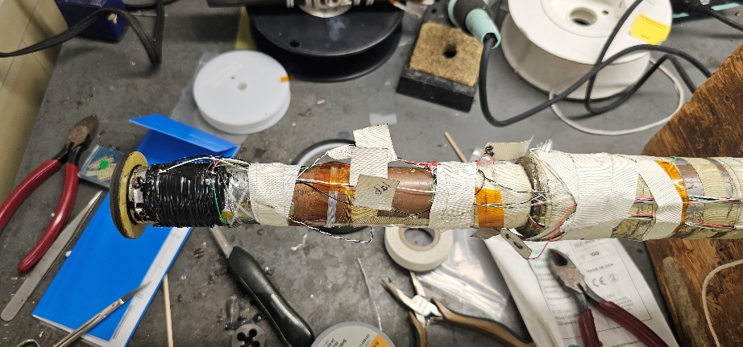
Quench propagation study on Nb3Sn strand
Year 2023
Nb₃Sn witness sample from QXFA coil
Strain gauge was used as a spot heater to quench the wire
5 m temperature and strain fiber to study quench propagation.
Test in liquid He at 4.5 K
Test 1: At 15T, 14T, 12T, 10T ramped up the current until quench
Strain fiber was lost at the feedthrough level
Magnetic Field | Critical Current
15T | 376A
14T | 466A
12T | 693A
10T | 985A

Slide 5
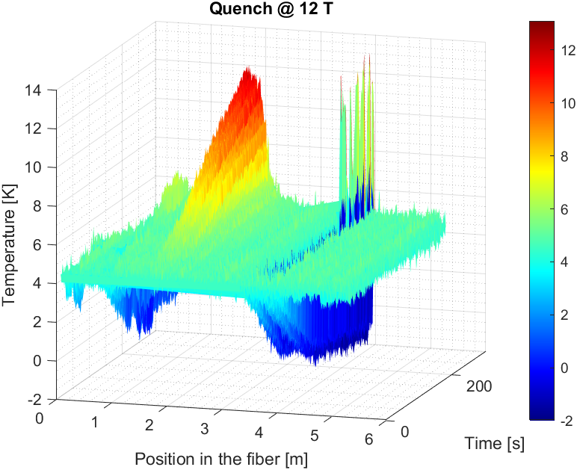
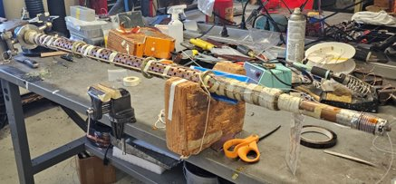
12T DATA analysis
Heating due to contact with the probe
Ramp before and after the quench (just first wrapping)
Issue: negative T variation during ramping suggests that
Strain and temperature are not fully decoupled

Slide 6
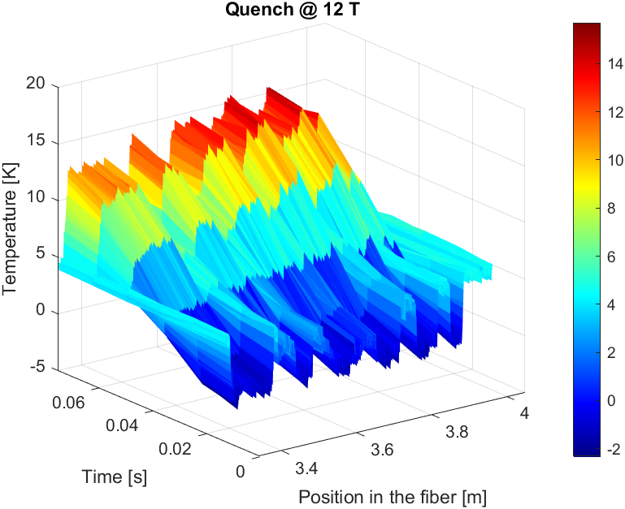
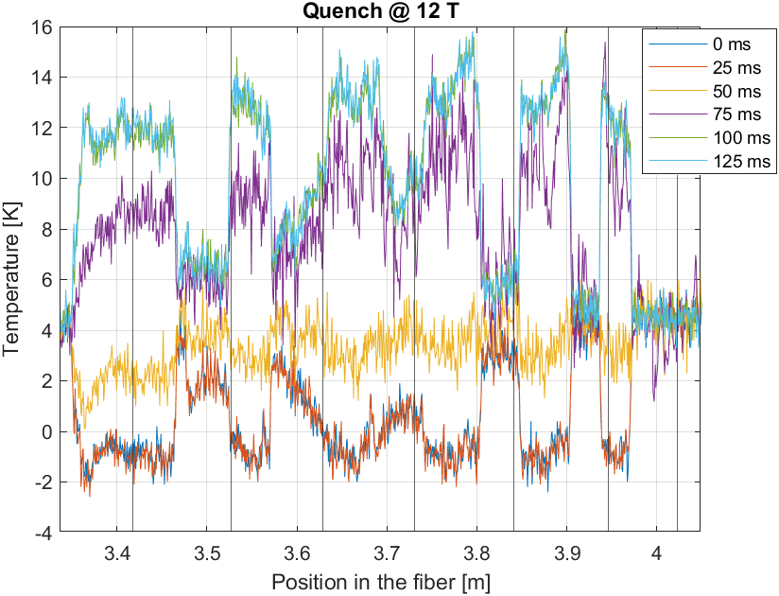
T variation during quench

Slide 7
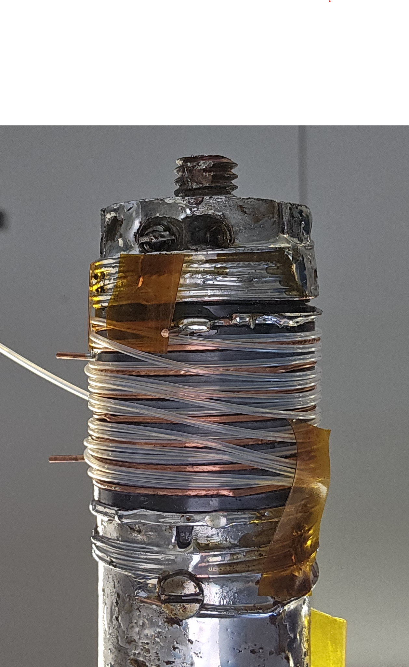
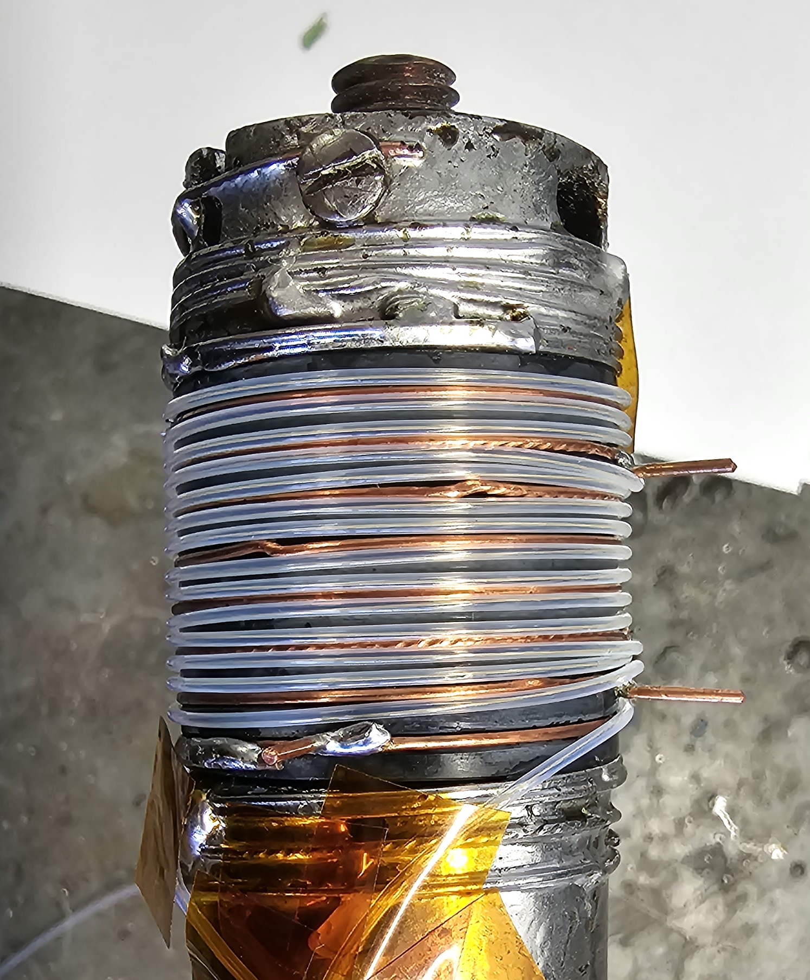
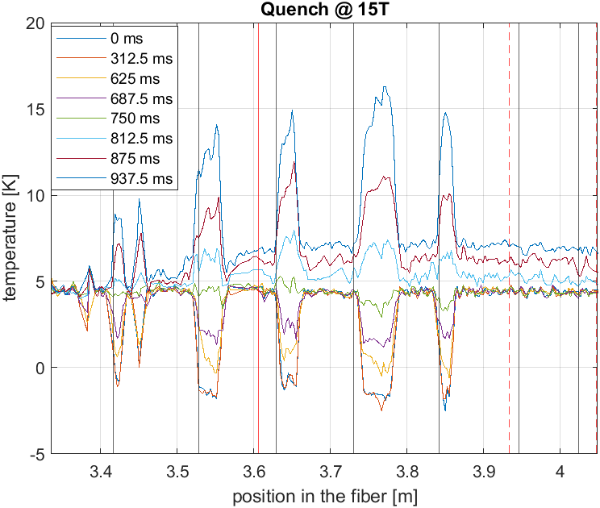
Quench at 15T with spot heater
Spot Heater
One side of the barrel was more sensitive to temperature variation, maybe this is due to the different arrangement of the sensors. Issue: we need better thermal contact?

Slide 8
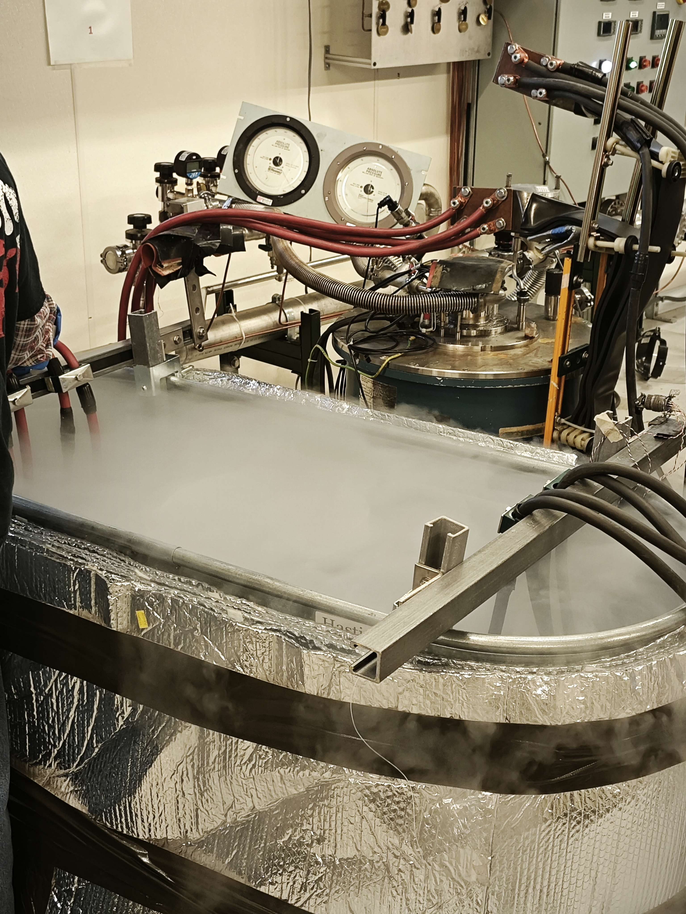
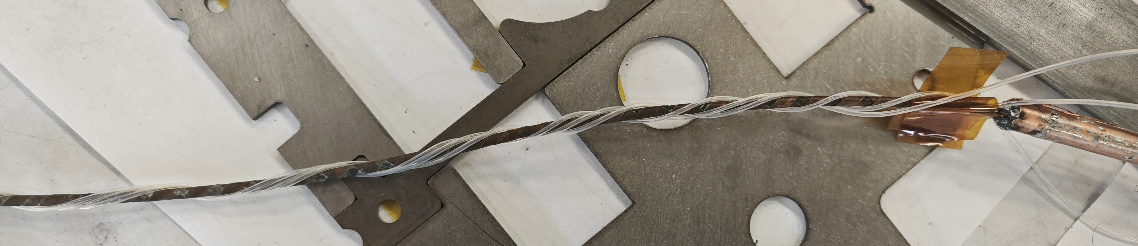
Experiment with STAR wire in liquid N
Fiber without Kapton
RUN 1: up to 700A
RUN 2: Up to 500 A
RUN 3: Up to 600 A
RUN 4: Up to 750 A
Fiber with Kapton
The cable and the fiber were wrapped in a kapton layer with sticky kapton holding it in place.
RUN 1: up to 500 A,
RUN 2: Up to 600 A
RUN 3: Up to 750 A
RUN 4: up to 650 A holding the current at 650 A for two minutes.
Notes:
with 10A /s up to 500 A and 5 A/s above 500A

Slide 9
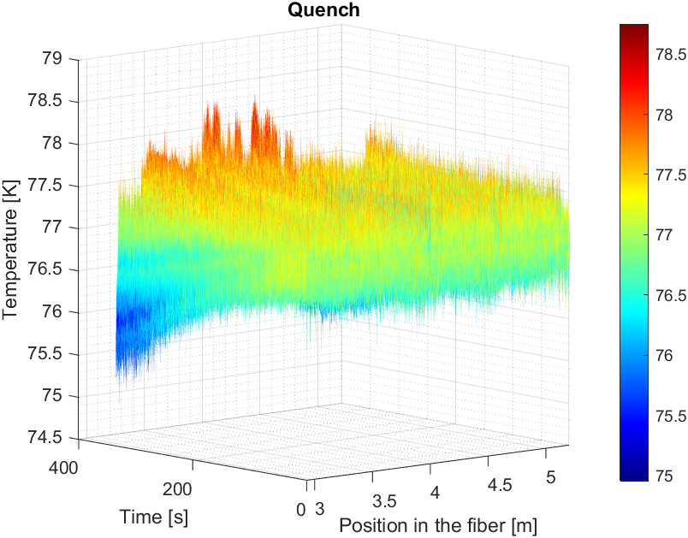
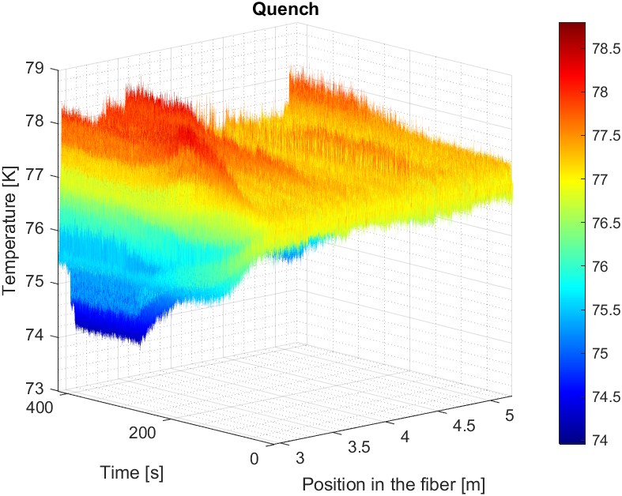
results
RUN 4/ no kapton
RUN 4/ kapton
Issue: we need better thermal contact. Question: can we small detect temperature variation in HTS without some kind of impregnation?

Slide 10
Outline
Quench propagation study using temperature fiber sensor
  Barrel Samples: Nb3Sn and REBCO
  Test with a star cable
Strain measurements on R&D magnets

Slide 11
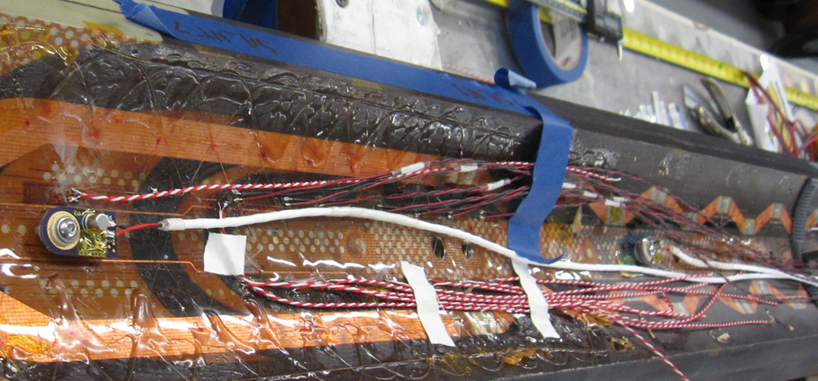
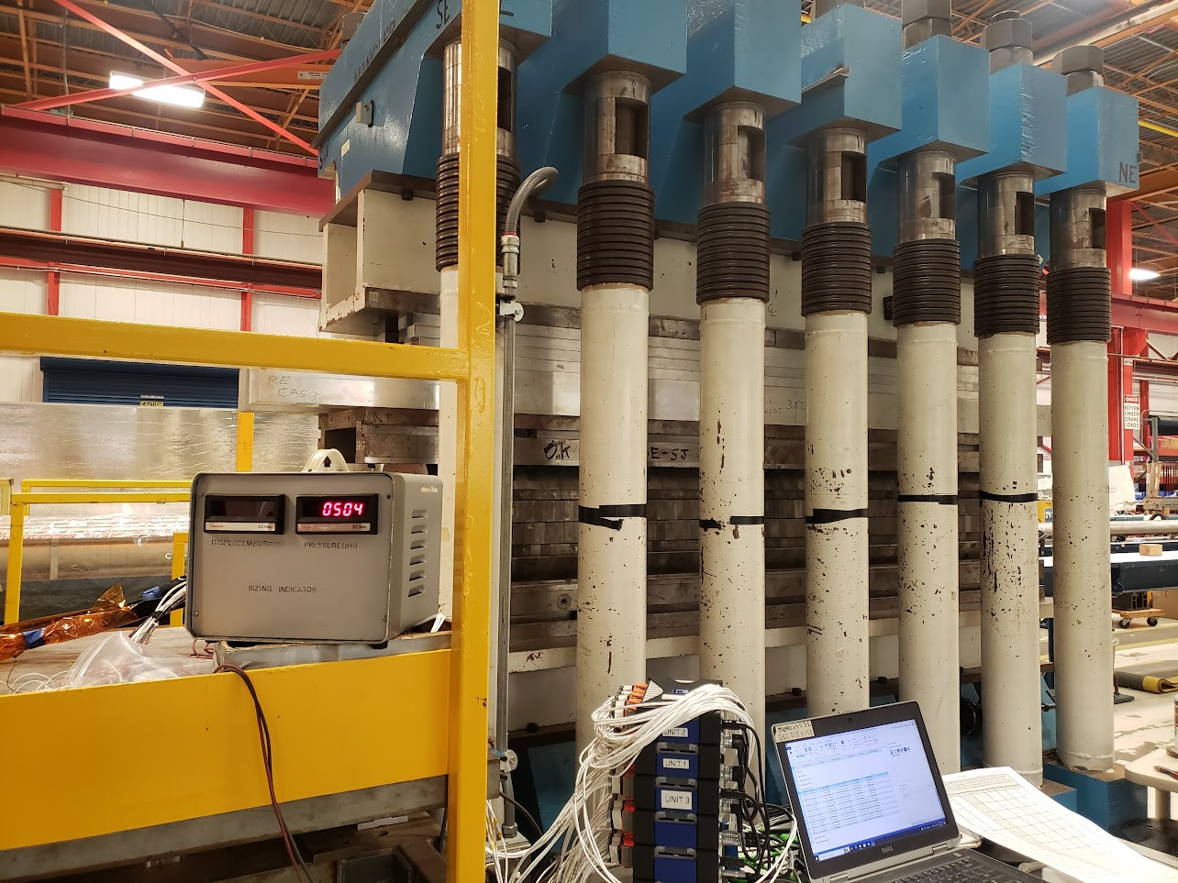
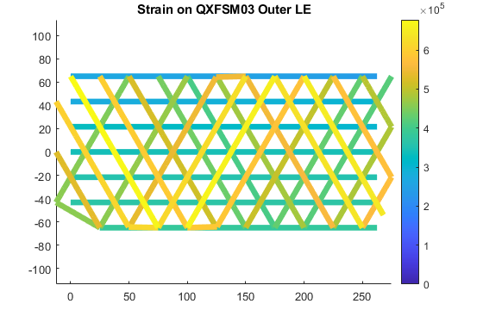
QXFSM03
Fibers have been installed on ID and OD of coil
Test goals:
  Validate fibers mounted directly to coil during magnet powering
  View pole/wedge strain discontinuity behaviour during operation
  Observe magnet mechanics
We lost the outer fibers during initial loading. Issue:
One break on the edge coming out of the coil
One termination was crashed

Slide 12
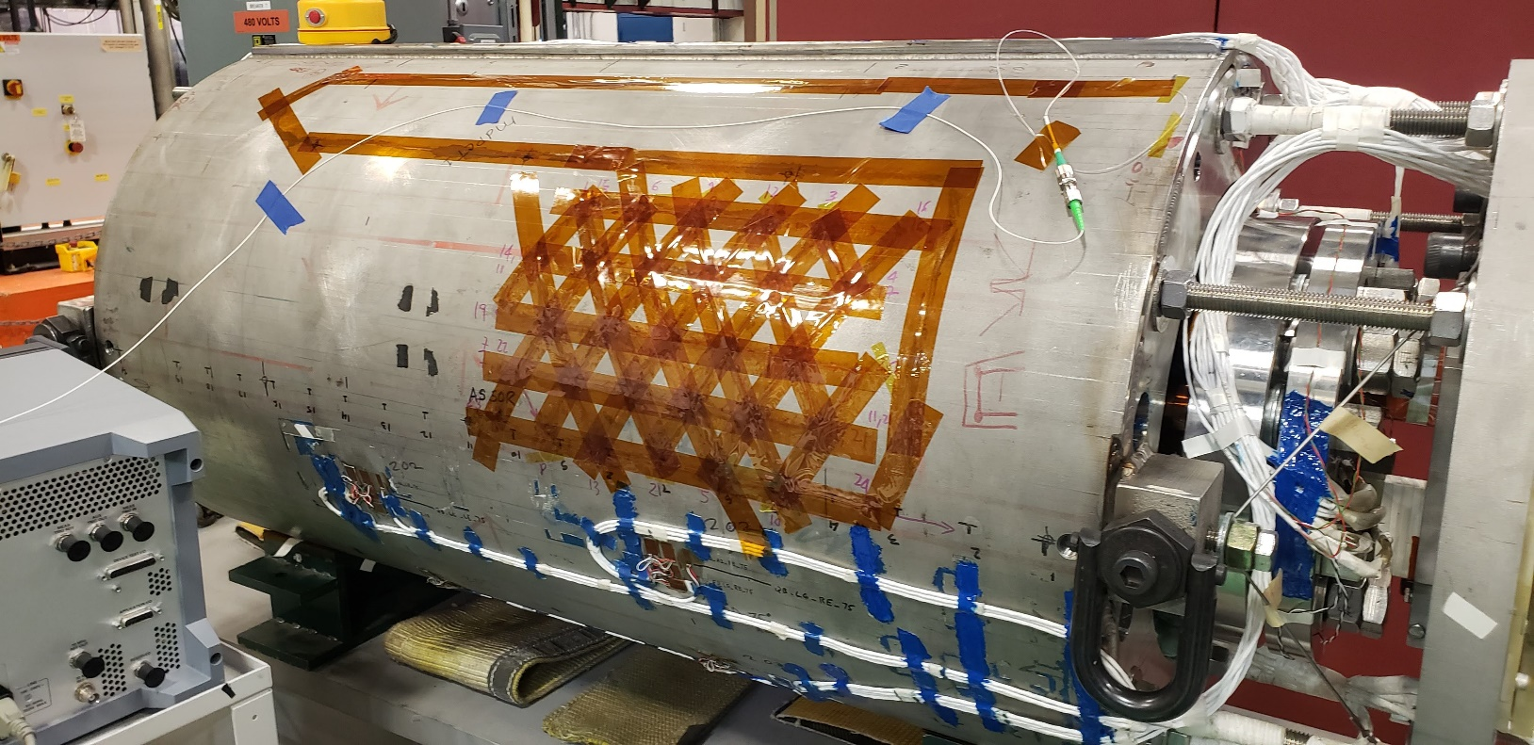
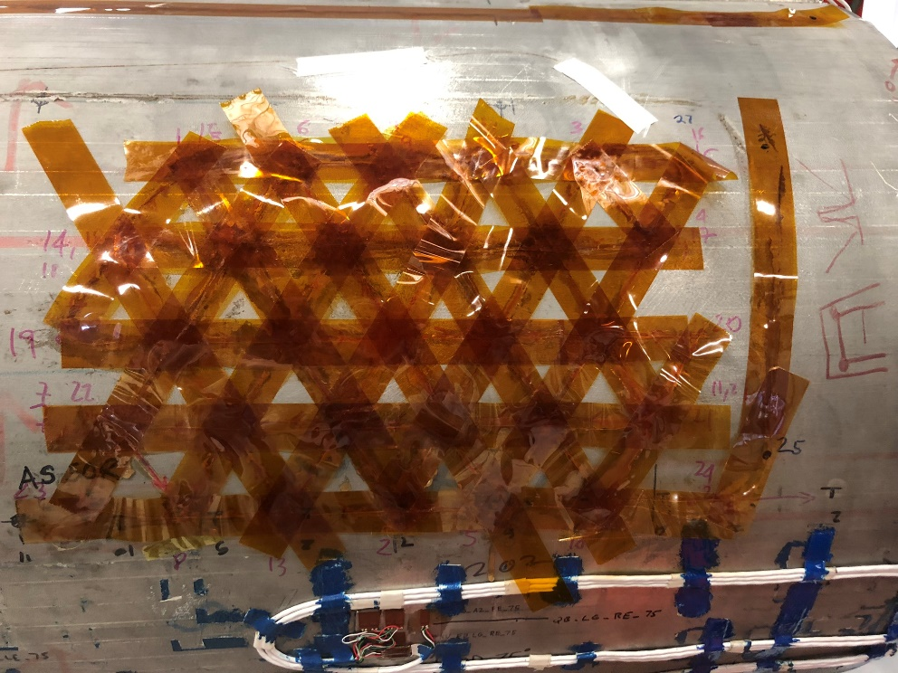
Fiber optics on SMCTM1 magnet
7 m Rayleigh fiber on the magnet skin
Validate updated fiber feedthrough and connectors at 1.9 K
Validate fiber splices at 1.9 K
Measure shell strain during testing: failed
Tape is used to guarantee a uniform small distribution of glue
Tape disconnected from the shell at cold
Fiber followed the tape

Slide 13
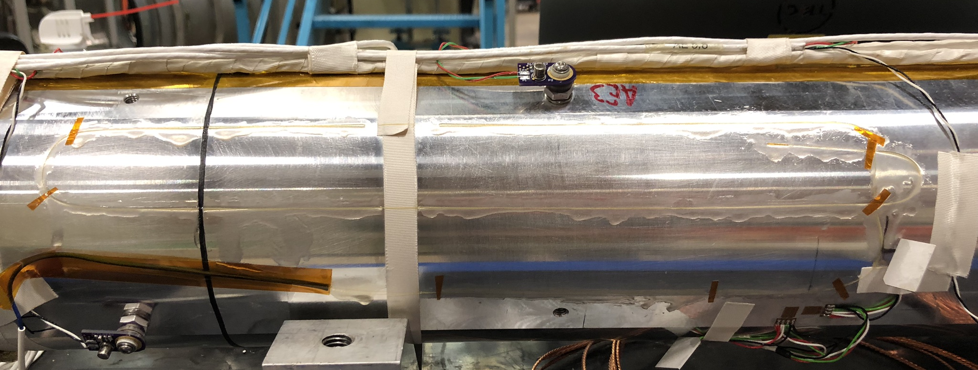
Strain fiber on CCT magnet
Fiber survived and we are collecting data during test.
  Signal at cold is still intermittent. We suspect that the issue is at the connector level. One possible solution is to splice everything.

Slide 14
Summary
Tests in liquid N and liquid He show that temperature variations can be measured
  Spatial information on where the quench is and how it propagates
However, there is still a long way to go to make those sensors a robust tool for quench detection:
    Are those sensitive/fast enough to detect a quench at the beginning and start protection?
    Good thermal contact
    Sample rate
Strain sensors are very easy to break especially in the presence of edges/angles/ feedthrough opening (ex. Exit a coil)
  Fiber need to be protected.
  Signal at cold is still intermittent.

Slide 15
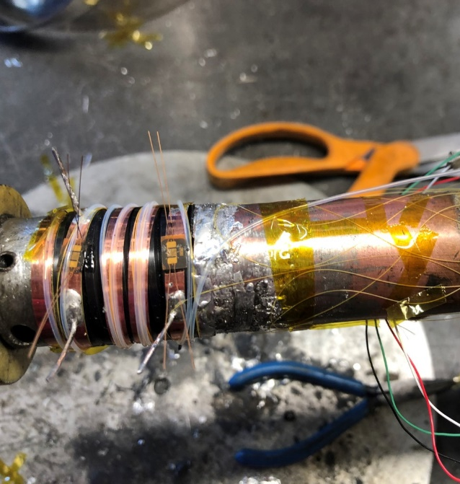
Future work
Use the barrel as a fast turnaround test bed to try to address some of the ongoing issues.
Acrylate coating temperature sensors (more sensitive at low T )
Trying to improve thermal contact: positions vs use of different epoxy resins and fiber response
Test the response of strain sensor vs T sensors for quench detection
Test splice vs connectors in a small cryostat to determine the best way of having feedthrough
Data streaming: off platform
REBCO TAPE ON A BARREL
Both strain and temperature sensors were installed:
  Two strain gauges were used as spot heaters
  Everything was covered with stycast
  Fibers are sitting on top of the REBCO tape
Data taken at 12T and 4.5 K
Current was increased up to voltage raise (280 A)
Quench induced by strain gauge at 260 A

Slide 16
Acknowledgments
Nisa Kuvvet, Undergraduate student @Dartmouth
Simone Busatto, Graduate student @LASA
Emily Spreitzer Undergraduate student NIU

Slide 18
Milestones
Calibration of FBG fibers in a small cryostat (2021)
Installation of fibers on an MDP magnet and strain measurement during a quench.
Modification of magnet test facility top plate to accommodate fiber line (2021)
Design a proof of principle experiment for quench detection:
Small coil fabrication and tests (March 2023)
Energy spectrum analysis (Dec 2023)
Coil azimuthal strain mapping:
Experiment on coil ten stacks sample made with different epoxy (March 2023)
Install distributed fiber on a mirror magnet for coil strain map (Dec 2022

Slide 19
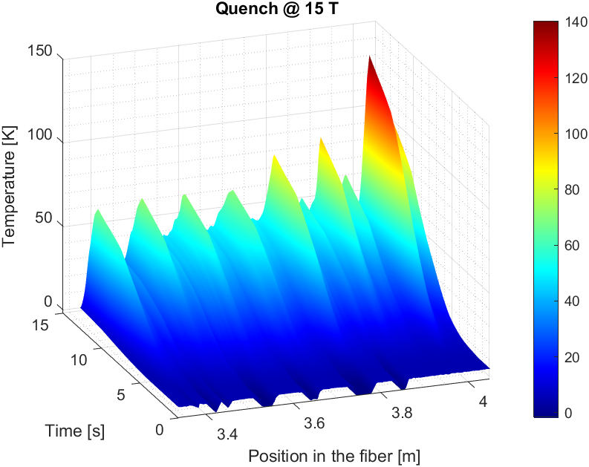
Spot Heater induced Quench
Magnetic Field​ | Current​
15T​ | 300A​
14T​ | 372A​
12T​ | 555A ​
10T​ | 788A
Test at 4 different magnetic fields (15T, 14T, 12T, 10T) at 4.5 K.
Current set at 80% of the critical current.
Increase of pulse power given to the spot heater
In the first test 13.08 mJ were required to quench the wire, most likely beccause of bad thermal contact between the spot heater and the wire.
Very high temperatures were reached during this test.

Slide 20
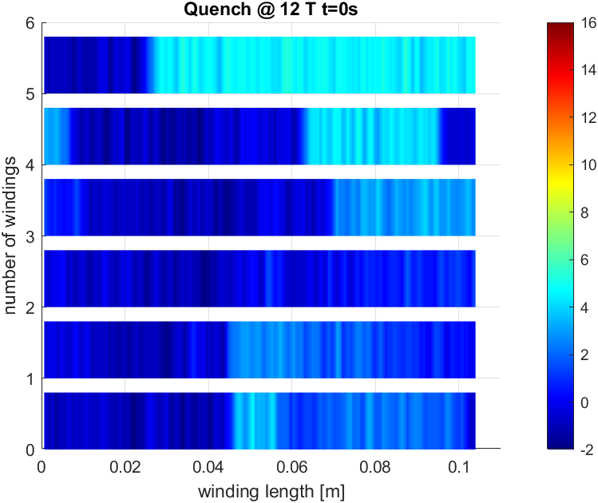
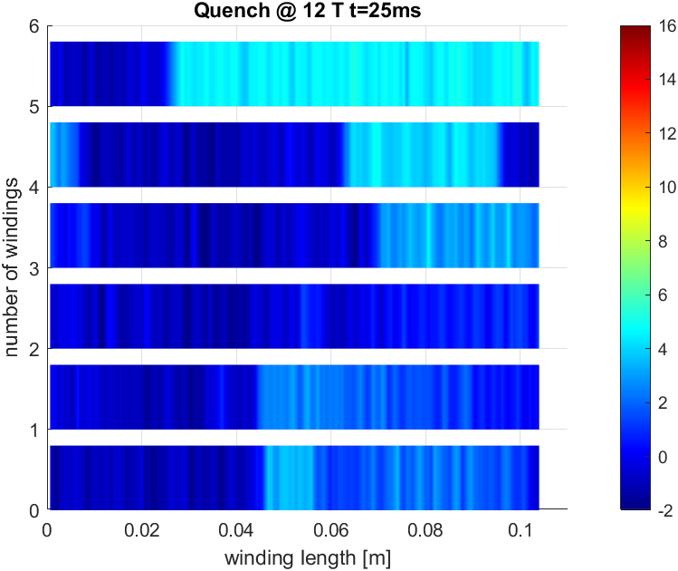
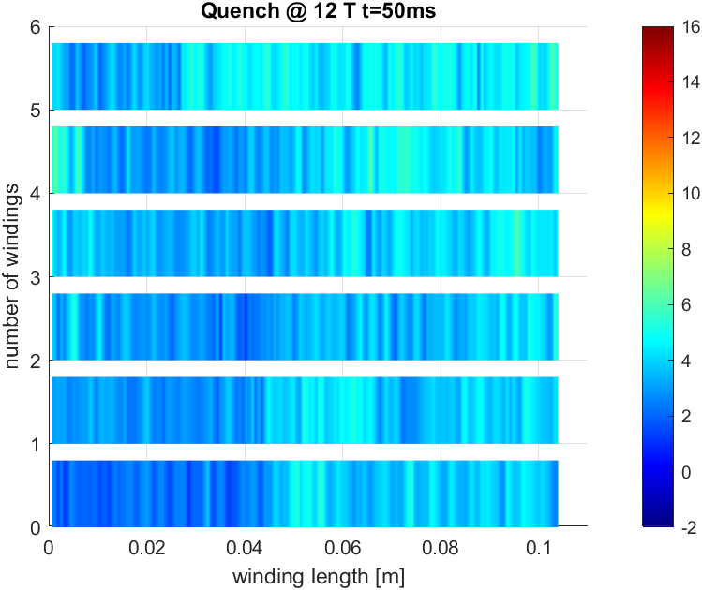
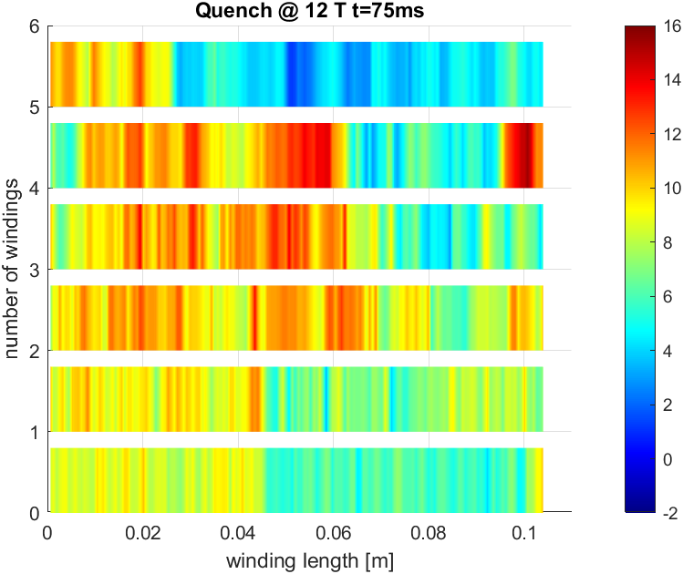
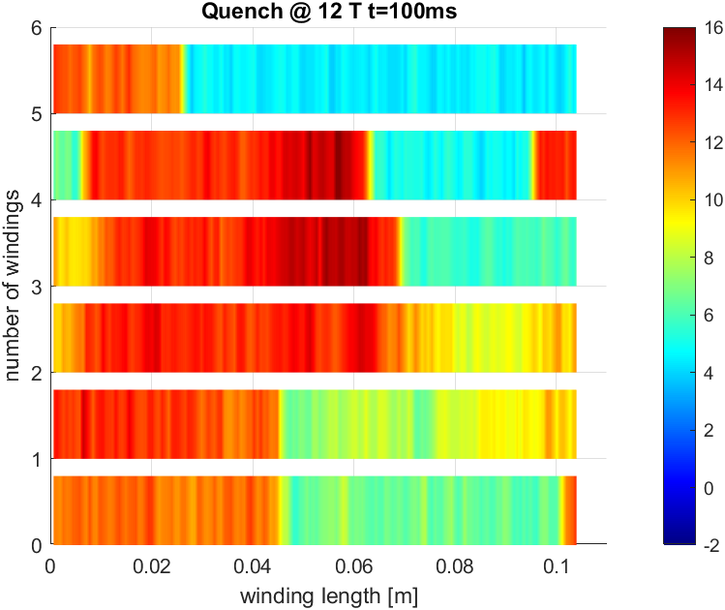
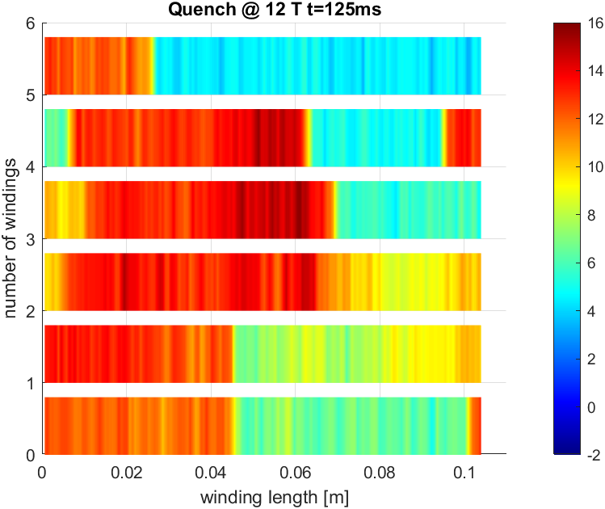
2D plot of the T profile

