Slide 1
Distributed Fiber optic strain measurement system for the CORC-based CCT
Linqing Luo
5/2/2024

Slide 2
Acknowledge
Colleagues: Hugh Higley, Derek Hochvert, Simone Johnson, Bob Memmo, Mike Naus, Matt Reynolds, Tengming Shen, Chet Spencer, Reed Teyber, Marcos Turqueti，Xiaorong Wang.
Funding support from DOE Office of Fusion Energy Sciences and the U.S. MDP from Office of High Energy Physics.

Slide 3
Outline
Motivation
Introduction of distributed fiber optic sensing
Test Setup
Result and discussion
Conclusion

Slide 4
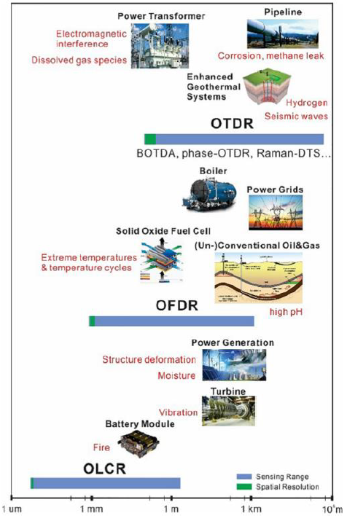
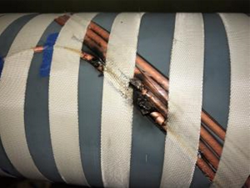
Motivation
Distributed temperature sensing may help avoid catastrophic thermal runaway
Burnup due to thermal runaway
Fiber optic sensing is an available distributed sensing technology
But a significant gap for applications in cryogenic environment
Identify the location of local heating in order to understand and improve the CORC magnet and conductor fabrication.
Lu et al. 2019. “Distributed Optical Fiber Sensing: Review
and Perspective.” Applied Physics Reviews 6 (4): 041302.

Slide 5
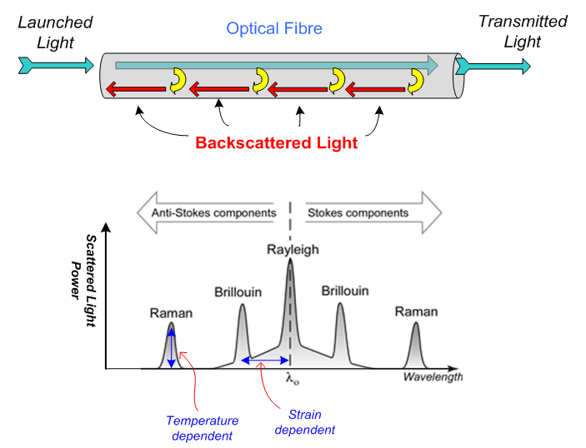
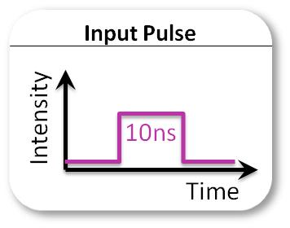
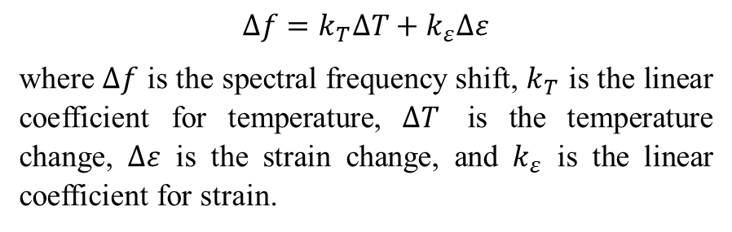
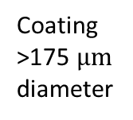
Distributed fiber optic sensing
Cladding
125 µm
Rayleigh, Raman, and Brillouin scattering
Core
9 µm
Coating
>175 $μm$
diameter
Backscattered spectrum
Buffer
250 µm
$∆f=k_{T}∆T+k_{ε}∆ε$
where $∆f$ is the spectral frequency shift, $k_{T}$ is the linear coefficient for temperature, $∆T$ is the temperature change, $∆ε$ is the strain change, and $k_{ε}$ is the linear coefficient for strain.

Slide 6
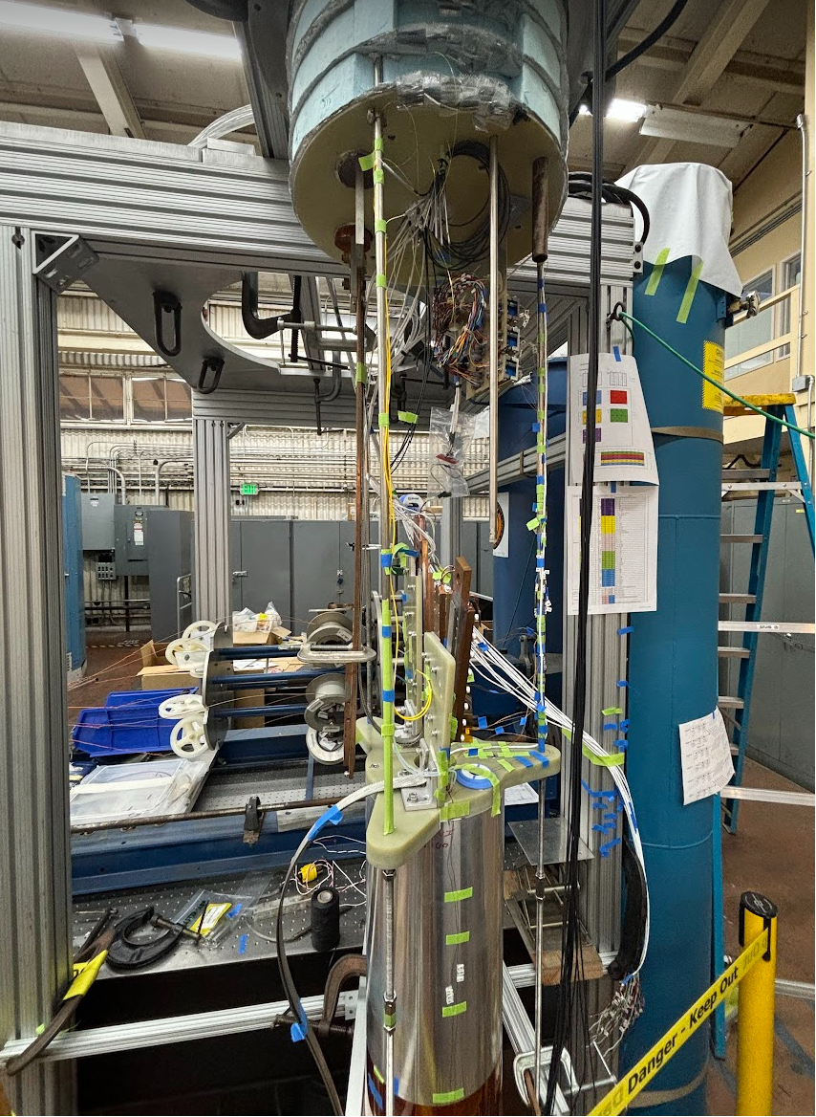
Test setup
6
2
1
Shell
Four optical fibers, each installed at:
  Shell
  Layer 1
  Layer 2
  Layer 6
Fiber at each layers are impregnated by Stycast.
Fiber at the outer shell is epoxy with Araldite.
Measurement frequency: 4.17Hz
6 channels fiber are measured at same time
Spatial resolution: 2.6mm.

Slide 7
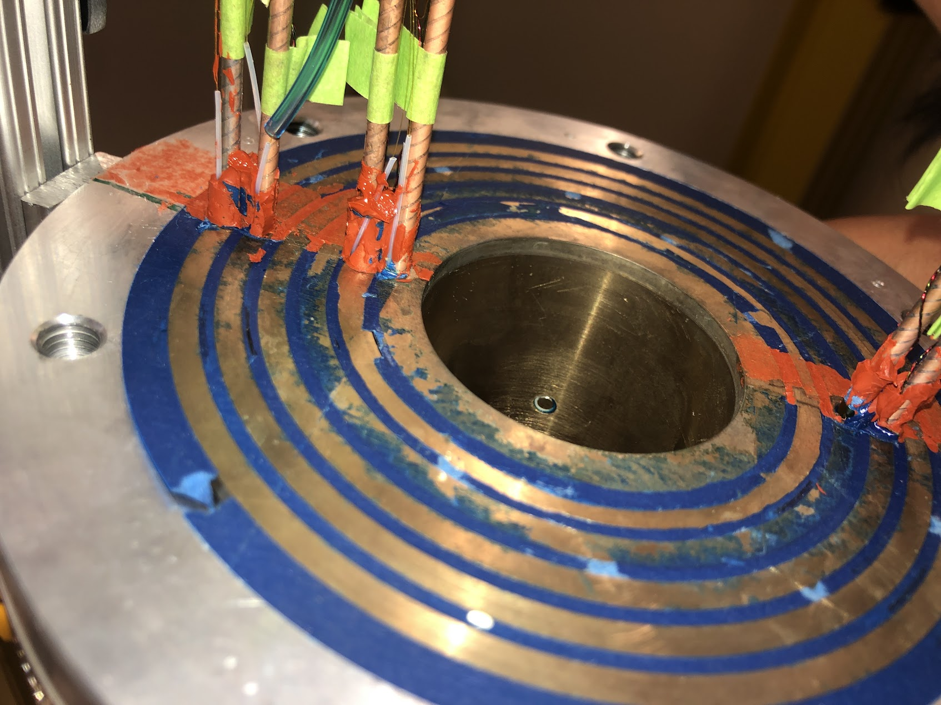
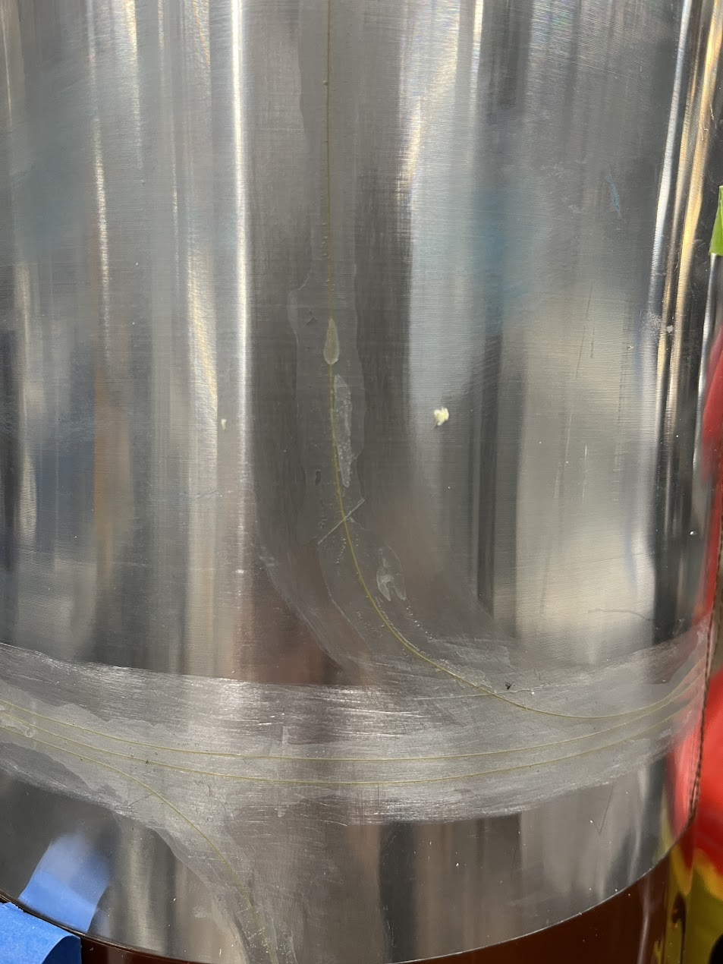
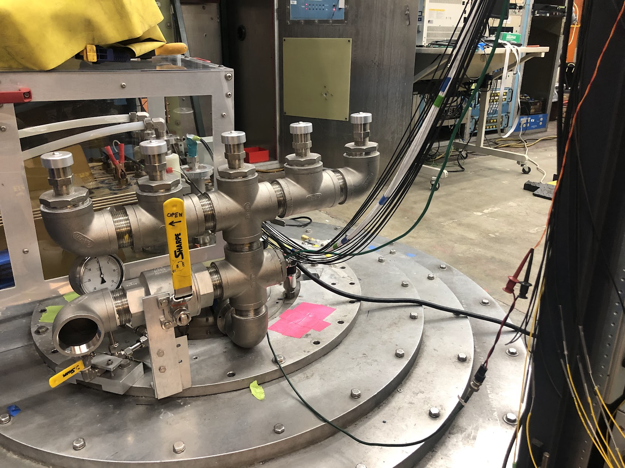
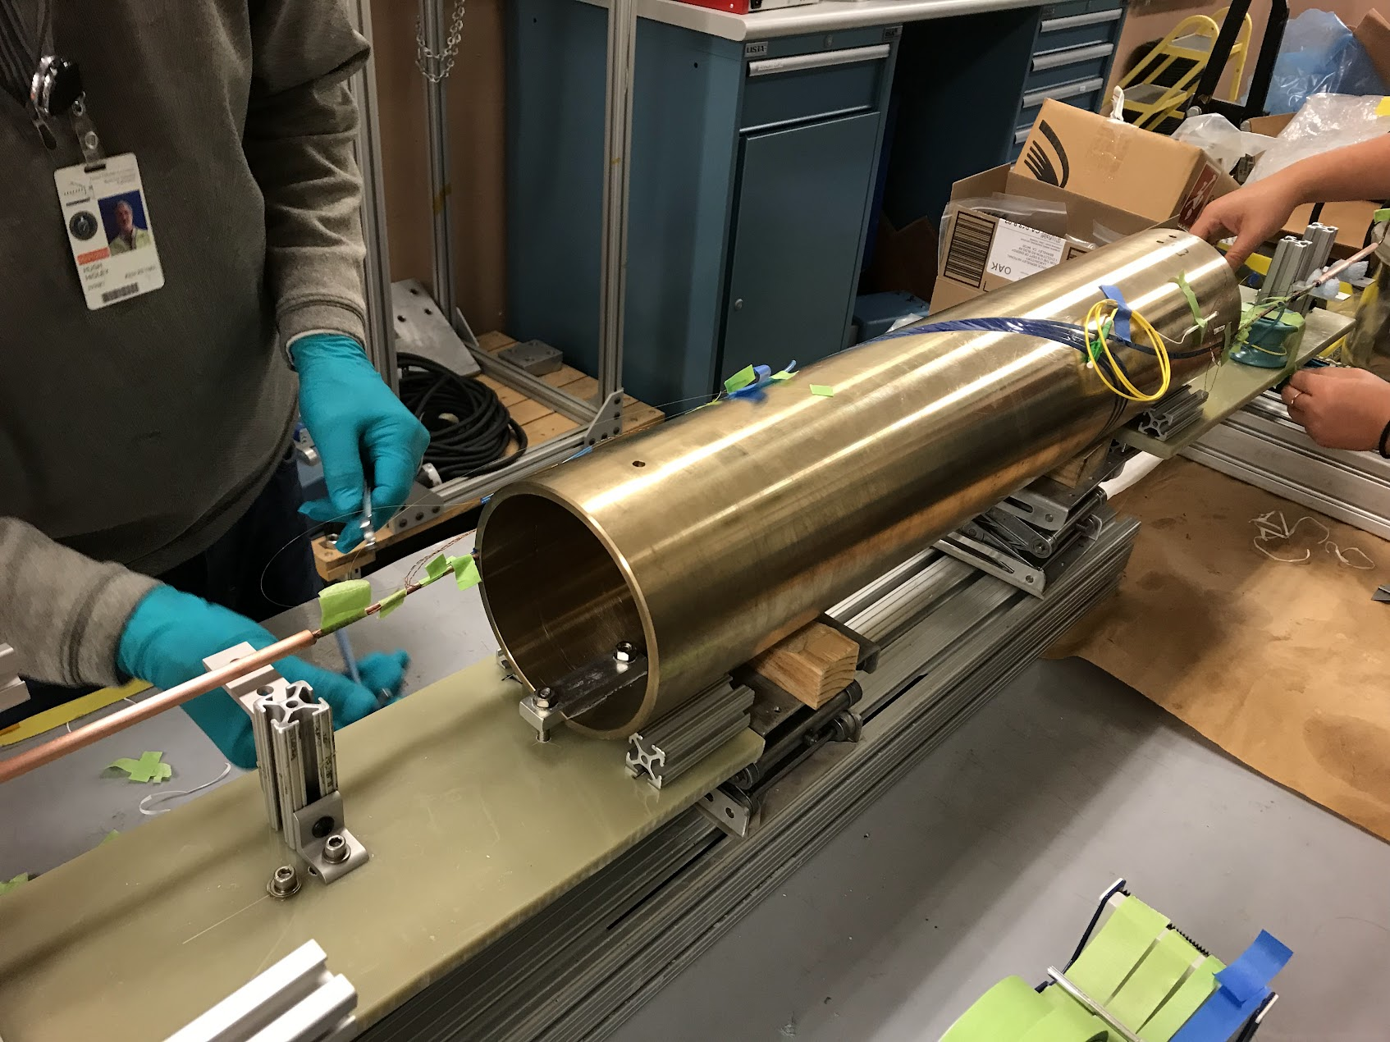
Test Setup
Optical fiber extension cable
Shell fiber

Slide 8
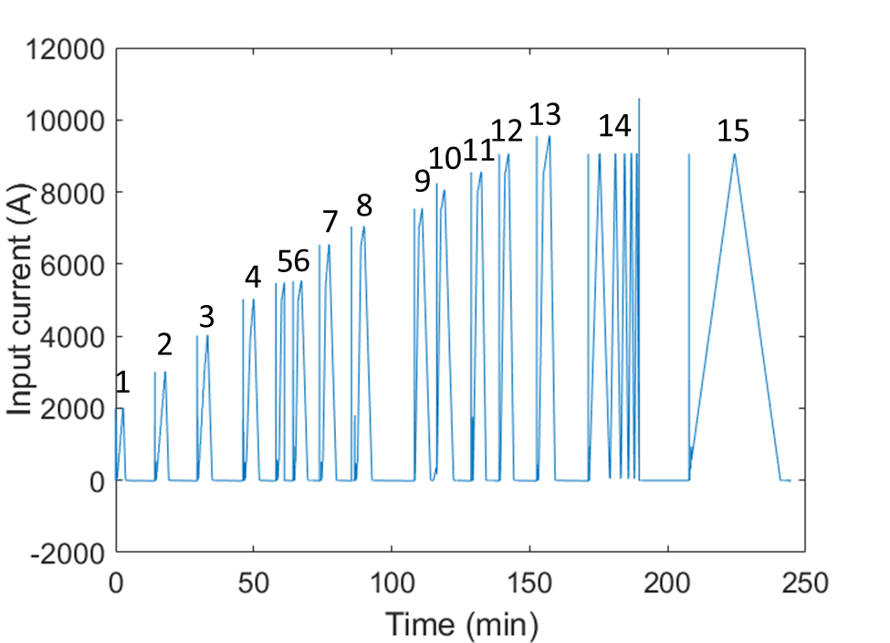
Test
All tests: 6 Layers are connected in series
Liquid helium test (4.2K)
Room temperature test
  First Ramp: 5A, 0.385V
  After that: Each ramp 10 A, 0.77V
Current input for the liquid helium test
All the plots had baselines as the first data of the same plot

Slide 9
Liquid Helium test

Slide 10
Shell fiber response
Compression
Unexpected current surge
->
Deformation
Remains for at least 9 hrs
Tension
Tension
Compression
Special event
Slow ramp 9000A
5500A
8000A
9000A
9500A
9000A
7000A
7500A
8500A
5500A
6500A
2000A
3000A
4000A
5000A

Slide 11
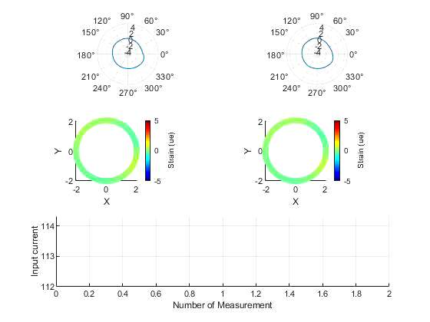
Shell
Loop 1 Strain
Loop 2 Strain
Fiber response VS current square
Shell response in one current input ramp

Slide 12
Layer 1
The residual shows mechanically deformation?
The rising with ramps shows thermal?
But disappearing fast->still mainly strain.
Phase change-> strain then thermal?
Phase change of the blue line

Slide 13
Layer 2

Slide 14
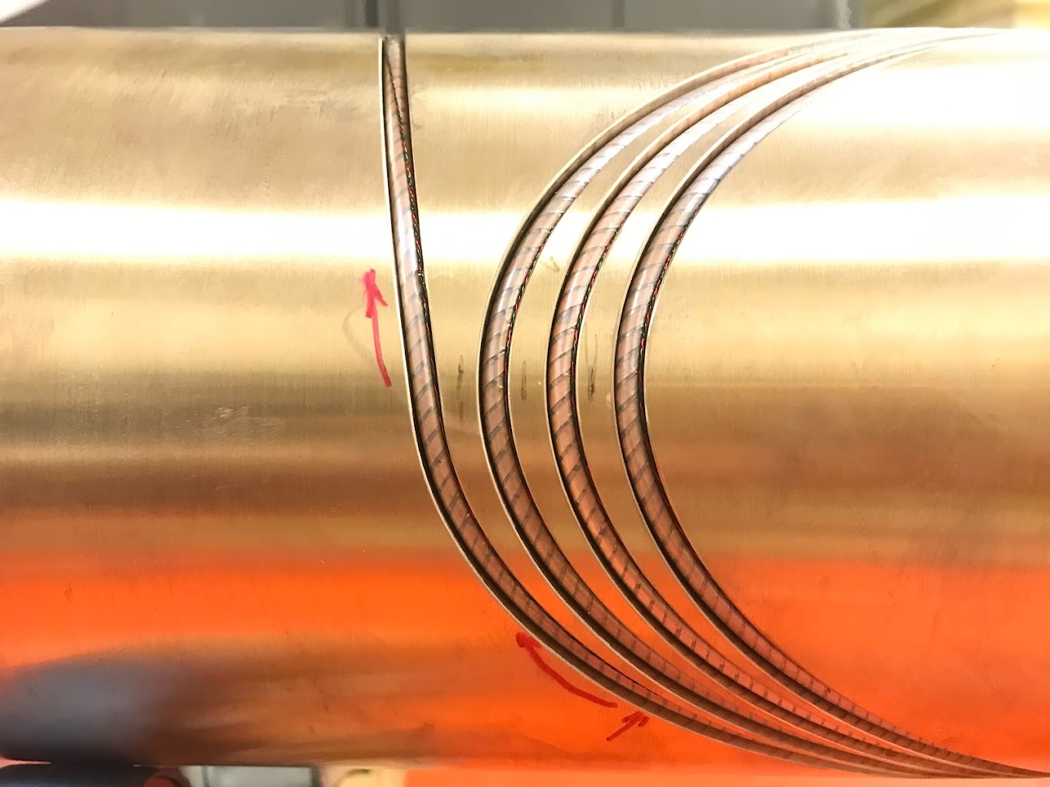
Layer6

Slide 15
Layer 1, Layer 2, Layer 6 fiber response VS current square

Slide 16
Room temperature test after the 4.2 K test

Slide 17
C3A_3turn_6Layers in Room temperature
Layer 1
As the current power input is low, the Lorentz force leaded mechanical deformation maybe small.
The rising up is mainly contributed by thermal generated inside the 6 layers magnet.
The drift is mainly due to the ambient temperature rise.

Slide 18
C3A_3turn_6Layers in Room temperature
Layer 2

Slide 19
C3A_3turn_6Layers in Room temperature
Shell

Slide 20
C3A_3turn_6Layers in Room temperature
Layer 6
At some locations, there are more heat detected.
These locations are close to the mid-plane of the coil.

Slide 21
Layer 6 Comparison between Room temperature and liquid helium test
Room temperature test
4.2 K test

Slide 22
Conclusion
Optical fiber survived in liquid helium and can be used for sensing strain and temperature;
Optical fiber measures the temperature change in the room temperature (<5.5mW/cm);
Optical fiber measures the strain deformation of the shell under Lorentz force;
Optical fiber may measure the thermal change of the magnet if there is temperature change in 4.2 K.

Slide 23
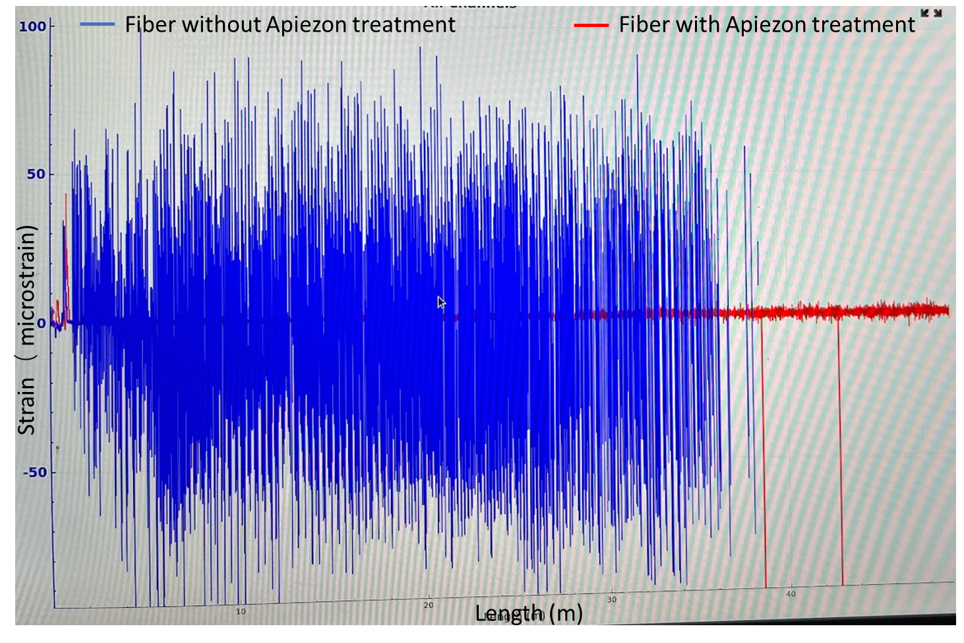
Next step for C3-40 turn magnet
Cable length range from 10 to 40 m.
Sensitivity and survival rate of the sensor needs to be improved
  Special installation method
  Different optical fiber design
    Signal to noise ratio improvement
    Radiation tolerance
  Customized interrogators

Slide 24
C3A_3Turn_6Layer in Room temperature, ambient temperature from night to day
Layer 1

Slide 25
C3A_3Turn_6Layer in Room temperature, Heating second day
Layer 1

Slide 26
C3A_3Turn_6Layer in Room temperature, ambient temperature from night to day
Layer 2

Slide 27
C3A_3Turn_6Layer in Room temperature, Heating second day
Layer 2

Slide 28
C3A_3Turn_6Layer in Room temperature, ambient temperature from night to day
Shell
Shell is colder at night

Slide 29
C3A_3Turn_6Layer in Room temperature, Heating second day
Shell

Slide 30
C3A_3Turn_6Layer in Room temperature, ambient temperature from night to day
Layer 6

Slide 31
C3A_3Turn_6Layer in Room temperature, Heating second day
Layer 6

