Slide 1
Transient Current Measurements for SMCT1b
S. Krave
MDP Collaboration Meeting
May 2024

Slide 2
This is less a presentation about acoustics
And more about coil motion…
Due to several compounding issues the acoustic sensors on this magnet were mostly non-functional
  Initial USB issues
    Fixed, new cord
  Sensors had no power
    Installed current limiting resistors on each channel
  Sensors produced incorrect data (Uncharaterized quench antenna mode)
    Data was EMI issue from sensor mis-wiring
  They still pick something up.

Slide 3
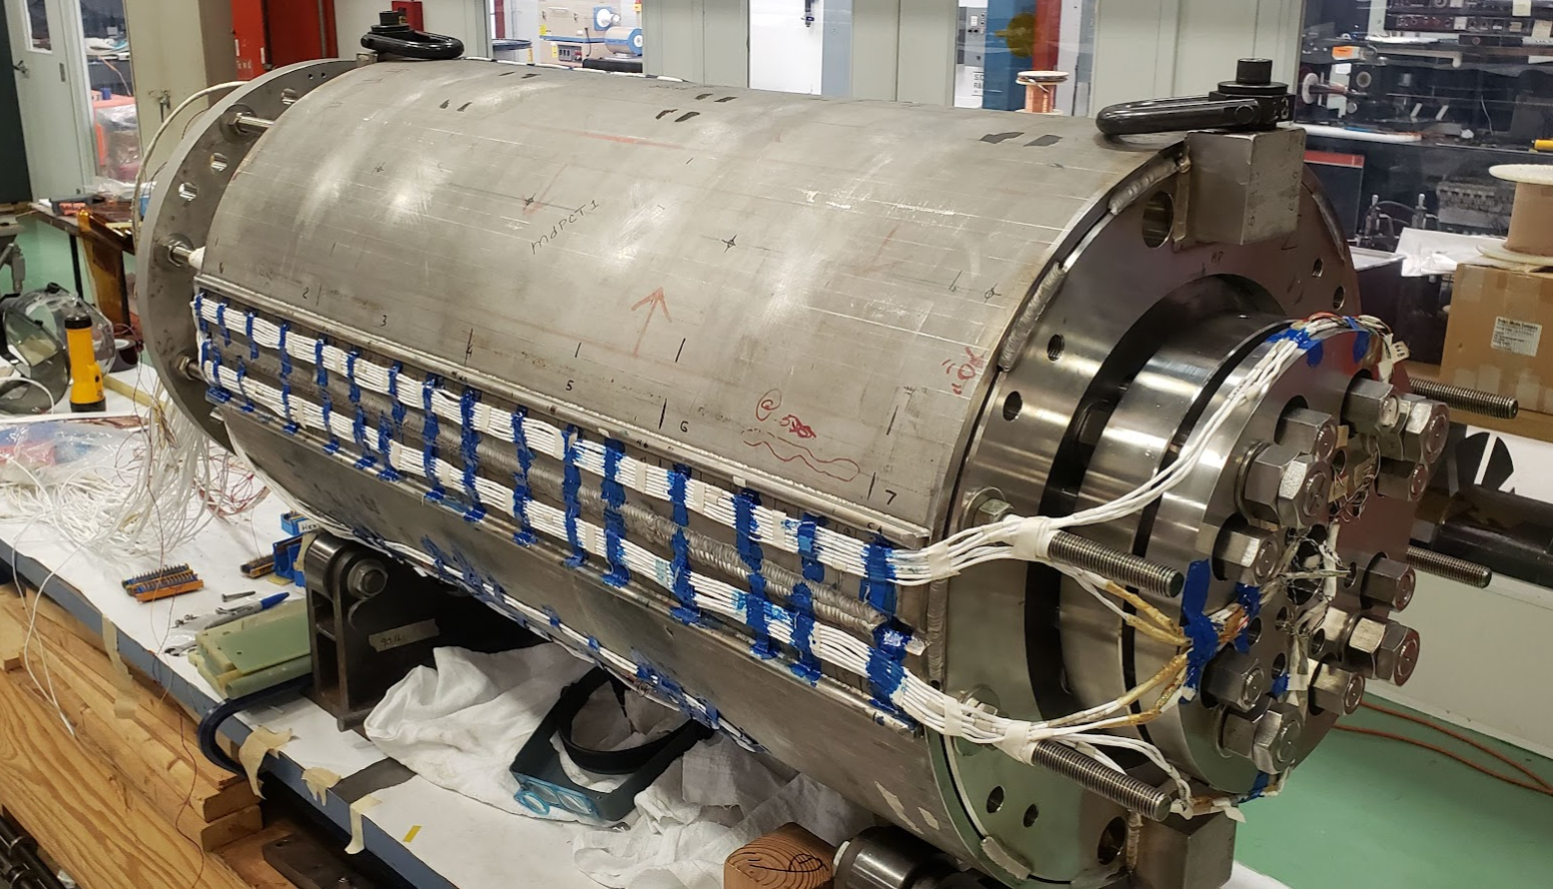
Acoustic Sensor Locations
1-4 are glued at MP 15mm from shell.
  Positions nearest to midplane close to body of magnet allow longest t_delay from side to side for improving positioning resolution
  Glued to small stainless blocks via stycast
5-8 are glued onto rod ends
  Possibly provide some L/r info, mostly longitudinal
4
8
Non-Transition
5
3
1
2
7
6
Transition
Acoustic Sensors referenced in the presentation are 1-4, mapped 4-1

Slide 4
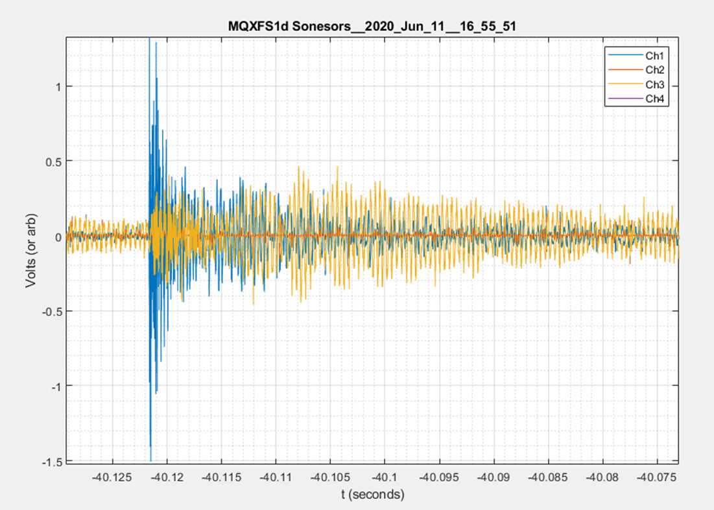
Example of data from acoustic sensors
Some participation in channels 1-4, picoscope A-D, (8,7,6,5) (from diagram above) on rods. Strange response, some delay, asymmetric behavior.
Response is not due to acoustic events
Step on channel A is an overlay of the trigger signal.
Events begin 200 µs before quench
  Turns out this was a spike.
    We will discuss…
1st data is on non Transition Side, but this may not mean anything
Delay of 80 µs
  Roughly .9 meters closer to the LE at 12 km/s
Largest data is on Magnet RE
Could be that wires pass magnet and pickup EMI that LE sensors don’t
Example Acoustic Event
(MQXFS1d)

Slide 5
We see two types of events
Largest events in sensor have high frequency ringing with fast decay
These data are just not working well in general.
Typical acoustic events have more broadband response with longer decays.
We will try measuring more stuff.
Many are non-symmetric, which is not expected of acoustic events
Some smaller events exhibit the typical behavior of AE sensors
Mixed mode behavior: Likely large electromagnetic component driving noise on sensors

Slide 6
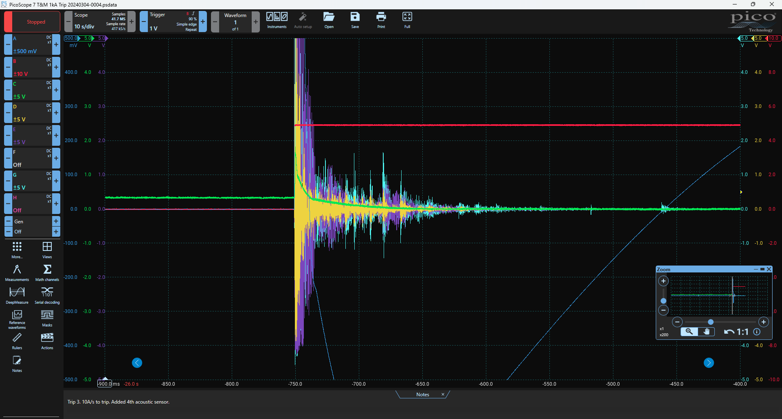
Recap: Acoustic sensors
Acoustic sensors are faulty.
  They have been fixed for the COMB dipole and CCT and are working well
Broken sensors pick up EMI.
  Uncharacterized quench antennas
  This EMI seems correlated with coil behavior/looks like acoustics from an overview
Comb Test Data

Slide 7
Adding Channels
Since we had extra channels on the picoscopes, we plugged in additional instrumentation
Halfcoil Bucked from AQD
Current (1V = 3kA)
Quench Trigger
A mix of plots for now from the picoscope app, used to capture and convert the data, and MATLAB, used for additional analysis and plotting.
This presentation focuses on ramp 55 when including current data, however voltage spikes and the correspondence in the acoustic channels holds for all ramps.
Spikes are most prevalent at high current and low to moderate ramp rates (below ~10ish kA).
I presume this is a mechanical hysteresis behavior with frictional forces preventing motion at lower current.

Slide 8
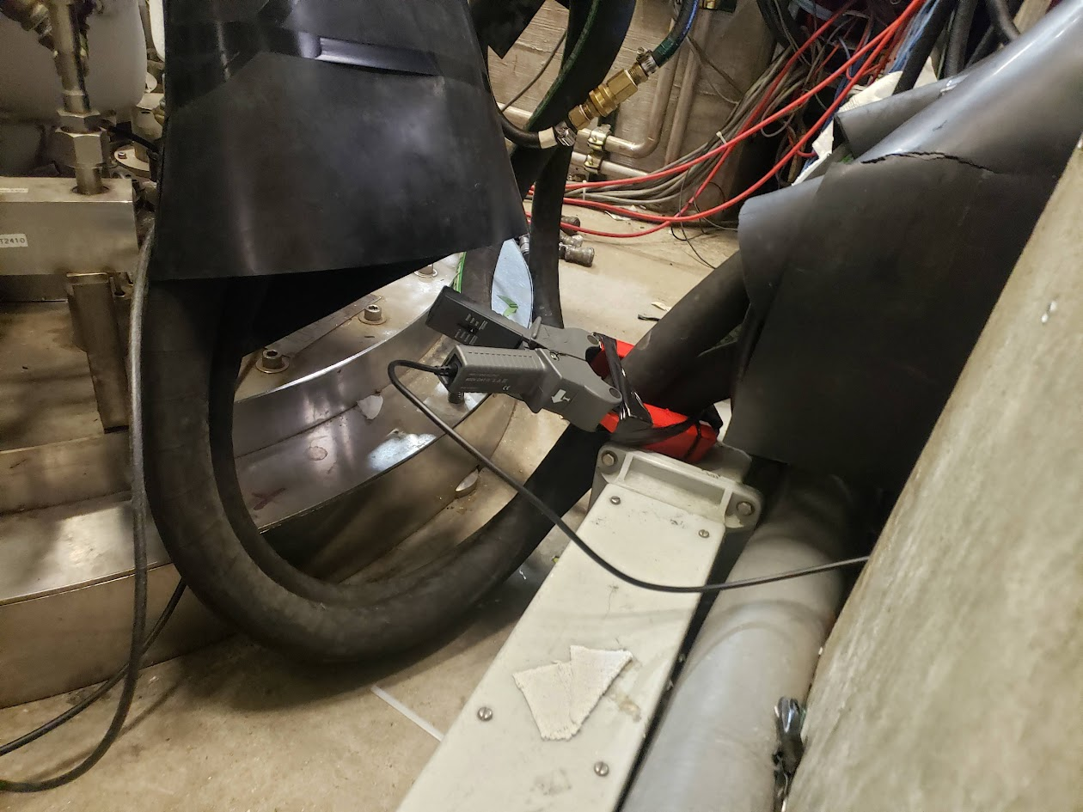
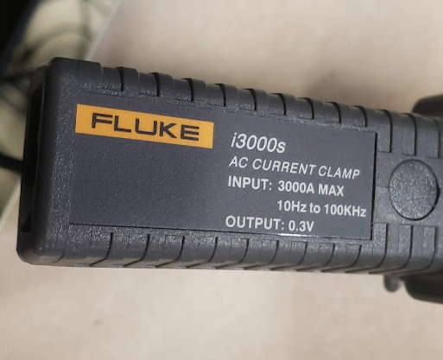
Transient Current Measurement for Last Quenches
Following in work done at CERN by Gerard Willering-Transients and quantification of Coil Displacement in Accelerator Magnets , We have installed an AC Current clamp on the VMTF to track small changes in magnet current.
Clamp Installed on + lead
Positive direction oriented towards magnet
Fluke I3000s, 10 Hz to 100 kHz
  Set to 10 mV/Amp
  Connected to picoscope
  A bit broken, but still functional. Held together with electrical tape.

Slide 9
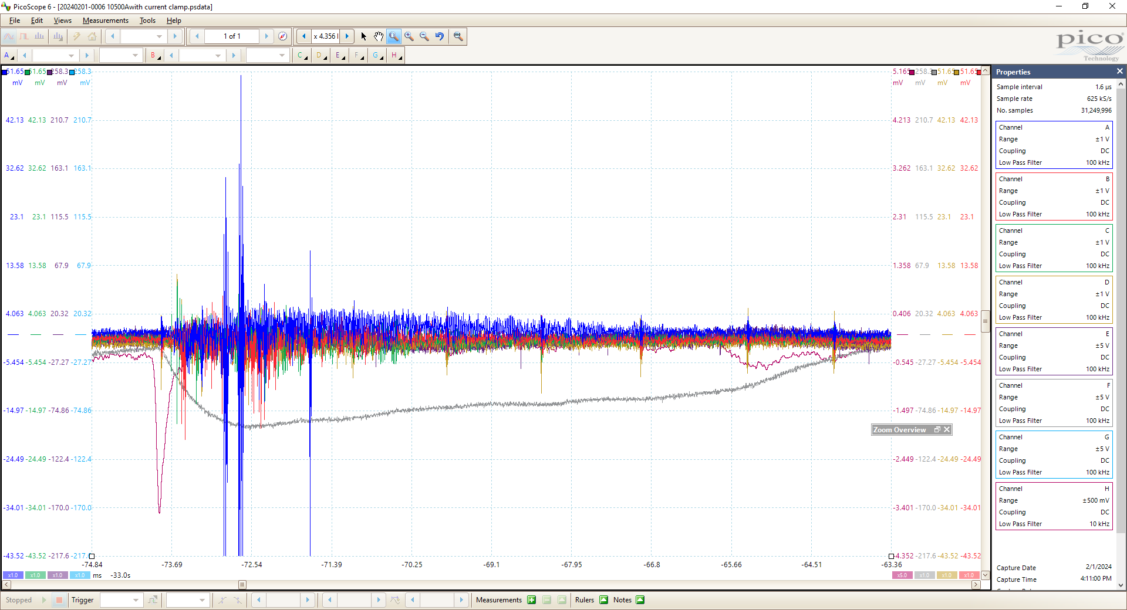
“Acoustic” response
Half Coil Bucked ~100 mV
Current Drop
-340 mA

Slide 10
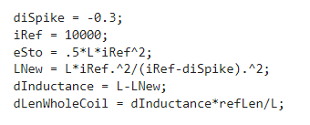
Determining displacement via conservation of energy
We can estimate a change in length based on inductance per unit length
Inductance/StraightSectionLength
  4.06 mH/0.5m = 0.0081 mH/M
  Note, for individual coils,
We can then assume energy is conserved and calculate the current change as a function of inductance
Example shown for 300 mA dip in current
  If this was an energy loss it would be 12.18 Joules
  The corresponding length change is 50 µm
We can further estimate the length change based on the different inductance from Inner/outer coil extracted from balancing. As a ratio of the total inductance or length change
  L_{total} = L_{inner} + L_{outer} (+2M), L_{outer} = 2.8 * L_{inner}, assume 2M is constant/ignorable…
  Dl_{inner}/dL = 3.8* dl_{total}/dL
  So that 300 mA spike above is now associated with a ~200 µm change of the inner coil

Slide 11
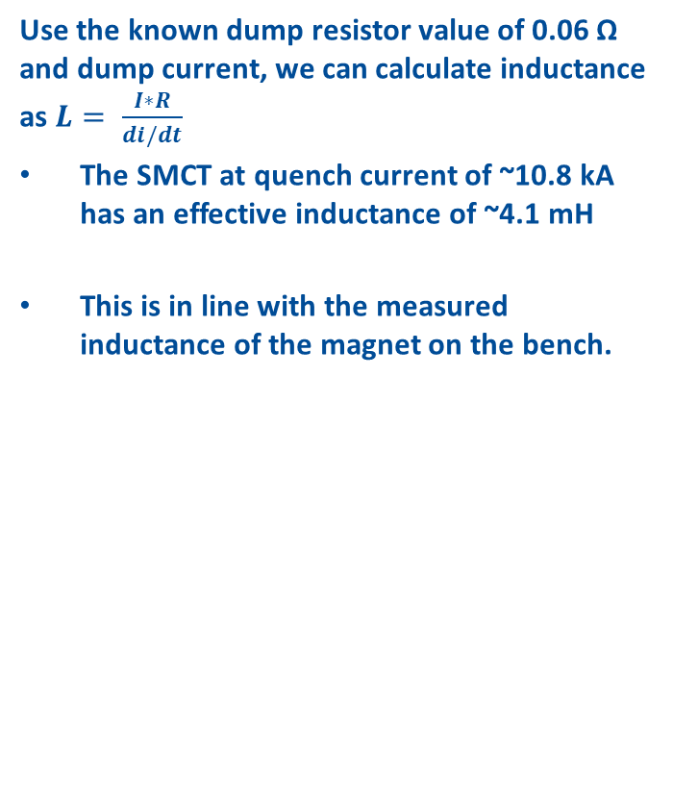
Calculating Inductance
Use the known dump resistor value of 0.06 Ω and dump current, we can calculate inductance as $L= \frac{I∗R}{di/dt}$
The SMCT at quench current of ~10.8 kA has an effective inductance of ~4.1 mH
This is in line with the measured inductance of the magnet on the bench.

Slide 12
Ramp 55: Data collected with normal ramp and AC Current measurement
Developed a dynamic filter to better identify spikes without washing out data shape
Using a min prominence of 0.075 A, 18 spikes were detected in the last 90 seconds of ramp
Average displacement for whole coil of 12.5 µm per detectable event
Total displacement of 223 µm
If the inner coil only is responsible for this shift, it is moving 855 µm in the last 90 seconds of the ramp

Slide 13
Example Data from Spike
One of the first current spikes recorded on slight current change between 10 and 10.5 kA. The magnet did not quench

Slide 14
This spike behavior is reversible
As a function of friction, this behavior exhibits hysteresis and is reversible.
It exists during ramp down as well; however, the spikes occur in the opposite direction as the magnet inductance is decreasing.
This spike is positive 20 mA

Slide 15
If we look at the halfcoil imbalance on each event, we see that it resolves in ~1/120 s. This corresponds to 0.5 NPLC, likely a result of the power supply correcting the current in response to the spike.
We can calculate the volt-seconds of this event as the integral over the time window, assuming that the filtering applied reasonably removes offsets to the data and that the regular signal is centered on 0.
The small voltage bump ends with a value of <1 mV*Second (except for the quench)

Slide 16
Converting halfcoil to similar units (by multiplying by I_{OP)}
Multiply by operating current at the time of each spike event, roughly 10 kA
Coil delta Q equivalent in Joules is nearly equivalent to halfcoil imbalance
  This delta Q was calculated above from the energy change at the operating current as a function of inductance.
  Does this make sense?
  I would have assumed that the voltage present is proportional to the imbalance of the half-coil bucked signal

Slide 17
Event 18 (Raw data) The Quench
Following I present a couple events worth of data, 1st the quench because that is what we care about, but then an additional event that is typical of all other observed events
AE: Yes
Current Spike: Yes
Coil Imbalance: Yes
Most activity in purple/yellow

Slide 18
Event 18 with filtered curves
Dump begins
Note that because of symmetric filter, Halfcoil data is blown out.
With filtering, sharp current spike is visible 10 ms before quench
Dump Forced commutation start

Slide 19
Note small bump in spike current channel as power supply appear to return to normal operation
Indicates that halfcoil spike is likely result of power supply correcting the current drop
This bump is almost always ~15 ms after the initial change (1 power line cycle)
  Why? One would assume that spike events are random
  Does the ripple in the magnet psu cause the motion???
This second spike is prevalent in many halfcoil signals.

Slide 20
Timing
The onset of the current spike precedes the halfcoil signal by approximately 200µs
This change in current is ~ 90 mA (1 part in 125,000)

Slide 21
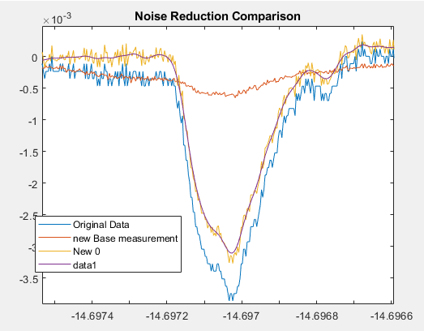
Noise reduction in signals
Signals contain a large amount of 60 Hz and 720 Hz noise (12 cycles per cycle)
Applied an effective comb (ish) filter subtracting median of 12 cycles at 720 Hz from smoothed data.
This shifts data where nothing is very different back to centered on 0
% oldDat is input data, Fs is sample frequency;
nplc = 12; %Use median value for 10 nplc to compute average
FsRef = 720; % Choose 60 Hz as reference, use 720 as it picks up a couple harmonics from the data.
lFilt = round(nplc*Fs/FsRef);
newRef = zeros(size(oldDat));
for n = 1:lFilt
redDat = oldDat(n:lFilt:end);
raDat = smoothdata(redDat,'movmedian', nplc);
newRef(n:lFilt:end)= raDat;
end
newDat = oldDat - newRef; %Subtract new reference waveform
toc

Slide 22
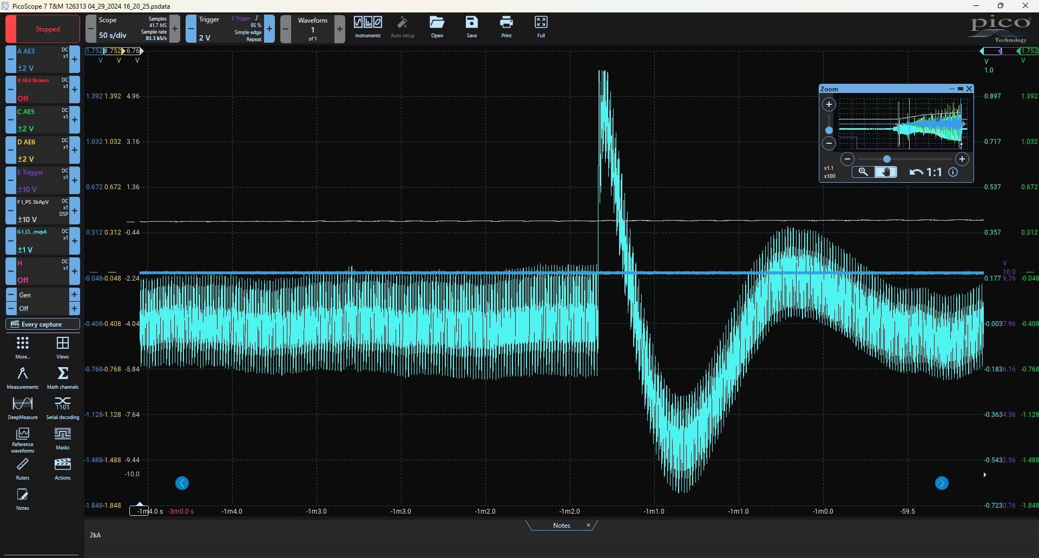
Application to other magnets
Having high resolution logging of the whole ramp allows us to see other features
On the Subscale CCT, we were running into a trip issue at low current (shown)
  8-10 amps in 5 msec
  With tuning we were able to get past this.
Low inductance magnets in VMTF have high ripple
  720 Hz, ~4A peak to peak on the CCT
  Similar behavior on COMB Dipole
  It will be difficult to look for small spikes with all of this background noise
    So far we don’t really see anything though…

Slide 23
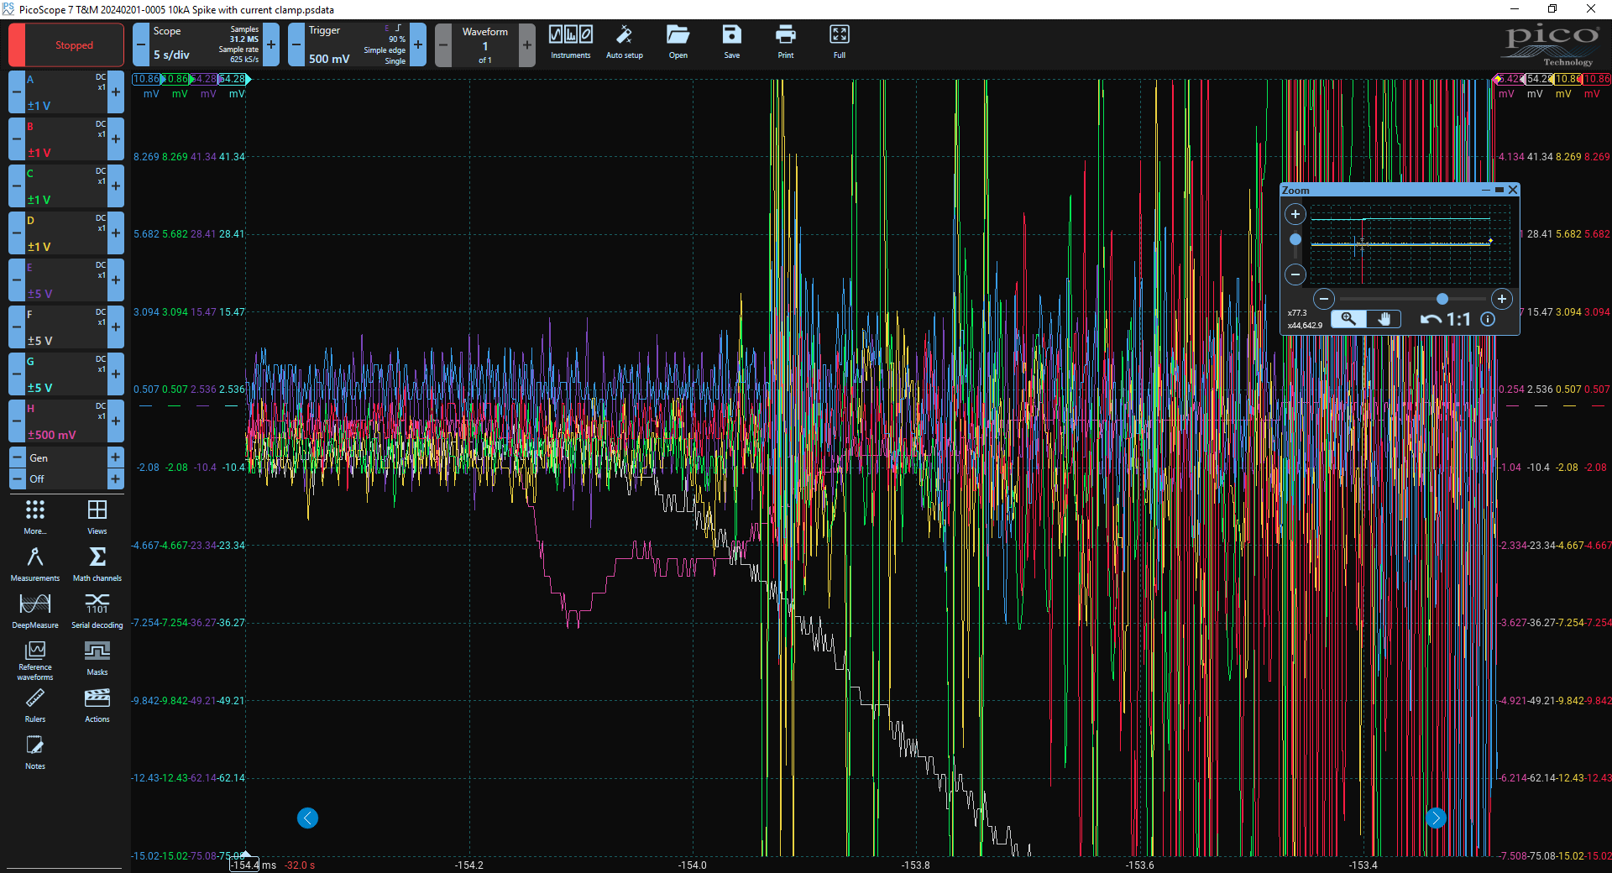
Conclusions
In the SMCT, Acoustic Sensors picked up spike events, but not in an acoustic fashion
  These have been patched for now, but a more robust coupling box is desired
Detailed AC current measurements suggest substantial relative coil motion.
Makeup energy is about equivalent to “lost” energy from spike, but this needs additional explanation.
When we have the option to have extra instrumentation, we will use a current clamp.

