Slide 1
Towards a Real Time ML Solution for Quench Characterization
MDP Collaboration Meeting
2 May 2024
Joseph DiMarco, Maira Khan, Steve Krave, Vittorio Marinozzi, Jennifer Ngadiuba, Stoyan Stoynyev, Nhan Tran

Slide 2
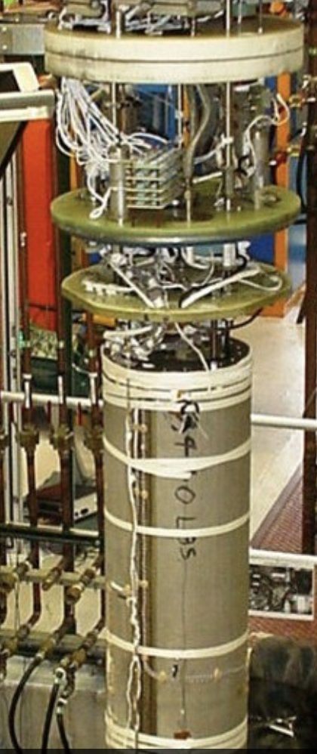
Real Time Characterization of Ramp Events
Analog Quench Protection
Trip Current
Internal/External Dump
Iso/Amp
Digital Quench Protection
Voltage Taps 256 sensors 10-10000 kHz +- 1 kV
Processing Unit: FPGA(s) + Ethernet Controls
Quench Antenna
~16-1286 sensors
100 kHz
+- 5V
live display
Method 1 (current): Use comparator or threshold on voltage taps based on J_op to trigger quench protection system, send all data to offline for later analysis
Method 2 (proposed): Use multiple data modalities online to filter, clock, de-noise, monitor live time metrics, flag quench precursors dynamically before porting to offline
Other possibilities: In-situ data reduction, simulations etc.
Strain Gauges
~256 sensors
100 kHz
+- 5V
AE Sensors
~32 sensors
0.1-10MHz
+- 5V
Storage Array
lsplay
Offline
Algorithms
SC magnet submerged in 1.8K superfluid He
Fiber-Optic Sensors
LUNA system
RF, Hall probe, other sensor possibilities

Slide 3
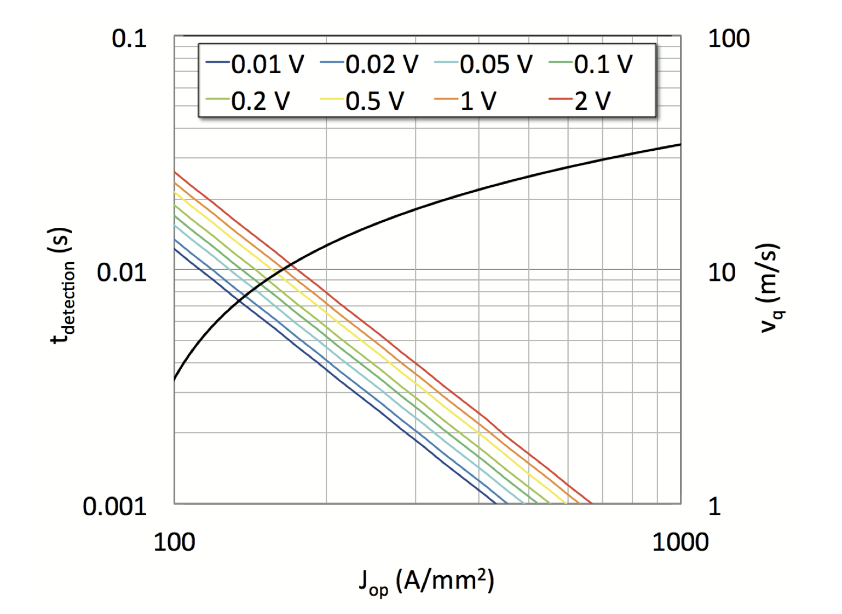
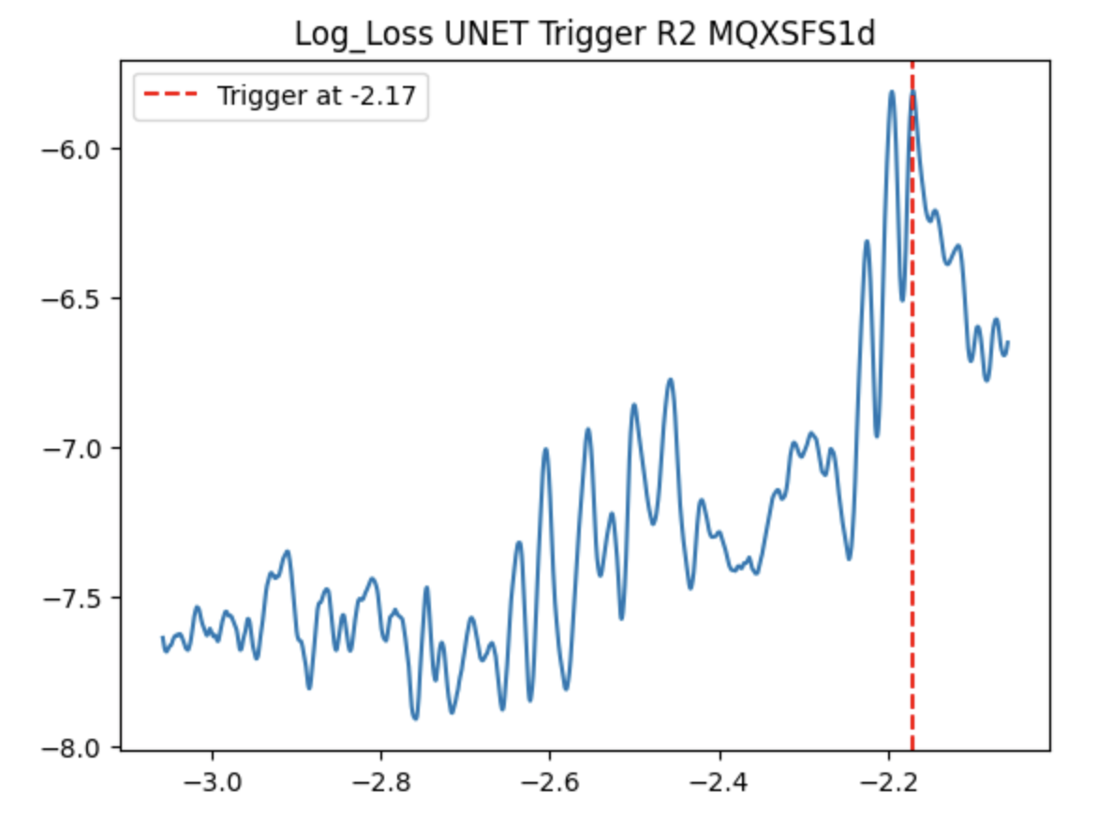
Data Driven Quench Characterization
System Objectives:
  Goal: Quench detection before some ms of quench event
  Modular and scalable with different sensor types, sample rates, number of channels
  Robust to changes in power supply noise
  Prevents false triggers during training ramp (high amplitude of signal that does not correlate with quench)
  Records metrics for interpretability of quench propagation in offline analysis
  Interfaces well with a database storage system
  Software task: Develop an algorithm that processes signals, and flags quench precursors within time and memory constraints
  Physics goal: Detect quench in a way that captures energy loaded to the magnet, flux jumps, and current re-distribution during the training ramp to determine when a quench will occur
Existing method: Rescale according to current density and choose particular voltage. Source: Magnet Quench 101
Our sample ML Trigger that uses acoustics + QA data

Slide 4
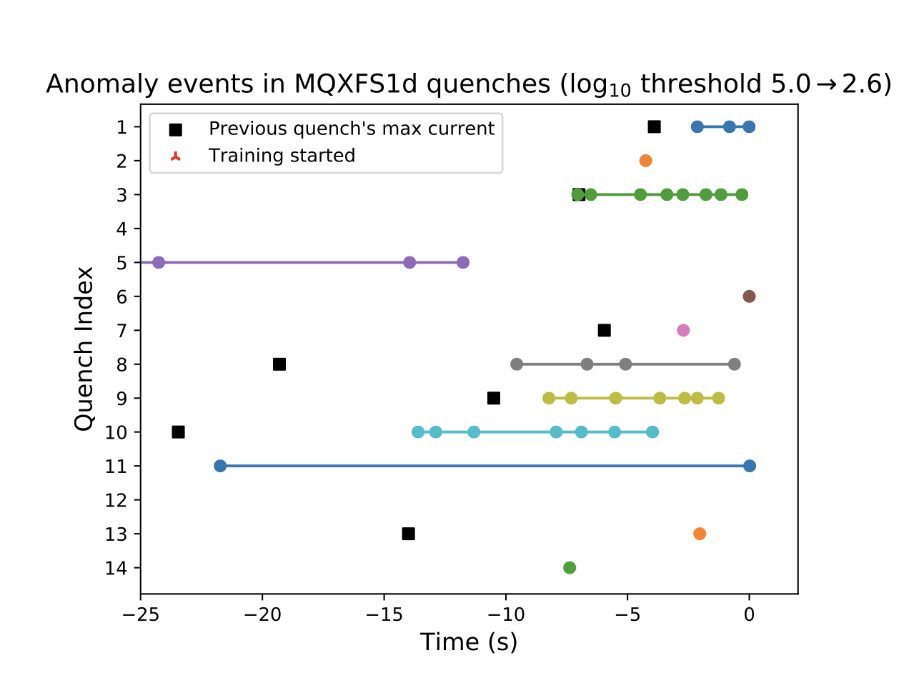
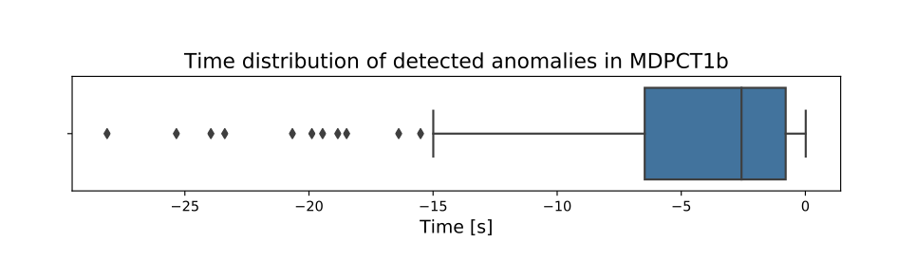
Previous Work
FNAL group has studied real time machine learning on acoustics data only where the model was given raw data with statistics with a focus on real time anomaly direction
Events were developed on two magnets with acoustic sensors
Focus was on exploring what was possible with viewing data with ML
Our current work focuses on developing denoising algorithms, running on multiple data types, and considering how these models may be interpreted with respect to raw data with MBHSM03 and MQXFA series magnets
source

Slide 5
Standard Algorithms vs. ML Approaches
 | Standard Algorithm | ML Inference Techniques | Evaluation Metric
Signal Denosing | frequency domain technique (bandpass, FFT, etc.) | denoising auto-encoder, blocked weight matrix | SNR of 1D Signals Number of signals above noise floor at quench
Quench Boundary Detection | Weighted threshold by J_op | reconstruction loss on dynamic threshold | rate of false and true triggers ~s of quench, exceeding previous current
Quench Precursor Identification and Recall | limited, possible state machine history | reconstruction loss history n-k ramping history | dB/dt, dE/dt Triggers above previous quench current
Cross Sensor Correlation (Sensor and Data Type) | correlation coefficients between single RMS at a given t | latent space projections of channels | correlation density of channels and sensors
Spatial Localization | signal amplitude normalized to noise RMS at (x_i, y,_i, t_j) | reconstruction loss at (x_i, y,_i, t_j) | ||s||_{x,y} ______________ ||L||_{x,y}
Event Characterization | k-cluster of signal features | latent space separation | Transient events, flux jumps, current redistribution, Kaiser effect (in development)
*The latency and parameter footprint (memory resources) are also studied

Slide 6
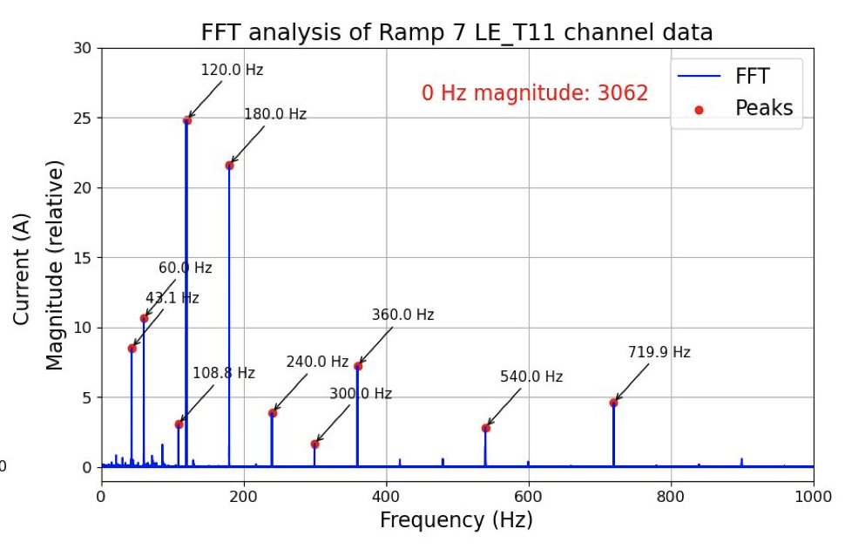
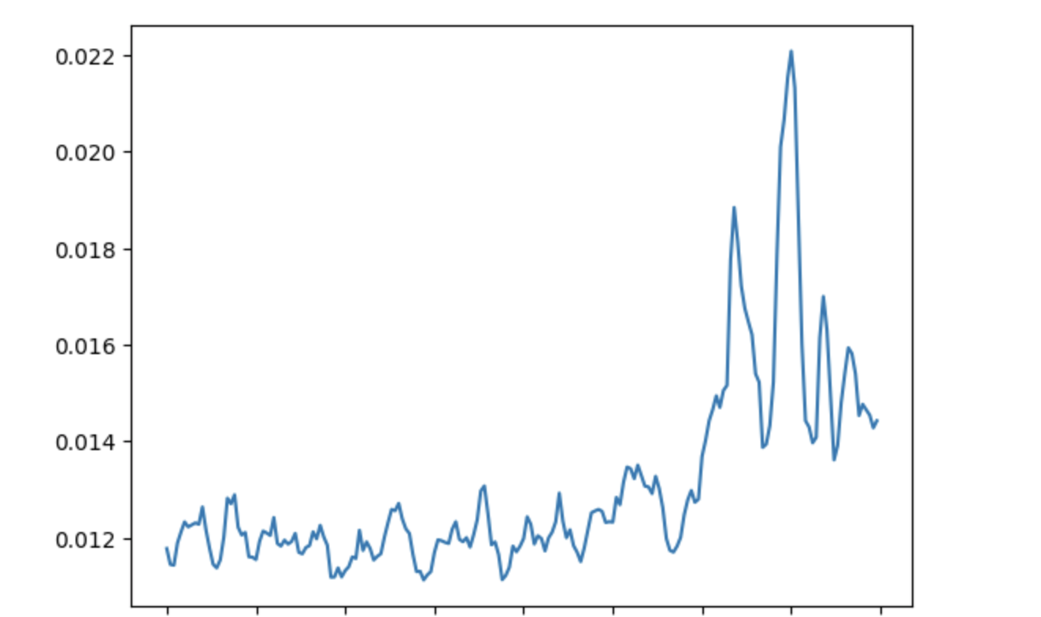
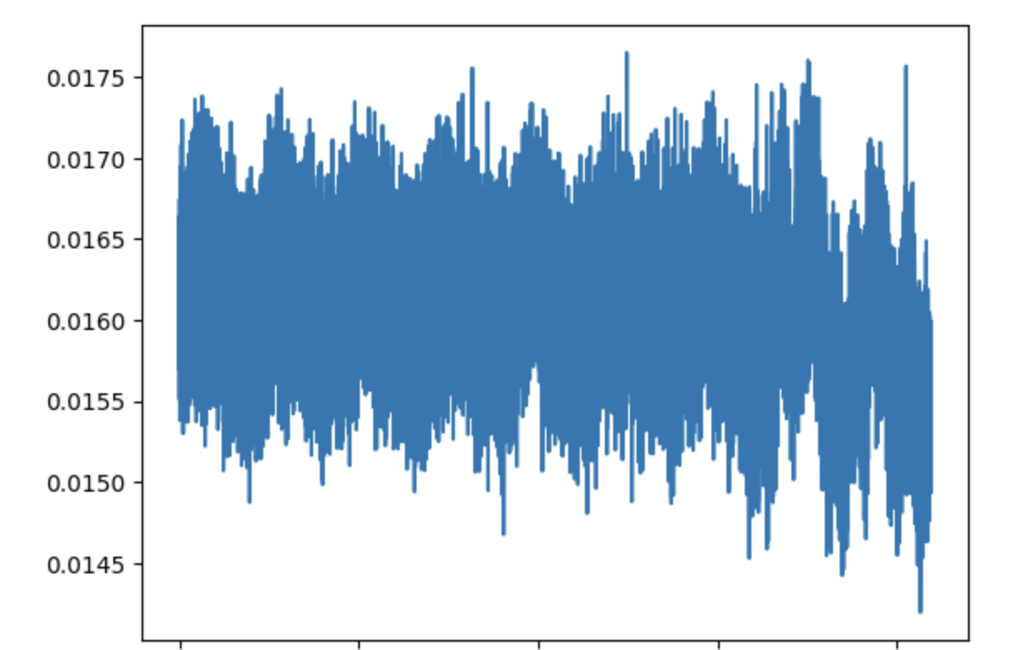
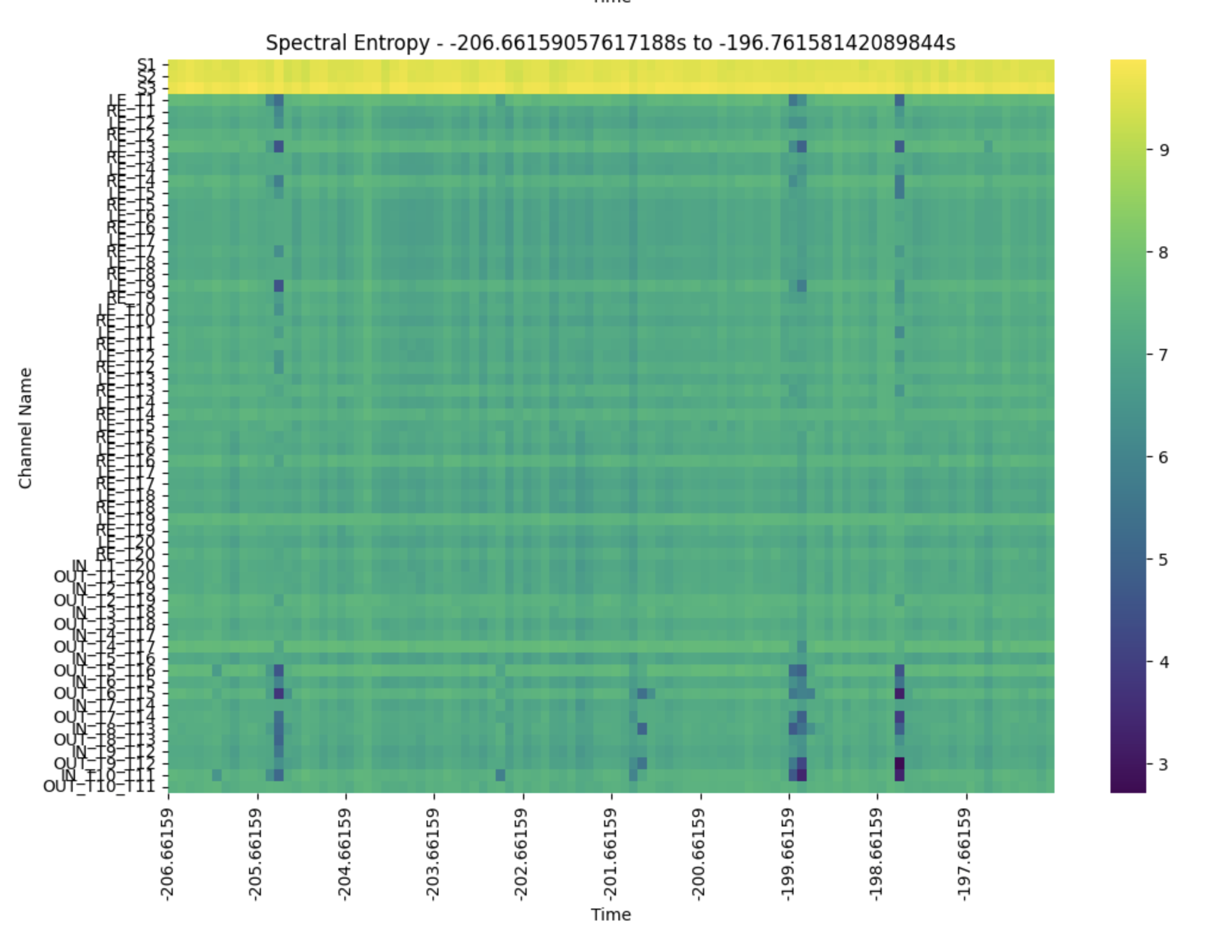
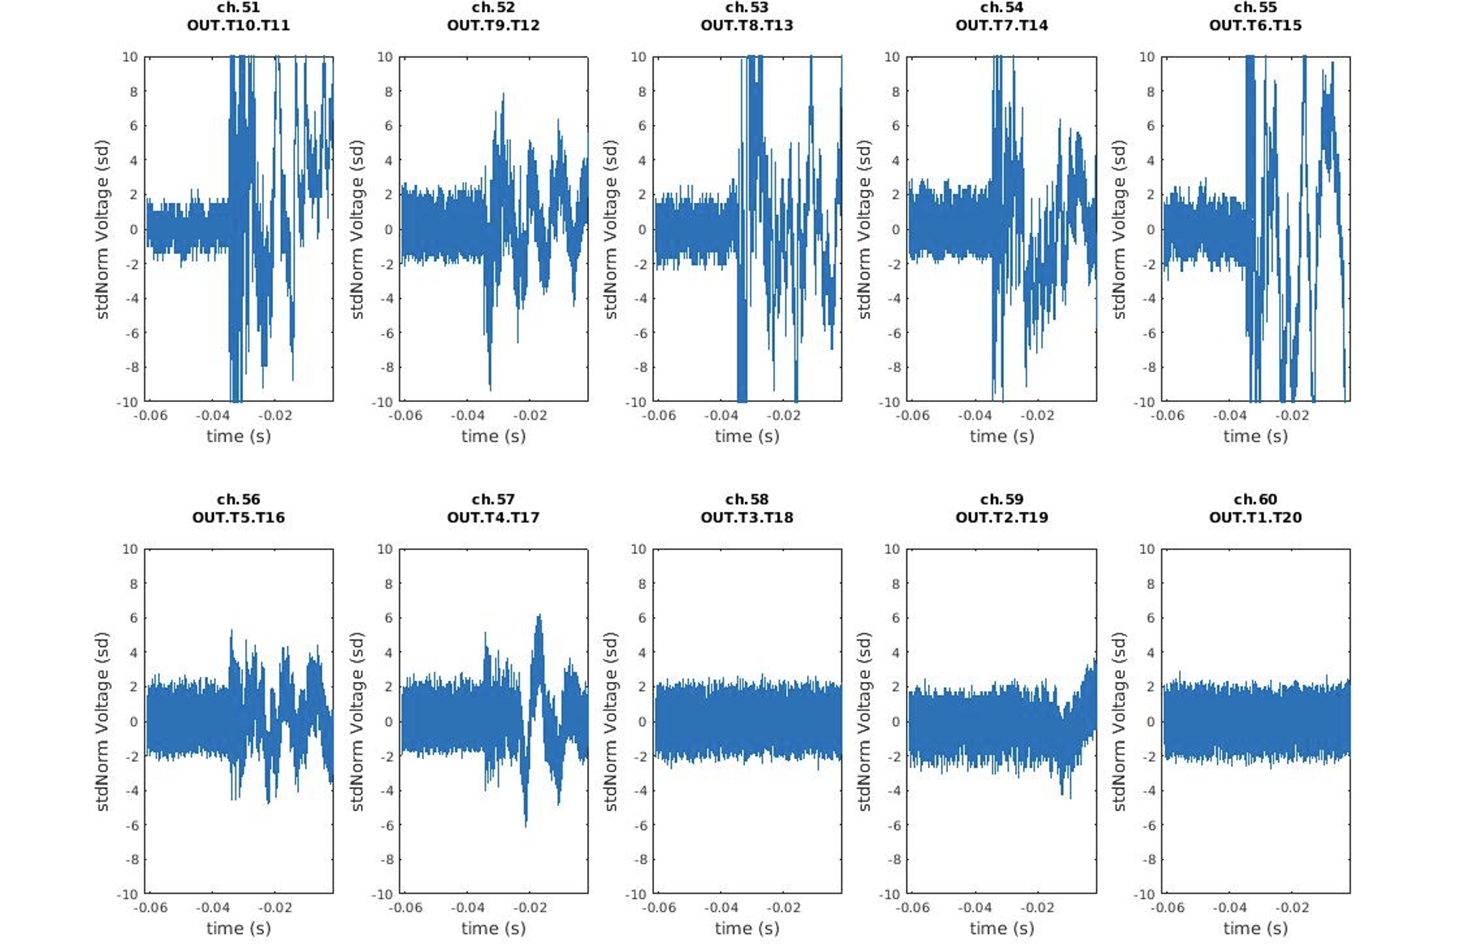
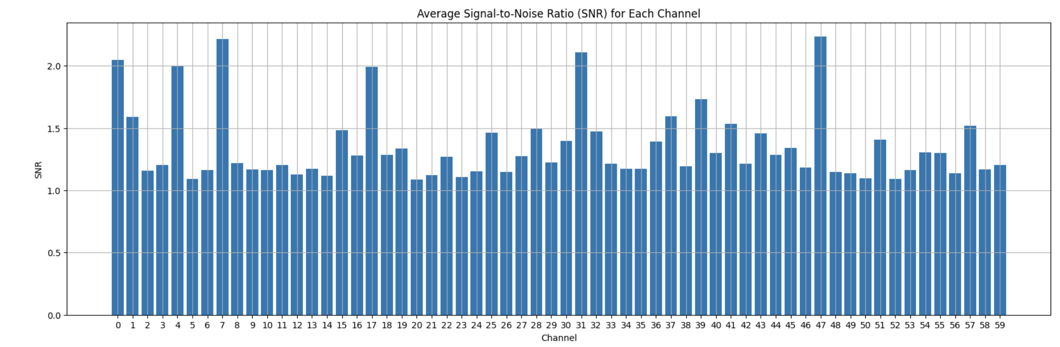
Filtering and SNR at Quench Time
Raw Inputs:
  MBHS03 Magnet
  QA voltages at 100kHz
  Acoustic voltages 1MHz
  Current at 1 MHz
  Rolling window of 20ms, 20us step
Filtering and Preprocessing
  Removed multiples of 60Hz for QA and Acoustic signals
  Computed spectral entropy of raw windowed signals
  Why? Spectral entropy is robust to variations in noise, potentially helping with issues with power supply
  Work in progress: Build single inference matrix to replace SE/FFT filter
Raw waveform
STFFT to remove 60Hz Harmonics
Spectral entropy over window
Noise floor remains consistent in time
SNR varies across channels, some more sensitive than others

Slide 7
Algorithm Logic
Filter 60Hz
Spectral entropy filter
Output: float value of spectral entropy in the window
Input: QA channels
Raw waveform of 20ms with 20us step
Is L1 difference between actual and reconstructed data > n sigma of RMS floor of previous
  ~10s of acoustic data?
  ~3s on QA?
  If yes, trigger
  If not trigger, set n to n-1
Input: AE channels
Raw waveform of 20ms with 20us step
Filter 60Hz
Spectral entropy filter
Output: float value of spectral entropy in the window
We are taking into account the following
Acoustic events tend to have much higher relative amplitude
QA events tend to occur more densely, and transients may occur in a short time span
3. Investigations into adaptive weighting and normalization of two model trigger streams are underway
Neural network updates gradient values every 7s

Slide 8
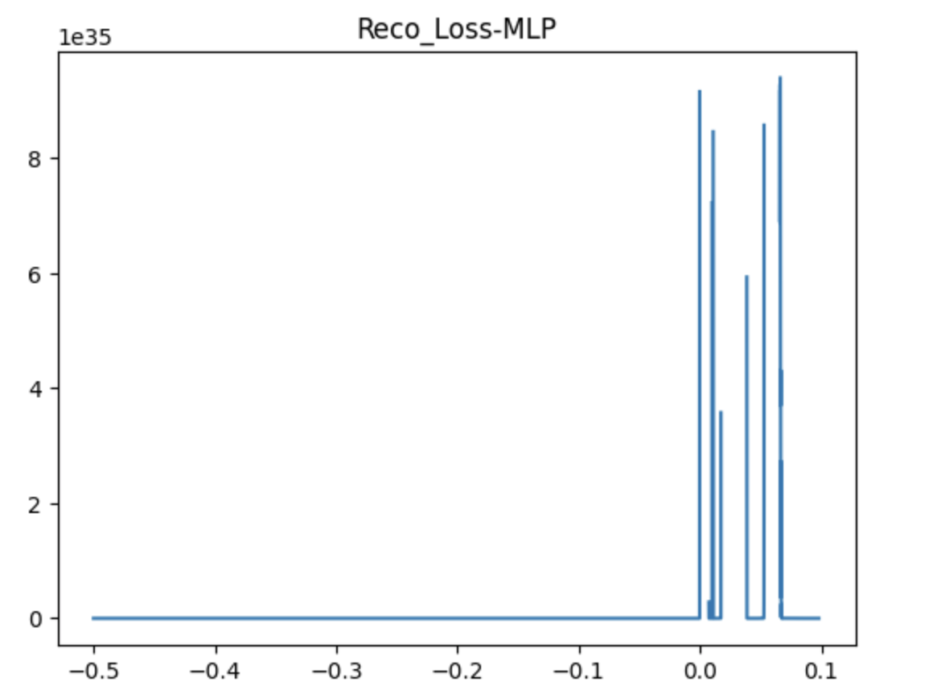
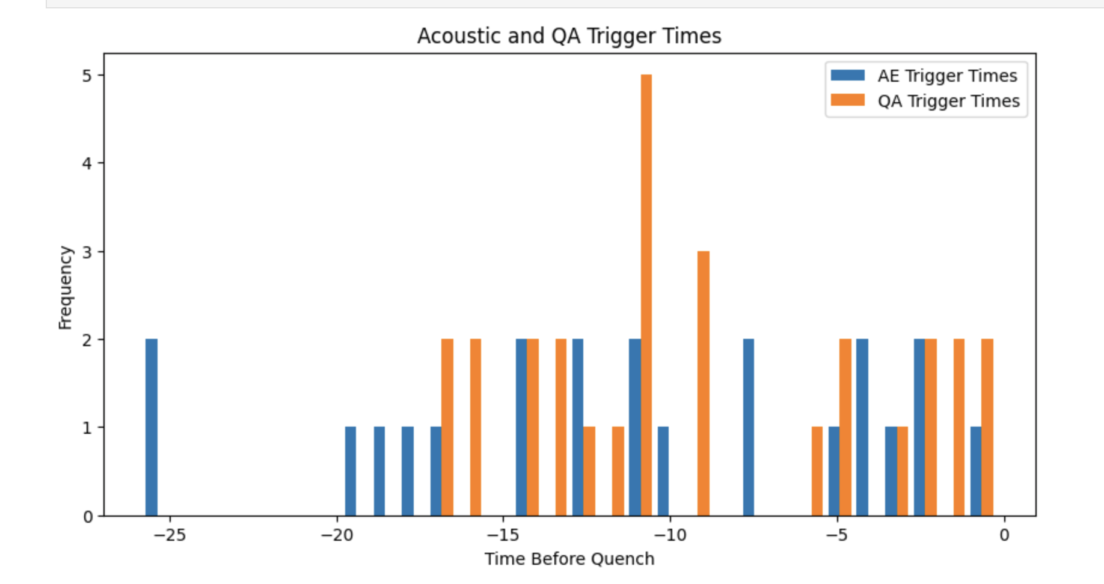
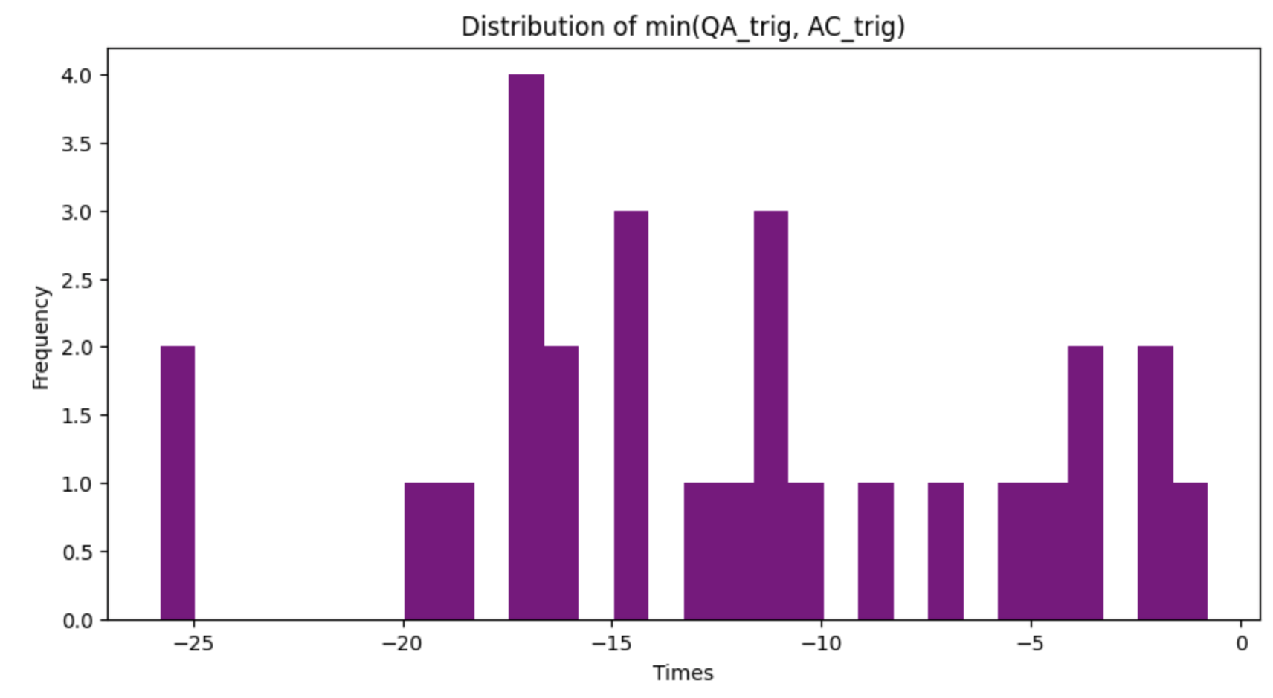
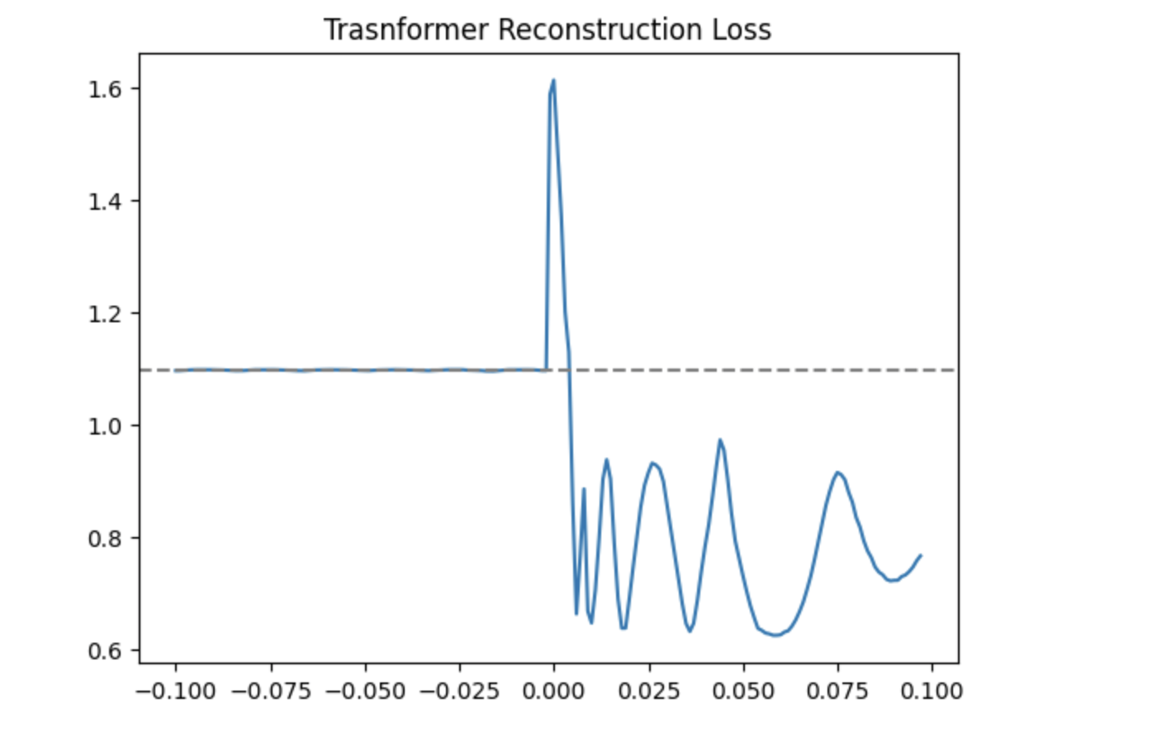
Quench “Anomaly” Trigger
To detect the quench boundary, we weight a dynamic threshold based on the RMS of the reconstruction loss
We evaluated for 29 ramps, ramps n >1. The QA trigger missed 1 ramp. The acoustic trigger missed 6 ramps
The model seems to trigger a “precursor or anomalous event earlier with acoustics than quench antenna
Possible causes: Power supply changes, event density by current boosting
Sample loss triggers by different machine learning architectures

Slide 9
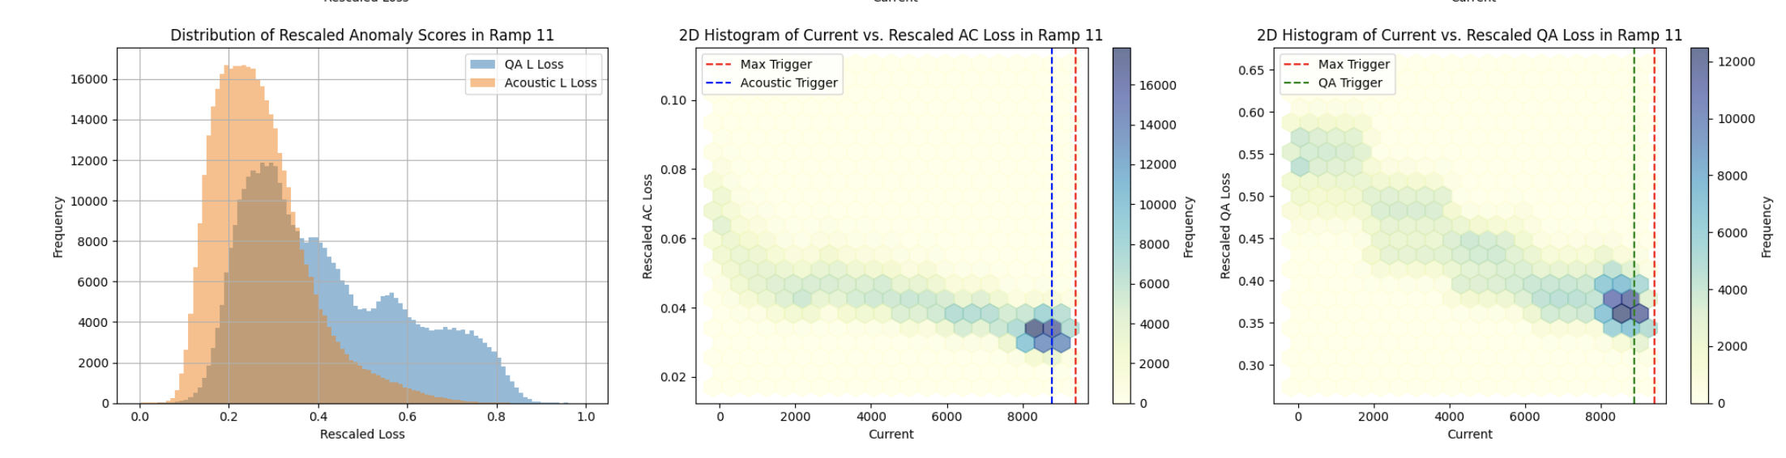
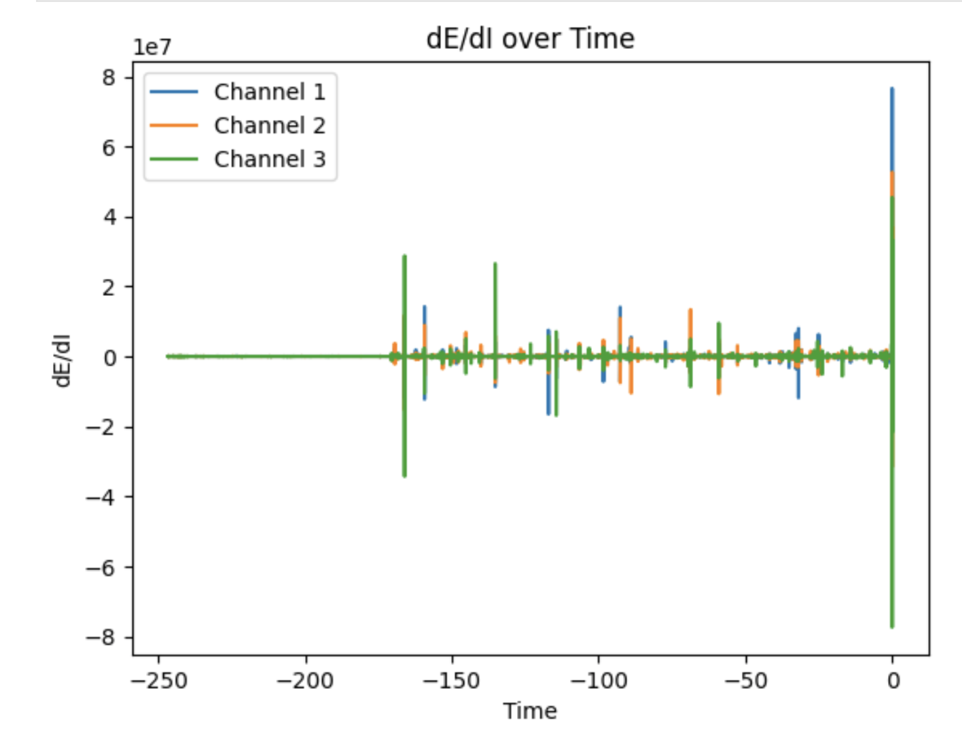
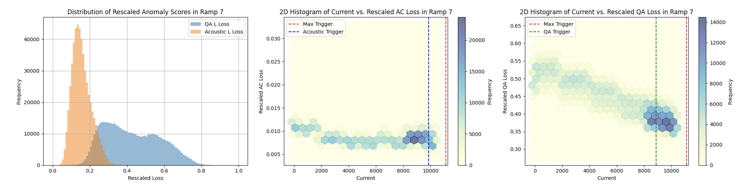
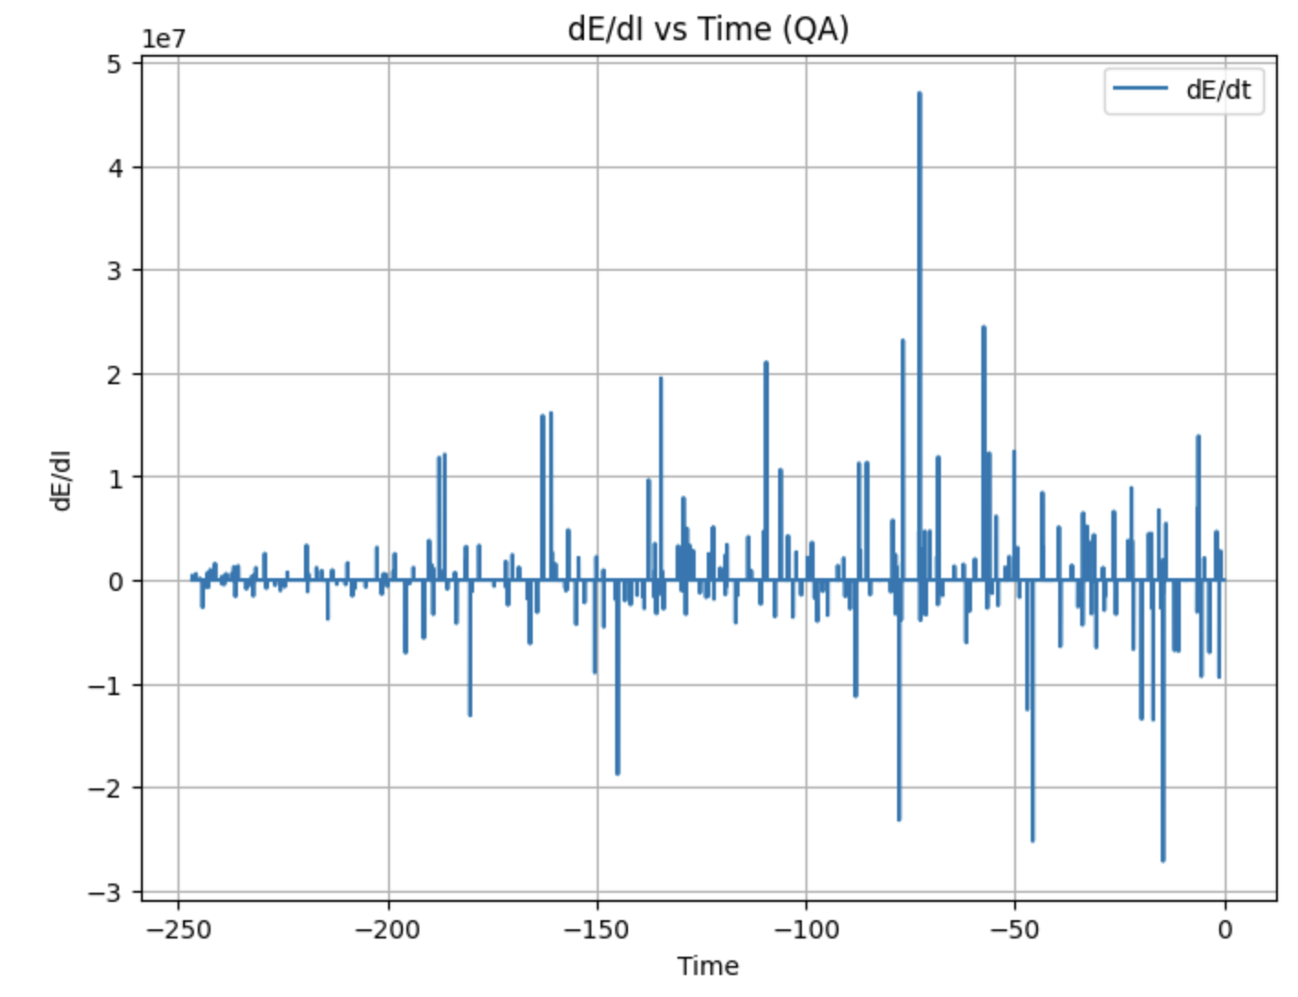
Quench Precursor Identification
We can compare the changes in reconstruction loss of the auto-encoder with changes in energy and field of the magnet. At higher currents, the loss is higher, and detects hotspots close to the quench

Slide 10
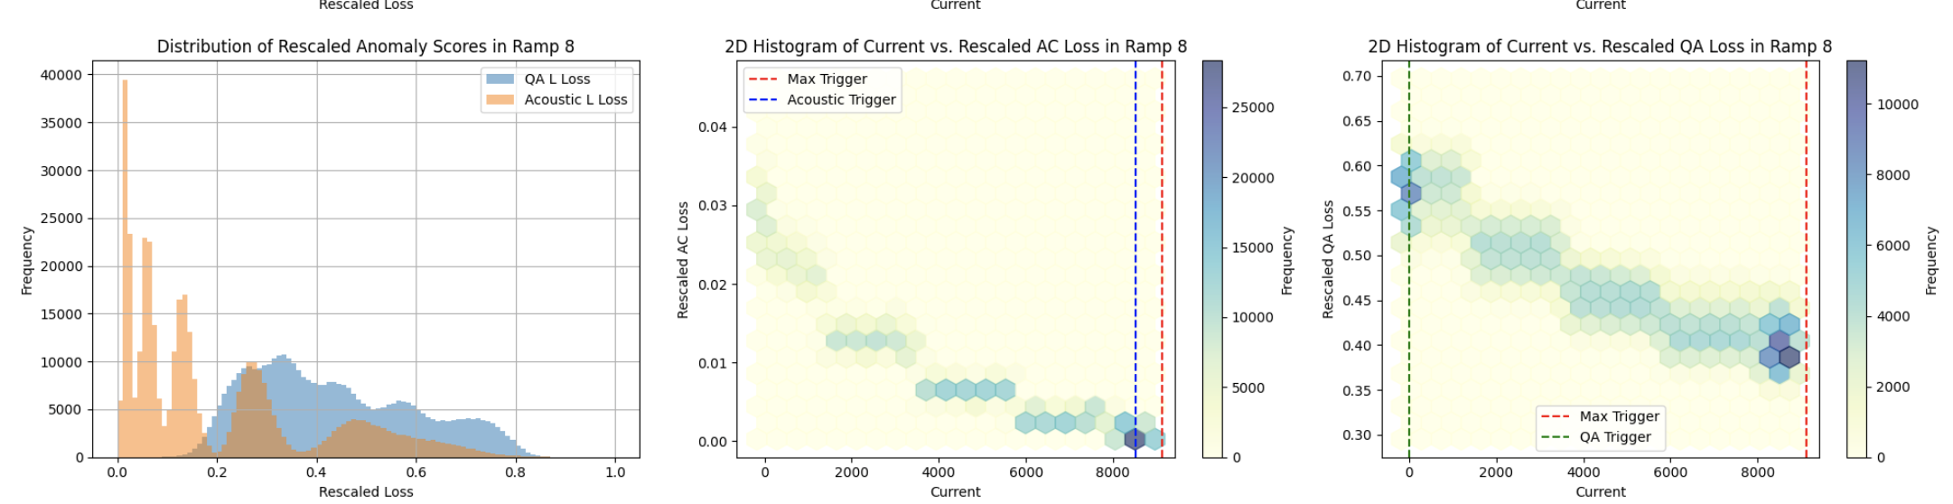
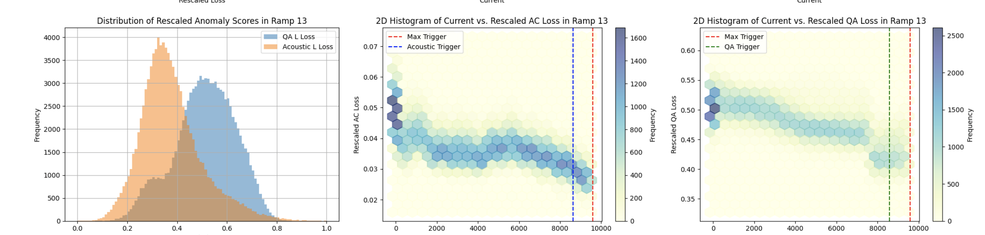
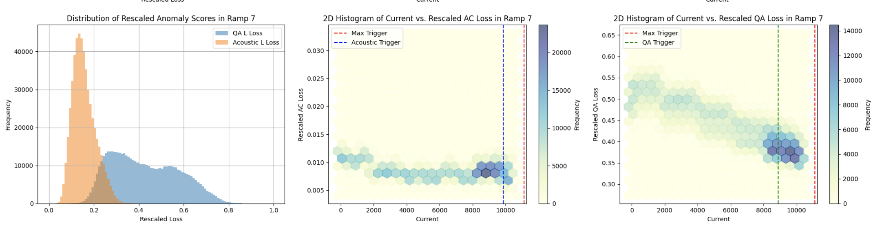
Precursors: Quieter Ramps
Acoustic triggers seem to line up right before the quench on quieter ramps, or due to small perturbations
Edge effects due to window size over RMS may create a trigger as a false artifact of an anomaly

Slide 11
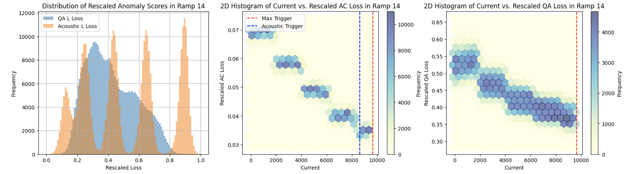
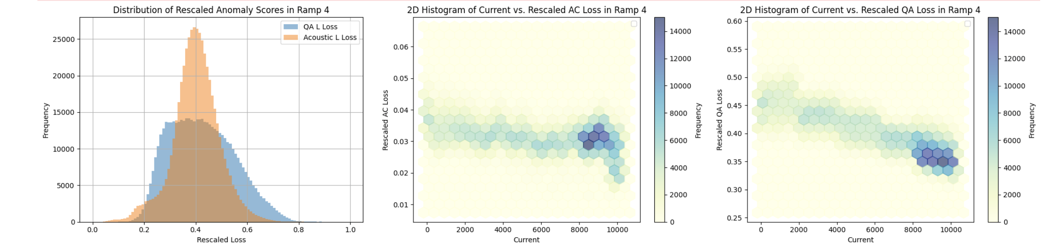
General Behavior
Across all ramps spread of loss seems to be higher for quench antenna or acoustic. This is probably due to the greater numbers of channels and noise in QA.
Acoustic events seem to line up with QA events, but smaller more subtle acoustic events many not be captured in our anomaly model due to window sizing, RMS fits of loss, and boundary effects
We do however see consistent correlations in acoustic and quench antenna using the ML model
Must now compare with standard statistics
Event density varies by current ramp rate and previous training

Slide 12
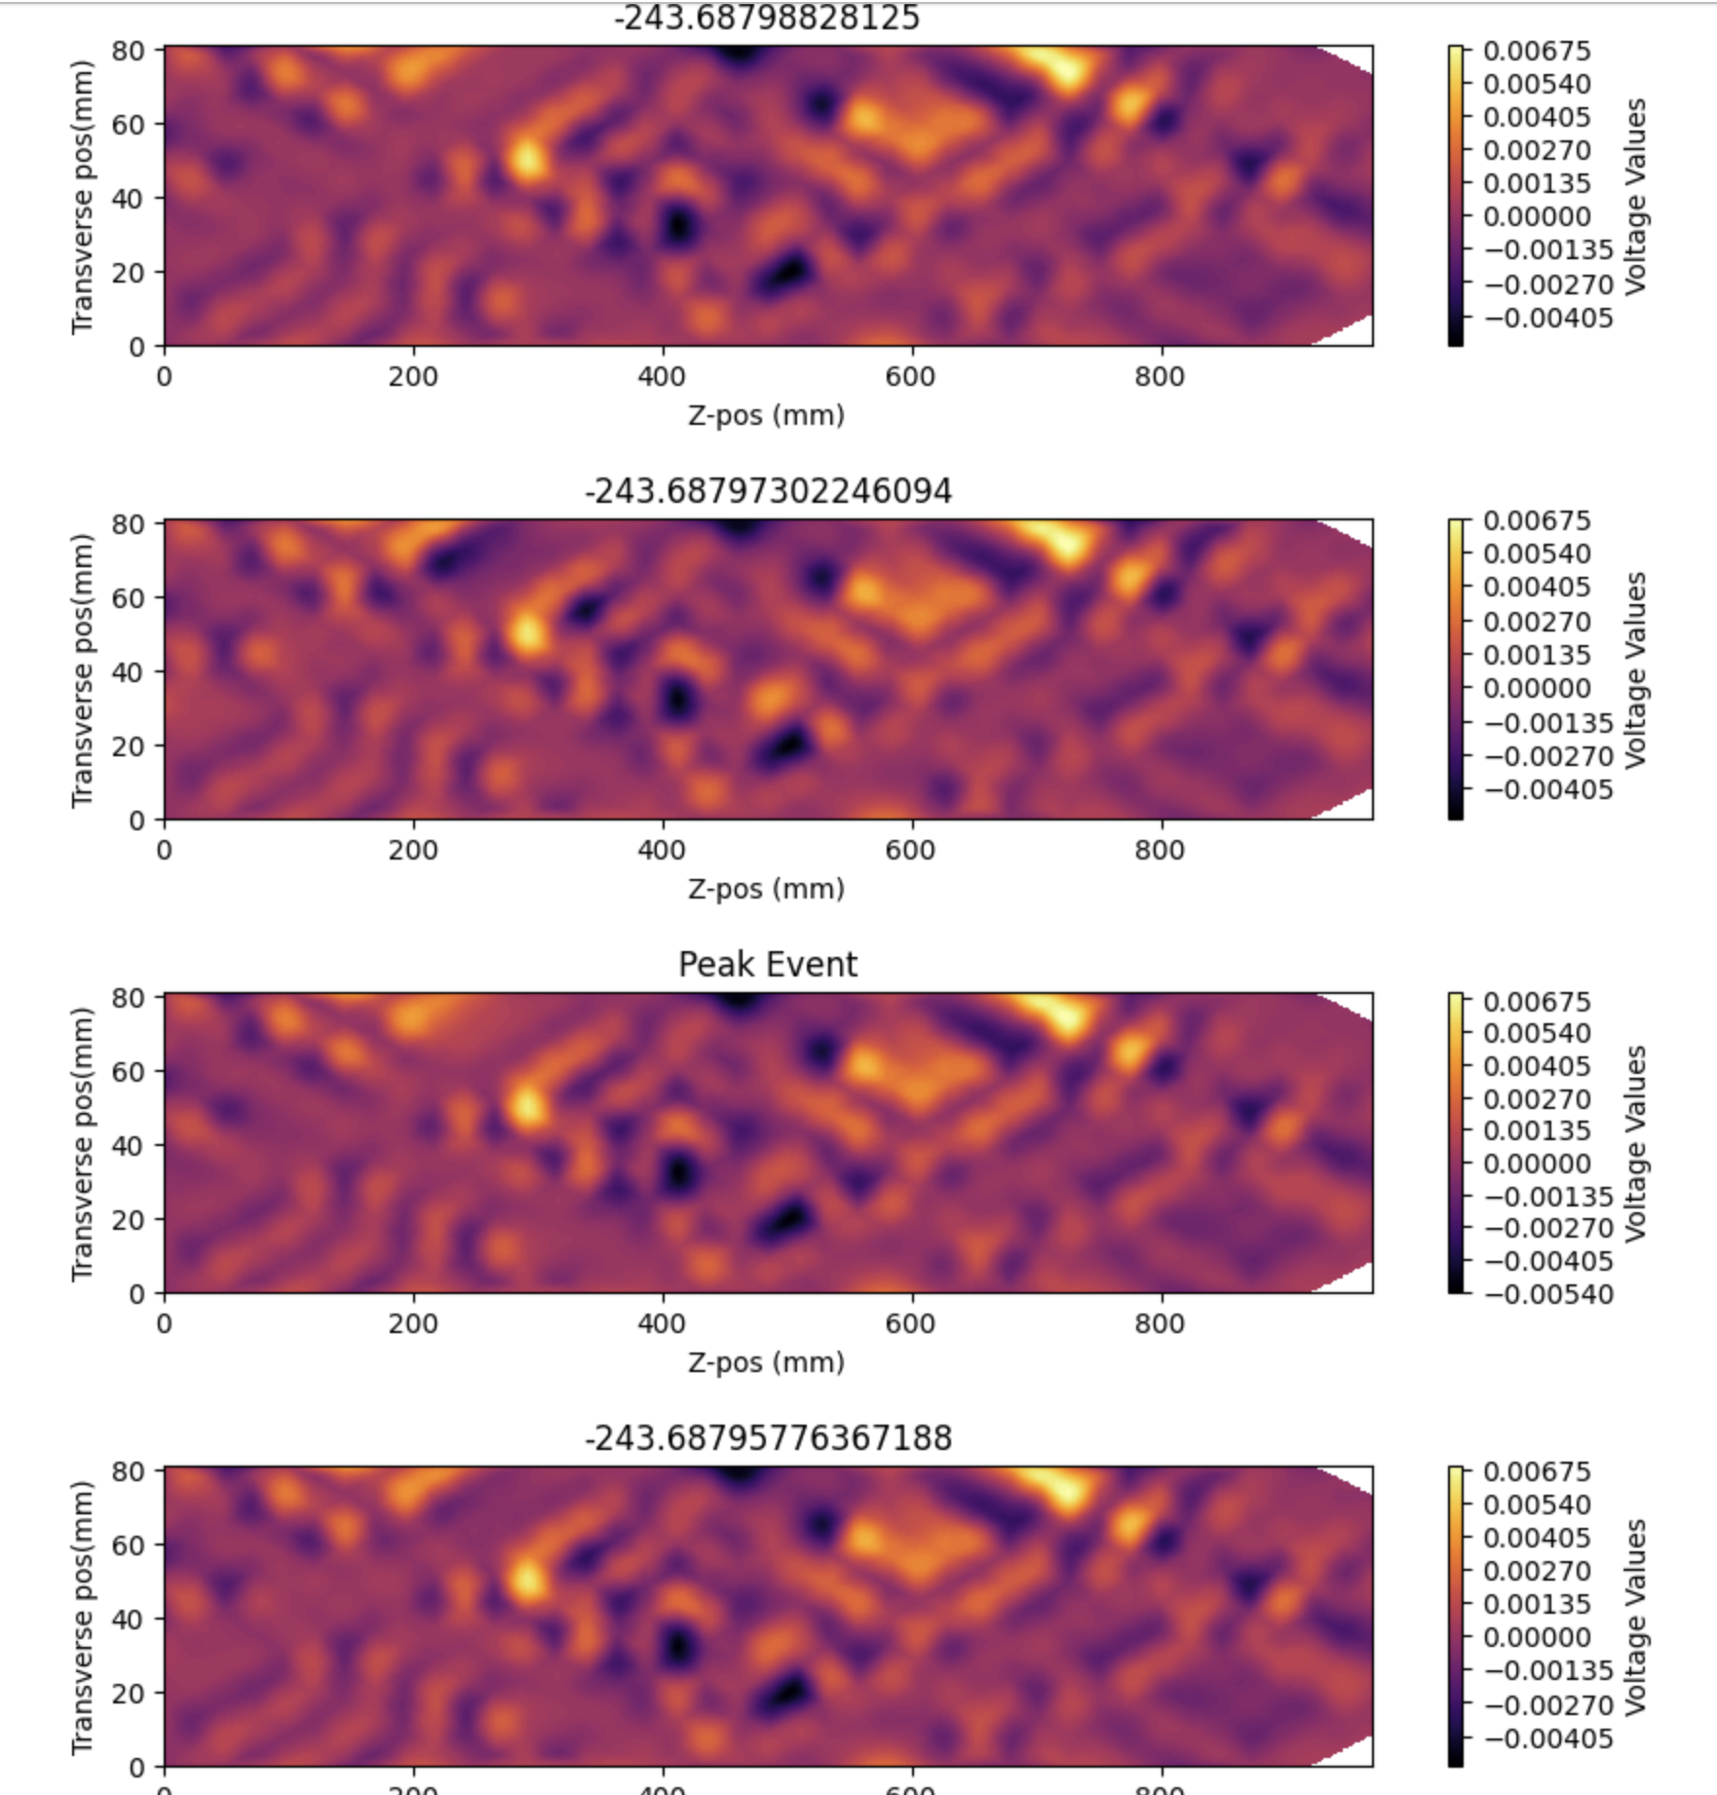
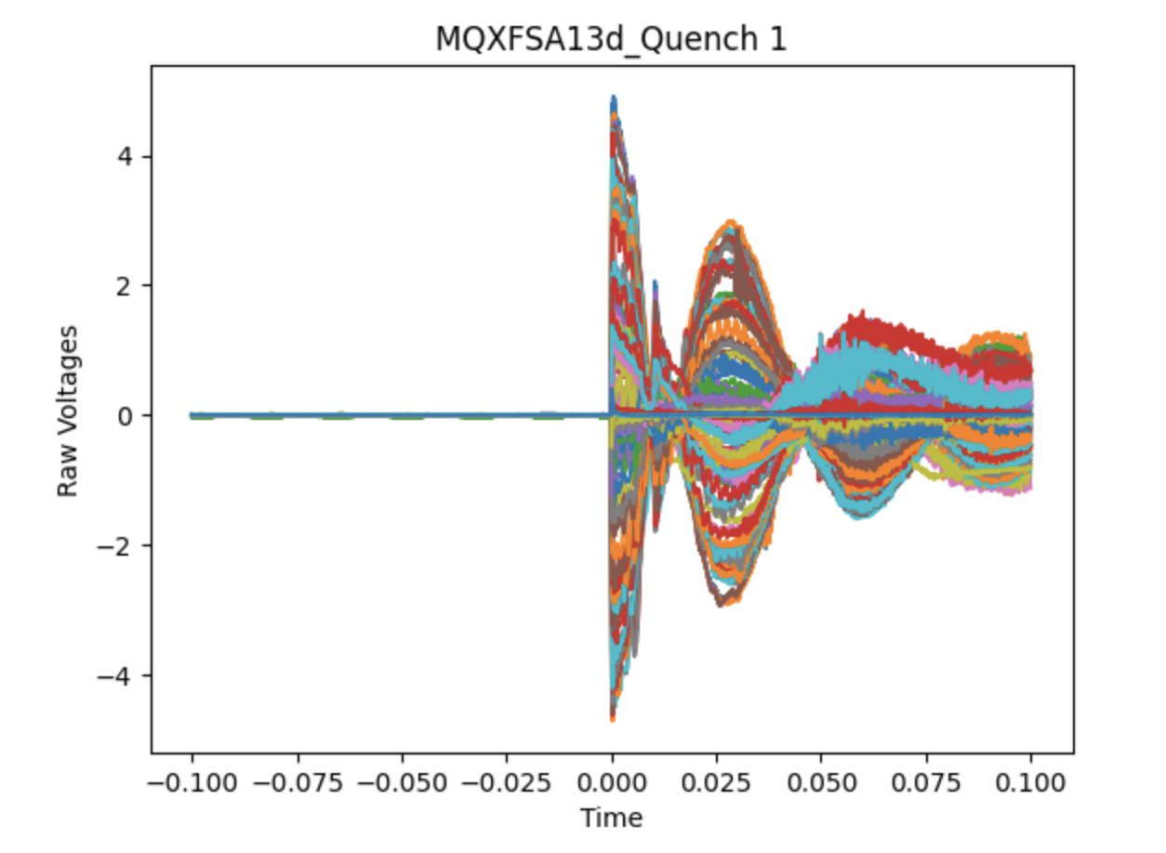
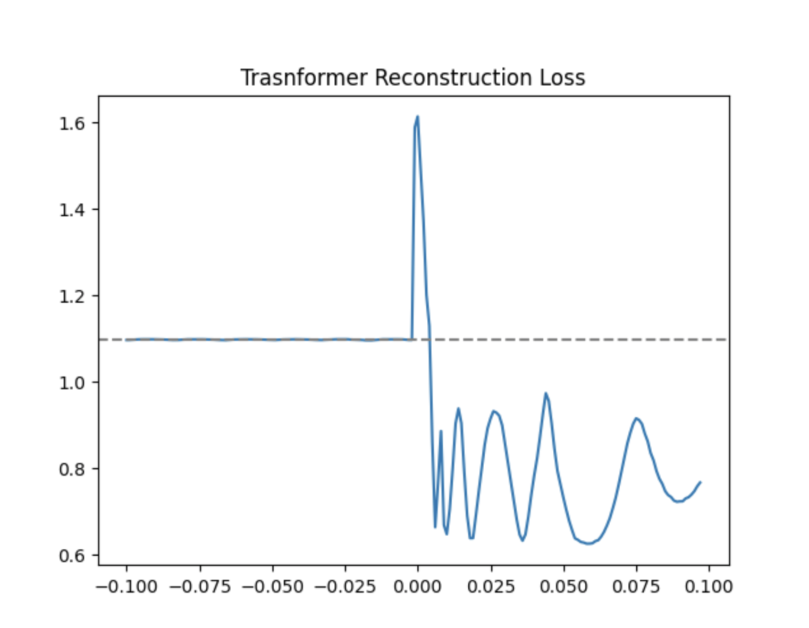
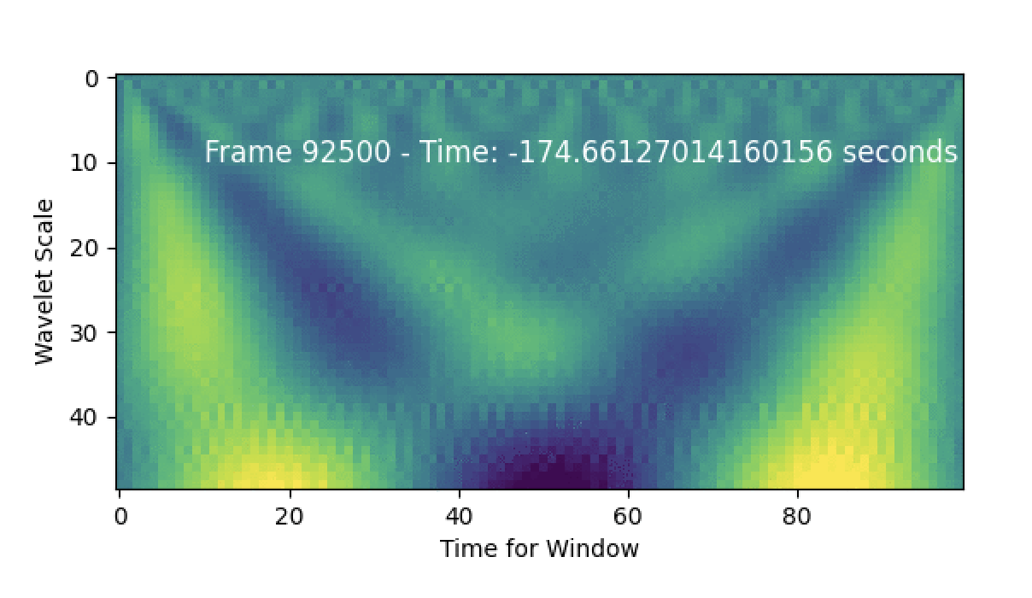
In the Works
We are investigating the use of models using a more consistent dataset: MQXA series magnet to see if our models may better capture the quench boundary or characterize the individual channel
Also, we might return to other feature representations now that r understand the data better
Future: HTS magnet analysis at boundary?
We have overlayed machine learning models with our loss on the actual write geometry
Aim: To see model is able to characterize geometry without explicit direction

Slide 13
Real Time and Edge Application of Algorithms
 | Spectral Entropy Reconstruction | Statistics Computation | Denoising Weight Matrix
GPU processing time of 20ms at 20us step per channel at 16bit precision | 1 MHz: ~22us 100KHz:~17us | 1 MHz: ~2us 100KHz: ~1us | To be studied
 | Dense Autoencoder | U-Net Autoencoder | Transformer Autoencoder
GPU Inference time of 20ms window inputs at 16-bit precision | Acoustic Trigger: ~54us QA Trigger: ~79us | Acoustic Trigger: ~2ms QA Trigger: ~3ms | QA Trigger: ~12ms
Best Total Time Trigger Efficiency within ~25s | False Triggers: 1/29 Missed Triggers: 0/29 True Triggers: 28/29 | False Triggers: 2/29 Missed Triggers: 3/29 True Triggers: 24/29 | In progress
 | Spectral Entropy Reconstruction | Raw Statistics | Denoising Weight Matrix
Memory Footprint per 20ms window (Bytes) | 1 MHz: 16000b 100kHz: 1600 b | 1 MHz: 32000B 100kHz: 32000B | To be studied
 | Dense Autoencoder | U-Net Autoencoder | Transformer Autoencoder
Model Parameter Count (SE) Parameter Count (stats) | Acoustics: 67,184 QA: 96,956 | Acoustics: 463,52 QA: 658,692 | Acoustics: 49,280 QA: 196,864
*All timing benchmarks are preliminary, seem stochastic

Slide 14
Conclusions and Outlook
    We have developed a series of tools and metrics for real time denoising and quench characterization
    Our models seem to recover events that occur across the training ramp and establish correlations between acoustic and quench antenna sensor data
    We are still investigating various adaptive weighting algorithms to deal with the multiple types of data and varying window size
    The lack of consistent data in training makes consistent training challenging. Data regularity study to come
    We should eventually evaluate our algorithms on steady state data for actual real time control
    For now, the model serves as an interesting tool for flagging potential precursors and understanding them
    Lots of room for ML in other parts of this problem: objective function optimization, RF type analysis
    Temperature sensors would contextualize many of these readings

