Slide 1

Cryo-Electronics Quench Detector Development at BNL
MDP collaboration meeting, May 02, 2024
Piyush N Joshi

Slide 2
Outline
Motivation. Why we need cryogenic Quench detector
Cryogenic QD versus normal quench detector
Implementing 77K cryogenic quench detector system
Proposed components for 77K operation
Proposed architecture for cold rotating coil measurement system
Summary

Slide 3
Acknowledgement
Soumyajit Mandal and Jack Fried of BNL Instrumentation department for suggestions on cold electronic components already used in liquid Argon detector.

Slide 4
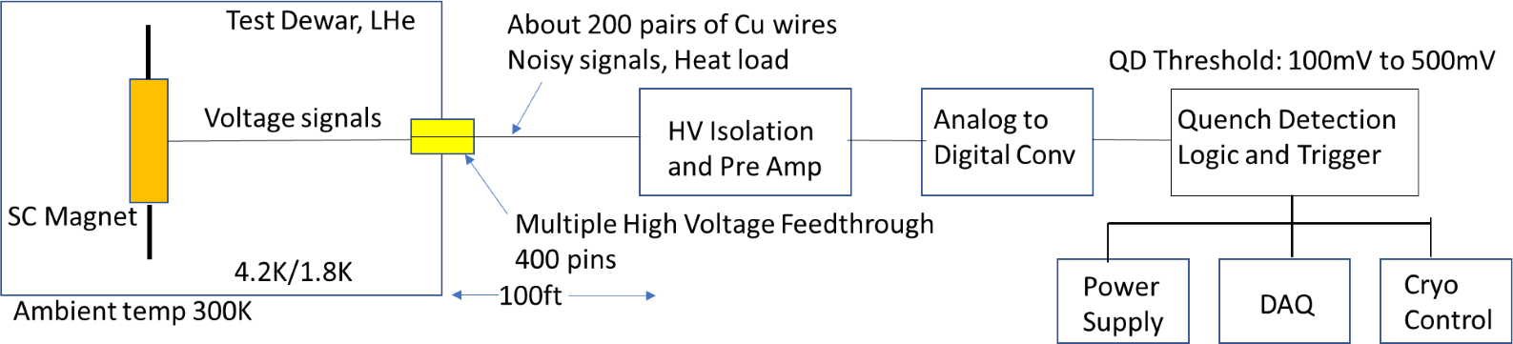
Motivation and Conventional QD issues
Conventional quench detection techniques are reaching limits of their application. Major issues are :
Requirement of lower quench detection threshold for HTS magnets.
Generation of very high voltages during quenching of high inductance magnets.
High heat load on cryogenic system due to increased number of instrumentation wires
Costly interfaces and High voltage feedthroughs.
Requirement of better than conventional signal to noise ratio for detection of microvolt level quench signals.

Slide 5
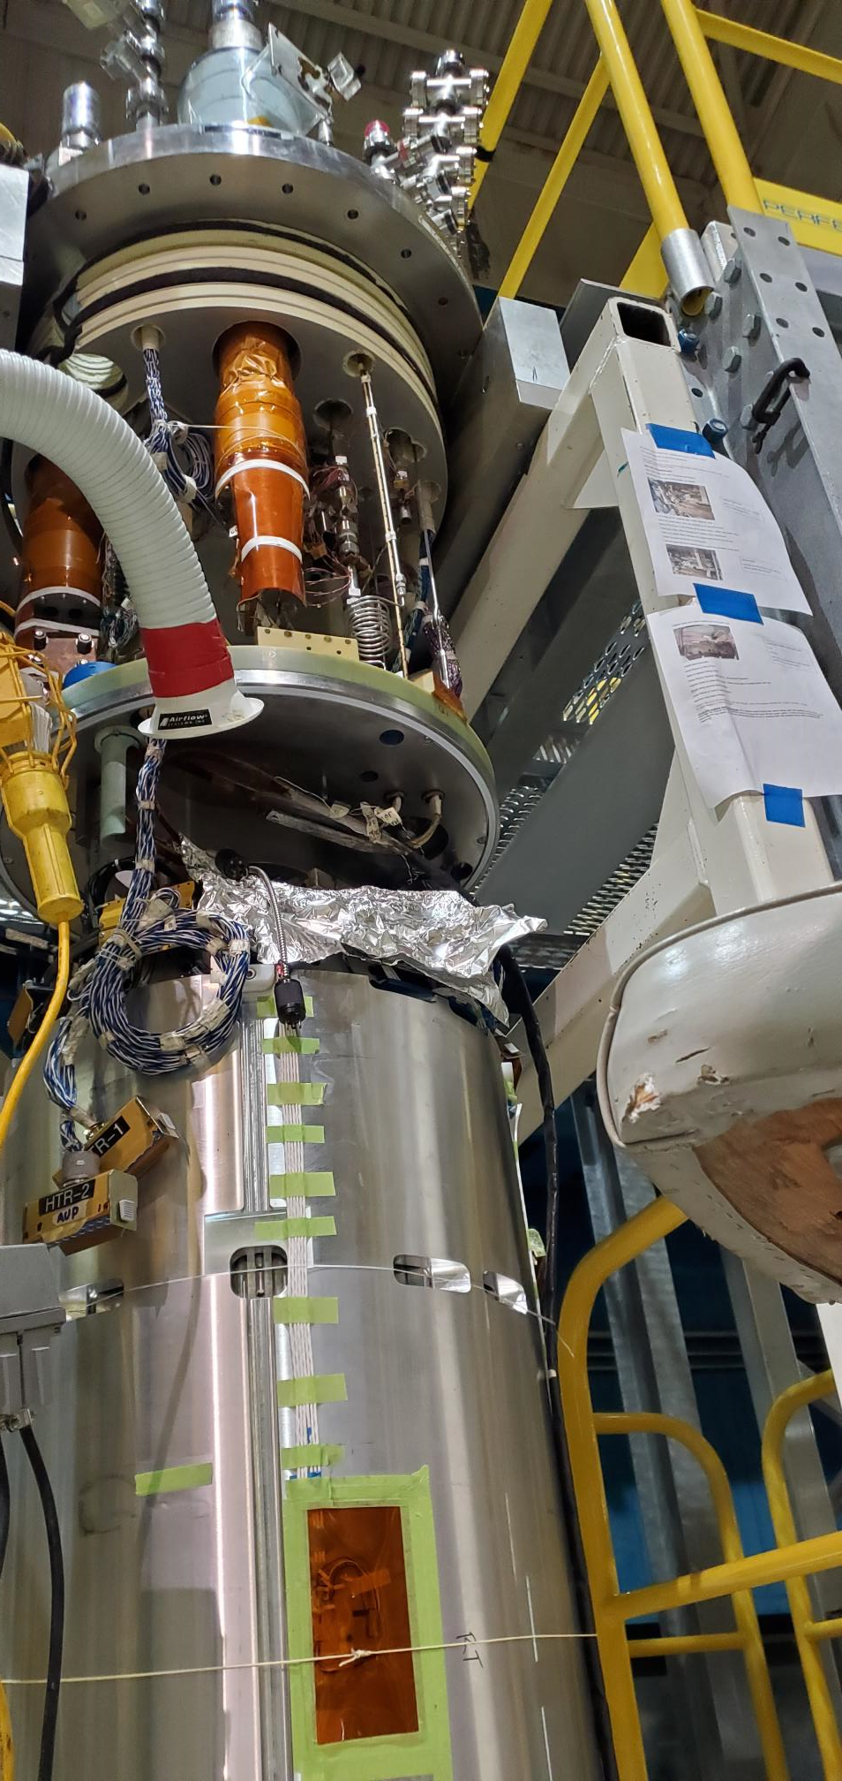
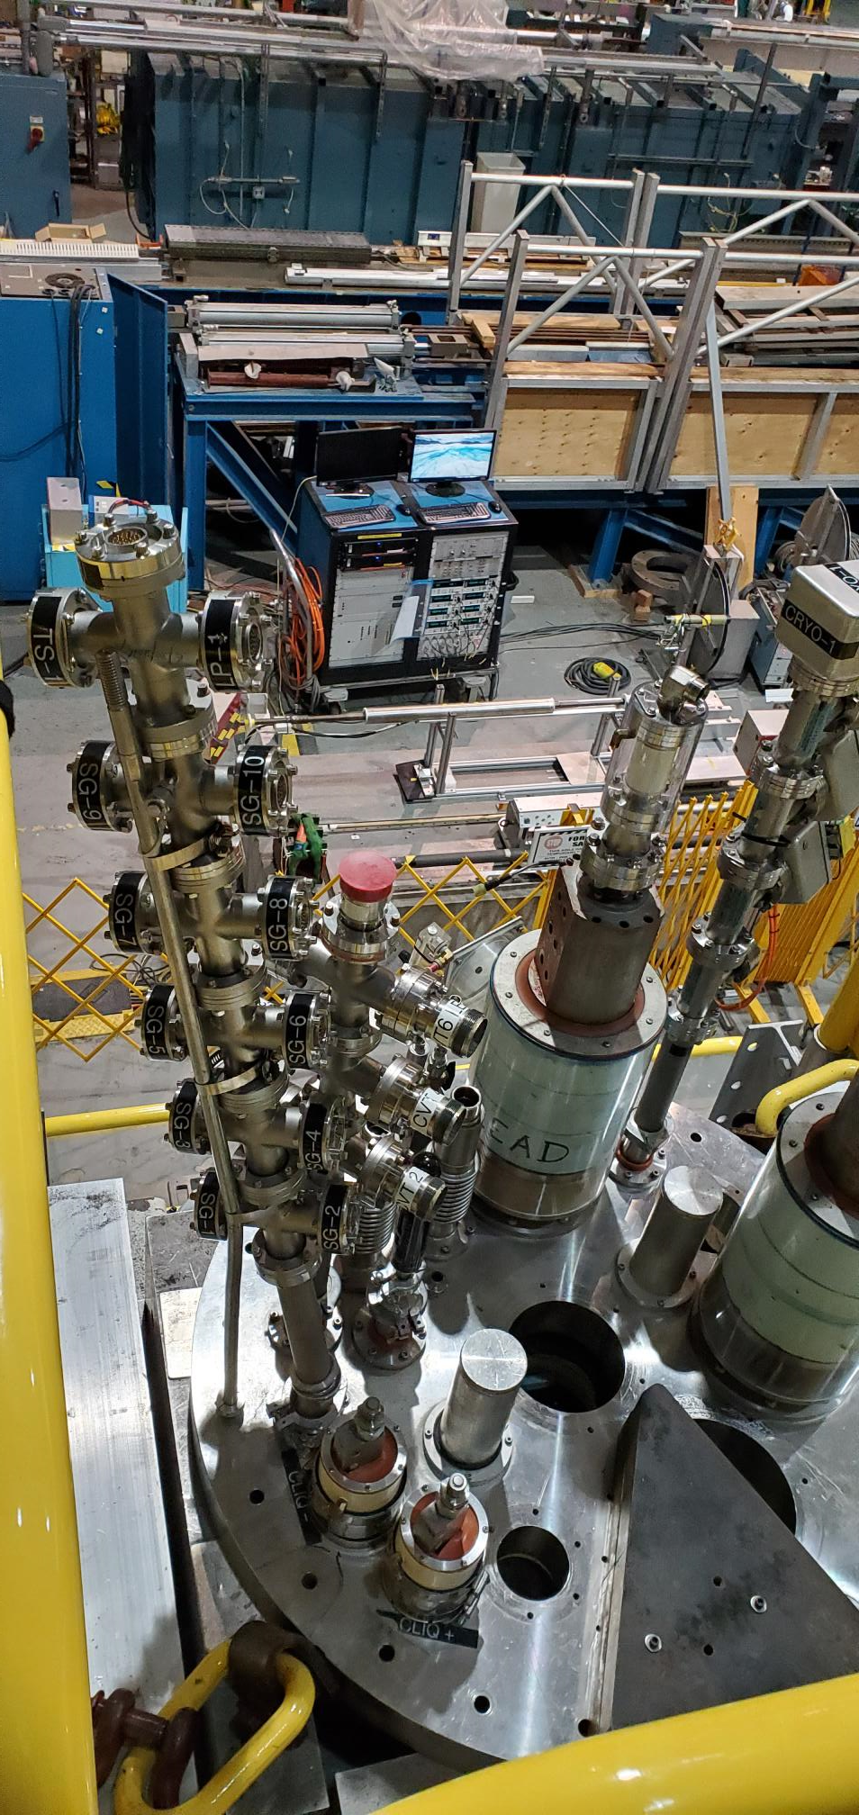
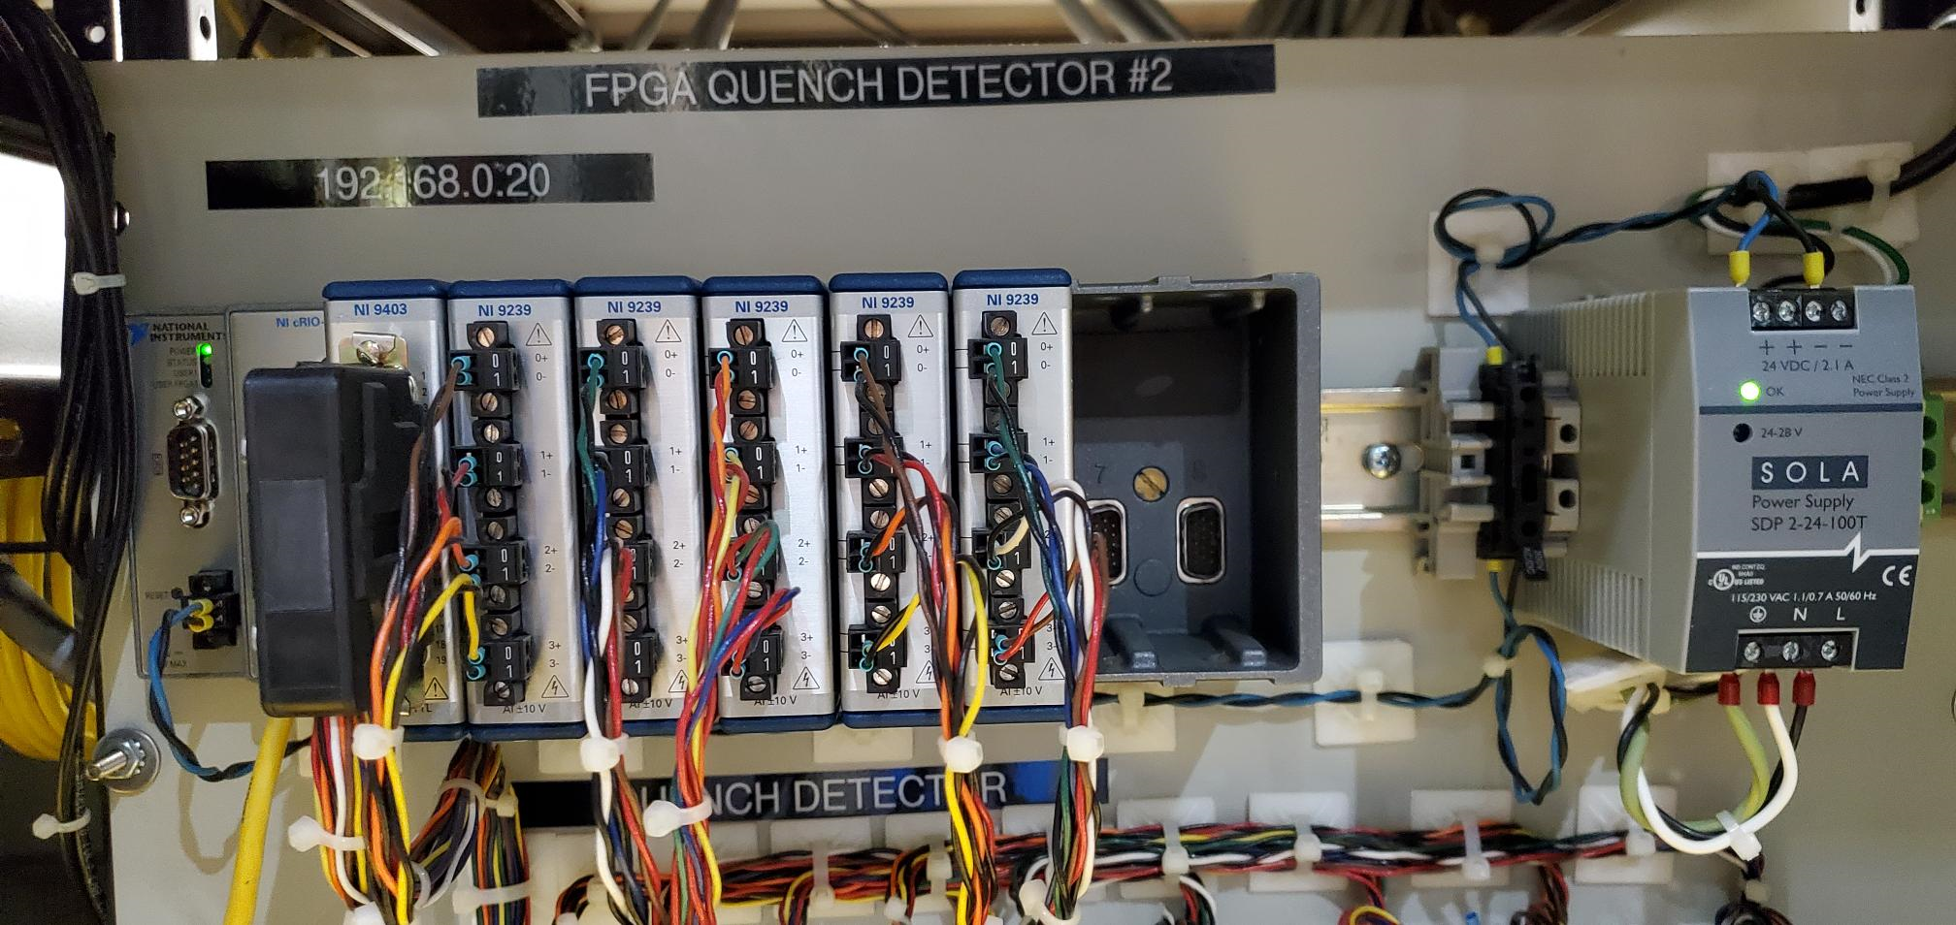
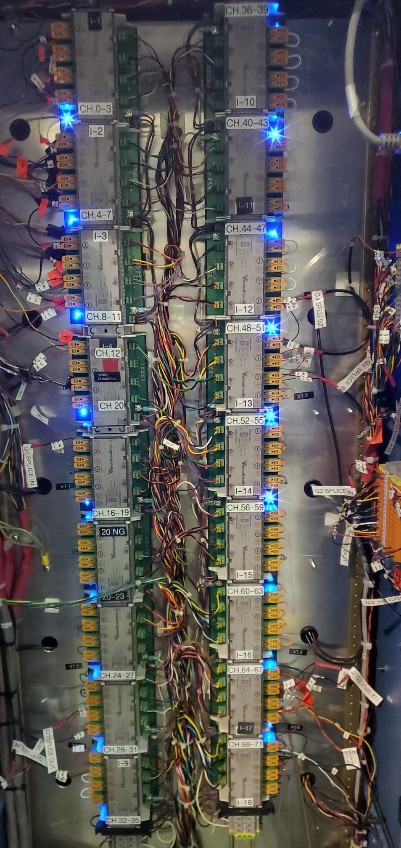
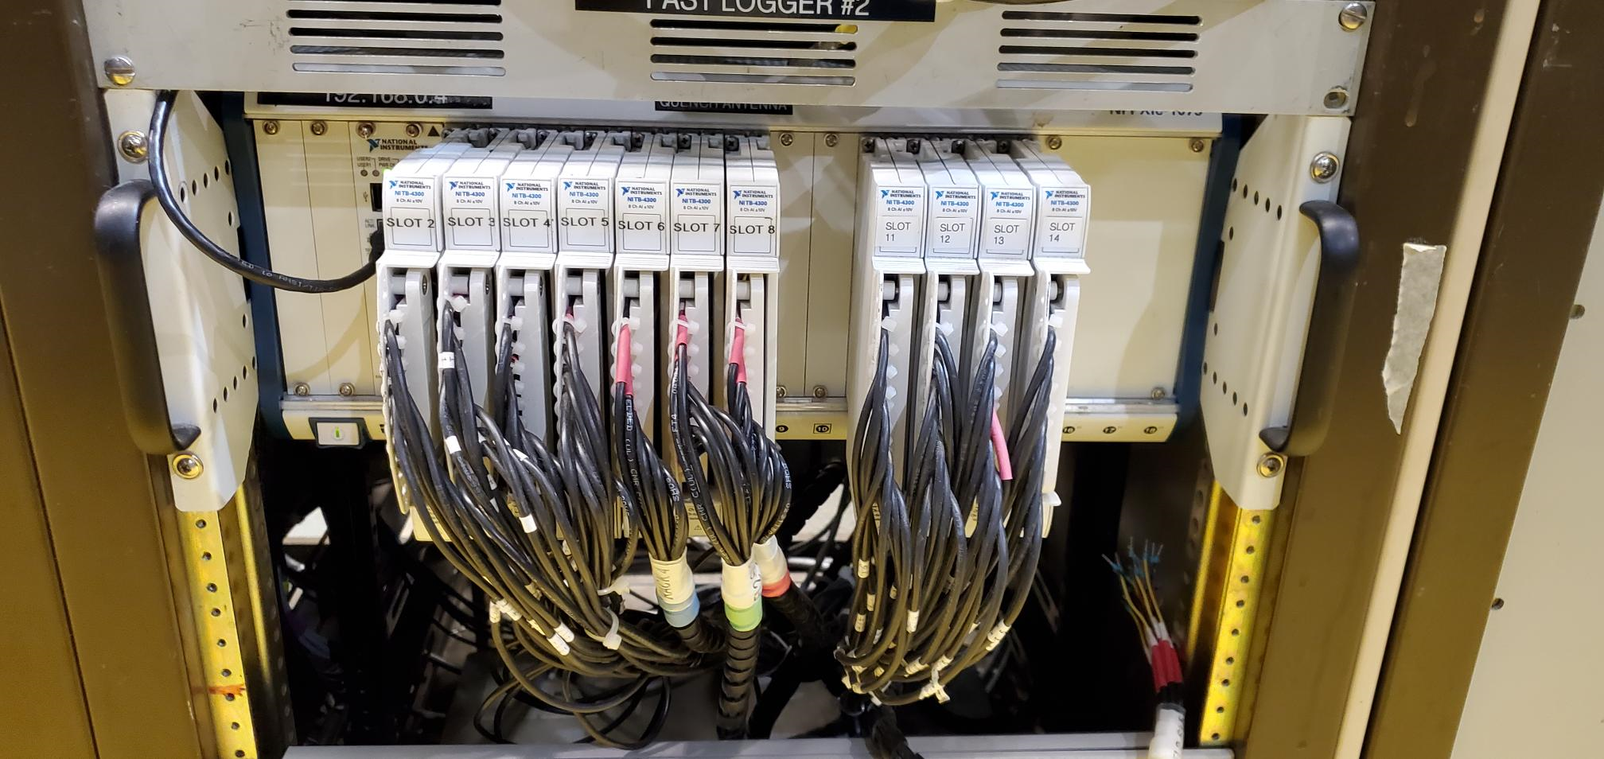
Present Setup
Quench Detector at 300K
HV Isolators at
300K
High Voltage Connectors
At 300K
Fast logger > 200channels
At 300K
SC magnet at 4.5K

Slide 6
Solution
Introducing quench detection electronics inside the test dewar in proximity of SC magnet at cryogenic temperature takes care of most of the above issues.
Introducing Optical Fiber based interface will take care of high voltage isolation and improves signal to noise ratio
Benefits: Lower heat load and fewer feedthroughs
Schedule:
Phase 1: Test components in liquid nitrogen (77K)with HTS coils. Using Off-the Self components and utilizing ADCs and FPGAs developed by BNL Instrumentation department for DUNE project. (Feb. 2025)
Phase 2: Based upon the results of Phase 1, explore CMOS quench detection electronics capable of operating at 4.2K (Feb. 2026)

Slide 7
Implementing 77K QD system
Acquire and test various off-the-self cryoelectronic devices and components required to assemble cold quench detection system operating at 77K
The components which must be developed and tested at 77K are:
  Instrumentation amplifier with voltage clamp to amplify the differential voltage between coil monitoring points.
  Amplified output digitized by an analog-to-digital converter (ADC).
  Capacitively-isolated local power supply.
  Capacitively-isolated digital output.
The secondary goal will be to develop analog signal transmission through optical fiber. If successful, this will be a big breakthrough in testing SC magnets and cables. Analog signal transmission over optical fiber provides inherent high voltage isolation and very superior signal to noise ratio as compared to analog signal transmitted over copper cable over long distances. This will require the development of light modulator proportional to analog voltage operating at cryogenic temperature.

Slide 8
Implementing 77K QD system
Couple of fiber optic cables,
Very low heat load, low noise
HV Iso
& Amp
A/D
Converter
Digital
Interface
Fiber Interface
Logic and Trigger
Simple Fiber Optic Feedthrough
77K
Cu Wires
Data
Logger
Power
Supply
Cryo
Control

Slide 9
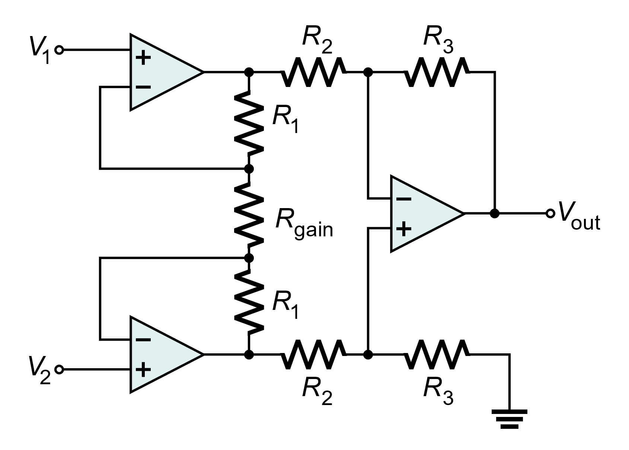
Isolation and Pre-Amplifier
Instrumentation amplifier to amplify the differential voltage between coil monitoring points.
Amplified output digitized by an analog-to-digital converter (ADC).
Capacitively-isolated local power supply.
Capacitively-isolated digital output signals.
Voltage inputs and outputs on copper cables, could potentially be replaced by optical fibers in later versions
V_{DD,ISO}
V_{DD,ISO}
AC Power
Rectifier
DC Filter
V_{DD,ISO}
V_{REF}
v_{OUT}
Capacitive digital isolator
D_{OUT}
Superconducting coil
ADC
77K

Slide 10
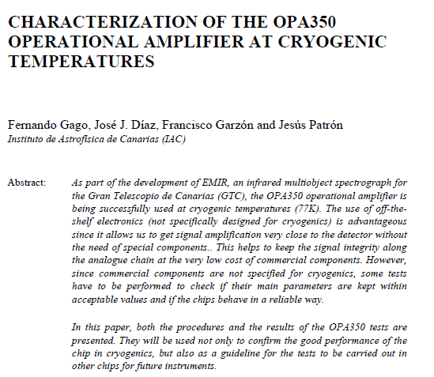
Choice of Op-Amp
Prefer CMOS designs since they are more likely to function normally at cryogenic temperatures
Amplifiers with rail-to-rail outputs are preferred
Option 1: OPA350 (Texas Instruments)
  CMOS, low input current
  Operates at 77K but can have startup issues

Slide 11
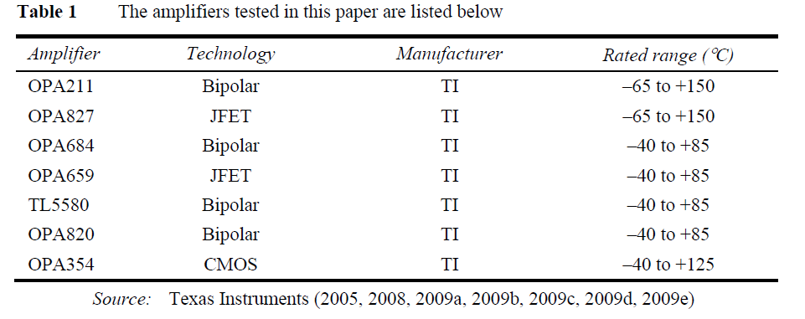
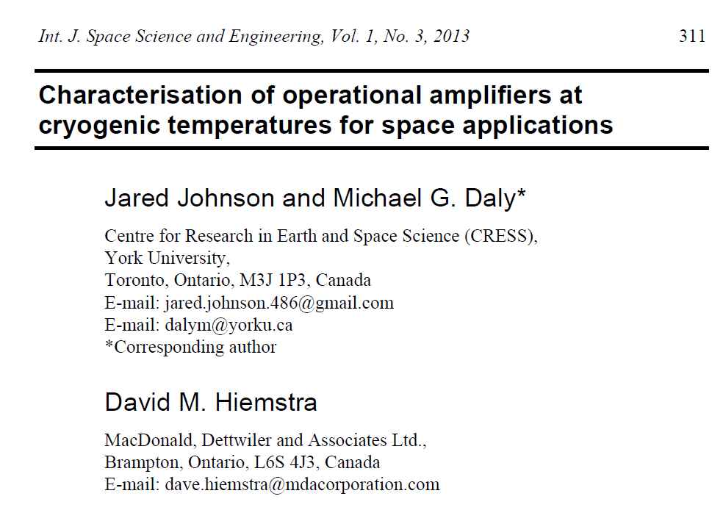
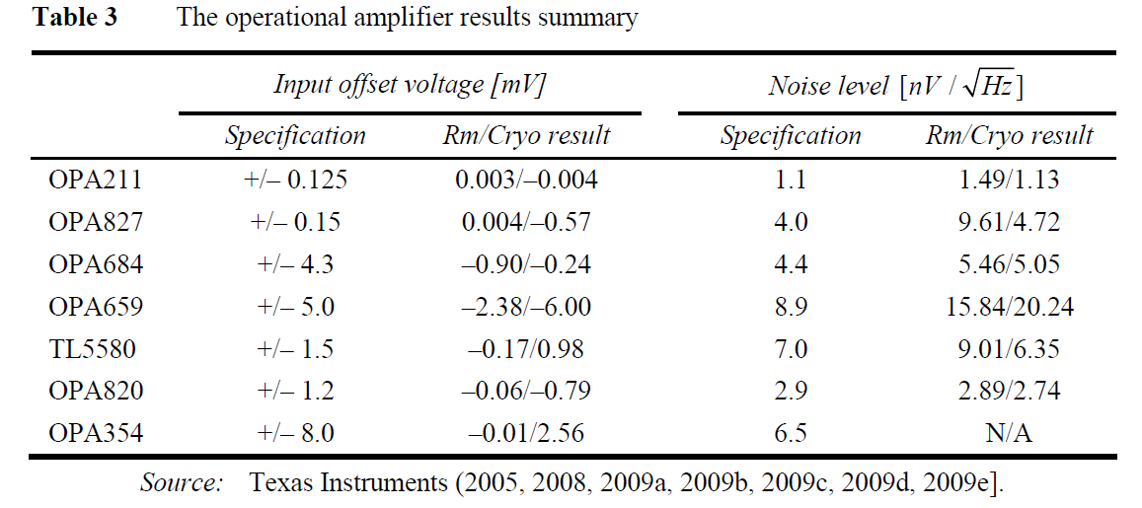
Choice of op-amp (2)
Choice 2: OPA211 (Texas Instruments)
  Bipolar, low input voltage noise
  Operates normally at 77K

Slide 12
Choice of ADC
Instrumentation group has experimentally studied the performance of several ADCs at 77K for the short-baseline neutrino detector (SBND) project.
  The AD7274 (Analog Devices) ADC was selected and tested at 77K and is currently in wide use within LAr at 85K.
  Easy to use, up to 3 Ms/s, 3-wire serial output (SPI), V_{DD} = 3.3V (nominal).
  Good choice for this project.

Slide 13
Choice of capacitive digital isolator
Many variants are commercially available.
Examples:
  OnSemi NCID9400 (quad-channel, up to 10 Mb/s, 5 kV isolation).
  Texas Instruments ISO772x-Q1 (dual-channel, up to 100 Mb/s, 5 kV isolation).
Performance at 77K is not tested yet.

Slide 14
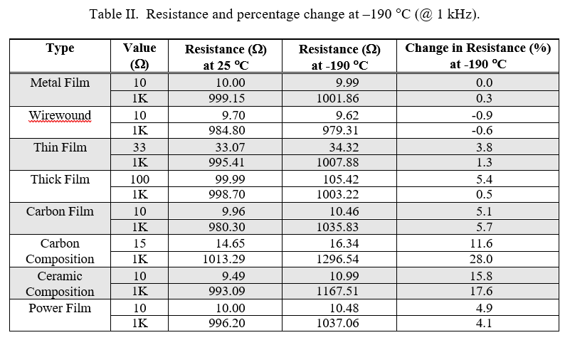
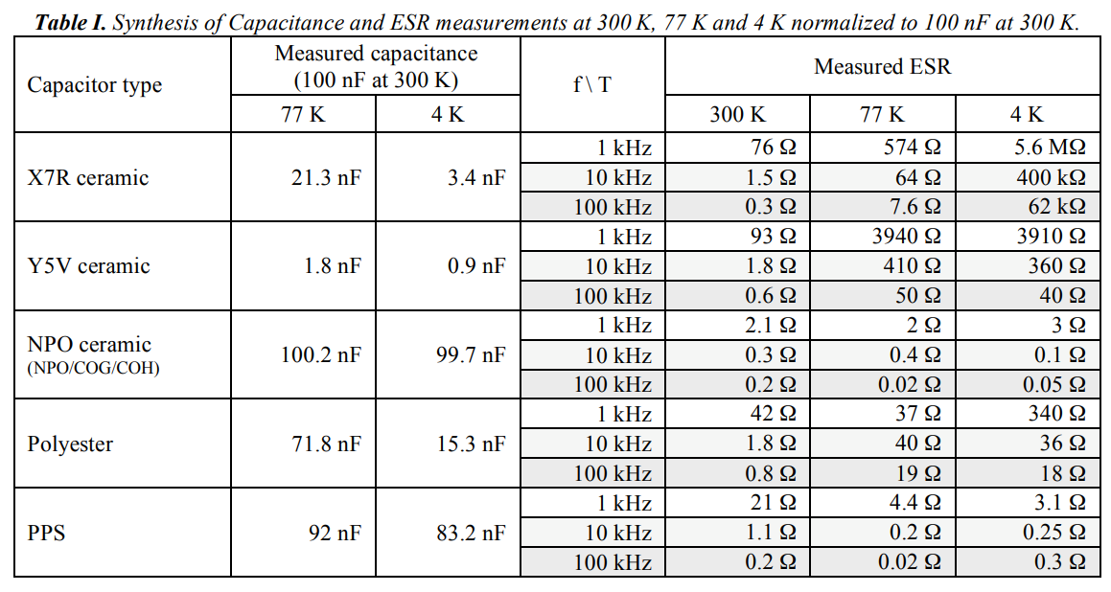
Choice of passive elements
NPO capacitors found to show very little change in capacitance and effective series resistance (ESR) down to 4 K.
Metal film resistors found to show excellent stability in resistance down to -190ºC (83K).
F. Teyssandier, D. Prêle. “Commercially Available Capacitors at Cryogenic Temperatures.” Ninth International Workshop on Low Temperature Electronics- WOLTE9, Jun 2010, Guaruja, Brazil.
R. Patterson, A. Hammoud, and S. Gerber. “Performance of Various Types of Resistors at Low Temperatures.” Test Report, August 2001, NASA Glenn Research Center, Cleveland, Ohio.

Slide 15
Development of cold harmonic coils
PCB based Harmonic coil
  (similar to concept from Joe DiMarco)
Compatible at <4 K
Harmonic coil rotating in liquid Helium
Improved measurement precision with reduced thermal noise
Exploring adding of cold amplifier on PCB for enhanced measurement precision
Cryogenic feedthrough for overlapping measurement
Using existing facilities to study deviation of warm to cold measurement
Initially use of motor in warm, transplanting motion through cold feedthrough and cold sliprings.

Slide 16
Concept
Motor
Slip-ring and Feed through
Cascading of coils to cover large magnets
Magnet Coils
PCB based rotating coil
Warm Measurement
Cold Measurement

Slide 17
Project Stages
Calibration of developed PCB coil in BNL harmonic coil Calibration facility
Cross calibration of developed PCB coil using pre-calibrated coil (AUP harmonic coil) in 1 meter Quadrupole magnet
Warm to cold measurement deviation in 1 meter Quadrupole magnet
Noise floor measurement
Development of cold amplifier
Cascading PCB coils to cover long magnets

Slide 18
Summary
Quench detection at very low half coil voltage difference threshold (sub millivolt) requires QD to be located very close to magnet inside the cryostat
Initial attempt will be to assemble 77k quench detector using off-the–self components and components validated by BNL’s Instrumentation department for LAr detector.
Test the Cryogenic QD for very low threshold on HTS coil (heater induced quench)
Assemble 4.5K QD using FPGA embedded in the 4.5K cryostat. Some validation of FPGA operation at 4.5K is done by BNL’s IO Dept.
Assemble rotating coil (PCB) system to operate in liquid helium (No warm bore tube)

Slide 19
Extra slides

Slide 20
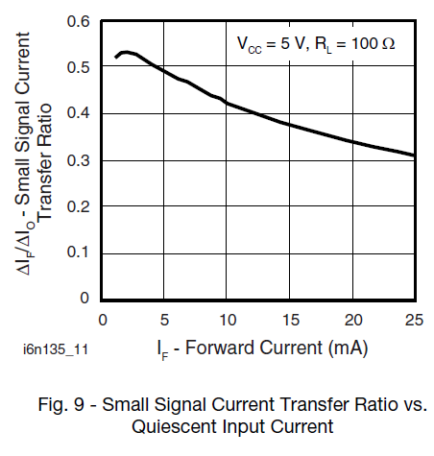
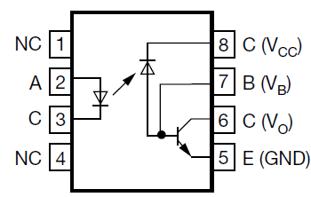
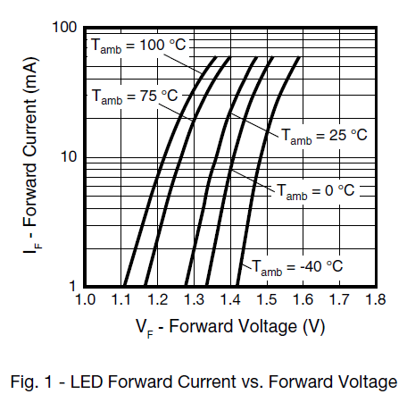
Choice of optical isolator (2)
Small-signal input-output gain (known as the current transfer ratio or CTR) is a function of both bias current and temperature and needs to be calibrated.
Option 1: 6N135 (Vishay)
  Small-signal bandwidth = 2 MHz
  Maximum data rate = 1 MBd
  Isolation voltage = 5.3 kV

Slide 21
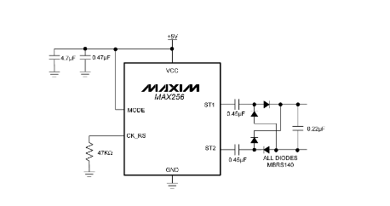
Capacitor coupled PS
Vout=3.7V

Slide 22
Guidelines
When summarizing the status of the R&D topics, please consider:
  issues encountered over the last year and proposed solutions (lessons learned).
    Performed LTS/HTS hybrid common coil test. Achieved 8.7 T combined in one configuration and xx T in other configuration.
    Encouraging test results => increase number of turns in insert
    Useful results from magnetization studies => ramp rate dependence not studied + increase the scale ?
    Challenges encountered in HTS manufacturing with wet winding technique => improve manufacturing ?
  current or upcoming milestones (next 6-8 months) – can they be met? If not, what are the obstacles to progress?
    Upcoming STTR coil test => increase combined hybrid common coil magnetic field to 13-14 T => doable => quench protection remains concern.
  Identifying near and mid-term conductor needs to provide guidance to the CPRD group.
    3m to 4m of CORC for quench studies
For the discussion:
  Identifying R&D issues.
    Quench detection techniques, Cold electronics, magnetization studies, conductor performance, mechanical degradation studies
  Discussing challenges, if any, in meeting the milestones.
    New technology
  Again, addressing conductor needs for the next two years.
    HTS tapes for bent racetrack samples (corc, single tape) for quench detection, magnetization studies, conductor performance, mechanical degradation studies

