Slide 1
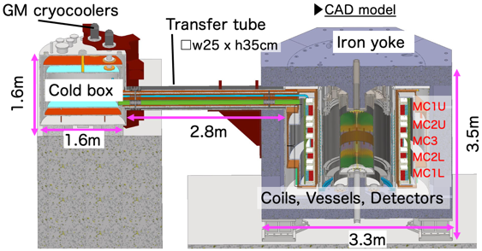
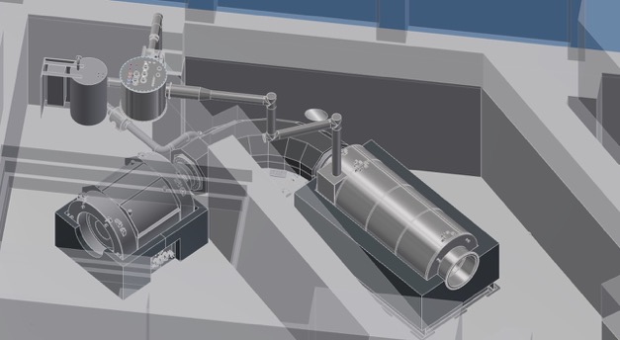
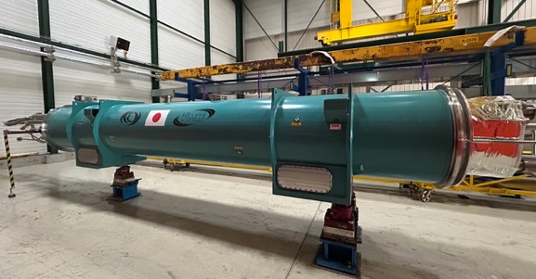
KEK Cryogenics Science Center
High Precision
J-PARC g-2/EDM
High Radiation Hardness
J-PARC COMET
High Field
HL-LHC D1

Slide 2
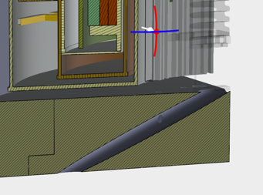
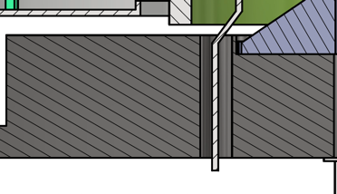
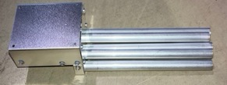
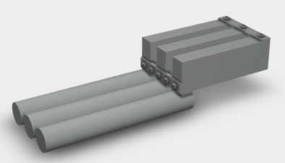
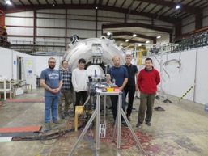
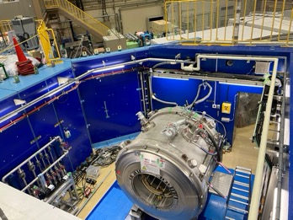
Superconducting Magnet R&D for g-2/EDM experiment, MuSEUM experiment
g-2/EDM Superconducting Magnet System
Muon Storage Solenoid with high precision magnetic field extending MRI technologies
  Yoke design modification was just started for kicker coil power line optimization
Straight hole
Precision magnetic field measurement system
Tilted hole
NMR magnetic field measurement system with ultra high accuracy of a couple of ppb -> Making new design
  To cancel RF interference btw probes, they should be covered by Al shield box separately.
International collaboration with FNAL and ANL
  Cross calibration of NMR probes, that are individually developed : -> Increase validity
Previous prototype
New design of field mapping system
Preparation of MuSEUM experiment
Cross calibration between US and JP probes
Muonium hyper fine structure measurement in J-PARC
  Experimental area (H1) is ready in Nov. 2023
  Magnet was moved to the area, and ramped up.
  Plan
    Shimming work : Mar. 2024
    Beam run : Apr. - Jun. 2024
MRI magnet in H1 area

Slide 3
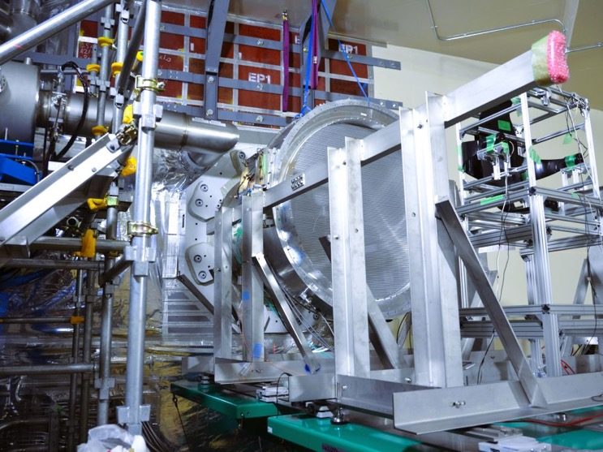
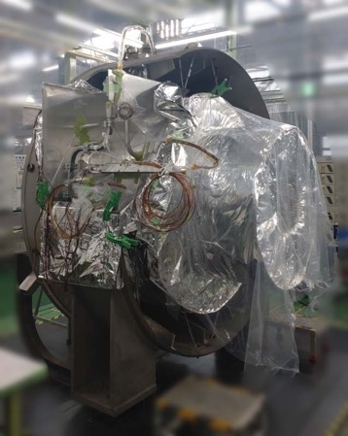
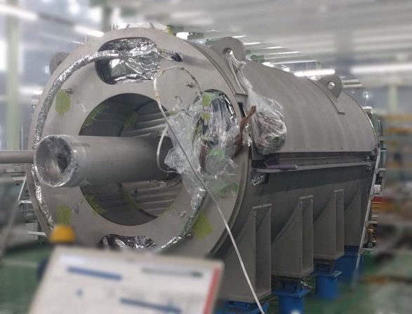
COMET magnet system
COMET Phase-α operation
  Inject J-PARC’s proton beam to the COMET beamline
    Without capture solenoid
  Four excitation runs,
    Three with the dipole negative pole (Negative muons enhanced)
    One at the positive pole (Positive muons).
  Profile on the beam transported by the TS
  Succeeded in observing muon beams transported by the TS
Capture Solenoid Construction
  Under Assembly at Mitsubishi Electric
  Electric failure of CS coldmass arose has been repaired
  Assembly of CS and TS1 subassemblies is complete
  (Coil connection, piping, radiation shield assembly, vacuum vessel assembly, etc.)
  Final magnet assembly underway
CS coil
BS 磁石
TS1 subassembly
CS subassembly
Notes:
For radiation hard technologies, the construction of superconducting magnets for the muon-to-electron conversion search experiment (COMET) is underway and developed into the rad-hard superconducting magnet technology for future large-intensity accelerator applications, including the MLF second target station.
For COMET, the construction of capture solenoid is underway. due to the electric failure found in a coil the schedule is delayed. The construction of transport solenoid is almost completed and cold test was performed. Although there are some issues with mechanical structure was found the issue was resolve with additional supports. Field measurement was also performed and the results were satisfactory,
For rad-hard superconducting magnet technologies, various studies such as studies of radiation hardness of various magnet materials including superconductors, and development of rad-hard insulation technologies are underway in a collaboration with some US and Japanese institutes. (LBNL, BNL, UC Berkeley, and Kyoto Univ.)

Slide 4
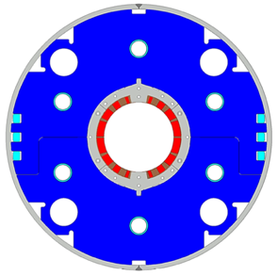
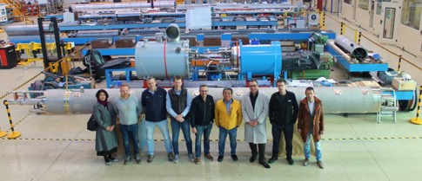

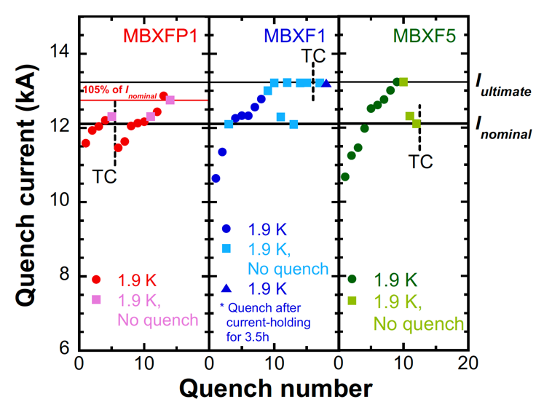
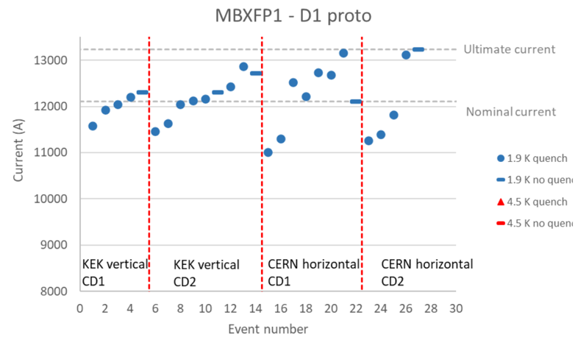
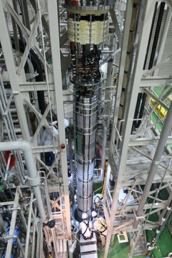
HL-LHC D1 magnet construction
New beam interaction region SC magnet system for HL-LHC
Beam separation dipole (D1) by KEK
  Design study of D1 for HL-LHC within the framework of the CERN-KEK collaboration since 2011.
  150 mm single aperture, 35 Tm (5.6 T x 6.3 m), Nb-Ti technology.
  Development 2-m long model magnets (3 units) at KEK
Deliverables for HL-LHC
  1 full-scale prototype cold mass (LMBXFP)
  6 series cold masses (LMBXF1-6)
So far, 3 magnets have been tested at KEK.
  2 series magnets (MBXF1&5) successfully demonstrated to reach the ultimate current of 13.2 kA (108% of nominal current).
First D1 prototype (MBXFP1) was delivered to CERN (April, 2023) and the cold test is underway in horizontal cryostat.
MBXFP1 was stably operated at the ultimate current for 8 hours.

Slide 5
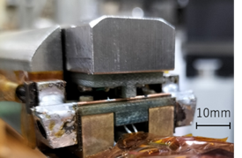
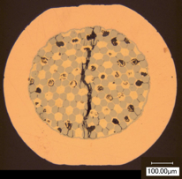
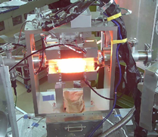
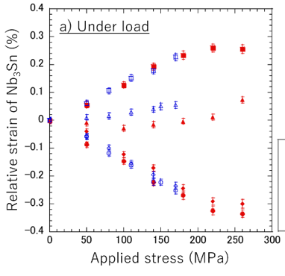
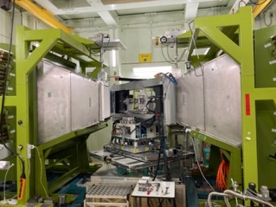
R&D of Nb3Sn conductor for future high field accelerator magnet
Nb₃Sn conductor development for FCC
in collaboration with CERN
Characterization of Nb₃Sn conductors
Degradation by transverse compressive stress
Achievement in the R&D of the 1st phase (2017~2022)
Compression
φ1.0 mm
Compressive
stress
DT wire with J_{c}=1100 A/mm²
non-Cu J_{c}>1100 A/mm²
at 4.2 K, 16 T
Stress limit
Nb₃Sn wire
40%
Neutron diffraction experiments
with Cu-Nb reinforcement
without reinforcement
Radial perpendicular
to the loading axis
• J_{c} improvement by 40% in the Distributed-Tin wire
• Fabrication of short Rutherford cables
Axial
Targets in the R&D of the 2nd phase (2024~2027)
• Longer piece length with J_{c} sufficient for 12T magnet
• Enhancement of J_{c} towards 1500 A/mm² at 4.2K, 16 T
• Mechanical reinforcement for transverse compression
Radial along
the loading axis
J-PARC/MLF
BL19(TAKUMI)
In-situ internal strain measurement
under transverse compression
Lattice spacing (Å)
Phase evolution during HT

Slide 6


UNIVERSITY OF
CALIFORNIA
A collaboration framework to advance high-temperature superconducting magnets for accelerator facilities
A proposal to the U.S.-Japan Science and Technology Cooperation Program in High Energy Physics
Toru Ogitsu¹ and Tengming Shen² for the project team
KEK, 2. Lawrence Berkeley National Laboratory,
Kyoto University, Brookhaven National Laboratory & UC Berkeley

Slide 7
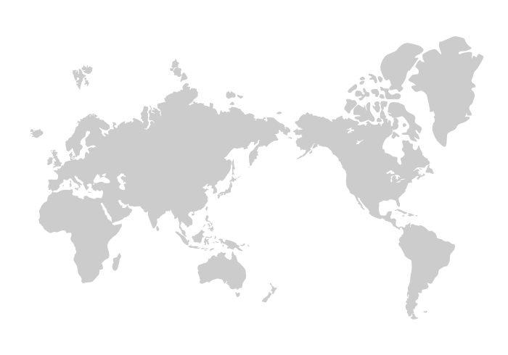
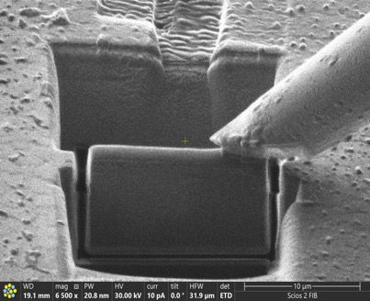
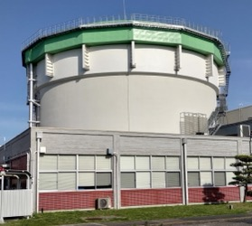
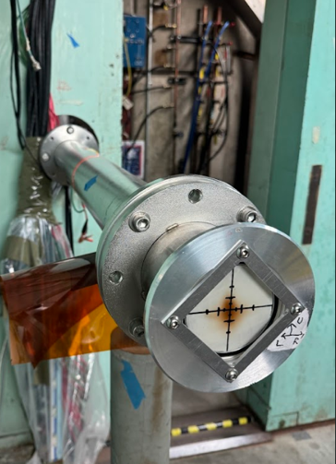
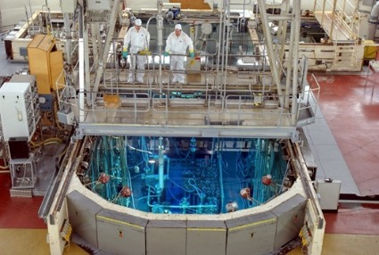
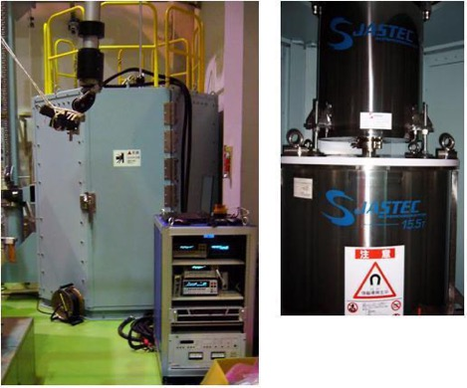
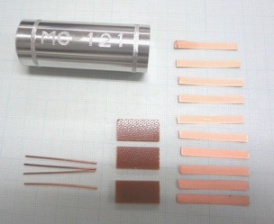
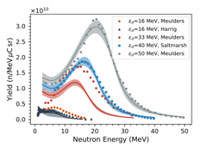
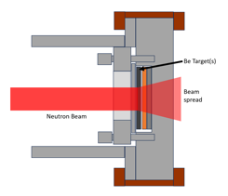
Task 1: Irradiation Test of HTS Conductors
UC Berkeley Hot-Lab
FIB-SEM, TEM
JAEA:JRR3
GdBCO
EuBCO
YBCO
Irrad. Samp
IrSmp
UC Berkeley
LBNL
BRR3
KEK
LBNL
88”Cyclotron
Irradiation Sample
Tohoku U. Oharai Center
Hot-Lab 15T Ic Meas. Inst.
Irrad. Samp.
GdBCO
w/wo shield

Slide 8
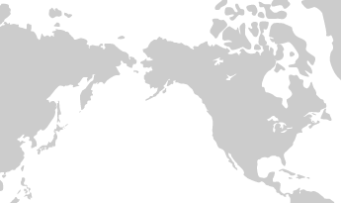
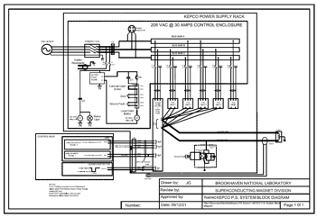
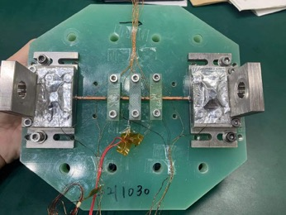
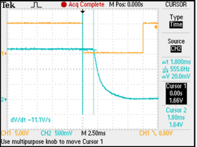

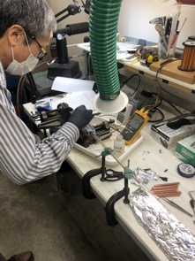
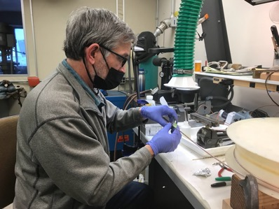
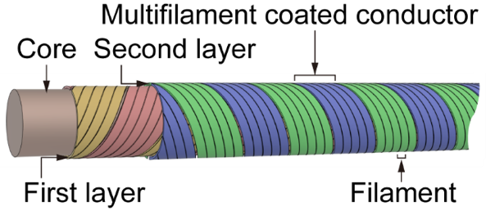
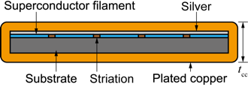
Task 2: Quench Stability and Protection of Spiral conductors
Short sample test stand at Kyoto U.
Quench detection
system at BNL
Advanced quench protection technologies
KEK
Advanced quench protection technologies
BNL
LBNL
Student and Technology Exchange
Kyoto
Univ.
SCSC Cable developed by Kyoto U.

Slide 9
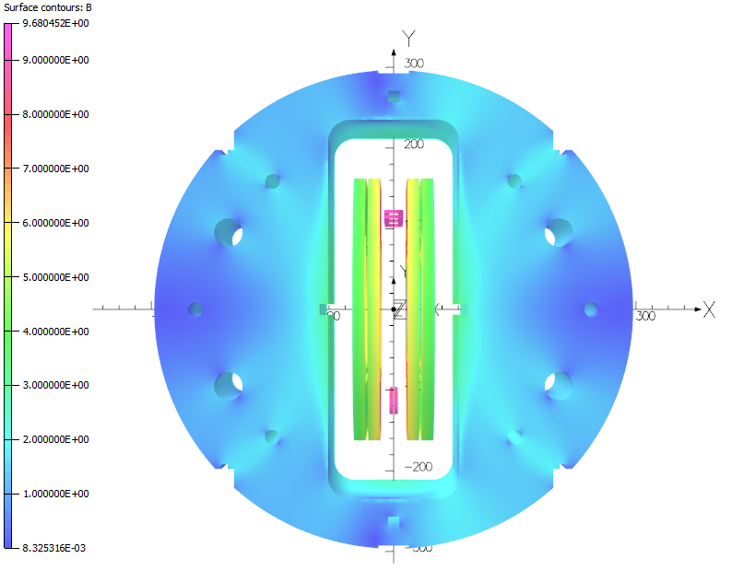
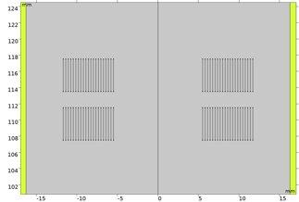
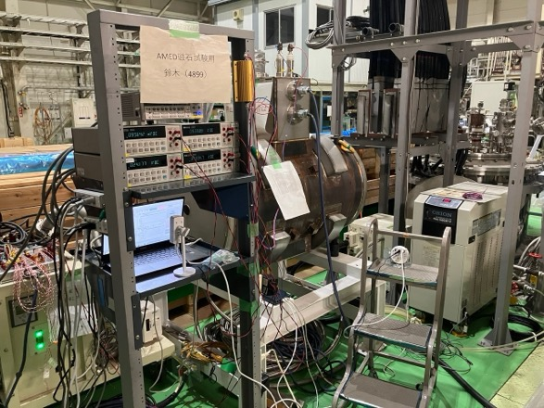
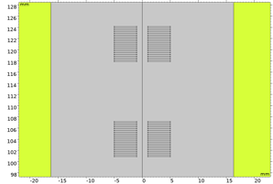




Task 3: AC Loss and Field Quality of HTS magnet
REBCO (flat racetrack) coils
CT1 Magnet Excitation Test Set Up
Nb₃Sn coils
$${\vec{B}}_{ext}$$
$${\vec{B}}_{ext}$$
$${\vec{B}}_{ext}$$
$${\vec{B}}_{ext}$$
Field Simulation of Task 4 coil test
KEK
Student and Technology Exchange
LBNL
Kyoto Univ.
AC Loss computation of SCSC Cable

Slide 10
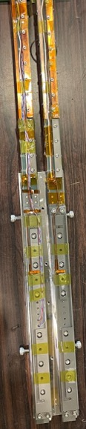
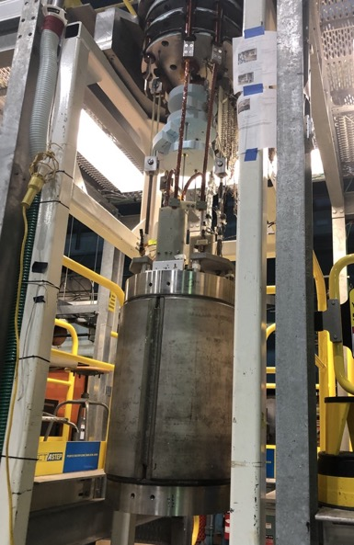
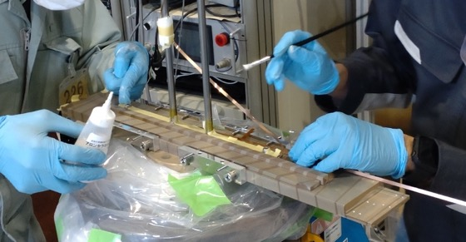
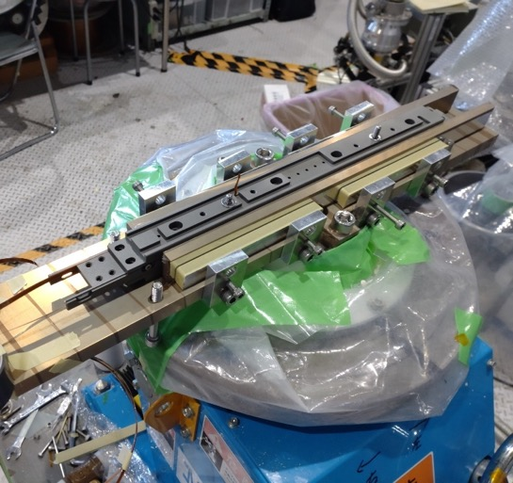
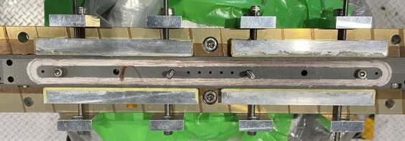
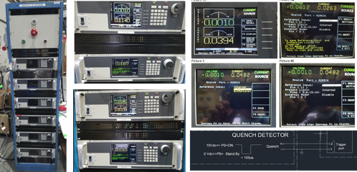
Task 4: HTS/LTS high field hybrid accelerator dipole
HTS Racetrack coil with Inorganic Insulation
Insert Coil
10T Test Magnet
KEK
BNL
Bipolar Power Supply

Slide 11
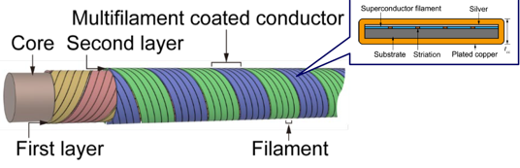




Task 4; FY2024-2026
Taking advantage of successful achievements with SCSC cable by Kyoto U. in Task 2 and 3 (with external funding)
Develop 2 types of test racetrack coils
1 SCSC coil
2 CORC coil (CORC is SCSC like but without striation)
Test these coils at BNL 10T test stand
Compare field error associated with shielding current
And mechanical properties of cables.
SCSC Cable
CORC Cable

Slide 12
Other Developments
J-PARC Hadron E80 Experiment Detector Solenoid
  Construction & Development Support
J-PARC MLF Second Target Muon Capture Solenoid
  Design Study R&D Support
    High-Rad HTS Magnet R&D
Super KEKB QCS Upgrade (FNAL-KEK Collaboration)
  R&D Support
    Quench Protection Study for High Current Density SCM
PF Superconducting Multi-Wiggler
  R&D Support
    Quench Protection Study for High Current Density SCM
And more..
  US-JP with FNAL, TUAT and Tokyo U. : IBS development
  CERN-KEK: Revive Aluminum Stabilized NbTi Conductor
MLF Second Target Muon Capture Solenoid
SuperKEKB QC1P

Slide 13
Resources and Collaborations
Collaboration
Concurrent appointments
ACC(Tsukuba)
ARL
IPNS
SuperKEKB
RSC
MEC
HL-LHC D1 etc
HL-LHC D1 Detector SCM Rad-Hard SCM
ITDC
QCS
CRC
PF
Cryogenics Science Center (CSC)
Researcher: 7
Technical Stuff: 7
J-PARC
Multi-Wiggler
Cryogenics Section
iCASA
ILC SCM etc
g-2/EDM COMET etc
High Field, Rad-Hard SCM
Detector Solenoid etc
External Collaborators
Tokyo U.
Tohoku U.
Tokai U.
CERN
FNAL
Kyoto U.
TUAT
NIMS
LBNL
BNL

Slide 14
Summary
User Support
  Cryogen Supply: ~140kL Liq. He (90% recovery rate)
  SCM System Operations at J-PARC: no trouble
  Construction and Development of SCM: HL-LHC D1, COMET, g-2/EDM, E80
  R&D support for SCM: SuperKEKB QCS, PF Multi-wiggler, J-PARC Second Target Capture Solenoid, etc…
R&D for future programs
  High Field Rad-hard SCM: CERN-KEK, US-Japan, JSPS, etc
Resources and Collaborations
  Try to compensate resource shortage by widening collaborations

