Slide 1
Aligning MDP with P5 Priorities
Steve Gourlay
US Magnet Development Program
Fermilab

Slide 2
P5 Takeaways
Sustainability will be very important
Recommendations dependent on magnet technology
  Off-shore Higgs Factory, i.e. FCC-ee
  Vigorous R&D toward a cost-effective 10 TeV pCM collider
    Focus is on a major international collider facility in the US – Muon Collider
    Goal of being ready to build major test facilities and demonstrator facilities

Slide 3
P5 Takeaways
The US should participate in the International Muon Collider Collaboration (IMCC) and take a leading role in defining a reference design. We note that there are many synergies between muon and proton colliders, especially in the area of development of high-field magnets. R&D efforts in the next 5-year timescale will define the scope of test facilities for later in the decade, paving the way for initiating demonstrator facilities within a 10-year timescale (Recommendation 6).
Proposed Demonstrator facilities will be for a Muon Collider
Only option for an energy frontier machine in the US

Slide 4
P5 Takeaways
Convene a targeted panel with broad membership across particle physics later this decade that makes decisions on the US accelerator-based program at the time when major decisions concerning an off-shore Higgs factory are expected, and/or significant adjustments within the accelerator-based R&D portfolio are likely to be needed. A plan for the Fermilab accelerator complex consistent with the long-term vision in this report should also be reviewed.
The panel would consider the following:
The level and nature of US contribution in a specific Higgs factory including an evaluation of the associated schedule, budget, and risks once crucial information becomes available.
Mid- and large-scale test and demonstrator facilities in the accelerator and collider R&D portfolios.
A plan for the evolution of the Fermilab accelerator complex consistent with the long-term vision in this report, which may commence construction in the event of a more favorable budget situation.

Slide 5





HEP Future Facility Landscape
HL-LHC
81 - 115 TeV, 14 - 20T
CERN Council Decision on FCC
June 2026
yes
FCC-ee
FCC-hh
no
Lower cost e⁺e⁻ or muon collider if mature enough
Linear Collider
“Targeted Panel”
USMC
Muon Collider
3 TeV or 10 TeV Low Luminosity
10 TeV Muon Collider
US MCC
IF
Then?
Or?
Decision still pending
Decision in 2026
“Fast” FCC-hh
2020
2030
2040
2050
2060
2070
2080
2090

Slide 6
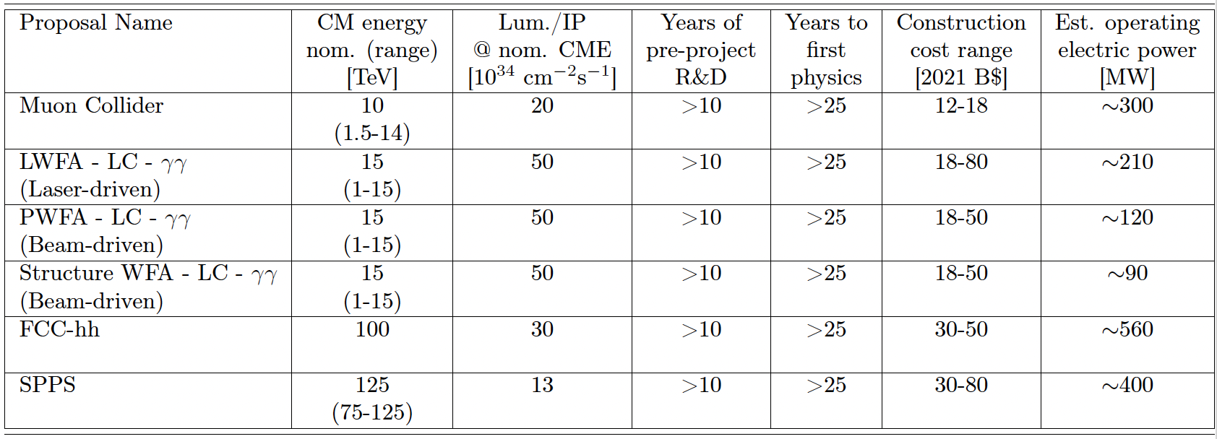
Summary of colliders with high parton CM energy
(from the Snowmass ITF)

Slide 7
Framework based on constraints
CERN needs to do something for the future
  Must avoid a significant gap between operational facilities
HE-LHC not on the table. Would be relatively short term, so at best 16T magnets “might” be ready in time. This is only a 50% increase in energy
LEP3 being explored, but not very seriously (e⁺e⁻ in LHC tunnel)
Cost – capital and operational (energy consumption)

Slide 8
New environment should influence program priorities
Focus on Impact
Prepare for “Targeted Panel” later this decade to make decisions on the US accelerator-based program – coincident with decisions on off-shore Higgs factory
  Also, a review of a plan for the Fermilab accelerator complex consistent with the long-range vision – Muon Collider?
Cost reduction at this point is premature – need to have a robust platform to start with
Workforce development should be an explicit component of our program

Slide 9
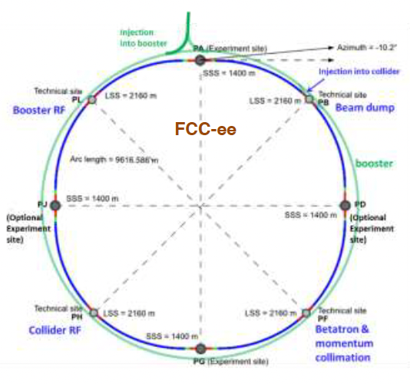
FCC-ee
Stage 1 of the Future Circular Collider (FCC)
  e⁺e⁻ Higgs factory, electroweak and top factory
  Two 90.7 km rings and booster in the same tunnel
  240MW power consumption at Higgs (240 GeV)
  357 MW @ tt-bar
Proposed US Magnet Scope
  IR magnets and cryostats (4 IRs)
  Low field collider and booster ring magnets
  FCC-hh collider ring magnets

Slide 10
CERN Future Circular Collider - hh
  Re-use FCC-ee tunnel, high luminosity, LHC experience
CERN
CERN
CERN
100 TeV, 16 T magnets, 100 km
100 TeV, 17.8 T magnets, 91 km
80 TeV, 14 T magnets, 91 km
50mm, Nb₃Sn, HTS?
50mm, Nb₃Sn, HTS?
50mm, Nb₃Sn, HTS?
Huge power consumption (560 MW) with Nb₃Sn, may need to develop HTS @ 20K

Slide 11
FCC-hh
High Field magnets 14 – 20T
Power load (synch rad) on cold vacuum chamber 4 MW (X10³ higher than LHC)
Stored beam energy 9 GJ (X10 higher than HL-LHC)
ITF cost range 30 – 50 B$ w/o contingency, escalation
Power consumption 4 TW-hr/year
MDP contribution
  Robust, Nb₃Sn dipoles
  FCC not helped by 20T
    Cost with Nb₃Sn at 14T is already a concern – 20T won’t be less expensive
    No amount of value engineering will make it affordable
    And no arguable reason for higher energy exists at this point to make it worth the extra cost
  HTS for reduced power consumption and IRs (2212 for large bore/high gradient)

Slide 12
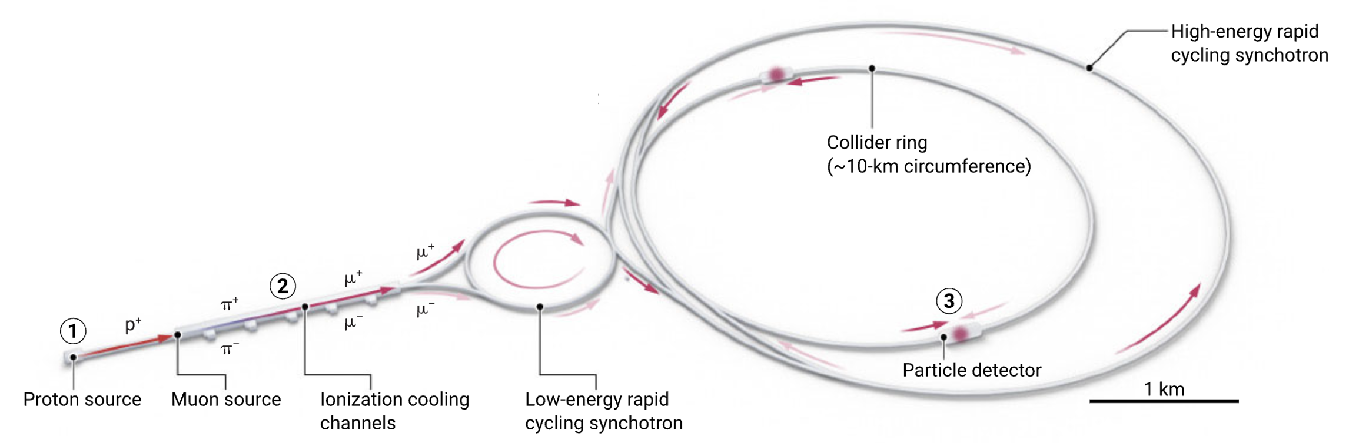
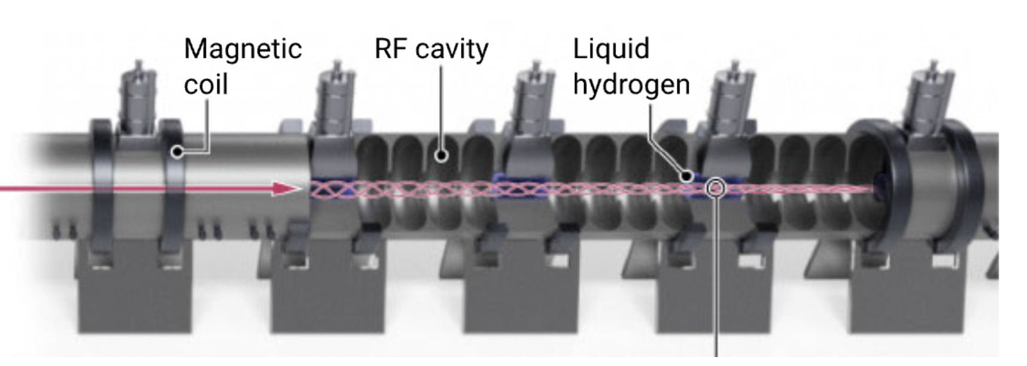
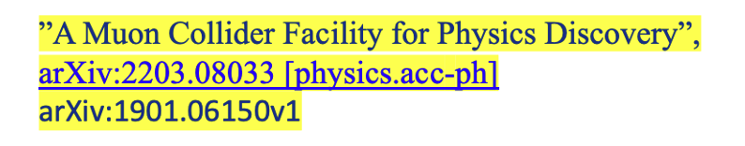
Muon Collider
Only option for US energy frontier facility
Proposal with the broadest physics reach
  Most challenging technically
    But others have significant challenges
  Lowest power/luminosity
  Smallest footprint
Cooling Channel
https://www.science.org/content/article/muon-collider-could-revolutionize-particle-physics-if-it-can-be-built

Slide 13
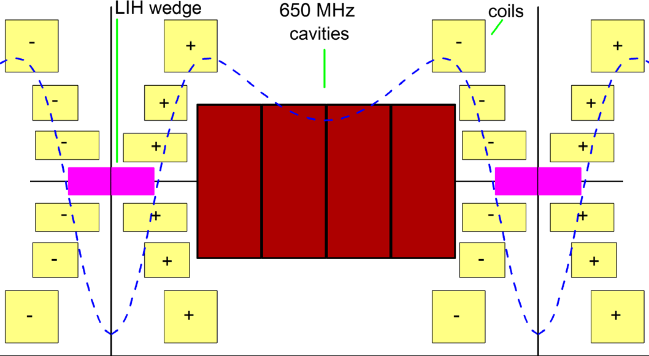
Possible path to a Muon collider
P5 – Plan for Demonstrator within 10 years
Under discussion
  Start with 1.5 Cell cooling channel
    14T Nb₃Sn solenoids, RF, absorber
In parallel, MDP development of high field HTS solenoid technology
  This is essential for Demonstrator
Also consider high radiation environment, operation at 20K
Directed R&D
Take note:
US Muon Collider Collaboration Meeting at FNAL August 7 – 9, 2024
IMCC Demonstrator Workshop at FNAL September 23 – 24, 2024

Slide 14
How can MDP impact near-term decisions and provide a foundation for directed R&D?
Some possibilities
Near-term impact (2 – 5 years)
  Robust, large bore Nb₃Sn 12 – 14T dipole based on SMCT and/or CCT
    Relevant to Muon Collider
    Restore confidence in Nb₃Sn – potential impact on FCC-hh
  Solve some fundamental problems with REBCO using small solenoids
    Learn more, faster and lower cost than hybrid
    Explore cable geometries
  Low-field HTS-driven collider and booster ring dipoles for FCC-ee
Tune in to the HEPAP meeting next week
to hear OHEP P5 response
  Nice work, but . . .
  20T is a distraction and a dilution of our limited resources – and no impact
  On the contrary, a mixed outcome could have negative impact
  Wrap it up, put a bow on it, and move on

Slide 15
Synergies with FES and other HEP programs
Excellent opportunities to enhance complementarity with fusion magnet technology
Despite what private companies say, there is lots of work to do on REBCO
Contributions to fusion magnet technology development from the public sector (Labs, Universities) include:
  Fundamental technology development
  New cable geometries
  Test facilities
  Workforce development
  Simulation and validation
  Cross-cutting research
  Providing tools for the community
  Create a technological foundation through peer-review
HEP
HTS Solenoids for Muon Collider
and Dark Matter Searches

Slide 16
Longer-Term Vision (5 – 20 years)
Let’s view the future with optimism
Increased GARD budget and directed R&D programs
This would be time to look at . . .
  High field Solenoids
  Value engineering of Nb₃Sn based on development of reliable platform
  IR quads
  Dipoles with B > 14T (large and small bore)

Slide 17
General Observations
  Tests are few and far between
    More interlab participation
  Consolidate parallel development efforts– lots of ways to increase efficiency
  Transition more mature diagnostic techniques from R&D to tools
  Good to see groups working together on SMCT

