Slide 1
MDP 2024 Collaboration Meeting
Planning the update of our Roadmaps following P5
Soren Prestemon
US Magnet Development Program
Lawrence Berkeley National Laboratory

Slide 2
Our structure was revised with the 2020 Updated Roadmaps
  Current Strategic Priorities:
  Probing stress management structures
  Hybrid HTS/LTS designs
  Understanding and impacting the disturbance-spectrum
  Advancing both LTS and HTS conductors, optimized for HEP applications

Slide 3
P5 identified 10 pTeV colliders for the energy frontier
Colliders
Higgs factories
10 pTeV energy frontier
SC Magnets for IRs, misc.
Not a driver for magnet R&D
Muon collider
Hadron collider
These opportunities serve as drivers for magnet R&D

Slide 4
Identifying focal points, priorities, and synergies
We remain a GARD program, i.e. our focus is on “generic magnet R&D”
Cost
Performance
Sustainability

Slide 5
Schedule for updating our roadmaps

Slide 6
Background

Slide 7
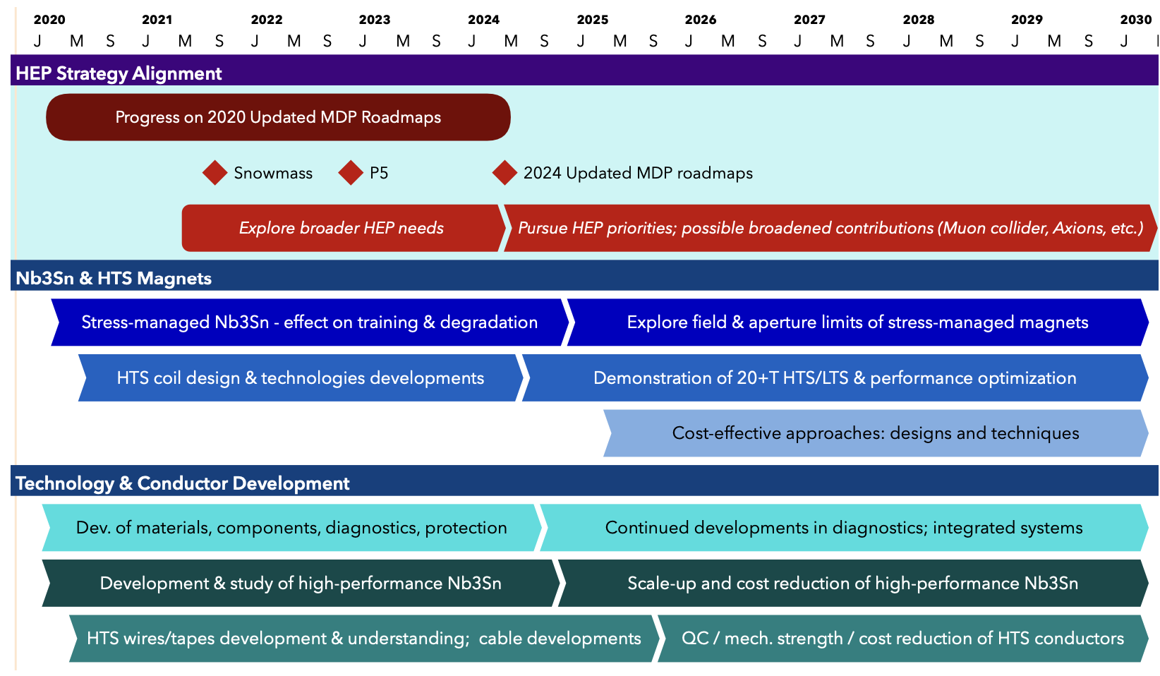
US MDP 2020 roadmaps – long range – time for an update!
Continue alignment with physics community needs
Focus on “stress-management” as well as hybrid HTS/LTS magnet technology
Continue to invest in the “science of magnets” and in improved conductors

Slide 8
Driving considerations in magnet R&D focus
The Muon collider is the only collider with “on-shore” potential
Both Muon and hadron colliders absolutely depend on magnet developments
The Muon collider requires some use of HTS
Both machines will be challenged by construction and operational costs
As part of this initiative, we recommend targeted collider R&D to establish the feasibility of a 10 TeV pCM muon collider. A key milestone on this path is to design a muon collider demonstrator facility.
Support vigorous R&D toward a cost-effective 10 TeV pCM collider based on proton, muon, or possible wakefield technologies, including an evaluation of options for US siting of such a machine, with a goal of being ready to build major test facilities and demonstrator facilities within the next 10 years
Although we do not know if a muon collider is ultimately feasible, the road toward it leads from current Fermilab strengths and capabilities to a series of proton beam improve- ments and neutrino beam facilities, each producing world-class science while performing critical R&D towards a muon collider. At the end of the path is an unparalleled global facility on US soil. This is our Muon Shot.

Slide 9
The P5 recognized commonality in 10pTeV collider R&D
Parallel to the R&D for a Higgs factory, the US R&D effort should develop a 10 TeV pCM collider, such as a muon collider, a proton collider, or possibly an electron-positron collider based on wakefield technology. The US should participate in the International Muon Collider Collaboration (IMCC) and take a leading role in defining a reference design.
We note that there are many synergies between muon and proton colliders, especially in the area of development of high-field magnets. R&D efforts in the next 5-year timescale will define the scope of test facilities for later in the decade, paving the way for initiating demonstrator facilities within a 10-year timescale (Recommendation 6).
Hadron collider magnet R&D
Muon collider magnet R&D
High field dipoles
Sustainability

Slide 10
Sustainability is a major concern for future colliders
Accelerator technologies play a key role in sustainability. Investments in high field magnets by the DOE Magnet Development Program and NSF’s MagLab have advanced the state of the art in conductors and magnet design to the benefit of particle physics, but also materials science, fusion energy research (FES), and commercial development. In this context, high temperature superconducting materials, operated at temperatures higher than superfluid or liquid helium, can play a key role in reducing energy consumption e.g. for future colliders including muons or FCC-hh.
This roadmap relies on the design and construction of accelerators and detectors at the forefront of particle physics. The technology choices for achieving the Higgs factory and 10 TeV pCM collider goals need to be determined based on technical feasibility, cost-effectiveness, host site capacity, sustainability, and synergies with the demands of other science topics.
Other new technologies such as muon and possibly wakefield colliders have potential to improve power required for a given luminosity and reduce the size and impact of future facilities. Innovation in electric power generation, management and distribution also contribute to sustainable development and shall be encouraged.

Slide 11
Cost is a driving, and likely decisive, factor in a future collider
The panel recommends dedicated R&D to explore a suite of promising future projects. One of the most ambitious is a future collider concept: a 10 TeV parton center-of-mo- mentum (pCM) collider to search for direct evidence and quantum imprints of new physics at unprecedented energies. Turning this concept into a cost-effective, realistic collider design demands that we aggressively develop multiple innovative accelerator and detector technologies. This process will establish whether a proton, electron, or muon accelerator is the optimal path to our goal.
We do not yet have a technology capable of building a 10 TeV pCM energy machine, but the case for one is clear. Extensive R&D is required to develop cost-effective options. Possibilities include proton beams with high-field magnets, muon beams that require rapid capture and acceleration of muons within their short lifetime, and conceivably electron and positron beams with wakefield acceleration.
The technology choices for achieving the Higgs factory and 10 TeV pCM collider goals need to be determined based on technical feasibility, cost-effectiveness, host site capacity, sustainability, and synergies with the demands of other science topics.

Slide 12
Recap of our MDP vision and goals
Maintain and strengthen US Leadership in high-field accelerator magnet technology for future colliders
Focus on the four primary goals identified in the the original MDP Plan
  Explore the performance limits of Nb₃Sn accelerator magnets, with a focus on minimizing the required operating margin and significantly reducing or eliminating training
  Develop and demonstrate an HTS accelerator magnet with a self-field of 5T or greater, compatible with operation in a hybrid HTS/LTS magnet for fields beyond 16T
  Investigate fundamental aspects of magnet design and technology that can lead to substantial performance improvements and magnet cost reduction
  Pursue Nb₃Sn and HTS conductor R&D with clear targets to increase performance and reduce the cost of accelerator magnets
Further develop and integrate the teams across the partner laboratories and Universities for maximum value and effectiveness to the program
Identify and nurture cross-cutting / synergistic activities with other programs to more rapidly advance progress towards our goals

Slide 13
Our Program was initiated as a result of the 2013 P5 report
Strategic priorities for the current plan:
  Probing stress management structures
  Hybrid HTS/LTS designs
  Understanding and impacting the disturbance-spectrum
  Advancing both LTS and HTS conductors, optimized for HEP applications
Message from last MDP CM: Need to increase focus on hybrid magnets
- Intrinsically connects the core program priorities

Slide 14
Goals for the collaboration meeting
Related to program roadmap:
  How have we progressed towards program milestones? Are the milestones still appropriate?
  What issues jeopardize success? How can we address them?
  What challenges were encountered over the last year? What lessons were learned?
Related to collaboration functioning:
  Where do we see opportunities to improve, e.g.
    Communication & coordination (e.g. within Areas, between Areas, with ”G7” management team)
    Leveraging of infrastructure; investment in, and development of, infrastructure, etc.
  What appears to be working well? How can we build on that?
  Are there lessons-learned that can/should influence how we collaborate more broadly, e.g. with HFM?
Related to long-term planning:
  Lets clarify the process to develop our updated roadmaps – goal is new document before end of 2024!
  How can we best impact HEP goals and strategic plans?

