Slide 1


MQXFA13b
Coil Pack and Shimming Proposal
Using Coil 150
Dan Cheng, Mike Solis, Paolo Ferracin, Jennifer Doyle
2/7/24
LBNL

Slide 2
Outline
Coil Selection Review Recap
Coil CMM Summary
Coil Matrix
Proposed Coil Pack and shimming
Summary

Slide 3
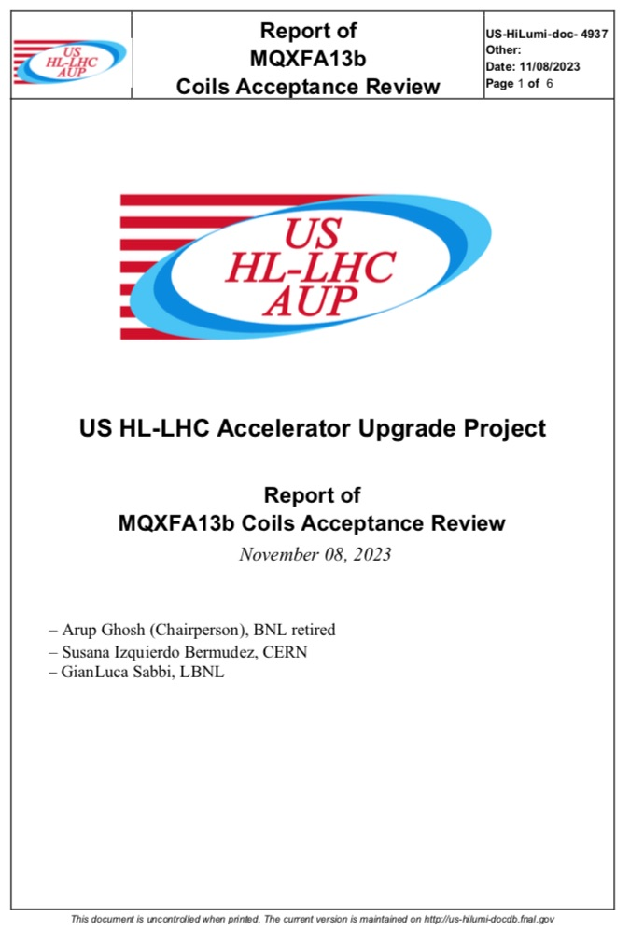
Coil Selection Review Report Summary
A13b Coil Selection Review was held 08-Nov-2023
  https://indico.fnal.gov/event/61966/
  (MQXFA13 Ref) See https://indico.fnal.gov/event/56491/
Coils 241 and 150 were approved for use; a few notes:
  Coils 234 and 242 are small on the ends, so these will remain on hold for now
  All coils have b6 correction
  All electrical QC passed (A13 coils to LHe exposure levels)
  Fabrication reports and CMM reported

Slide 4
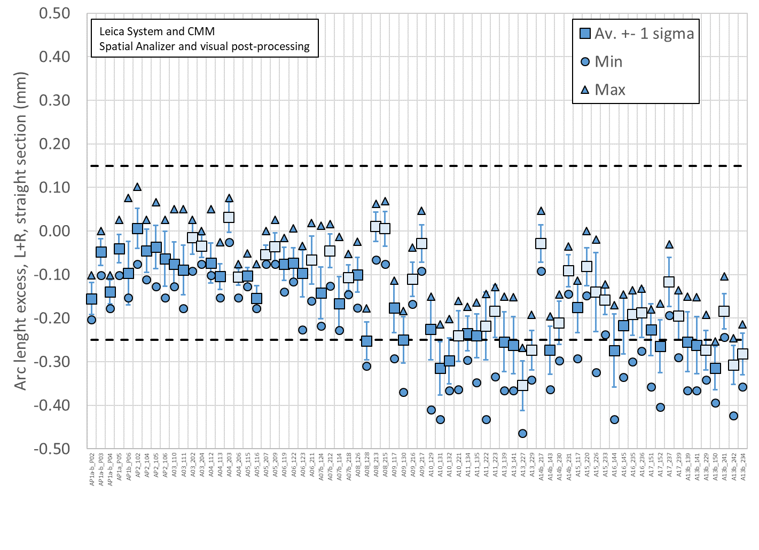
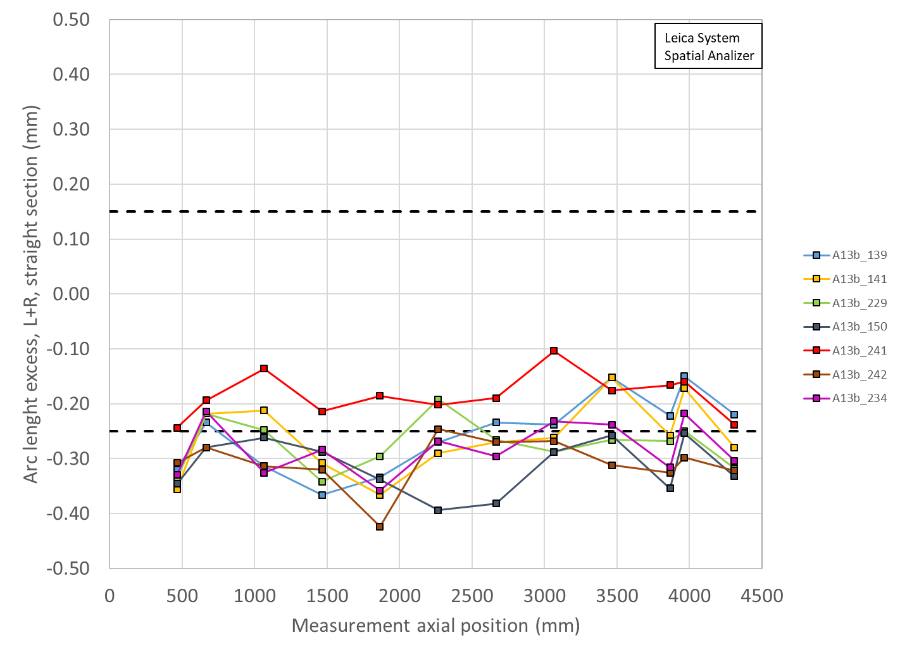
Total Arc Length Excess (Leica)
Coils mostly smaller than spec
3965 mm is location of SG:
139 ~-150 µm (~-255 µm avg)
141 ~-172 µm (~-262 µm avg)
150 ~-254 µm (~-315 µm avg)
241 ~-160 µm (~-184 µm avg)
242 ~-298 µm (-307 µm avg)
229 ~-250 µm (-274 µm avg)
234 ~-218 µm (-282 µm avg)

Slide 5
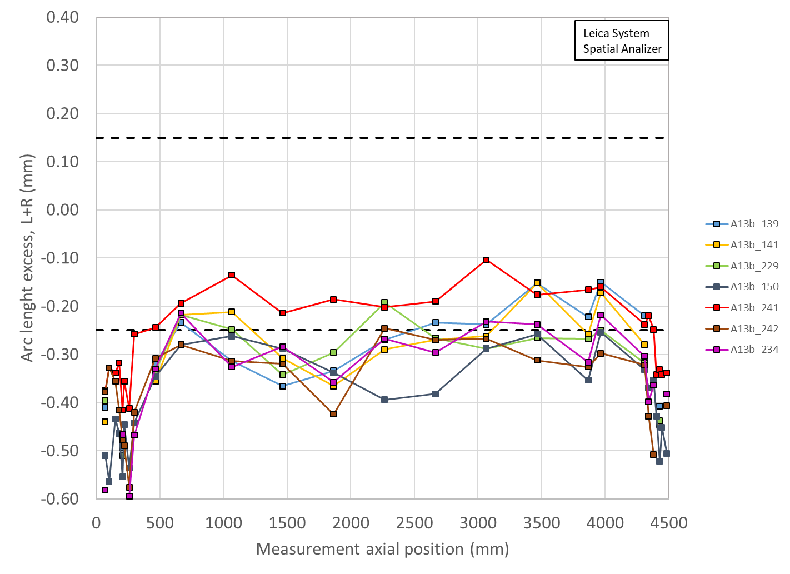
Total Arc Length Excess (With Ends shown)
Coil ends data shows post-test measurements for MQXFA13 coils (139, 141, 229)
All other data are showing virgin data

Slide 6
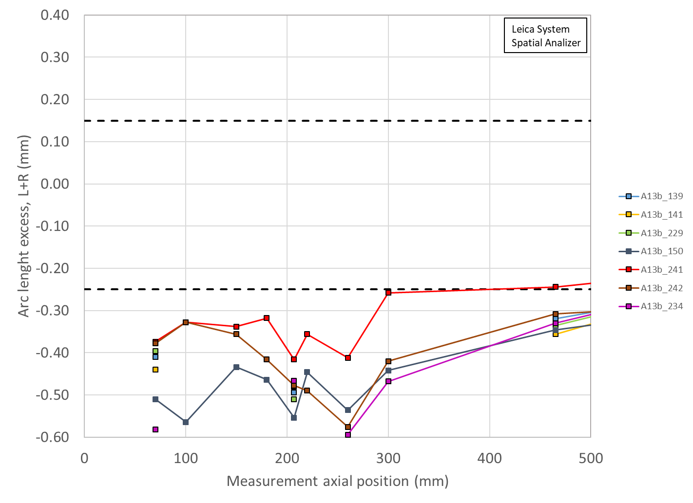
Total Arc Length Excess (LE Detail)
Coil ends data shows post-test measurements for MQXFA13 coils (139, 141, 229)
All other data are showing virgin data

Slide 7
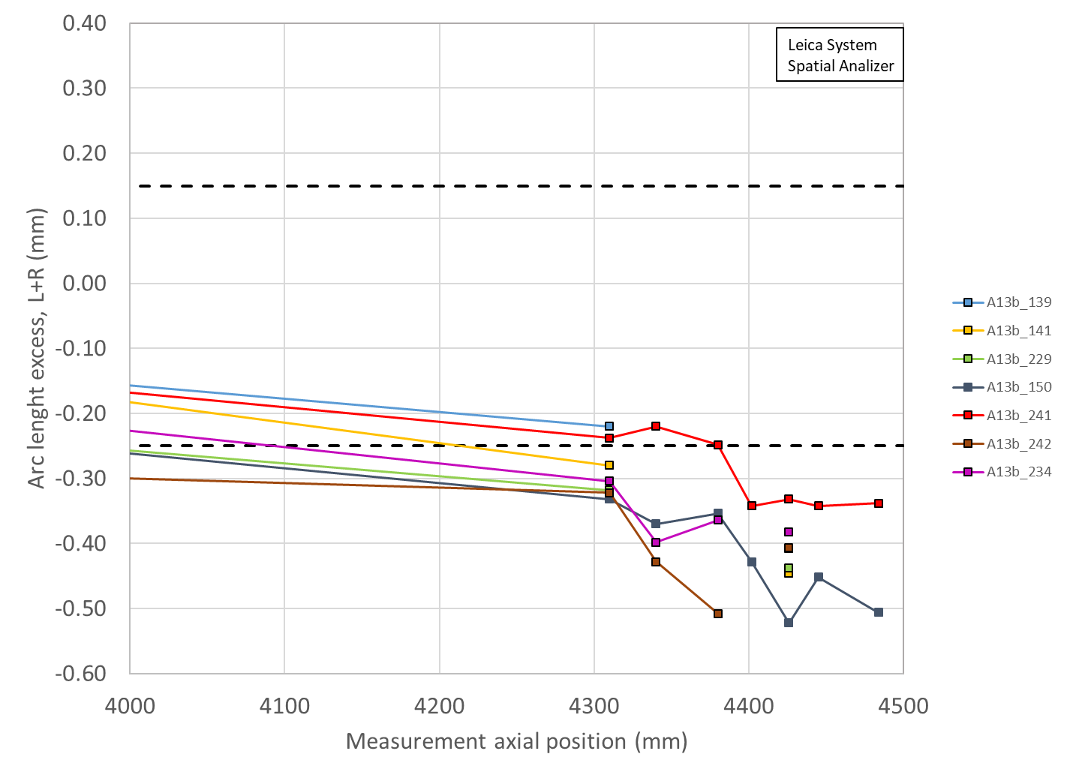
Total Arc Length Excess (RE Detail)
Coil ends data shows post-test measurements for MQXFA13 coils (139, 141, 229)
All other data are showing virgin data

Slide 8
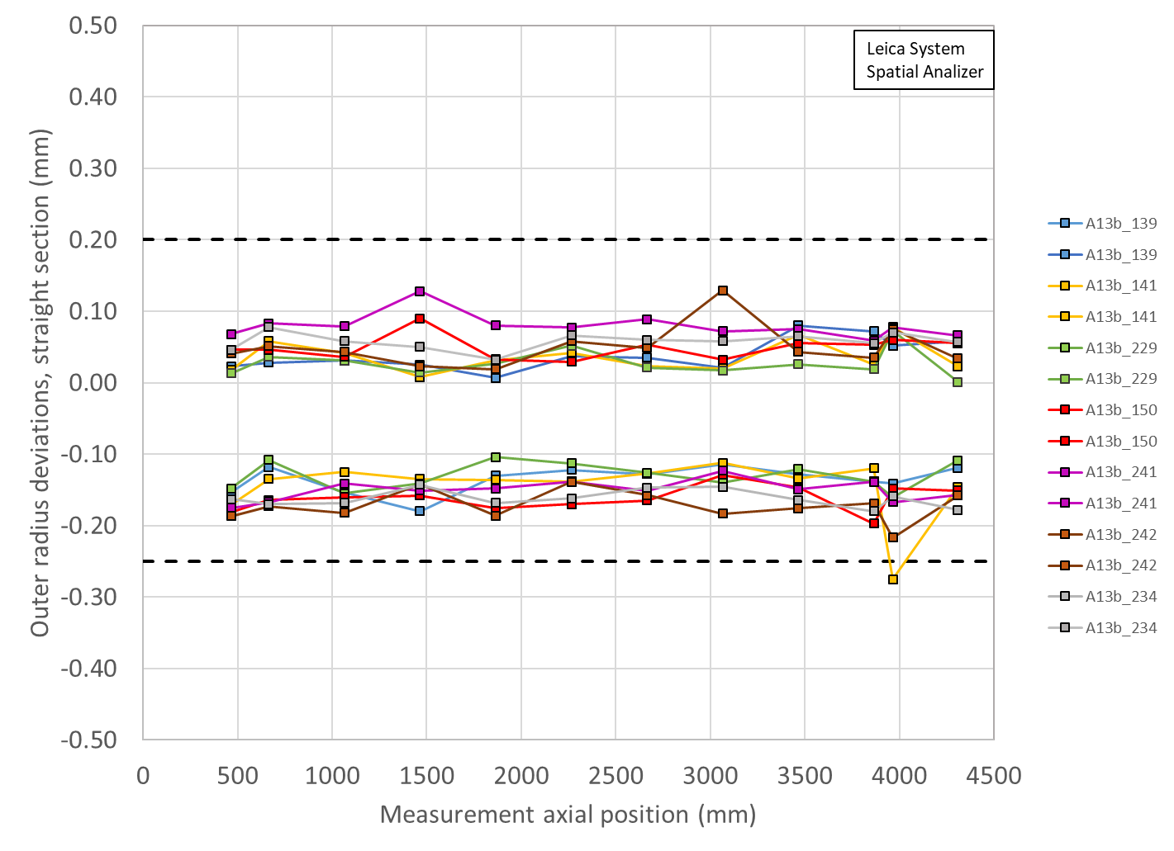
Outer Radius Profile Deviations (Leica)
All Coils avg. within spec
  But mostly smaller overall
Outer Radius deviation ranges are all similar among the coils

Slide 9
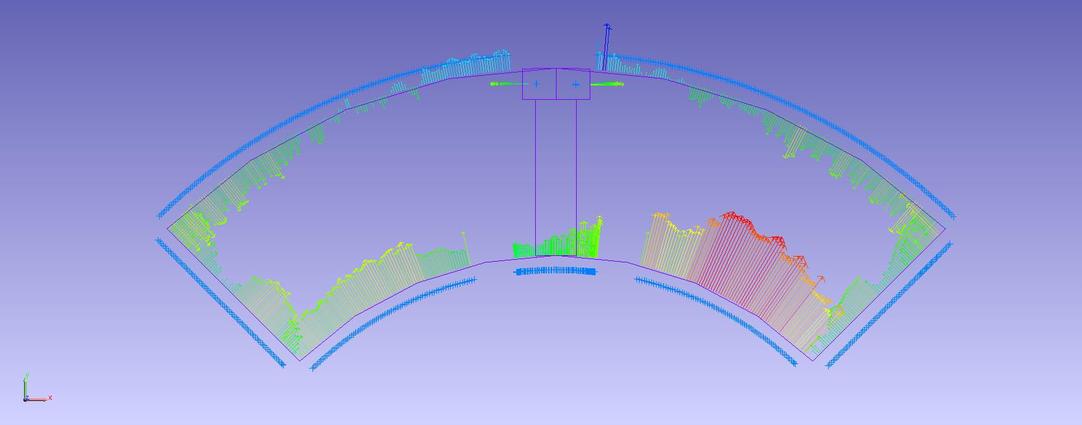
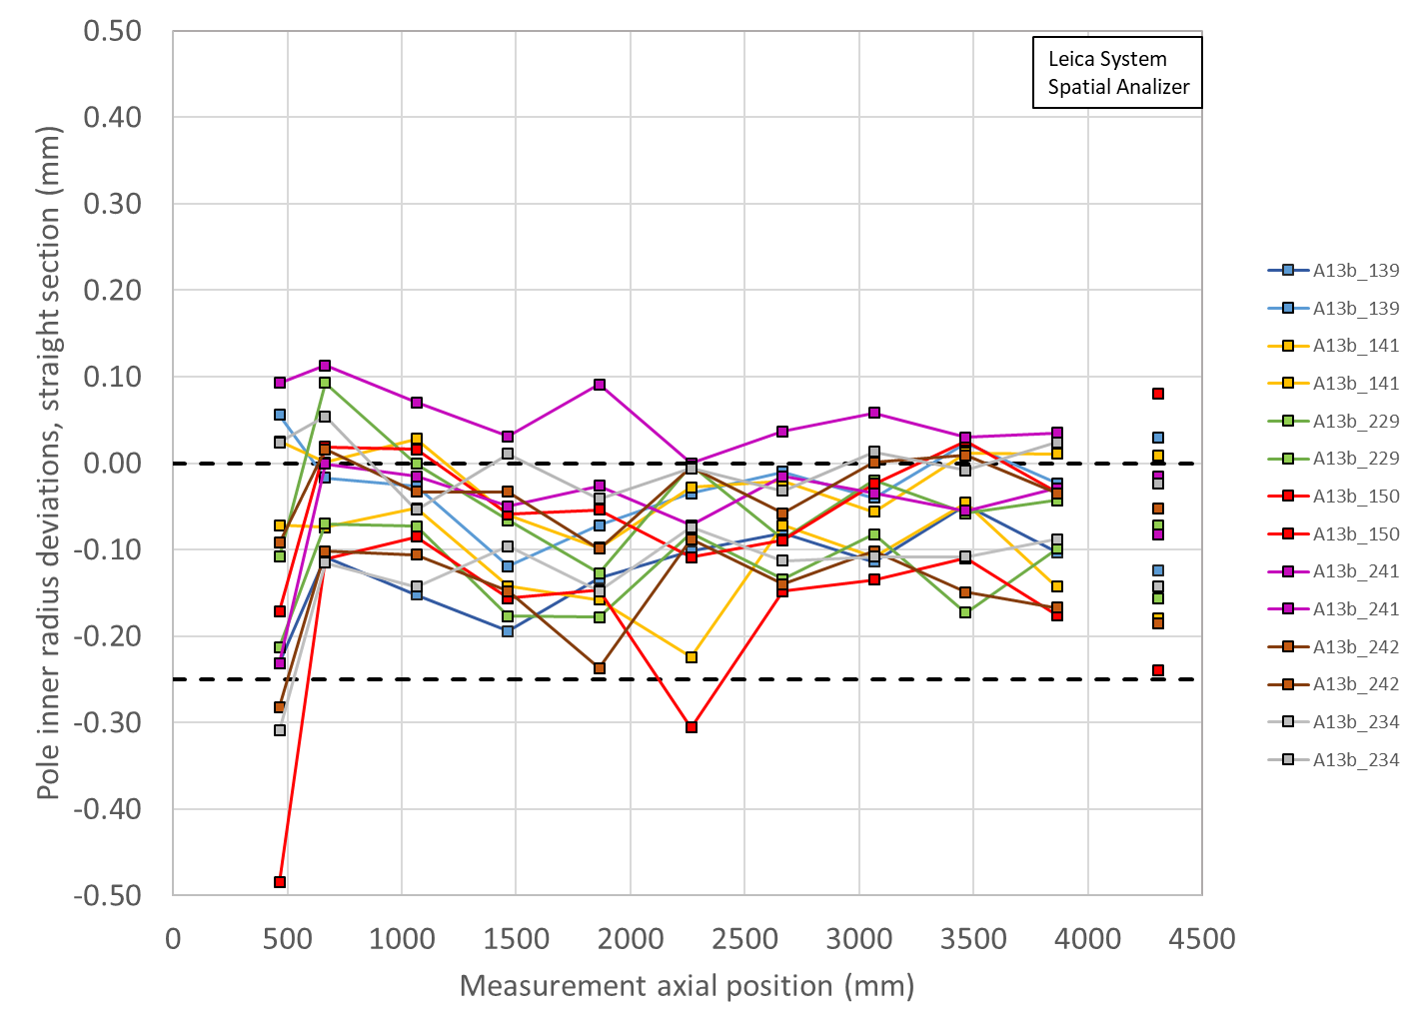
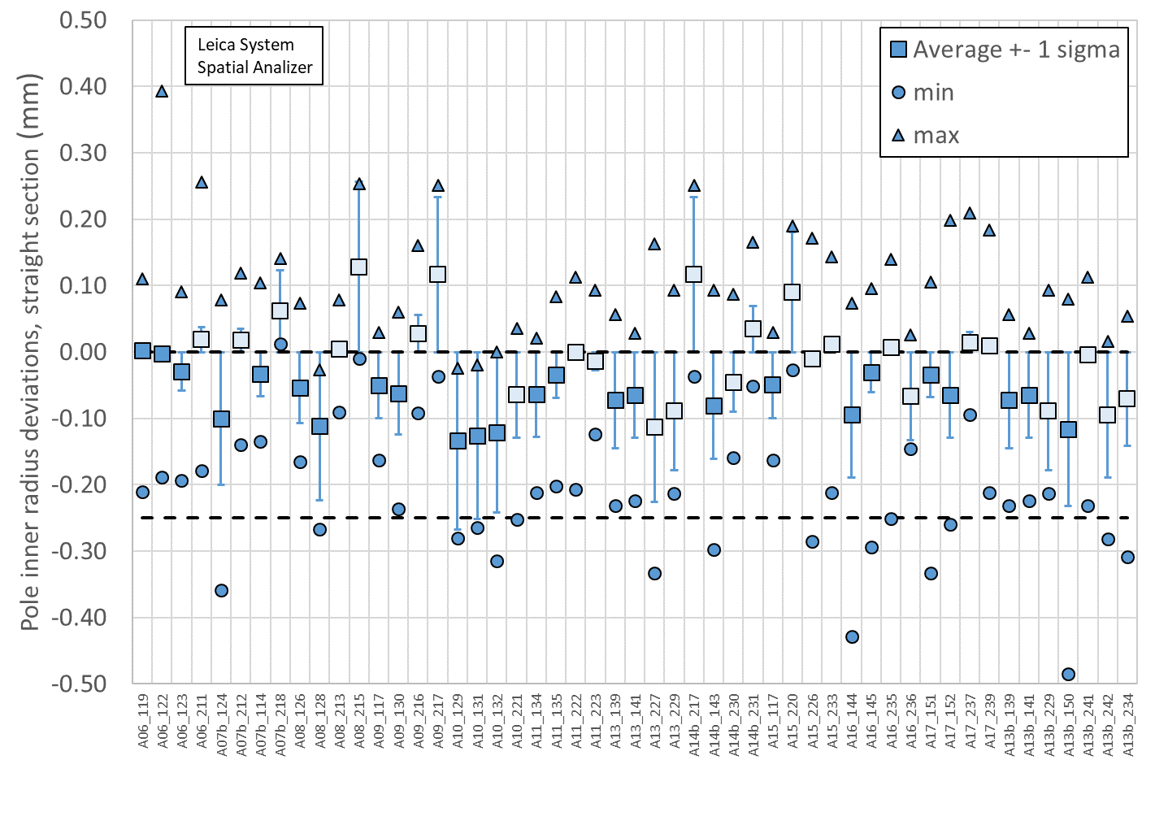
Pole Inner Radius Deviations (Pion Locations)
Inner Radius of the pole key is small (deviation into the bore)

Slide 10
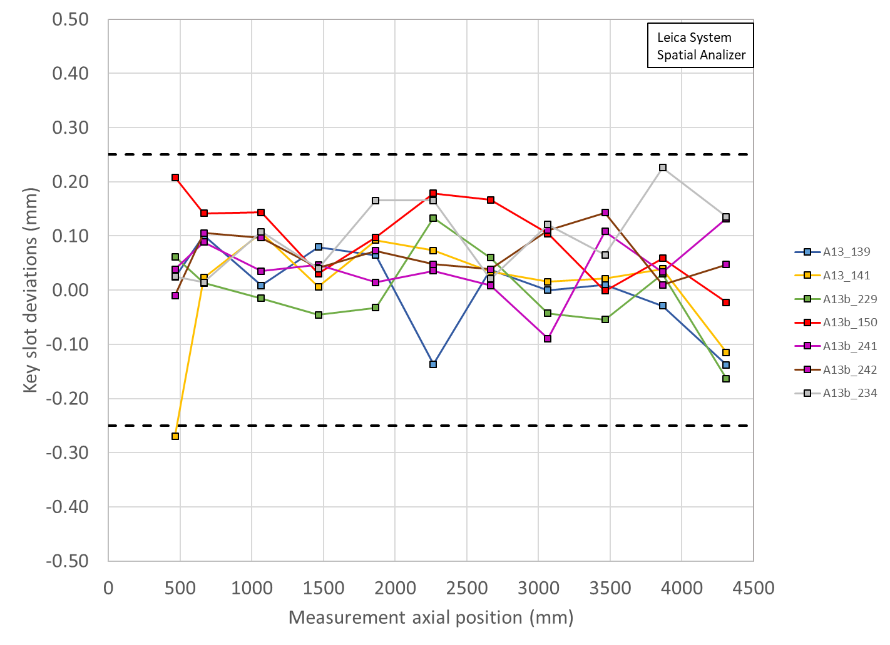
Key Slot Deviations
All Coils within spec
No keyslots out of spec

Slide 11
MQXFA13b II Coils Matrix, Coil 150
Coil | b6 Corr. | Keyway shift | Avg. Pole Inner R Dev | Avg R Dev. | Avg. Midpl Dev.
139 | Yes | Ok | ~nominal | ~-49 µm | ~-128 µm
141 | Yes | Ok | ~nominal | ~-51 µm | ~-131 µm
229 | Yes | Ok | ~nominal | ~-51 µm | ~-138 µm
150 | Yes | Ok | ~nominal | ~-57 µm | ~-157 µm
241 | Yes | Ok | ~nominal | ~-37 µm | ~-92 µm
242 | Yes | Ok | ~nominal | ~-56 µm | ~-154 µm
234 | Yes | Ok | ~nominal | ~-54 µm | ~-141 µm
OD: all coils are slightly undersized, significantly more than earlier coils
Midplane: all coils are undersized, will require extra midplane shims
Pole inner radii show deviations into the bore even though average is ~nominal; pions will need to be machined in these locations
LBNL measurements are using Leica system data

Slide 12
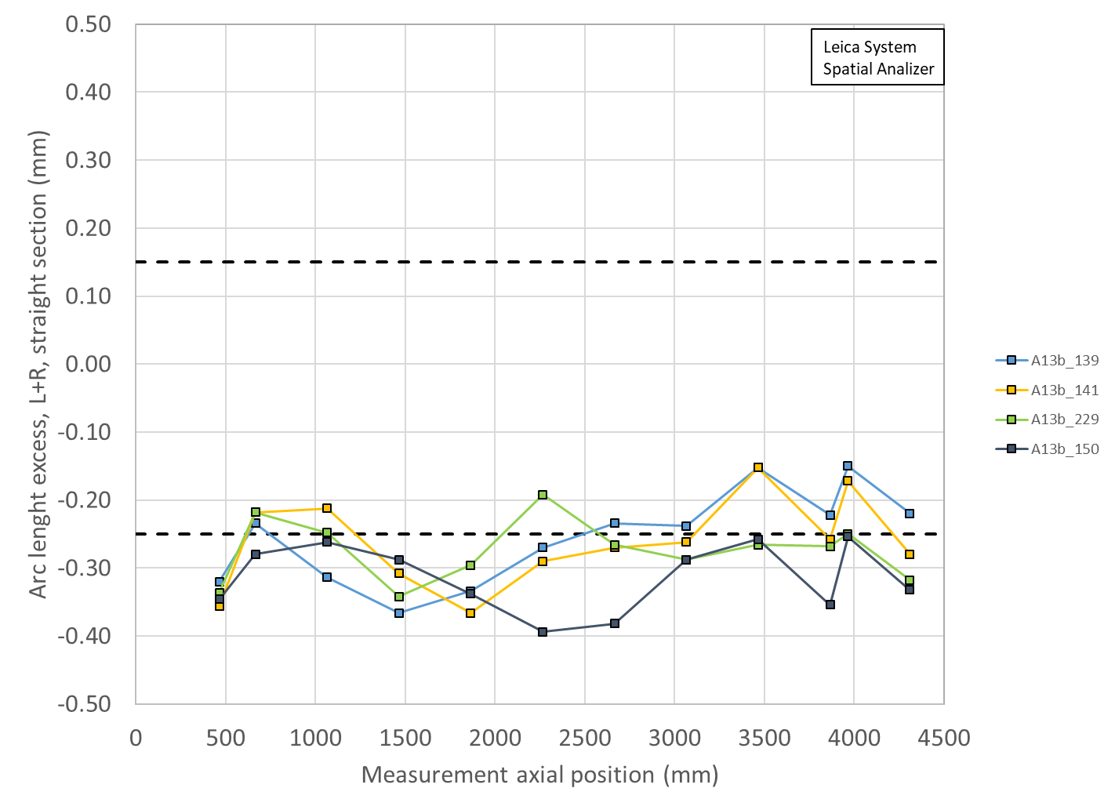
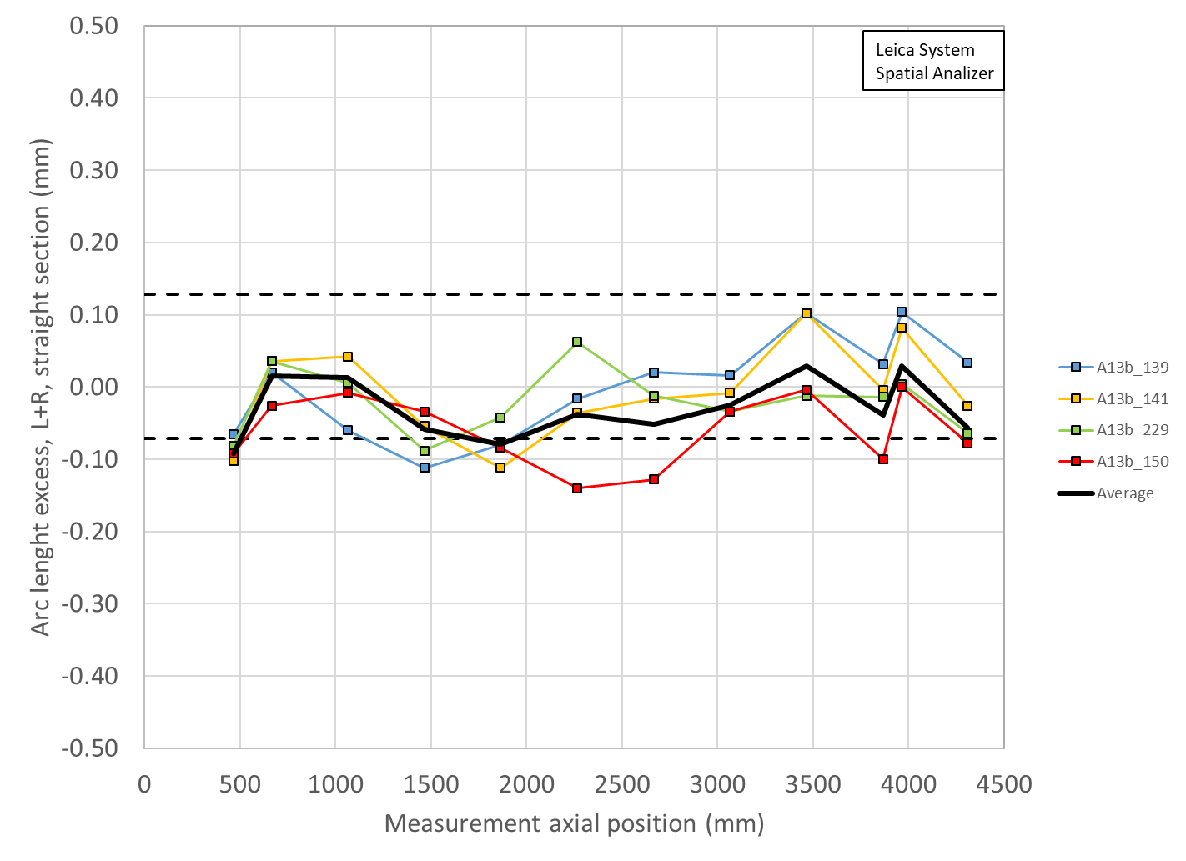
Coil Size estimates with midplane shims
Coil measurement plots created to show the effect of adding shims to both midplanes of Coils 139, 141, 229, 150
Limited by thicknesses of Kapton midplane shim availalble
Shimmed
0.005” on Coil 139
0.005” on 141
0.005” on 150
0.005” on 229
Unshimmed
Virgin coil measurements

Slide 13
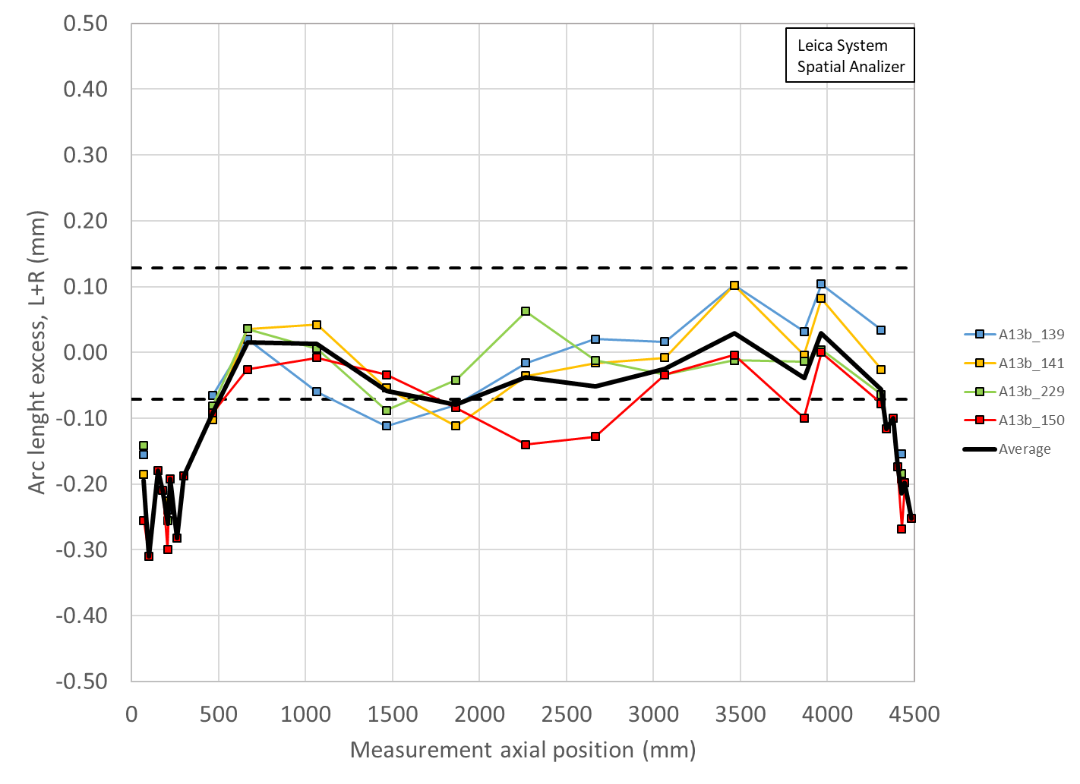
Coil Size estimates with midplane shims with Ends
Coil measurement plots created to show the effect of adding shims to both midplanes of Coils 139, 141, 229, 150
Limited by thicknesses of Kapton midplane shim availalble
Shimmed
0.005” on Coil 139
0.005” on 141
0.005” on 150
0.005” on 229
Unshimmed
Virgin coil measurements

Slide 14
MQXFA13b Peak voltages
Coils reported in mechanical ordering from CSR
Peak voltages evaluated in usual failure scenarios
All coils from A13 (Q2, Q3, Q4) must stay in their respective quuadrants
All coils available can be used in Q1
P1 | P2 | P3 | P4 | V
234 | 139 | 229 | 141 | 332
150 | 139 | 229 | 141 | 350
242 | 139 | 229 | 141 | 330
241 | 139 | 229 | 141 | 345

Slide 15
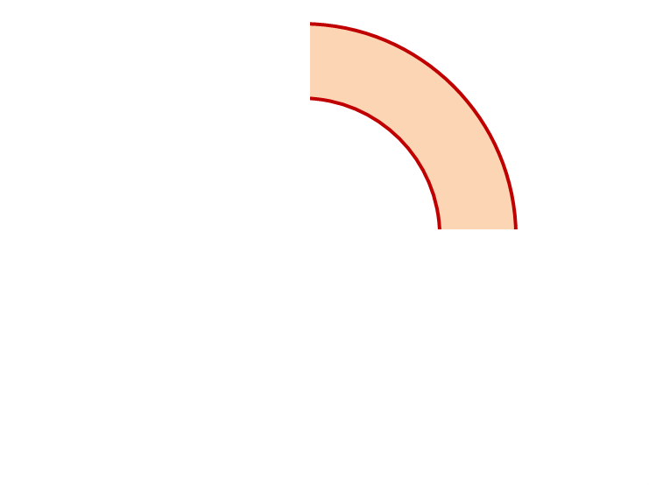
MQXFA13b Proposed Coil Arrangement
8 x δ_{midplane} = 2 π x δR_{OR}
~0.002” Undersized R
neglected
~.005” Undersized per Midpl.
Add 0.005” shim per side
~0.002” Undersized R
Neglected
~0.006” Undersized per Midpl.
Add 0.005” shim per side
139
150
Q2
Q1
Q3
Q4
229
141
~0.002” Undersized R
Neglected
~0.005” Undersized per Midpl.
Add 0.005” shim per side
~.002” Undersized R
Neglected
~0.005” Undersized per midpl.
Add 0.005” shim per side
Coil Electrical Order: A :150 – 141 – 139 – 229: B
Conforms to a favorable order based on RRR data

Slide 16
MQXFA13b Coil Pack Build 1 (Fuji) with 150
Nominal Collar R: 114 mm
Nominal Coil R: 113.376 mm
Nominal Radial shim = 0.025” (0.624 mm)
  But we still target ~0.020”
Fuji radial stack up is ~0.021” (~0.54 mm)
  0.0045” Coil GPI + 0.007” Fuji + 0.005” Kapton & 0.005” G11
Add Kapton to various midplanes
 | 150 | 139 | 229 | 141
Kapton Ground plane insulation | 0.0045” (0.114 mm)
Coil Specific Radial Shim | 0 | 0 | 0 | 0
Coil-specific midplane shim | 0.005” 0.125 mm | 0.005” 0.125 mm | 0.005” 0.125 mm | 0.005” 0.125 mm
Fuji paper | 0.007” (0.175 mm)
Radial Shim | 0.005” Polyimide + 0.005” G11 (~0.25 mm)

Slide 17
MQXFA13b Coil Pack Build (Final) with 150
Nominal Collar R: 114 mm
Nominal Coil R: 113.376 mm
Nominal Radial shim = 0.025” (0.624 mm)
  But we still target ~0.020”
Actual radial stack up is ~0.020” (~0.51 mm)
  0.0045” Coil GPI + 0.005” Kapton + 0.005” Kapton & 0.005” G11
Add Kapton to various midplanes
 | 150 | 139 | 229 | 141
Kapton Ground plane insulation | 0.0045” (0.114 mm)
Coil Specific Radial Shim | 0 | 0 | 0 | 0
Coil-specific midplane shim | 0.005” 0.125 mm | 0.005” 0.125 mm | 0.005” 0.125 mm | 0.005” 0.125 mm
Fuji paper | 0.000” (0.0 mm)
Radial Shim | 0.005” Polyimide + 0.005” Polyimide + 0.005” G11 (~0.38 mm)

Slide 18
Summary
Coils 139, 141, 229 + New Coil 150 chosen for the MQXFA13b magnet
  Midplane shimming determined to be added:
    Coil 139 will have 0.005” per side added
    Coil 141 will have 0.005” per side added
    Coil 150 will have 0.005” per side added
    Coil 229 will have 0.005” per side added
  Coil 150, 139 will be upper coils
    Most coils will require a number of Pions to be machined, even for the lower coils
Coil circuit order is 150 – 141 – 139 – 229
  Conforms to a favorable order based on RRR data

Slide 19
Additional Slides

