Slide 1
Loading shim proposal for A13b
Paolo Ferracin, Dan Cheng, Laura Garcia Fajardo, Giorgio Vallone
on behalf of the MQXF collaboration
MQXFA13b Structure & Shims Review
LBNL, USA
February 14th, 2024

Slide 2
Outline
Updated loading shim plan of A13b with coil 150 replacing coil 241
Issue of field quality in 13b with coil
Issue of the radial deviation

Slide 3
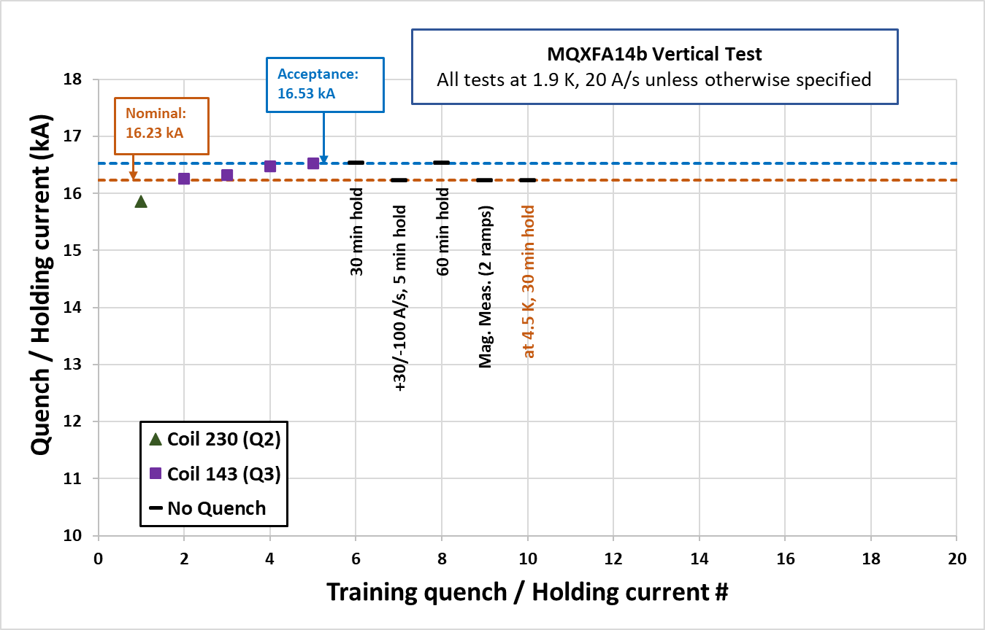
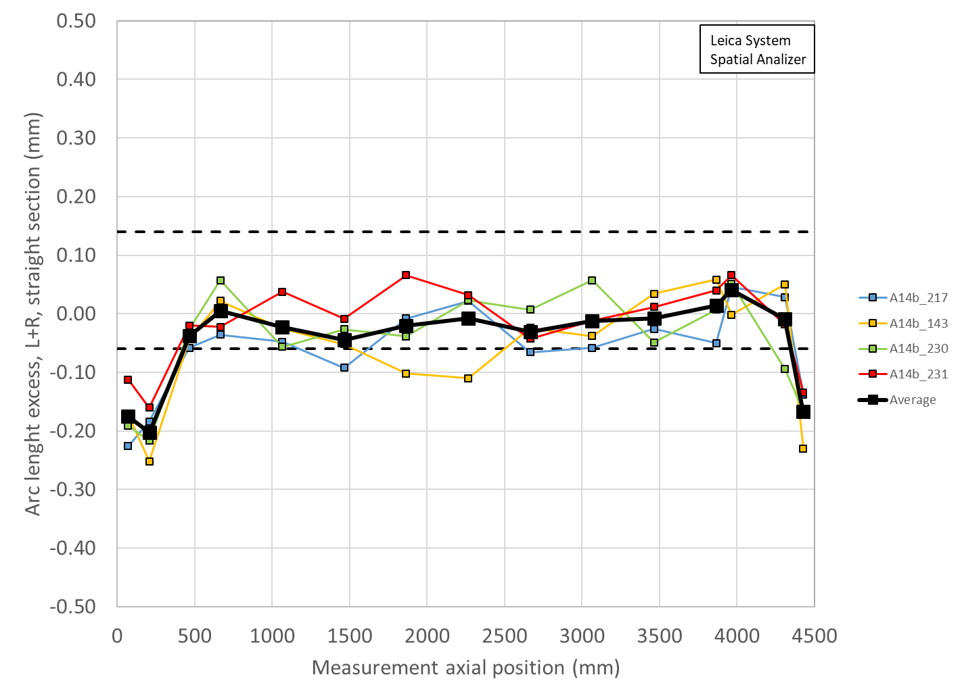
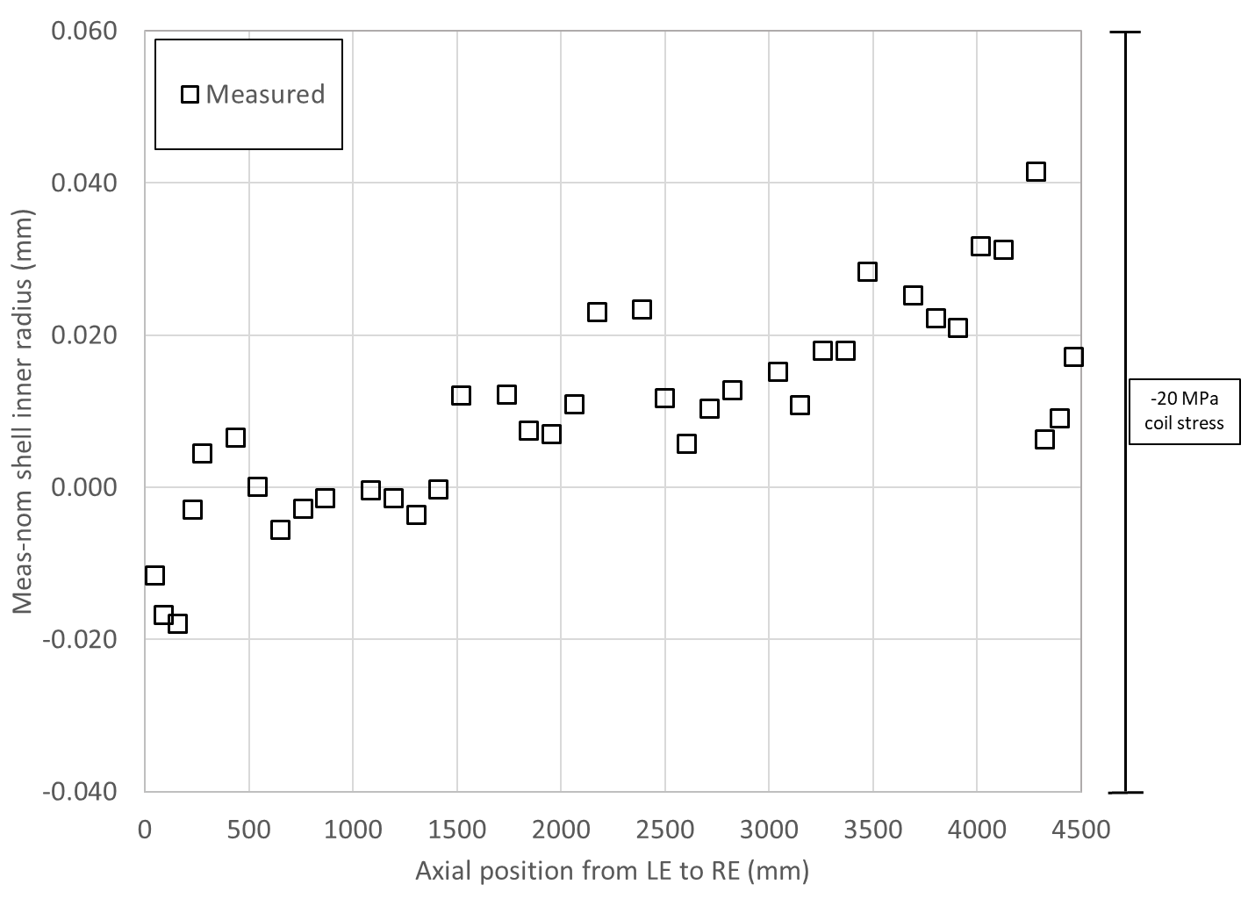
A14b quench performance, shimmed coil size, shell size, and loading key size
Loading shim size: 43 mils, 1.092 mm
Total key size: 13.84 mm

Slide 4
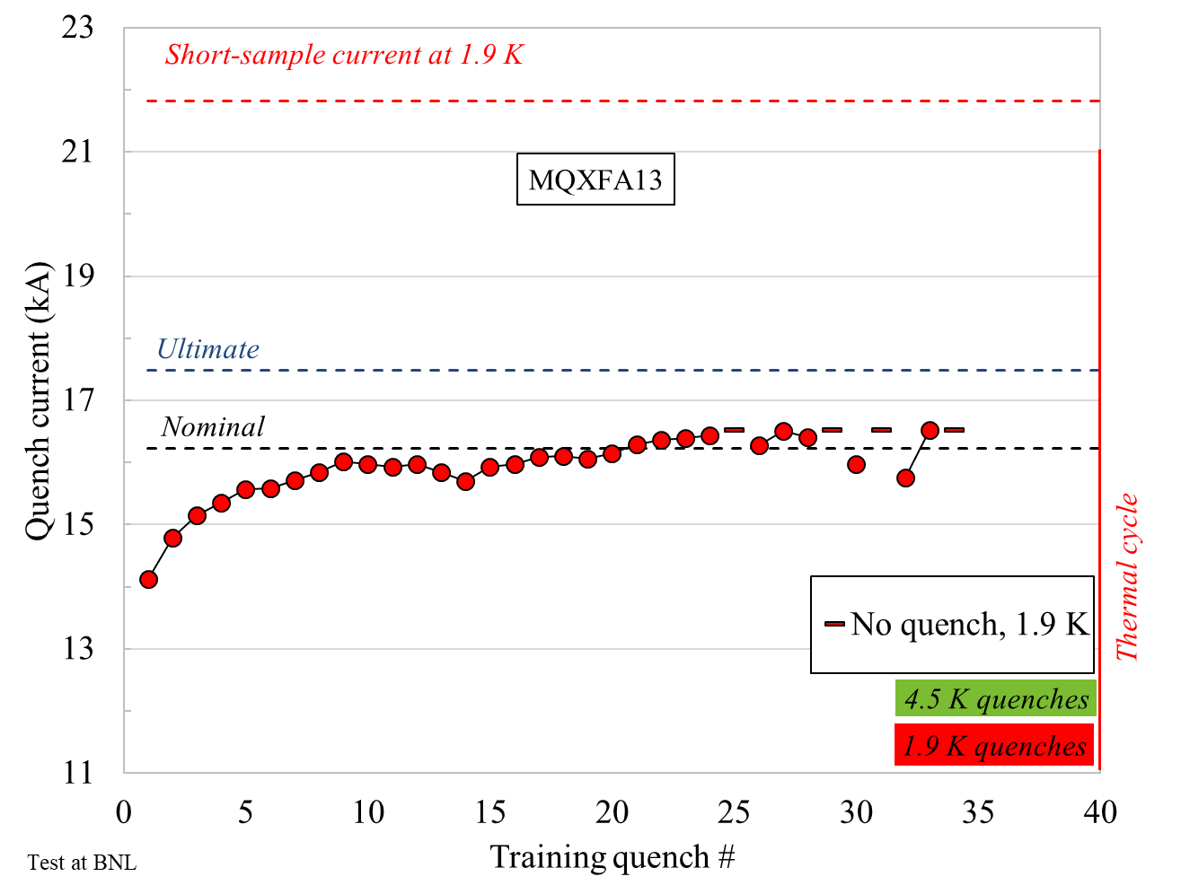
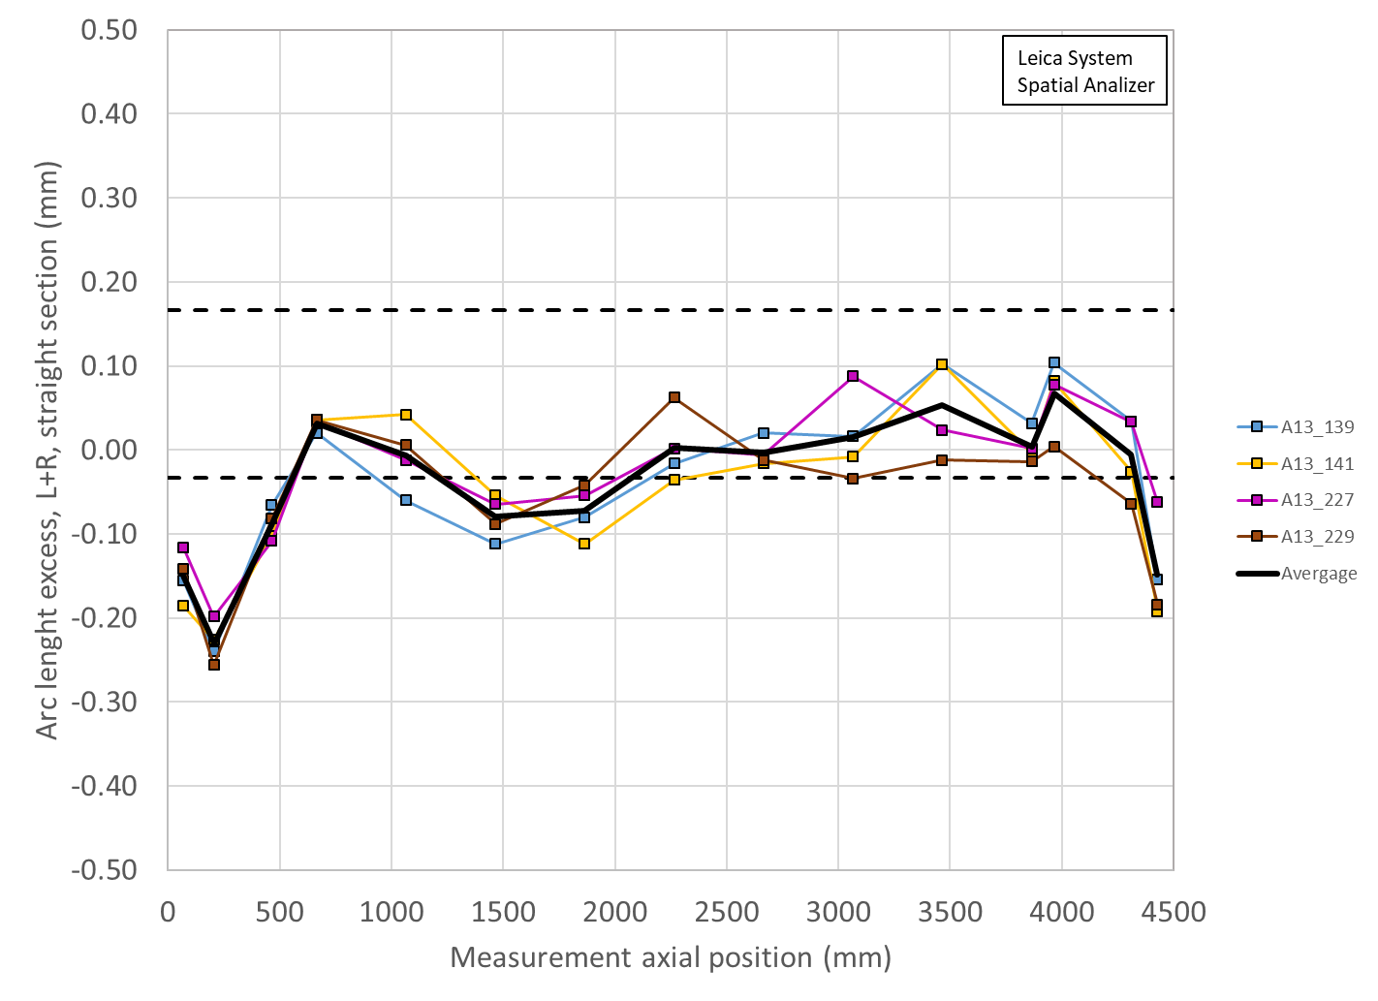

A13 quench performance, shimmed coil size, shell size, and loading key size
Loading shim size: 38 mils, 0.965 mm
Total key size: 13.72 mm

Slide 5
A05 quench performance, shimmed coil size, shell size, and loading key size
Why A05?
  Very good magnet, short training
  Instead
    A06, good but trained first at 4.5 K then 1.9 K
    A07/A08 not good
    A10/A11 good but long training
    A8b good but 3 re-tested coils
    A03, A04, good but work in progress to collect data…..

Slide 6
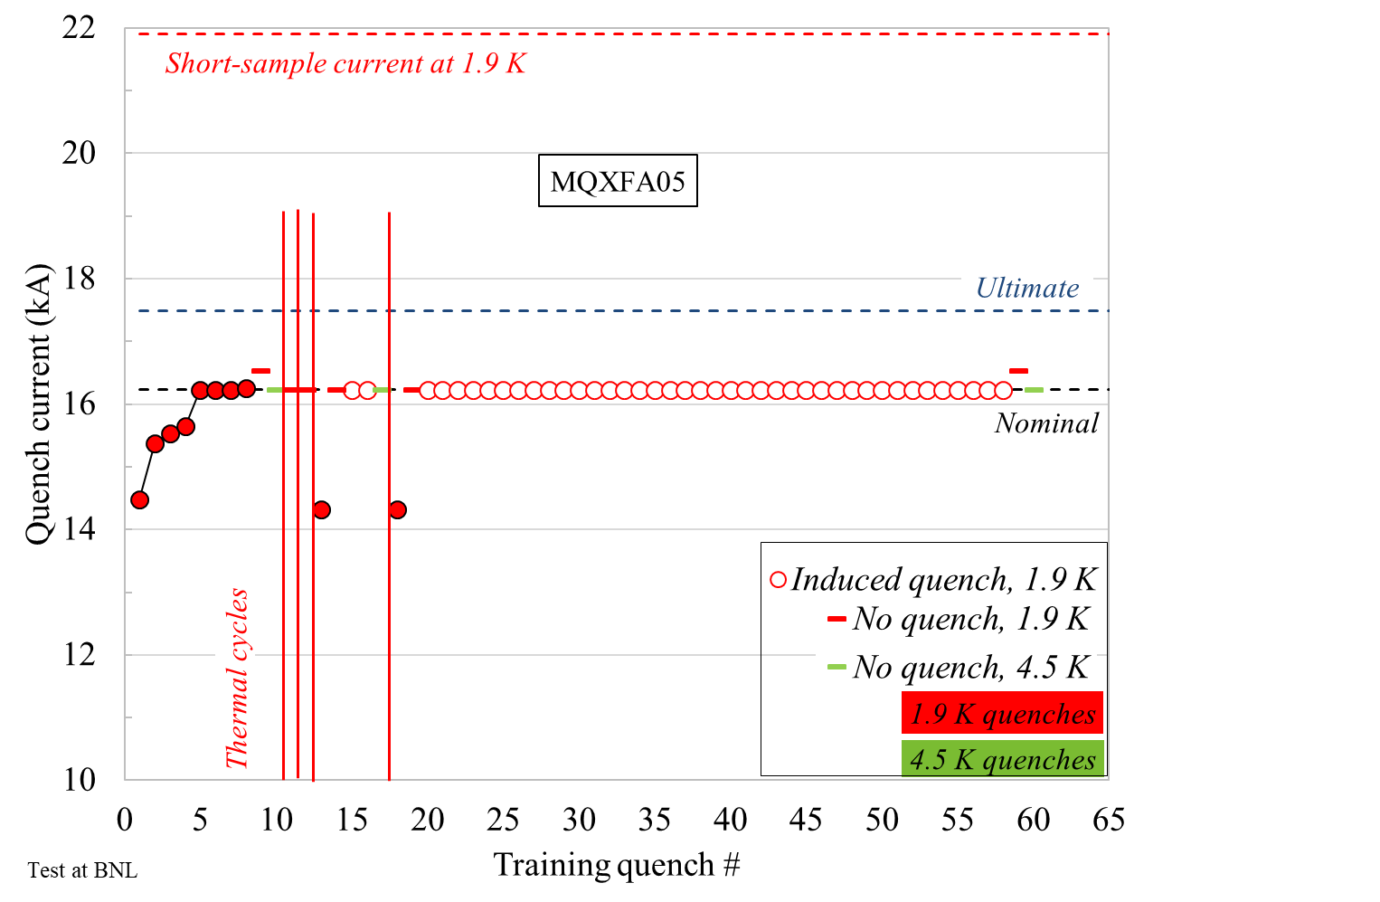
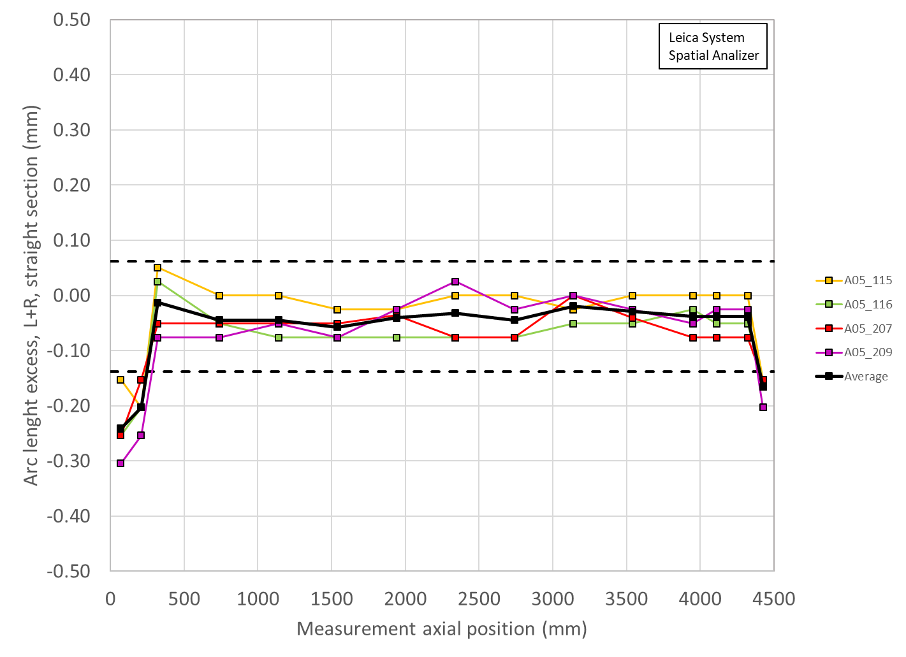
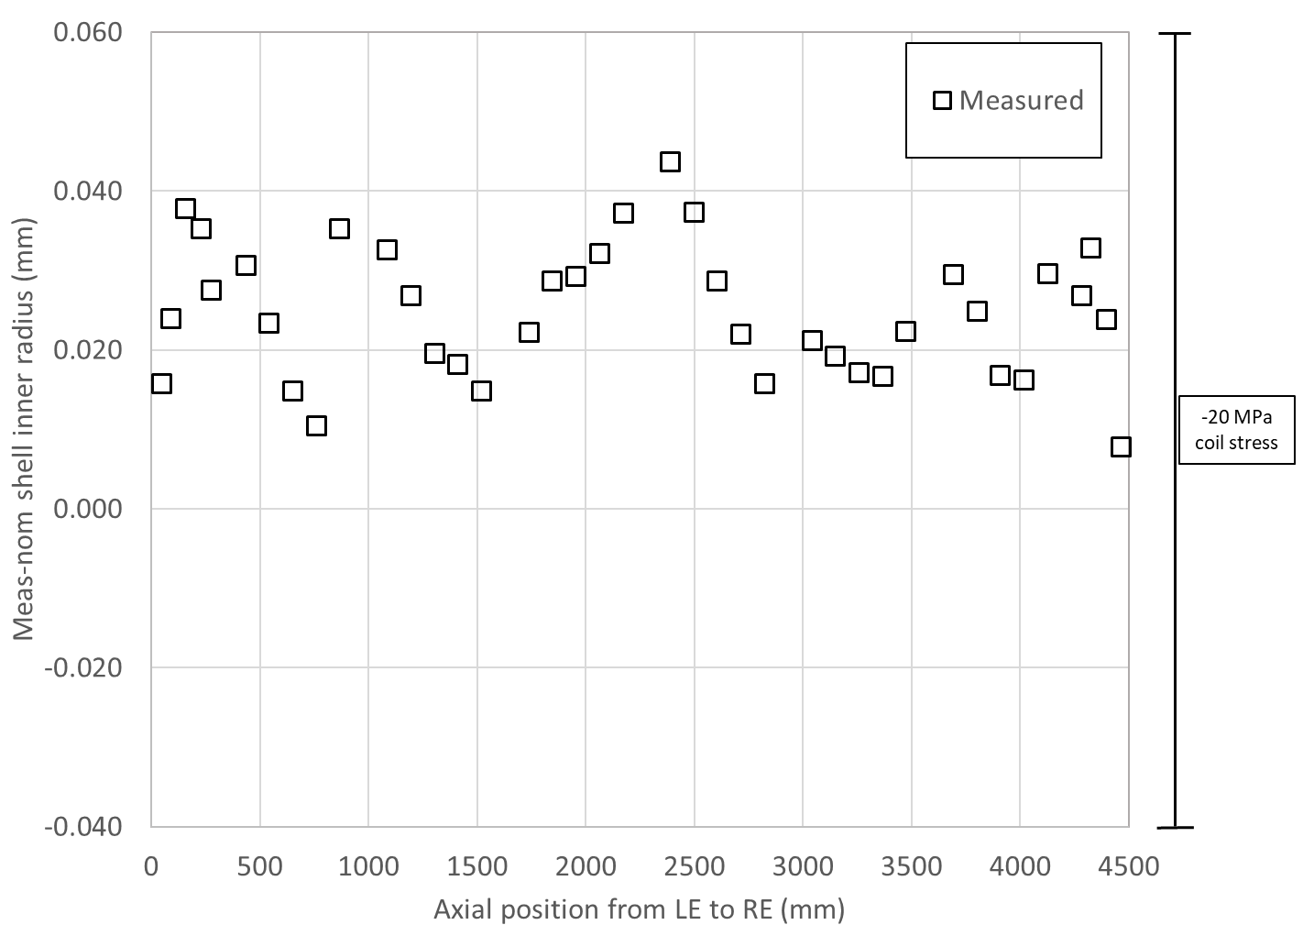
A05 quench performance, shimmed coil size, shell size, and loading key size
Loading shim size: 41 mils, 1.041 mm
Total key size: 13.79 mm

Slide 7
Summary A14b, A05, A13
Loading shim size: 43 mils, 1.092 mm
Total key size: 13.84 mm
Loading shim size: 41 mils, 1.041 mm
Total key size: 13.79 mm
Loading shim size: 38 mils, 0.965 mm
Total key size: 13.72 mm

Slide 8
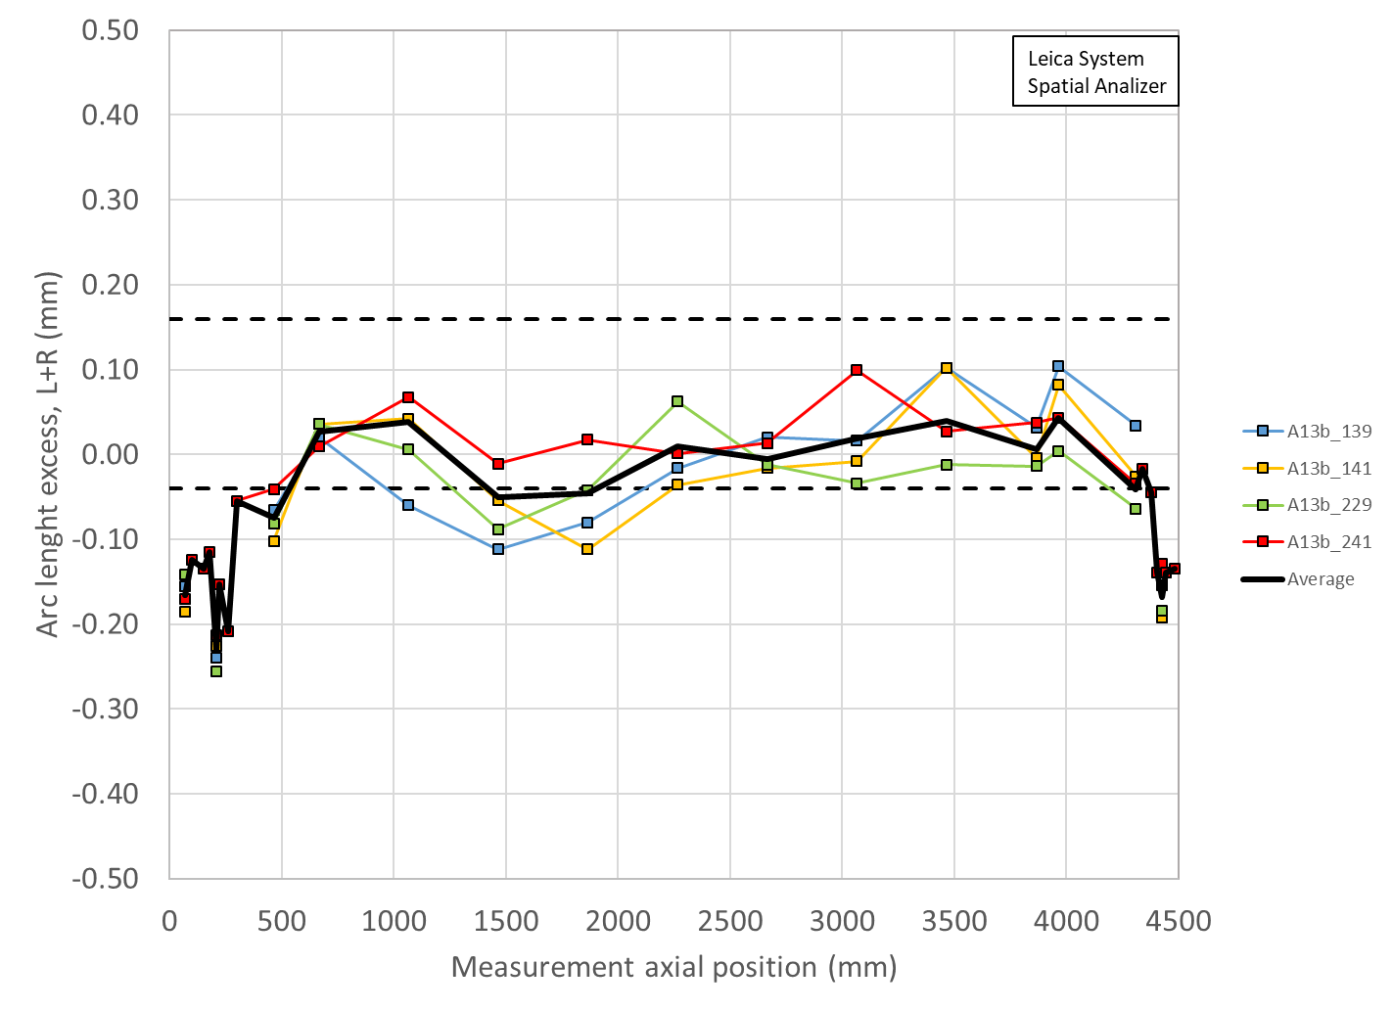
A13b shimmed coil size

Slide 9
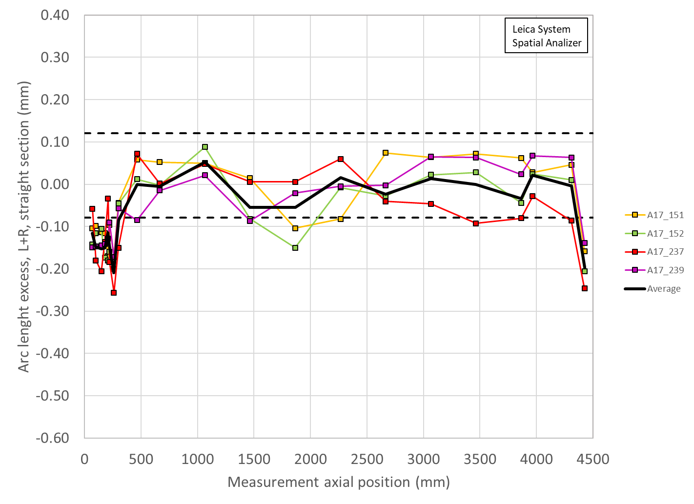
Summary
Coil arc length (shimmed) deviation and key/shim size
 | Ave ss | LE min | RE min | Key | Shim | Shim
 | mm | mm | mm | mm | mils | mm
A13b | -0.030 | -0.310 | -0.252 | ? | ? | ?
A17 | -0.006 | -0.210 | -0.197 | 13.74 | 39 | 0.991
A07b | -0.023 | -0.180 | -0.126 | 13.84 | 43 | 1.092
A16 | 0.037 | -0.140 | -0.125 | 13.77 | 40 | 1.016
A15 | 0.001 | -0.156 | -0.070 | 13.72 | 38 | 0.965
A14b | -0.011 | -0.203 | -0.167 | 13.84 | 43 | 1.092
A13 | -0.007 | -0.230 | -0.148 | 13.72 | 38 | 0.965
A8b | -0.001 | -0.285 | -0.214 | 13.77 | 40 | 1.016
A11 | 0.006 | -0.196 | -0.074 | 13.74 | 39 | 0.991
A10 | -0.145 | -0.348 | -0.313 | 13.82 | 42 | 1.067
A8 | -0.046 | -0.340 | -0.269 | 13.72 | 38 | 0.965
A7 | -0.055 | -0.218 | -0.179 | 13.77 | 40 | 1.016
A6 | -0.053 | -0.217 | -0.279 | 13.72 | 38 | 0.965
A5 | -0.039 | -0.241 | -0.165 | 13.79 | 41 | 1.041

Slide 10
From arc length deviation to radial deviation
Δ_arc-length * 4 = 2π Δr
Δr = Δ_arc-length * 2/ π

Slide 11
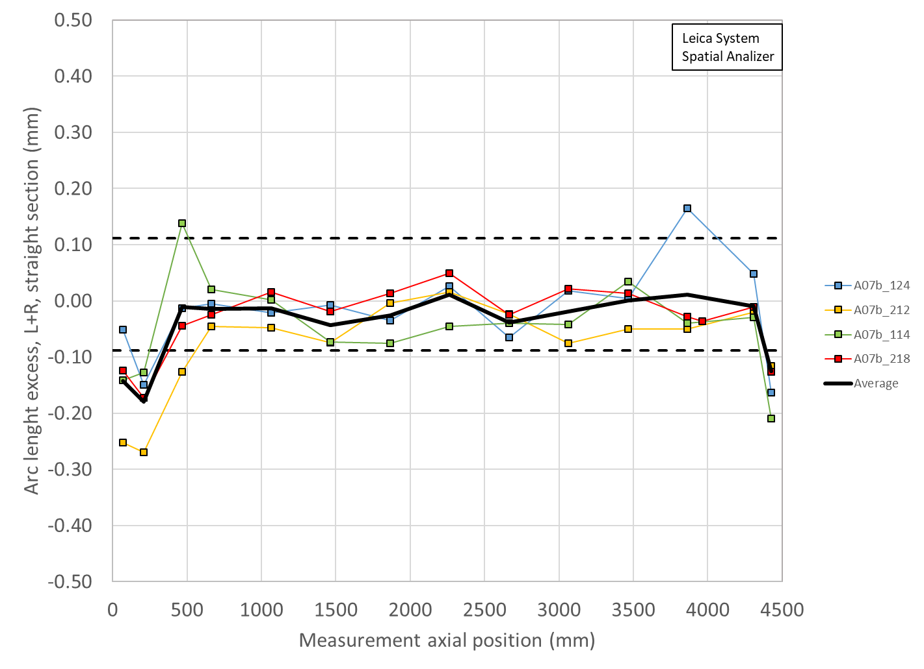
Summary
Coil radial (shimmed) deviation and key/shim size
 | Ave ss | LE min | RE min | Key | Shim | Shim | Ave ss + shim | LE + shim | RE + shim
 | mm | mm | mm | mm | mils | mm | mm | mm | mm
A13b | -0.019 | -0.197 | -0.160 | ? | ? | ? | ? | ? | ?
A17 | -0.004 | -0.134 | -0.125 | 13.74 | 39 | 0.991 | 0.987 | 0.857 | 0.865
A07b | -0.015 | -0.115 | -0.080 | 13.84 | 43 | 1.092 | 1.077 | 0.977 | 1.012
A16 | 0.023 | -0.089 | -0.080 | 13.77 | 40 | 1.016 | 1.039 | 0.927 | 0.936
A15 | 0.000 | -0.099 | -0.045 | 13.72 | 38 | 0.965 | 0.965 | 0.866 | 0.920
A14b | -0.007 | -0.129 | -0.107 | 13.84 | 43 | 1.092 | 1.085 | 0.963 | 0.985
A13 | -0.004 | -0.146 | -0.094 | 13.72 | 38 | 0.965 | 0.961 | 0.819 | 0.871
A8b | 0.000 | -0.181 | -0.136 | 13.77 | 40 | 1.016 | 1.016 | 0.835 | 0.880
A11 | 0.004 | -0.124 | -0.047 | 13.74 | 39 | 0.991 | 0.995 | 0.867 | 0.944
A10 | -0.092 | -0.221 | -0.199 | 13.82 | 42 | 1.067 | 0.975 | 0.846 | 0.868
A8 | -0.029 | -0.216 | -0.172 | 13.72 | 38 | 0.965 | 0.936 | 0.749 | 0.793
A7 | -0.035 | -0.139 | -0.114 | 13.77 | 40 | 1.016 | 0.981 | 0.877 | 0.902
A6 | -0.034 | -0.138 | -0.178 | 13.72 | 38 | 0.965 | 0.931 | 0.827 | 0.787
A5 | -0.025 | -0.154 | -0.105 | 13.79 | 41 | 1.041 | 1.016 | 0.887 | 0.936

Slide 12
A07b
Let’s assume that
  A13b “upper” is like A14b
  A13b “lower” is like A05

Slide 13
Summary straight section
Coil radial (shimmed) deviation + key/shim size
 | Ave ss | Key | Shim | Shim | Ave ss + shim
 | mm | mm | mils | mm | mm
A13b up | -0.019 | 13.84 | 43 | 1.092 | 1.073
A13b low | -0.019 | 13.79 | 41 | 1.041 | 1.023
A14b | -0.007 | 13.84 | 43 | 1.092 | 1.085
A5 | -0.025 | 13.79 | 41 | 1.041 | 1.016

Slide 14
Summary LE
Coil radial (shimmed) deviation + key/shim size
 | LE | Key | Shim | Shim | LE + shim
 | mm | mm | mils | mm | mm
A13b up | -0.197 | 13.89 | 45 | 1.143 | 0.946
A13b low | -0.197 | 13.84 | 43 | 1.092 | 0.895
A14b | -0.129 | 13.84 | 43 | 1.092 | 0.963
A5 | -0.154 | 13.79 | 41 | 1.041 | 0.887

Slide 15
Summary RE
Coil radial (shimmed) deviation + key/shim size
 | RE | Key | Shim | Shim | RE + shim
 | mm | mm | mils | mm | mm
A13b up | -0.197 | 13.89 | 45 | 1.143 | 0.946
A13b low | -0.197 | 13.84 | 43 | 1.092 | 0.895
A14b | -0.107 | 13.84 | 43 | 1.092 | 0.985
A5 | -0.105 | 13.79 | 41 | 1.041 | 0.936

Slide 16
Summary and proposal
 | Ave ss | Key | Shim | Shim | Ave ss + shim
 | mm | mm | mils | mm | mm
A13b up | -0.019 | 13.84 | 43 | 1.092 | 1.073
A13b low | -0.019 | 13.79 | 41 | 1.041 | 1.023
 | LE | Key | Shim | Shim | LE + shim
 | mm | mm | mils | mm | mm
A13b up | -0.197 | 13.89 | 45 | 1.143 | 0.946
A13b low | -0.197 | 13.84 | 43 | 1.092 | 0.895
 | RE | Key | Shim | Shim | RE + shim
 | mm | mm | mils | mm | mm
A13b up | -0.197 | 13.89 | 45 | 1.143 | 0.946
A13b low | -0.197 | 13.84 | 43 | 1.092 | 0.895
Proposed target
  Aiming at a shim of 43 mils, with the possibility of going to 45 mils depending on SG data

Slide 17
Outline
Updated loading shim plan of A13b with coil 150 replacing coil 241
Issue of field quality in 13b with coil 241
Issue of the radial deviation

Slide 18
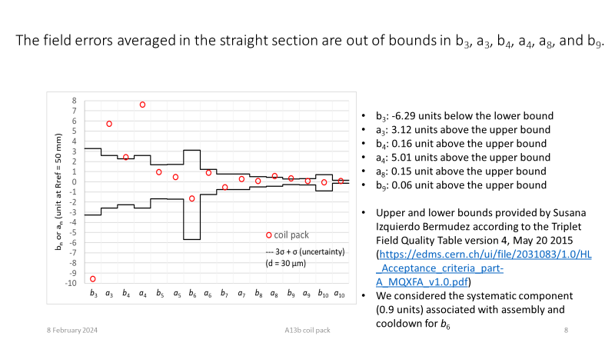
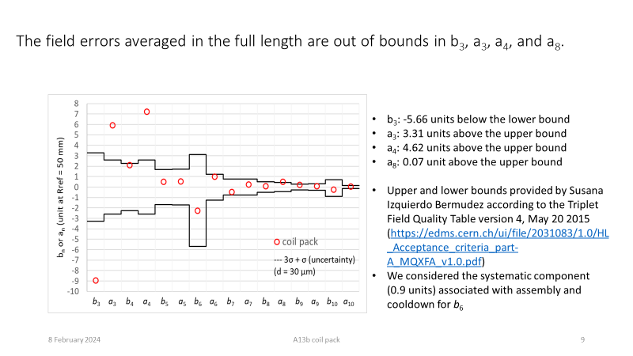
A13b with coil 241
Good agreement with Roxie computations where 241 (Q1) is shifted outwards by about 0.2 mm radially

Slide 19
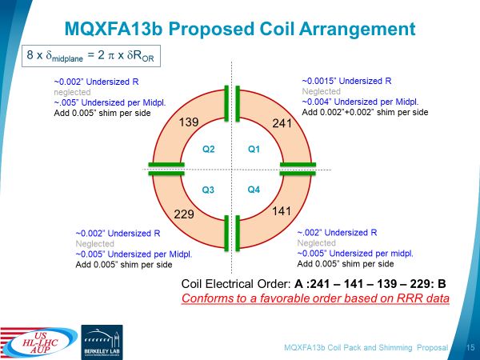
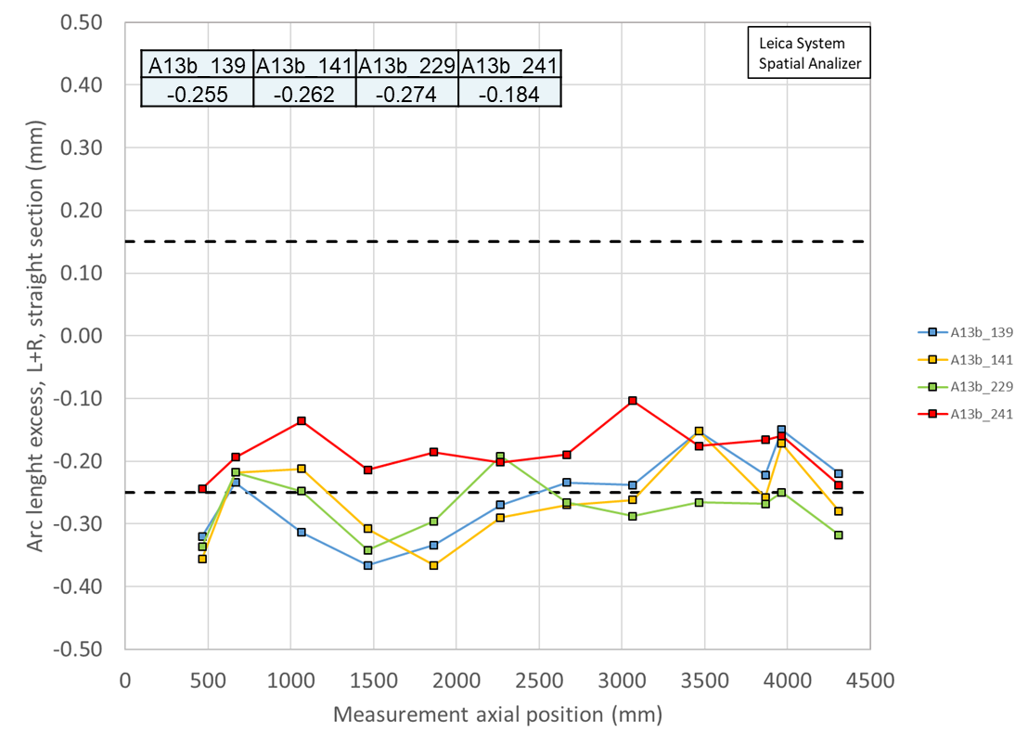
Original A13b shim plan
Using virgin coils size

Slide 20
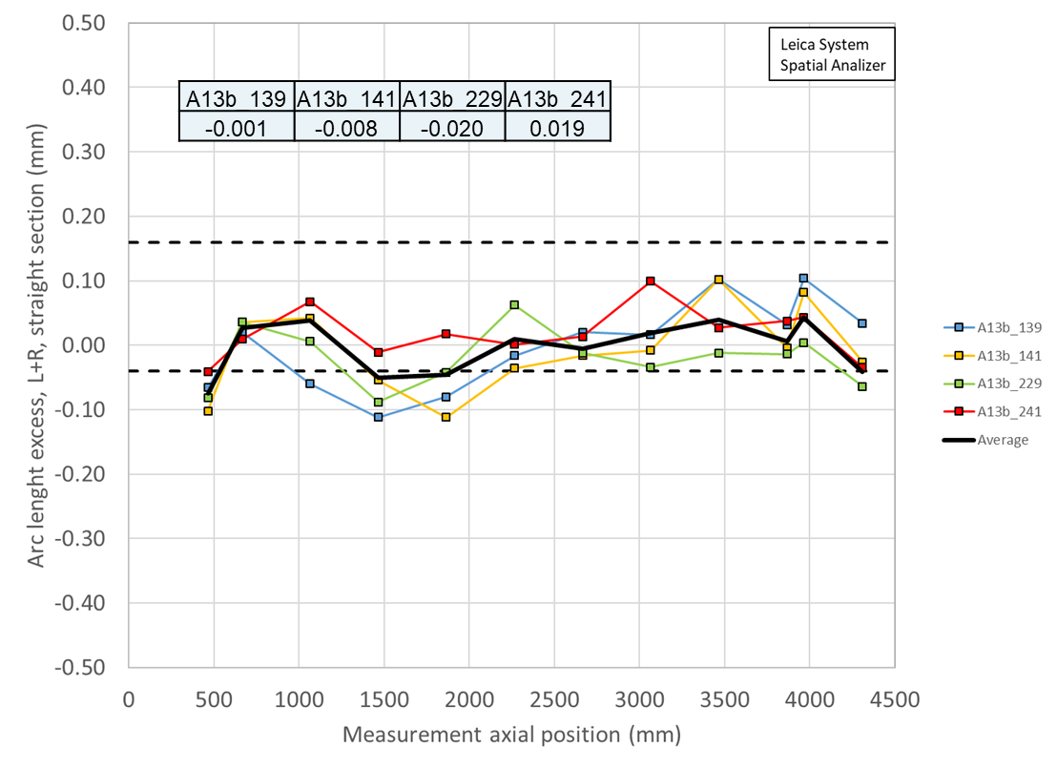
Original A13b shim plan
Using virgin coils size

Slide 21
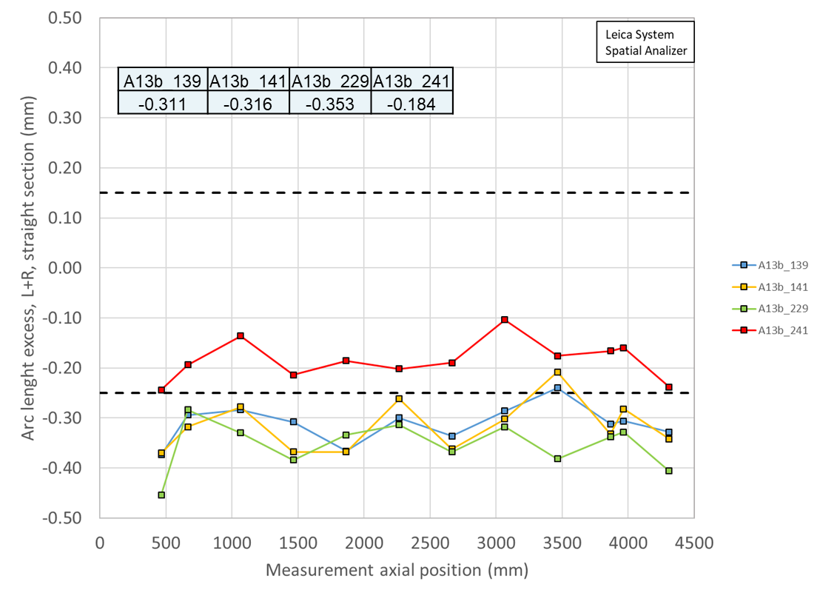
Original A13b shim plan
Using tested coil size (for Q2 to Q4)

Slide 22
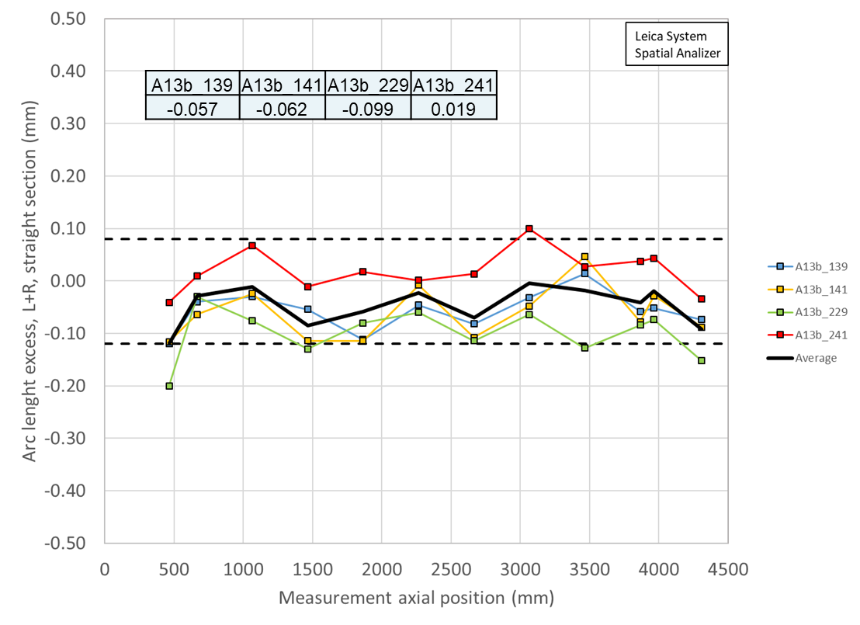
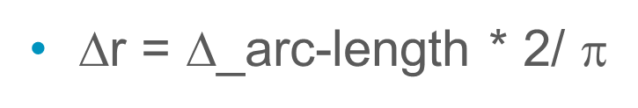
Original A13b shim plan
Using tested coil size (for Q2 to Q4)

Slide 23
The case of A7b and A8b

Slide 24
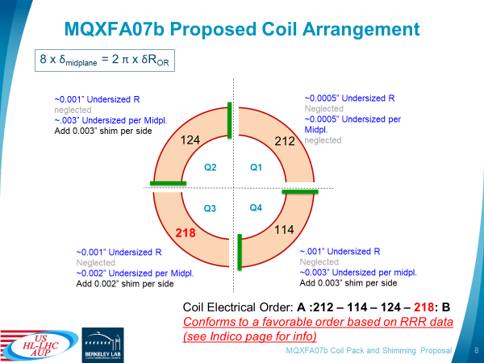
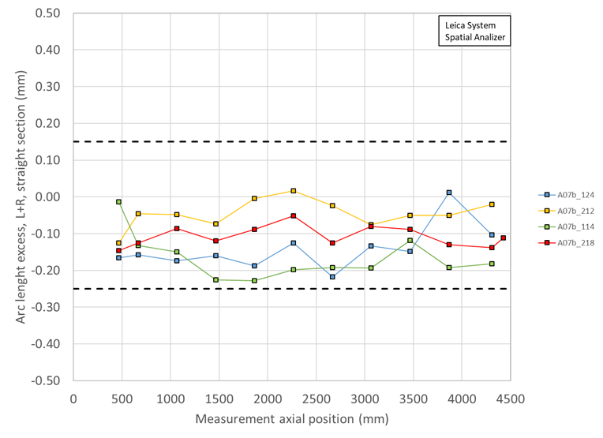
Original A7b shim plan
Using virgin coils size
New coil in Q3 (bottom left) and not the biggest virgin coil

Slide 25
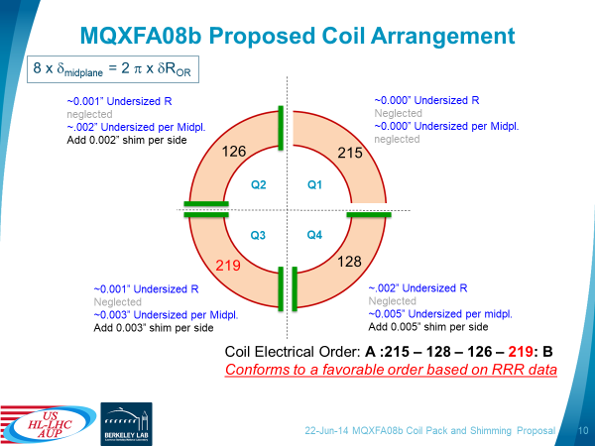
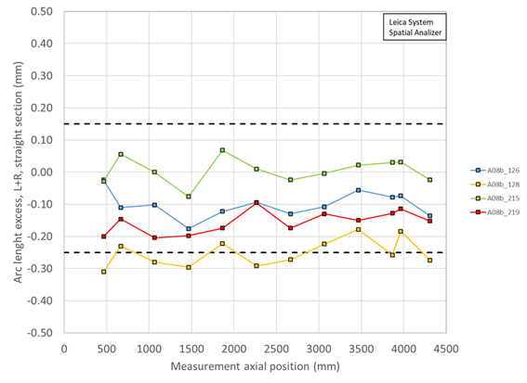
Original A8b shim plan
Using virgin coils size
New coil in Q3 (bottom left) and not the biggest virgin coil

Slide 26
The case of A13b with coil 150

Slide 27
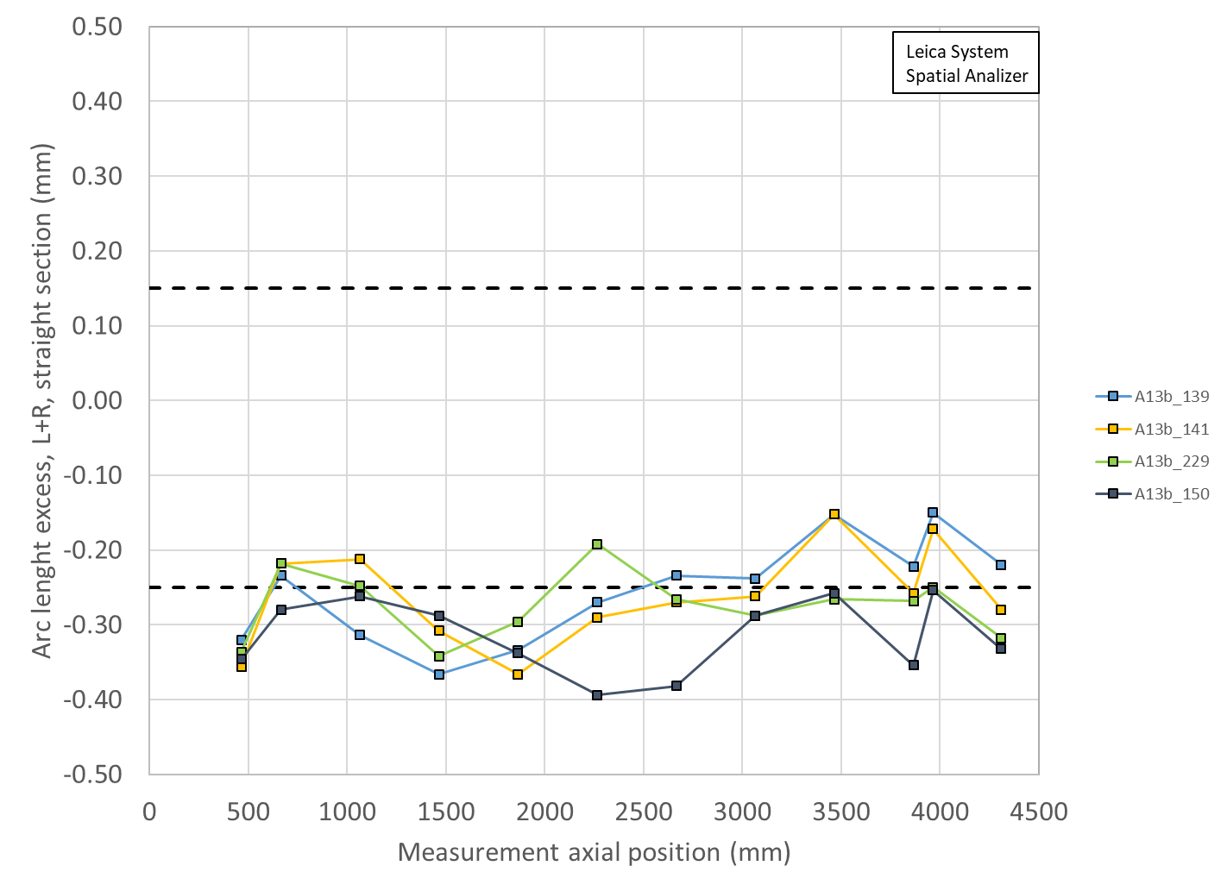
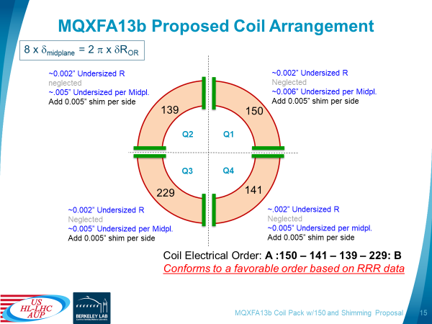
New A13b shim plan
Using virgin coils size
A13b_139 | A13b_141 | A13b_229 | A13b_150
-0.255 | -0.262 | -0.274 | -0.315

Slide 28
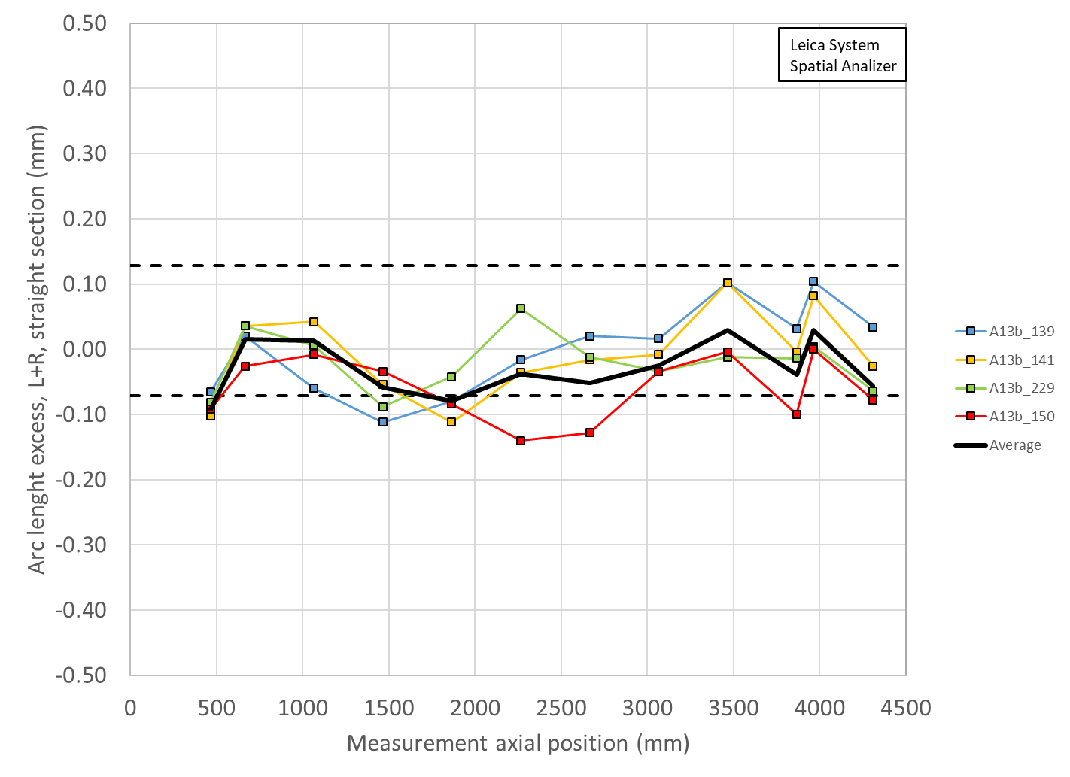
New A13b shim plan
Using virgin coils size
A13b_139 | A13b_141 | A13b_229 | A13b_150
-0.001 | -0.008 | -0.020 | -0.061
A13b_139 | A13b_141 | A13b_229 | A13b_150
-0.255 | -0.262 | -0.274 | -0.315

Slide 29
Outline
Updated loading shim plan of A13b with coil 150 replacing coil 241
Issue of field quality in 13b with coil 241
Issue of the radial deviation

Slide 30
Issue of the radial deviation

Slide 32
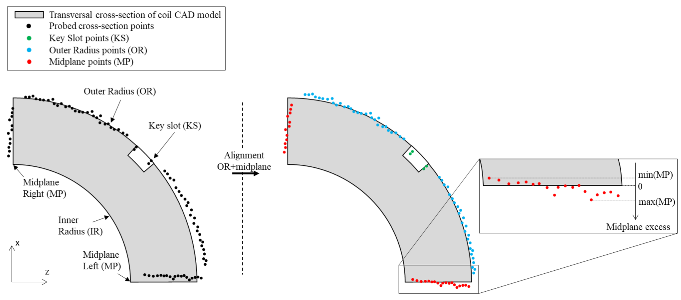
Impregnated coil dimensional tolerances
Arc length excess (straight section)
The impregnated coil is accepted for use in MQXFA if its arc length excesses along the straight section are within the following tolerances: +0.150/-0.250 mm
The arc length excess, which is difference between the measured coil arc length and the nominal one, is determined by fitting outer radius and mid-planes points with the nominal profile, with equal weighting and imposing as symmetrical the two mid-planes offsets. The sum of the two measured mid-plane offsets provides the arc length excess

Slide 33
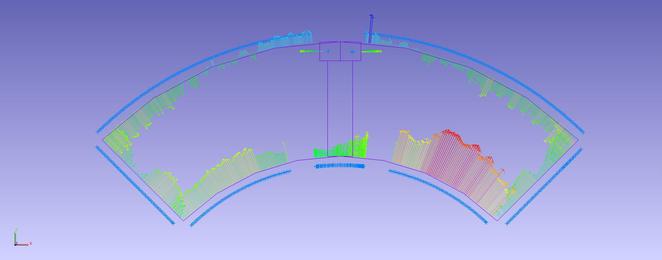
Arc length excess

Slide 34
Impregnated coil dimensional tolerances
Outer radius profile deviation
The impregnated coil is accepted for use in MQXFA if its outer radius profile deviations along the straight section are within the following tolerances: +0.200/-0.250 mm
The outer radius profile deviation, which is given by the variation of each point on the outer radius with respect to the nominal outer radius, is determined by fitting outer radius and mid-planes points with the nominal profile, with equal weighting and imposing as symmetrical the two mid-planes offsets. Positive deviation indicates more material than nominal, negative indicates less material than nominal.

Slide 35
Outer radius profile deviation

Slide 36
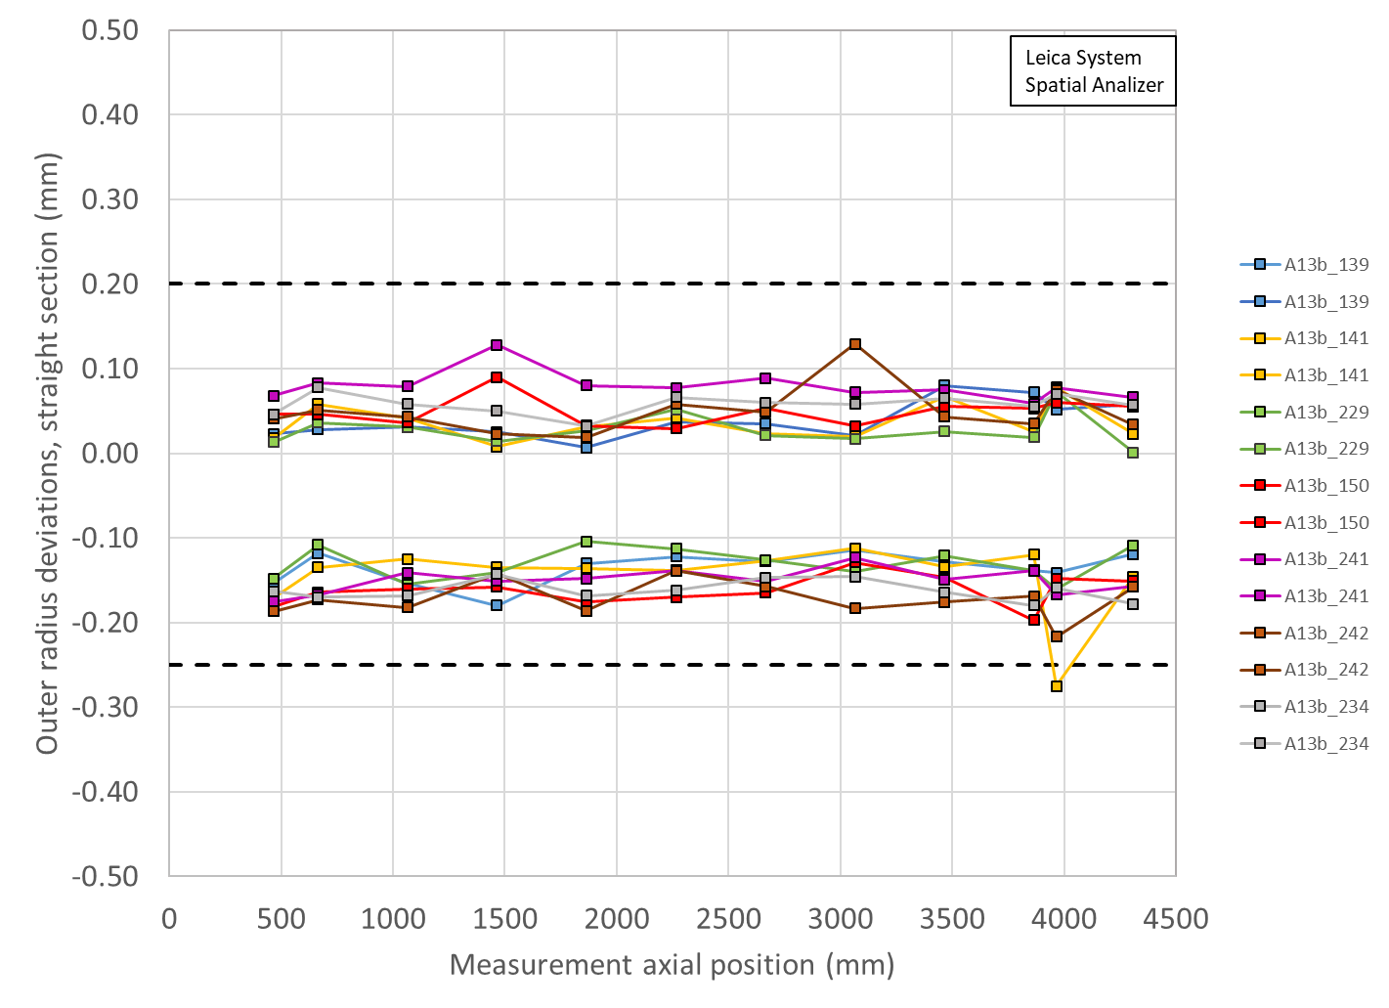
Outer radius profile deviations straight section (min-max)
A13b_139 | A13b_141 | A13b_229 | A13b_150
-0.049 | -0.051 | -0.051 | -0.058

Slide 37
Summary
Coil radial (shimmed) deviation and key/shim size
 | Ave ss | LE min | RE min | Key | Shim | Shim | Ave ss + shim | LE + shim | RE + shim
 | mm | mm | mm | mm | mils | mm | mm | mm | mm
A13b | -0.019 | -0.197 | -0.160 | ? | ? | ? | ? | ? | ?
A17 | -0.004 | -0.134 | -0.125 | 13.74 | 39 | 0.991 | 0.987 | 0.857 | 0.865
A07b | -0.015 | -0.115 | -0.080 | 13.84 | 43 | 1.092 | 1.077 | 0.977 | 1.012
A16 | 0.023 | -0.089 | -0.080 | 13.77 | 40 | 1.016 | 1.039 | 0.927 | 0.936
A15 | 0.000 | -0.099 | -0.045 | 13.72 | 38 | 0.965 | 0.965 | 0.866 | 0.920
A14b | -0.007 | -0.129 | -0.107 | 13.84 | 43 | 1.092 | 1.085 | 0.963 | 0.985
A13 | -0.004 | -0.146 | -0.094 | 13.72 | 38 | 0.965 | 0.961 | 0.819 | 0.871
A8b | 0.000 | -0.181 | -0.136 | 13.77 | 40 | 1.016 | 1.016 | 0.835 | 0.880
A11 | 0.004 | -0.124 | -0.047 | 13.74 | 39 | 0.991 | 0.995 | 0.867 | 0.944
A10 | -0.092 | -0.221 | -0.199 | 13.82 | 42 | 1.067 | 0.975 | 0.846 | 0.868
A8 | -0.029 | -0.216 | -0.172 | 13.72 | 38 | 0.965 | 0.936 | 0.749 | 0.793
A7 | -0.035 | -0.139 | -0.114 | 13.77 | 40 | 1.016 | 0.981 | 0.877 | 0.902
A6 | -0.034 | -0.138 | -0.178 | 13.72 | 38 | 0.965 | 0.931 | 0.827 | 0.787
A5 | -0.025 | -0.154 | -0.105 | 13.79 | 41 | 1.041 | 1.016 | 0.887 | 0.936

Slide 38
Summary
Coil radial (shimmed) deviation and key/shim size
 | Ave ss | OR_Ave ss | LE min | OR_LE_min | RE min | OR_RE_min | Key | Shim | Shim | Ave ss + shim | LE + shim | RE + shim
 | mm | mm | mm | mm | mm | mm | mm | mils | mm | mm | mm | mm
A13b | -0.002 |  | -0.147 |  | -0.107 |  | ? | ? | ? | ? | ? | ?
A17 | -0.004 | -0.041 | -0.134 | -0.051 | -0.125 | -0.061 | 13.74 | 39 | 0.9906 | 0.987 | 0.857 | 0.865
A07b | -0.015 | -0.022 | -0.115 | -0.046 | -0.080 | -0.044 | 13.84 | 43 | 1.092 | 1.077 | 0.977 | 1.012
A16 | 0.023 | -0.044 | -0.089 | -0.065 | -0.080 | -0.072 | 13.77 | 40 | 1.016 | 1.039 | 0.927 | 0.936
A15 | 0.000 | -0.028 | -0.099 | -0.049 | -0.045 | -0.036 | 13.82 | 42 | 1.0668 | 1.067 | 0.968 | 1.022
A14b | -0.007 | -0.029 | -0.129 | -0.055 | -0.107 | -0.050 | 13.84 | 43 | 1.092 | 1.085 | 0.963 | 0.985
A13 | -0.004 | -0.054 | -0.146 | -0.079 | -0.094 | -0.070 | 13.72 | 38 | 0.965 | 0.961 | 0.819 | 0.871
A8b | 0.000 | -0.025 | -0.181 | -0.067 | -0.136 | -0.061 | 13.77 | 40 | 1.016 | 1.016 | 0.835 | 0.880
A11 | 0.004 | -0.043 | -0.124 | -0.070 | -0.047 | -0.051 | 13.74 | 39 | 0.991 | 0.995 | 0.867 | 0.944
A10 | -0.092 | -0.053 | -0.221 | -0.078 | -0.199 | -0.074 | 13.82 | 42 | 1.067 | 0.975 | 0.846 | 0.868
A8 | -0.029 |  | -0.216 |  | -0.172 |  | 13.72 | 38 | 0.965 | 0.936 | 0.749 | 0.793
A7 | -0.035 |  | -0.139 |  | -0.114 |  | 13.77 | 40 | 1.016 | 0.981 | 0.877 | 0.902
A6 | -0.034 | -0.020 | -0.138 | -0.024 | -0.178 | -0.051 | 13.72 | 38 | 0.965 | 0.931 | 0.827 | 0.787
A5 | -0.025 | NA | -0.154 | NA | -0.105 | NA | 13.79 | 41 | 1.041 | 1.016 | 0.887 | 0.936
OD | min | max | avg
Original | -0.062 | 0.053 | 0.002
5mil | -0.022 | 0.092 | 0.038
3mil | -0.038 | 0.076 | 0.024
2mil | -0.046 | 0.068 | 0.016

Slide 39
Summary
Coil radial (shimmed) deviation and key/shim size
The fitting of the outer profile with nominal OR + mid-planes introduces an OR deviation of
  Straight section
    From -0.022 mm to -0.054 mm
  RE
    From -0.046 mm to -0.078 mm
  LE
    From -0.036 mm to -0.074 mm
Therefore
  For azimuthally smaller coils, we have a systematic negative deviation in the OR
  The variation magnet to magnet is of the order of 1 mil in the straight section
  The variation magnet to magnet is of the order of 1-2 mil in the ends

Slide 40
What if we fit including the mid-plane shim?
Case 1: smaller coil
Coil 242, position 1465 mm
After fitting with nominal coil geometry (OR + mid-plane) we get
  Average mid-plane deviation: -0.160 mm
  OR deviation: -0.058 mm
Adding a 0.126 mm (5 mils) per side on the mid-plane reduces the OR deviation from -0.058 mm to -0.024 mm
The reduction is in OR deviation is proportional to the mid-plane correction

Slide 41
What if we fit including the mid-plane shim?
Case 2: nominal coil
Coil 213, position 1465 mm
After fitting with nominal coil geometry (OR + mid-plane) we get
  Average mid-plane deviation: +0.008 mm
  OR deviation: 0.002 mm
The OR deviation is minimal for almost nominal coil (kind of obvious)
Adding a 0.126 mm (5 mils) per side on the mid-plane introduces a OR deviation of +0.038 mm

Slide 42
Appendix

Slide 43
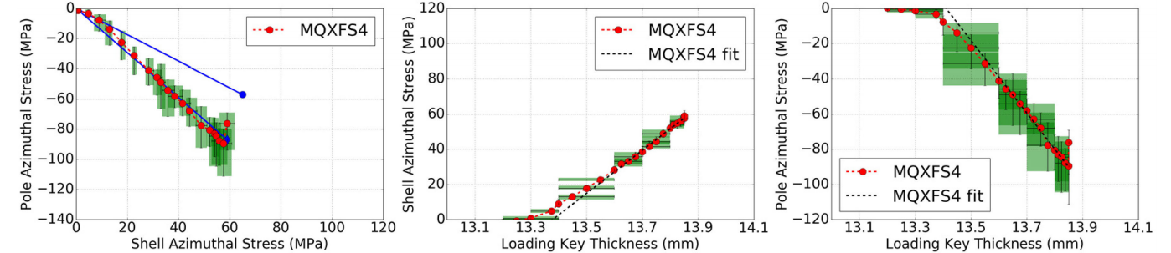
Magnet assembly and loading
Sensitivity analysis
+0.100 mm of coil outer radius increase
  -20 MPa of coil stress variation
  +12 MPa of shell stress variation
+0.100 mm of total coil arc-length increase (0.050 per mid-plane)
  -13 MPa of coil stress variation
  +8 MPa of shell stress variation
FE values confirmed in short models, like MQXFS4
By E. Takala

Slide 44


Slide 45


