Slide 1
MQXFA12b coil dimensions
P. Ferracin, Dan Cheng, Jennifer Doyle, Katherine Ray, Michael Solis
on behalf of the MQXF collaboration
MQXFA13b Coils Acceptance Review
January 23rd, 2024
LBNL, Berkeley, CA, USA

Slide 2
Outline
Data taking and processing
Impregnated coil dimensional tolerances
Results (straight section)
Arc length excess
Outer radius profile deviation
Inner radial deviations (coil blocks)
Inner radial deviations (pole)
Key slot deviations
Best-fit outer radius
Appendix

Slide 3
Outline
Data taking and processing
Impregnated coil dimensional tolerances
Results (straight section)
Arc length excess
Outer radius profile deviation
Inner radial deviations (coil blocks)
Inner radial deviations (pole)
Key slot deviations
Best-fit outer radius
Appendix

Slide 4
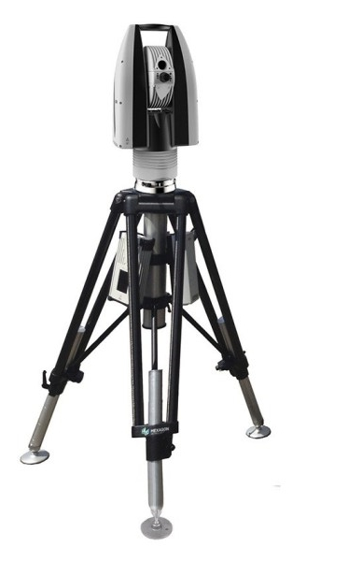
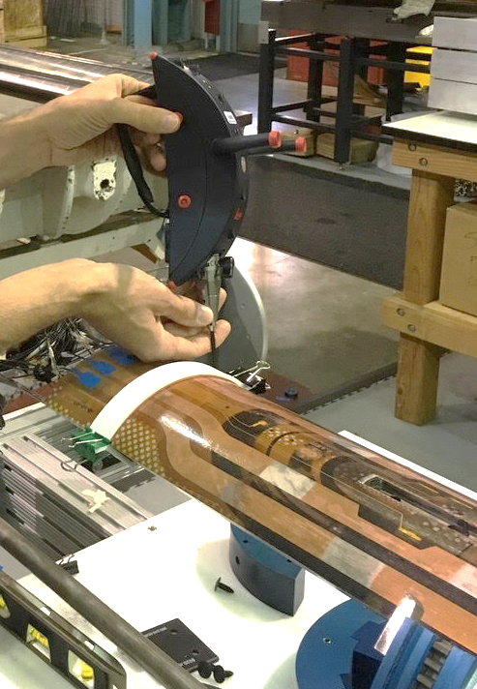
Data taking and processing
Leica System
AT960 with T-Probe
Data processed using
Spatial Analyzer

Slide 5
Post processing
Each cross section is treated separately.
Coils cross-sections are measured in 15 different locations along the coil length, from 70 mm close to the lead end to 4426 mm close to the return end.
The 12 so-called straight section locations, where the pole key slot is present, are from 465 mm close to the lead end to 4310 mm close to the return end.
The strain gauge is at location 3965 mm.

Slide 6
Outline
Data taking and processing
Impregnated coil dimensional tolerances
Results (straight section)
Arc length excess
Outer radius profile deviation
Inner radial deviations (coil blocks)
Inner radial deviations (pole)
Key slot deviations
Best-fit outer radius
Appendix

Slide 7
Impregnated coil dimensional tolerances (for series coils)

Slide 8
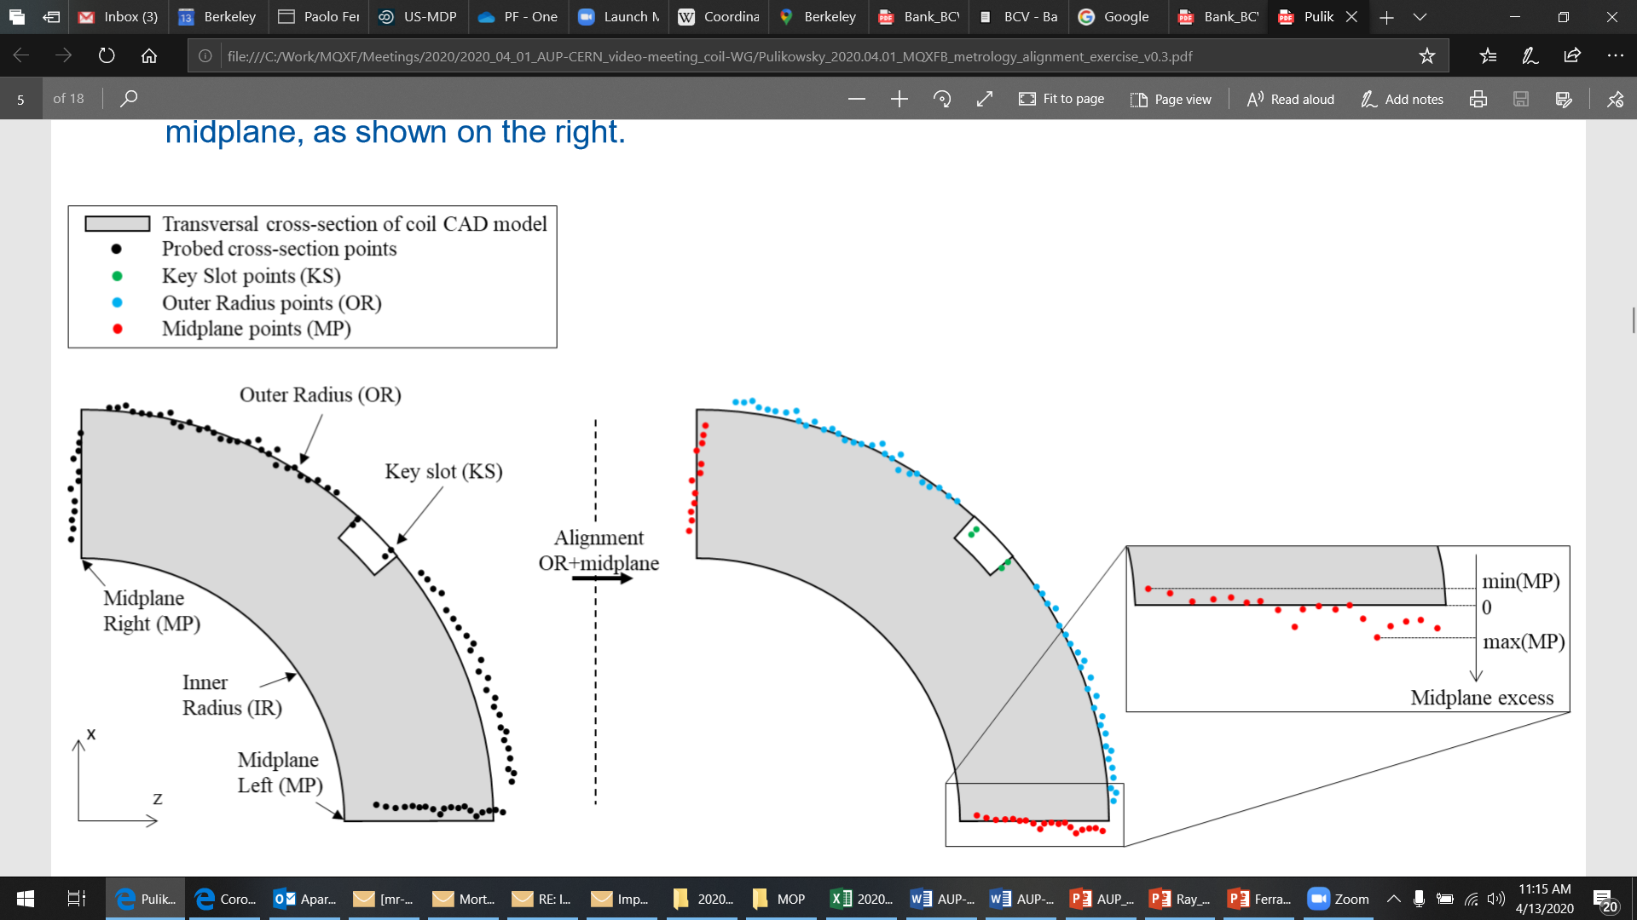
Impregnated coil dimensional tolerances Arc length excess (straight section)
The impregnated coil is accepted for use in MQXFA if its arc length excesses along the straight section are within the following tolerances: +0.150/-0.250 mm
The arc length excess, which is difference between the measured coil arc length and the nominal one, is determined by fitting outer radius and mid-planes points with the nominal profile, with equal weighting and imposing as symmetrical the two mid-planes offsets. The sum of the two measured mid-plane offsets provides the arc length excess

Slide 9
Impregnated coil dimensional tolerances Arc length excess (ends)
At 260 and 300 mm (for the lead end) and at 4340 and 4380 mm (for the return end) the absolute value of the coil delta arc-length must not exceed 210 mm.
The coil delta arc-length is the difference between the coil arc length at each location in the ends and the average coil arc-length in the straight section.

Slide 10
Impregnated coil dimensional tolerances Outer radius profile deviation
The impregnated coil is accepted for use in MQXFA if its outer radius profile deviations along the straight section are within the following tolerances: +0.200/-0.250 mm
The outer radius profile deviation, which is given by the variation of each point on the outer radius with respect to the nominal outer radius, is determined by fitting outer radius and mid-planes points with the nominal profile, with equal weighting and imposing as symmetrical the two mid-planes offsets. Positive deviation indicates more material than nominal, negative indicates less material than nominal.

Slide 11
Impregnated coil dimensional tolerances “Coil blocks” inner radius profile deviation
The impregnated coil is accepted for use in MQXFA if its “coil blocks” inner radius profile deviations (E-F in next slide) along the straight section are within the following tolerances: +0.150/-0.250 mm
The “coil blocks” inner radius profile deviations, which is given by the variation of each point on the inner radius with respect to the nominal radius, is determined by fitting outer radius and mid-planes points with the nominal profile, with equal weighting and imposing as symmetrical the two mid-planes offsets. Positive deviation indicates more material than nominal, negative indicates less material than nominal.

Slide 12
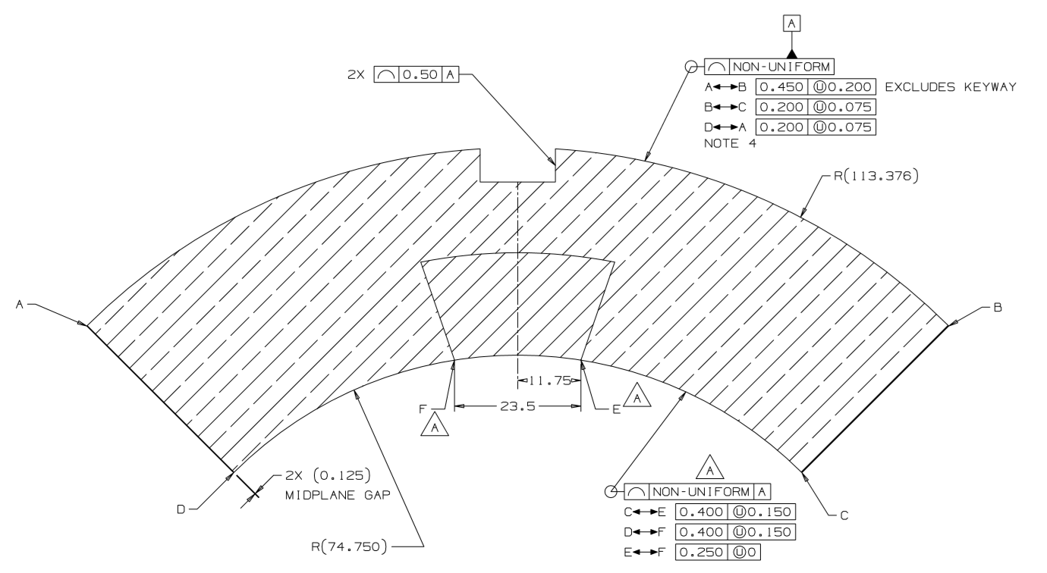
Impregnated coil dimensional tolerances

Slide 13
Impregnated coil dimensional tolerances “Pole” inner radius profile deviation
The impregnated coil is accepted for use in MQXFA if its “pole” inner radius profile deviations (C-E and D-F in next slide) along the straight section are within the following tolerances: +0.000/-0.250 mm*
The “pole” inner radius profile deviations, which is given by the variation of each point on the inner radius with respect to the nominal radius, is determined by fitting outer radius and mid-planes points with the nominal profile, with equal weighting and imposing as symmetrical the two mid-planes offsets. Positive deviation indicates more material than nominal, negative indicates less material than nominal.

Slide 14
Impregnated coil dimensional tolerances
* Cross-section measurements shall be taken close to all possible bumper locations. In addition, data shall be taken on the surface surrounding the pole holes where bumpers are inserted and projected on the closest measured cross-section.

Slide 15
Impregnated coil dimensional tolerances Pole key slot mis-alignment
The impregnated coil is accepted for use in MQXFA if its pole key slot mis-alignment along the straight section are within the following tolerances: +0.250/-0.250 mm
The pole key slot mis-alignment, which is the misalignment of the center of the pole key slot with respect to the nominal position, is determined by fitting outer radius and mid-planes points with the nominal profile, with equal weighting and imposing as symmetrical the two mid-planes offsets.
View from LE, positive shift towards left

Slide 16
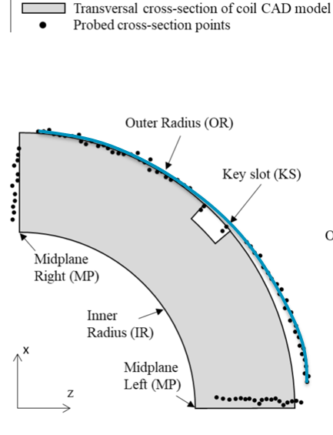
Best-fit outer radius
The best-fit outer radius is determined by best-fitting only the outer radius points.
No tolerance is specified
Used to monitor coil-to-collar contact surfaces (“LQ effect”)

Slide 17
Outline
Data taking and processing
Impregnated coil dimensional tolerances
Results (straight section)
Arc length excess
Delta arc length excess straight section - ends
Outer radius profile deviation
Inner radial deviations (coil blocks)
Inner radial deviations (pole)
Key slot deviations
Best-fit outer radius
Appendix

Slide 18
Arc length excess

Slide 19
Impregnated coil dimensional tolerances Arc length excess (straight section)
The impregnated coil is accepted for use in MQXFA if its arc length excesses along the straight section are within the following tolerances: +0.150/-0.250 mm
The arc length excess, which is difference between the measured coil arc length and the nominal one, is determined by fitting outer radius and mid-planes points with the nominal profile, with equal weighting and imposing as symmetrical the two mid-planes offsets. The sum of the two measured mid-plane offsets provides the arc length excess

Slide 20
Arc length excess straight section

Slide 21
Arc length excess straight section

Slide 22
Arc length excess straight section
Conclusions
All coils with several points out of spec
Action items
The coils will be shimmed on the mid-plane to compensate

Slide 23
Outline
Data taking and processing
Impregnated coil dimensional tolerances
Results (straight section)
Arc length excess
Delta arc length excess straight section - ends
Outer radius profile deviation
Inner radial deviations (coil blocks)
Inner radial deviations (pole)
Key slot deviations
Best-fit outer radius
Appendix

Slide 24
Impregnated coil dimensional tolerances Arc length excess (ends)
At 260 and 300 mm (for the lead end) and at 4340 and 4380 mm (for the return end) the absolute value of the coil delta arc-length must not exceed 210 mm.
The coil delta arc-length is the difference between the coil arc length at each location in the ends and the average coil arc-length in the straight section.

Slide 25
Arc length excess full length

Slide 26
Arc length excess LE

Slide 27
Arc length excess RE

Slide 28
Delta between arc length excess straight section and spacer-wedge transition

Slide 29
Delta arc length excess straight section - ends
Conclusions
All coils except 150 within spec
225 and 225 both before and after the loading
150 marginally out of spec
Action items
No action items

Slide 30
Outline
Data taking and processing
Impregnated coil dimensional tolerances
Results (straight section)
Arc length excess
Delta arc length excess straight section - ends
Outer radius profile deviation
Inner radial deviations (coil blocks)
Inner radial deviations (pole)
Key slot deviations
Best-fit outer radius
Appendix

Slide 31
Outer radius profile deviation

Slide 32
Impregnated coil dimensional tolerances Outer radius profile deviation
The impregnated coil is accepted for use in MQXFA if its outer radius profile deviations along the straight section are within the following tolerances: +0.200/-0.250 mm
The outer radius profile deviation, which is given by the variation of each point on the outer radius with respect to the nominal outer radius, is determined by fitting outer radius and mid-planes points with the nominal profile, with equal weighting and imposing as symmetrical the two mid-planes offsets. Positive deviation indicates more material than nominal, negative indicates less material than nominal.

Slide 33
Outer radius profile deviations straight section (min-max)

Slide 34
Outer radius profile deviations straight section

Slide 35
Outer radius profile deviations straight section
Conclusions
All coils within spec
Action items
No action items

Slide 36
Outline
Data taking and processing
Impregnated coil dimensional tolerances
Results (straight section)
Arc length excess
Delta arc length excess straight section - ends
Outer radius profile deviation
Inner radial deviations (coil blocks)
Inner radial deviations (pole)
Key slot deviations
Best-fit outer radius
Appendix

Slide 37
Inner radial deviations (coil blocks)

Slide 38
Impregnated coil dimensional tolerances “Coil blocks” inner radius profile deviation
The impregnated coil is accepted for use in MQXFA if its “coil blocks” inner radius profile deviations (E-F in next slide) along the straight section are within the following tolerances: +0.150/-0.250 mm
The “coil blocks” inner radius profile deviations, which is given by the variation of each point on the inner radius with respect to the nominal radius, is determined by fitting outer radius and mid-planes points with the nominal profile, with equal weighting and imposing as symmetrical the two mid-planes offsets. Positive deviation indicates more material than nominal, negative indicates less material than nominal.

Slide 39
Coil blocks inner radial deviations straight section (min-max)

Slide 40
Coil blocks inner radial deviations straight section

Slide 41
Coil blocks inner radial deviations straight section
Conclusions
Some coils marginally out of spec in few positions
Action items
Non critical non conformity
Increase of LHe space between cold bore and inner coil in one location

Slide 42
Outline
Data taking and processing
Impregnated coil dimensional tolerances
Results (straight section)
Arc length excess
Delta arc length excess straight section - ends
Outer radius profile deviation
Inner radial deviations (coil blocks)
Inner radial deviations (pole)
Key slot deviations
Best-fit outer radius
Appendix

Slide 43
Inner radial deviations (pole)

Slide 44
Impregnated coil dimensional tolerances “Pole” inner radius profile deviation
The impregnated coil is accepted for use in MQXFA if its “pole” inner radius profile deviations (C-E and D-F in next slide) along the straight section are within the following tolerances: +0.000/-0.250 mm*
The “pole” inner radius profile deviations, which is given by the variation of each point on the inner radius with respect to the nominal radius, is determined by fitting outer radius and mid-planes points with the nominal profile, with equal weighting and imposing as symmetrical the two mid-planes offsets. Positive deviation indicates more material than nominal, negative indicates less material than nominal.

Slide 45
Pole inner radial deviations straight section (min-max)

Slide 46
Pole inner radial deviations straight section

Slide 47
Pole inner radial deviations straight section
Conclusions
Several out of spec positions, in all coils,
Coil bumper thickness to be corrected to compensate
Action items
Coil bumper thickness to be corrected to compensate

Slide 48
Outline
Data taking and processing
Impregnated coil dimensional tolerances
Results (straight section)
Arc length excess
Delta arc length excess straight section - ends
Outer radius profile deviation
Inner radial deviations (coil blocks)
Inner radial deviations (pole)
Key slot deviations
Best-fit outer radius
Appendix

Slide 49
Key slot deviations*
*View from LE, positive shift towards left

Slide 50
Impregnated coil dimensional tolerances Pole key slot mis-alignment
The impregnated coil is accepted for use in MQXFA if its pole key slot mis-alignment along the straight section are within the following tolerances: +0.250/-0.250 mm
The pole key slot mis-alignment, which is the misalignment of the center of the pole key slot with respect to the nominal position, is determined by fitting outer radius and mid-planes points with the nominal profile, with equal weighting and imposing as symmetrical the two mid-planes offsets.
View from LE, positive shift towards left

Slide 51
Key slot deviations

Slide 52
Key slot deviations

Slide 53
Key slot deviations
Conclusions
No data out of spec
*See LBNL note and Record of Decision in Docdb-2844

Slide 54
Outline
Data taking and processing
Impregnated coil dimensional tolerances
Results (straight section)
Arc length excess
Delta arc length excess straight section - ends
Outer radius profile deviation
Inner radial deviations (coil blocks)
Inner radial deviations (pole)
Key slot deviations
Best-fit outer radius
Appendix

Slide 55
Best-fit outer radius
The best-fit outer radius is determined by best-fitting only the outer radius points.
No tolerance is specified
Used to monitor coil-to-collar contact surfaces (“LQ effect”)

Slide 56
Best-fit outer radius deviations

Slide 57
Best-fit outer radius deviations

Slide 58
Best-fit outer radius deviations
Conclusions
Data consistent with previous magnets

Slide 59
Out of specs
Arc length excess
All coils several points out of spec
The coils will be shimmed on the mid-plane to compensate
Delta arc length excess straight section – ends
All coils except 150 within spec
225 and 225 both before and after the loading
150 marginally out of spec
Outer radius profile deviation
All coils within spec
Inner radial deviations (coil blocks)
Some coils marginally out of spec in few positions
Non critical non conformity
Increase of LHe space between cold bore and inner coil in one location
Inner radial deviations (pole)
Several out of spec positions, in all coils,
Coil bumper thickness to be corrected to compensate
Key slot deviations
No data out of spec
Best-fit outer radius deviations
Data consistent with previous magnets

Slide 60
Outline
Data taking and processing
Impregnated coil dimensional tolerances
Results (straight section)
Arc length excess
Delta arc length excess straight section - ends
Outer radius profile deviation
Inner radial deviations (coil blocks)
Inner radial deviations (pole)
Key slot deviations
Best-fit outer radius
Appendix

Slide 61
Appendix

Slide 62
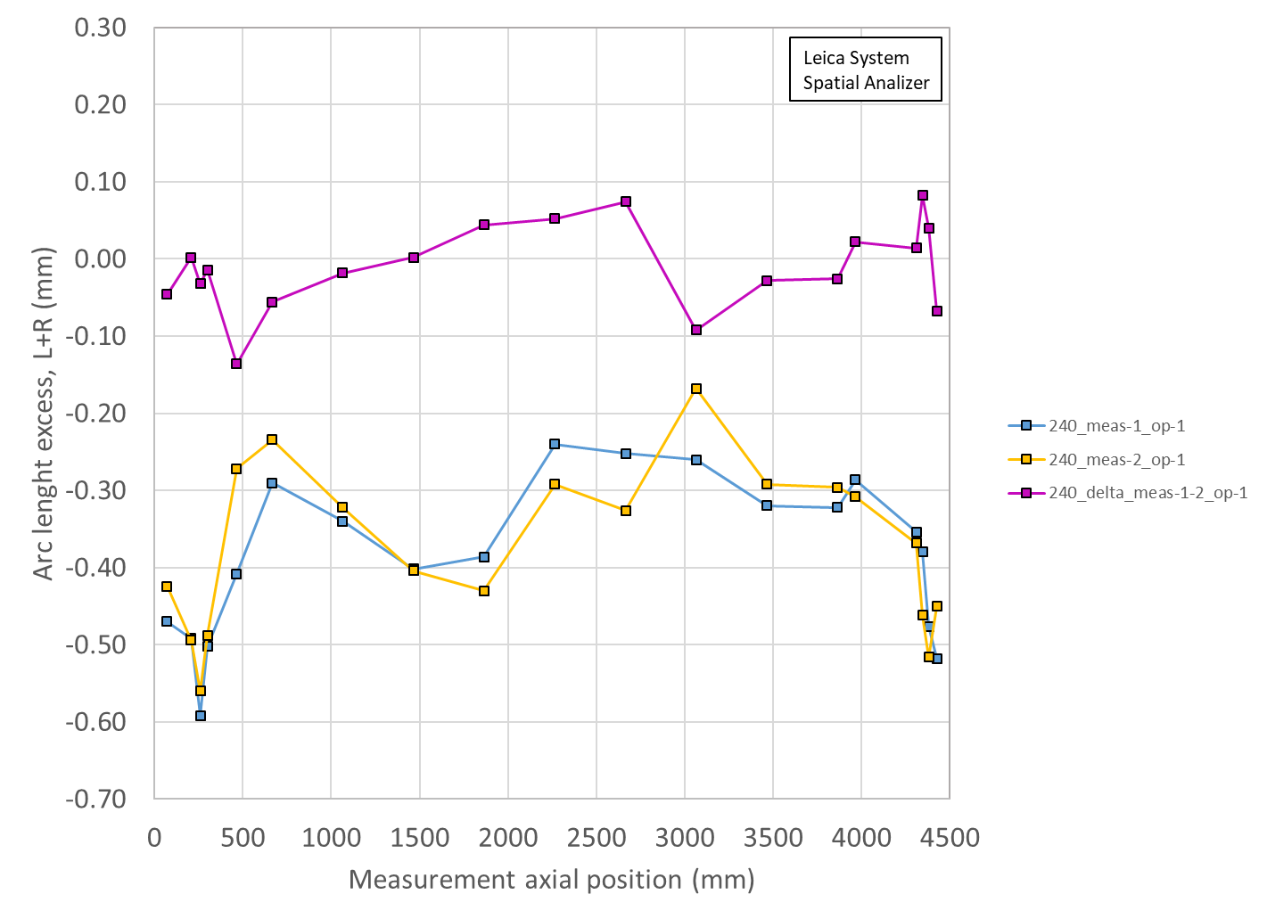
Reproducibility
Coil 240, same operator, 2 independent meas.

Slide 63
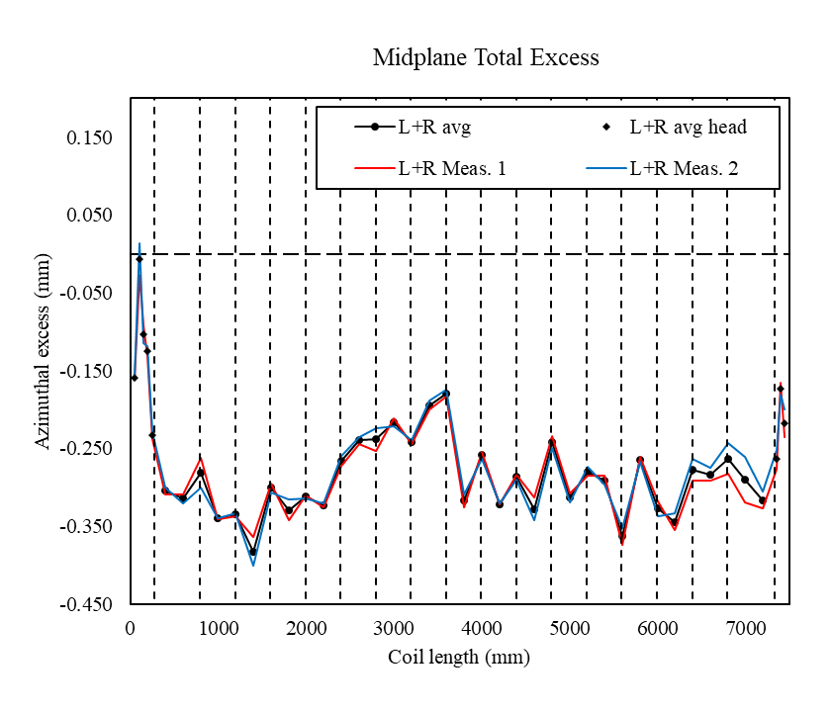
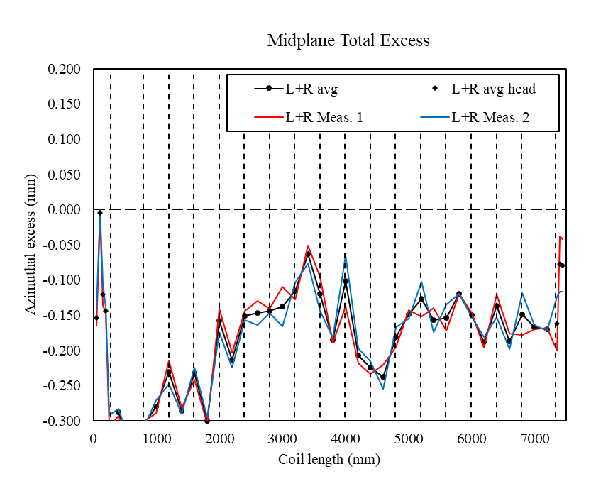
CERN coil 140 and 139

Slide 64
Arc length excess straight section

Slide 65
Arc length excess straight section (with min/max straight sect and full-length)

