Slide 1
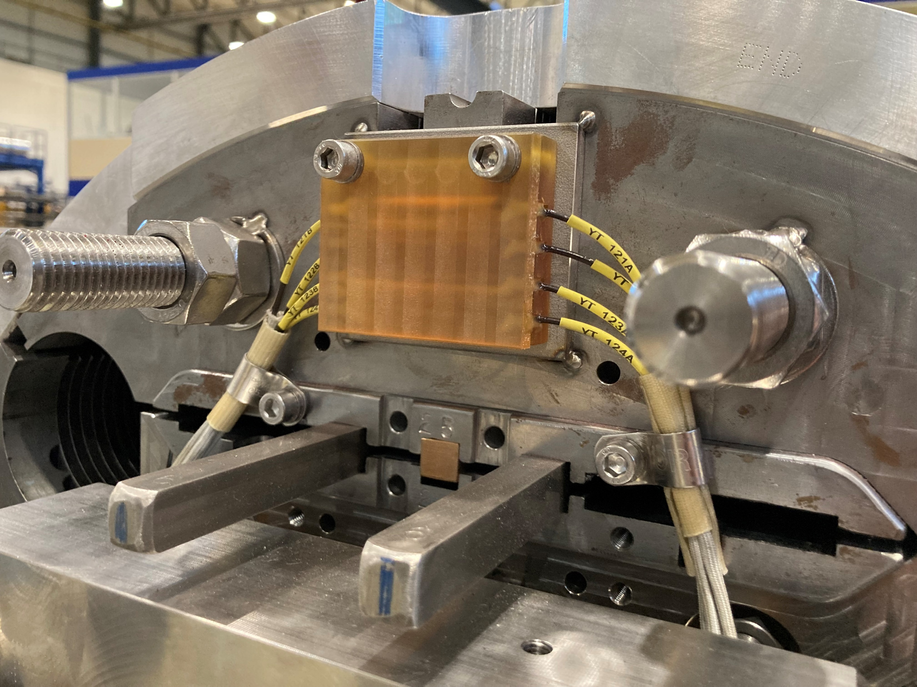
CERN
Magnet, Non-LE
FN
2/13/24

Slide 2
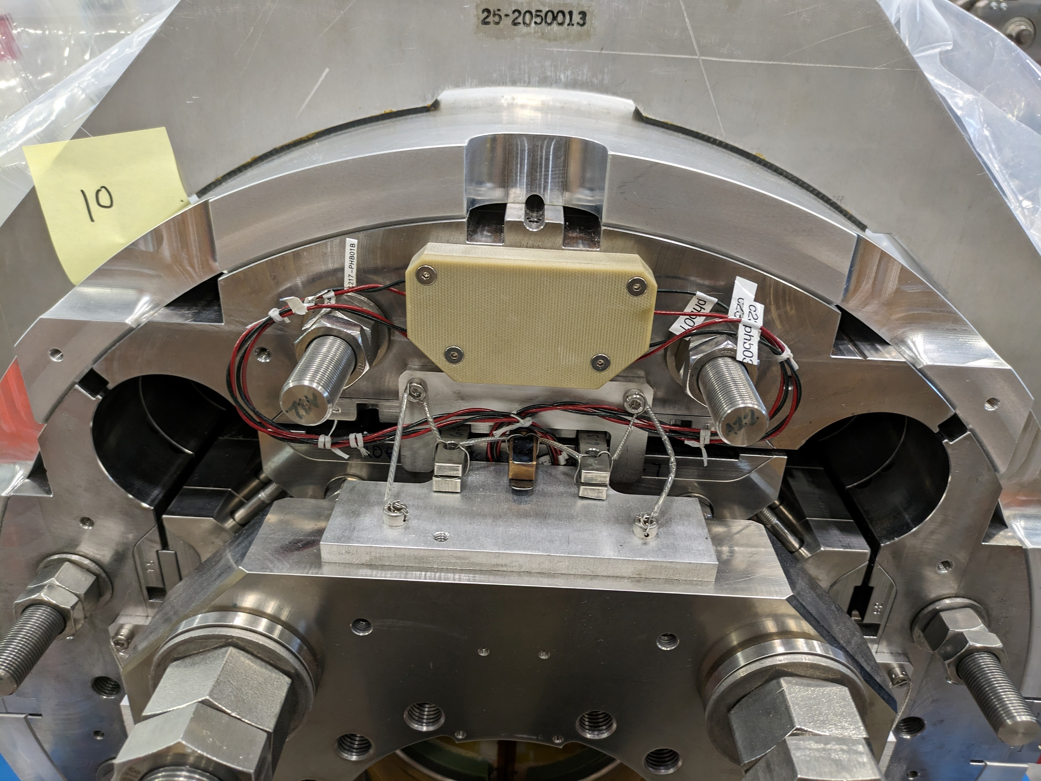
FNAL
Non-LE MQXB
FN
2/13/24

Slide 3
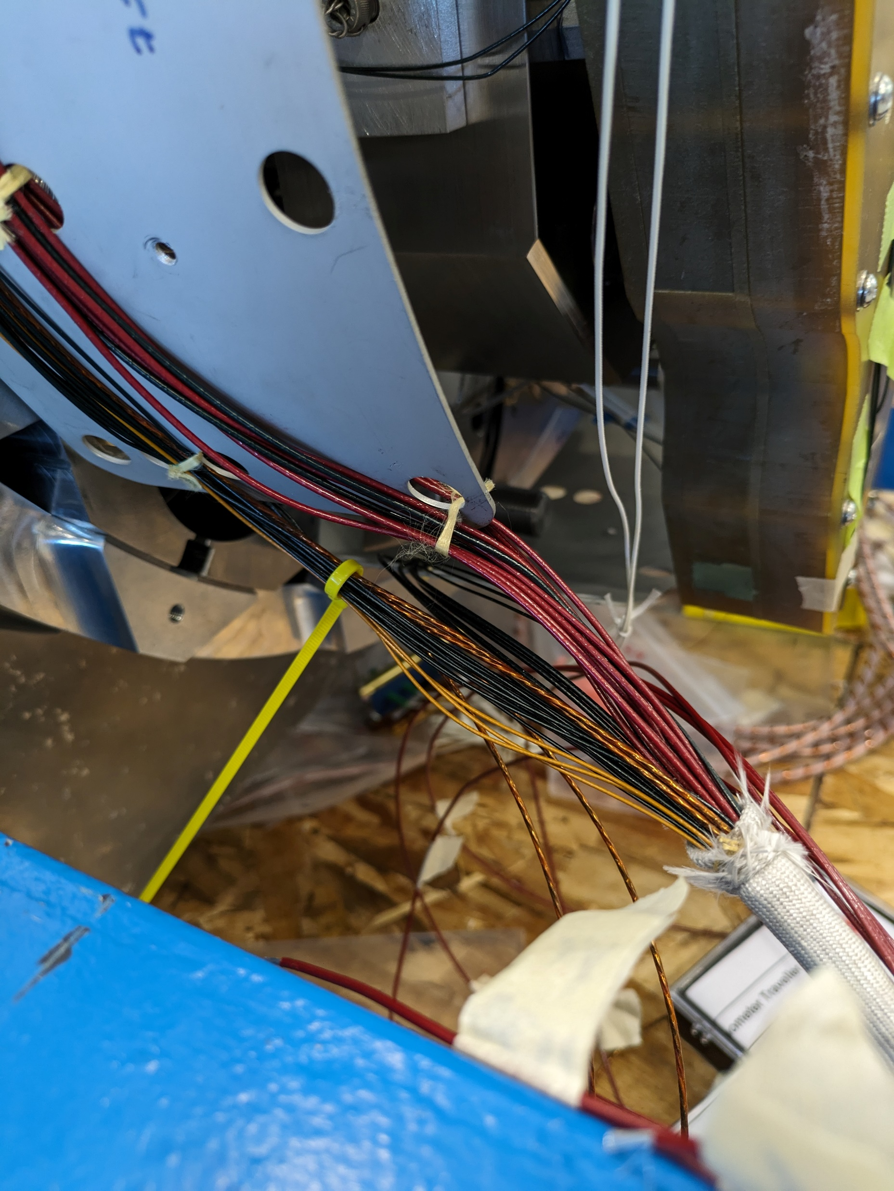
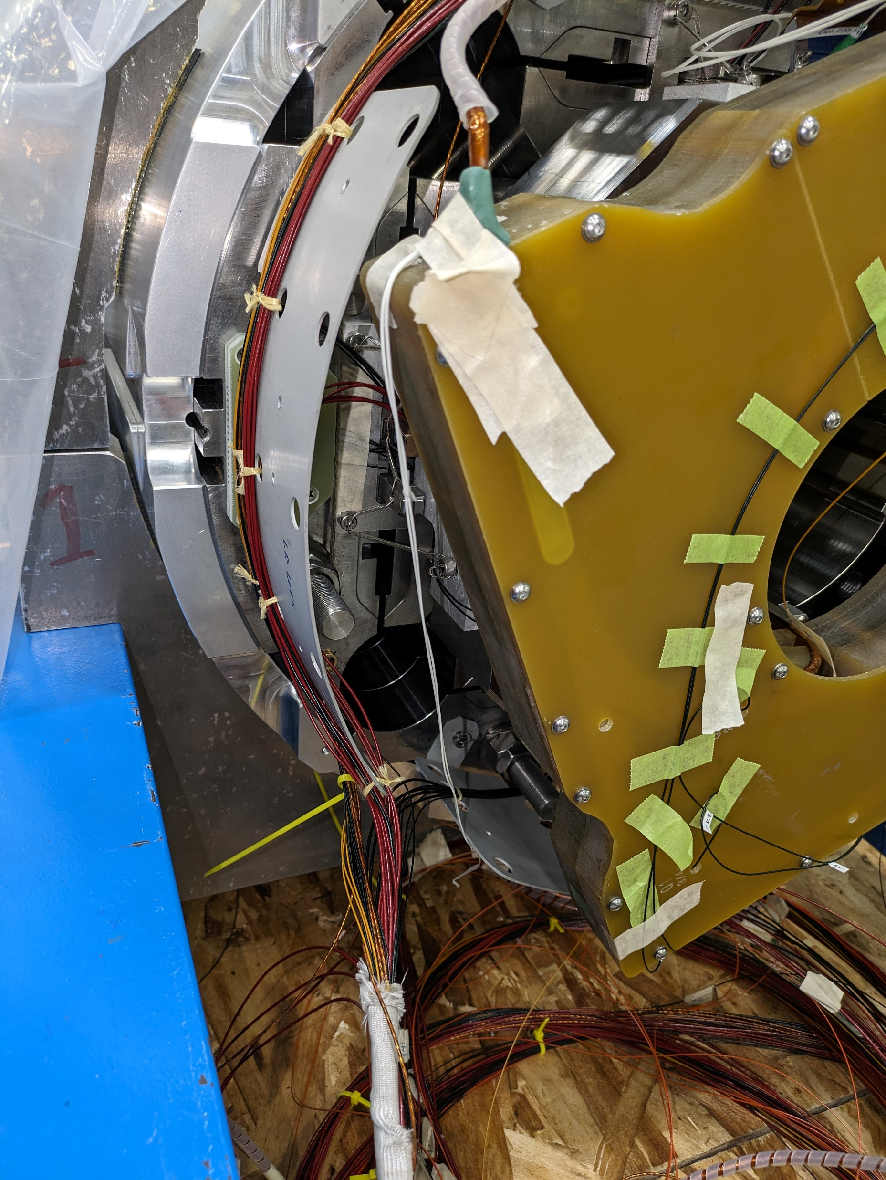
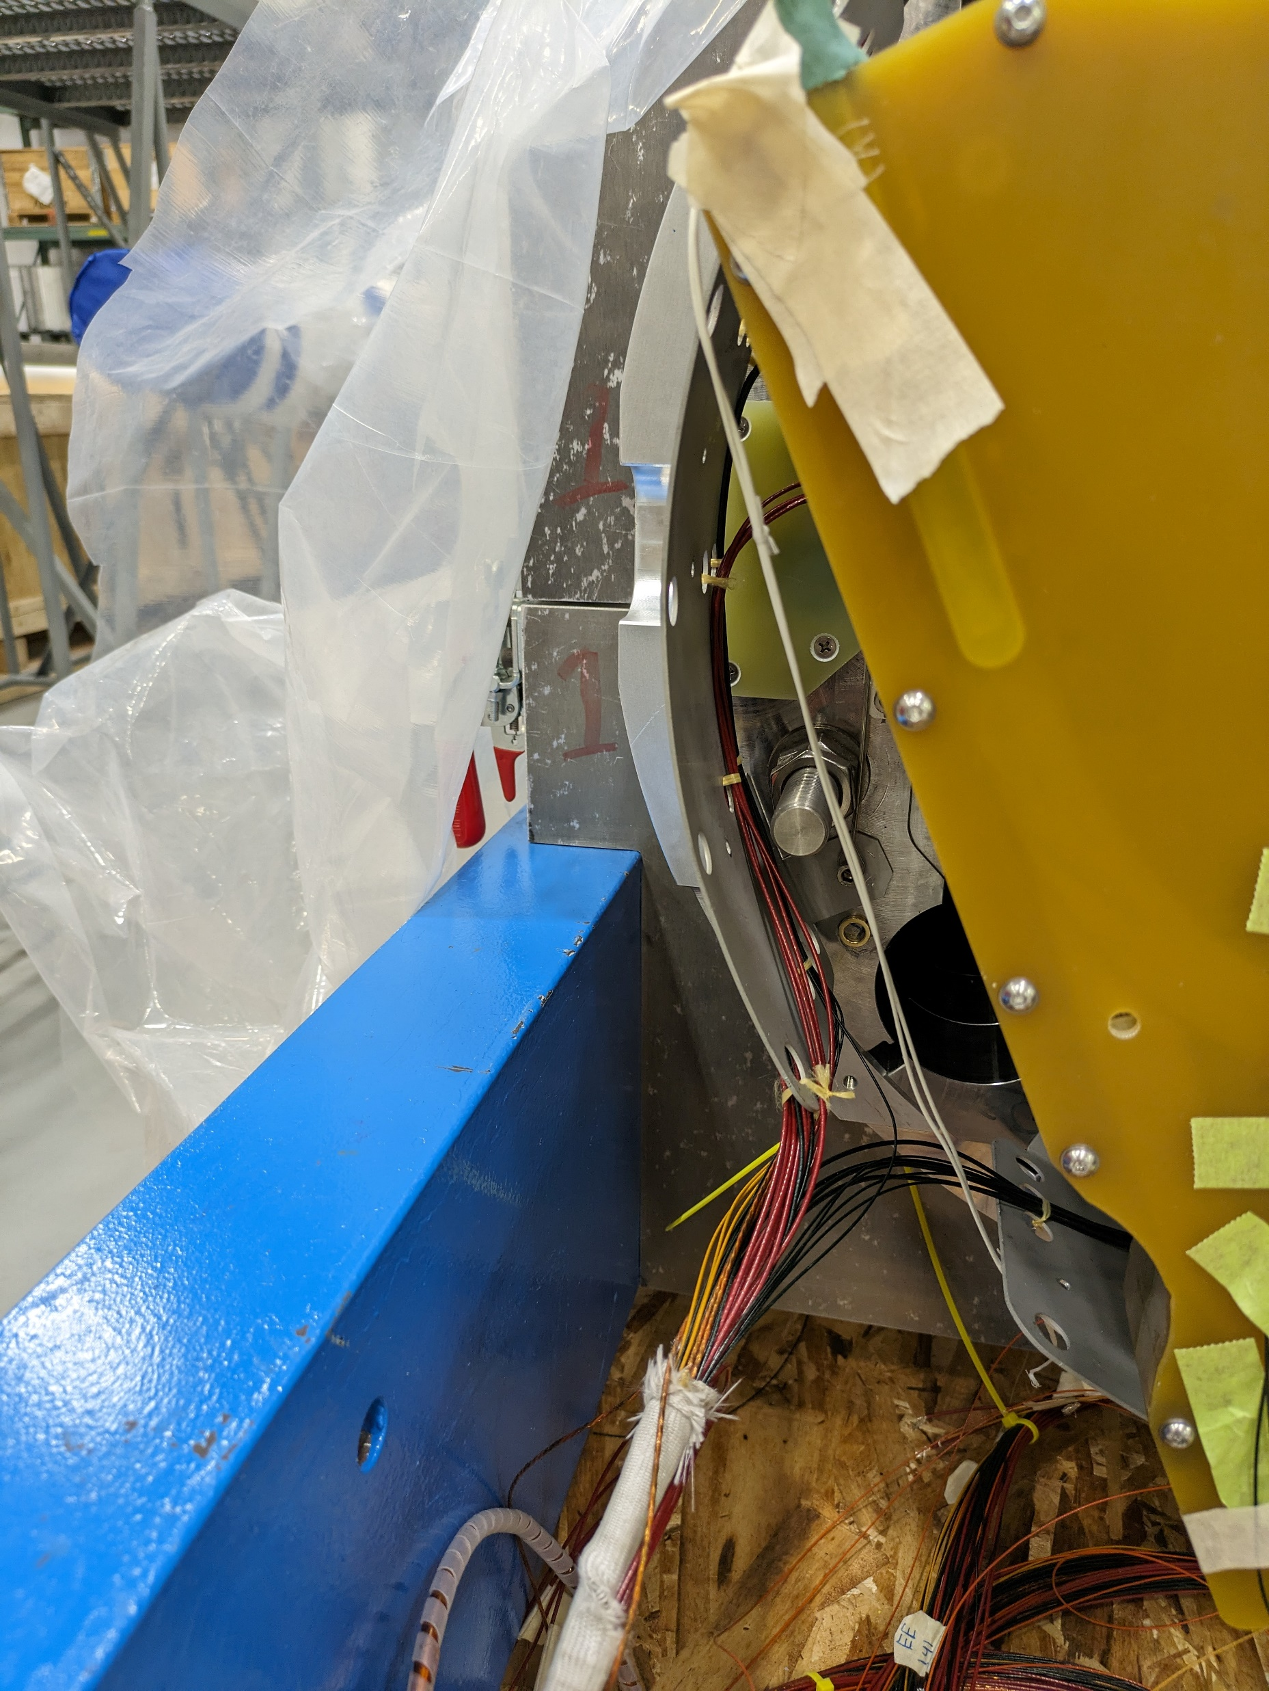
FNAL
LE Skirt, MQXB
FN
2/13/24

