Slide 1
IERC News (FEB 15, 2024)
Repair work on the leak on the 1st floor near Fritz Schwartz office should have started today but it has been postponed.
We had a meeting this morning with ISD in order to agree on how to proceed with the interdependence between ISD maintained equipment and the ODH analysis of our lab spaces. Some progress but still more work to do.
With Adam we did some more investigation on the Chilled water circuit and clearly is not working as it should.
We plan to have a walk through with Blake Hanauer soon to identify the spot for the installation of the filter and understand a bit better how the system actually works.

Slide 2
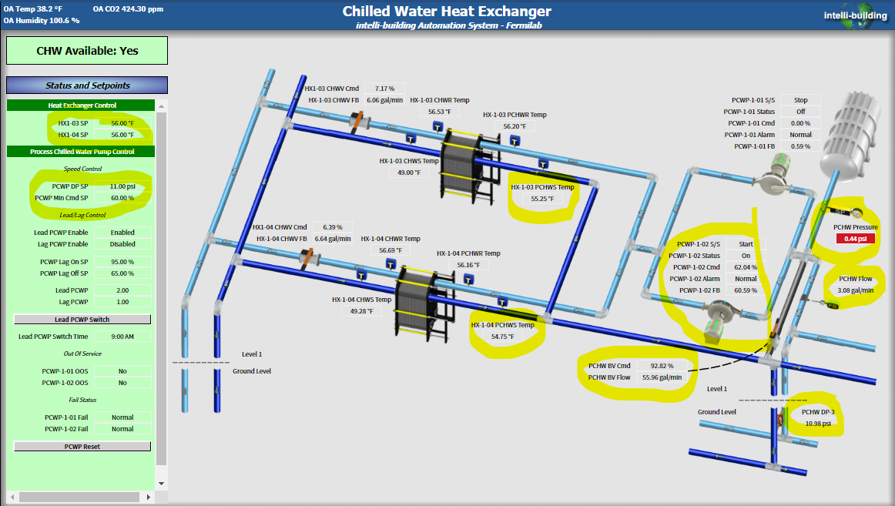
IERC News (FEB 15, 2024)

Slide 3
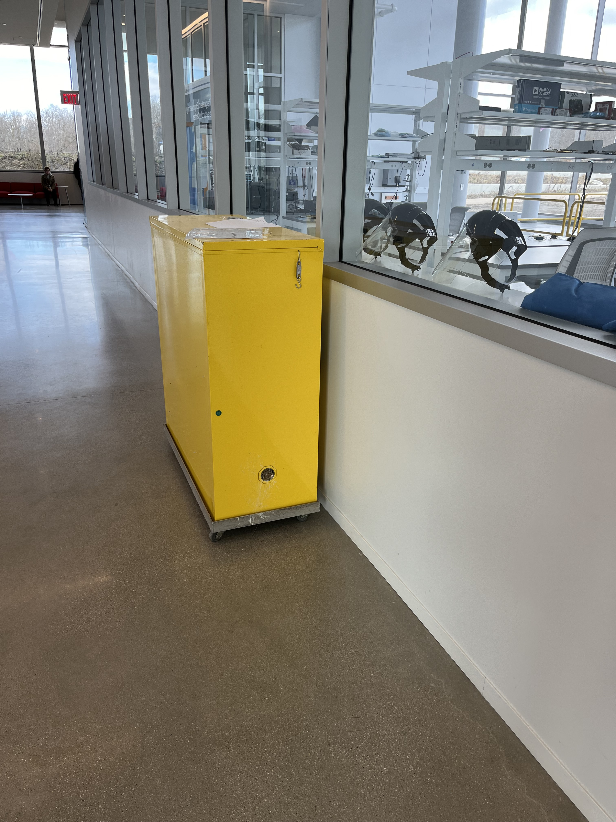
IERC News (FEB 15, 2024)
An extra fire cabinet has been shipped from SiDet and is a IERC now. A second fire cabinet is in G-West (G-723). They should be used to store the flammable material that was moved out of the large conference room and is now in the mechanical room on the 1st floor.
Next week I have invited Wally Levernier to update us on the issue of the birds hitting the IERC windows.
With Donna we installed a T/RH sensor in the G211 clean room to track Temperature and humidity. We record every 5 minutes 24/7

Slide 4
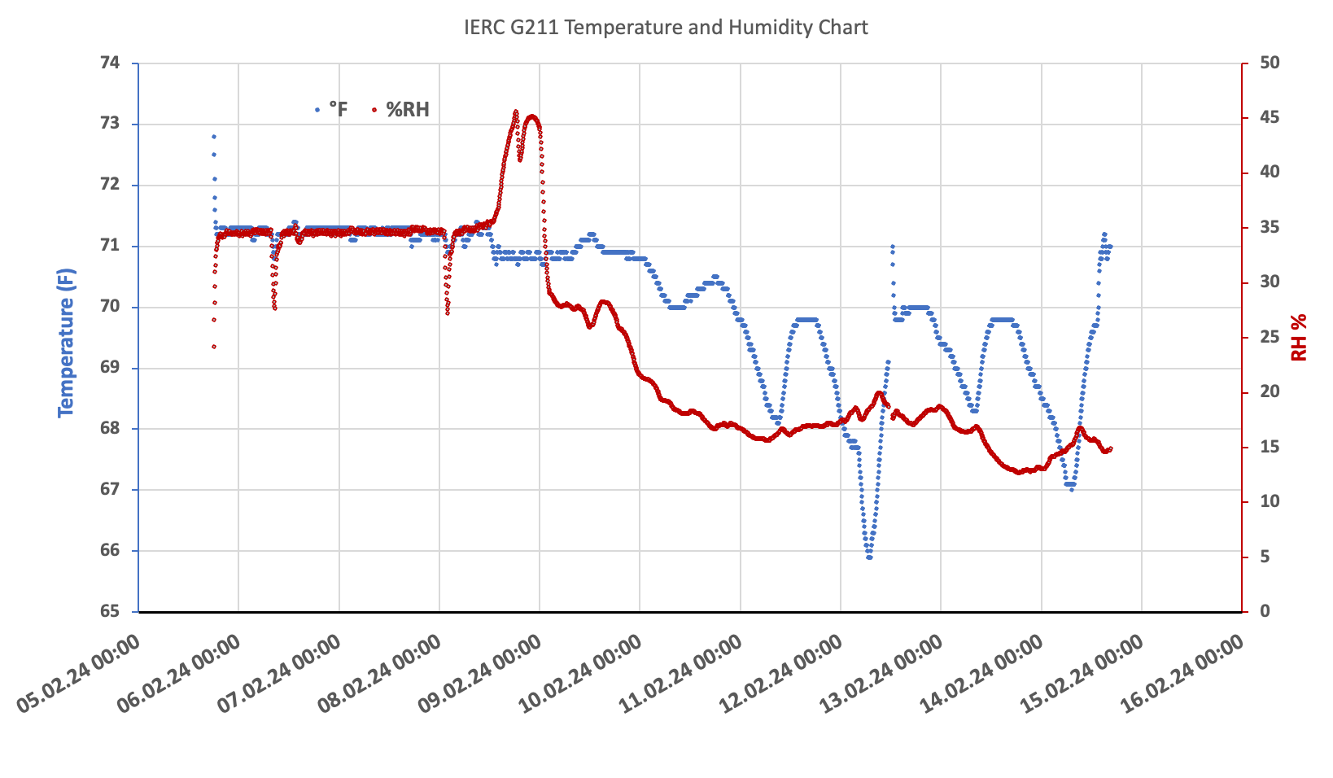
IERC News (FEB 15, 2024)
42%
35%
What are these events?
What happened here?
FEB 8 between 12:00 and 13:00

Slide 5
From Previous Meetings

Slide 6
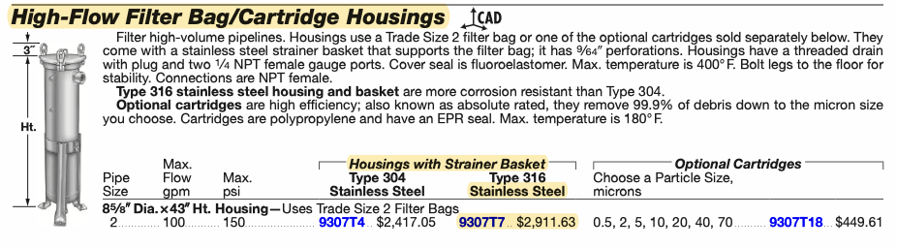
IERC News (FEB 8, 2024)
Chilled water circuit:
Blake Hanauer from ISD is proposing to use the same style unit filter that already installed in other areas throughout the lab. With ISD Ops taking care of the filter changes and chemical treatments it is best we keep a universal system in place rather than stocking parts and filters for many different applications. This is good and we are waiting for a quote on the work for the replacement.

Slide 7
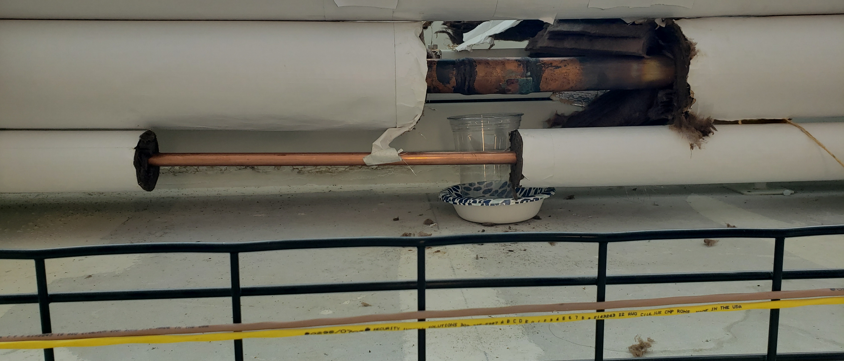
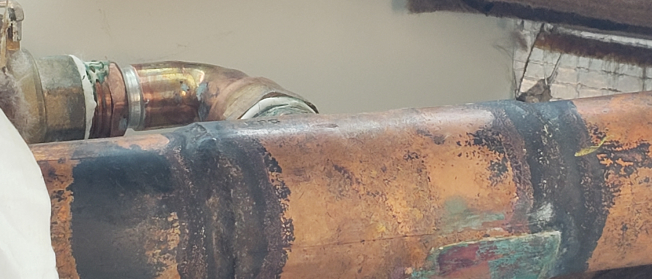
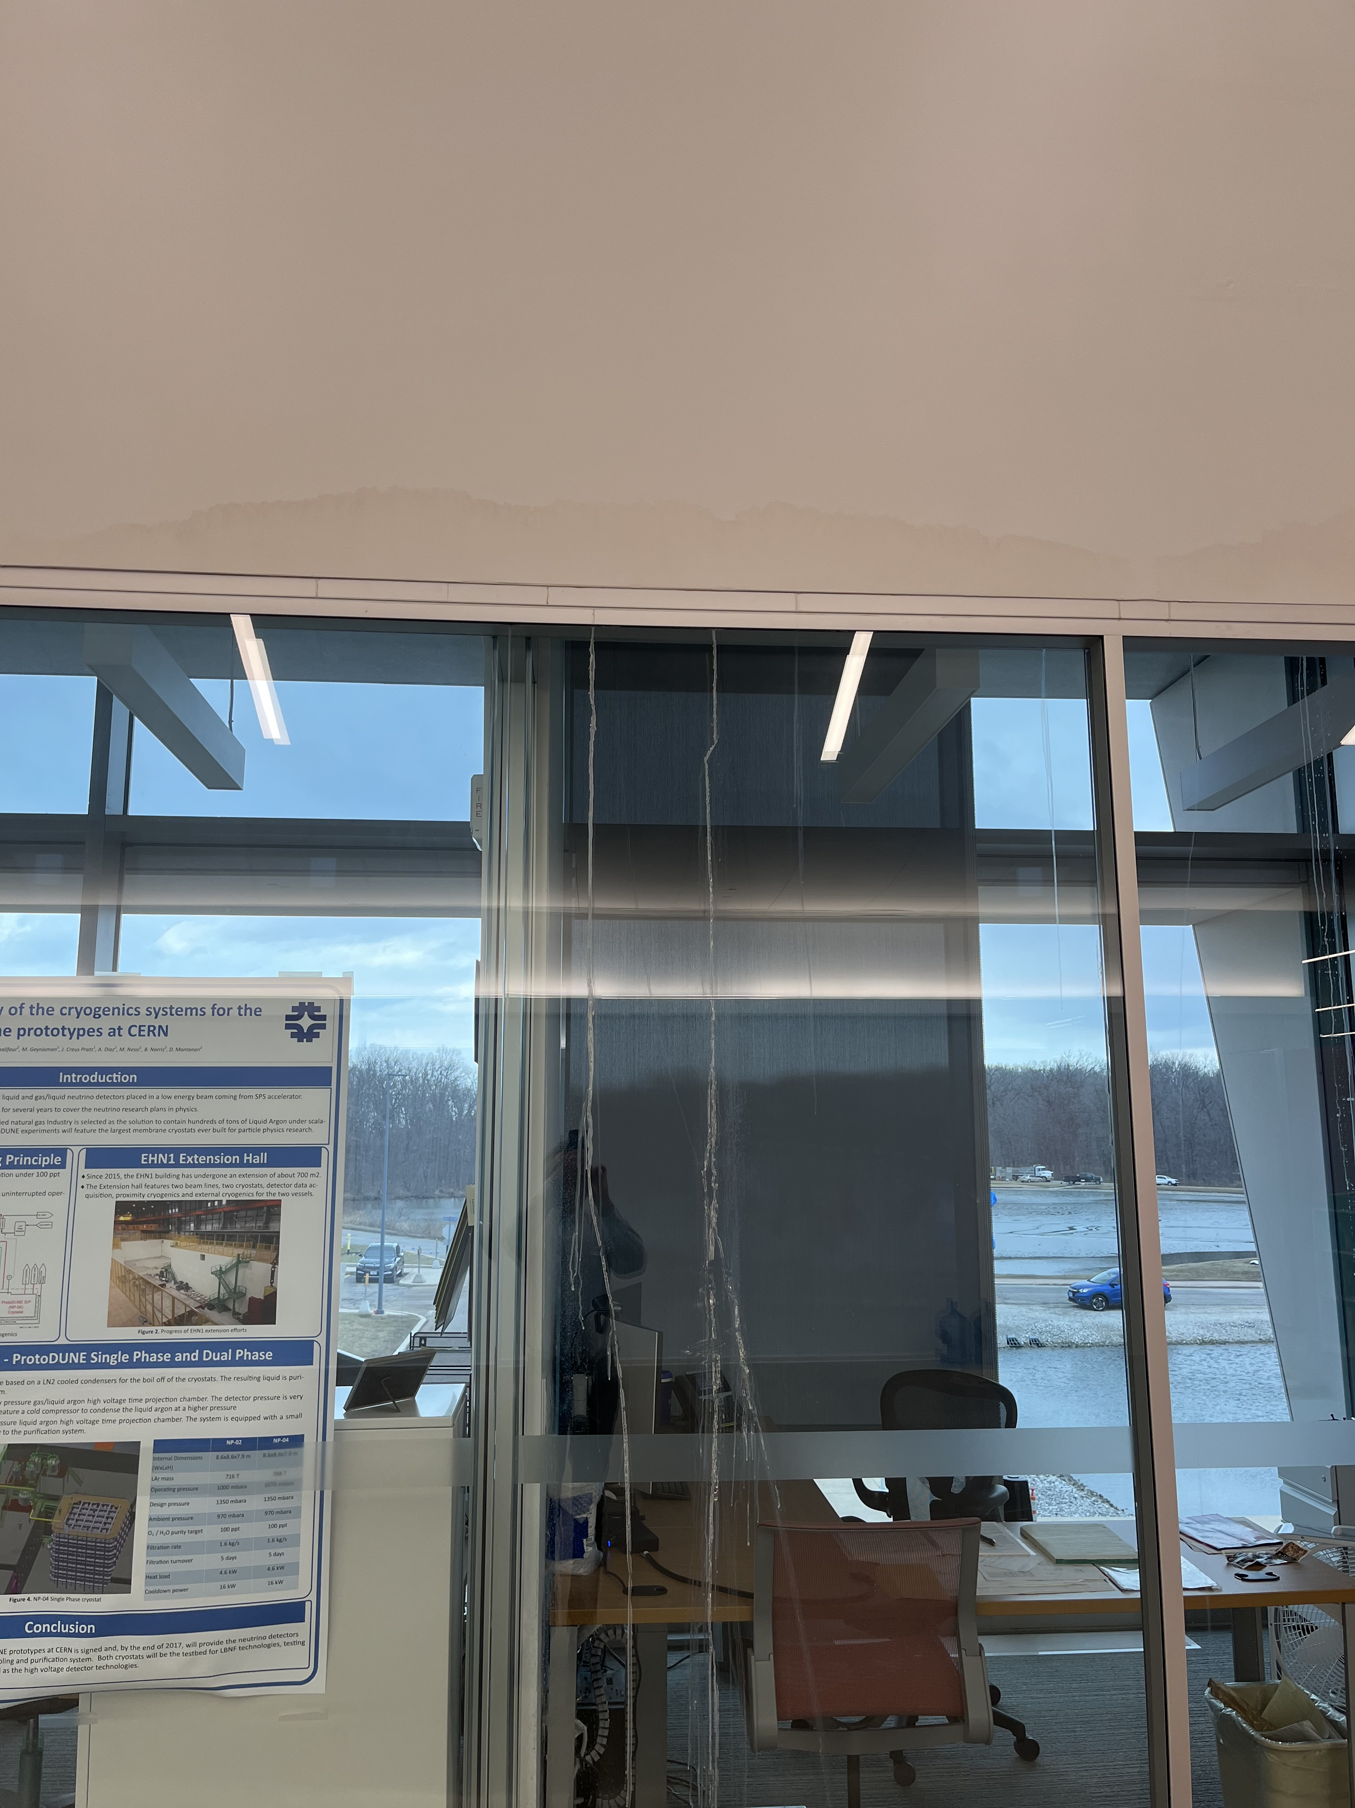
IERC News (FEB 8, 2024)
Leak on the 1st floor near Fritz Schwartz office. What is the status ?
Stains left on the wall and windows

Slide 8
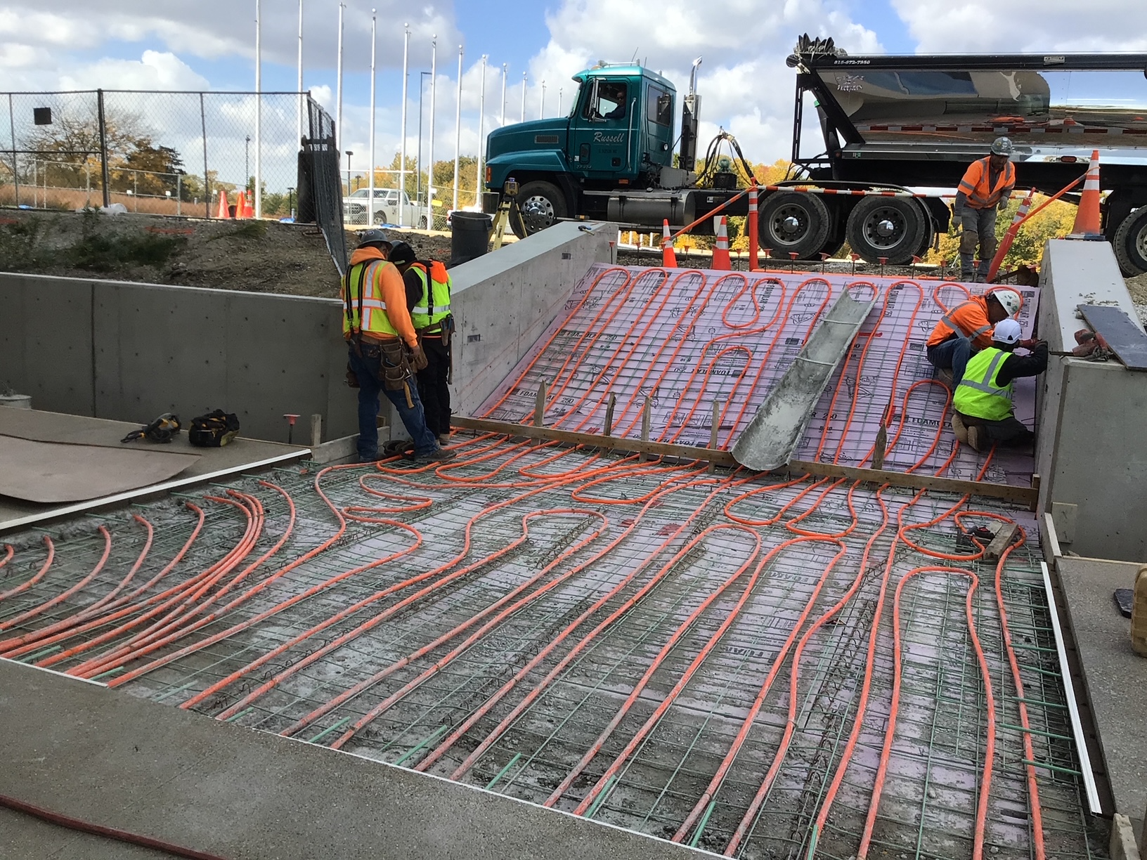
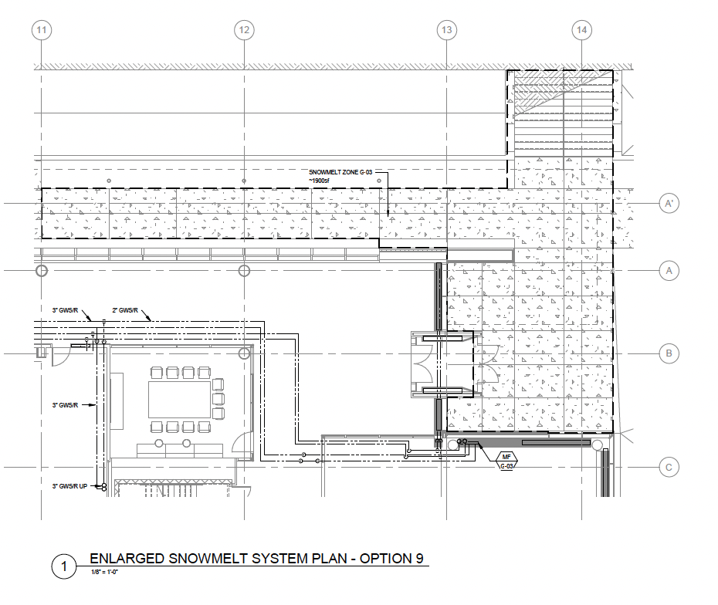
IERC News (FEB 8, 2024)
Heated sidewalks:
  it turned out that this system is only present along the “dead” path between WH and IERC. Not on the foot path between the parking lot and the north entrance to IERC
Not working ?

Slide 9
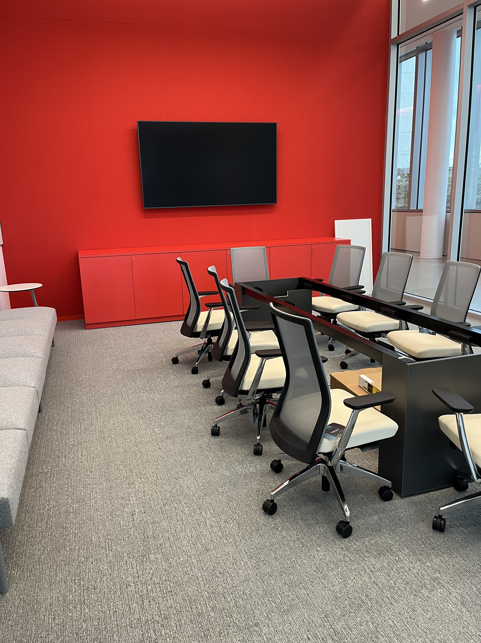
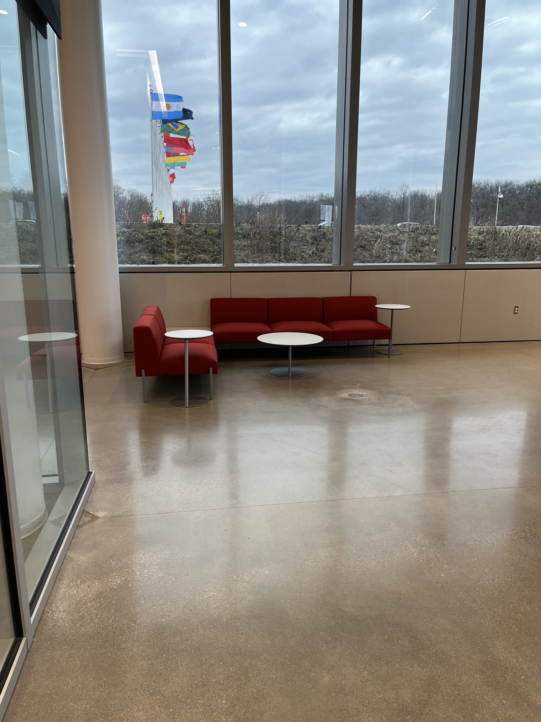
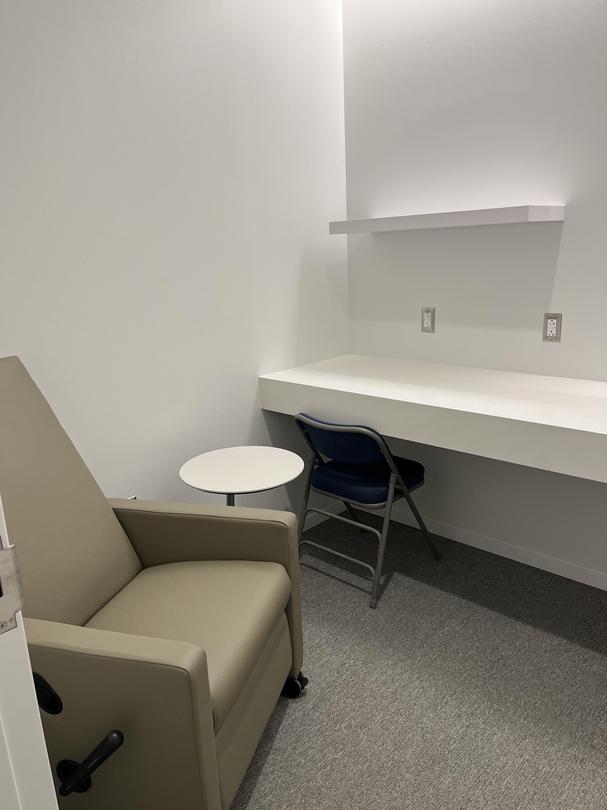
IERC News (FEB 8, 2024)
New furniture installed in the conference rooms, common areas and wellness centers. Furniture for completing double occupancy offices still on hold
Spring Barret (sbarrett@fnal.gov) and Cathy Barker (cbarker@fnal.gov) will be managing the 3 conference rooms: Cantilever (1880), The Ground Plane (G771) and “no name yet” (1416) . 1416 does not have zoom equipment only local AV (audio visual) equipment.

Slide 10
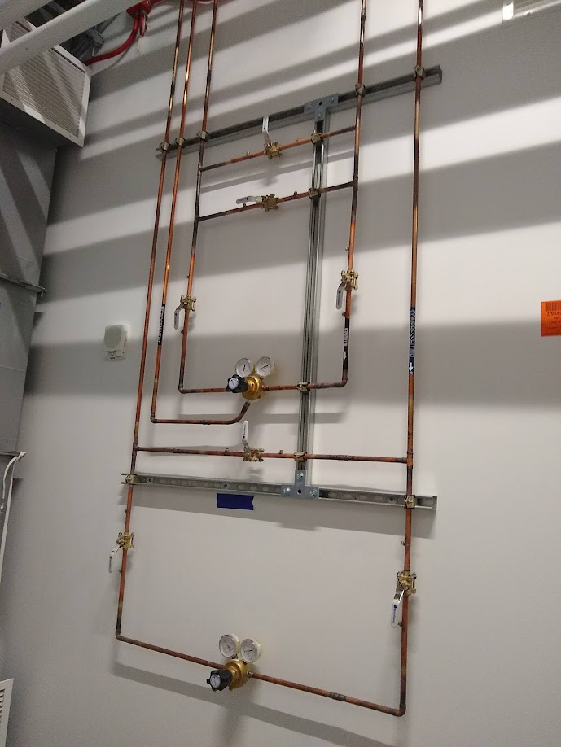
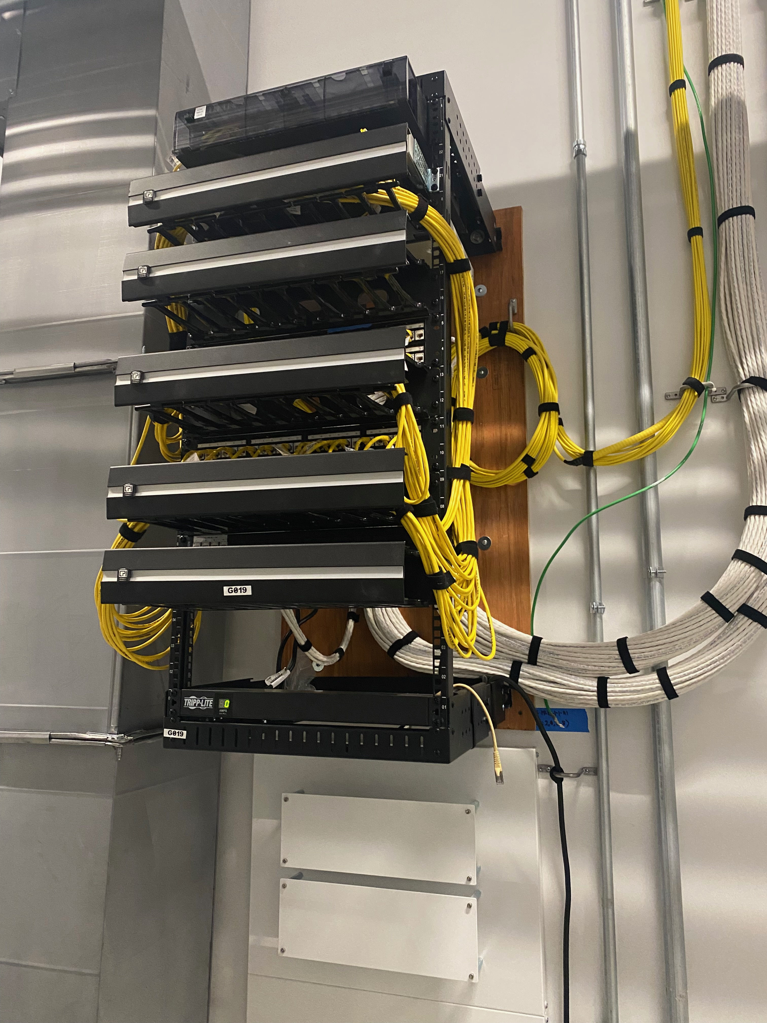
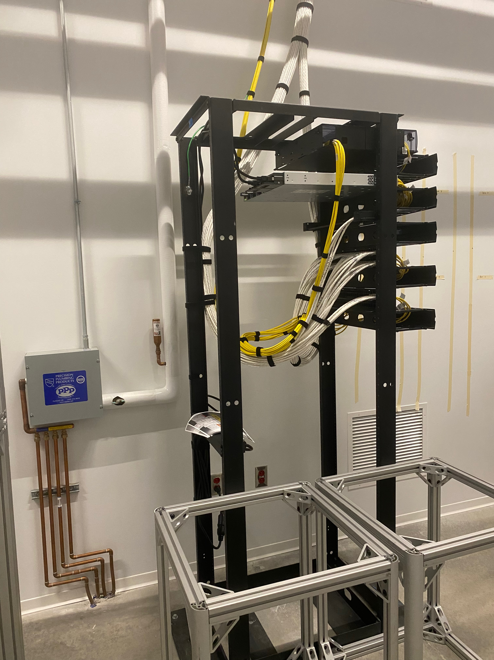
IERC News (FEB 8, 2024)
There has been a recent request (C. Pena) for more space in the south chase to install more chiller units for a dilution refrigerator and other equipment to be installed in Great Hall East (G321). Space is limited and Don Mitchel is keeping track of the space in the chase. Any change should be coordinated with the relevant stake holders and eventually green-lighted by him.

Slide 11
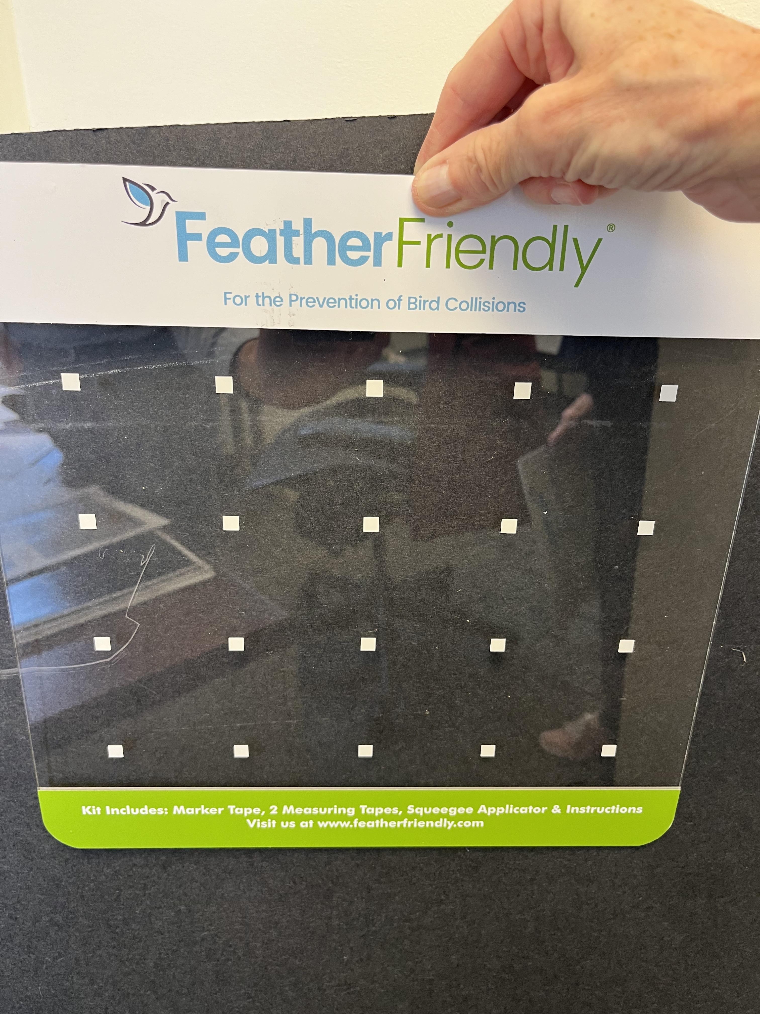
IERC News (FEB 8, 2024)
There have been some issues with birds hitting the windows of IERC (East and West). Wally Levernier (Fermilab ecologist) is following this issue. A possible solution would be to install visual deterrents such as adhesive dots or similar.
The 2 large TV screen for Mu2e were actually found on the upper floor of the Mu2e building.

Slide 12
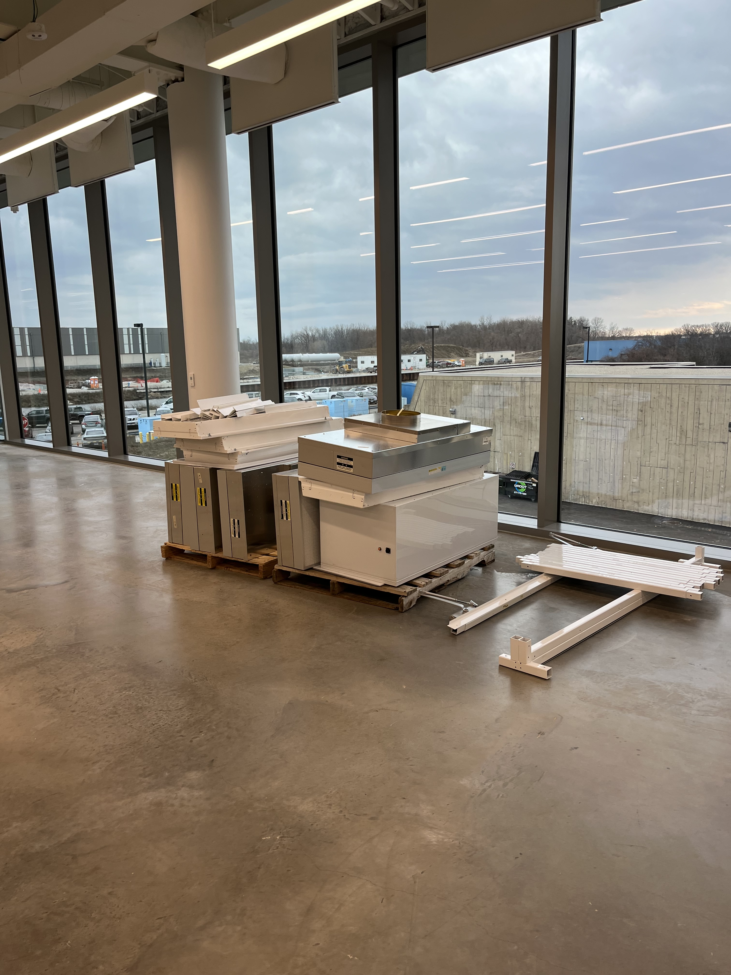
IERC News (FEB 8, 2024)
We are temporarily moving the dismounted class 100 clean room from G-WEST to the unfinished large conference room on the 1st floor. This is in preparation for the laying of the new floor, however the PO 707736 is on hold since the awarded company did not quote prevailing wages (req. was signed August 2023).

Slide 13
IERC News (FEB 1, 2024)
DOE Safety tour of IERC (JAN 31st at 11:00am) went pretty well, I think. Nothing major to report. Thanks to all participants.
We had a meeting with ISD (Aria Soha) regarding the needed improvements on the chilled water circuit. Blake Hanauer will get us a quote for the filter installation and regular maintenance from ISD.
Lisa Reger is organizing a meeting with the relevant people on ISD to make sure that maintenance and other interventions on equipment that are linked to the ODH analysis for IERC are properly identified and we have the necessary procedures in place. Meeting is scheduled for Feb 15, 10:00 to 11:00 in the IERC “cantilever” room.

Slide 14
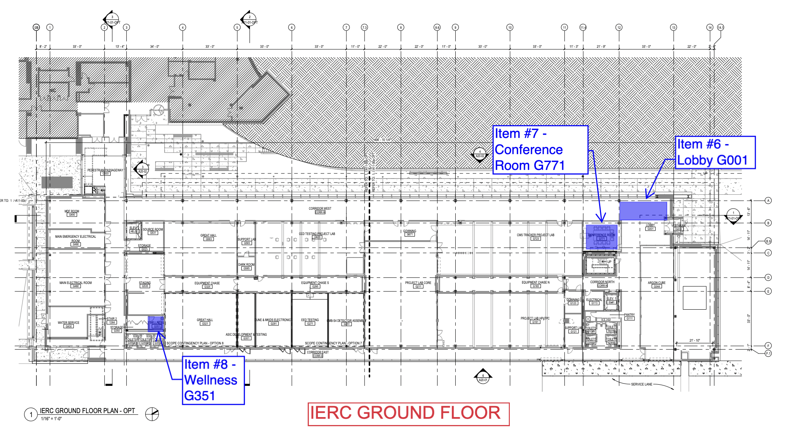
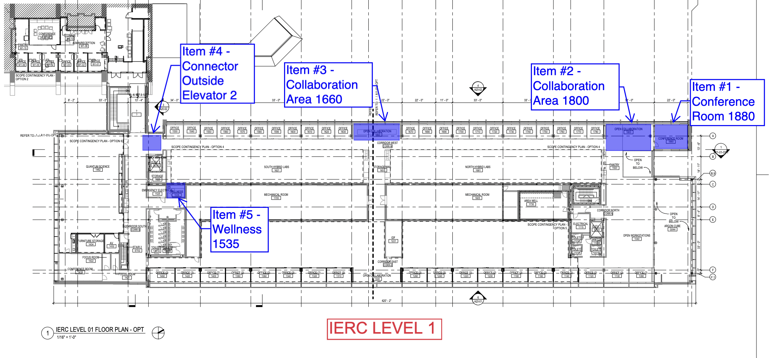
IERC News (FEB 1, 2024)
Monday Feb 5th will start the installation of the new furniture for the conference rooms, common areas and wellness centers. We need to empty the conference room from the current “borrowed” furniture.
List of furniture is available here: https://indico.fnal.gov/event/63058/contributions/283340/attachments/174664/236877/IERC Conference Collaboration Furniture.pdf
The completion of the furniture for the double occupancy offices is still on-hold (req. 350162)

Slide 15
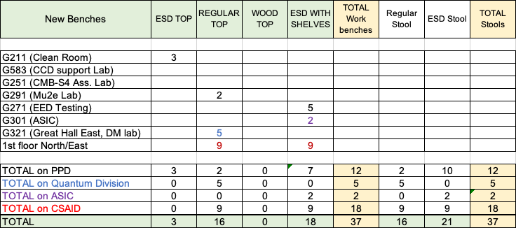
IERC News (FEB 1, 2024)
As agreed this is the list of new workbenches for the various labs that I have collected. Final negotiations in progress.
Mu2e to return 2 workbenches to CMB-S4 for the CMB-S4 assembly lab
One extra ESD workbench with shelves is available in G211
2 workbenches to be returned from Alan Prosser
We had to cut the request from G211 from 5 to 3 and from EED from 6 to 5 in order to fit into the PPD budget

Slide 16
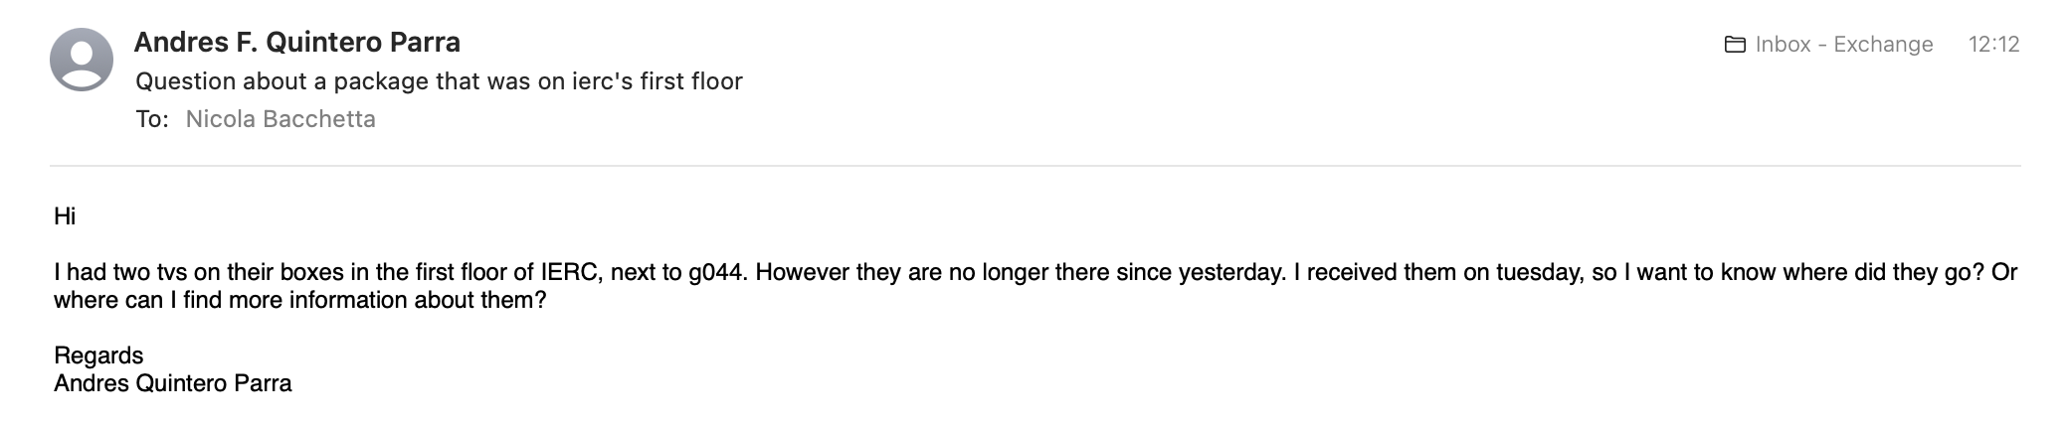
IERC News (FEB 1, 2024)
I have removed the link to the zoom meeting from the indico agenda. I have asked Leticia to send the new zoom link (which will be always the same) together with the weekly reminder.
Does anybody know anything about this ?

Slide 17
IERC News (JAN 25, 2024)
We have an on-going visit today from AMTS who is charged to assess the cost/possibility of using space at IERC for advanced microelectronic packaging equipment.
We have a now a meeting with ISD (Aria Soha) on the 29th at 11:30am to discuss how to proceed with the IERC chilled water circuit
We have a DOE Safety tour of IERC scheduled for the 31st at 11:00am
Please try to discard the many cardboard boxes still laying around in the labs.

Slide 18
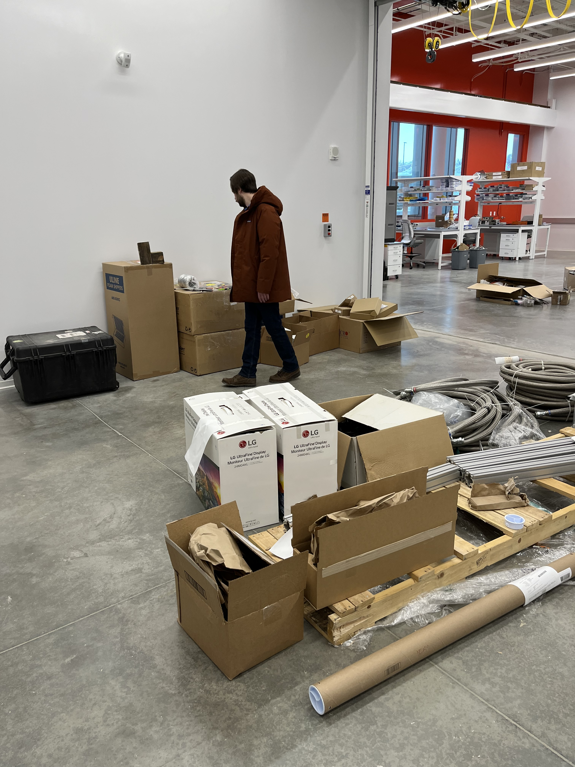
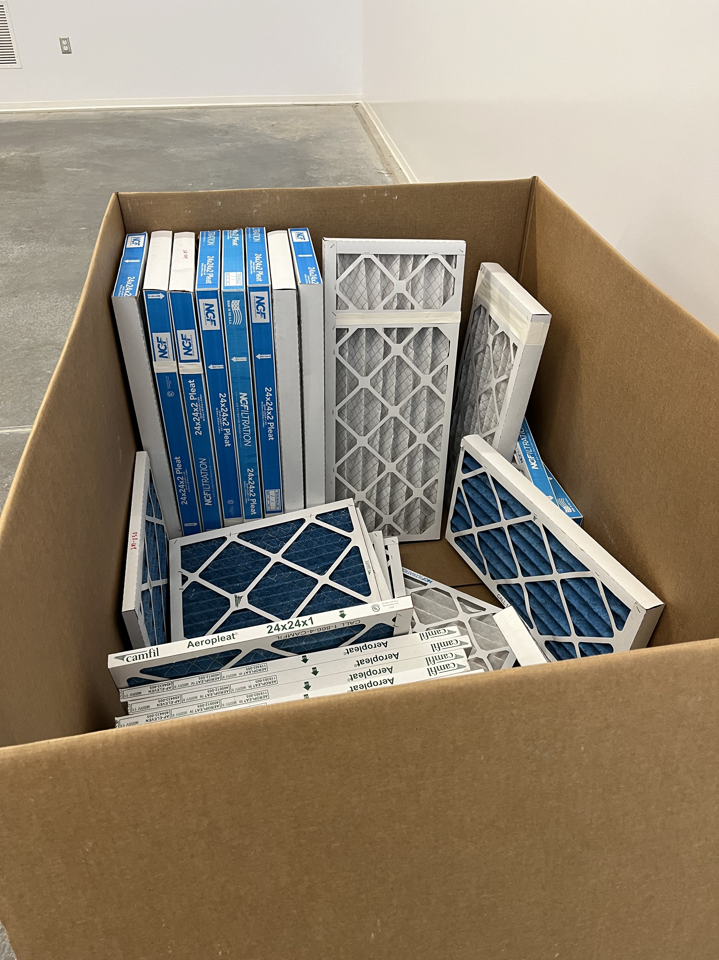
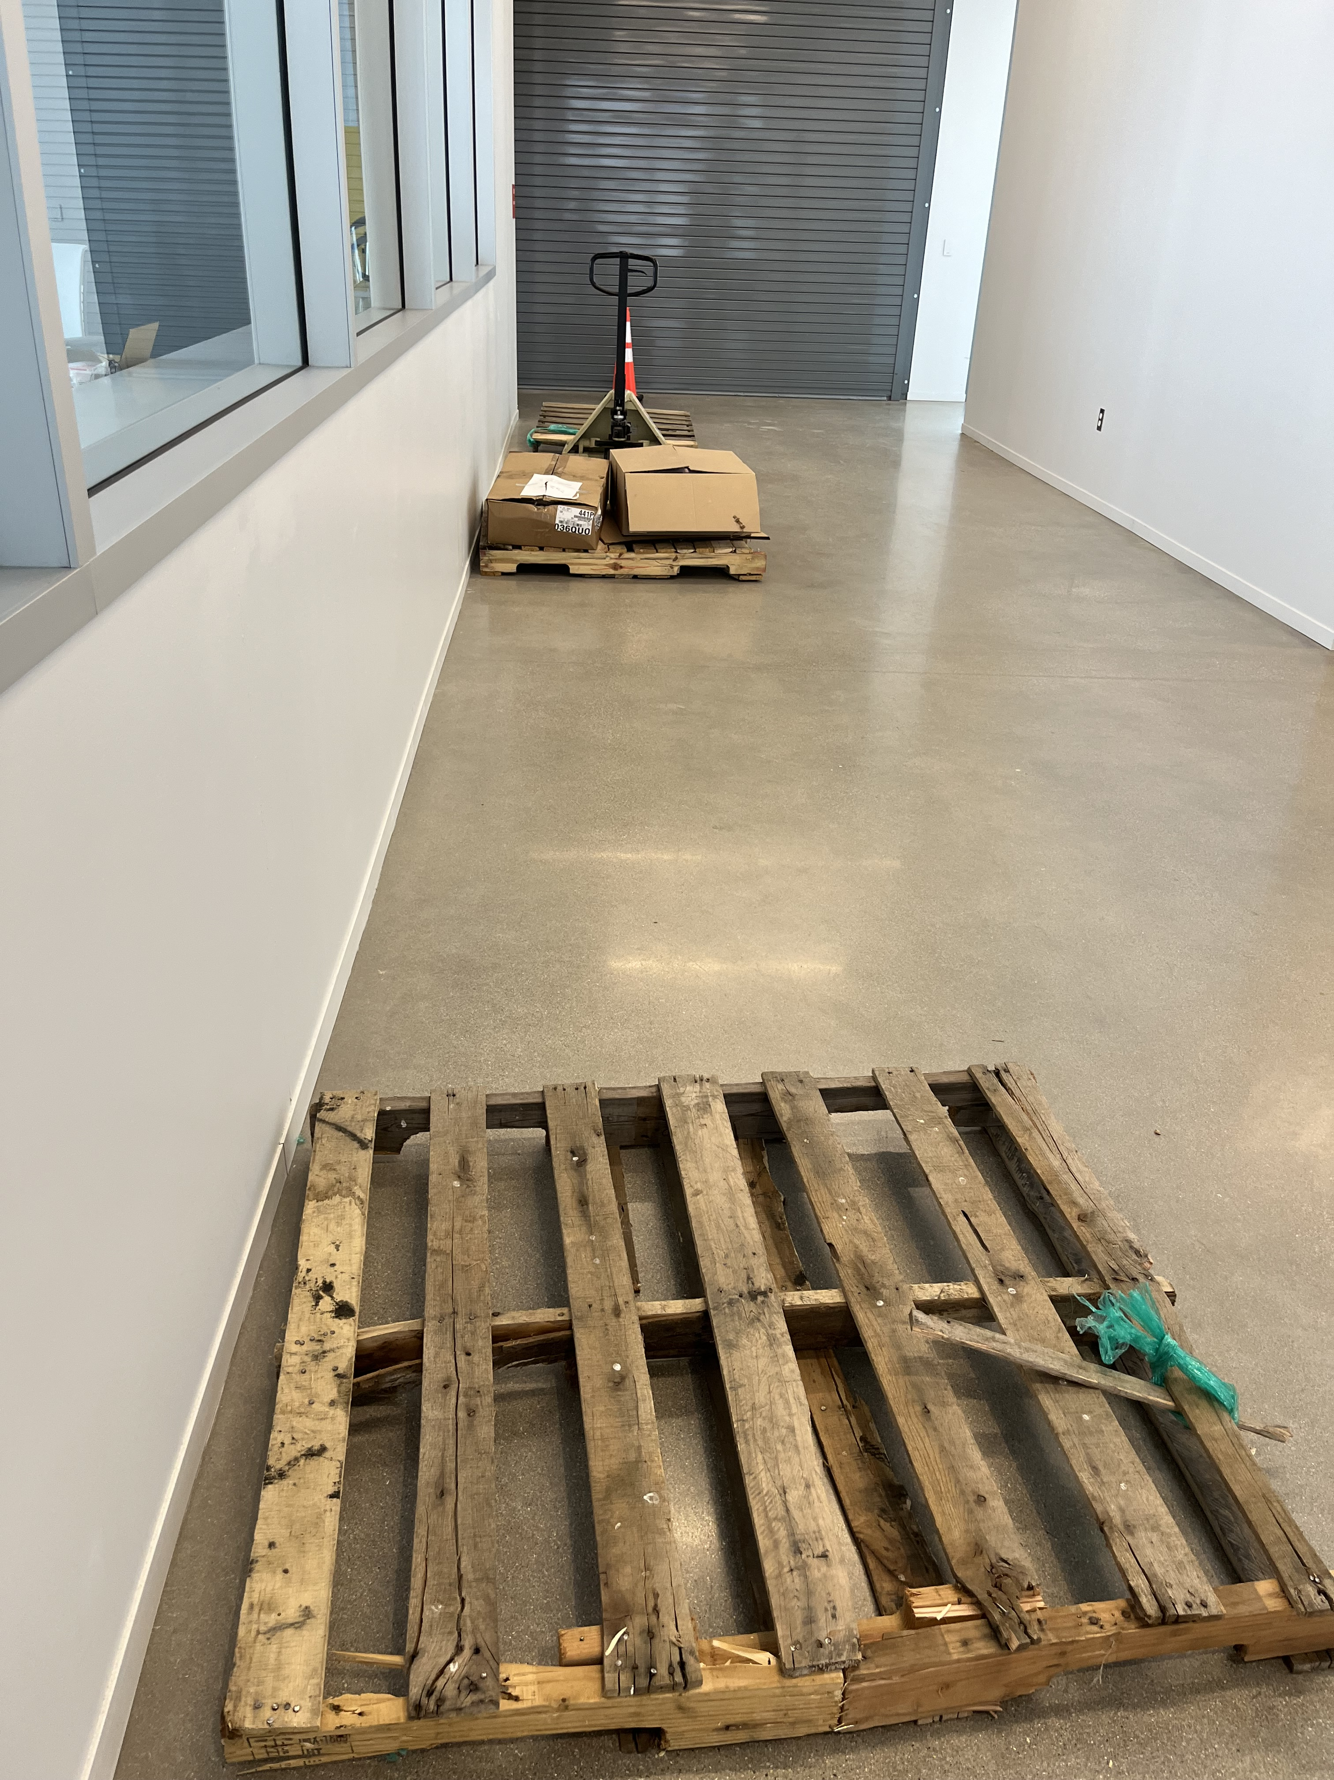
IERC News (JAN 25, 2024)
Also, I think we should get rid of these old pallets

Slide 19
IERC News (JAN 25, 2024)
From Brian Rubik:
  we’ve tentatively scheduled the IERC conference / collaboration furniture install to start on Monday, February 5th. The installers believe that all furniture listed below and shown in the attached PDF can be installed in 2 days (Monday / Tuesday). Please arrange for any temporary furniture, equipment, or any other materials that have been placed in these areas to be relocated before the 5th.

Slide 20
IERC News (JAN 11, 2024)
The erratic behaviour of some of the IERC lights seems to have been resolved now.
Meade was onsite today investigating and was able to fix the lighting issue. Meade rebooted the system and everything now functions properly. Crestron tech support thought it may have been power outage of some sort that may have caused the issue.
A visit from the NIU president (Lisa Freeman) has been scheduled for January 18th at 12:30 (1/2 hour). This seems to be mainly aimed at neutrino activities and Monica and Flor are on board.
Also a visit from AMTS is scheduled for the 18th in order to assess the compatibility of IERC for potential future use for advanced packaging. Jim Hirschauer, Rick Ford, Dan Fograse and Brian Rubik are following this.

Slide 21
IERC News (JAN 11, 2024)
Safety walk-through by DOE (Madiar, Rachel) is foreseen for Friday January 26th 2-3 pm.
Dave Pushka and Dave Jayson worked on cleaning up the large conference room area where left over from the building construction was left.

Slide 22
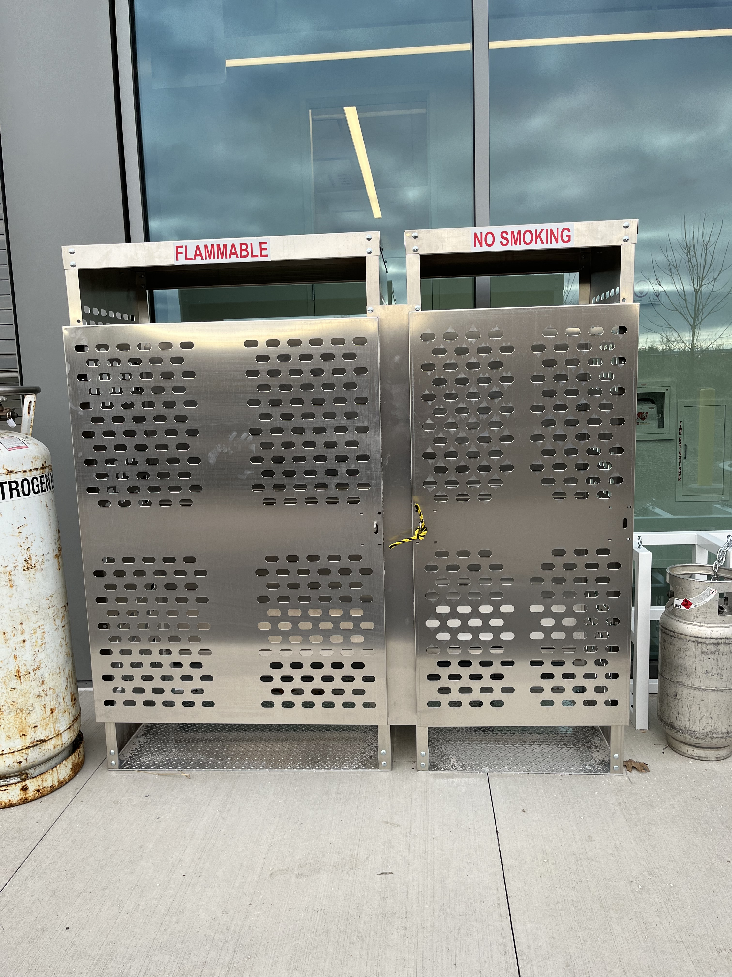
IERC News (JAN 4, 2024)
Some issues were reported regarding lights in the bathrooms. Not clear whether this is resolved. Dave Jayson was informed.
Gas rack has been installed. Would remove the old rack and start using it.
Be reminded that you need to switch OFF the crane remote controllers otherwise the batteries will quickly deplete. We found several controllers with depleted batteries.

Slide 23
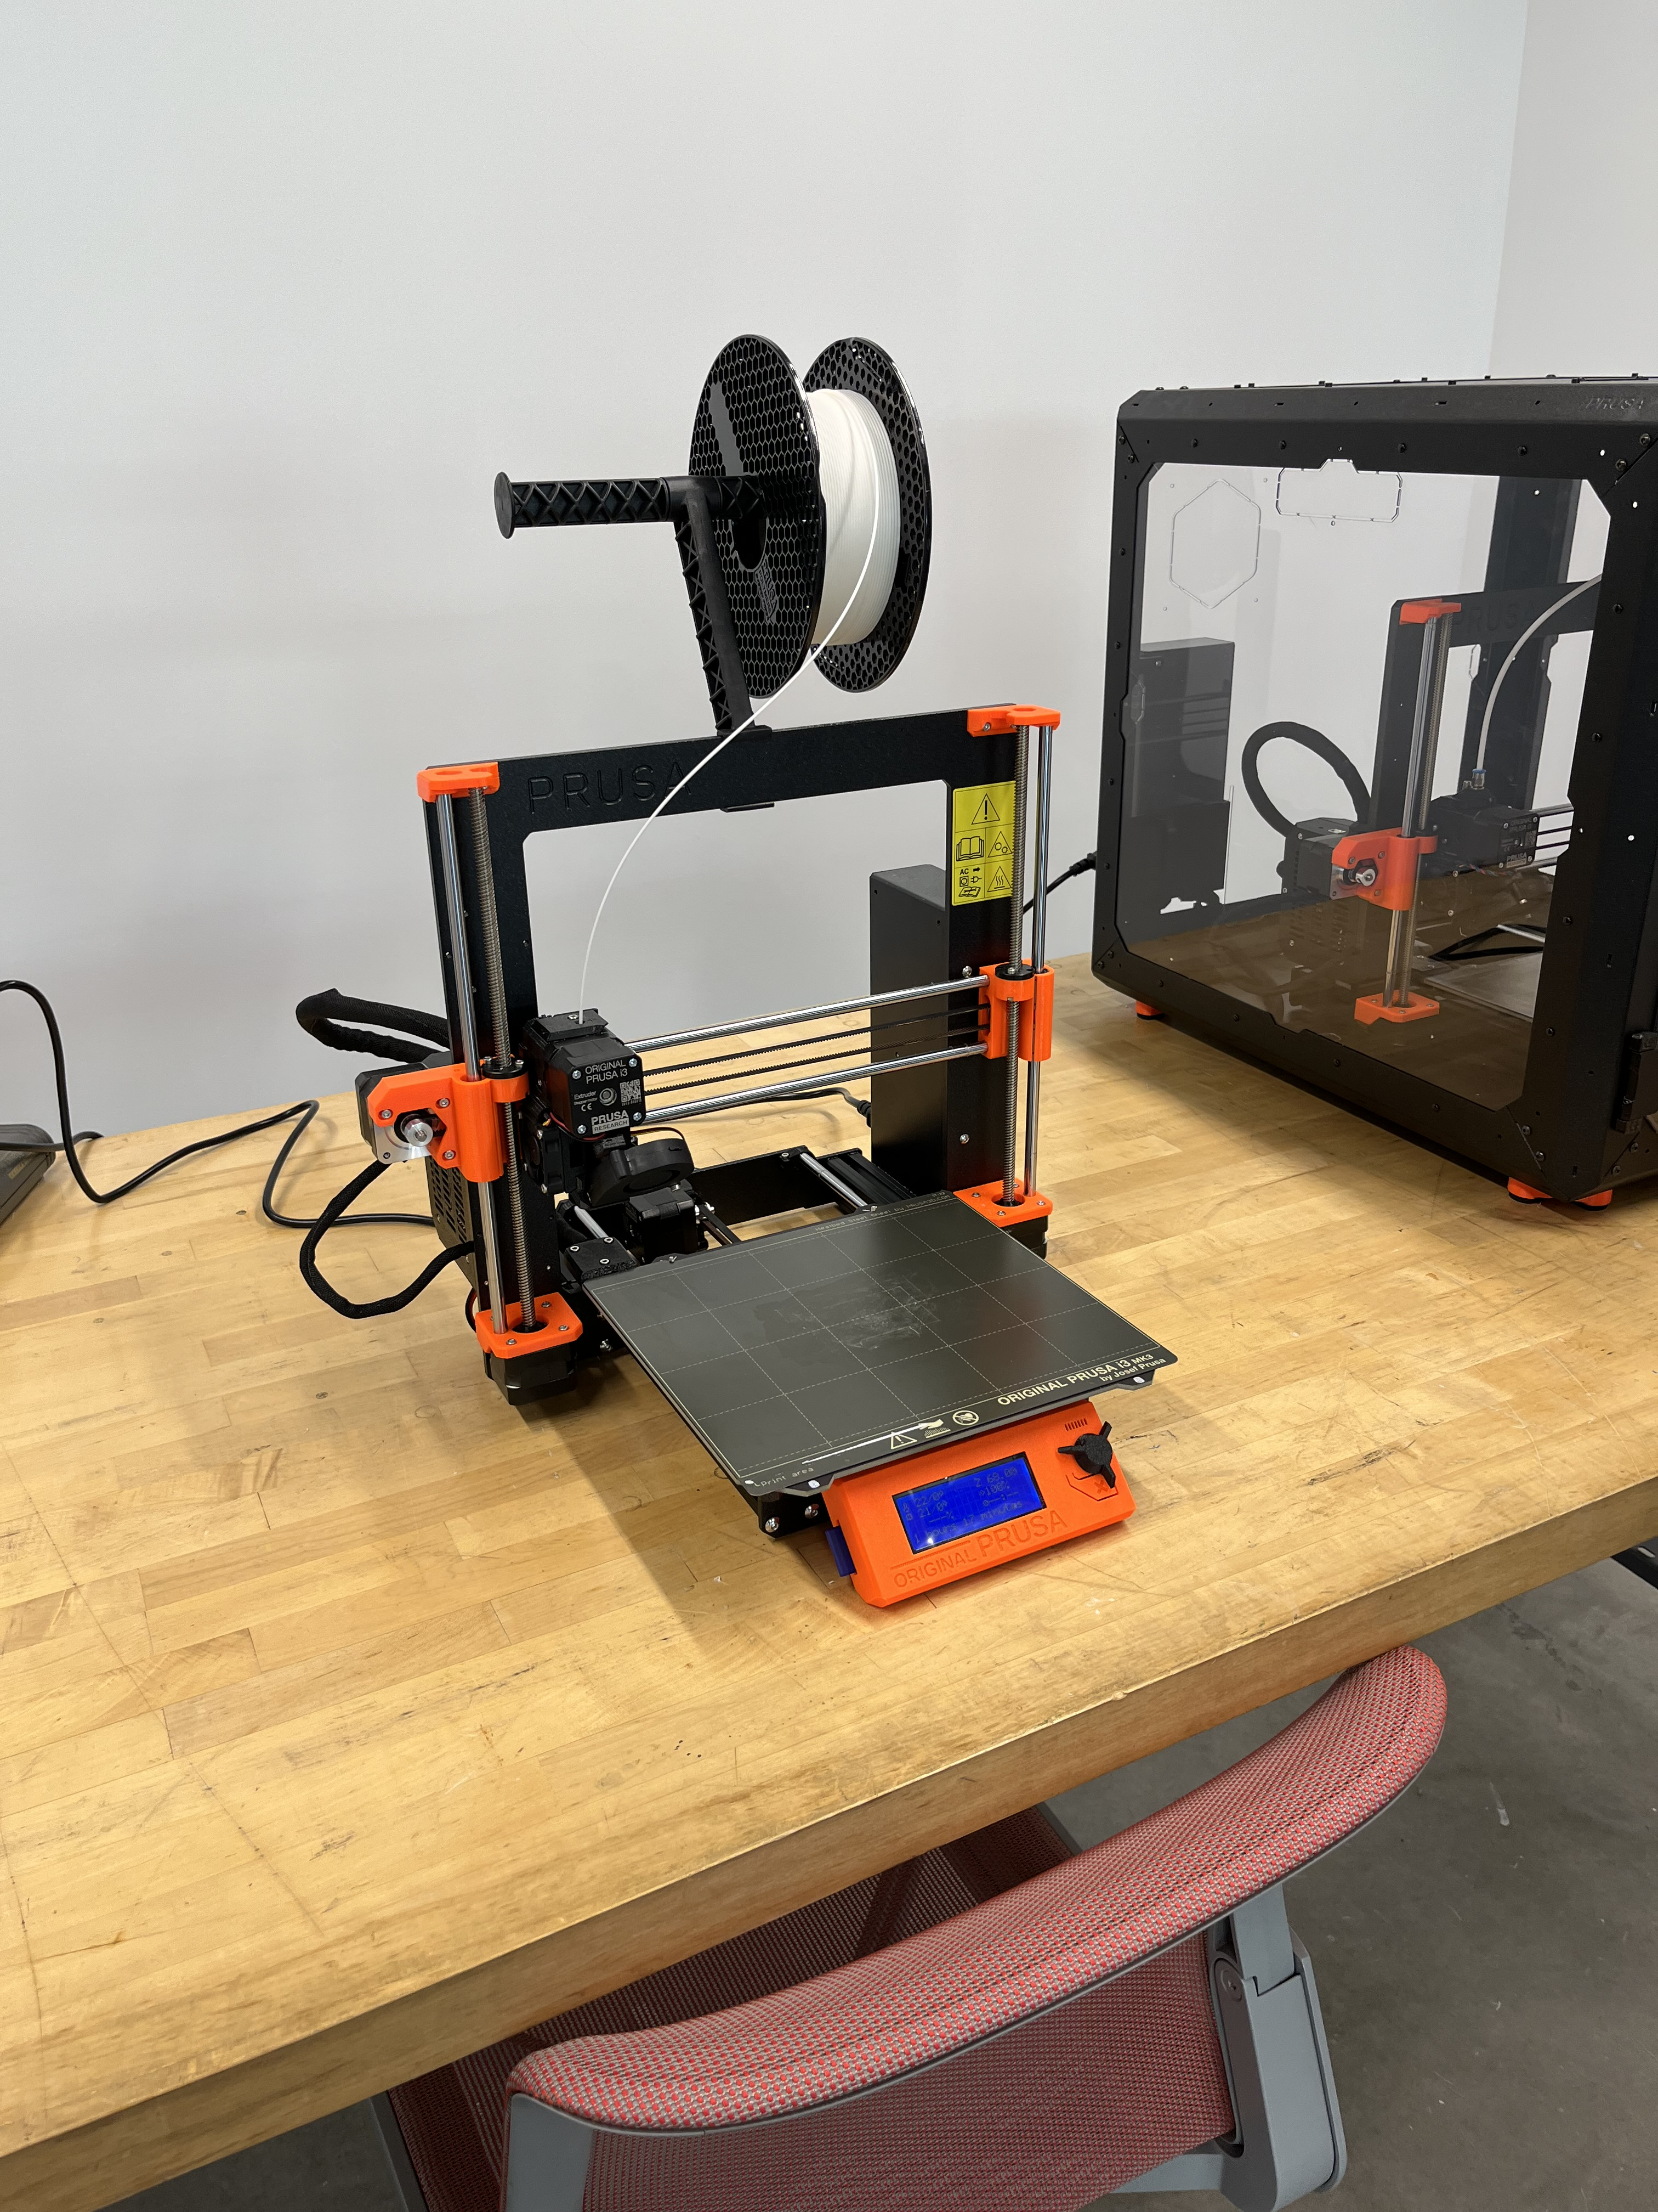
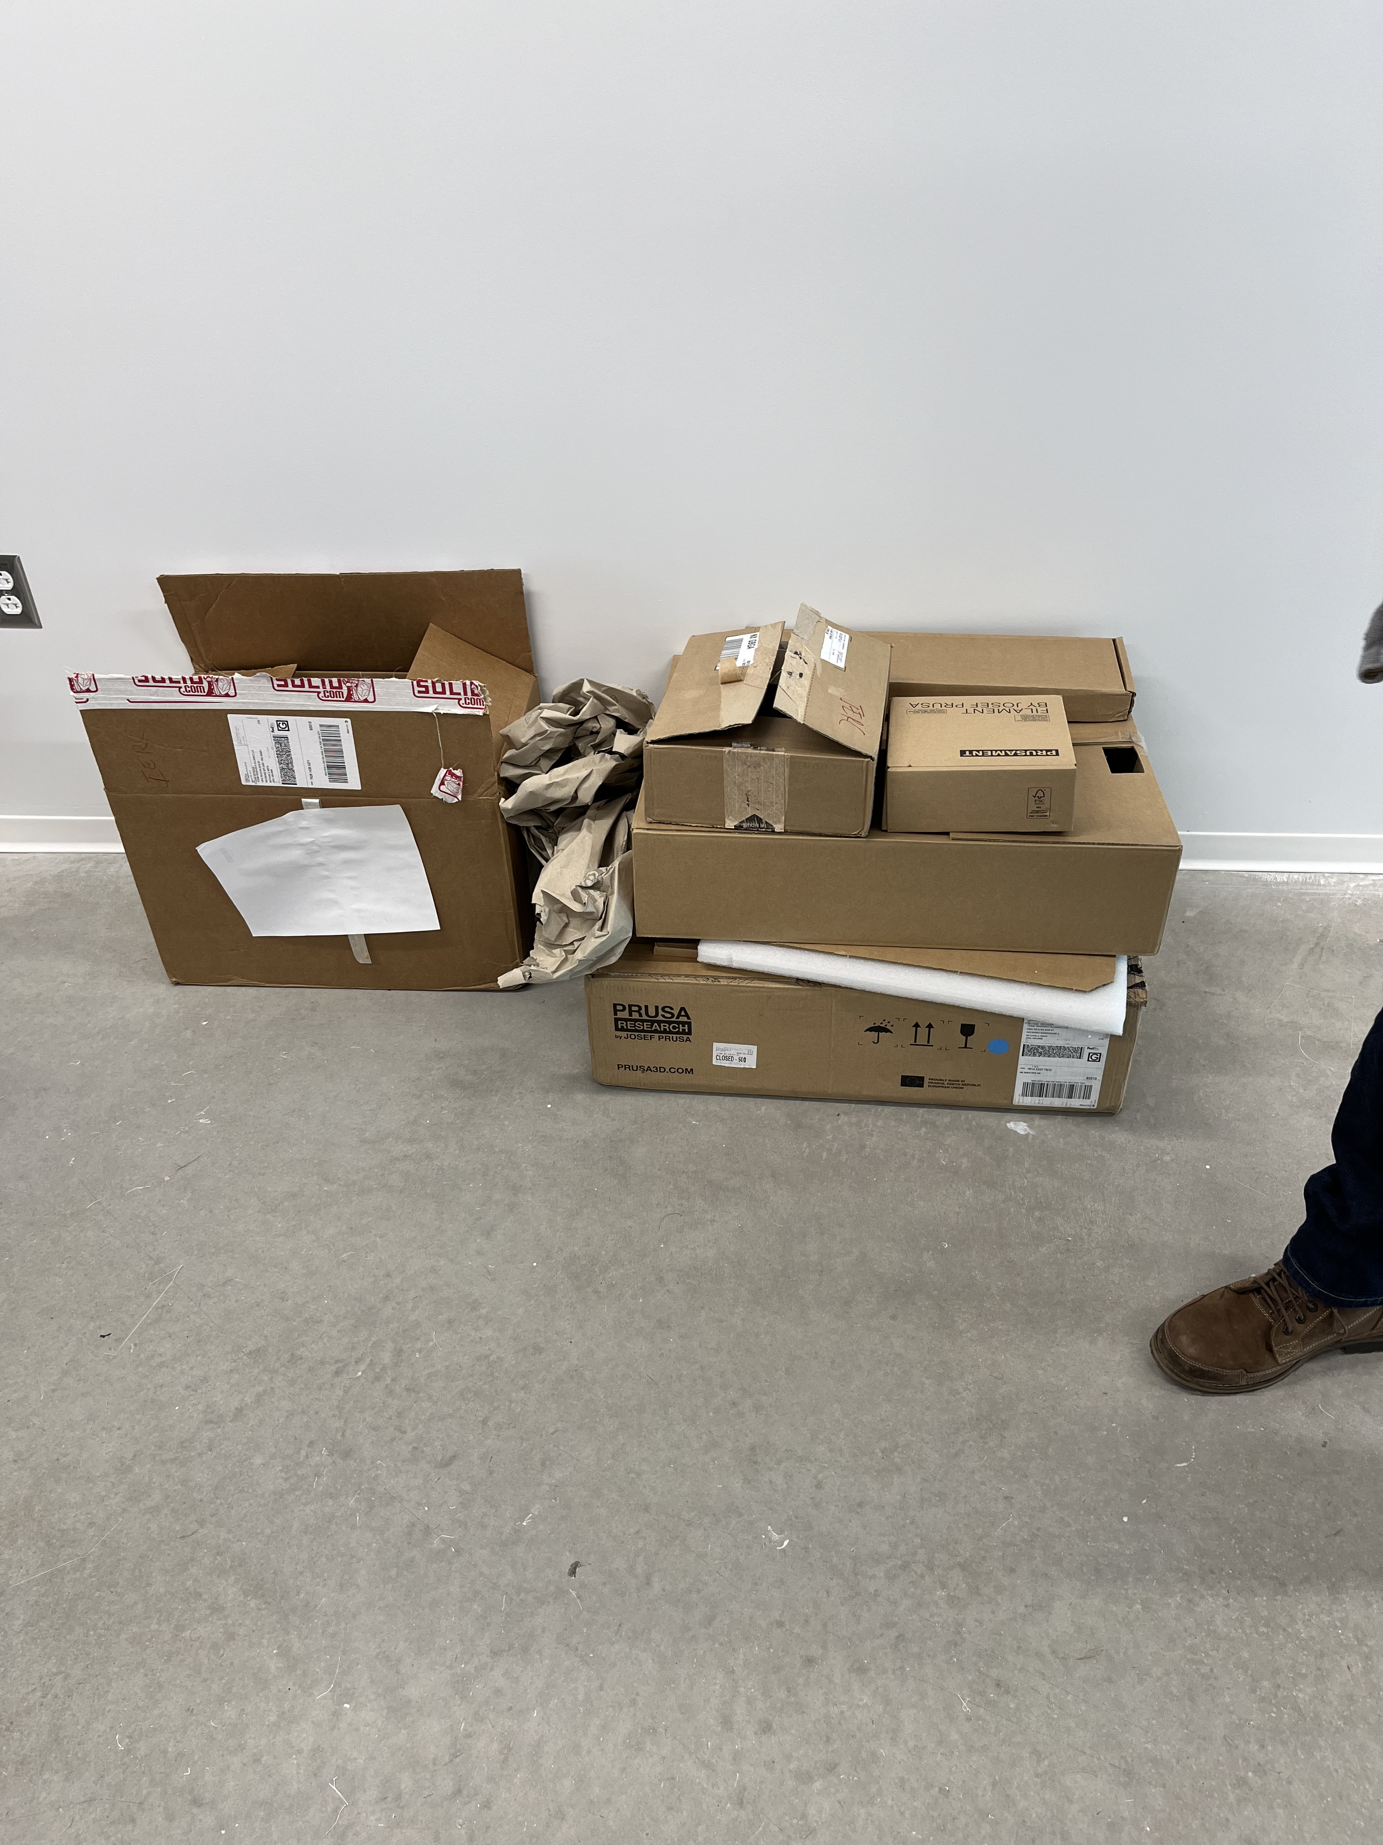
IERC News (JAN 4, 2024)
Safety walk through this morning in preparation for a DOE walk-through Jan 16th (perhaps to be postponed to the following week since I am not available that week):
3D printer should be in an enclosed box (like the one next to it)
Cardboard boxes should be disposed of and not left on the floor (fire hazard)

Slide 24
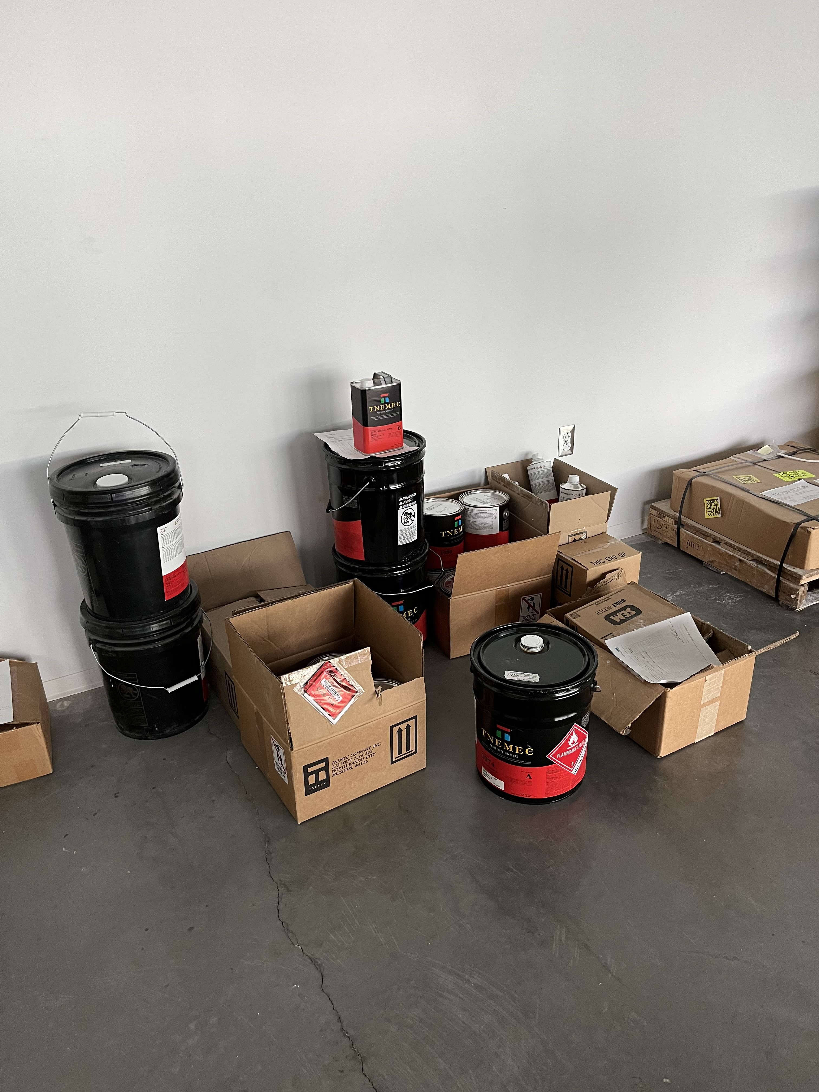
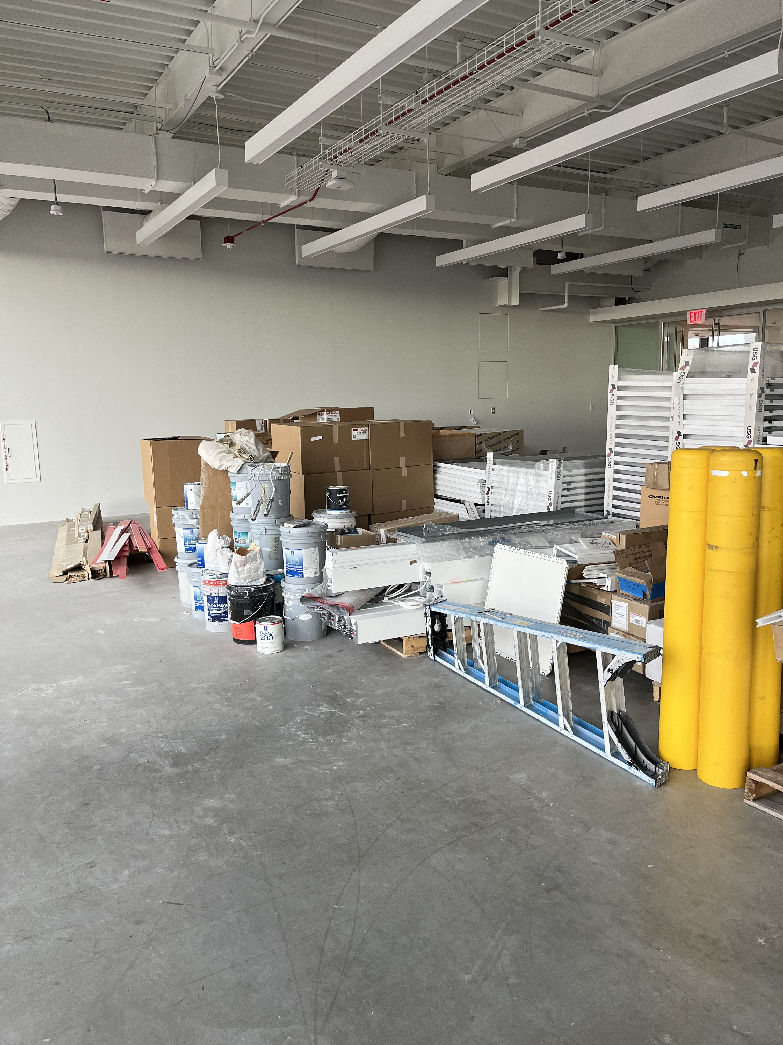
IERC News (JAN 4, 2024)
We still have a lot of left over material from Mortensen in the large conference room (1462) that need proper storage. There are several chemical and flammable material containers left on the floor.

Slide 25
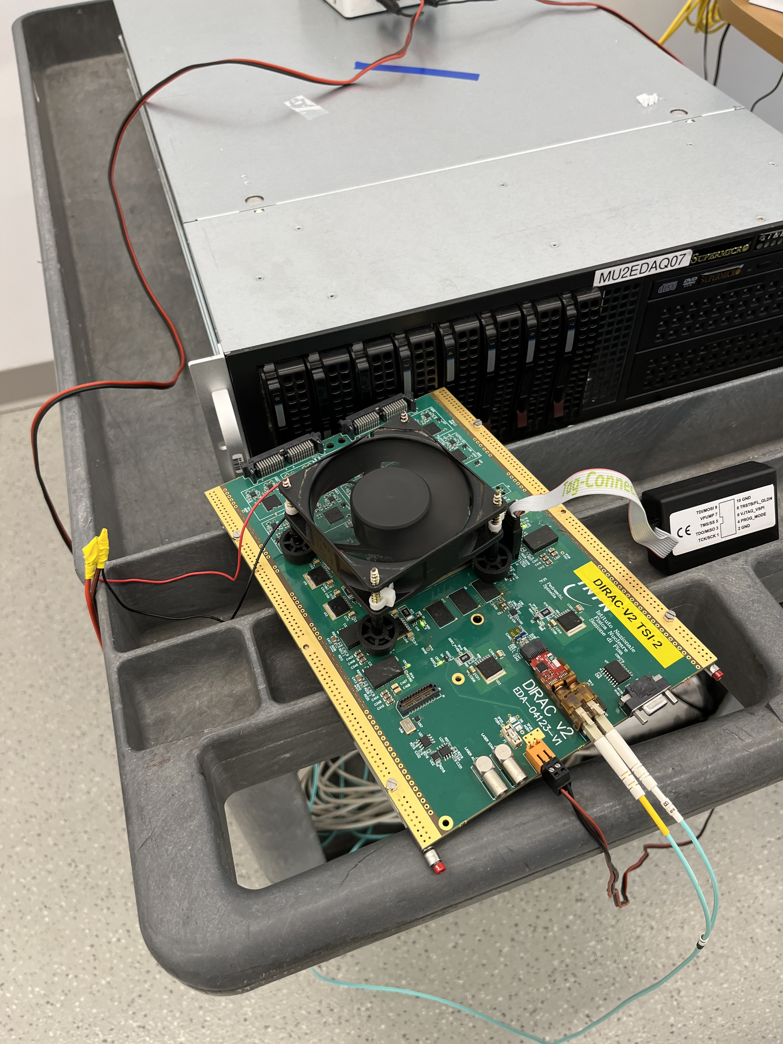
IERC News (JAN 4, 2024)
In G291 there are a few setup that seem in use:
Do they all have an ORC ?
The setup here does not seem to be properly placed and protected

Slide 26
IERC News (JAN 4, 2024)
A visit from the NIU president (Lisa Freeman) has been scheduled for January 18th at 12:30 (1/2 hour)
I will not be available that week. They seem to be interested mainly in the neutrino program and Flor and Monica were also contacted. Is this OK ?

Slide 27
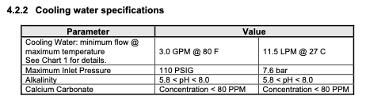
IERC News (DEC 14, 2023)
More electrical work needed for Great Hall West (Adam) and East (Cristian). Meeting today with Dave Featherston to detail the job and start the process
Proposal for how to proceed with the chilled water circuit:
  Get the water treated (should be relative simple and inexpensive) for right PH (ISD).
  Start using it for Great Hall West (it is already in use for the CCD lab)
  Proceed in parallel with the plan for installing permanent filters (ISD)
  Place this circuit in the list of those that are regularly tested by Fehr (ISD)
Cryomech cryocooler specifications

Slide 28
IERC News (DEC 14, 2023)
Cryomech cryocooler specifications
Working on the Julie scan procedures for “small” work which eventually will be used for the gas shack installation at IERC (sorry is taking much longer that I had anticipated).

Slide 29
IERC News (DEC 14, 2023)
There is a proposal for placing a “tech. shop” on the first floor inside mechanical room 1605. We’ll talk to safety (James) tomorrow
Electrically powered Drill Press,
Electrically powered Band Saw (vertical or horizontal)
Electrically powered Grinder, Electrically powered Belt sander, and Electrically powered Dust collections system (vacuum) for both
abrasive machines
Sheet Metal Shear
Sheet Metal Brake
Sheet Metal circle punch (roto punch)
Sheet Metal notcher
Bench with a vise

Slide 30
IERC News (DEC 14, 2023)
From Tim Niemiec ITD Network Analyst:
Switches in IERC are in need of new IOS and will require a reboot. I would like to schedule these the week of Christmas to minimize user outages. The list is below, thoughts or recommendations on who to notify if you like the timeline?
s-ierc-g44-1
s-ierc-g535-1
s-ierc-idf-1
s-ierc-idf-2
s-ierc-idf-3
s-ierc-idf-4
s-ierc-mdf-1
s-ierc-mdf-2

Slide 31
IERC News (DEC 14, 2023)
From Joe Rogers:
The Security Department will be taking a proactive approach in response to this new change and will patrol these areas more often next week in the event there is any confusion. Since each of your facilities operate uniquely, we ask that you help spread the news with your stakeholders. If there are any immediate issues please call the Security Operations Center at 630-840-3414 or for any card access issues, please direct those to cardaccess@fnal.gov.
  Dear colleagues,
  As we mentioned in November, we are committed to keeping Fermilab employees and users/affiliates informed and aware of updates to building access.
  All Fermilab employees, users, and affiliates as well as DOE-badged personnel now have access to the following buildings using the card readers installed at:
  · IERC (Integrated Engineering Research Center)
  · IARC (Illinois Accelerator Research Center)
  · FCC (Feynman Computing Center)
  · ICB (Industrial Center Building)
  SiDet will be added to this list in the near future as card reader access control is added to its doors. A further announcement will be made when that implementation schedule is finalized.
  Signage is installed on all entrances with contact numbers if you have any issues with the badge readers. Per our usual protocol, business visitors are permitted entry with a properly badged escort.

Slide 32
IERC News (DEC 7, 2023)
These are the request for benches I have received so far. Please have a look and let me know if this is OK.

Slide 33
IERC News (NOV 30, 2023)
Proposed new policy for those building:
  Open to active DOE, User, Affiliate, and employee LSSO/HSPD12 badge holders via card readers at building entrances.
  All offices with accountable equipment and/or export-controlled, sensitive, or personally identifiable information must be secured.
  Need to manage access to individual Labs at IERC. Our model of having responsible person for each Lab and require training was considered adequate.
  If export-controlled items/information, CUI, or sensitive information will be installed stored, or used in a lab or any office, a control plan will be developed by the lab manager in cooperation with SEMD and submitted to the Site Office in advance of utilization.
I made a formal request to both Brian Sherin and Joseph Rogers to add 2 card readers to the IERC building:
  To be able to open the middle garage door on the North East for deliveries
  To be able to access the chase

Slide 34
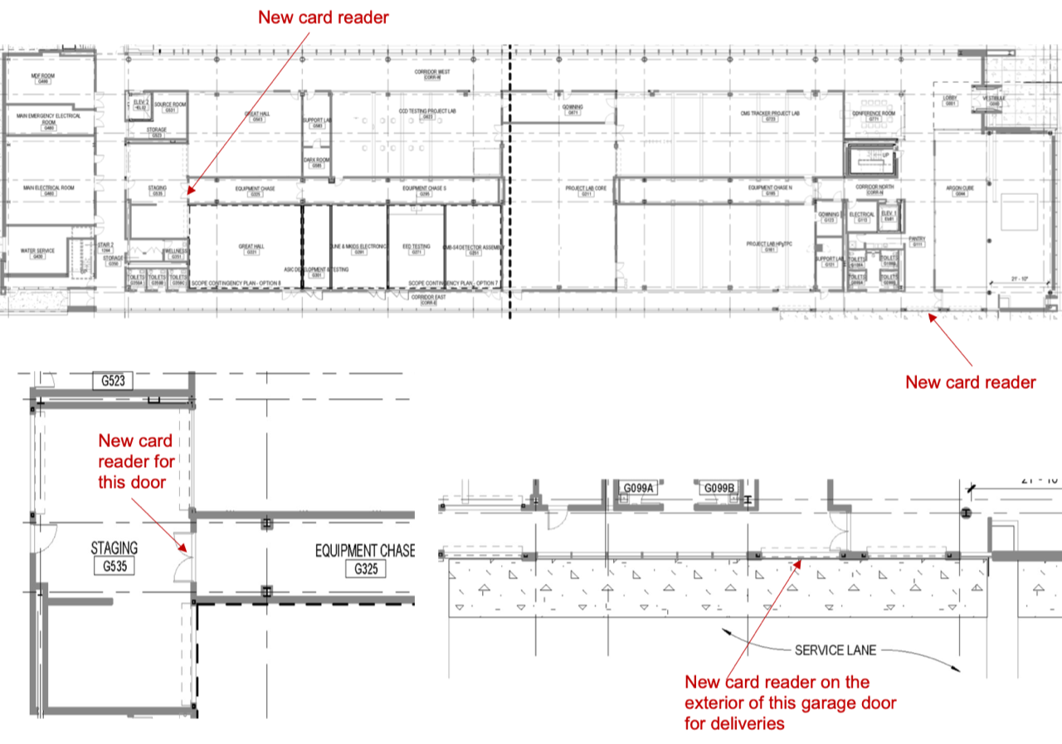
IERC News (NOV 30, 2023)

Slide 35
IERC News (NOV 30, 2023)
There was some discussion on some technical specification on the chilled water circuit at IERC and Adam agreed to summarize the issues and where we are standing.

Slide 36
IERC News (NOV 16, 2023)
The new AFM for IERC is now Dave Jayson (djayson@fnal.gov)
Sue Sprosty is phasing out and I want to thank her for all the work she did for the building during her tenure.
Scrap metal can has been provided outside by the dumpster.
The roll up door has been serviced. Technicians verified voltage, no lose connection. No problems found. Controller opened and closed the door several times and worked flawlessly.
All cranes monthly preventive maintenance completed today.
Electrical work is on-going for Adam and Claudio. Not sure yet about the requests for M. Utes (Mu2e) and for the Great Hall East.

Slide 37
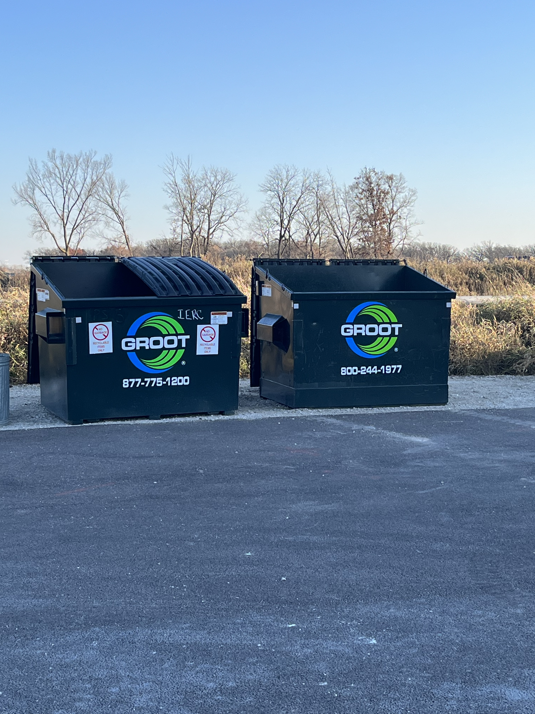
IERC News (NOV 16, 2023)
Recycle
Regular

Slide 38
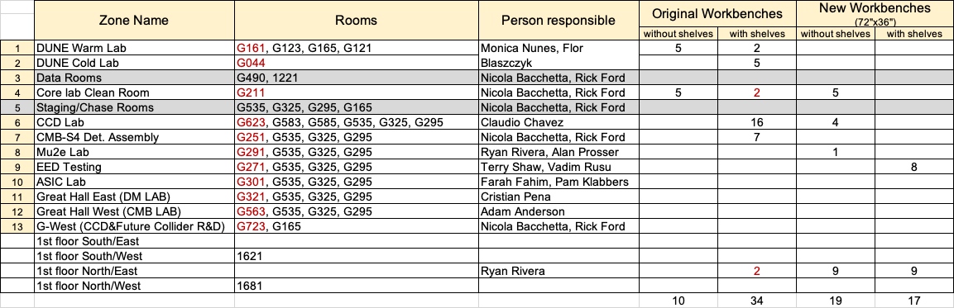
IERC News (NOV 16, 2023)
Working on the order for new work benches and chairs
I have collected already a few requests and I need to complete asking everyone. In any case we are already exceeding the number of work stations we thought we could afford.
Options are regular, ESD or wood tops, with or without extra shelves.

Slide 39
IERC News (NOV 16, 2023)
We had a meeting last week to discuss the issues related with the HVAC system in relationship with the ODH analysis. I think we are moving in the direction of having a good understanding with ISD and be part of the distribution chain for interventions and alarms. Details to follow.

Slide 40
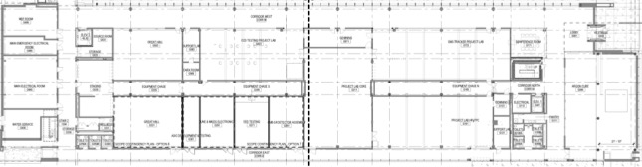
Workbenches location (plus sign means “with shelves”)
4 (leftover from SiDet)
7⁺
16⁺
5, 2⁺
2⁺
1⁺
5, 2⁺
5⁺
South/West
North/West
2⁺
South/East
North/East

Slide 41
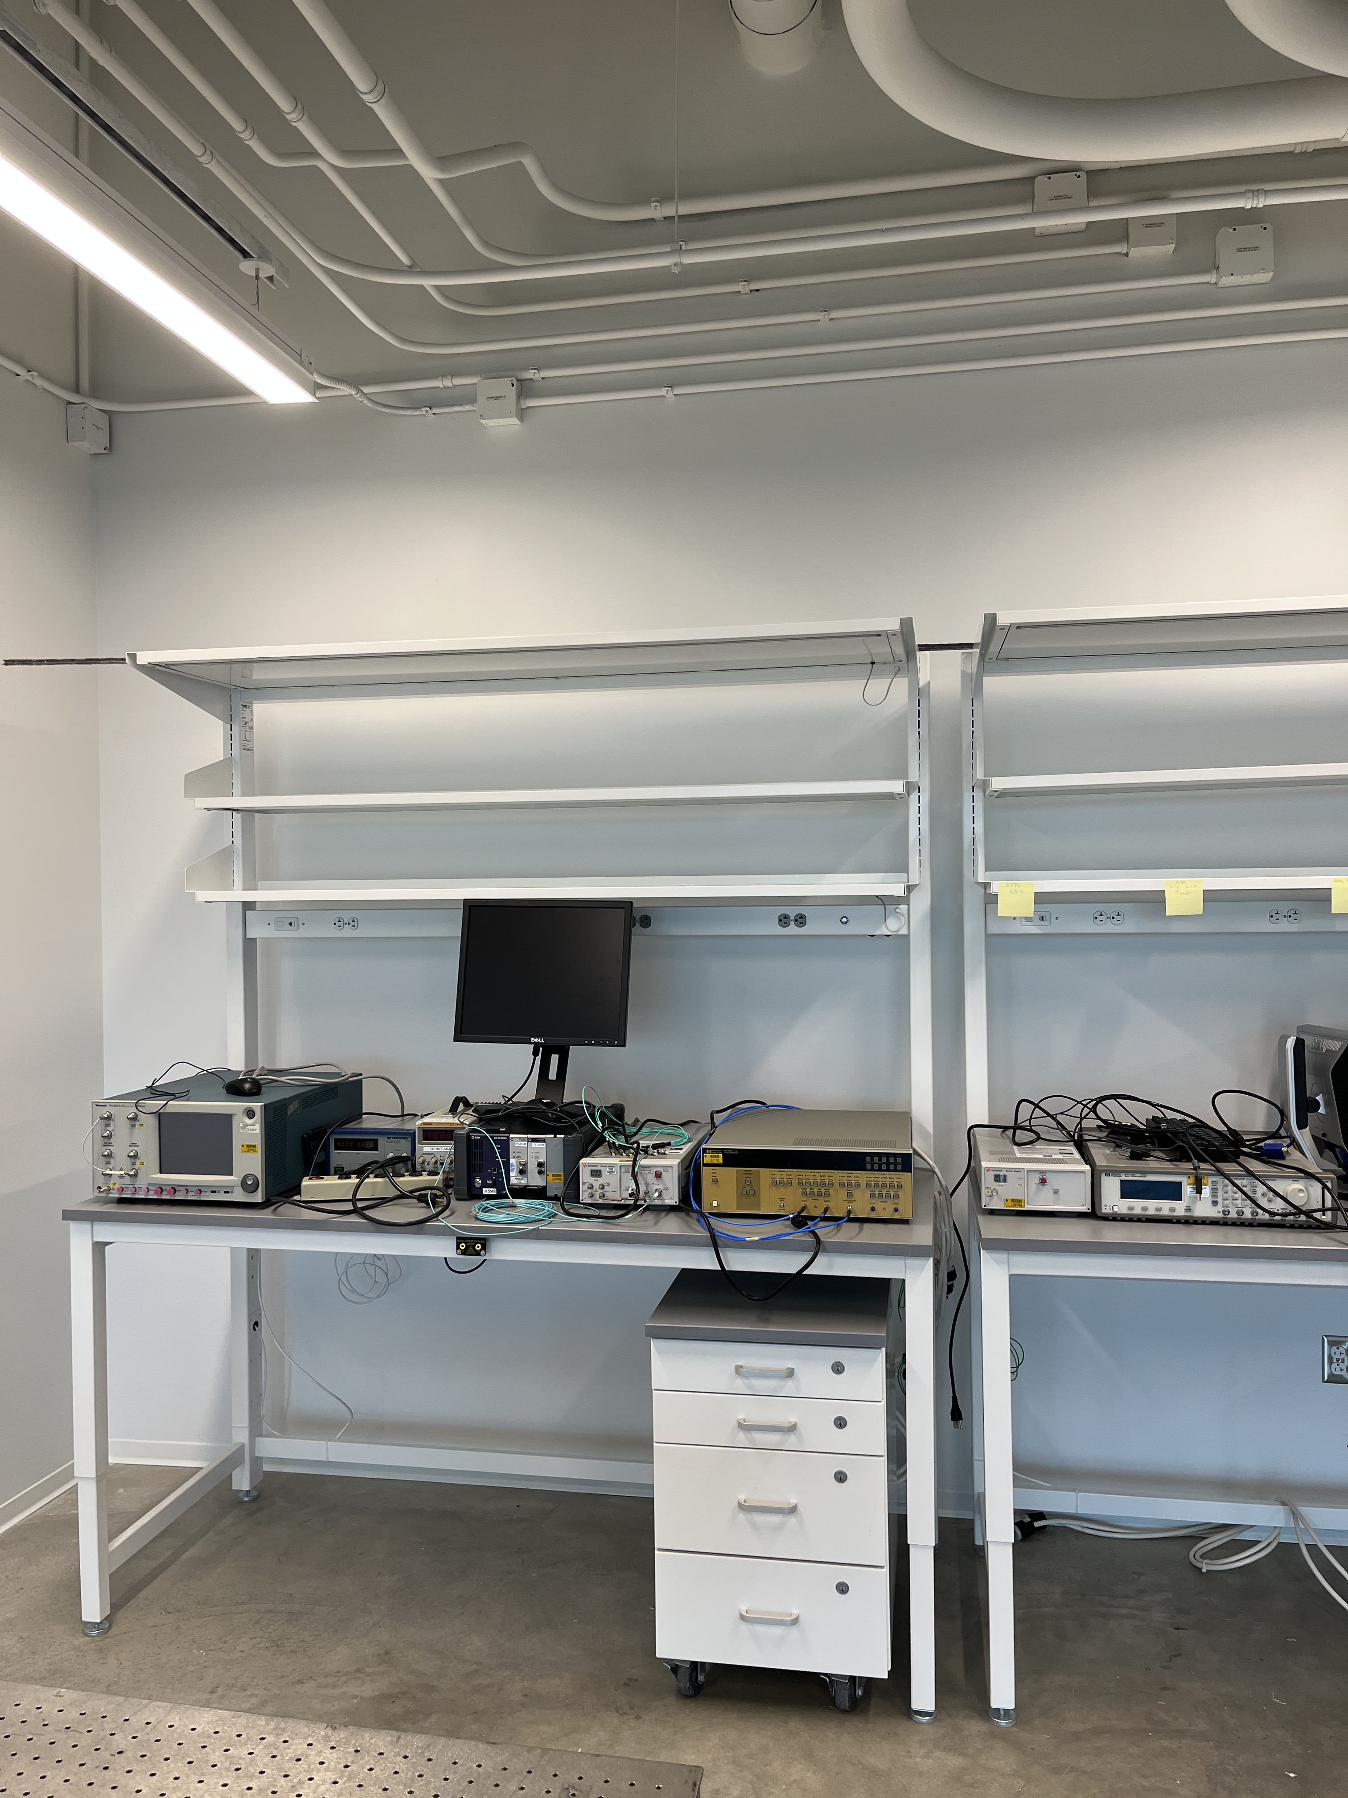
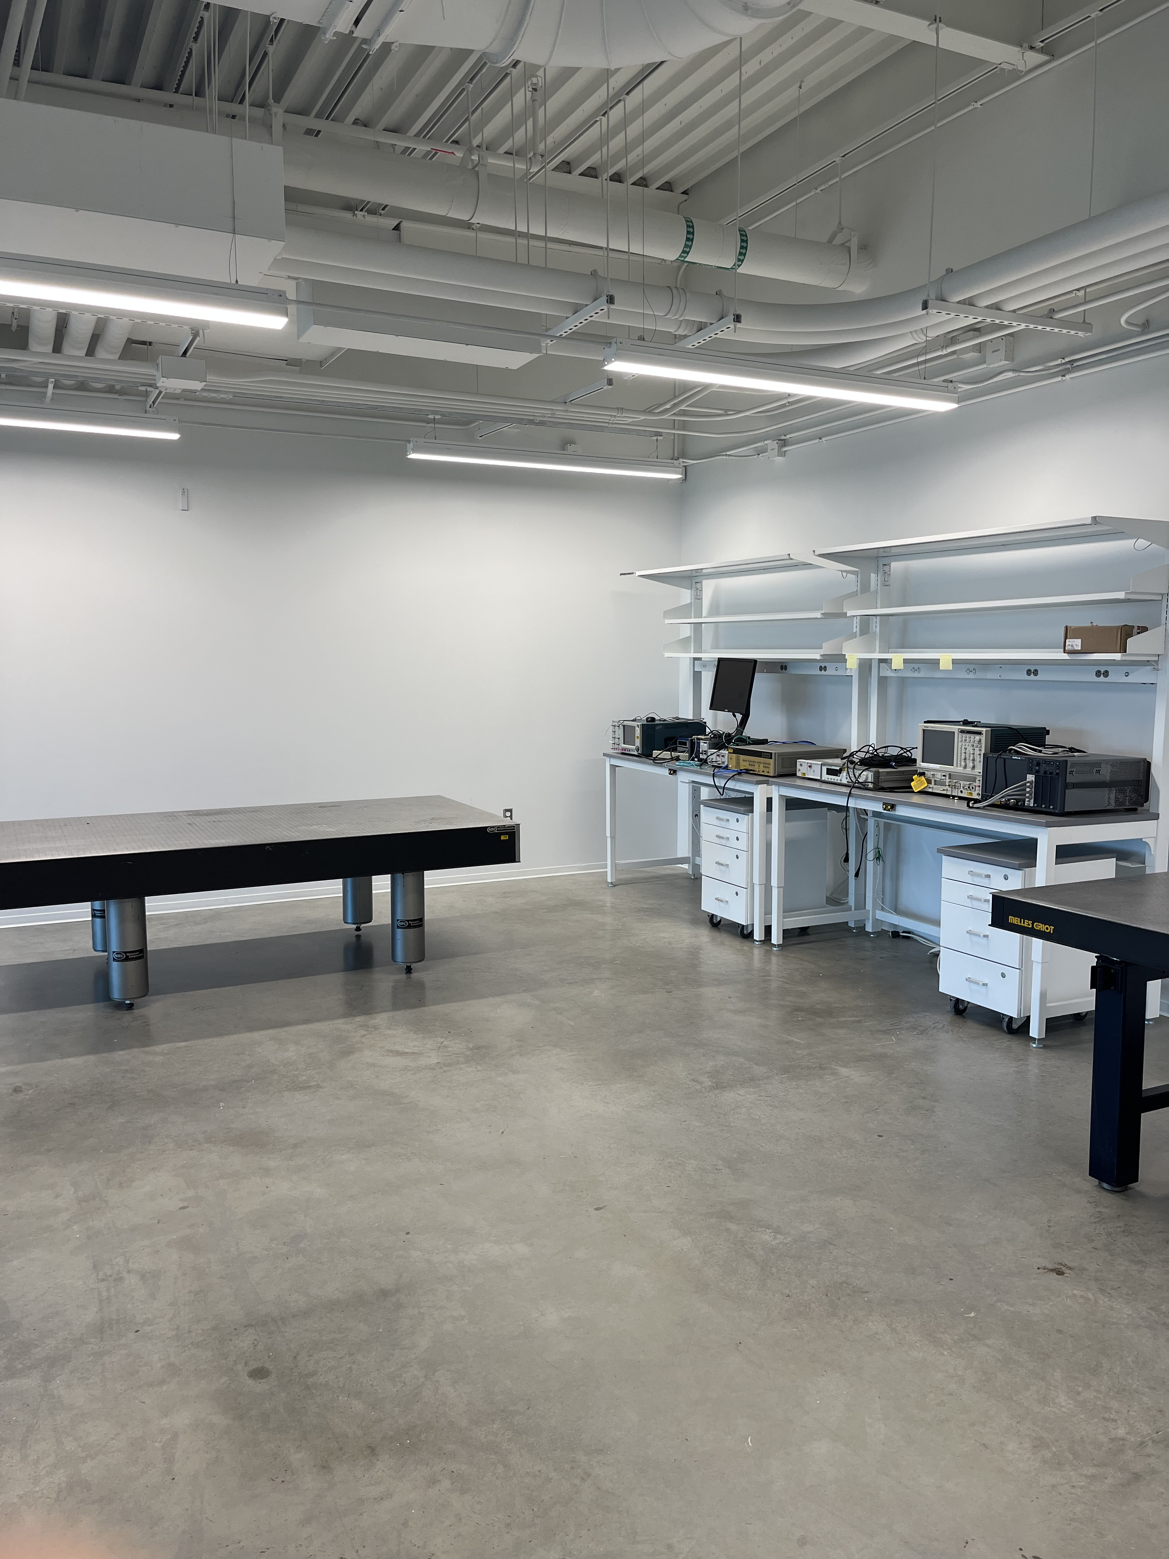

Slide 42
IERC News (NOV 9, 2023)
As already mentioned (slide 6) P.O. were issued for missing furniture for the meetings rooms, wellness rooms and common areas (Brian Rubik). Except for the large conference room (1462) and adjacent conference room (1416). A temporary small table was placed there, but a more suitable table is available.
We are in the process of acquiring new workbenches and chairs for the labs (Lisa Carrigan and Rick Ford).
I understand that Sue will soon be replaced by somebody else as building manager.
Sue also will work on signage for emergency gathering points and weather shelters. Leo will update the IERC Hazard Awareness training (some names have changed) and then ask Ryan Rivera, Dave Pushka and Rick Ford to see that people in their groups who have offices in the building take it.

Slide 43
IERC News (NOV 9, 2023)
Flor was asking about dumpsters.
There was a meeting where Lisa and Del expressed their concern with people from ISD and came away with the feeling that they had been heard. A walk-through with some people who will be doing maintenance on parts of the system will happen tomorrow at 2pm.
Donna and Monica are following up the cleaning of the laboratory space
Status of the electrical work (Adam, Claudio and Vadim).
Status and plans for Great Hall East (321)
Status of cranes audible warnings
Status of outdoor gas rack

Slide 44
IERC News (OCT 26, 2023)
Pick up trash and recycle is every 2 weeks^{(*)} on Thursday
We are continuing to try to understand what is going on with the HVAC system and how to make sure that we are in the loop for green-lighting interventions which might have consequences on the ODH assessment of certain areas. Lisa is trying to organize another meeting for next week. Andrew Martens and Michael Michalak seem to be the right people to interface with for the HVAC system. A schematics of the system is attached to the agenda.
It was reported yesterday that there was a “gas-like” smell in the clean room. Anybody else smelled something strange ? Fire brigade came in with sniffers but could not measure anything, so it should be safe to continue working there.
(*) The bi-wkly is also only 2 times per month. Not done every other week. When there are 5 weeks in a month, a week will be skipped. Bi-wkly service is never on the last Thrs. of every month, it’s the week before or after (except 5 wk months). Kimberly Hamilton <kahamilt@fnal.gov>

Slide 45
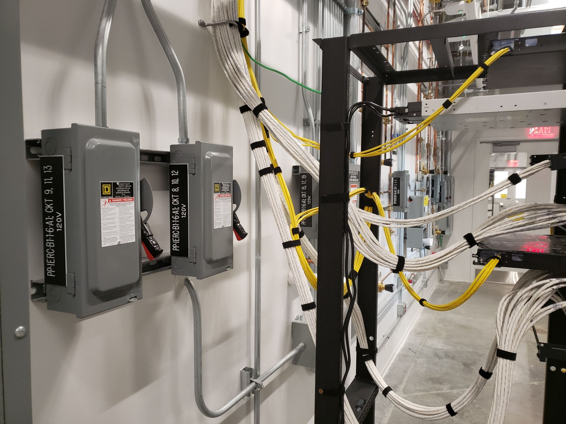
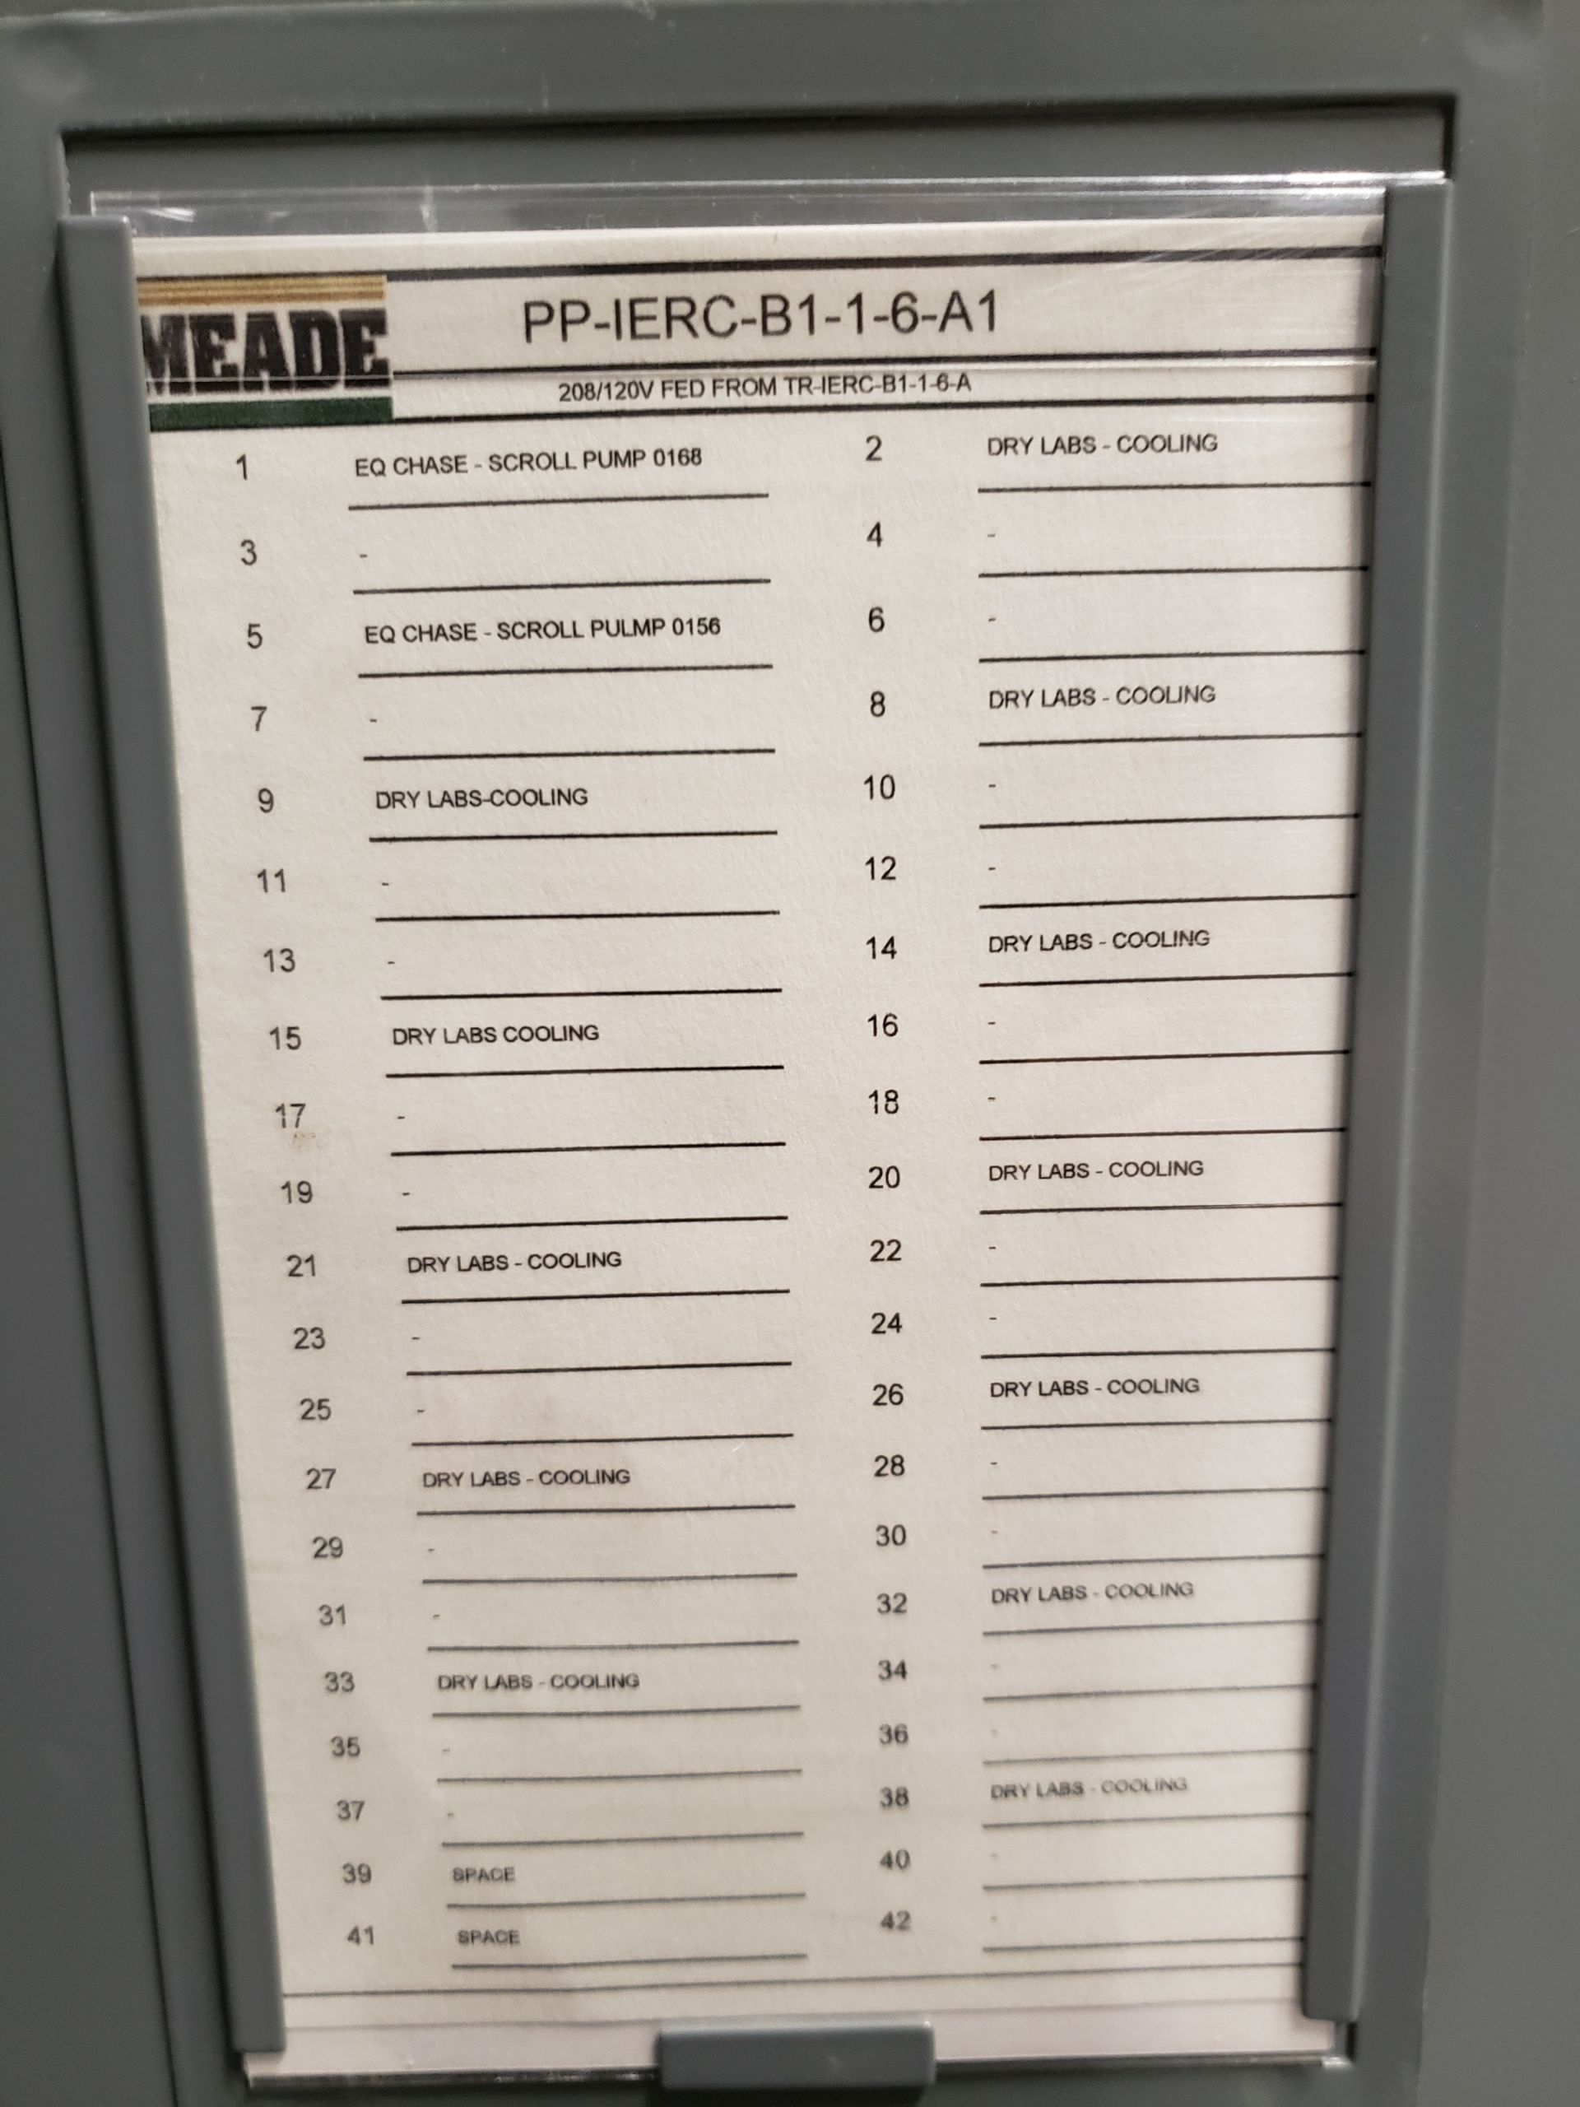
IERC News (OCT 26, 2023)
Cleaning of the labs can be done using the PPD IERC ops code as clarified by Rick (sorry, I had misunderstood the standing policy). Dune cold and Warm labs should use ND ops code.
We still need electrical work to be performed and it is very slow moving. Latest is for Mu2e TDAQ (Michael Utes) who met with Dave Featherston recently.

Slide 46
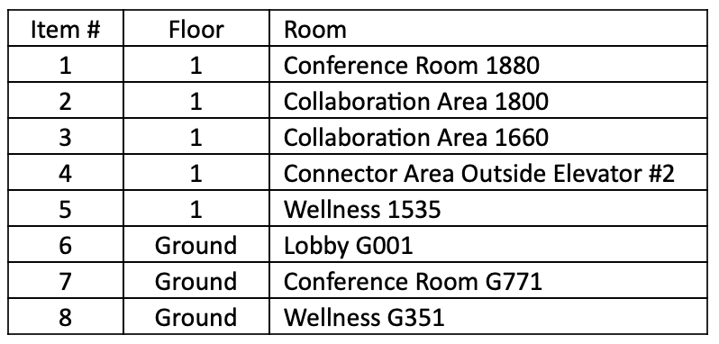
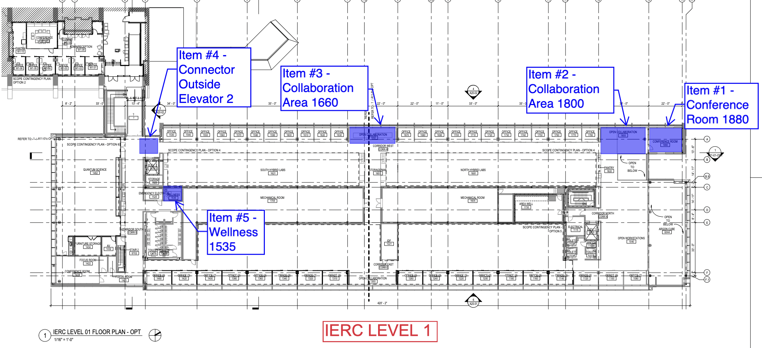
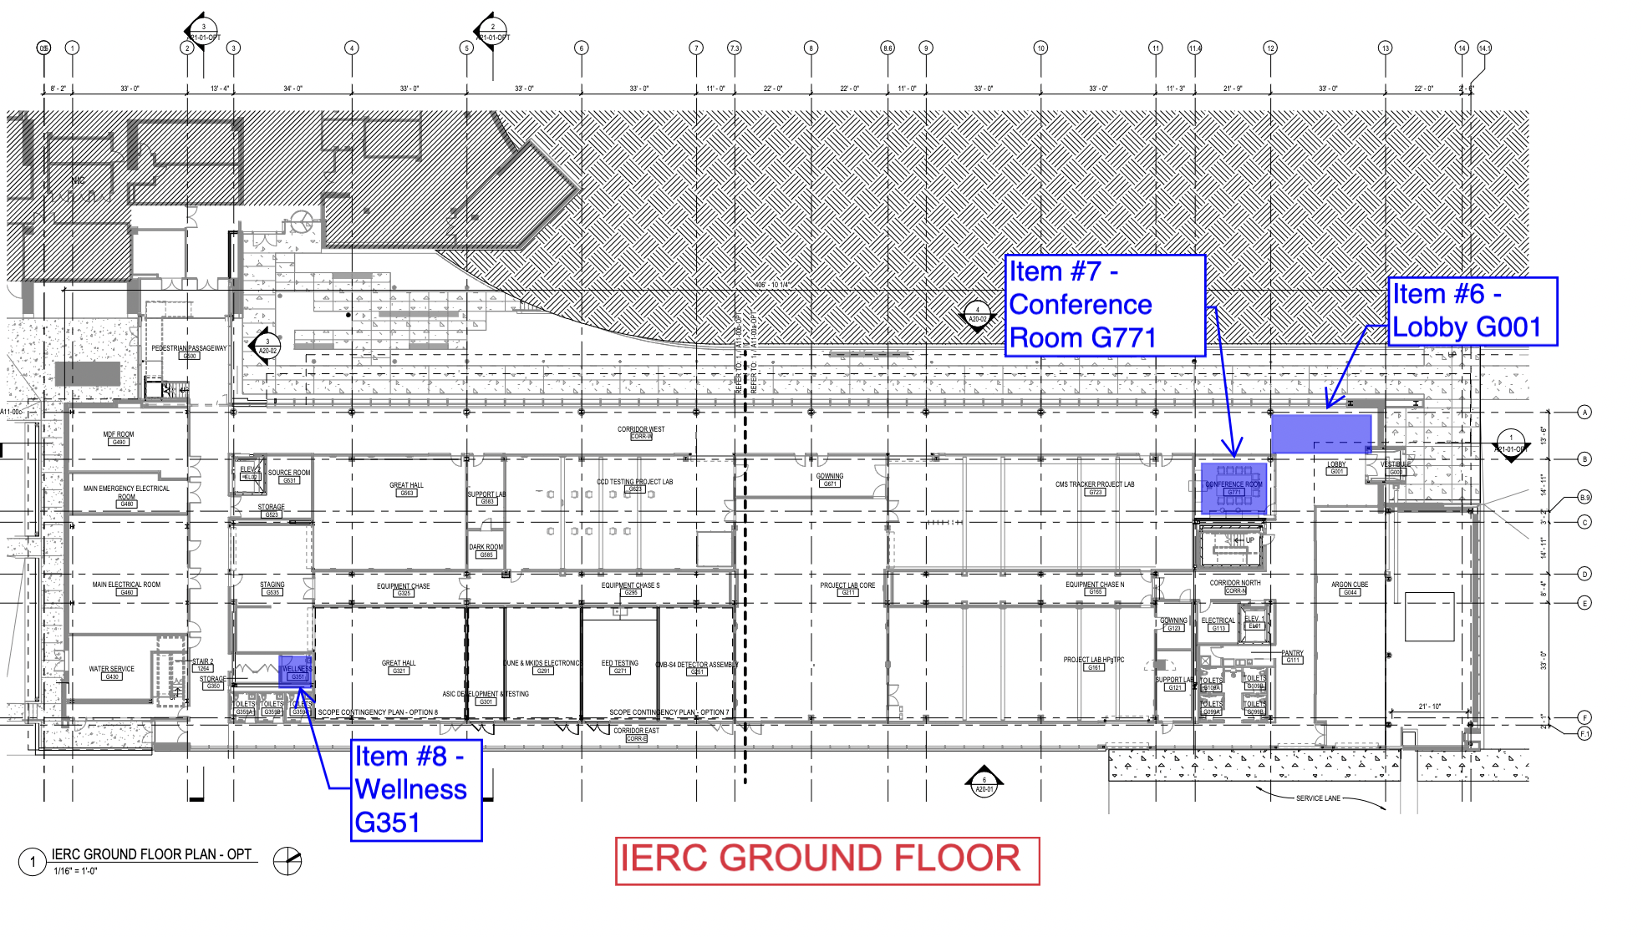
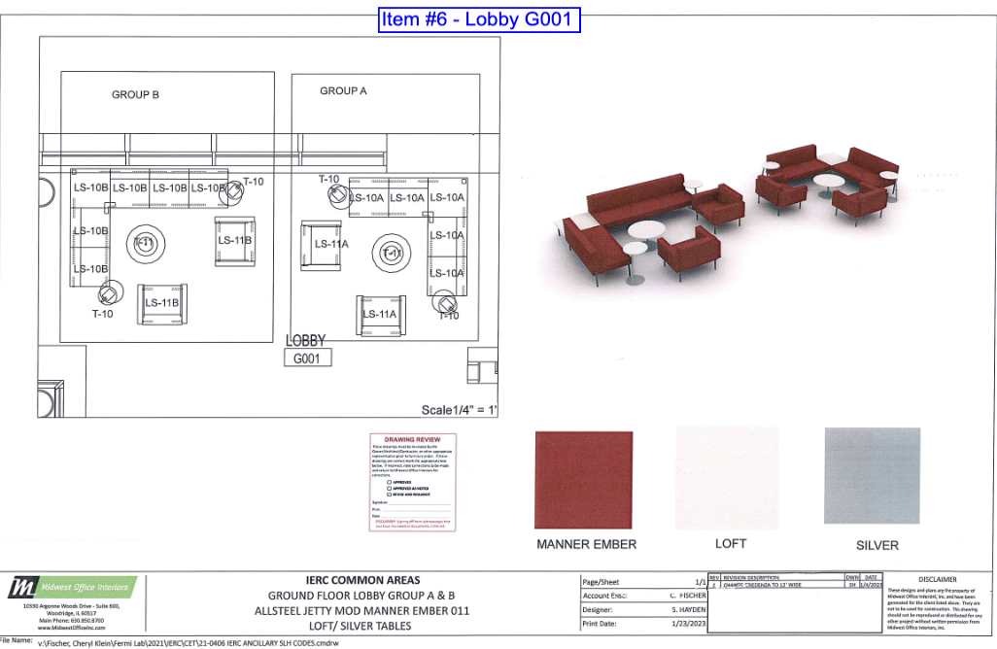
IERC News (OCT 26, 2023)
Furnitures POs have been issued to complete the meetings rooms, wellness rooms and common areas (Brian Rubik).
Lobby G001
Full list of furnitures and pictures is appended to the agenda page

Slide 47
IERC News (OCT 26, 2023)
Also Audio/Video equipment has been purchased on-project for all conference rooms above including 1416. Is this implying that they are “zoom” ready conference room or is there extra equipment to be purchased ?
Furnitures are expected to arrive in mid/end of January 2024.
As time approaches we should then remove current furniture.
A.Prosser: The large optical table is now in G291 for now. If this is a problem it can be moved out in relatively little time.
G321 should have been vacated by the contractor yesterday and free for usage by us (Cristian Pena, Rakshya Khatiwada, Andrew Sonnenschein)
Next week I will be away and I think I won’t be able to connect. Perhaps we should still have a meeting to discuss any progress on the HVAC system situation. Can some of you lead the discussion ?

Slide 48
IERC News (OCT 19, 2023)
Dan spoke with the contractor and agreed that Contractor will be removing all of their equipment and materials from G321 by end of day next Wednesday 10/25/23.
As already announced we will have monthly safety walk-through. First was today at 11:00am.
HEERC_safety mailing list is now fixed. Still not in the approval list for intervention on the HVAC system which might have an impact on the ODH analysis. Dan, can you comment ?
Monica, Flor and Daniel Urrea (Clorica) are making arrangements for Clorica to clean the Cleanroom, CCD room and Dune Warm Lab weekly. Donna will measure (since this is the first time we do it ourselves) ESD property of the floor before/after.
Optical table for A.Prosser in final location but larger optical table does not fit in the elevator. Need to understand what can be done.

Slide 49
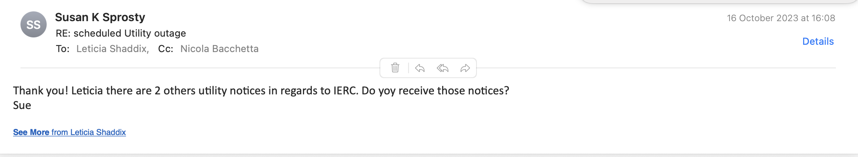
IERC News (OCT 19, 2023)
We continue experiencing issues with card readers, access is lost, regained, re-lost… and we do not seem to understand the root of the problem.
Follow up from Marcel Borcean on cranes.
  The limit switch adjustments were made during the monthly inspections. Cranes are operational. Audible warning devices are missing on 3 cranes. This was noted during commissioning. It is not a big task but it will need to be corrected. Please advise if the original contractor will warranty this repair.
HVAC to be shut-off next Monday but it still un-clear which one. Is it just the clean room HVAC system ? Also we do not receive these notes unless Sue’s forwarding them to us.

Slide 50
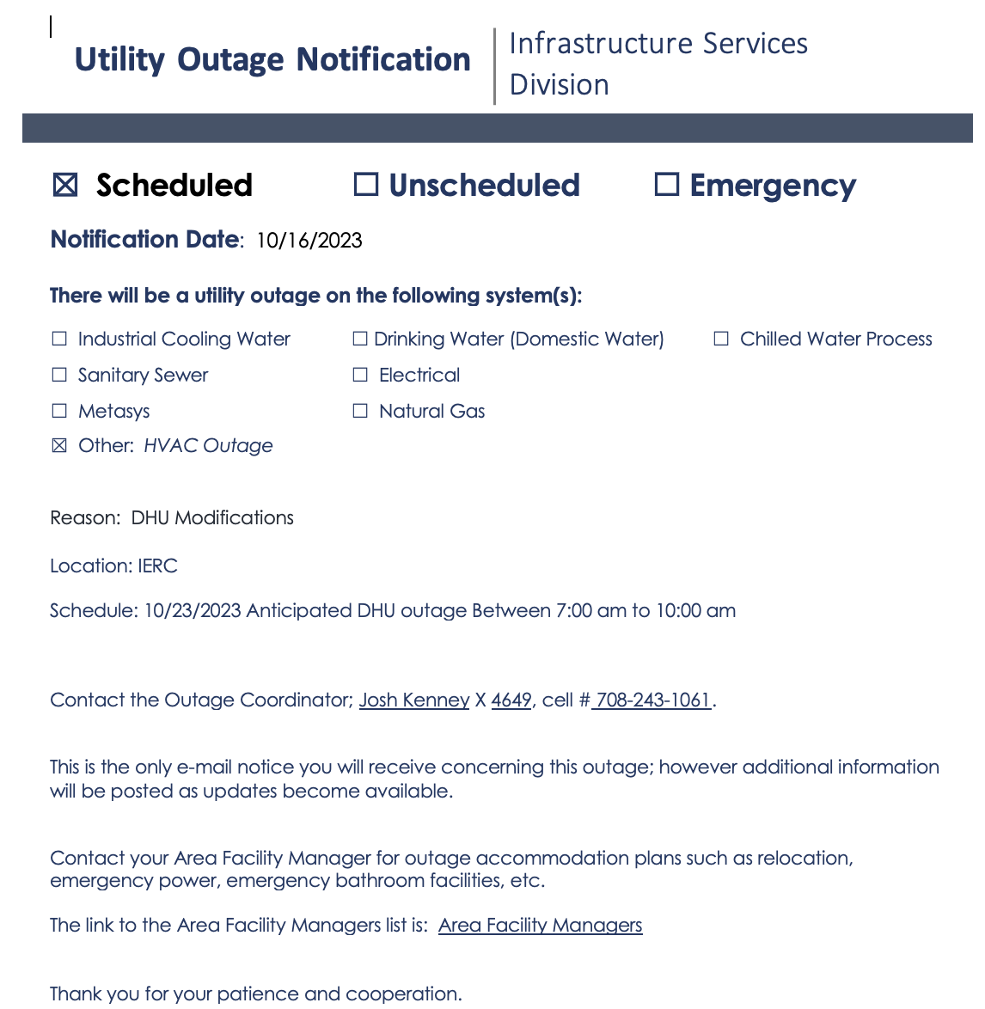
IERC News (OCT 19, 2023)

Slide 51
IERC News (OCT 12, 2023)
Tenants at IERC should contact their department Admin for Travel / Vouchers / and Orders (this has not changed).
Spring Barrett and Cathy Barker will be stocking the cabinets, filling the copiers/printers with paper, and keeping track of the Conference room. They will go to IERC once a week to make sure things are good.
I agreed with James Burke (Safety) to have monthly safety walk-through. First is Thursday 19th at 11:00am. The idea is for them to familiarize with the equipment that is currently at IERC since they will be required to sign off on any ORC. If some of you can be in the lab and explain what is going on it would be beneficial.
Chilled water: fall under the purview of the ISD Mechanical Shop, supervised by John (JP) Pollock. Fehr Solution (water treatment consultant) should have the IERC chilled water system added to their list for regular sampling. Question: Was a Sample Point or Chem Feeder installed in this system?

Slide 52
IERC News (OCT 12, 2023)
As a follow up on the HVAC intervention on the 29th of September, we had a meeting with ISD and Safety to discuss better procedures for such cases as they potentially alter the normal situation in terms of ODH analysis for various places at IERC. A specific HEERC_safety@fnal.gov list will be created with the idea to be in the loop of the approval process for such events. In any case, once approved, all events will be announced to the HEERC_managers@fnal.gov list with as much advance notice as possible. Question: is ODH the only issue here ?
We are in the process of developing the necessary procedures for being able to perform simple “Julie scans” ourselves without having to call the outside company who is very expensive. We will test drive the procedure for the installation of the new gas shack outside IERC North/Est end soon.
If you need to place some equipment in the storage room (G523) you can do so. In the future we might purchase cabinets to populate the room.

Slide 53
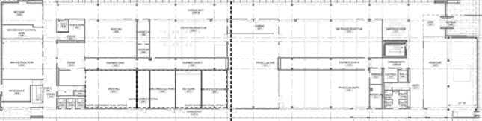
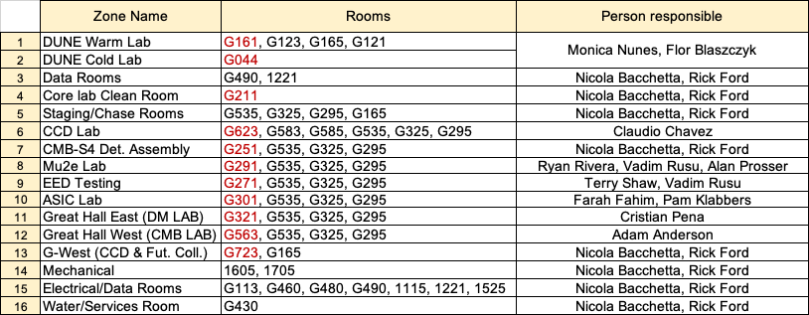
This slide was sent to Lori Limberg (card access). Let me know if there are modifications needed
G490
A.Anderson
C.Chavez
G671
G771
G480
G523
G723
G563
G623
Core Lab
Clean Room
G-WEST
CCD & Future Collider R&D
Great Hall West
(CMB-S4)
CCD
DUNE Cold
G460
G535
N.Bacchetta
F.Blaszczyk
G325
G295
N.Bacchetta
G165
C.Pena
G321
ASIC
Mu2e
EED
G251
DUNE Warm
G113
G044
G430
G301
G291
G271
CMB-S4
Det.Ass.
G211
M.Nunes
G123
G350
Great Hall East
(DM detectors)
R.Rivera
V.Rusu
A.Prosser
G161
F.Fahim
T. Shaw
V. Rusu
A.Anderson
G121
People requesting access to any of the zones (1 to 16) or to specific lab in red, should be given automatically access to the other rooms in the zone

Slide 54
IERC News (OCT 5, 2023)
Gas shack: Had a conversation with Arv Vasonis and agreed that for the moment we will install the gas rack where we now have the bottles next to the 3rd garage door on the north/east side of the building
2 large dumpsters (cardboard + regular waste) to be placed on the north/east side of the building. Sue is following this up.
People with office at IERC should ask for a key. There were instances when Security passed by and locked all doors and you might be locked out of your office if you do not have a key. I’ll try to understand whether I can ask security NOT to lock office door. Link for requesting a key here: https://www-esh.fnal.gov/pls/apex/f?p=150:1:17089239814925::::: Specify in the request your office number (but the key is actually the same for all offices and it is V2BB1)
We need waste basket for the offices. Also would the cleaning services clean the offices and emtpy the waste baskets ?
Admin person for IERC to be nominated

Slide 55
IERC News (OCT 5, 2023)
Great Hall East (G321) has now been assigned for work related to SNSPD characterization for BREAD, quantum capacitance detectors and related generic r&d. Person responsible for it would be Cristian Pena.
As a general reminder:
If electrical work is needed it should be addressed to Dave Featherston
If any type of gas is involved and ODH analysis should be done prior to move the relevant equipment there. Contact Del Allspach
If equipment is to be place in the chase, Don Mitchel is keeping track of the 3D model and should be consulted prior to install any new equipment. No equipment should be placed there without prior authorization.
An ORC should be requested before operating any setup in any lab at IERC, even when the setup has already been reviewed when elsewhere. https://fermipoint.fnal.gov/service/tsworc/Lists/tsworc/NewForm.aspx?Source=/service/tsworc/&Beam=0&orc=1

Slide 56
IERC News (OCT 5, 2023)
For any Ethernet connection, please follow the standard Fermilab procedures and submit a ServiceNow request:
http://appora.fnal.gov/pls/default/node_registration.html https://fermi.servicenowservices.com/kb_view.do?sysparm_article=KB0010655
We have found recently that some patch jumpers for the LAB connections at IERC were moved on the patch panels to centrally managed network equipment in the Equipment Chases. I think it should be a common sense that nobody but Network Services/Network Cabling are allowed to connect/disconnect/ move anything in the racks with network equipment. We expect that users in the new IERC building will demonstrate a common sense by not touching the centrally managed infrastructure. For any networking needs, users just need to submit a ServiceNow request and we will take care of the rest.
We have been scrutinized recently by Cyber security for locations with network equipment and who can access it. If it continues to happening, we might be required to replace all racks with network equipment in the IERC by the lockable cabinets at the expense of IERC stakeholders.
It is important that we are notified with some advance notice of any intervention at IERC, especially for what concern power outages and the HVAC system as it has an impact on safety since the ODH analysis is linked to the proper functioning of the HVAC system.

Slide 57
IERC News (OCT 5, 2023)
Plans for 1st floor open space laboratories:
  Electronics lab space: meant for bench top type of setups (electrical, optical, test stations etc.)
    In the process of getting appropriate space dividers
    Lab cubicles: 16.5’ wide by 21’ long
  Tech lab space: meant for more mechanical work and to provide space for the technicians to have their space/material and computer etc. in support of the activities on-going at IERC.
    Lab cubicles: 11’ wide by 21’ long
We are in the process of purchasing new benches/chairs for equipping more labs at a reasonable price.
TECH LAB SPACE
TECH LAB SPACE
ELECTRONICS LAB SPACE
ELECTRONICS LAB SPACE
A. Prosser
J.Estrada

Slide 58
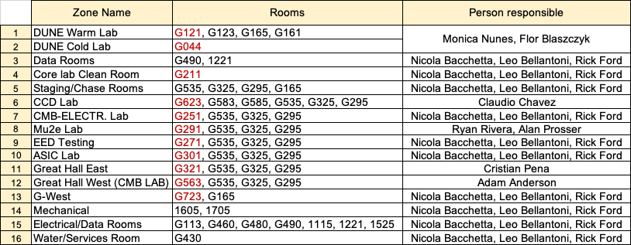
Access zones for HEERC
People requesting access to any of the zones (1 to 16) or to specific lab in red, should be given automatically access to the other room in the zone

Slide 59
Follow up items from previous meetings
There is a proposal for where to place fixed phones in the building and I need to follow that up with the formal request. A certain number of phones should be already available.
Need to add a card reader for G165 (south chase)
Would be nice to upgrade one of the meeting rooms to ZOOM room in 2024 (likely 1880)
Need to take care of properly drain the condesation water from the compressor in G430

