Slide 1
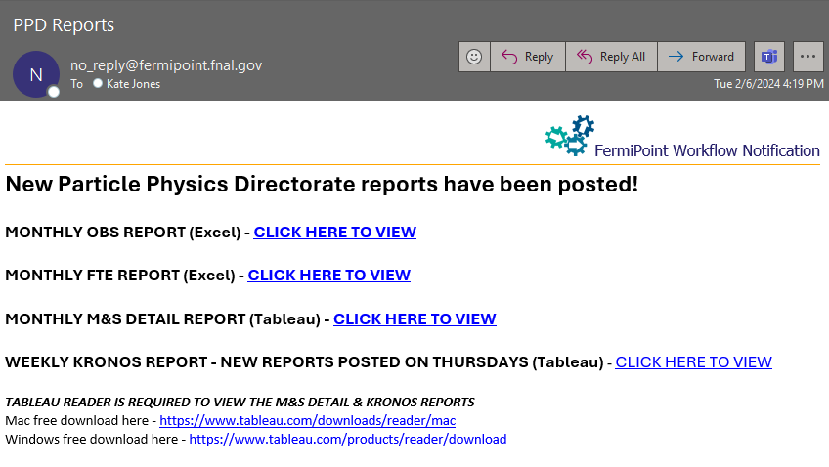
Financial Reports
Directorate-wide info now included in financial reports
PPD, ND, and THD
This does NOT replace any other ND or THD reports

Slide 2
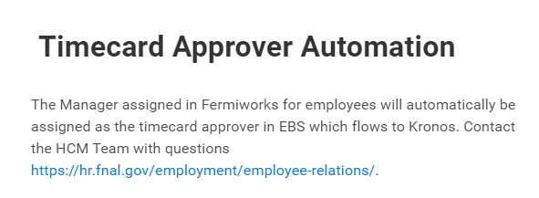
Timecard Approvers
Timecard Approvers now come from WorkDay
Approver is the Manager listed in WorkDay

Slide 3
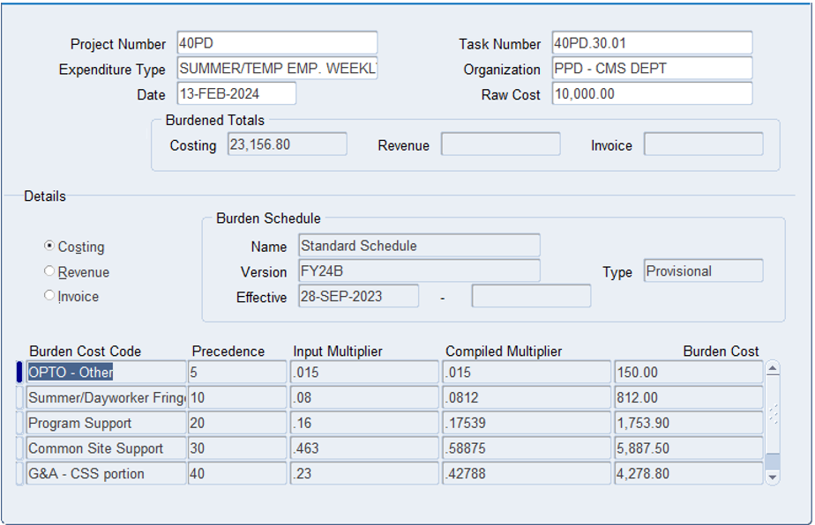
Summer OPTO Rate
New OPTO rate for Summer/Temp
“Paid Leave for All Workers Act” (aka “Any Reason Leave”) effective 1/1/2024
1.5% OPTO applied before the 8% fringe rate
Retroactively applied to the beginning of FY24

Slide 4
Signature Authority Updates
More scrutiny on PS and CSS tasks
Approval authority for Department Heads was up to $50k, has been reduced
Now up to $5k
Over $5k will be sent to Kevin for review & approval

Slide 5
Reminder: Financial Liaison Assignments
Org | Prior Financial Manager | New Financial Manager
PPD - ASTROPHYSICS DEPT (40PD/Base) | Kate Jones | Kimberly Swendsen
PPD - ASTROPHYSICS DEPT (Non-Base) | Kate Jones | Kate Jones
PPD - CMS DEPT | Kimberly Swendsen | Kate Jones
PPD - DETECTOR RESEARCH AND DEVELOPMENT | Kimberly Swendsen | Kimberly Swendsen
PPD - PPD DIVISION OFFICE | Kate Jones | Kate Jones
PPD - MUON DEPARTMENT | Kate Jones | Kate Jones
PPD - DETECTOR DEV AND OPS DEPT | Kimberly Swendsen | Kate Jones
PPD - ALIGNMENT AND METROLOGY | Kate Jones | Kimberly Swendsen
PPD - SUPPORT SERVICES DEPT | Kimberly Swendsen | Kimberly Swendsen
PPD - ELECTRICAL ENGINEERING DEPT | Kate Jones | Kimberly Swendsen
PPD - MECHANICAL ENGINEERING DEPT | Kate Jones | Kimberly Swendsen
All ND departments | Molly Anderson | (no change)
All THD departments | Rob Carrara | (no change)

