Slide 1
Near Detector Technologies (A WG6 Teaser Talk)
Thorsten Lux

Slide 2
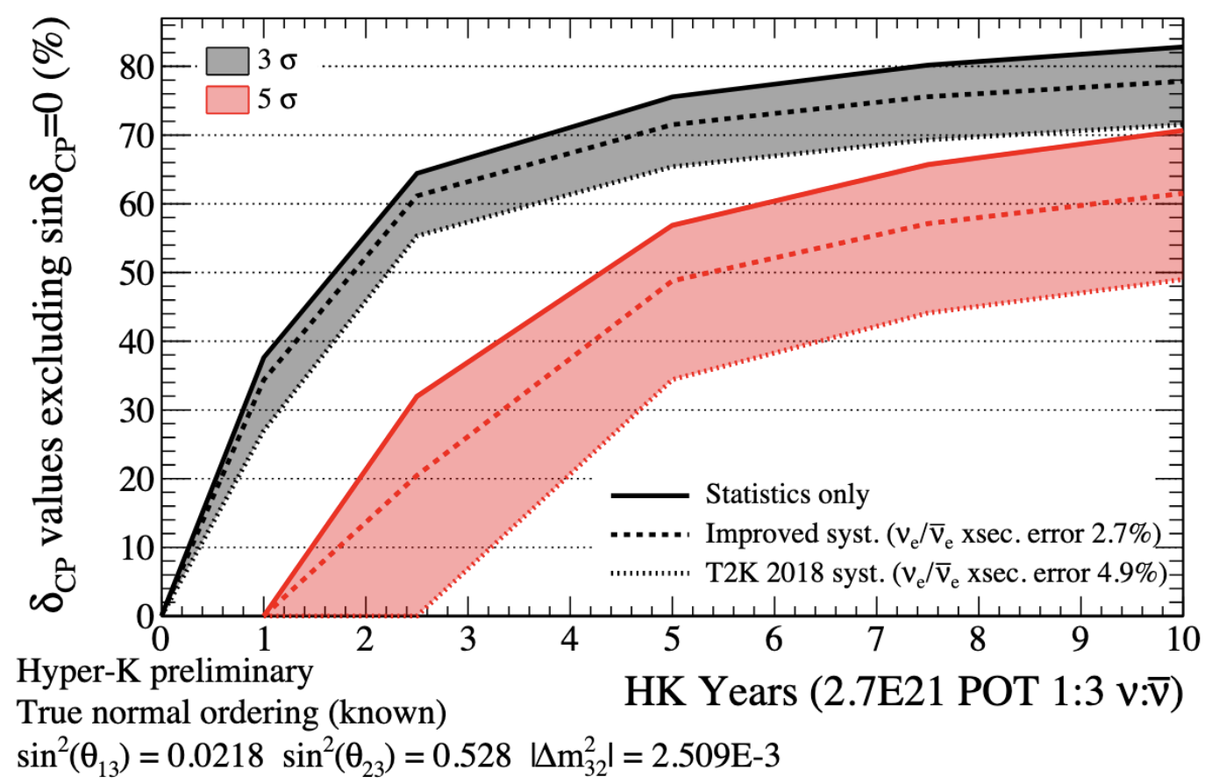
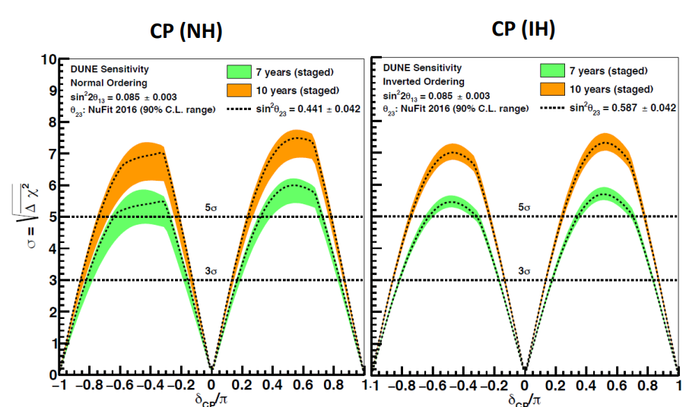
Why do we need Near Detectors?
See talk by S. Dolan
Objective of current and future LBNO experiments is to measure with precision δ_{CP} phase
⇒ Systematic uncertainties are the big enemy!
HK
Improved systematics
T2K-level systematics
DUNE
Sensitivity to exclude CP conserving values for $δ_{CP}$
Can delay physics results by several years.
Or prevent them altogether!
But we luckily have Near Detectors!

Slide 3
LBNO Concept
Far detector
Near detectors
Neutrino source: Accelerator + target + decay tunnel
L ≈ hundreds of m
L ≈ hundreds of km (choice depends on L/E_{ν} )
Huge masses of 10s of ktons
Often underground
Oscillated neutrino spectrum
Constraints on neutrino flux before oscillation
Neutrino cross sections
Direction of neutrino beam
Proton synchrotron (30-120 GeV)
Target to produce mesons
Magnetic system to select polarity
Decay tunnel to let mesons decay and produce neutrinos

Slide 4
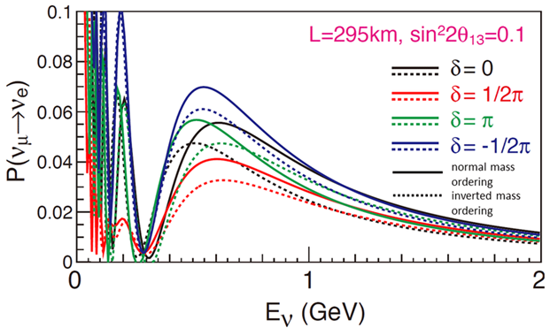
LBNO Concept
Detectors provide event rates in bins of reconstructed neutrino energy:
$$\frac{{dN}_{β}^{ND}}{{∆E}_{υ}^{reco}}=N_{target}^{ND}\sum_{i}{φ^{ND}}(E_{υ})σ_{i}^{ND}\left(E_{υ}\right)T_{i}^{ND}\left(E_{υ},E_{υ}^{reco}\right)ε_{i}^{ND}\left(E_{υ},E_{υ}^{reco}\right){dE}_{υ}$$
ND:
$$\frac{{dN}_{β}^{FD}}{{∆E}_{υ}^{reco}}=N_{target}^{FD}\sum_{i}{φ^{FD}}(E_{υ})σ_{i}^{FD}\left(E_{υ}\right)T_{i}^{FD}\left(E_{υ},E_{υ}^{reco}\right)ε_{i}^{FD}\left(E_{υ},E_{υ}^{reco}\right)P_{υ_{α}→υ_{β}}\left(E_{υ}\right){dE}_{υ}$$
FD:
Cross-sections for ith interaction mode
Energy migration tensor
Efficiency/ acceptance
Oscillation probability
Neutrino flux
We need the oscillation probability from event rates with high precision
From the oscillation probability we extract then the oscillation parameters

Slide 5
LBNO Concept
See talk by E. Miller
Detectors provide event rates in bins of reconstructed neutrino energy:
$$\frac{{dN}_{β}^{ND}}{{∆E}_{υ}^{reco}}=N_{target}^{ND}\sum_{i}{φ^{ND}}(E_{υ})σ_{i}^{ND}\left(E_{υ}\right)T_{i}^{ND}\left(E_{υ},E_{υ}^{reco}\right)ε_{i}^{ND}\left(E_{υ},E_{υ}^{reco}\right){dE}_{υ}$$
ND:
$$\frac{{dN}_{β}^{FD}}{{∆E}_{υ}^{reco}}=N_{target}^{FD}\sum_{i}{φ^{FD}}(E_{υ})σ_{i}^{FD}\left(E_{υ}\right)T_{i}^{FD}\left(E_{υ},E_{υ}^{reco}\right)ε_{i}^{FD}\left(E_{υ},E_{υ}^{reco}\right)P_{υ_{α}→υ_{β}}\left(E_{υ}\right){dE}_{υ}$$
FD:
Cross-sections for ith interaction mode
Energy migration tensor
Efficiency/ acceptance
Oscillation probability
Neutrino flux
Near Detector contributes to reduce uncertainty from neutrino flux and cross-sections
σ^{ND} and σ^{FD} (ideally by measurement) from ND
Crucial to understand relation between reconstructed and true neutrino energy

Slide 6
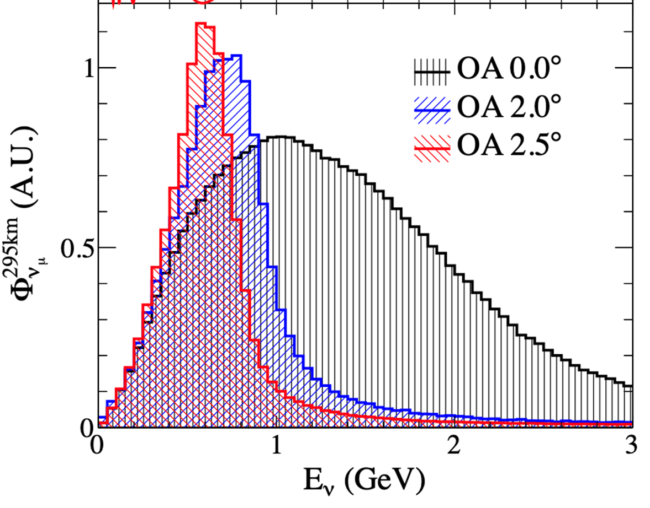
Neutrino Fluxes: Energy Spectrum
Important to understand what neutrino fluxes one can expect
Are the detectors on-axis or off-axis?
On-axis: Wide neutrino energy spectrum
Off-axis: Narrower neutrino energy spectrum peaking at lower energies
Neutrino beams are very wide and covering the whole experimental area
Measuring at different angles helps to deconvolute flux and cross-section

Slide 7
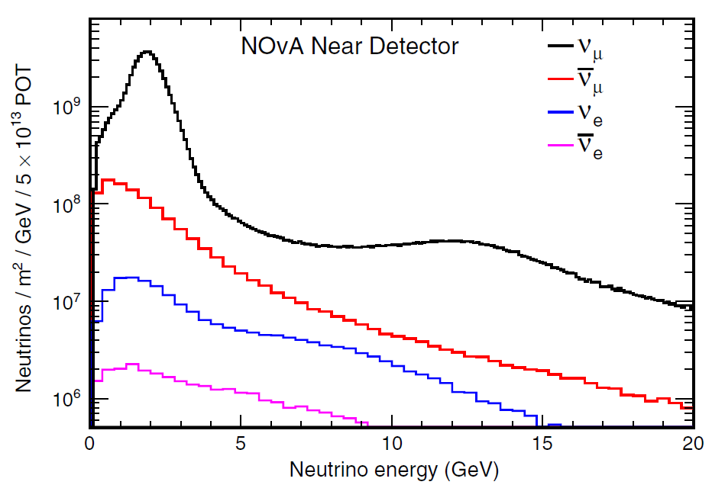
Neutrino Fluxes: Composition
Naïve picture: Start with pure ν_{μ} beam characterized at ND and measure oscillated beam containing ν_{μ} and ν_{e} at FD
Reality: Production process of neutrino beam results in contamination
Fractions depends on several experimental aspects: proton energy, target geometry, horn system, beam angle, …
Knowledge important for experiment sensitivity
Enables to measure cross-sections also for ν_{e}

Slide 8
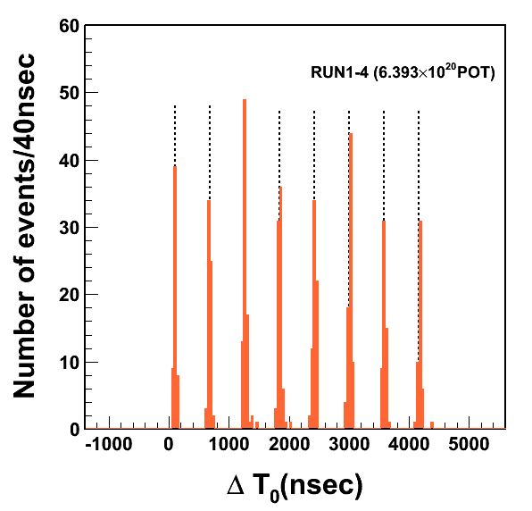
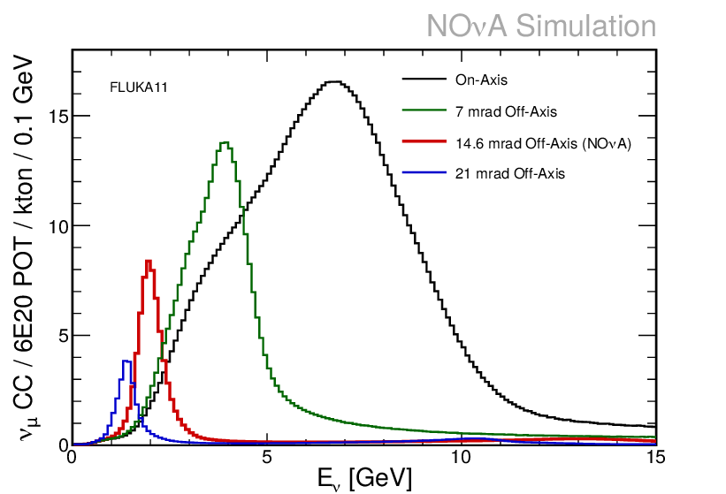
Neutrino fluxes: Intensity/Beam Power
T2K: 1 spill with 8 bunches
Intensity of neutrino flux impact on ND design
Higher flux means more statistics opening new opportunities
Beam power can be increased by more spills or more neutrinos per spill
More neutrinos per spill implies more pile up background (also from out of fiducial volume interactions)
Impressive increase in intensity and neutrinos per spill over last decades:
Past: K2K => 1.4 x 10¹² p.o.t.
Current: T2K => 2.65 x 10¹⁴ p.o.t.
Next generation: DUNE => 7.5 x 10¹³ p.o.t. HK => 3.2 x 10¹⁴ p.o.t.
⇒ ND technologies with smaller N_{target} become interesting!
See talk by T. Sekiguchi and A. Burleigh

Slide 9
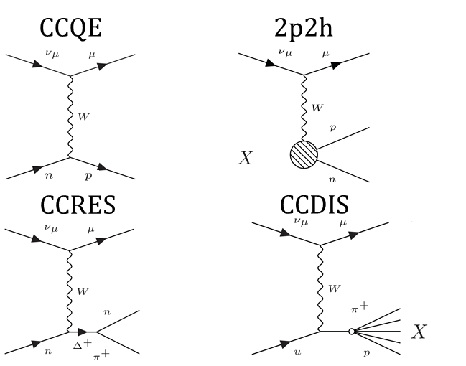
Cross-Sections
See talk by L. Munteanu and S. Dolan
At neutrino energies relevant for LBNO, there are 4 interaction modes:
Depend on target material => ND should provide cross-sections for FD target!

Slide 10
Event Topologies
Interaction not on free nucleons
Nuclear effects/ Final State Interactions (FSI) can alter the event observables
Effects depend on target material
More relevant for low neutrino energies
ND provides insight in FSI

Slide 11
Neutrino Energy Reconstruction
The oscillation parameters depend on the true neutrino energy => precise knowledge of energy response function T(E_{rec}, E_{true}) crucial.
1) Kinematic energy reconstruction (suitable for true QE events):
2) Calorimetric energy resolution:
Requires only kinematics of outgoing muon
Problem: Sums include neutral particles (neutrons, π0) which might escape undetected
Kinetic energy of outgoing nucleons
Total energy of outgoing mesons

Slide 12
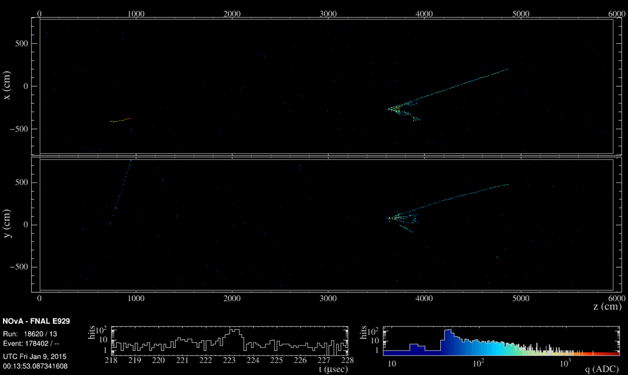
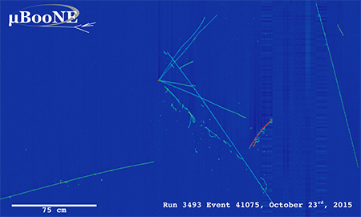
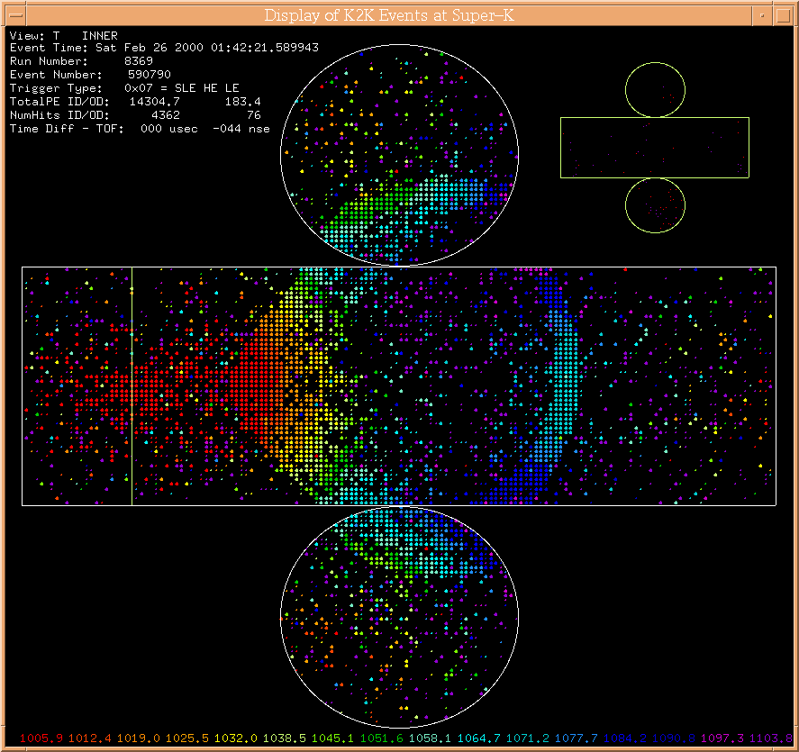
Far Detector Technologies
Liquid Argon
LAr TPCs
DUNE
10 kton per module (up to 4 in total)
Baseline: 1300 km
Target: Ar
Scintillator
Bar tracker
NOvA
14 kton
Baseline: 810 km
Target: CH
Water
Water Cherenkov detectors
SK and HyperK
22.5 and 190 kton
Baseline: 300 km
Target: H₂O

Slide 13
Many Expectations on Near Detectors
(ν_{e} /ν_{μ}) /(‾ν_{e} /‾ν_{μ}) cross-section ratio
Understanding the nuclear effects
Energy response function T(E_{rec}, E_{true})
FD target cross-section
Flux+cross-sections at various off-axis positions with the same detector
Wrong-sign contamination in the beam
Total intensity and direction of the neutrino beam
What we want:
Large target mass
Fine granularity
Magnet
Same target as in FD
Low detection threshold
Good PID and momentum reconstruction
Detect neutral particles
Moveable
4π acceptance with high efficiency
What we need:

Slide 14
Many Expectations on Near Detectors
(ν_{e} /ν_{μ}) /(‾ν_{e} /‾ν_{μ}) cross-section ratio
Understanding the nuclear effects
Energy response function T(E_{rec}, E_{true})
FD target cross-section
Flux+cross-sections at various off-axis positions with the same detector
Wrong-sign contamination in the beam
Total intensity and direction of the neutrino beam
What we want:
Large target mass
Fine granularity
Magnet
Same target as in FD
Low detection threshold
Good PID and momentum reconstruction
Detect neutral particles
Moveable
4π acceptance with high efficiency
Hardly possible that one ND technology provides all this!
⇒ Selection of target detector technologies on the next slides
What we need:

Slide 15
2D Scintillator Tracker
Plastic/liquid scintillator excellent choice as target (several tons)
Good light yield
Excellent timing information
Classical approach:
Scintillator bars with WLS fiber
Signal read by MPPC provides information about deposited charge
Alternating layers provide either xz or yz information of tracks
Freely choosable bar dimensions

Slide 16
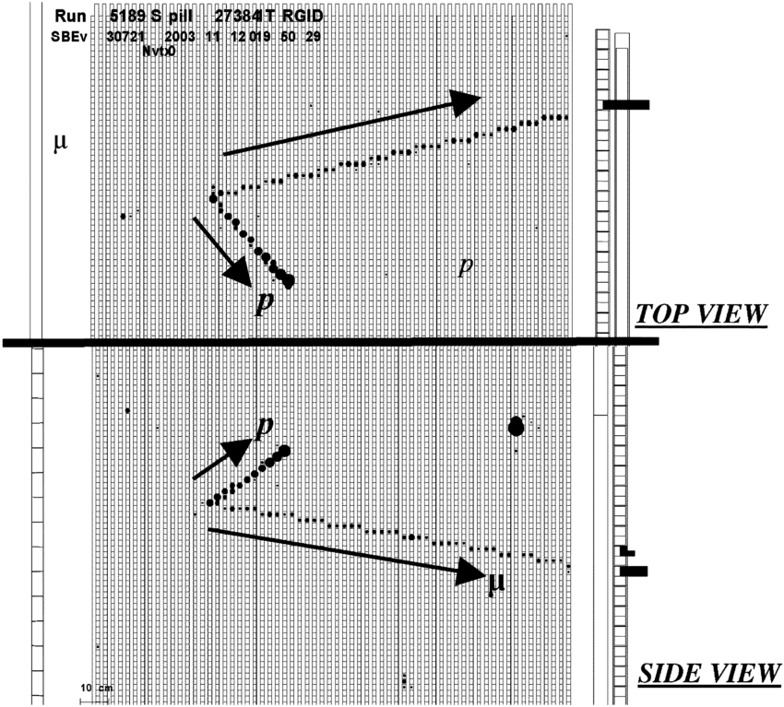
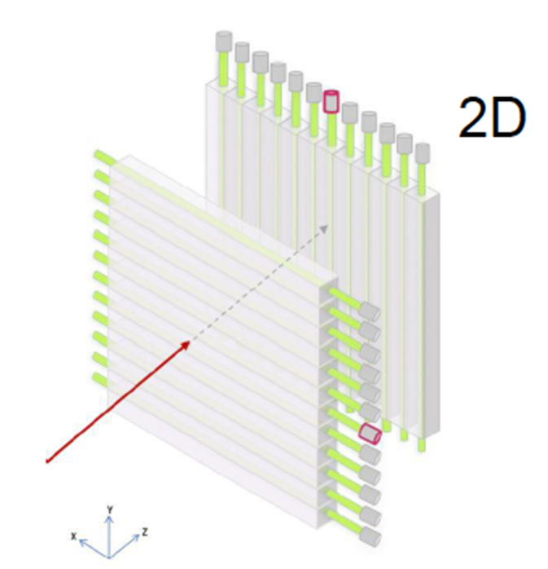
2D Scintillator Tracker
Very successfully used in K2K, T2K and NOvA
Easy to construct
Drawbacks:
Both views are independent and 3D reconstruction might be ambiguous
Relative high track detection threshold (at least 3 hits in each view)
High angle tracks (along one bar) not/badly reconstructed
KEK event display

Slide 17
3D Scintillator Tracker
How to overcome the drawbacks of the 2D tracker?
Go 3D using cubes instead of bars and 3 WLS fibers per cube!
“Minor” issues (for 2 ton detector):
Instead of 10,000 bars (1x1x200 cm³), one needs 2,000,000 cubes (1x1x1cm³)!
Readout channels go up from 10,000 to about 60,000!
Very stringent requirements on tolerances and alignment of the different components
But impressive advantages as ND target

Slide 18
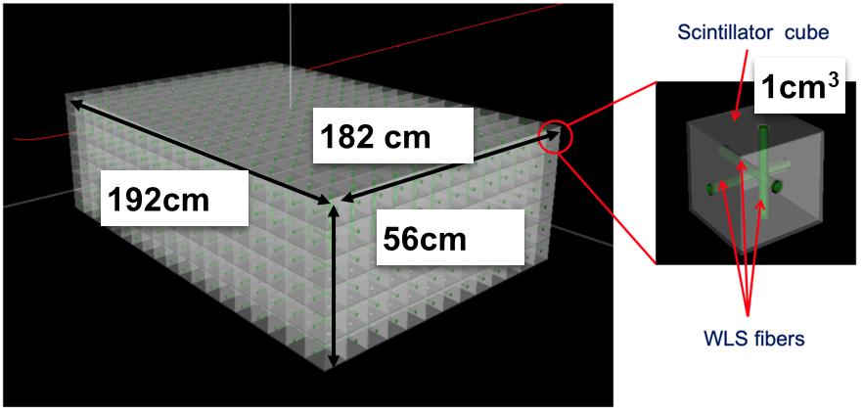
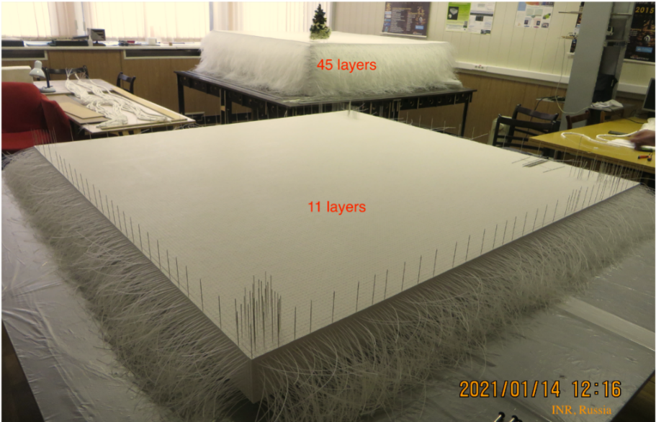
3D Scintillator Tracker: SuperFGD
Built for T2K ND280 Upgrade and installed in October 2023
2M optically isolated cubes produced and 6M holes precisely drilled
Assembled in 56 layers with fishing lines
Final assembly in box with WLS fibers

Slide 19
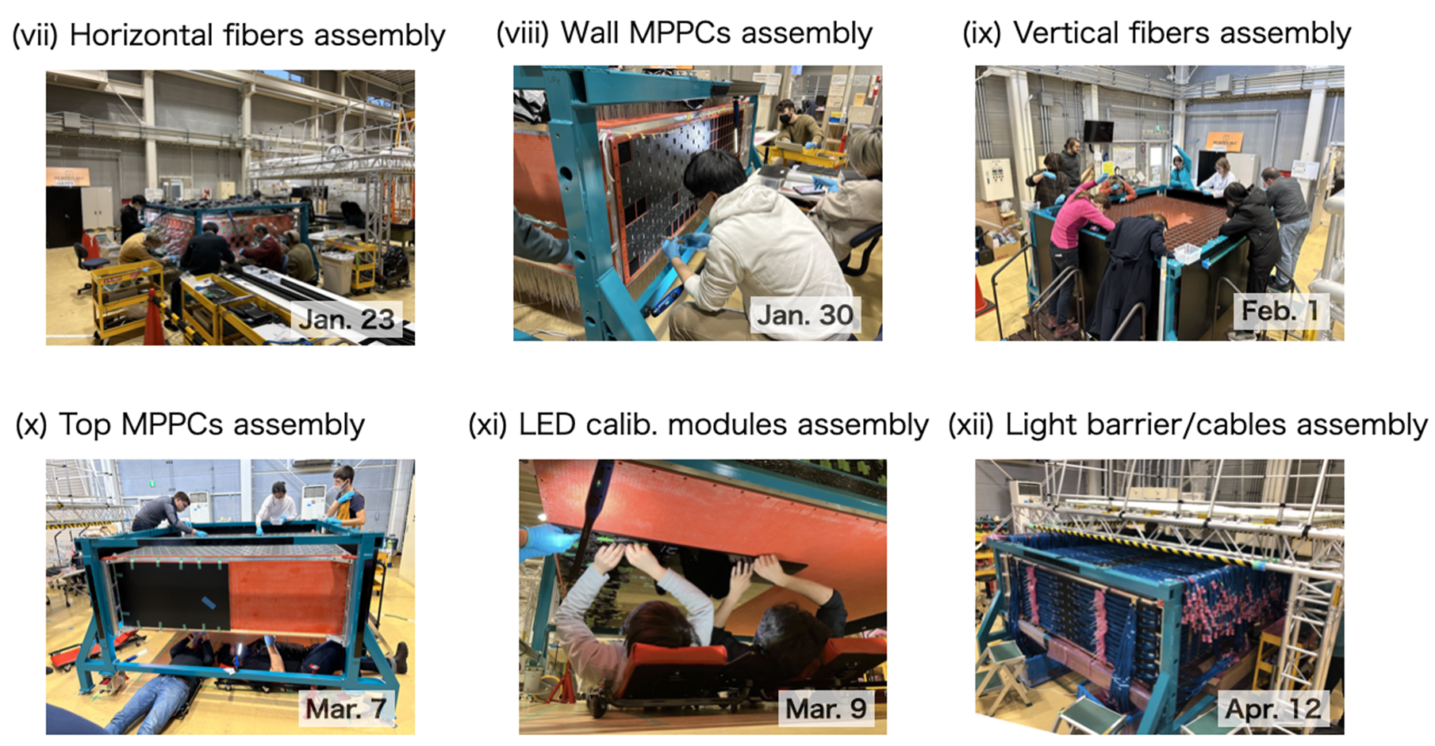
SuperFGD: Production + Assembly
Production of cubes: ~100k per month
Cube preparation:
190 cubes for one string
182 strings mounted to 1 layer (40k cubes)
~20 months for all layers
Layer by layer installed carefully aligned with 56k holes in box
Very slow and labour intensive assembly work
~6 months to complete assembly

Slide 20
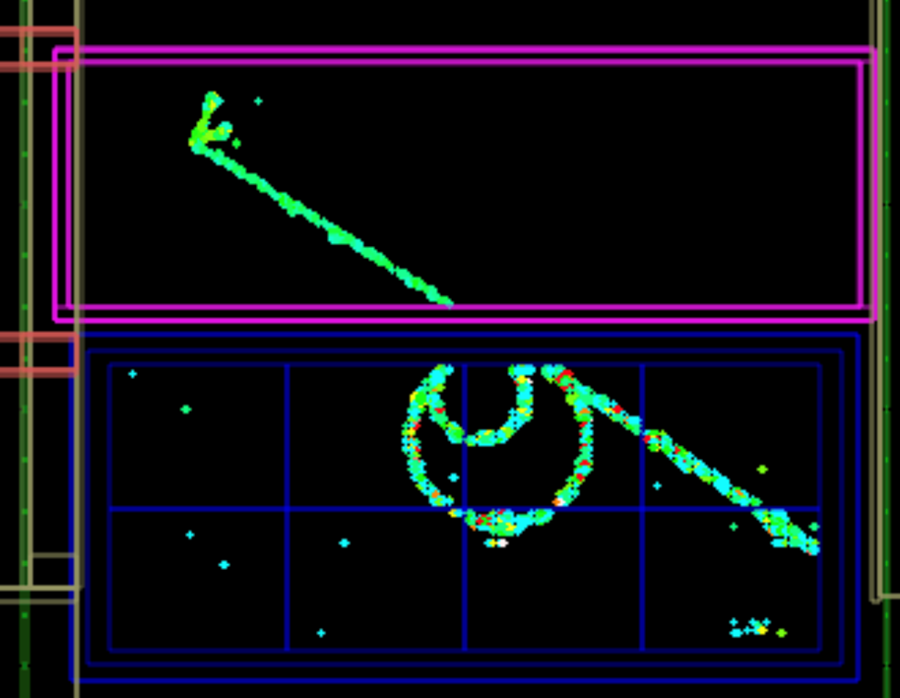
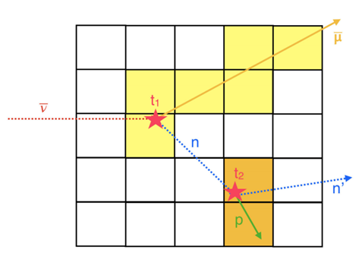
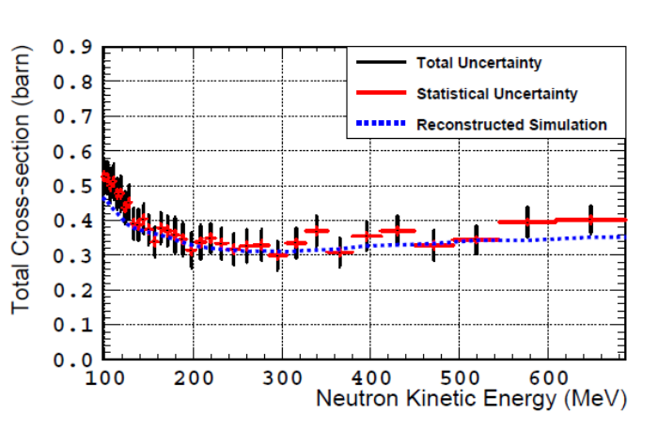
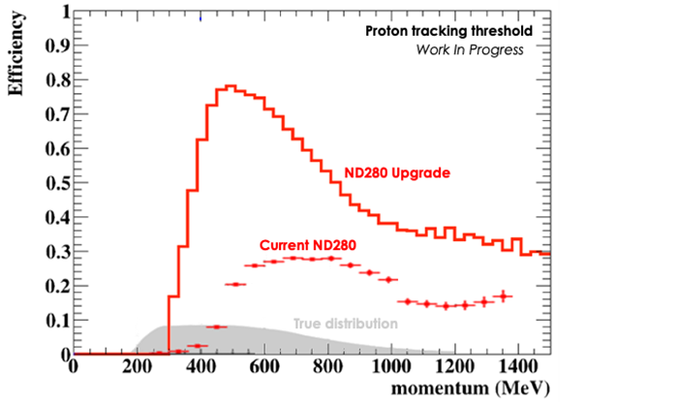
SuperFGD: Performance
See talk by T. Doyle
data
First data with neutrino beam taken
Much lower threshold for protons and much higher efficiency
Allows detecting neutrons (tested with neutron testbeam) with about 50% efficiency
Neutron energy reconstruction via TOF measurement possible
SuperFGD

Slide 21
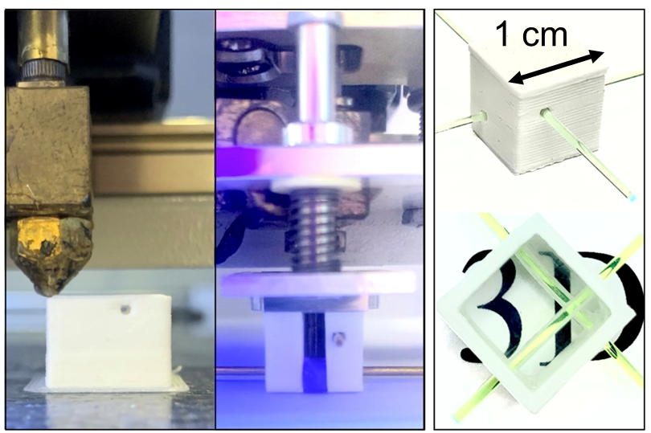
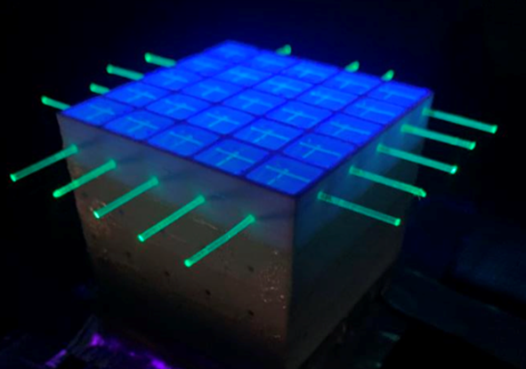
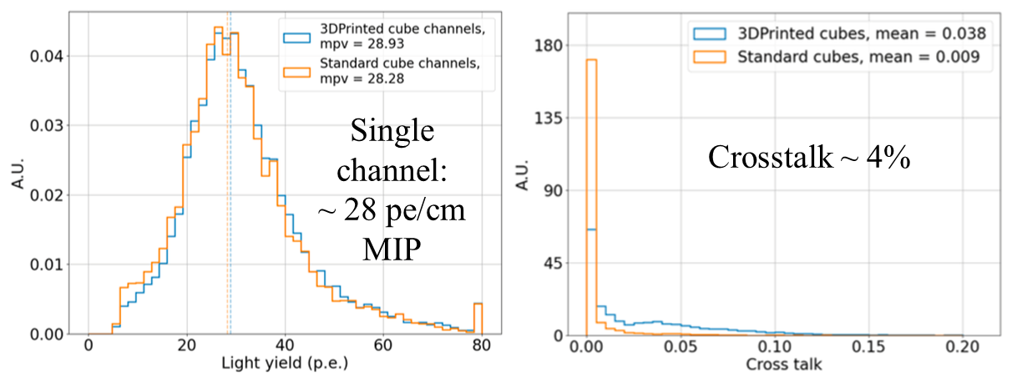
HyperFGD R&D
See talk by Umut Kose
How to build HyperFGDs (SuperFGD++)?
⇒ You do not want to handle 10M cubes and drill 30M holes by hand …
3DET collaboration is developing 3D printing of plastic scintillator
Prototype has been printed
Performance similar to standard cube production

Slide 22
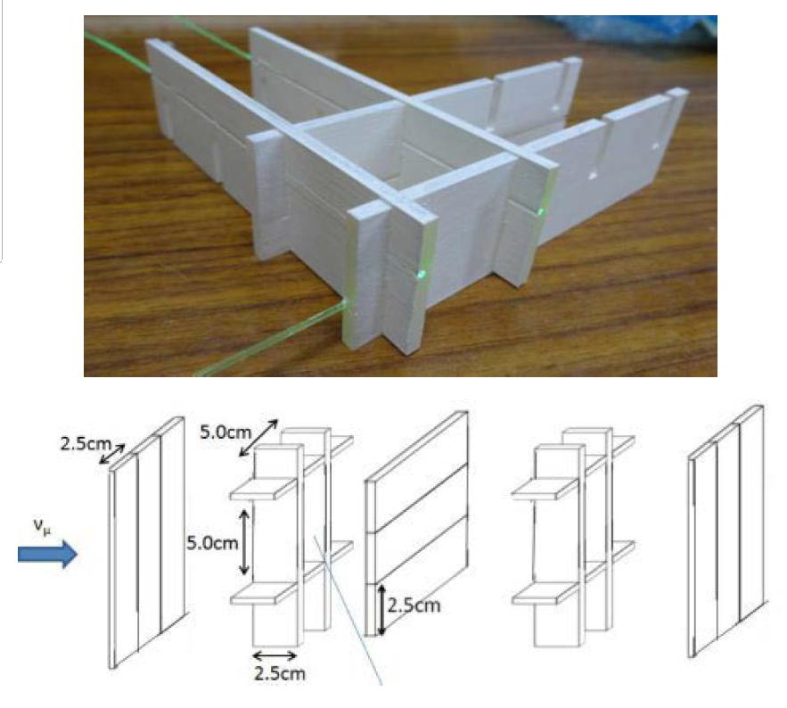
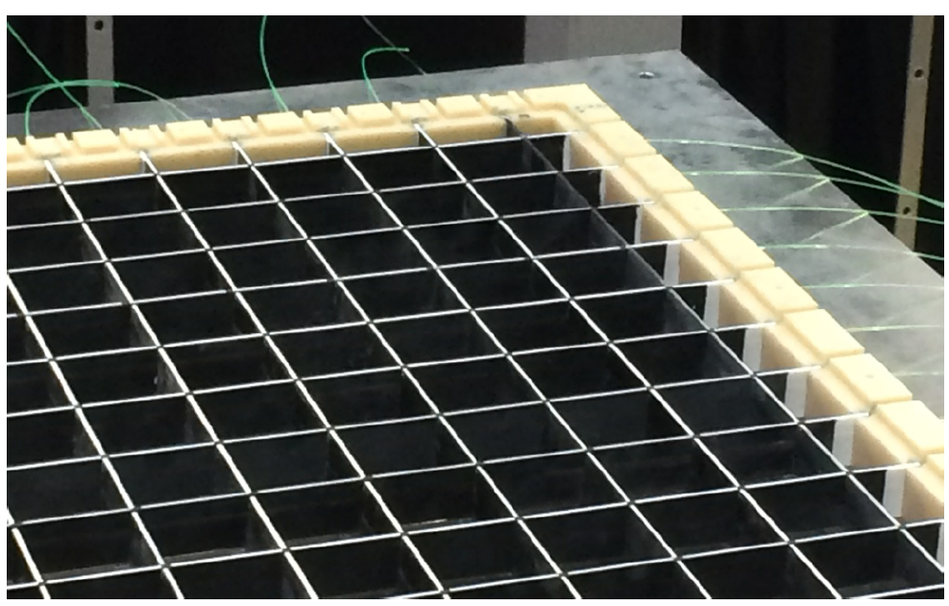
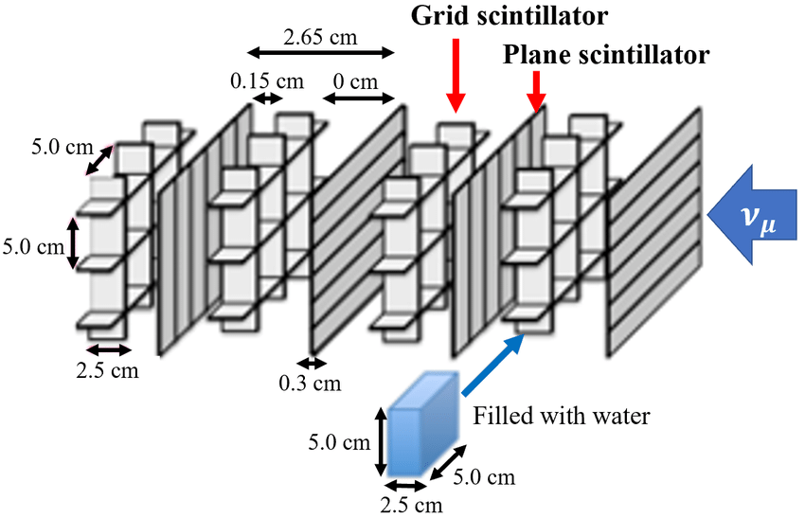
Plastic Scintillator Detector: WAGASCI
Scintillators and WLS fibers to surround a voxel filled with water
80% H₂O and 20% CH as target
Approach allows to measure cross-section on H₂O by subtracting known CH cross section (or to run without water for some runs)

Slide 23
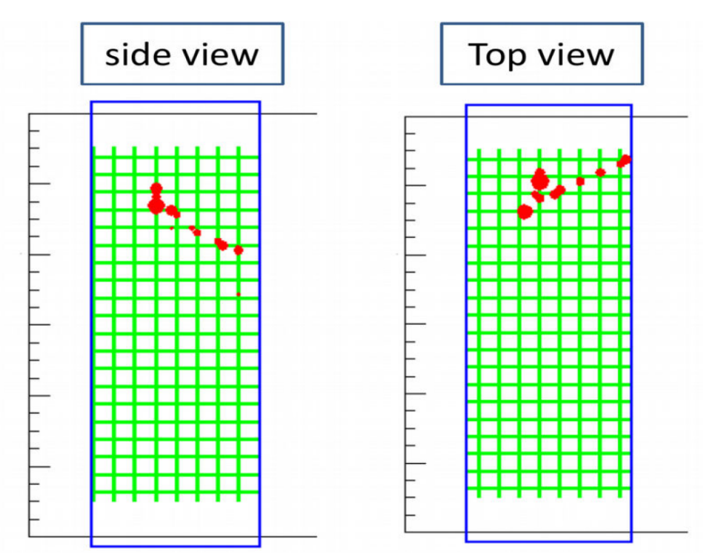
Plastic Scintillator Detector: WAGASCI
Drawbacks:
Light yield limited
Smaller voxel size, imply smaller fraction of H₂O
Detector of 700 kg operated at J-PARC at 1.5 degree off-axis
First physics results presented in 2020
R&D on similar concepts using fibres instead of scintillator panels ongoing
First event

Slide 24
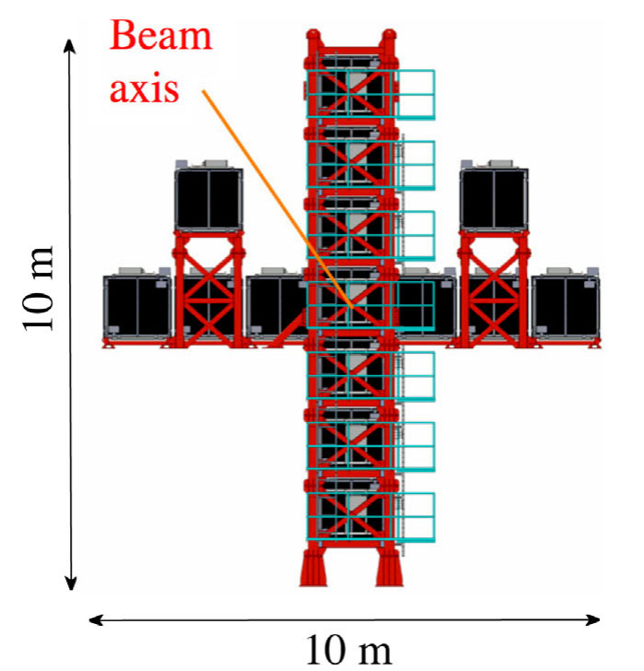
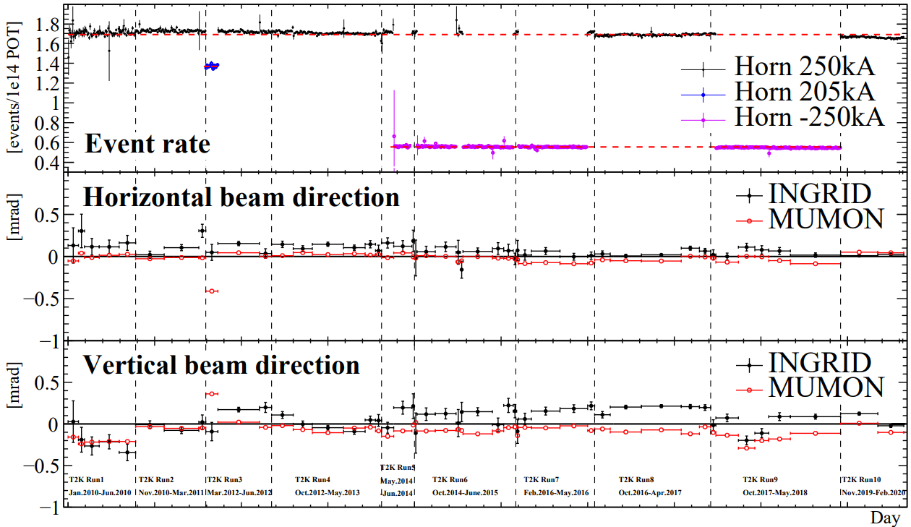
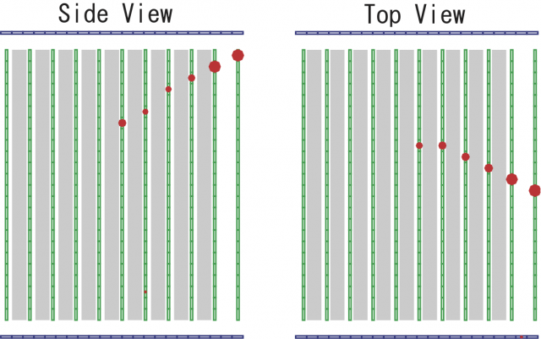
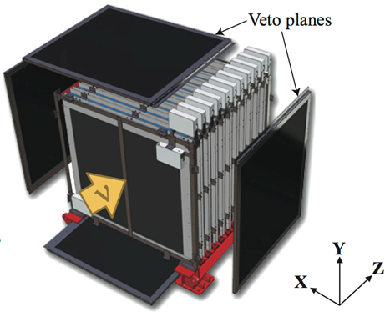
Plastic Scintillator Detector: INGRID
Neutrino beam stability and direction crucial to control systematic uncertainties
Simple but efficient approach: Sandwich of a lot of iron interleaved with tracking layers
Oriented as cross allows reconstructing distribution of interaction horizontally and vertically ⇒ beam profile
No vertex activity information but crucial for data taking in T2K

Slide 25
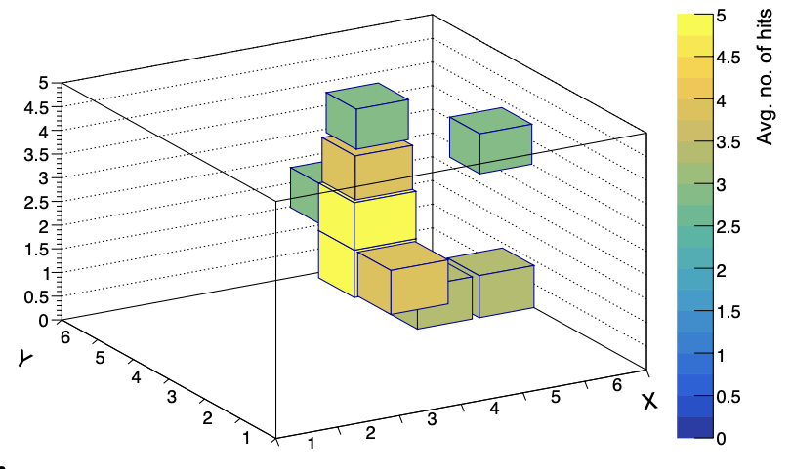
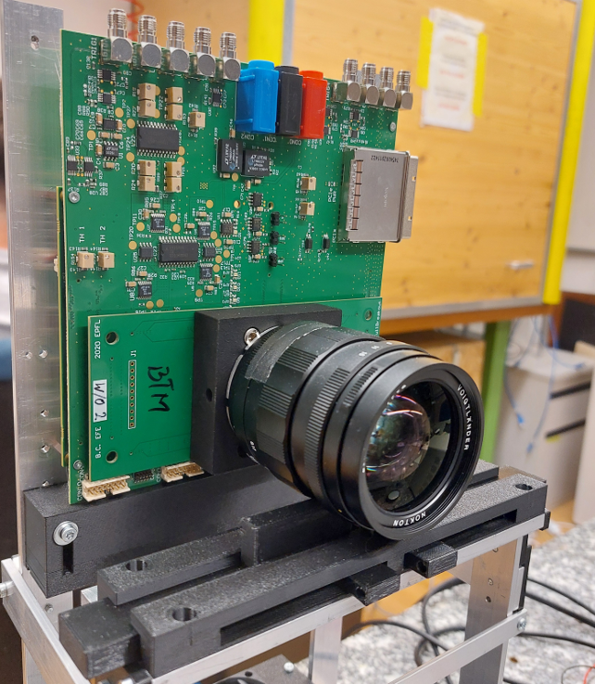
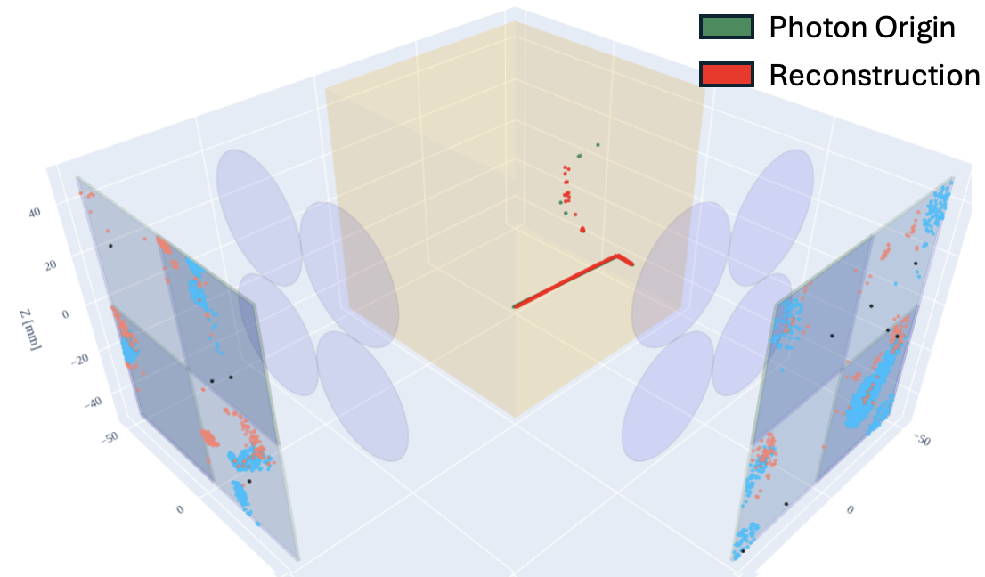
Plastic Scintillator Detector R&D
See talk by M. Franks
Development at ETH Zurich of CMOS SPAD array imaging sensors (goal: 1 cm²)
Each pixel is a readout channel
Position of each pixel (20 μm)
Single pixel sub-ns resolution
Monolithic: digitization on chip
⁹⁰Sr electron
Cheap solution for read out scintillating fibres $→$ reconstruct protons ≥150 MeV/c
See talk by T. Dieminger
PLATON:
3D photographs of 𝜈 interactions in scintillator
Potential for sub-mm spatial resolution
Tape out: 16 pixel cluster

Slide 26
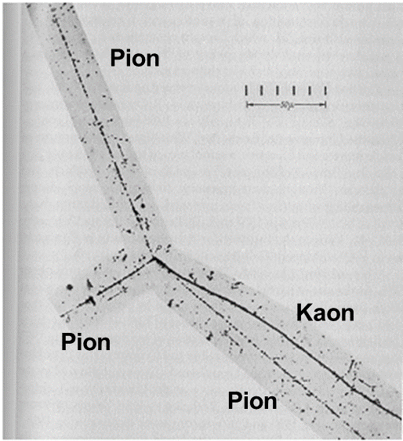
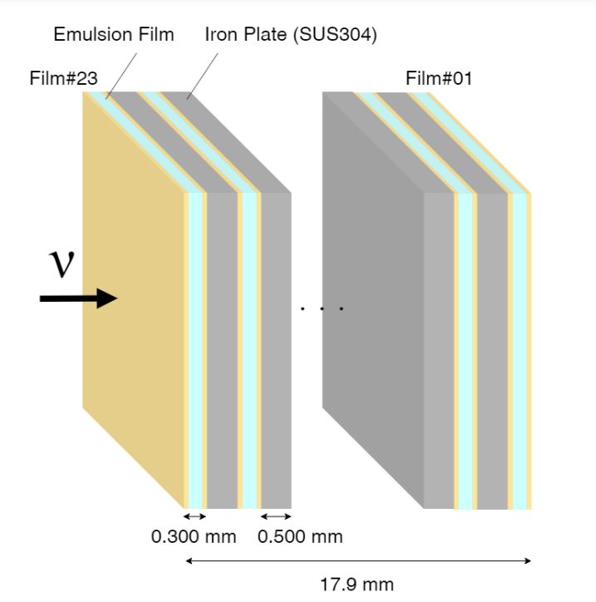
Nuclear Emulsion Detector: NINJA
Historical detector providing e.g. first evidence of Kaon into 3 pion decay
Adaptation of classical photography ⇒ biggest drawback: film needs to be extracted, developed and scanned
Biggest advantage: excellent point resolution defined by grain size ( < μm resolution)
Sampling approach: emulsion films interleaved with target material
First evidence of the decay of the Kaon into 3 Pions was found in 1949

Slide 27
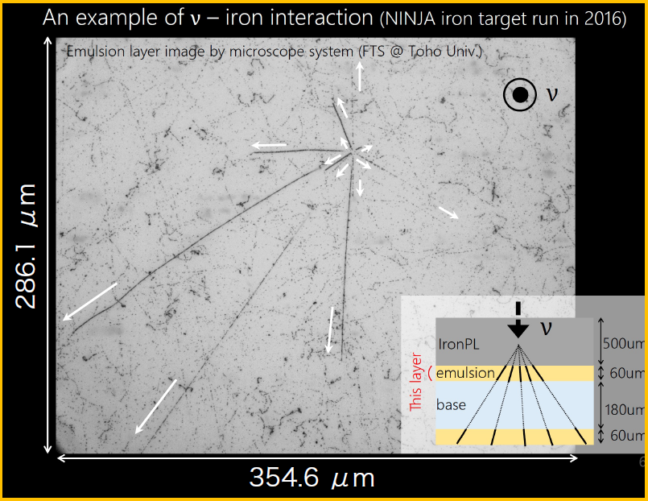
Nuclear Emulsion Detector: NINJA
Neutrino Interaction research with Nuclear emulsion and J-PARC Accelerator (NINJA)
Operated at T2K beamline (next to WAGASCI)
Started with Fe target, more recently with H₂O
Excellent spatial resolution allows to distinguish if interaction happened in emulsion or target
Low detection threshold
R&D ongoing to improve performance => e.g. thicker emulsion layer to improve angular resolution
See talk by T. Hayakawa
See poster by N. Otani

Slide 28
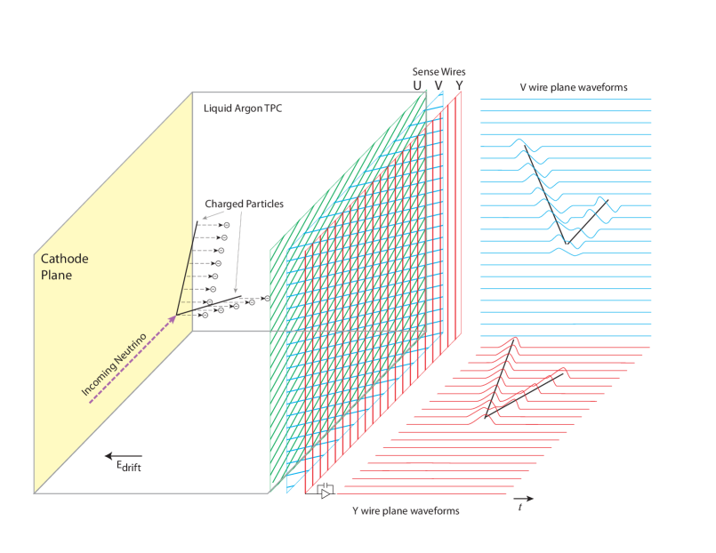
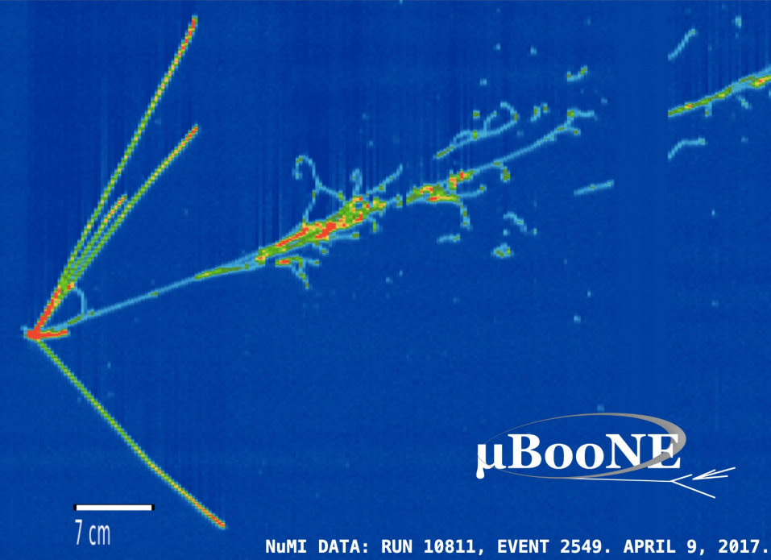
Liquid/Gaseous Detectors: LAr TPC
LAr TPC technology has been developed for more than 20 years
Provides bubble chamber like images of event with low detection threshold
Possible to have large, completely sensitive detection volumes
Very interesting technology for ND if FD also used this technology (DUNE)
But some drawbacks:
Very slow detector with readout windows of about 500 μs per m of drift
Cryogenic system and electronics needed
Challenging to have magnetized/moveable detector

Slide 29
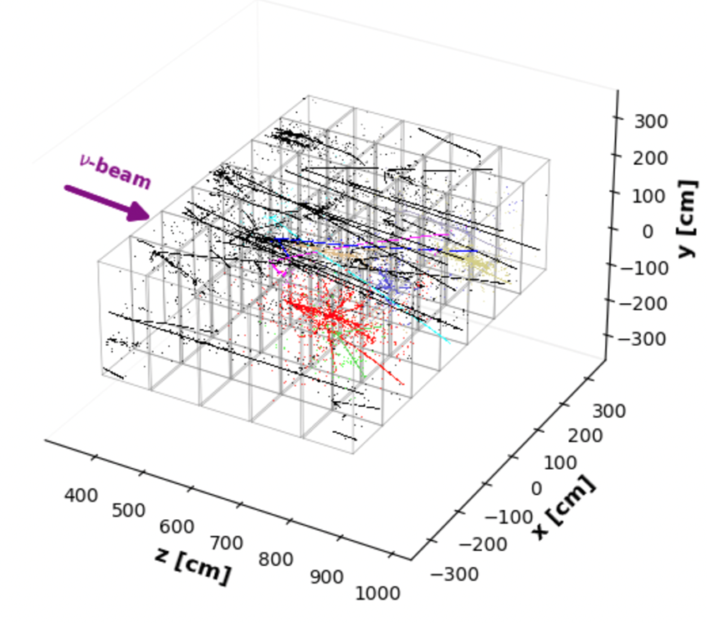
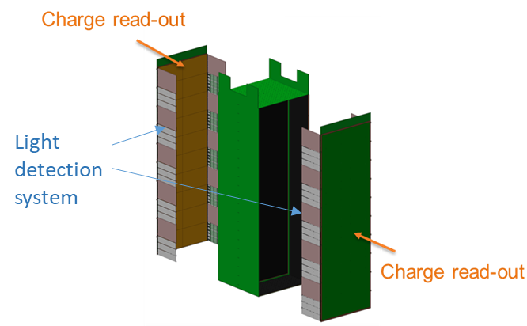
Liquid/Gaseous Detectors: LAr TPC
Impressive R&D work towards a LAr TPC for ND ongoing since many years
Biggest Challenge to overcome: Pile-up!
For DUNE with 130 ton of LAr and 1.2 MW beam, about 50 events are expected during one spill
Complicates event reconstruction
Collaboration works on interesting ideas:
Pixel instead of classical wire readout including development of dedicated ASIC for LAr
Independent modules each with photon detection system

Slide 30
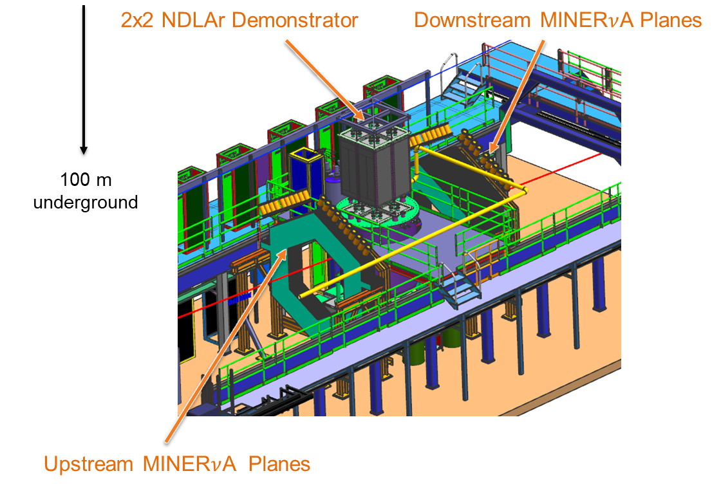
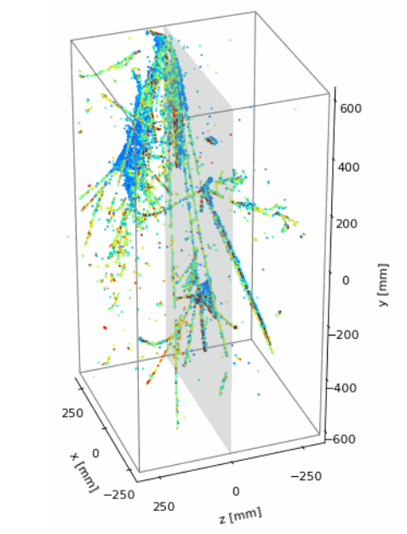
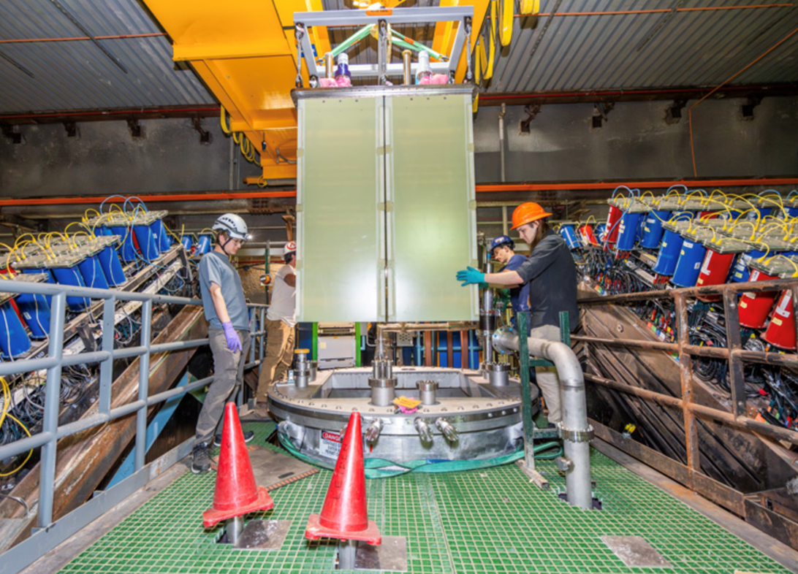
Liquid/Gaseous Detectors: LAr TPC
Several prototypes were built
Millions of cosmics taken with large module 0 from 2021 to 2023
2x2 NDLAr demonstrator currently taking neutrino data in MINERvA pit (330k pixels charge readout + light detection system)
Important step towards final NDLAr TPC
See talks by A. Cudd and S. Kumaran

Slide 31
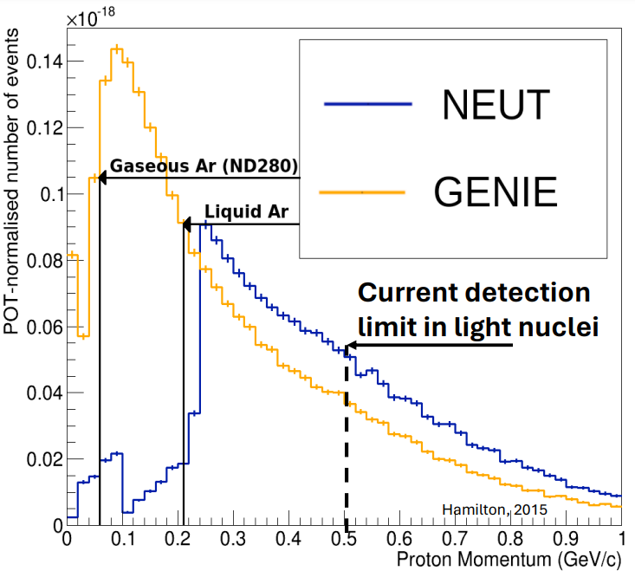
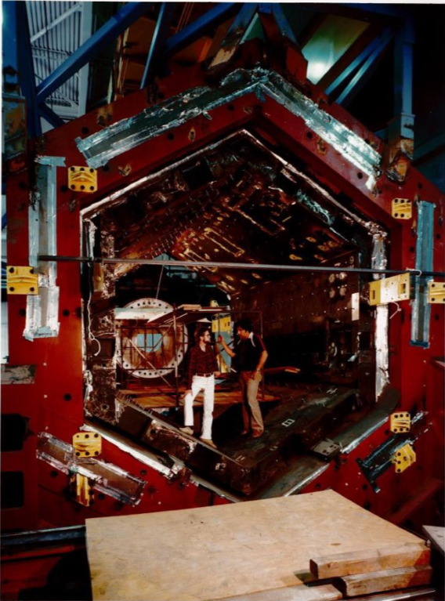
Liquid/Gaseous Detectors: HP TPC
SPAD SciFi
NINJA (H2O)
Emulsion detector (interaction in emulsion)
Gaseous TPCs would allow to go to even lower detection thresholds than LAr
Low density implies low statistics => increase pressure to 10 to 15 bar + profit from high power beams
Ideal to study nuclear effects relevant for neutrino interactions
Possibly same detector could be used with different gases => different targets
HP TPC R&D ongoing since many years for several applications (first TPC in 1979 was a HP TPC)
HP TPC R&D is also part of the DRD1 collaboration
Atm TPC also used for PID ⇒ see talk G. Collazuol
FGD
SFGD
PEP-4 TPC

Slide 32
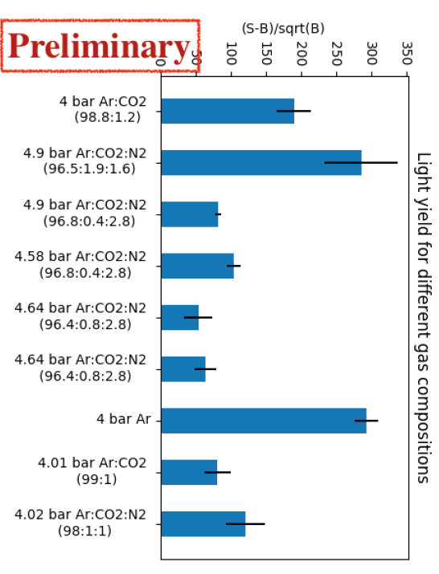
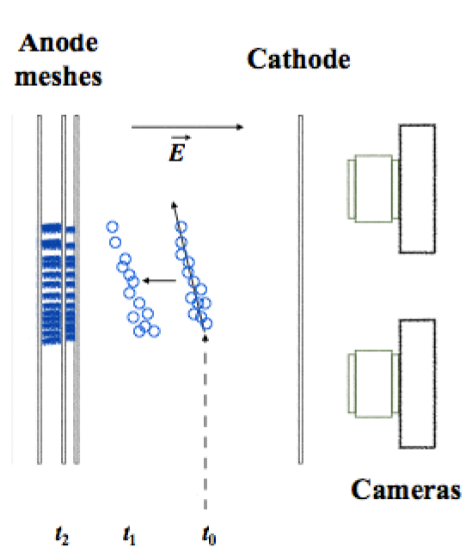
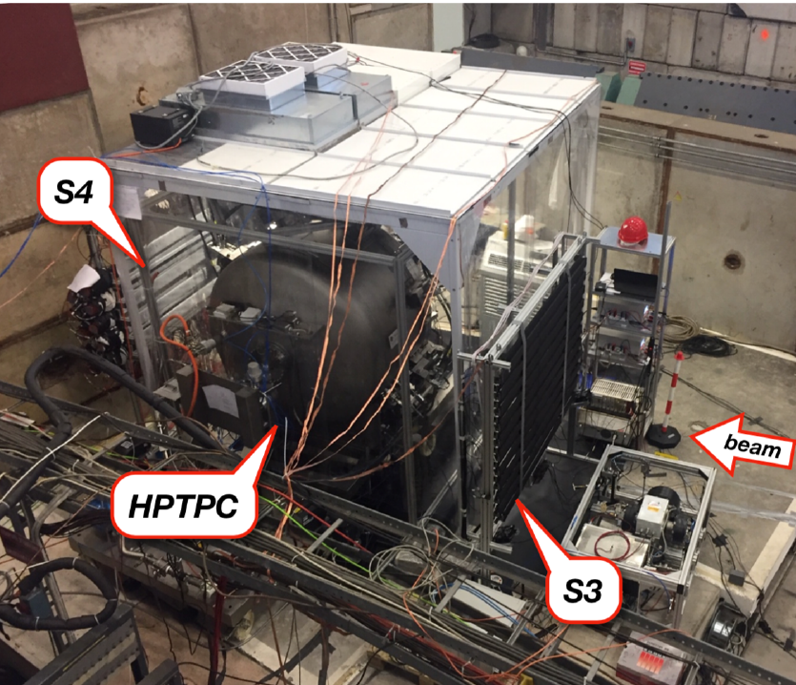
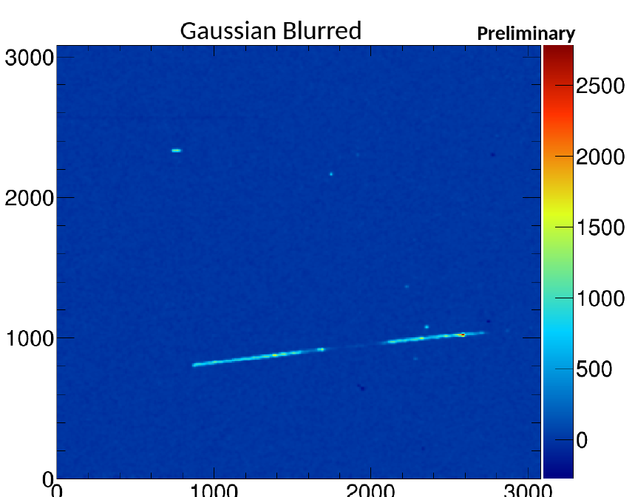
Liquid/Gaseous Detectors: HP TPC
R&D carried out at many institutes
UK-led collaboration built large prototype and tested at T10 beamline at CERN
Images of events taken by 4 CCD cameras behind the cathode
Tested light yield with various gas mixtures
Instruments 2021, 5(2), 22

Slide 33
Liquid/Gaseous Detectors: HP Hydrogen TPC
Neutrinos were studied in hydrogen bubble chambers
Pure hydrogen TPC would be interesting
First was built 1984 (Nuclear Instruments and Methods in Physics Research 225 (1984) 550-556)
More recently the MuCap experiment at PSI uses a hydrogen TPC at 10 bar to study muon capture
Several challenges:
Safety
Scaling to larger volumes
Low density of H2 => 20 times less statistics than Ar
Few electrons per cm for MIPs => small signals
⇒ Lots of interesting R&D possible (could be also for other technologies allowing H as target)

Slide 34
Water Cherenkov Detectors
Water Cherenkov detectors are excellent as FD (SK/HK)
Some drawbacks as ND:
High detection threshold
No vertex activity information
Particles often not contained (much smaller than FD)
Limited size affects ring development
But also advantages:
Cost effective for large masses => interesting for ν_{e} measurements
Same target material
K2K had 1 kton WC detector
Significant R&D work ongoing for Intermediate Water Cherenkov Detector (IWCD) for HK including testbeam at CERN (WCTE)
K2K
Moving!

Slide 35
T2K/HK Case
Far detector
Neutrino source: Accelerator + target + decay tunnel
SuperFGD
Scintillator bars
Magnetized ND280 (2.5º)
Scintillator bars + H₂0
100 ton of H₂0
Moveable
1.7-4º
R&D towards a HK ND280++ upgrade ongoing!
INGRID (on-axis)
NINJA/WAGASCI (1.5º)

Slide 36
Conclusions
Near detectors are crucial for success of LBNO experiments
Especially true for DUNE and HK which will be systematic uncertainties limited
Reduction of systematic uncertainties from about 15-20% to about 3-6%
Achieved by development of large variety of excellent ND technologies
There is not “the-one-and-only” ND technology but the combination of different ones is the key
Possibly opens possibilities for new BSM studies
Still room for a lot of R&D and new ideas!
Join the WG6 sessions for much more detailed talks
C. Giganti talk at Neutrino 2024

Slide 37
NuFACT 2024 Talks and Posters
NINJA:
Tomohiro Hayakawa, Sep 18, 2024, 12:22 PM, WG2
SuperFGD:
Tristan Doyle, Sep 19, 2024, 2:05 PM, WG6
LAr TPC:
Sindhujha Kumaran, Sep 19, 2024, 4:35 PM, WG6
Andrew Cudd, Sep 19, 2024, 4:39 PM
TPC:
Gianmaria Collazuol, Sep 19, 2024, 5:15 PM
Plastic Scintillators:
Matthew Franks, Sep 20, 2024, 3:25 PM
Till Dieminger, Sep 20, 2024, 3:05 PM

Slide 38
Publications
HP-TPC:
Instruments 2021, 5(2), 22
JINST 19 (2024) 06, P06018
Phys. Rev. D 102, 033005
arXiv:1910.06422v1 [physics.ins-det] 14 Oct 2019
CERN-SPSC-2017-030 / SPSC-P-355
MuCap:
Nucl.Instrum.Meth.A 628 (2011) 199-203
SciPost Phys. Proc. 5, 017 (2021)
Plastic Scintillators:
IEEE TRANSACTIONS ON NUCLEAR SCIENCE, VOL. 52, NO. 6, DECEMBER 2005
2020 JINST 15 P12003
Physics Letters B, Volume 840, 10 May 2023, 137843
NINJA:
https://j-parc.jp/researcher/Hadron/en/pac_1801/pdf/P71_2018-4.pdf
Prog. Theor. Exp. Phys. 2022 063H01
WAGASCI:
Journal of Physics: Conference Series 1468 (2020) 012152
arXiv:1610.06367v1 [physics.ins-det] 20 Oct 2016
ND LAr TPC:
arXiv:1808.02969v3 [physics.ins-det] 16 Sep 2018
Small selection …

Slide 39
Liquid/Gaseous Detectors: HP TPC R&D
Aim: gas mixture enriched in hydrogen
Transverse Kinematic Imbalance analysis to select events on free protons => no nuclear effects
Problem is pressure vessel: all detectors (HP TPC, ECAL, …) must be inside => conceptual design for DUNE
Phys. Rev. D 102, 033005
JINST 19 (2024) 06, P06018

Slide 40
There is not “the one” ND Technology
One technology is not covering the full wish list
ND complexes normally consist of set of complementary detector technologies
Plans for DUNE ND complex good example

