Slide 1



Update on the Target Station and Beamlines of MELODY (2024)
Nikos on behalf of MELODY

Slide 2
China Spallation Neutron Source
CSNS is the only large-scale proton accelerator in China today
Strong needs from other fields than neutron scattering
Excellent capability to support multiple platforms like muons
Phased development from 100 kW (I) -> 500 KW (II)
Instrument tuning and Day-one experiments: January - March 2018. Initial operation: Since April 2018
Present beam power: 160 kW - stable - in 2024/8
CSNS
Dongguan
Hongkong
Notes:
As most of you have come to CSNS before, we are in southern China, in Dongguan City, which is close to Hongkong. If you come to CSNS you can fly to Hongkong and it will be 1 to 2 hours driving to our campus

Slide 3
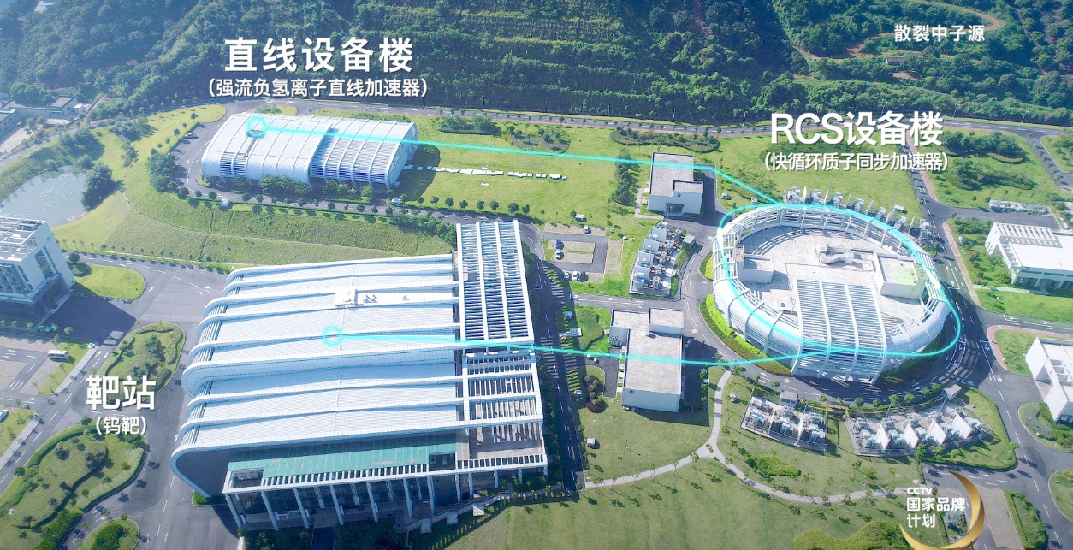
    LINAC building
protons 80 to 250 MeV
Power from 100 kW to 500 KW (phase-II)
    RCS building
    Neutron target
    and experiment hall
1.6 GeV, 62.5 to 312.5 μA, 25 Hz
MELODY

Slide 4
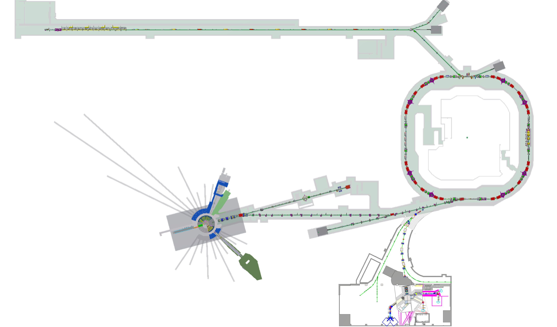
CSNS II Project (Approved on Jan. 11, 2024)
300MeV SC
9 more neutron spectrometers
500 kW
500 kW
MELODY
Notes:
In the beginnning of this year, the central government has approved the phase ii upgrade of CSNS. The linear accelerator will be upgrade to 300MeV with a superconducting Linac in order to reduce the space charge of the beam. The RCS ring will be able to accelerate the protons with a beam poewer of 500kW. The neutron target station will also be upraded accordingly,and 9 more neutron spectrometers will be built. Our MELODY project will extract 1 pulse from the 25Hz proton beam to hit on a stand-alone target.

Slide 5

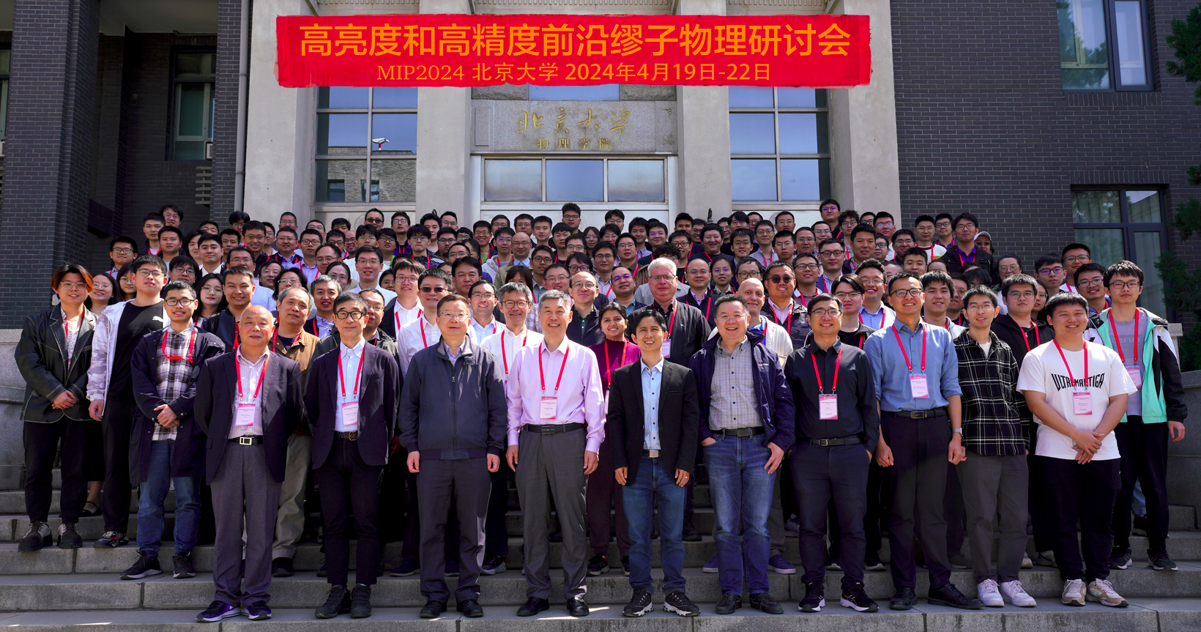
Chinese Muon Community
muSR users
Particle Physicists
USTC
Fudan University
IOP
Zhejiang University
…
Peking University
IHEP
SJTU
SYSU
…
MIXE
IHEP
CIAE
Museums
…
5
Notes:
In China there is a big muon community. There are many long time Chinese muSR users who have been doing musr research abroad for many years, they are keen at a musr facility in China. The number of Particle physicists who are interested in muon physics is also increasing in these years. Also as you know that China is an ancient country and archeology is important in China, several groups already expressed their interests in doing MIXE study with MELODY. In recent years there are more and more Chinese scientists becoming interested in muon science. The muon workshop in this year attract more than 100 scientist to attend the meeting.

Slide 6
Scientific Goals
μSR applications
Muon technology
Muon moderation
Muonium production
Muon acceleration
Muon detector development
…
Superconductivity
Magnetism
Semiconductor
Biosystems
…
MIXE and others
Particle Physics
Elementary analysis
Muon imaging
Single Event Effect
…
Muonium physics
More to be proposed…
Notes:
The science goals of MELODY will also be focused on these 4 fields. CSNS is a material research center and the major goal of MELODY is to provide a good muSR research platform to do studies on Superconductivity/ magnetism/ semiconductors etc. Also we will push the muon technology development including muon moderation, accleration and muonium production. MIXE experiments and other applications such as muon imaging and single event effect are also our science goals. Several groups of particle physicists are proposing more muon physics experiments on MELODY.

Slide 7
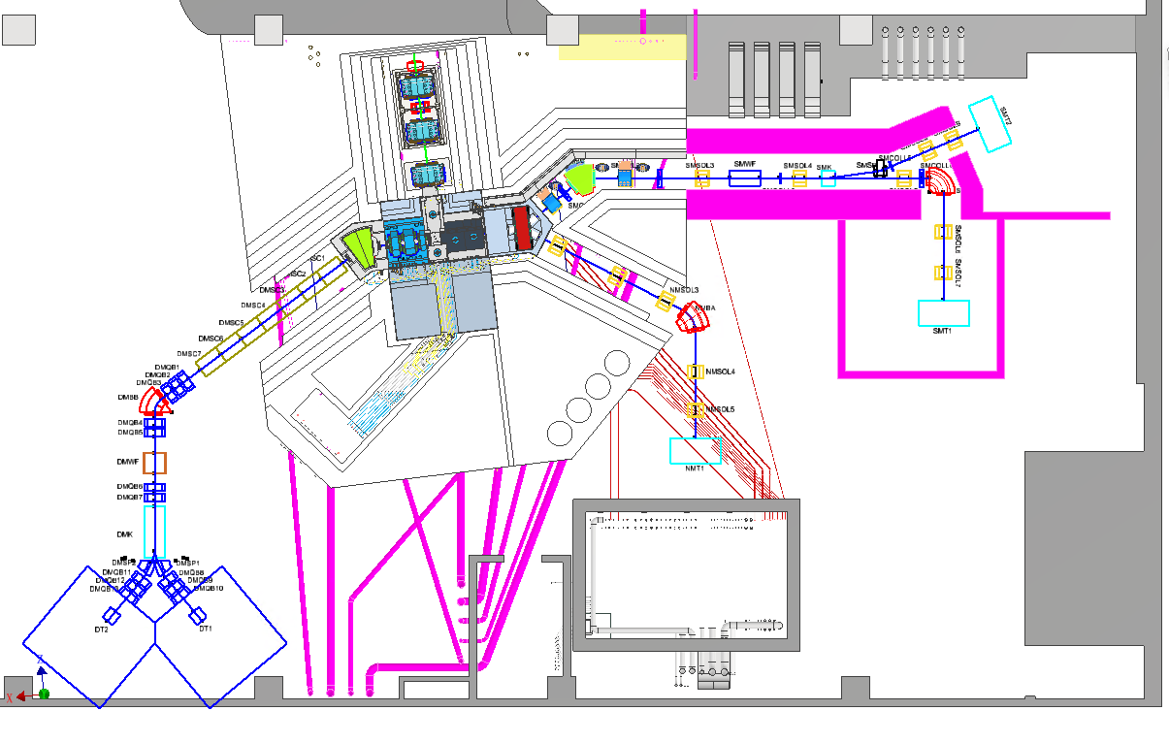
Overview of MELODY
Proton Beam
SMBT
SMT2
NMBT
DMBT
1. Baseline
μSR applications
Waste Target
NMT
2. Reserved negative muons
SMT1
Water Cooling system (underground)
control room
Sampling room
DMT2
DMT1
3. Reserved decay muons
Notes:
This is an overview design of MELODY. The protons from the RCS ring hits on a thick copper target. During CSNS-II we will build a surface muon beam and one muSR spectrometer. Because the proton pulse has two bunches, we use a kicker to kick one of the bunches to the second terminal to carry out muon technology development. We also reserve the beam tunnels for a decay muon beam and a dedicated negative muon beam. The negative muon beam is a byproduct of the surface muon, because it’s extracted from the first bending magnet of the surface muon beamline.

Slide 8
Design features
Target
  Stand-alone target: more freedom to design
  Thick target: 10 cm interaction length
  Copper Target: high production
Beamlines
  Surface Muon: Solenoid focusing; AI optimized; Large acceptance
  Negative Muon: by-product, low cost, dedicated μ⁻ beam
  Decay Muon: Large acceptance; wide applications
Baseline design foreseen in 2028
upgrade
Notes:
There are several design features of MELODY. Our target is a stand-alone target, the repetition rate is low but it also gives us more freedom to design the target. We can use thicker target and denser materials to achieve higher muon production efficiency. We use solenoids for the surface muon beam to reach a large acceptance, we designed a dedicated negative muon beam with a low cost. And because of the low repetition rate, we designed a muSR spectrometer with large number of detectors to reach a resonable counting rate, and the design asymmetry is high.

Slide 9
Design Parameters
Proton driver | Power | Repetition | Energy | Time Structure |  | σ_{x} | σ_{y}
 | 20 kW | 1 Hz | 1.6 GeV | 120ns/409ns |  | 3.1 mm | 8.5 mm
Muon beam | Surface Muon (SMBT) |  | Negative Muon (NMBT) |  |  | Decay Muon (DMBT)
Momentum | 28 MeV/c |  | 28 MeV/c |  |  | 20~120 MeV/c
dp/p | 6% |  | 13% |  |  | 8% @ 120 MeV/c
Beam spot | Φ10mm-Φ100mm |  | Φ100mm |  |  | Φ30mm
Intensity | 10⁵-10⁷ μ⁺/s |  | 4×10⁵ μ⁻/s |  |  | 4×10⁶ μ⁺/s
Polarization | > 95% |  | ~ 20 % |  |  | > 70%
Pulse width | 130 ns (SP) ~ 520ns (DP) |  | 520 ns |  |  | 130 ns (SP) ~ 520ns (DP)
Spectrometer | Segments | Asymmetry | Count Rate |  | FOM: A²*R | Temperature |  | LF/TF
 | 1584/3024* | ~0.3 | 38/76* MEv/h |  | 2.9/5.8* | 2K ~ 300K |  | 5000 G/ 400 G
* Can be upgraded to
Notes:
Here are the design parameters. The proton driver will be 20kW with 1 Hz. The surface muon will has a tunable beam spot from 10mm to 100mm with all collimators open, and the beam intensity will be from 10⁵to 10⁷ muons per second. There will be single pulse mode and double pulse mode for the users to choose. The negative muon beamline will have a fixed momentum the same with surface muon. The decay muon will have a tunable momentum from 20 to 120 mev/c. Because the funding is limited, we will build half of the detectors of the spectrometer, and with this half setting we will reach a counting rate of 38 MEv/h and in the future we can upgrade it to 76.

Slide 10
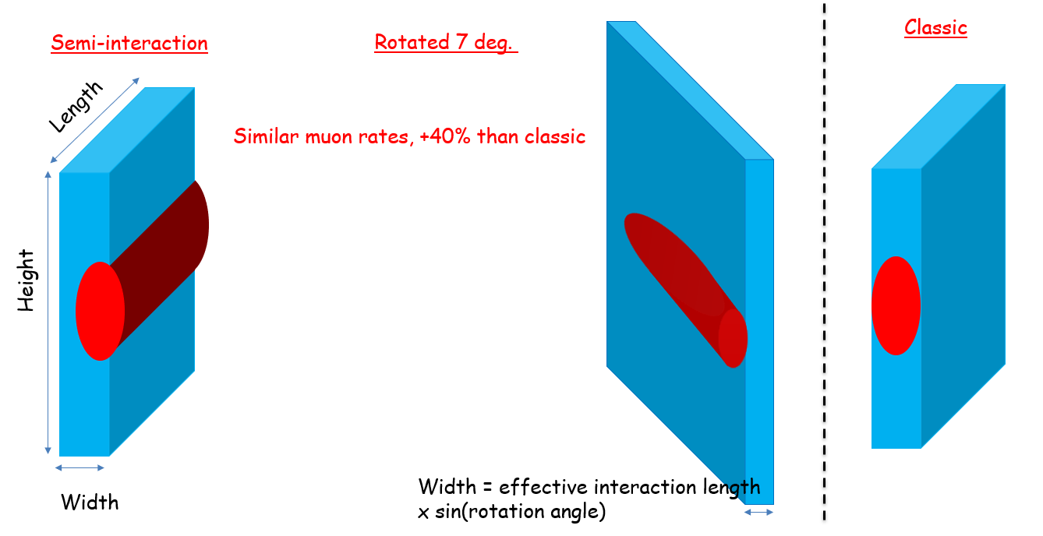
Physics Design of the Target Station
Lei Liu, Nikos, Wu Chen et al.
protons
Thick target: ~ one nuclear interaction length, slab-shape.
Use quadrupole and solenoid to collect muons and pions:
  perpendicular to proton beam to maximize the muon yield.
3 different beam irradiation strategies:
  Rotated option preferred: high yield, easy for alignment, better extensibility to the decay muon beamline
Quadrupole for pions & decay muon
Target
Solenoid
for surface muons
350mm
Keep extensibility
Optimization priority
* The improvement is up to the size of the proton beam spot.

Slide 11
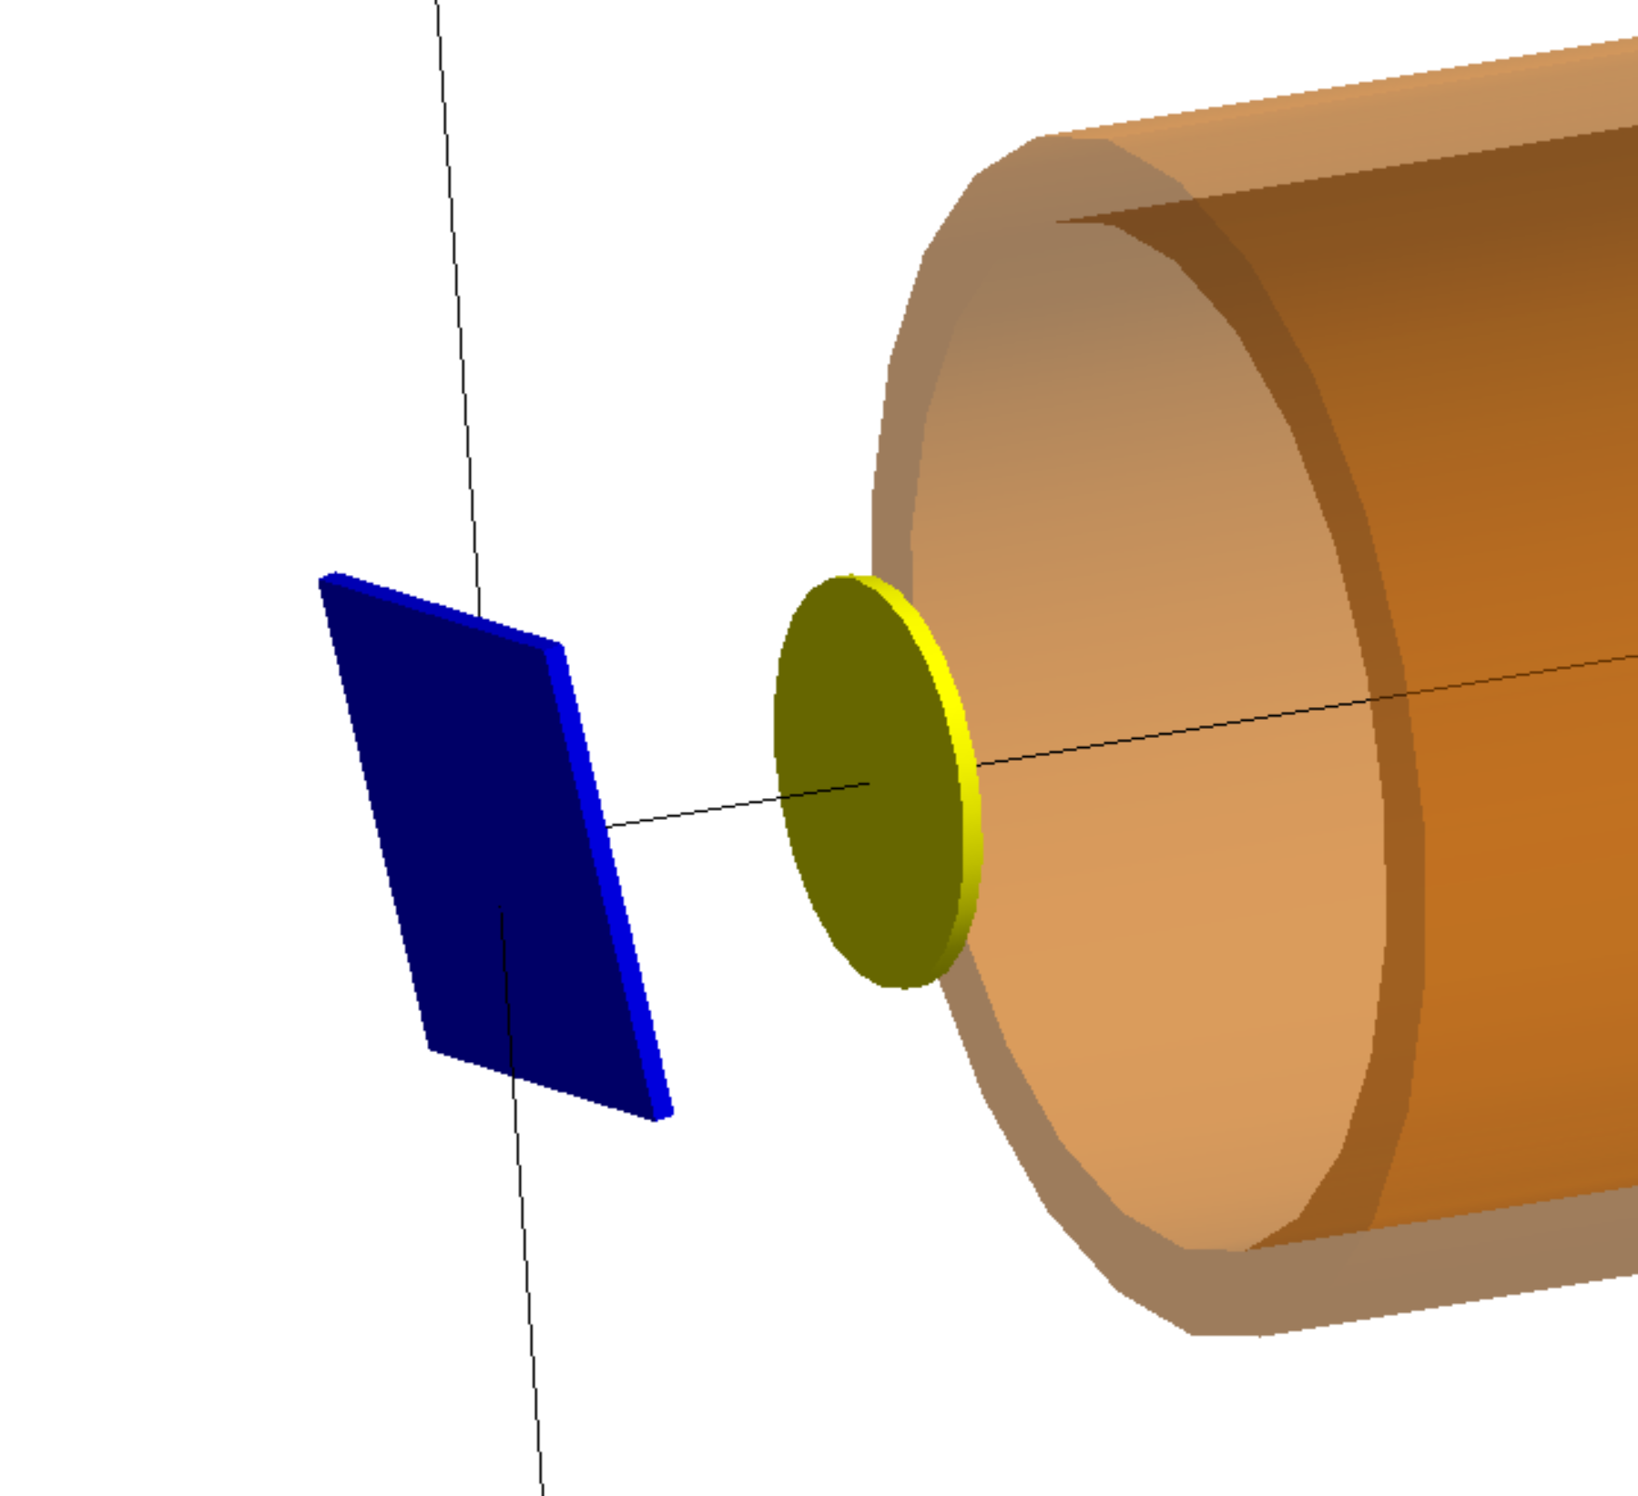
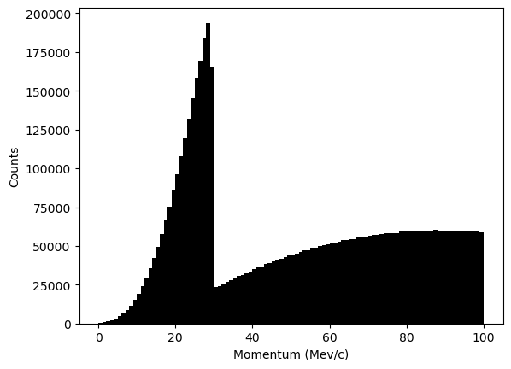
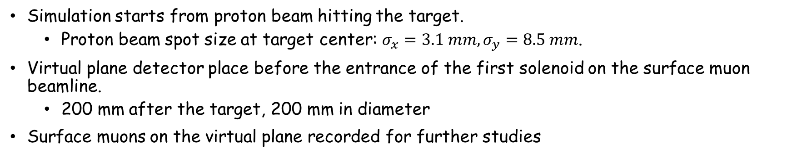
Simulation for Optimizing the Target
Simulation starts from proton beam hitting the target.
  Proton beam spot size at target center: $σ_{x}=3.1 mm,σ_{y}=8.5 mm$.
Virtual plane detector place before the entrance of the first solenoid on the surface muon beamline.
  200 mm after the target, 200 mm in diameter
Surface muons on the virtual plane recorded for further studies
Muon Target
Muons recorded on the virtual plane
200 mm
Select surface muons
200 mm
Proton Beam
Virtual Detector

Slide 12
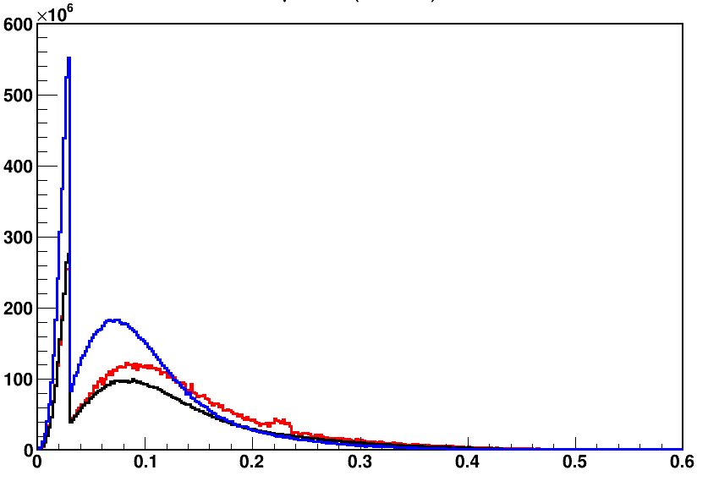
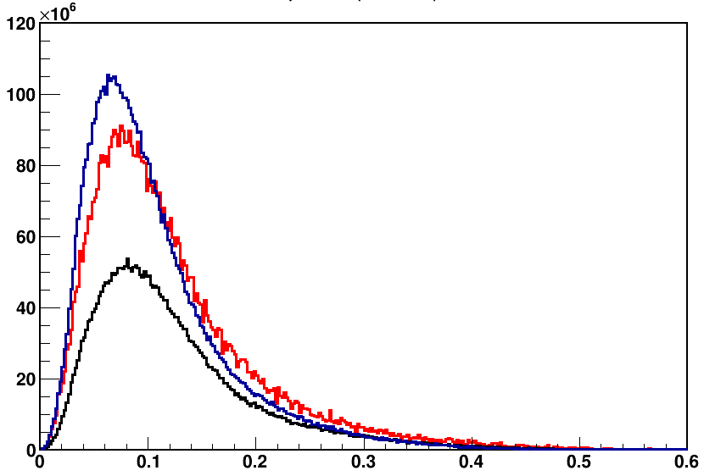
FLUKA (baseline) vs G4bl: μ+ and μ- (rates) for Copper, collection sideways at the virtual detector
μ+ rates as function of momentum
μ- rates as function of momentum
FLUKA
FLUKA
μ+ / sec, bin = 0.002 GeV/c
μ- / sec, bin = 0.002 GeV/c
G4 Bertini
G4 Bertini
G4 incl
G4 inclxx
P GeV/c
P GeV/c
MC | FLUKA | Bert. | inclxx
μ+ / sec (10⁹) | 10.7 | 8.7 | 13.3
μ+ / sec (10⁹) ≤ 29.8 MeV | 1.46 | 1.5 | 2.9
MC | FLUKA | Bert. | inclxx
μ- / sec (10⁹) | 5.9 | 3.5 | 6
All MC predicts a ratio of μ+ / μ- around 2
Stat. < 1%
For surface muons rates
FLUKA and G4 Bertini predict similar total rates
G4 inclxx predicts x2
MC | FLUKA | Bert. | Inclxx
μ+ / μ- | 1.8 | 2.5 | 2.3

Slide 13
Predicted surface muon rates sideways at the virtual detector, for ε_{xx’} = 7700 & ε_{yy’} = 6950 π mm mrad
Target Material Choice, surface muon rates only
μ+ / sec (10⁶ ), 20 kW - P ≤ 29.8 MeV/c | 5000 π mm mrad
dx in σx | Graphite | Copper | Tungsten
0 | 52 | 104 | 79
-1 | 57 | 122 | 96
-2 | 56 | 120 | 90
-3 | 35 | 72 | 54
+10%
+17%
+22%
Statistical errors 4% for Gr, 3% for W, and 2% for Cu
Copper predicted almost 2 times larger rates than Graphite
Same improvement in rates for the rotated target
Tungsten has higher rates than Graphite but not Copper
  May not a) be optimized well in displacements, b) multiple scattering due to much higher Z
FLUKA4.2

Slide 14
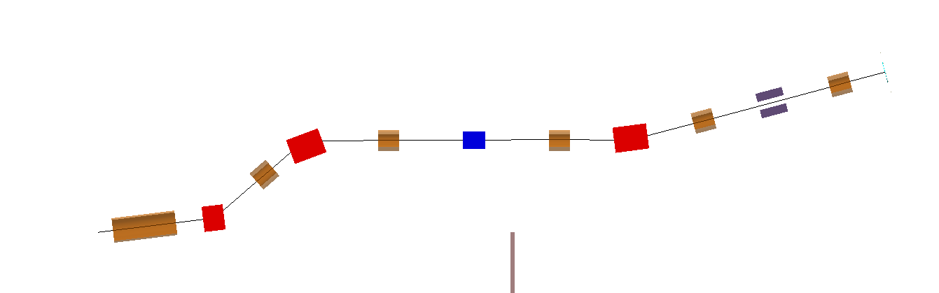
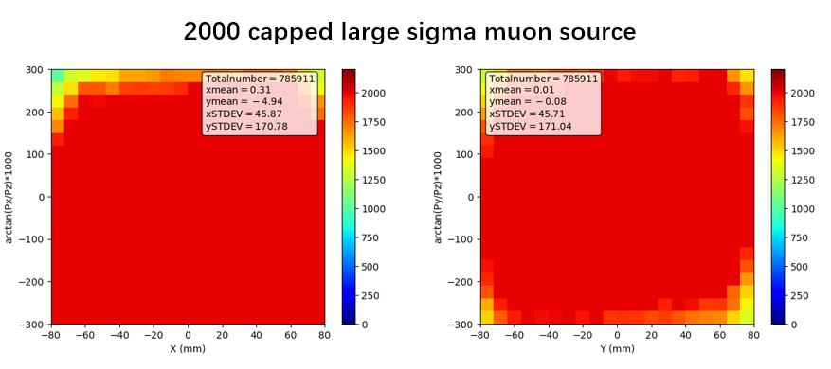
New analysis for the target selection
MS5
Sample
MS4
MBB
MS2
MS3
Wien-Filter
Proton-target interaction: FLUKA
MS1
Kicker
MBC
Coll3
MSX
MBA
Coll2
Coll1
Transport by G4bl
Generated surface muons phase space at the target region
Generate a uniform-like and isotropic distribution of surface muons
Transport it to the sample position, sample with Φ = 3 - 10 cm
Trace back the detected by the sample surface muons at the target region
Liu Guangdong / CSNS

Slide 15
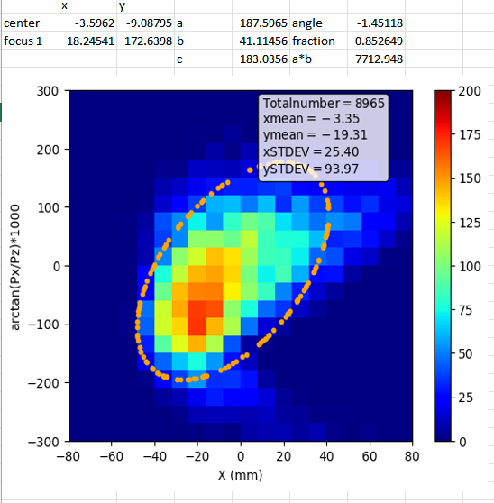
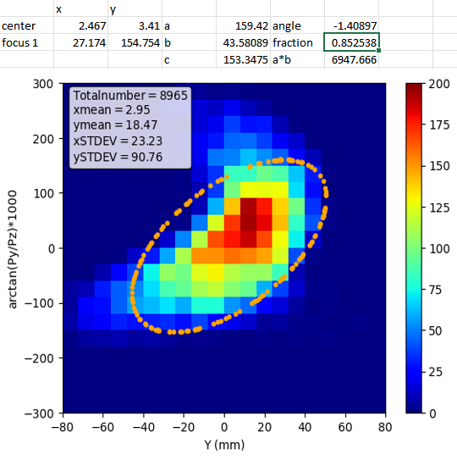
phase space and emittances of the traced back surface muons at 20 cm sideways of the interaction point
e_{xx’} = 7700 π mm mrad, e_{yy’} = 6950 π mm mrad
85% of the traced back surface muons
is included in the ellipses
Liu Guangdong / CSNS
Next, we apply these emittances to the target selection analysis

Slide 16
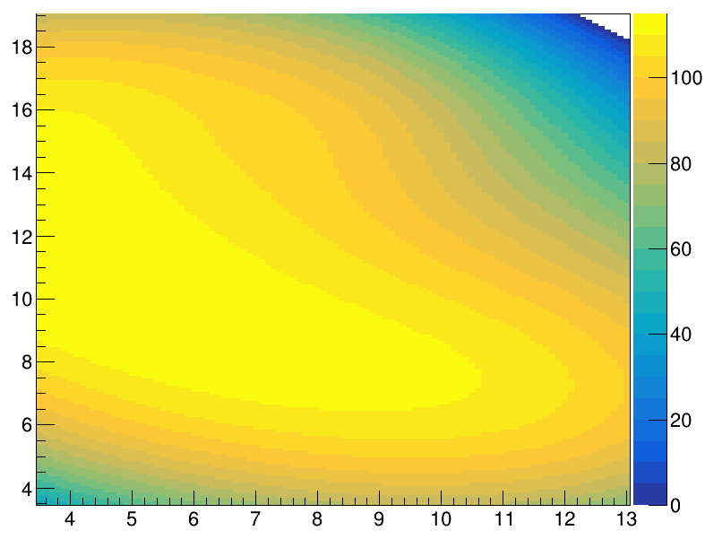
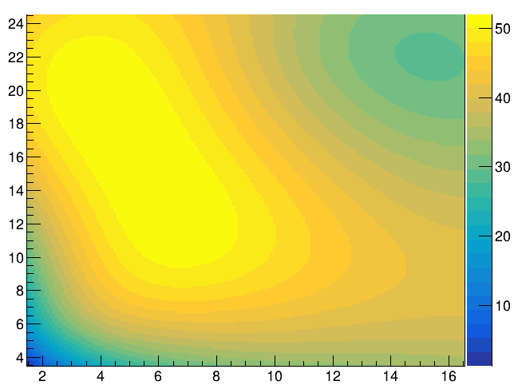
AI fit for best target parameters
Surface muon rates (in the palette) as function of rotation angle (x-axis) and effective interaction length (y-axis)
Palette in 10⁶
surface muons/sec
Palette in 10⁶
surface muons/sec
For Copper
For Graphite
Rates in each contour are within 4%
Rates in each contour are within 4%
5 deg, eff. intL = 14 cm
Width = 1.22 cm
*
5 deg, eff. intL = 14 cm
Width = 1.22 cm
effective interaction Length, cm
effective interaction Length, cm
*
*
7 deg, eff. intL = 10 cm
Width = 1.22 cm
*
7 deg, eff. intL = 10 cm
Width = 1.22 cm
rotation angle, deg.
rotation angle, deg.
Statistical error from AI analysis 4%

Slide 17
Selected target of Copper AI results vs FLUKA and G4bl
Length = 24 cm
rotated Slab,
7⁰ degrees
Predicted surface muon rates sideways at the virtual detector,
for ε_{xx’} = 7700 & ε_{yy’} = 6950 π mm mrad
μ+ / sec (10⁶) , P ≤ 29.8 MeV/c,
AI | FLUKA | G4 Bertini | G4 inclxx
112 | 118 | 115 | 229
AI training done with FLUKA
Effective interaction length = 10 cm
Height = 24 cm
Stat. error, AI ~ 4%, FLUKA ~ 2%, G4 < 1%
p
The target rotation is selected than the semi-interaction case because:
There is an easier implementation of cooling and an easier beam alignment with the target
Width = 1.22 cm

Slide 18
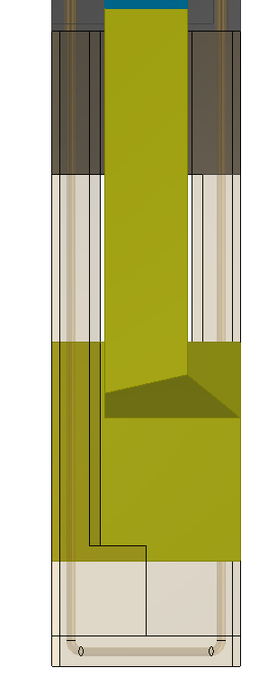
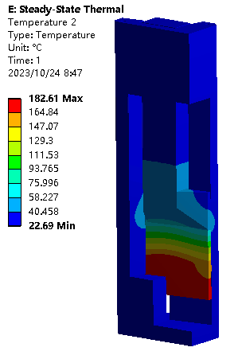
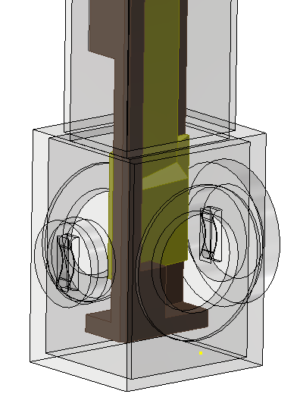
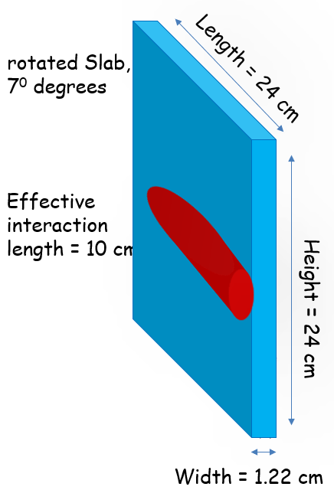
Target and Cooling Design
Proton beam
Copper target
Water-cooled base
Cooling water pipeline
target and vacuum chamber
* Not the final design.
Fixed target in a vacuum chamber
  Cu, 24 cm * 24 cm * 1.22 cm，tilted by 7 degrees
  > 5 years lifetime
Inflatable bellows connection to muon beamline
A cooling water pipeline is designed inside the target base to cool the target. The maximum temperature of the target core is lower than 200 ℃. Rise of temperature in the cooling water is < 15 degrees.

Slide 19
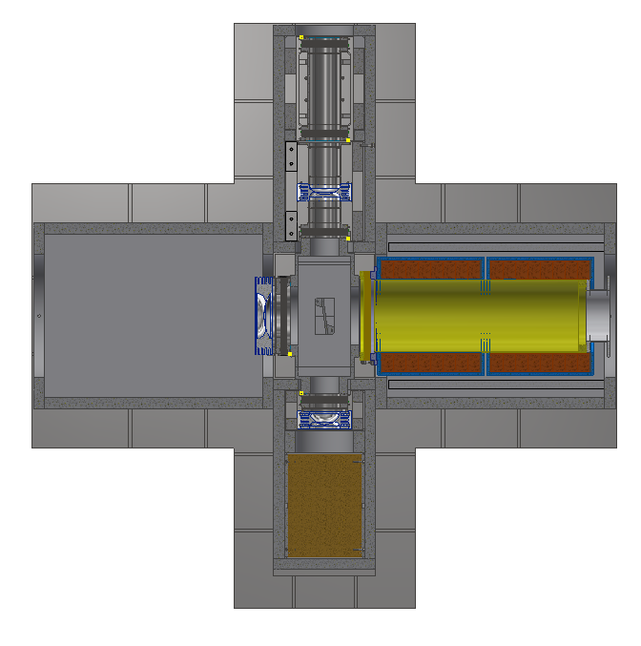
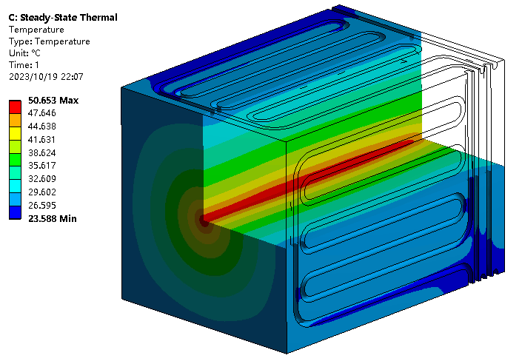
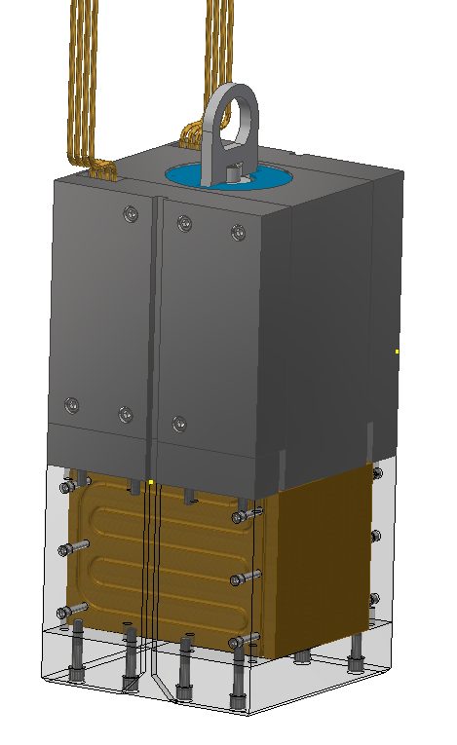
Proton Beam Dump Design
Beam Power: 10.5 kW of beam power will be directly deposited here.
Structure: Copper material with a square design. Each side features a water-cooled pipeline with a 12mm inner diameter. The pipeline is seamlessly wound to prevent water leakage at the base.
Simulation Analysis Results: In a water-cooled environment, the water temperature rises by 8.6°C. The maximum temperature at the center of the beam dump reaches 50°C.
Proton beam
beam dump

Slide 20
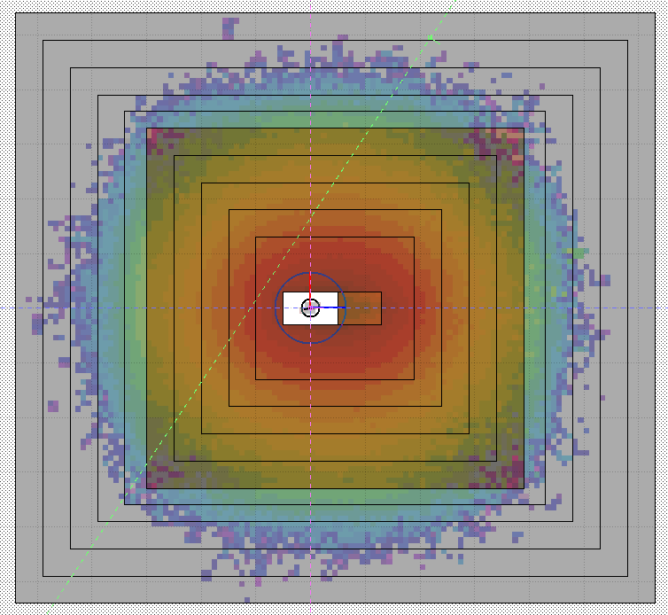
Energy deposition for different parts @ 20 kW
Horizontal view
Shielding
  Iron: 4.3 kW
  Concrete: 1.3E-5
Target: 2.8 kW
Dump: 10.3 kW
Total = 17.4 kW
For the shielding, most of the energy is deposited at its first iron layer
The total value of energy deposition will not change when using different materials, only the distribution
x
z

Slide 21
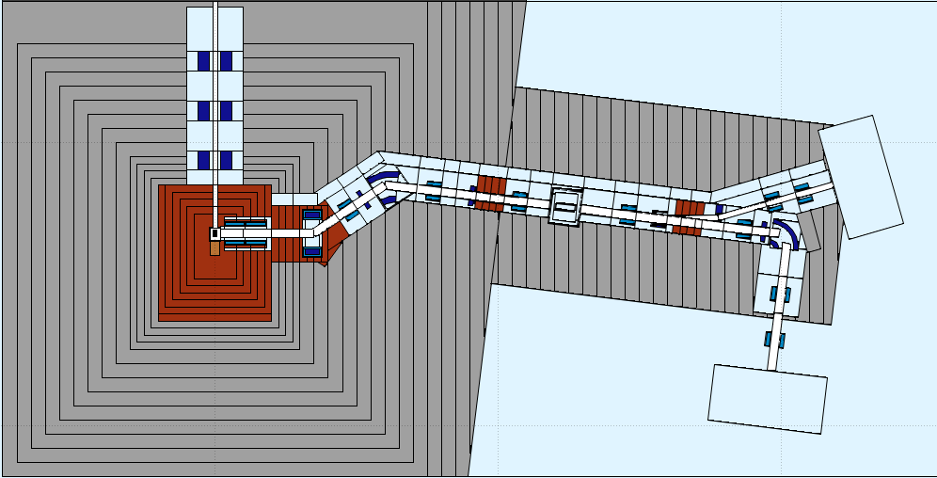
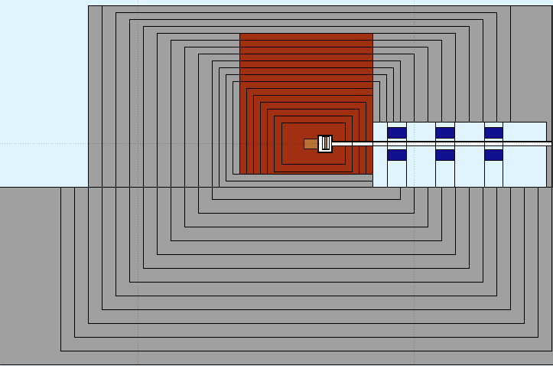
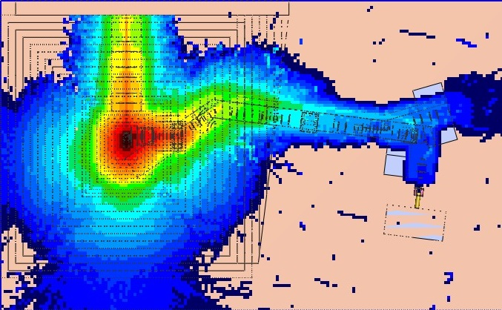
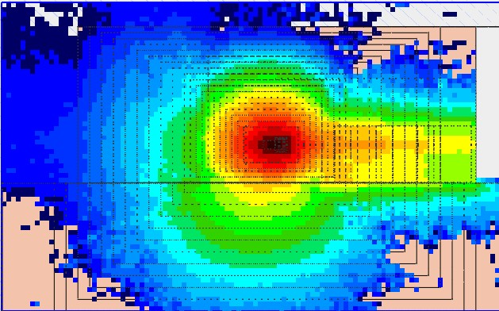

Shielding design
prompt radiation < 1 μSv / hour at detectors
Mild steel at target station surroundings
+ concrete extensions
水平面
竖直面
屏蔽体位置 | 缪子靶站屏蔽需求
Downstream | 3.1m低碳钢+5.5m混凝土
Upstream | 1.7m低碳钢+6.5m混凝土
Left to beam | 2m低碳钢+8m混凝土
Right to beam | 2m低碳钢+5.5m混凝土
Upper part | 4m低碳钢+1m混凝土
Lower part | 1.1m低碳钢+4m混凝土
Prompt radiation
水平面
竖直面
Zhang Gang / CSNS
瞬发辐射剂量率（mSv/h）

Slide 22
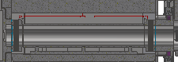
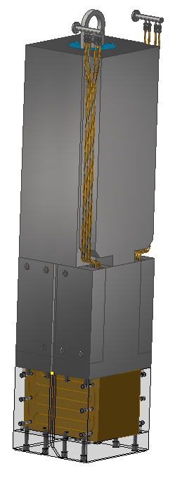
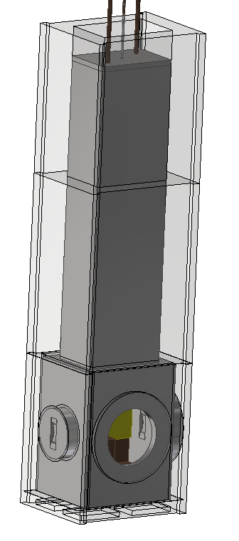
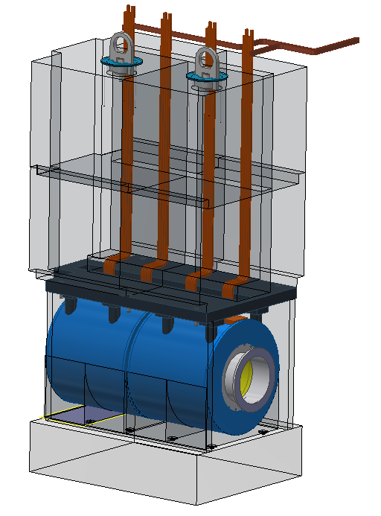
Units in High Radiation Areas
4 units to be maintained remotely.
All from the top of the shielding, cut connections from 2.2m above the beamline.
Target lifetime > 5 years
Radiation Dose on the first magnet is 10k Gy/h, ~50M Gy/y, MIC cable is needed
  ~30 years of lifetime.
Proton Beampipe
Proton dump
Target chamber
magnet

Slide 23
Conclusion and Plan
A new target station in CSNS for a muon source (MELODY)
  1.6 GeV proton beam, 20 kW, 1 Hz pulsed beam
Physics design: Completed.
  Thick copper target with solenoid to collect muons
  Optimized for surface muon beamline. Extensible for other beamlines
Equipment Design: Finalization in progress
Manufacturing: Expected to commence in approximately one year
Testing and Installation: Scheduled for completion in approximately two years
Equipment design
Equipment manufacturing
Testing and Installation
2024.10
2025.12
2026.10

Slide 24
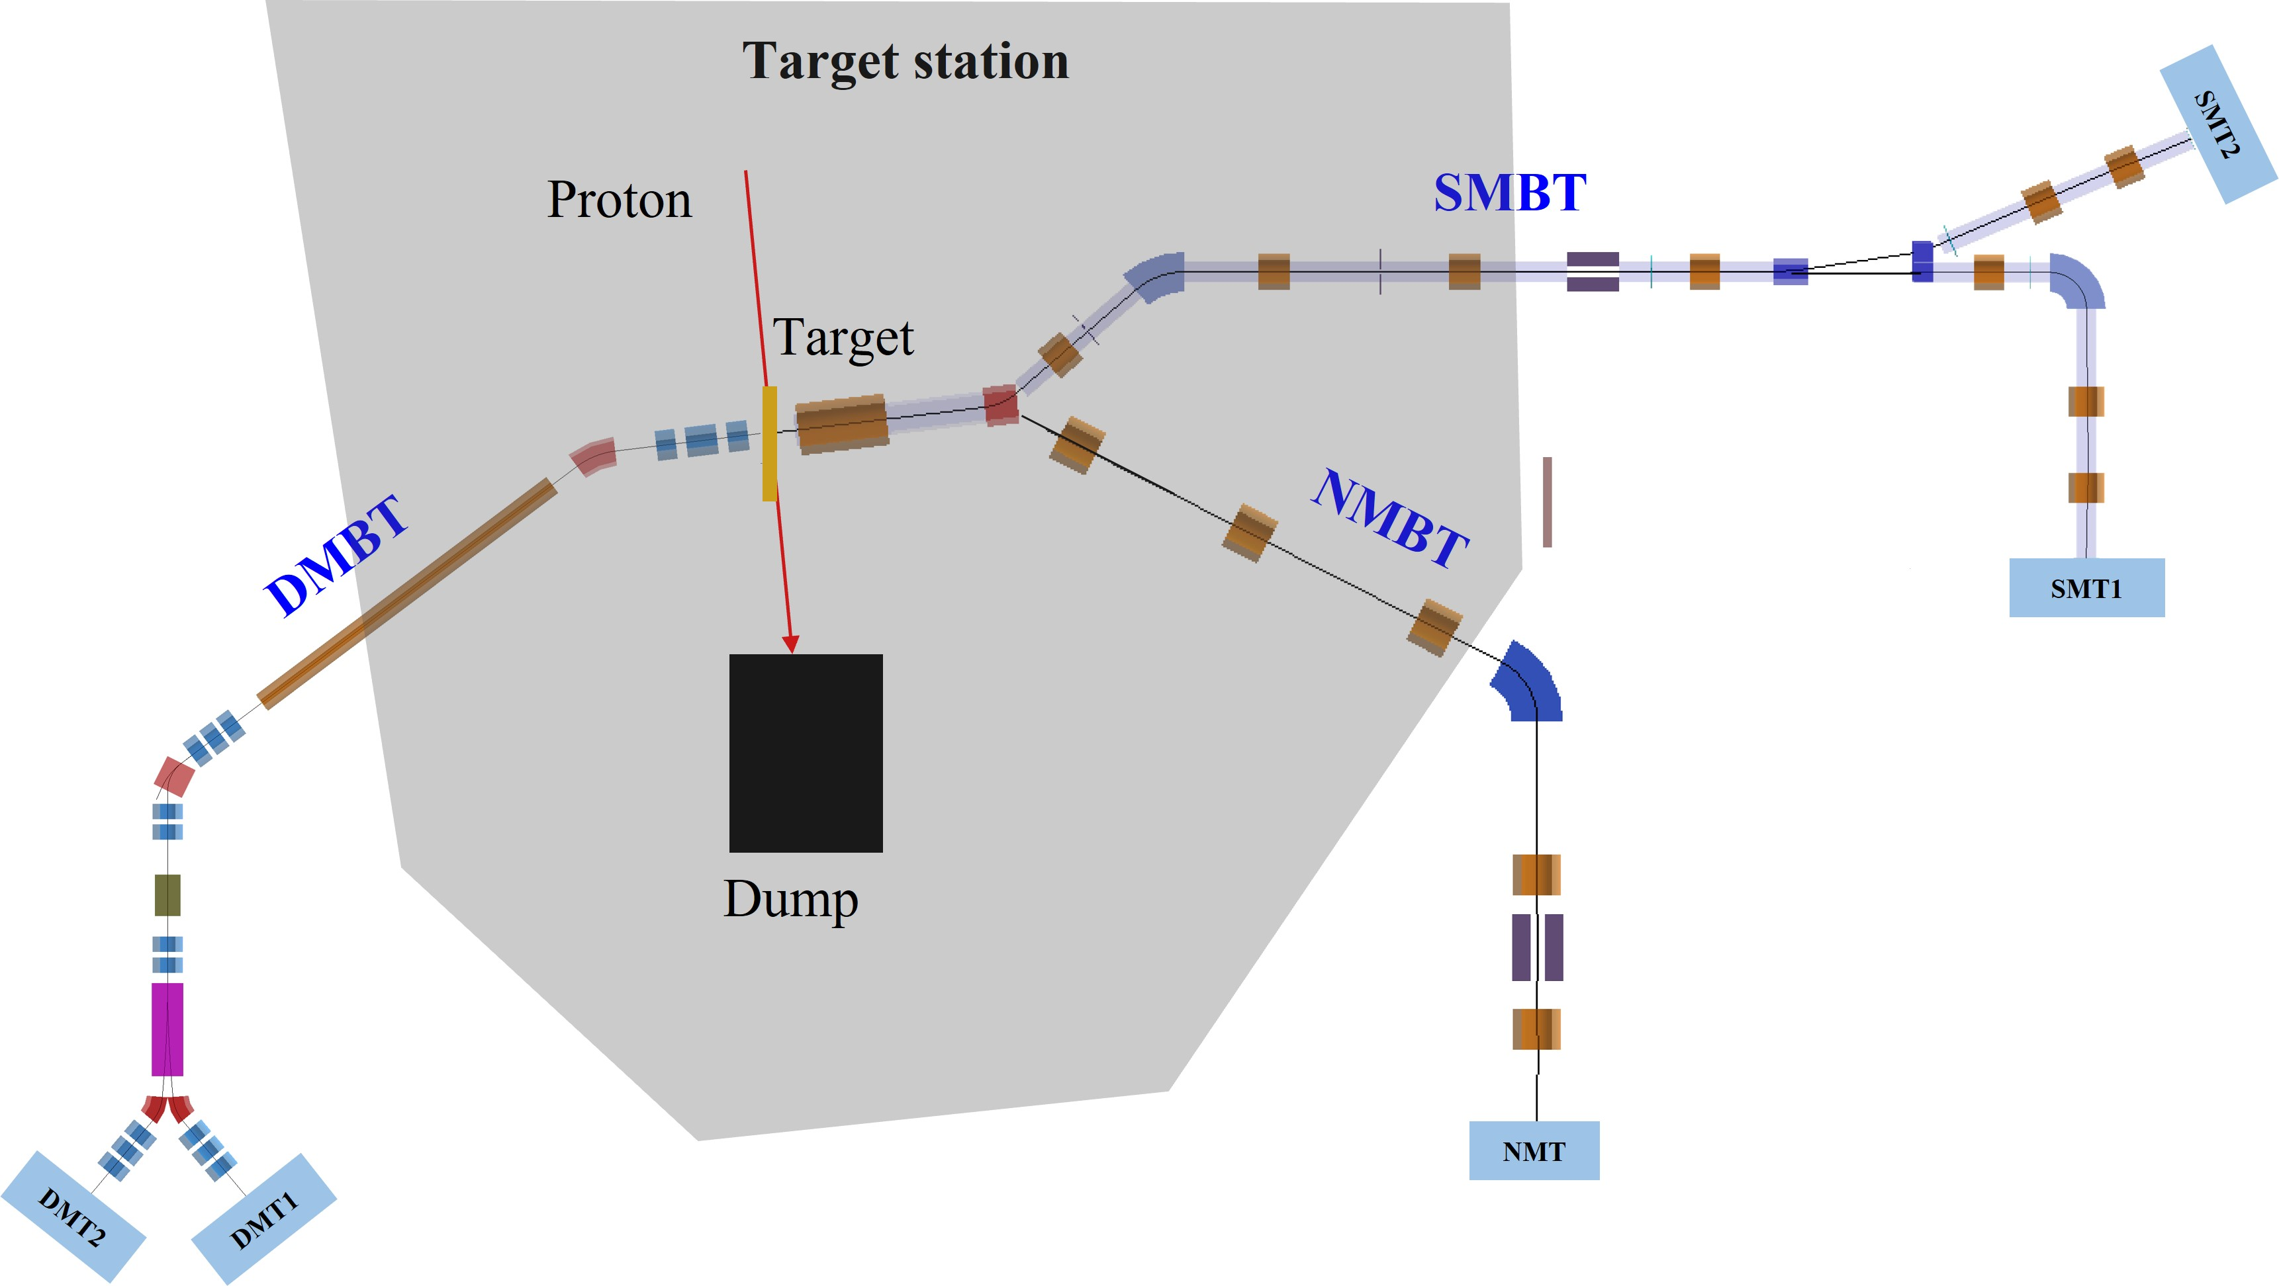
MELODY beamline layout
Bao Yu, You Lv, Liu Guangdong, Chen Cong
Building SMBT (SMT1 & SMT2), NMBT and DMBT are reserved
SMBT: Surface muon, 2 terminals, µSR technique and muon beam study.
NMBT: Negative muon, 1 terminal, MIXE technique.
DMBT: Decay muon, 2 terminals, MIXE and µSR technique.
MELODY beamline layout
Notes:
This graph shows the MELODY beamline layout. Three muon beamlines, including SMBT, NMBT and DMBT, are planned to be built on both sides of the target. During the CSNS-II period, we will build the surface muon beam line and the two experimental terminals. We will also reserve the NMBT, DMBT and their terminals.

Slide 25
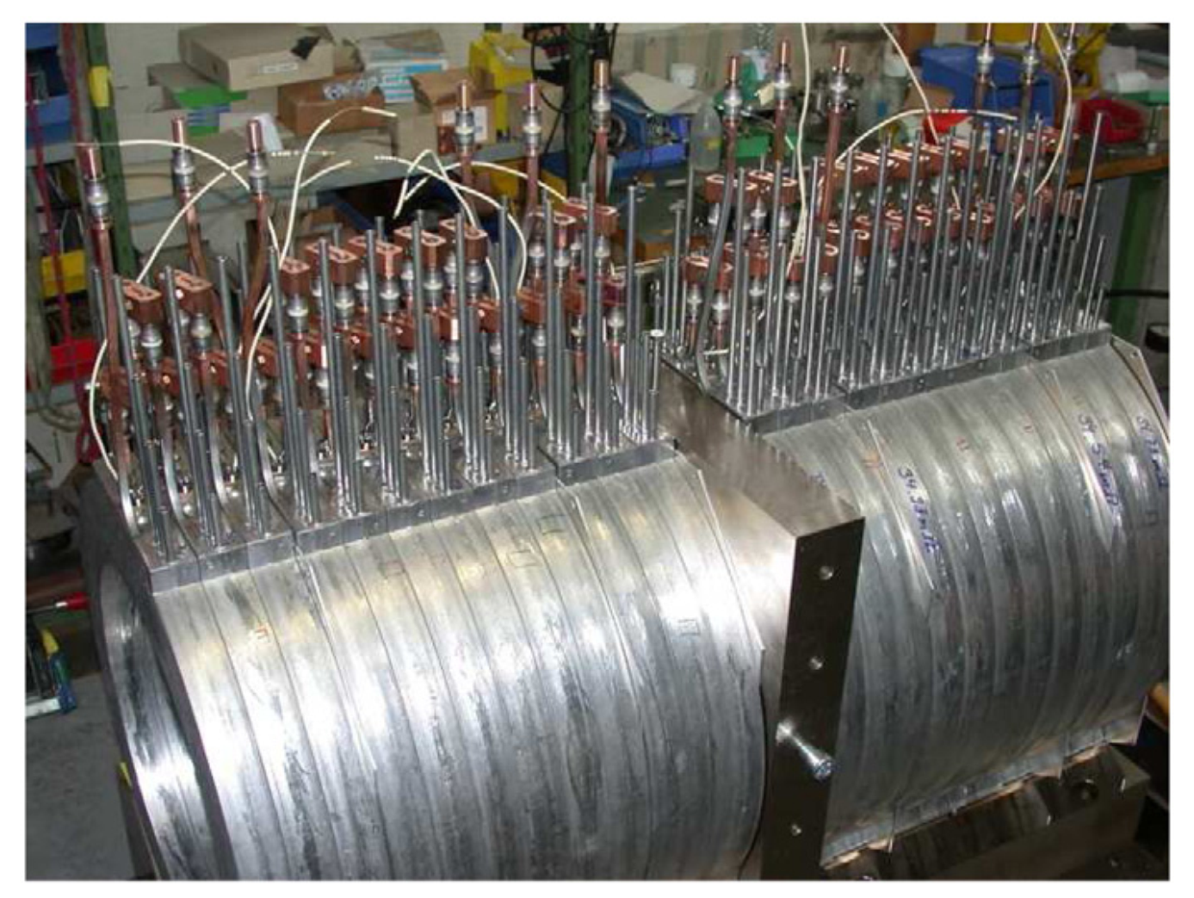
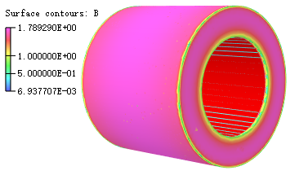
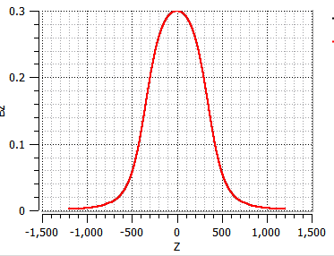
SMSOLX design
Capture solenoid (SMSOLX): design refer to PSI μE4 beamline
Two large-aperture solenoids @MIC(mineral insulation cables)
Inner radius：250 mm
Length：676.8 mm each
Distance to target center：350 mm
Solid angle：1.17 sr (steradian)
Maximum field：0.3 T
PSI μE4 capture solenoid
SMSOLX
MELODY SMSOLX design
Notes:
First is the capture solenoid, it is deigned refer to PSI μE4 beamline. The capture solenoid for MELODY consist of two large-aperture solenoids with mineral insulation cables and its inner radius is 250 mm. The distance between the capture solenoid and the target is 350 mm, so the solenoid needs to be strong radiation resistance.

Slide 26
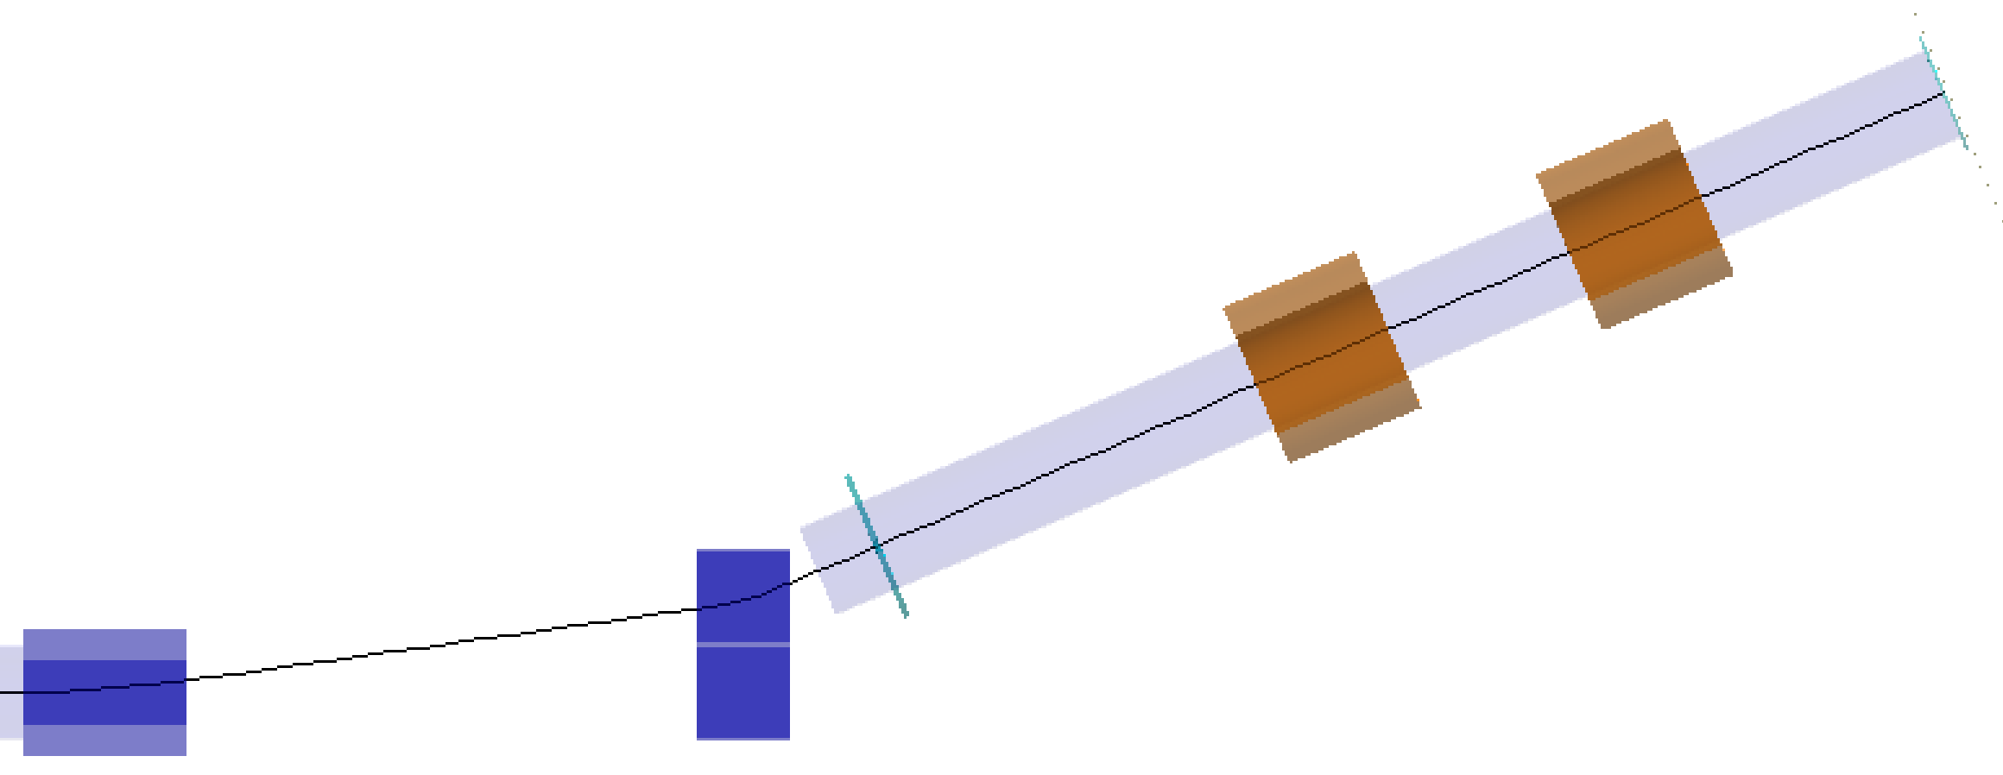
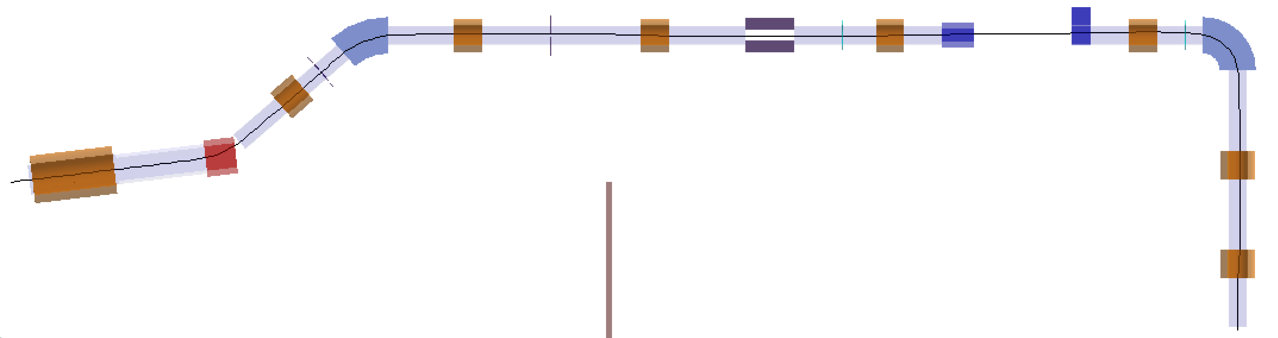
SMBT layout
SMT2
SMSOL9
SMSOL8
SMBB
@40.9
SMK
@8
Coll5
Coll2
Coll3
Coll4
SMBC
@90
Proton
Coll1
SMSP
@15
SMSOL2
SMSOL3
SMWF
SMSOL4
SMSOL5
SMSOLX
SMSOL1
SMBA @34
SMSOL6
Layout of SMBT
SMSOL7
Design parameters
SMT1
Momentum：28 MeV/c, Polarization：>95%
Intensity：>10⁵ μ/s, Positron background：<1%
Beamline layout
1 capture solenoid, 9 focusing solenoids, 3 dipole bending magnet.
SMWF (Wien filter), SMK (kicker), SMSP (Septum), 5 collimators
Optical design with TRANSPORT
Features: fully solenoids focusing, high acceptance, cost-efficient
Notes:
The SMBT is designed to collect and transport the surface muons from target to the terminals. The designed parameters are listed here. It has a beam momentum of about 28 MeV/c, and the polarization is higher than 95%, the beam intensity is higher than 10⁵ μ/s. The background particle mainly is positron should be less than 1%. We use the TRANSPORT software for beamline optics design, as shown in theright. This picture shows the layout of SMBT. We use a large-aperture solenoid to capture the surface muons, and we also use 9 solenoids to focus the beam along the beamline. Meanwhile, we use 3 dipole bending magnets to adjust the beam direction and select the beam momentum. We use a Wien filter to remove the positrons from the beam. The kicker and septum are used to split muon beam into two separate beams for the two terminals. Five collimators are used to adjust the beam spot size and the beam intensity at the terminal. The beamline shows a feature of high acceptance and cost-efficient due to that we use fully solenoid to focus the beam instead of quadrupole magnet.

Slide 27
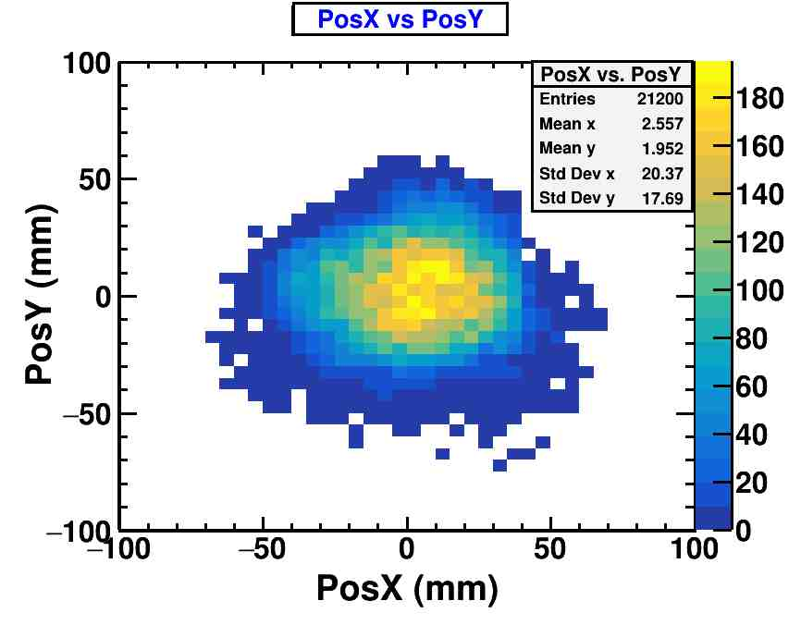
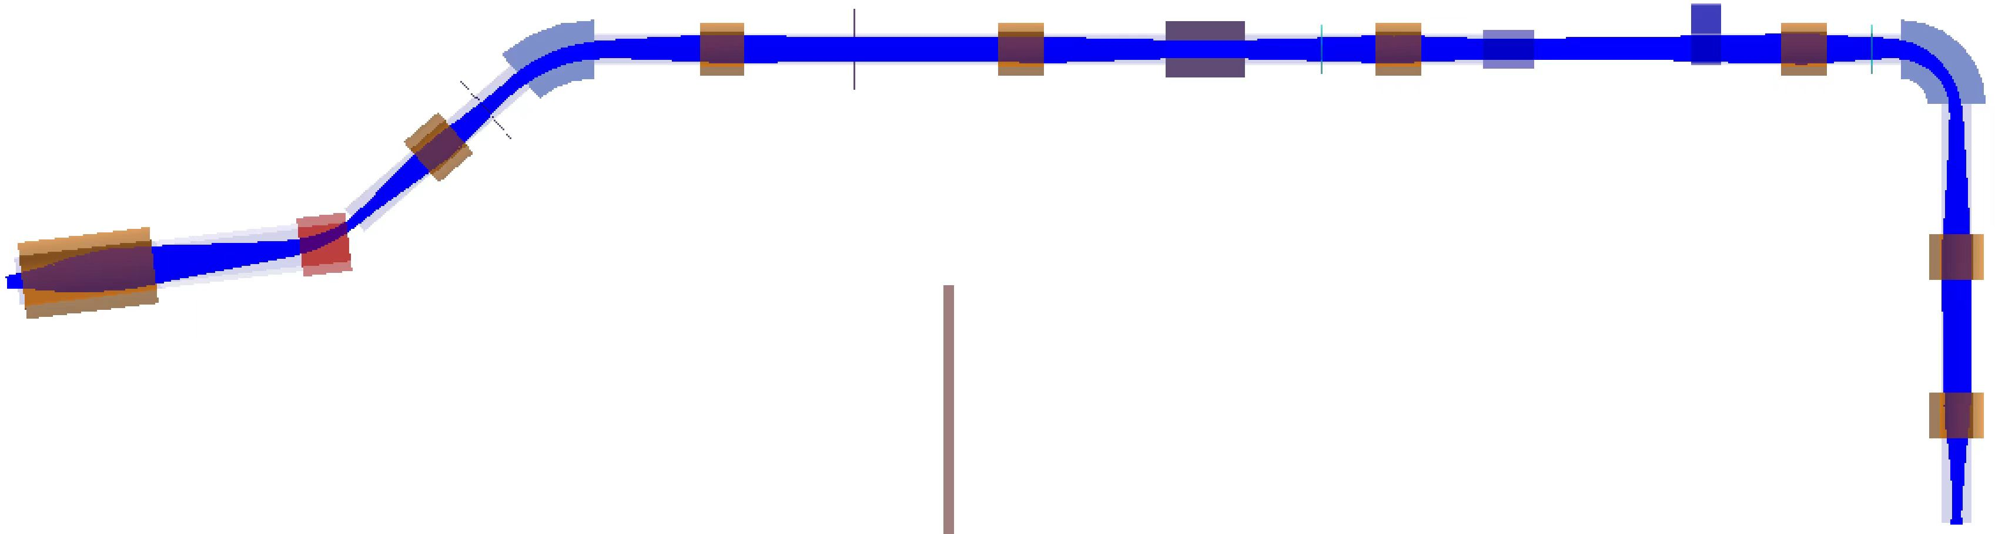
Multi-particle tracking simulation
Beam transportation is simulated with G4beamline
The magnets and fields are designed and solved with FEA software.
The field maps and initial muons are inputted to G4beamline
The muon information is recorded at the sample position
Momentum, profile, intensity, polarization…
Beam profile on sample
Sample
Muon transport simulation
Notes:
The beam transportation is also simulated with G4bl. The magnets and fields are designed and solved with FEA (finite element analysis) software. We import the field maps of all the magnets and initial muons file to G4bl to simulated the beam transportation. And the muon information at the sample position is recorded, including the beam momentum, profile, intensity and polarization.

Slide 28
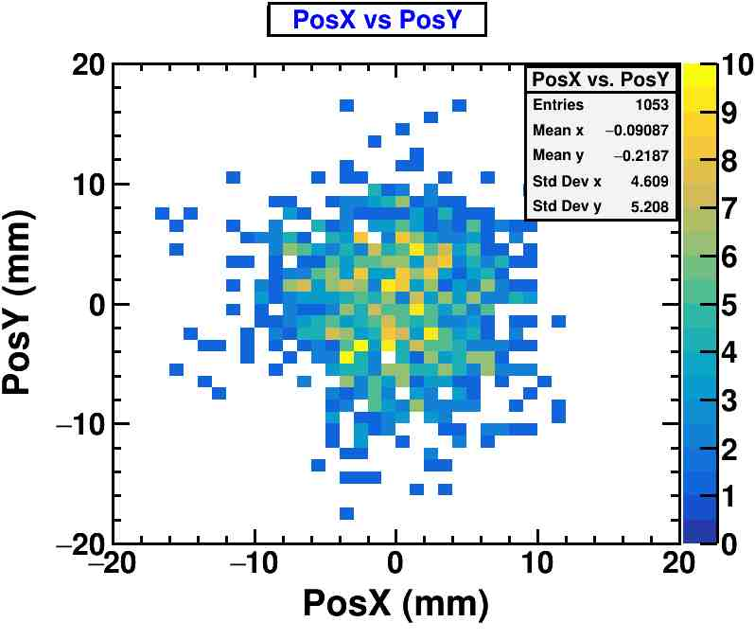
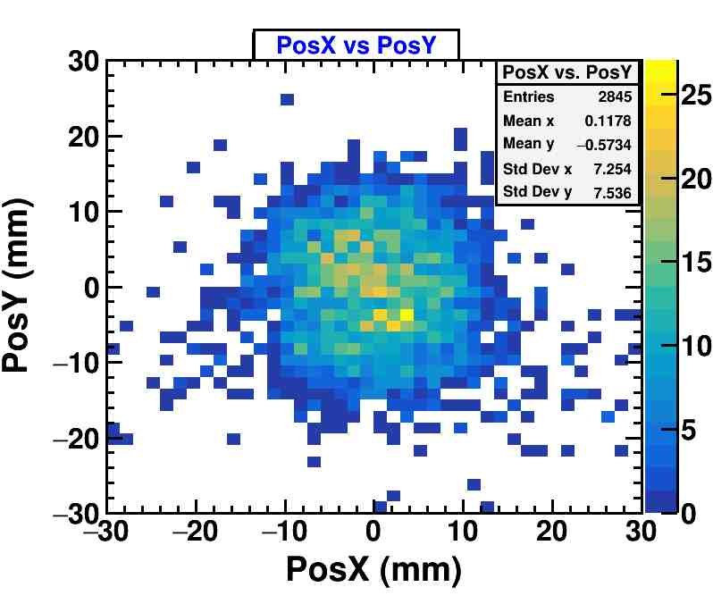
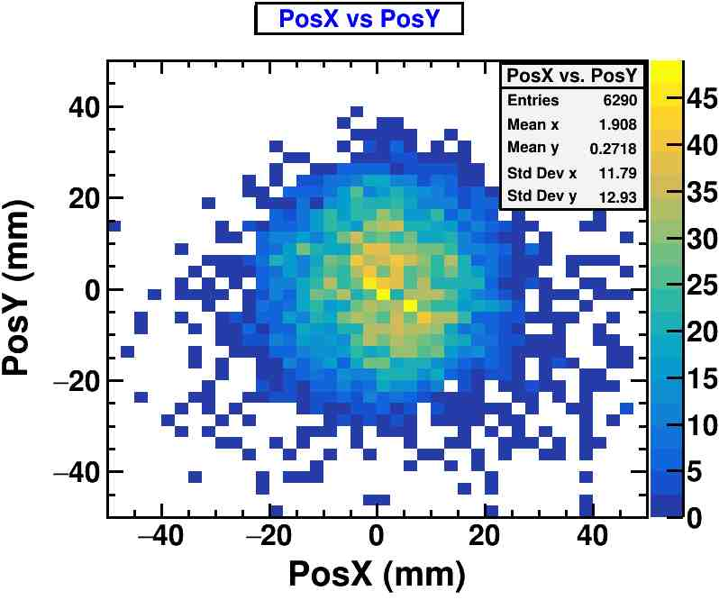
Different beam spot results @SMT
Beam intensity: design parameters (>10⁵ μ/s)
Terminal | Φ10 mm | Φ20 mm | Φ30 mm | Φ50 mm | Φ100 mm
SMT1 (μ⁺/s) | 1.1×10⁵ | 7.3×10⁵ | 2.0×10⁶ | 8.2×10⁶ | 1.6×10⁷
SMT2 (μ⁺/s) | * | 1.7×10⁵ | 8.4×10⁵ | 6.5×10⁶ | 1.8×10⁷
Typical beam profile @SMT1
Φ 20
Φ 30
Φ 50
Notes:
The beam intensity with different beam spot size is shown in this table. The commonly used beam spot size for uSR experiment is 20 mm or 30 mm. And, in this condition, the beam intensity is much higher than the design parameter of 10⁵ μ/s. And these graph shows the typical beam profile with different beam spot size.

Slide 29
Beamline summary
Systematic physical design of SMBT is presented. Good results are obtained with A.I. optimization.
All the magnet devices have been designed and will be developed in the next step.
The beam measurement detector have been fabricated and will be tested with ISIS muon beam in the next week.
The NMBT and DMBT are reserved and will be built in the future.
Beamline | Terminal | Intensity (μ/s) @ Beam spot(mm) | Polarization | Momentum (MeV/c) | Momentum dispersion (FWHM) | Status
SMBT | SMT1 | 7.3×10⁵ @ Φ20 1.6×10⁷ @ Φ100 | 95% | 28 | 7% | Building
 | SMT2 | 1.7×10⁵ @ Φ20 1.8×10⁷ @ Φ100 | 95% | 28 | 6% | Building
NMBT | NMT | 4.4×10⁵ @ Φ100 | * | 29 | 13% | Reserve
DMBT | DMT1 | 3.5×10⁶ @ Φ30 | * | 20-120 | 8% | Reserve
 | DMT2 | 3.5×10⁶ @ Φ30 | * | 20-120 | 8% | Reserve
MELODY beamline parameters
Notes:
Finally is my summary. Systematic physical design of SMBT is presented. Good results are obtained with A.I. optimization. All the magnet devices have been designed and will be developed in the next step. The beam measurement detector have been fabricated and will be tested with ISIS muon beam in the next week. The NMBT and DMBT are reserved and will be built in the future.

Slide 30
Timeline of MELODY
Project has been approved and will be built in 5 years.
Complete of Muon Hall
Start trial run
Notes:
Here is the time line of melody. Starting from this year, we will build the project in 6 years. And in 2 and half years we will complete the construction of the experimental hall and start the installation of the equipment. And by the middle of 2028 we will start the trial run to make sure we can provide a good muon beam for users by the end of 2029.

Slide 31
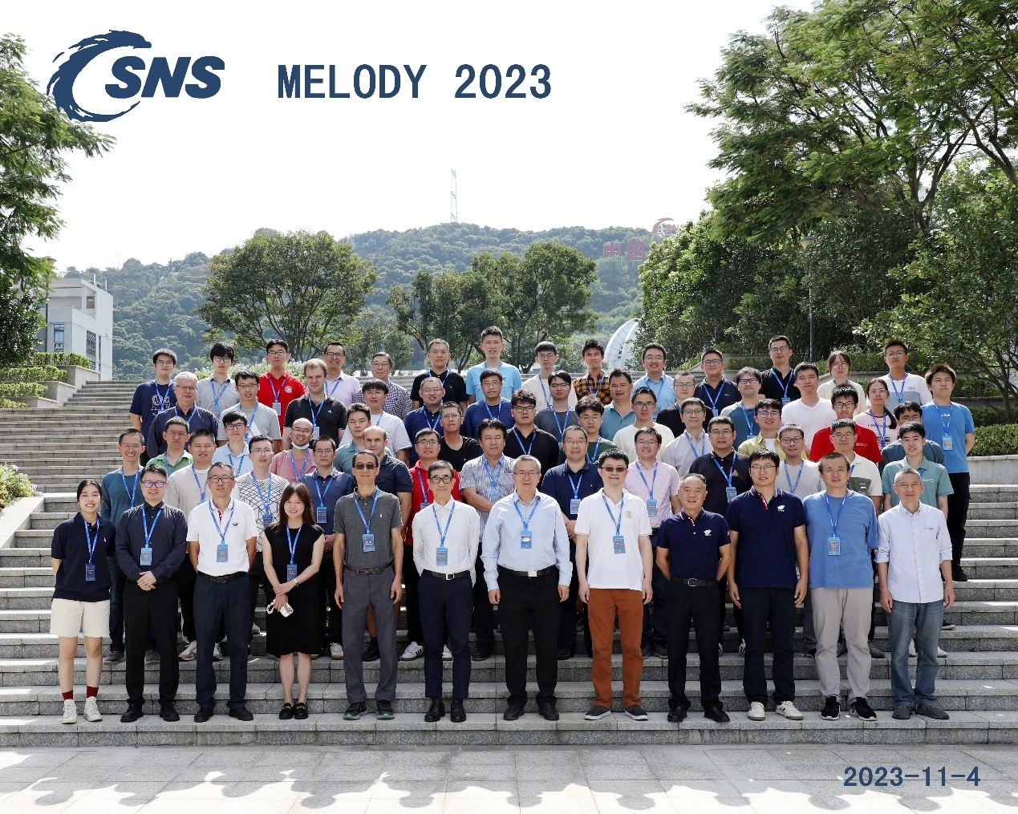
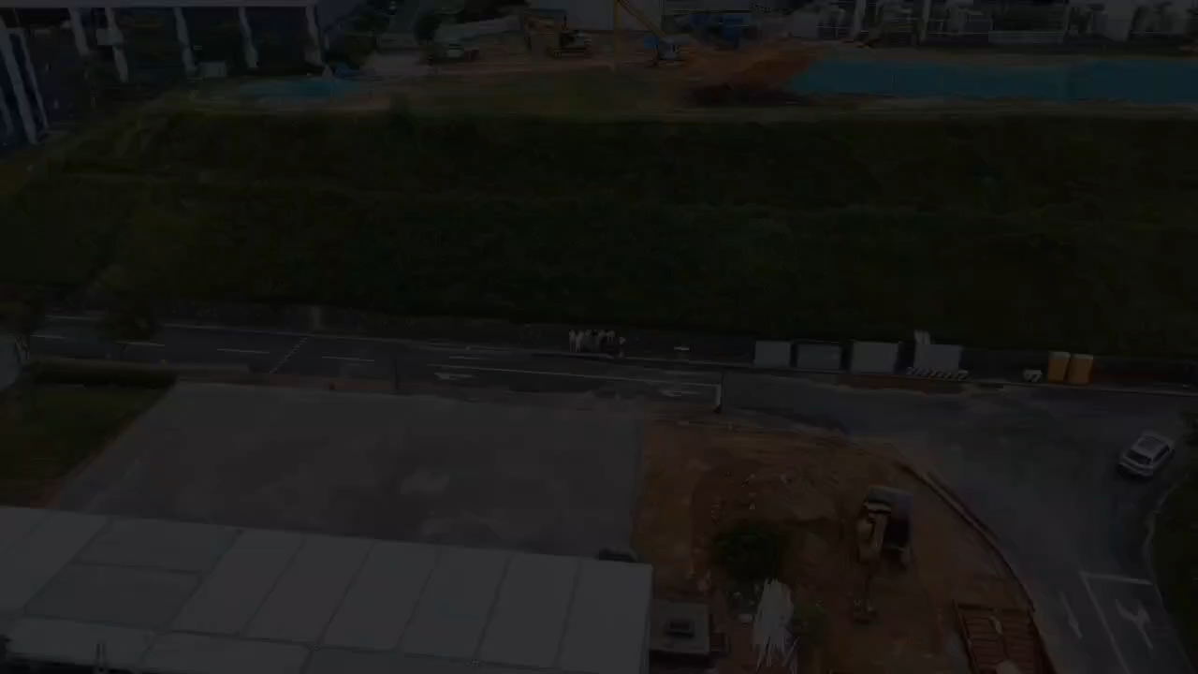
The first workshop and international review of MELODY were held successfully in November 2023 and June 2024 respectively
MELODY’s site construction has started, last month
Thank you
Notes:
We have organised a first workshop for MELODY last year, and we hope to host all of you in this year.

Slide 32
extra

Slide 33
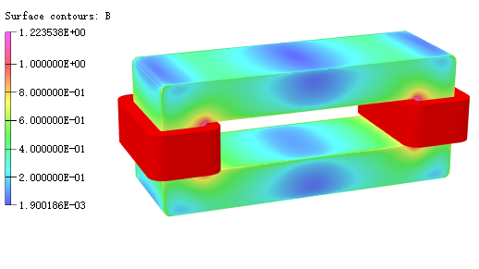
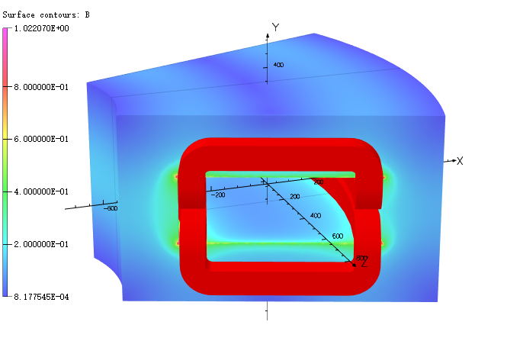
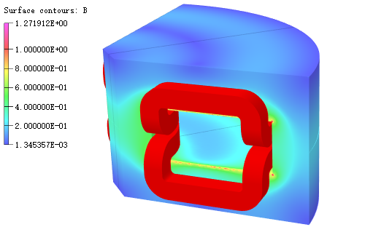
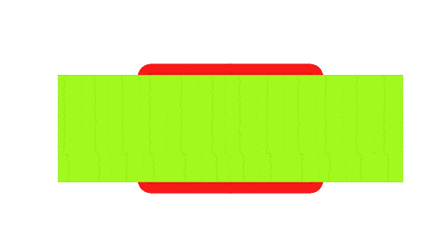
Dipole bending magnet design
Dipole magnet parameters:
Parameters | Deflect angle (degree) | Maximum field (T) | Magnetic gap (mm) | Power (kW)
SMBA | 34 | 0.105 | 240 | 3.7
SMBB | 40.9 | 0.082 | 240 | 1.6
SMBC | 90 | 0.164 | 240 | 6.2
SMBA (rectangular bidirectional) model
SMBB model
SMBC model
Notes:
The SMBT have three different dipole bending magnets, including a rectangular bidirectional dipole magnet, and two normal sector dipole magnets. The parameters of the dipole are listed in this table and the models are shown in the bottom graph.

Slide 34
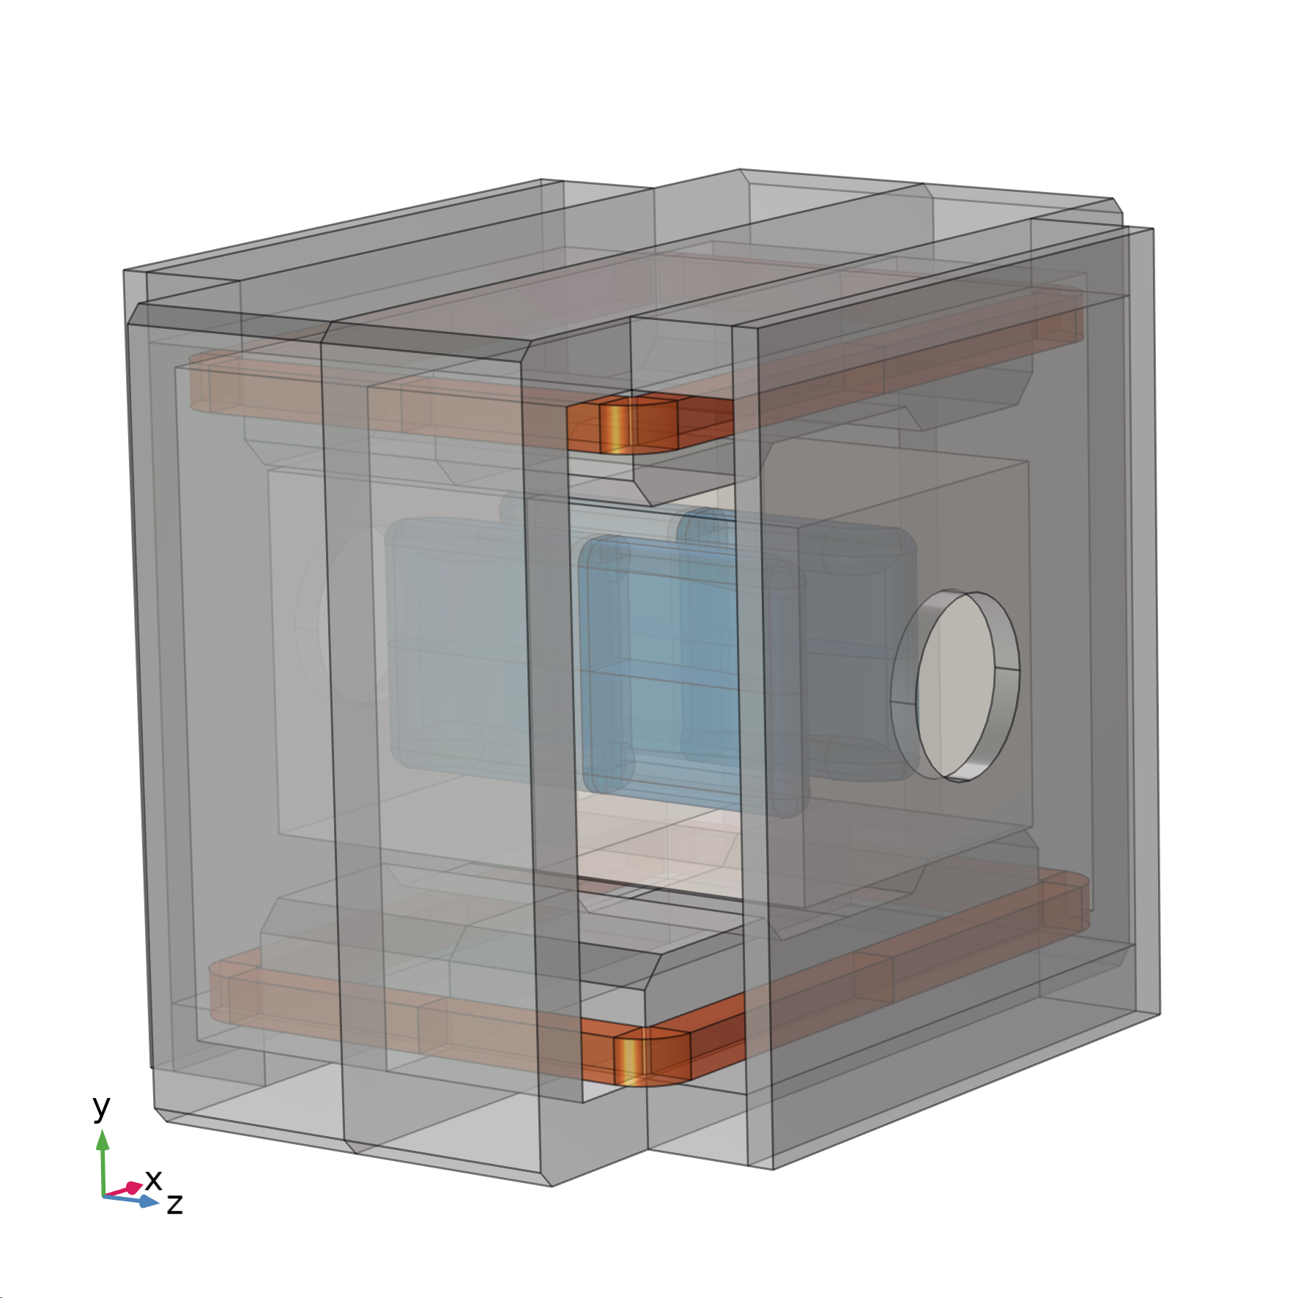

Wien filter design (preliminary)
Wien filter: design refer to PSI
Majority contamination: positrons, same momentum as surface muons.
Wien filter: velocity selection, remove positrons efficiency.
Field: An orthogonal electric and magnetic field
Wien filter parameters:
Magnetic field：280 Gauss
Magnetic gap：700 mm
Length, width, height：800 mm×1800 mm×1340 mm
Maximum voltage：±200 kV
Electrode gap：180 mm
Electric field：2.212 MV/m
Length, width：833 mm ×440 mm
Wien filter model
Schematic diagram of wien filter
Notes:
The wien filter is also designed refer to PSI. The majority contamination in the muon beam is positrons, which has the same momentum as surface muons. And the wien filter is used to remove the positrons by selecting the particle velocity. The parameters of wien filter are listed here.

Slide 35


Beamline optimization
Goals：Maximize the beam intensity for different beam spot sizes by tunning the beamline parameters.
Optimized parameters: positions of the dipole magnets(3), positions and field strengths of the solenoids (9×2), positions and sizes of the collimators (5×2).
More than 30 adjustable parameters, very larger parameter space.
Strategy：Combining A.I. algorithms and G4beamline
1. Genetic algorithm：Global search
2. Iterated local search：Global & local search
$$x_{1}±δx$$
f(x₁)
x₁
Iterative convergence process.
Convergence schematic
Notes:
We optimize the beamline to maximize the beam intensity for different beam spot sizes by tunning the beamline parameters. The optimized parameters including positions of the dipole magnets, the positions and field strengths of the solenoids, and the positions and sizes of the collimators. There are more than 30 adjustable parameters with very larger parameter space. So, we combine the A.I. (artificial intelligence) algorithms and G4bel to optimize the beamline. Two algorithms are used, including the genetic algorithm and iterated local research algorithm.

Slide 36




Beam intensity measurement
Detector solution: Scintillator + PMT + Waveform-Sampling Electronics
µ+ stop in Scint1 and decay
e+ pass through Scint1 and Scint2.
Signal recorded by waveform-sampling electronics.
Intensity of µ+ and e+ reconstructed by PSD method.
The detector prototype will be tested at ISIS muon beam NEXT WEEK.
Schematic diagram of intensity measurement
Detector prototype
Simulated signal waveform
Notes:
The intensity measurement detector system is used to measure the beam intensity and estimate the ratio of background positrons at the terminal. A double-stacked scintillator detector with PMT readout and waveform-sampling electronics is proposed. The detector system has been fabricated and will be tested at ISIS next week.

Slide 37


Kicker design
The second pulse have to be kicked for μSR experiments.
Magnetic kicker is designed
Field（T） | 0.02581
Length (mm) | 530
Angle (degree) | 8
Gap (mm) | 250
Width (mm) | 210
Rise time（ns） | <250
Flat time（ns） | >300
Fall time（ms） | <20
1 s
Proton time structure
200-360ns (150ns) muon>95%
The time between proton pulses is 289 ns, but it decreased for muon pulses.
The beam loss caused by kicker is less than 5%
Kicker Field
Muon time structure (single pulse)
Notes:
The kicker magnet is used to split the beam into two beam bunches for uSR experiment. The muon time structure is shown in the right-bottom graph. And the parameters of the kicker are listed in this table, it has a rise time less than 250 ns with a flat time of 300ns. The beam loss caused by kicker is estimated less than 5%.

