Slide 1
Enforcing Self-Consistent Kinematic Constraints in Neutrino Energy Estimators Using GENIE Atmospheric Events
NuFact 2024
by J. L. Barrow
The University of Minnesota
with a Special Thanks to S. Wu, R. R. Richi, T. Thakore, C. Borden, & M. Rabelhofer
September 18th, 2024

Slide 2
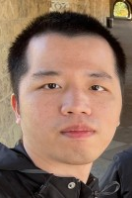
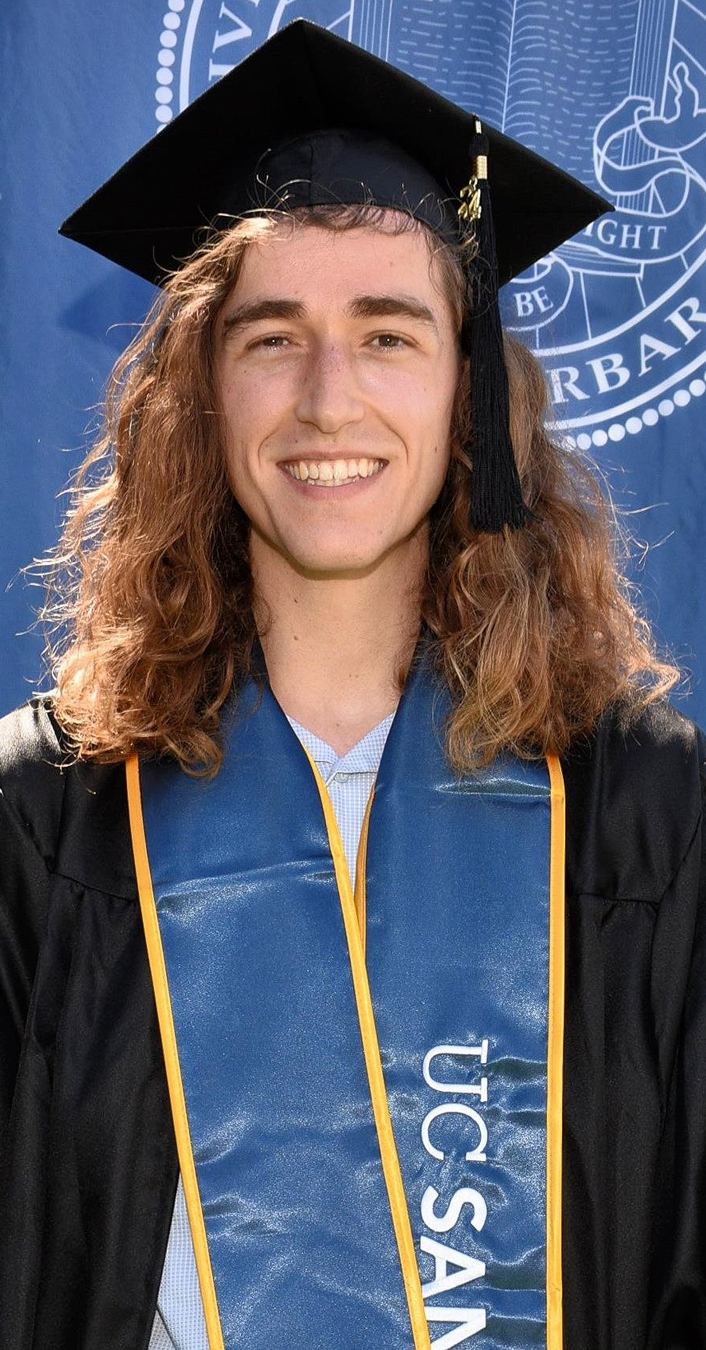
Chief Collaborators
Shaowei Wu Uni. of Minnesota
Graduate Student Network Architecture and transformer code development, ML expertise
Miranda Rabelhofer
Formerly IU Postdoc DUNE/NOvA data prep., ML expertise
Raisa Rahman Richi
Franklin & Marshall College
FNAL SIST UG Intern GENIE simulated data preparation, EAF job management, plotting
Tarak Thakore
Formerly U. Cinci.
URA Visiting Scholar
Postdoc DUNE data prep., Conda environment, burgeoning ML expertise
Casey Borden
IU
Incom. Grad. Stud. Native ROOT to Pandas dataframe conversion, plotting
Thanks to many, many more for discussions!
Care to join us?

Slide 3
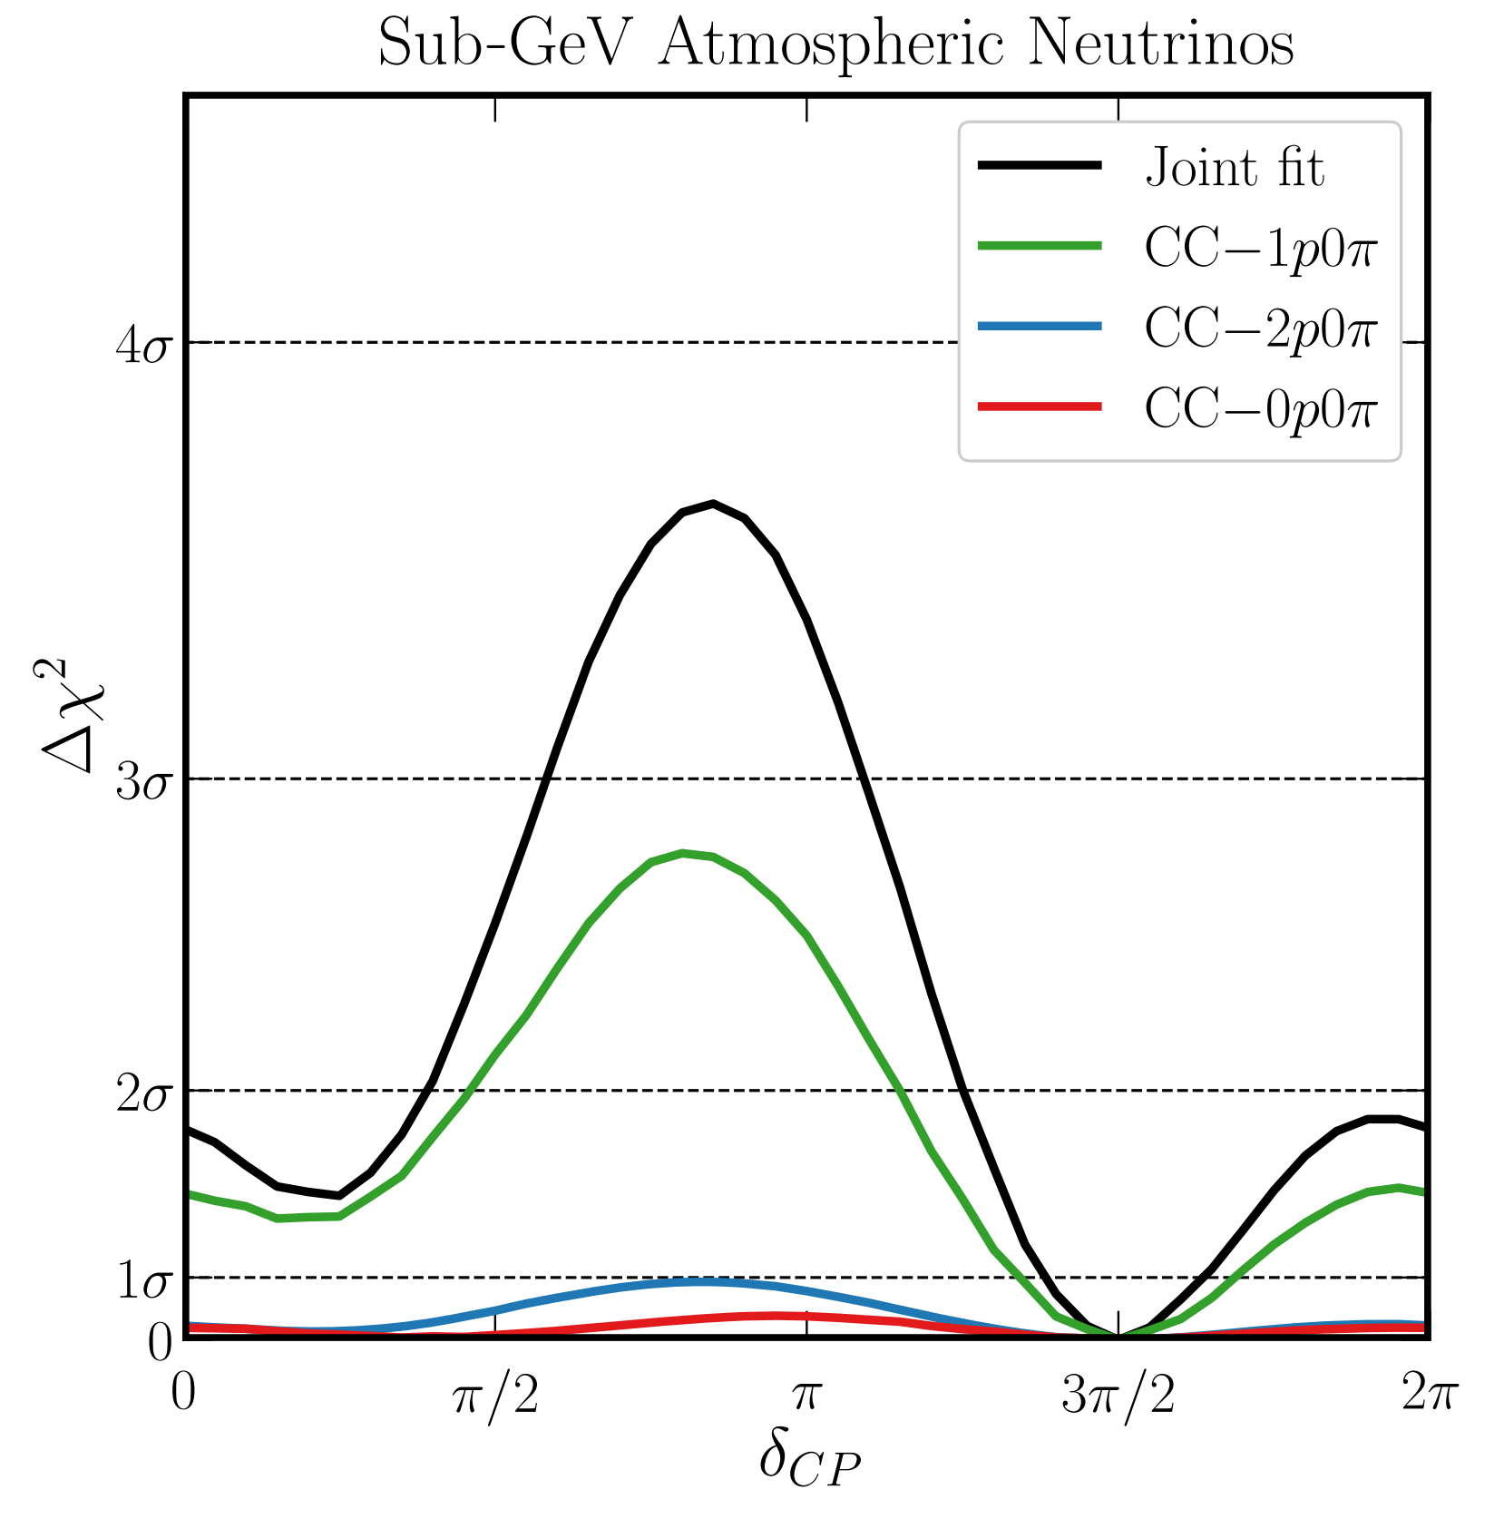
Some Recent Realizations…
Atmospheric $ν$ oscillation sensitivities got me thinking…
Machado, Kelly, Martinze-Soler et al: Phys. Rev. Lett. 123, 081801 (2019)
A key point at low energies…
Angle reco. is sensitivity driver
Need to point well to get $L$
$E$ doesn’t matter as much
$\sim 3σ$ $δ_{CP}$ sensitivity w/$\sim 15°$ pointing…
$\sim 5σ$ $δ_{CP}$ sensitivity with $\sim 7°$ pointing…?
Use primarily $CC1μ1p0π$ interactions
Atmospherics to be DUNE’s first physics measurement
Beam won’t be active for $\sim 2$ years…
Why am I telling you all this?
DUNE FD $400kt⋅yr$ exposure
Using the NuWro $ν$ event generator
Assuming $\sim 15°$ angle resolution
$30 MeV p$ kinetic energy threshold
Input $δ_{CP}$ value
Sub-GeV Atmospheric Neutrinos and CP Violation in DUNE

Slide 4
How to Potentially Improve Energy Estimators?
For accelerator-based energy estimators:
Many $E_{ν}$ estimators are likely kinematically incomplete…
The key thing is the momentum as a vector $\vec{p_{ν}}$, not only $\left|\vec{p_{ν}}\right|$
Implies need to reconstruct both magnitude and direction well
~Ignoring kinematic/angular constraint on $E_{ν}$
Given known angular resolution & some ~nuclear physics smearing…
…and some true incoming angular spread (divergence)…
…should know when to reject an energy prediction from estimator
If energy estimator is incorrect, we continue training…
If energy estimator seems correct…
Check if consistent w/angle! Minimize loss with energy & angle!
Neutrino oscillations with the MINOS, MINOS+, T2K, and NOvA experiments

Slide 5
$$\vec{p_{ν_{1_{pred}}}}$$
$$θ_{2_{pred}}$$
$$≠$$
$$θ_{1_{pred}}$$
$$\vec{p_{ν_{2_{pred}}}}$$
$${E_{ν}}_{1_{pred}}=E_{ν_{2_{pred}}}$$
$$\vec{p_{ν_{1_{pred}}}}≠\vec{p_{ν_{2_{pred}}}}$$
$$θ_{1_{pred}}≠θ_{2_{pred}}$$
We should continue training until things are kinematically consistent!
Must include new inputs to loss function!
“Consider a neutrino of initial true energy $E_{ν}$ whose incoming angle lies along the green dotted line. Consider a ML algorithm's output derived from two independent (stochastically differentiable) trainings, each utilizing a simplified loss function of the form $L\left(E_{ν}^{true},E_{ν}^{pred}\right)$. The predicted energy of an incoming neutrino of true momentum $p_{ν}$ comes from the magnitude $E_{ν}≡\left|p_{ν}\right|$. If training 1 and training 2 end after achieving similar loss or accuracy criteria (which are dependent only on variables of energy), even if each predicts very similar scalar energies $E_{ν}≈\left|p_{ν_{1_{pred}}}\right|≈\left| p_{ν_{2_{pred}}}\right|$ for an incoming neutrino on an event-by-event basis, there is no automatic guarantee that angular correlations are respected in a kinematically consistent way $θ_{ν}≉θ_{1_{pred}}≉θ_{1_{pred}}$ without a loss function which penalizes such behavior.”

Slide 6
Argument as follows…
Many (not all) ML kinematic estimators optimize a single loss function of a single variable, $s_{ν}$:
$$L\left(s_{ν}^{true},s_{ν}^{pred}\right)=⋯$$
$L$ here can be any particular style of loss function…
Mean square error, mean absolute error, mean absolute % error…
We seek to encourage learning by instead making the loss composite and multivariate on possibly many kinematic variables simultaneously, $s_{ν}, x_{ν},…$
$$ℒ\left(\left\{s_{ν}^{true},s_{ν}^{pred}\right\},\left\{x_{ν}^{true},x_{ν}^{pred}\right\},…\right)=αL_{s}\left(s_{ν}^{true},s_{ν}^{pred}\right)+βL_{x}\left(x_{ν}^{true},x_{ν}^{pred}\right)+⋯$$
Can use this to imbue physics into the loss function
“Physics motivated loss functions”
“Physics informed machine learning” (PIML)

Slide 7
Argument as follows…
Many (not all) ML kinematic estimators optimize a single loss function of a single variable, $s_{ν}$:
$$L\left(s_{ν}^{true},s_{ν}^{pred}\right)=⋯$$
$L$ here can be any particular style of loss function…
Mean square error, mean absolute error, mean absolute % error…
We seek to encourage learning by instead making the loss composite and multivariate on possibly many kinematic variables simultaneously, $s_{ν}, x_{ν},…$
$$ℒ\left(\left\{s_{ν}^{true},s_{ν}^{pred}\right\},\left\{x_{ν}^{true},x_{ν}^{pred}\right\},…\right)=αL_{s}\left(s_{ν}^{true},s_{ν}^{pred}\right)+βL_{x}\left(x_{ν}^{true},x_{ν}^{pred}\right)+⋯$$
$→$ $ℒ\left(\left\{s_{ν}^{true},s_{ν}^{pred}\right\},\left\{x_{ν}^{true},x_{ν}^{pred}\right\},…\right)→ℒ\left(\left\{E_{ν}^{true},E_{ν}^{pred}\right\},\bigcup_{i=1}^{3}{\left\{p_{ν_{i}}^{true},p_{ν_{i}}^{pred}\right\}},…\right)$
$$→ℒ\left(\left\{E_{ν}^{true},E_{ν}^{pred}\right\},\bigcup_{i=1}^{3}{\left\{p_{ν_{i}}^{true},p_{ν_{i}}^{pred}\right\}},…\right)=αL_{E}\left(E_{ν}^{true},E_{ν}^{pred}\right)+\sum_{i=1}^{3}{β_{i}L_{i}\left(p_{ν_{i}}^{true},p_{ν_{i}}^{pred}\right)}+L\left(⋯\right)+⋯$$

Slide 8
Past “Composite” Losses w/LSTM
Long Short-Term Memory (LSTM) NN architecture
Previously utilized for $ν$ and $ℓ$ energy estimation in NOvA
A. Sutton, Domain Generalization with Machine Learning in the NOvA Experiment
D. Torbunov, Improving Energy Estimation at NOvA with Recurrent Neural Networks
D. Torbunov, BNL Seminar
Used something akin to…
$$\frac{1}{2}\left[L_{E}\left(E_{ν}^{true},E_{ν}^{pred}\right)+L_{ℓ}\left(E_{ℓ}^{true},E_{ℓ}^{pred}\right)\right]$$
Permits basic understanding of $E_{had}$ via assumed energy conservation (not in loss)
The LSTM was optimized for these two variables, down to its two-headed architecture
Can in principle go beyond two variables, but requires many changes (hard coded)
LSTM development in NOvA taken over by Shaowei Wu
Initial application of LSTM to DUNE beam events followed
Initial developments made on a new model w/a transformer
This model architecture is more flexible, easily handling many loss variables at once
Shaowei redeveloped this model for our purposes, with eyes toward DUNE & NOvA
S. Wu

Slide 9
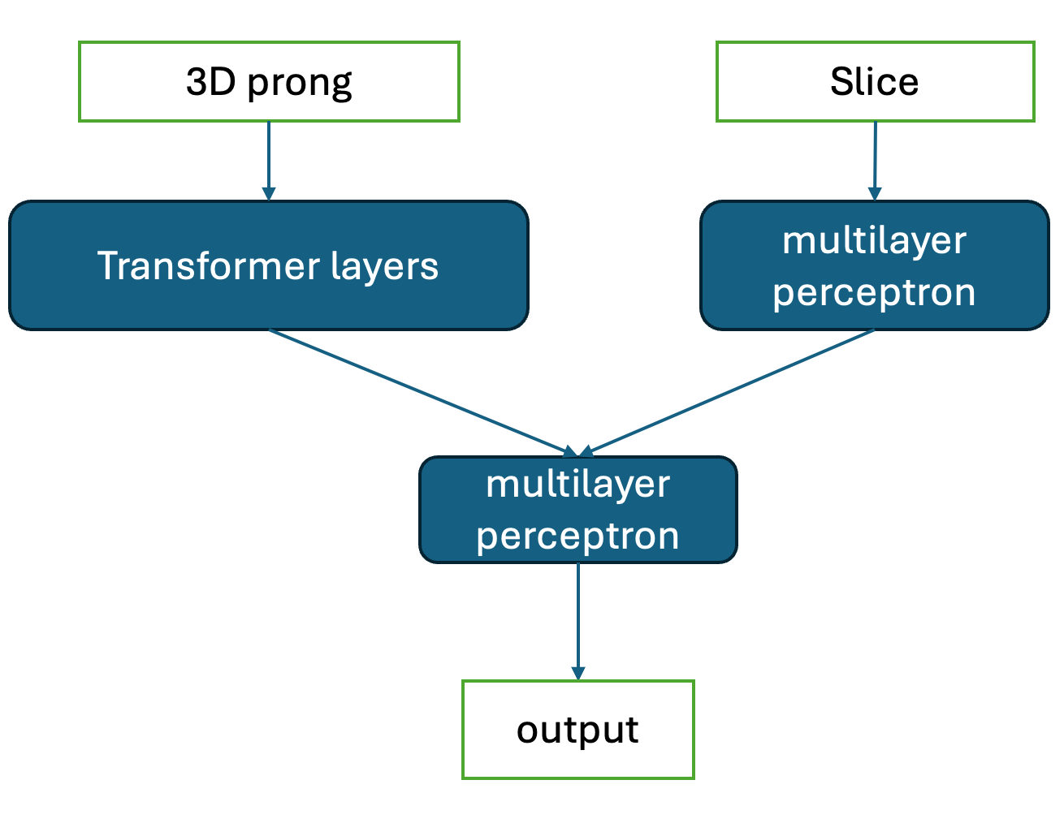
Transformer Network is Up & Running!
Vector Input
Scalar Input
“Prong” level inputs
“Slice” level inputs
Thanks so much to Shaowei!
Training has been successful
Simple stuff thus far
Now making lots of data sets
Atmospherics first, beams soon
wswxyq/transformer_EE github
tarak-thakore/transformer_EE github
tarak-thakore/transformer_EE at josh_develop github
From Shaowei Wu

Slide 10
Data Preparation w/GENIE & DUNE
Current data preparation requirements:
Convert some ROOT file to CSV
CSV columnated data is easily importable to Pandas
Columns represent particular branch variables
Scalar/Slice or Vector/Prong type inputs are available
Scalar example: Total visible energy
Vector example: All indexed track lengths for a given event
Losses computed only against scalar variables
Rows represent whole events
New columns/variables can be added at will
Model configured to take any number of columns as input
Used for training features or losses
Richi:
CSVs with topological/process selections on truth-level GENIE events w/LArTPC-motivated kinetic energy thresholds
Tarak: CSVs from DUNE events using AnaTrees
Casey: Work directly from DUNE AnaTree/CAFs
R. R. Richi GENIE events with thresholds and topological selections
T. Thakore DUNE Events Coming Soon!
C. Borden Direct (Up)ROOT to Pandas data conversion
Coming Soon!

Slide 11
Previously Chosen Training Variables
Scalars (event level variables)
Final_State_Lepton_PDG, Final_State_Lepton_Mass
Final_State_Lepton_Energy *THIS IS CHEATING FOR NC*
Final_State_Lepton_Momentum_X…Momentum_Y…Momentum_Z
Vectors
Final_State_Particles_PDG, Final_State_Particles_Mass
Final_State_Particles_Energy
Final_State_Particles_Momentum_X…Momentum_Y…Momentum_Z
Targets (for loss function)
Initial_State_Neutrino_Energy, Initial_State_Neutrino_Momentum_X…Momentum_Y…Momentum_Z

Slide 12
Currently Chosen Training Variables These are about to change…??
Scalars (event level variables)
Final_State_Lepton_PDG, Final_State_Lepton_Mass
Final_State_Lepton_Energy *THIS IS CHEATING FOR NC*
Final_State_Lepton_Momentum_X…Momentum_Y…Momentum_Z
$KE_{Tot}$, $P_{Tot}$, $P_{miss_{simple}}$ (a la A. Furmanski, UMN)
Vectors—NOW INCLUDING VISIBLE LEPTONS
Final_State_Particles_PDG, Final_State_Particles_Mass
Final_State_Particles_Energy
Final_State_Particles_Momentum_X…Momentum_Y…Momentum_Z
Targets (for loss function)
Initial_State_Neutrino_Energy, Initial_State_Neutrino_Momentum_X…Momentum_Y…Momentum_Z
Initial_State_Neutrino_Momentum_X…Momentum_Y…Momentum_Z
Will show that this may have not been a great idea…
Future: Utilize CC & NC classifier, move back to separating lepton
Potentially directly classify within the new model with the transformer
Future: Go for both $\left(E_{ν},p_{x_{ν}},p_{y_{ν}},p_{z_{ν}}\right)$ and $\left(E_{ℓ},p_{x_{ℓ}},p_{y_{ℓ}},p_{z_{ℓ}}\right)$ together a la LSTM loss?

Slide 13
GENIE-Only Results Many Plots Shown Here from Richi
Using oscillated atmospheric neutrinos at Homestake
BEAM SIMULATION COMPARISONS TO COME
$E_{ν}ϵ\left(0.1,1\right)GeV$, any $ν$ flavor, any process, $NpNπ$ topologies
Using kinetic energy thresholds alone
train indices size: ~1.8M (~75%) valid indices size: ~200k (5%) test indices size: ~500k (20%)
R. R. Richi

Slide 14
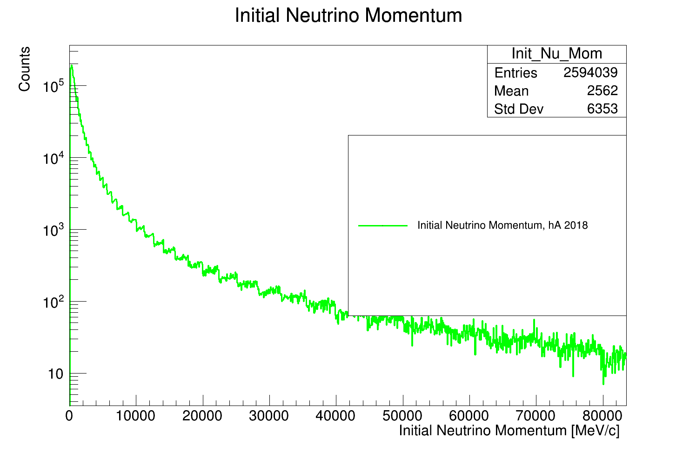
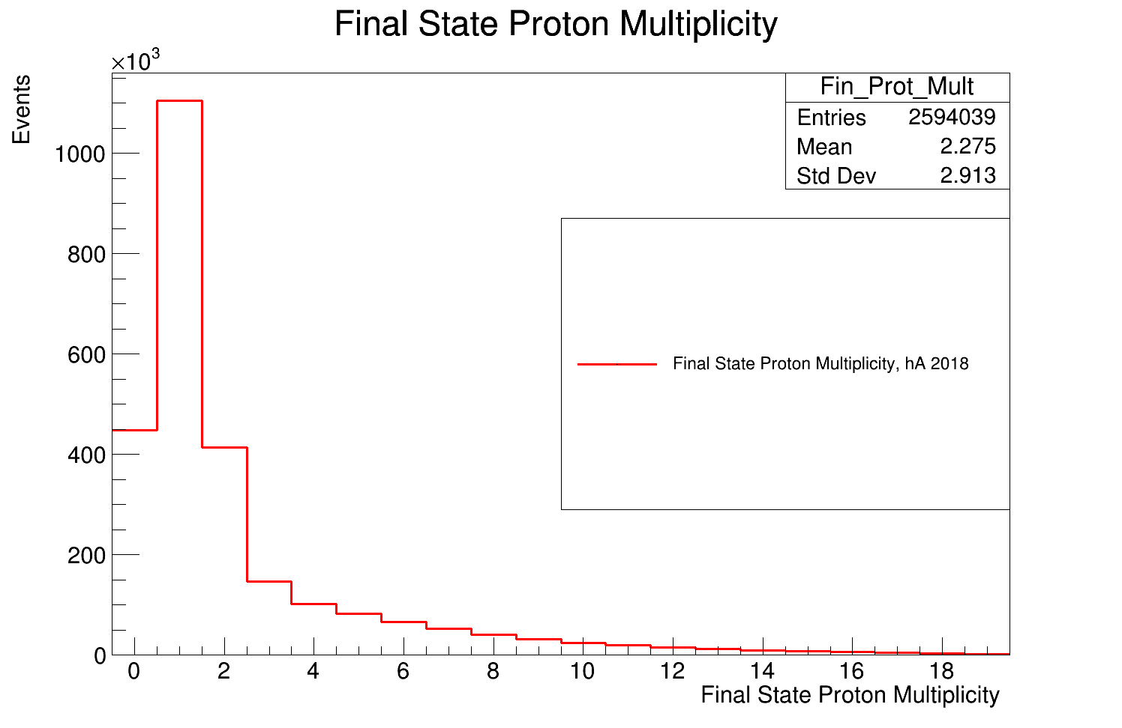
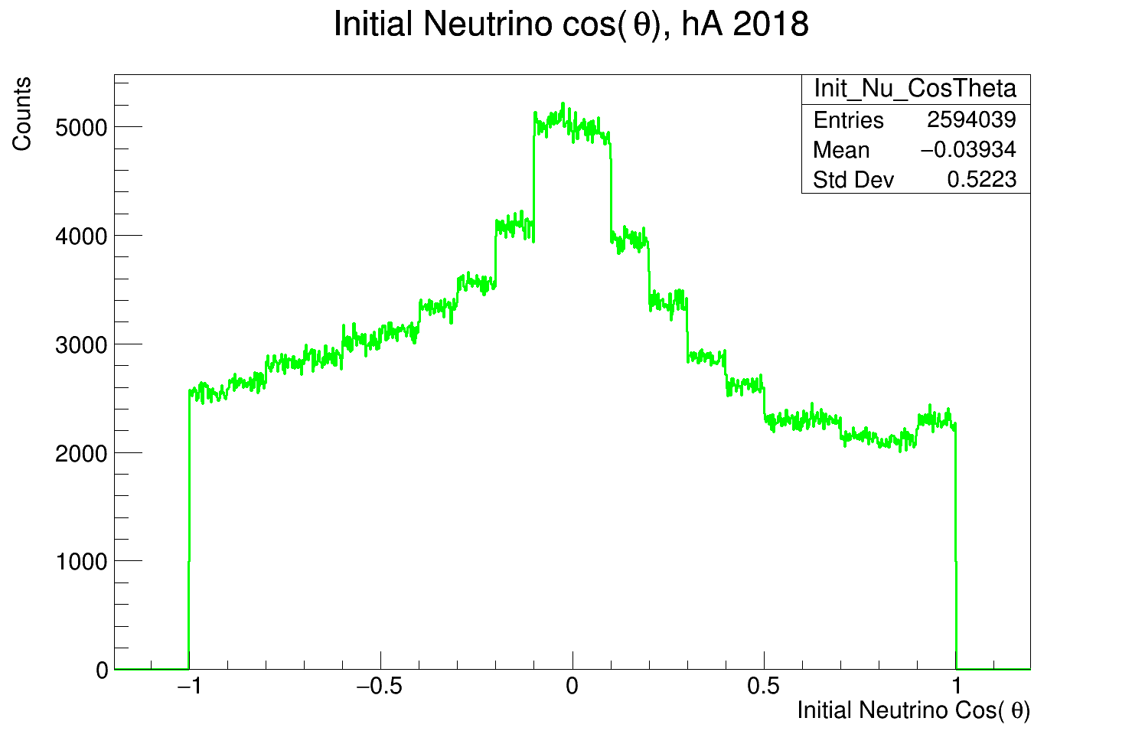
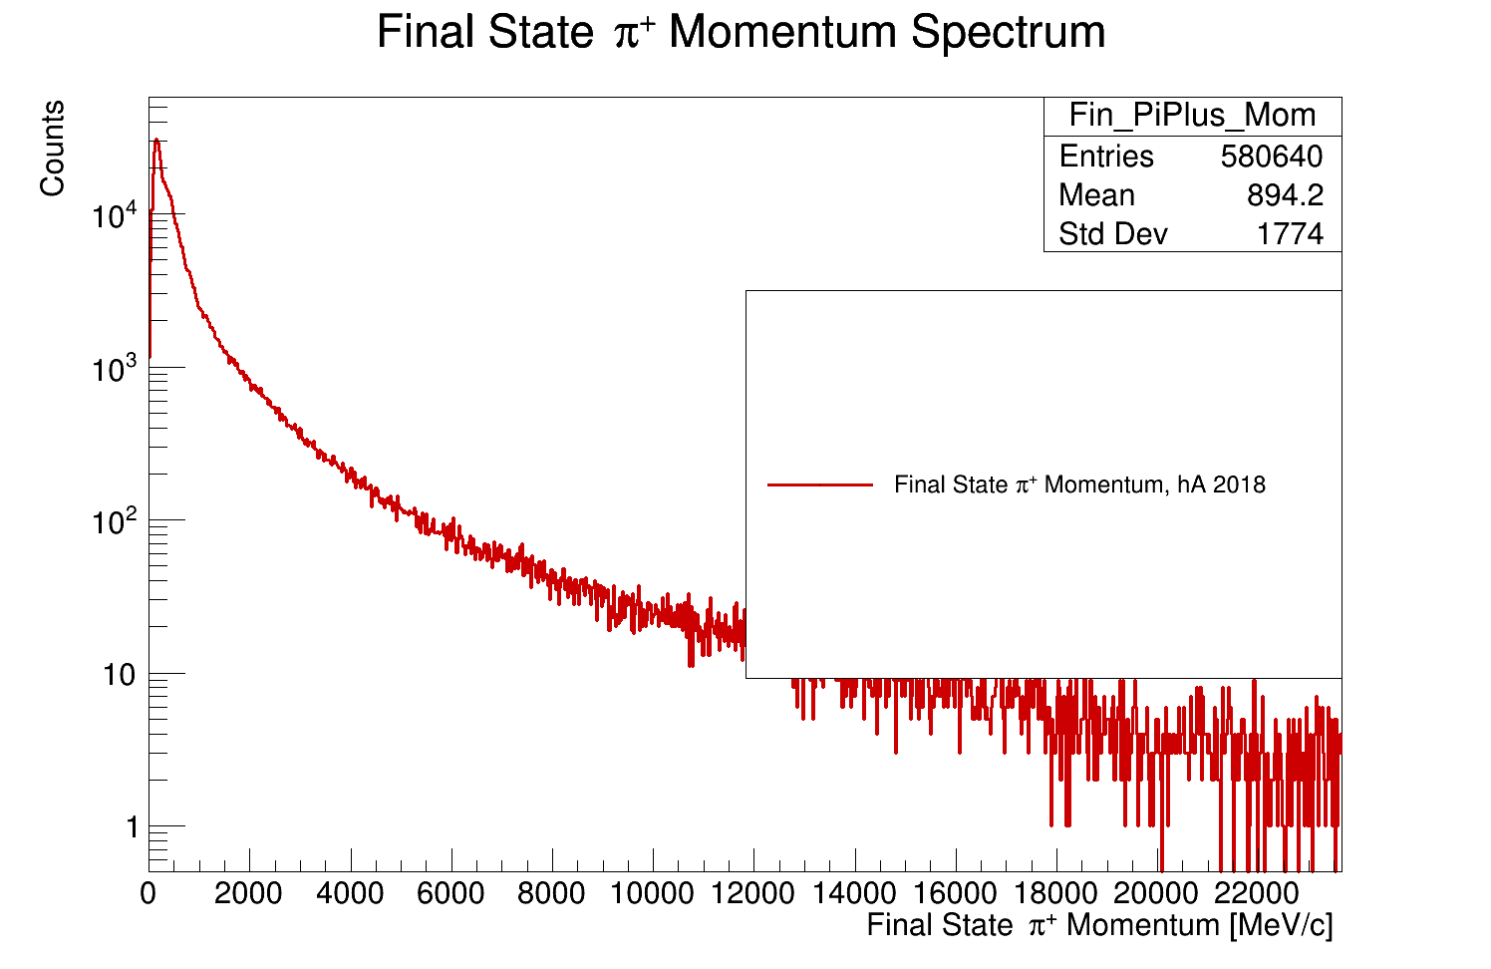
Example histograms
Full Honda atmospheric flux sample with oscillations at Homestake
(same as in PDK study)
$$E_{ν}ϵ\left(0.1,100\right)GeV$$
Any $ν$ flavor
Any process
$$NpNπ$$
$hA_BR$ Nuclear model configuration

Slide 15
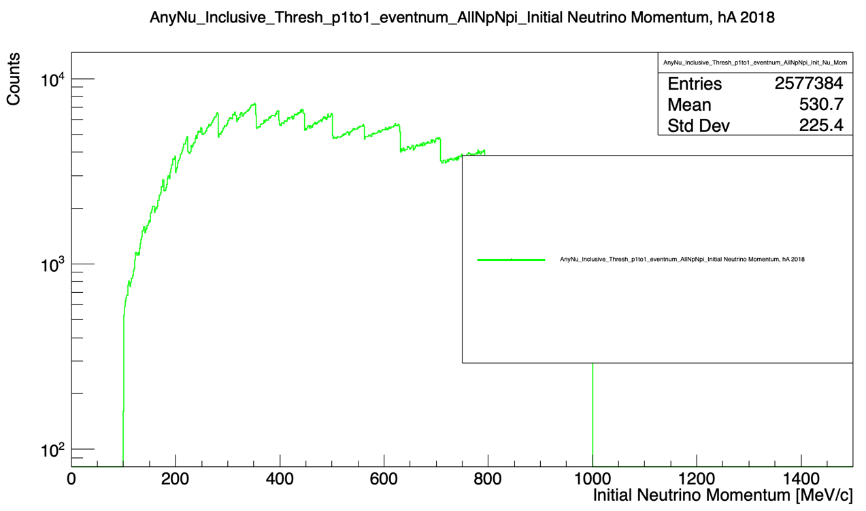
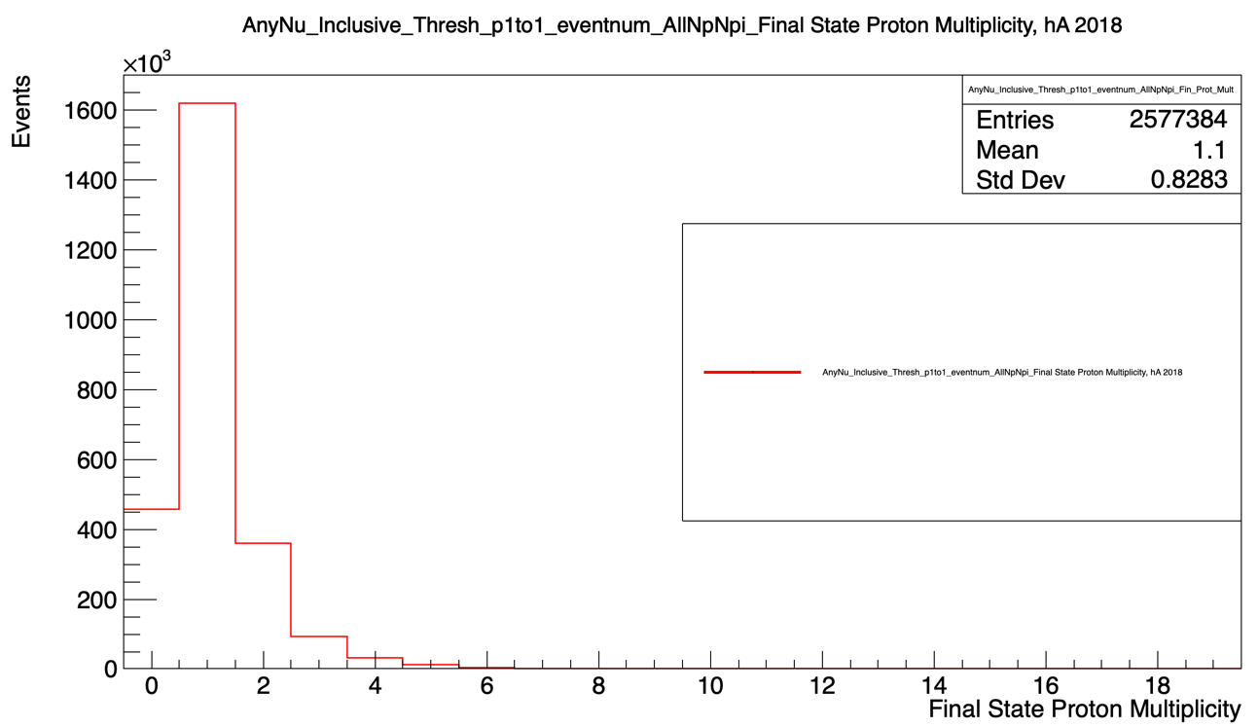
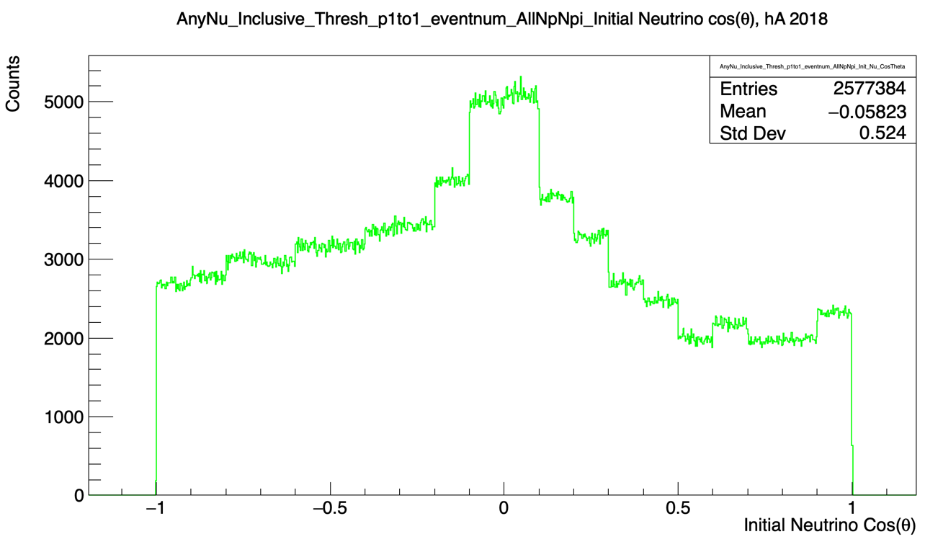
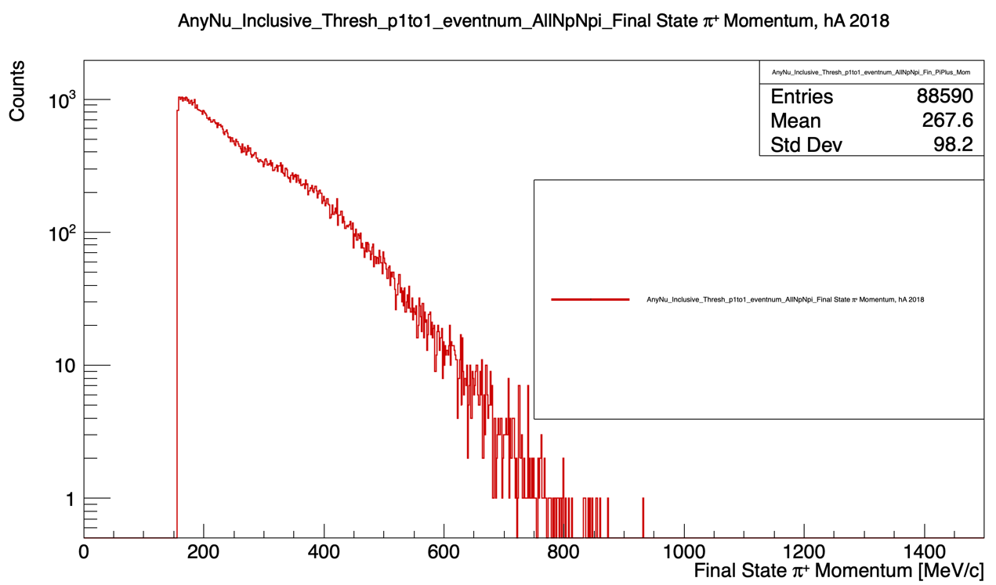
Example histograms
PARTIAL Honda atmospheric flux sample with oscillations at Homestake
(same as in PDK study)
$$E_{ν}ϵ\left(0.1,1\right)GeV$$
Any $ν$ flavor
Any process
$$NpNπ$$
$hA_BR$ Nuclear model configuration

Slide 16
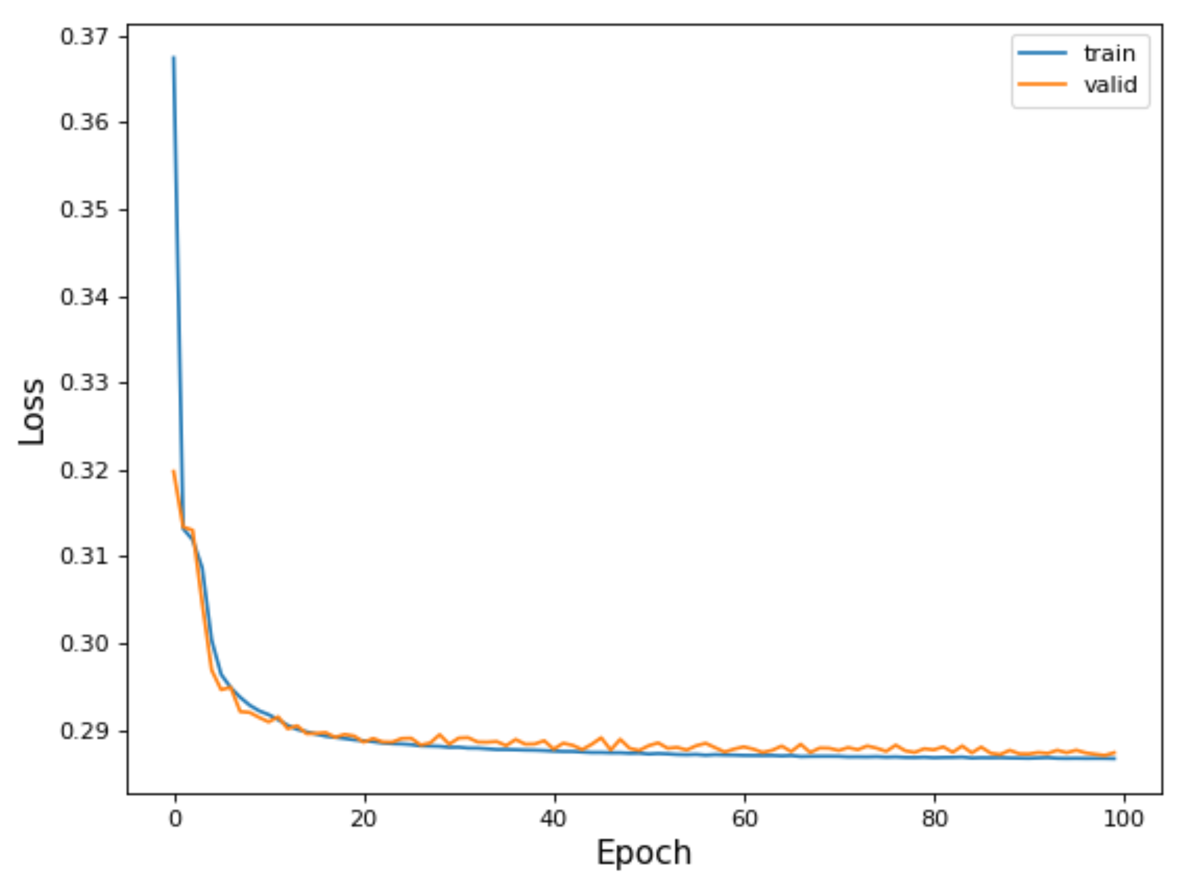
Training
Selection:
$E_{ν}ϵ\left(0.1,1\right)GeV$
All processes
All $ν$ flavors
All topologies
Any number protons, pions, etc.
NO NEUTRONS
Loss variables: $\left(E_{ν},p_{x_{ν}},p_{y_{ν}},p_{z_{ν}}\right)$ MAE
Validation

Slide 17
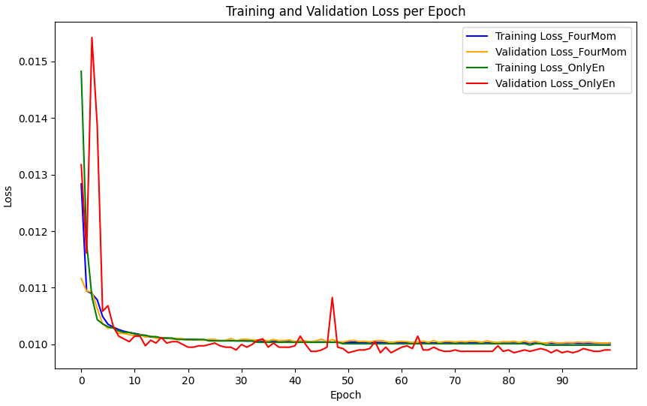
Training
$E_{ν}$ only
Selection:
$E_{ν}ϵ\left(0.1,1\right)GeV$
All processes
All $ν$ flavors
All topologies
Any number protons, pions, etc.
NO NEUTRONS
Loss variables: $\left(E_{ν},p_{x_{ν}},p_{y_{ν}},p_{z_{ν}}\right)$
Loss variables: $E_{ν}$ only MAE
Validation
$E_{ν}$ only
Training
$$\left(E_{ν},p_{x_{ν}},p_{y_{ν}},p_{z_{ν}}\right)$$
Validation
$$\left(E_{ν},p_{x_{ν}},p_{y_{ν}},p_{z_{ν}}\right)$$

Slide 18
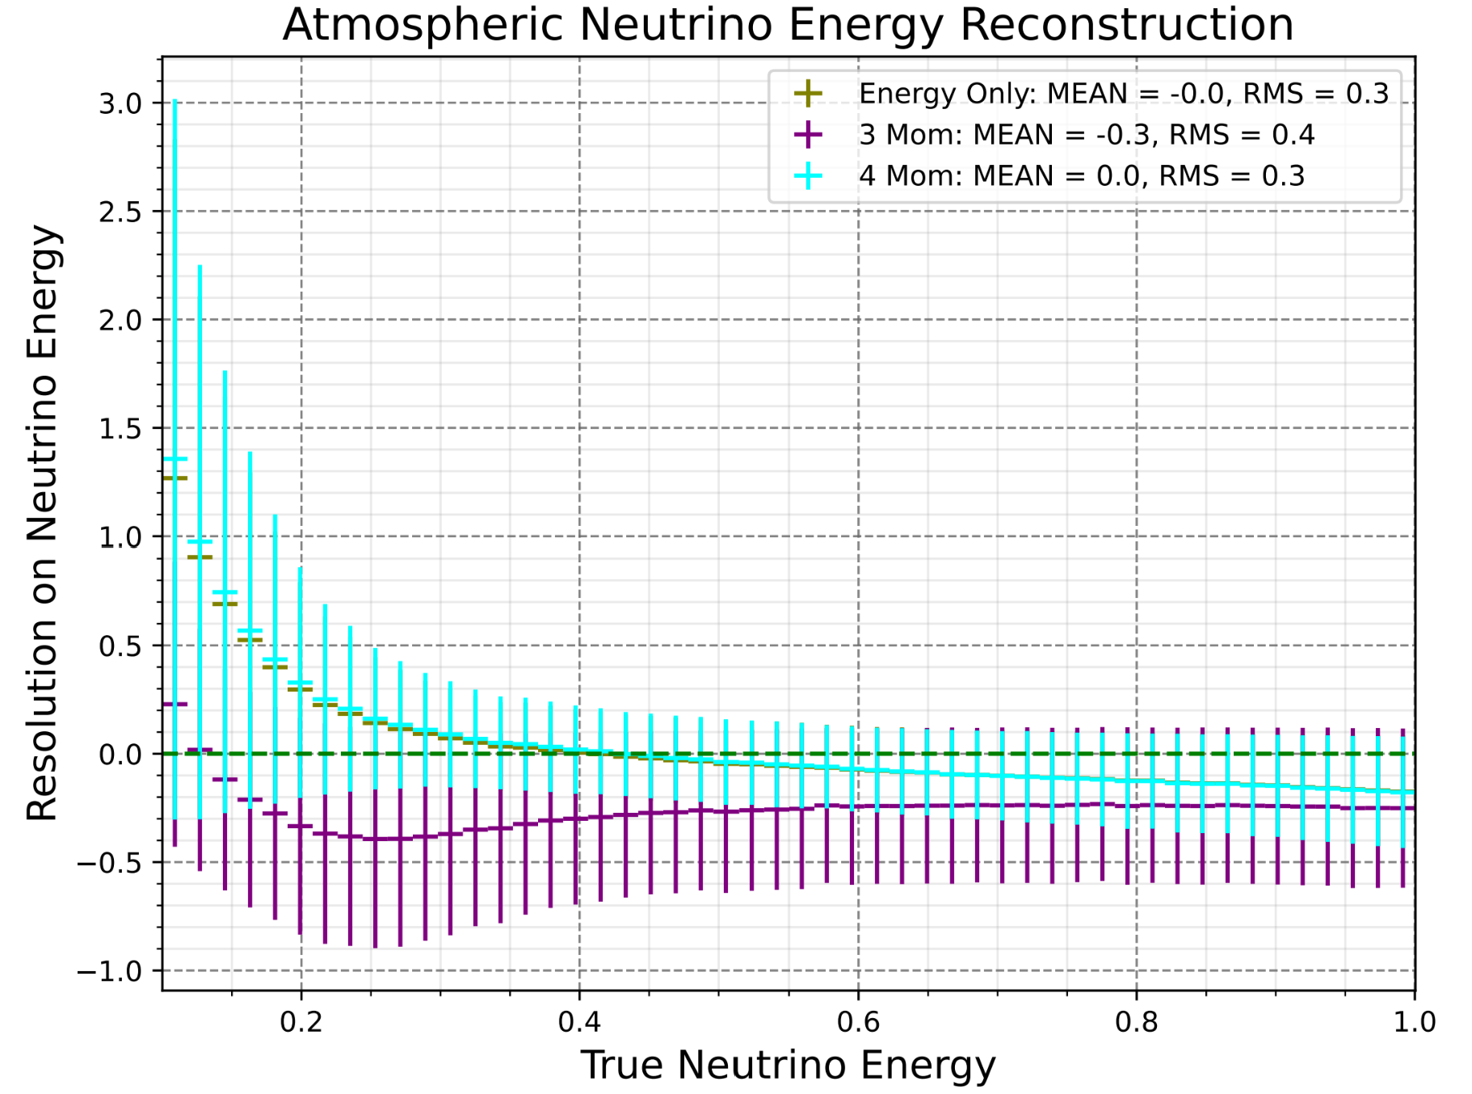
Changing loss variables leads to different resolutions
Selection:
$E_{ν}ϵ\left(0.1,1\right)GeV$
All processes
All $ν$ flavors
All topologies
Any number protons, pions, etc.
NO NEUTRONS
MAE

Slide 19
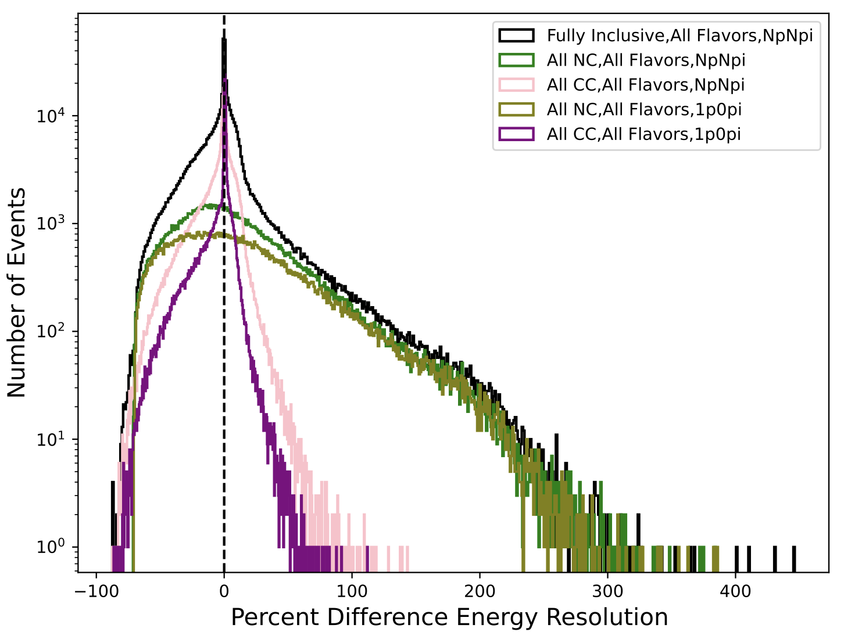
Selection:
$E_{ν}ϵ\left(0.1,1\right)GeV$
All $ν$ flavors
NO NEUTRONS
Loss variables: $\left(E_{ν},p_{x_{ν}},p_{y_{ν}},p_{z_{ν}}\right)$
MAE
Logscale $Y$

Slide 20
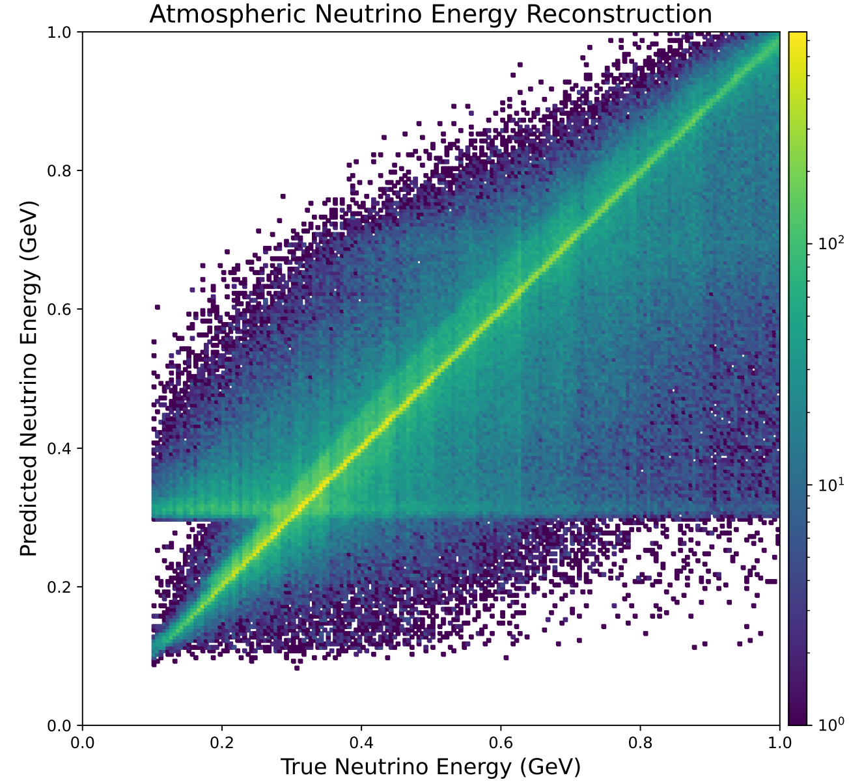
Selection:
$E_{ν}ϵ\left(0.1,1\right)GeV$
All processes
All $ν$ flavors
All topologies
Any number protons, pions, etc.
NO NEUTRONS
Loss variables:
$\left(E_{ν},p_{x_{ν}},p_{y_{ν}},p_{z_{ν}}\right)$ MAE
Fermi motion? $μ? μ+π$ Mass???
Logscale $Z$

Slide 21
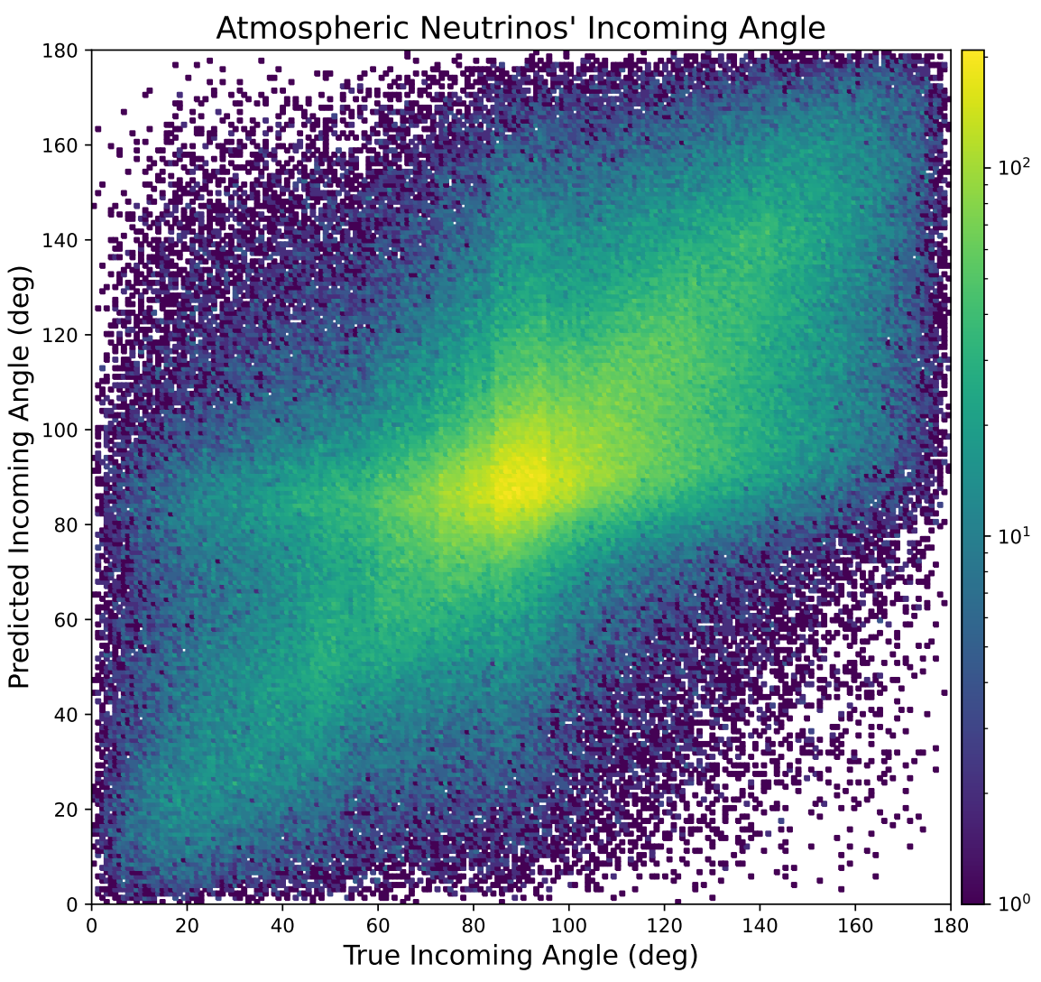
Selection:
$E_{ν}ϵ\left(0.1,1\right)GeV$
All processes
All $ν$ flavors
All topologies
Any number protons, pions, etc.
NO NEUTRONS
Loss variables: $\left(E_{ν},p_{x_{ν}},p_{y_{ν}},p_{z_{ν}}\right)$ MAE
Choice of training & target variables
under investigation
Logscale $Z$

Slide 22
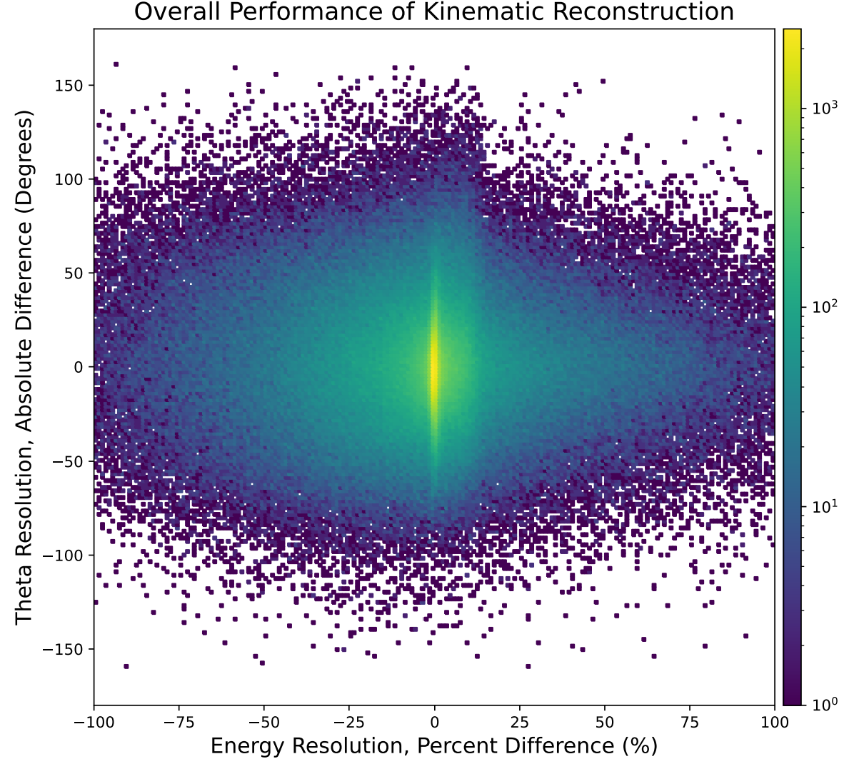
Selection:
$E_{ν}ϵ\left(0.1,1\right)GeV$
All processes
All $ν$ flavors
All topologies
Any number protons, pions, etc.
NO NEUTRONS
Loss variables: $\left(E_{ν},p_{x_{ν}},p_{y_{ν}},p_{z_{ν}}\right)$ MAE
Logscale $Z$

Slide 23
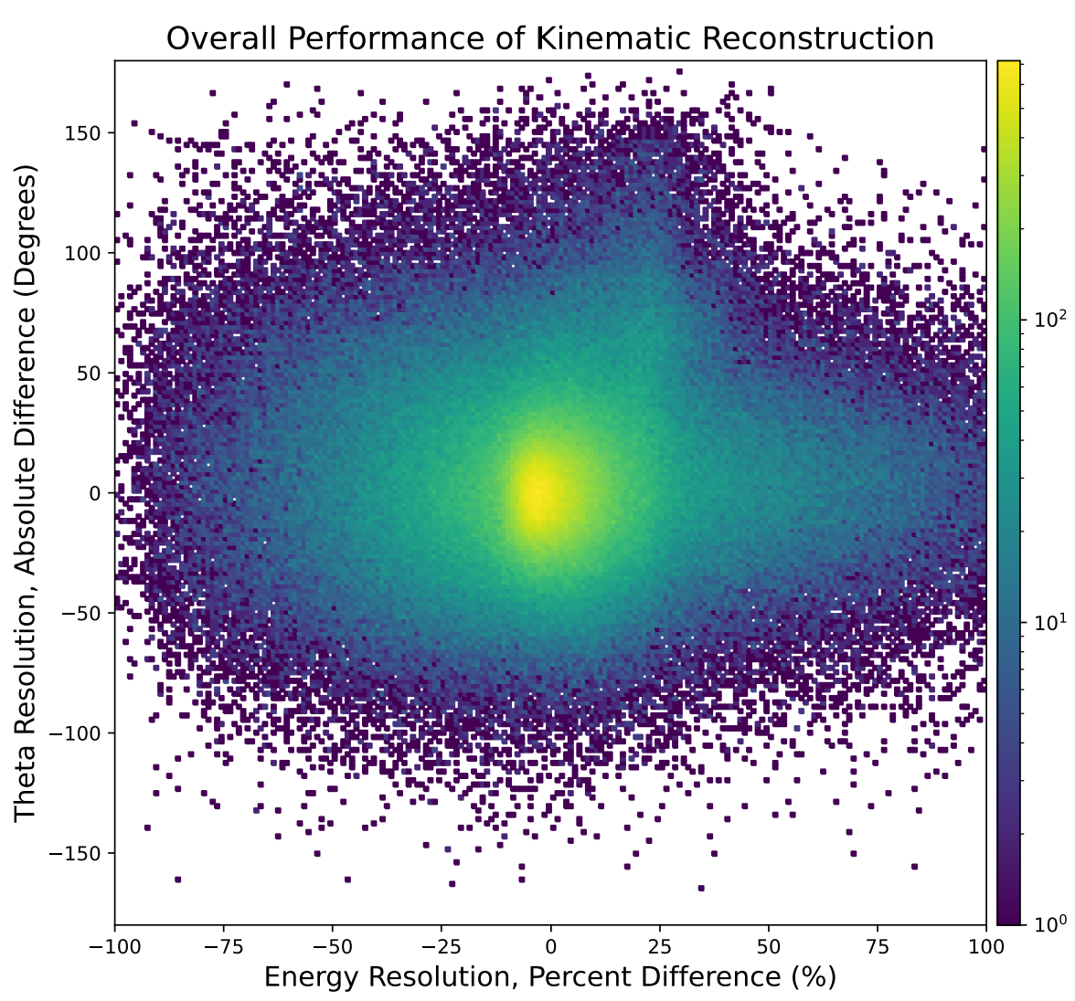
Selection:
$E_{ν}ϵ\left(0.1,1\right)GeV$
All processes
All $ν$ flavors
All topologies
Any number protons, pions, etc.
NO NEUTRONS
Loss variables: $\left(E_{ν},p_{x_{ν}},p_{y_{ν}},p_{z_{ν}}\right)$ **MSE**
Logscale $Z$

Slide 24
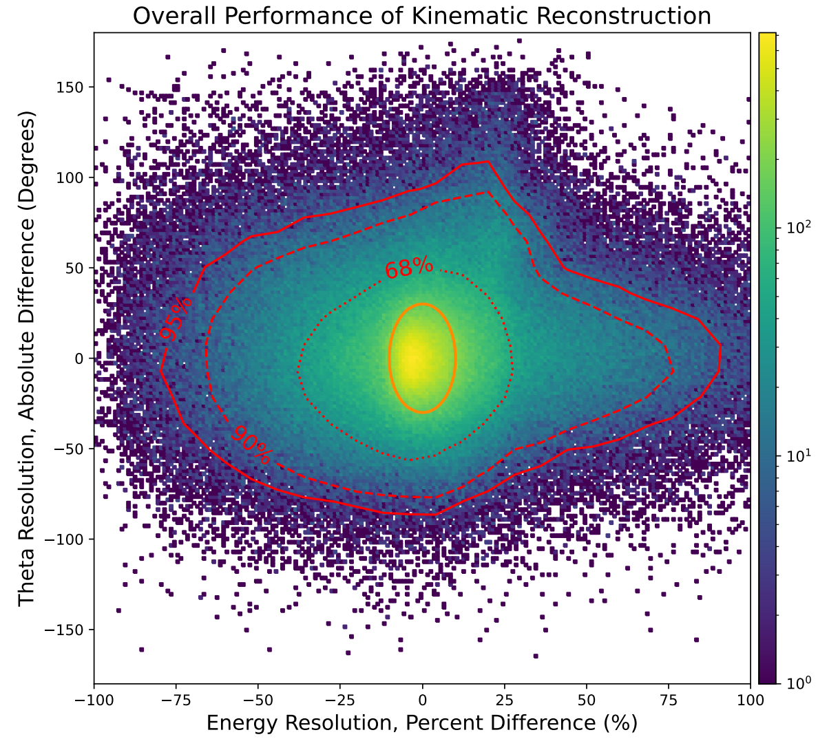
Selection:
$E_{ν}ϵ\left(0.1,1\right)GeV$
All processes
All $ν$ flavors
All topologies
Any number protons, pions, etc.
NO NEUTRONS
Loss variables: $\left(E_{ν},p_{x_{ν}},p_{y_{ν}},p_{z_{ν}}\right)$ **MSE**
Logscale $Z$

Slide 25
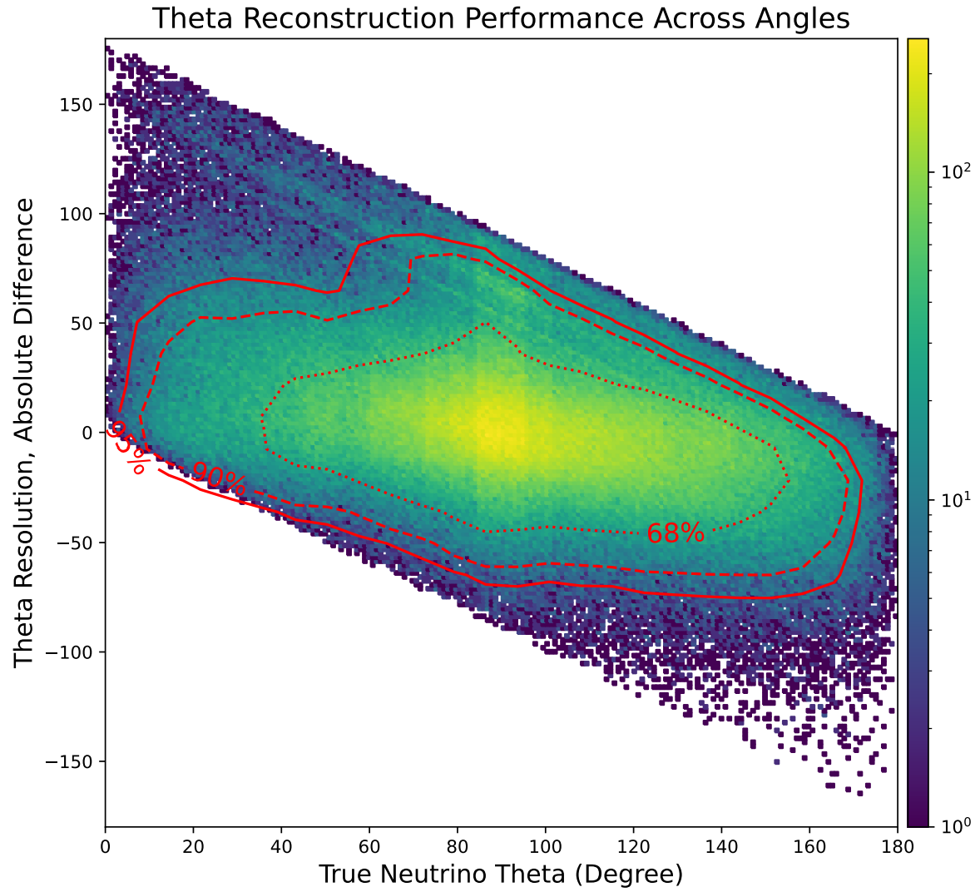
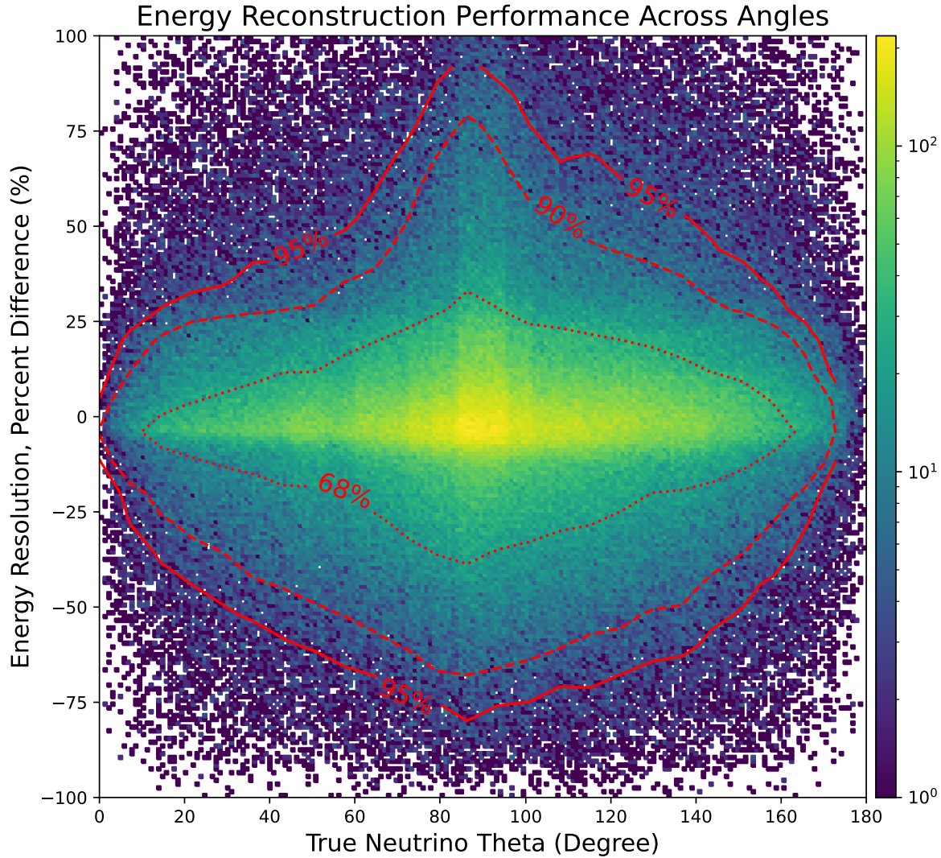
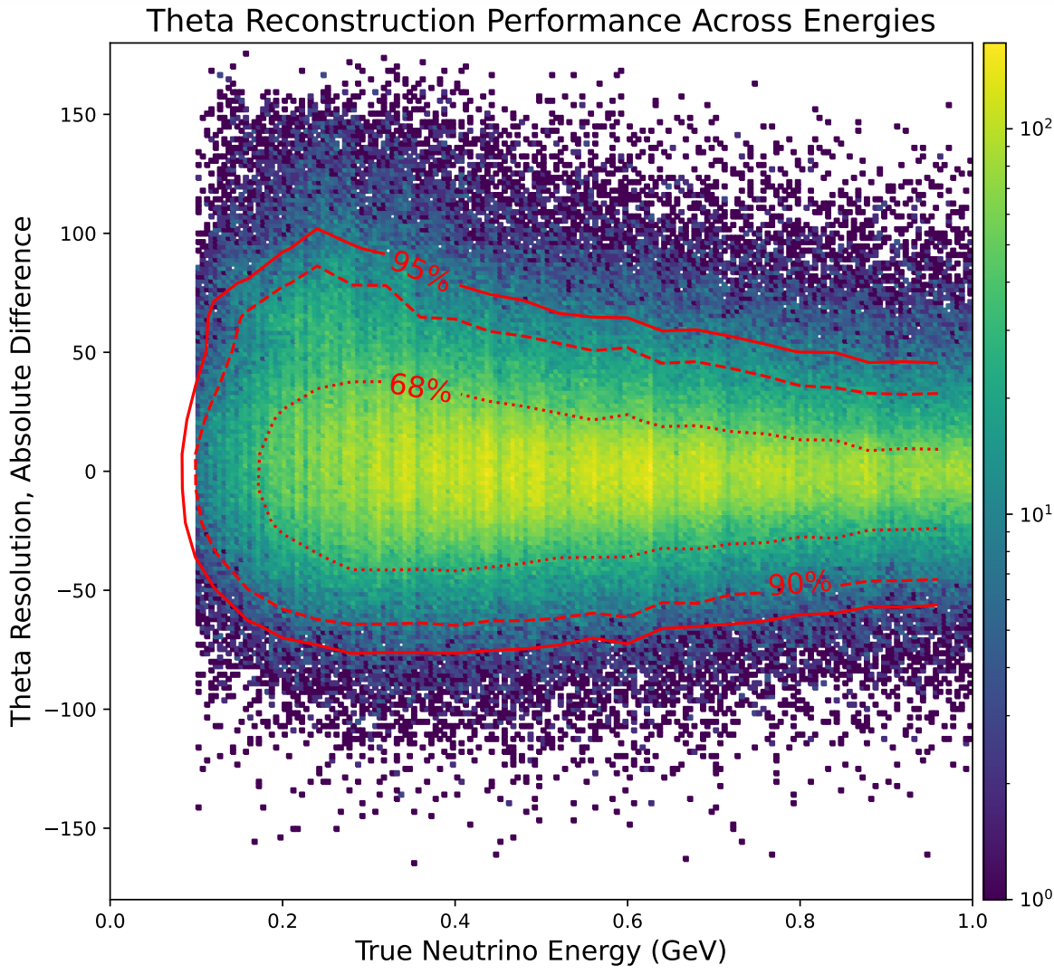
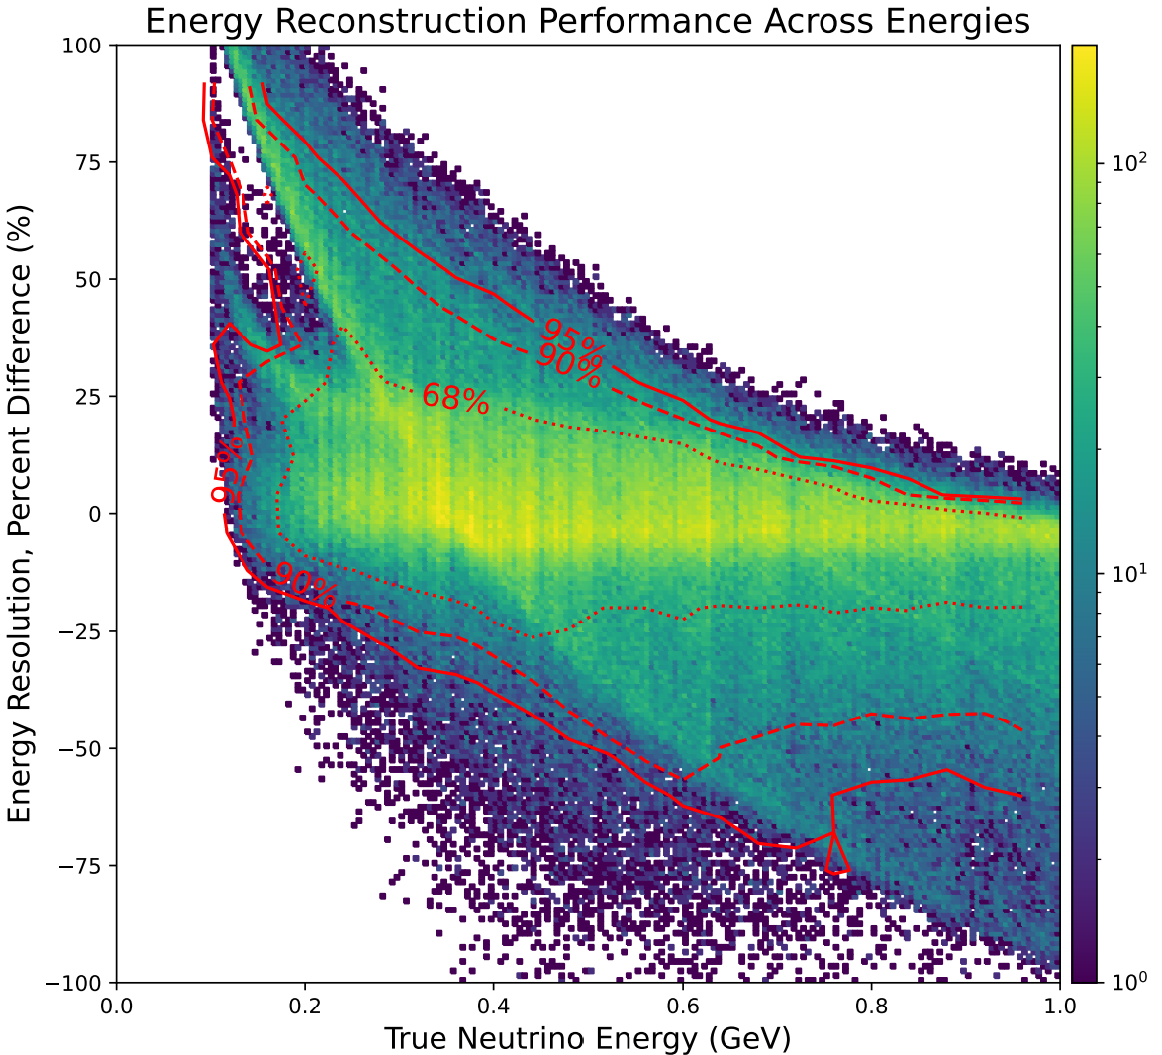
Selection:
$E_{ν}ϵ\left(0.1,1\right)GeV$
All processes
All $ν$ flavors
All topologies
Any number protons, pions, etc.
NO NEUTRONS
Loss variables: $\left(E_{ν},p_{x_{ν}},p_{y_{ν}},p_{z_{ν}}\right)$ **MSE**

Slide 26
Selection:
$E_{ν}ϵ\left(0.1,1\right)GeV$
All processes
All $ν$ flavors
All topologies
Any number protons, pions, etc.
NO NEUTRONS
Loss variables: $\left(E_{ν},p_{x_{ν}},p_{y_{ν}},p_{z_{ν}}\right)$ **MSE**
Logscale $Z$

Slide 27
Selection:
$E_{ν}ϵ\left(0.1,1\right)GeV$
All processes
All $ν$ flavors
All topologies
Any number protons, pions, etc.
NO NEUTRONS
Loss variables: $\left(E_{ν},p_{x_{ν}},p_{y_{ν}},p_{z_{ν}}\right)$ MAE
Logscale $Z$

Slide 28
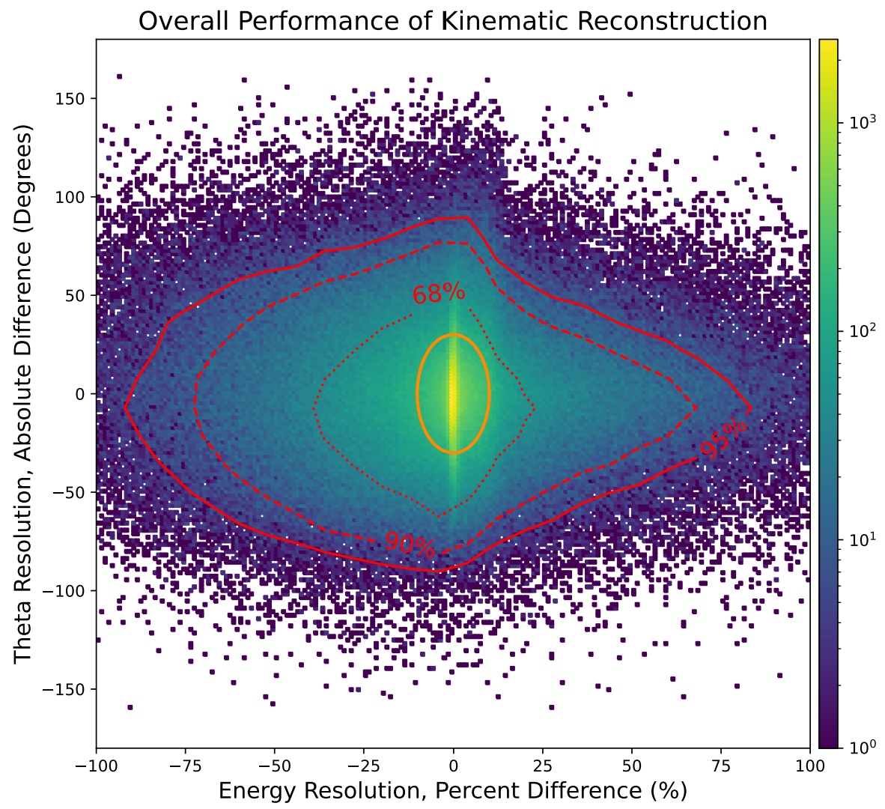
Selection:
$E_{ν}ϵ\left(0.1,1\right)GeV$
All processes
All $ν$ flavors
All topologies
Any number protons, pions, etc.
NO NEUTRONS
Loss variables: $\left(E_{ν},p_{x_{ν}},p_{y_{ν}},p_{z_{ν}}\right)$ MAE
Logscale $Z$

Slide 29
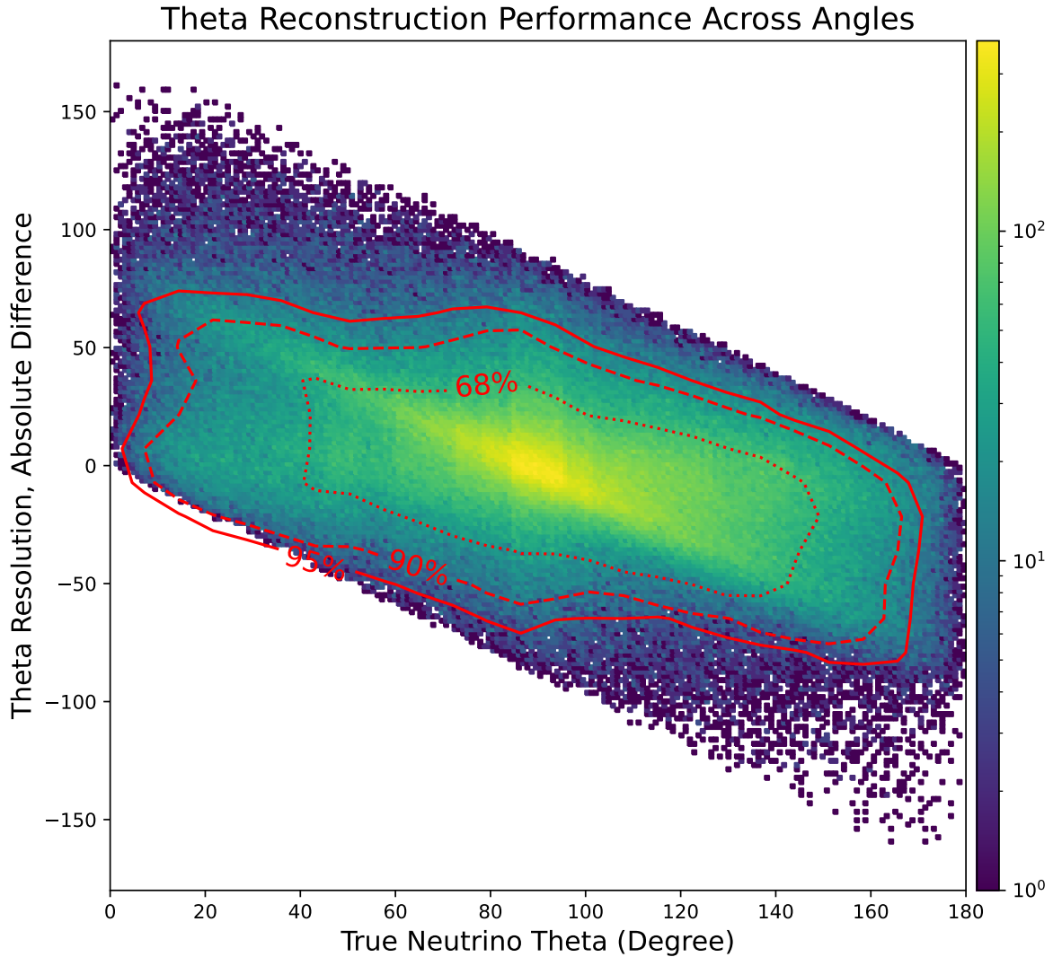
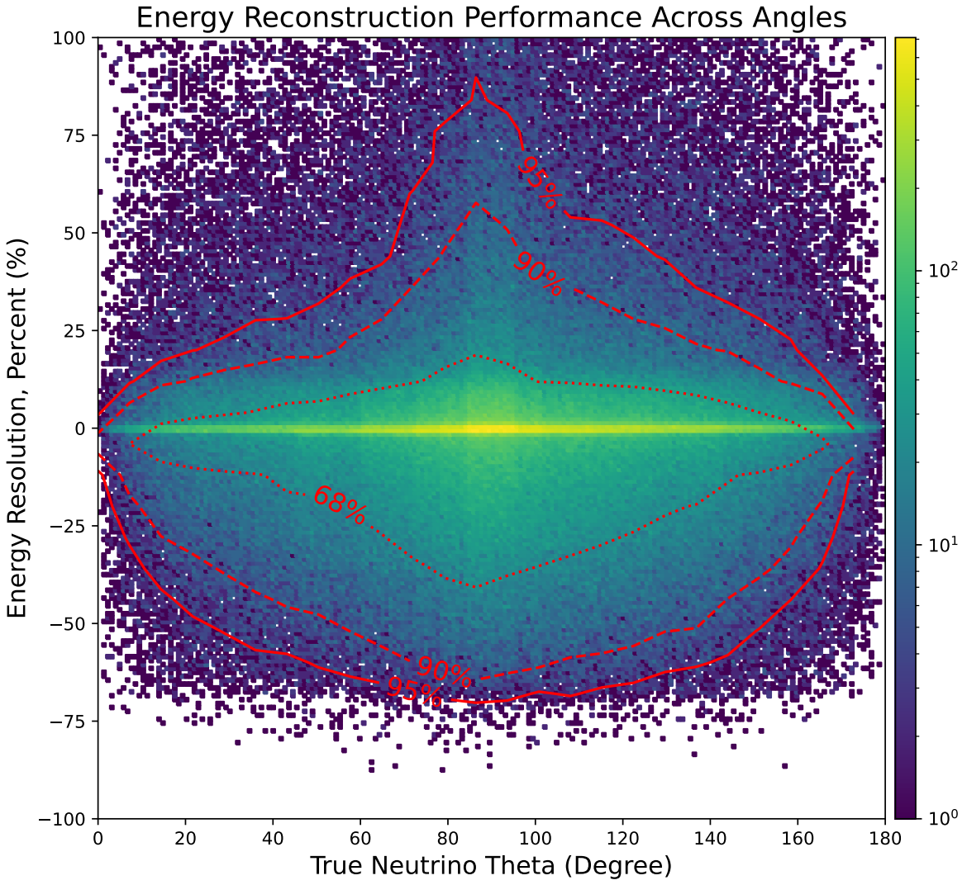
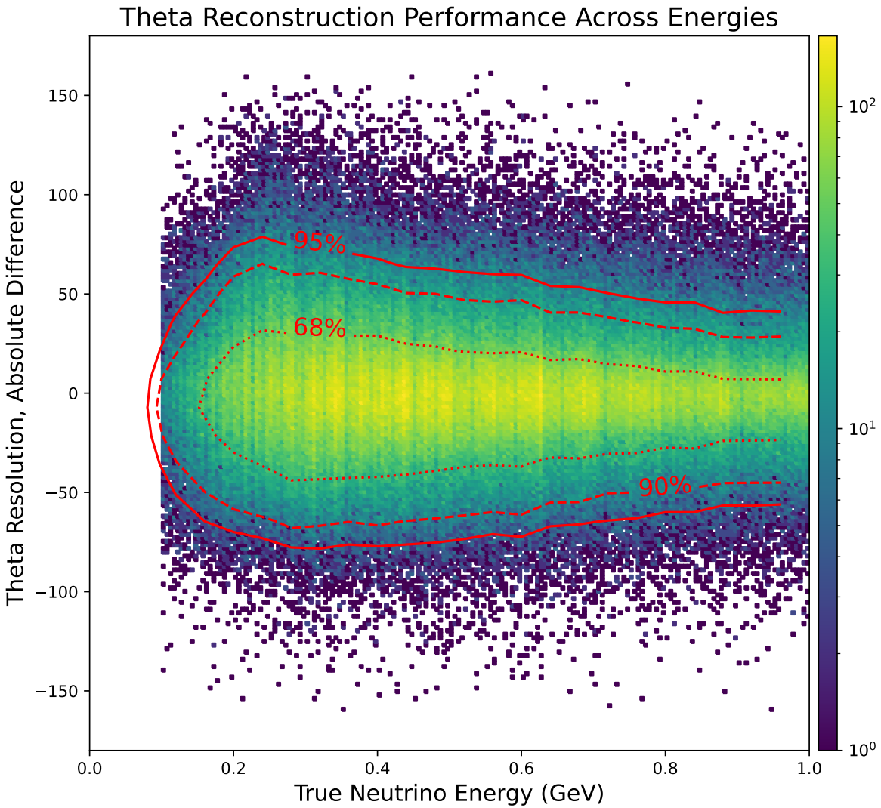
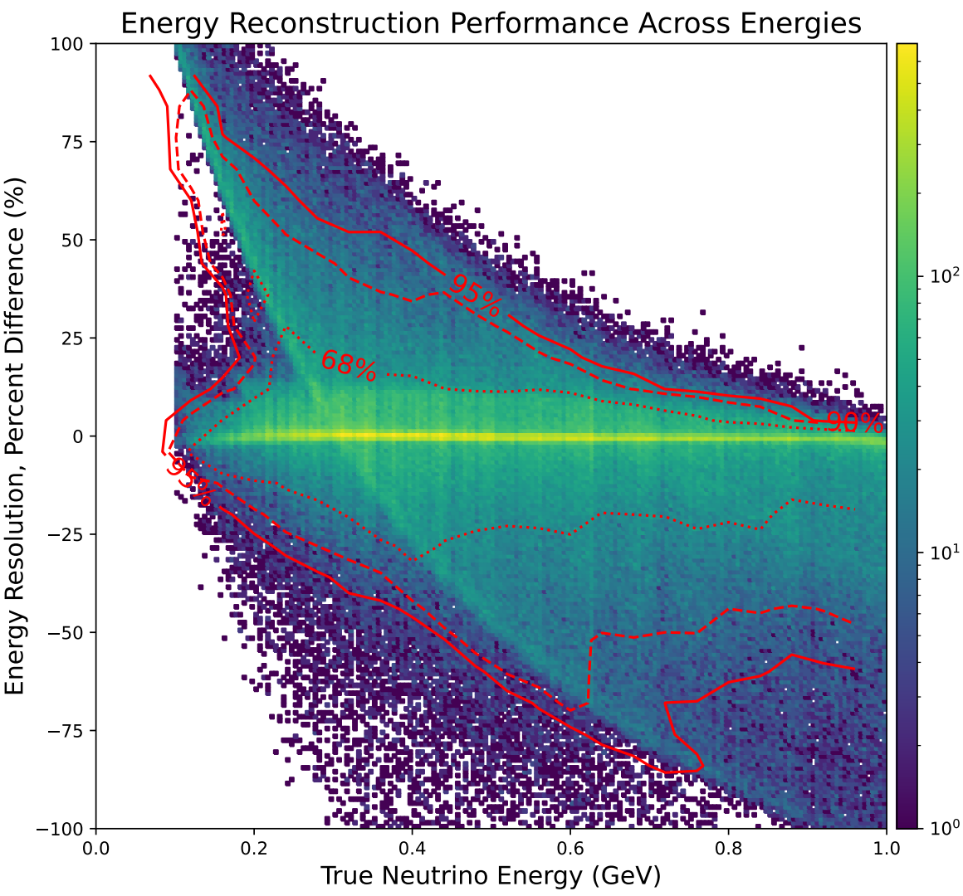
Selection:
$E_{ν}ϵ\left(0.1,1\right)GeV$
All processes
All $ν$ flavors
All topologies
Any number protons, pions, etc.
NO NEUTRONS
Loss variables: $\left(E_{ν},p_{x_{ν}},p_{y_{ν}},p_{z_{ν}}\right)$ MAE
Logscales $Z$

Slide 30
Selection:
$E_{ν}ϵ\left(0.1,1\right)GeV$
All processes
All $ν$ flavors
All topologies
Any number protons, pions, etc.
NO NEUTRONS
Loss variables: $\left(E_{ν},p_{x_{ν}},p_{y_{ν}},p_{z_{ν}}\right)$ **MSE**

Slide 31
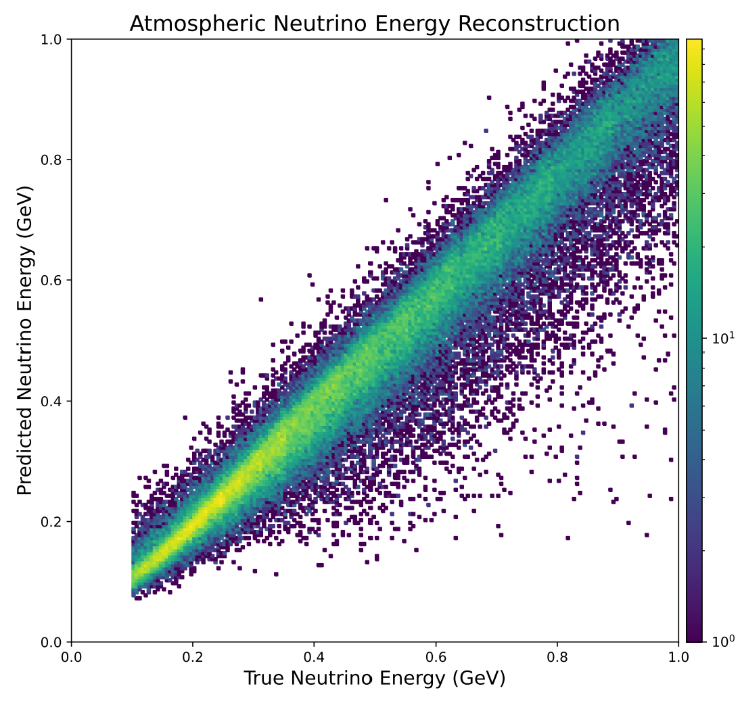
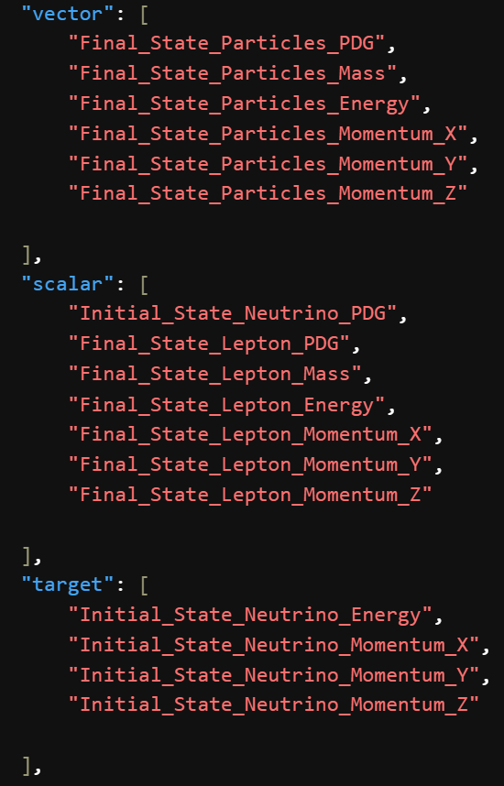
Selection:
TRAINING ON $E_{ν}ϵ\left(0.1,100\right)GeV$
SHOWING ONLY $E_{ν}ϵ\left(0.1,1\right)GeV$
**NO THRESHOLDS**
All processes
All $ν$ flavors
All topologies
Any number protons, pions, etc.
NO NEUTRONS
Loss variables: $\left(E_{ν},p_{x_{ν}},p_{y_{ν}},p_{z_{ν}}\right)$ **MAE**
*PREVIOUS TRAINING VARIABLES*
**CHEATS ON NC EVENTS!!**
Logscale $Z$
Only showing ~100k events here!

Slide 32
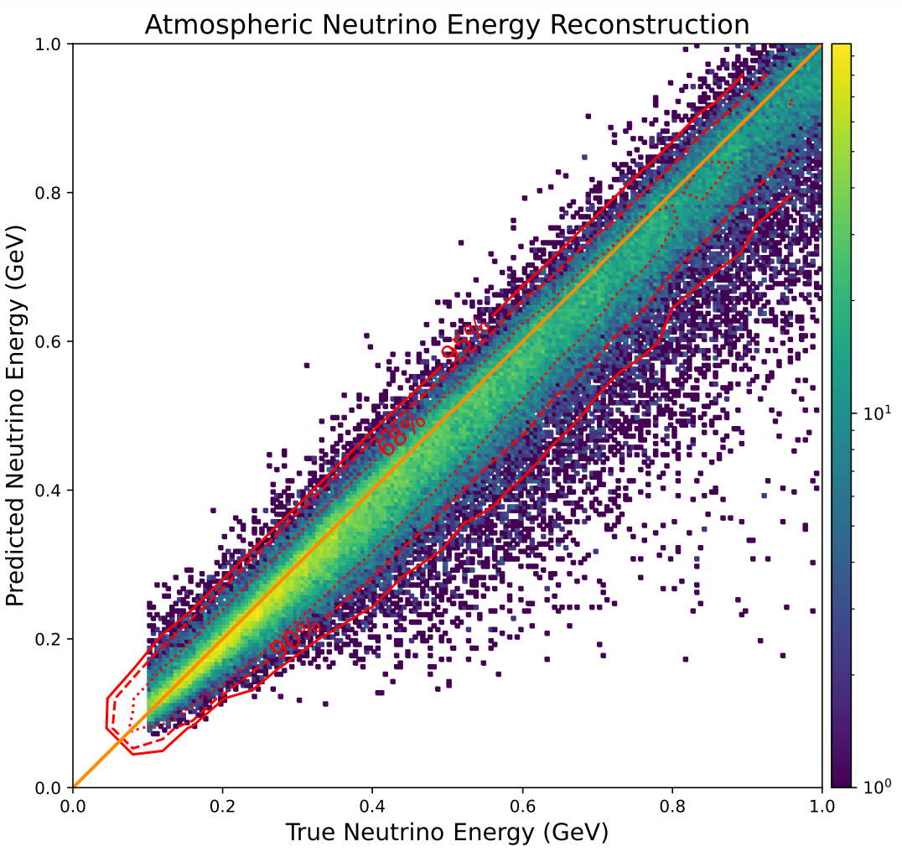
Selection:
TRAINING ON $E_{ν}ϵ\left(0.1,100\right)GeV$
SHOWING ONLY $E_{ν}ϵ\left(0.1,1\right)GeV$
**NO THRESHOLDS**
All processes
All $ν$ flavors
All topologies
Any number protons, pions, etc.
NO NEUTRONS
Loss variables: $\left(E_{ν},p_{x_{ν}},p_{y_{ν}},p_{z_{ν}}\right)$ **MAE**
*PREVIOUS TRAINING VARIABLES*
**CHEATS ON NC EVENTS!!**
Logscale $Z$
Only showing ~100k events here!

Slide 33
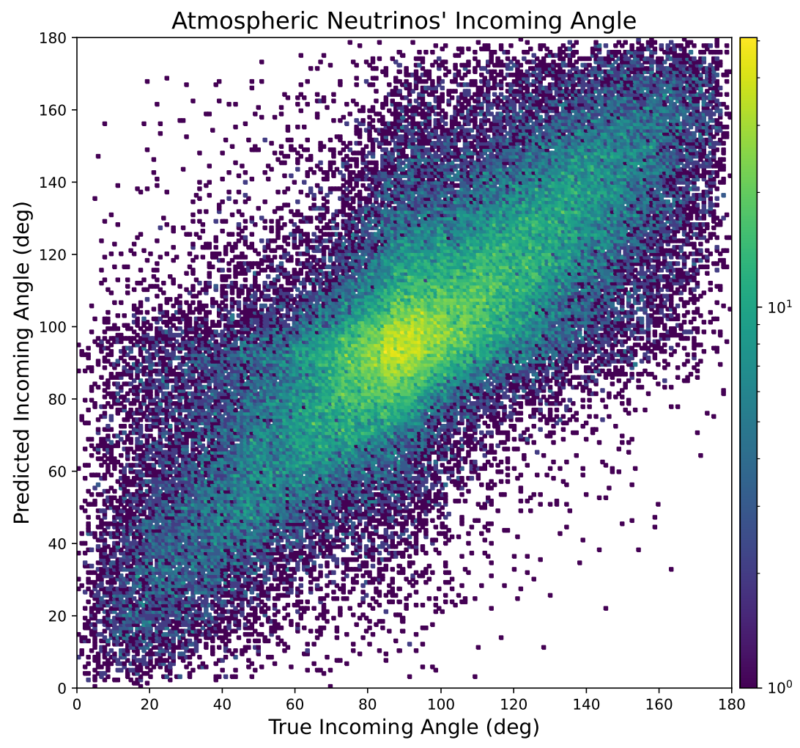
Selection:
TRAINING ON $E_{ν}ϵ\left(0.1,100\right)GeV$
SHOWING ONLY $E_{ν}ϵ\left(0.1,1\right)GeV$
**NO THRESHOLDS**
All processes
All $ν$ flavors
All topologies
Any number protons, pions, etc.
NO NEUTRONS
Loss variables: $\left(E_{ν},p_{x_{ν}},p_{y_{ν}},p_{z_{ν}}\right)$ **MAE**
*PREVIOUS TRAINING VARIABLES*
**CHEATS ON NC EVENTS!!**
Logscale $Z$
Only showing ~100k events here!

Slide 34
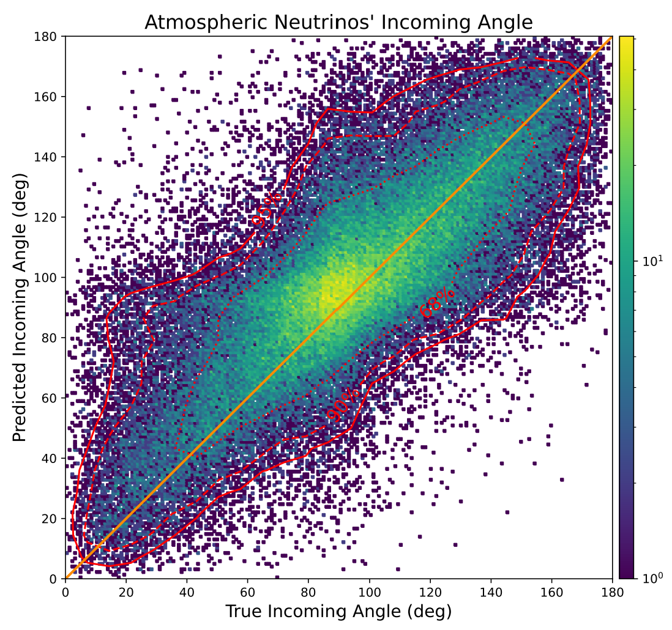
Selection:
TRAINING ON $E_{ν}ϵ\left(0.1,100\right)GeV$
SHOWING ONLY $E_{ν}ϵ\left(0.1,1\right)GeV$
**NO THRESHOLDS**
All processes
All $ν$ flavors
All topologies
Any number protons, pions, etc.
NO NEUTRONS
Loss variables: $\left(E_{ν},p_{x_{ν}},p_{y_{ν}},p_{z_{ν}}\right)$ **MAE**
*PREVIOUS TRAINING VARIABLES*
**CHEATS ON NC EVENTS!!**
Logscale $Z$
Only showing ~100k events here!

Slide 35
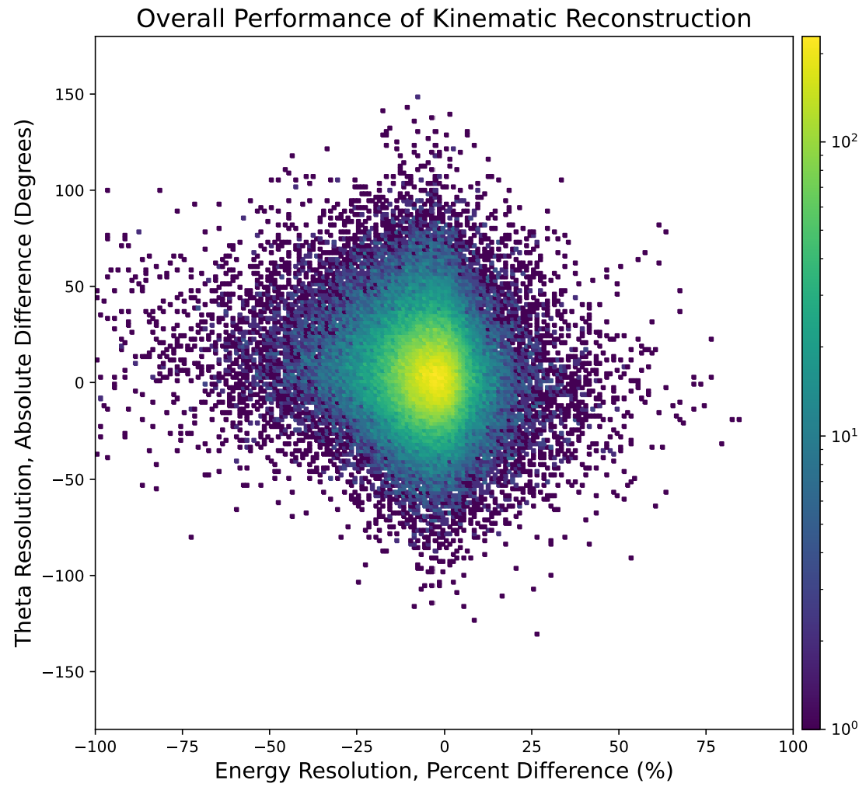
Selection:
TRAINING ON $E_{ν}ϵ\left(0.1,100\right)GeV$
SHOWING ONLY $E_{ν}ϵ\left(0.1,1\right)GeV$
**NO THRESHOLDS**
All processes
All $ν$ flavors
All topologies
Any number protons, pions, etc.
NO NEUTRONS
Loss variables: $\left(E_{ν},p_{x_{ν}},p_{y_{ν}},p_{z_{ν}}\right)$ **MAE**
*PREVIOUS TRAINING VARIABLES*
**CHEATS ON NC EVENTS!!**
Logscale $Z$
Only showing ~100k events here!

Slide 36
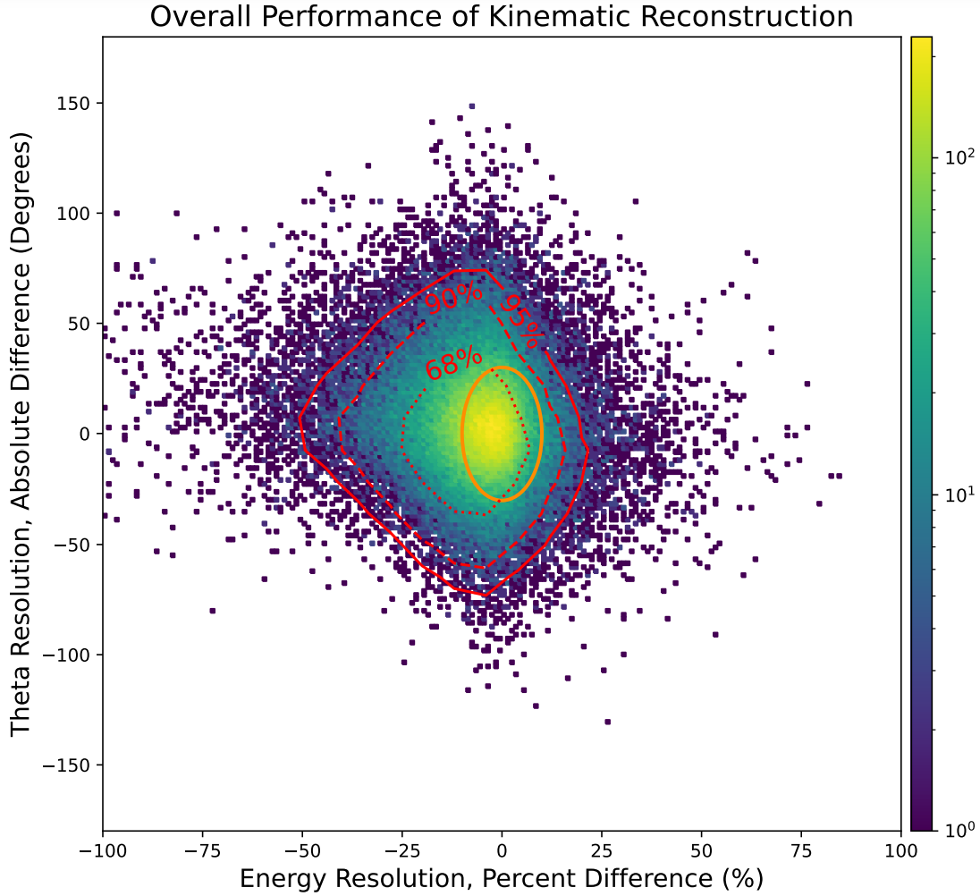
Selection:
TRAINING ON $E_{ν}ϵ\left(0.1,100\right)GeV$
SHOWING ONLY $E_{ν}ϵ\left(0.1,1\right)GeV$
**NO THRESHOLDS**
All processes
All $ν$ flavors
All topologies
Any number protons, pions, etc.
NO NEUTRONS
Loss variables: $\left(E_{ν},p_{x_{ν}},p_{y_{ν}},p_{z_{ν}}\right)$ **MAE**
*PREVIOUS TRAINING VARIABLES*
**CHEATS ON NC EVENTS!!**
Logscale $Z$
Only showing ~100k events here!

Slide 37
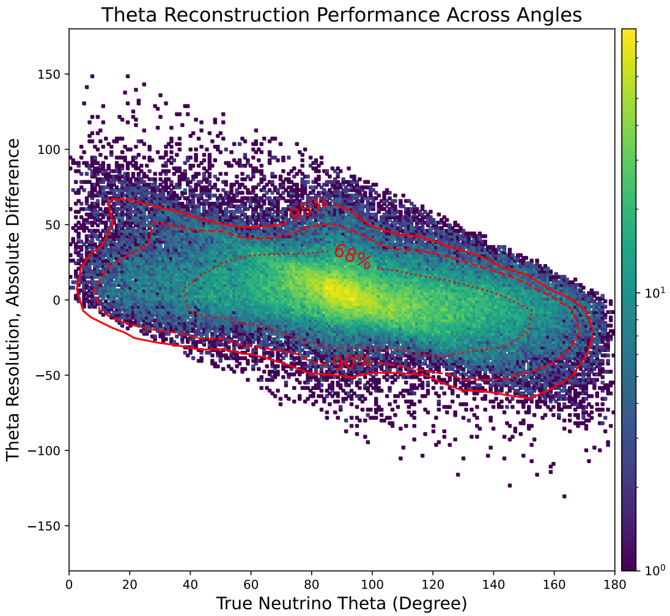
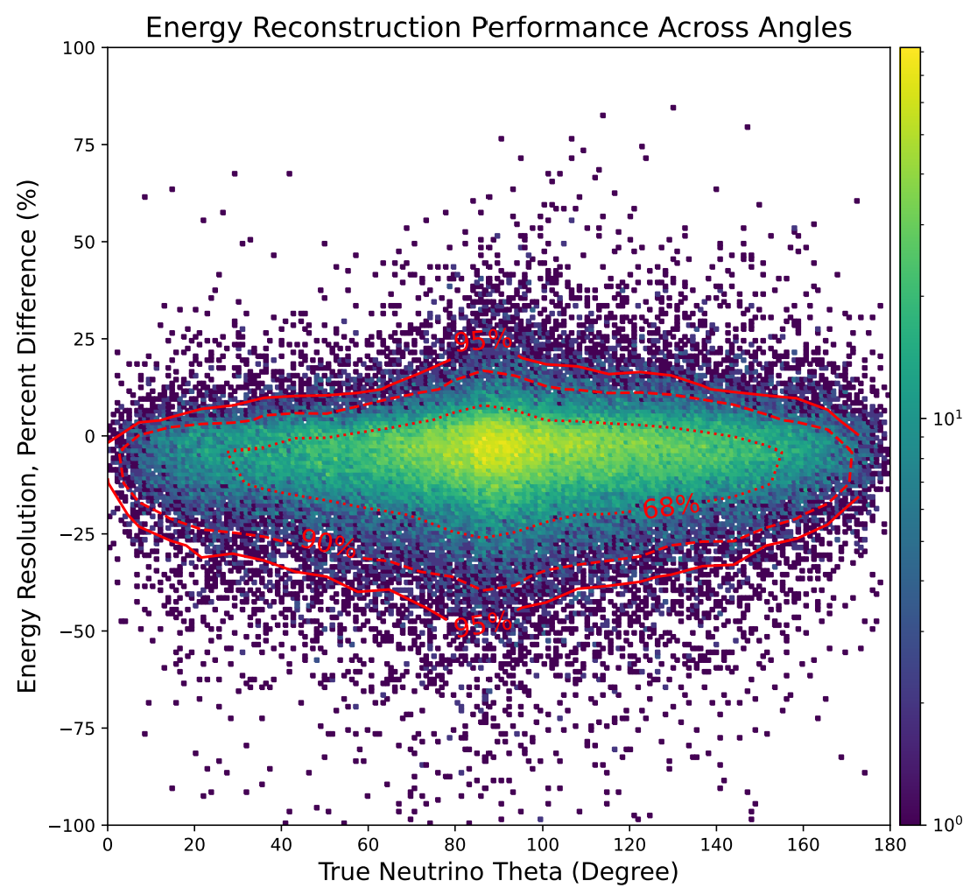
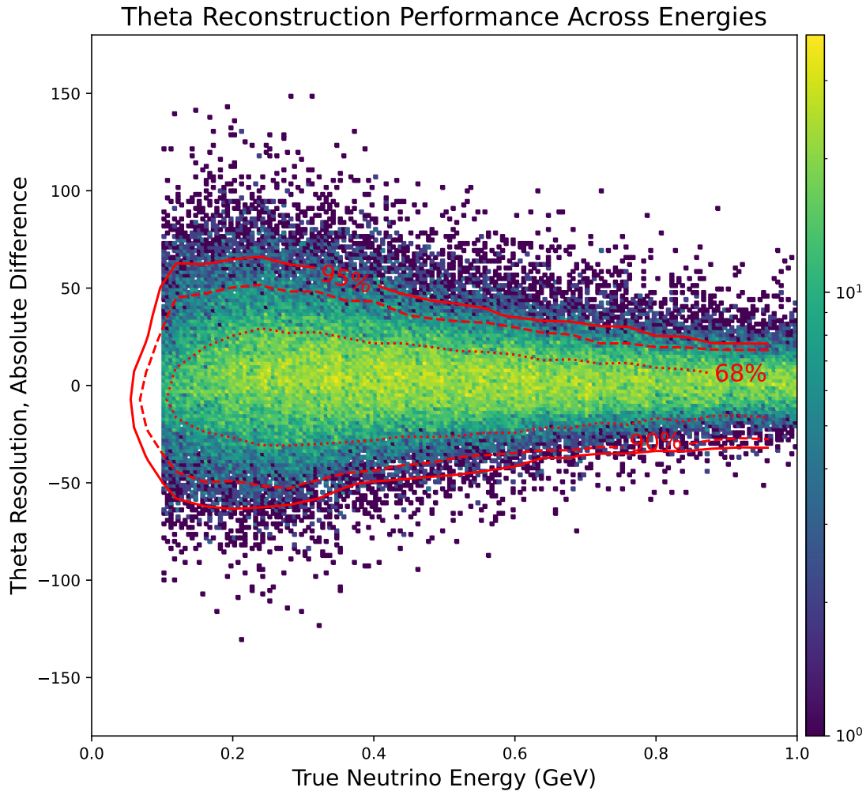
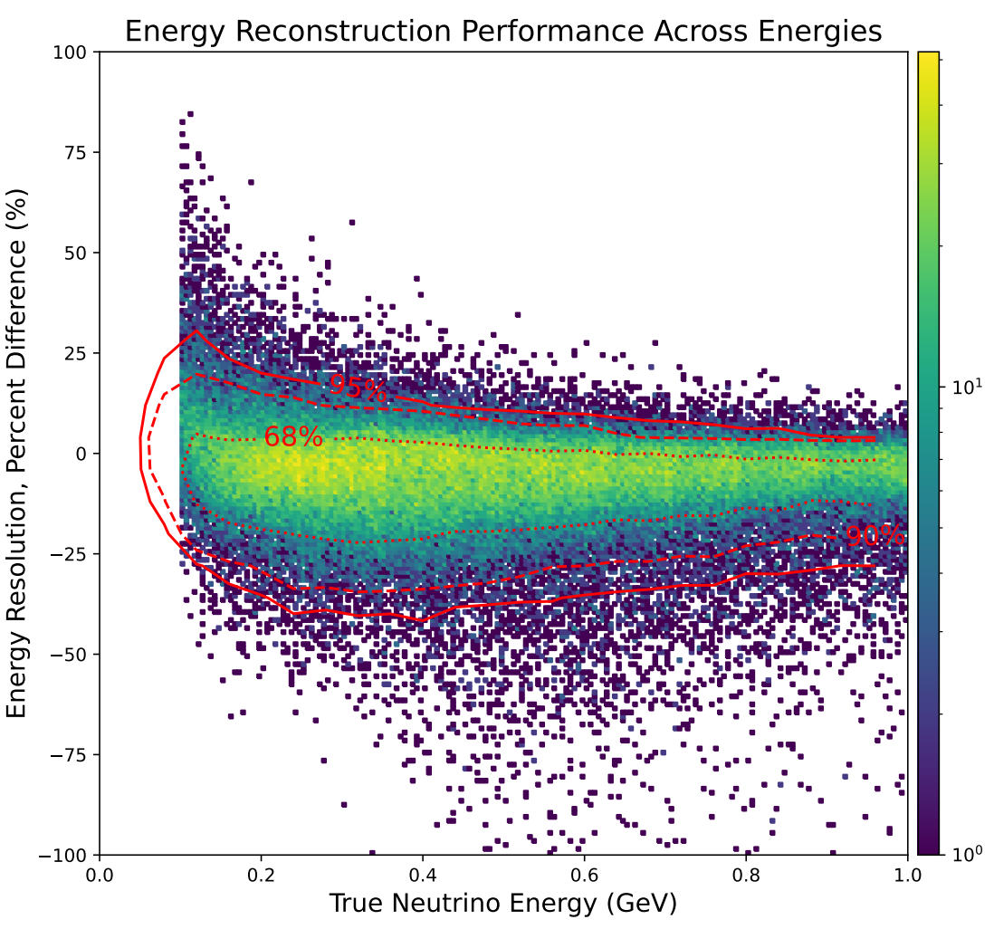
Only showing ~100k events here!
Selection:
TRAINING ON $E_{ν}ϵ\left(0.1,100\right)GeV$
SHOWING ONLY $E_{ν}ϵ\left(0.1,1\right)GeV$
**NO THRESHOLDS**
All processes
All $ν$ flavors
All topologies
Any number protons, pions, etc.
NO NEUTRONS
Loss variables: $\left(E_{ν},p_{x_{ν}},p_{y_{ν}},p_{z_{ν}}\right)$ **MAE**
*PREVIOUS TRAINING VARIABLES*
**CHEATS ON NC EVENTS!!**
Logscales $Z$

Slide 38
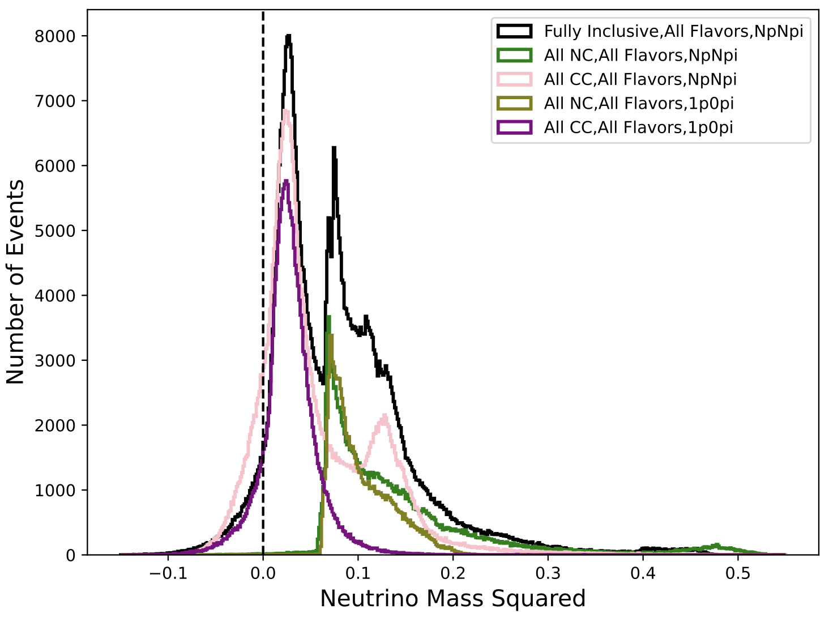
CC processes reconstruct lower masses
Selection:
$E_{ν}ϵ\left(0.1,1\right)GeV$
All $ν$ flavors
NO NEUTRONS
Loss variables: $\left(E_{ν},p_{x_{ν}},p_{y_{ν}},p_{z_{ν}}\right)$
MAE

Slide 39
NC processes reconstruct higher masses
Selection:
$E_{ν}ϵ\left(0.1,1\right)GeV$
All $ν$ flavors
NO NEUTRONS
Loss variables: $\left(E_{ν},p_{x_{ν}},p_{y_{ν}},p_{z_{ν}}\right)$
MAE

Slide 40
Selection:
$E_{ν}ϵ\left(0.1,1\right)GeV$
All $ν$ flavors
NO NEUTRONS
Loss variables: $\left(E_{ν},p_{x_{ν}},p_{y_{ν}},p_{z_{ν}}\right)$
MAE
New physical process turning on? $2p$? $1p1π$?

Slide 41
Summary & Discussion
Initial forays: GENIE-only simultaneous energy/angle prediction promising
Need to study more effects of…
Topological selection, CC & NC processes, nuclear model configuration, training sizes, loss function styles, target/predicted variables, etc…
New GENIE samples ready to go, will be running over many of them…
Will be considering flattening fluxes
Atmospherics have very hard spectral shape—want to make tool broadly useful
Plan:
Test including lepton scalar features once again, for training on at least CC-only
Consider different loss functions and loss variable combinations…
Angle directly, $P_{miss}$, baseline directly, others…we have completed many of these already!
LSTM style with $ν$ and $ℓ$ playing a role in loss, combinations thereof—$p_{ν}^{μ}$ & $p_{ℓ}^{μ}⟹Q^{2}$?
Loss function of $p_{ν}^{μ}$ directly—minimize to make $ν$ mass as small as possible!
Consider different loss function coefficients—may help improve angular resolution?
Come out with GENIE-only “concept” paper: LE, ME, HE atmospherics and beam
Target two reconstruction papers in DUNE and NOvA separately
DUNE: atmospherics in FD, beam in ND?—new atmospheric productions ready for this
NOvA: beam events in ND—target improved cross section measurements

Slide 42
Thank-you for your attention!
Questions? Comments?

Slide 43
Backups

Slide 44
Data Frames Loaded via .csv Files
Polars replacing Pandas for data handling possible
Development branch: wswxyq/transformer_EE at polars
Smarter than Pandas, more memory efficient for CSV loading
S. Wu

Slide 45
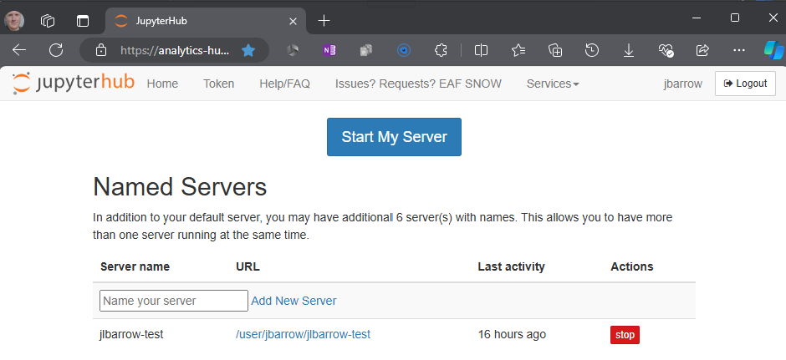
FNAL Elastic Analysis Facility
EAF Documentation

Slide 46
FNAL Elastic Analysis Facility
EAF Documentation

Slide 47
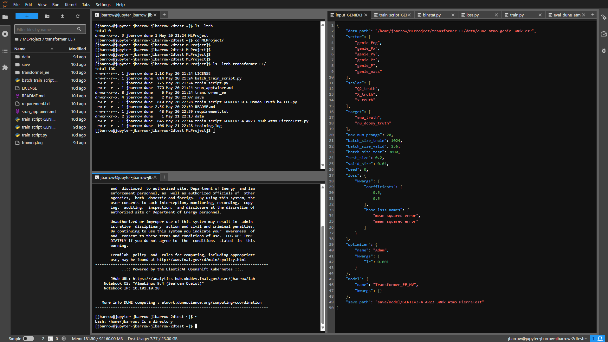
FNAL Elastic Analysis Facility
EAF Documentation

Slide 48
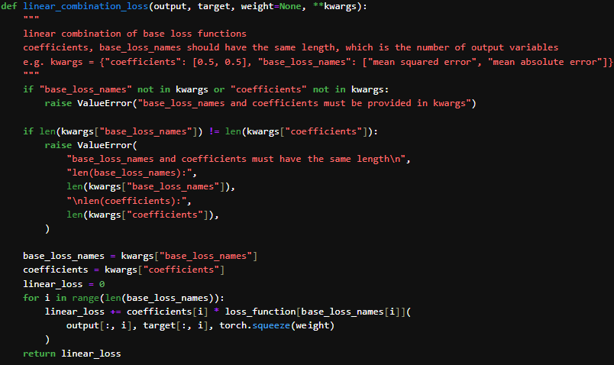
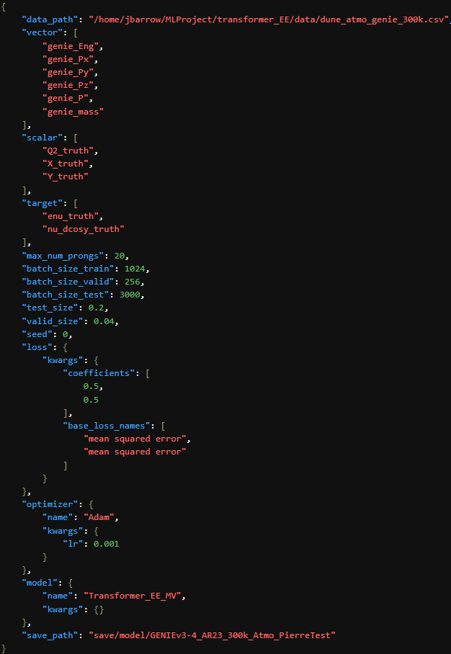
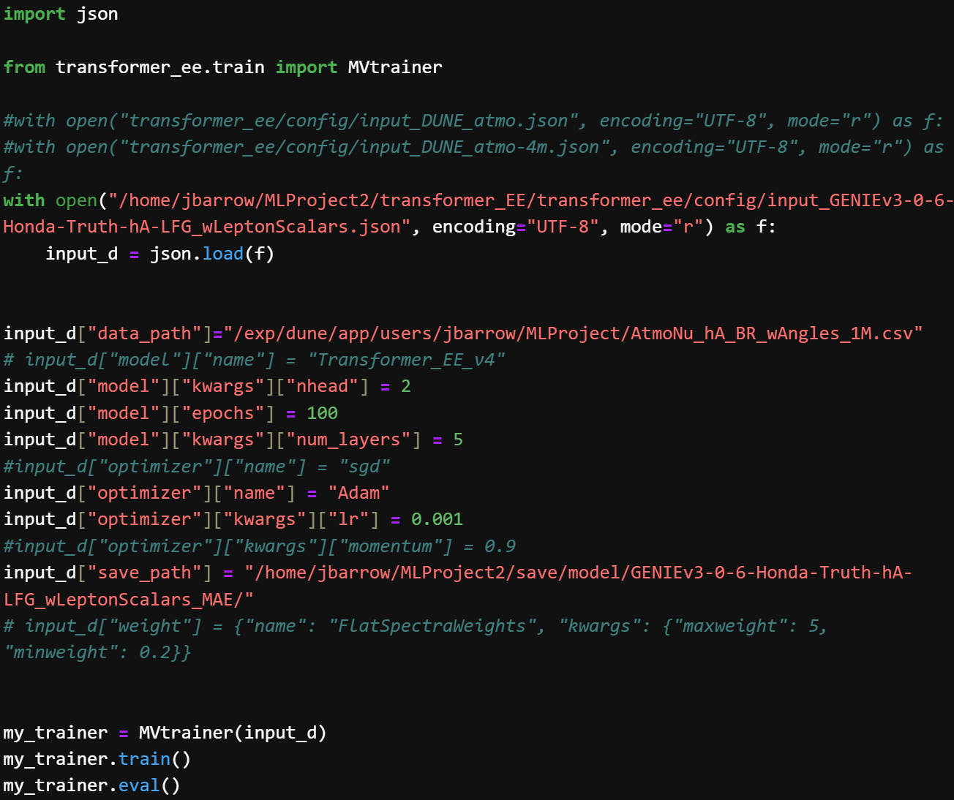
Input .json file Configures training variables
Configures target variables
Used in composite loss
Configures individual loss functions per variable

Slide 49
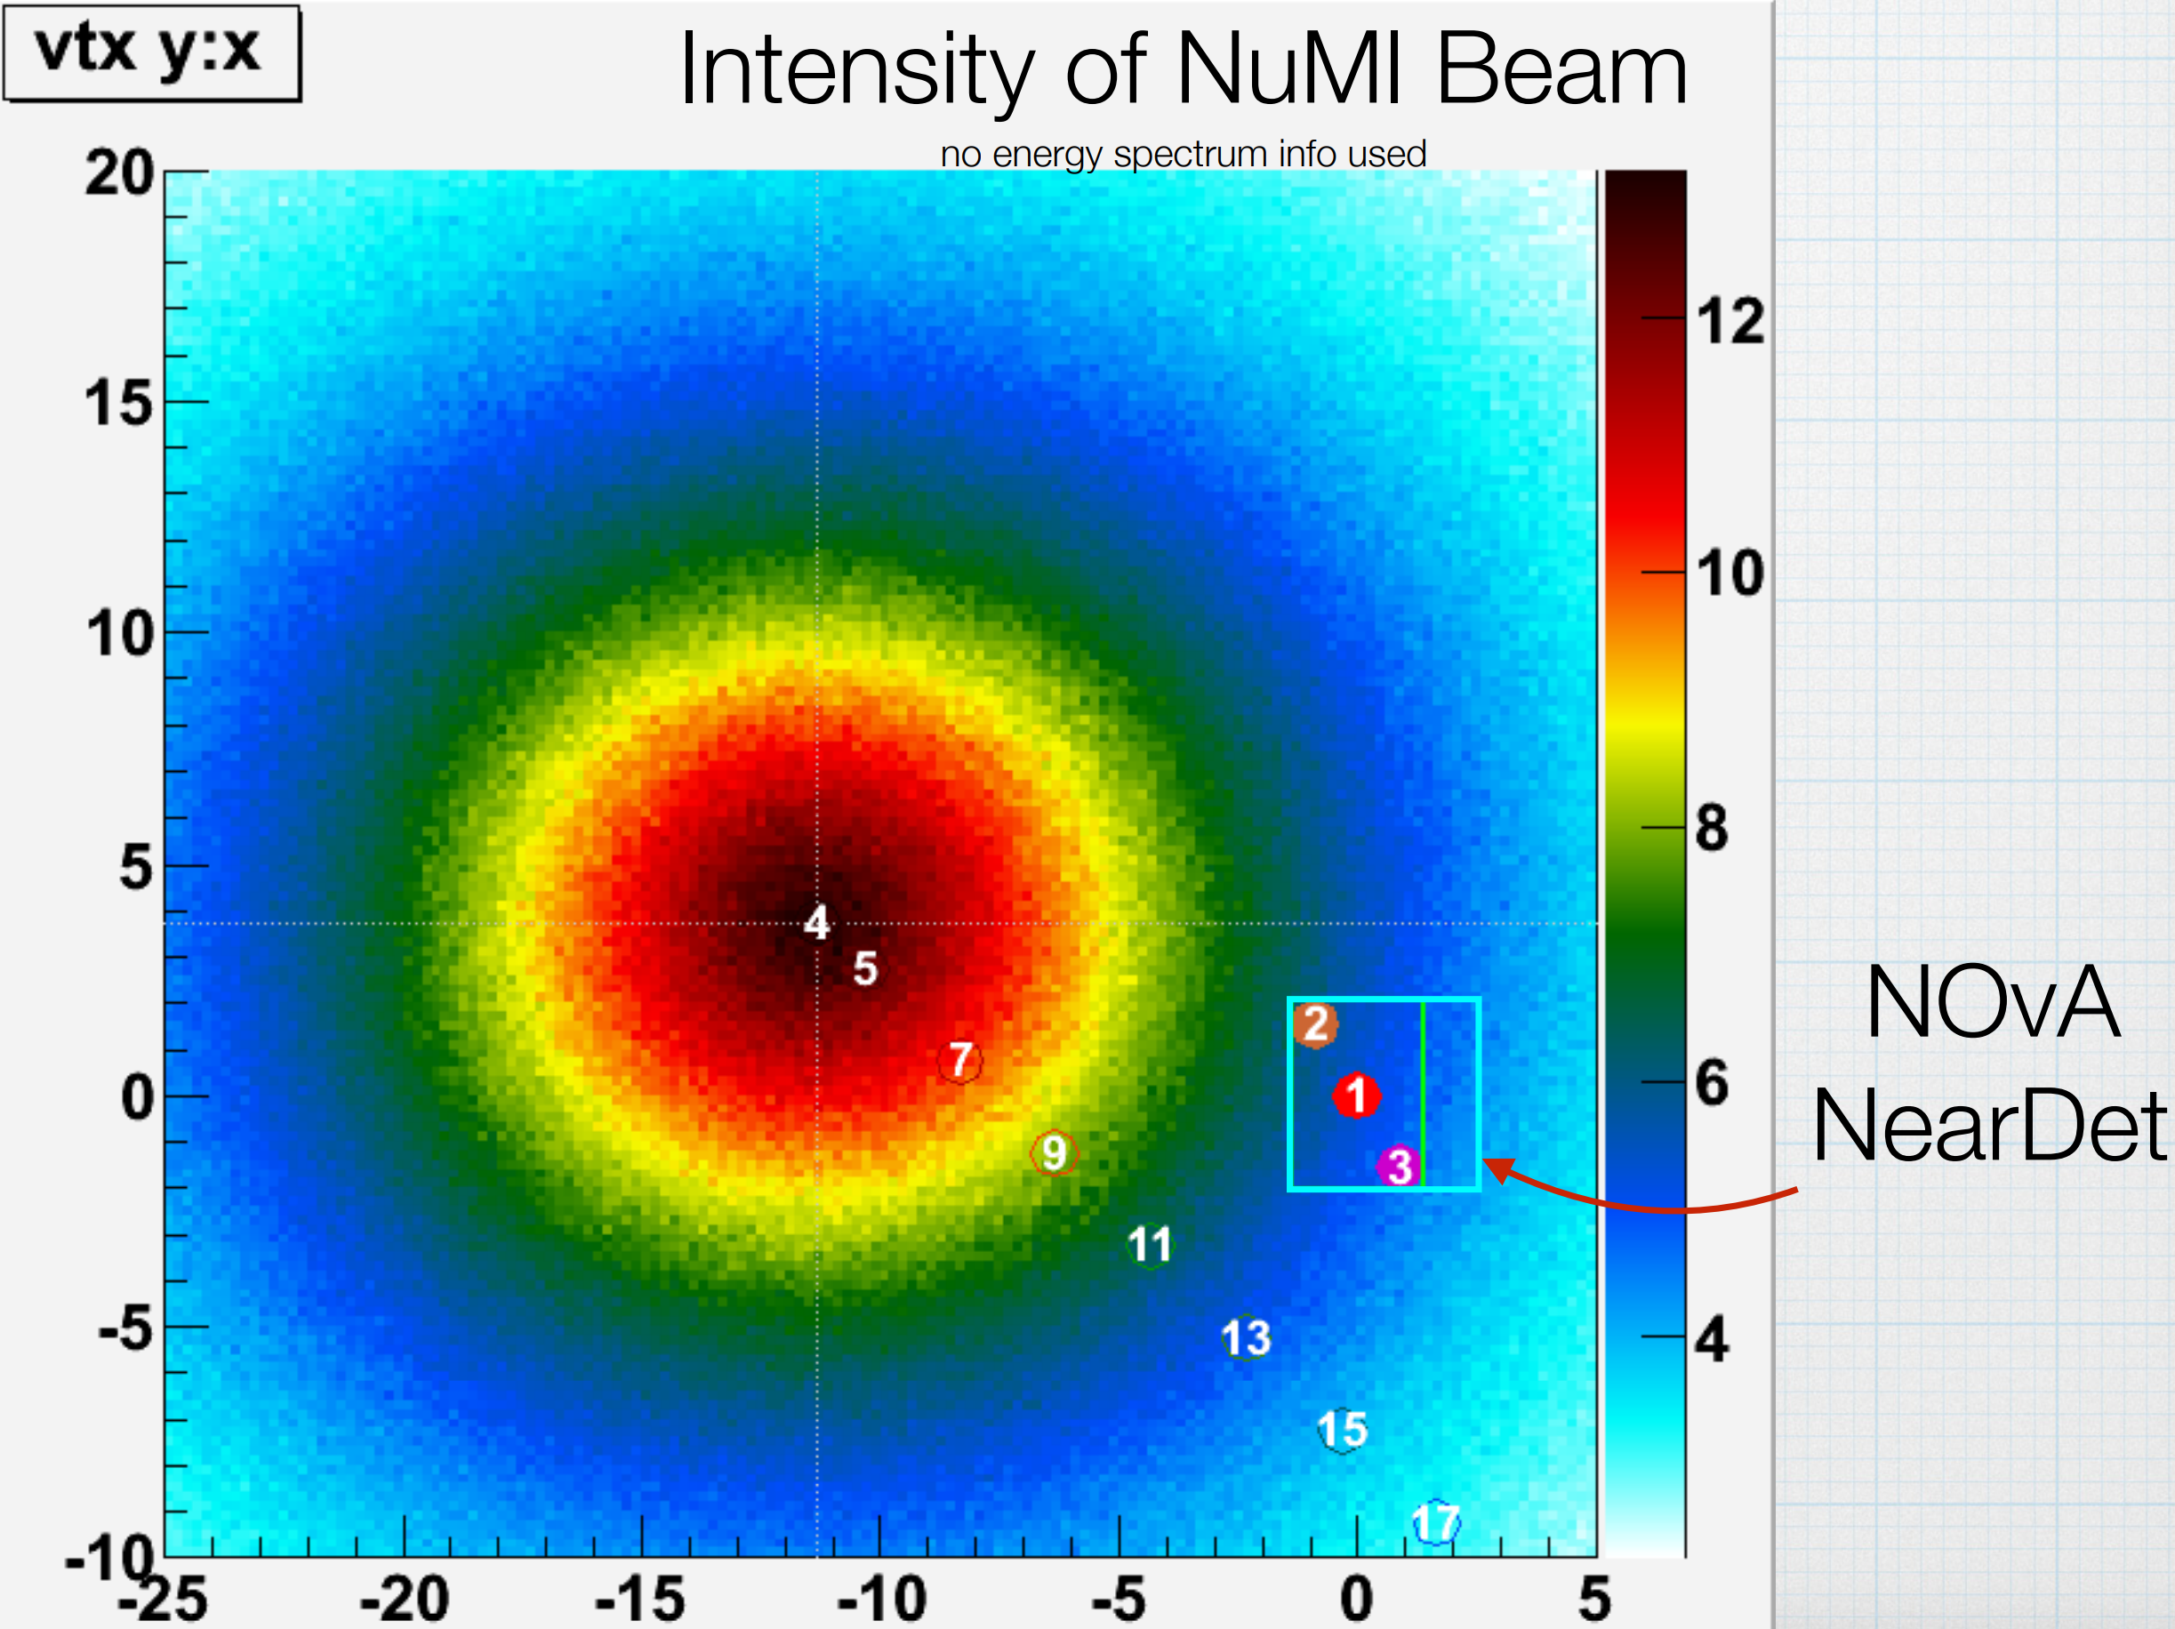
Robert Hatcher: Preliminary schema for a common flux/geometry driver

Slide 50
How to Potentially Improve Energy Estimators?
Proposing some basics for update to LSTM_EE:
Include angular factor in loss function
Should keep training until some kinematic consistency found
Hopefully will improve energy estimation given extra kinematic constraint
Should be aware of true $(p_{x},p_{y},p_{z})$ and predicted $\left(p_{x},p_{y},p_{z}\right)$
Many variable already included as input, but not predicted as output
Currently only the energy enters the loss function
Some features could already be “subliminally” informing angular reco…
Include buffer between true & reco. angle in loss
Need to make sure not to overtrain given…
Nuclear modeling biases
Neutrons, nuclear remnants
Plan to include input/output with/without neutrons/HadrBlobs
Detector resolution/reconstruction issues
Prongs in NO$ν$A have limiting resolution…
Study effects of inclusive/exclusive CC training samples
Will be topologically based on prong multiplicities (most likely)
Does energy resolution improve with angular constraint?
Does energy resolution improve with specific kinds of topologies?
Should loss function be non-linear?

Slide 51
Currently considering truth-only samples
GENIEv3.0.6
Uses fully oscillated Honda flux
Homestake site
$15km$ production height
Hack to put in $ν_{τ},{\overline{ν}}_{τ}$
May need to remake all of this with flattened fluxes
Fast falloff of spectral index limits training on high energy events
$\sim E_{ν}^{−2.5}$
Beam events “ready to go”
Currently have NuMI flux files
Again, may need to flatten
Signal selection to check performance
$CC1p0π$ focus of Pedro et al’s paper
Energy ranges to study validity
$0.1−1.0GeV$ a la Pedro et al
$0.1−5.0GeV$
$0.1−4.0$ studied by Farrell and Higuera for their CVN tool to identify nueCC, numuCC, NC
$\sim 5.0GeV$ is containment cutoff in reduced geometry
$0.1−10.0GeV$
Rough expected containment in full geometry

Slide 53
Want to be able to easily configure these…All code developed!
Want to be conservative! But made with LArTPCs in mind…
Will update when moving to NOvA-oriented analysis
$→$NOvA reconstructed prongs, etc…

