Slide 1
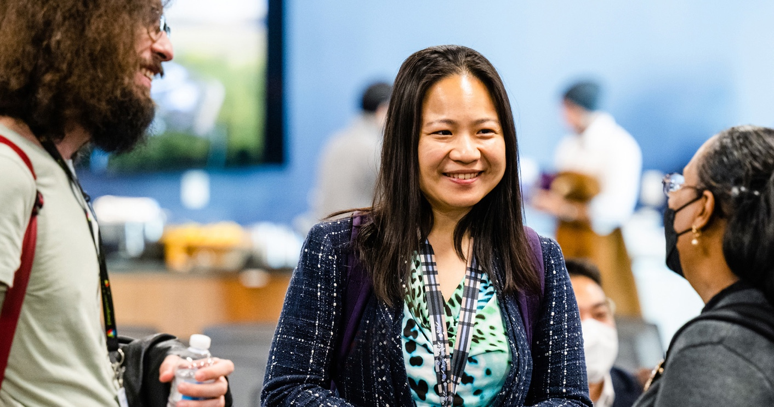
DEIA
AT THE
Argonne
September 2024
Camille Reynolds
Lydia Finney
Philip Anderson
DEIA Lead
DEIA Manager
Chief Diversity Officer

Slide 2
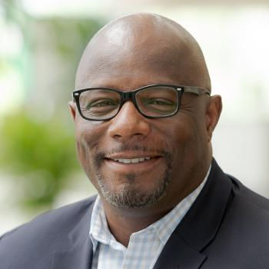

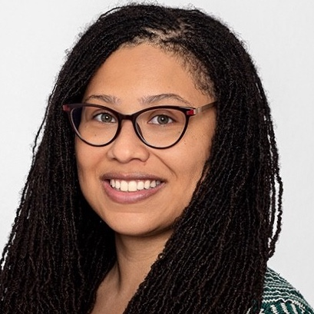
Meet the DEIA Office
Helping the Lab become a more diverse and inclusive workplace
Philip Anderson Ph.D., CDP
Chief Diversity Officer
Lydia Finney
Ph.D., CDP
DEIA Manager
Camille Reynolds
MA
DEIA Lead
Notes:
The Diversity, Equity, Inclusion, and Accessibility (DEIA) Office works to help the Laboratory meet its goal of becoming a more diverse workplace and fostering an inclusive culture. We do this through the building of consensus. We co-create solutions with the input of our ERGs, our DEIA Councils, and the Leadership Team of the Lab. All three of us are subject matter experts on DEIA – Philip with a strategic focus, Lydia with an operational focus, and Camille with a tactical focus – and through shared decision-making we work together to ensure that all voices are heard as we work to make the Lab a safe, welcoming and inclusive environment.

Slide 3
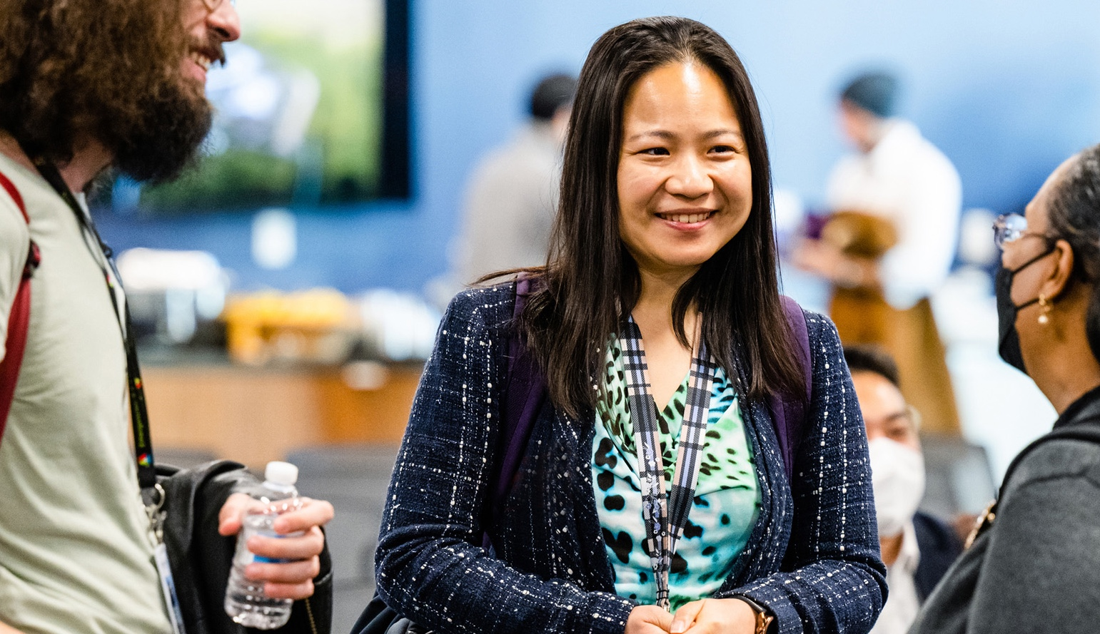
Agenda
Culture of Inclusion
Why DEIA Matters to Our Mission
Overview of the DEIA Plan

Slide 4
A Culture of inclusion
Grounding our work in social science
Organizational Culture
A system of shared beliefs, values, norms, habits, and assumptions that impact the organization’s environment and influence how people behave within it.
Organizations with diverse leadership and teams can outperform those with homogenous leadership and homogeneous teams.
A key part of successful and diverse teams is enabling an inclusive workplace culture.
Source: Global Diversity, Equity, and Inclusion Benchmarks (GDEIB), April 2021
Notes:
::::::::::::::::::::::::::::::
Risk Statement
If we do not develop leadership competence in the areas of diversity, equity and inclusion, develop staff, and institutionalize core values, then the Lab’s ability to attract and retain diverse talent will be adversely impacted.
Argonne is at the ‘Utilitarian Culture’ stage in the Inclusion Maturity Model framework. This is defined by:
Utilitarian Culture – employees abide by whatever rules are essential; however, they often develop countercultural norms and rules to protect themselves
Leaders recognize the importance of diversity, equity and inclusion
Formal systems exist to develop employees, but may not result in professional growth
Core values are practiced in pockets of the organization
Argonne is moving towards: the ‘Normative Culture’ stage of the Inclusion Maturity Model Framework:
Normative Culture – Employees contribute their commitment because the goals and core values of the Lab are aligned with their own
Leaders take ownership of diversity, equity and inclusion
Development opportunities support the professional growth of employees
Core values are fully integrated into key processes and systems that drive performance
Argonne is moving away from ‘Fragmented Culture’:
Fragmented Culture – employees join and stay at the Lab for physical or economic reasons
Diversity, equity and inclusion is considered an HR role
Staff development is tactical and adhoc – there is no strategic direction
Employee behavior is not aligned with a set of core values
Drivers of Service Maturity:
Leadership Development driven by a set of validated core competencies
Strategic development of talent
Institutionalization of Core Values

Slide 5
A Culture of inclusion
Grounding our work in social science
Inclusive Culture
Creates and sustains an organization where respect, equity, and positive recognition of differences are cultivated, diverse voices are heard, and everyone feels valued
Source: Global Diversity, Equity, and Inclusion Benchmarks (GDEIB), April 2021
Notes:
::::::::::::::::::::::::::::::
Risk Statement
If we do not develop leadership competence in the areas of diversity, equity and inclusion, develop staff, and institutionalize core values, then the Lab’s ability to attract and retain diverse talent will be adversely impacted.
Argonne is at the ‘Utilitarian Culture’ stage in the Inclusion Maturity Model framework. This is defined by:
Utilitarian Culture – employees abide by whatever rules are essential; however, they often develop countercultural norms and rules to protect themselves
Leaders recognize the importance of diversity, equity and inclusion
Formal systems exist to develop employees, but may not result in professional growth
Core values are practiced in pockets of the organization
Argonne is moving towards: the ‘Normative Culture’ stage of the Inclusion Maturity Model Framework:
Normative Culture – Employees contribute their commitment because the goals and core values of the Lab are aligned with their own
Leaders take ownership of diversity, equity and inclusion
Development opportunities support the professional growth of employees
Core values are fully integrated into key processes and systems that drive performance
Argonne is moving away from ‘Fragmented Culture’:
Fragmented Culture – employees join and stay at the Lab for physical or economic reasons
Diversity, equity and inclusion is considered an HR role
Staff development is tactical and adhoc – there is no strategic direction
Employee behavior is not aligned with a set of core values
Drivers of Service Maturity:
Leadership Development driven by a set of validated core competencies
Strategic development of talent
Institutionalization of Core Values

Slide 6
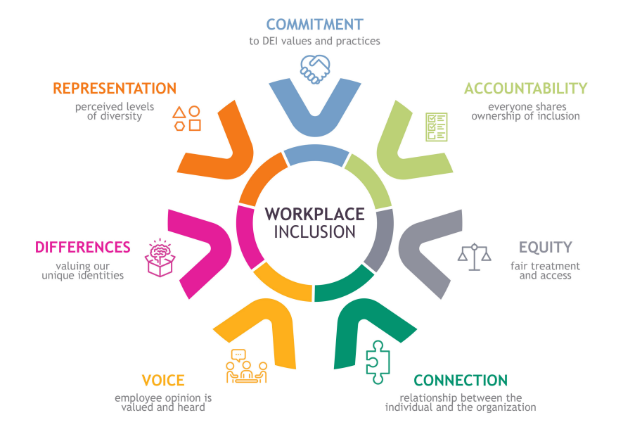
Diversity, Equity, Inclusion and Accessibility
Creating a culture of inclusion using a seven-point model for DEIA
Social science research has identified seven key elements of workplace inclusion.
Using this model helps us ensure we are addressing all the areas that matter in creating a diverse, equitable, inclusive and accessible environment.
Source: Ensuring All Voices Are Heard: an inclusive research approach to develop a framework for workplace inclusion, Kaleidoscope Group, 2023.

Slide 7



Why DEIA?
DEIA supports our workforce, workplace, community and research
17%
Diverse
Teams
More innovative
Make smarter decisions
Team
Performance
20%
Decision-making Quality
29%
Inclusive leaders enhance team performance, too.
Team
Collaboration
Notes:
Across a wide variety of organizations, an engaged and diverse team – where every member feels included and empowered to contribute – proves both more innovative and more intelligent in their decision making. Not only does this increase net innovation, but it also has the corollary effect of reducing errors and decreasing structural risk.
The empirical results are striking: diverse and especially inclusive teams typically see 17% net improvement in team performance and 20% superior decision-making quality, as discovered in this Deloitte analysis. By being diverse enough to avoid groupthink, and inclusive enough so that those who disagree are allowed to speak up, teams think, act, and perform better.
Workforce: Developing the talents, skills and perspectives of a diverse and high-performing employee base to bring out the best in the organization.
Workplace: Creating an inclusive culture where every employee feels valued, respected and safe to be their authentic self.
Communities: Cultivating and strengthening strategic partnerships with diverse suppliers and organizations.
Research: Establishing a competitive advantage to enhance the Lab's innovation and scientific research.

Slide 8
DEIA End-to-End
Strategic Process
What environment
do we want to create?
Why
is it
important?
How
will we accomplish
it?
When
will we
deliver?
How
will we define success?
Lab Director’s Statement
Strategic
Mission
DEIA
Plan
Execution
Evaluation
of Success
Vision
Commitment
to DEIA
Purpose
Stakeholders
Value Proposition
Core Values
Challenges
Structure
Goals
Outcomes
Timeline
Project Planning
Change
Management
Deliverables
Behavior Change
Compliance
Metric

Slide 9
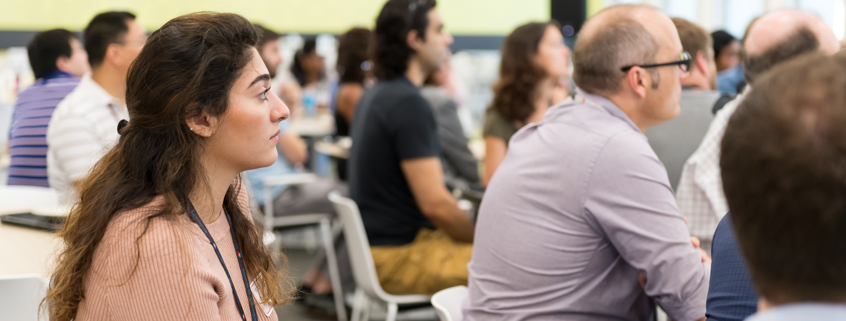
DEIA Mission statement
Diversity, equity, inclusion and accessibility is essential to the achievement of Argonne’s science and technology mission and is at the forefront of what we do and who we are.
Our commitment to Argonne’s Core Values compels us to identify and remove systemic inequities so that all employees are seen and heard.
We engage our workforce to create a psychologically safe work environment that delivers innovative and equitable science and technology to our community and the nation.
We implement and communicate inclusive best practices and accountability measures to empower employees to respect, value, and celebrate our differences and similarities, so that marginalized and underrepresented employees have equal access to career-advancing opportunities to thrive.
Notes:
Take a moment to think about where this connects to your day-to-day life? When we work to make sure that everything is fair, we are living our Core Values. When we have a work environment where everyone feels psychologically safe, we will all contribute our best work. When we are confident that underrepresented employees have equal access to career-advancing opportunities, we know that our structures are sound, and our processes provide us all with opportunities. What does this look like in your day-to-day?

Slide 10
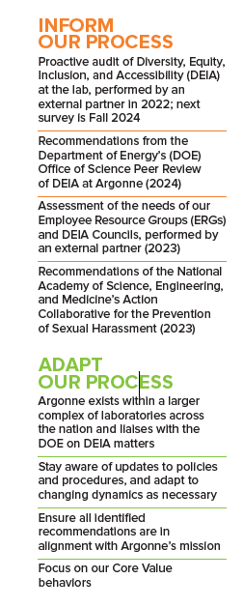
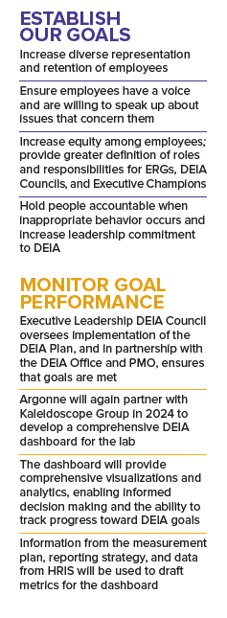
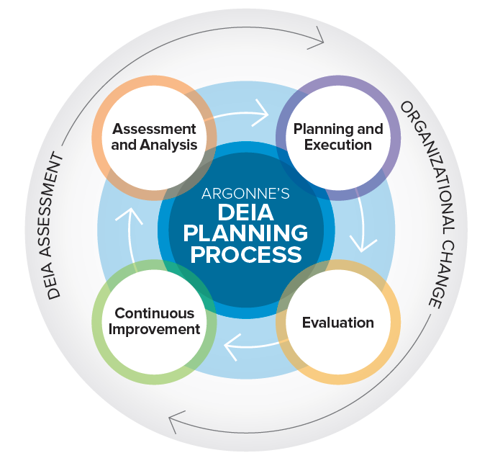
Argonne’s DEIA
Planning process
Notes:
To advance, we employ assessment, joint analysis and action planning with leaders and staff, and an evaluation plan to measure success.
Assessment and analysis informs our process. Planning and execution establishes our goals. Evaluation monitors our goal performance. And Continuous improvement helps us adapt our process.

Slide 11


How do we know it’s working?
PEOPLE
ENVIRONMENT
The racial and ethnic diversity of employees has increased from 24.5% in 2016 to 35.0% in 2024
In 2024, at senior leader levels, we are at parity with 50% women.
In 2023, 50% of all laboratory new hires were minorities (46% in 2021 and 2022).
Hiring of people with disabilities has increased from 2.3% in 2020 to 10% in 2024.
Veteran hiring has increased from 3% in 2018 to 5.5% in 2024.
Pulse check surveys show increased trust in managers (77% positive in 2022 to 82% in 2024), sense of voice in decision making (61 to 63%), and fair treatment regardless of culture, background or perspective (61%
to 67%)
A total of total of 187 employees attended new workshops on Argonne’s Core Values
of Impact, Safety, Respect, Integrity, and Teamwork
Argonne was recognized as a “Best Places to Work for Disability Inclusion” by Disability:IN for the fourth year in a row
Notes:
Grounding these in the 4 challenges that we identified –
Put the proof points into the notes – the details that tie it back.
Core Values – in Perf. App. Are helping to ensure that we have accountability

Slide 12
Questions

