Slide 1
Temperature measurements of low-energy electrons using synchrotron radiation in a solenoid
S. Kladov, N. Banerjee

Slide 2
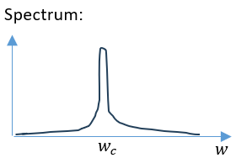
Goals and methods
In moving longitudinally frame:
usual synchrotron radiation with really low gamma ($γ_{⊥}\sim 1$):
radiation
particle
$$P_{1}=\frac{2}{3}\frac{mr_{e}}{c} γ_{⊥}^{4}w_{c}^{2}v_{⊥}^{2}=\frac{2}{3}\frac{mr_{e}}{c}w_{c}^{2}\frac{2eT_{⊥}\left[eV\right]}{m}$$
$${\left.w_{c}\right|}_{moving}=w_{0}=\frac{eH}{m}$$
$$L$$
Moving frame
In laboratory frame:
$$w_{c}\left(mean\right)=γw_{0}=γ\frac{eH}{m}=\left(1+\frac{T_{⊥}}{mc^{2}}\right)\frac{eH}{m}$$
Two methods of $T_{⊥}$ measurement:
$P_{1}$ (radiating power)
$w_{c}$ (radiation frequency)
S. Kladov, N. Banerjee, ? et al. SI in the solenoid of the Test Stand
1/6

Slide 3
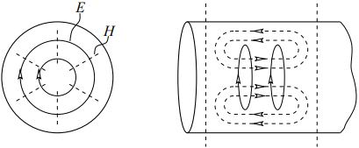
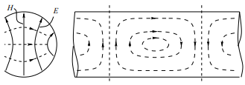
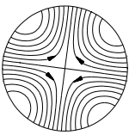
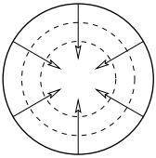
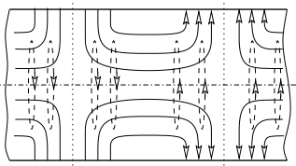
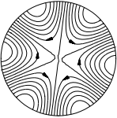
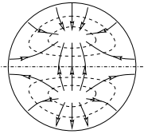
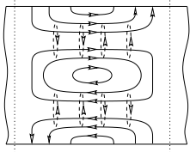
Realistic picture
Detector antenna
Waveguide:
Waveguide modes propagating
Particle orbit
$$L$$
TE01
TE11
TE21
TE31
Solid - E
Dashed - H
5 cm
Electron source
Cyclotron radius: $r_{c}\sim 0.002−0.18$ mm
TH01
TH11
So $r_{c}$ < 1% of the waveguide radius
S. Kladov, N. Banerjee, ? et al. SI in the solenoid of the Test Stand
2/6

Slide 4
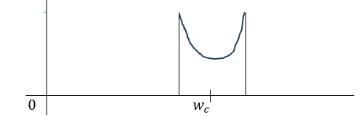
Signal Prediction
Spectrum $(w = n w_{c})$:
In laboratory frame:
$$w^{′}=γ_{∥}w_{c}\left(1−β_{∥}\sin{ψ}\right)$$
$$\sin{ψ}=\frac{1}{β_{∥}}\left(1−\frac{w^{′}}{w_{c}}\right)$$
$$ρ\left(ψ\right)\sim 1+\sin^{2}{ψ}$$
$$\frac{dP}{dν}\left[\frac{W}{Hz}\right]=A P_{total}\left[1+\frac{1}{β_{∥}^{2}}{\left(1−\frac{w^{′}}{w_{c}} \right)}^{2}\right]I_{beam}\left[A\right]T_{⊥}\left[eV\right]$$
$A$ – normalization
Low transverse energy $→ n=1$
Radiation is incoherent
$$P_{collected}=P_{1}\frac{L}{β_{∥}c}I_{beam}\left[A\right]\frac{1}{e}\sim 1 pW$$
2a
energy radiated from 1 electron
Electron flux
a
$$w_{c}−β$$
$$w_{c}+β$$
$\sim 0.1$ GHz
S. Kladov, N. Banerjee, ? et al. SI in the solenoid of the Test Stand
3/6

Slide 5
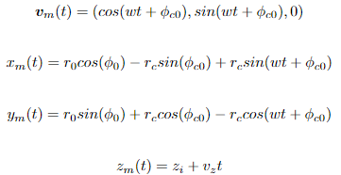
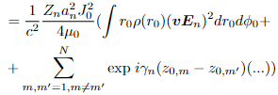
Coupling to Waveguide
$$A_{n}=−\frac{1}{2}\frac{\int{{\hat{E}}_{n}∙J e^{iγ_{n}z}dV}}{\int{{{\hat{E}}_{n}}_{⊥}×{{\hat{B}}_{n}}_{⊥}dS}}$$
$$φ_{c1}$$
S. Kladov, N. Banerjee, ? et al. SI in the solenoid of the Test Stand
4/6

Slide 6
Coupling to Waveguide
$$P=\frac{Z_{n}e^{2}v_{⊥}^{2}}{4c^{2}μ_{0}}a_{n}^{2} {\overline{\left(vE_{n}\right)}}^{2}=\frac{2e^{3}T_{⊥}\left[eV\right]}{4μ_{0}ma^{2}c}\frac{\sqrt{\frac{μ_{0}}{ε_{0}}}}{\sqrt{1−f_{mn}^{2}\frac{c^{2}}{w_{c}^{2} a^{2}}}}\frac{{\overline{\left(vE_{n}\right)}}^{2}}{\int{r_{0}E_{n_{⊥}}^{2}dr_{0}dφ_{0}}} \frac{L}{β_{∥}c}I_{beam}\left[A\right]\frac{1}{e}$$
$${\frac{dP}{dν}}_{mean}\left[\frac{W}{Hz}\right]=\frac{πe^{2}}{2ma^{2}w_{c}}\frac{L}{β_{∥}^{2}c^{2}}\frac{T_{⊥}\left[eV\right]I_{beam}\left[A\right]}{\sqrt{1−f_{mn}^{2}\frac{c^{2}}{w_{c}^{2} a^{2}}}}\frac{{\overline{\left(vE_{n}\right)}}^{2}}{\int{r_{0}E_{n_{⊥}}^{2}dr_{0}dφ_{0}}}$$
$${\frac{dP}{dν}}_{mean}\left[\frac{W}{Hz}\right]=\frac{2π^{2}ε_{0}}{w_{c}}\frac{Lr_{e}}{β_{∥}^{2}a^{2}}\frac{T_{⊥}\left[eV\right]I_{beam}\left[A\right]}{\sqrt{1−f_{mn}^{2}\frac{c^{2}}{w_{c}^{2} a^{2}}}}\frac{{\overline{\left(vE_{n}\right)}}^{2}}{\int{r_{0}E_{n_{⊥}}^{2}dr_{0}dφ_{0}}}$$
$$P=\frac{Z_{n}e^{2}v_{⊥}^{2}}{4{c^{2}μ}_{0}}a_{n}^{2} {\overline{\left(vE_{n}\right)}}^{2}$$
$$\overline{{\left(v E_{n}\right)}^{2}}=\int{r_{0}ρ\left(r_{0},φ_{0}\right){\left(v E_{n}\right)}^{2}dr_{0}dφ_{0}dφ_{c0}dφ_{c1}}$$
Averaging by initial electron position
Averaging by time
Averaging by initial electron transverse velocity direction
S. Kladov, N. Banerjee, ? et al. SI in the solenoid of the Test Stand
4/6

Slide 7
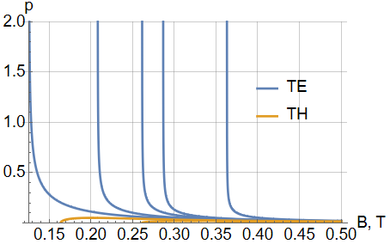
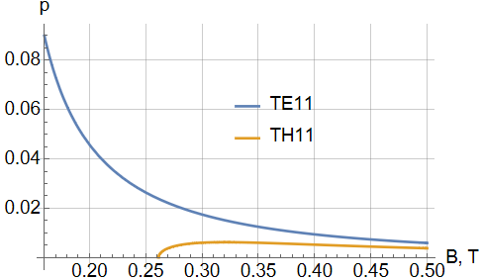
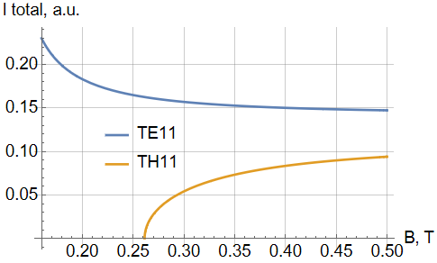
Numbers
Parameter | Lowest | Nominal | Highest
$B$[T] | 0.06 | 0.1 | 0.5
$E_{||}$ [keV] | 1 | 1.36 | 10
$I_{beam}$[mA] | 5 | 100 | 3000
$L$[m] |  | 0.7
$r$[mm] |  | 25
$w_{c}$[GHz] | 10.5 | 17.6 | 87.9
$E_{⊥}$[eV] (expected) | 0.1 | 1 | 10
$r_{c}$[mm] | 0.0021 | 0.034 | 0.18
$P_{collected}$[pW] | 0.08 | 12.4 | 10827
$Δν$[GHz] | 0.2 | 0.4 | 5.53
IOTA radiation power and coupling to all modes
Doesn’t depend on the cyclotron radius if it is small enough
Parameter | $B=0.5$ T | $B=0.375$ T | $B=0.25$ T
$\frac{dP}{df}$[${10}^{−22} W/Hz$] | 3.38 | 305 | 61864
$p_{{TE}_{01}}$[%] | 0.09 | 0.19 | -
$p_{{TE}_{11}}$[%] | 0.59 | 1.1 | 2.6
$p_{{TE}_{21}}$[%] | 0.06 | 0.11 | -
$p_{{TE}_{31}}$[%] | 0.004 | 0.009 | -
$p_{{TH}_{01}}$[%] | 0.018 | 0.03 | 0.06
$p_{{TH}_{11}}$[%] | 0.38 | 0.56 | -
1 keV, 0.5 T, 3A 1 eV
IOTA parameters
S. Kladov, N. Banerjee, ? et al. SI in the solenoid of the Test Stand
5/6

Slide 8
Experimental setup
amplifier
What can be done:
Increase the magnetic field: $\frac{dW}{dν}\sim B$ ?
Increase the solenoid length: $\frac{dW}{dν}\sim L$
Increase the beam current: $\frac{dW}{dν}\sim I_{beam}$
Reduce the beam energy: $\frac{dW}{dν}\sim \frac{1}{β_{∥}}\sim 1/√E$
Reduce the amplifier temperature: $\frac{dW}{dν}\sim \frac{1}{T}$
antenna
voltmeter
Fridge, T~30K
Johnson–Nyquist Noise generated:
${\frac{dW}{dν}}_{noise}=KT=4 {10}^{−22} W/Hz$
${\frac{dW}{dν}}_{max}=p\frac{dP}{df}=11.5 {10}^{−22} W/Hz$
$$L$$
short
StN ~= 3
If one particle – power $\sim v_{g}\sim \frac{1}{Z_{n}}$ $→$ no infinity
If constant particle supply – the whole radiation reaches the detector ->
Infinity is determined by the field spread and waveguide quality factor
S. Kladov, N. Banerjee, ? et al. SI in the solenoid of the Test Stand
6/6

Slide 9
Thank you! Questions time.

Slide 10
z
$$H_{⊥}\sim \sqrt{1−λ^{2}/λ_{n}^{2}}H_{||}=0.825H_{||}$$
$$E_{⊥}\sim \frac{w}{cg}H_{||}=\frac{5.1 2.5}{3}H_{||}=4.25H_{||}$$
TE11:
$E_{r}\sim \frac{1}{r}; E_{φ}\sim \frac{1}{a}$ ($a$ – waveguide radius)
$→$ The most efficient – rod?
TE01:
$E_{r}=0; E_{φ}=const$
r
beam

