Slide 1
LBNF - Beamline – Target Complex
Unable to attend Operations Meeting
-- Keith
Horns
Preparing for review of Horns B & C conductors
Friction Stir Welding
SDSMT rework is enroute
Test Stand stub piece being prepped to be shipped to vendor in Germany
Agreement almost reached with PNL to do samples for qualification
Starting investigation into spider support within horn and possible spark issue
Continue to pursue vendor to make large ceramic insulating ring
Assembly of Prototype hangers is 90% completed
Looking into thermocouple electrical standoff for conductor monitoring

Slide 2
LBNF - Beamline – Target Complex
Horns Power Supply
Recovery Choke
Vendor 1: rebuilt choke now being tested in single cell test setup
Vendor 2: first article just received
Vendor 3: order placed
Many procurements in process
Water systems
Test Stand Skid preparing drawings and documents for procuring vendor to build skid
Nearing the completion of drawing sets for Horn B & Horn C RAW systems
Newly assigned engineer becoming familiar with Water Cooling Panel RAW system

Slide 3
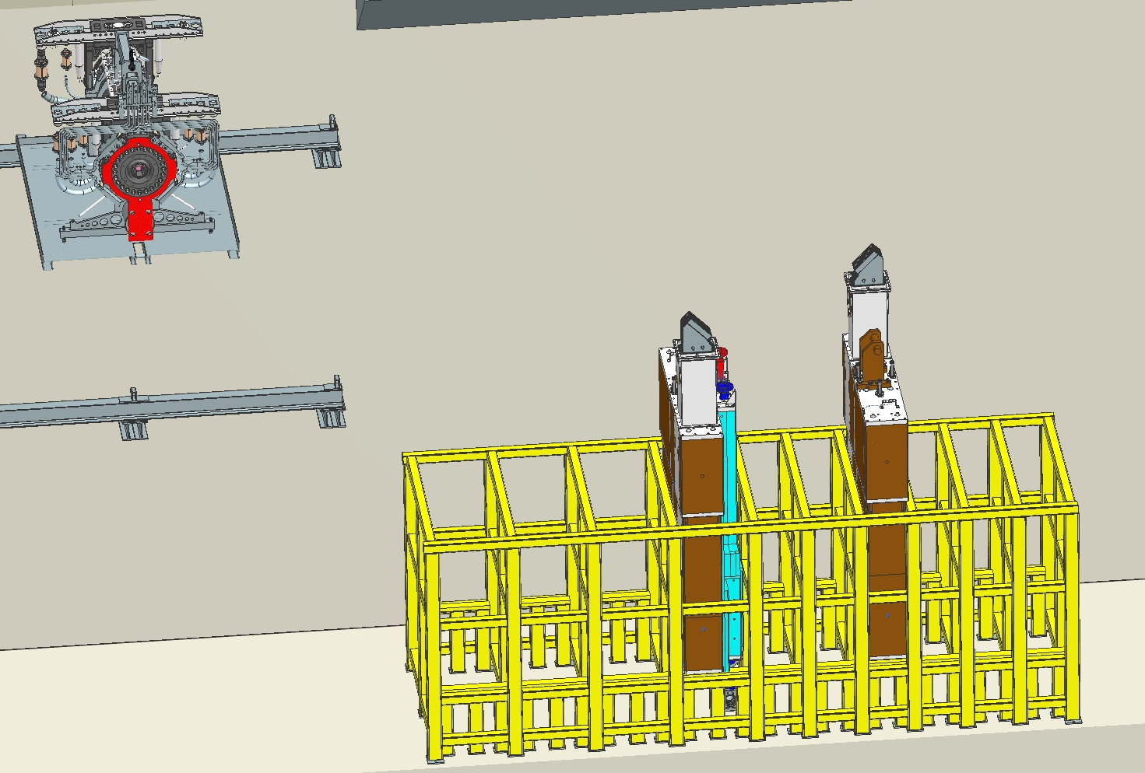
LBNF - Beamline – Target Complex
Stripline
Held Technical review of stripline layout for Horn Test Stand; finalizing details and preparing to start procurement
LBNF stripline FEA analyses continue
Remote Handling
Designing of stand to hold activated/used striplines

