Slide 1
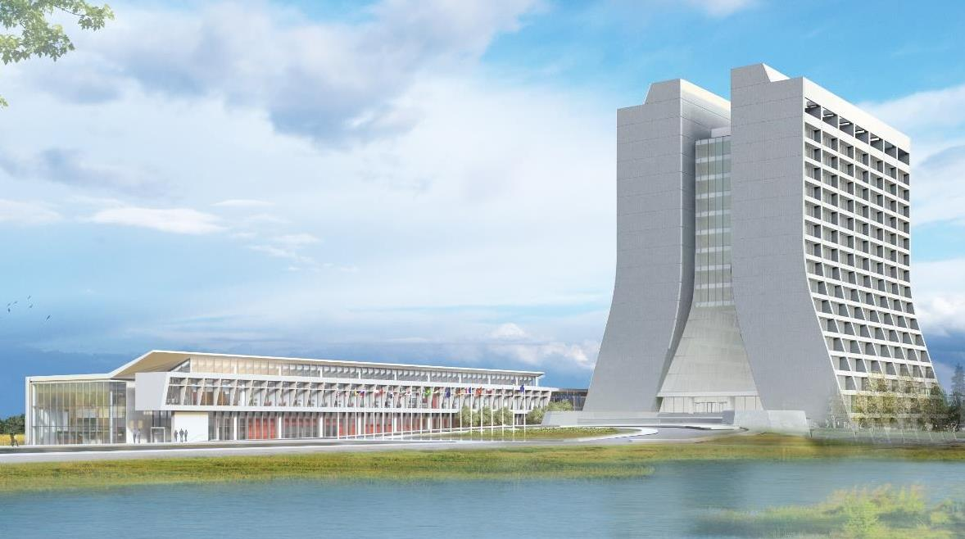
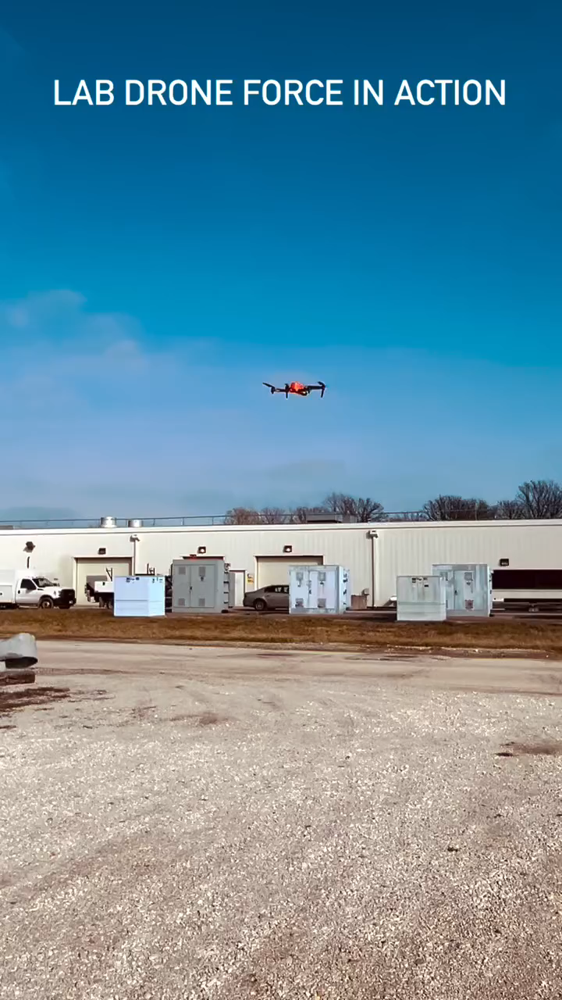
Infrastructure Services Division Updates
Pressing Issues / Special Topic: Building Walks
Noteworthy Items: Slide #3
Active Projects and Contractors Onsite: Slide #4/5
Mechanical and Utility Outages: Slide #6
Safety Success – Because of the new use of drones for roof audits and inspections we have been able to create an avenue to reduce staff going up on roofs, and to allow teams to better write HA’s due to seeing the whole picture of the surroundings.

Slide 2
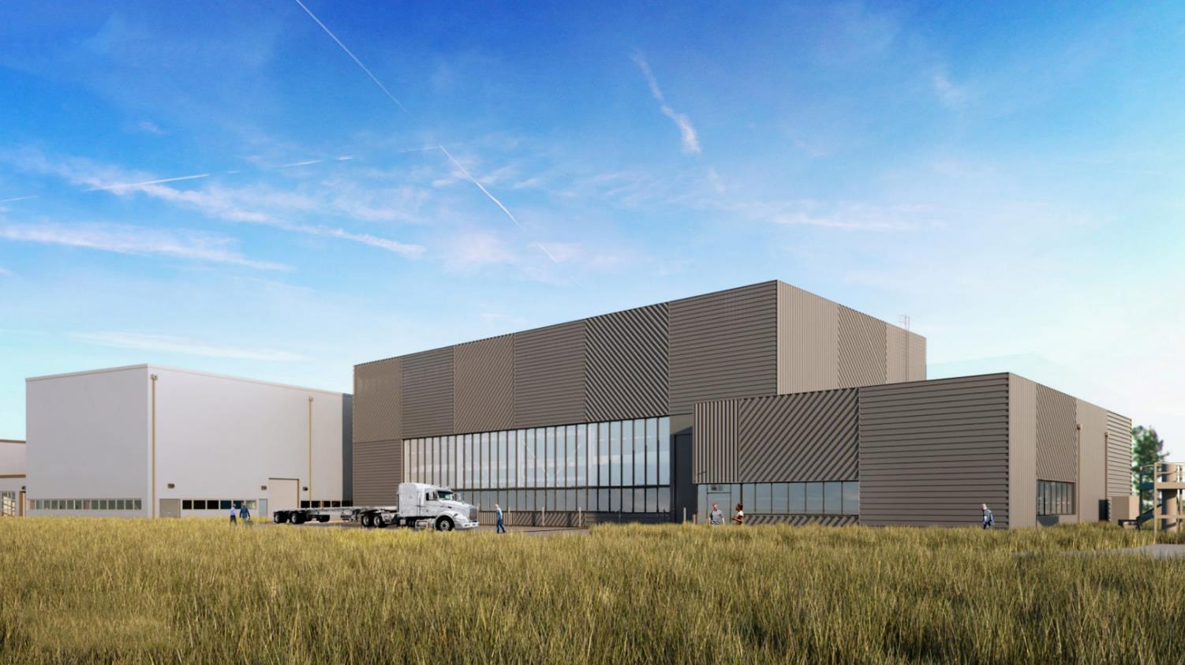
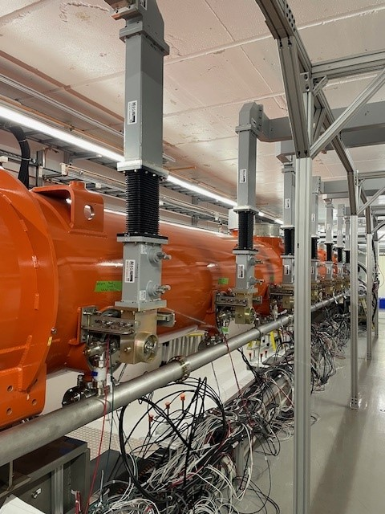
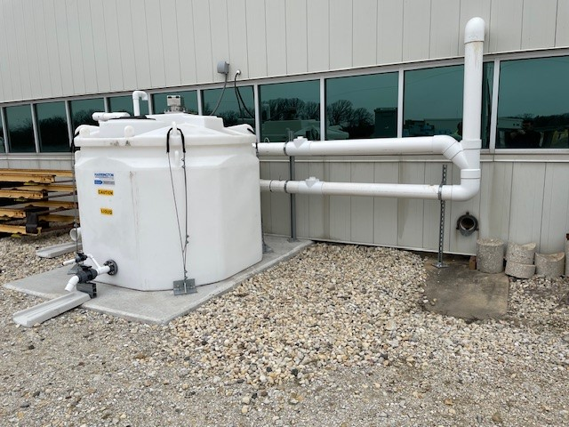
Special Topic:
CMTF – Cryo Tube Work – Thanks to the team at CMTF for taking me on a walk to see the cryo tube work. This was helpful for us to plan the high bay lighting work and understanding the concerns of ISD working over these enclosures and scheduling work. Thanks Dan Lambert.
MI-65 Overflow & Downspout Tanks – The work on these tanks is complete and the authorization for use is in the works. The meeting was great in talking through operation and how the science and ISD responsibilities figured out. Thanks Jim .

Slide 3
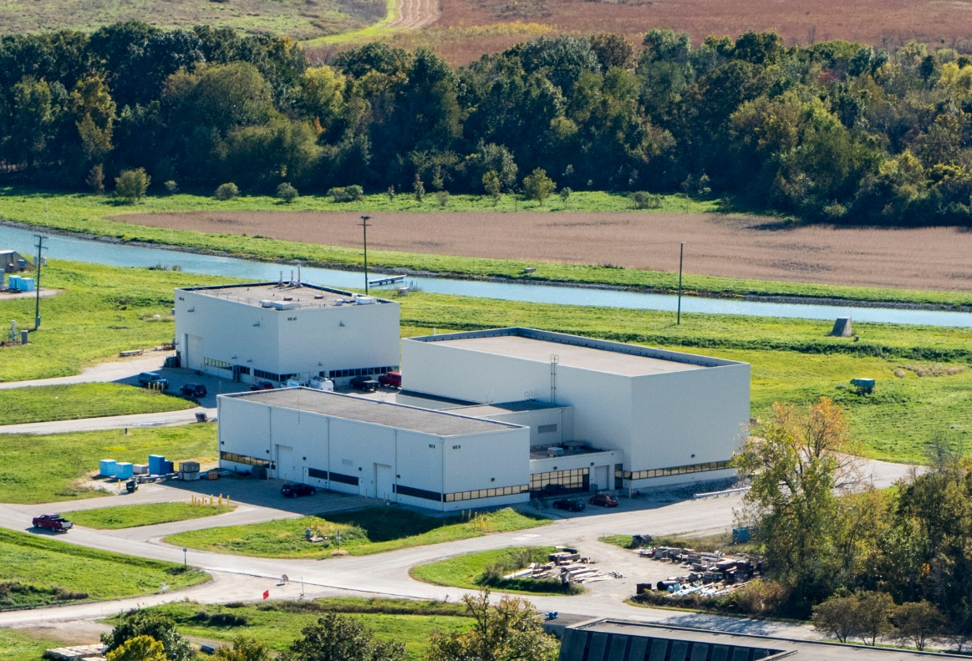
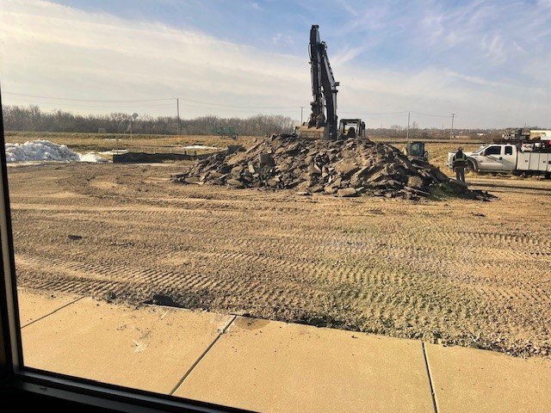
Noteworthy Items
Ameresco Building Walks – FREP (Fermilab Resilience and Efficiency Project) building walks to determine our saving to have an added solar component to our facilities will be of value. Walks include looking at mechanicals/HVAC mainly.
SWA 2nd Refurbishing – we are currently working with Real Property on providing containers to handle any cleanouts of old unwanted stuff. Also working on the initial plans and approvals to get things rolling.
Maintenance Repairs – Overhead doors are starting to get quoted and HA’s are getting created, Plus more…
Work Orders – The switchover to our new work order system (FAMIS360) has happened. With that said, there have been a couple bumps in that switchover.
  Task Codes – it seems the system defaults to division task codes, so we are working to open that field to make it empty until someone puts in a correct task code.
  Cancelled tickets – some tickets in the old system are being cancelled – however they are being re-created in the new system.

Slide 4

Active Projects and Contractors on Site
AD Projects:
Door EOL Replacements – Requisition for 13 doors on the eol list is in progress. Plus 4 others on a fast track working with Scott on locations like SWA, ME7, & AP0, MT Worm.
Office Refurbishing – Working with Scott on priority of office batches, SOW for these are starting to be developed.
Exterior Ladder EOL replacements – Currently 24 ladders are targeted. SOW is being developed.
Card Reader Installation – Transfer Gallery is next on the list. Awaiting Contractor scheduling.
Roof Repairs in progress: MS6, MI-8, TG, MS4, and SWA. – Currently waiting on the new training requirements for contractors to get this service back in motion. Plan is being worked as a work around.
New Roofs – HAB is next, completing Lab F.
NWA roof tin work is almost complete. Hopefully next week completion.
Started removing old antenna weighted mounts in preparation for the next batch of roofs to be completed. MI-60 is the first one.
Prairie Burns – Prairie burns have started again. There were 3 this past week.

Slide 5
Active Projects and Contractors on Site
AD Projects:
Potential next Projects – APOTH Door & Frame Replacement (waiting on quote), A0 cleanroom sanitary line replacement (performed walkdown and waiting on quote), MI Building Concrete Coatings, C0 Service Building (in beginning phase). – No Change
Metal Roof Coatings – SOW of work is being developed, project will have to go out to bid due to size.
Lighting Work/Upgrades – A-0 is almost done except for a change order. NML & CMTF has started and the crane operator situation is almost resolved.
Foundation Leaks – MT6 –Had a walkthrough with the contractor for epoxy work, will push forward with Req, still in progress.
Anchor Inspections – Contractor, Premier, has been brought on board as an inspection service through Safety.

Slide 6
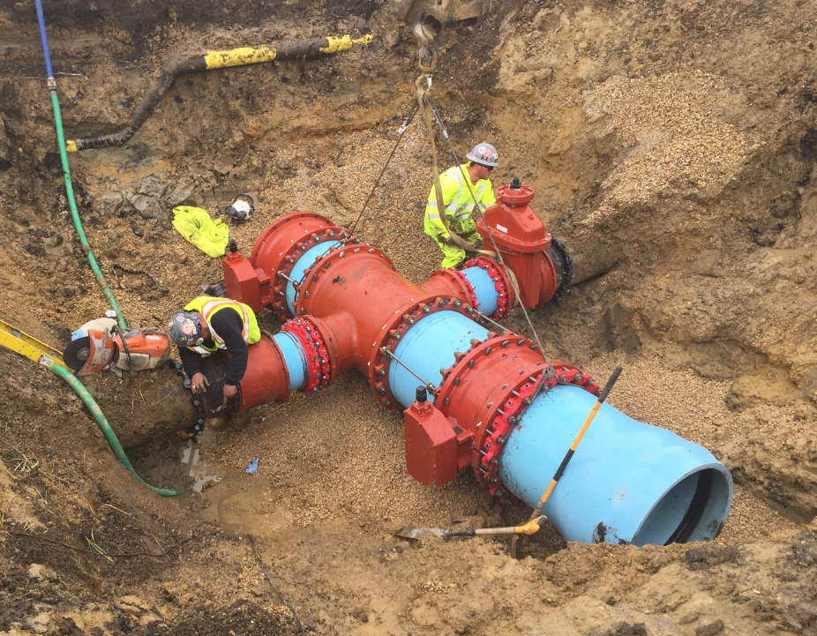
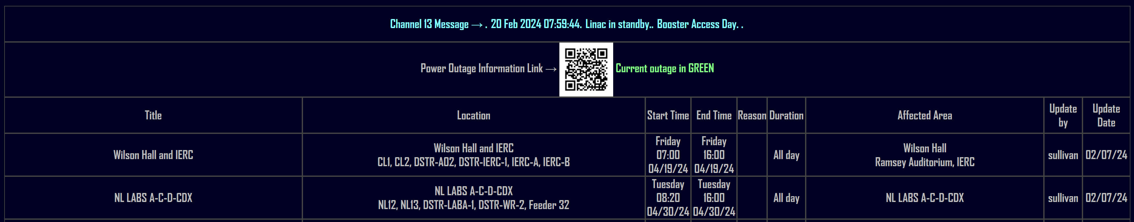
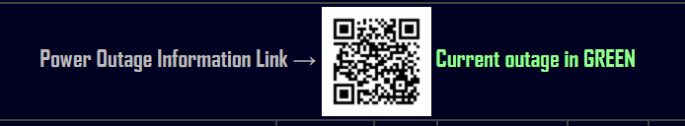
Mechanical and Utility Outages
Planned Power Outages
Current Outage Schedule is populated.
Shutdowns are scheduled to begin in May.

Slide 7
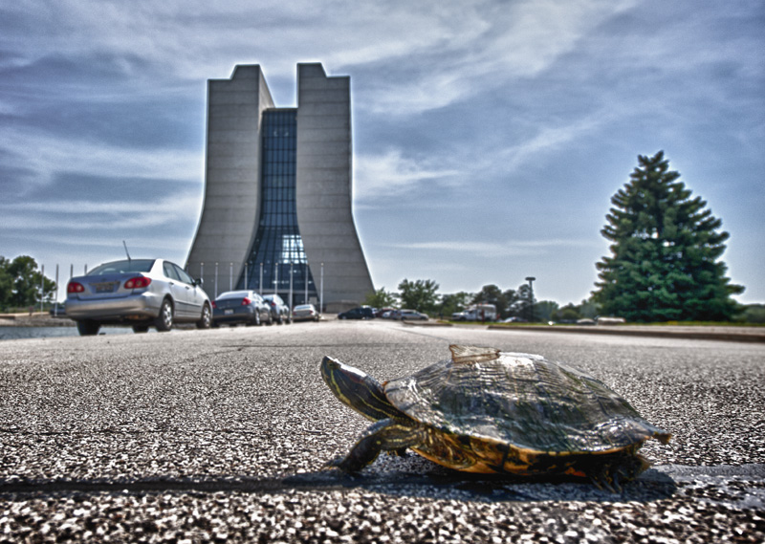
Road Closures
Closures from Fermilab today or R&G site
  Lab closures
  Closures close to WH

