Slide 1
Moving the Downstream Transport Solenoid to the Mu2e Hall
Andy Hocker, L2 Manager for Mu2e Solenoids
FNAL-OHEP Meeting
21 February 2024

Slide 2
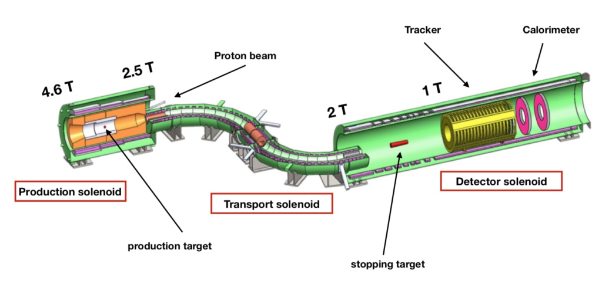
The magnet in question
✓

Slide 3
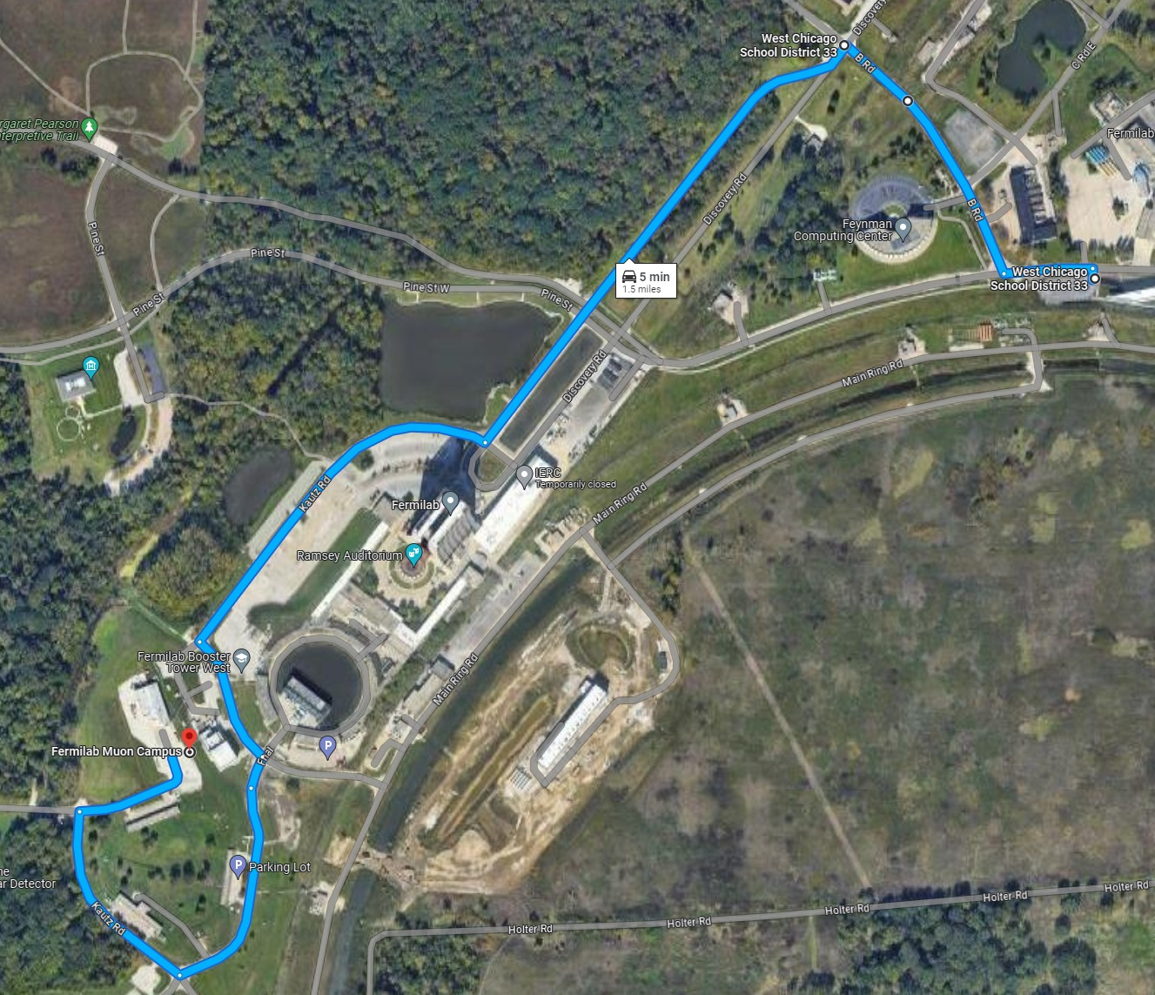
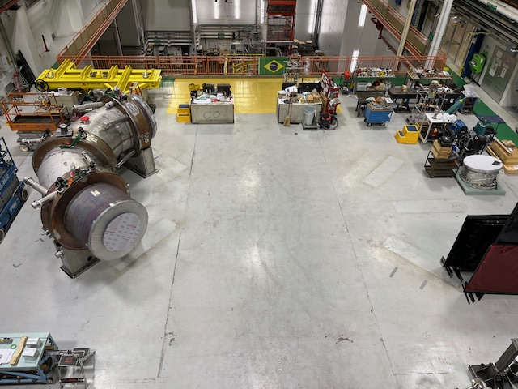
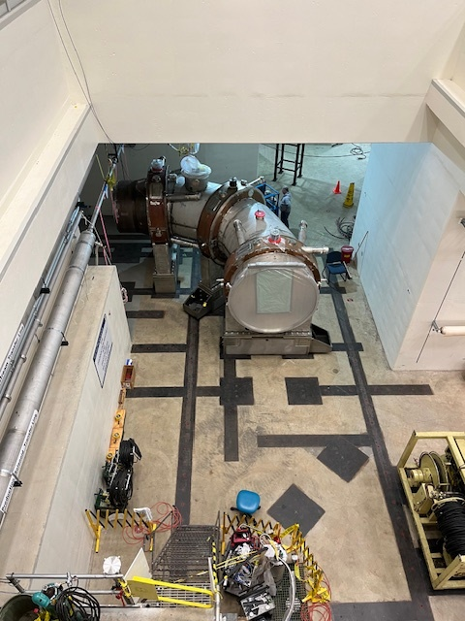
The task
HAB
Mu2e

Slide 4
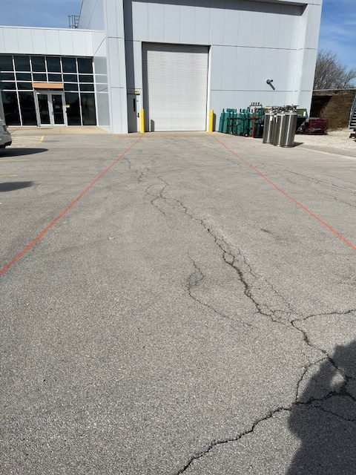
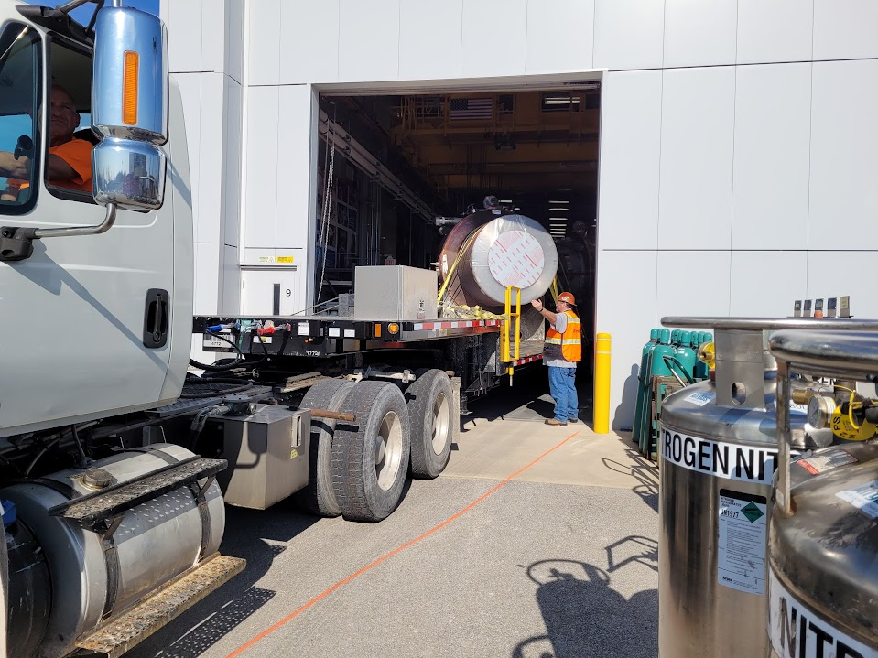
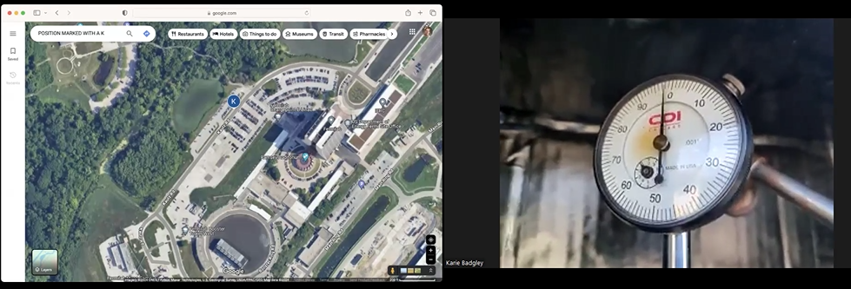
Lessons learned / improvements from previous move
Extended trucking “lane” into the parking lot to make lining up the truck easier
Added GPS tracking to monitoring display

Slide 5
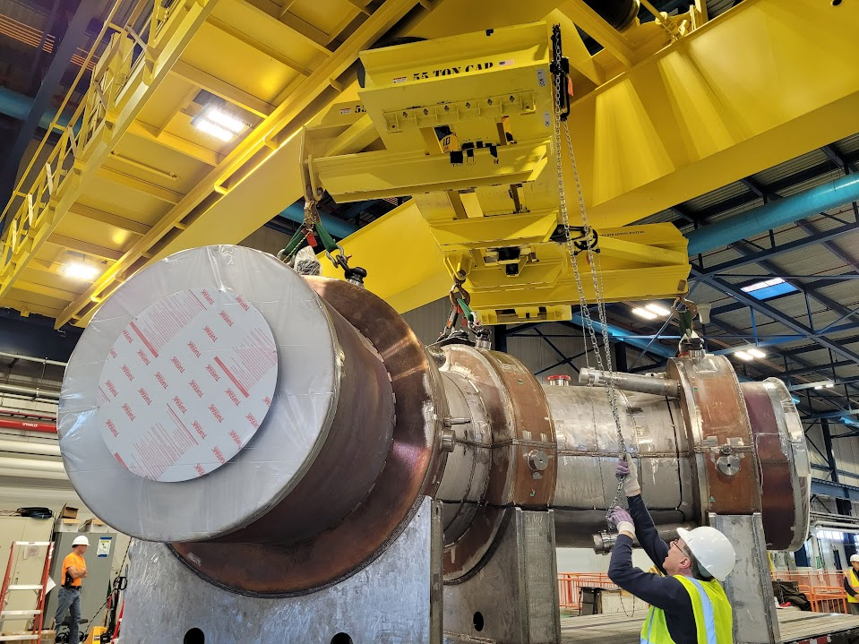
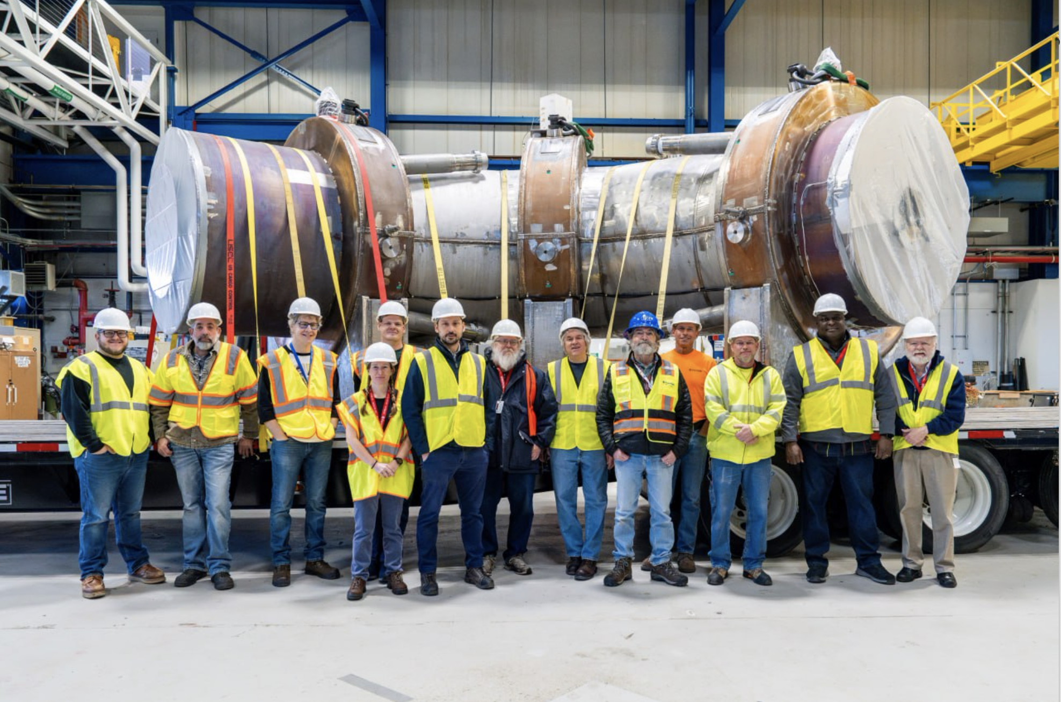
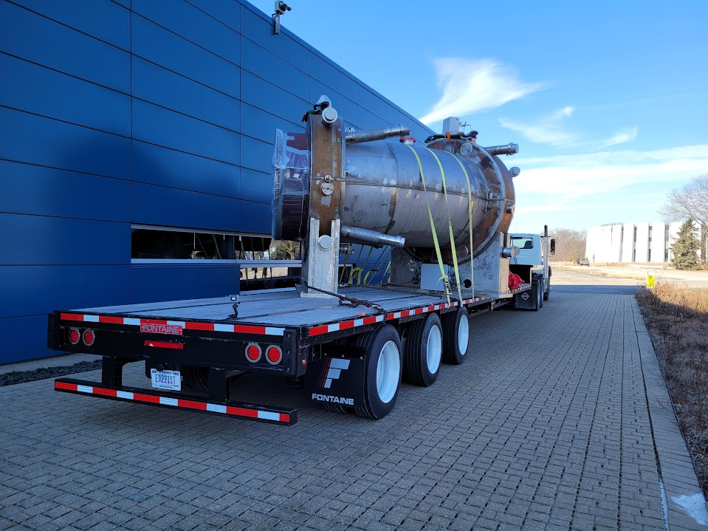
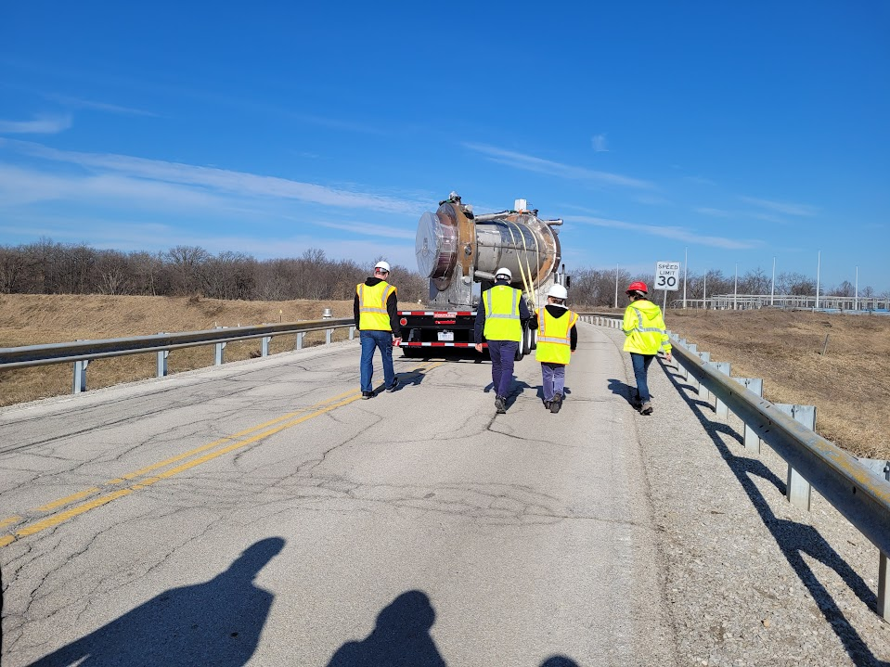
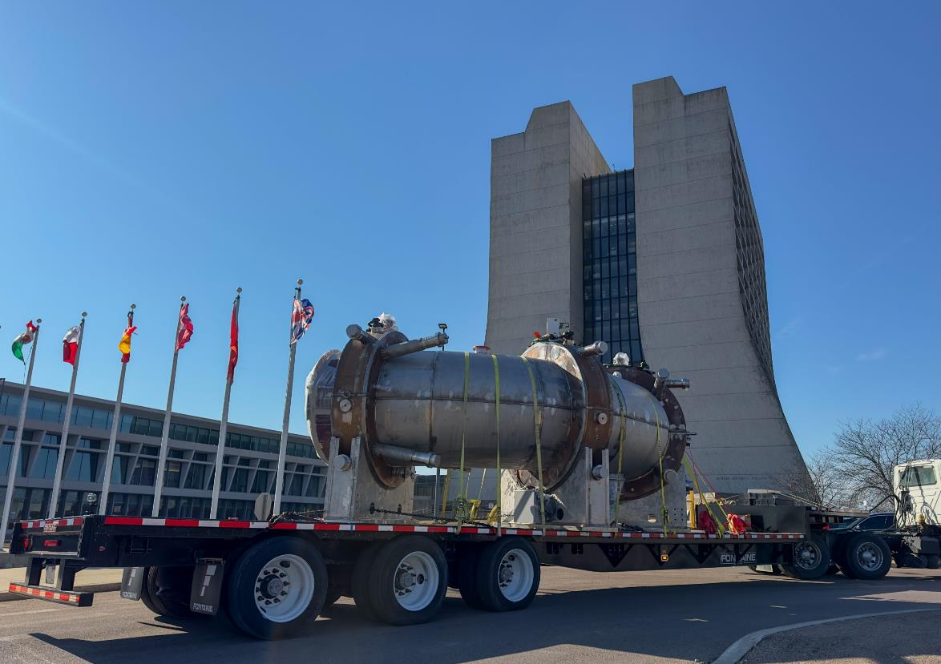
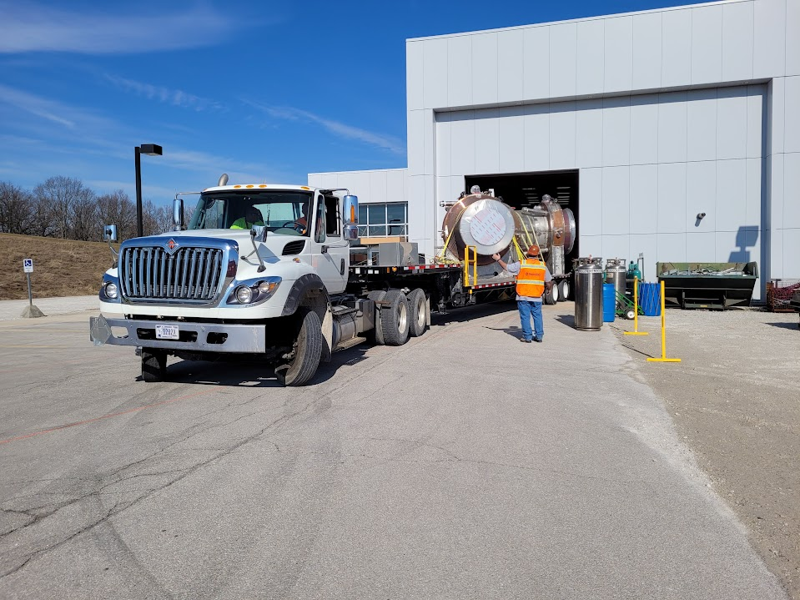
Execution
Weather fully co-operated with our planned move date of 20-FEB-2024

Slide 6
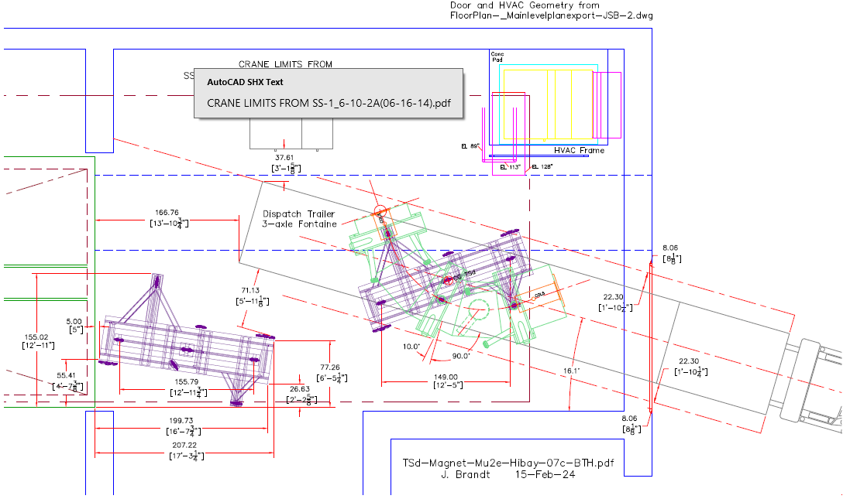
Into the building
Due to the odd geometry of the Transport Solenoid, the truck needed to back into Mu2e at an angle in order to pick the magnet up with the building crane
More clearance to the door this time (8” vs. 5”) plus our extended lane lines
45 minutes of jockeying the truck was reduced to about 10 minutes

Slide 7
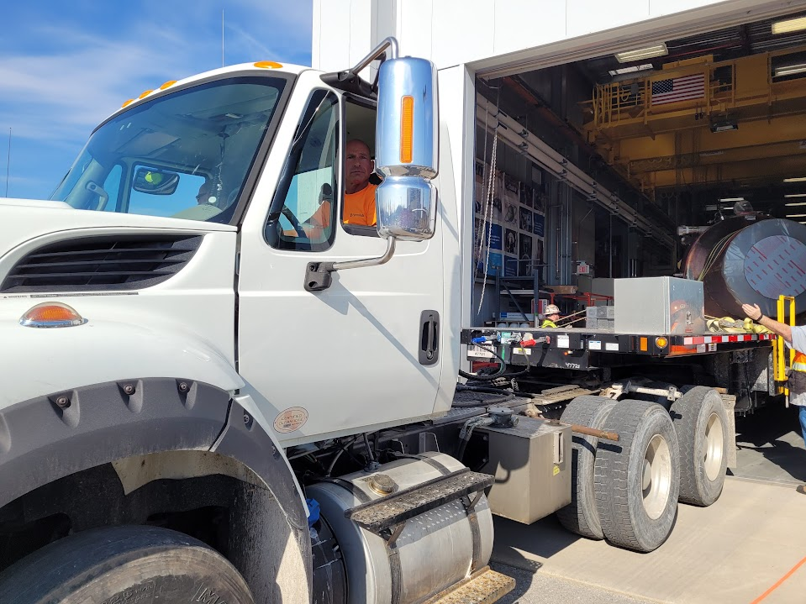
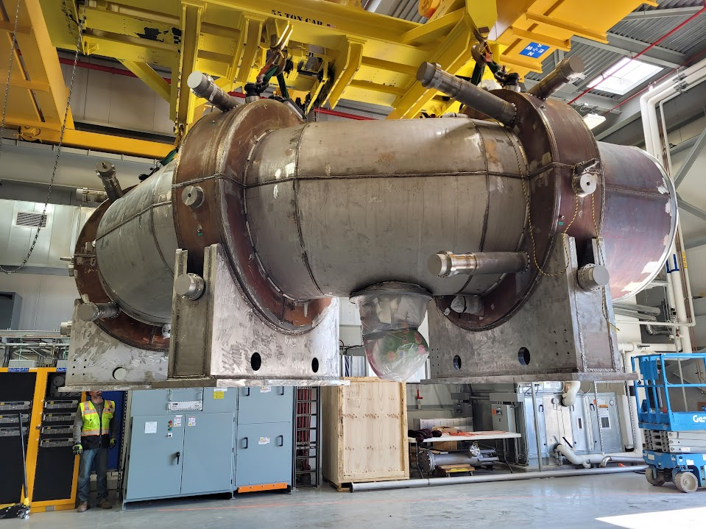
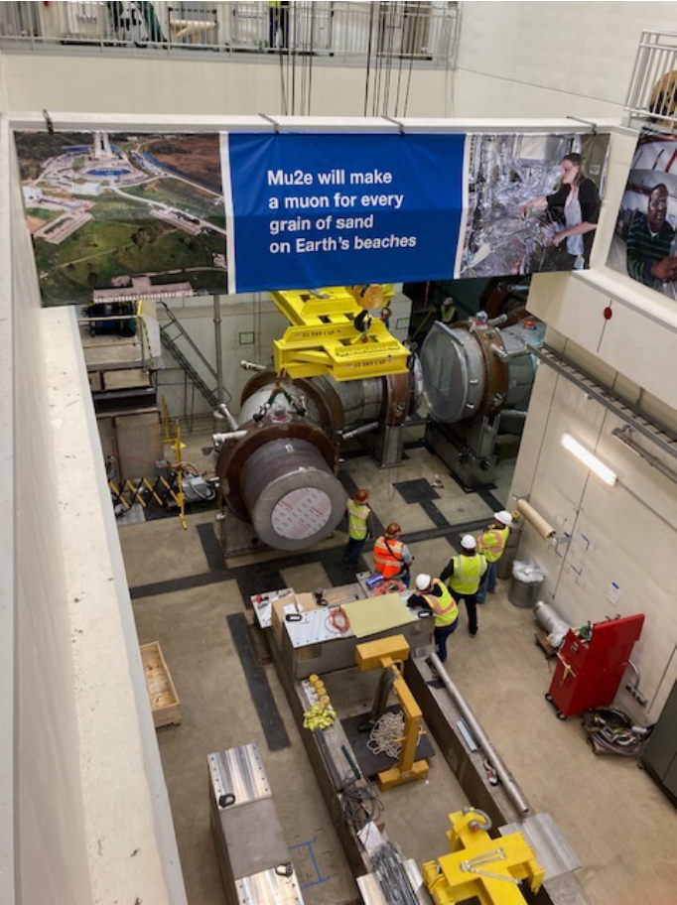
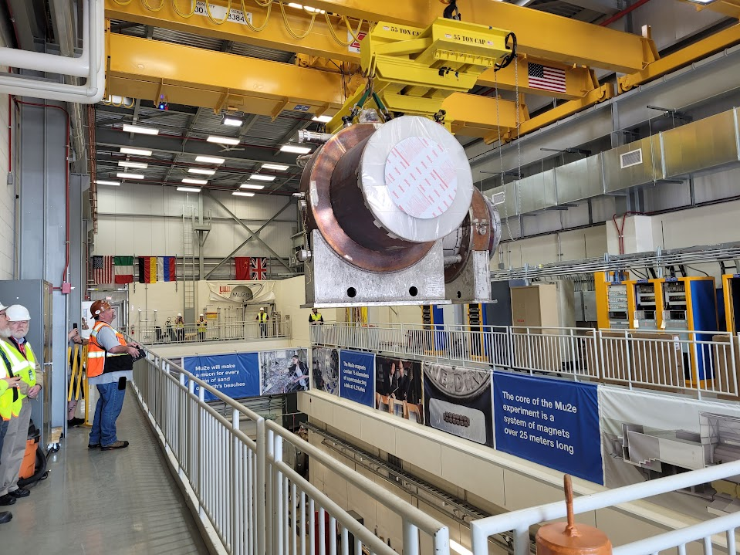
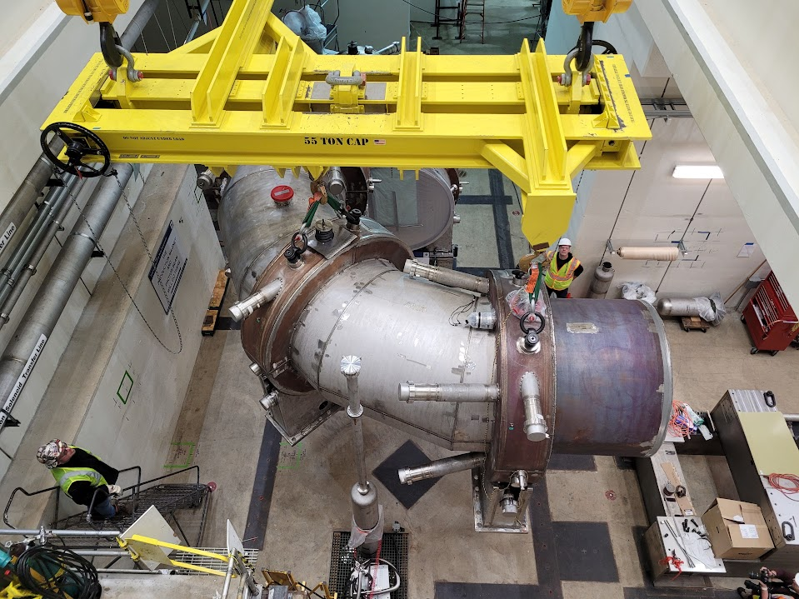
At Mu2e
Temporary stop downstairs to mark the footprint on the floor

Slide 8
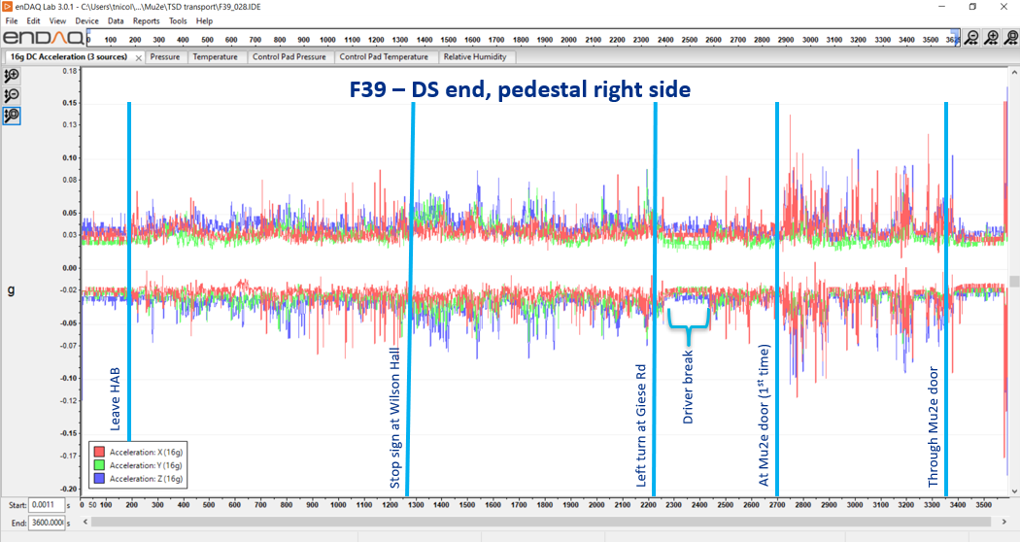
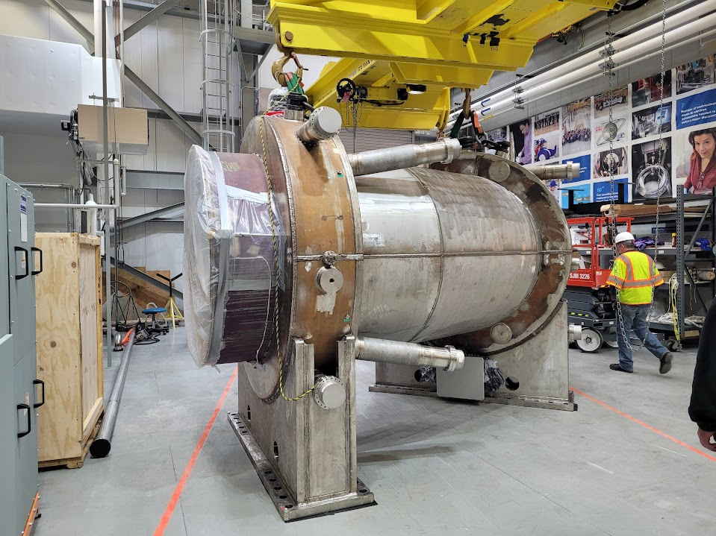
Transportation complete
Biggest loads seen during jockeying at Mu2e --- but still very small (< 0.2g)
Magnet passed basic health checks this morning
Prepping support stands and floor tracks for final move downstairs

Slide 9
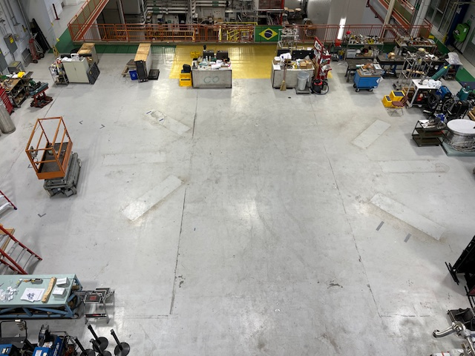
Empty nest

