Slide 1
Project Activities in MSD
Mayling Wong-Squires
AD Operations Friday 9am Meeting
23 February 2024

Slide 2
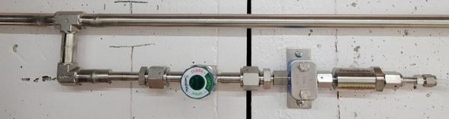
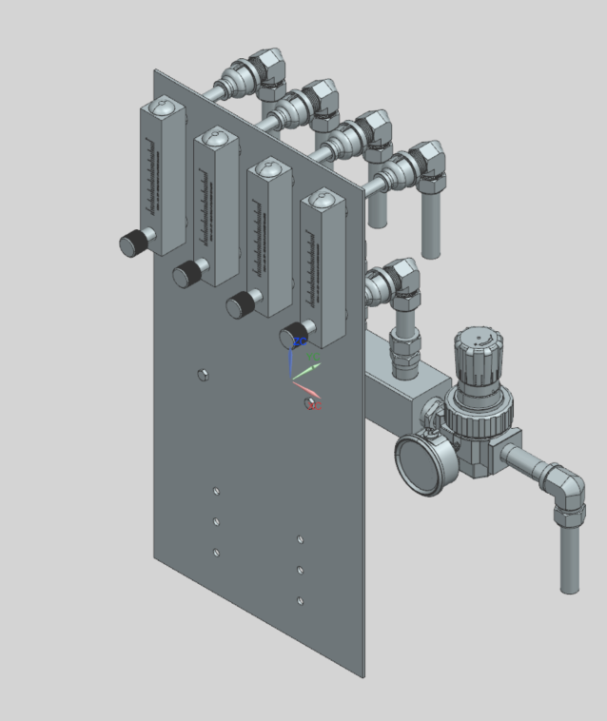
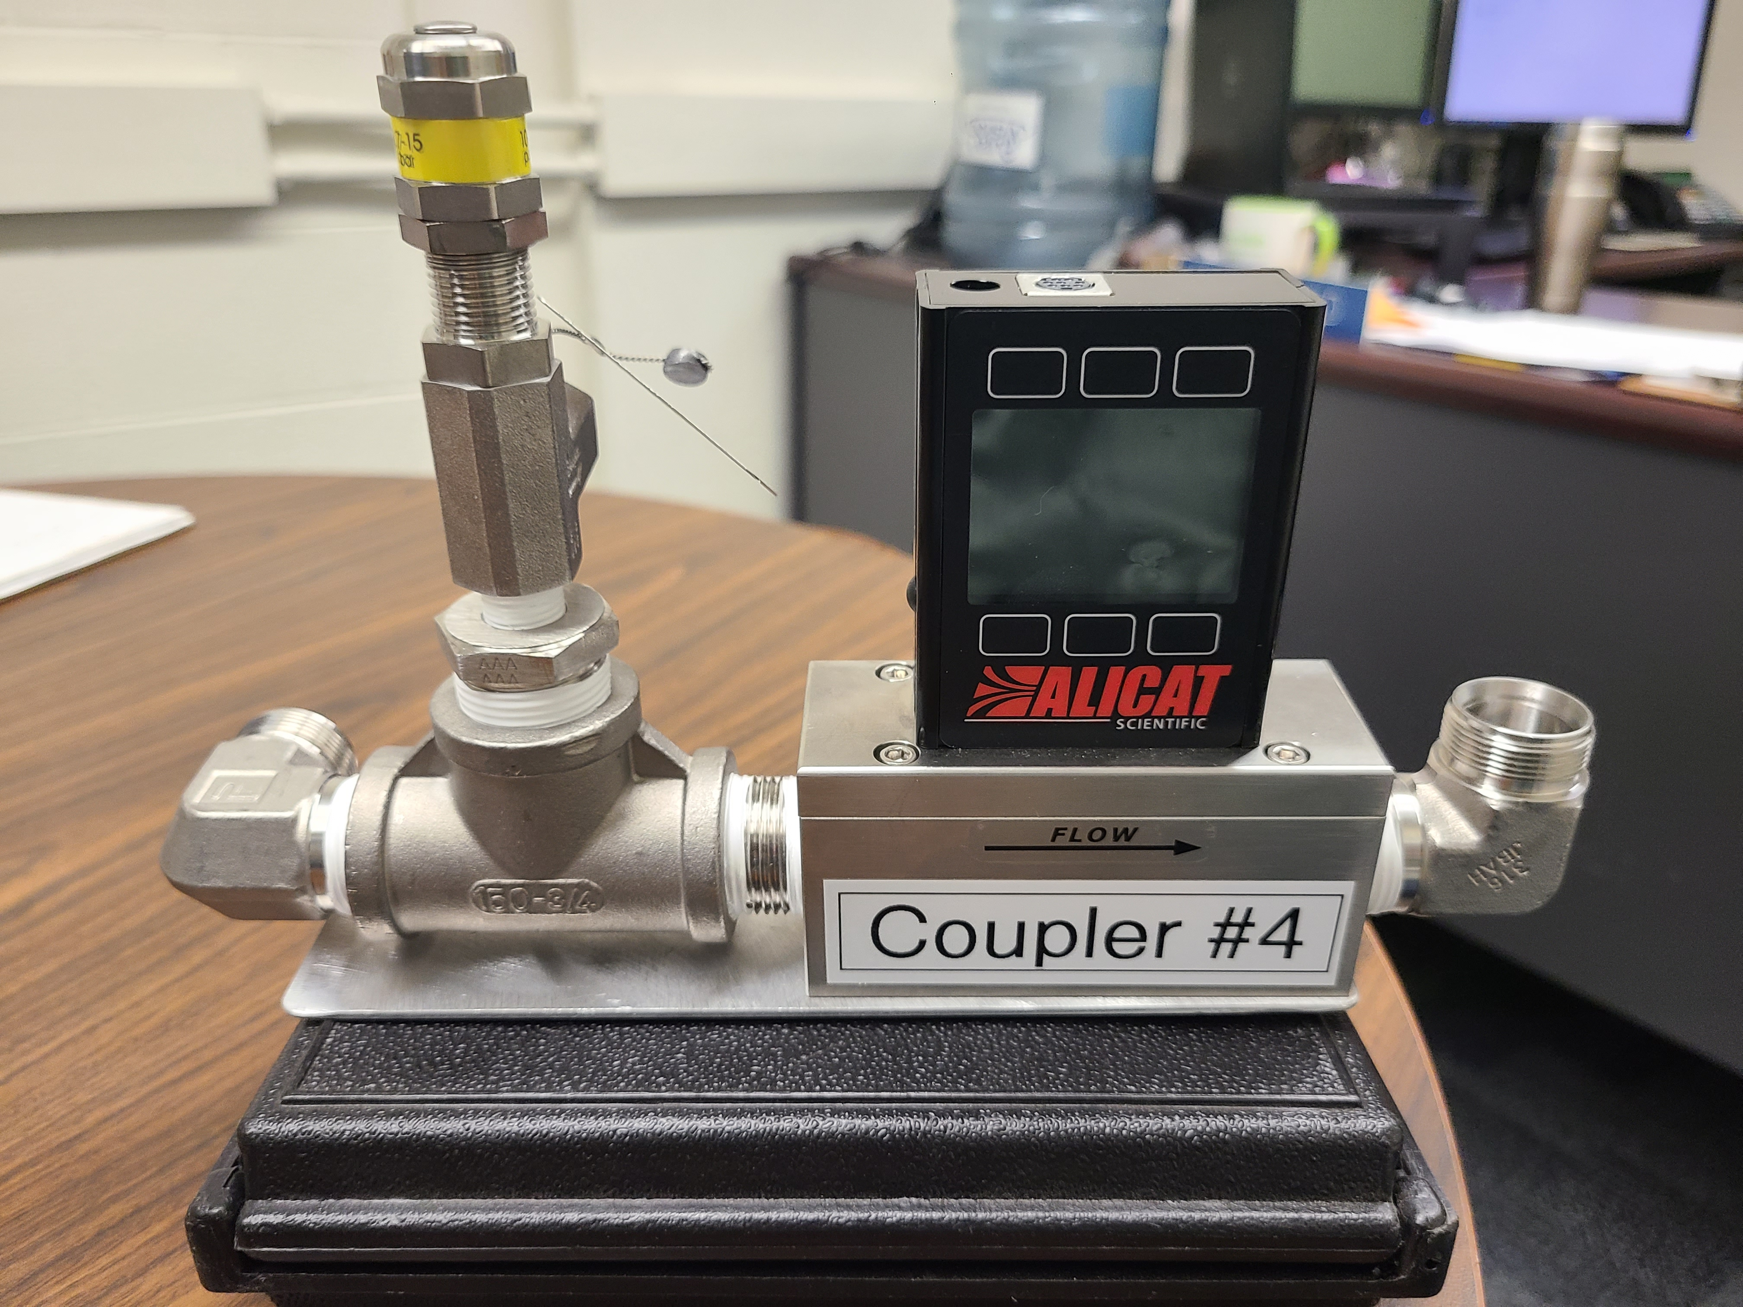
PIP-II LCW Update Maurice Ball (L3 Manager), Michael Geelhoed (CAM), Jerzy Czajkowski (Engineer), Jason Grischkat (CAD), Monika Sadowski (Engineer), Frank Rios (Technician), Amos Horton (Technician)
Monitoring bid process for Procurement Package for Utility Plant Process Clean Water Piping System
Bids due 2/27/2024
Updated Building Infrastructure Interface Specification Document
Continued with finalizing 2D Drawings for Warm Front End Ion Source, LEBT, and MEBT distribution manifolds and releasing in Teamcenter
Reviewed Failure Mode and Effects Analysis (FMEA) of Utility Nitrogen Gas System
Submitted purchase reqs for compressed air distribution manifolds for SRF cryo couplers
Typical piping/valve assembly for a Utility Nitrgen gas line
to be installed in the PIP-II Linac tunnel
Prototype of a compressed air flow and relief valve manifold assembly for a cryomodule coupler
3D model of compressed air distribution manifold assembly for a typical cryomodule coupler

Slide 3
PIP-II Instrumentation Update Dakota Krokosz
Wirescanners
Working to find a new vendor for Alumina96 ceramic frames with silver palladium traces. Our typical vendor Hybrid-Tek is no longer responding to our enquiries. Many vendors have no-bid due to lacking the capabilities to work with these materials.
Continuing to work with UHVD on actuator pricing due to sudden cost increase.
Coming up: Will require a mechanical technician for assembly of units in June.
Emittance Scanners
MEBT AES chamber order has been placed.
Linear actuator orders for both MEBT and LEBT have been placed. Currently waiting approvals.
Port Aligners, CF Flanges, and Feedthroughs have been ordered.
Coming up: Will require a mechanical technician for assembly of units in June.
Diagnostic Cart
Thermal simulation of the SNS Faraday Cup to see if it can be air cooled rather than water cooled is still in progress.
Transportation plan has been written and is pending review.
Waiting for RadiaBeam to issue a multi-stage PO for the development and delivery of the Bunch Shape Monitor.
Internal design review scheduled for middle of March. Procurements scheduled to begin in July.
Radiation simulations for 32 MeV and 177 MeV have been completed.
BPM’s
Replacement MEBT BPM buttons due last week of February.
Order for 2” aperture BPM prototype buttons placed; items estimated to arrive in June, then testing by James Fitzgerald on the test stand.
Coming up: Development of shoebox BPM will start in March.

Slide 4
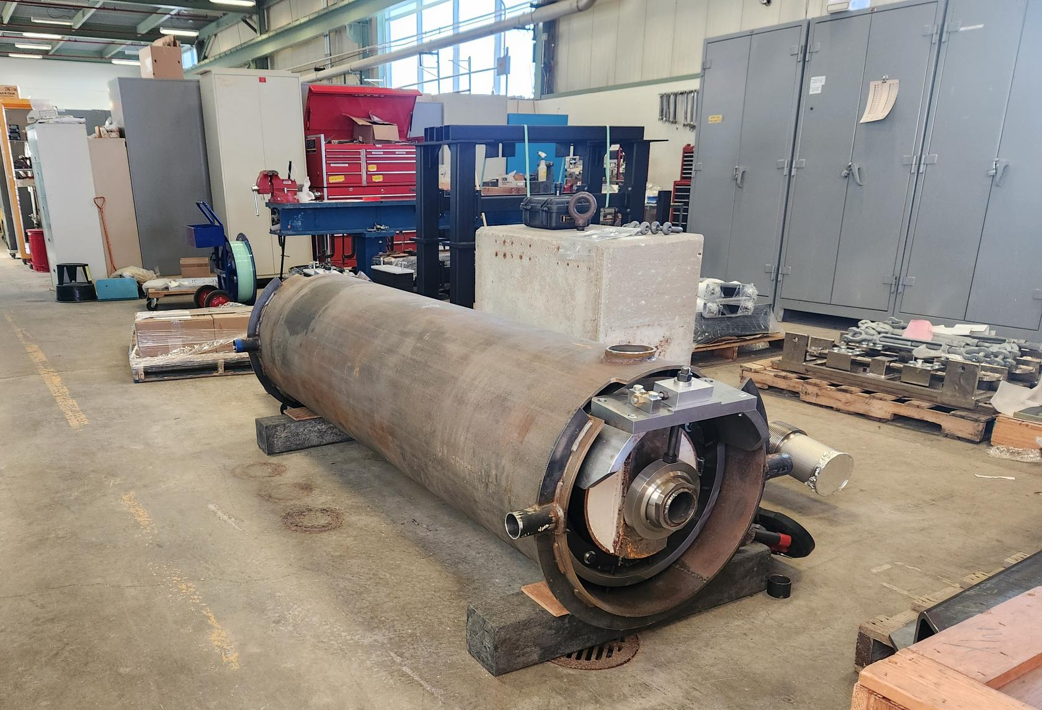
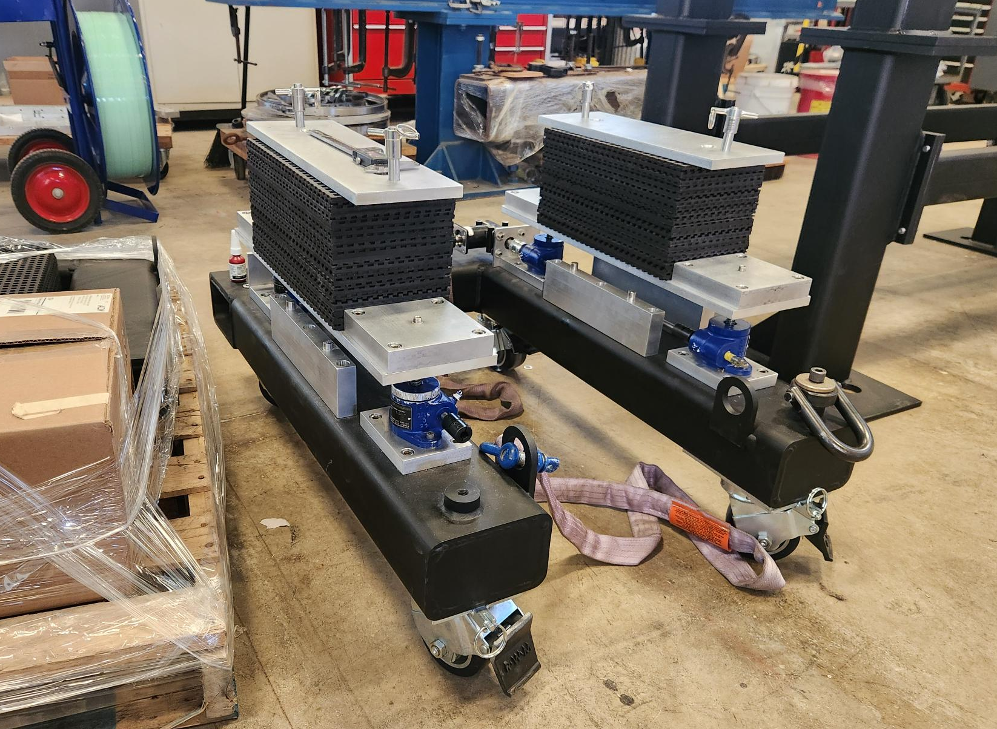
Mu2e Beamline Update Chris Ader, Jason Morin, Pat Minton,, Bob Steinberg (Mechanical Engineer), Dirk Hurd (Designer), Dan Vrbos (Technical), Greg Bulat (Procurement)
Working On:
Planning and procurement package for the installation of the entrance and exit collimators
Procurement package of riggers in process
Beam Sheet of layout by Project
Parts needed for the installation are done
Coming Up:
Installation of the entrance and exit collimators
Department Resources Needed:
Technician (assembly, testing of septa cart, and planning of collimator installation)
Fabrication Procurement (septa cart modifications)
Exit Collimator at the A0 Building
Septa Cart at A0 Building

