Slide 1
Muon Campus Operation Report
Jim Morgan
Friday 09:00 Operations Meeting
February 23, 2024

Slide 2
Muon Campus status
Working on recommendations from SAD/ASE Review
  ARR scheduled for March
  Also working on Shielding Assessment for future Mu2e operation
ESS1 Electrostatic Septum at A0 Clean Room
  Working on improvements to clean room and are revising assembly procedure
  Extra preparation for assembly has slowed timeline for installation
  Bake-outs of high voltage feed-throughs and stand-offs are finishing up
  Failure analysis and corrective plan are being conducted in parallel
  Cathodes have been straightened and will be polished and micro-polished
  Complication due to A/C installation and when to start – use portable temporarily?
Preparations for Electrostatic Septa mechanical installation
  Waiting for septa stands to be completed
Waiting to remove blocks from D40 Hatch for incoming and outgoing magnets
  8Q24 with rad hardened water lines at AP-50, ready to be lowered into tunnel
  Forklift and rad hard 8Q24 will be lowered into tunnel for installation
  Existing 8Q24 and four NSA sextupoles that had water leaks go to TD
  Need Q205 vacuum pipe parts from Machine Shop before starting work
Last rad hard water line installed on Q206
Study – M1-M3 Optics
Study – Alternative M5 optics
KPS5A PFL Repair
MC-1 Controlled Access
G-2 Trolley Run
Intentional Accelerator
Standby Period
<------------Week Days -------------------→

Slide 3
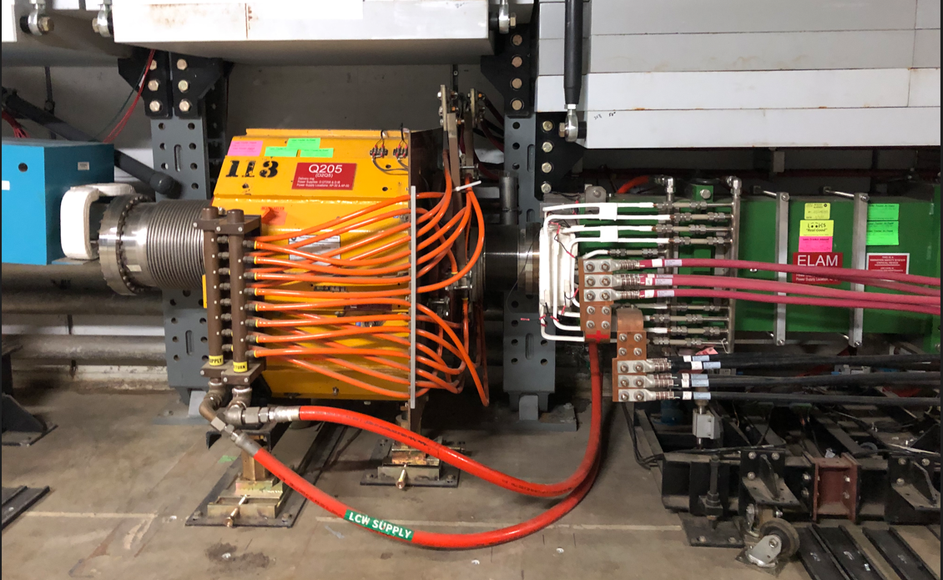
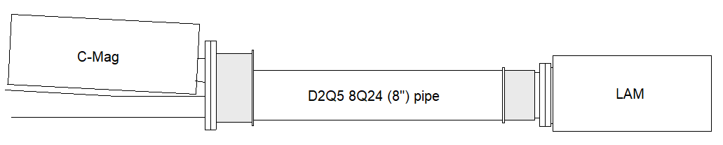
Elam, Q205 and special pipe
Change from Conflat to QD flange
Extracted beam
Delivery Ring beam

Slide 4
Upcoming work
ESS1 work will continue in the A0 Clean Room
  ESS1 assembly should happen next week, survey the following week
  Transport to NWA next for vacuum pump-down and high voltage testing
  High voltage conditioning follows at NWA
  Could optimistically be ready for tunnel installation in the beginning of April (late March in last week’s report), also needs stands to be ready
  High voltage power supply at AP-30 needs to be ready too, would stay at NWA and remain at voltage if supply is not ready
  If delayed long enough, vacuum spool will be installed in Delivery Ring
Q205 magnet swap and special vacuum pipe replacement
  Waiting on parts to be machined and/or fabricated for Q205 vacuum pipe
  Opening of D40 Hatch has been delayed until parts are in hand
Q203 location ready to for ESS1 installation
ARR Preparations for March

