Slide 1
MQXFA17 Overtemp excursion on NbTi splice And Proposed Recovery Options
D. Cheng, for the AUP team
February 22, 2024

Slide 2
Background
During the magnet splice operations two experienced technicians were assigned to make the second layer splice (“3/4” joint between Q1 and Q4)
When the operation was completed both technicians moved on to other tasks
Assumed that the other would turn off the variac that was controlling the heater
Approximately ~10 min. passed before building occupants started smelling burning G11
The variac was then powered off, but the G11 around the splice block was blackened by that time
No alarms or thermal protection were built into the splice tooling, since it was always supposed to be monitored for solder flow at ~200C, etc. when powered on
G11 discoloration was sanded/stoned for clean up, splice was packaged up as normal to stay stable while conditions were examined

Slide 3
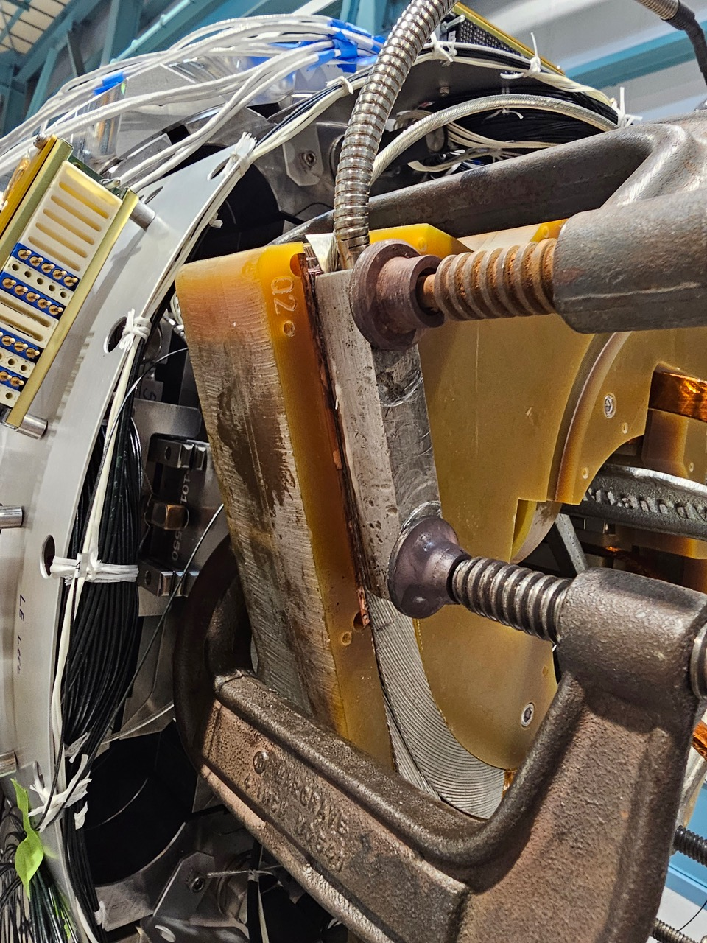
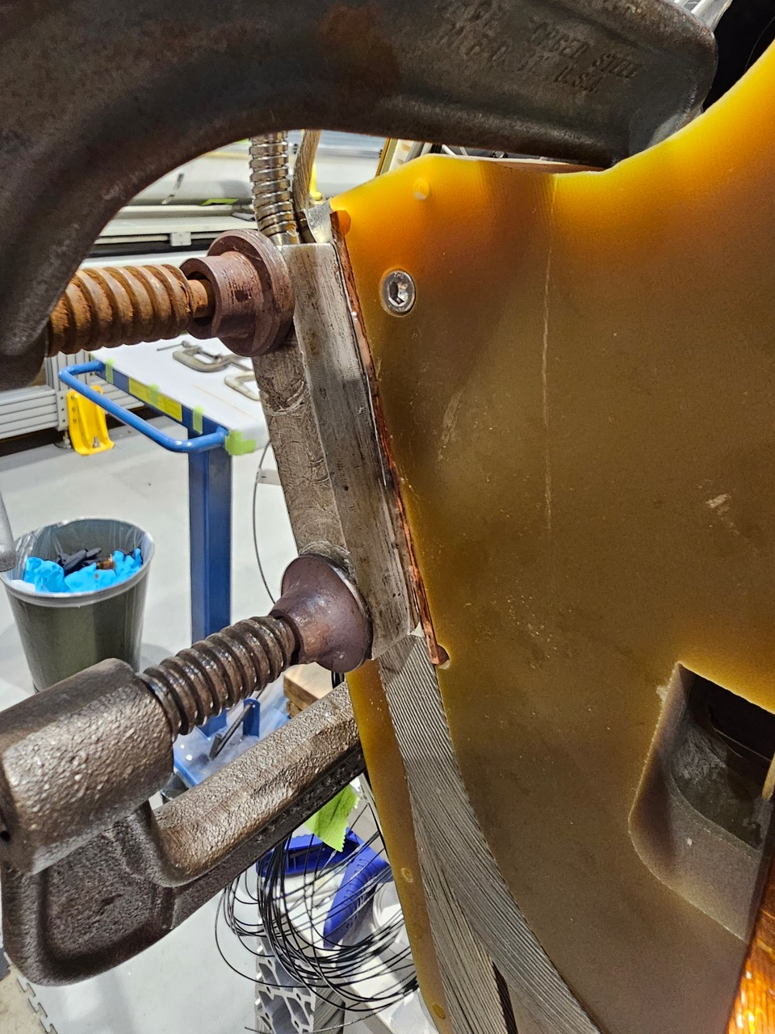
Background (2)
Splice joint setup

Slide 4
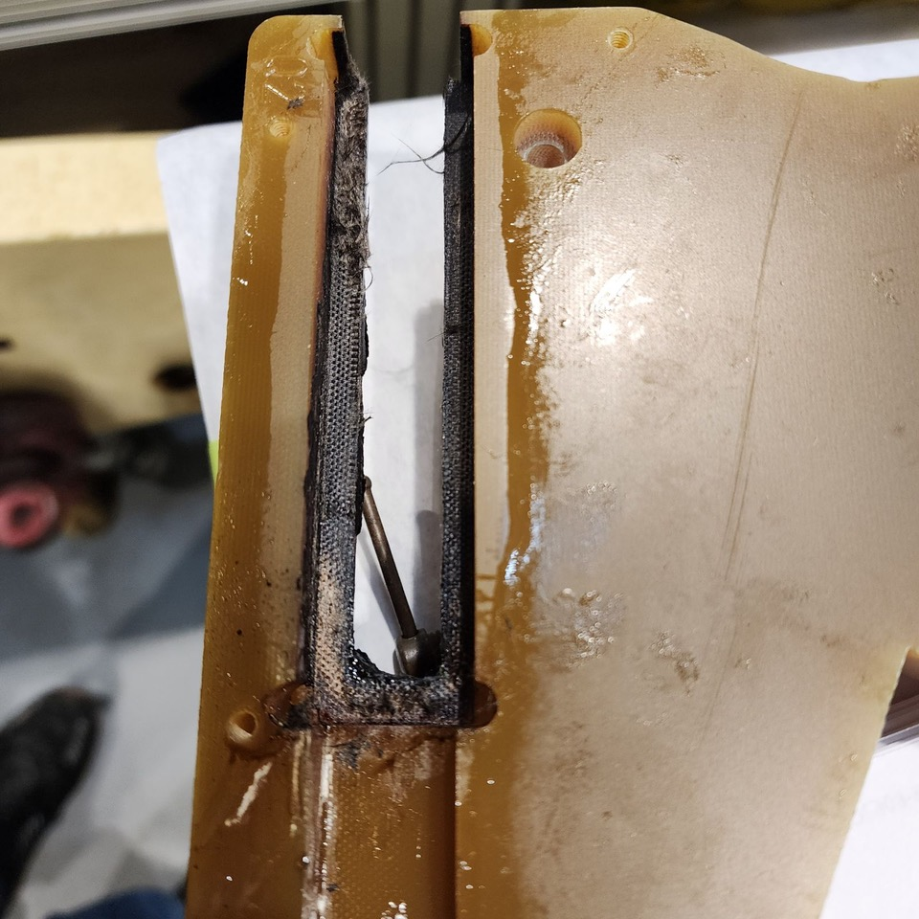
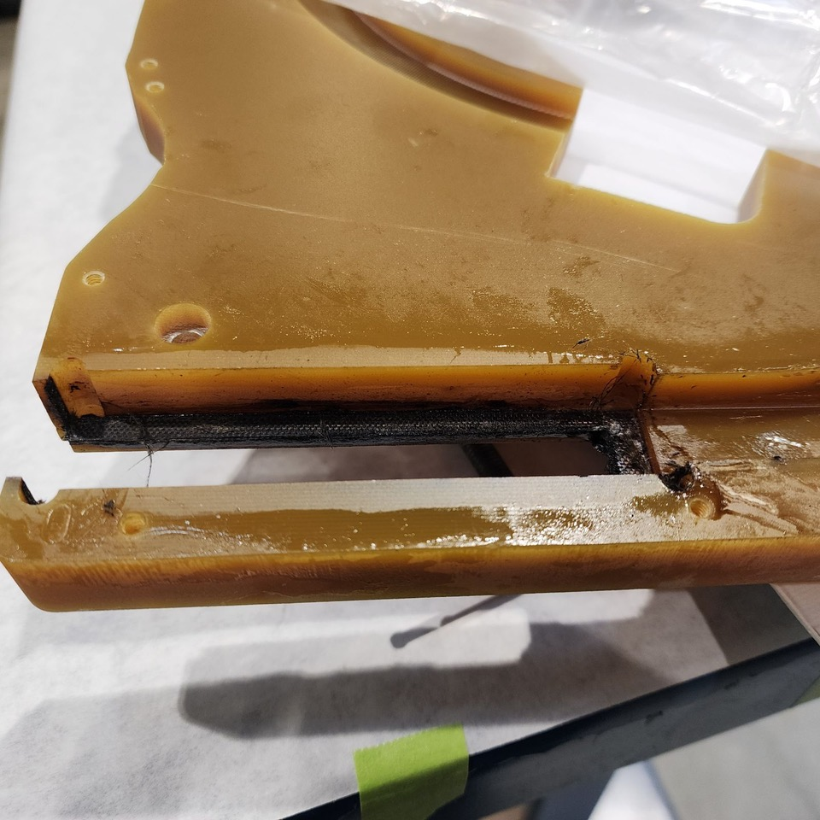
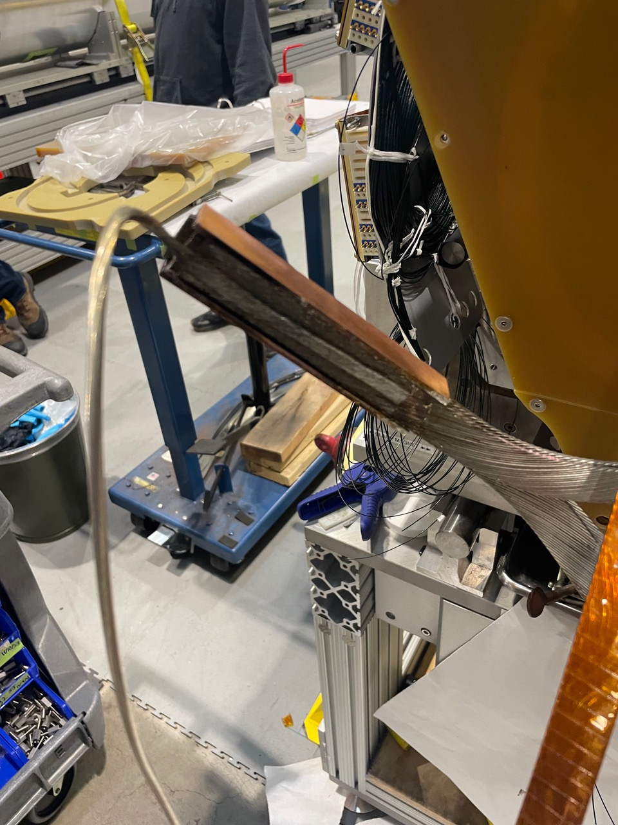
Background (3)

Slide 5
Preliminary Examination
Because no temperature monitoring was present the actual excursion was unknown
Flux burns off ~380 C, so temperature must have exceeded this value
Some sample G11 ”burn tests” were performed
One G11 pole key (bulk)
solder melts @ 190C approx 1 min 30 sec
Flux is gone @ 3 min 45 sec 380C
Discoloration @approx 380C-410C
Burnt G11 smell @ 410-415C
Visibly G11 burnt @ 480C
520c @6 min 30 sec
One thinner piece (~1/8” plate)
solder melts @ 190 1min 30sec
Flux is gone @ 3 min 45 sec 380C
~400 C visibly discoloring @ 4 min, and delaminating
Same clean up method Acetone and a wire brush after cool down
Preliminary conclusion from these tests is the the joint may be reached anywhere from 400C - 500C

Slide 6
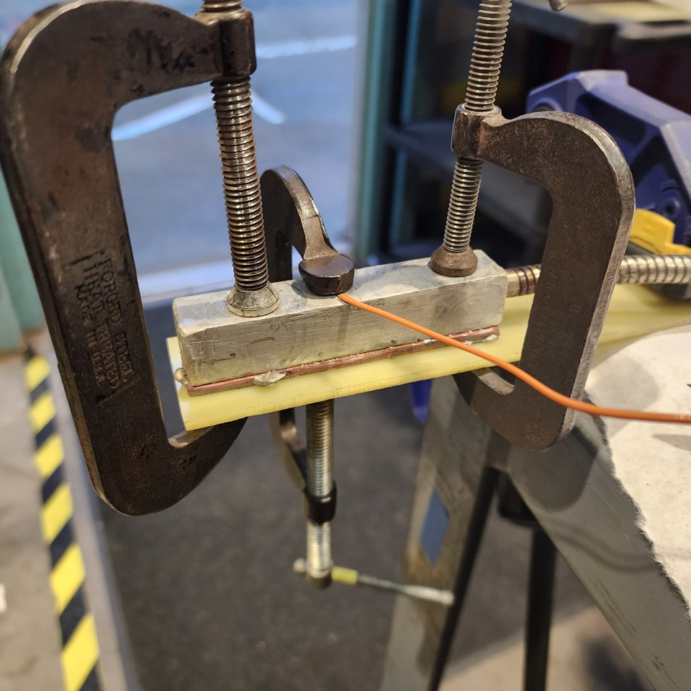
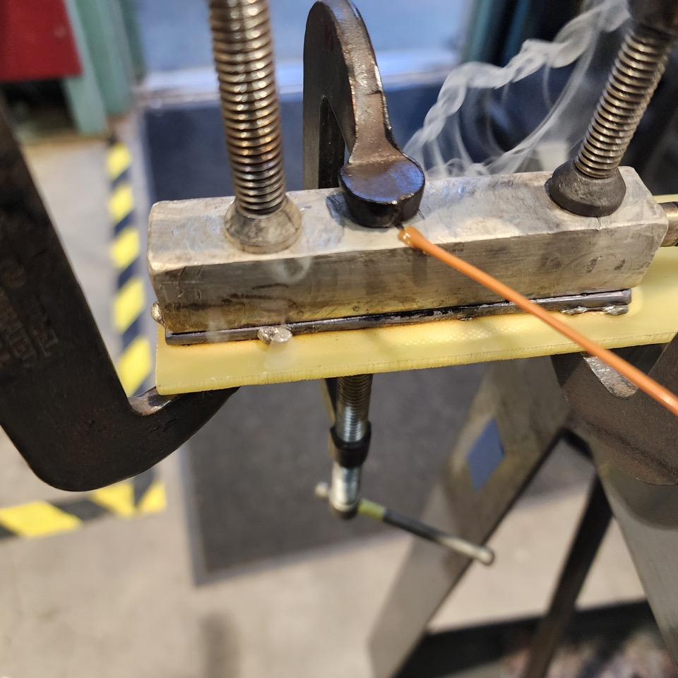
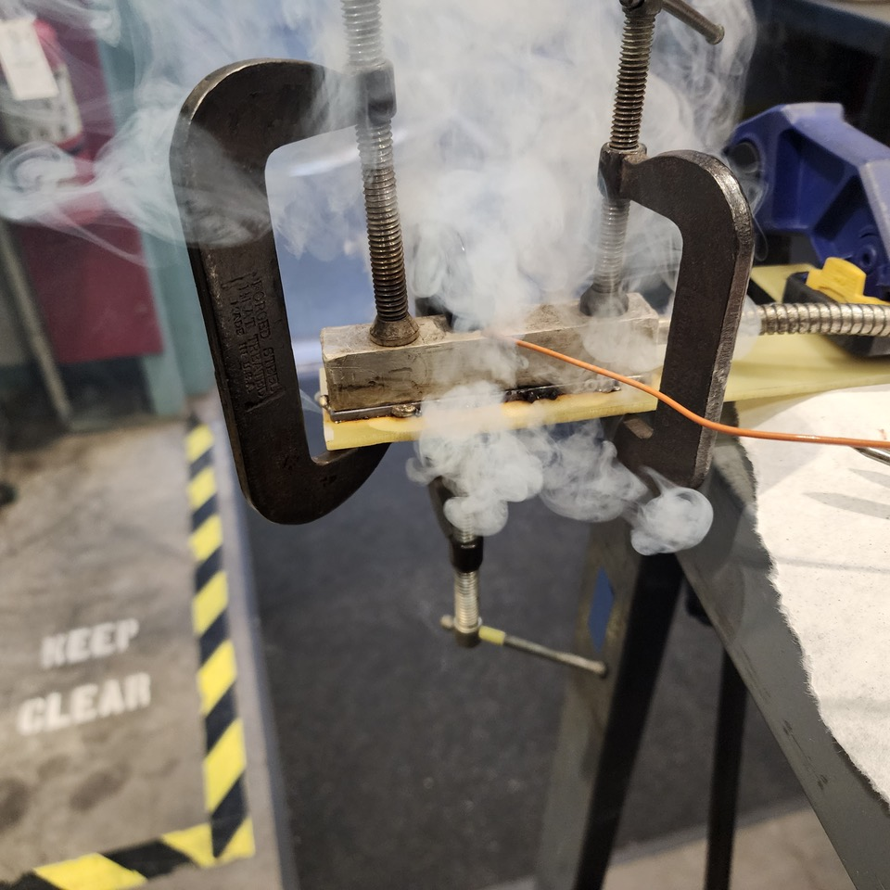
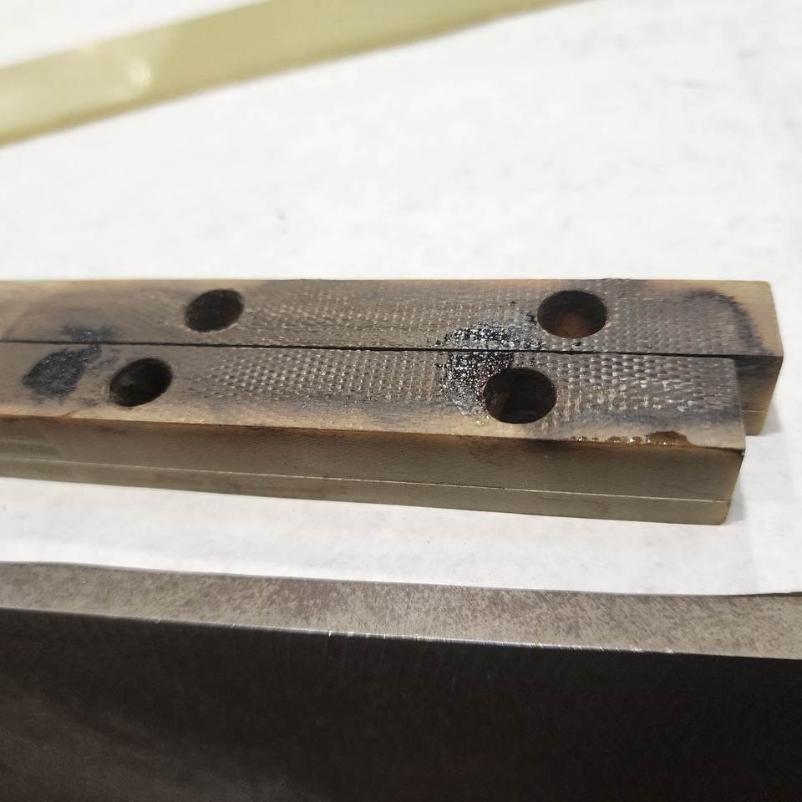
Preliminary Examination

Slide 7
Additional Examination Possible?
Can the CLIQ lead be used to determine temperature excursion in the joint?
Micrograph possible to compare with non-heated CLIQ lead?
This might be a NDE way to determine temperature excursion

Slide 8
Update
Splice joint was measured; currently showing 60 µohm resistance across the joint

Slide 9
Sectioning the NbTi splice joint
Each ~6 mm section will be cut in half
This allows metallography and magnetization measurements to be performed on the same sample section
Two samples
MQXFA17 overheated joint
Mockup sample joint
CLIQ lead
NbTi Leads

Slide 10
Proposed Replacement of NbTi Leads
Two options considered:
Option 1: Replace NbTi lead in the splice box
Will not require undoing of magnet preload
Least invasive
Dependent on the clearance of leads
This is a more complicated design solution
Option 2: Replace NbTi lead where it passes through the endplate
More invasive: Will require undoing of magnet preload (half azimuthal, full axial unload)
Fewer parts will need to be modified, but simple design

Slide 11
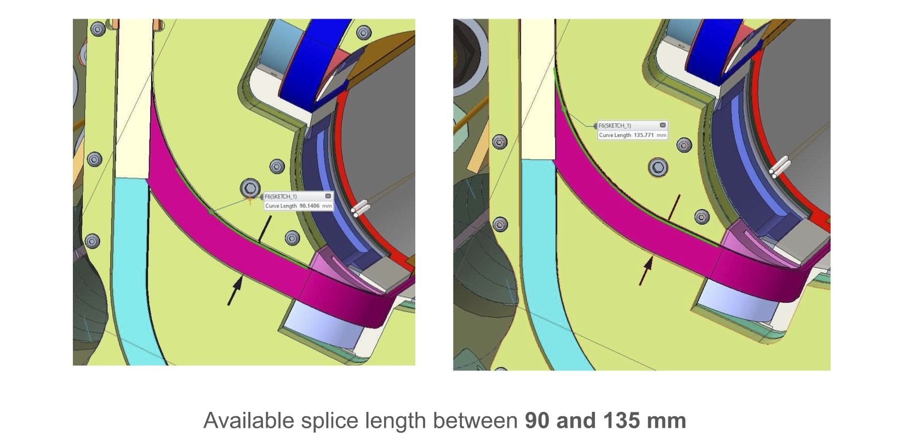
Proposed Replacement of NbTi Leads
Option 1: Examined splice box clearances
There is not enough length available to splice a NbTi lead replacement to the Q4 lead

Slide 12
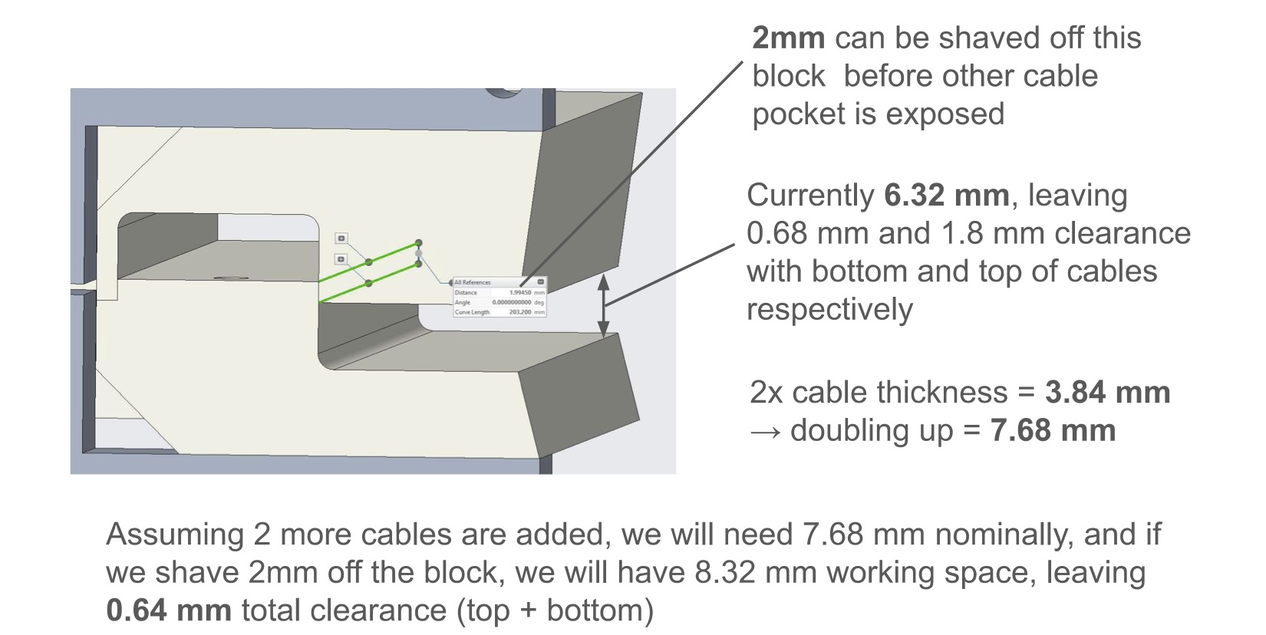
Proposed Replacement of NbTi Leads
Option 2: Placing NbTi splice in the endplate
Clearances are such that the restraint guide can be machined to provide clearance for two new NbTi leads
New NbTi leads

Slide 13
Option 2 Replacement of NbTi Leads
Option 2: Placing NbTi splice in the endplate
Replacement Lead
Cut Lead
New splice joint

Slide 14
Option 2 Replacement of NbTi Leads
Option 2: Placing NbTi splice in the endplate
Can be performed for both Q1 and Q4 leads
May also need to modify lead support ramp

Slide 15
Option 2 Replacement of NbTi Leads
Option 2: Placing NbTi splice in the endplate
115 mm splice joint (same as in normal joints) can be fit ~23 mm from the Coil theoretical end
May also need to modify lead support ramp

Slide 16
Option 2 Replacement of NbTi Leads
Option 2: Placing NbTi splice in the endplate
VT locations can be provided
Existing VT pass-thrus can accommodate 2nd wire for monitoring these new splice joints
Extra VTA01b wires from coils (currently unused and bundled) can be utilized for this pair

Slide 17
Option 2 Replacement of NbTi Leads
Summary of operations (off-normal) needed:
Undo splice joints, remove splice box
Unload magnet to half-azimuthal, no axial; remove LE endplate
Cut NbTi leads of Q1 and Q4
Modify/fabricate G11 restraint guides
Add new NbTi leads
Redo magnet preload to full axial, full-azimuthal
Make up magnet splices, include extra VT wires for NbTi splice joint monitoring
Then the usual magnet EQC/connectorization prep to finish magnet will follow

