Slide 1
MQXFS01 Lead Repair
Steve Krave, Dan Cheng
12/9/2015

Slide 2
Last Time
Preparing to splice leads
Modifying G10 to accommodate Splices

Slide 3
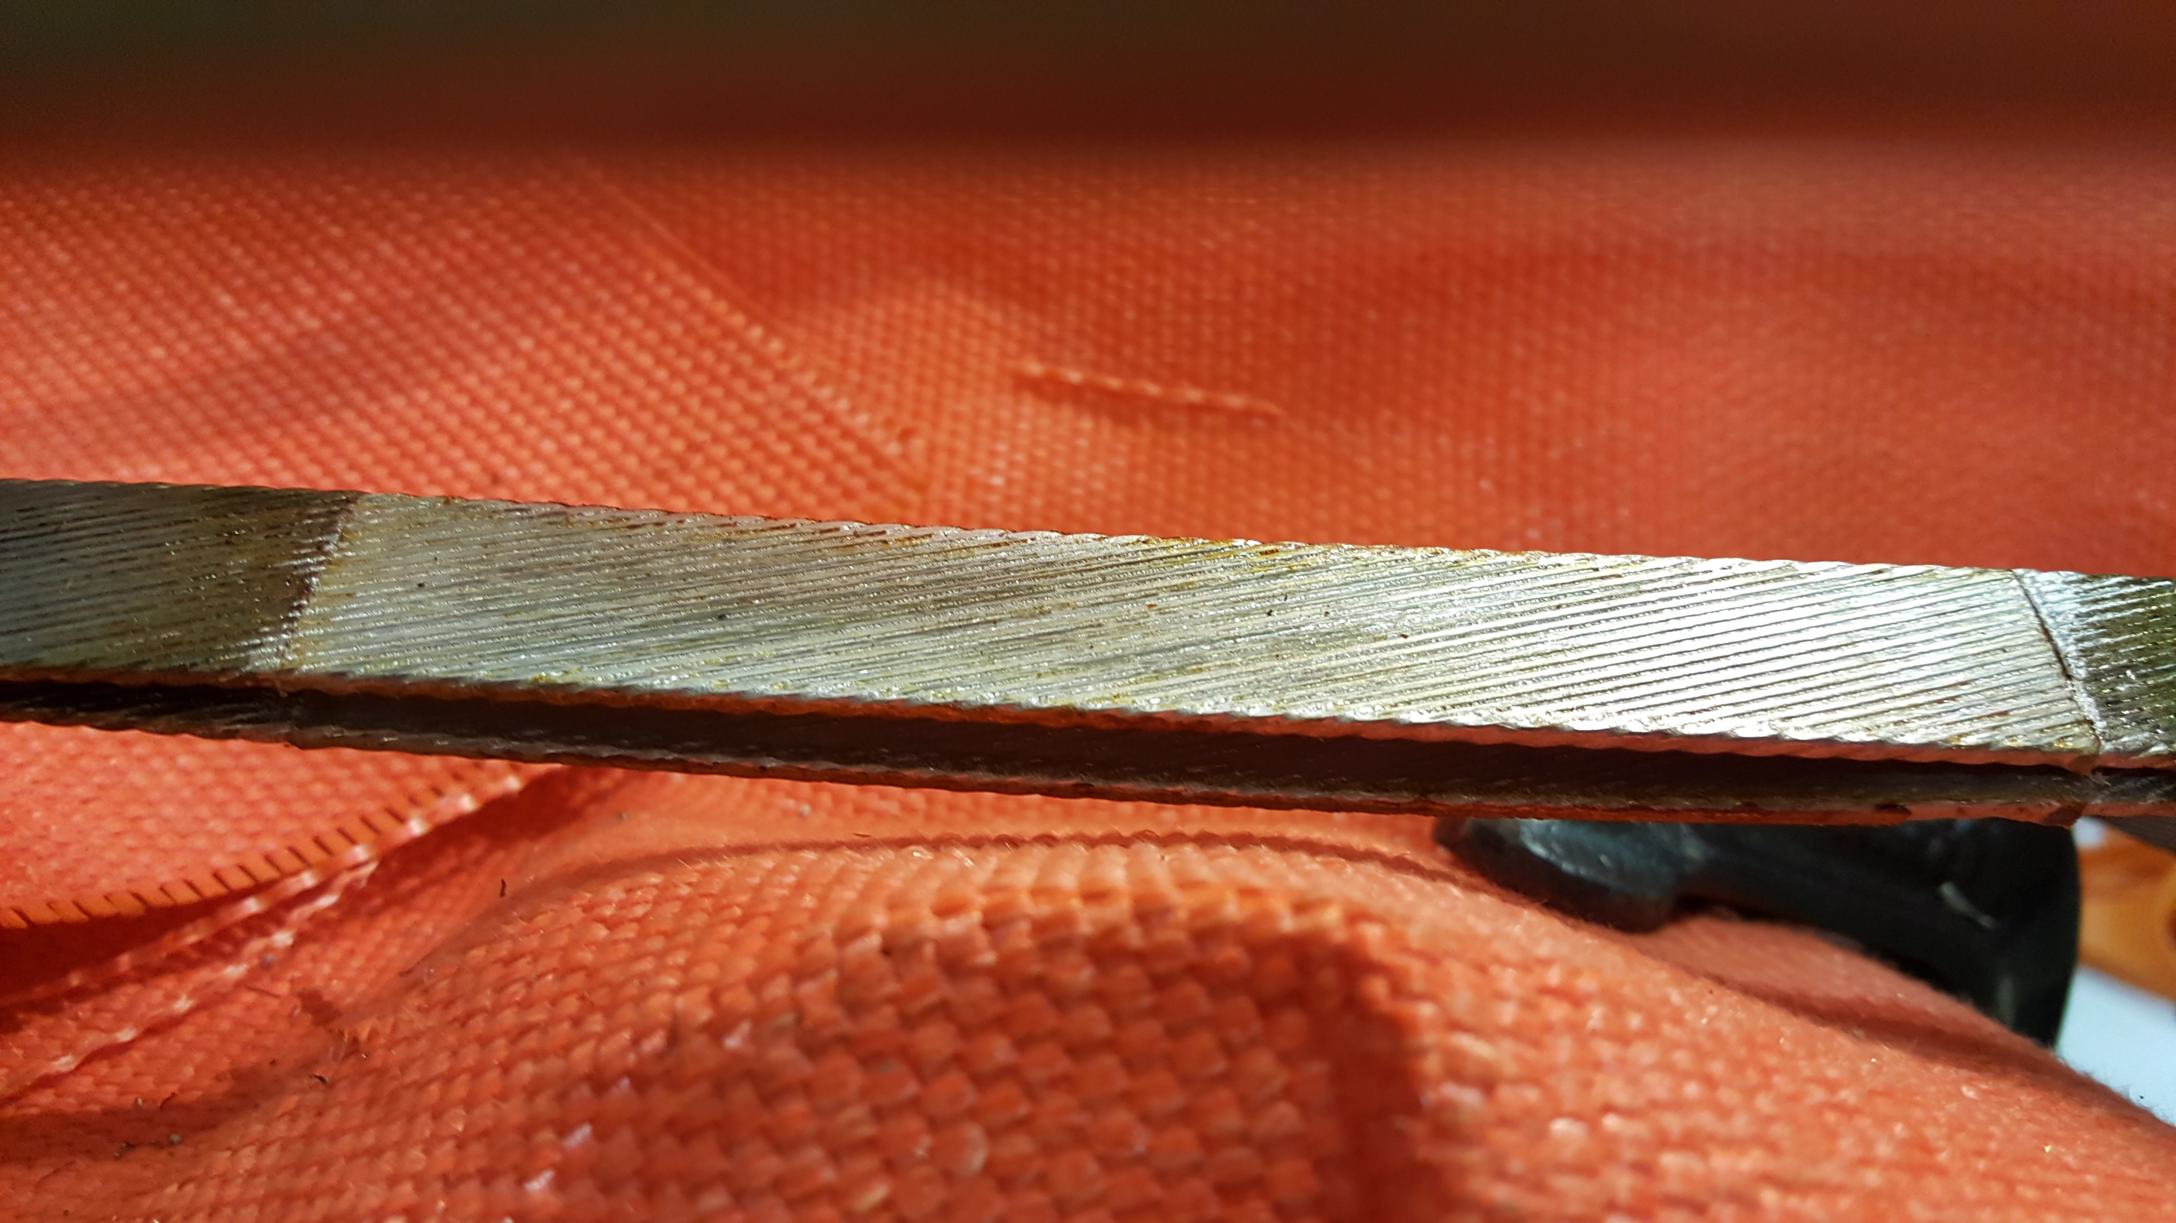
Pre-tinning of Leads
Leads and extensions were tinned using 70/30 Pb/Sn solder and Kester 1544 Rosin Activated Flux
Tevatron Solder/flux
VMTF Solder/flux
Good wetting observed
Consistent quality

Slide 4
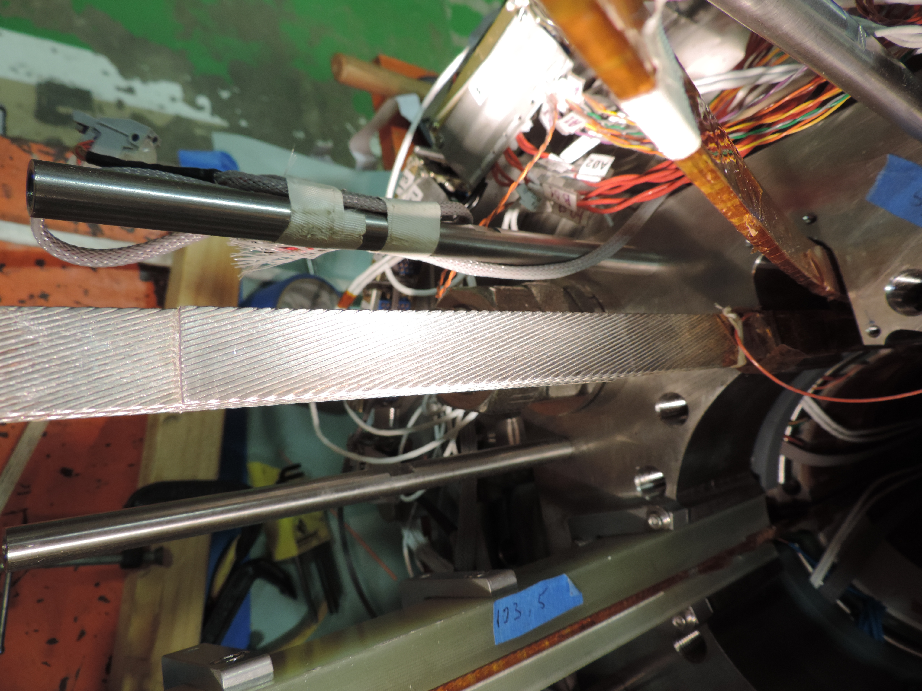
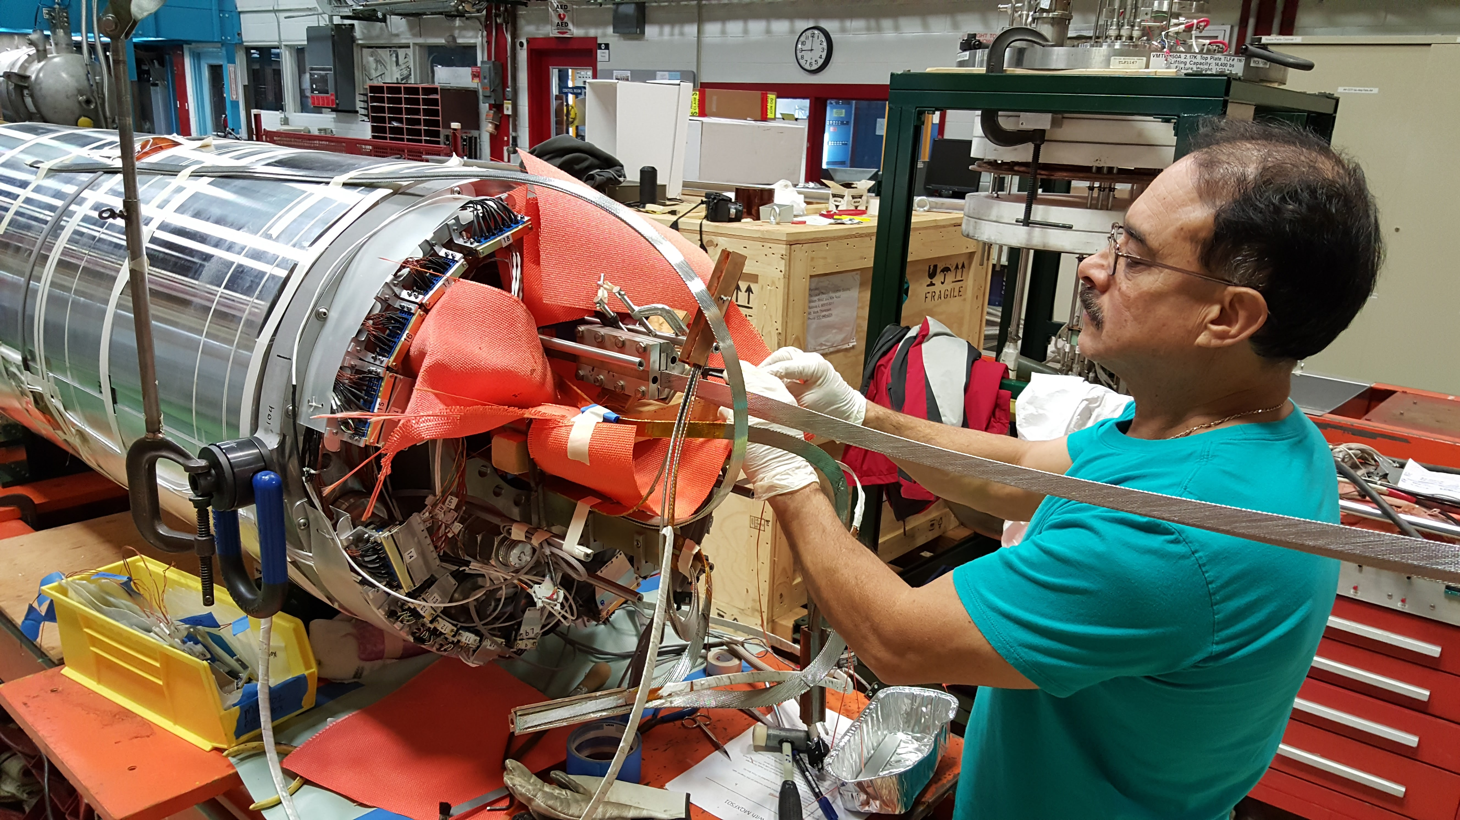
Soldering of Leads
Joints were staggered with 3 cable-splice interfaces
Splices appear to be very good.

Slide 5
Adding Voltage Taps
Voltage taps have been added and the connectors will be rung out shortly.
Pizza box will then be re-assembled.

Slide 8
Older Slides

Slide 9
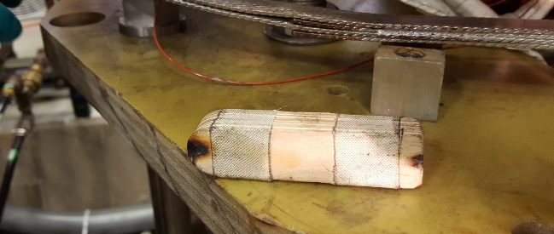
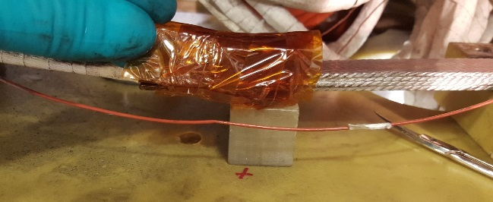
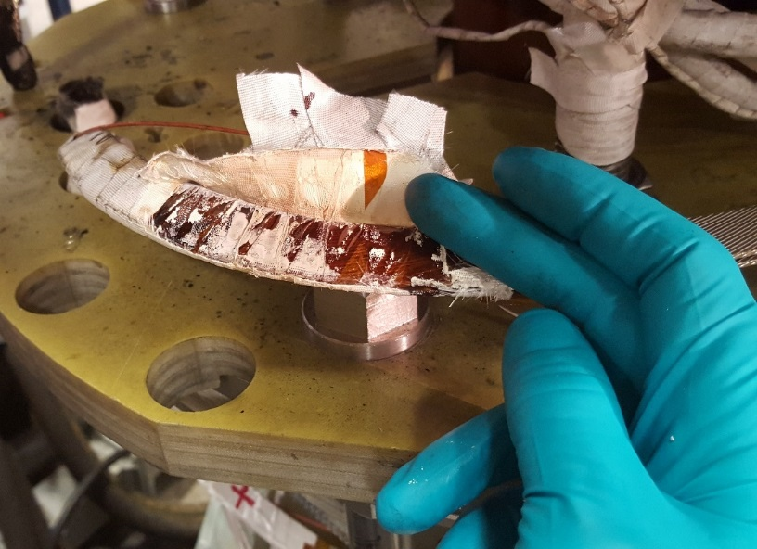
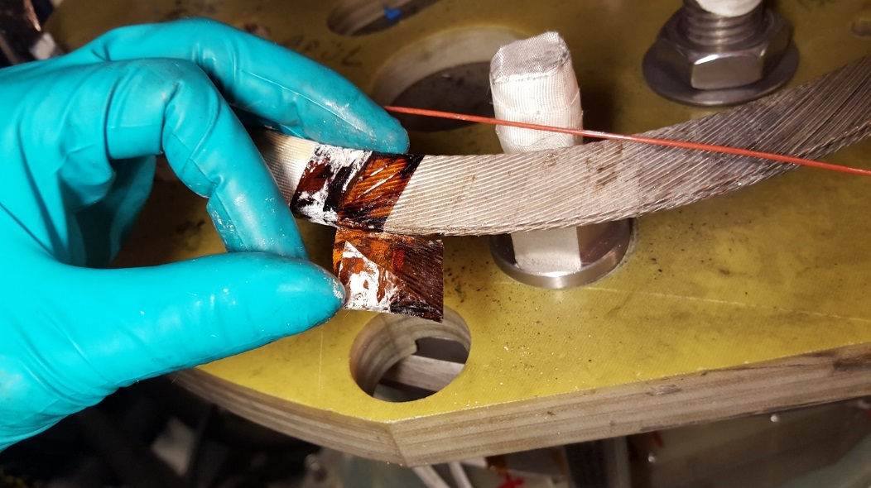
Positive Lead from VMTF Splice to Support Plate
At the beginning of the splice (side closer to magnet) the Kapton looks “crispy”
Burned popsicle stick standoff shows signs of overheating
Near support plate, burned Kapton and discolored staybrite are visible

Slide 10
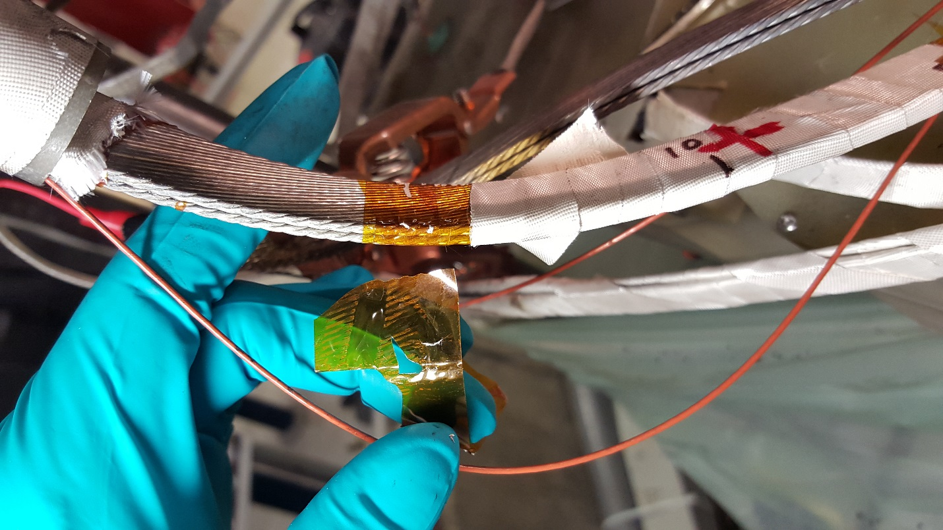
Positive Lead from Support Plate to Pizza Box
Below ~15cm above pizza box there was no more discoloration or signs of melted adhesive (less than ~260°C)

Slide 11
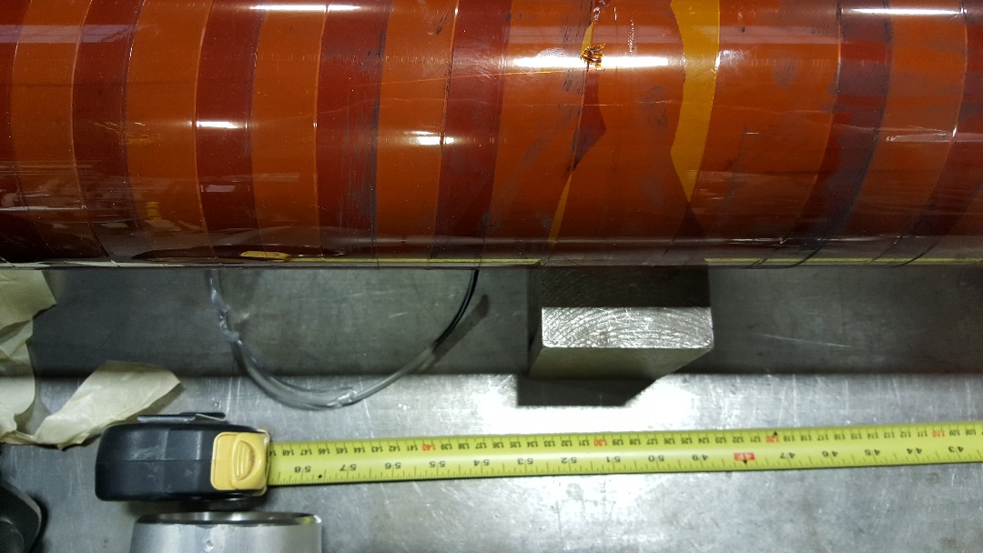
End of Carbon on Warm Finger
Carbon dust was observed on Warm finger that ended at ~145cm from Top Plate
Roughly at the level of the pizza box
Observation that may or may not be indication of helium level…

Slide 12
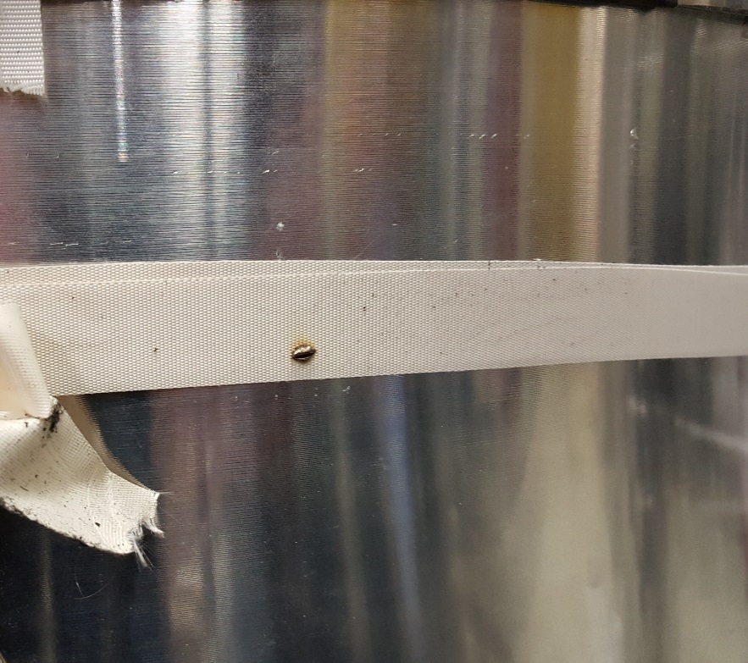
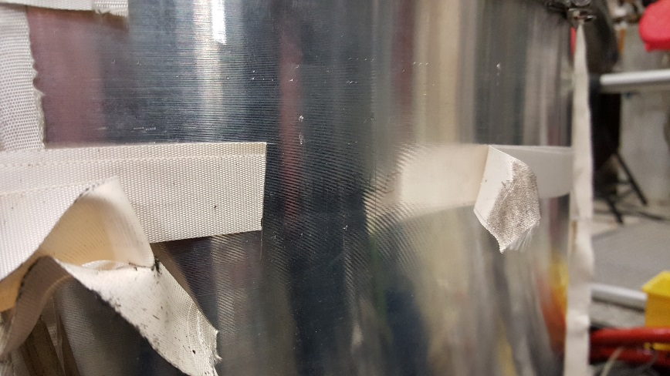
Debris Inside Dewar
On raising the magnet out of the dewar, melted lead was visible on bottom plate.
Small piece of metal had also stuck to the glass tape at the center mark of the magnet

Slide 13
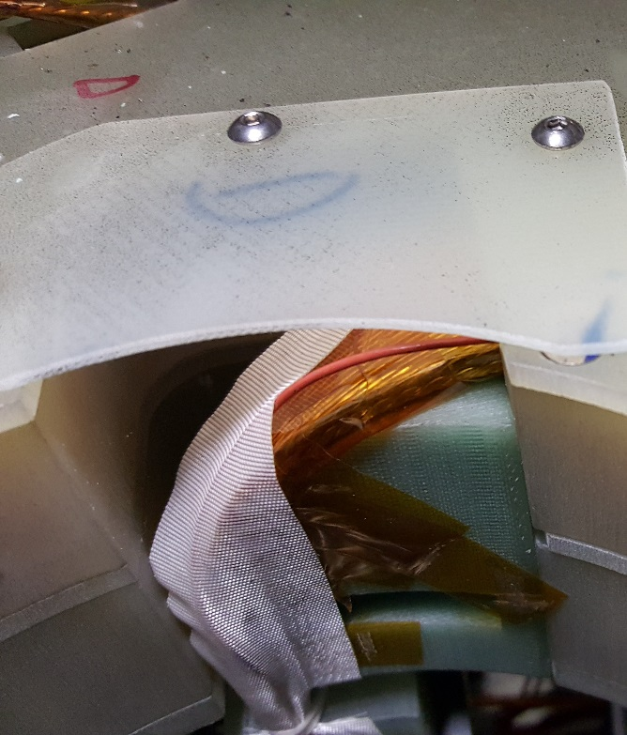
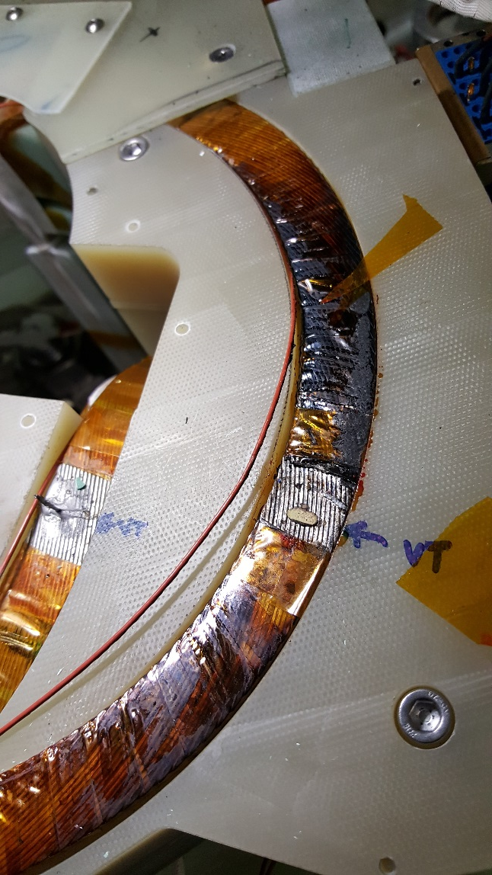
On Opening the Pizza Box
Strong smell of burned G-10
Charred Kapton around voltage tap on Negative Lead (>400°C)
Voltage tap solder on negative lead melted and flowed
Voltage tap solder on positive lead appears OK (>221°C)
It broke when the plate was removed

Slide 14
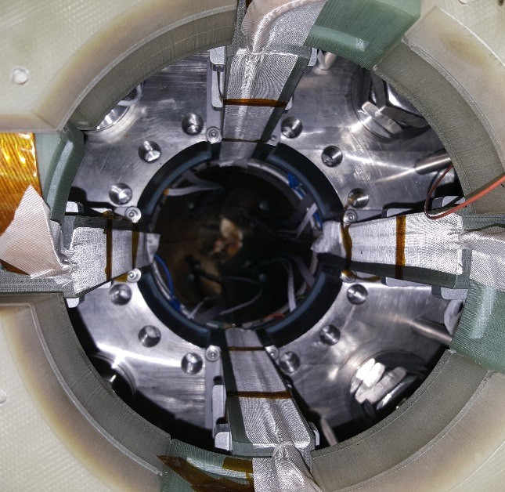
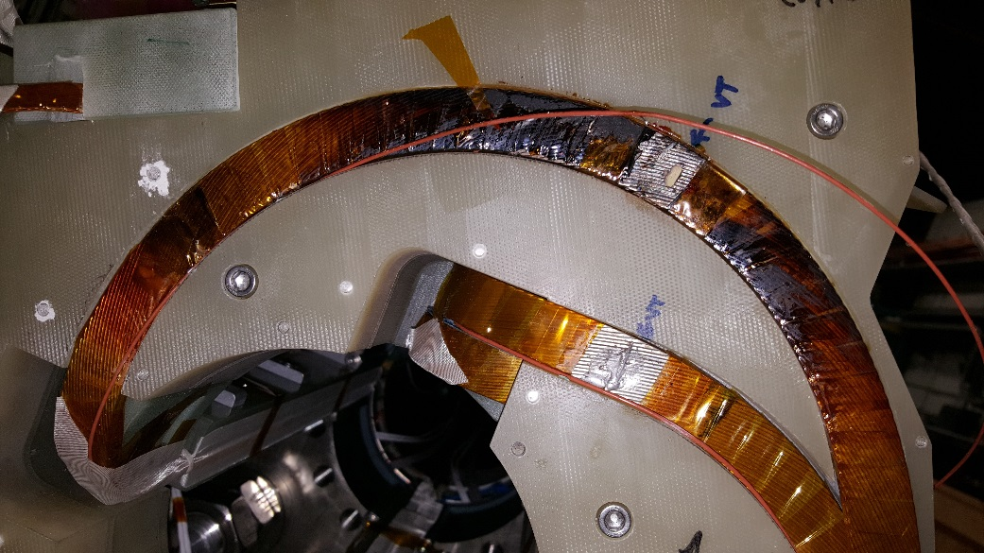
Remainder of Pizza Box
Other leads appear to be fine
Inside bore appears OK on first glance
Positive lead damage appears to end ~1” before exiting pizza box

Slide 15
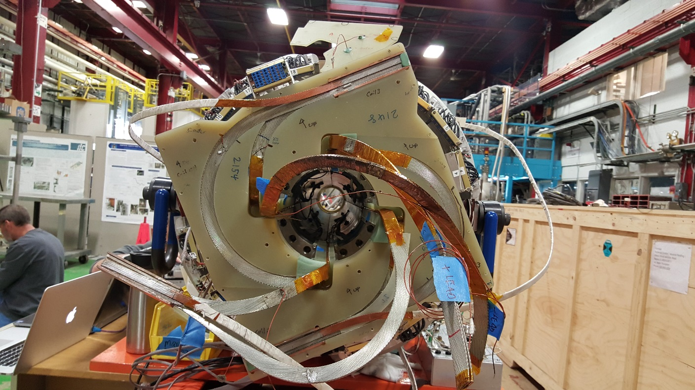
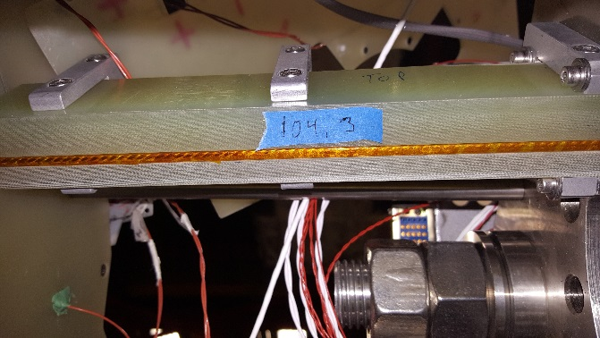
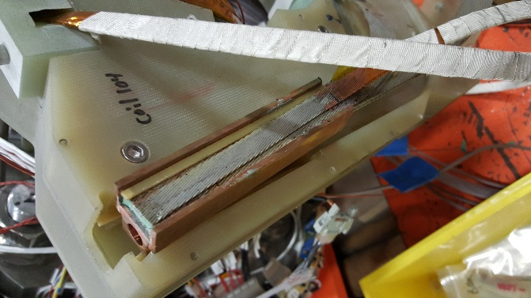
Pizza Box Layer 2
Splice in layer 1 was removed without issue without de-soldering
1st layer of pizza box, cover plates, and shims removed.
No visible change
No change in staybrite
No charred or discolored G10
No additional smell
Tape on leads to coils on ID removed
No visible discoloration or damage of tape, G10, or staybrite

Slide 16
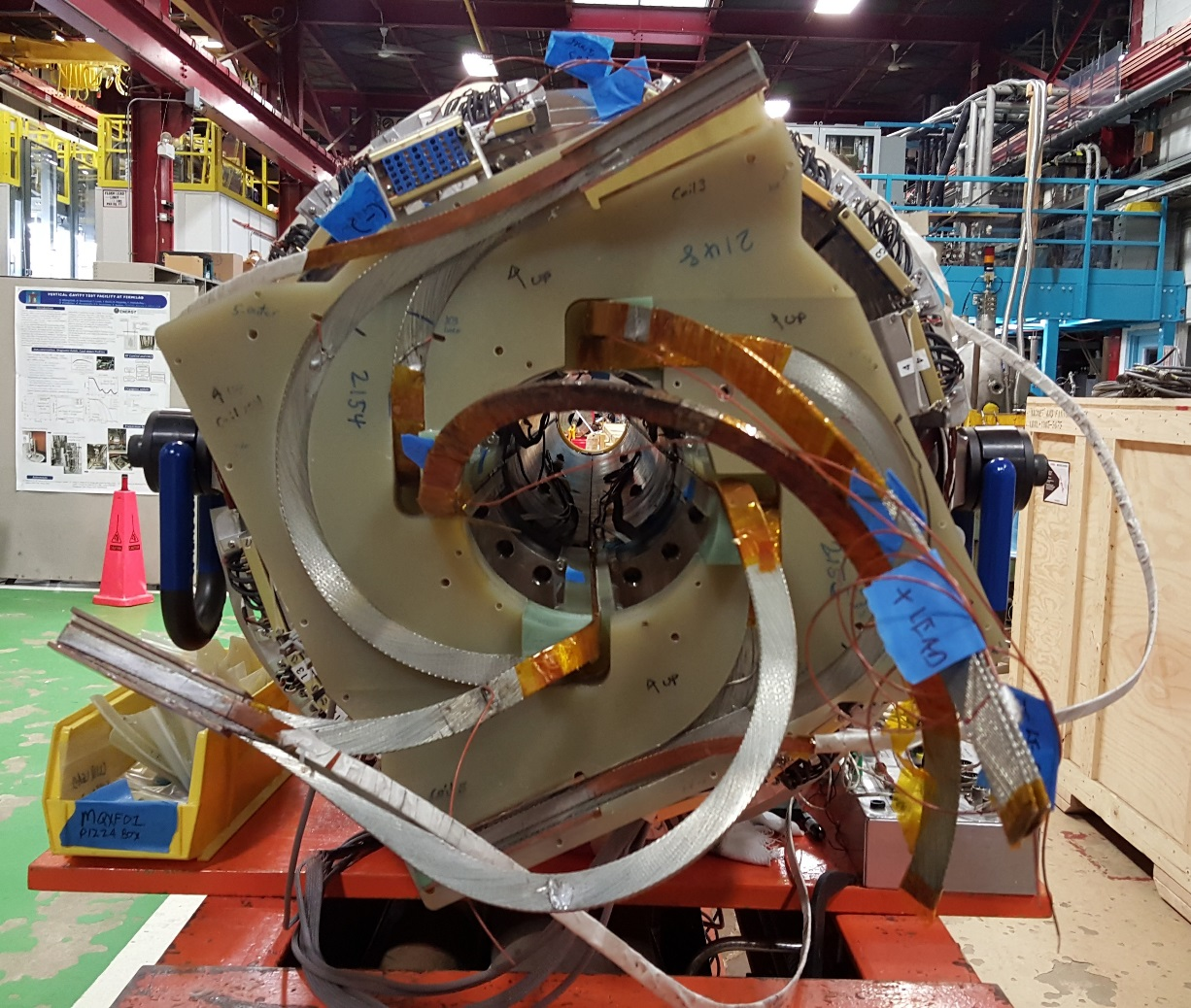
Moving Forward
We are moving forward with disassembly of the Pizza box
Dan C. Is here to work through the process
Splice will be made in straight section between pizza box and magnet

Slide 17
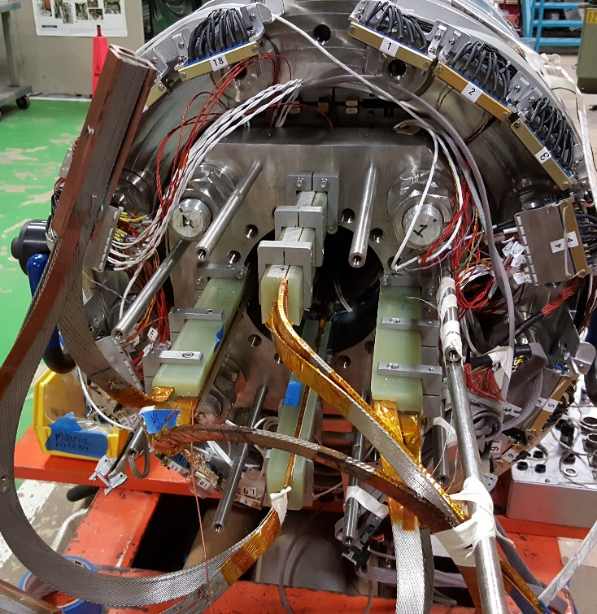
Pizza Box Disassembly
Layer 2 of the pizza box was easily separated by lifting the coil to coil splice out of the G10 and slipping the G10 layer off over the leads
Layer 1 was easily removed in 4 pieces by lifting the splices out of the G10
The Pizza Box attachment plate was removed by sawing in half with hacksaw and removing attachment screws

Slide 18
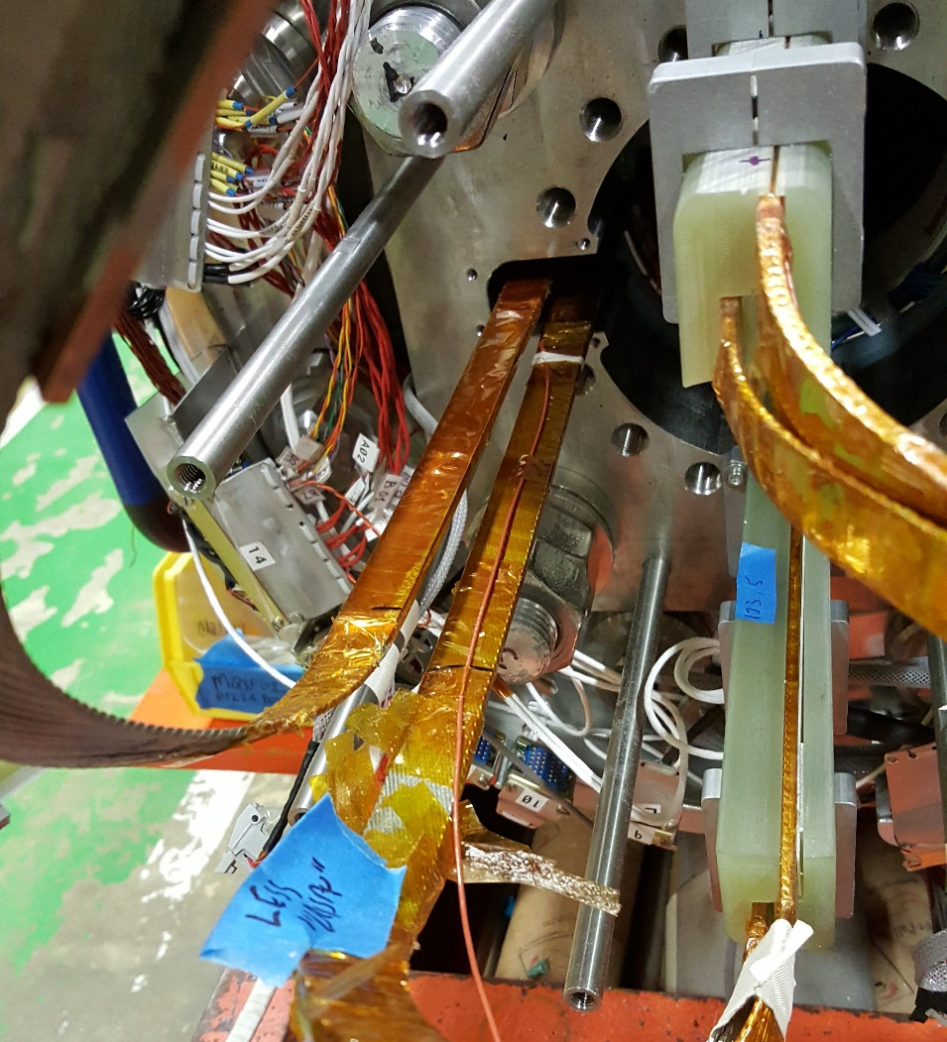
Lead Preparation
The lead supports on the positive and Negative lead have been removed.
No signs of any heating
Kapton has been removed back to the voltage taps near the magnet end plate
Voltage taps have been cut to splice into updated electrical plan

Slide 19
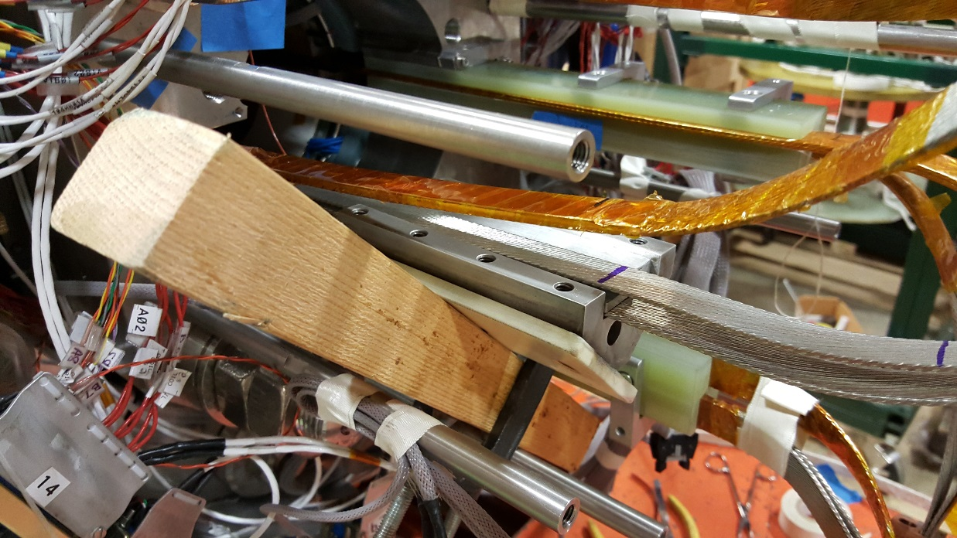
Lead Preparation
We are preparing to solder the extension leads
Standard splice fixture Fits in space with a little persuasion
Tinning of Extensions is in progress
Practice run before working on the magnet
Using Kester 1544 flux and 70/30 solder
Magnet leads will be cut at 220mm from end plate after tinned to prevent fraying

Slide 20
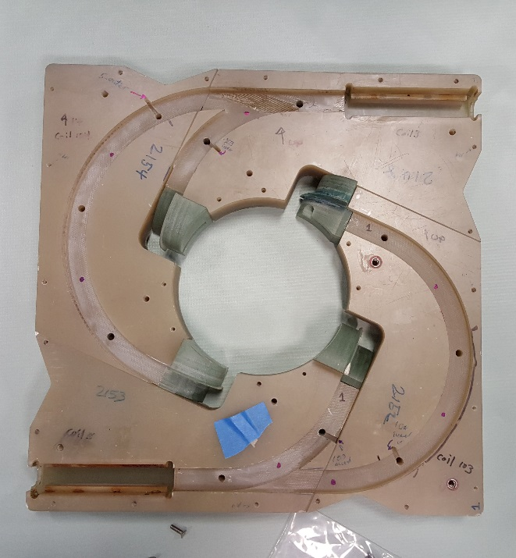
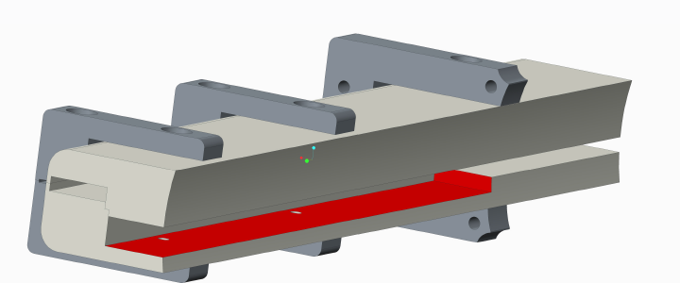
Modifications
Additional cooling holes are being added to Pizza box in both layer 1 and layer 2 (~double the current amount)
Lead support to pizza box is having cable channel increased by 4.5mm to accommodate splice
New lead extensions will use the pizza box routing as designed

Slide 21
Negative Lead With Scale
Scale starts at end plate.
Lead will be cut at 220 mm from end plate.
Splice will be from 100 mm to 220 mm.
WC Voltage Tap located at ~580mm from end plate.

Slide 22
Wires for analysis
After tinning, leads will be cut, freeing up cable for analysis.
2 strands will be removed from each cable of negative lead for RRR, Magnetization etc
Strands will be labeled as to which cable they came from and which is the magnet side
End of lead nearest magnet will be prepared for microscopy

