Slide 1
MQXFA13 – AUP227 metallographical inspection
Aleksandra Bartkowska, Mickaël Crouvizier, Stefano Sgobba
CERN, EN-MME-MM
07. 02. 2024
EDMS nr. 3014651
Notes:
Subtask 2

Slide 2
Metallographical analysis of MQXFA13 – AUP227 coil
Context of the study: Coil AUP227 from magnet MQXFA13 experienced several quenches below nominal current during training. The details of the coil’s history can be found in the link: https://indico.fnal.gov/event/61571/. The interface between end spacer and wedge in the AUP227 coil was identified as a suspected zone and the metallographic inspection was conducted in that area. Zones of interest were extracted by diamond wire saw cutting and the surface was polished up to 1 µm diamond paste.
Samples: MQXFA13 – AUP227 coil slice
Client: Giorgio Ambrosio
Experimental work and reporting by: Aleksandra Bartkowska (CERN EN-MME-MM)
Equipment:
Diamond wire saw
Keyence VHX7000 digital microscope

Slide 3
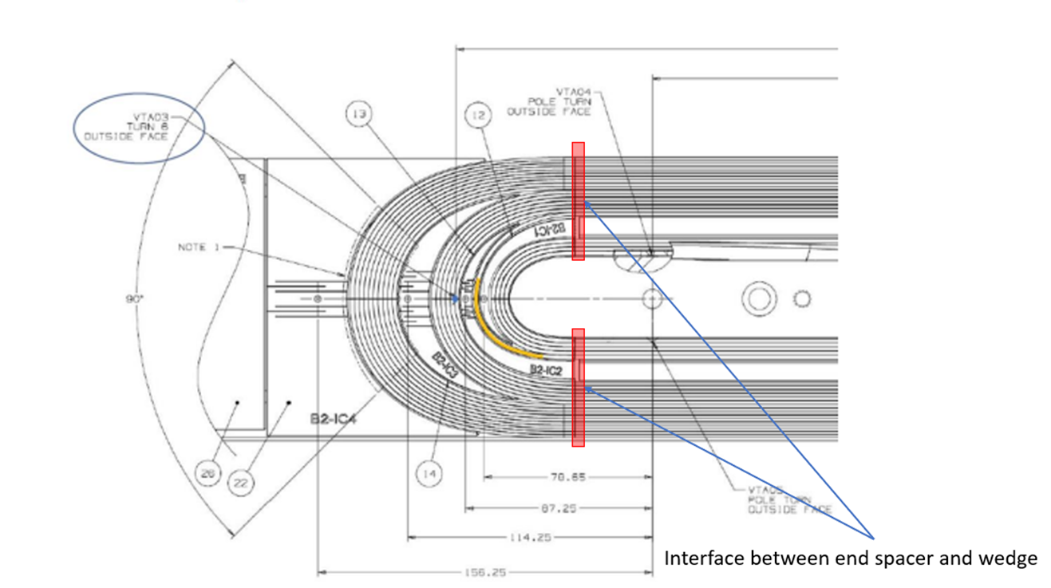
Volumes of interest (VOIs)
Transition between end spacer and wedge
MQXFA13 – AUP227
43 mm thick slice including the transition between end spacer and wedge was extracted as illustrated below.
OLJ
LJ
Extracted part

Slide 4
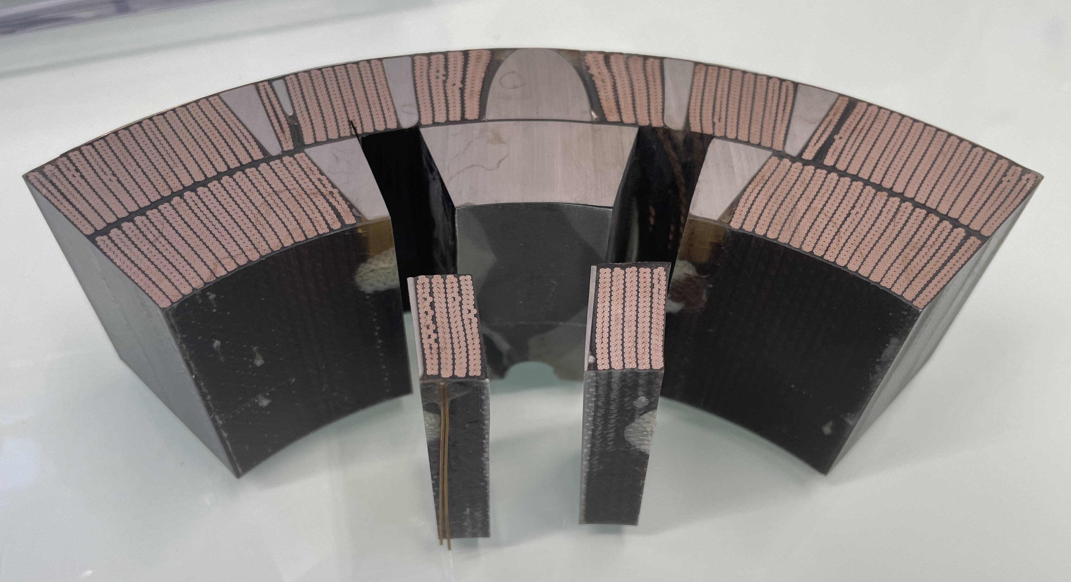
Volumes of interest (VOIs)
VOIs have been then extracted from the slice accordingly to schema below.
Inspected planes
Inspected planes
LJ
OLJ
LJ
OLJ
Pole blocks
Midplane blocks
All 4 blocks were analysed from the connection side plane
Notes:
Planes in contact with the transition

Slide 5
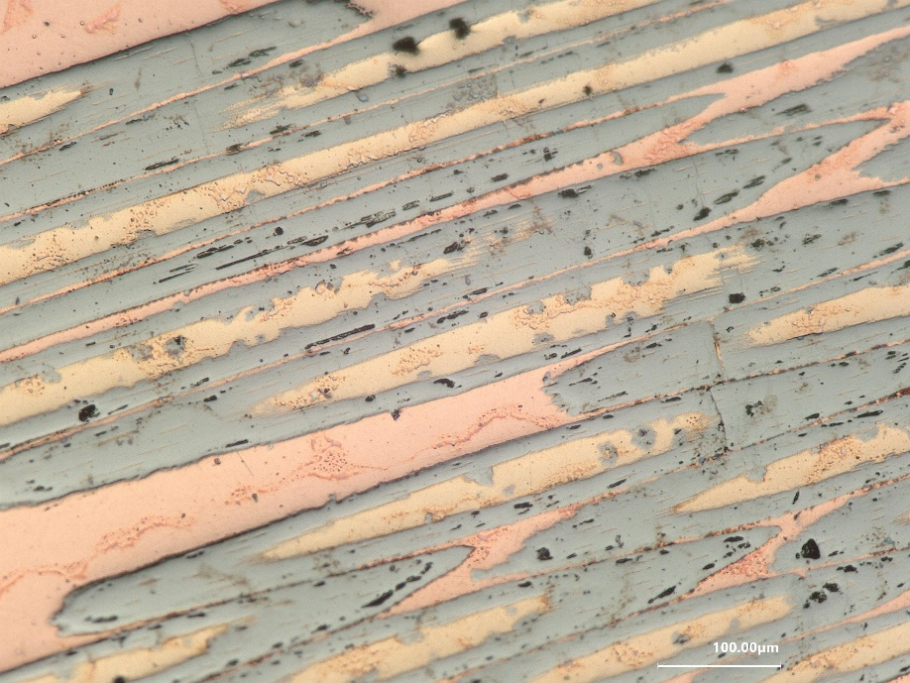
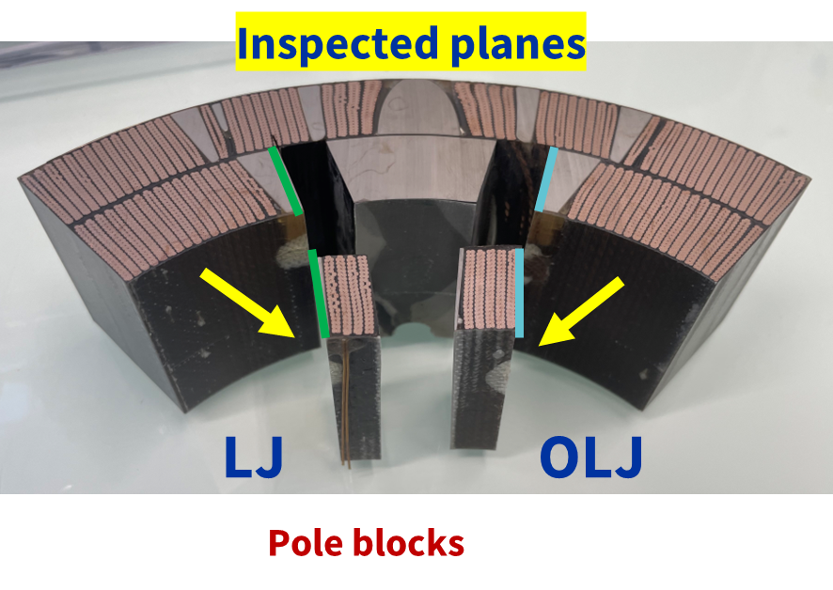
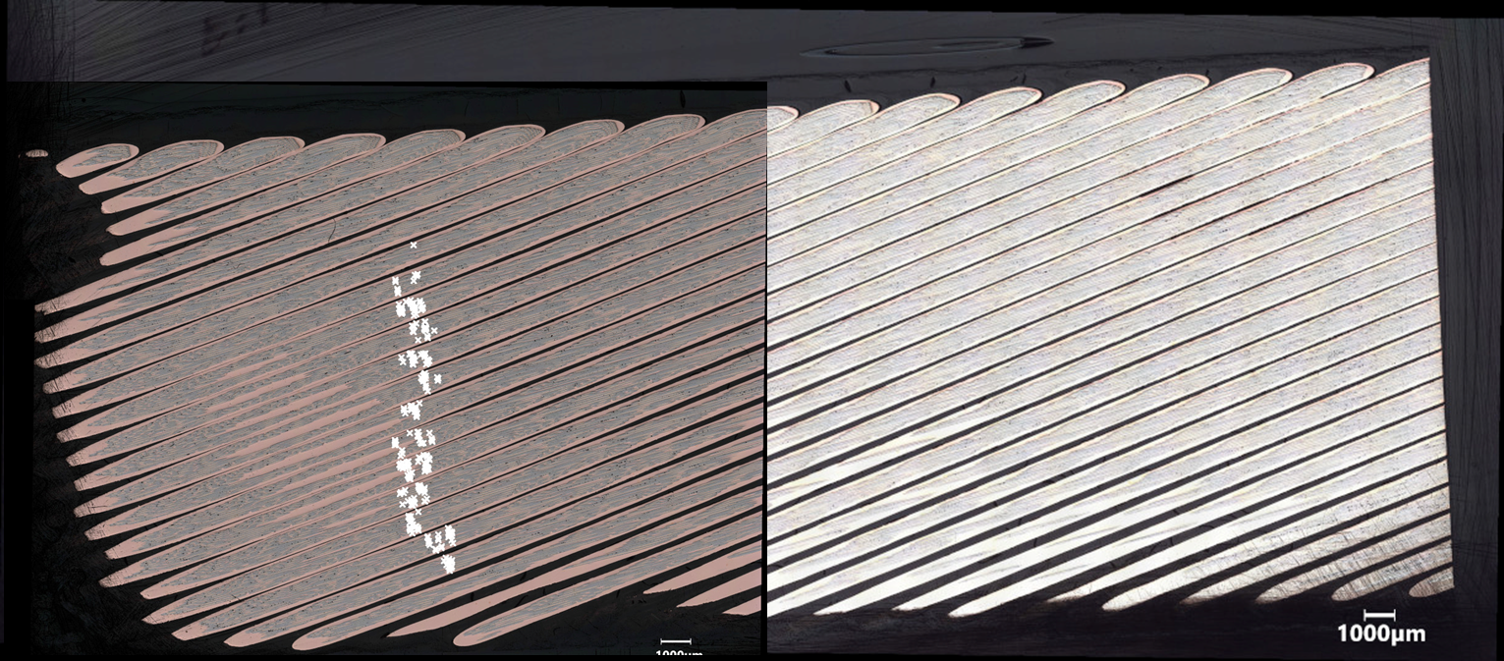
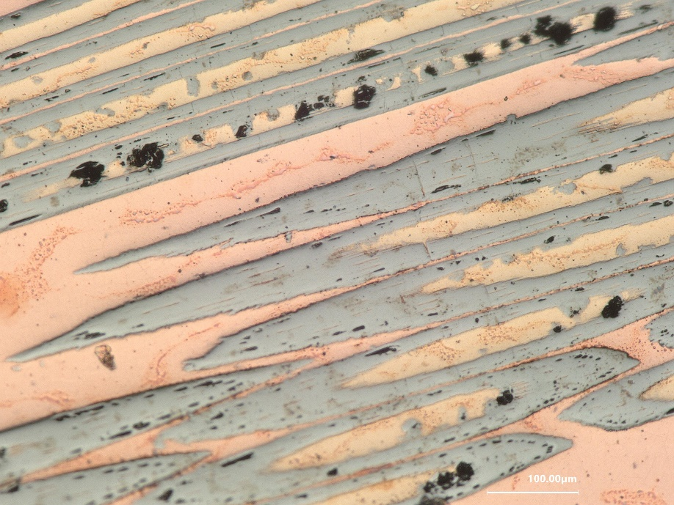
Pole blocks – connection side (LJ)
Transversal microcracks seem to follow the end spacer – wedge transition.
The thickness of a resin is higher than in the previously analysed samples (AUP coils #213 and #214)
Crack field
Notes:
Superconducting subelements cracks transversal

Slide 6
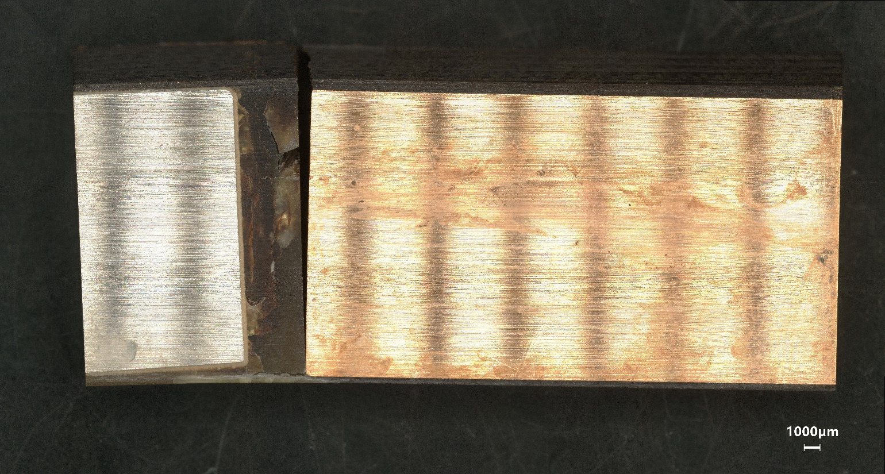
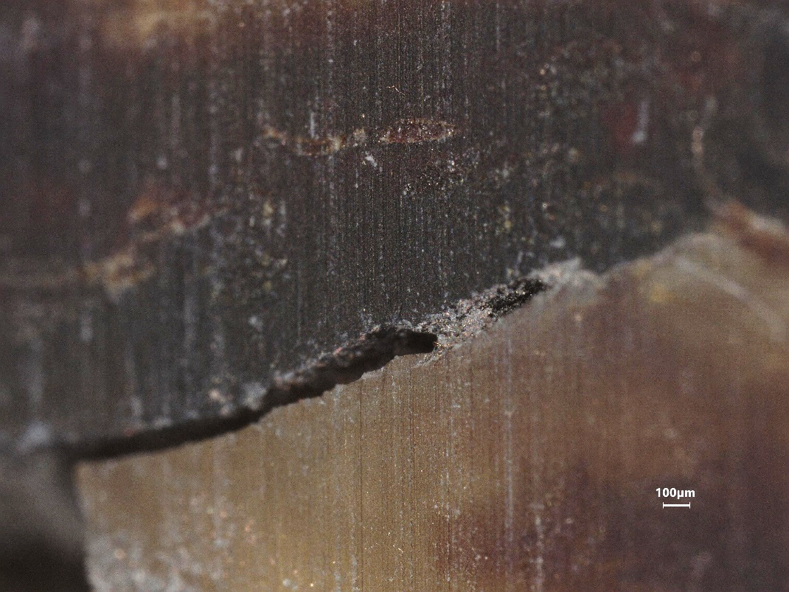
Resin evaluation (LJ side – pole blocks)
Region of crack concentration
The resin experienced decohesion after cutting, indicating its poor adhesion to copper block
Cracks were present in the resin

Slide 7
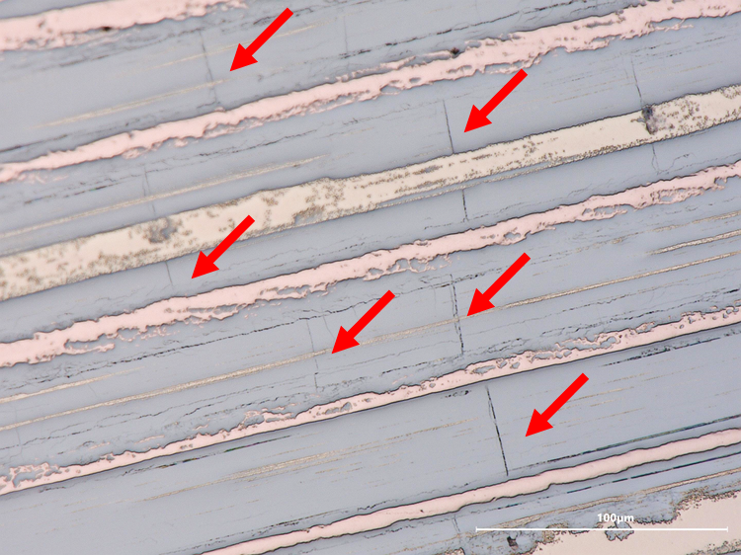
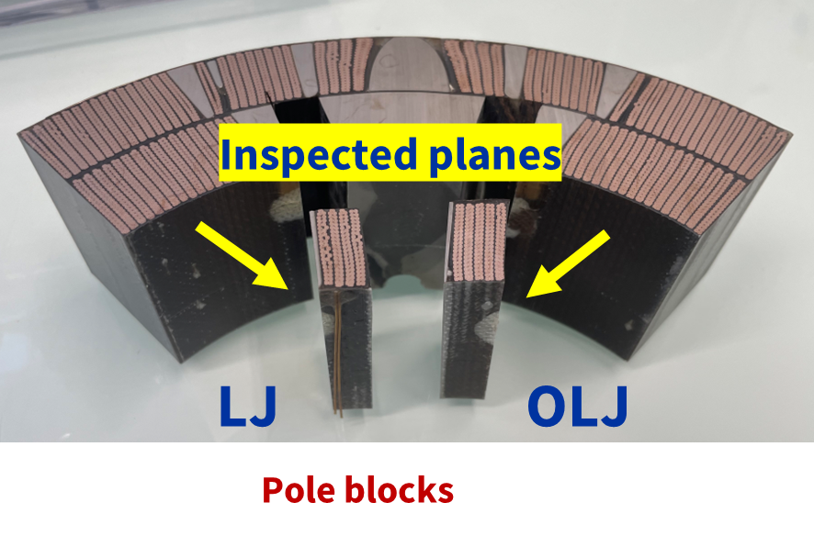
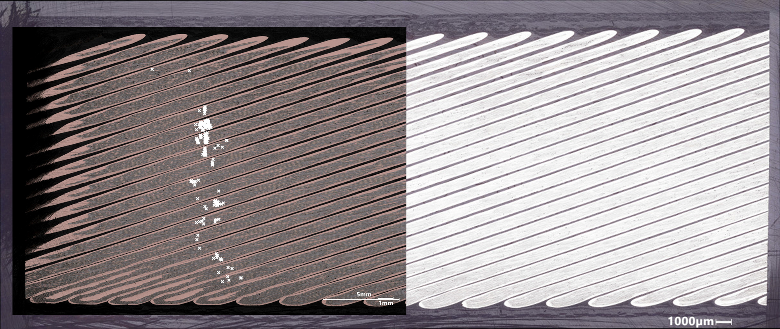
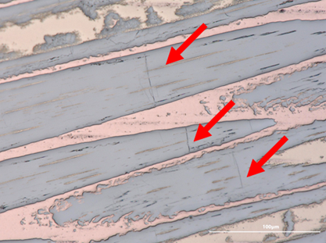
Pole blocks – connection side (OLJ)
Microcracks seem to follow the end spacer – wedge transition.
The thickness of a resin is higher than in the previously analysed samples
Crack field

Slide 8
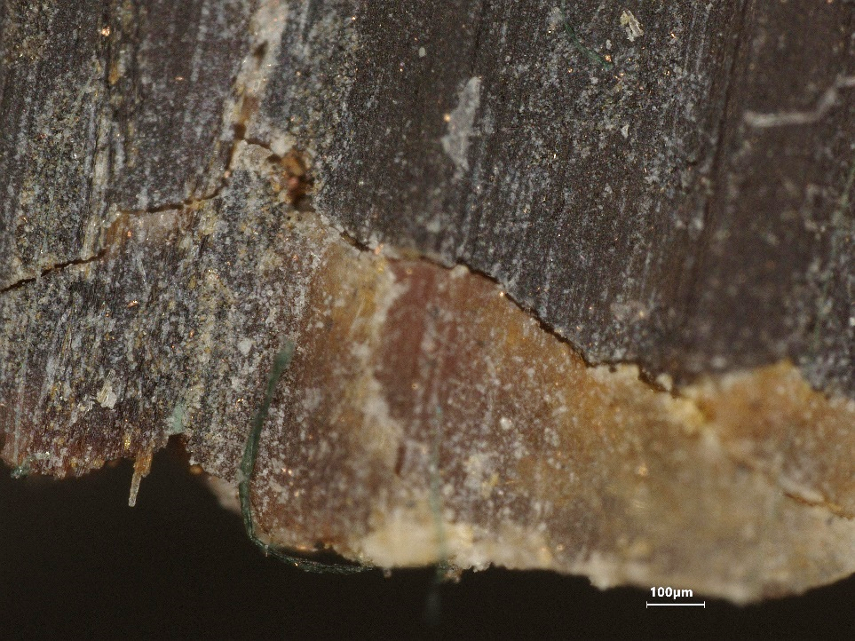
Resin evaluation (OLJ side – pole blocks)
Microcracks were observed in the resin, but less numerous than in the LJ side
Resin thickness is higher than in the previously analyzed coils (for both LJ and OLJ blocks)

Slide 9
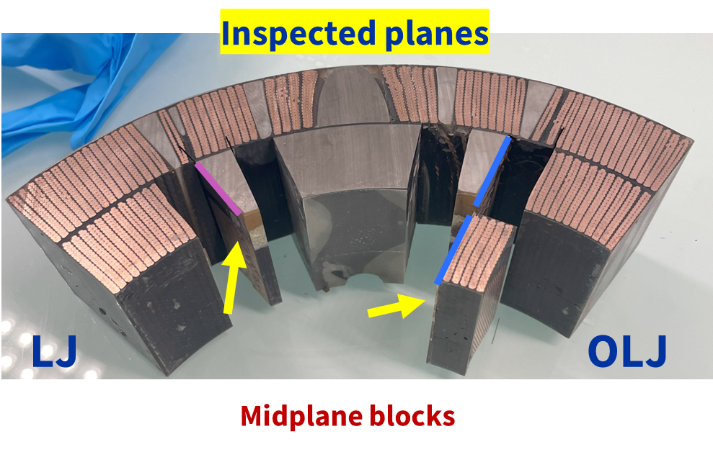
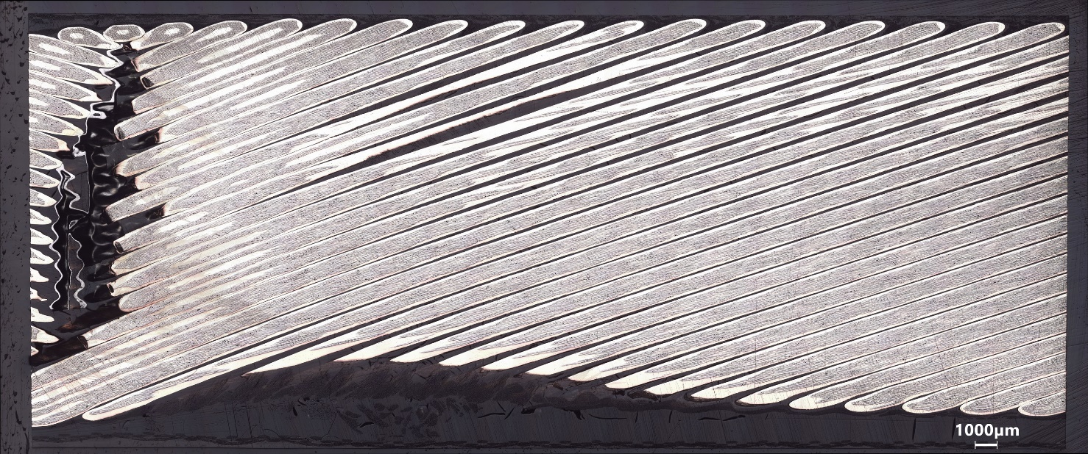
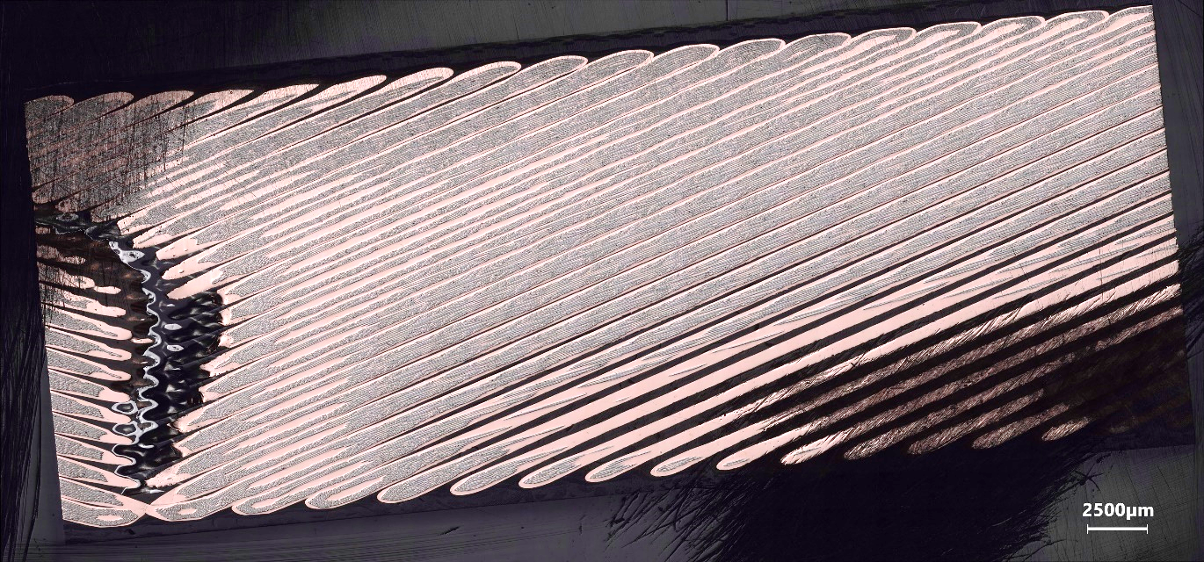
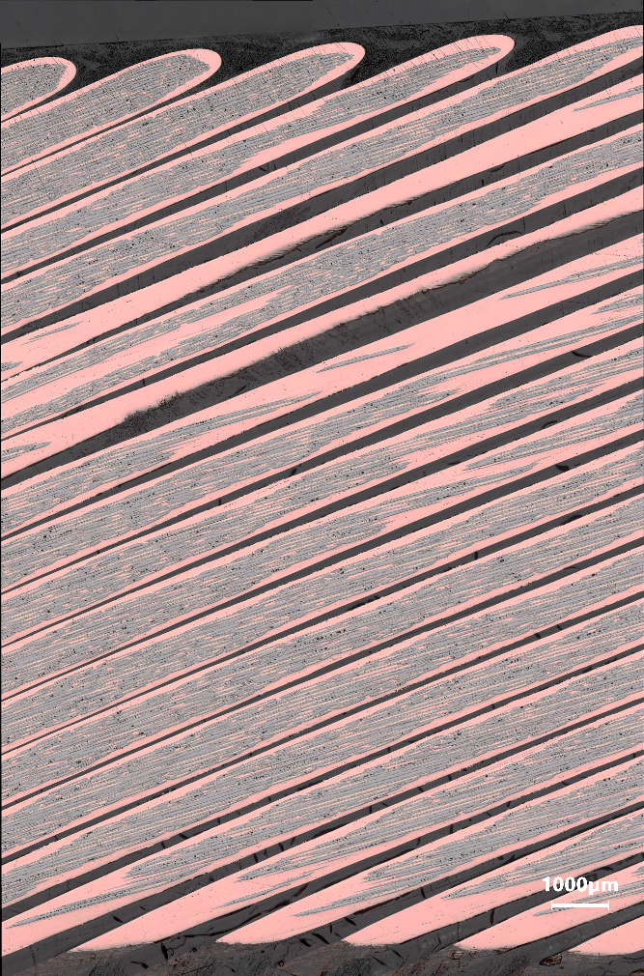
Midplane blocks (LJ and OLJ)
Midplane block (LJ side)
Midplane block (OLJ side)
Cracks were not observed in the midplane blocks (neither in LJ and OLJ sides).
Progressive polishing was made and examined up to the presented level and no cracks were observed.

Slide 10
Summary and conclusions
Metallurgical inspection of the longitudinal cuts (LJ and OLJ side) involving the first row of Rutherford cables adjacent to the end spacer/copper wedge transition revealed :
The presence of a localized field of cracks at first row’s midplane in the pole blocks,
The field of cracks is in correspondence to the transition between resin and copper wedge,
Microcracks are transverse with respect to the longitudinal axis of strands,
The cracks were not observed in the midplane blocks,
Thickness of resin area is higher than in previously analysed coils, cracks are present in the resin
The present results are in accordance with previous results obtained from the metallurgical inspection of MQXFA07 – AUP214 (EDMS nr. 2739504) and MQXFA08 - AUP213 (EDMS nr. 2777506).

