Slide 1
CZ – Prague SiPM massive testing
2024/02/27
Jaroslav Zalesak, Jan Smolik, Josef Zuklin, Michal Kovalcuk, Eva Fialova, Peter Filip

Slide 2
Status – 4 boxes measured, 5 failed SiPMs found (1+0+2+2) (spredsheet info included) 4 high DCR + anomalous extended IV 1 nor IV/DCR in LN2 response

Slide 3
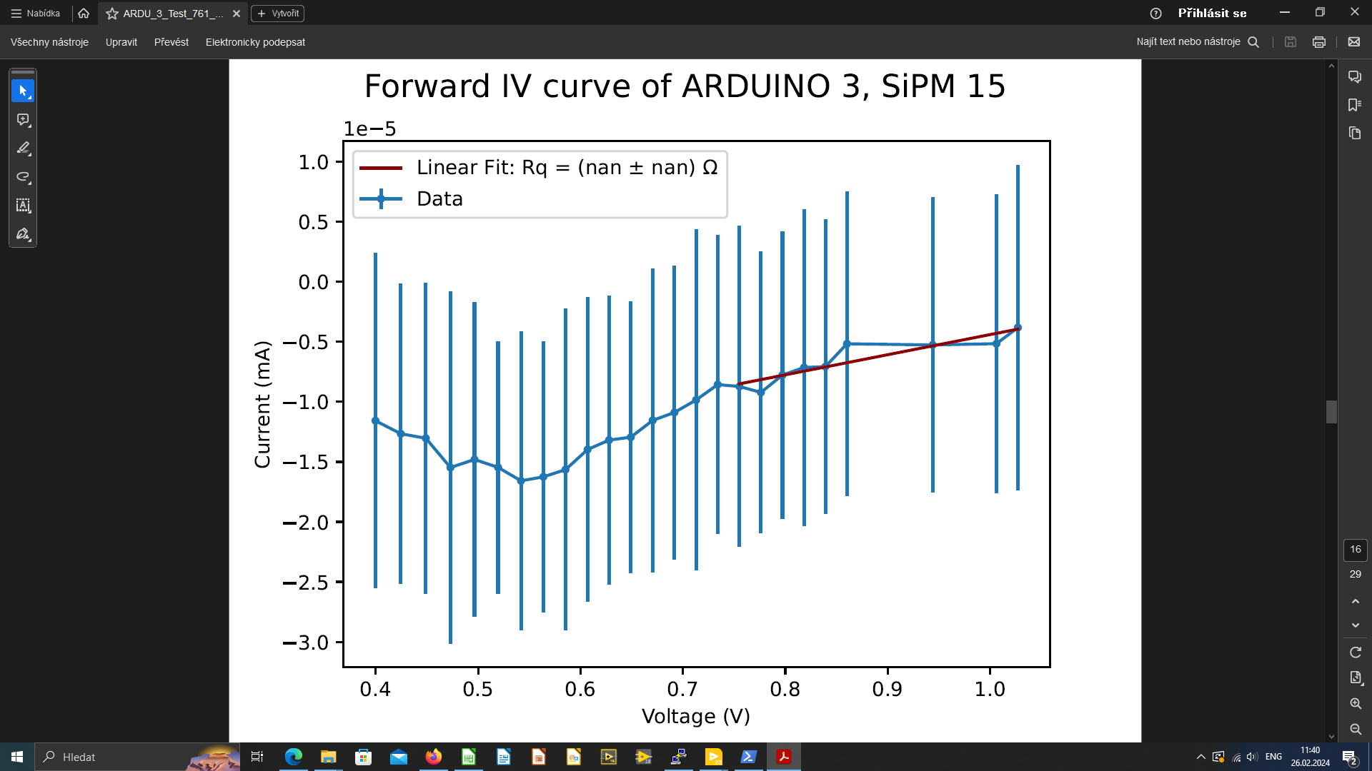
One motherboard failed: 2 SiPM positions (ch# 15 & 26) don’t give outputs, identified on last Fri
tried to switch the blue flat cable between the boards, we thought the problem could be with that, but the problem remained on the board.

Slide 4
Failure issue and solution
Stopped measurement on Mon, Feb 26
In contact w/ Marco G., he promised and already sen two spare doaghter boards
Meanwhile we will test the failure boards by exchanging with the working ones
If new arrived boards are solved the issue, we need to make a DAC re-calibration of the system according the Marco’s advise before resuming the measurements.
This week going to study the scripts to send to the database.

