Slide 1
ARRAKIS Updates
N. Carrara, M. van Nuland, L. Lepin, B. Russell, D. Rivera
(02/28/2024)

Slide 2
Arrakis 1.0
Things that worked in Arrakis 1.0:
Particle first logic; instead of trying to backtrack each hit, we label according to particle instances, moving in the direction of causality.
Splitting things up into hierarchies is a good idea, micro/meso/macro.
Labeling scheme which emphasizes completeness and mutual exclusivity is good.
Event by event works well, with unique track ids throughout a file. If Arrakis is fast enough, we can process an entire file at once.
Things that didn’t work in Arrakis 1.0:
Code had become complicated, functions were too big, too difficult to add new things or change the way input/output is translated through the code.
Looping and maps are slow in python, it would be better to use vectorized or numpy functions.
Debugging was difficult.
Some high-level variables are not totally fleshed out.

Slide 3
Arrakis 2.0
New features of Arrakis 2.0:
MPI + H5: Running logic over multiple events simultaneously.
Constructed a new container which allows us to do this on NERSC:
Plugins: Each event gets passed to a set of plugin functions which generate high-level variables.
Built-in profiling: Each function is decorated with a minimal timing/memory profiling for optimization.
Outputs: corresponding ARRAKIS.h5 file
calib_final_hits->(topology, physics_micro, physics_macro, unique_topology, unique_micro, unique_macro, vertex, tracklette_begin, tracklette_end, fragment_begin, fragment_end, track_begin, track_end, shower_begin)
clusters->(tracklettes, tracks, fragments, showers, blips, particles, interactions) (Look at standard record)

Slide 4
Arrakis 2.0
Created a new Dockerfile with the help of Pengfei Ding from NERSC: https://github.com/Neutron-Calibration-in-DUNE/BlipDocker
Container (blip:latest) builds off of NERSC containers with MPI+H5 built in. Installs all related python packages.
Next step is to build the core Arrakis code with the following template:
Start program
Load config
Parse config parameters
Configure plugins
Loop over each file
Load file to determine unique events and indices for each array type
Run whole file over file begin plugins
Set up output arrays in output h5 file
Send index, output information to each worker
Loop over each event in each worker
Grab event related information and pass to plugins in order
Collect output information and add to output files
Run whole file over file end plugins
Run end of file functions
Run end of program functions

Slide 5
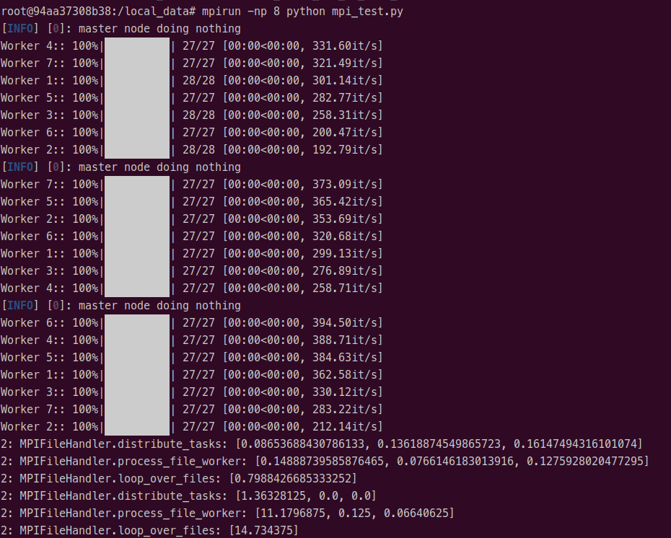
Arrakis 2.0
Testing locally with a few files shows that parsing events and grabbing them in worker nodes is very fast (also works in parallel with logging/decorators/yaml/tqdm).
192 events split to 7 workers
total time for function call for each file (sec)
total memory usage for function call for each file (Mb)

Slide 6
Arrakis 2.0
Once the framework is complete, we will begin writing labeling logic in plugins.
This is a great place for students to get involved!
Each plugin operates independently so it can be debugged easily.

