Slide 1
Charge mis-id Study
Xiaoyan Huang,
On Behalf of the DUNE Collaboration
Feb 22, 2024

Slide 2
Muon Sign Selection
In TMS, charge sign sensitivity comes from the curvature of the track in the magnetic field, but a simpler technique was used here to estimate the TMS charge sign sensitivity.
In this study, the TMS charge sign sensitivity was estimated by comparing the deviations of particle tracks from a straight line using truth information in the x − z view.
This sign selection metric provides a measure of performance with little dependence on the reconstruction.
[1]
[1]Ref DUNE Doc-DB 25546

Slide 3
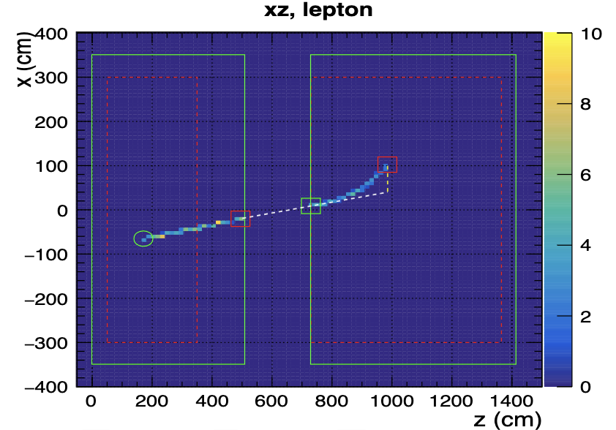
Method explained with figure
[2]
[1]
[2]Ref DUNE Doc-DB 25546, Clarence’s plots are also from here.

Slide 4
equation used
The equation derived for the “signed distance” is:
SD = (x3 − x1) − (x2 − x1)(z3 − z1)/(z2 − z1)
where x1,2,3, z1,2,3 is the x, z position of the ND-LAr exit point (or ND-LAr start point), TMS entry point (or ND-LAr exit point), and the last hit in the TMS, respectively.

Slide 5
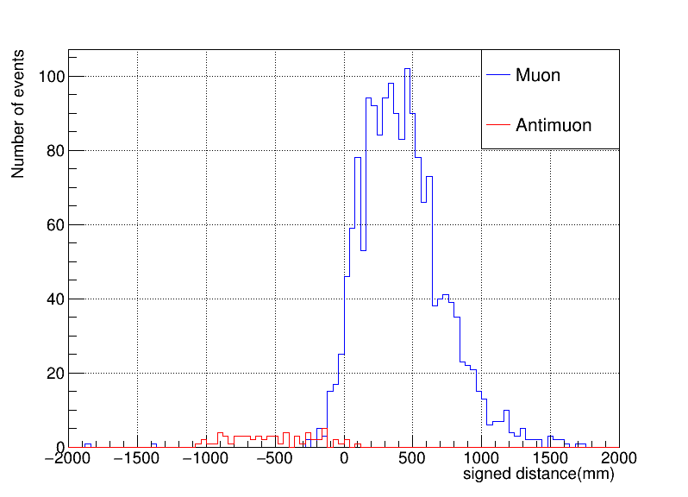
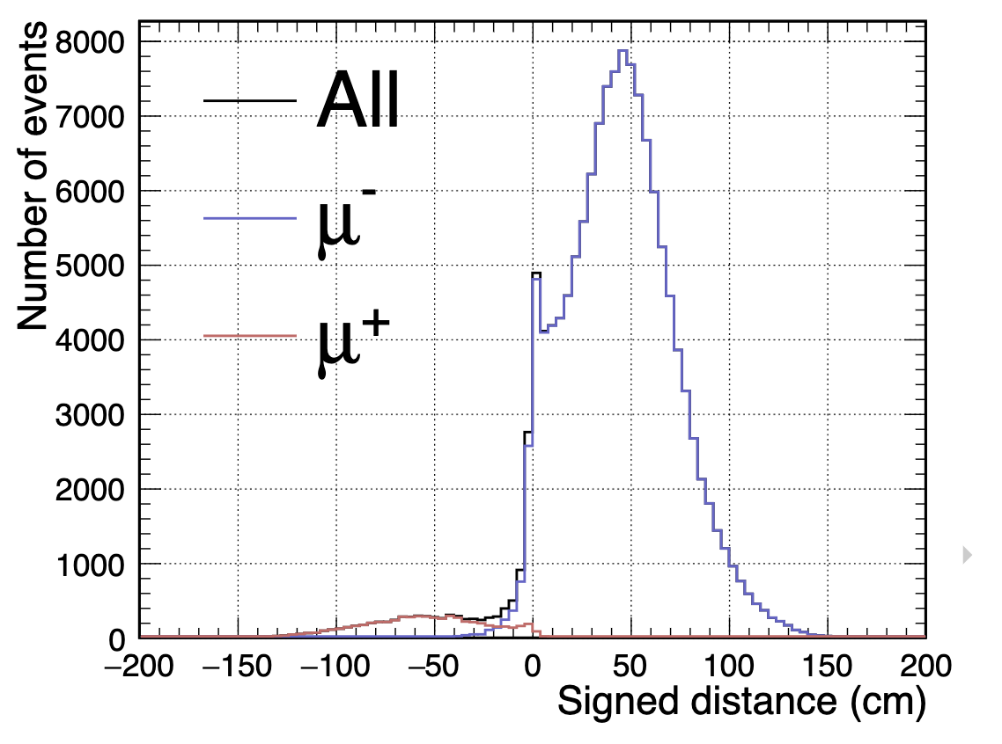
Comparison between Clarence’s results(similar study, about 2 years ago) and my results , mine are on the right
Comparisons

Slide 6
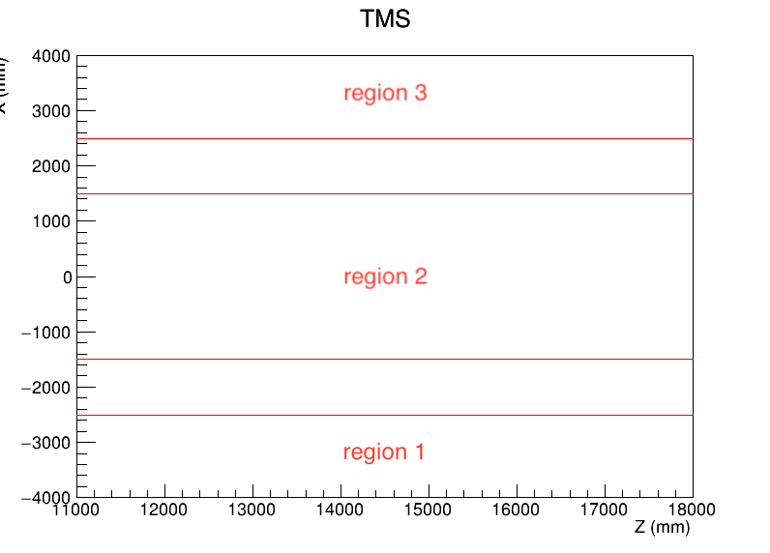
Some comments
Clarence’s study only uses tracks in the center region to avoid the changing field in the low and high x region. My study uses all three regions.

Slide 7
Some comments
region1_total: 251 | region2_total: 1326 | region3_total: 120
region1_not_contained: 4 | region2_not_contained: 42 | region3_not_contained: 9
region1_contained_percentage: 0.984 | region2_contained_percentage: 0.968 | region3_contained_percentage: 0.925
muon_lar_start_tms_end: 3346

Slide 8
Some comments
Problematic entries in the datafile
TrackHitPos = 15033,
3113.5, 15193, 2972.01, 15193, 3042.75,
15353, 2972.01, 15673, 2936.64, 15833,
2901.27, 15993, 2865.9, 16153, 2865.9,
-999, -999, -999, -999

Slide 9
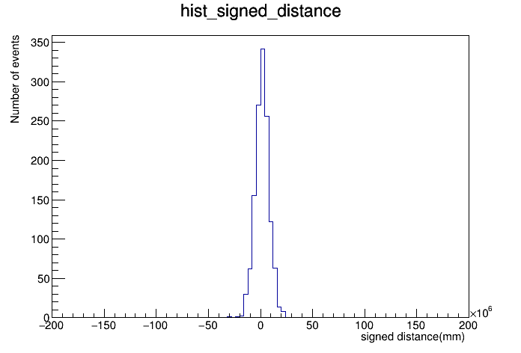
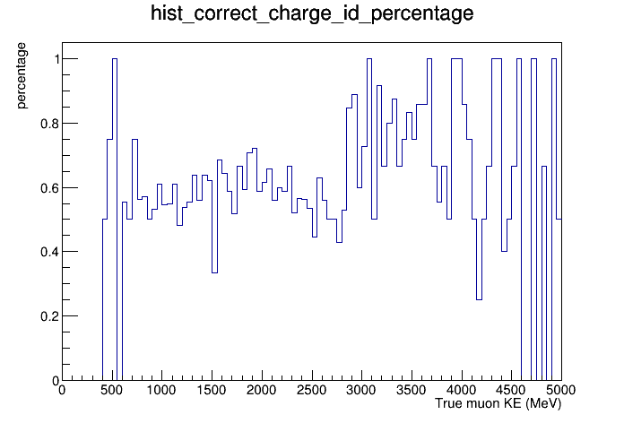
Some comments
Problematic entries in the datafile cause problems
Method 1. Use every hit, not just the end point. Loop over the hits summing the signed distance to the reference line.

Slide 10
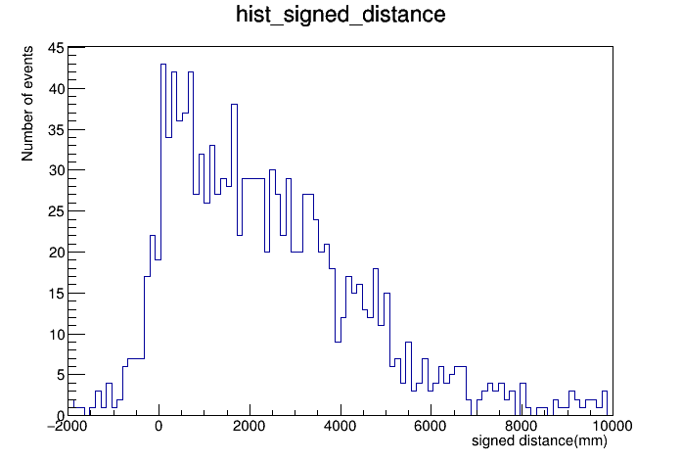
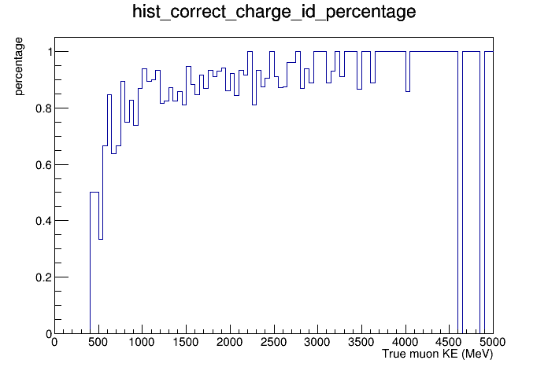
Some comments
Problematic entries in the datafile, temporary fixes
Use a line in my code to skip -999:
if event.TrackHitPos[i]==-999: continue

Slide 11
Some comments
Method 1. Use every hit, not just the end point. Loop over the hits summing the signed distance to the reference line.
correct_percentage: 0.894

Slide 12
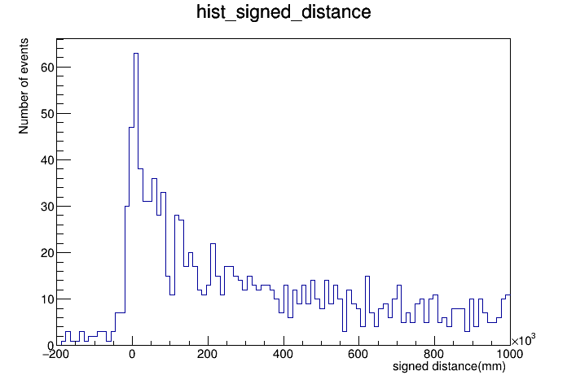
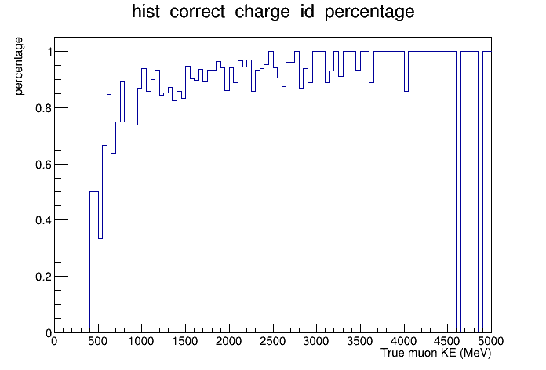
Some comments
Method 2. Use the signed distance squared rather than signed distance.Loop over the hits.
correct_percentage: 0.907

Slide 13
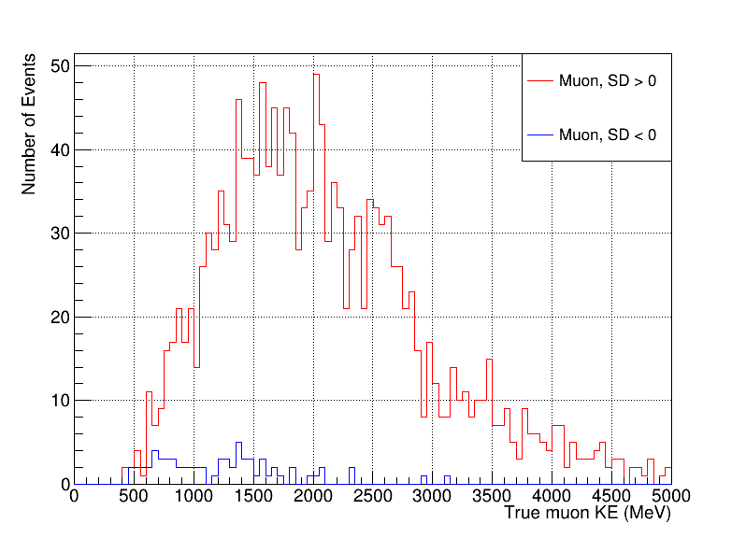
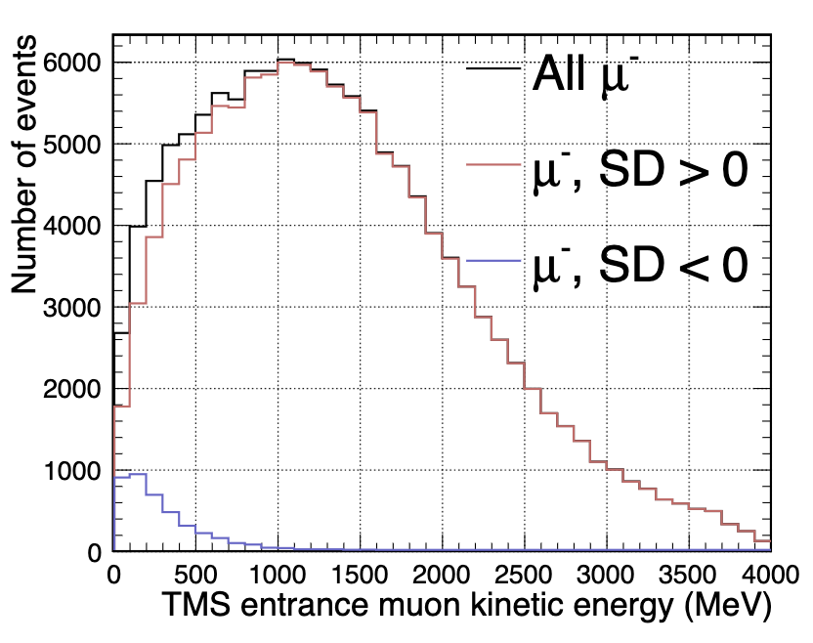
Because the data file I use contained much fewer events, I have smaller statistics, which is going to plague me when it comes to antimuons. A problem, my plot doesn’t have data between 0 to 500MeV, not sure if it is the low statistics or something else(muons with KE <500MeV don’t make it to TMS?).
Comparisons

Slide 14
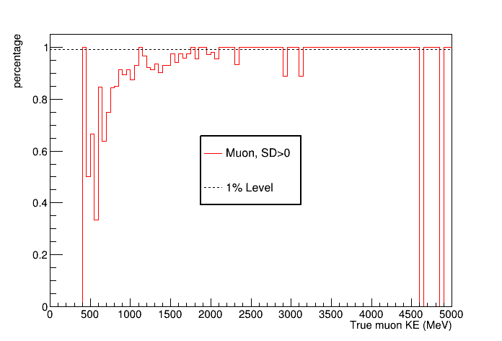
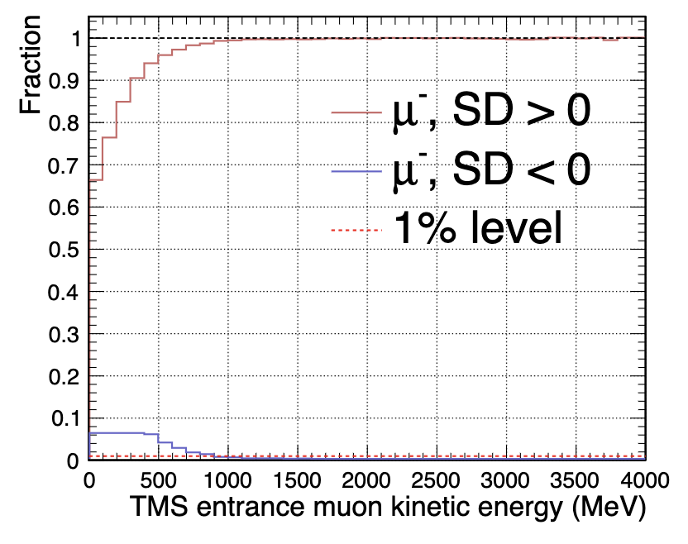
My total correct percentage is 93.5%, Clarence’s is 96.6%
Comparisons

Slide 15
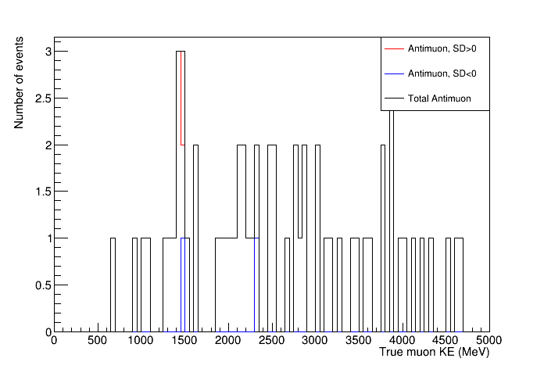
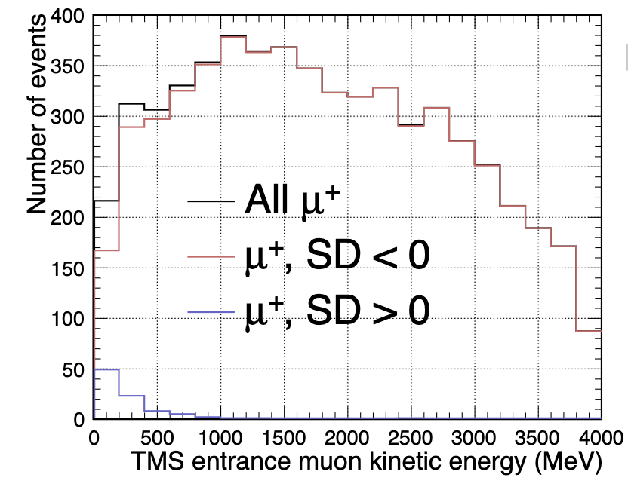
Comparisons
Low statistics make my plot unrecognizable

Slide 16
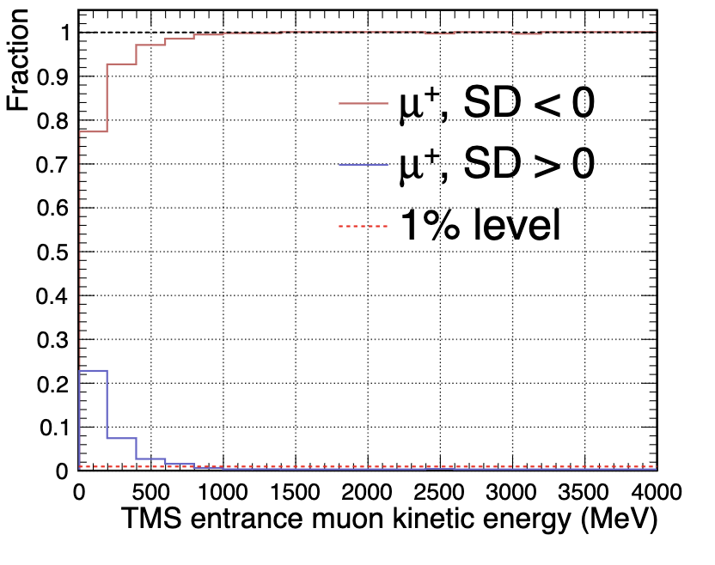
I have such low statistics, so no plot from me at this time
Comparisons

Slide 17
Conclusions
Reproduce the same plots by Clarence
Need data files with more statistics to reproduce plots with antimuons

Slide 18
Next Study
Scattering between LAr and TMS.
How often is a LAr muon scattered after LAr but before TMS such that the track matching thinks they are not from the same track?

Slide 19
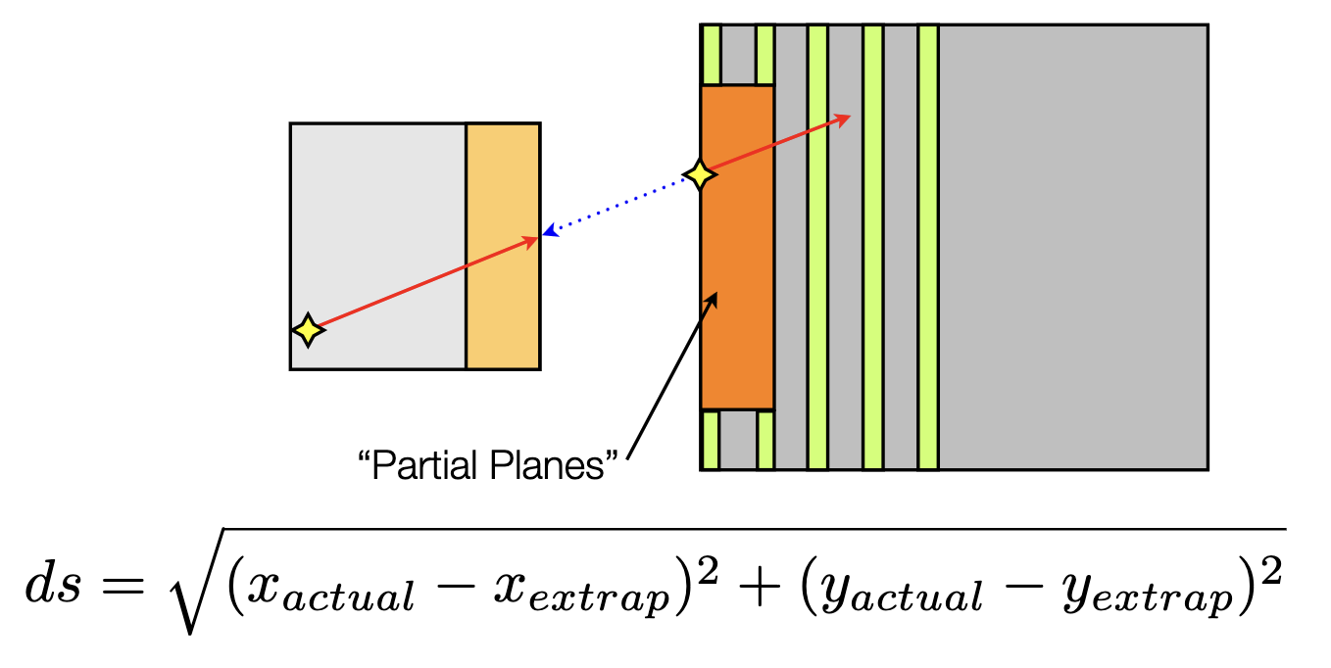
Next Study
How do we match muons? Method used in Minerva:
[3]
[3]Ref: Anne Norrick,
June 27, 2013
Minerva Week
If this comes out to be less than 40 cm, call it a match!

Slide 20
Problems
Not enough information in the data file I’m currently using.
Data file doesn’t contain the point muon leaves the Lar, nor the two points near the front of TMS.
END

