Slide 1
TMS: Planning for CD2
Tom Markiewicz / SLAC
28 February 2024

Slide 2
Hiro Tanaka’s Slides to LBNC
26 February 2024

Slide 6
TMS Input to Hiro

Slide 7
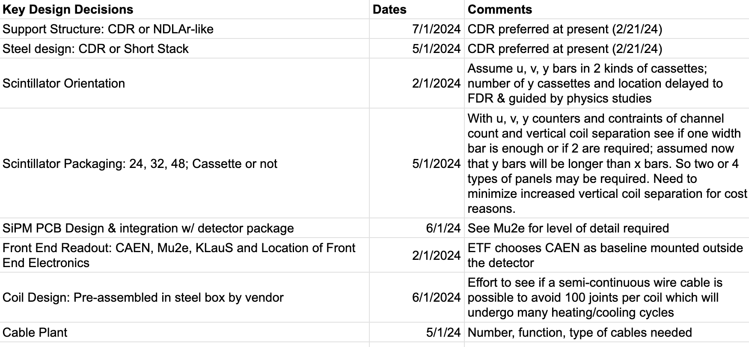
Preliminary Design Process https://docs.google.com/spreadsheets/d/1m3r-M81Zk5Hd5202g1WPvmlhwmAcCx54m2VgKfDqQ5g/edit#gid=847101774

Slide 8
Preliminary Design Process https://docs.google.com/spreadsheets/d/1m3r-M81Zk5Hd5202g1WPvmlhwmAcCx54m2VgKfDqQ5g/edit#gid=847101774

Slide 9
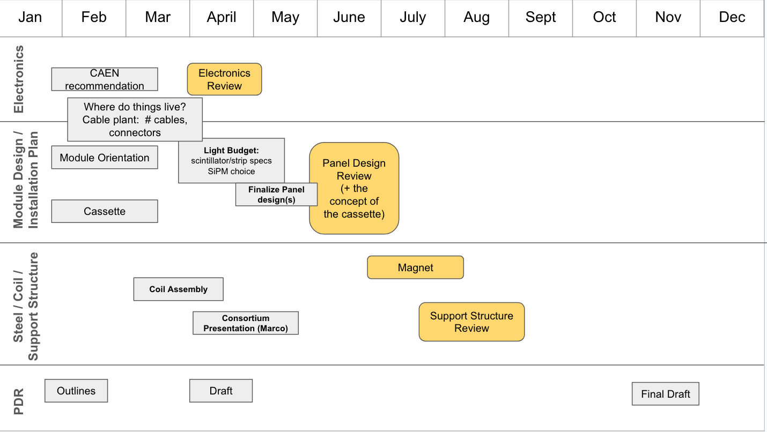
TMS Management Whiteboard https://docs.google.com/presentation/d/1tQ7ugWeMaOCmWHI6LdYk037knRLI_9DAFG8IQWXUqjI/edit#slide=id.p

Slide 10
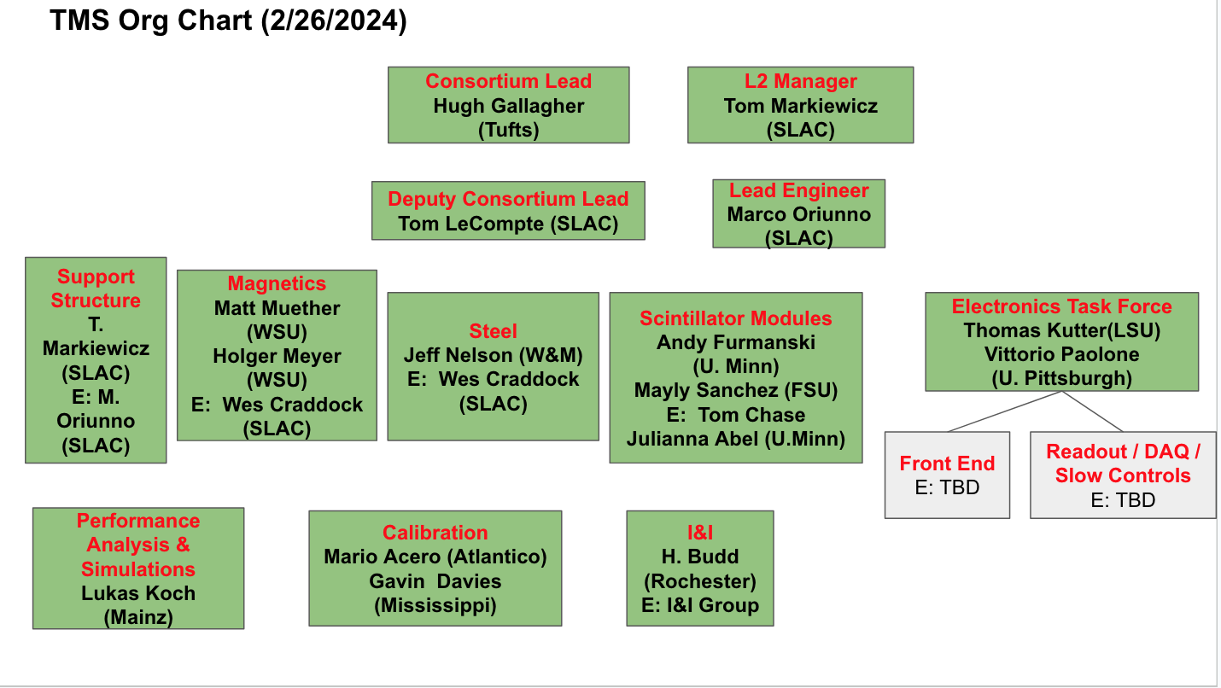

Slide 11
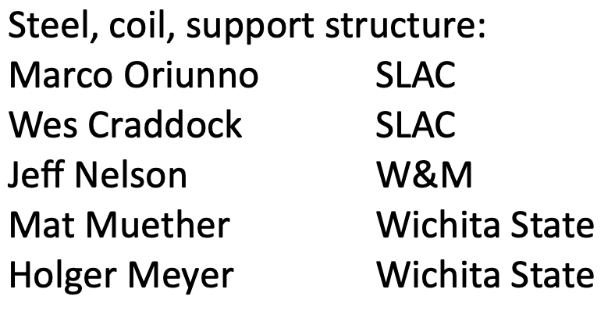
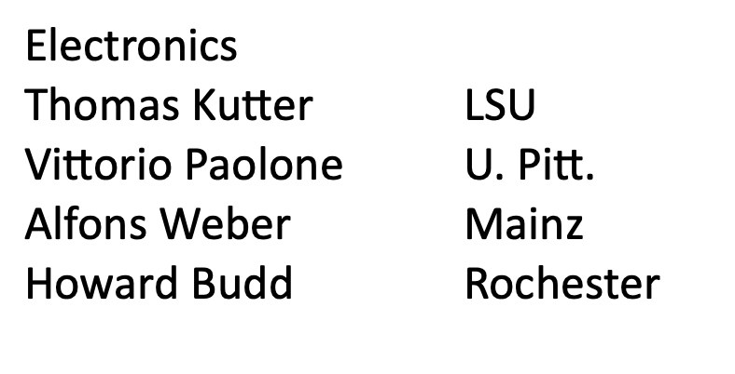
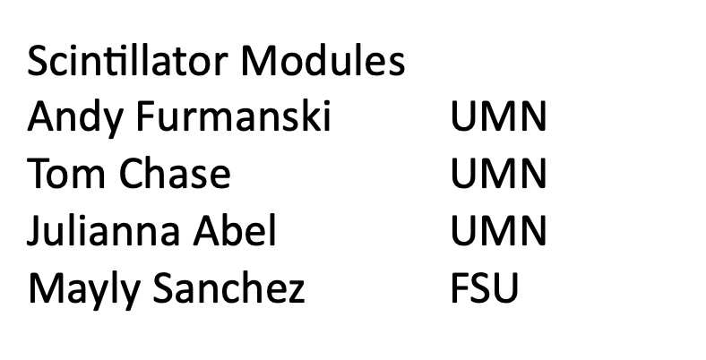
TMS Teams

Slide 12
Key Dates
Internal reviews to bless design decisions Summer 2024
ND Status Review (Office of Project Assessment) October 21-25, 2024
PDR Document complete November 2024
PDR External Review January 2025
LBNC, NSG, Directors Review Q1, Q2 2025
CD2 IPR Q3 2025

Slide 13
New Meeting(s)?
Need to bounce ideas off interested, experienced people, not necessarily the full consortium membership
TWM email suggested
Each team meets as needed
“Interface Meetings” Weekly alternating between Magnet-Detector and Detector-Electronics
If that is too much, how about Bi-weekly out of phase w/ Consortium meeting
Thoughts?

